Slide 1
Gene mapping in mice
Karl W Broman
Department of Biostatistics
Johns Hopkins University
http://www.biostat.jhsph.edu/~kbroman

Slide 2
Goal
Identify genes that contribute to common human diseases.

Slide 3
Inbred mice

Slide 4
Advantages of the mouse
Small and cheap
Inbred lines
Large, controlled crosses
Experimental interventions
Knock-outs and knock-ins

Slide 5
The mouse as a model
Same genes?
  The genes involved in a phenotype in the mouse may also be involved in similar phenotypes in the human.
Similar complexity?
  The complexity of the etiology underlying a mouse phenotype provides some indication of the complexity of similar human phenotypes.
Transfer of statistical methods.
  The statistical methods developed for gene mapping in the mouse serve as a basis for similar methods applicable in direct human studies.

Slide 6
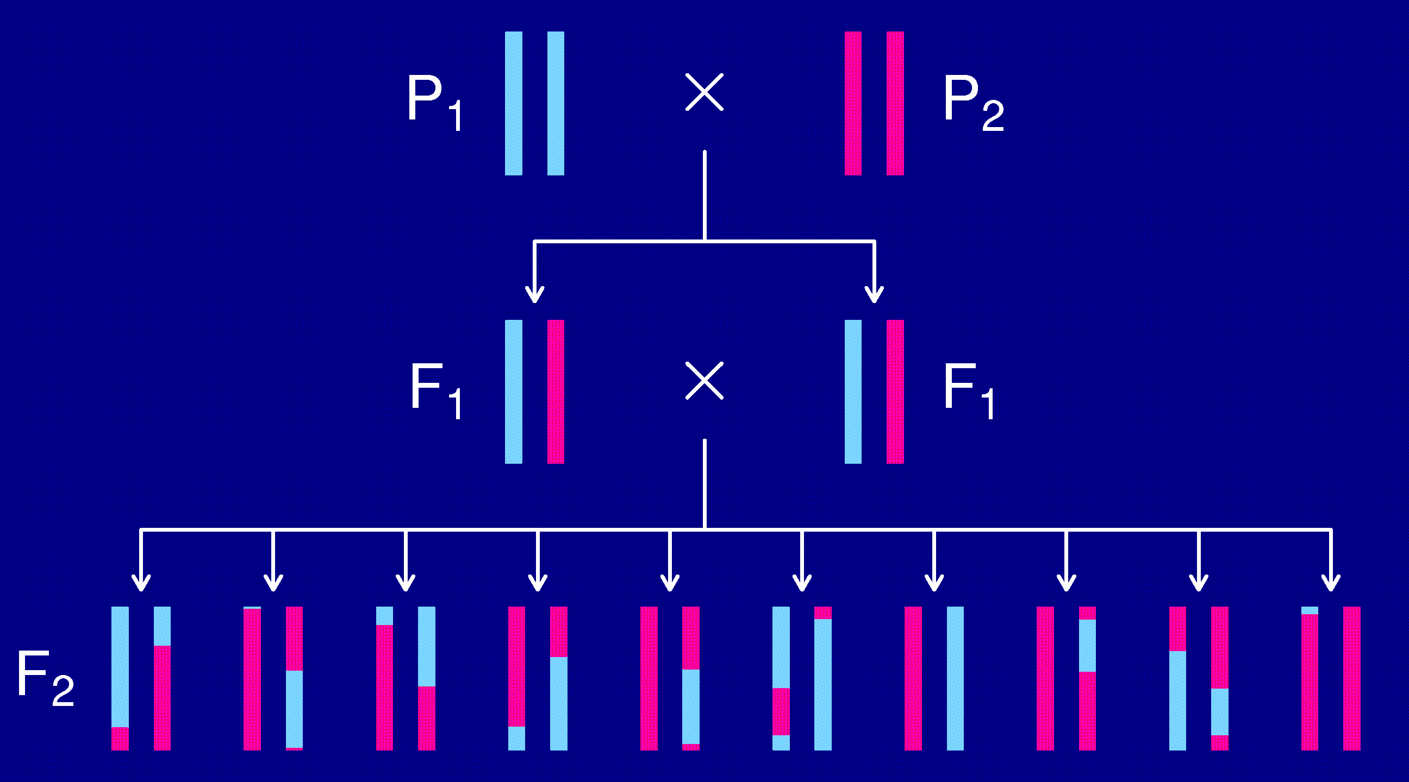
The intercross

Slide 7
The data
Phenotypes, y_{i}
Genotypes, x_{ij} = AA/AB/BB, at genetic markers
A genetic map, giving the locations of the markers.

Slide 8
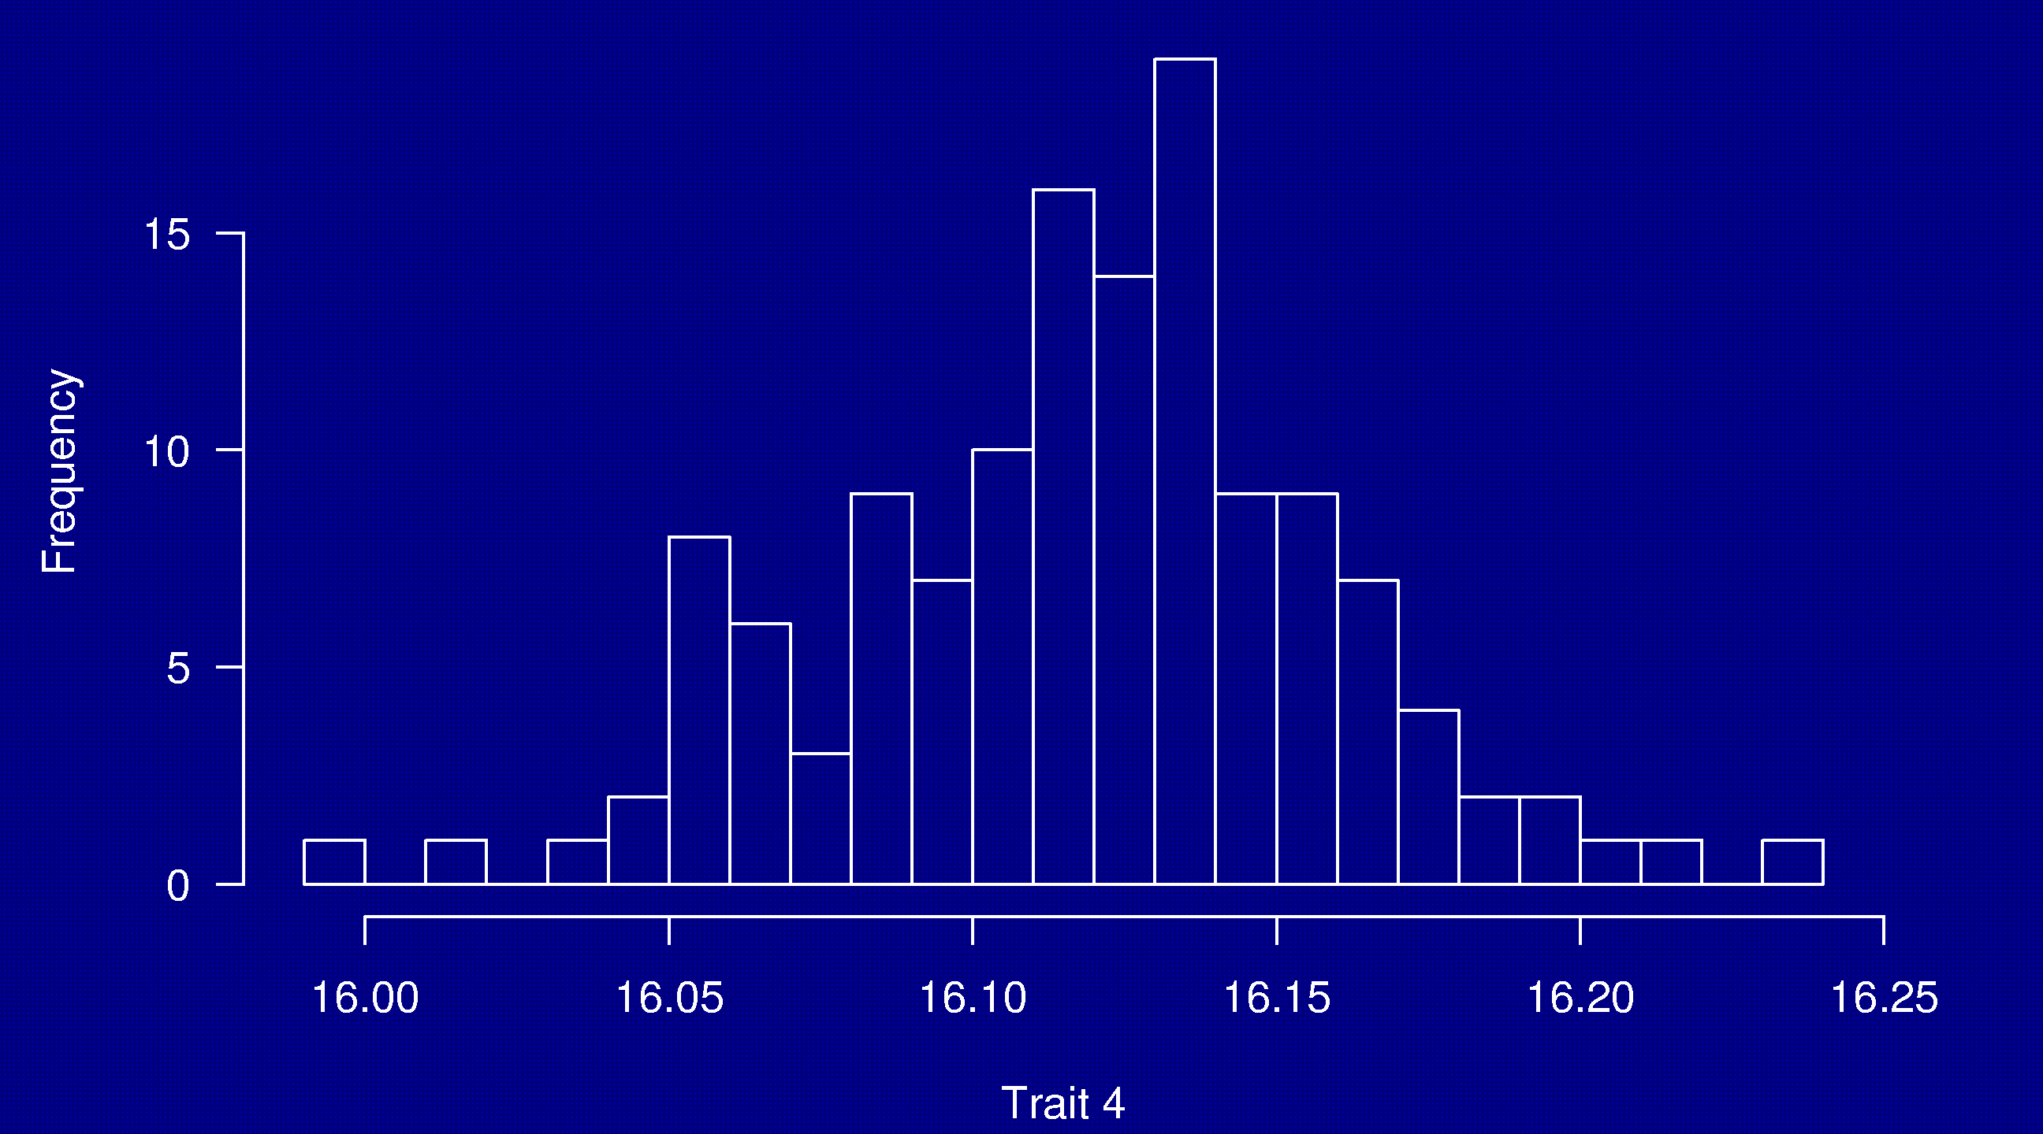
Phenotypes
133 females
(NOD × B6) × (NOD × B6)

Slide 9
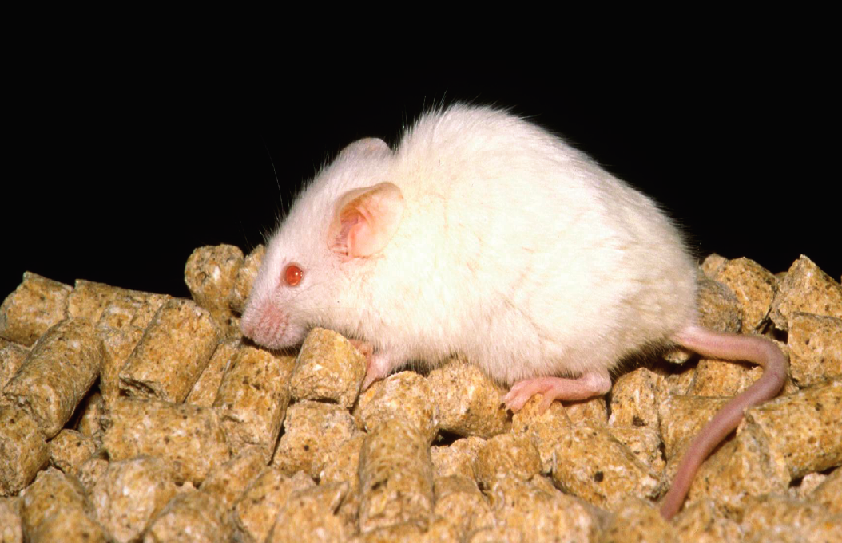
NOD

Slide 10
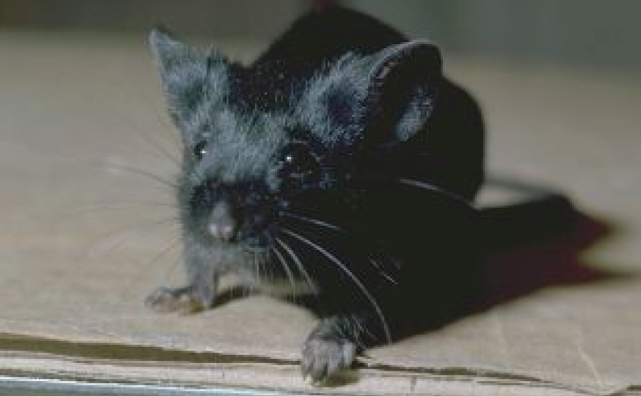
C57BL/6

Slide 11
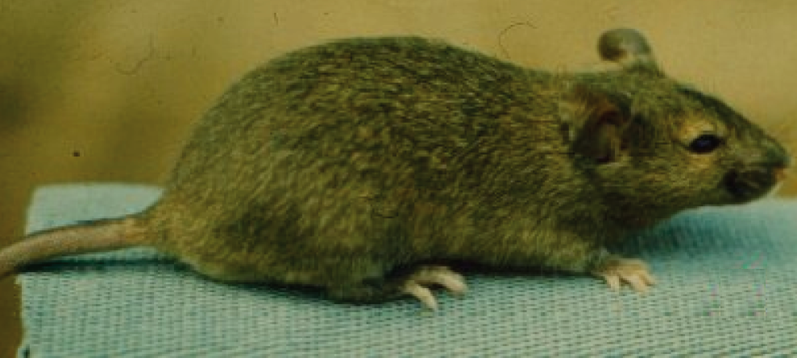
Agouti coat

Slide 12
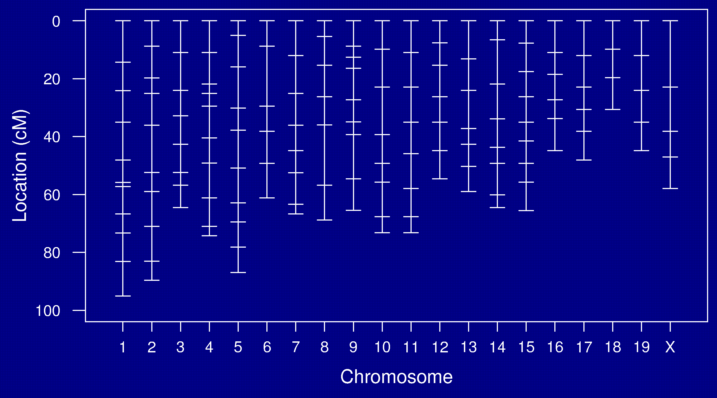
Genetic map

Slide 13
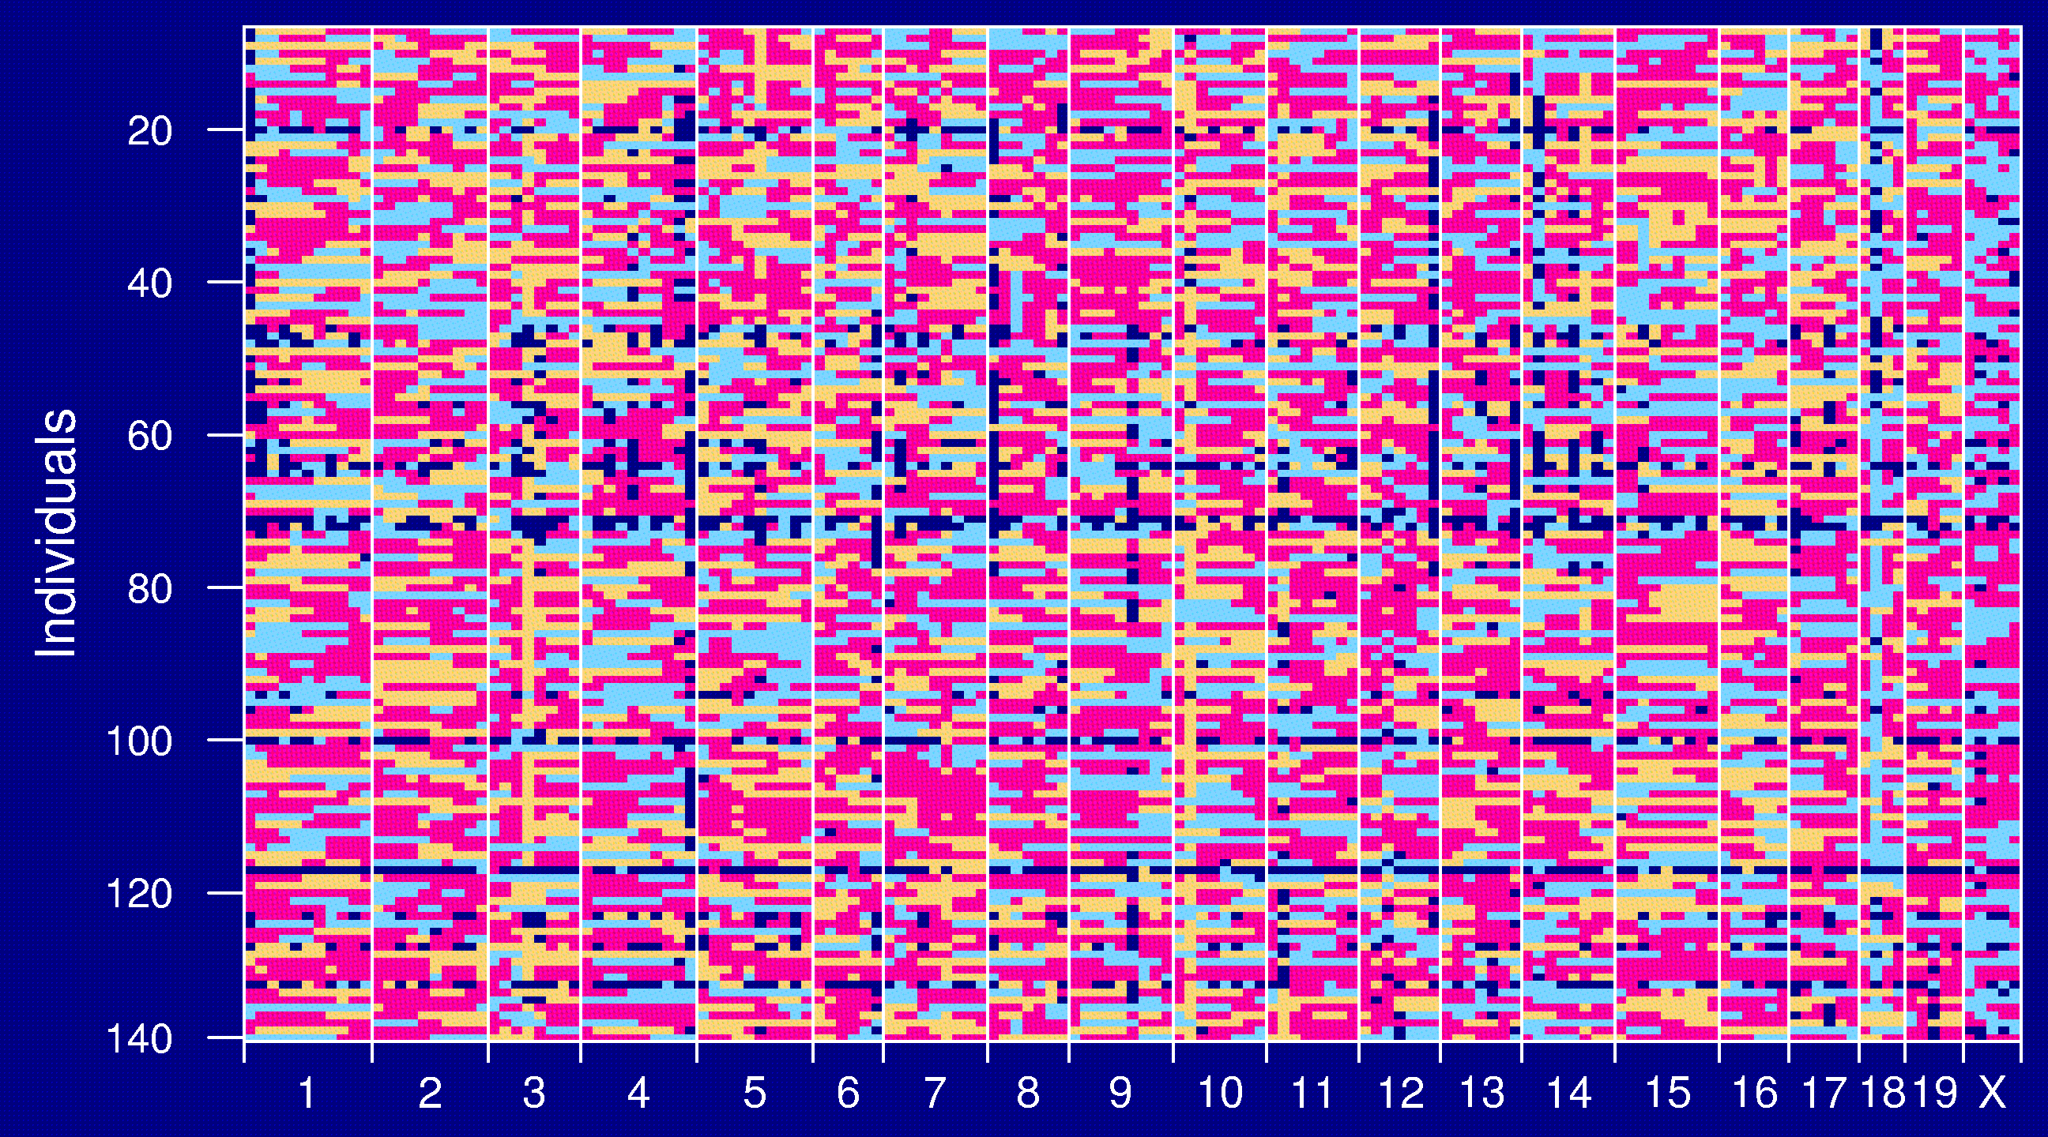
Genotype data

Slide 14
Goals
Identify genomic regions (QTLs) that contribute to variation in the trait.
Obtain interval estimates of the QTL locations.
Estimate the effects of the QTLs.

Slide 15
Models: recombination
No crossover interference
  Locations of breakpoints according to a Poisson process.
  Genotypes along chromosome follow a Markov chain.
Clearly wrong, but super convenient.

Slide 16
Models: gen ↔ phe
Phenotype = y, whole-genome genotype = g
Imagine that p sites are all that matter.
E(y | g) = μ(g₁,…,g_{p}) SD(y | g) = σ(g₁,…,g_{p})
Simplifying assumptions:
  SD(y | g) = σ, independent of g
  y | g ~ normal( μ(g₁,…,g_{p}), σ )
  μ(g₁,…,g_{p}) = μ + ∑ α_{j} 1{g_{j} = AB} + β_{j} 1{g_{j} = BB}

Slide 17
Interval mapping
Lander and Botstein 1989
Imagine that there is a single QTL, at position z.
Let q_{i} = genotype of mouse i at the QTL, and assume
y_{i} | q_{i} ~ normal( μ(q_{i}), σ )
We won’t know q_{i}, but we can calculate
p_{ig} = Pr(q_{i} = g | marker data)
y_{i}, given the marker data, follows a mixture of normal distributions with known mixing proportions (the p_{ig}).
Use an EM algorithm to get MLEs of θ = (μ_{AA}, μ_{AB}, μ_{BB}, σ).
Measure the evidence for a QTL via the LOD score, which is the log₁₀ likelihood ratio comparing the hypothesis of a single QTL at position z to the hypothesis of no QTL anywhere.

Slide 18
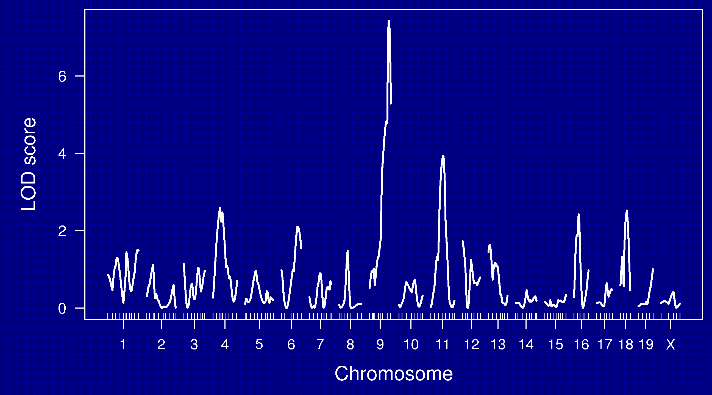
LOD curves

Slide 19
LOD thresholds
To account for the genome-wide search, compare the observed LOD scores to the distribution of the maximum LOD score, genome-wide, that would be obtained if there were no QTL anywhere.
The 95th percentile of this distribution is used as a significance threshold.
Such a threshold may be estimated via permutations (Churchill and Doerge 1994).

Slide 20
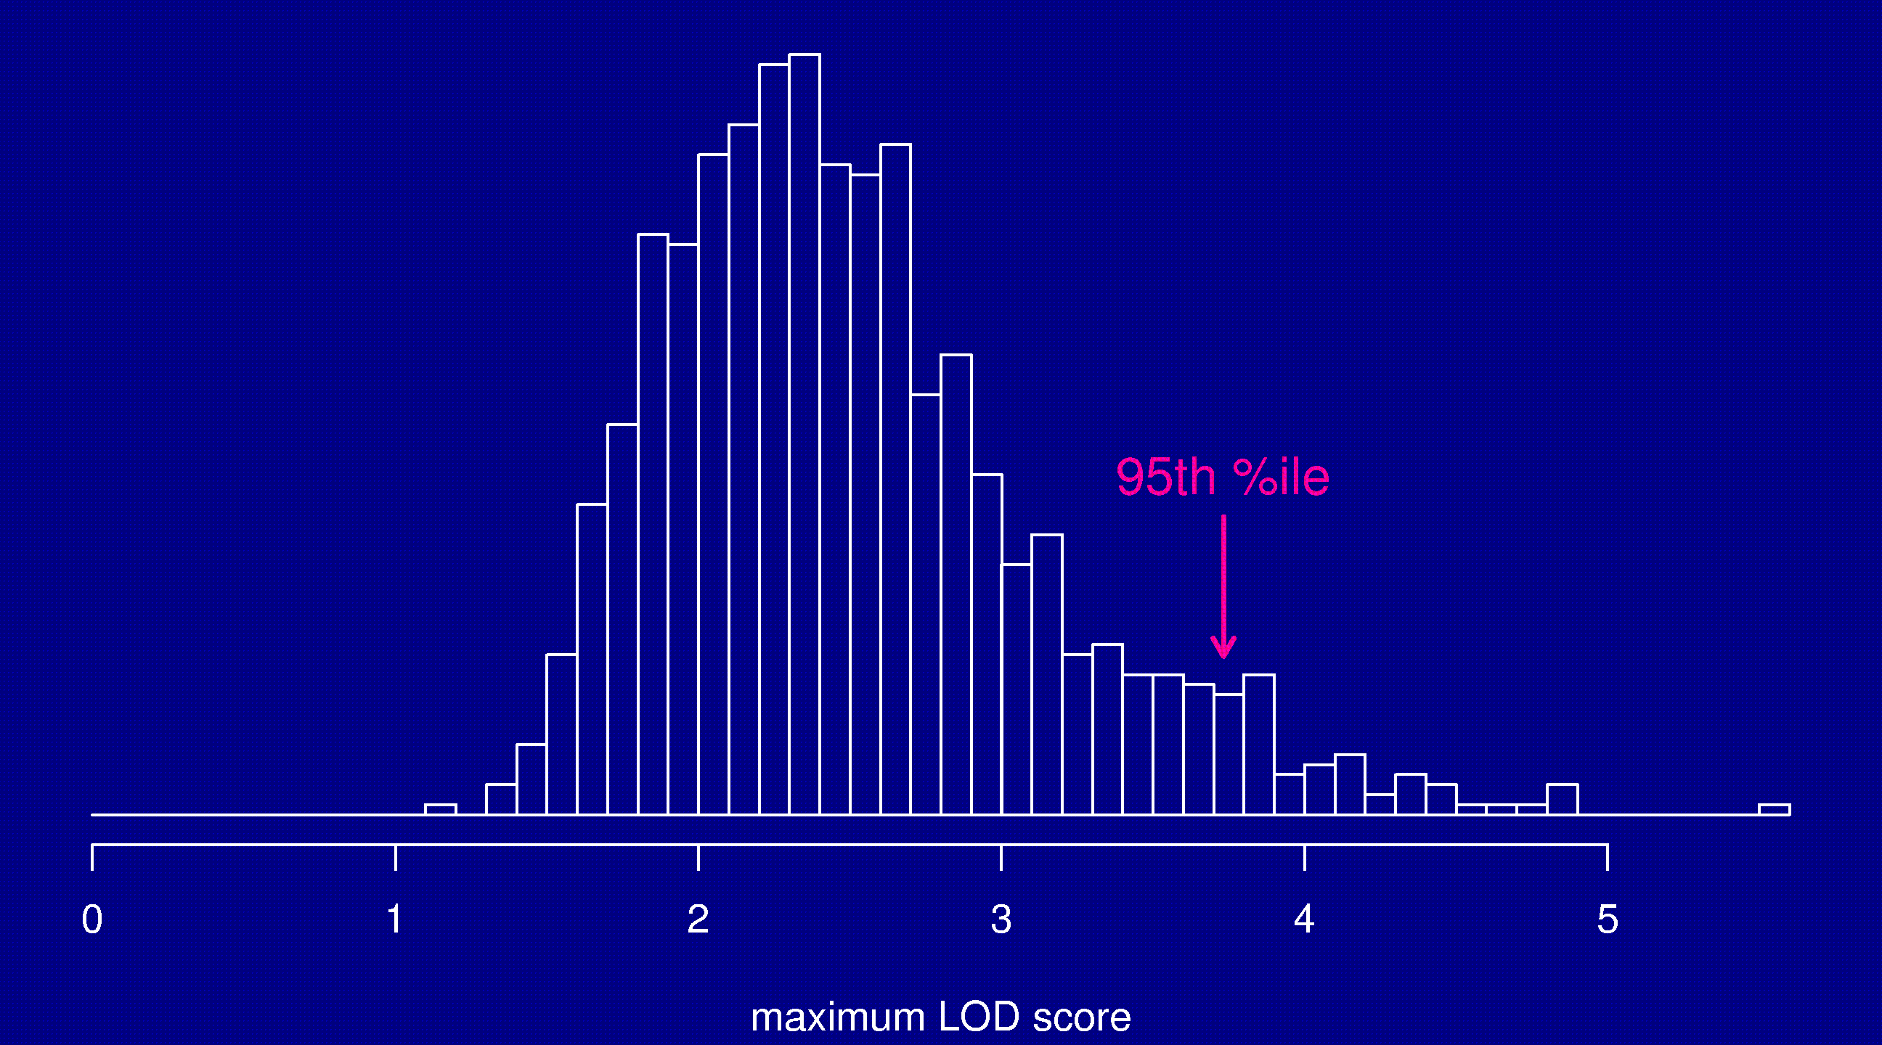
Permutation distribution

Slide 21
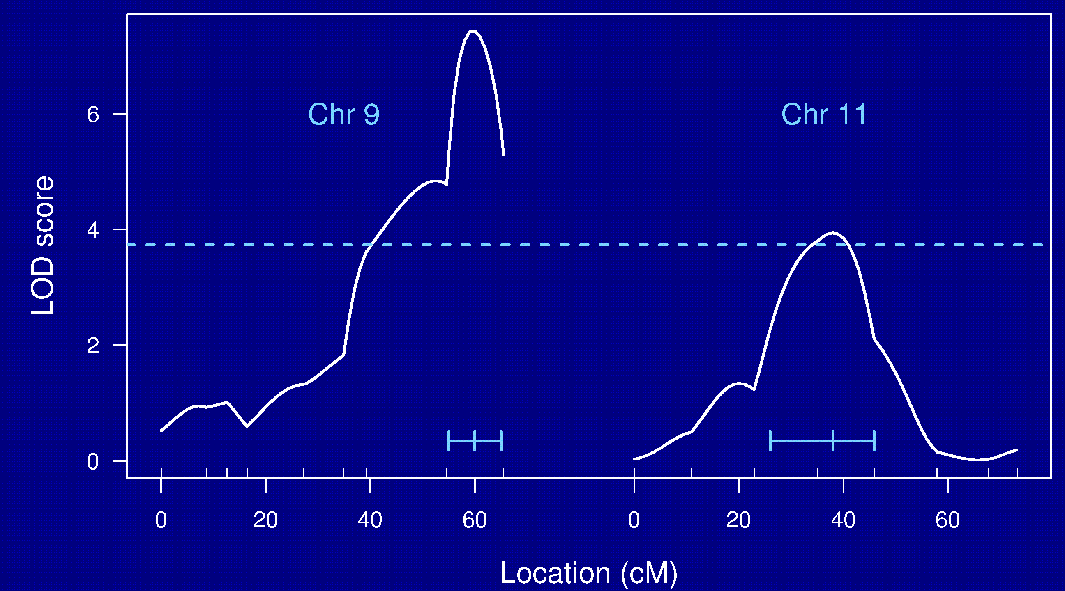
Chr 9 and 11

Slide 22
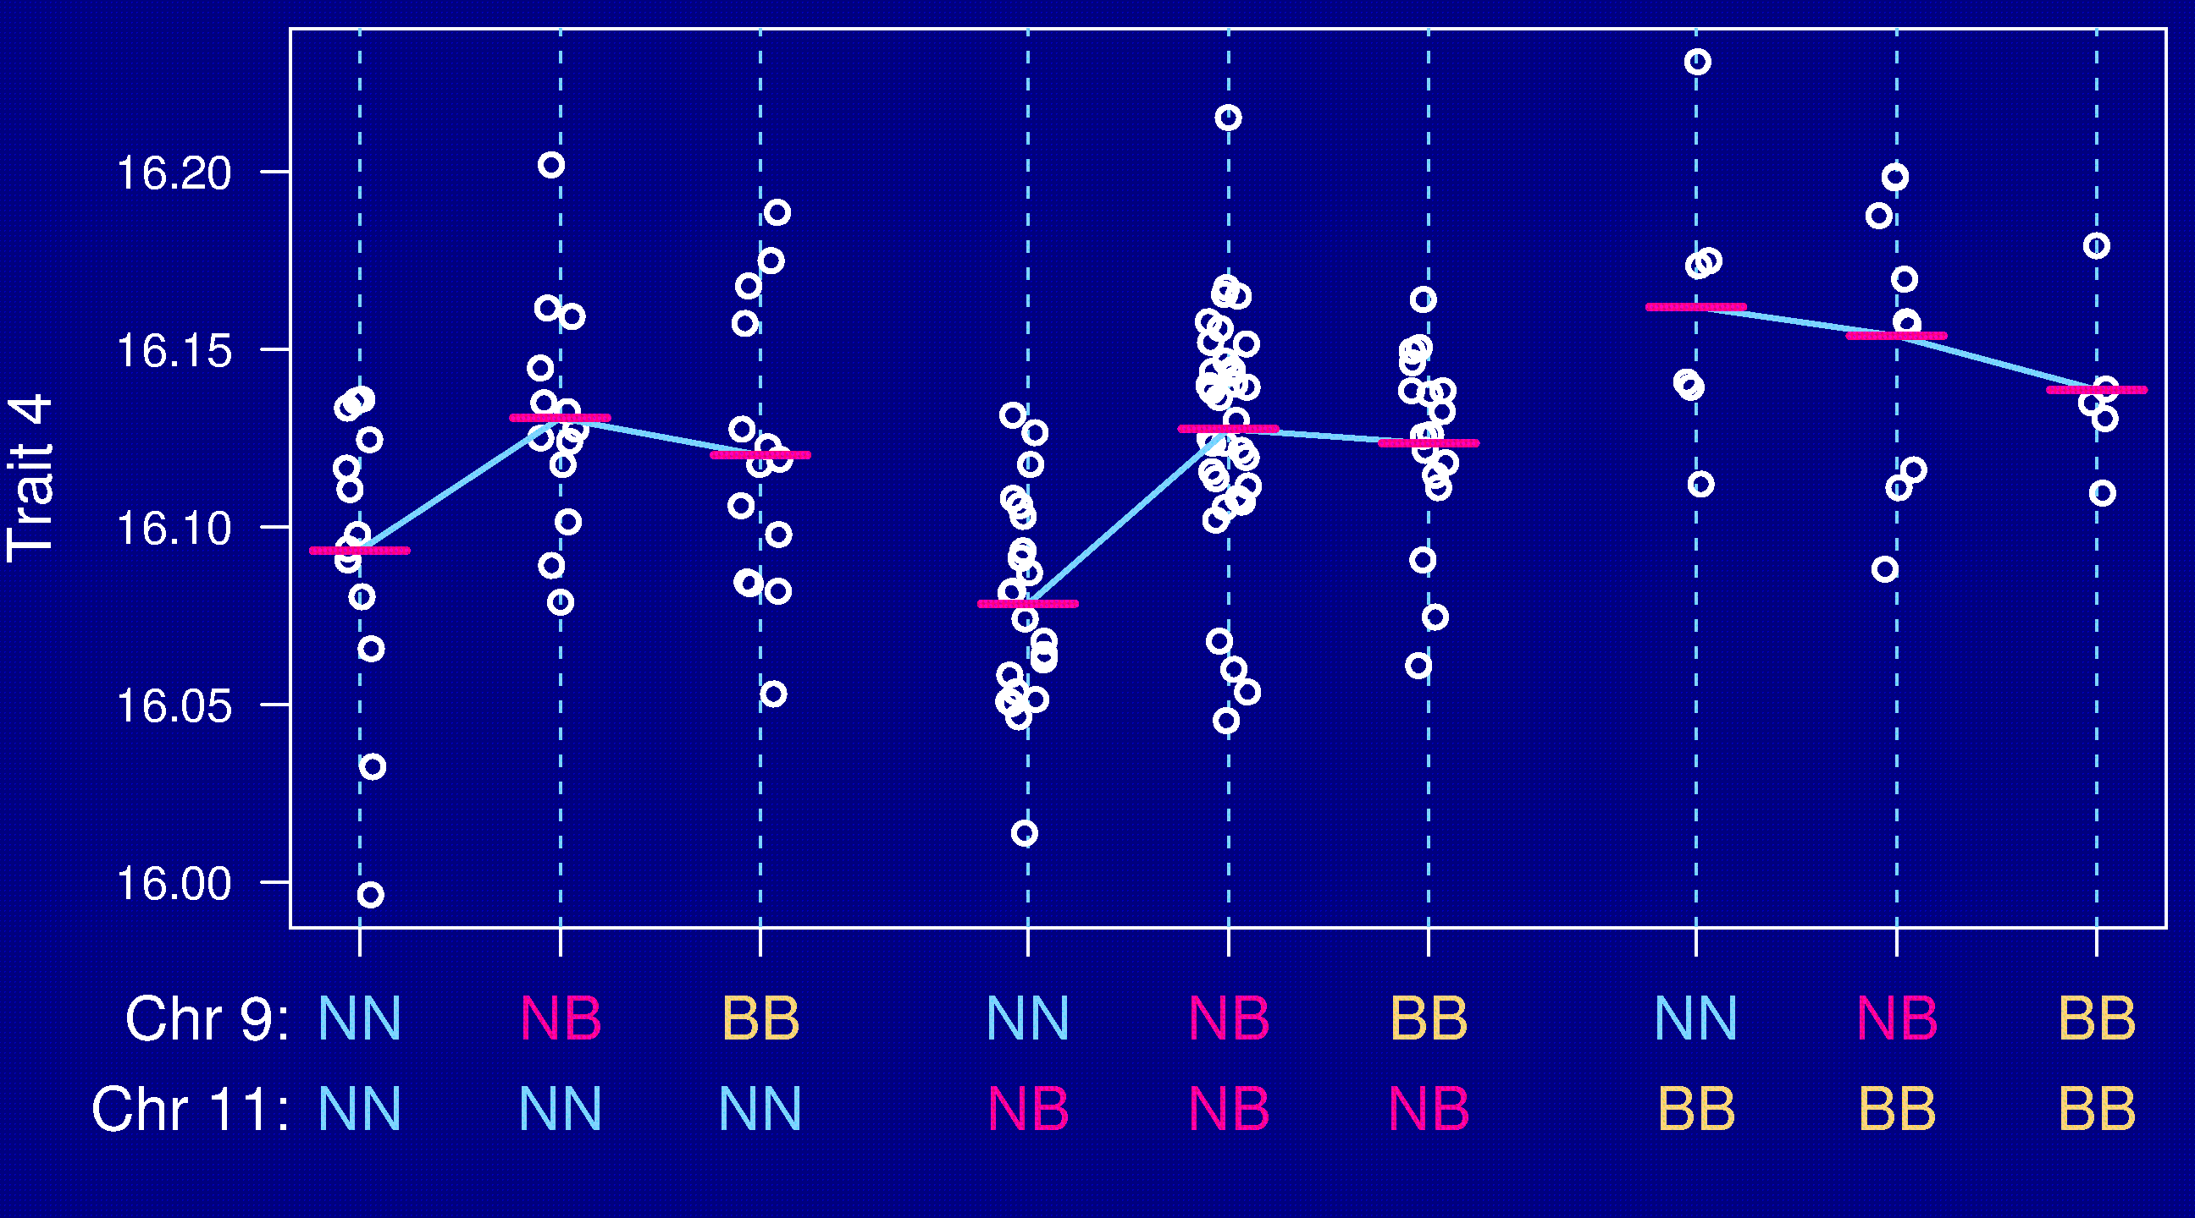
Epistasis

Slide 23
Going after multiple QTLs
Greater ability to detect QTLs.
Separate linked QTLs.
Learn about interactions between QTLs (epistasis).

Slide 24
Model selection
Choose a class of models.
  Additive; pairwise interactions; regression trees
Fit a model (allow for missing genotype data).
  Linear regression; ML via EM; Bayes via MCMC
Search model space.
  Forward/backward/stepwise selection; MCMC;
Compare models.
  BIC_{δ}(γ) = log L(γ) + (δ/2) |γ| log n
Miss important loci ↔ include extraneous loci.

Slide 25
Special features
Relationship among the covariates.
Missing covariate information.
Identify the key players vs. minimize prediction error.

Slide 26
Opportunities for improvements
Each individual is unique.
  Must genotype each mouse.
  Unable to obtain multiple invasive phenotypes (e.g., in multiple environmental conditions) on the same genotype.
Relatively low mapping precision.
Design a set of inbred mouse strains.
  Genotype once.
  Study multiple phenotypes on the same genotype.

Slide 27
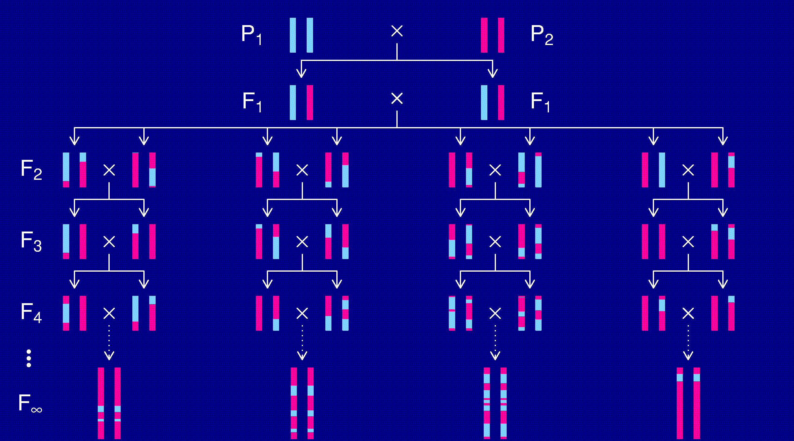
Recombinant inbred lines

Slide 28
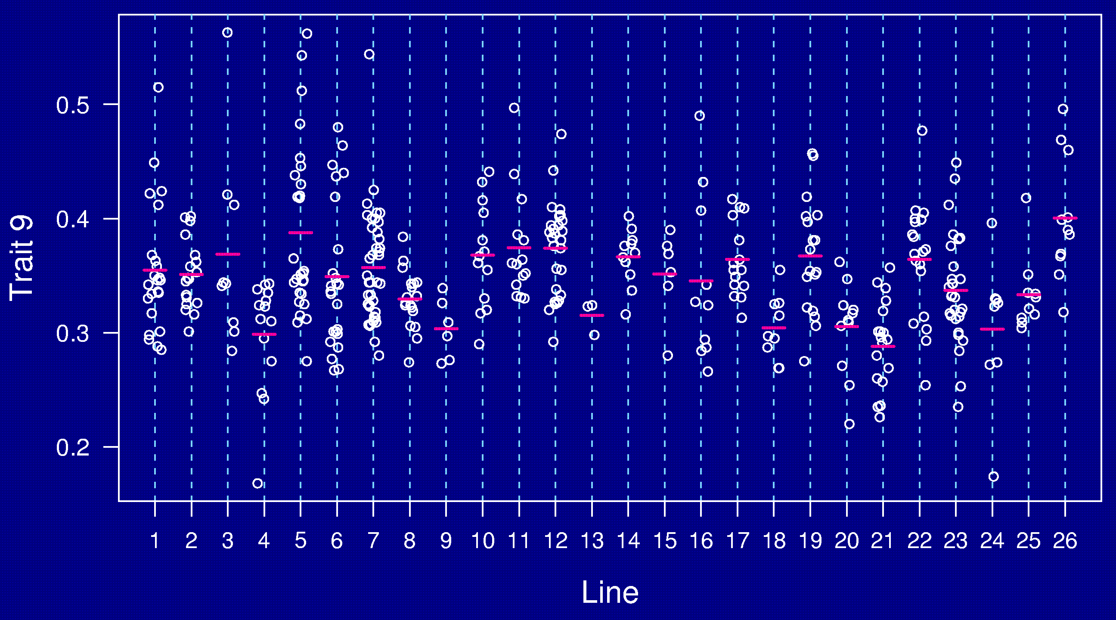
AXB/BXA panel

Slide 29
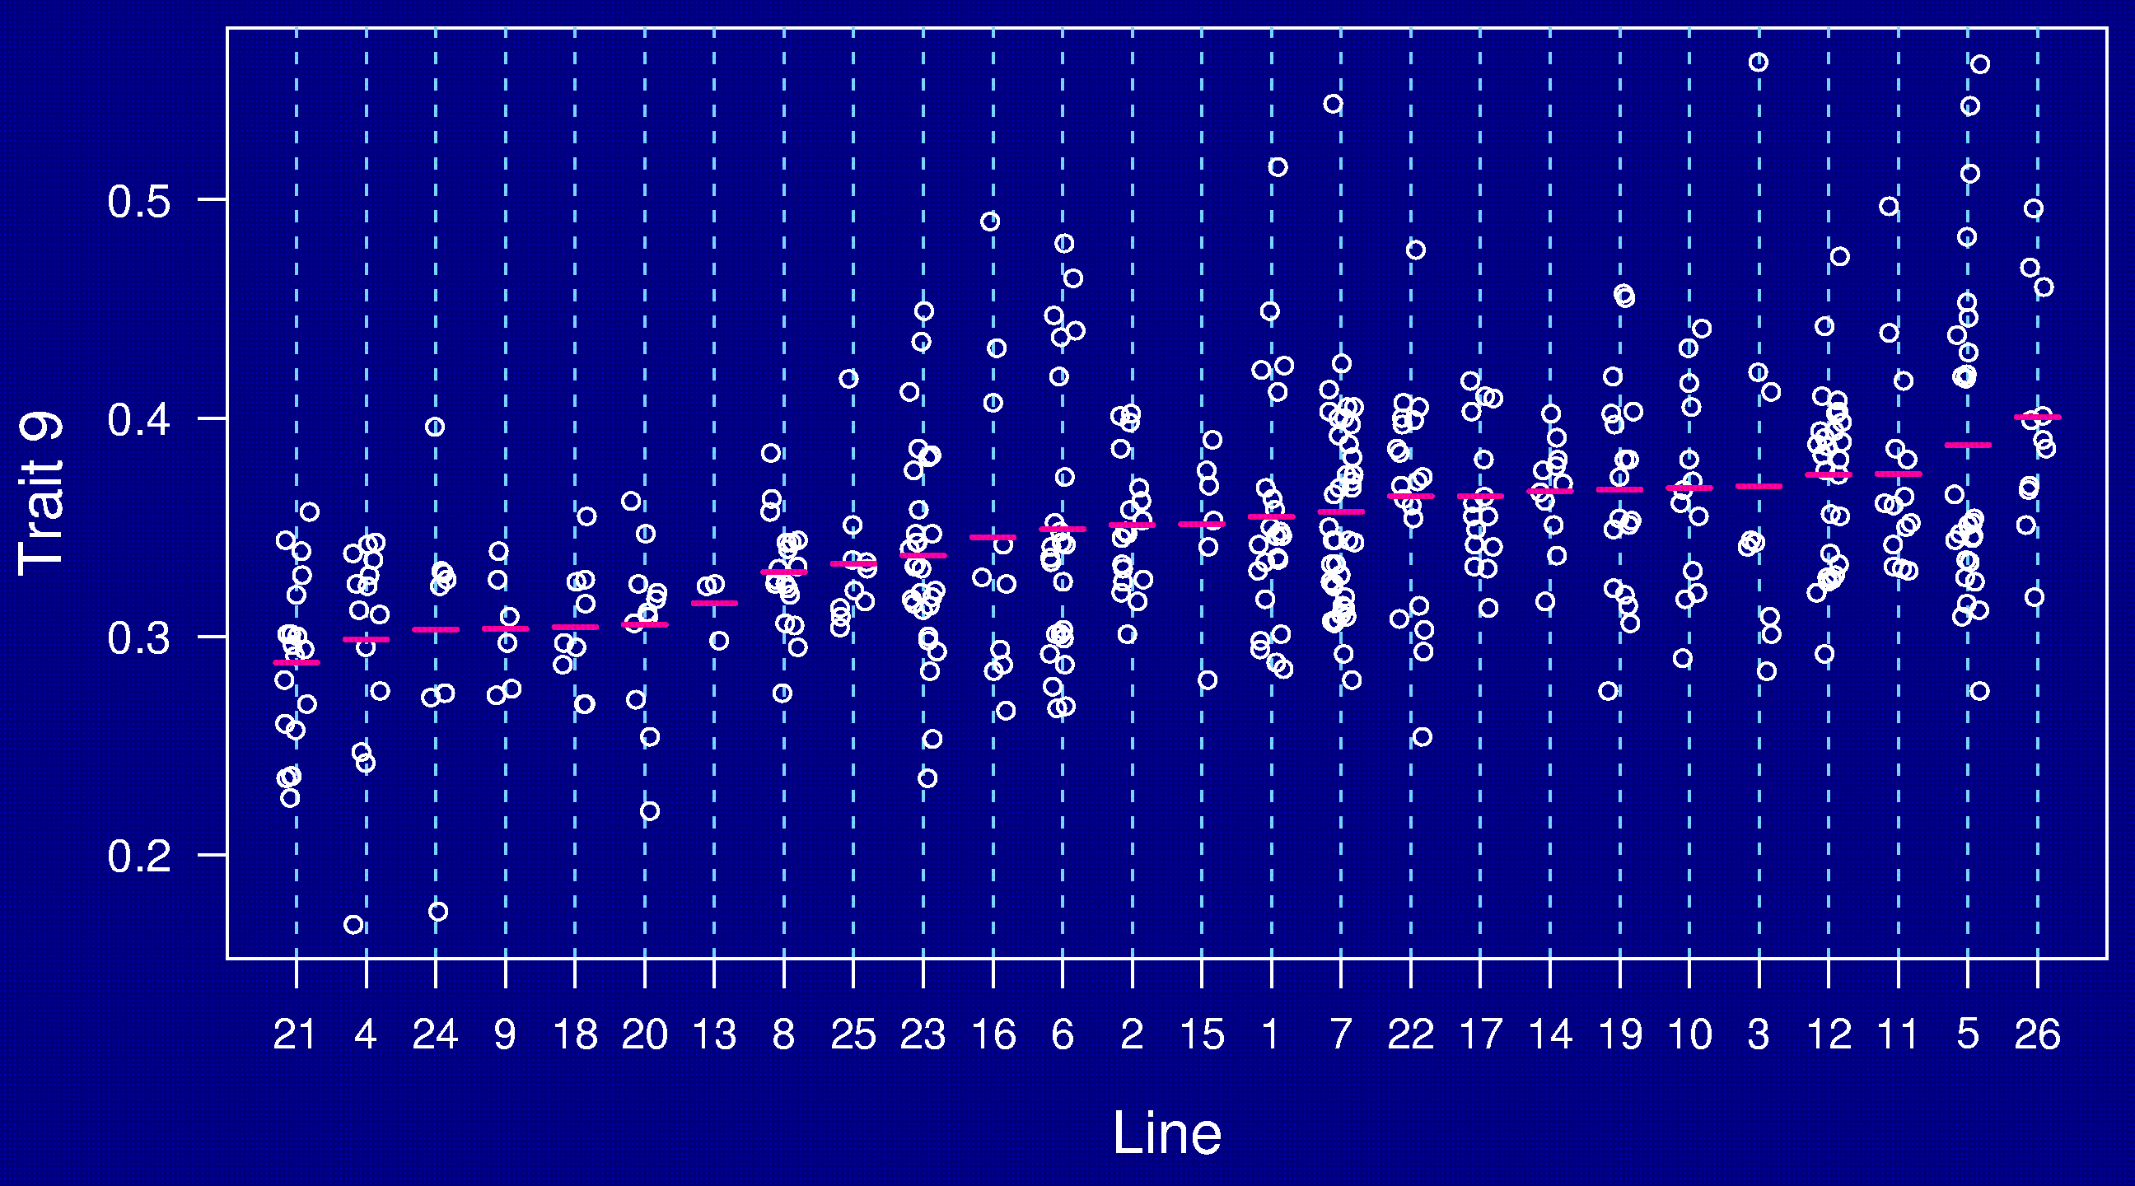
AXB/BXA panel

Slide 30
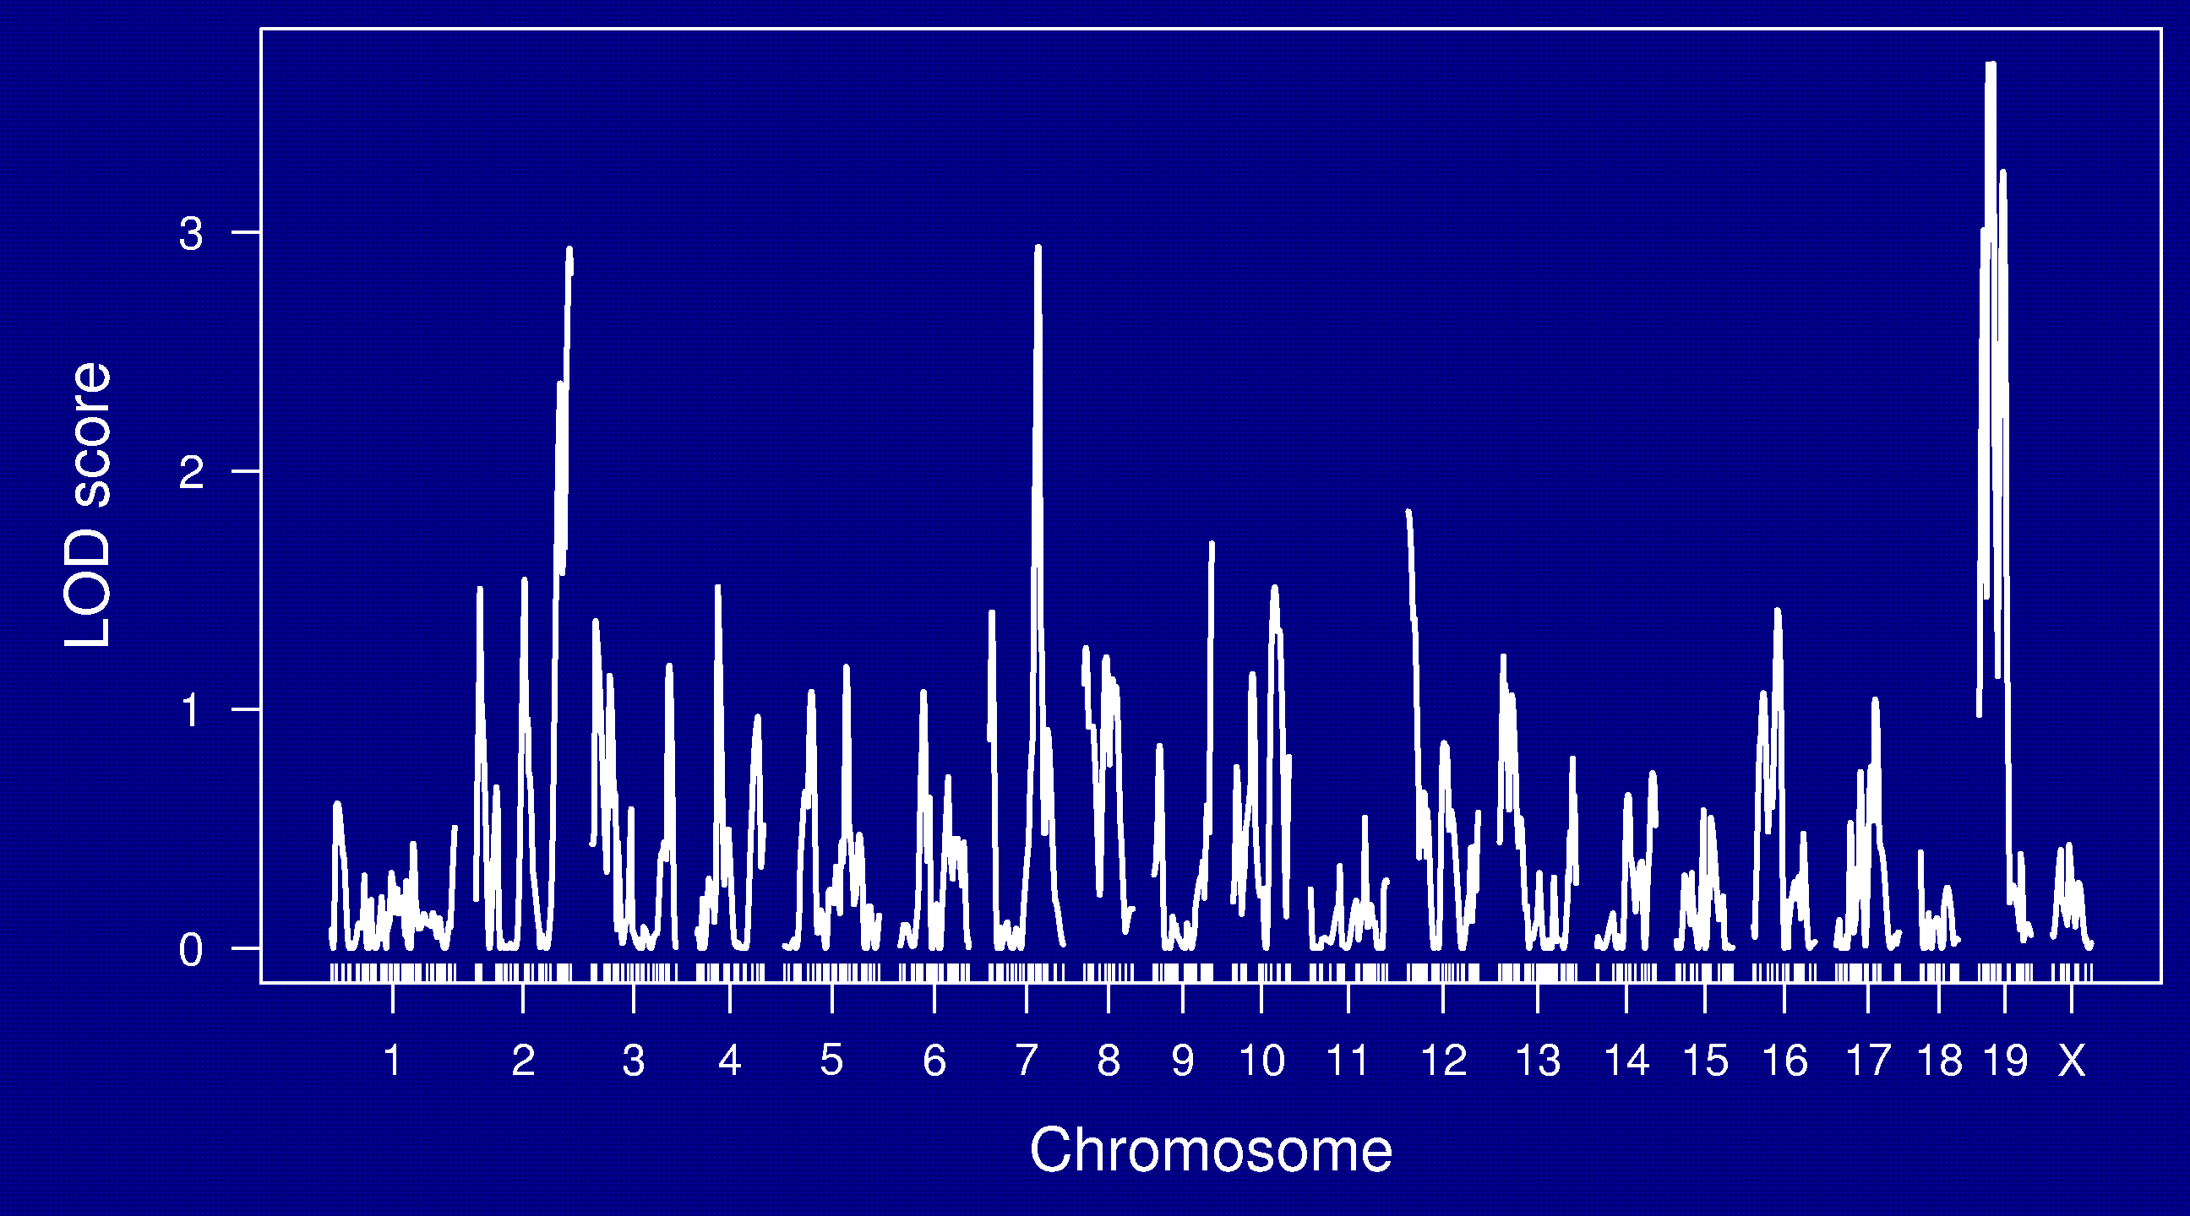
LOD curves

Slide 31
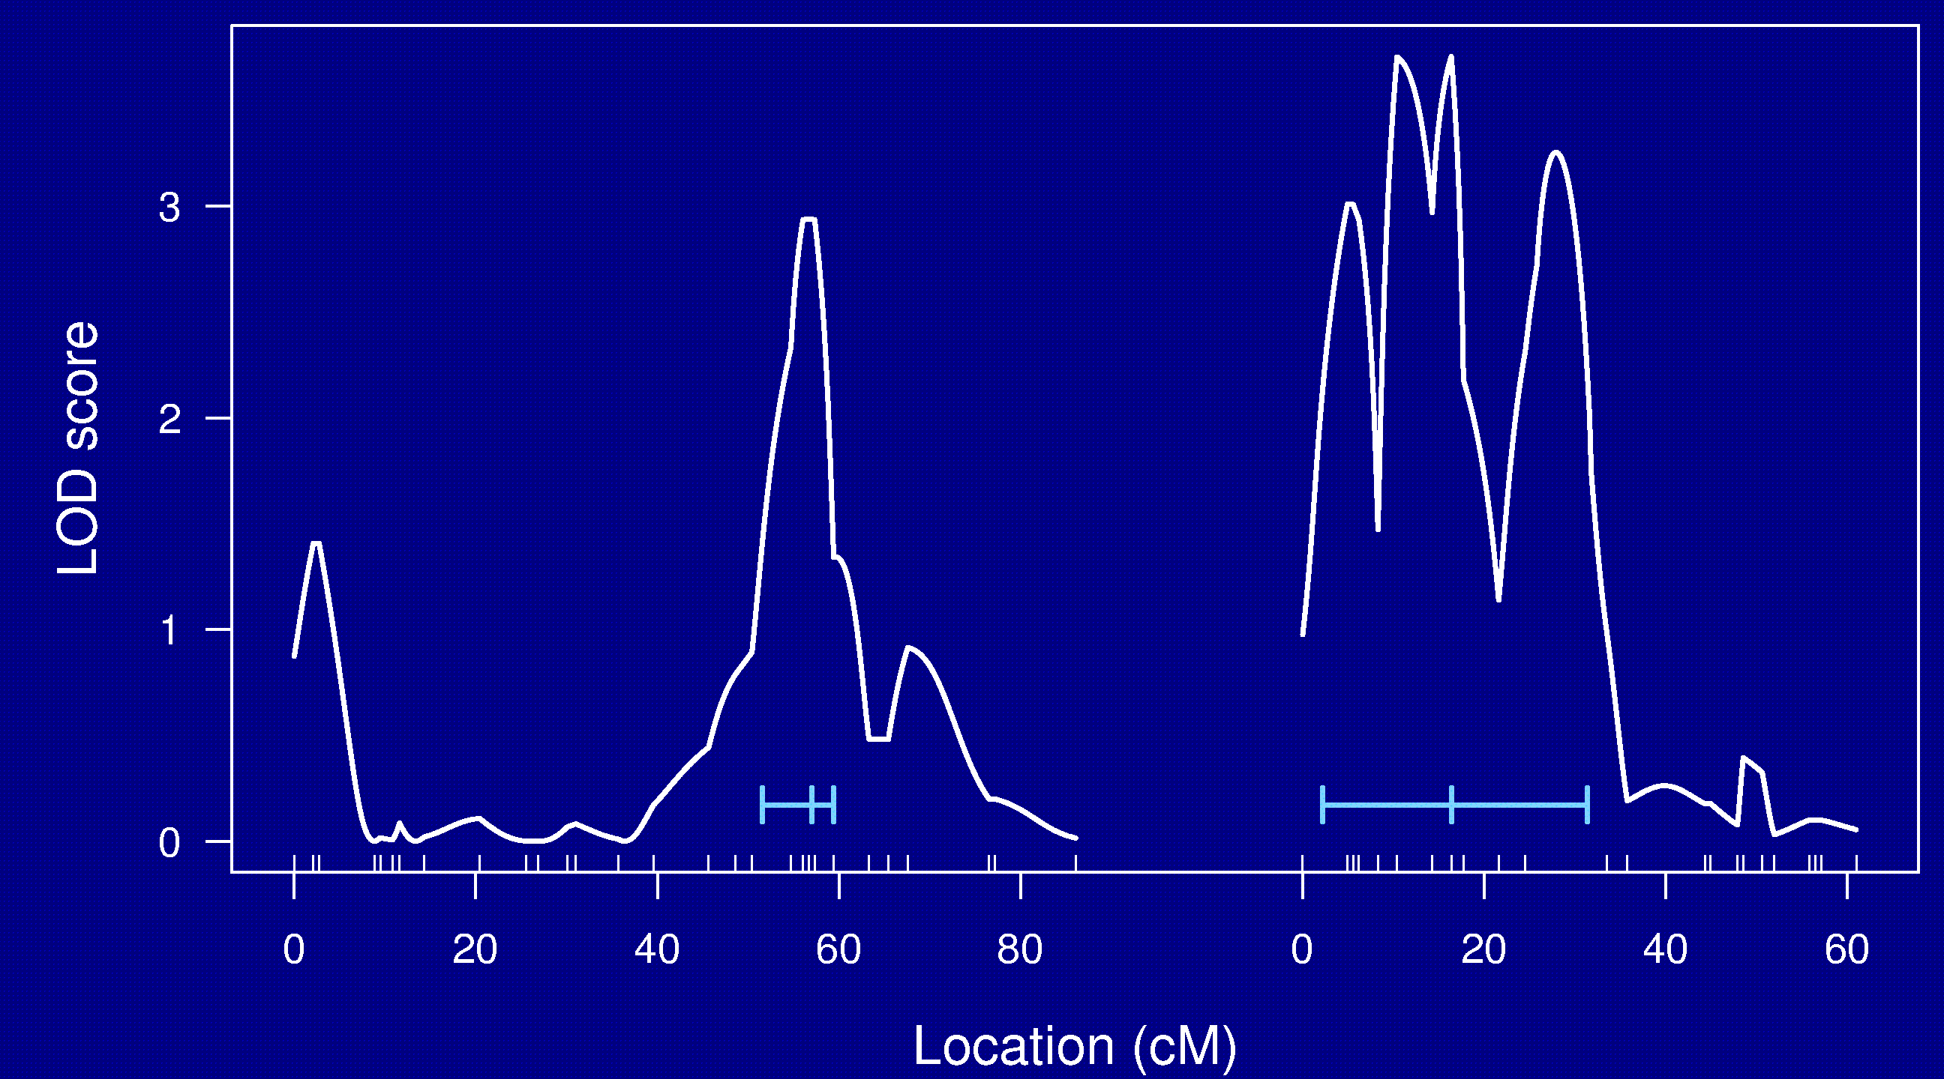
Chr 7 and 19

Slide 32
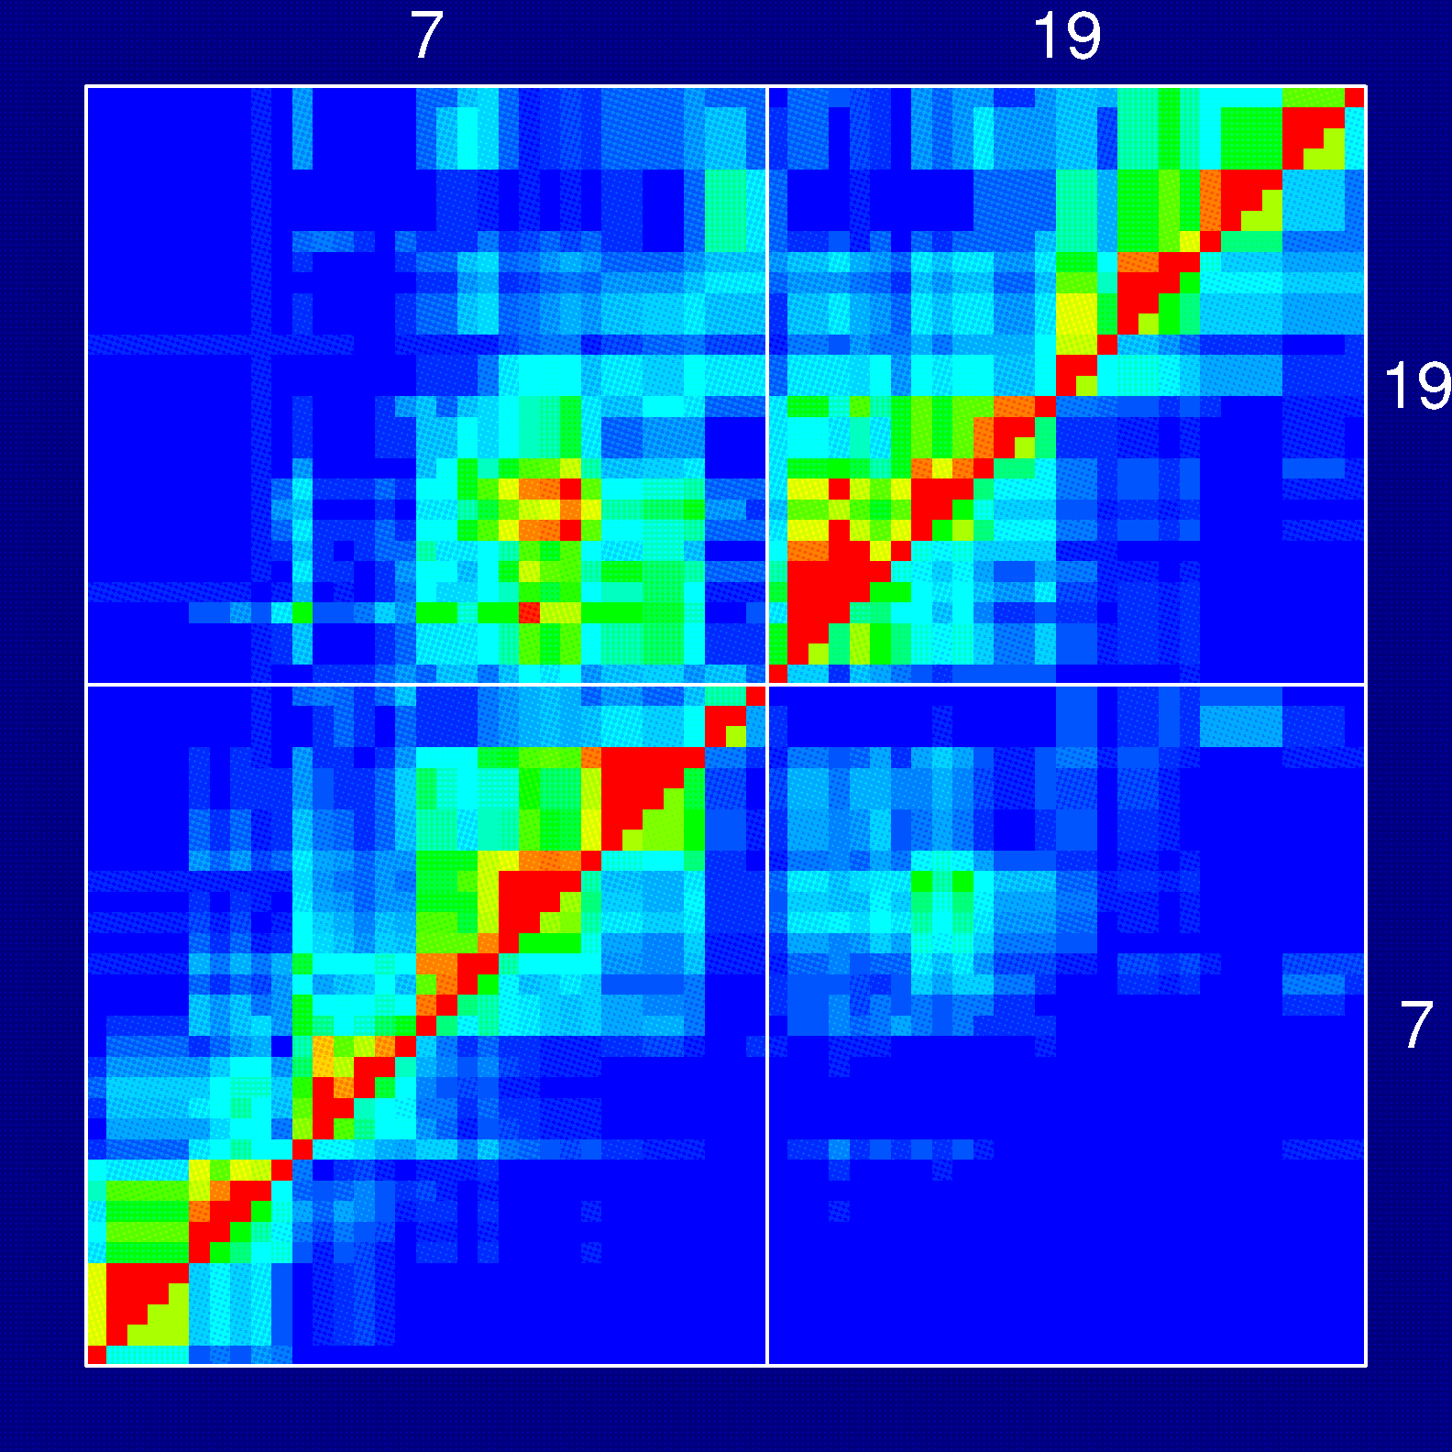
Recombination fractions

Slide 33
RI lines
Advantages
Each strain is a eternal resource.
  Only need to genotype once.
  Reduce individual variation by phenotyping multiple individuals from each strain.
  Study multiple phenotypes on the same genotype.
Greater mapping precision.
Disadvantages
Time and expense.
Available panels are generally too small (10-30 lines).
Can learn only about 2 particular alleles.
All individuals homozygous.

Slide 34
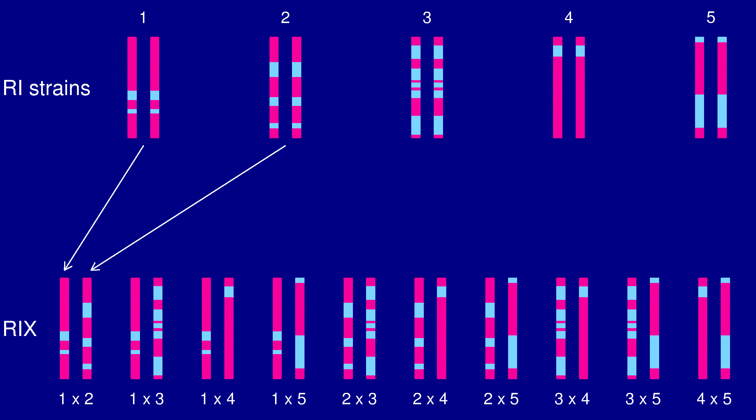
The RIX design

Slide 35
Heterogeneous stock
McClearn et al. (1970)
Mott et al. (2000); Mott and Flint (2002)
Start with 8 inbred strains.
Randomly breed 40 pairs.
Repeat the random breeding of 40 pairs for each of ~60 generations (30 years).
The genealogy (and protocol) is not completely known.

Slide 36
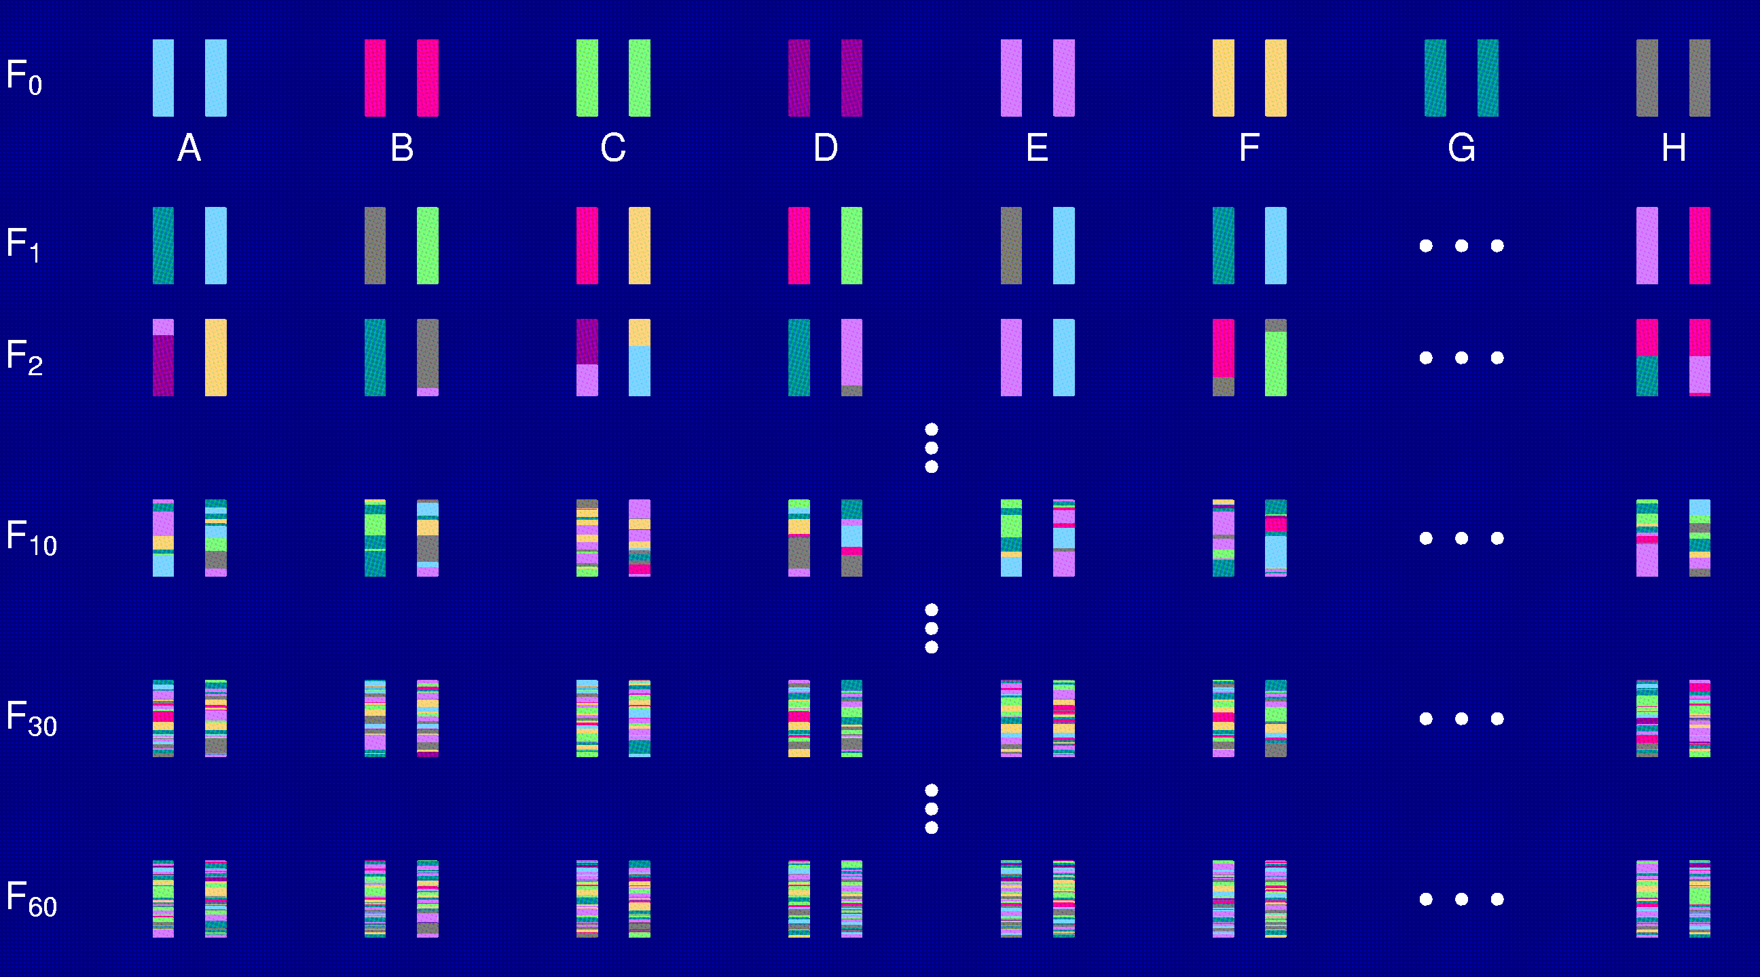
Heterogeneous stock

Slide 37
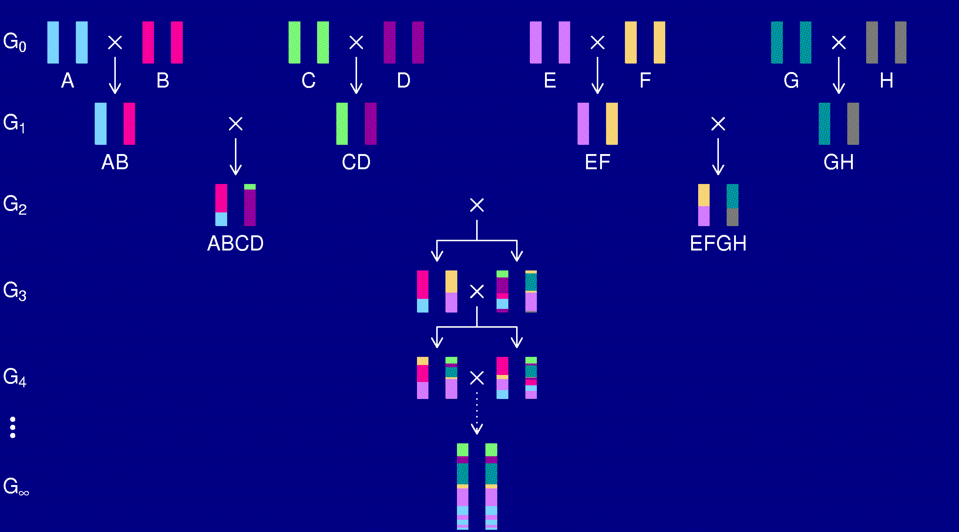
The “Collaborative Cross”

Slide 38
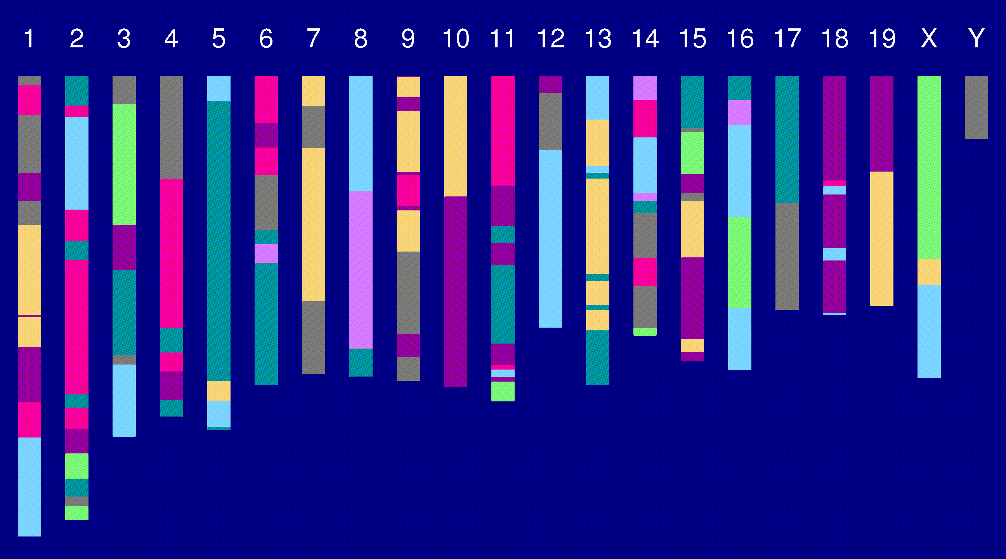
Genome of an 8-way RI

Slide 39
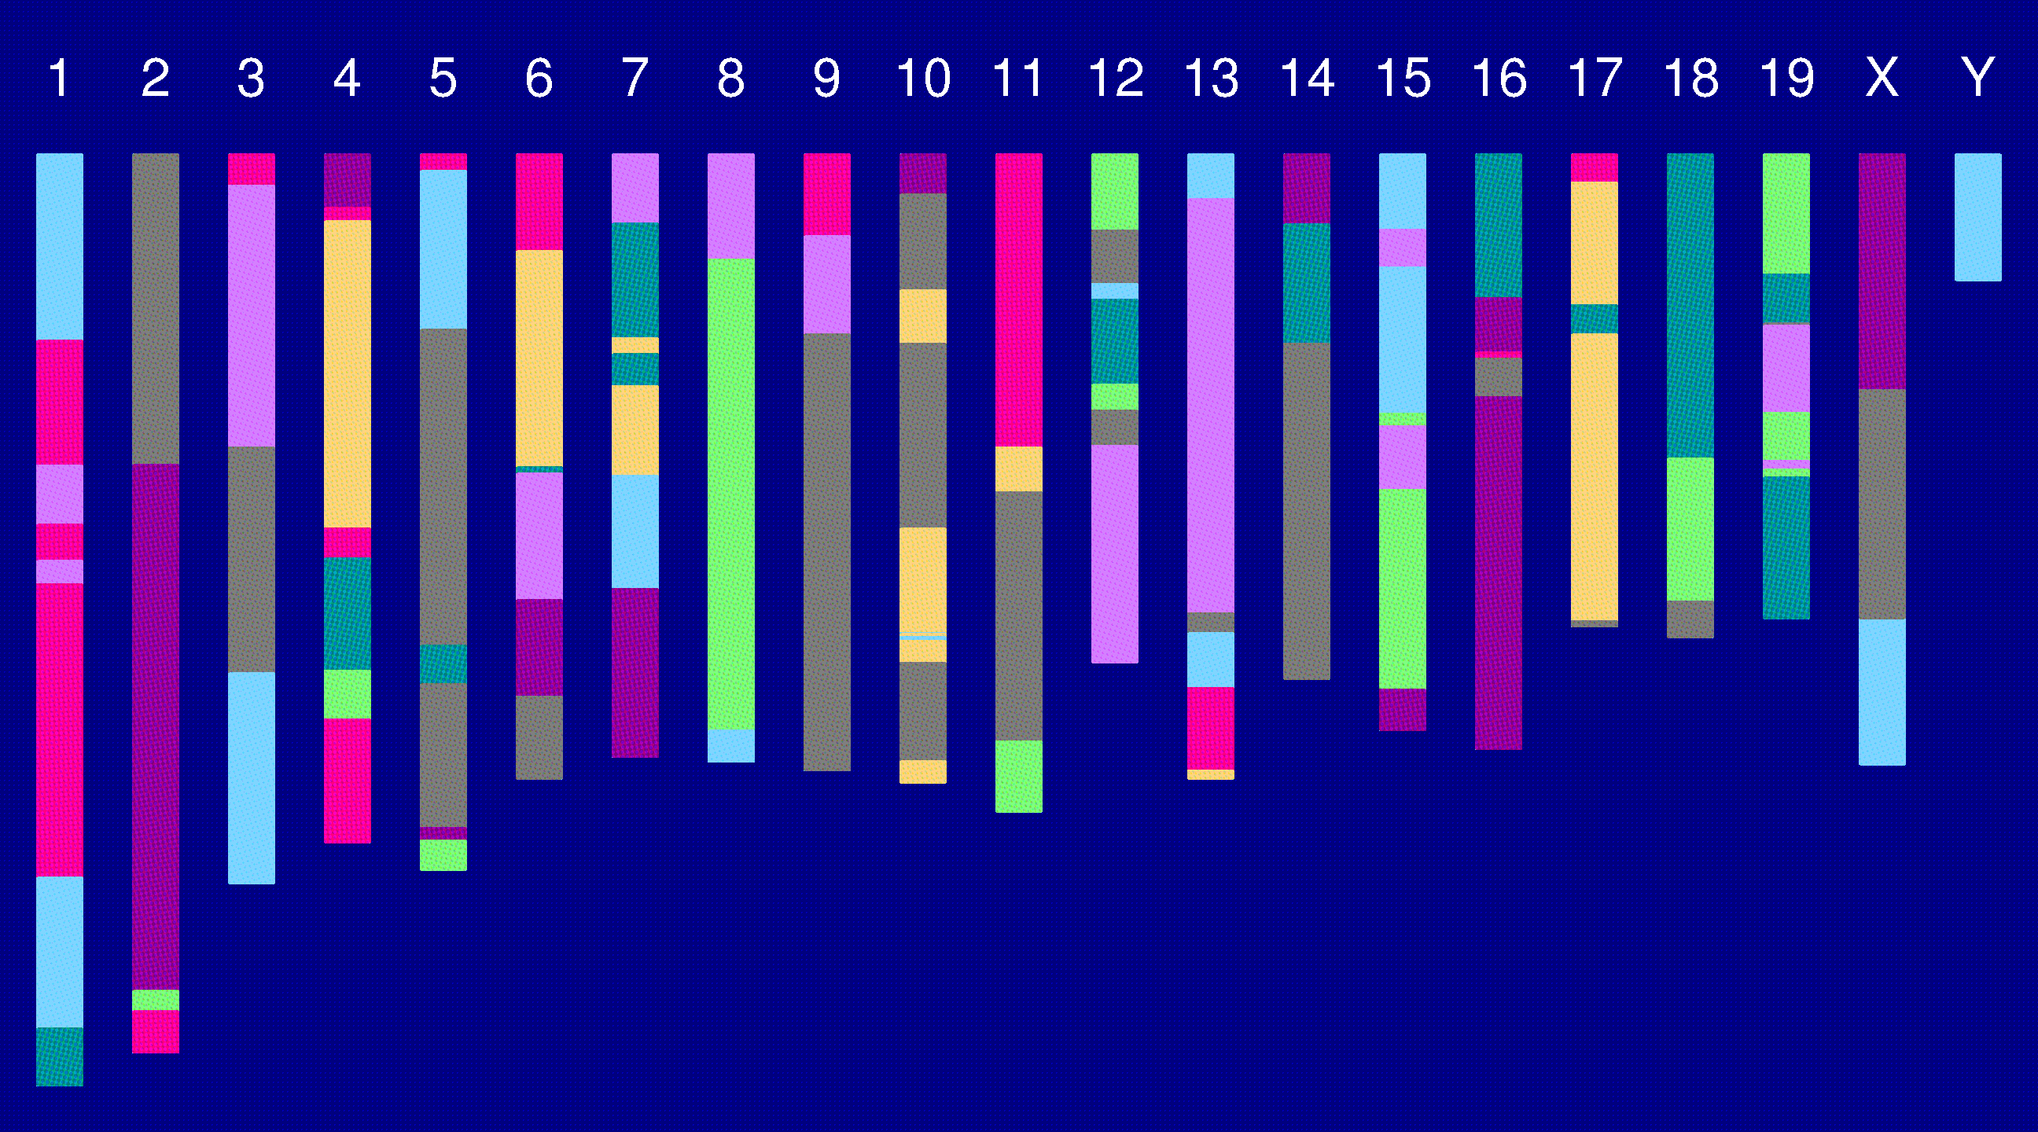
Genome of an 8-way RI

Slide 40
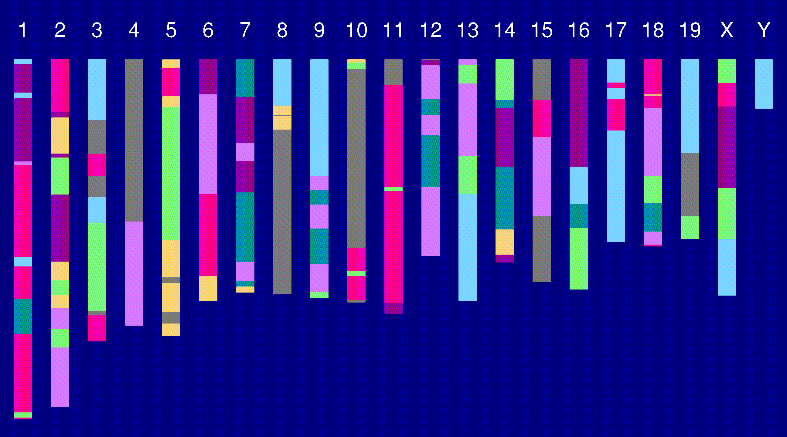
Genome of an 8-way RI

Slide 41
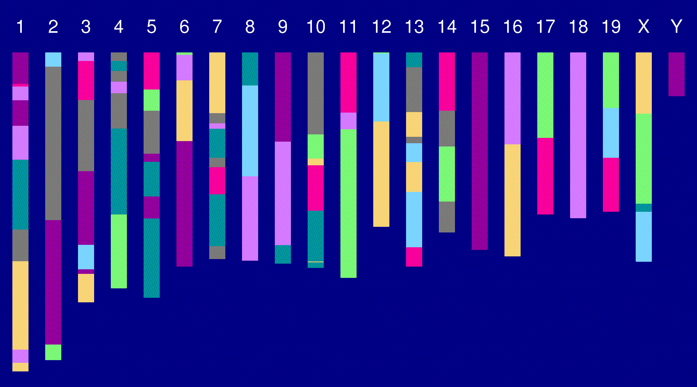
Genome of an 8-way RI

Slide 42
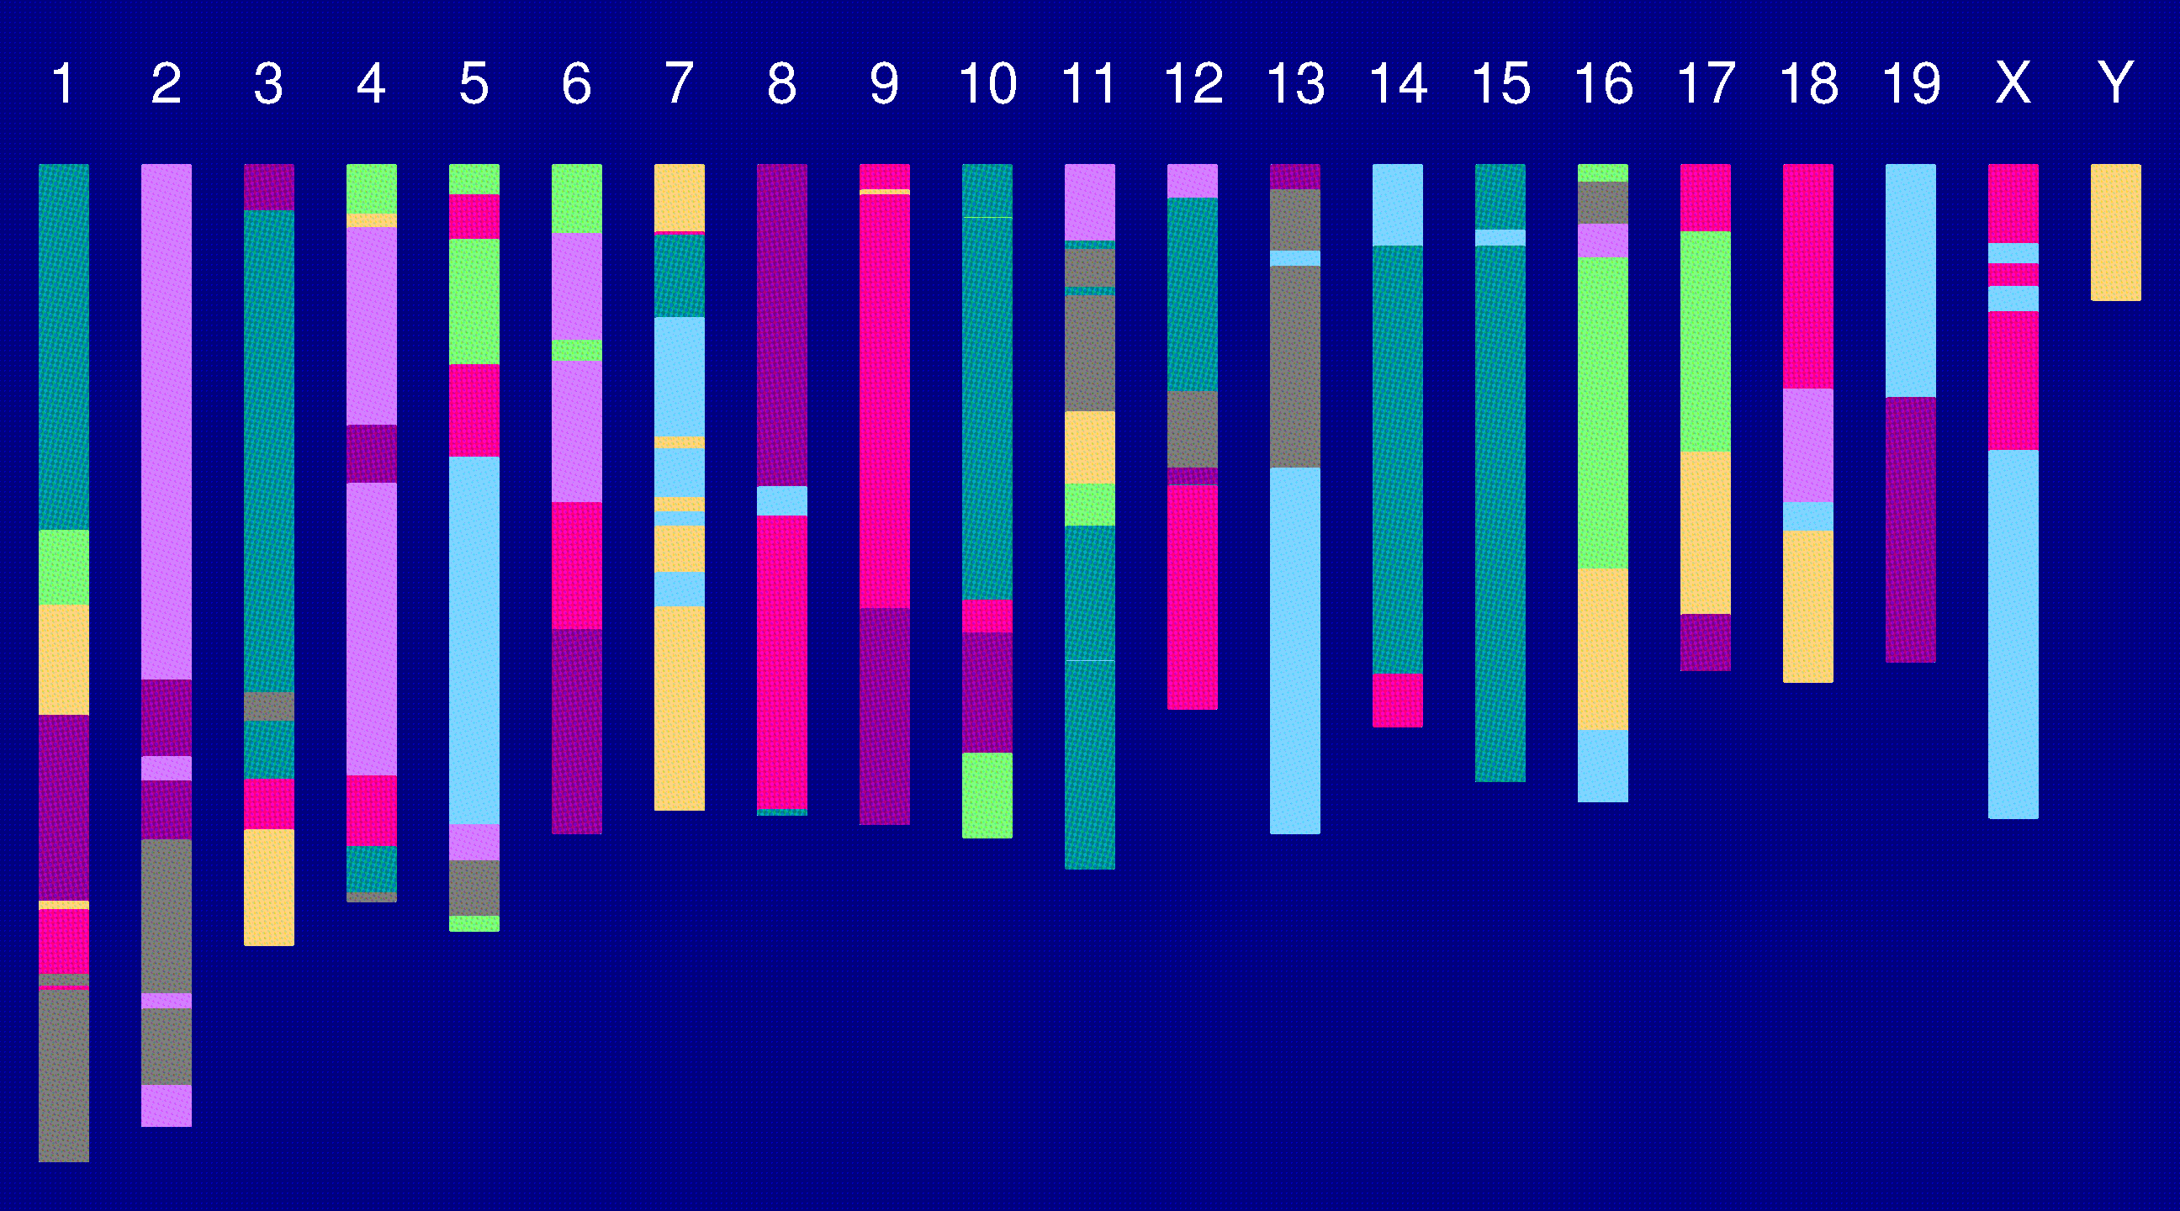
Genome of an 8-way RI

Slide 43
The “Collaborative Cross”
Advantages
Great mapping precision.
Eternal resource.
  Genotype only once.
  Study multiple invasive phenotypes on the same genotype.
Barriers
Advantages not widely appreciated.
  Ask one question at a time, or Ask many questions at once?
Time.
Expense.
Requires large-scale collaboration.

Slide 44
To be worked out
Breakpoint process along an 8-way RI chromosome.
Reconstruction of genotypes given multipoint marker data.
Single-QTL analyses.
  Mixed models, with random effects for strains and genotypes/alleles.
Power and precision (relative to an intercross).

Slide 45
Acknowledgments
Terry Speed, Univ. of California, Berkeley and WEHI
Tom Brodnicki, WEHI
Gary Churchill, The Jackson Laboratory
Joe Nadeau, Case Western Reserve Univ.

