Slide 1
The breakpoint process on RI chromosomes
Karl W Broman
Department of Biostatistics
Johns Hopkins University
http://www.biostat.jhsph.edu/~kbroman

Slide 2
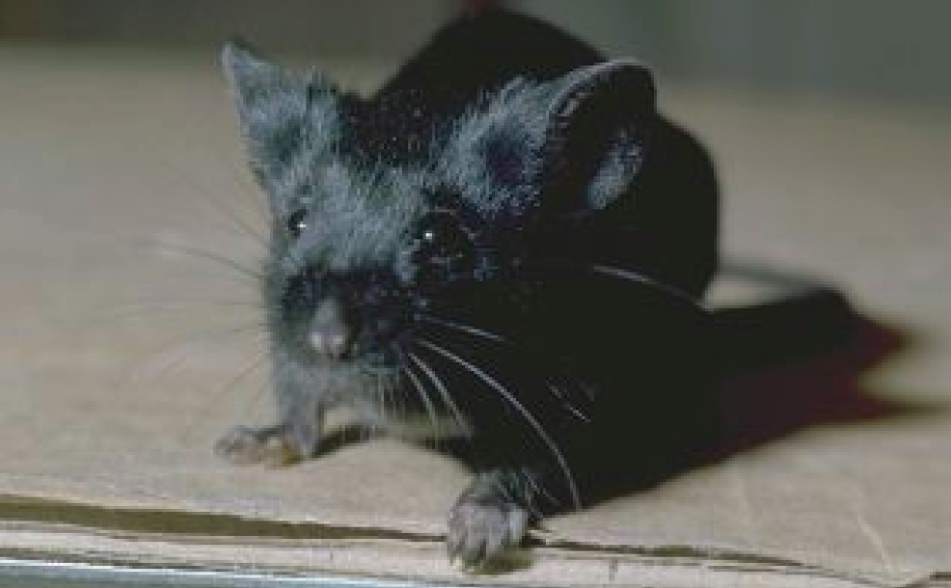
C57BL/6

Slide 3
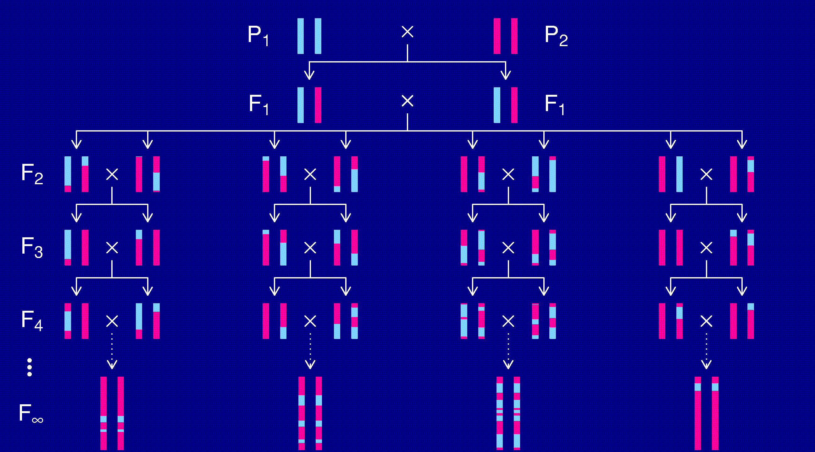
Recombinant inbred lines
(by sibling mating)

Slide 4
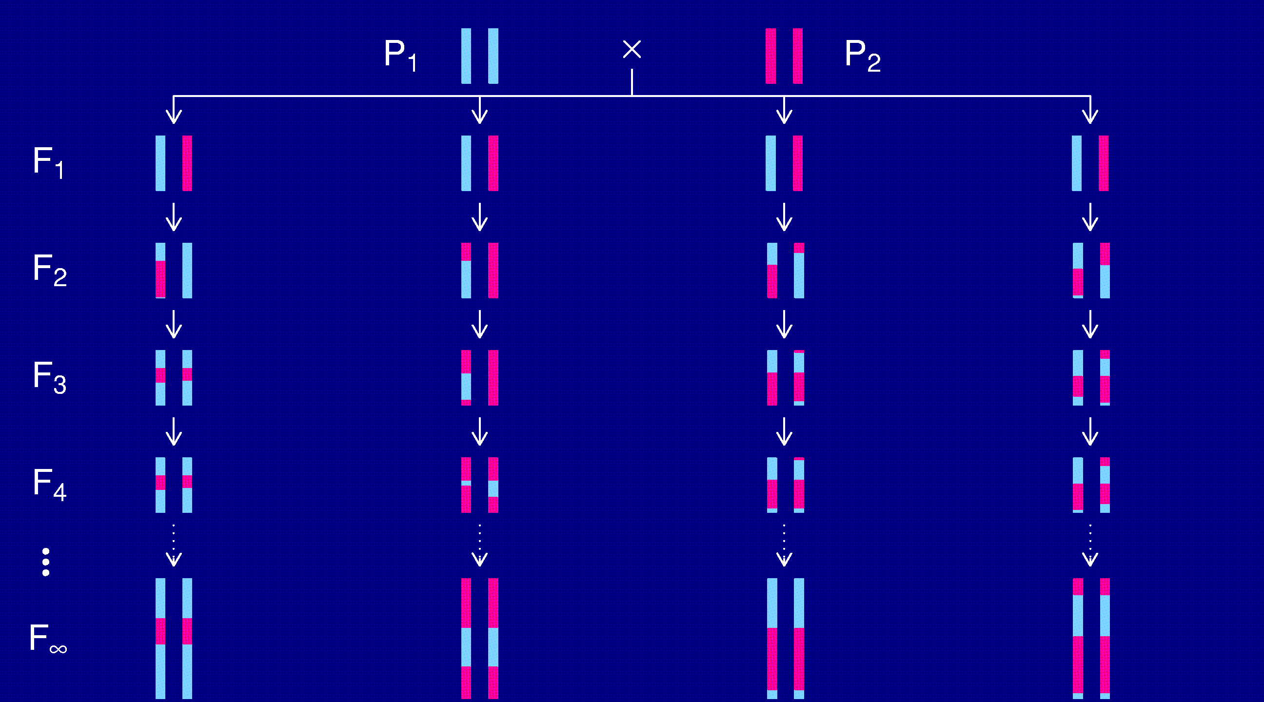
Recombinant inbred lines
(by selfing)

Slide 5
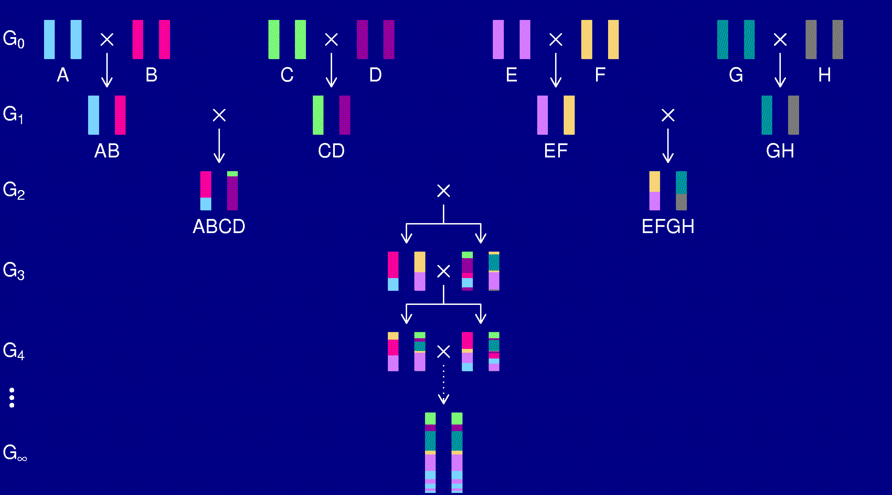
The “Collaborative Cross”

Slide 6
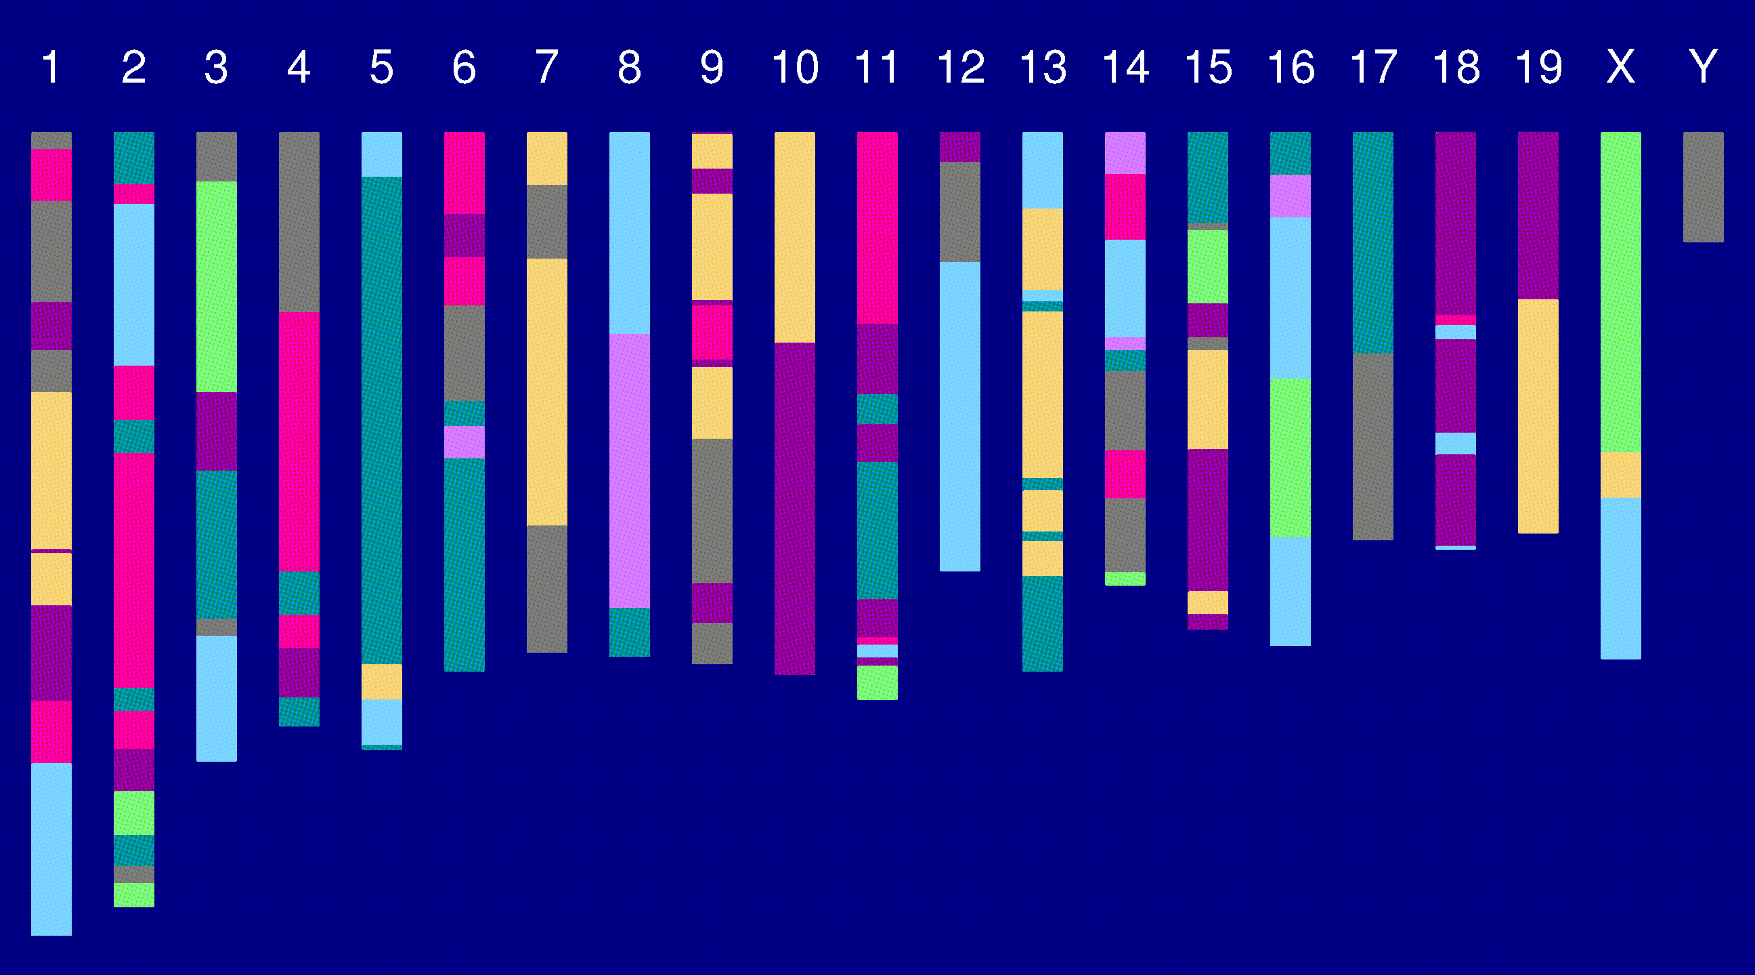
Genome of an 8-way RI

Slide 7
The goal
Characterize the breakpoint process along a chromosome in 8-way RILs.
  Understand the two-point transition matrix.
  Study the clustering of the breakpoints, as a function of crossover interference in meiosis.
Why?
  It’s interesting.
  Statistical analyses of such 8-way RIL data will require a model for this breakpoint process.

Slide 8
2 points in an RIL
1
2
r = recombination fraction = probability of a recombination in the interval in a random meiotic product.
R = analogous thing for the RIL = probability of different genotypes at the two loci in a random RIL.

Slide 9
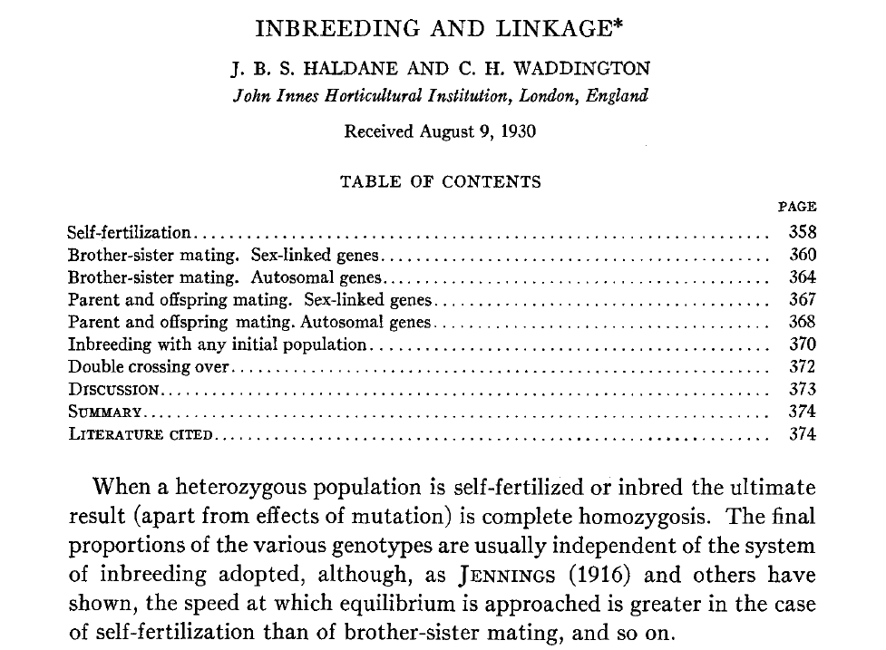
Haldane & Waddington 1931
Genetics 16:357-374

Slide 10
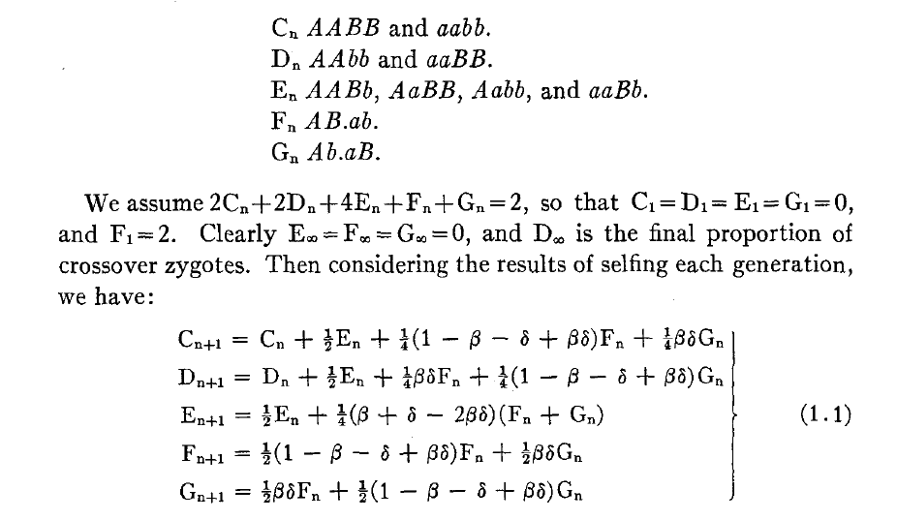
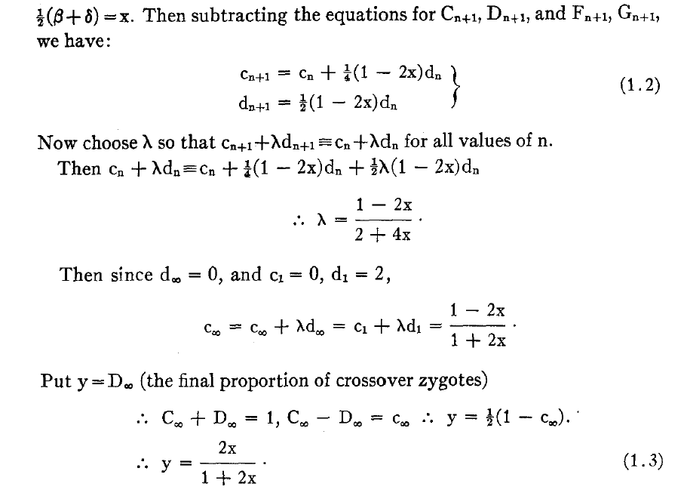
Equations for selfing

Slide 11
Recombinant inbred lines
(by selfing)

Slide 12
Recombinant inbred lines
(by sibling mating)

Slide 13
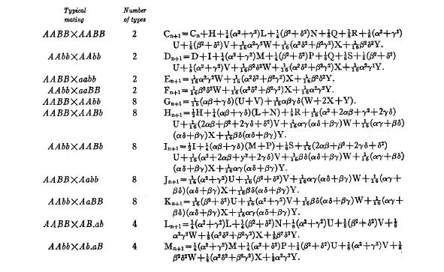
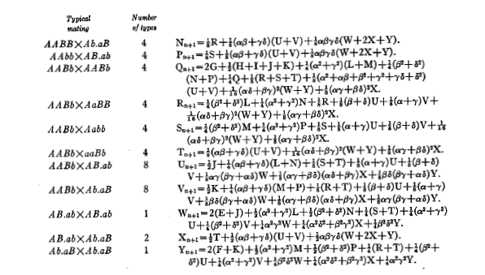
Equations for sib-mating

Slide 14
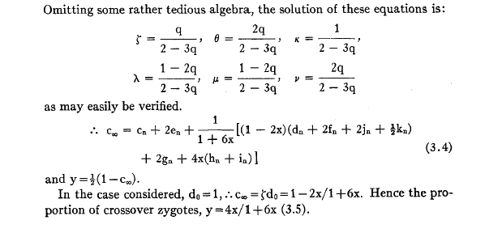
Result for sib-mating

Slide 15
Haldane & Waddington 1931
r = recombination fraction per meiosis between two loci
G_{i} = allele at marker i in an RIL by sib-matings.
Autosomes
  Pr(G₁=A) = Pr(G₁=B) = 1/2
  Pr(G₂=B | G₁=A) = Pr(G₂=A | G₁=B) = 4r / (1+6r)
X chromosome
  Pr(G₁=A) = 2/3 Pr(G₁=B) = 1/3
  Pr(G₂=B | G₁=A) = 2r / (1+4r)
  Pr(G₂=A | G₁=B) = 4r / (1+4r)
  Pr(G₂ ≠ G₁) = (8/3) r / (1+4r)

Slide 16
8-way RILs
Autosomes
  Pr(G₁ = i) = 1/8
  Pr(G₂ = j | G₁ = i) = r / (1+6r) for i ≠ j
  Pr(G₂ ≠ G₁) = 7r / (1+6r)
X chromosome
  Pr(G₁=A) = Pr(G₁=B) = Pr(G₁=E) = Pr(G₁=F) =1/6
  Pr(G₁=C) = 1/3
  Pr(G₂=B | G₁=A) = r / (1+4r)
  Pr(G₂=C | G₁=A) = 2r / (1+4r)
  Pr(G₂=A | G₁=C) = r / (1+4r)
  Pr(G₂ ≠ G₁) = (14/3) r / (1+4r)

Slide 17
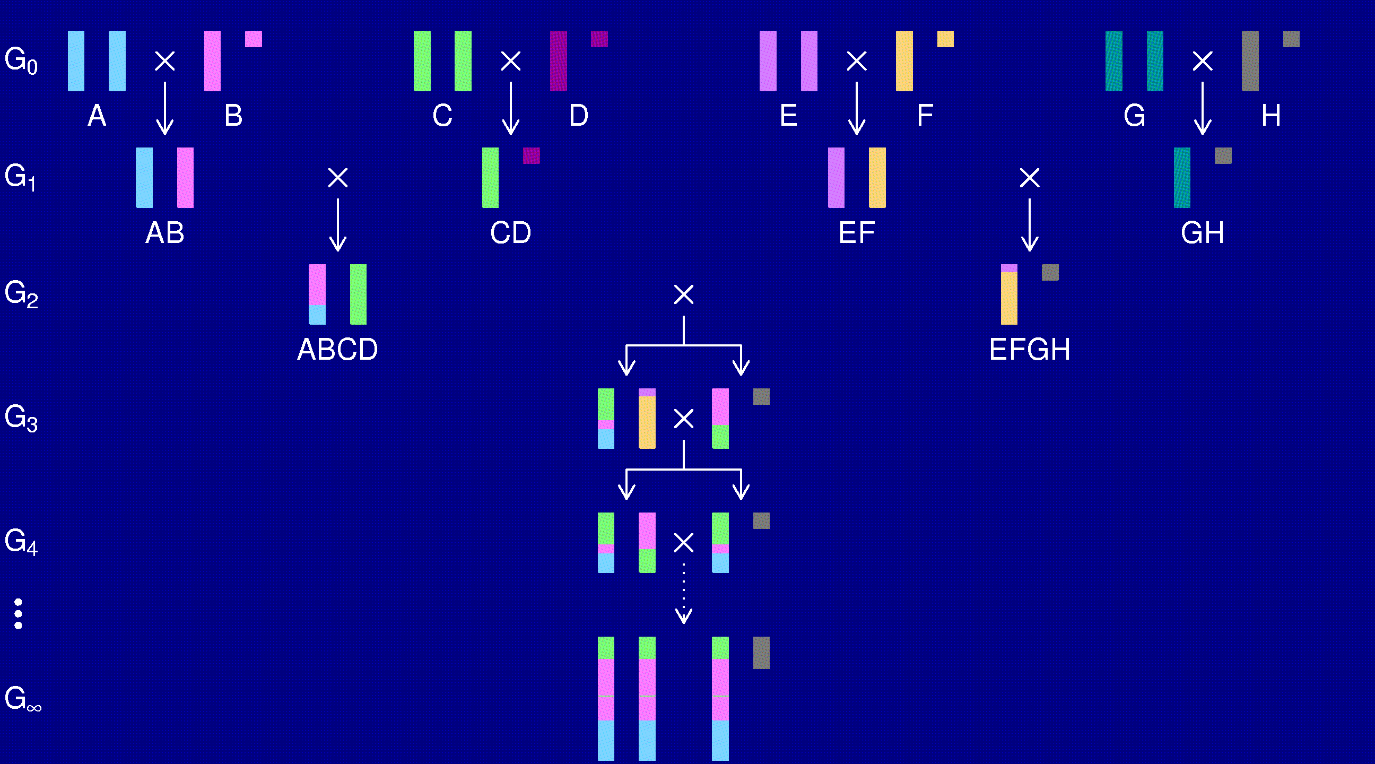
The X chromosome

Slide 18
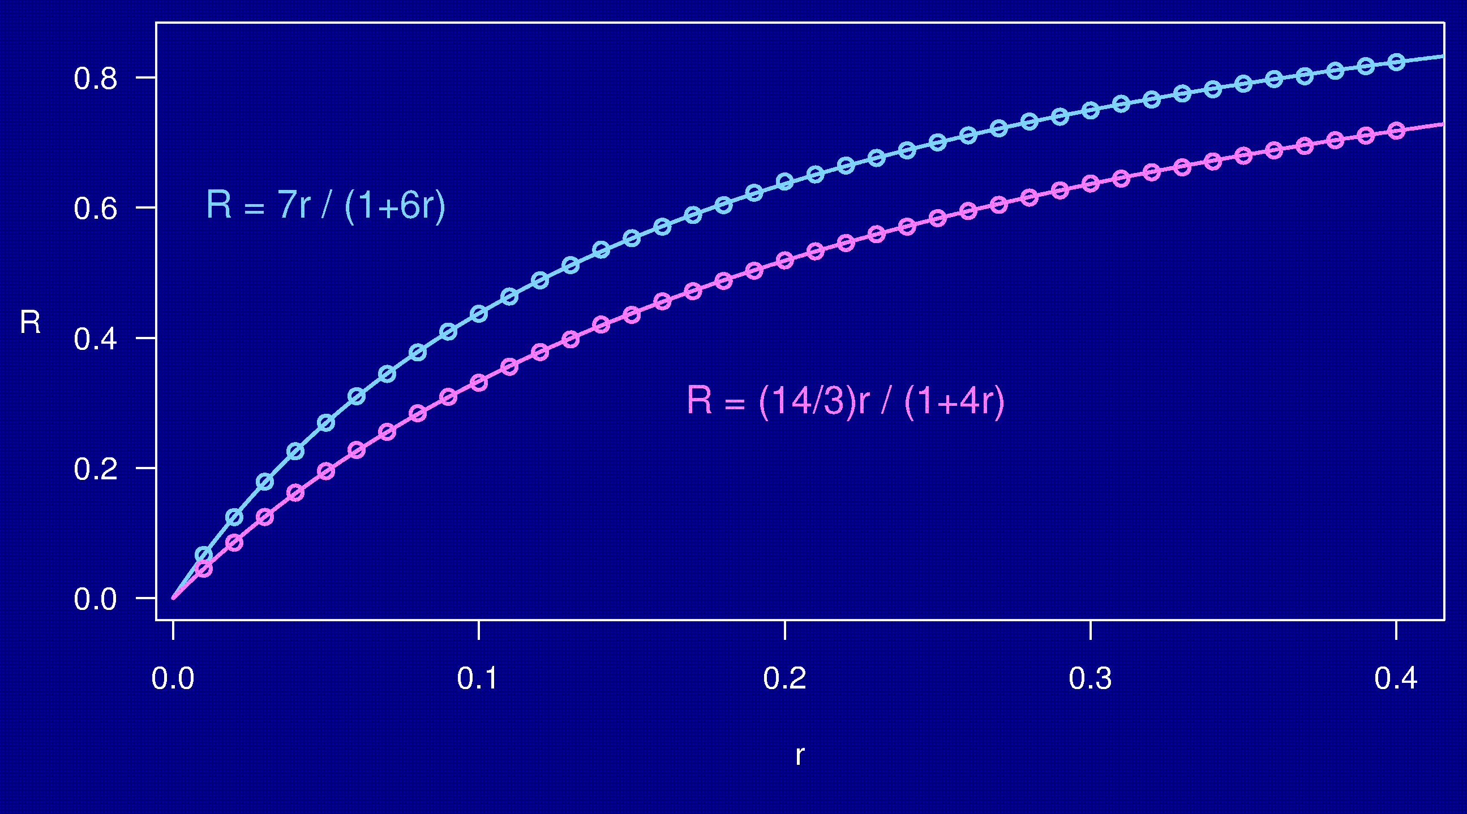
Computer simulations

Slide 19
3 points in an RIL
1
2
3
r_{ij} = recombination fraction for interval i,j
Coincidence = Pr(rec’n in both intervals) / (r₁₂ r₂₃)
= Pr(rec’n in 23 | rec’n in 12) / Pr(rec’n in 23)
No interference → = 1
Positive interference → < 1
Negative interference → > 1
H&W result + map function →
coincidence on a 2-way RIL chromosome
Notes:
This is actually included at the end of Haldane & Waddington (1931).

Slide 20
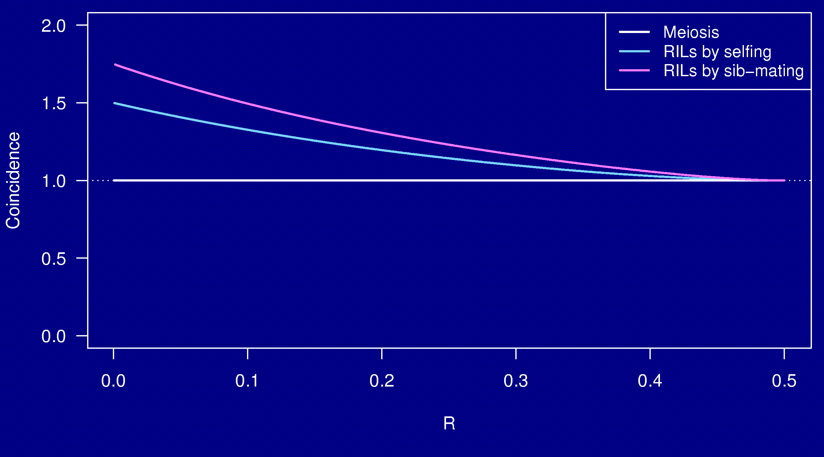
Coincidence
No interference

Slide 21
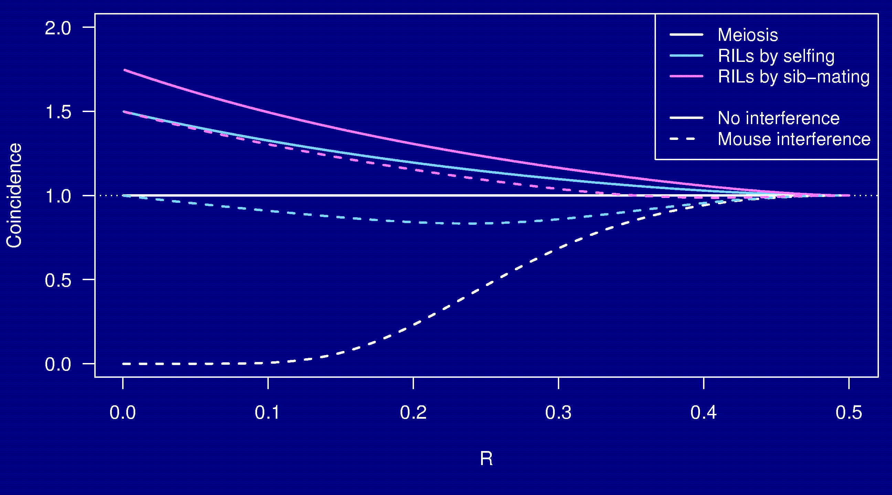
Coincidence

Slide 22
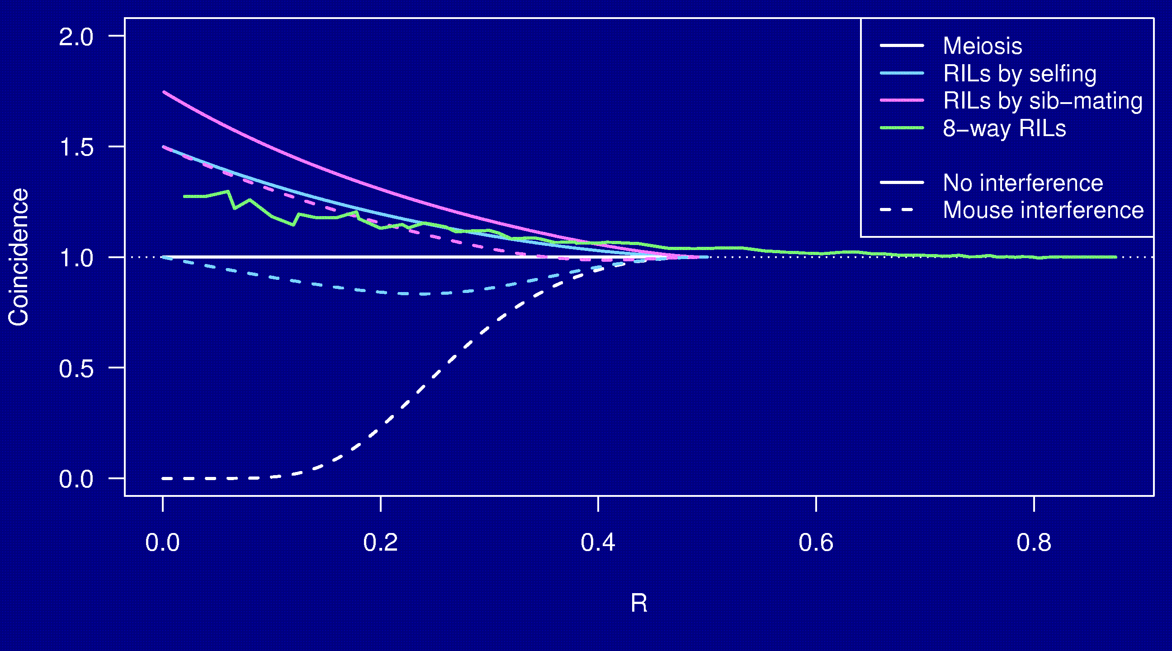
Coincidence

Slide 23
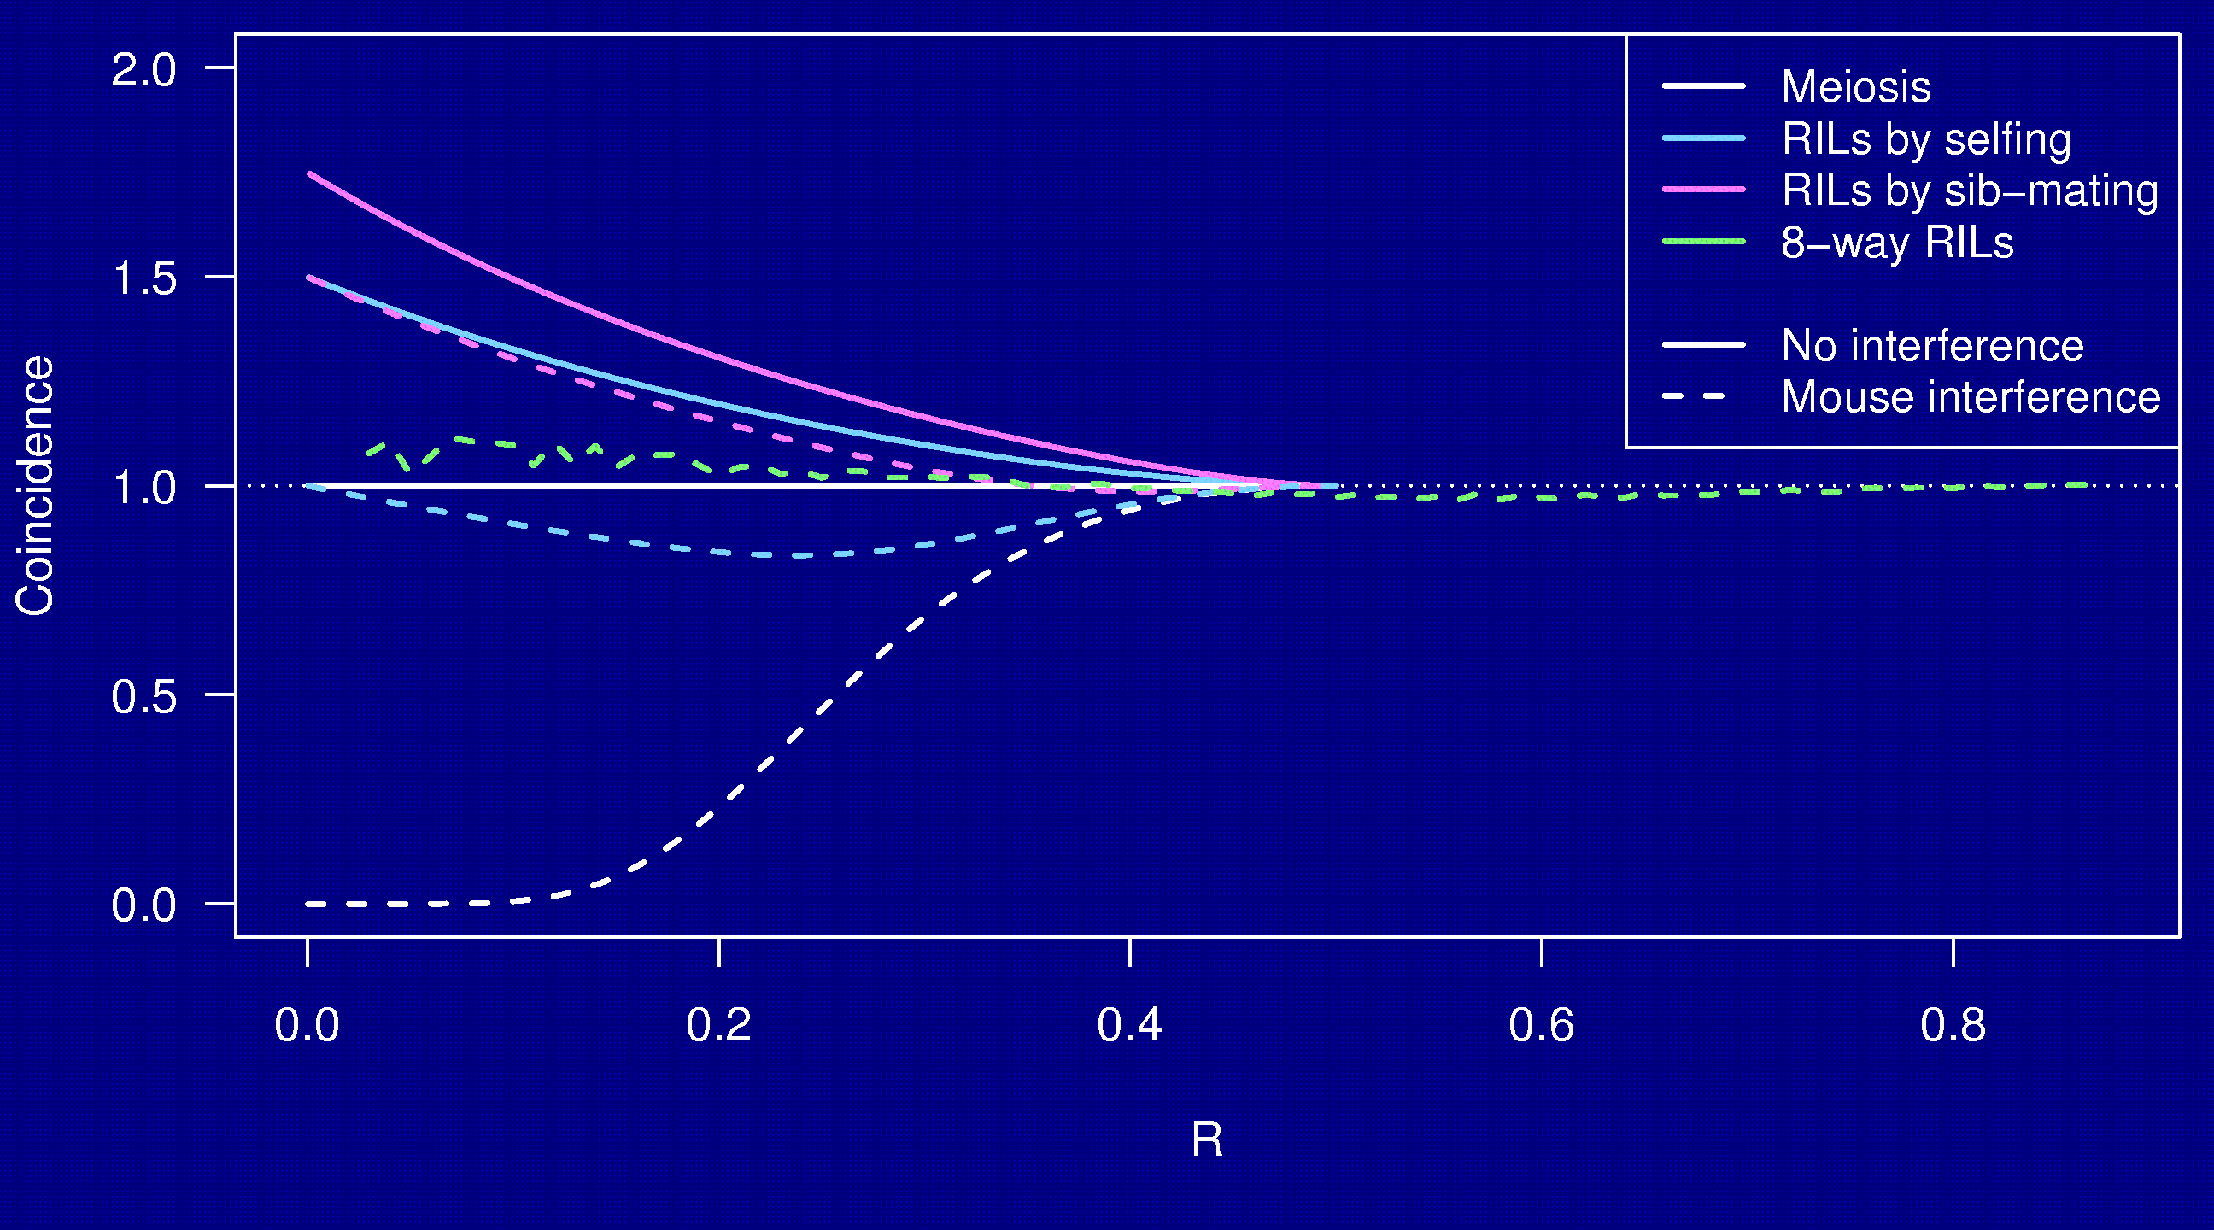
Coincidence

Slide 24
Why the clustering of breakpoints?
The really close breakpoints occur in different generations.
Breakpoints in later generations can occur only in regions that are not yet fixed.
The regions of heterozygosity are, of course, surrounded by breakpoints.

Slide 25
Summary
RILs are useful.
The Collaborative Cross could provide “one-stop shopping” for gene mapping in the mouse.
Use of such 8-way RILs requires an understanding of the breakpoint process.
We’ve extended Haldane & Waddington’s results to the case of 8-way RILs, but need to prove our results.
We’ve shown clustering of breakpoints in RILs by sib-mating, even in the presence of strong crossover interference.
Formulae for the 3-point problem in 8-way RILs still elude us.
We’d like to:
  Fully characterize the breakpoint process.
  Study data (e.g., on 2-way RILs via selfing in Arabidopsis).

