Slide 1
The breakpoint process on RI chromosomes
(a work in progress)
Karl W Broman
Department of Biostatistics
Johns Hopkins University
http://www.biostat.jhsph.edu/~kbroman

Slide 2
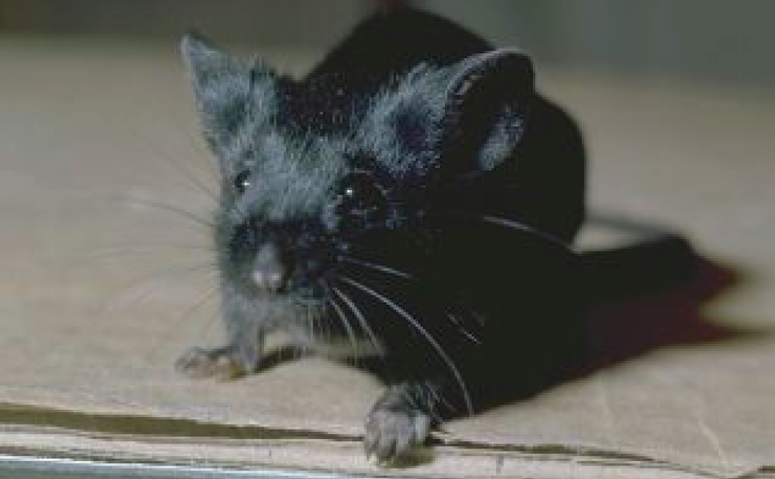
C57BL/6

Slide 3
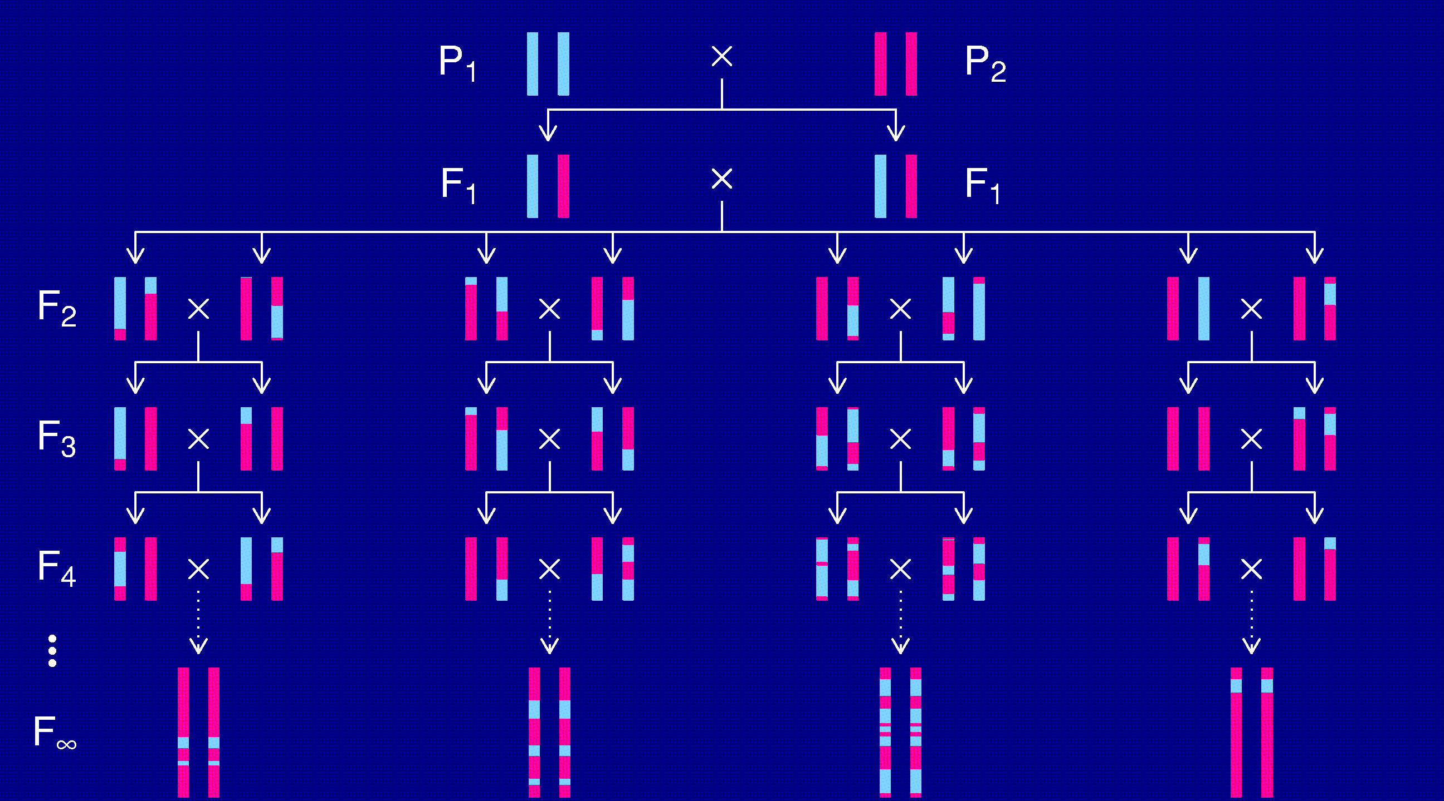
Recombinant inbred lines
(by sibling matings)

Slide 4
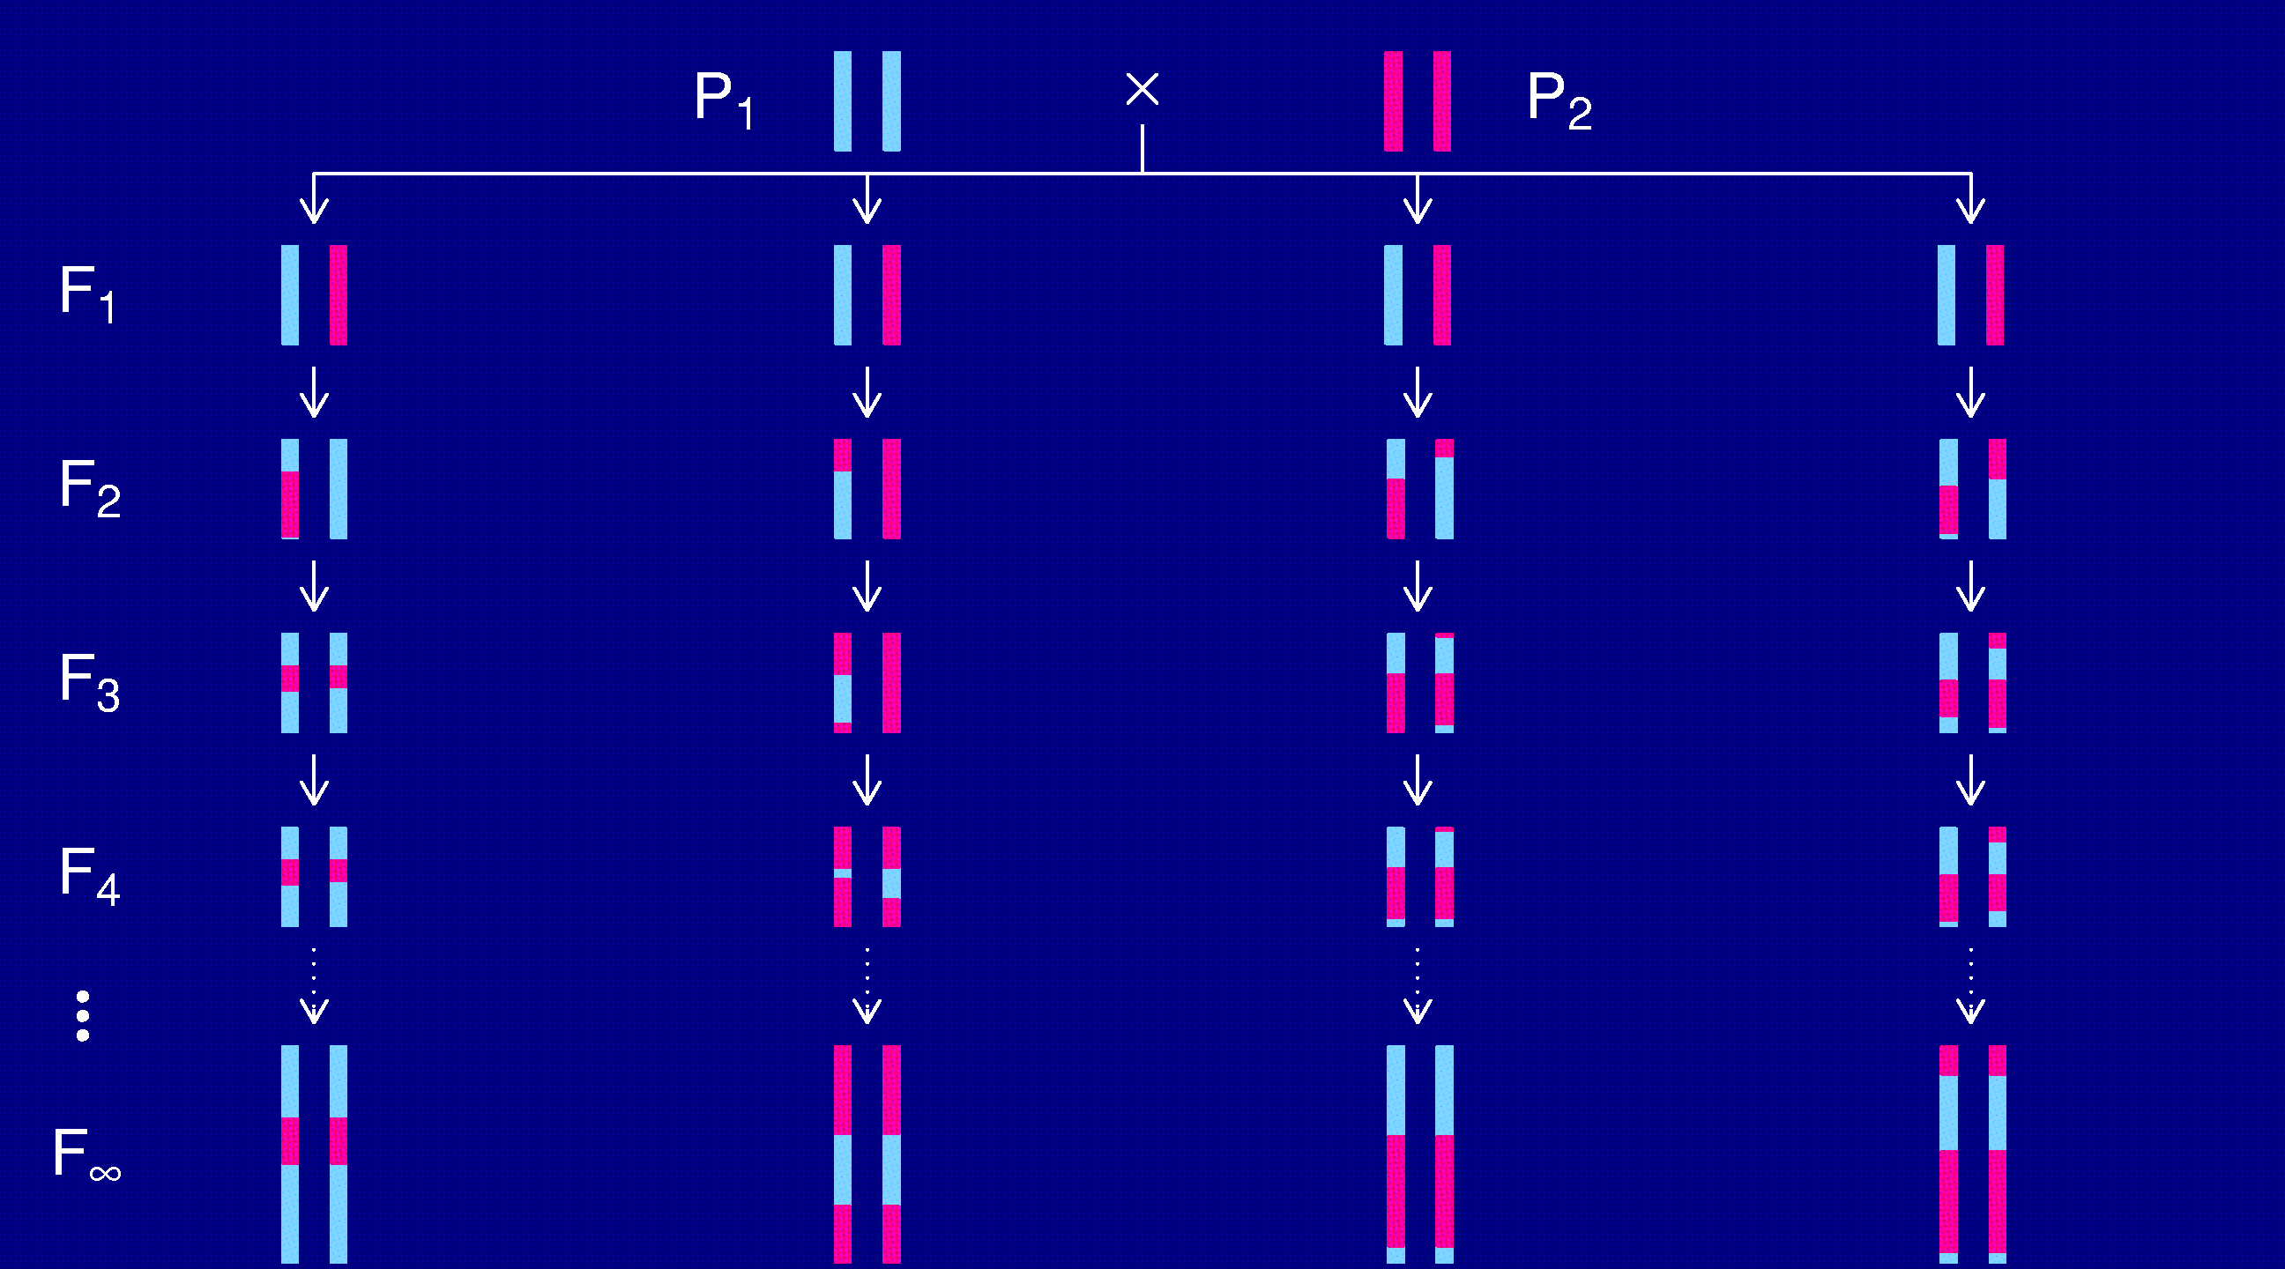
Recombinant inbred lines
(by selfing)

Slide 5
Advantages of RI lines
Each strain is a eternal resource.
  Only need to genotype once.
  Reduce individual variation by phenotyping multiple individuals from each strain.
  Study multiple phenotypes on the same genotype.
Greater mapping precision.
  More dense breakpoints on the RI chromosomes.

Slide 6
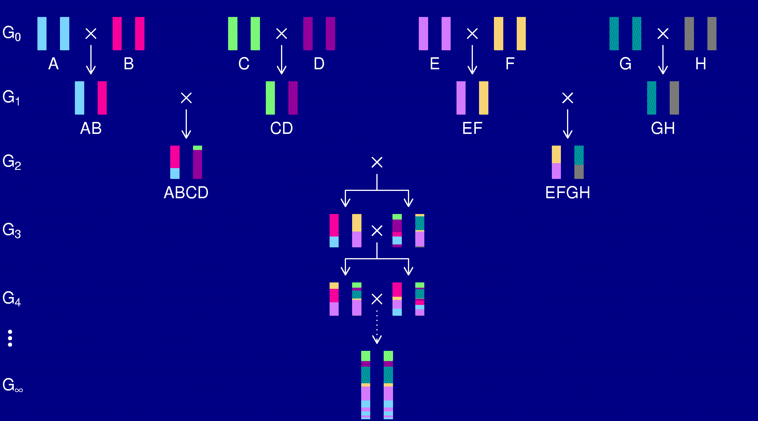
The “Collaborative Cross”

Slide 7
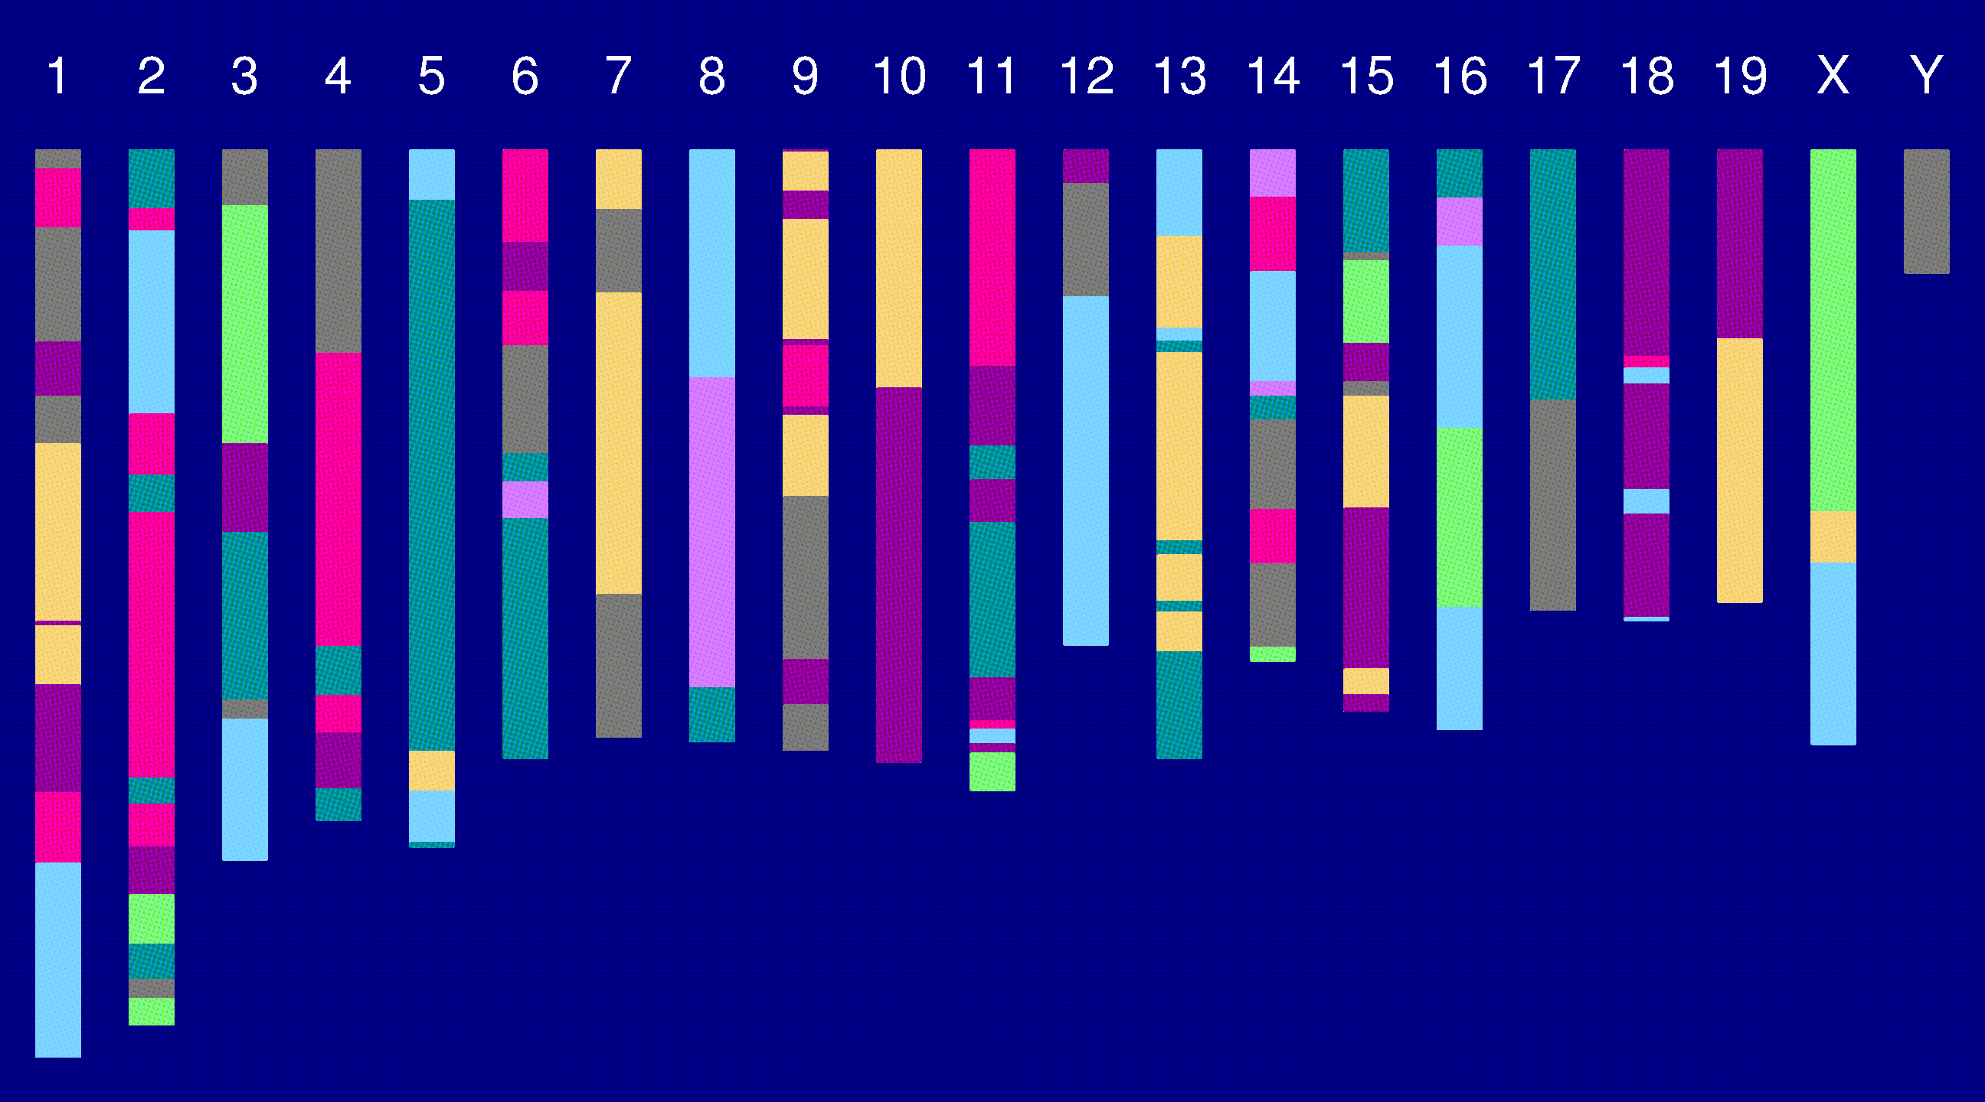
Genome of an 8-way RI

Slide 8
The goal
Characterize the breakpoint process along a chromosome in 8-way RILs.
  Understand the two-point transition matrix.
  Study the clustering of the breakpoints, as a function of crossover interference in meiosis.

Slide 9
Why?
It’s interesting.
Later statistical analyses will require:
  The transition matrix.
  A model for the whole process.
Actually, we’ll probably just assume that:
  The breakpoints follow a Poisson process.
  The genotypes follow a Markov chain.

Slide 10
Meiosis

Slide 11
Crossover interference
Most of the time we assume:
  Crossovers occur according to a Poisson process, and so genotypes along a chromosome follow a Markov chain.
In reality, crossovers tend not to occur too close together (positive crossover interference).
Crossover interference is particularly strong in the mouse.

Slide 12
2 points in an RIL
1
2
r = recombination fraction = probability of a recombination in the interval (in a random meiotic product).
R = analogous thing for the RIL = probability of different genotypes at the two loci in a random RIL.

Slide 13
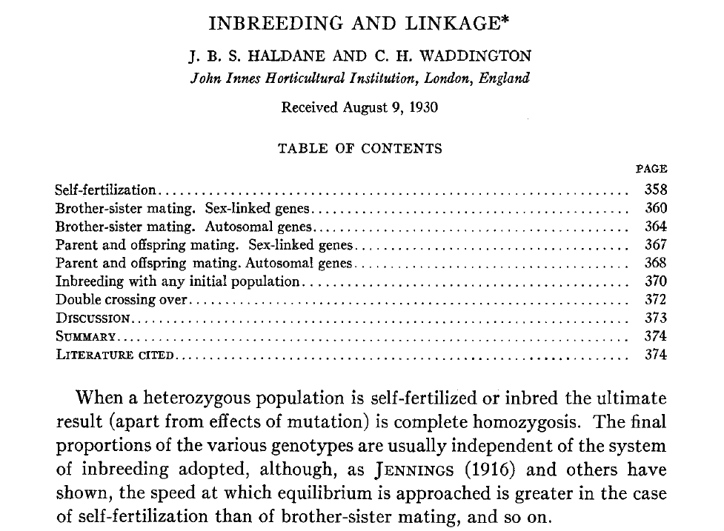
Haldane & Waddington 1931
Genetics 16:357-374

Slide 14
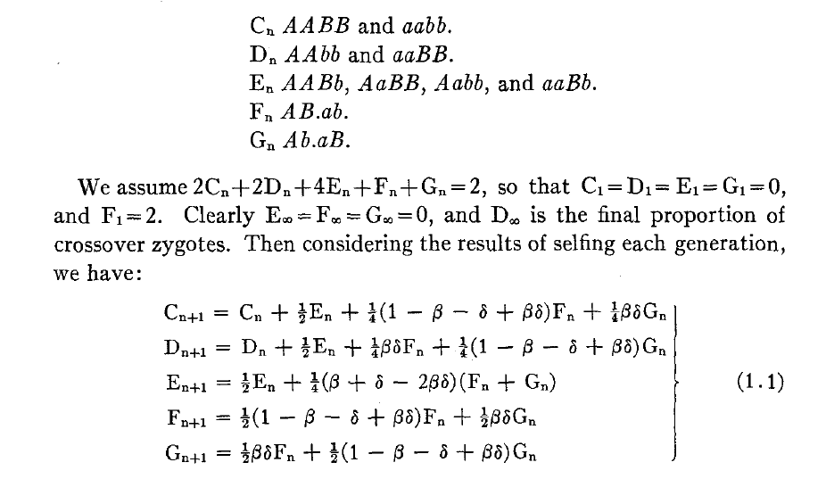
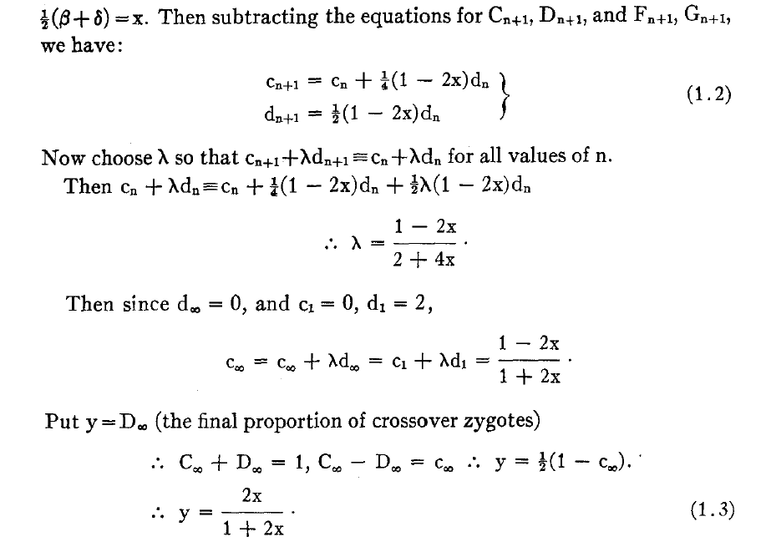
Equations for selfing

Slide 15
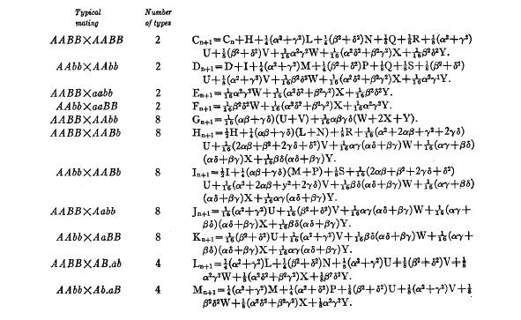
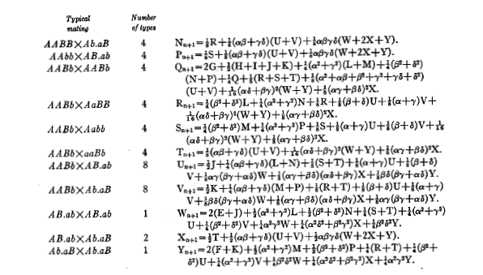
Equations for sib-matings

Slide 16
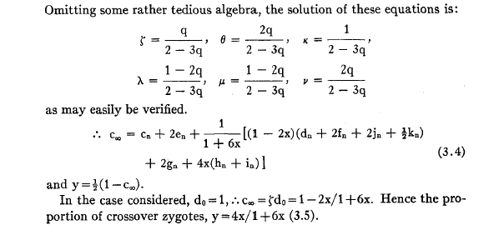
Result for sib-matings

Slide 17
Haldane & Waddington 1931
r = recombination fraction per meiosis between two loci
G_{i} = allele at marker i in a random RIL.
Autosomes
  Pr(G₁=A) = Pr(G₁=B) = 1/2
  Pr(G₂=B | G₁=A) = Pr(G₂=A | G₁=B) = 4r / (1+6r)
X chromosome
  Pr(G₁=A) = 2/3 Pr(G₁=B) = 1/3
  Pr(G₂=B | G₁=A) = 2r / (1+4r)
  Pr(G₂=A | G₁=B) = 4r / (1+4r)
  Pr(G₂ ≠ G₁) = (8/3) r / (1+4r)

Slide 18
8-way RILs
Autosomes
  Pr(G₁ = i) = 1/8
  Pr(G₂ = j | G₁ = i) = r / (1+6r) for i ≠ j
  Pr(G₂ ≠ G₁) = 7r / (1+6r)
X chromosome
  Pr(G₁=A) = Pr(G₁=B) = Pr(G₁=E) = Pr(G₁=F) =1/6
  Pr(G₁=C) = 1/3
  Pr(G₂=B | G₁=A) = r / (1+4r)
  Pr(G₂=C | G₁=A) = 2r / (1+4r)
  Pr(G₂=A | G₁=C) = r / (1+4r)
  Pr(G₂ ≠ G₁) = (14/3) r / (1+4r)

Slide 19
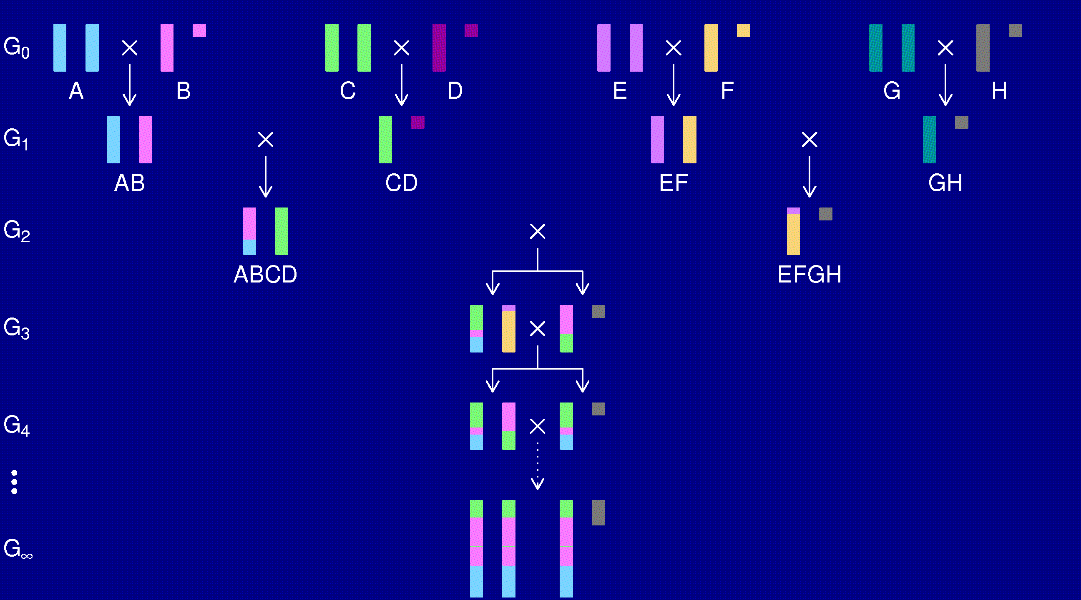
The X chromosome

Slide 20
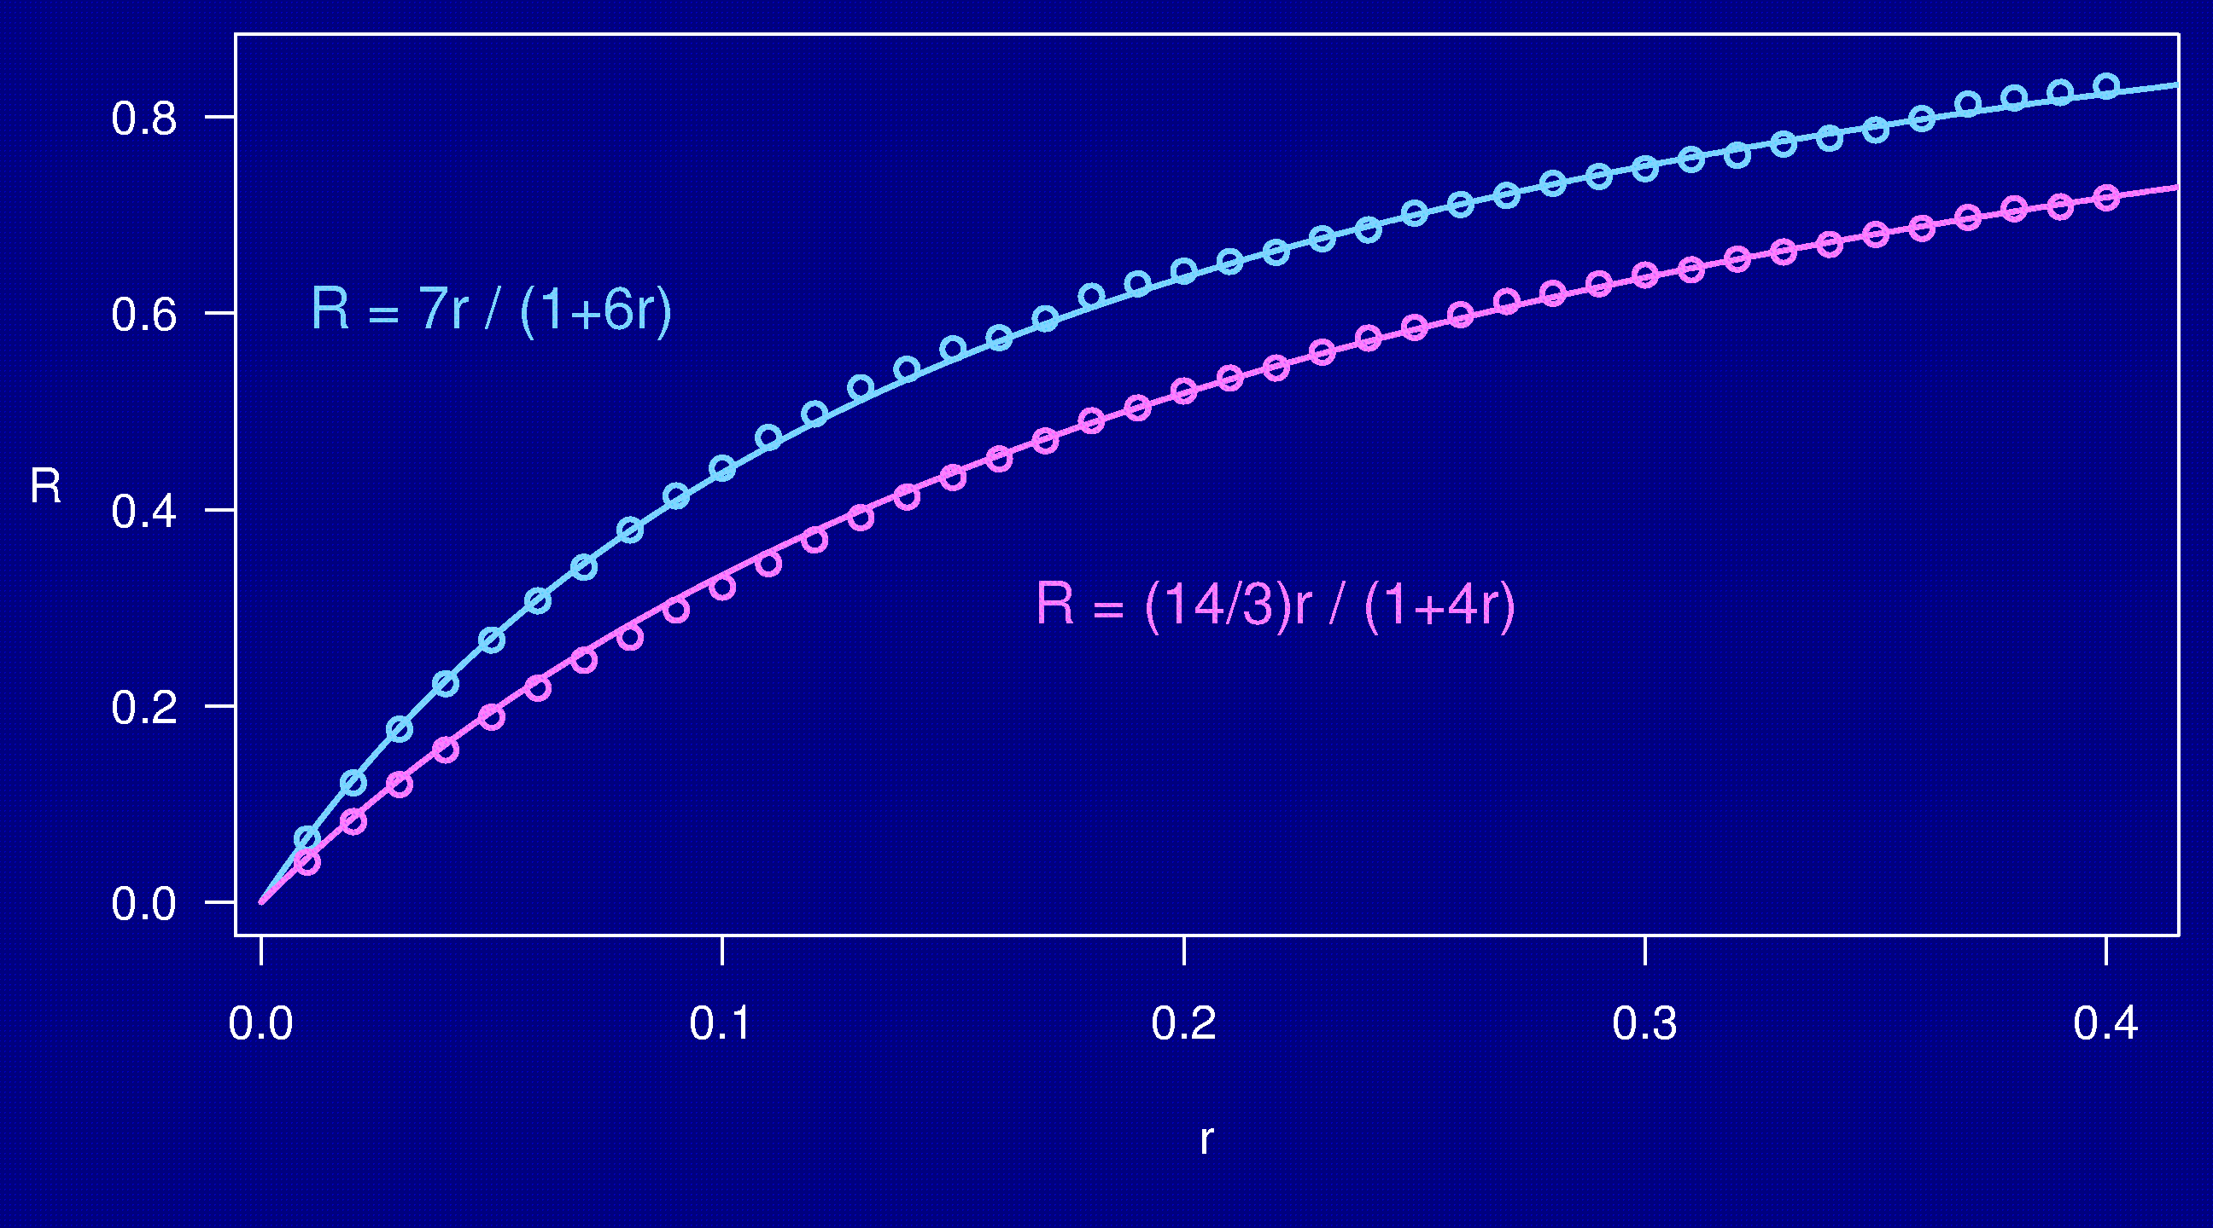
Computer simulations

Slide 21
Coincidence
1
2
3
r_{ij} = recombination fraction for interval i,j
Coincidence = Pr(rec’n in both intervals) / (r₁₂ r₂₃)
= (r₁₂ + r₂₃ – r₁₃) / (2 r₁₂ r₂₃)
No interference → = 1
Positive interference → < 1
Negative interference → > 1

Slide 22
3 points in 2-way RILs
1
2
3
M = map function; r = M(d)
r₁₃ = M⁻¹[ M(r₁₂) + M(r₂₃) ]
Combine this with the result of H&W, and we can get the equivalent coincidence type thing for the RIL chromosome.
Here we assume r₁₂ = r₂₃ = r.

Slide 23
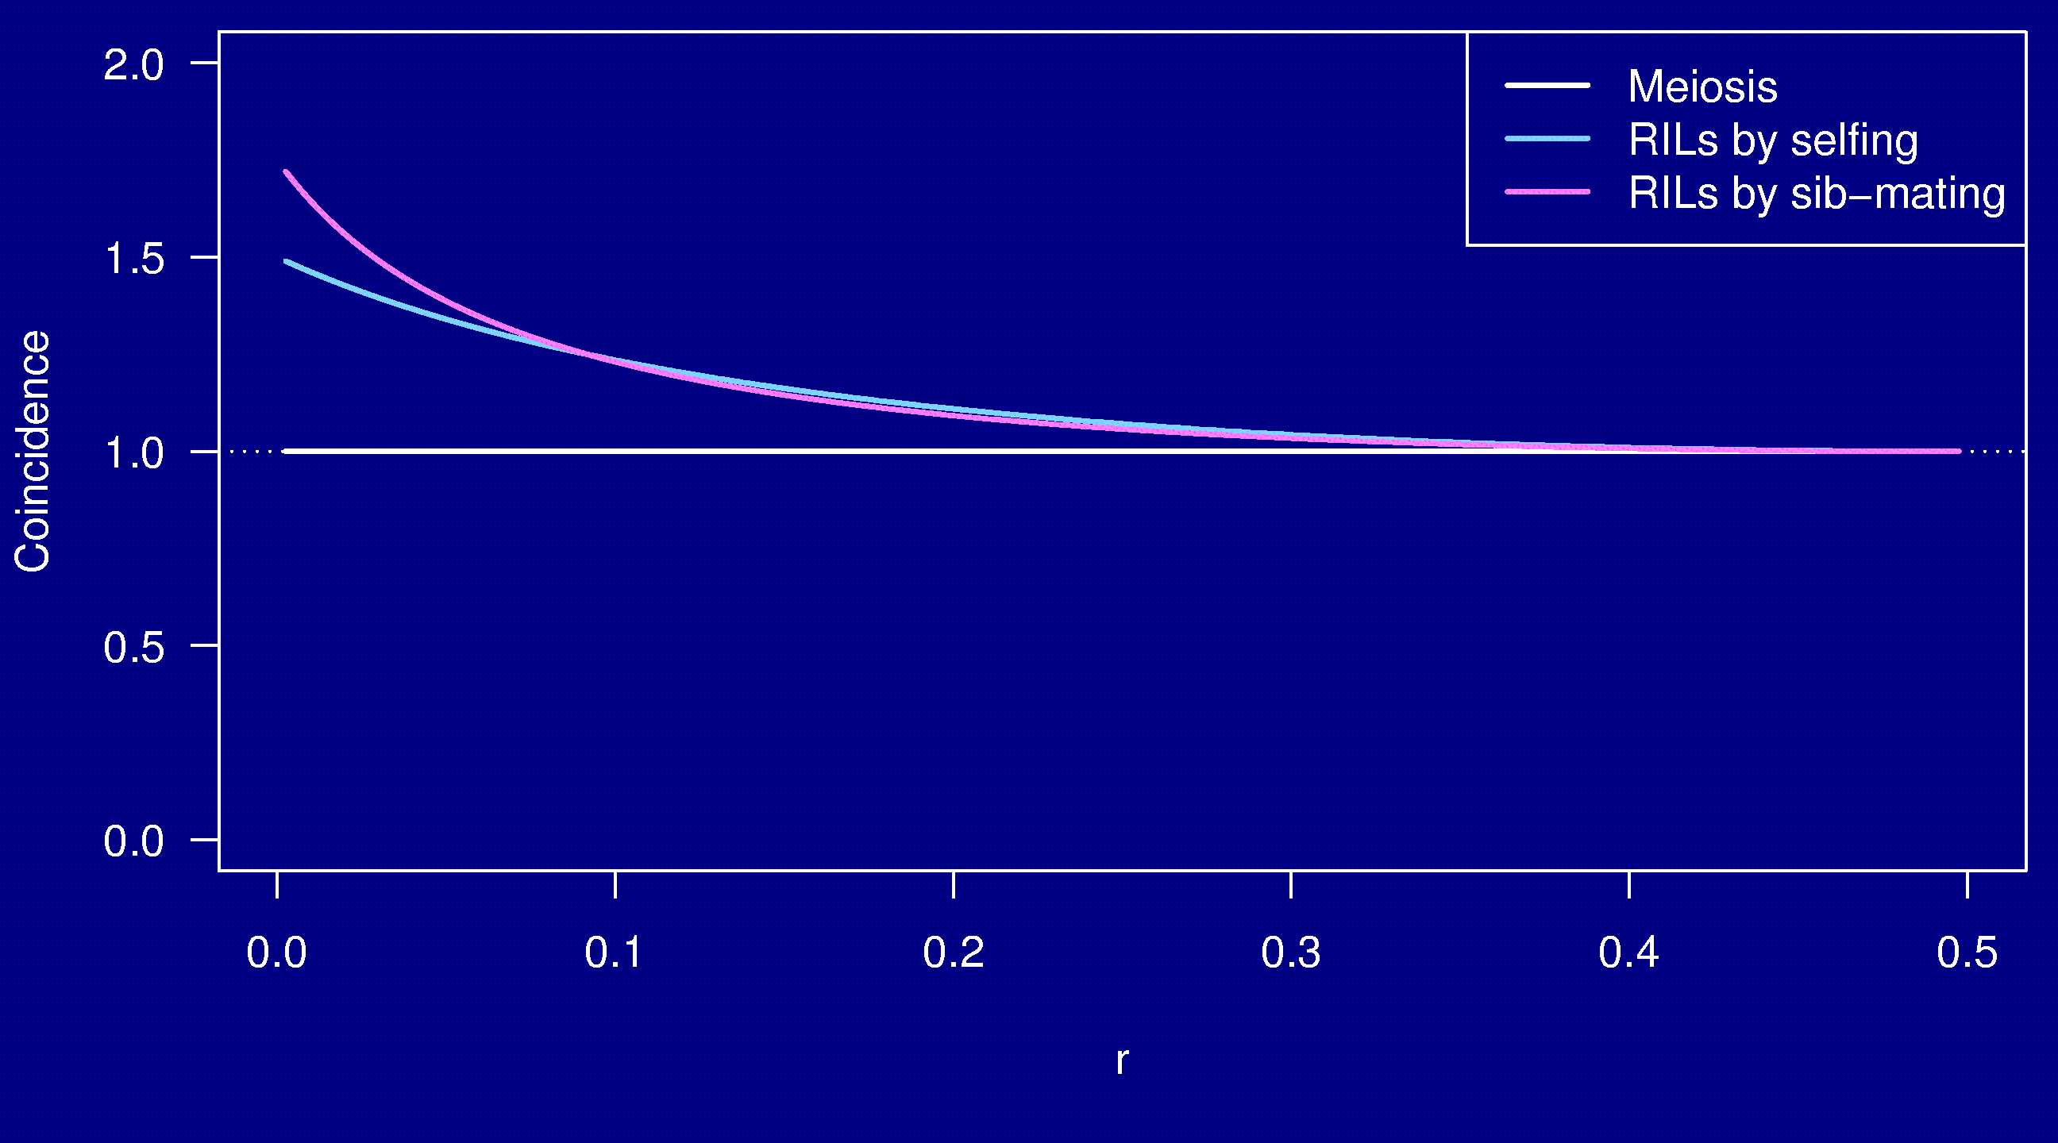
Coincidence
No interference

Slide 24
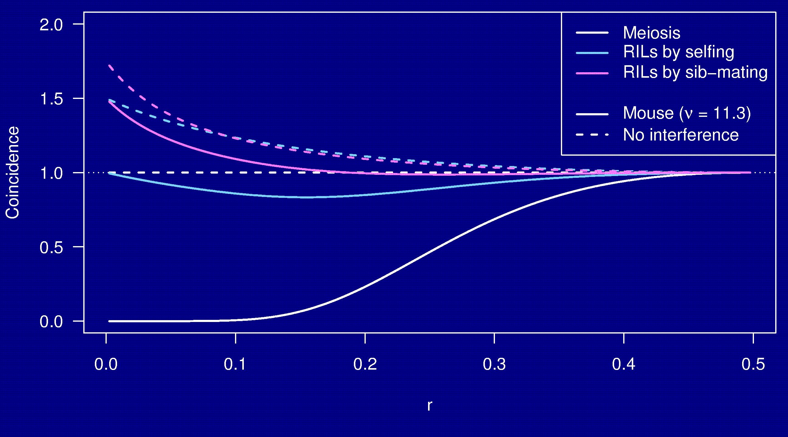
Coincidence

Slide 25
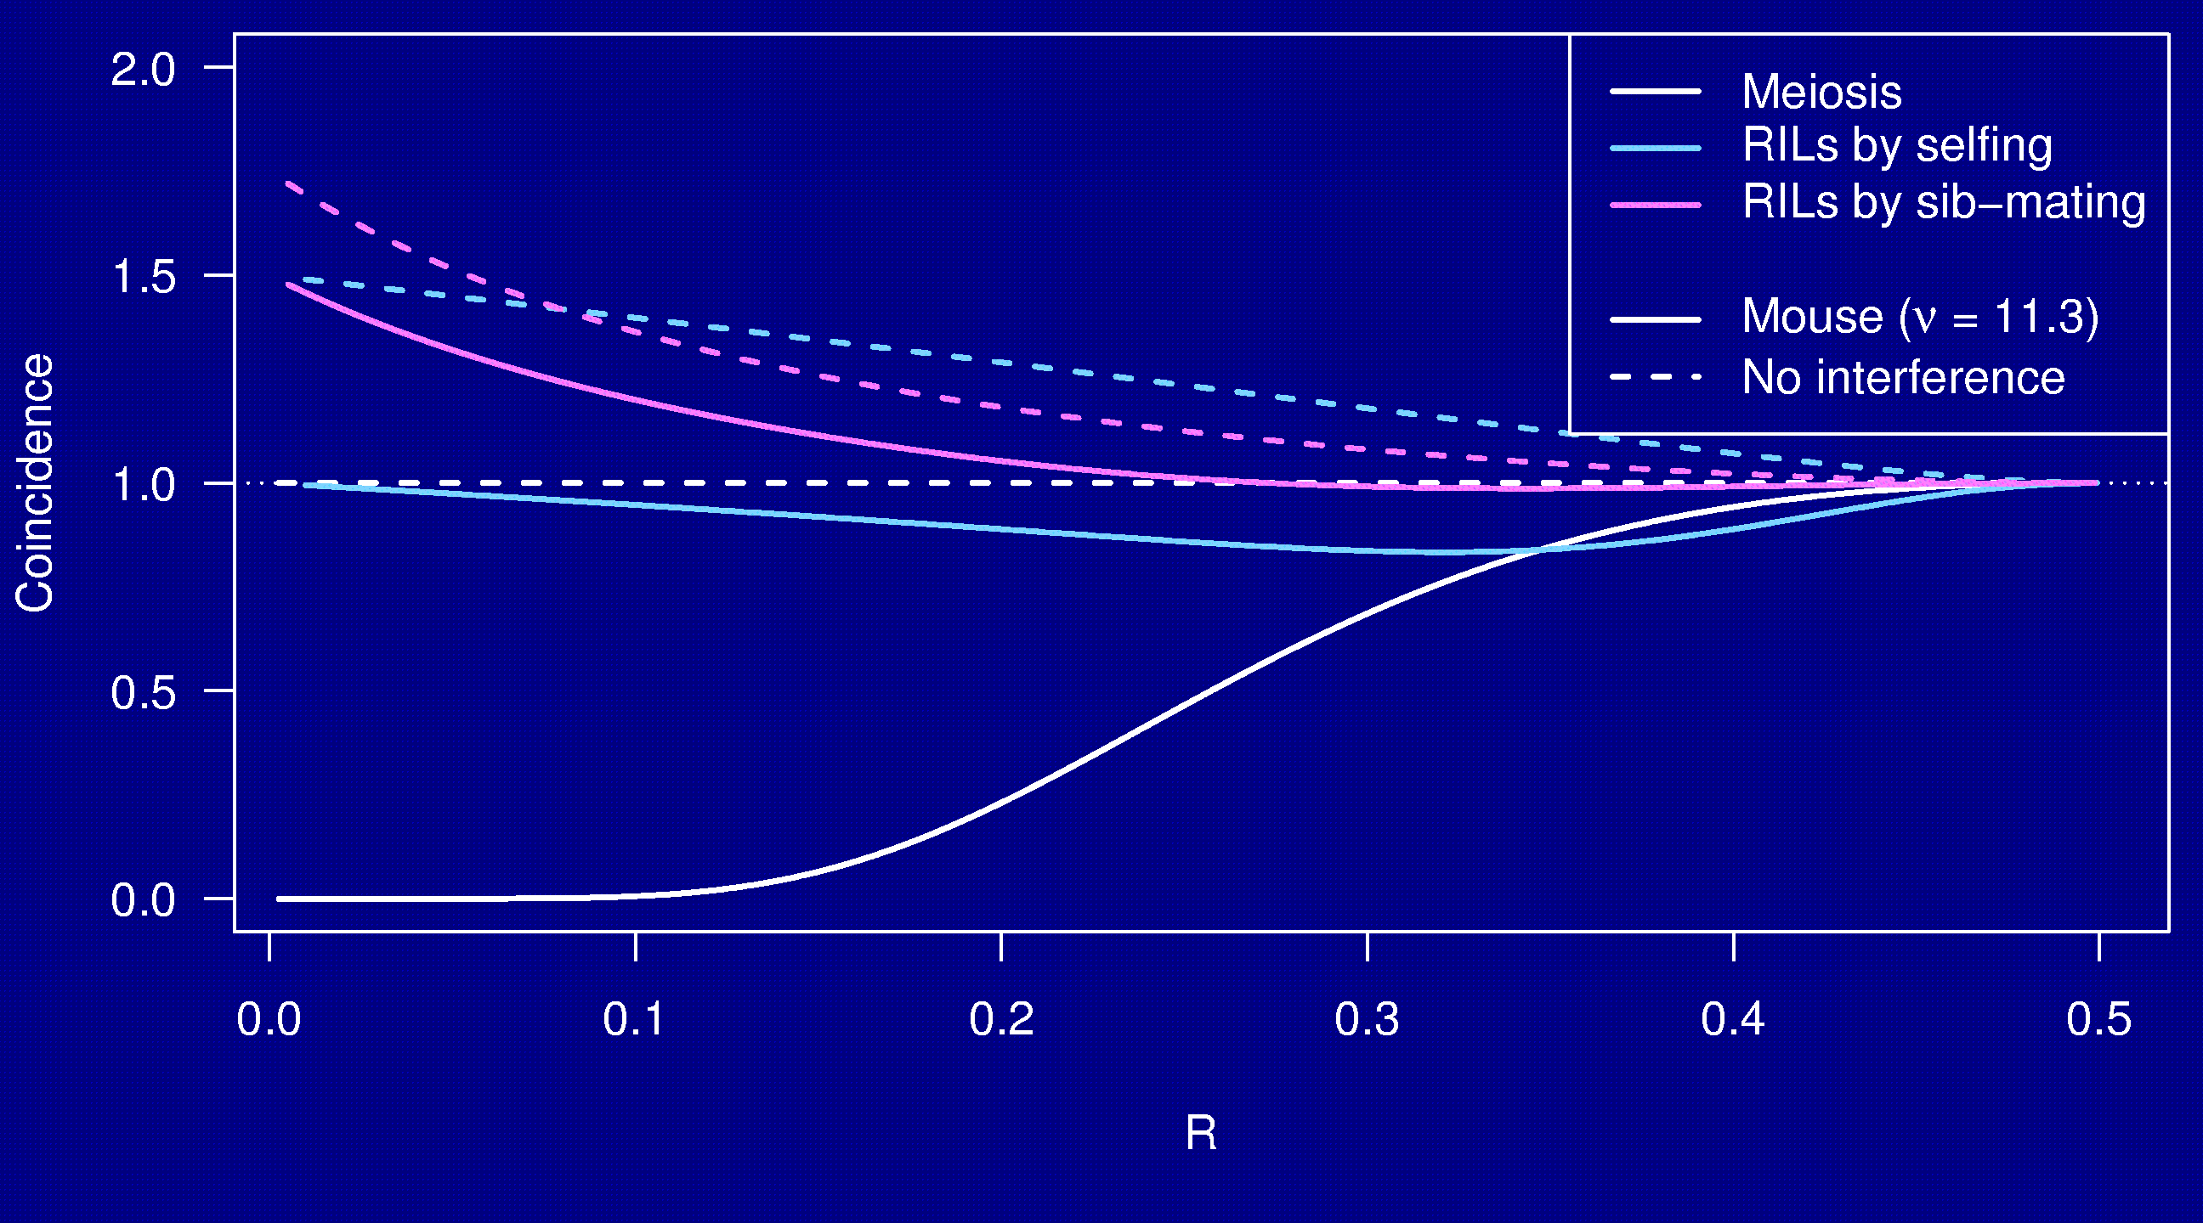
Coincidence

Slide 26
Why the clustering of breakpoints?
The really close breakpoints occur in different generations.
Breakpoints in later generations can occur only if there is heterozygosity (i.e., the region is not yet fixed).
The regions of heterozygosity are, of course, surrounded by breakpoints.

Slide 27
Summary
RILs are useful.
The Collaborative Cross could provide “one-stop shopping” for gene mapping.
Use of 8-way RILs requires an understanding of the breakpoint process.
We’ve extended Haldane & Waddington’s results on 2-way RILs, but need to prove our results.
We’ve come to understand 3 points in 2-way RILs, but need to extend this to the 8-way RILs.
We’d like to:
  Fully characterize the breakpoint process.
  Study data (e.g., on 2-way RILs via selfing in Arabidopsis).

