Slide 1
Statistical issues in QTL mapping in mice
Karl W Broman
Department of Biostatistics
Johns Hopkins University
http://www.biostat.jhsph.edu/~kbroman

Slide 2
Outline
Overview of QTL mapping
The X chromosome
Mapping multiple QTLs
Recombinant inbred lines
Heterogeneous stock and 8-way RILs

Slide 3
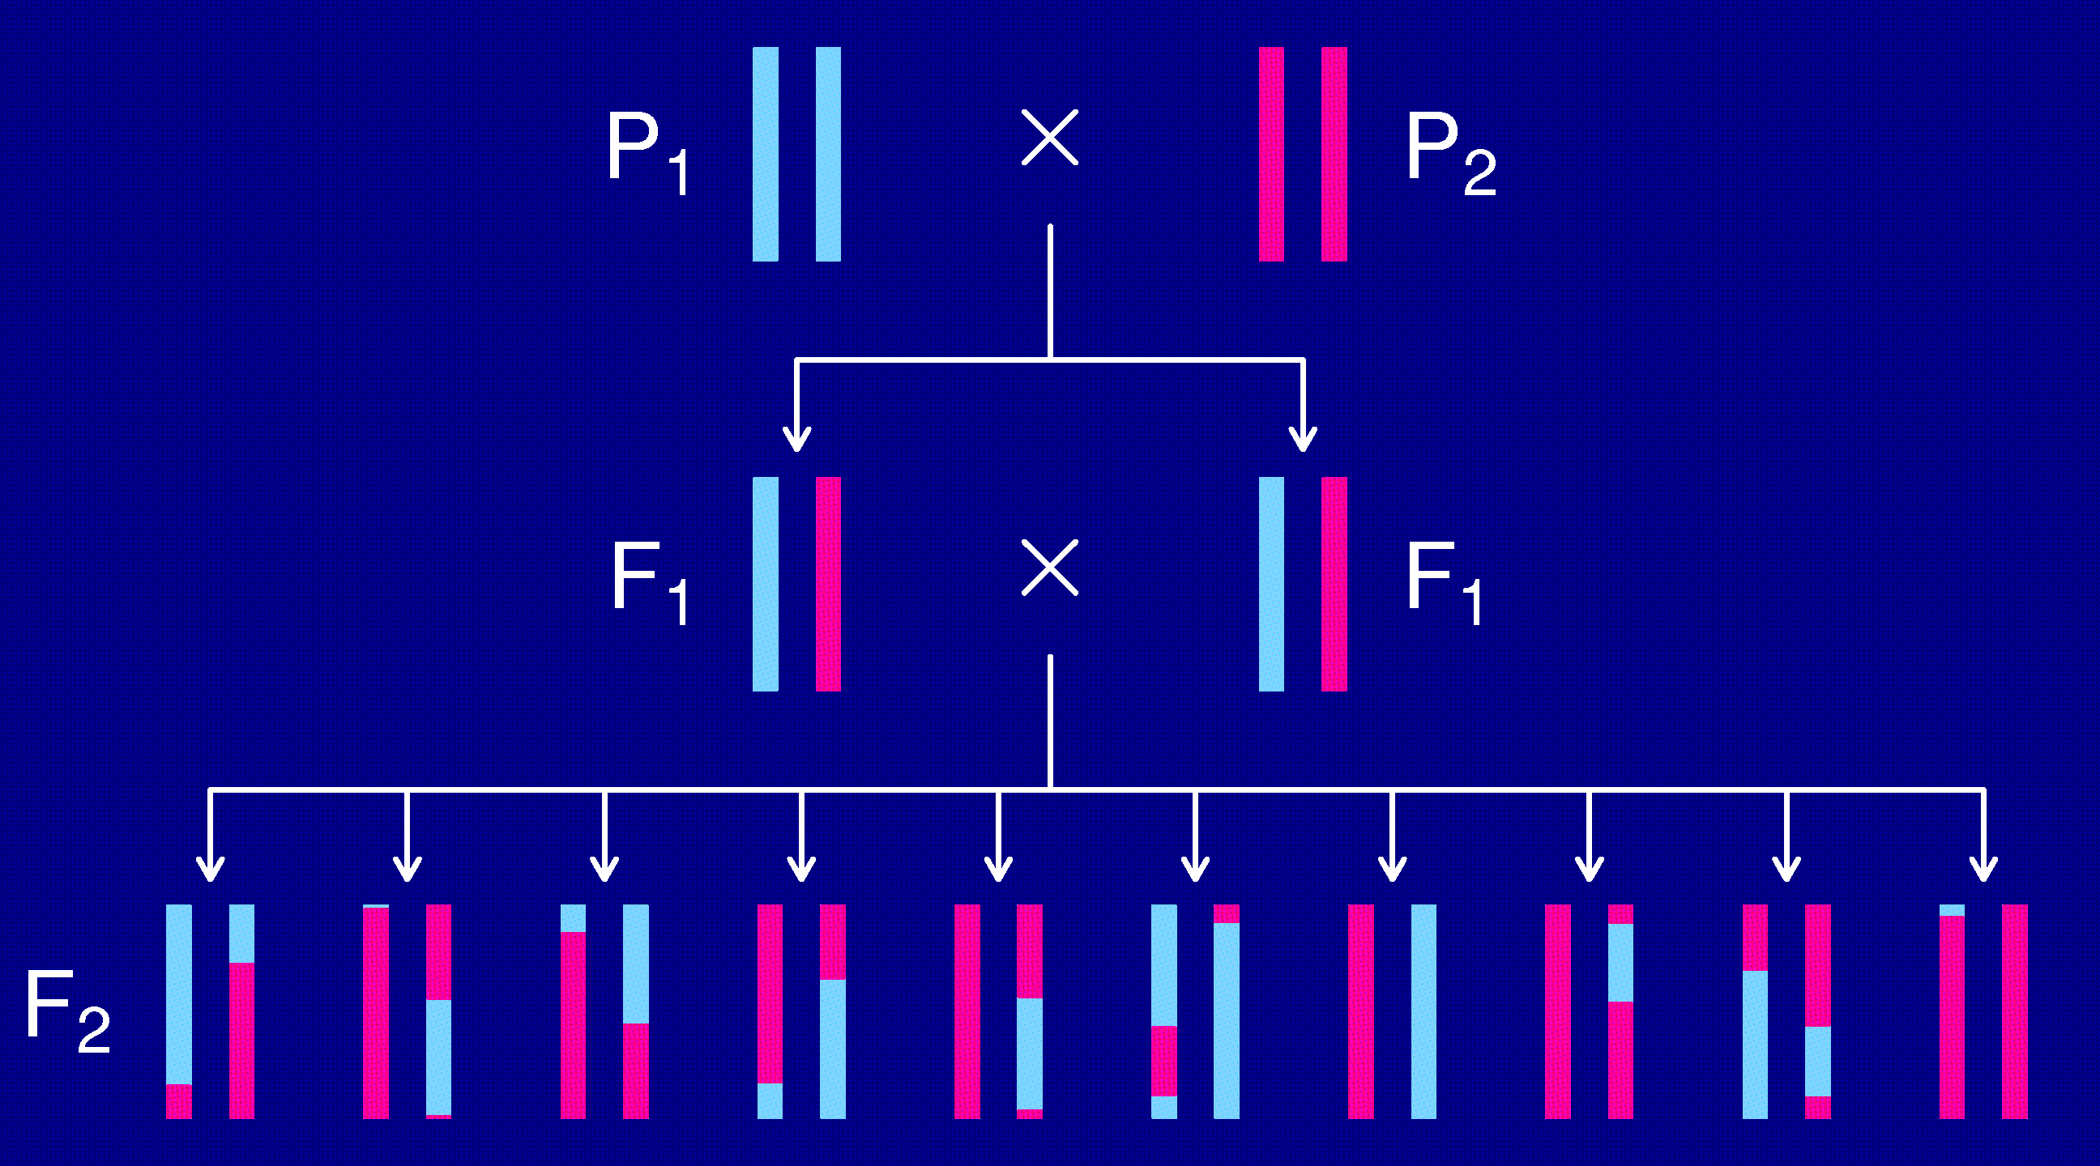
The intercross

Slide 4
The data
Phenotypes, y_{i}
Genotypes, x_{ij} = AA/AB/BB, at genetic markers
A genetic map, giving the locations of the markers.

Slide 5
Goals
Identify genomic regions (QTLs) that contribute to variation in the trait.
Obtain interval estimates of the QTL locations.
Estimate the effects of the QTLs.

Slide 6
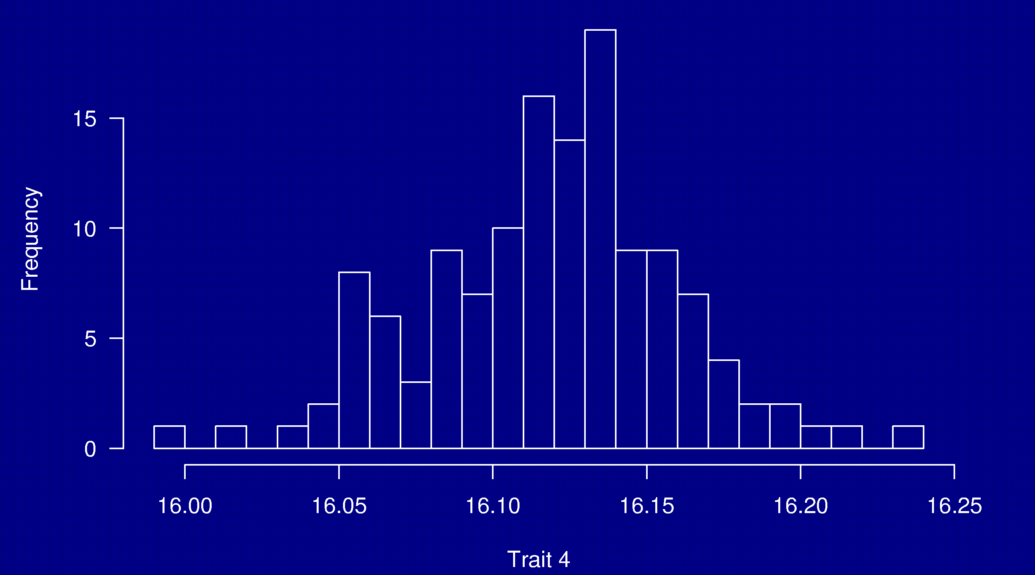
Phenotypes
133 females
(NOD × B6) × (NOD × B6)

Slide 7
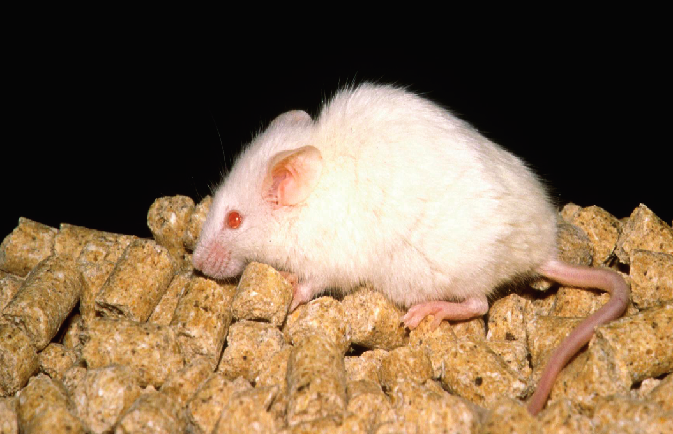
NOD

Slide 8
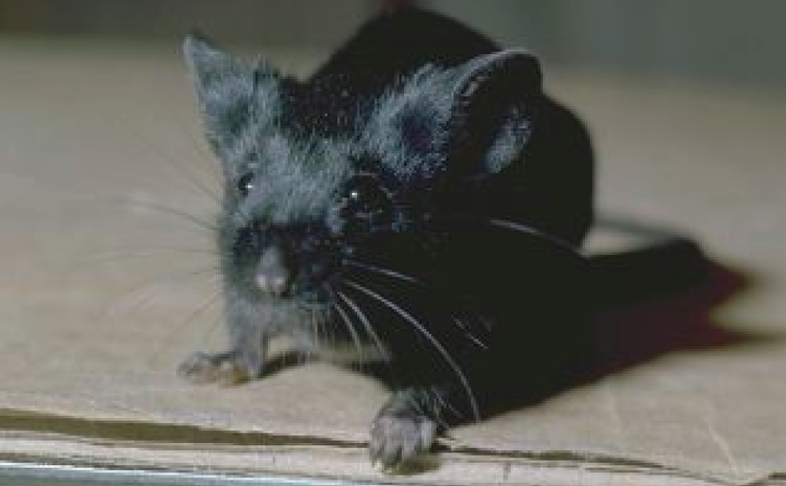
C57BL/6

Slide 9
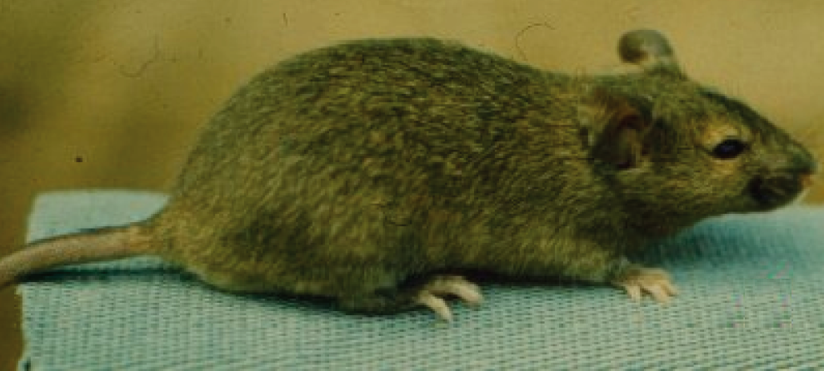
Agouti coat

Slide 10
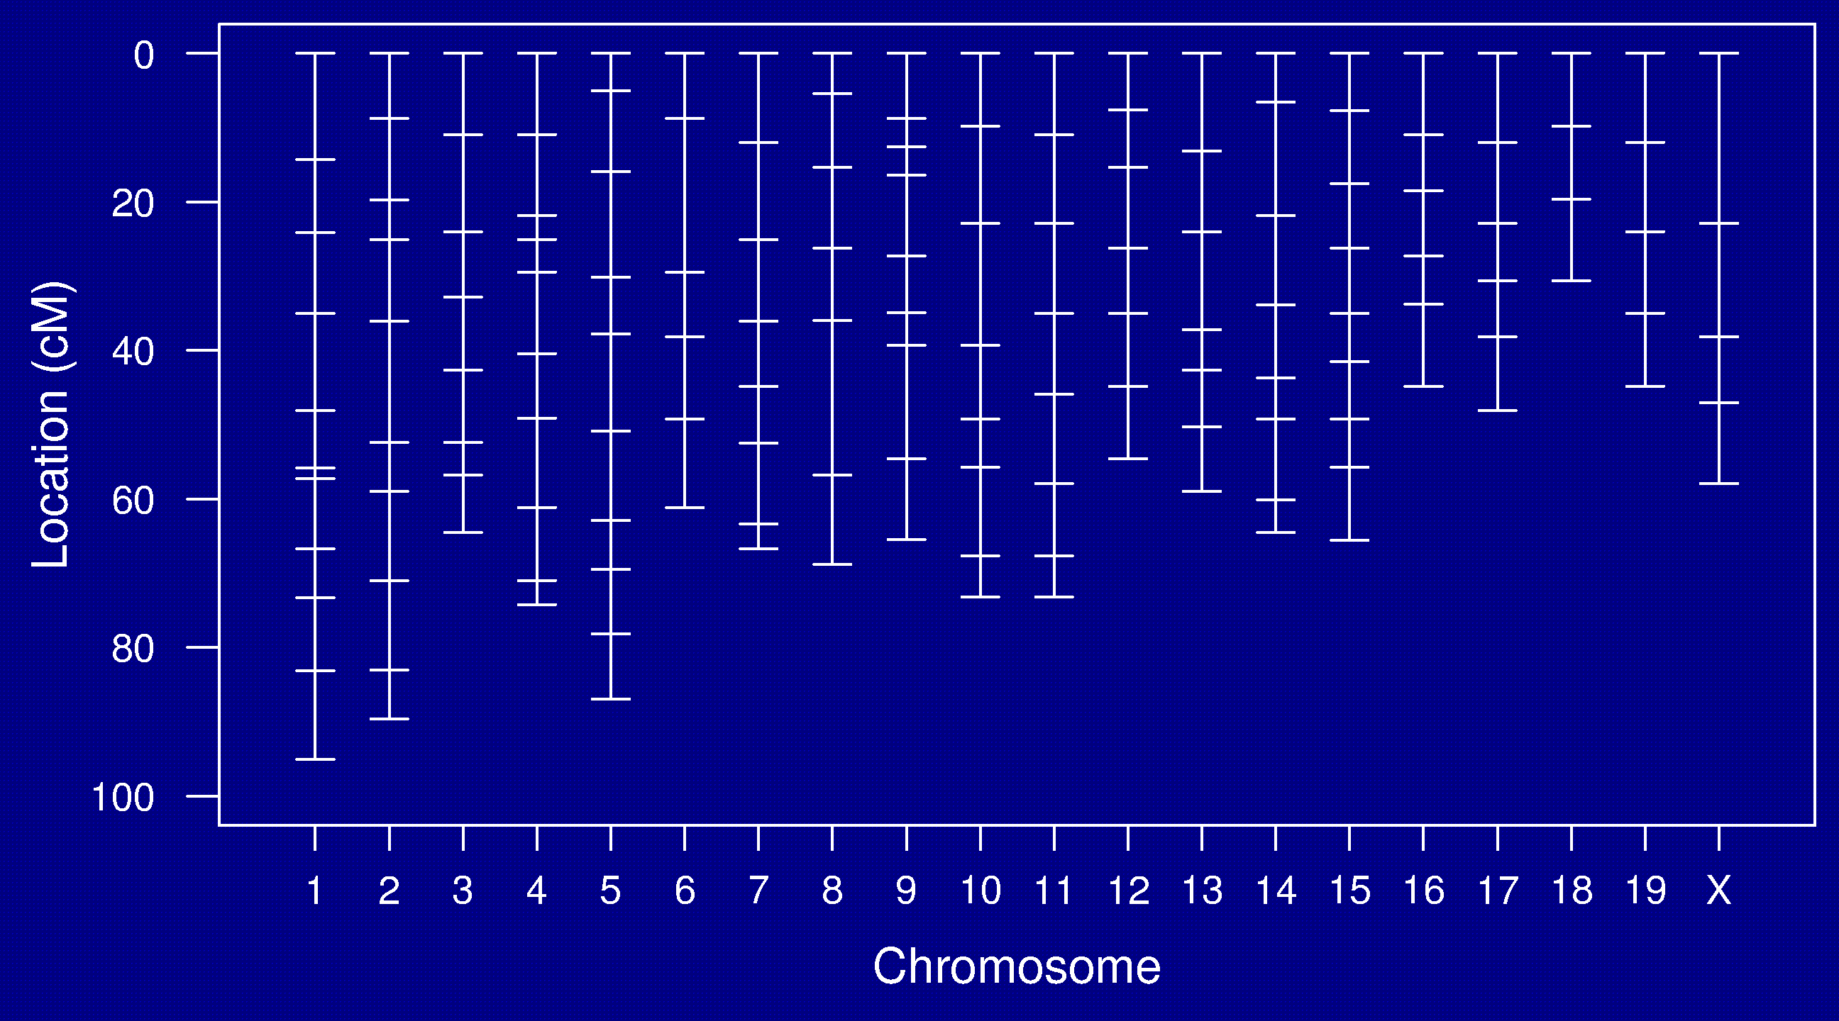
Genetic map

Slide 11
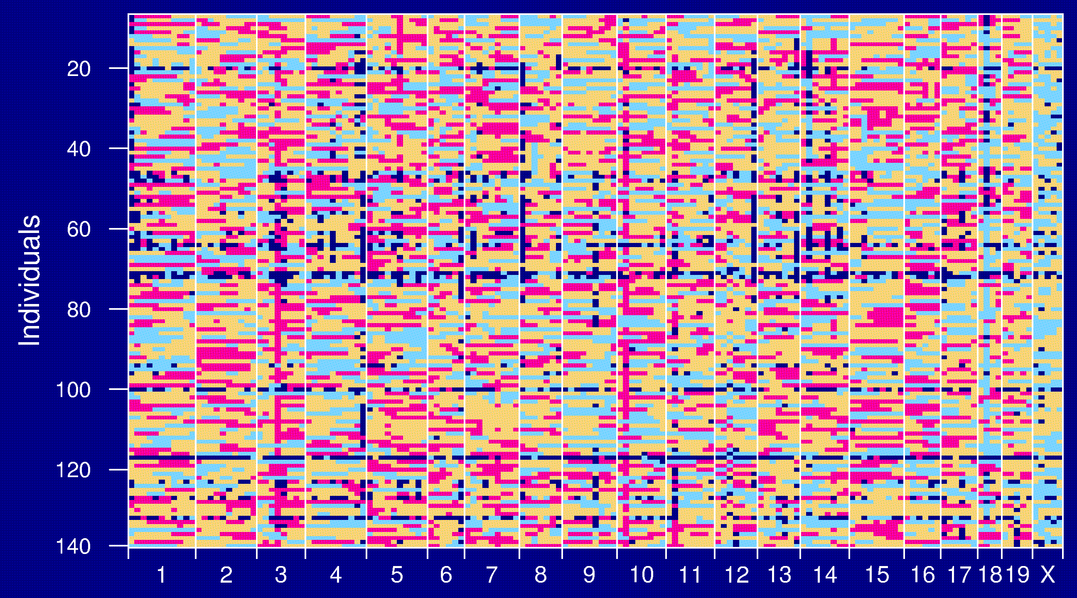
Genotype data

Slide 12
Goals
Identify genomic regions (QTLs) that contribute to variation in the trait.
Obtain interval estimates of the QTL locations.
Estimate the effects of the QTLs.

Slide 13
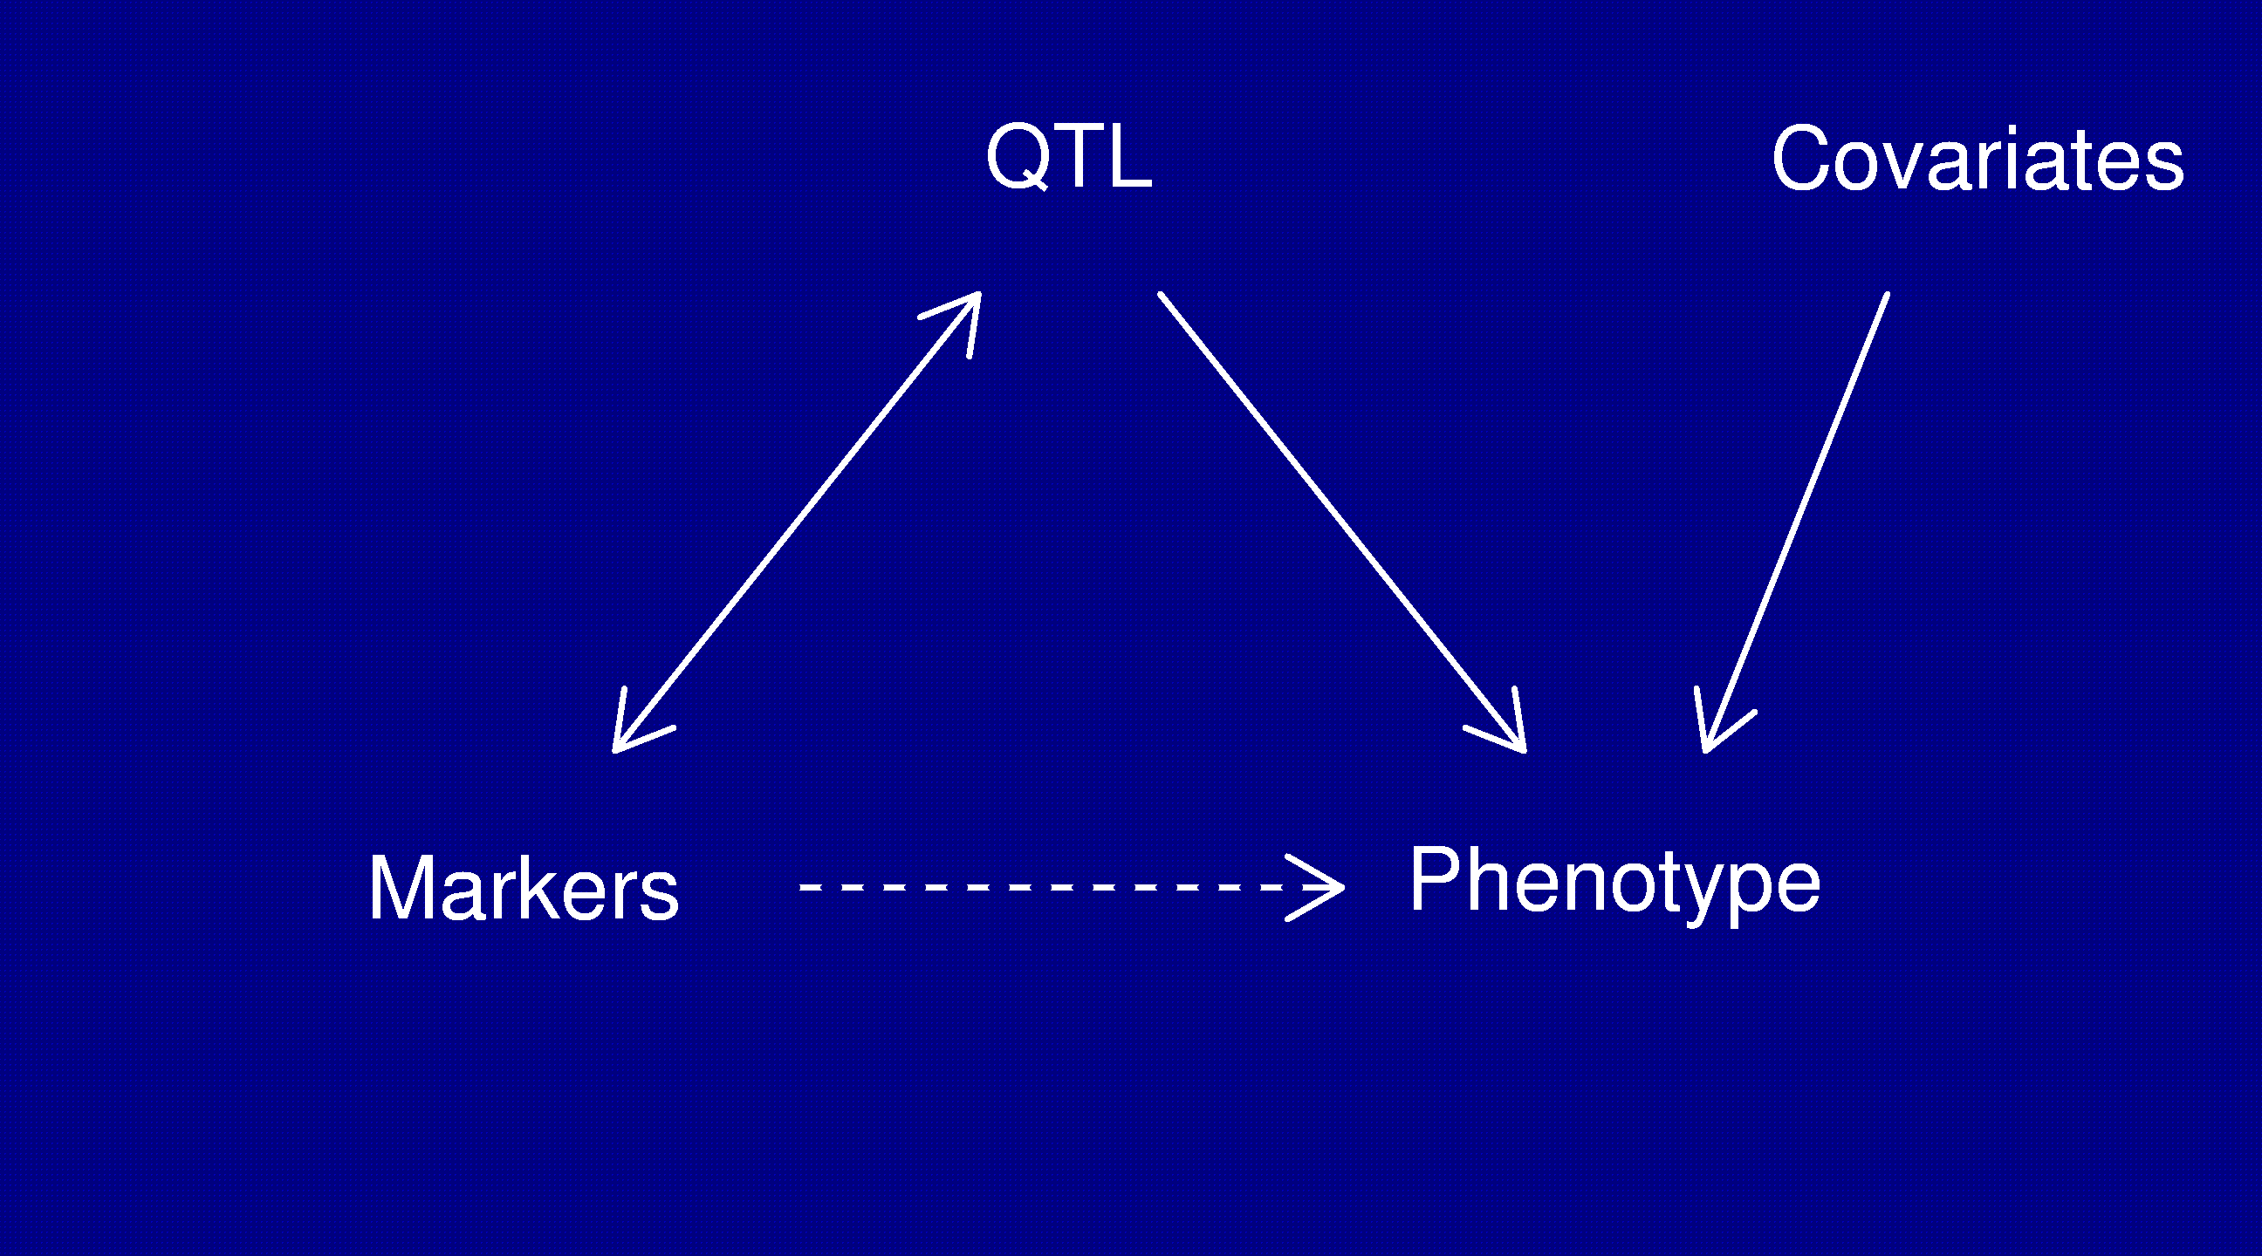
Statistical structure
Missing data: markers ↔ QTL
Model selection: genotypes ↔ phenotype

Slide 14
Models: recombination
No crossover interference
  Locations of breakpoints according to a Poisson process.
  Genotypes along chromosome follow a Markov chain.
Clearly wrong, but super convenient.

Slide 15
Models: gen ↔ phe
Phenotype = y, whole-genome genotype = g
Imagine that p sites are all that matter.
E(y | g) = μ(g₁,…,g_{p}) SD(y | g) = σ(g₁,…,g_{p})
Simplifying assumptions:
  SD(y | g) = σ, independent of g
  y | g ~ normal( μ(g₁,…,g_{p}), σ )
  μ(g₁,…,g_{p}) = μ + ∑ α_{j} 1{g_{j} = AB} + β_{j} 1{g_{j} = BB}

Slide 16
Interval mapping
Lander and Botstein 1989
Imagine that there is a single QTL, at position z.
Let q_{i} = genotype of mouse i at the QTL, and assume
y_{i} | q_{i} ~ normal( μ(q_{i}), σ )
We won’t know q_{i}, but we can calculate
p_{ig} = Pr(q_{i} = g | marker data)
y_{i}, given the marker data, follows a mixture of normal distributions with known mixing proportions (the p_{ig}).
Use an EM algorithm to get MLEs of θ = (μ_{AA}, μ_{AB}, μ_{BB}, σ).
Measure the evidence for a QTL via the LOD score, which is the log₁₀ likelihood ratio comparing the hypothesis of a single QTL at position z to the hypothesis of no QTL anywhere.

Slide 17
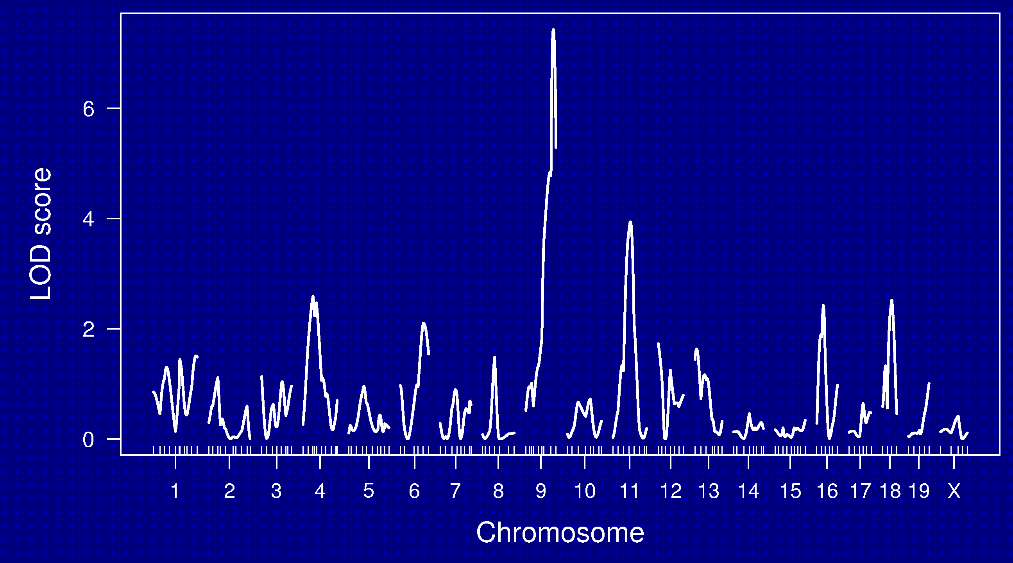
LOD curves

Slide 18
LOD thresholds
To account for the genome-wide search, compare the observed LOD scores to the distribution of the maximum LOD score, genome-wide, that would be obtained if there were no QTL anywhere.
The 95th percentile of this distribution is used as a significance threshold.
Such a threshold may be estimated via permutations (Churchill and Doerge 1994).

Slide 19
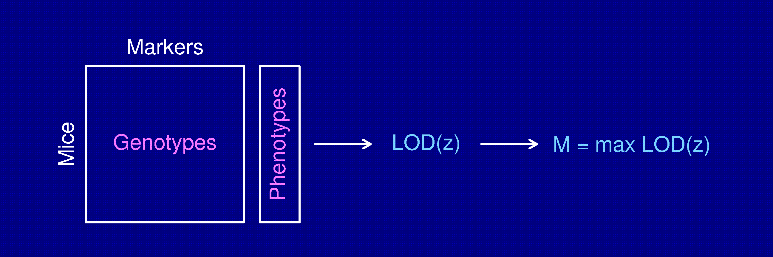
Permutation test
Shuffle the phenotypes relative to the genotypes.
Calculate M* = max LOD*, with the shuffled data.
Repeat many times.
LOD threshold = 95th percentile of M*.
P-value = Pr(M* ≥ M)

Slide 20
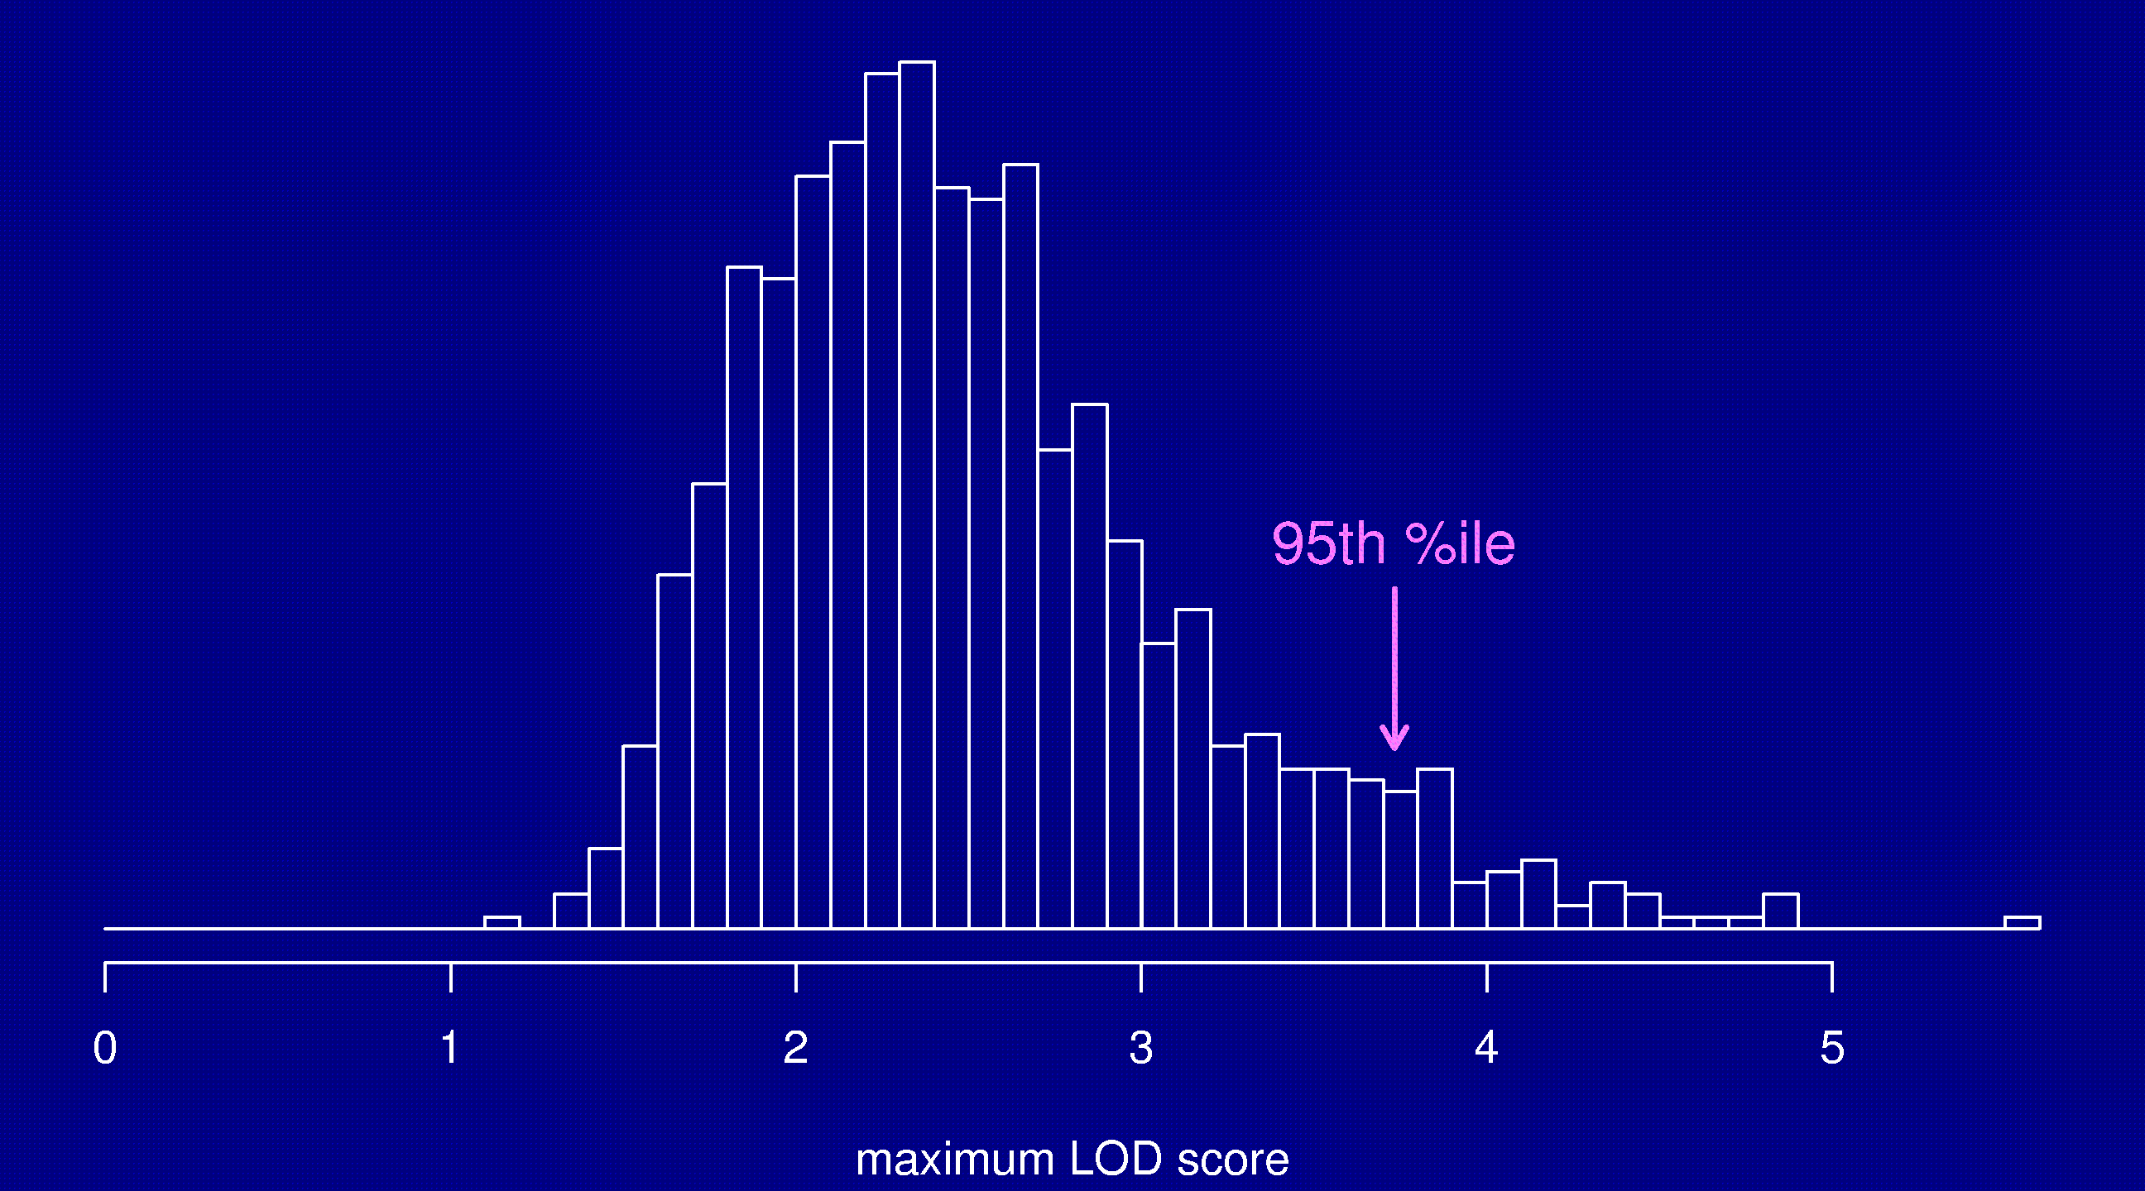
Permutation distribution

Slide 21
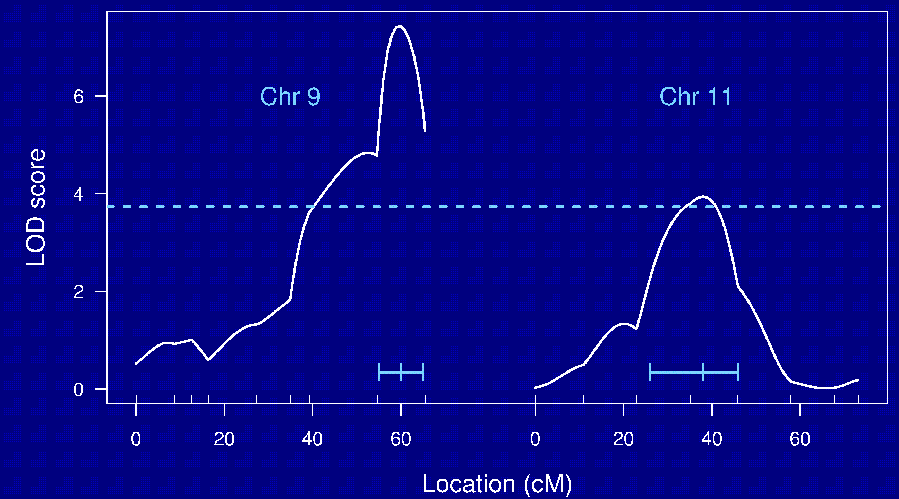
Chr 9 and 11

Slide 22
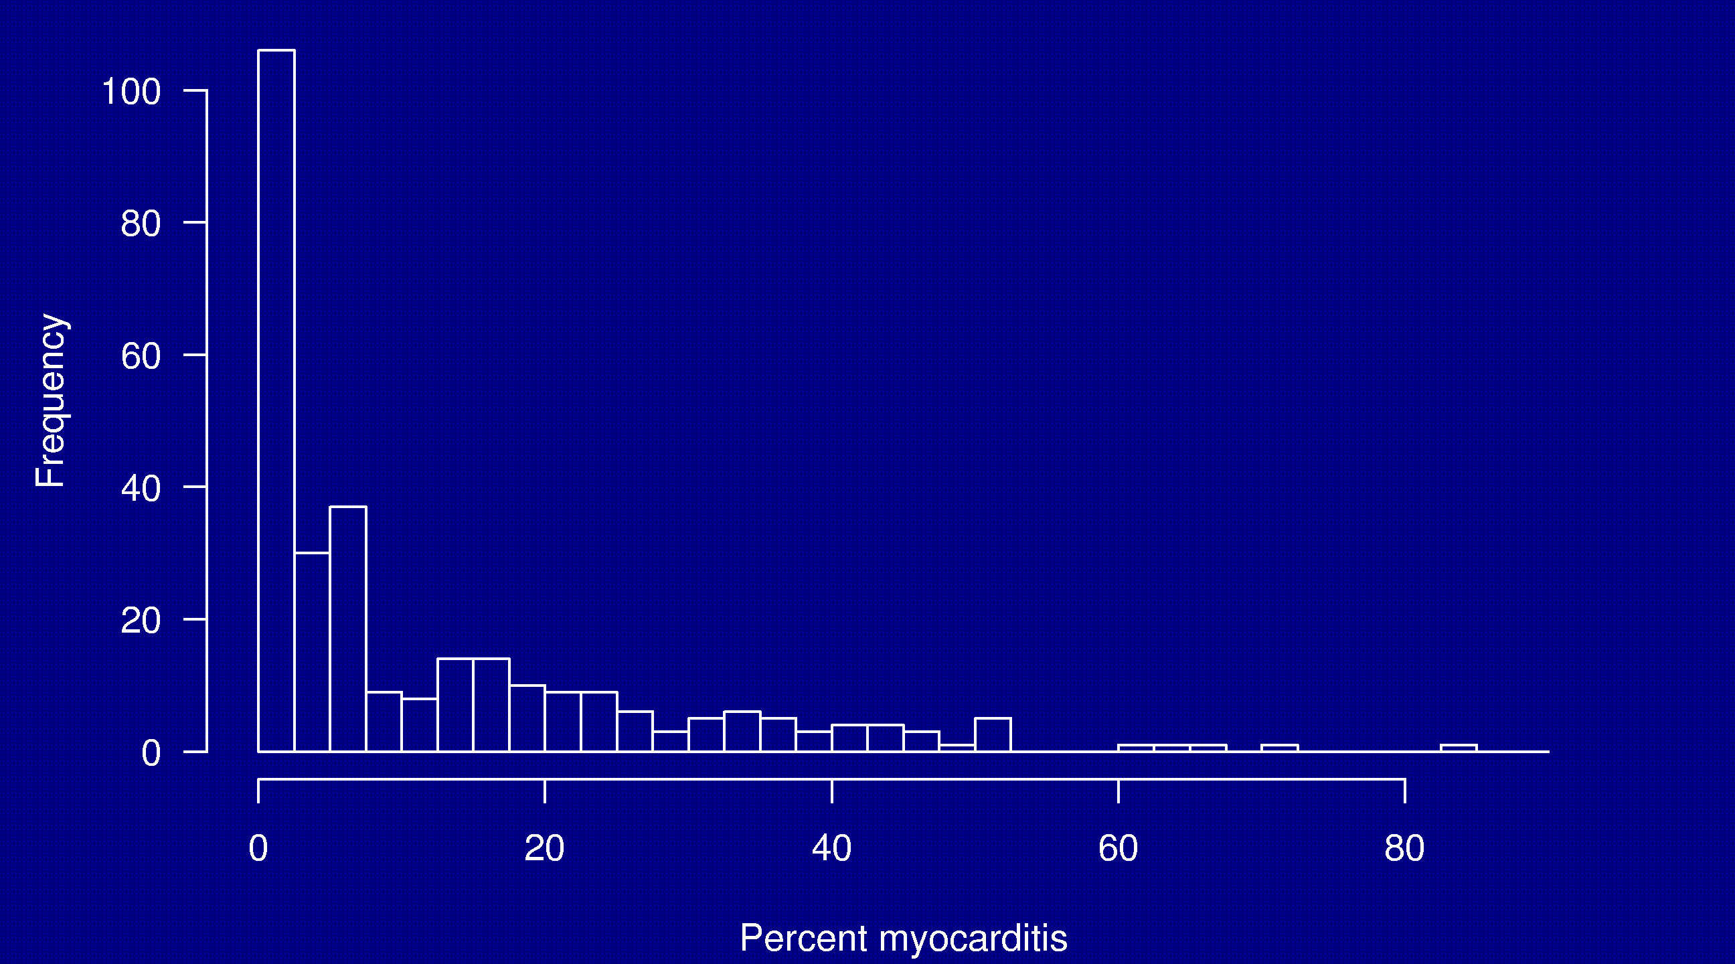
Non-normal traits

Slide 23
Non-normal traits
Standard interval mapping assumes that the residual variation is normally distributed (and so the phenotype distribution follows a mixture of normal distributions).
In reality: we see binary traits, counts, skewed distributions, outliers, and all sorts of odd things.
Interval mapping, with LOD thresholds derived via permutation tests, often performs fine anyway.
Alternatives to consider:
  Nonparametric linkage analysis (Kruglyak and Lander 1995).
  Transformations (e.g., log or square root).
  Specially-tailored models (e.g., a generalized linear model, the Cox proportional hazards model, the model of Broman 2003).

Slide 24
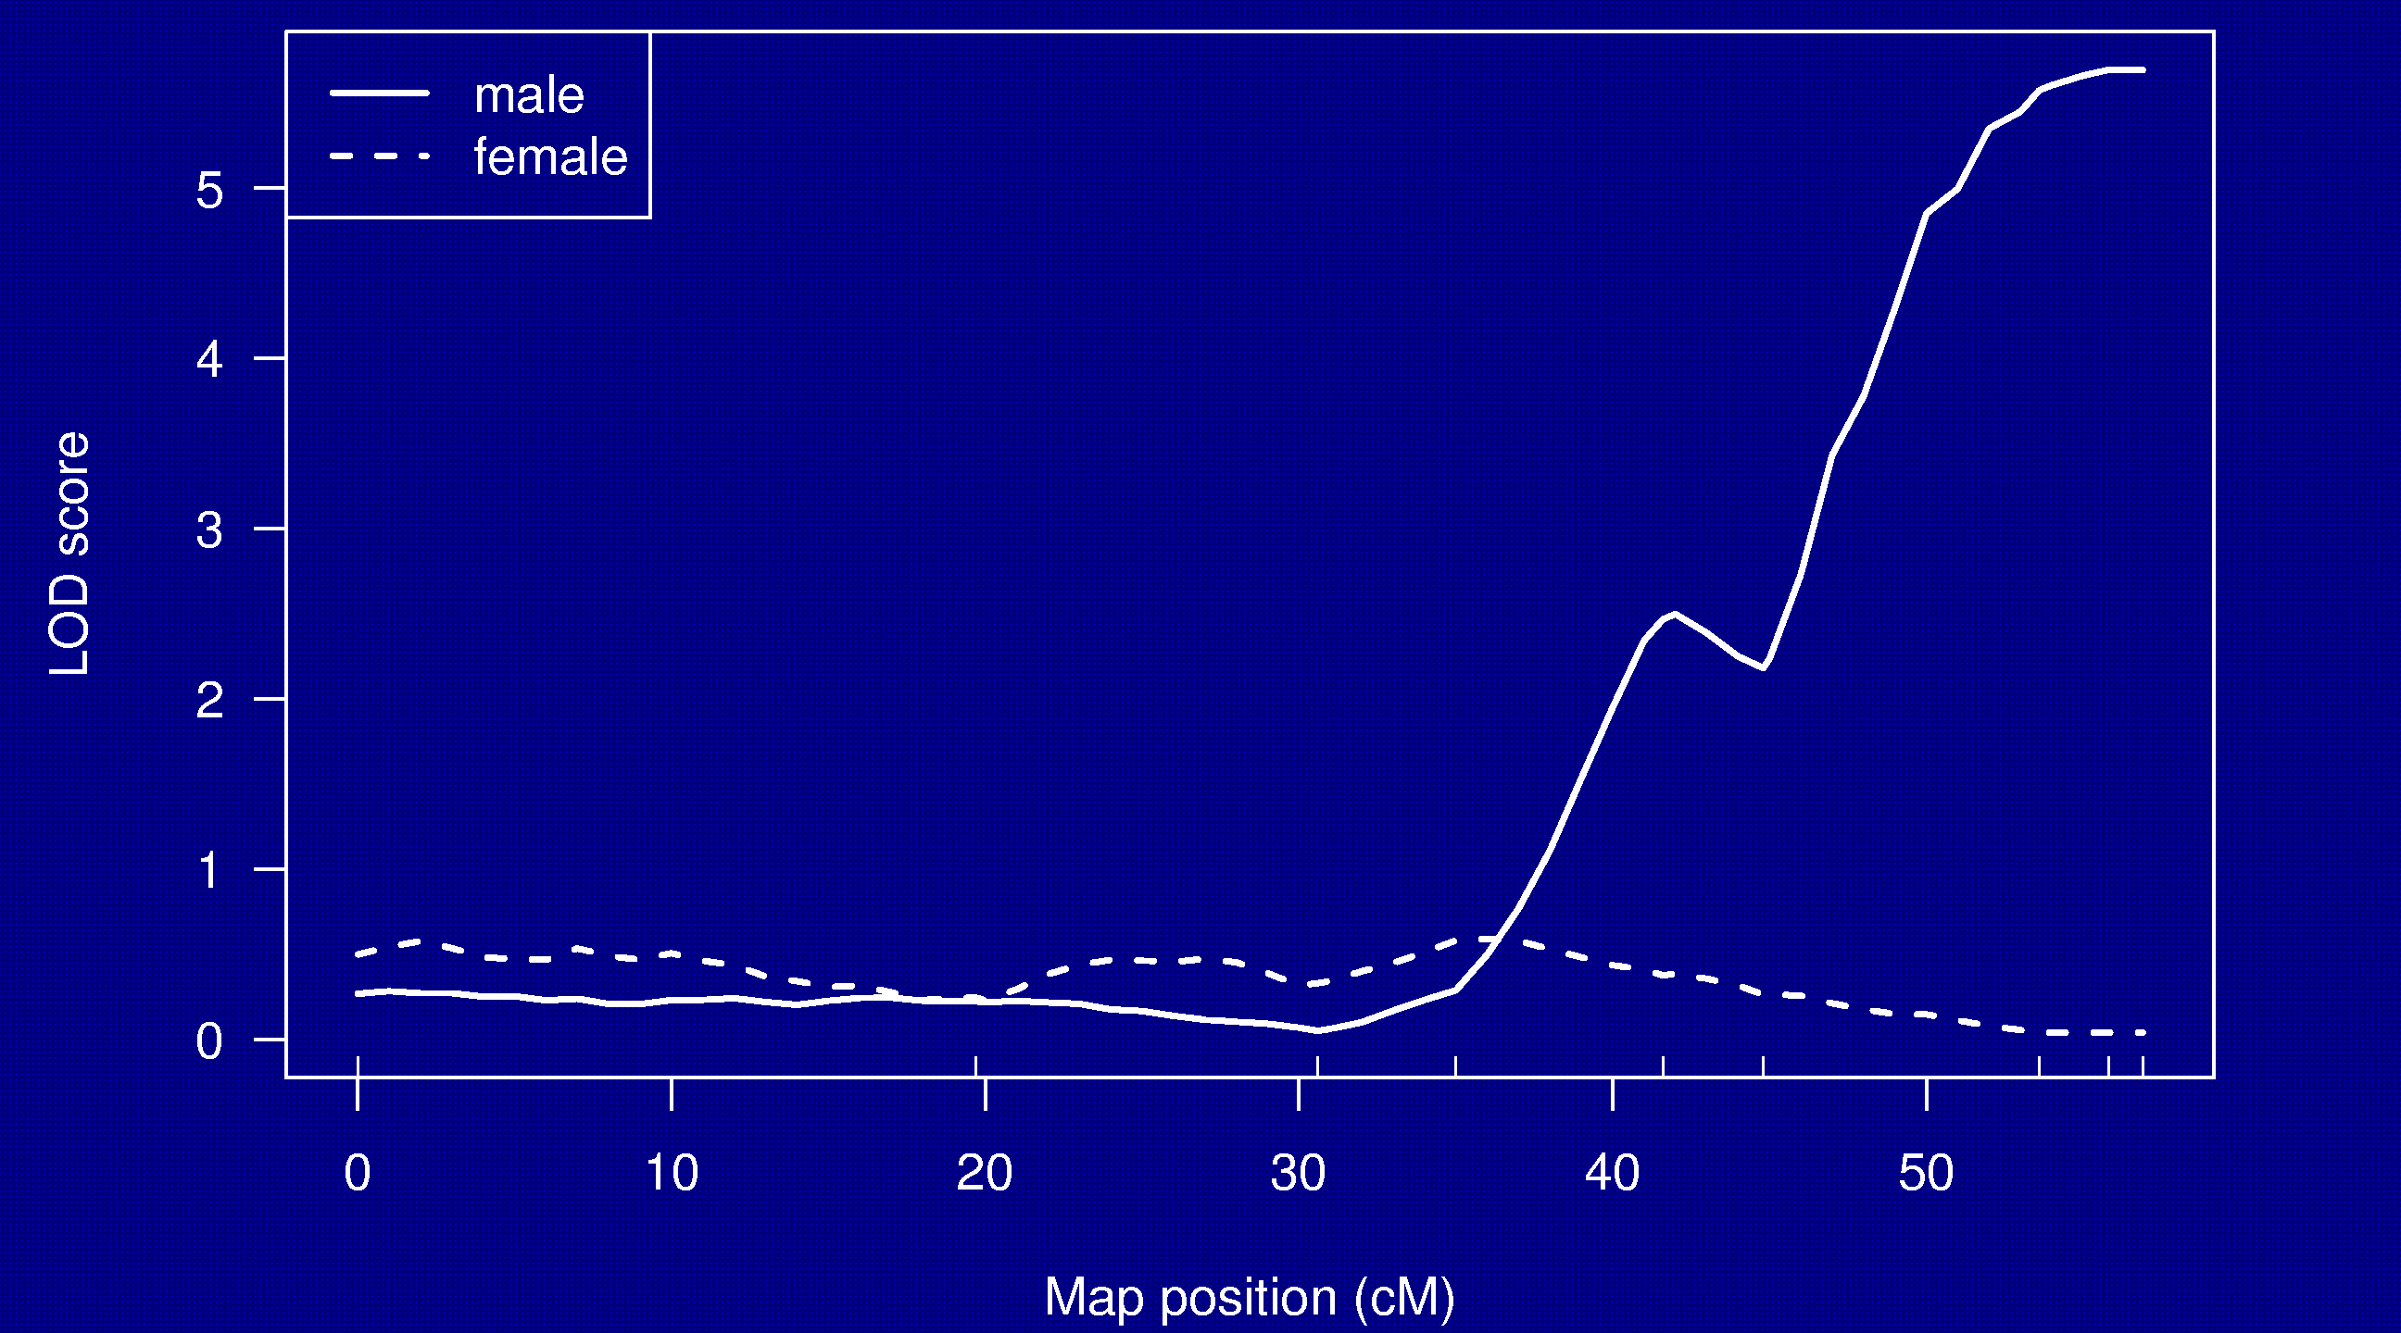
Split by sex

Slide 25
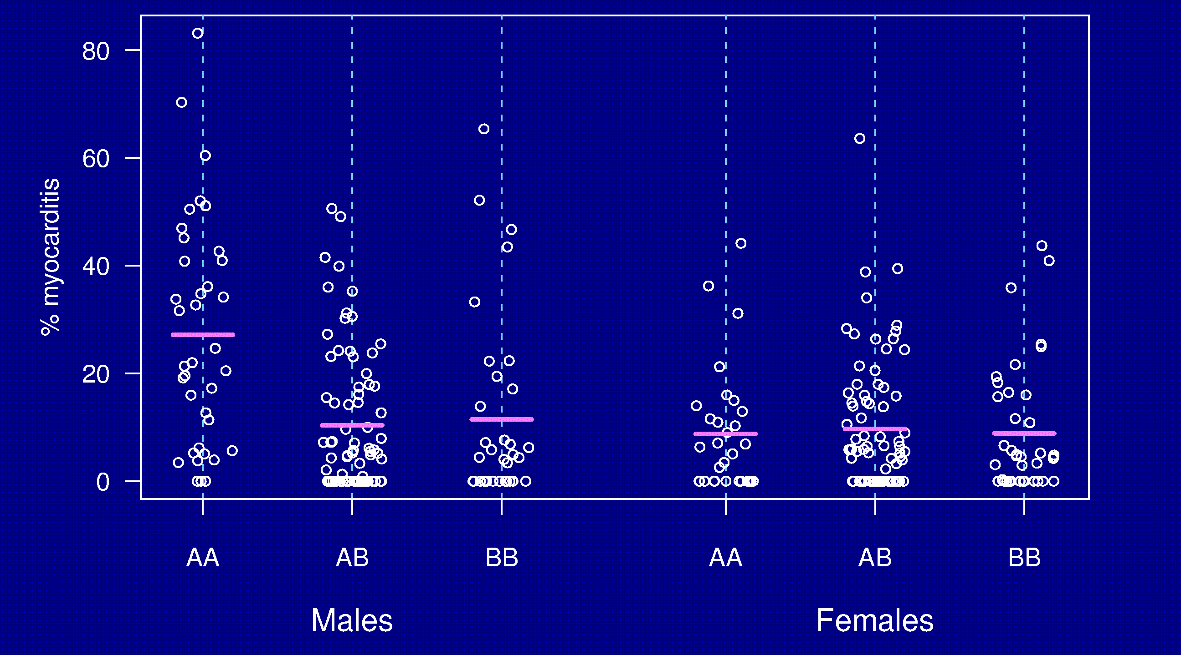
Split by sex

Slide 26
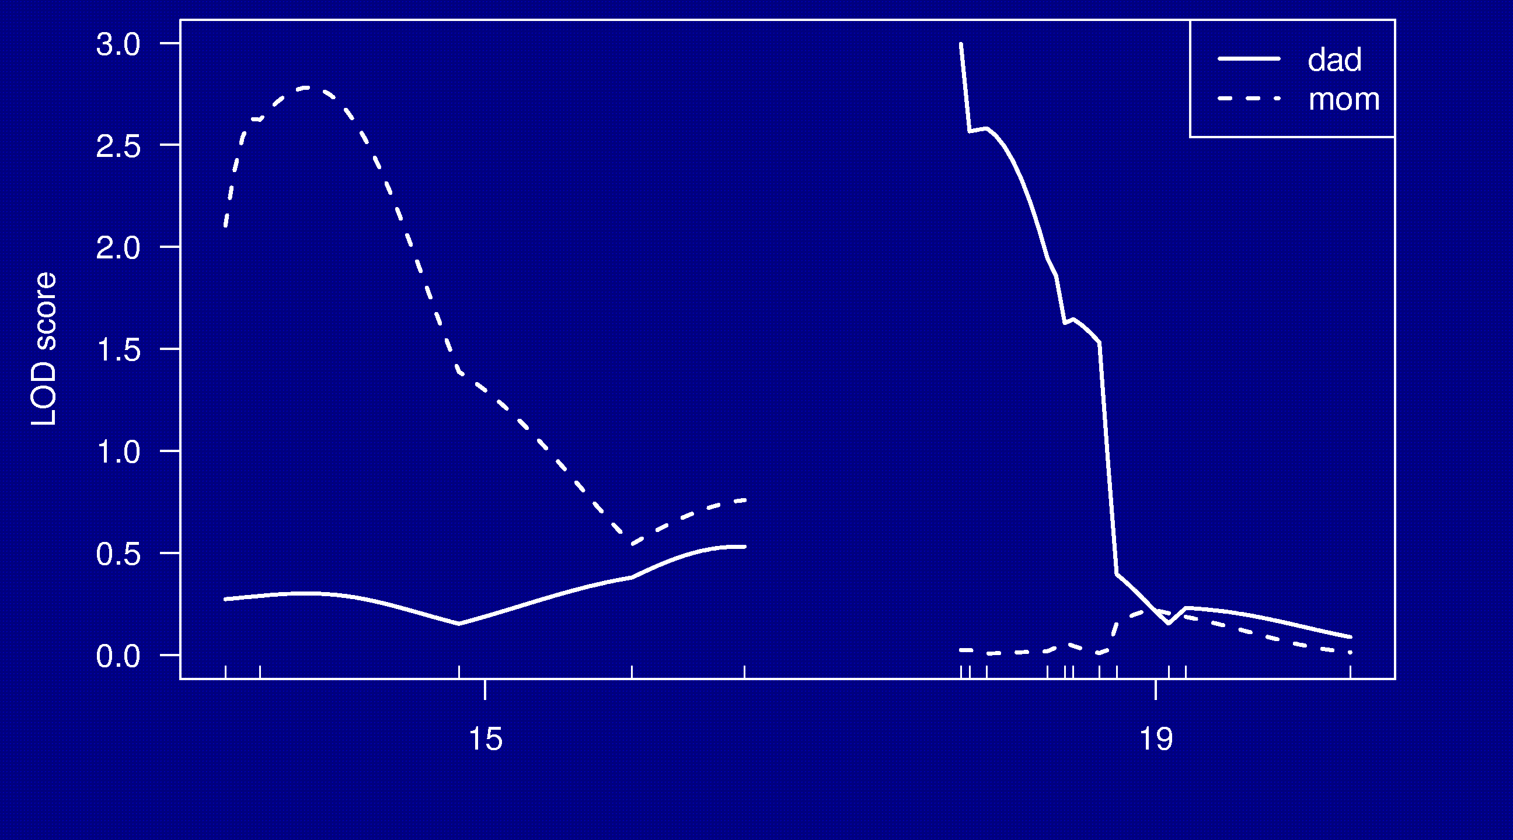
Split by parent-of-origin

Slide 27
Split by parent-of-origin
Percent of individuals with phenotype
 | Genotype at D15Mit252 |  |  | Genotype at D19Mit59
P-O-O | AA | AB |  | AA | AB
Dad | 63% | 54% |  | 75% | 43%
Mom | 57% | 23% |  | 38% | 40%

Slide 28
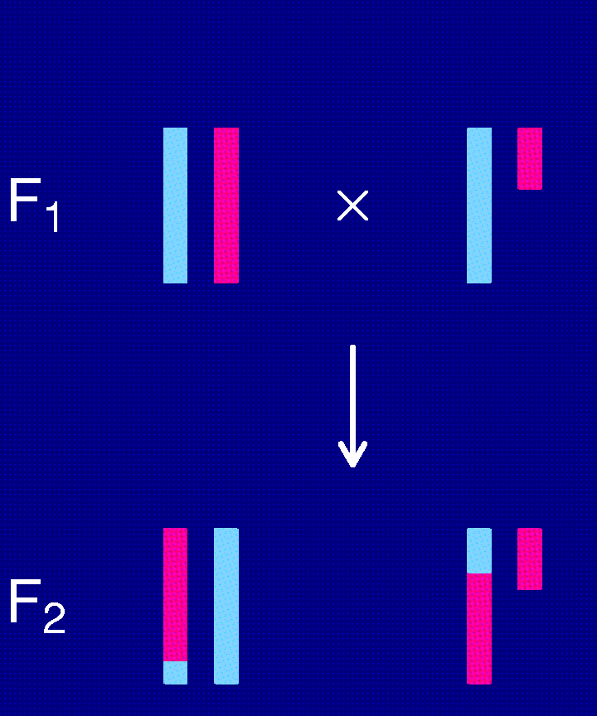
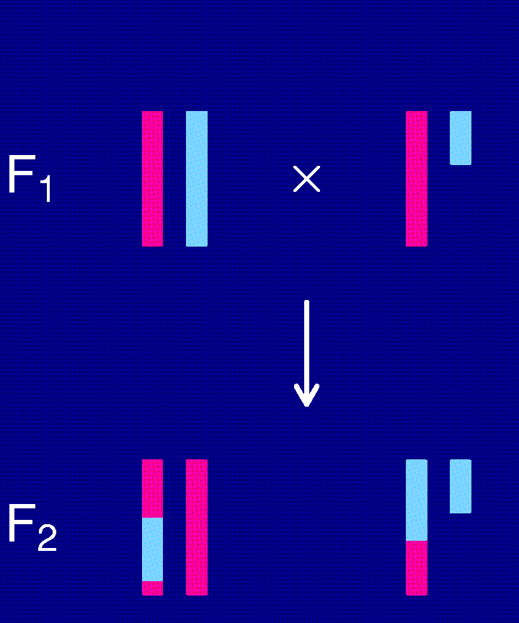
The X chromosome
(N × B) × (N × B)
(B × N) × (B × N)

Slide 29
The X chromosome
BB ≡ BY? NN ≡ NY?
Different “degrees of freedom”
  Autosome NN : NB : BB
  Females, one direction NN : NB
  Both sexes, both dir. NY : NN : NB : BB : BY
  ⇒ Need an X-chr-specific LOD threshold.
“Null model” should include a sex effect.

Slide 30
Chr 9 and 11

Slide 31
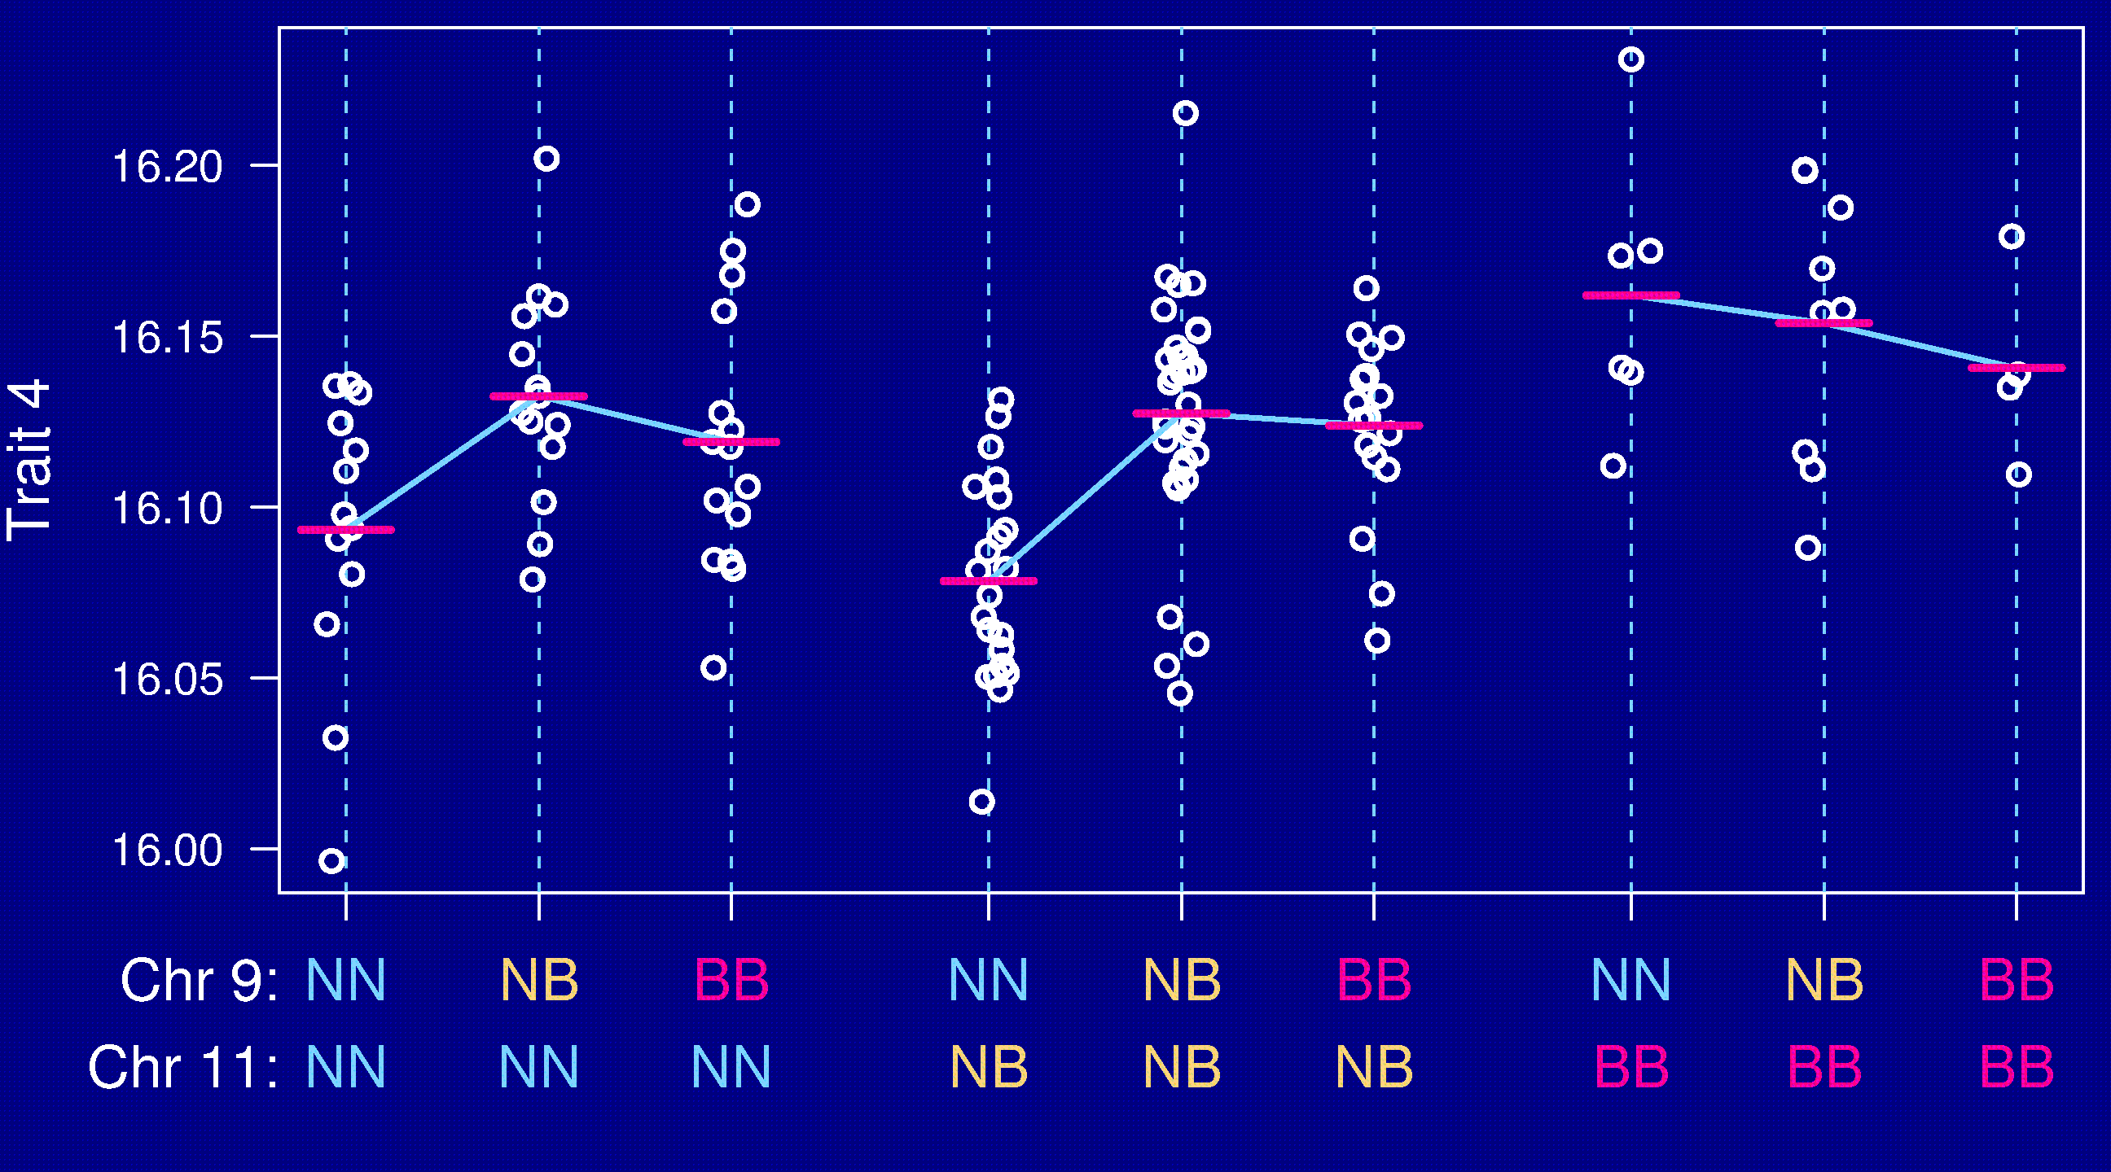
Epistasis

Slide 32
Going after multiple QTLs
Greater ability to detect QTLs.
Separate linked QTLs.
Learn about interactions between QTLs (epistasis).

Slide 33
Model selection
Choose a class of models.
  Additive; pairwise interactions; regression trees
Fit a model (allow for missing genotype data).
  Linear regression; ML via EM; Bayes via MCMC
Search model space.
  Forward/backward/stepwise selection; MCMC
Compare models.
  BIC_{δ}(γ) = log L(γ) + (δ/2) |γ| log n
Miss important loci ↔ include extraneous loci.

Slide 34
Special features
Relationship among the covariates.
Missing covariate information.
Identify the key players vs. minimize prediction error.

Slide 35
Opportunities for improvements
Each individual is unique.
  Must genotype each mouse.
  Unable to obtain multiple invasive phenotypes (e.g., in multiple environmental conditions) on the same genotype.
Relatively low mapping precision.
Design a set of inbred mouse strains.
  Genotype once.
  Study multiple phenotypes on the same genotype.

Slide 36
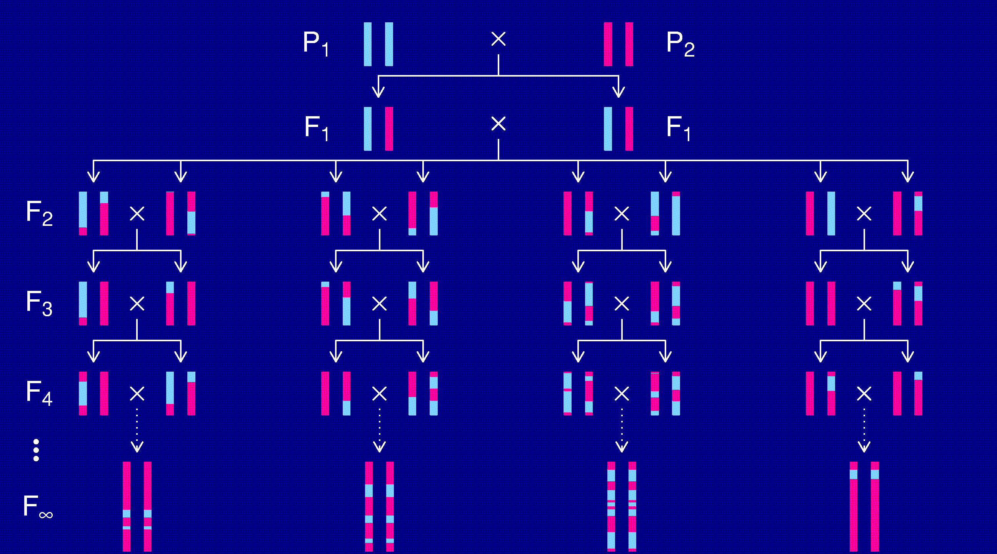
Recombinant inbred lines

Slide 37
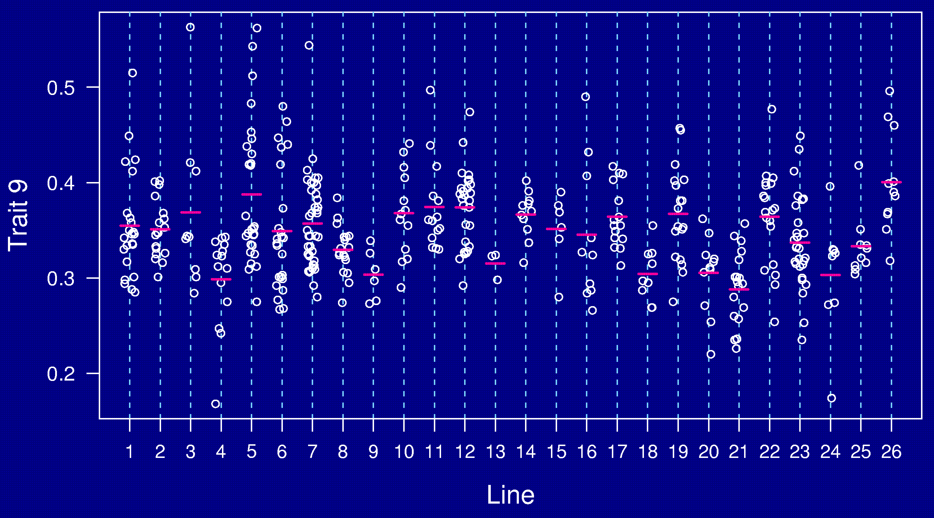
AXB/BXA panel

Slide 38
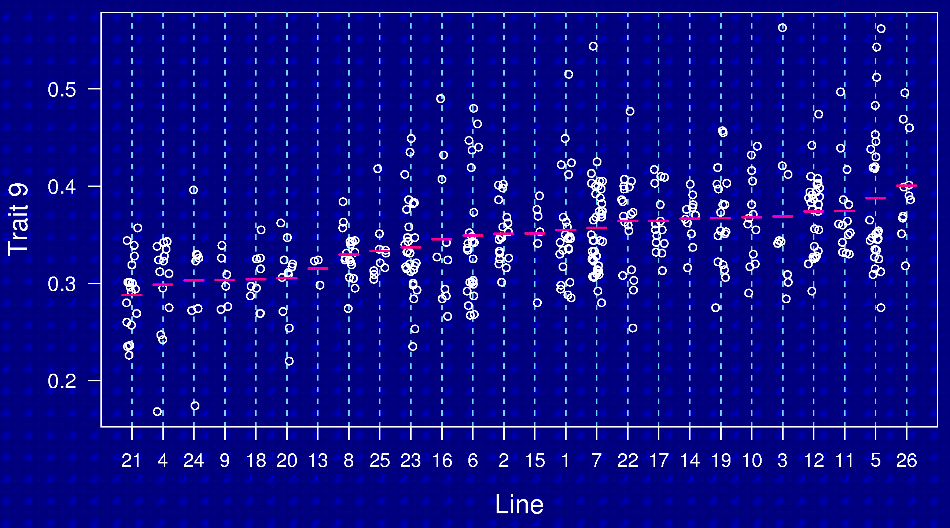
AXB/BXA panel

Slide 39
The usual analysis
Calculate the phenotype average within each strain.
Use these strain averages for QTL mapping as with a backcross (taking account of the map expansion in RILs).
Can we do better?
    With the above data:
    Ave. no. mice per strain = 15.8 (SD = 8.4)
    Range of no. mice per strain = 3 – 39

Slide 40
A simple model for RILs
y_{si} = μ + β x_{s} + η_{s} + ε_{si}
  x_{s} = 0 or 1, according to genotype at putative QTL
  η_{s} = strain (polygenic) effect ~ normal(0, )
  ε_{si} = residual environment effect ~ normal(0, )

Slide 41
RIL analysis
If and were known:
  Work with the strain averages,
  Weight by
  Equivalently, weight by
  where
  Equal n_{s}: The usual analysis is fine.
  h² large: Weight the strains equally.
  h² small: Weight the strains by n_{s}.

Slide 42
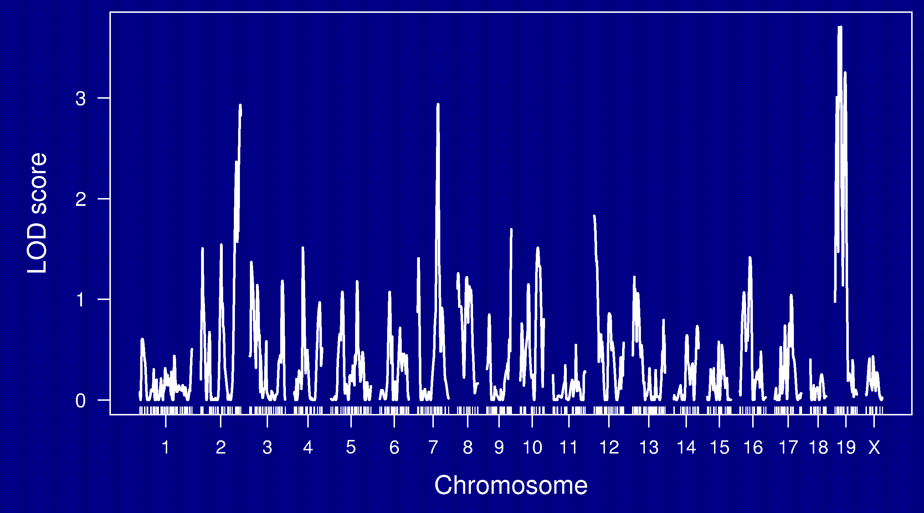
LOD curves

Slide 43
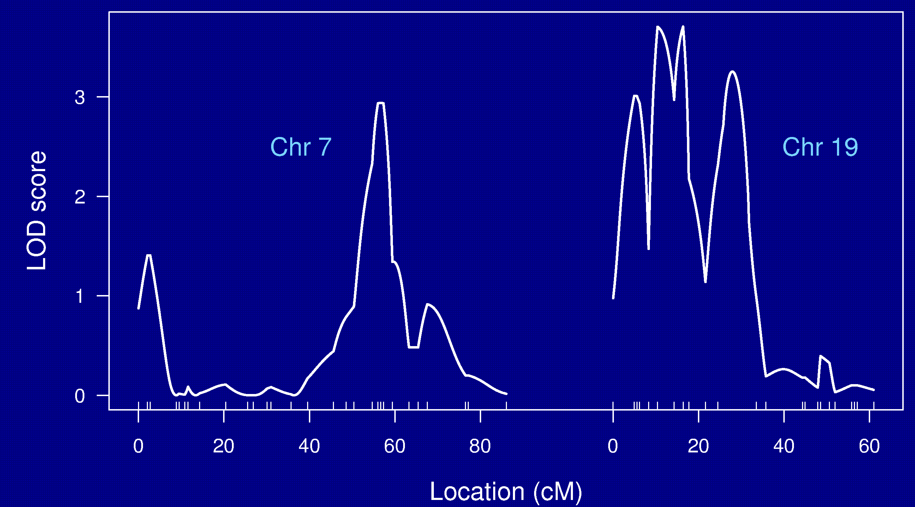
Chr 7 and 19

Slide 44
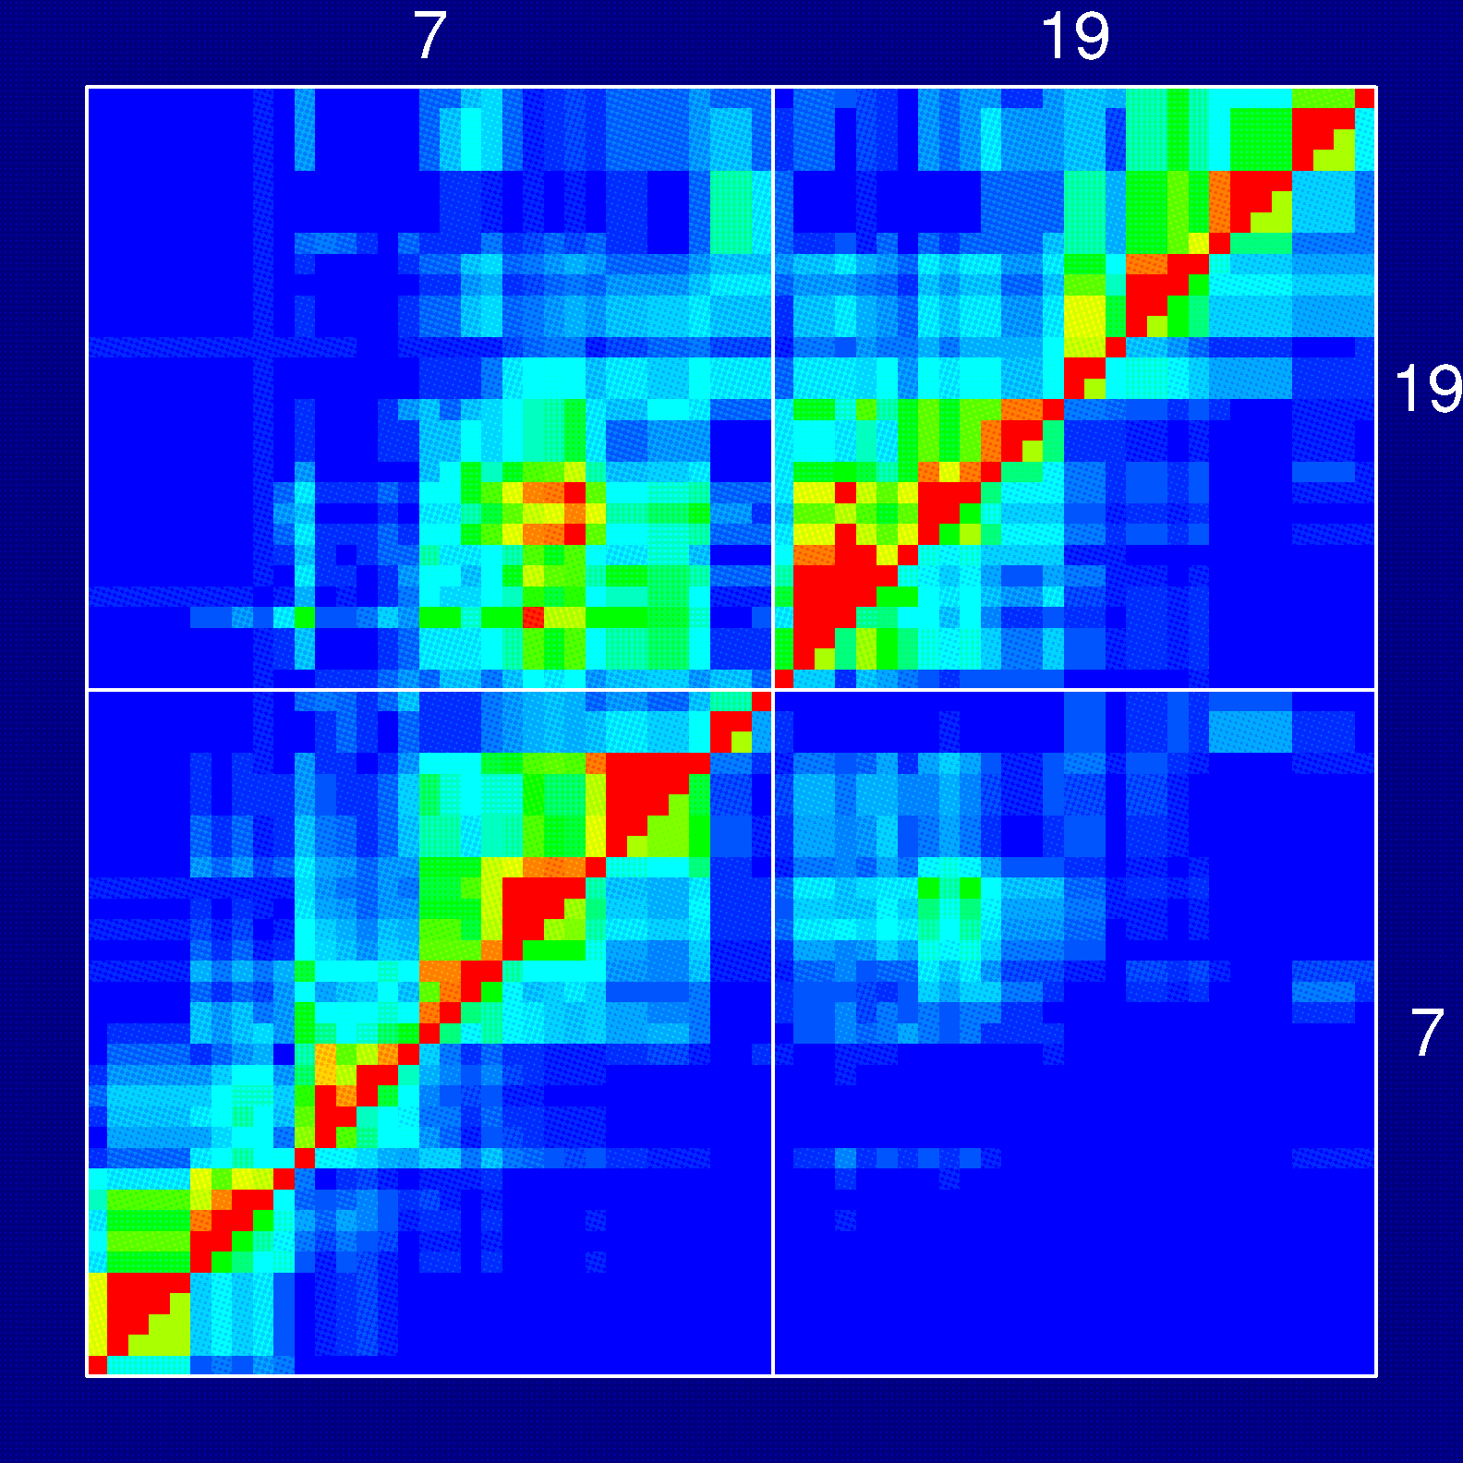
Recombination fractions

Slide 45
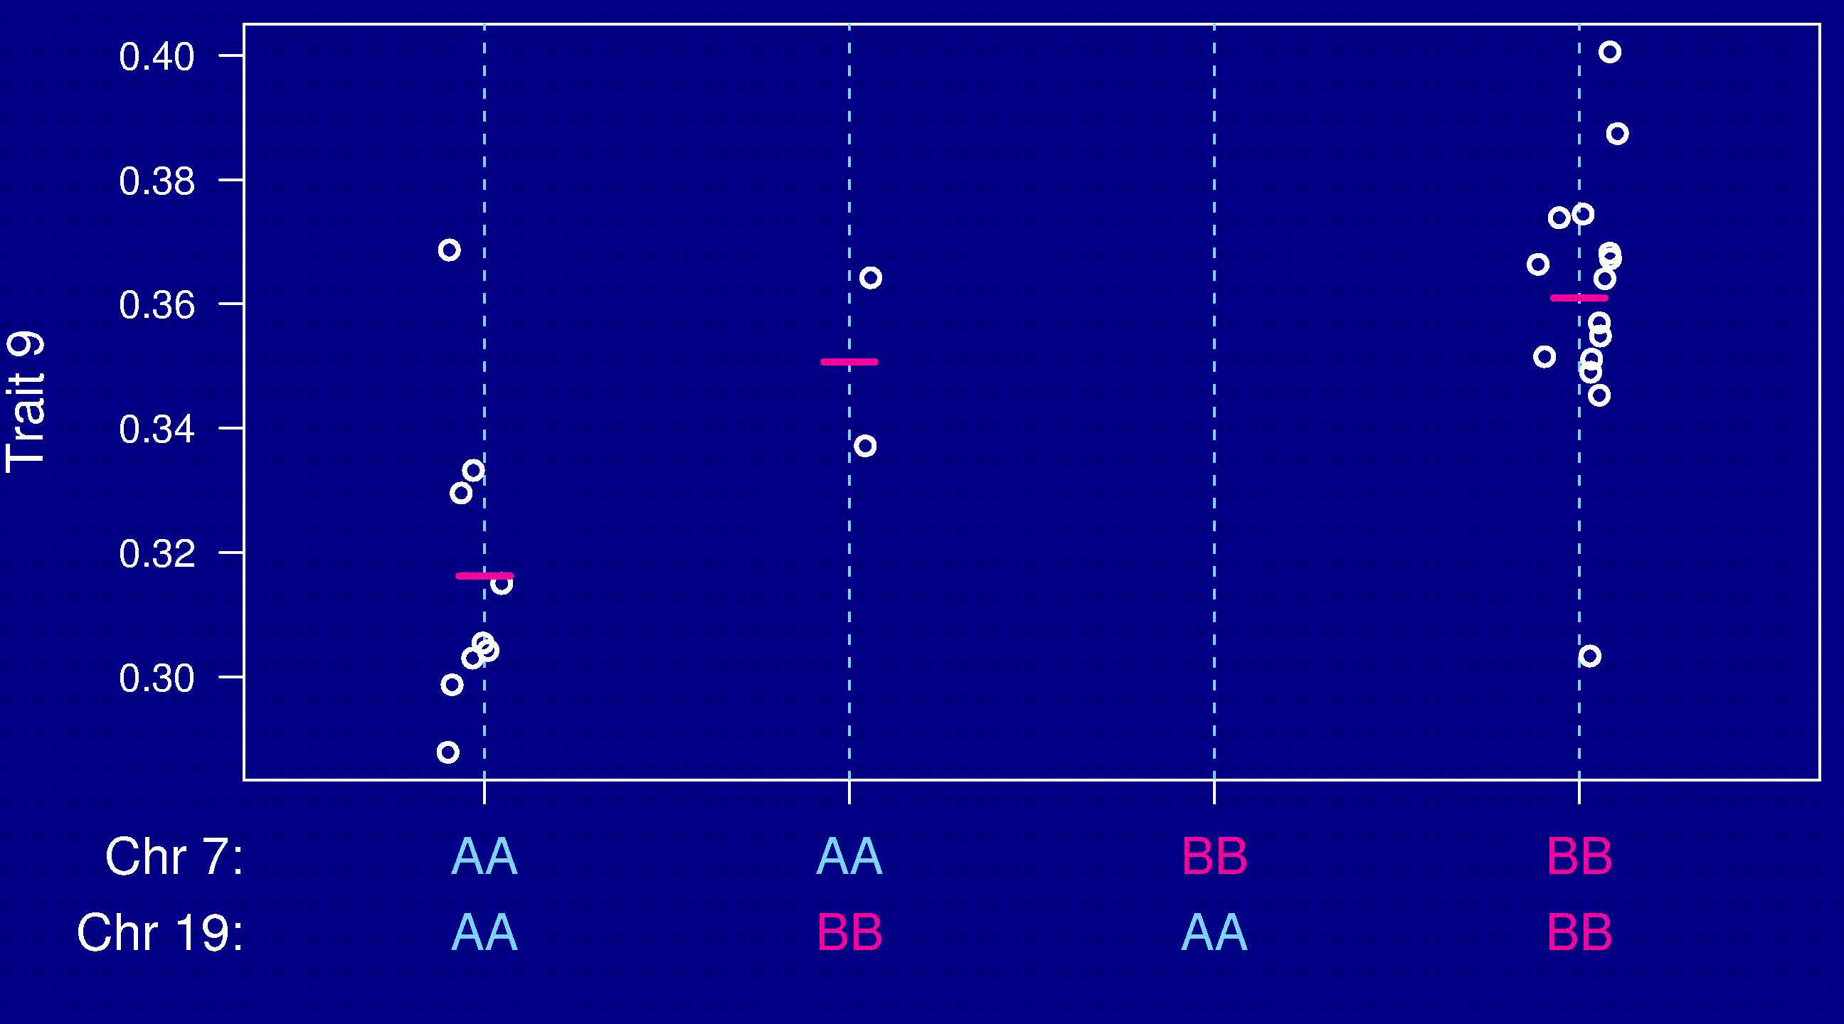
Chr 7 and 19

Slide 46
RI lines
Advantages
Each strain is a eternal resource.
  Only need to genotype once.
  Reduce individual variation by phenotyping multiple individuals from each strain.
  Study multiple phenotypes on the same genotype.
Greater mapping precision.
Disadvantages
Time and expense.
Available panels are generally too small (10-30 lines).
Can learn only about 2 particular alleles.
All individuals homozygous.

Slide 47
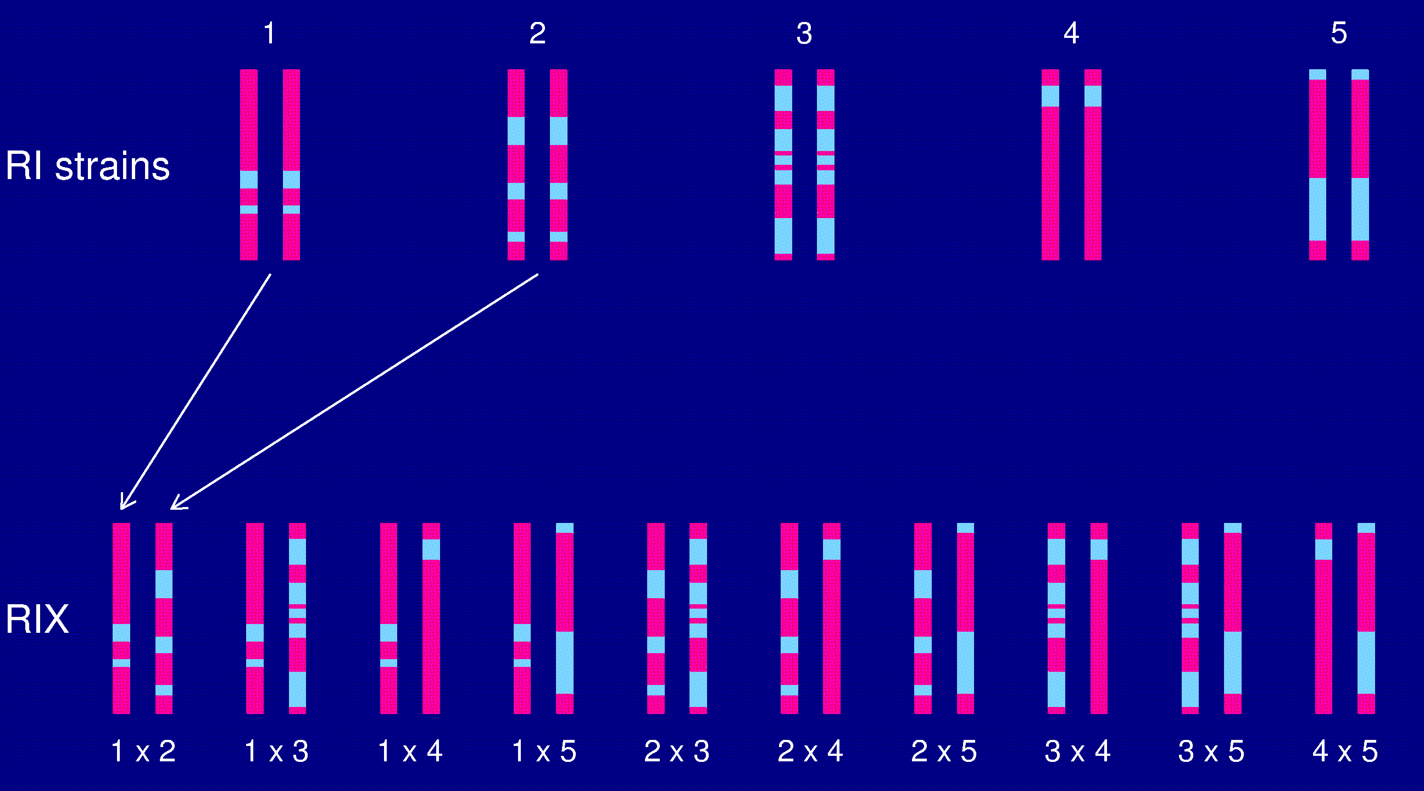
The RIX design

Slide 48
Heterogeneous stock
McClearn et al. (1970)
Mott et al. (2000); Mott and Flint (2002)
Start with 8 inbred strains.
Randomly breed 40 pairs.
Repeat the random breeding of 40 pairs for each of ~60 generations (30 years).
The genealogy (and protocol) is not completely known.

Slide 49
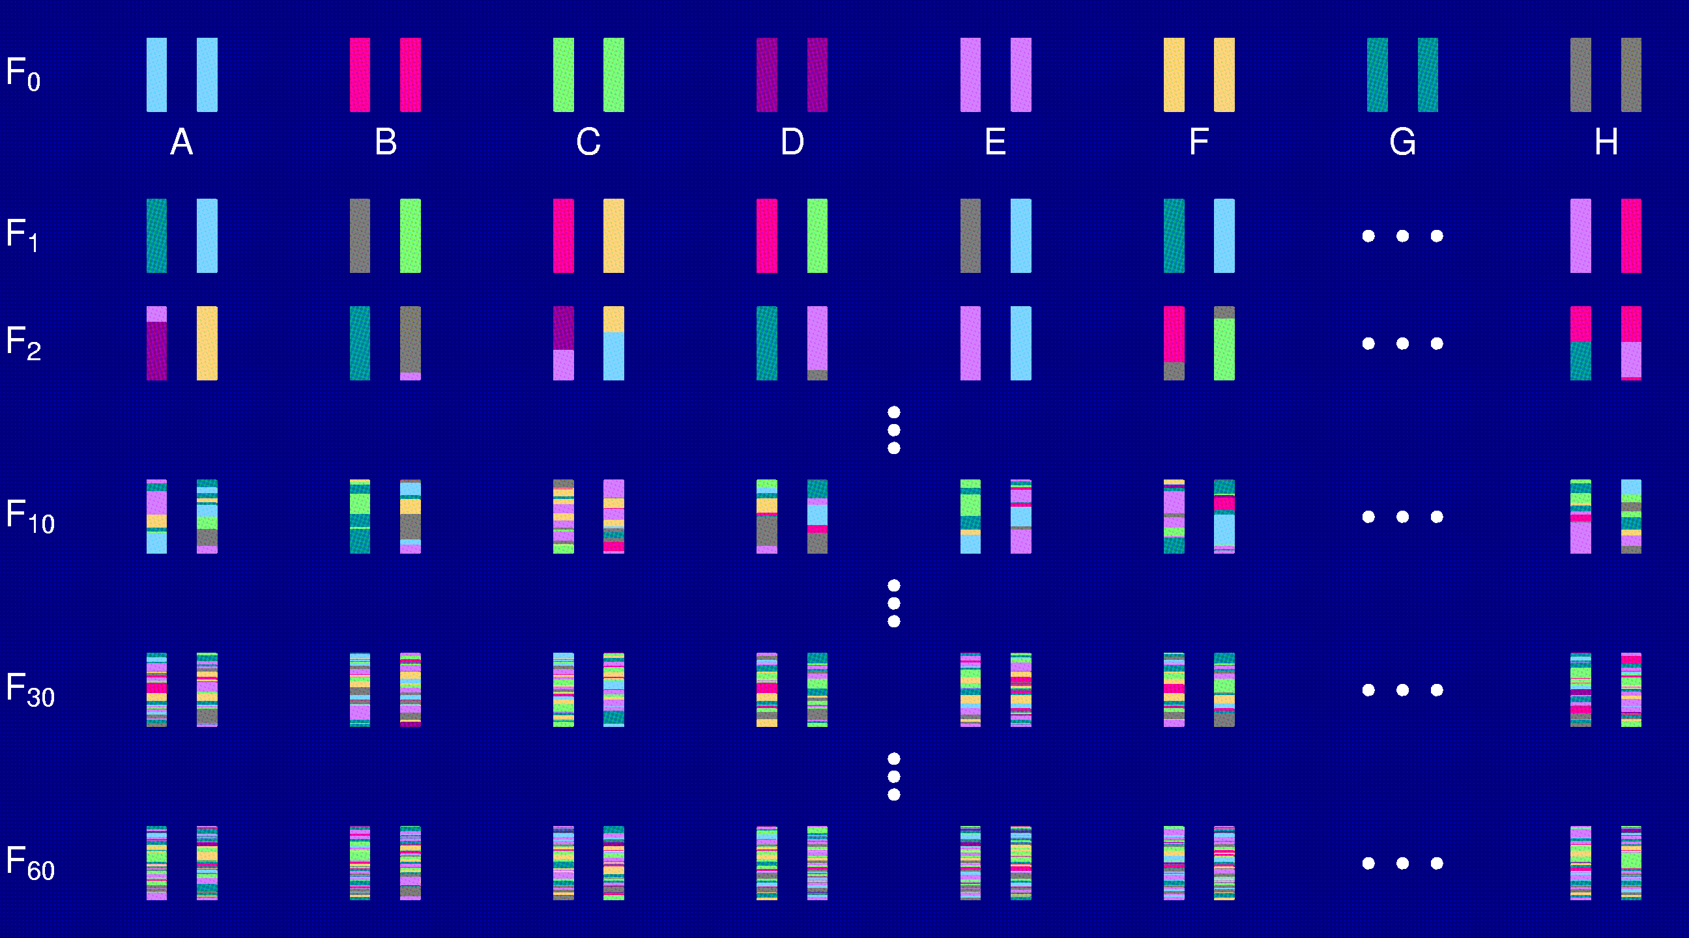
Heterogeneous stock

Slide 50
Heterogeneous stock
Advantages
Great mapping precision.
Learn about 8 alleles.
Disadvantages
Time.
Each individual is unique.
Need extremely dense markers.

Slide 51
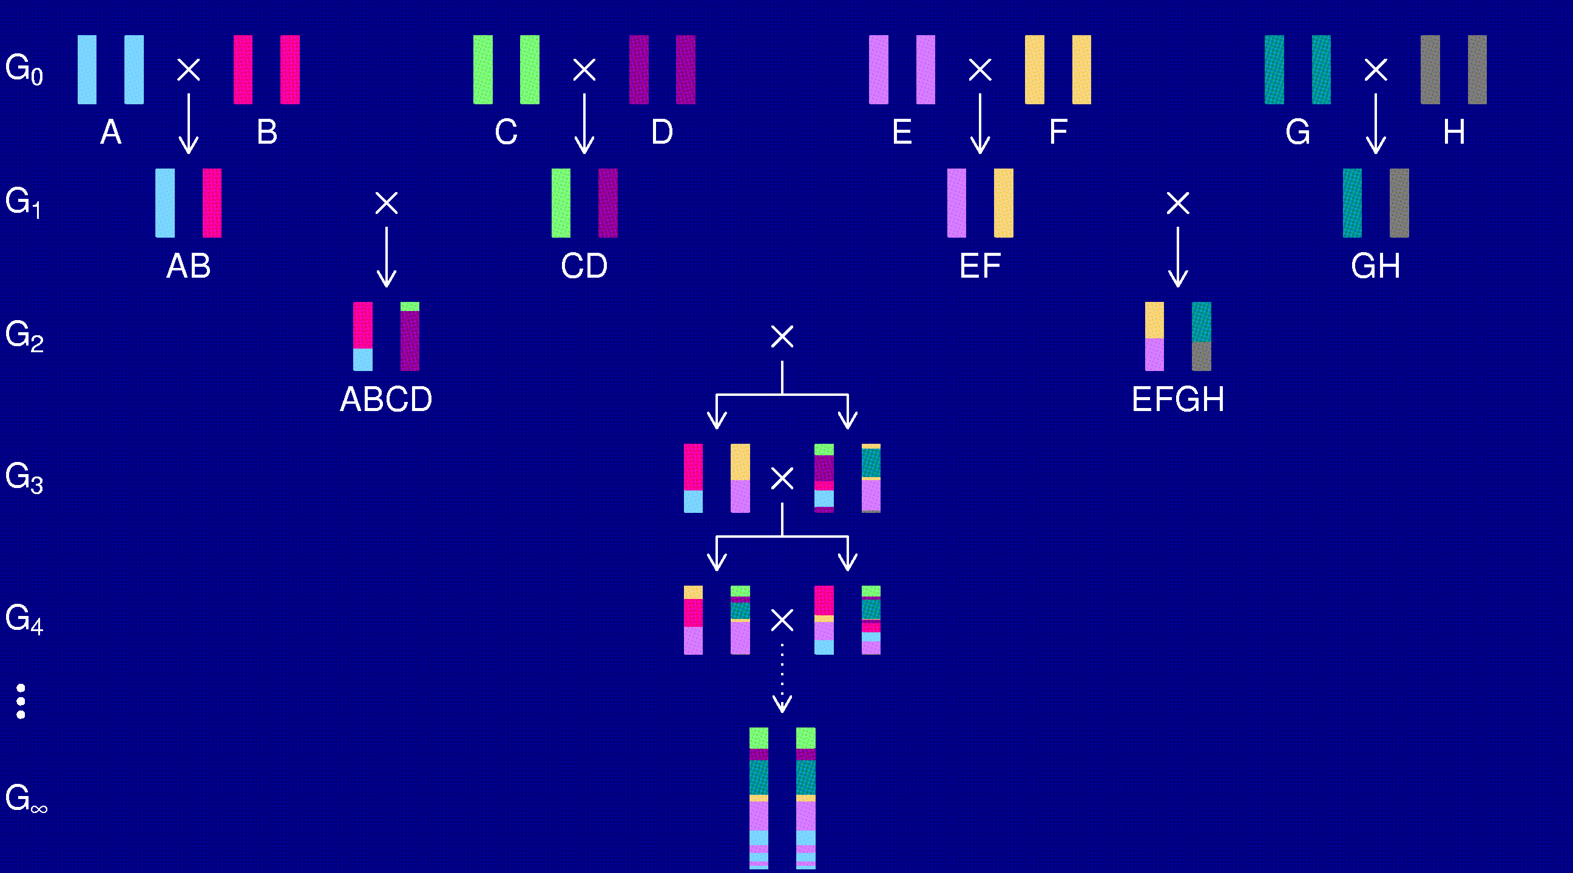
The “Collaborative Cross”

Slide 52
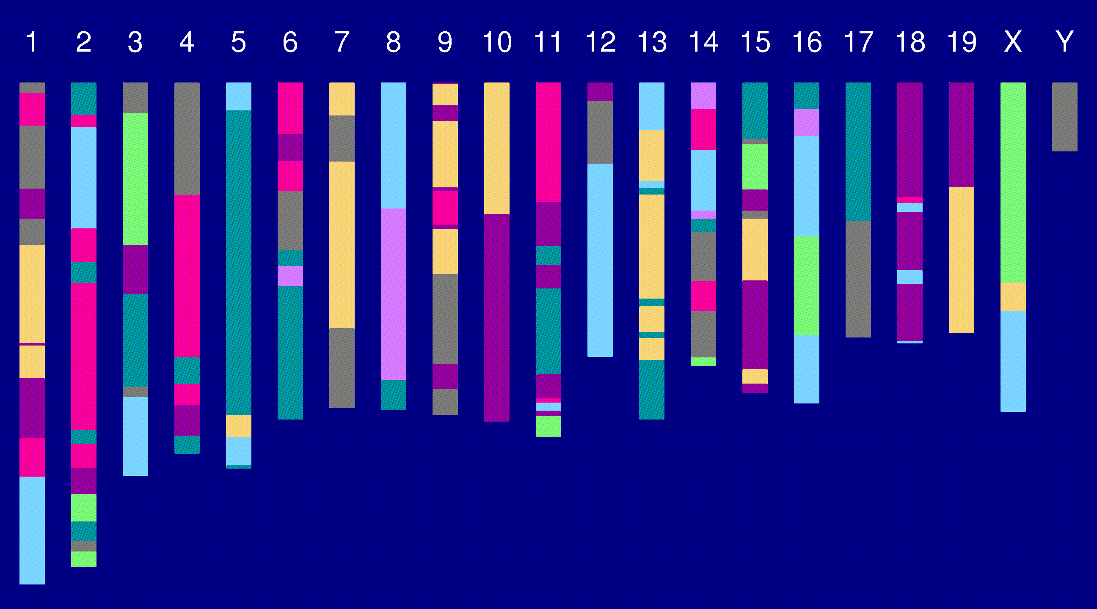
Genome of an 8-way RI

Slide 53
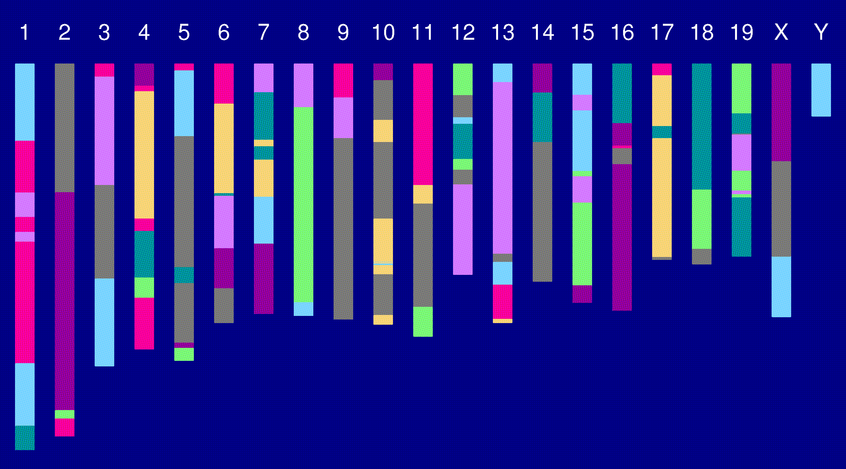
Genome of an 8-way RI

Slide 54
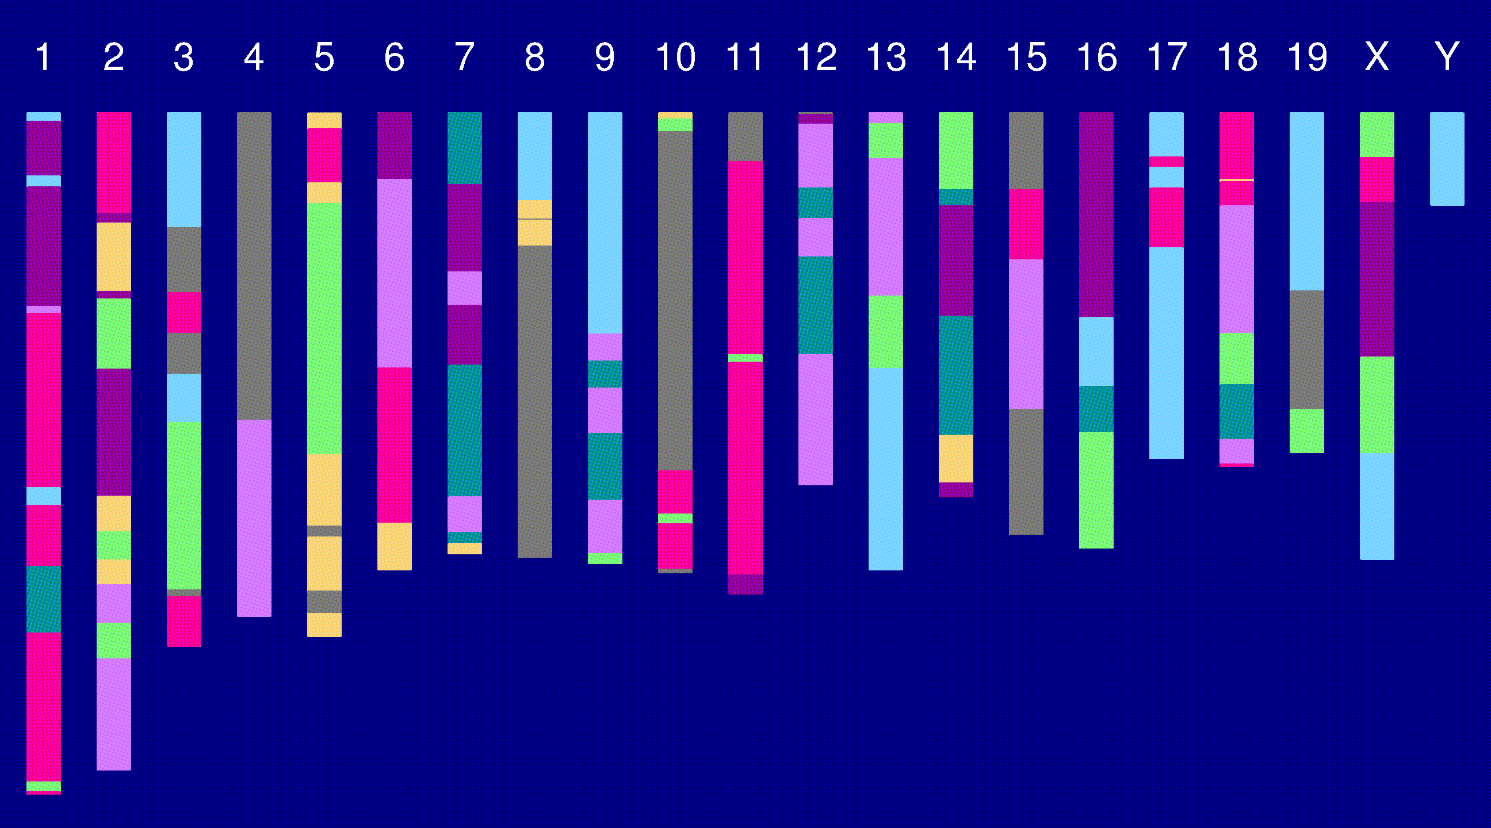
Genome of an 8-way RI

Slide 55
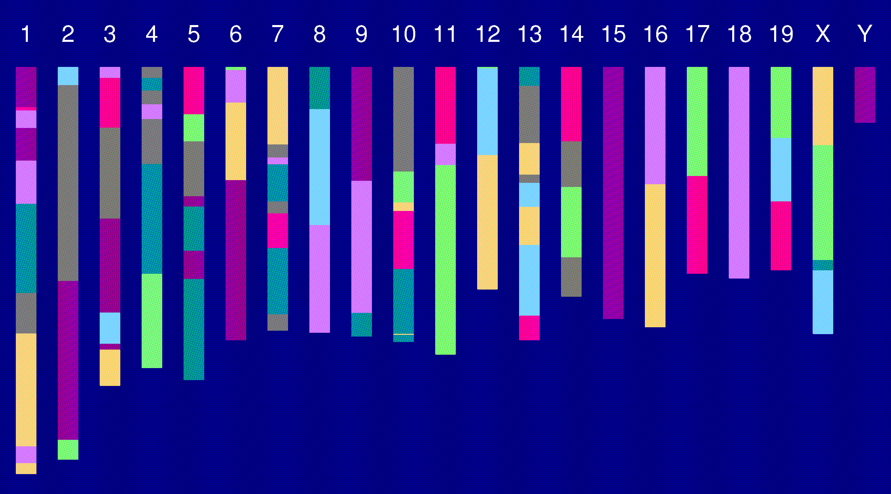
Genome of an 8-way RI

Slide 56
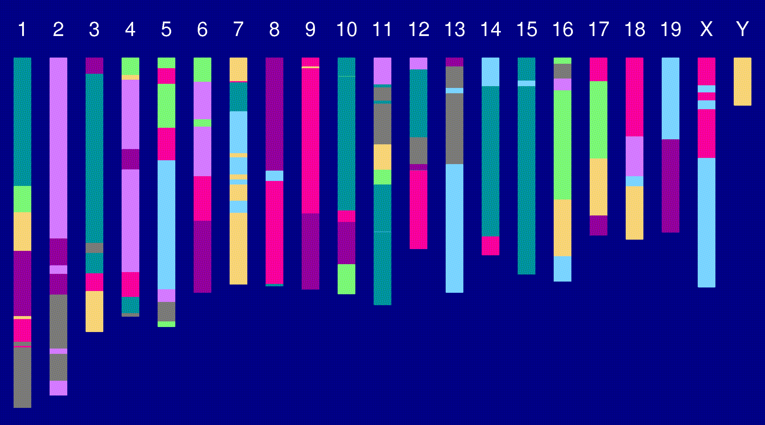
Genome of an 8-way RI

Slide 57
The “Collaborative Cross”
Advantages
Great mapping precision.
Eternal resource.
  Genotype only once.
  Study multiple invasive phenotypes on the same genotype.
Barriers
Advantages not widely appreciated.
  Ask one question at a time, or Ask many questions at once?
Time.
Expense.
Requires large-scale collaboration.

Slide 58
To be worked out
Breakpoint process along an 8-way RI chromosome.
Reconstruction of genotypes given multipoint marker data.
Single-QTL analyses.
  Mixed models, with random effects for strains and genotypes/alleles.
Power and precision (relative to an intercross).

Slide 59
Haldane & Waddington 1930
r = recombination fraction per meiosis between two loci
Autosomes
  Pr(G₁=AA) = Pr(G₁=BB) = 1/2
  Pr(G₂=BB | G₁=AA) = Pr(G₂=AA | G₁=BB) = 4r / (1+6r)
X chromosome
  Pr(G₁=AA) = 2/3 Pr(G₁=BB) = 1/3
  Pr(G₂=BB | G₁=AA) = 2r / (1+4r)
  Pr(G₂=AA | G₁=BB) = 4r / (1+4r)
  Pr(G₂ ≠ G₁) = (8/3) r / (1+4r)

Slide 60
8-way RILs
Autosomes
  Pr(G₁ = i) = 1/8
  Pr(G₂ = j | G₁ = i) = r / (1+6r) for i ≠ j
  Pr(G₂ ≠ G₁) = 7r / (1+6r)
X chromosome
  Pr(G₁=AA) = Pr(G₁=BB) = Pr(G₁=EE) = Pr(G₁=FF) =1/6
  Pr(G₁=CC) = 1/3
  Pr(G₂=AA | G₁=CC) = r / (1+4r)
  Pr(G₂=CC | G₁=AA) = 2r / (1+4r)
  Pr(G₂=BB | G₁=AA) = r / (1+4r)
  Pr(G₂ ≠ G₁) = (14/3) r / (1+4r)

Slide 61
Acknowledgments
Terry Speed, Univ. of California, Berkeley and WEHI
Tom Brodnicki, WEHI
Gary Churchill, The Jackson Laboratory
Joe Nadeau, Case Western Reserve Univ.

