Slide 1
Gene mapping in model organisms

Slide 2
Goal
Identify genes that contribute to common human diseases.

Slide 3
Inbred mice

Slide 4
Advantages of the mouse
Small and cheap
Inbred lines
Large, controlled crosses
Experimental interventions
Knock-outs and knock-ins

Slide 5
The mouse as a model
Same genes?
  The genes involved in a phenotype in the mouse may also be involved in similar phenotypes in the human.
Similar complexity?
  The complexity of the etiology underlying a mouse phenotype provides some indication of the complexity of similar human phenotypes.
Transfer of statistical methods.
  The statistical methods developed for gene mapping in the mouse serve as a basis for similar methods applicable in direct human studies.

Slide 6
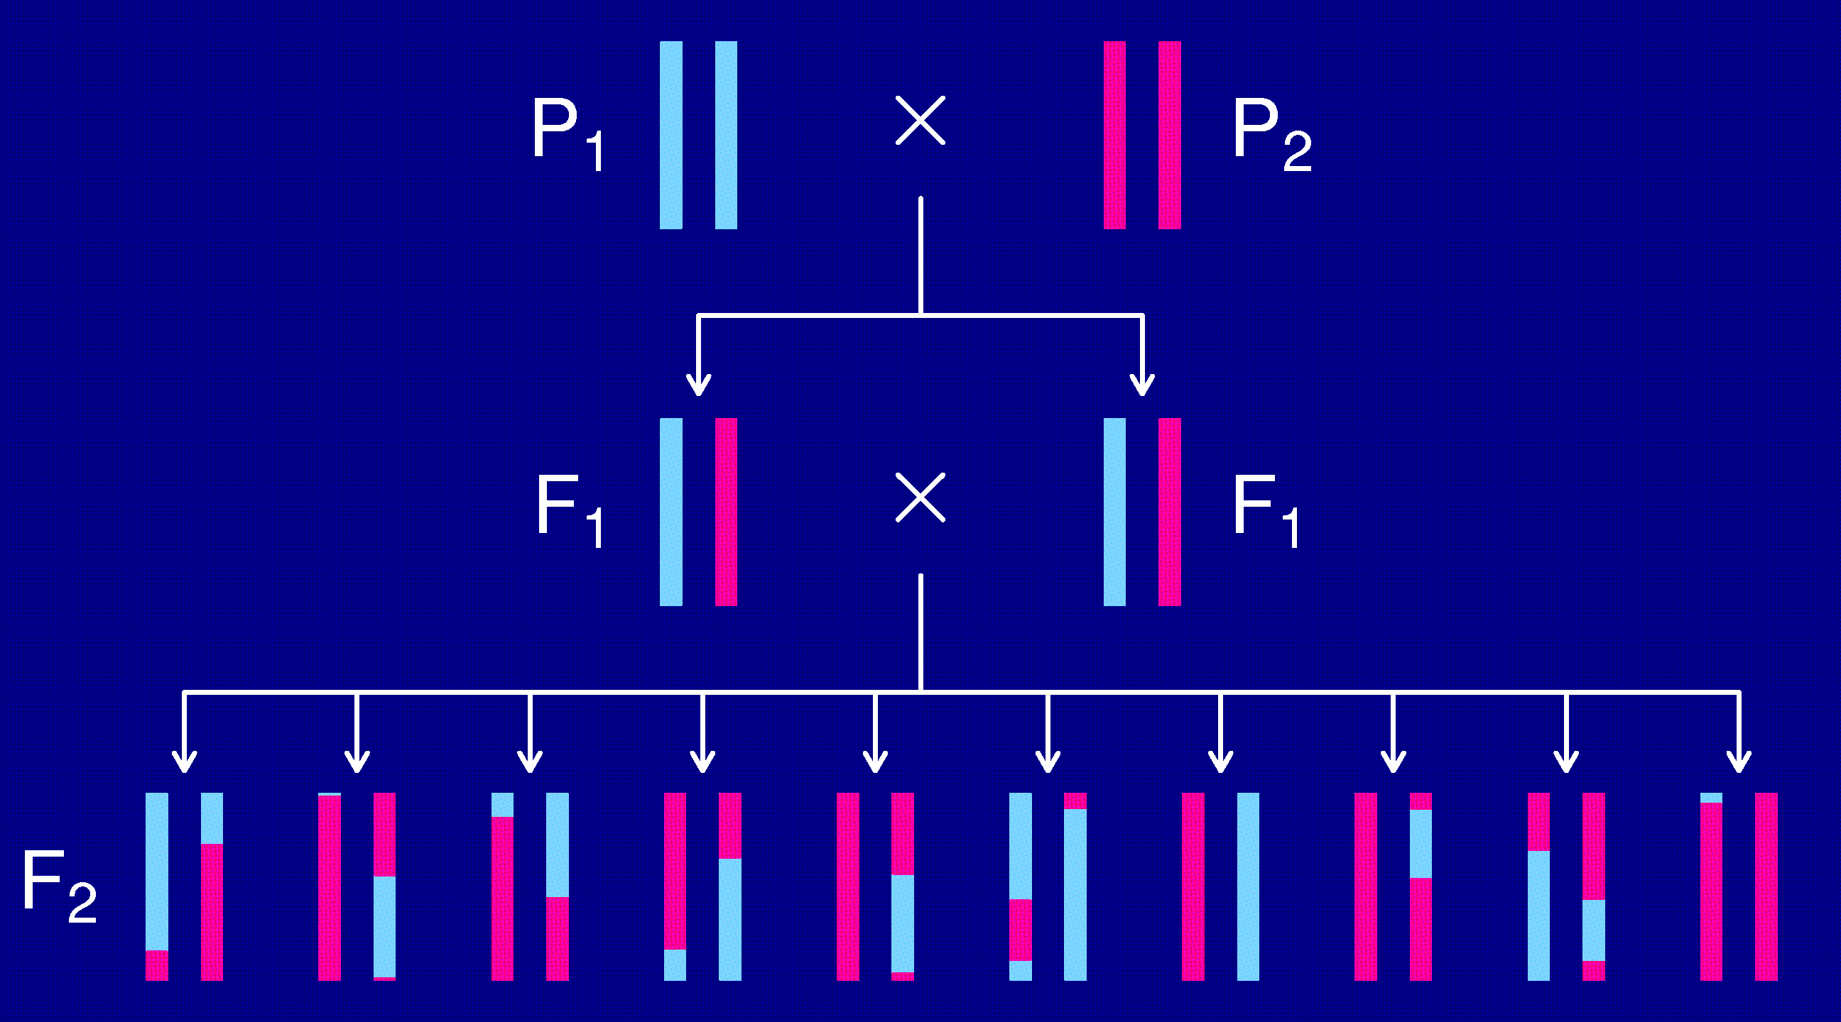
The intercross

Slide 7
The data
Phenotypes, y_{i}
Genotypes, x_{ij} = AA/AB/BB, at genetic markers
A genetic map, giving the locations of the markers.

Slide 8
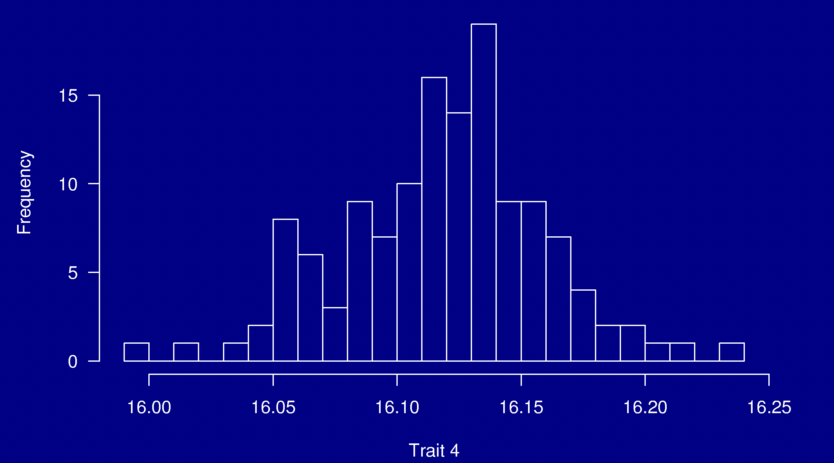
Phenotypes
133 females
(NOD × B6) × (NOD × B6)

Slide 9
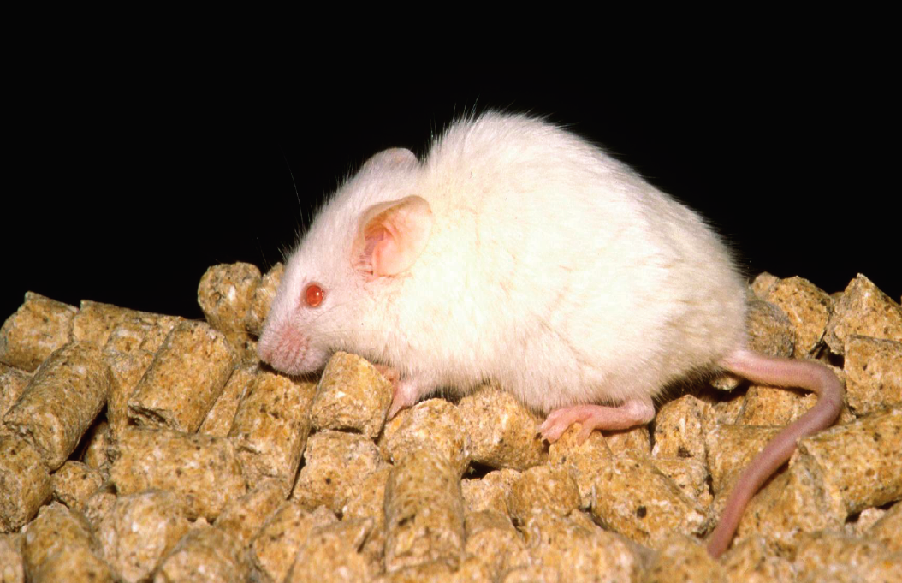
NOD

Slide 10
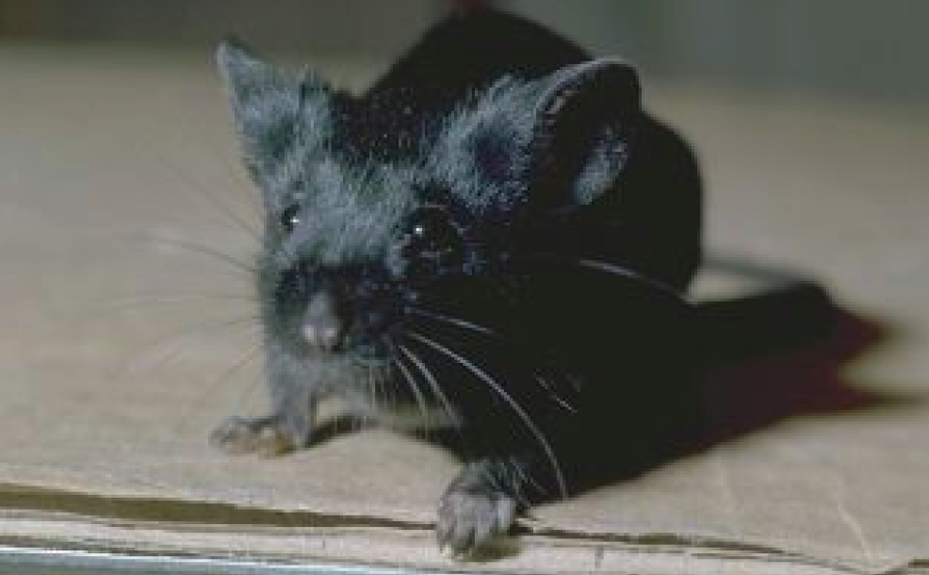
C57BL/6

Slide 11
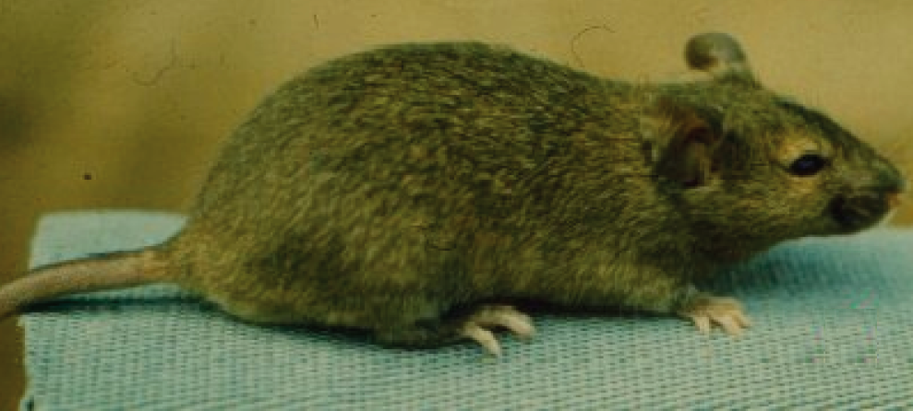
Agouti coat

Slide 12
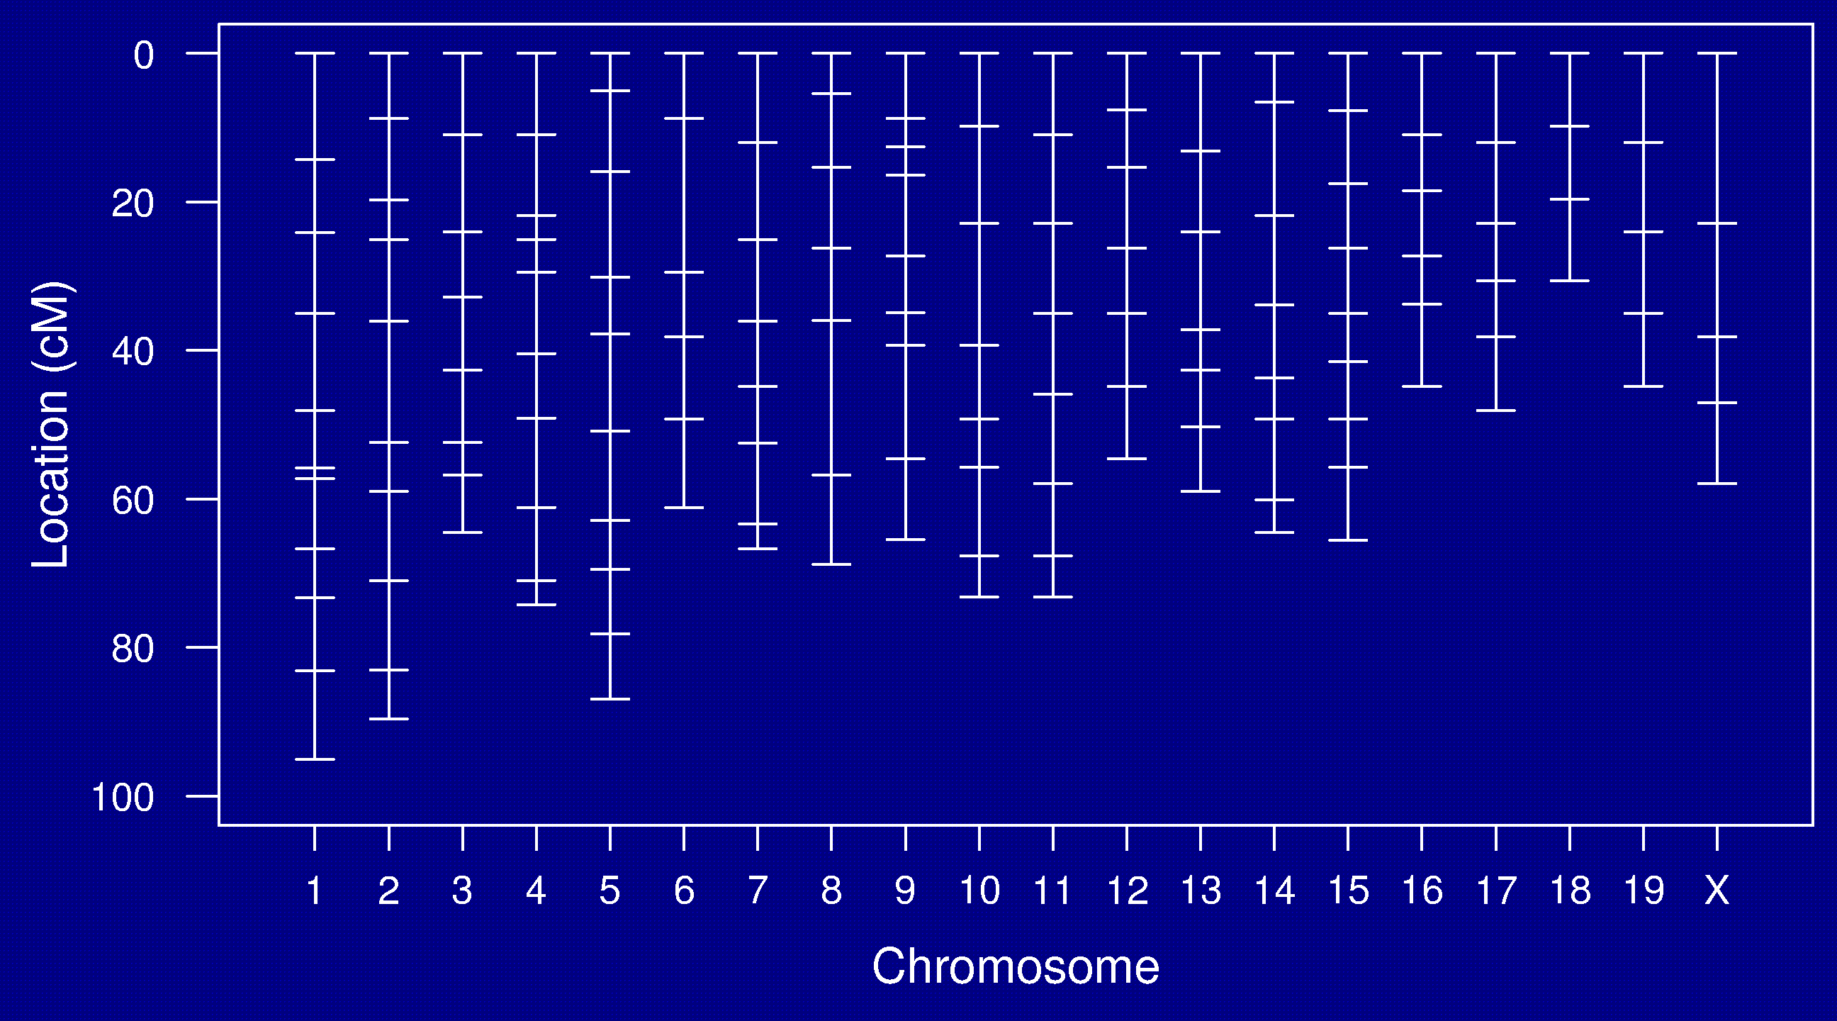
Genetic map

Slide 13
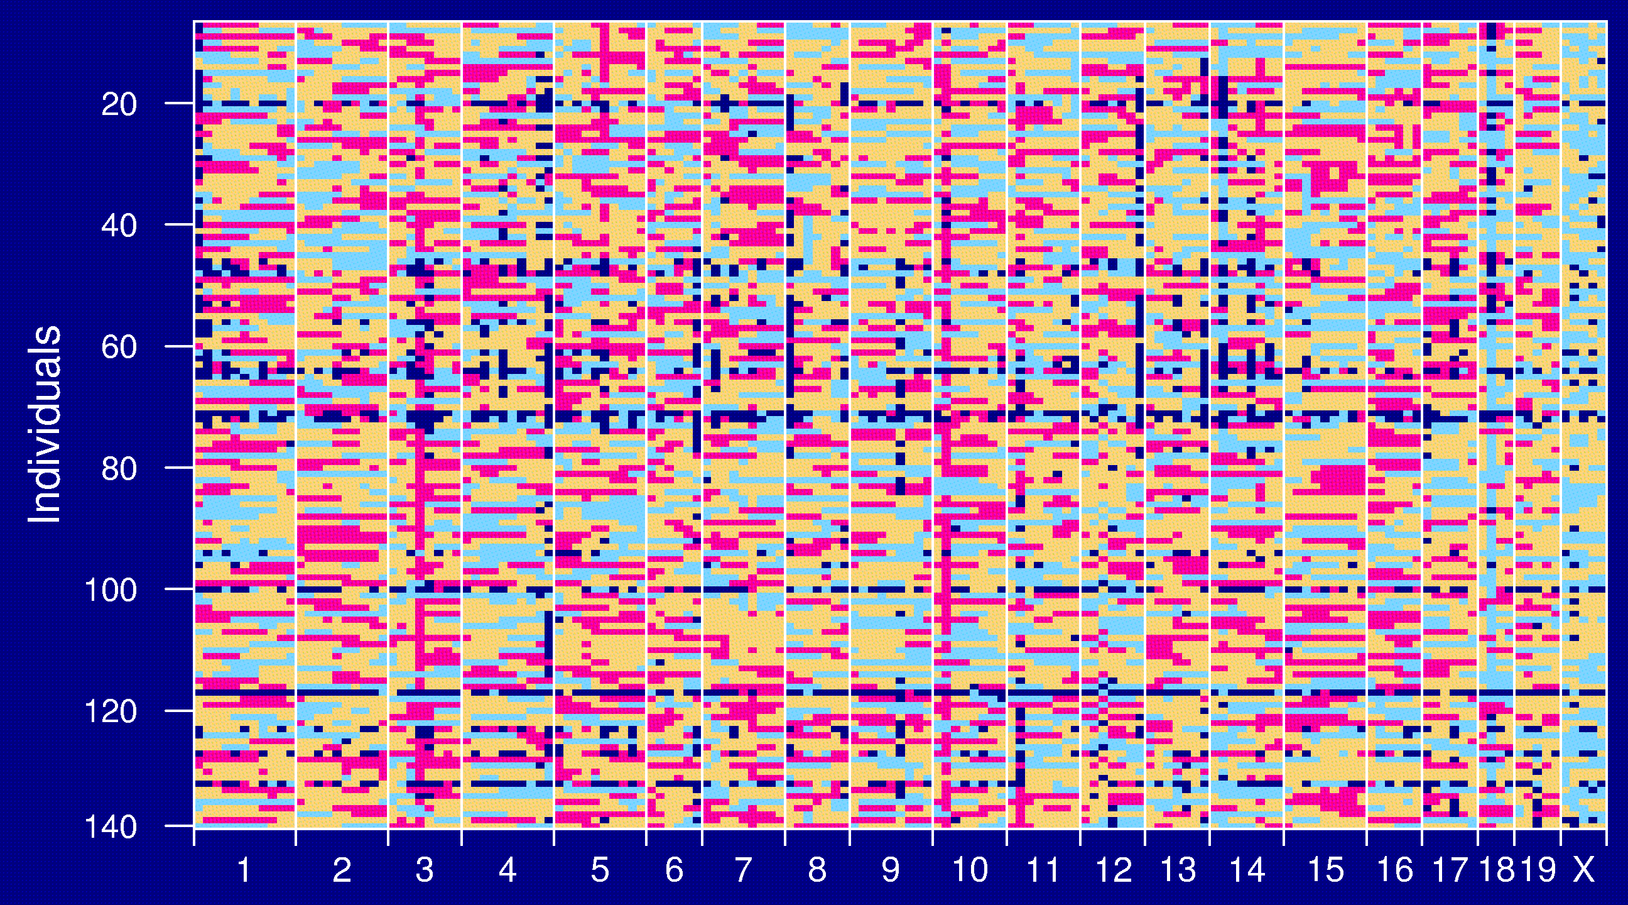
Genotype data

Slide 14
Goals
Identify genomic regions (QTLs) that contribute to variation in the trait.
Obtain interval estimates of the QTL locations.
Estimate the effects of the QTLs.

Slide 15
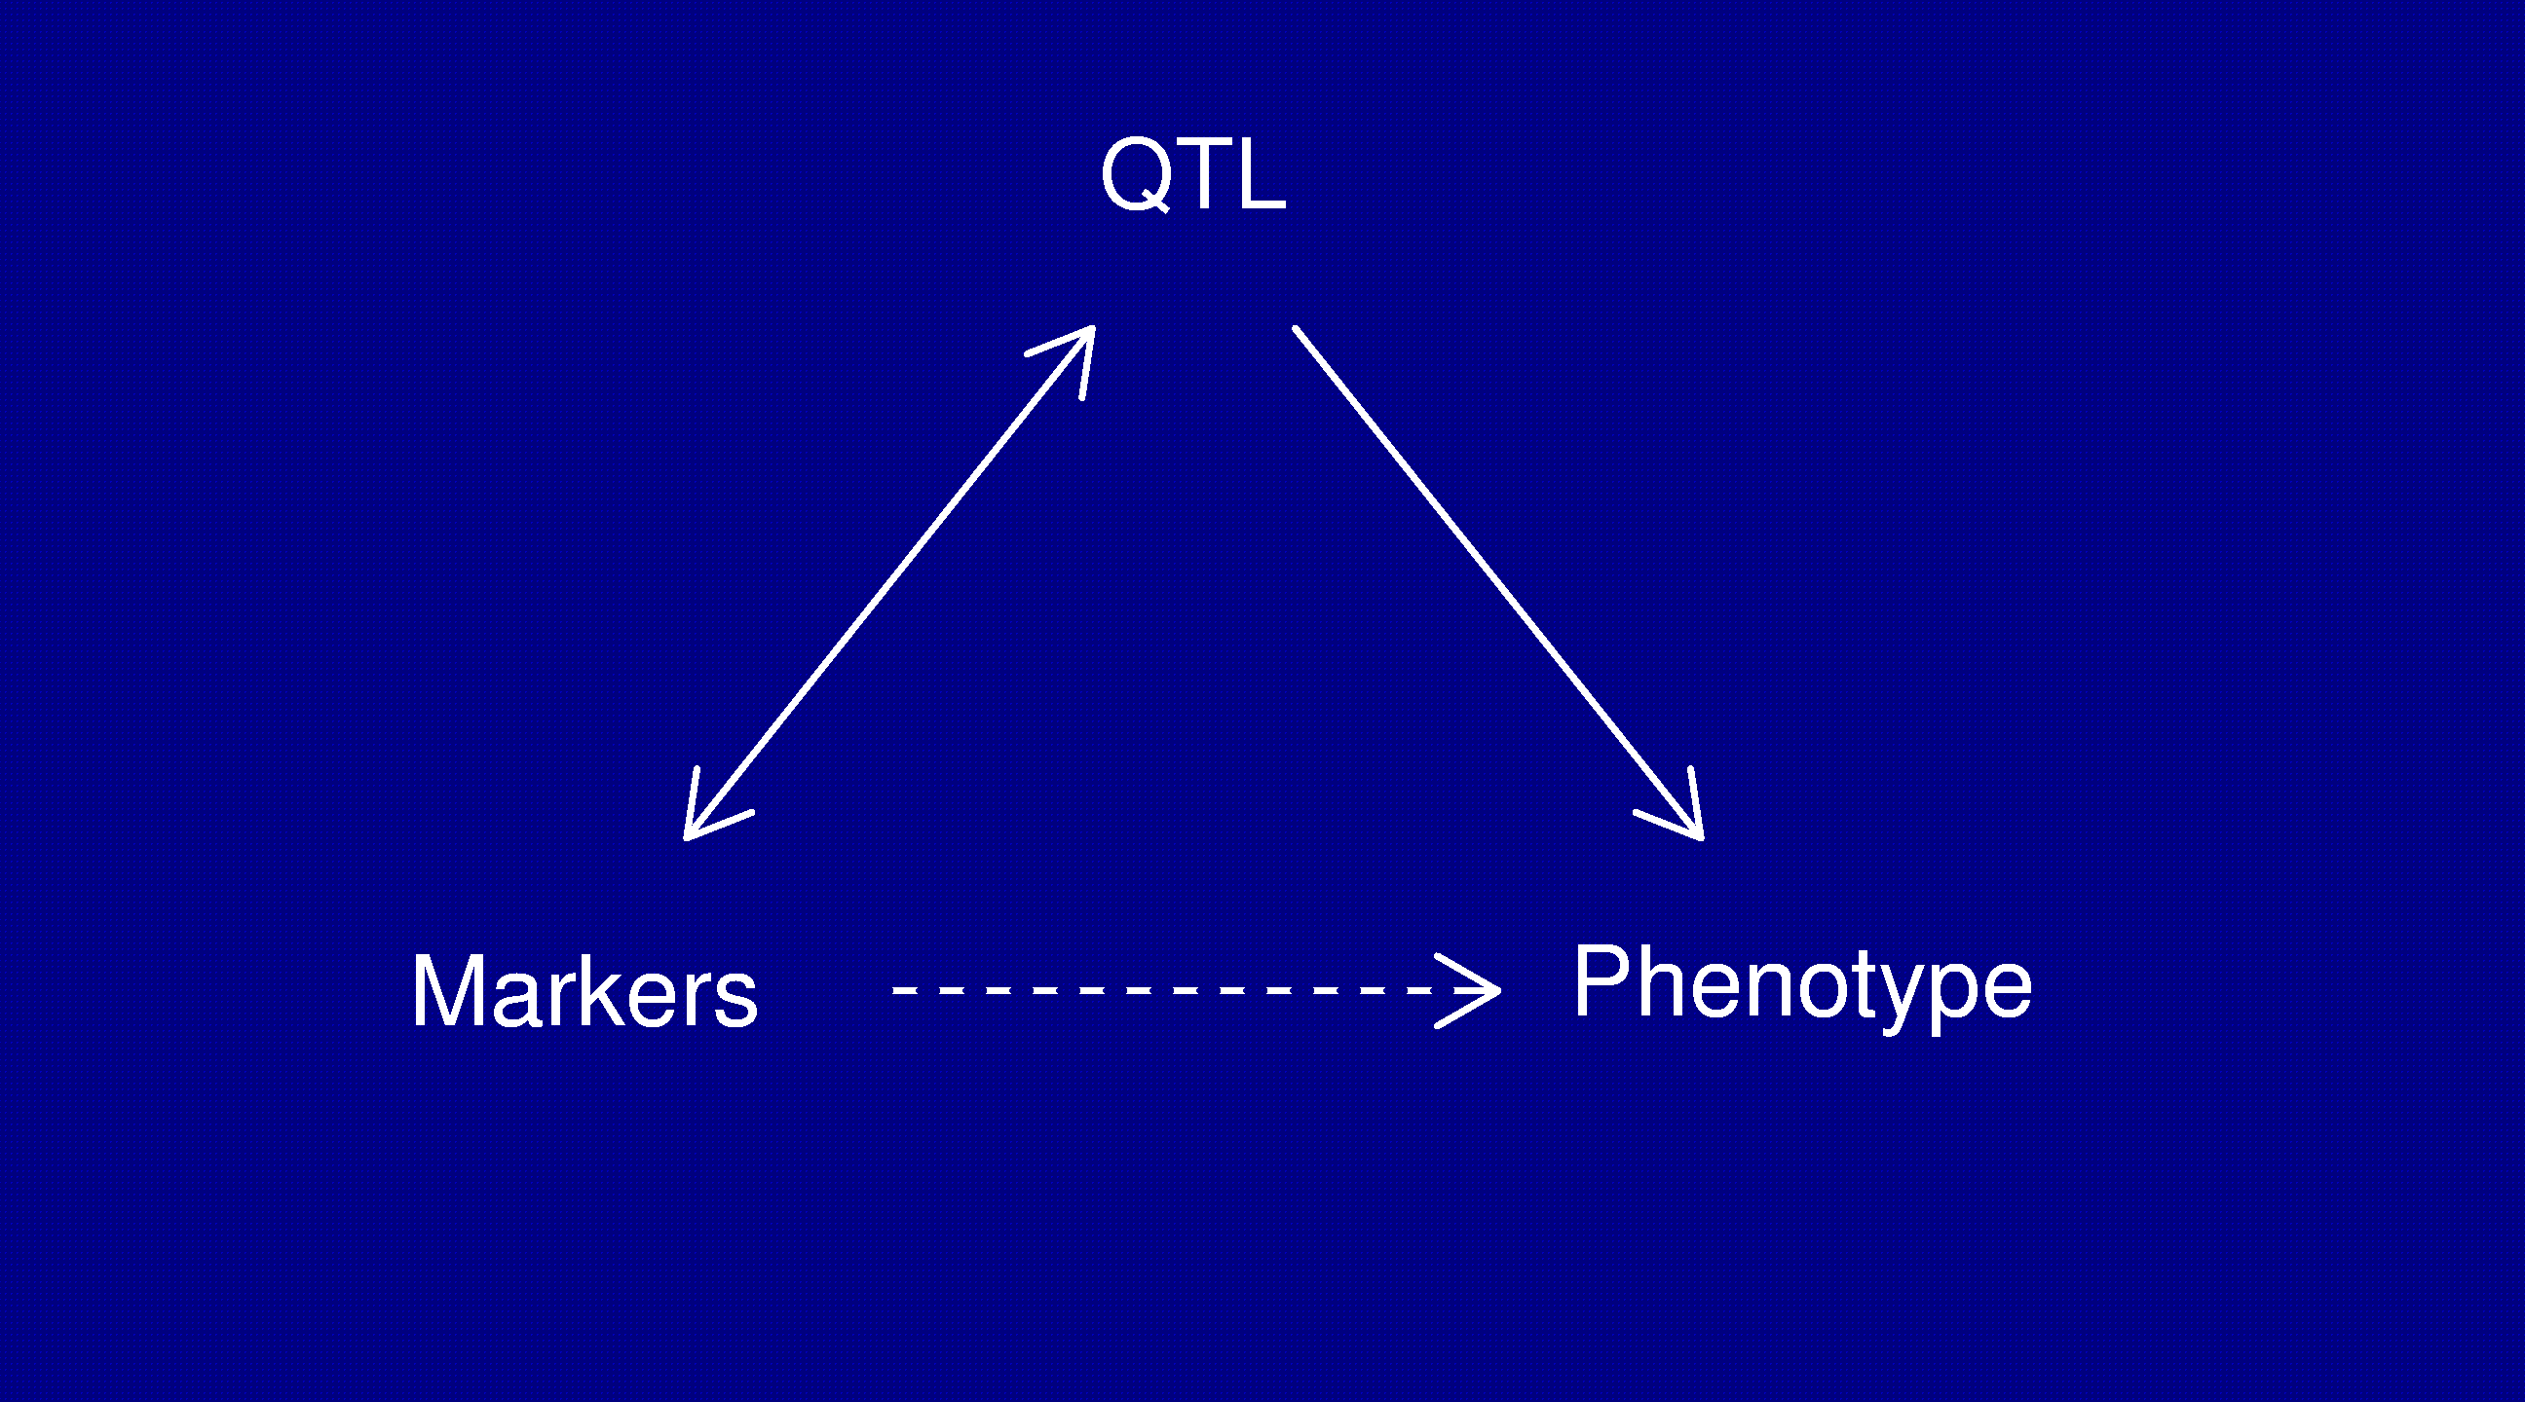
Statistical structure
Missing data: markers ↔ QTL
Model selection: genotypes ↔ phenotype

Slide 16
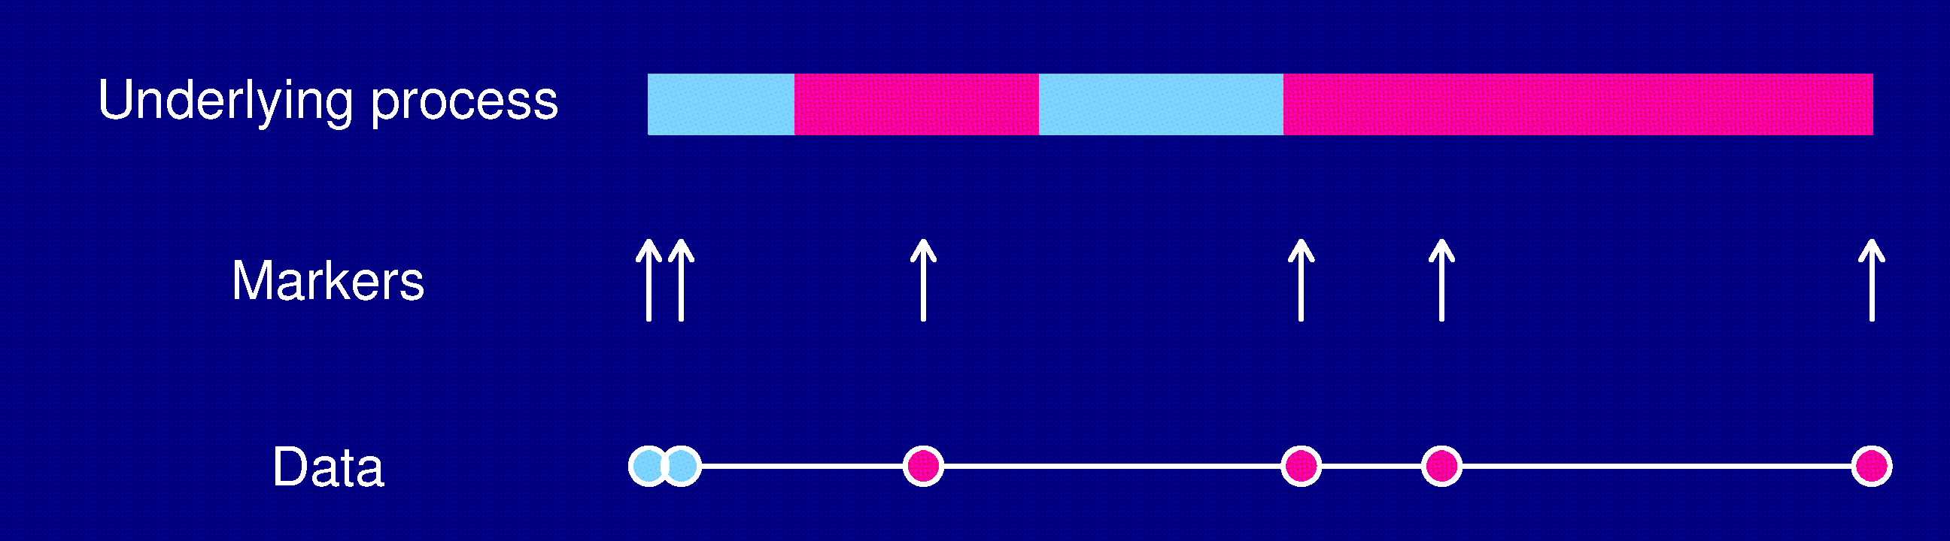
Models: recombination
No crossover interference
  Locations of breakpoints according to a Poisson process.
  Genotypes along chromosome follow a Markov chain.
Clearly wrong, but super convenient.

Slide 17
Models: gen ↔ phe
Phenotype = y, whole-genome genotype = g
Imagine that p sites are all that matter.
E(y | g) = μ(g₁,…,g_{p}) SD(y | g) = σ(g₁,…,g_{p})
Simplifying assumptions:
  SD(y | g) = σ, independent of g
  y | g ~ normal( μ(g₁,…,g_{p}), σ )
  μ(g₁,…,g_{p}) = μ + ∑ α_{j} 1{g_{j} = AB} + β_{j} 1{g_{j} = BB}

Slide 18
Before you do anything…
Check data quality
Genetic markers on the correct chromosomes
Markers in the correct order
Identify and resolve likely errors in the genotype data

Slide 19
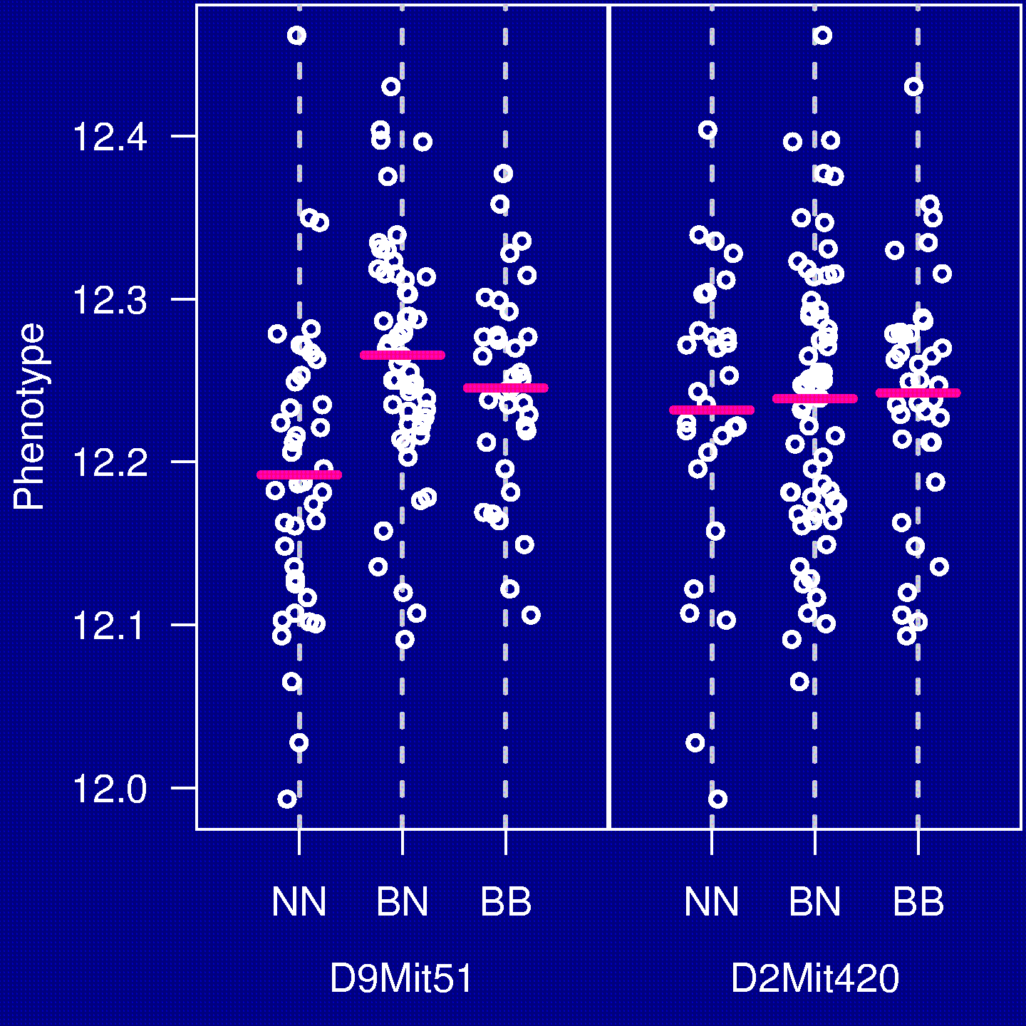
The simplest method
“Marker regression”
Consider a single marker
Split mice into groups according to their genotype at a marker
Do an ANOVA (or t-test)
Repeat for each marker

Slide 20
Marker regression
Advantages
Simple
Easily incorporates covariates
Easily extended to more complex models
Disadvantages
Must exclude individuals with missing genotypes data
Imperfect information about QTL location
Suffers in low density scans
Only considers one QTL at a time

Slide 21
Interval mapping
Lander and Botstein 1989
Imagine that there is a single QTL, at position z.
Let q_{i} = genotype of mouse i at the QTL, and assume
y_{i} | q_{i} ~ normal( μ(q_{i}), σ )
We won’t know q_{i}, but we can calculate (by an HMM)
p_{ig} = Pr(q_{i} = g | marker data)
y_{i}, given the marker data, follows a mixture of normal distributions with known mixing proportions (the p_{ig}).
Use an EM algorithm to get MLEs of θ = (μ_{AA}, μ_{AB}, μ_{BB}, σ).
Measure the evidence for a QTL via the LOD score, which is the log₁₀ likelihood ratio comparing the hypothesis of a single QTL at position z to the hypothesis of no QTL anywhere.

Slide 22
Interval mapping
Advantages
Takes proper account of missing data
Allows examination of positions between markers
Gives improved estimates of QTL effects
Provides pretty graphs
Disadvantages
Increased computation time
Requires specialized software
Difficult to generalize
Only considers one QTL at a time

Slide 23
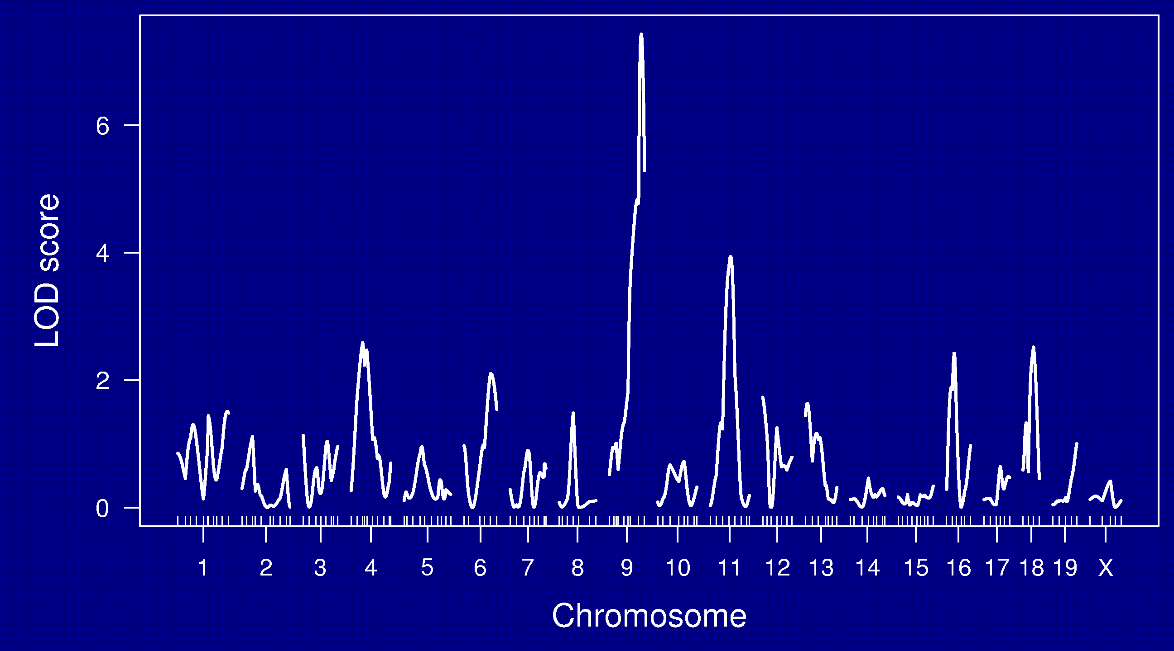
LOD curves

Slide 24
LOD thresholds
To account for the genome-wide search, compare the observed LOD scores to the distribution of the maximum LOD score, genome-wide, that would be obtained if there were no QTL anywhere.
The 95th percentile of this distribution is used as a significance threshold.
Such a threshold may be estimated via permutations (Churchill and Doerge 1994).

Slide 25
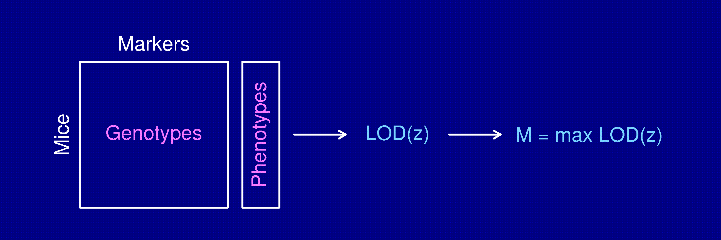
Permutation test
Shuffle the phenotypes relative to the genotypes.
Calculate M* = max LOD*, with the shuffled data.
Repeat many times.
LOD threshold = 95th percentile of M*
P-value = Pr(M* ≥ M)

Slide 26
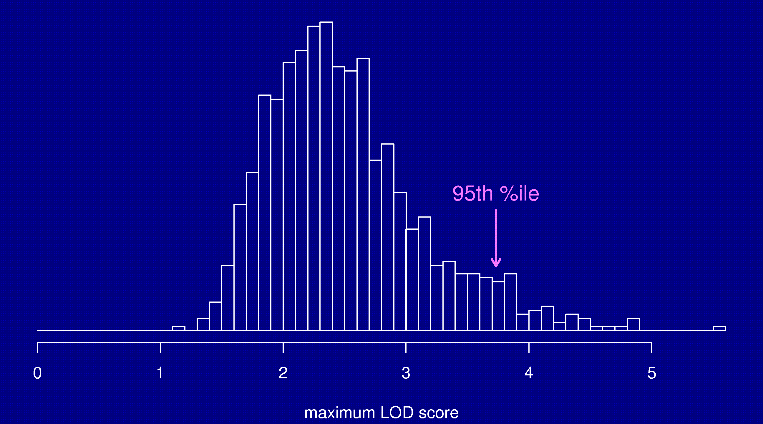
Permutation distribution

Slide 27
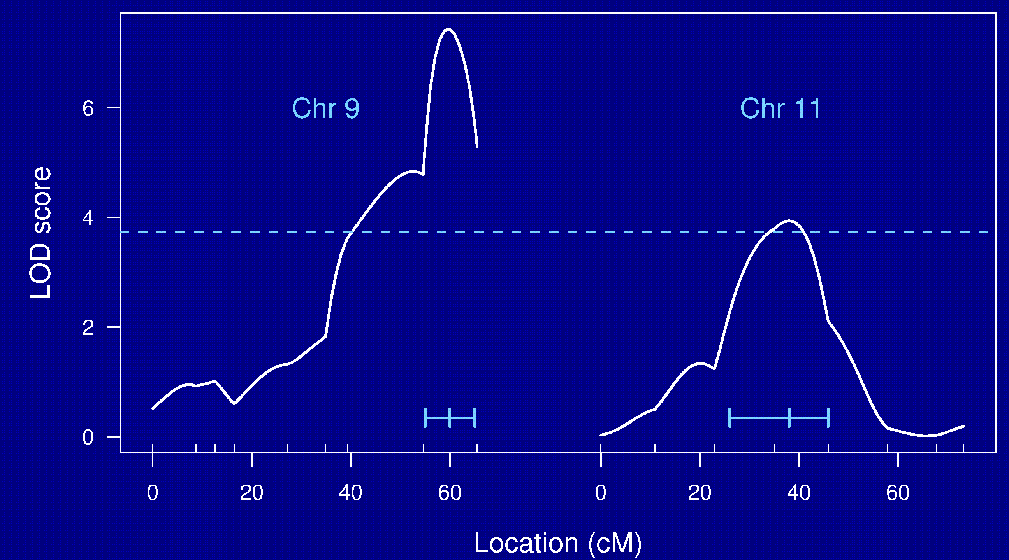
Chr 9 and 11

Slide 28
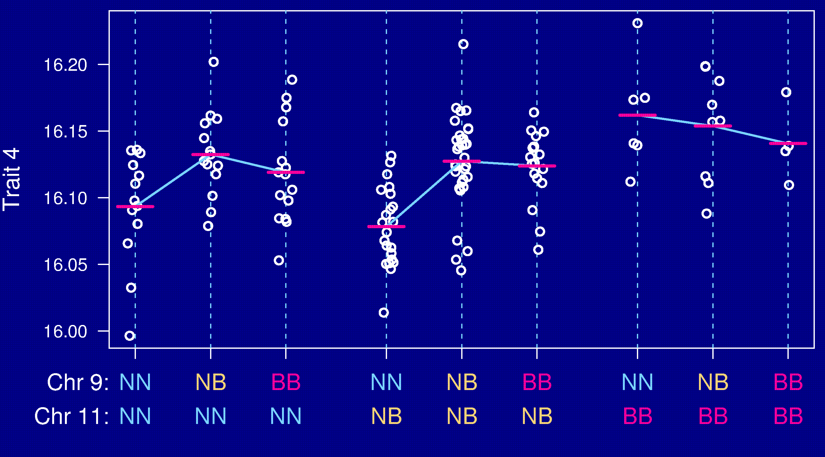
Epistasis

Slide 29
Going after multiple QTLs
Greater ability to detect QTLs.
Separate linked QTLs.
Learn about interactions between QTLs (epistasis).

Slide 30
Multiple QTL mapping
Simplistic but illustrative situation:
  No missing genotype data
  Dense markers (so ignore positions between markers)
  No gene-gene interactions
Which β_{j} ≠ 0?
→ Model selection in regression

Slide 31
Model selection
Choose a class of models
  Additive; pairwise interactions; regression trees
Fit a model (allow for missing genotype data)
  Linear regression; ML via EM; Bayes via MCMC
Search model space
  Forward/backward/stepwise selection; MCMC
Compare models
  BIC_{δ}(γ) = log L(γ) + (δ/2) |γ| log n
Miss important loci ↔ include extraneous loci.

Slide 32
Special features
Relationship among the covariates
Missing covariate information
Identify the key players vs. minimize prediction error

Slide 33
Opportunities for improvements
Each individual is unique.
  Must genotype each mouse.
  Unable to obtain multiple invasive phenotypes (e.g., in multiple environmental conditions) on the same genotype.
Relatively low mapping precision.
Design a set of inbred mouse strains.
  Genotype once.
  Study multiple phenotypes on the same genotype.

Slide 34
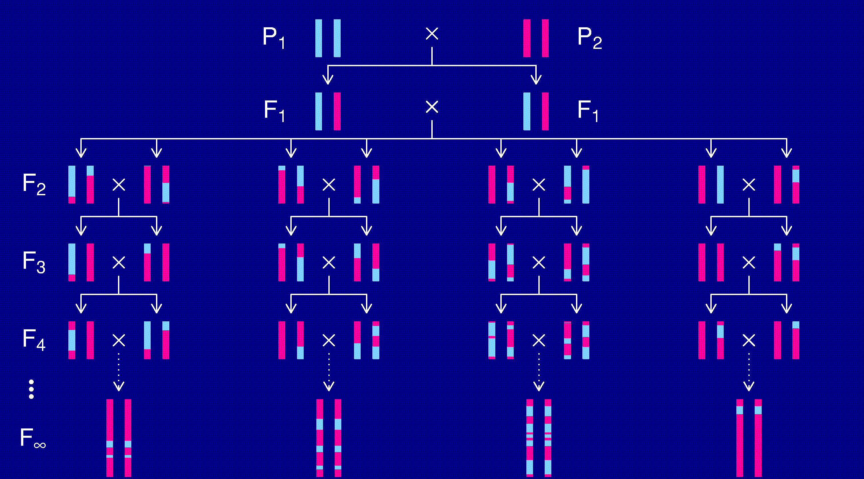
Recombinant inbred lines

Slide 35
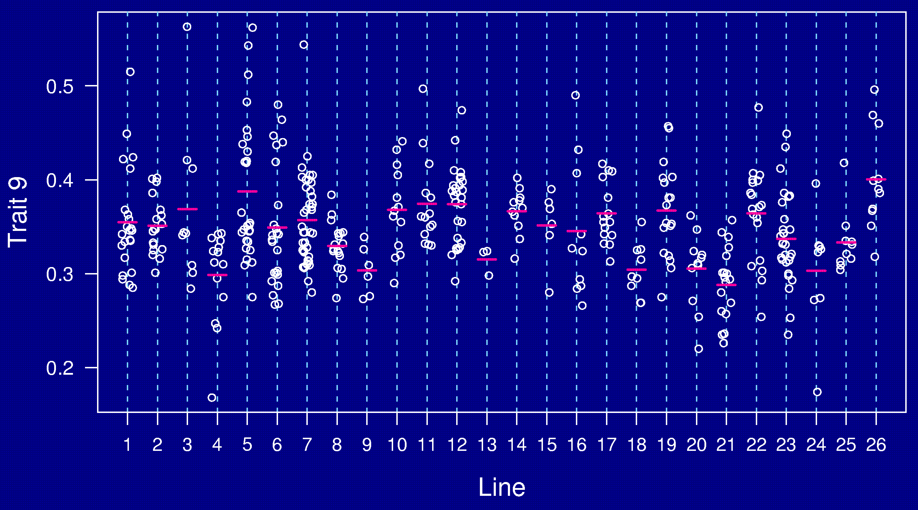
AXB/BXA panel

Slide 36
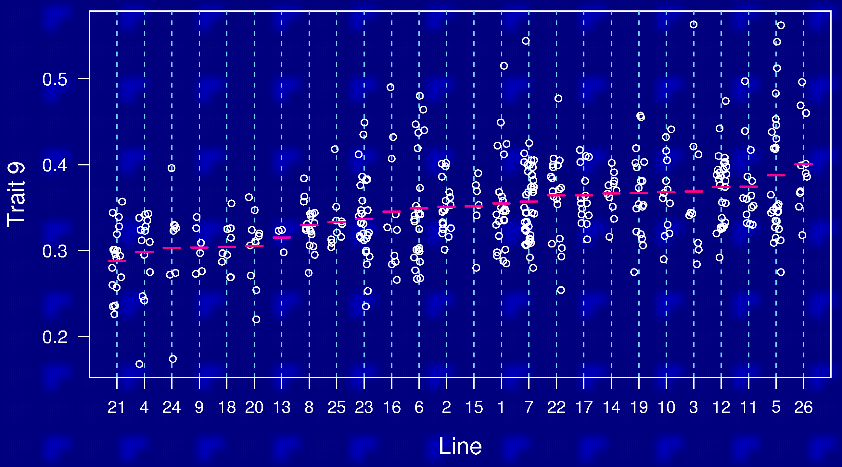
AXB/BXA panel

Slide 37
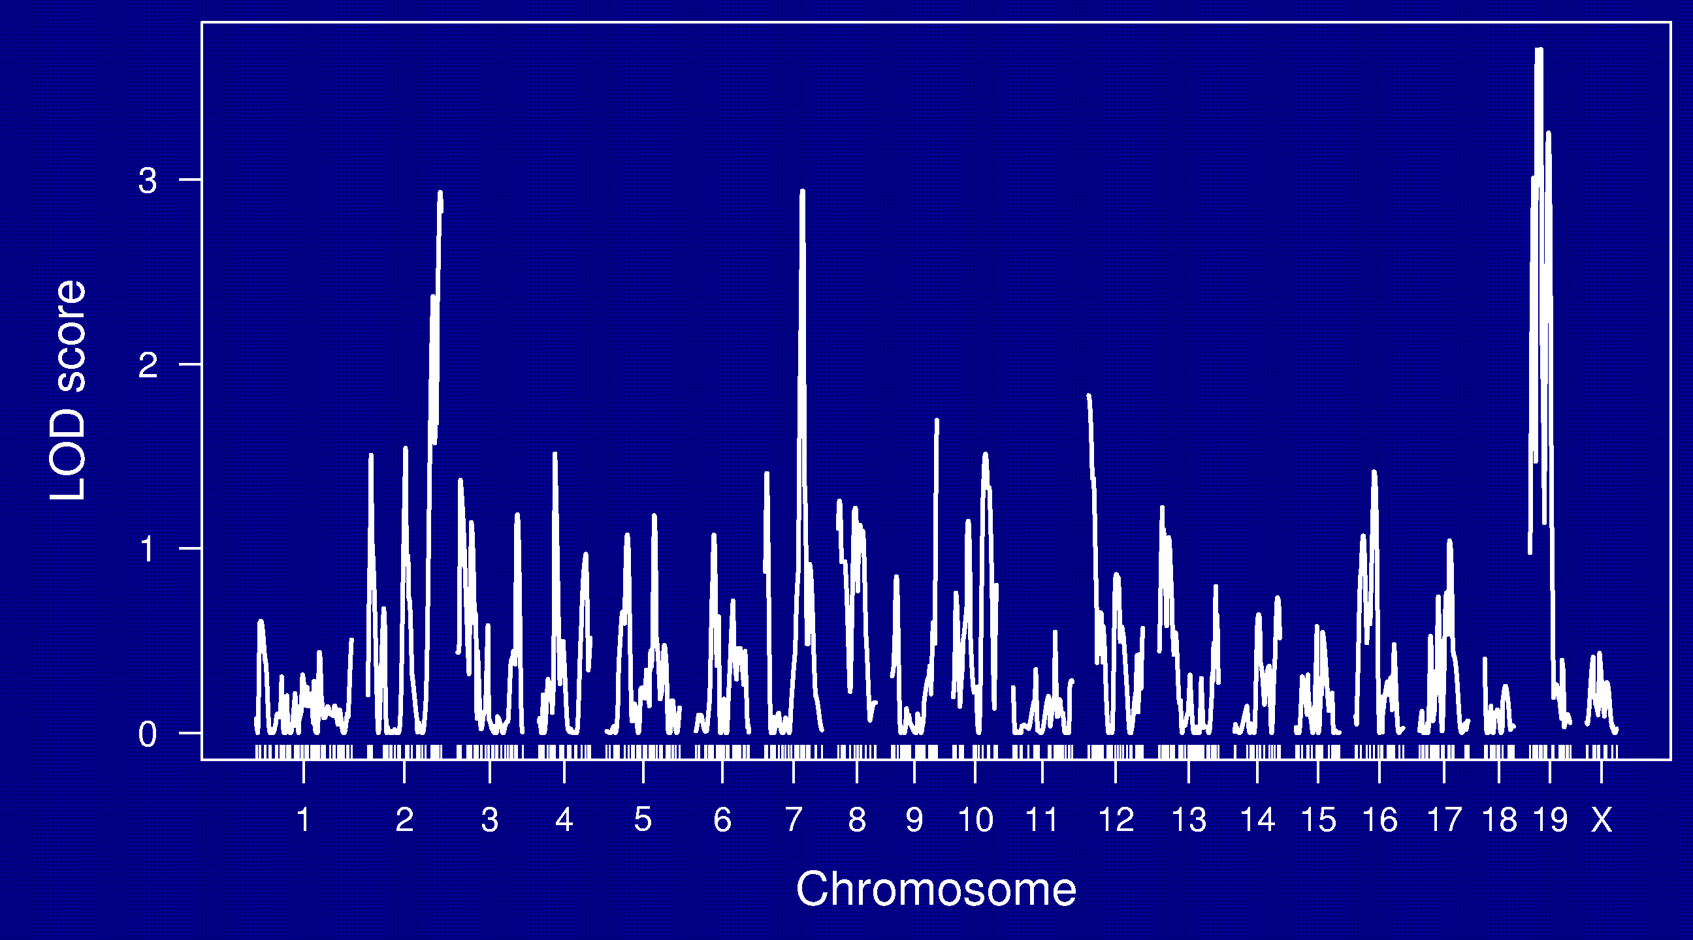
LOD curves

Slide 38
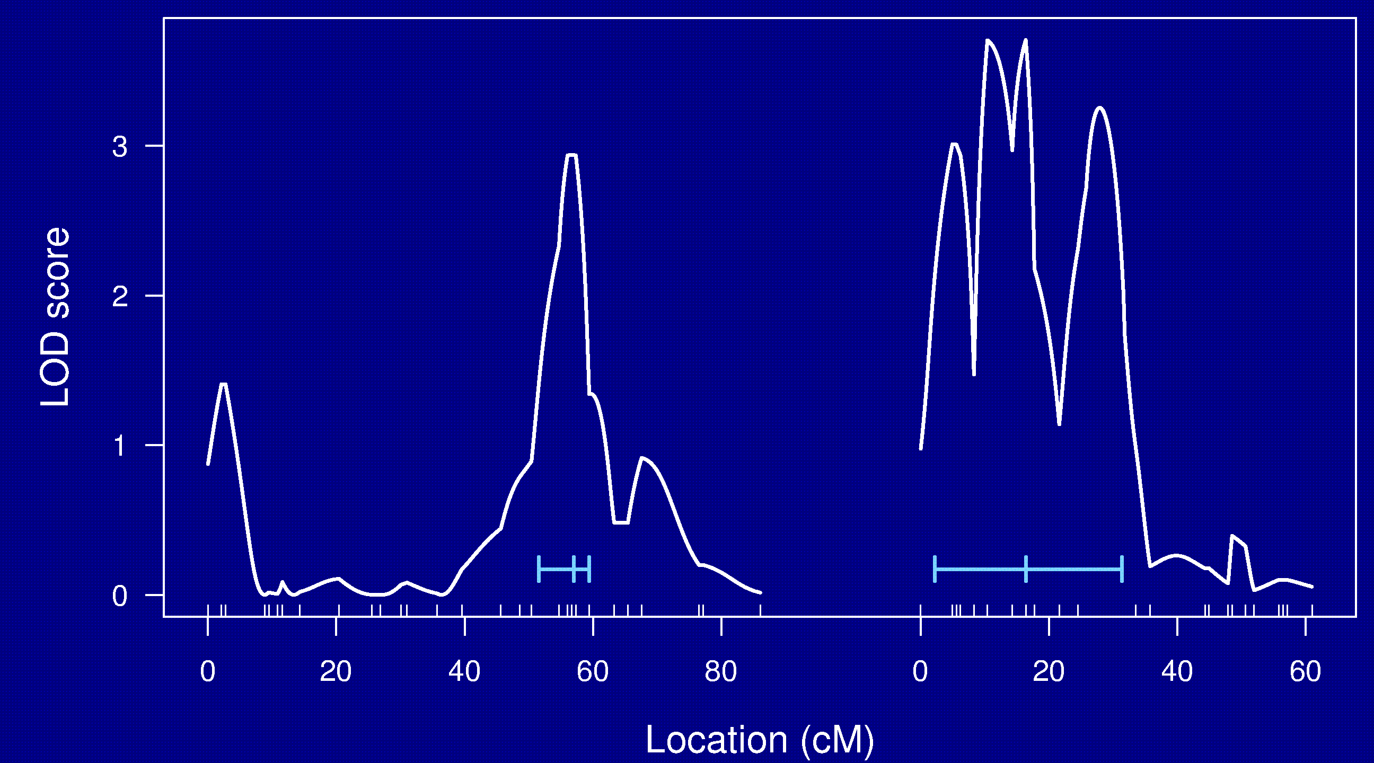
Chr 7 and 19

Slide 39
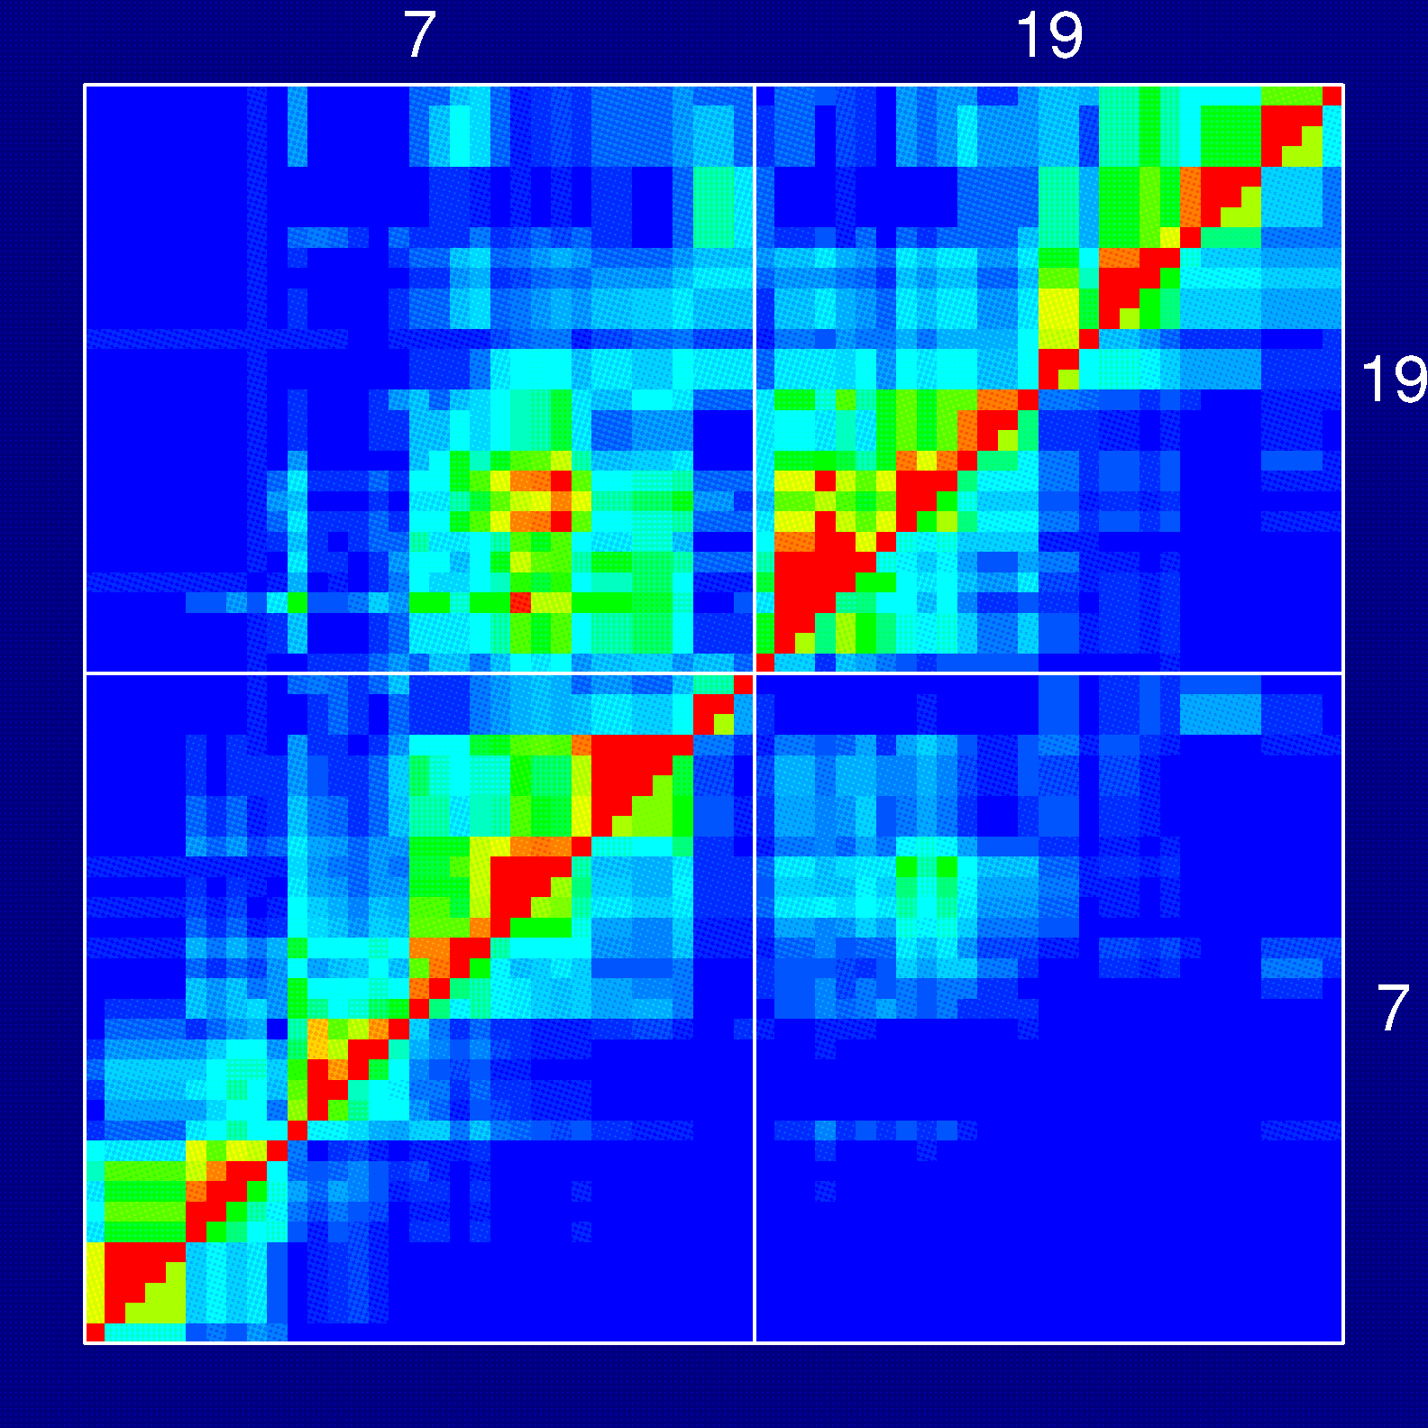
Pairwise recombination fractions
Upper-tri: rec. fracs.
Lower-tri: lik. ratios
Red = association
Blue = no association

Slide 40
RI lines
Advantages
Each strain is a eternal resource.
  Only need to genotype once.
  Reduce individual variation by phenotyping multiple individuals from each strain.
  Study multiple phenotypes on the same genotype.
Greater mapping precision.
Disadvantages
Time and expense.
Available panels are generally too small (10-30 lines).
Can learn only about 2 particular alleles.
All individuals homozygous.

Slide 41
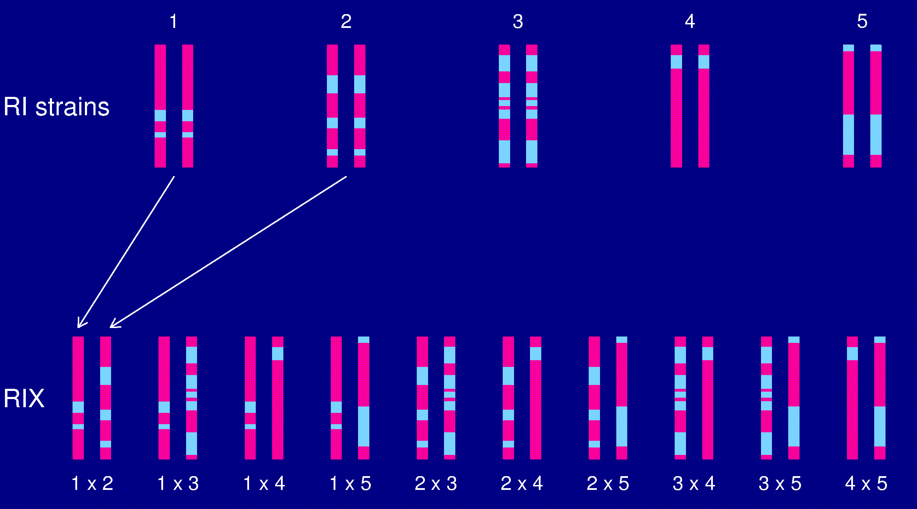
The RIX design

Slide 42
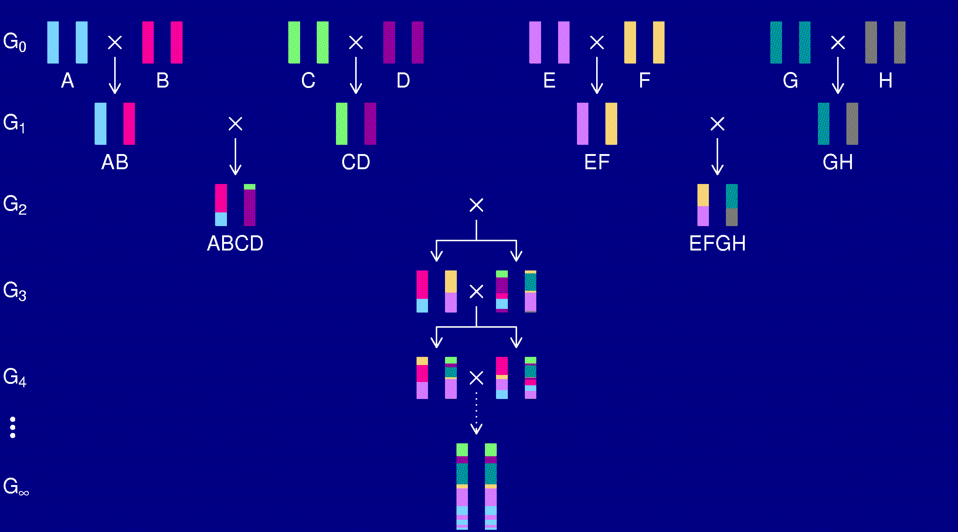
The “Collaborative Cross”

Slide 43
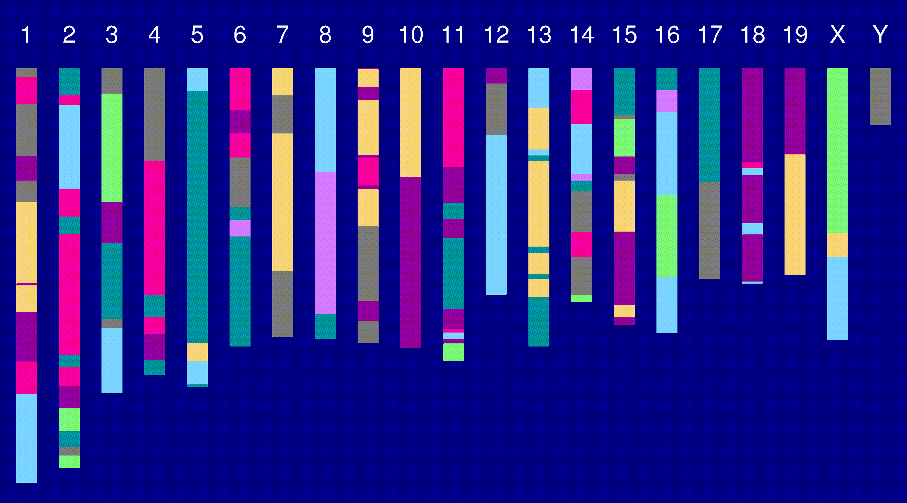
Genome of an 8-way RI

Slide 44
The “Collaborative Cross”
Advantages
Great mapping precision.
Eternal resource.
  Genotype only once.
  Study multiple invasive phenotypes on the same genotype.
Barriers
Advantages not widely appreciated.
  Ask one question at a time, or Ask many questions at once?
Time.
Expense.
Requires large-scale collaboration.

Slide 45
To be worked out
Breakpoint process along an 8-way RI chromosome.
Reconstruction of genotypes given multipoint marker data.
QTL analyses.
  Mixed models, with random effects for strains and genotypes/alleles.
Power and precision (relative to an intercross).

Slide 46
Haldane & Waddington 1931
r = recombination fraction per meiosis between two loci
Autosomes
  Pr(G₁=AA) = Pr(G₁=BB) = 1/2
  Pr(G₂=BB | G₁=AA) = Pr(G₂=AA | G₁=BB) = 4r / (1+6r)
X chromosome
  Pr(G₁=AA) = 2/3 Pr(G₁=BB) = 1/3
  Pr(G₂=BB | G₁=AA) = 2r / (1+4r)
  Pr(G₂=AA | G₁=BB) = 4r / (1+4r)
  Pr(G₂ ≠ G₁) = (8/3) r / (1+4r)

Slide 47
8-way RILs
Autosomes
  Pr(G₁ = i) = 1/8
  Pr(G₂ = j | G₁ = i) = r / (1+6r) for i ≠ j
  Pr(G₂ ≠ G₁) = 7r / (1+6r)
X chromosome
  Pr(G₁=AA) = Pr(G₁=BB) = Pr(G₁=EE) = Pr(G₁=FF) =1/6
  Pr(G₁=CC) = 1/3
  Pr(G₂=AA | G₁=CC) = r / (1+4r)
  Pr(G₂=CC | G₁=AA) = 2r / (1+4r)
  Pr(G₂=BB | G₁=AA) = r / (1+4r)
  Pr(G₂ ≠ G₁) = (14/3) r / (1+4r)

Slide 48
Areas for research
Model selection procedures for QTL mapping
Gene expression microarrays + QTL mapping
Combining multiple crosses
Association analysis: mapping across mouse strains
Analysis of multi-way recombinant inbred lines

Slide 49
References
Broman KW (2001) Review of statistical methods for QTL mapping in experimental crosses. Lab Animal 30:44–52
Jansen RC (2001) Quantitative trait loci in inbred lines. In Balding DJ et al., Handbook of statistical genetics, Wiley, New York, pp 567–597
Lander ES, Botstein D (1989) Mapping Mendelian factors underlying quantitative traits using RFLP linkage maps. Genetics 121:185 – 199
Churchill GA, Doerge RW (1994) Empirical threshold values for quantitative trait mapping. Genetics 138:963–971
Kruglyak L, Lander ES (1995) A nonparametric approach for mapping quantitative trait loci. Genetics 139:1421-1428
Broman KW (2003) Mapping quantitative trait loci in the case of a spike in the phenotype distribution. Genetics 163:1169–1175
Miller AJ (2002) Subset selection in regression, 2nd edition. Chapman & Hall, New York

Slide 50
More references
Broman KW, Speed TP (2002) A model selection approach for the identification of quantitative trait loci in experimental crosses (with discussion). J R Statist Soc B 64:641-656, 737-775
Zeng Z-B, Kao C-H, Basten CJ (1999) Estimating the genetic architecture of quantitative traits. Genet Res 74:279-289
Mott R, Talbot CJ, Turri MG, Collins AC, Flint J (2000) A method for fine mapping quantitative trait loci in outbred animal stocks. Proc Natl Acad Sci U S A 97:12649-12654
Mott R, Flint J (2002) Simultaneous detection and fine mapping of quantitative trait loci in mice using heterogeneous stocks. Genetics 160:1609-1618
The Complex Trait Consortium (2004) The Collaborative Cross, a community resource for the genetic analysis of complex traits. Nature Genetics 36:1133-1137
Broman KW. The genomes of recombinant inbred lines. Genetics, in press

Slide 51
Software
R/qtl
http://www.biostat.jhsph.edu/~kbroman/qtl
Mapmaker/QTL
http://www.broad.mit.edu/genome_software
Mapmanager QTX
http://www.mapmanager.org/mmQTX.html
QTL Cartographer
http://statgen.ncsu.edu/qtlcart/index.php
Multimapper
http://www.rni.helsinki.fi/~mjs

