Slide 1
The genetic dissection of complex traits

Slide 2
Linkage mapping in mouse and man

Slide 3
The genetic approach
Start with the phenotype; find genes the influence it.
  Allelic differences at the genes result in phenotypic differences.
Value: Need not know anything in advance.
Goal
  Understanding the disease etiology (e.g., pathways)
  Identify possible drug targets

Slide 4
Approaches to gene mapping
Experimental crosses in model organisms
Linkage analysis in human pedigrees
  A few large pedigrees
  Many small families (e.g., sibling pairs)
Association analysis in human populations
  Isolated populations vs. outbred populations
  Candidate genes vs. whole genome

Slide 5
Outline
A bit about experimental crosses
Meiosis, recombination, genetic maps
QTL mapping in experimental crosses
Parametric linkage analysis in humans
Nonparametric linkage analysis in humans
QTL mapping in humans
Association mapping

Slide 6
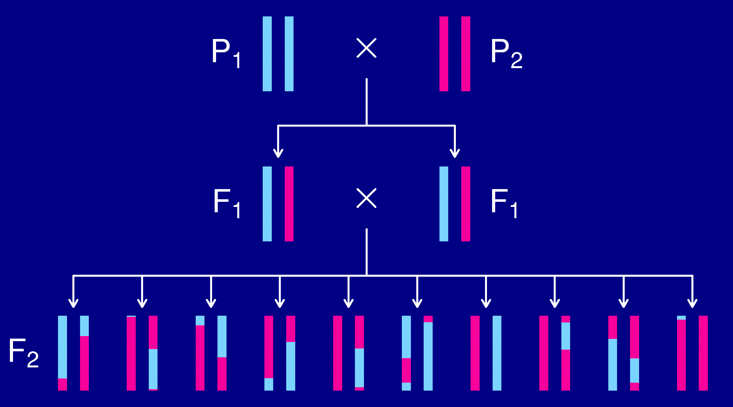
The intercross

Slide 7
The data
Phenotypes, y_{i}
Genotypes, x_{ij} = AA/AB/BB, at genetic markers
A genetic map, giving the locations of the markers.

Slide 8
Goals
Identify genomic regions (QTLs) that contribute to variation in the trait.
Obtain interval estimates of the QTL locations.
Estimate the effects of the QTLs.

Slide 9
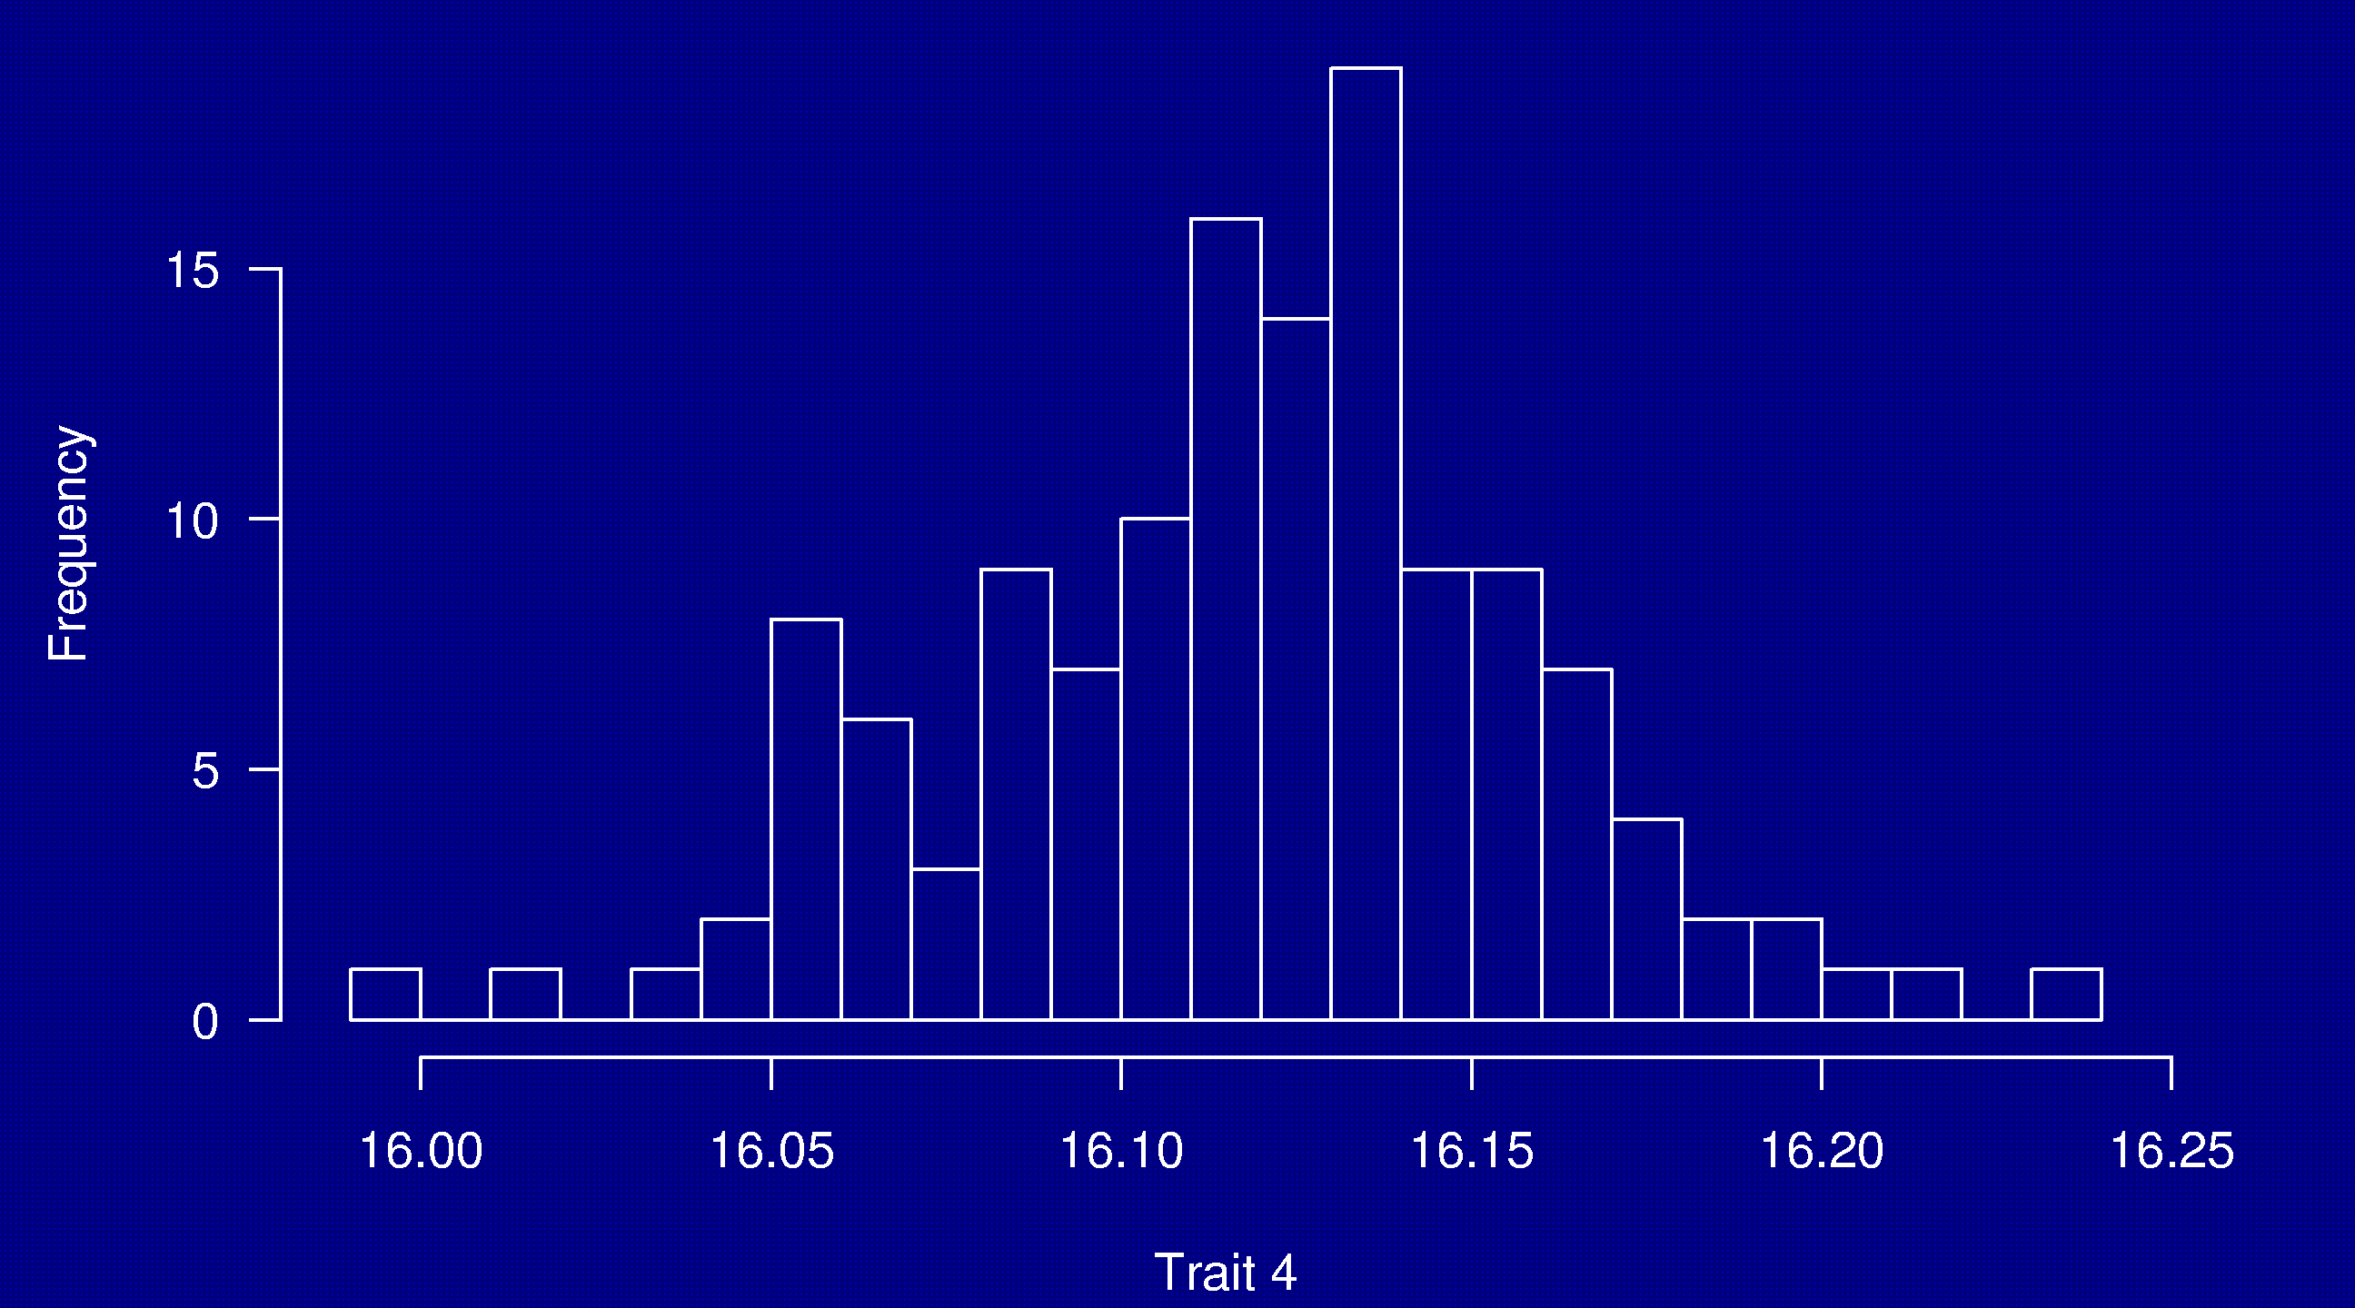
Phenotypes
133 females
(NOD × B6) × (NOD × B6)

Slide 10
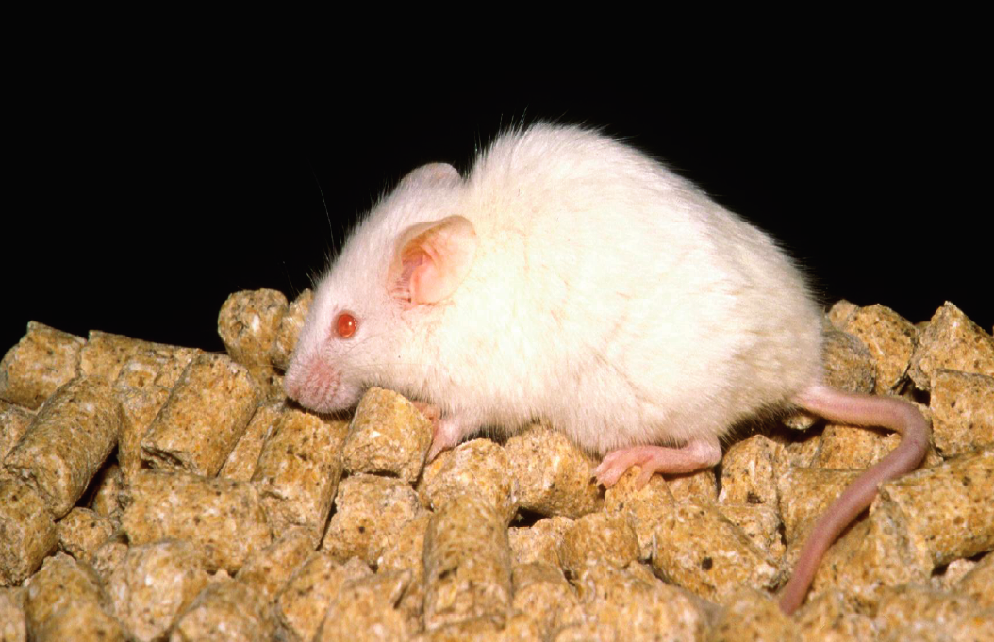
NOD

Slide 11
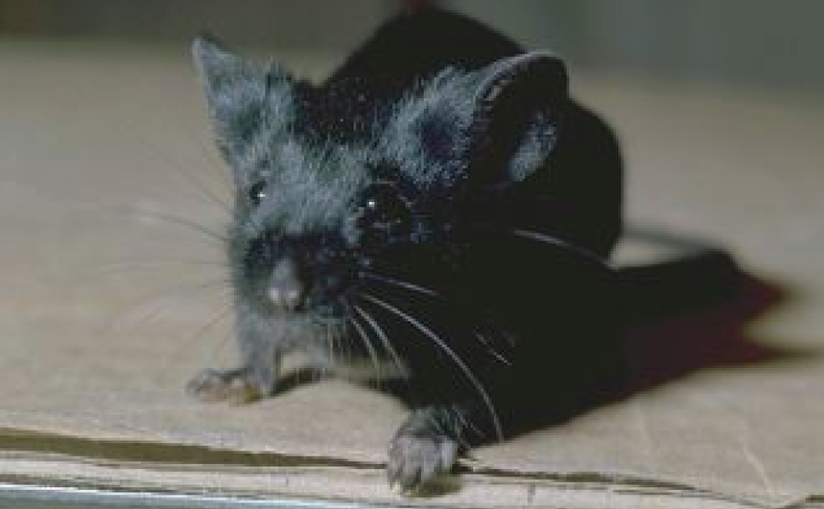
C57BL/6

Slide 12
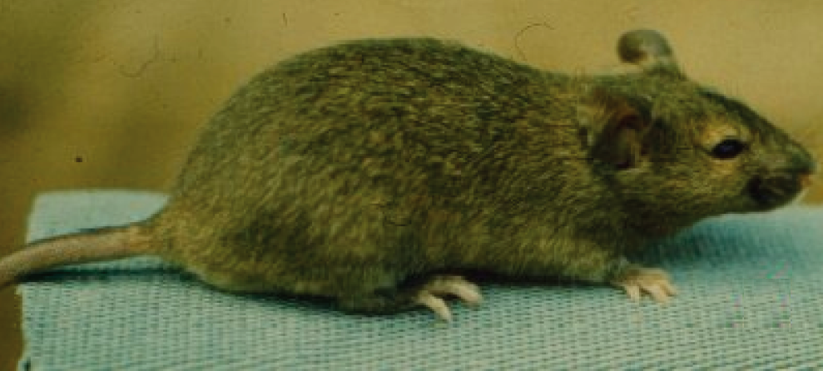
Agouti coat

Slide 13
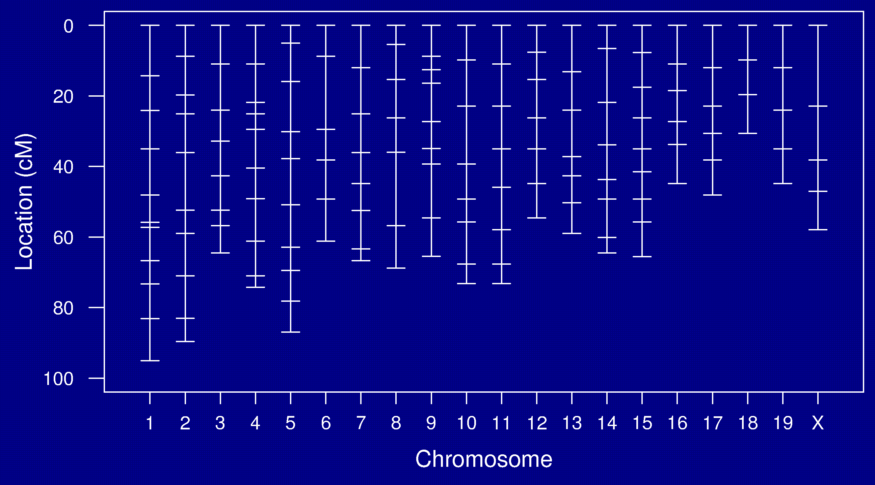
Genetic map

Slide 14
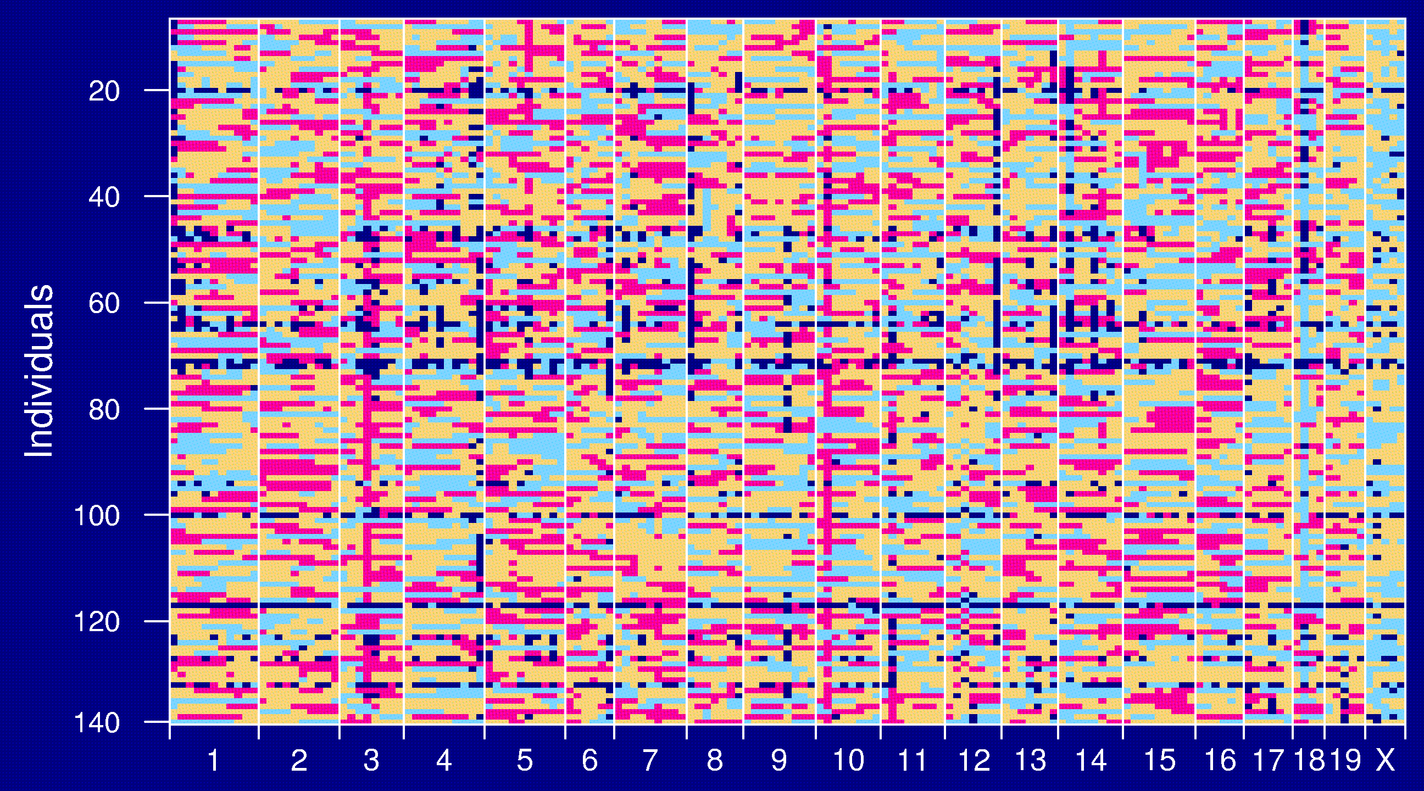
Genotype data

Slide 15
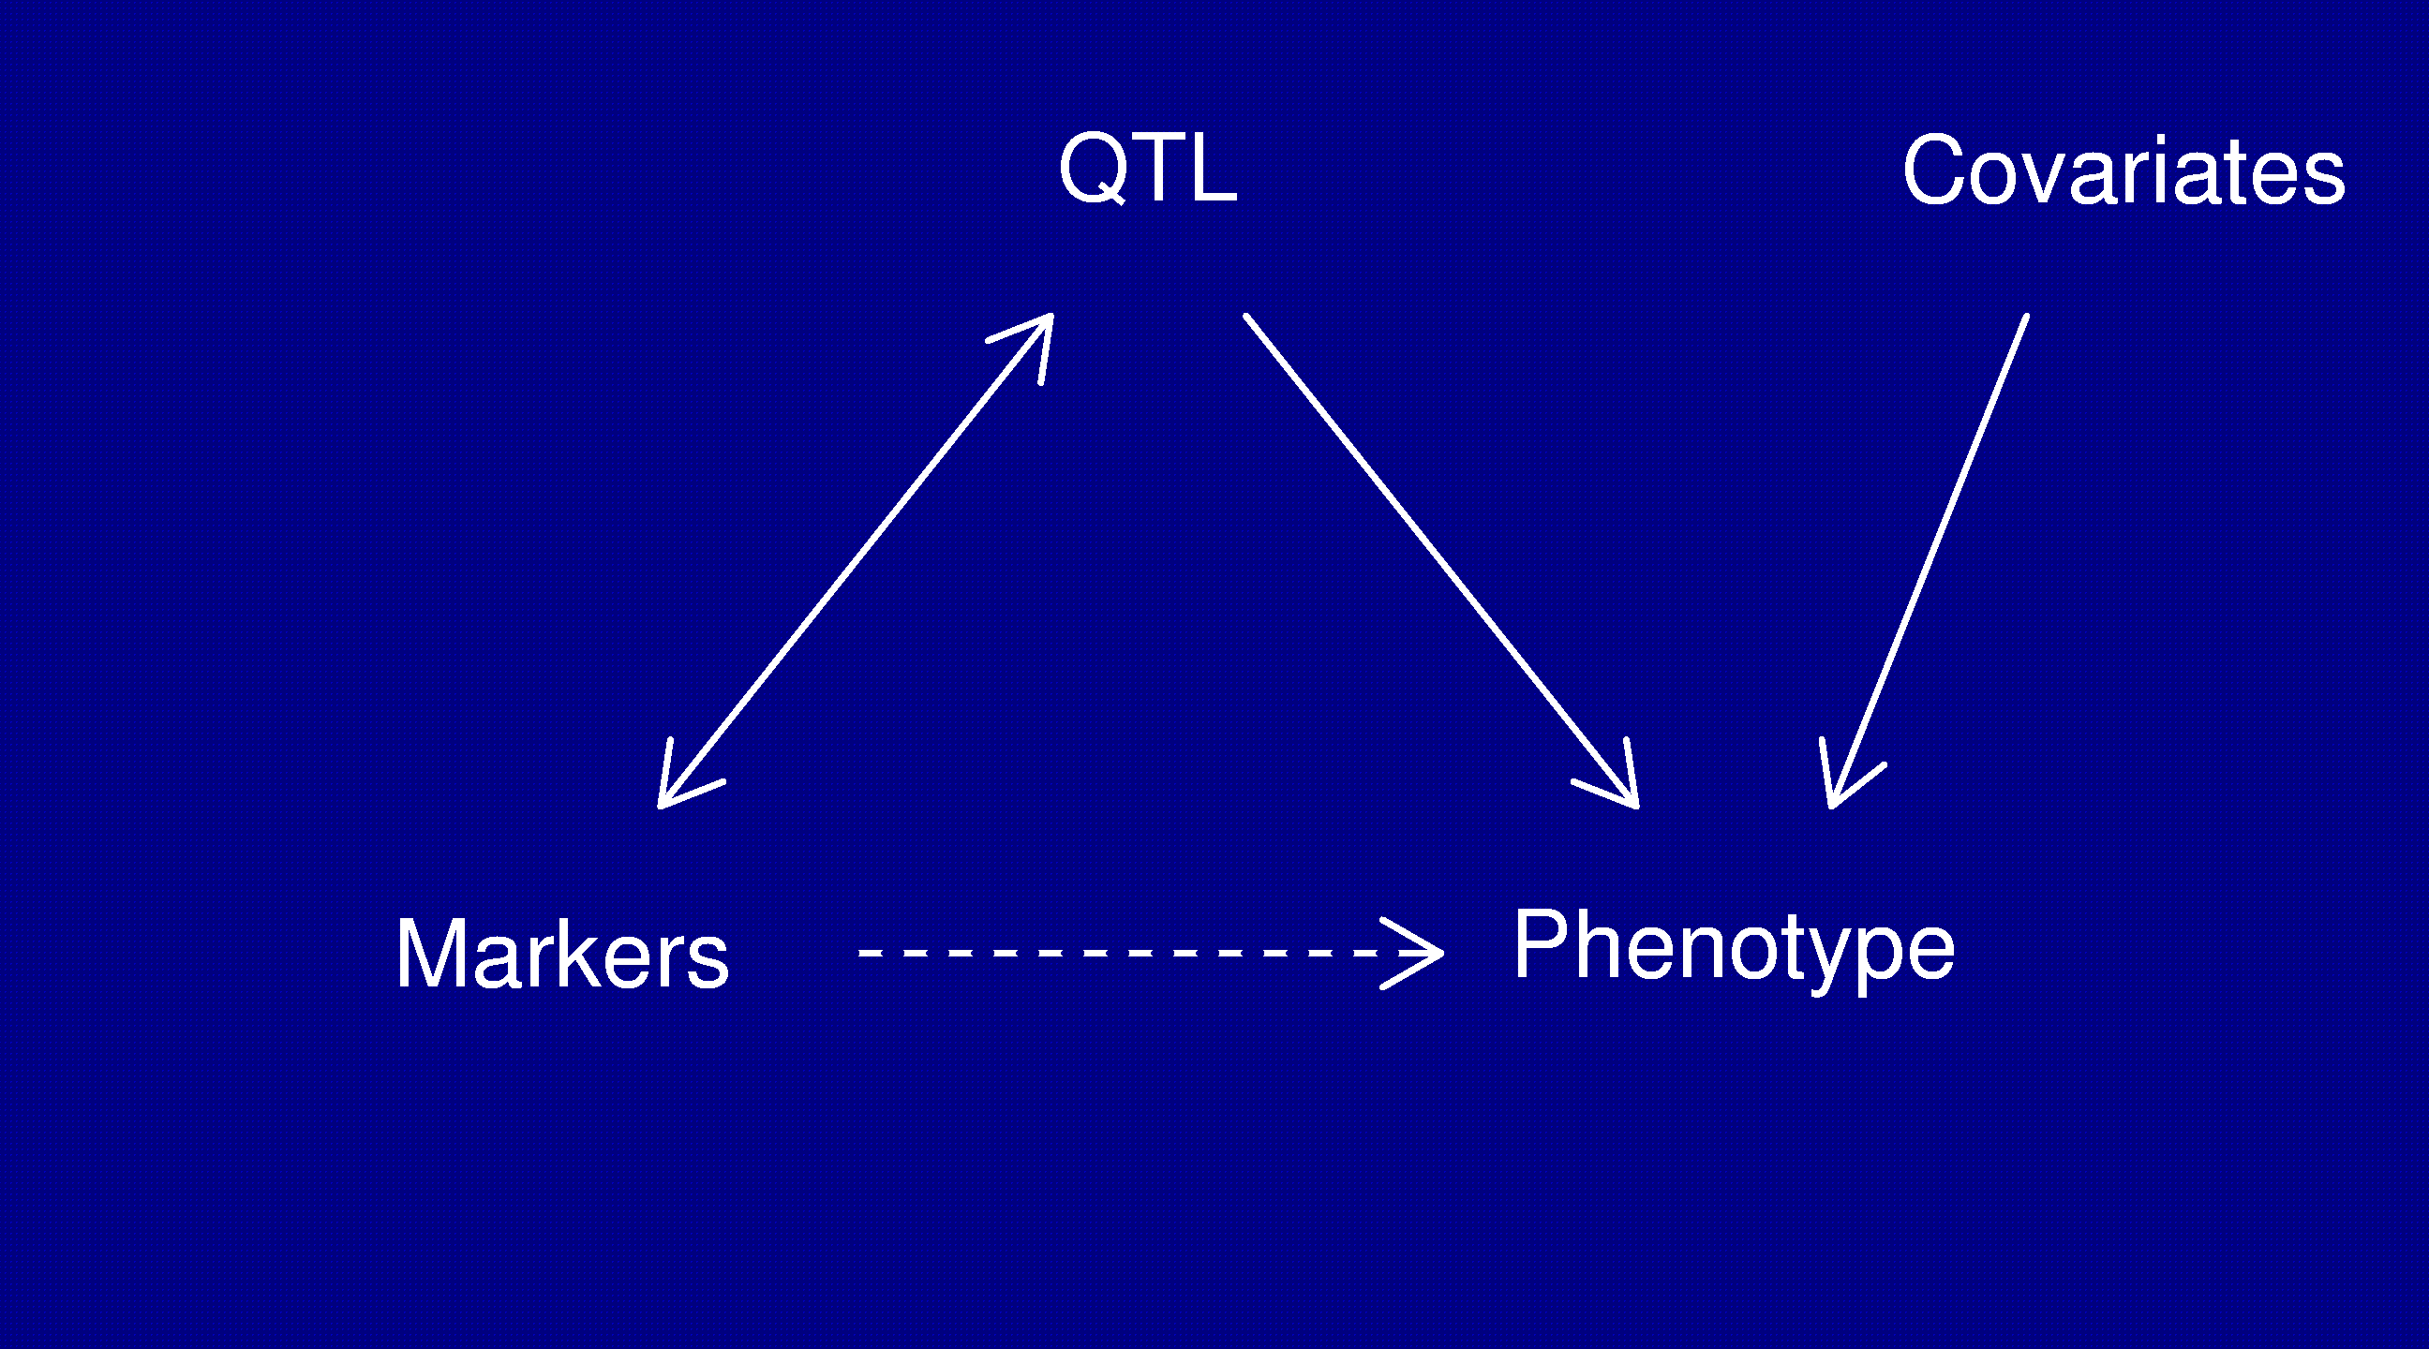
Statistical structure
Missing data: markers ↔ QTL
Model selection: genotypes ↔ phenotype

Slide 16
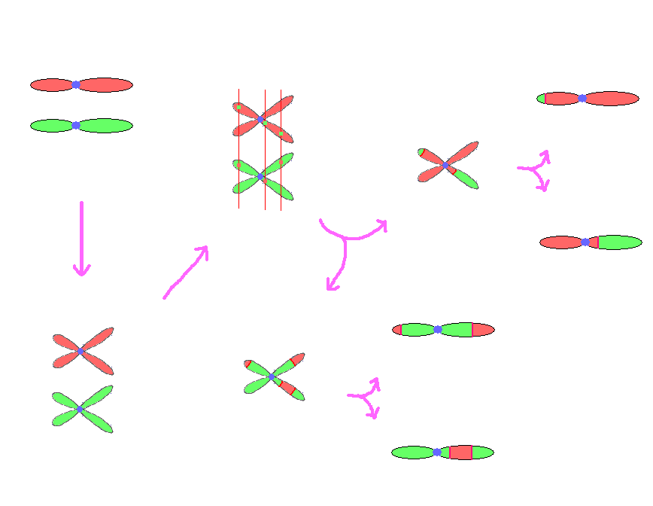
Meiosis

Slide 17
Genetic distance
Genetic distance between two markers (in cM) =
Average number of crossovers in the interval
in 100 meiotic products
“Intensity” of the crossover point process
Recombination rate varies by
  Organism
  Sex
  Chromosome
  Position on chromosome

Slide 18
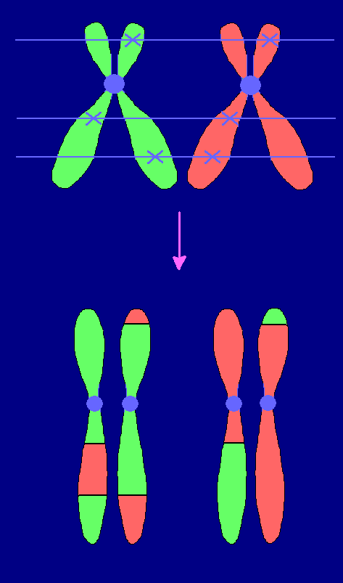
Crossover interference
Strand choice
  → Chromatid interference
Spacing
  → Crossover interference
Positive crossover interference:
Crossovers tend not to occur too
close together.

Slide 19
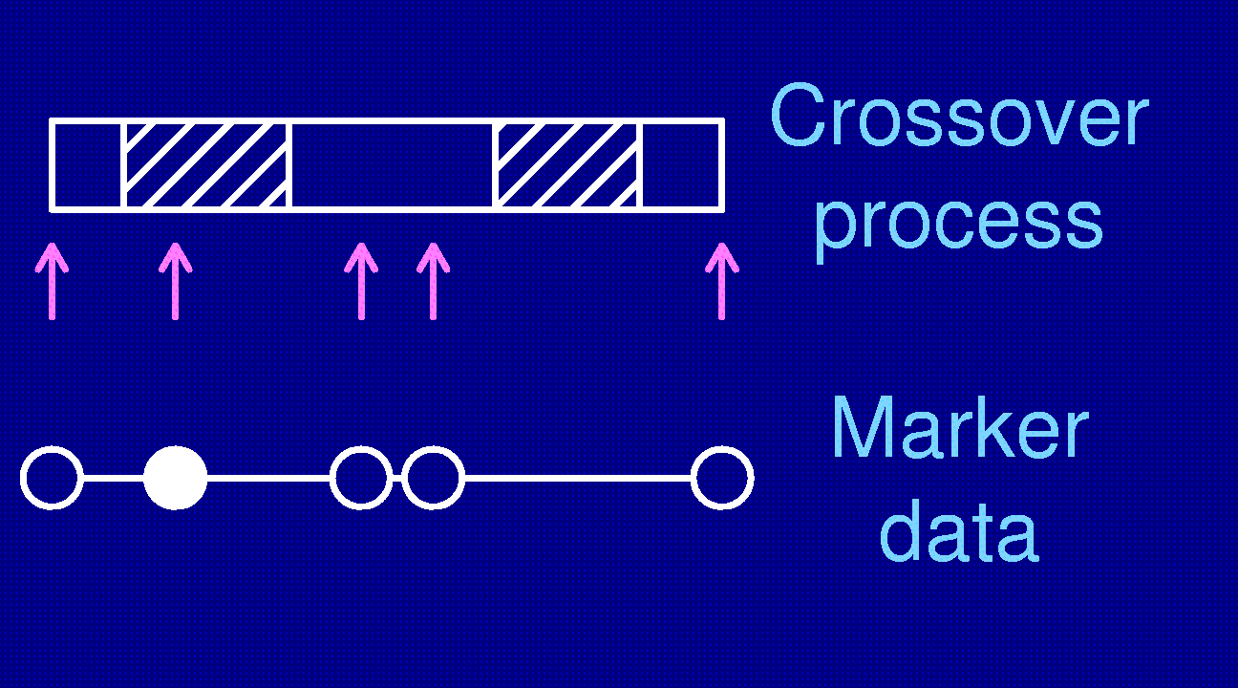
Recombination fraction
We generally do not observe the locations of crossovers; rather, we observe the grandparental origin of DNA at a set of genetic markers.
Recombination across an interval indicates an odd number of crossovers.
Recombination fraction =
Pr(recombination in interval) = Pr(odd no. XOs in interval)

Slide 20
Map functions
A map function relates the genetic length of an interval and the recombination fraction.
r = M(d)
Map functions are related to crossover interference,
but a map function is not sufficient to define the crossover process.
Haldane map function: no crossover interference
Kosambi: similar to the level of interference in humans
Carter-Falconer: similar to the level of interference in mice

Slide 21
Models: recombination
We assume no crossover interference
  Locations of breakpoints according to a Poisson process.
  Genotypes along chromosome follow a Markov chain.
Clearly wrong, but super convenient.

Slide 22
Models: gen ↔ phe
Phenotype = y, whole-genome genotype = g
Imagine that p sites are all that matter.
E(y | g) = μ(g₁,…,g_{p}) SD(y | g) = σ(g₁,…,g_{p})
Simplifying assumptions:
  SD(y | g) = σ, independent of g
  y | g ~ normal( μ(g₁,…,g_{p}), σ )
  μ(g₁,…,g_{p}) = μ + ∑ α_{j} 1{g_{j} = AB} + β_{j} 1{g_{j} = BB}

Slide 23
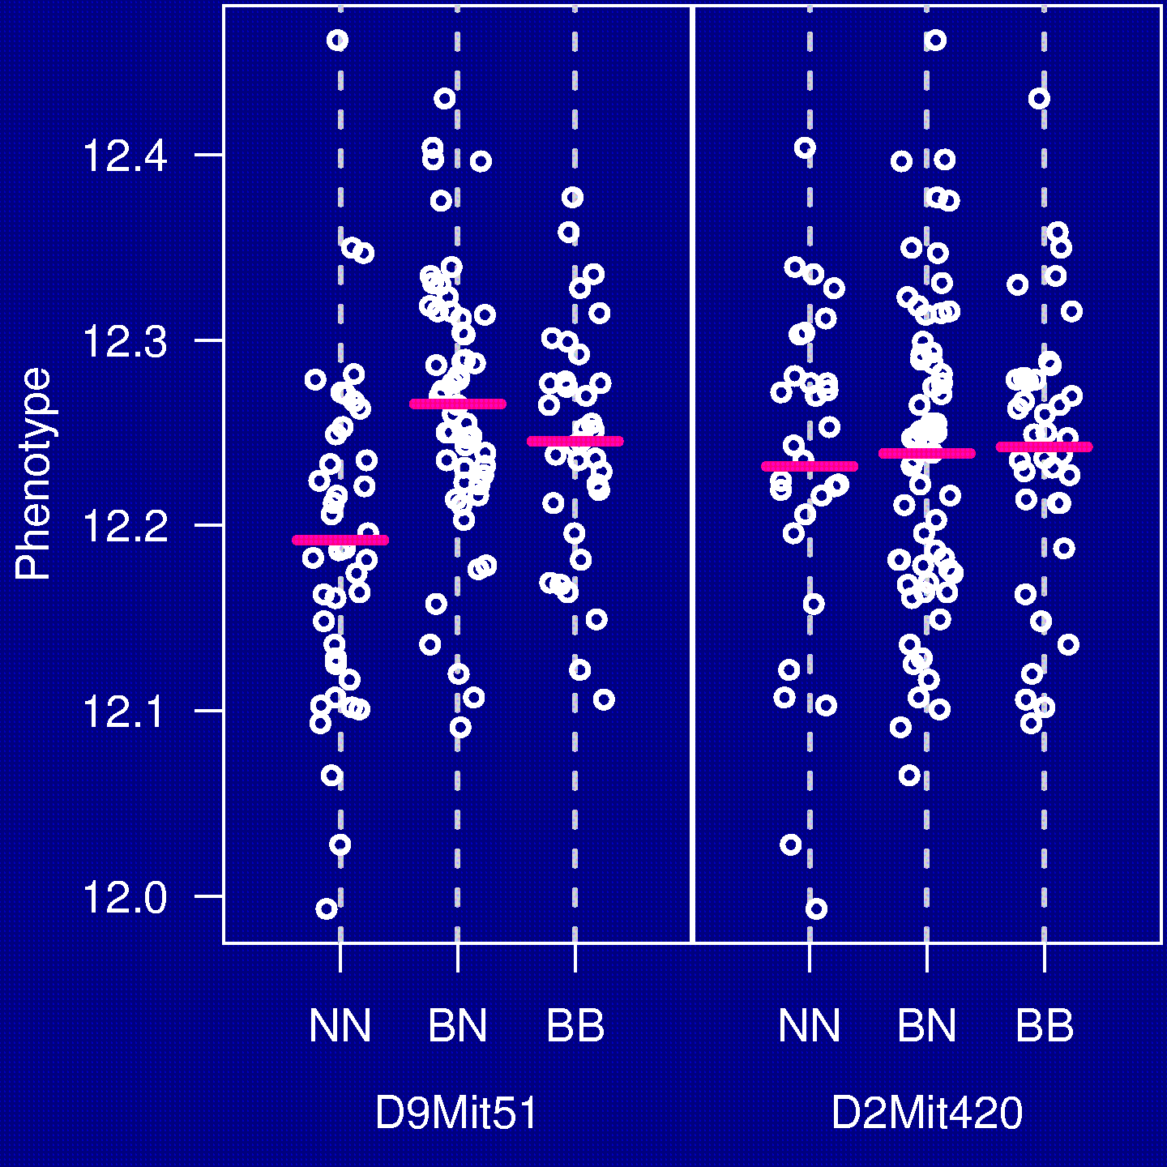
The simplest method
“Marker regression”
Consider a single marker
Split mice into groups according to their genotype at a marker
Do an ANOVA (or t-test)
Repeat for each marker

Slide 24
Marker regression
Advantages
Simple
Easily incorporates covariates
Easily extended to more complex models
Doesn’t require a genetic map
Disadvantages
Must exclude individuals with missing genotypes data
Imperfect information about QTL location
Suffers in low density scans
Only considers one QTL at a time

Slide 25
Interval mapping
Lander and Botstein 1989
Imagine that there is a single QTL, at position z.
Let q_{i} = genotype of mouse i at the QTL, and assume
y_{i} | q_{i} ~ normal( μ(q_{i}), σ )
We won’t know q_{i}, but we can calculate (by an HMM)
p_{ig} = Pr(q_{i} = g | marker data)
y_{i}, given the marker data, follows a mixture of normal distributions with known mixing proportions (the p_{ig}).
Use an EM algorithm to get MLEs of θ = (μ_{AA}, μ_{AB}, μ_{BB}, σ).
Measure the evidence for a QTL via the LOD score, which is the log₁₀ likelihood ratio comparing the hypothesis of a single QTL at position z to the hypothesis of no QTL anywhere.

Slide 26
Interval mapping
Advantages
Takes proper account of missing data
Allows examination of positions between markers
Gives improved estimates of QTL effects
Provides pretty graphs
Disadvantages
Increased computation time
Requires specialized software
Difficult to generalize
Only considers one QTL at a time

Slide 27
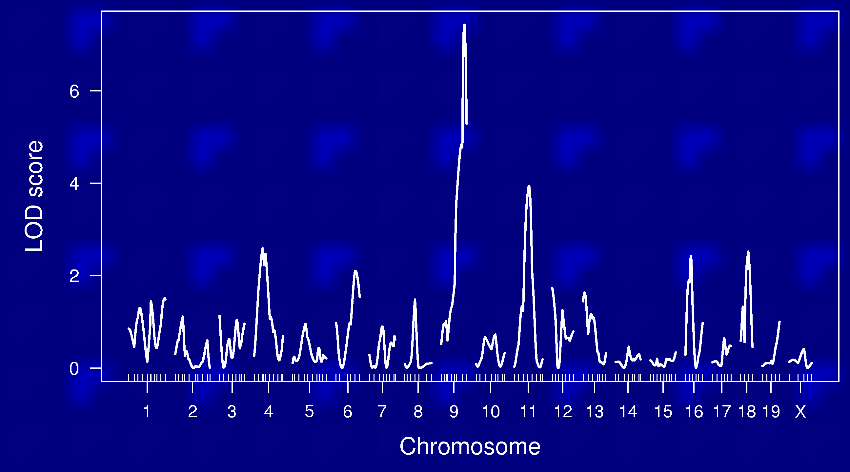
LOD curves

Slide 28
LOD thresholds
To account for the genome-wide search, compare the observed LOD scores to the distribution of the maximum LOD score, genome-wide, that would be obtained if there were no QTL anywhere.
The 95th percentile of this distribution is used as a significance threshold.
Such a threshold may be estimated via permutations (Churchill and Doerge 1994).

Slide 29
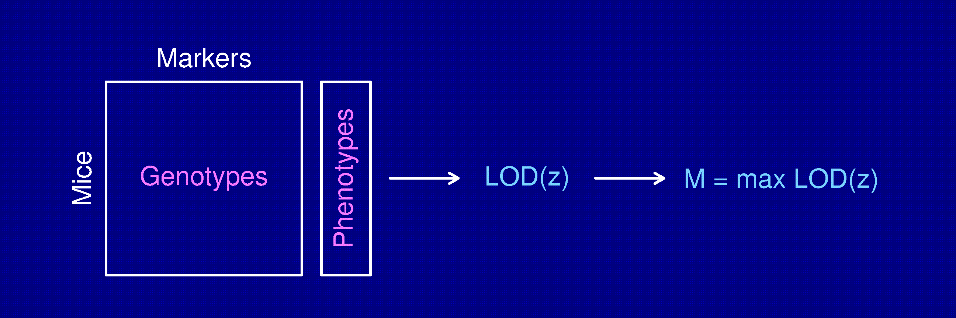
Permutation test
Shuffle the phenotypes relative to the genotypes.
Calculate M* = max LOD*, with the shuffled data.
Repeat many times.
LOD threshold = 95th percentile of M*.
P-value = Pr(M* ≥ M)

Slide 30
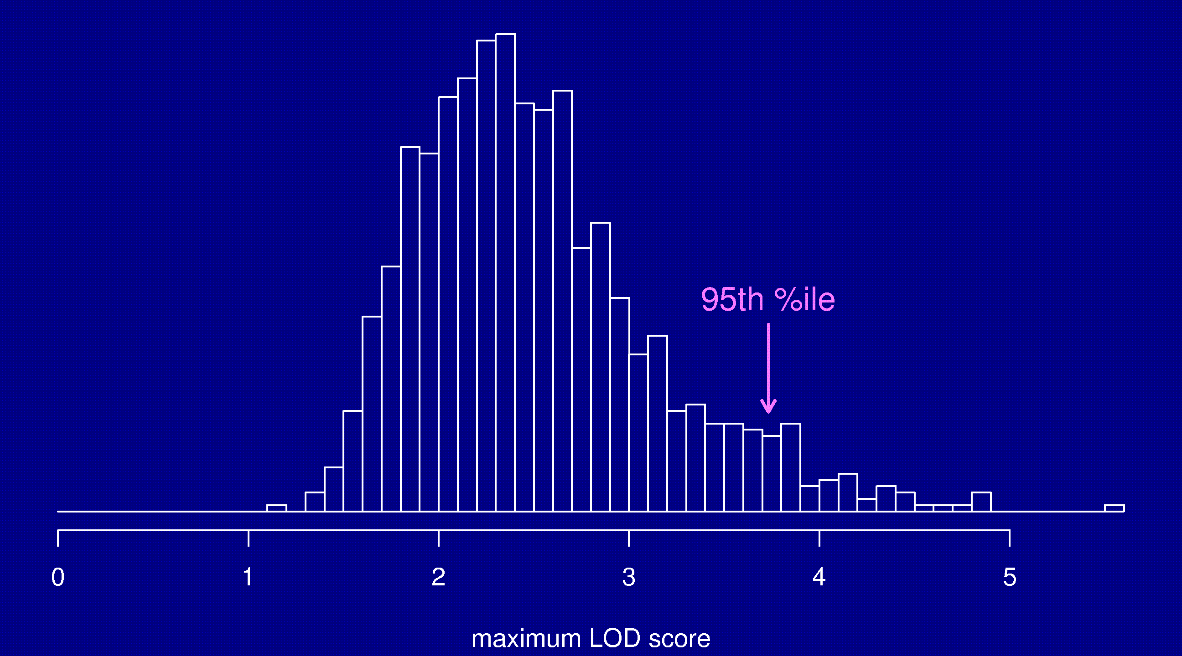
Permutation distribution

Slide 31
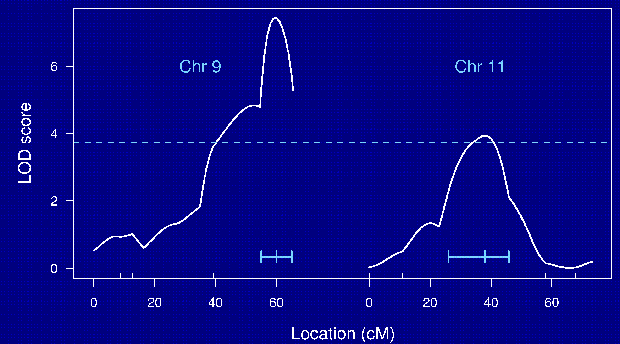
Chr 9 and 11

Slide 32
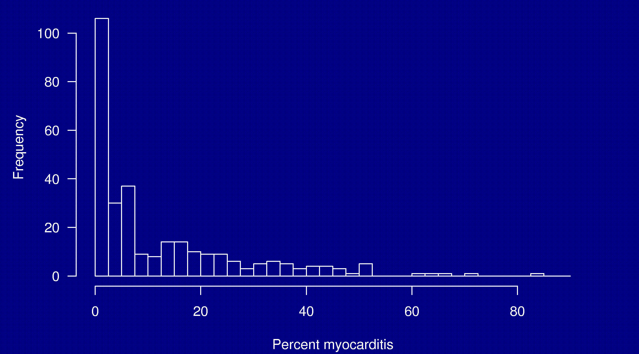
Non-normal traits

Slide 33
Non-normal traits
Standard interval mapping assumes that the residual variation is normally distributed (and so the phenotype distribution follows a mixture of normal distributions).
In reality: we see binary traits, counts, skewed distributions, outliers, and all sorts of odd things.
Interval mapping, with LOD thresholds derived via permutation tests, often performs fine anyway.
Alternatives to consider:
  Nonparametric linkage analysis (Kruglyak and Lander 1995).
  Transformations (e.g., log or square root).
  Specially-tailored models (e.g., a generalized linear model, the Cox proportional hazards model, the model of Broman 2003).

Slide 34
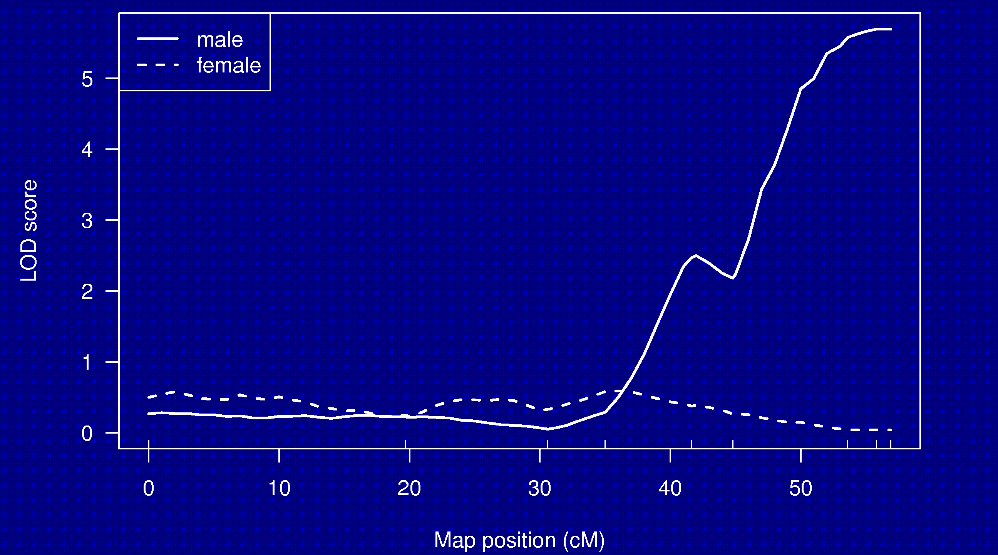
Split by sex

Slide 35
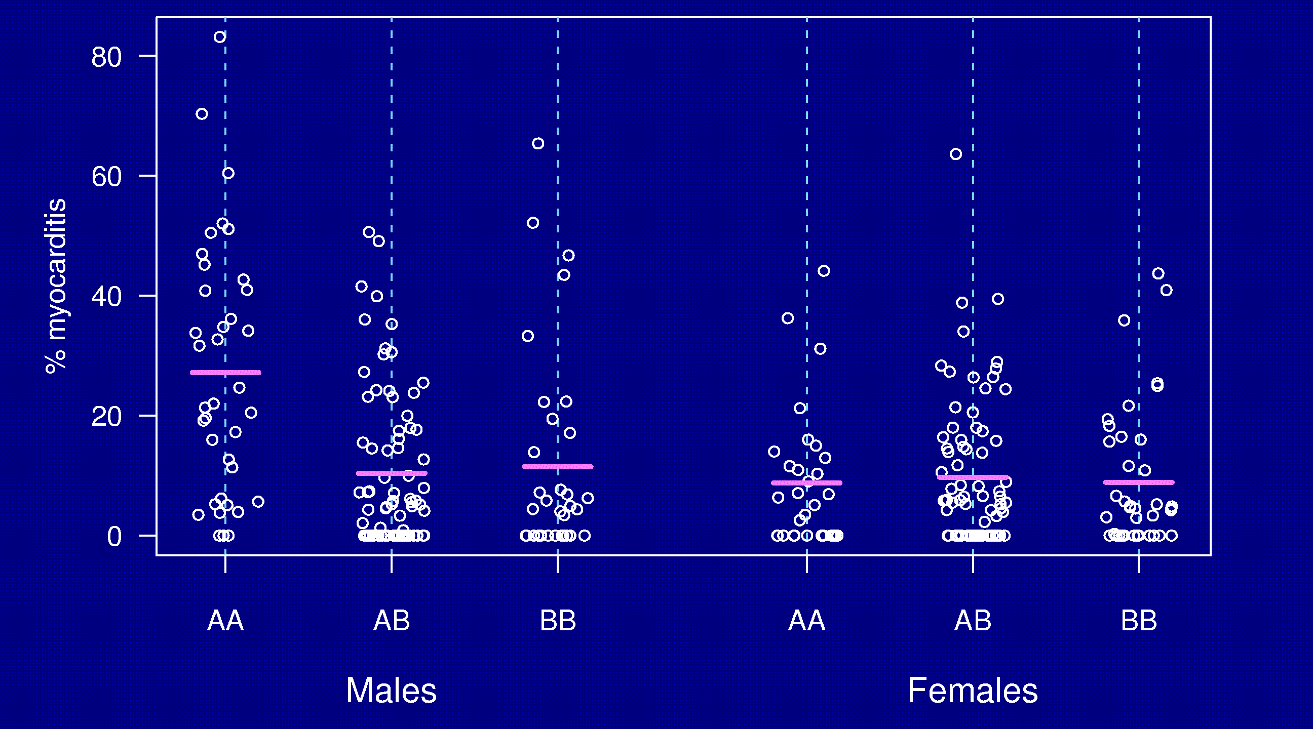
Split by sex

Slide 36
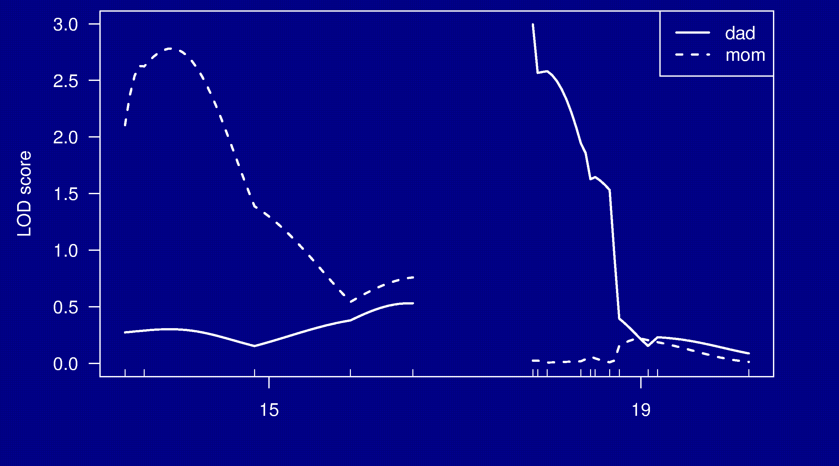
Split by parent-of-origin

Slide 37
Split by parent-of-origin
Percent of individuals with phenotype
 | Genotype at D15Mit252 |  |  | Genotype at D19Mit59
P-O-O | AA | AB |  | AA | AB
Dad | 63% | 54% |  | 75% | 43%
Mom | 57% | 23% |  | 38% | 40%

Slide 38
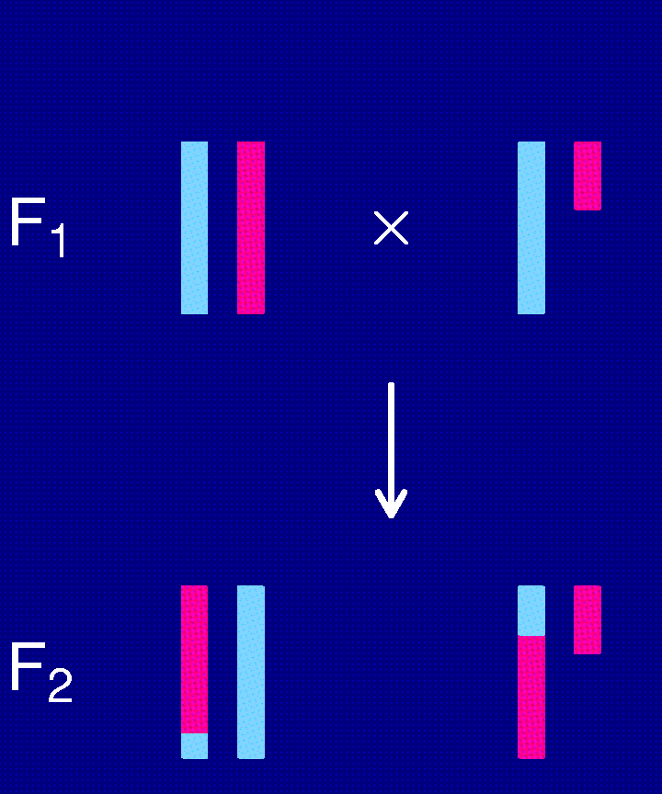
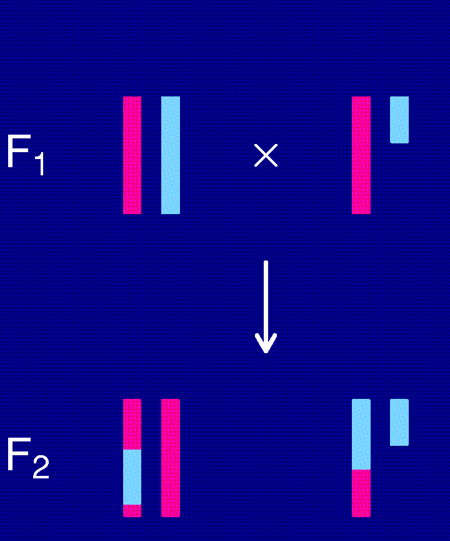
The X chromosome
(N × B) × (N × B)
(B × N) × (B × N)

Slide 39
The X chromosome
BB ≡ BY? NN ≡ NY?
Different “degrees of freedom”
  Autosome NN : NB : BB
  Females, one direction NN : NB
  Both sexes, both dir. NY : NN : NB : BB : BY
  ⇒ Need an X-chr-specific LOD threshold.
“Null model” should include a sex effect.

Slide 40
Chr 9 and 11

Slide 41
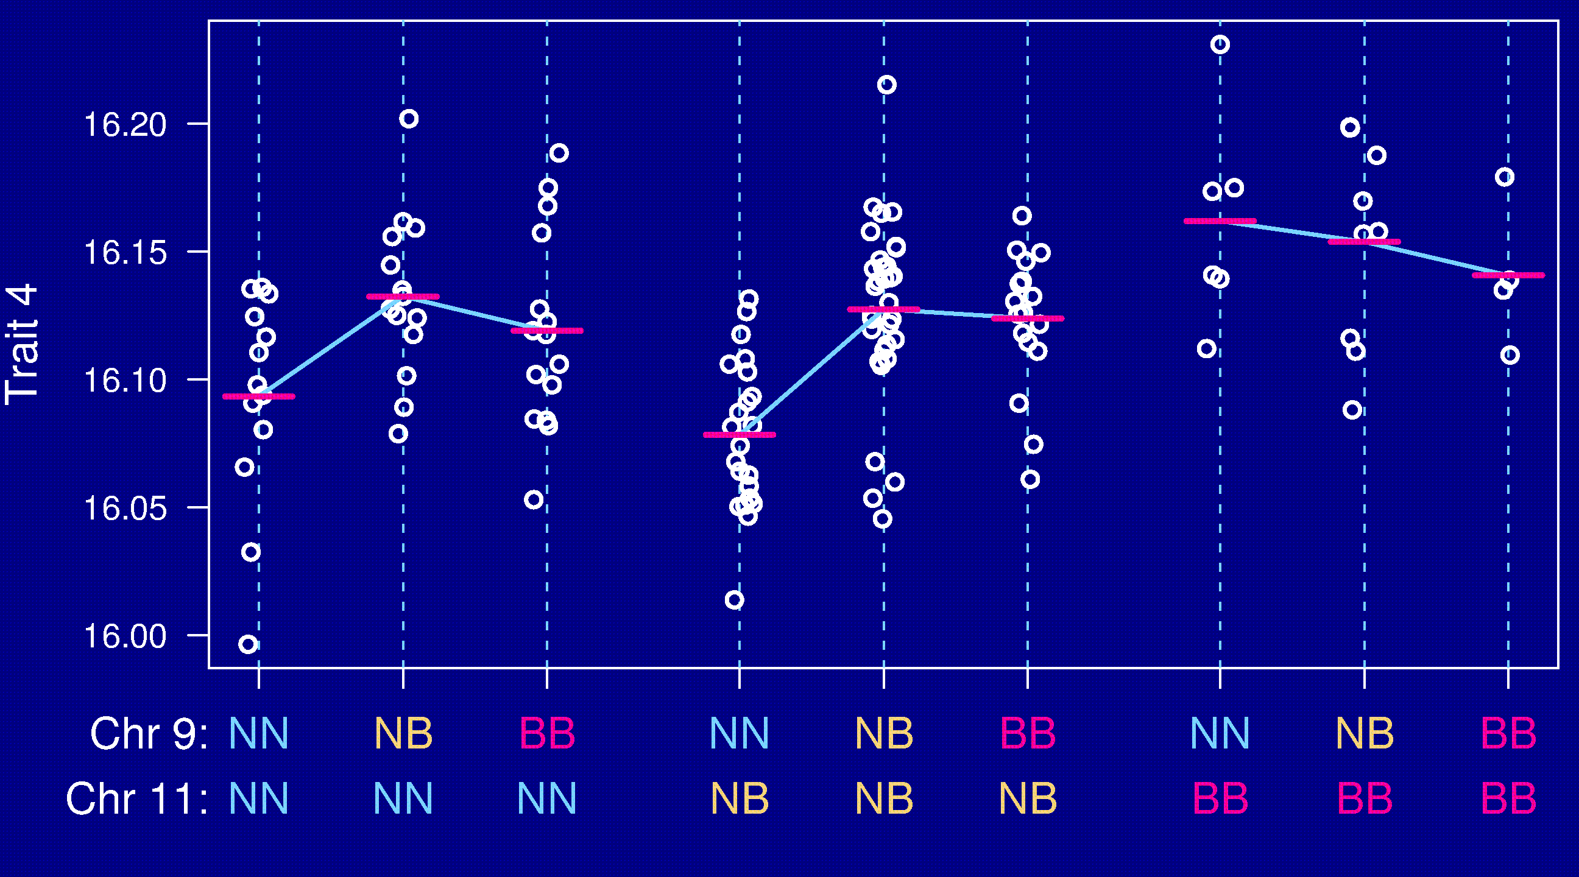
Epistasis

Slide 42
Going after multiple QTLs
Greater ability to detect QTLs.
Separate linked QTLs.
Learn about interactions between QTLs (epistasis).

Slide 43
Model selection
Choose a class of models.
  Additive; pairwise interactions; regression trees
Fit a model (allow for missing genotype data).
  Linear regression; ML via EM; Bayes via MCMC
Search model space.
  Forward/backward/stepwise selection; MCMC
Compare models.
  BIC_{δ}(γ) = log L(γ) + (δ/2) |γ| log n
Miss important loci ↔ include extraneous loci.

Slide 44
Special features
Relationship among the covariates
Missing covariate information
Identify the key players vs. minimize prediction error

Slide 45
Before you do anything…
Check data quality
Genetic markers on the correct chromosomes
Markers in the correct order
Identify and resolve likely errors in the genotype data

Slide 46
Software
R/qtl
http://www.biostat.jhsph.edu/~kbroman/qtl
Mapmaker/QTL
http://www.broad.mit.edu/genome_software
Mapmanager QTX
http://www.mapmanager.org/mmQTX.html
QTL Cartographer
http://statgen.ncsu.edu/qtlcart/index.php
Multimapper
http://www.rni.helsinki.fi/~mjs

Slide 47
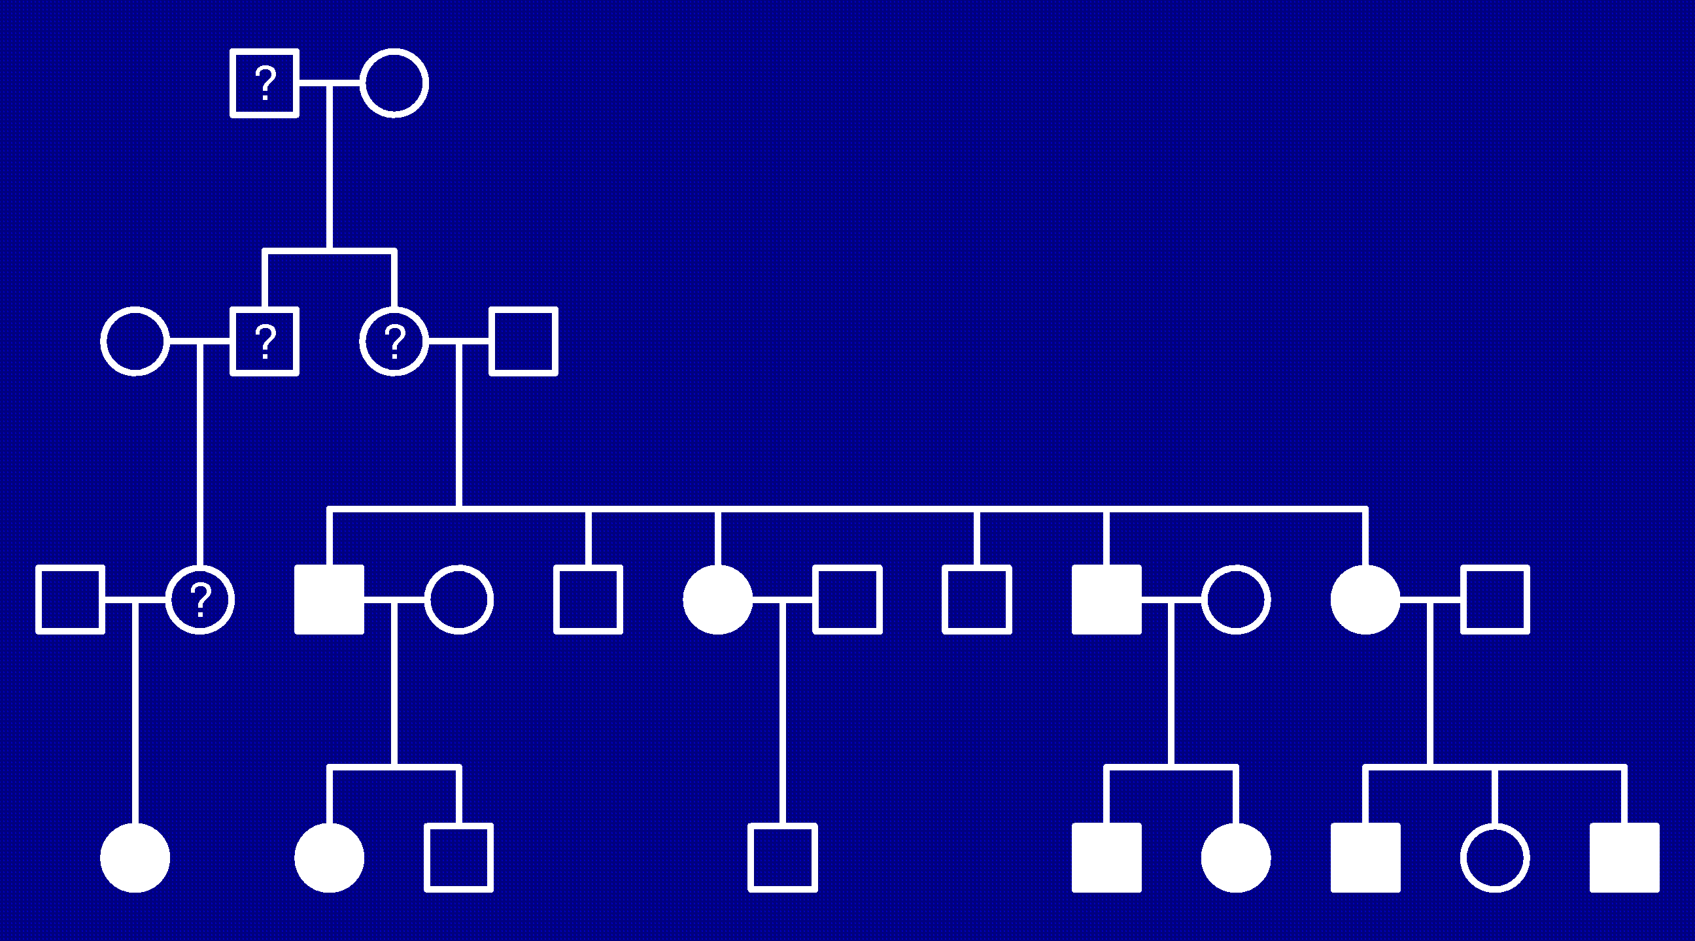
Linkage in large human pedigrees

Slide 48
Before you do anything…
Verify relationships between individuals
Identify and resolve genotyping errors
Verify marker order, if possible
Look for apparent tight double crossovers, indicative of genotyping errors

Slide 49
Parametric linkage analysis
Assume a specific genetic model. For example:
  One disease gene with 2 alleles
  Dominant, fully penetrant
  Disease allele frequency known to be 1%.
Single-point analysis (aka two-point)
  Consider one marker (and the putative disease gene)
  θ = recombination fraction between marker and disease gene
  Test H₀: θ = 1/2 vs. H_{a}: θ < 1/2
Multipoint analysis
  Consider multiple markers on a chromosome
  θ = location of disease gene on chromosome
  Test gene unlinked (θ = ∞) vs. θ = particular position

Slide 50
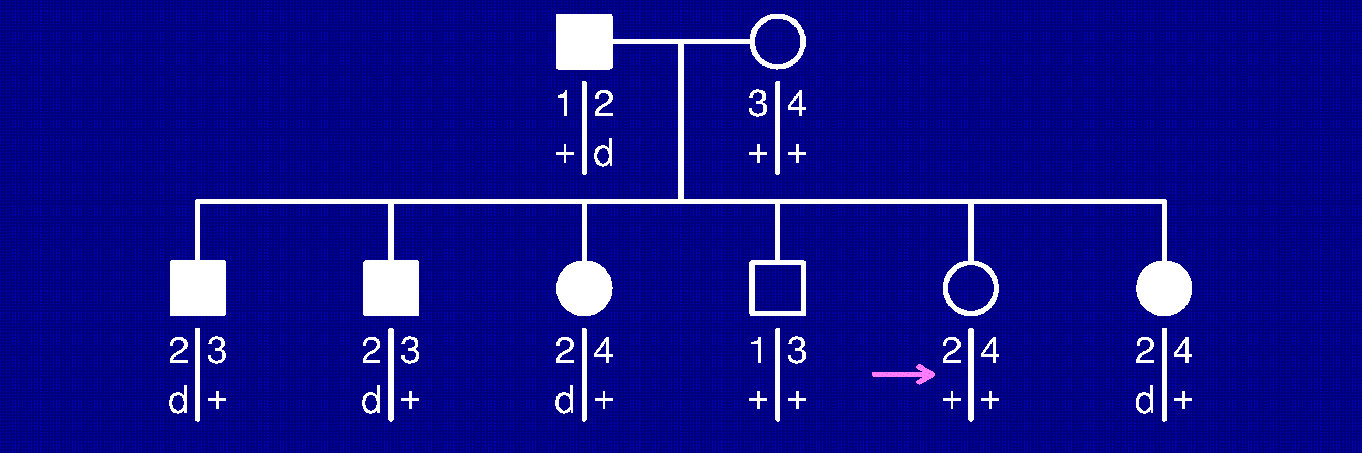
Phase known

Slide 51

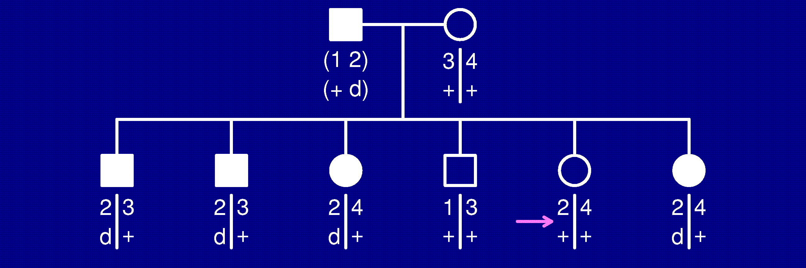
Phase unknown

Slide 52
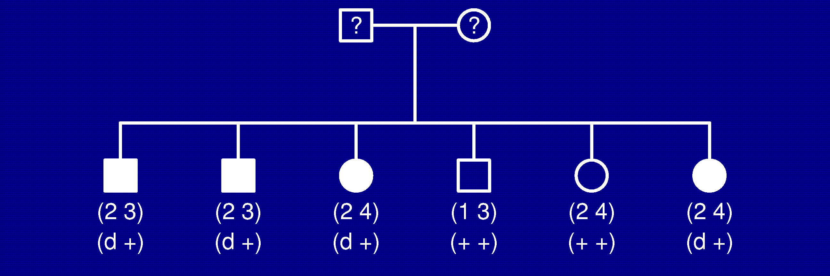
Missing data
The likelihood now involves a sum over possible parental genotypes, and we need:
  Marker allele frequencies
  Further assumptions: Hardy-Weinberg and linkage equilibrium

Slide 53
More generally
Simple diallelic disease gene
  Alleles d and + with frequencies p and 1-p
  Penetrances f₀, f₁, f₂, with f_{i} = Pr(affected | i d alleles)
Possible extensions:
  Penetrances vary depending on parental origin of disease allele f₁ → f_{1m}, f_{1p}
  Penetrances vary between people (according to sex, age, or other known covariates)
  Multiple disease genes
We assume that the penetrances and disease allele frequencies are known

Slide 54
Likelihood calculations
Define
  g = complete ordered (aka phase-known) genotypes for all individuals in a family
  x = observed “phenotype” data (including phenotypes and phase-unknown genotypes, possibly with missing data)
For example:
Goal:

Slide 55
The parts
Prior = Pop(g_{i}) Founding genotype probabilities
Penetrance = Pen(x_{i} | g_{i}) Phenotype given genotype
Transmission Transmission parent → child
= Tran(g_{i} | g_{m(i)}, g_{f(i)})
Note: If g_{i} = (u_{i}, v_{i}), where u_{i} = haplotype from mom and v_{i} = that from dad
Then Tran(g_{i} | g_{m(i)}, g_{f(i)}) = Tran(u_{i} | g_{m(i)}) Tran(v_{i} | g_{f(i)})

Slide 56
Examples

Slide 57
The likelihood
Phenotypes conditionally independent given genotypes
F = set of “founding” individuals

Slide 58
That’s a mighty big sum!
With a marker having k alleles and a diallelic disease gene, we have a sum with (2k)^{2n} terms.
Solution:
  Take advantage of conditional independence to factor the sum
  Elston-Stewart algorithm: Use conditional independence in pedigree
    Good for large pedigrees, but blows up with many loci
  Lander-Green algorithm: Use conditional independence along chromosome (assuming no crossover interference)
    Good for many loci, but blows up in large pedigrees

Slide 59
Ascertainment
We generally select families according to their phenotypes. (For example, we may require at least two affected individuals.)
How does this affect linkage?
If the genetic model is known, it doesn’t: we can condition on the observed phenotypes.

Slide 60
Model misspecification
To do parametric linkage analysis, we need to specify:
  Penetrances
  Disease allele frequency
  Marker allele frequencies
  Marker order and genetic map (in multipoint analysis)
Question: Effect of misspecification of these things on:
  False positive rate
  Power to detect a gene
  Estimate of θ (in single-point analysis)

Slide 61
Model misspecification
Misspecification of disease gene parameters (f’s, p) has little effect on the false positive rate.
Misspecification of marker allele frequencies can lead to a greatly increased false positive rate.
  Complete genotype data: marker allele freq don’t matter
  Incomplete data on the founders: misspecified marker allele frequencies can really screw things up
  BAD: using equally likely allele frequencies
  BETTER: estimate the allele frequencies with the available data (perhaps even ignoring the relationships between individuals)

Slide 62
Model misspecification
In single-point linkage, the LOD score is relatively robust to misspecification of:
  Phenocopy rate
  Effect size
  Disease allele frequency
However, the estimate of θ is generally too large.
This is less true for multipoint linkage (i.e., multipoint linkage is not robust).
Misspecification of the degree of dominance leads to greatly reduced power.

Slide 63
Other things
Phenotype misclassification (equivalent to misspecifying penetrances)
Pedigree and genotyping errors
Locus heterogeneity
Multiple genes
Map distances (in multipoint analysis), especially if the distances are too small.
All lead to:
  Estimate of θ too large
  Decreased power
  Not much change in the false positive rate
Multiple genes generally not too bad as long as you correctly specify the marginal penetrances.

Slide 64
Software
Liped
ftp://linkage.rockefeller.edu/software/liped
Fastlink
http://www.ncbi.nlm.nih.gov/CBBresearch/Schaffer/fastlink.html
Genehunter
http://www.fhcrc.org/labs/kruglyak/Downloads/index.html
Allegro
Email allegro@decode.is

Slide 65
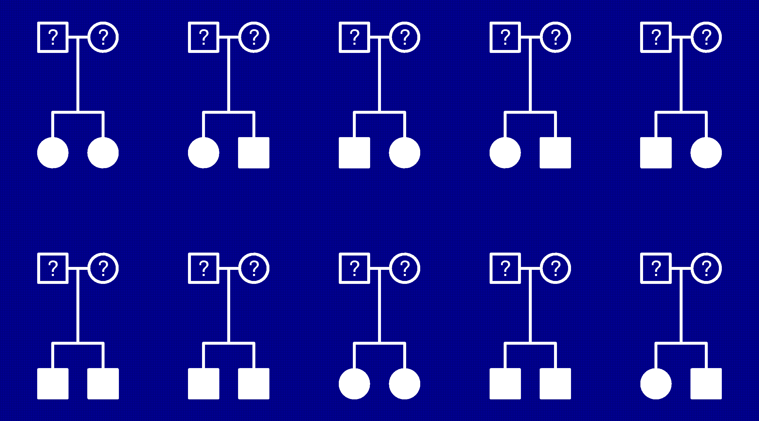
Linkage in affected sibling pairs

Slide 66
Nonparametric linkage
Underlying principle
Relatives with similar traits should have higher than expected levels of sharing of genetic material near genes that influence the trait.
“Sharing of genetic material” is measured by identity by descent (IBD).

Slide 67
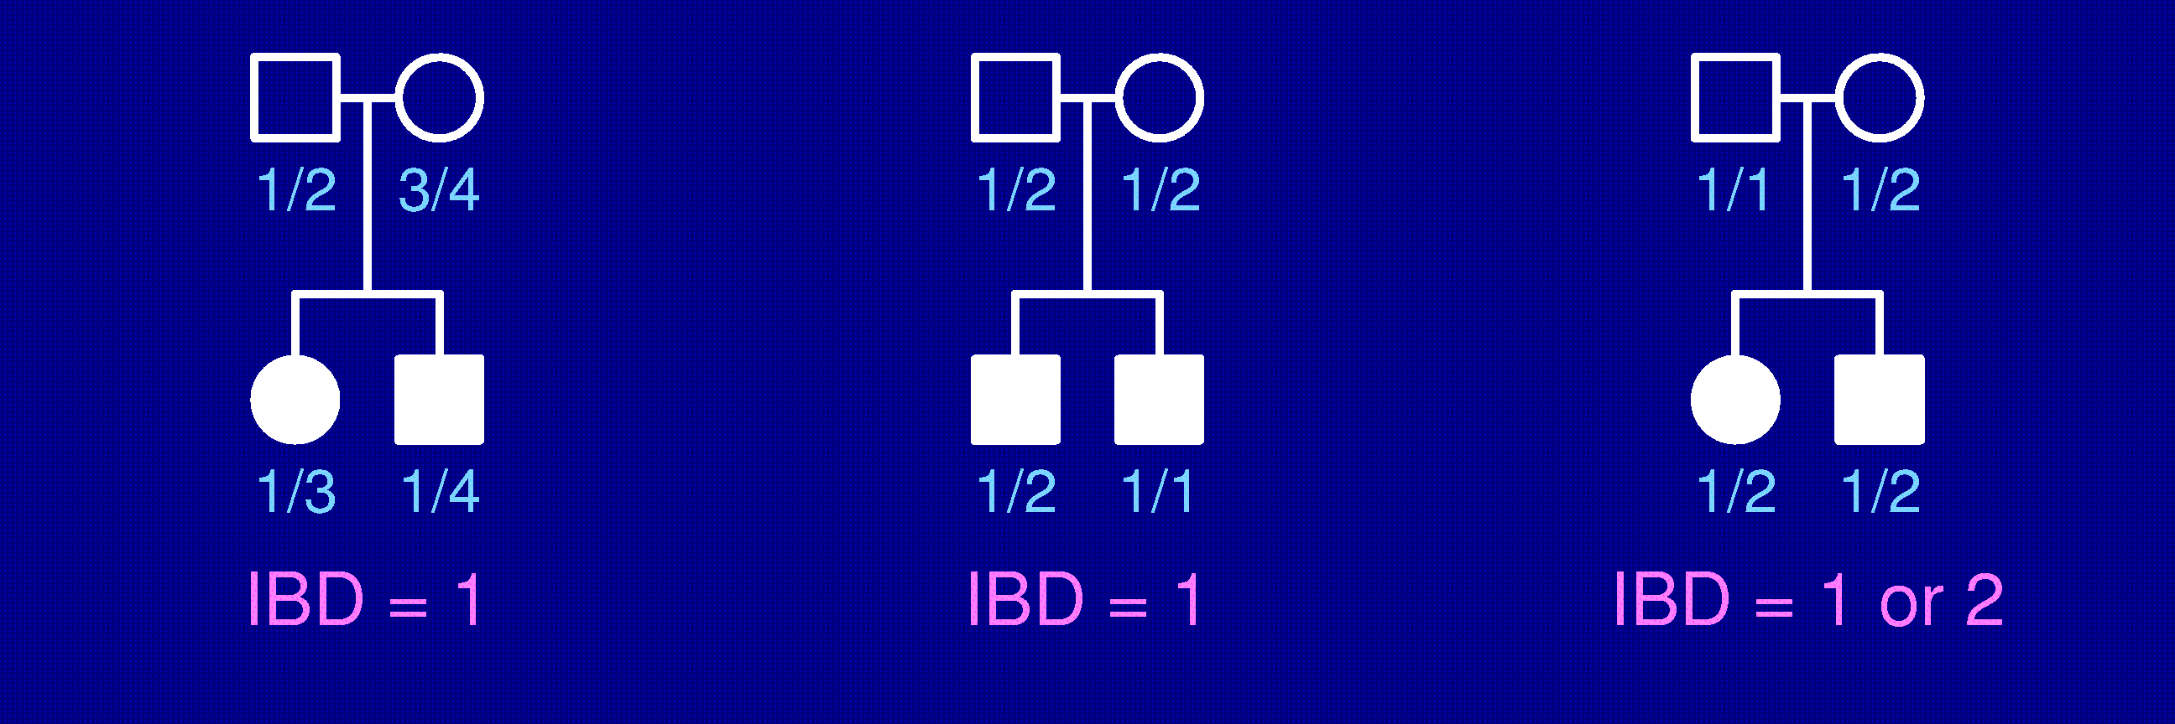
Identity by descent (IBD)
Two alleles are identical by descent if
they are copies of a single ancestral allele

Slide 68
IBD in sibpairs
Two non-inbred individuals share 0, 1, or 2 alleles IBD at any given locus.
A priori, sib pairs are IBD=0,1,2 with probability
1/4, 1/2, 1/4, respectively.
Affected sibling pairs, in the region of a disease susceptibility gene, will tend to share more alleles IBD.

Slide 69
Example
Single diallelic gene with disease allele frequency = 10%
Penetrances f₀ = 1%, f₁ = 10%, f₂ = 50%
Consider position rec. frac. = 5% away from gene
 |  | IBD probabilities
Type of sibpair |  | 0 | 1 | 2 |  | Ave. IBD
Both affected |  | 0.063 | 0.495 | 0.442 |  | 1.38
Neither affected |  | 0.248 | 0.500 | 0.252 |  | 1.00
1 affected, 1 not |  | 0.368 | 0.503 | 0.128 |  | 0.76

Slide 70
Complete data case
Set-up
n affected sibling pairs
IBD at particular position known exactly
n_{i} = no. sibpairs sharing i alleles IBD
Compare (n₀, n₁, n₂) to (n/4, n/2, n/4)
Example: 100 sibpairs
(n₀, n₁, n₂) = (15, 38, 47)

Slide 71
Affected sibpair tests
Mean test
Let S = n₁ + 2 n₂.
Under H₀: π = (1/4, 1/2, 1/4),
E(S | H₀) = n var(S | H₀) = n/2
Example: S = 132
Z = 4.53
LOD = 4.45

Slide 72
Affected sibpair tests
χ² test
Let π₀ = (1/4, 1/2, 1/4)
Example: X² = 26.2
LOD = X²/(2 ln10) = 5.70

Slide 73
Incomplete data
We seldom know the alleles shared IBD for a sib pair exactly.
We can calculate, for sib pair i,
p_{ij} = Pr(sib pair i has IBD = j | marker data)
For the means test, we use in place of n_{j}
Problem: the deminator in the means test,
is correct for perfect IBD information, but is too small in the case of incomplete data
Most software uses this perfect data approximation, which can make the test conservative (too low power).
Alternatives: Computer simulation; likelihood methods (e.g., Kong & Cox AJHG 61:1179-88, 1997)

Slide 74
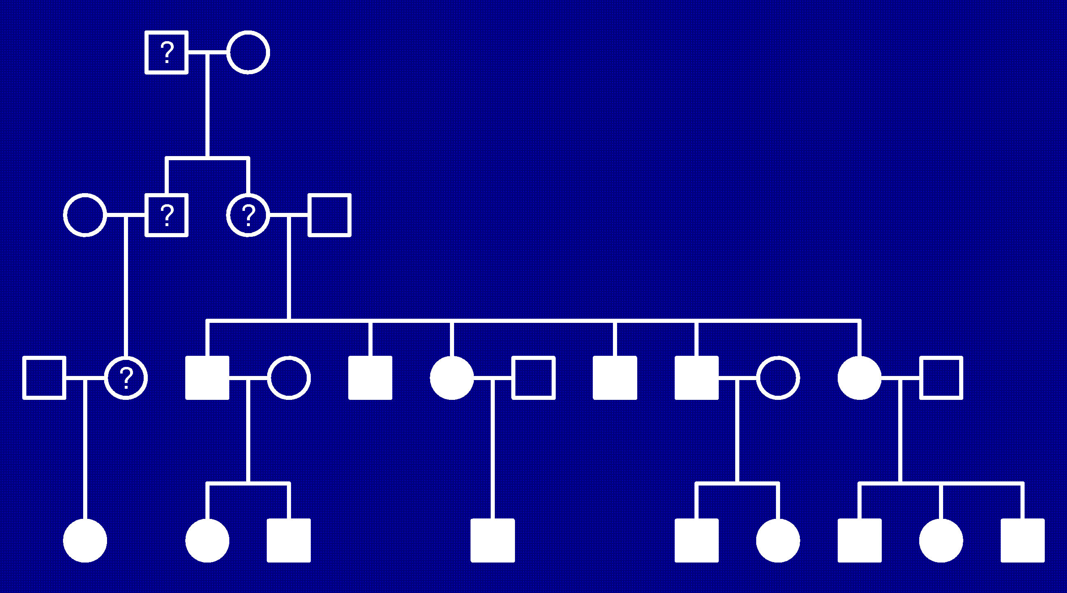
Larger families
Inheritance vector, v
Two elements for each subject
= 0/1, indicating grandparental origin of DNA

Slide 75
Score function
S(v) = number measuring the allele sharing among affected relatives
Examples:
  S_{pairs}(v) = sum (over pairs of affected relatives) of no. alleles IBD
  S_{all}(v) = a bit complicated; gives greater weight to the case that many affected individuals share the same allele
  Sall is better for dominance or additivity; Spairs is better for recessiveness
Normalized score, Z(v) = {S(v) – μ} / σ
  μ = E{ S(v) | no linkage }
  σ = SD{ S(v) | no linkage }

Slide 76
Combining families
Calculate the normalized score for each family
Z_{i} = {S_{i} – μ_{i}} / σ_{i}
Combine families using weights w_{i} ≥ 0
Choices of weights
  w_{i} = 1 for all families
  w_{i} = no. sibpairs
  w_{i} = σ_{i} (i.e., combine the Z_{i}’s and then standardize)
Incomplete data
  In place of S_{i}, use
  where p(v) = Pr( inheritance vector v | marker data)

Slide 77
Software
Genehunter
http://www.fhcrc.org/labs/kruglyak/Downloads/index.html
Allegro
Email allegro@decode.is
Merlin
http://www.sph.umich.edu/csg/abecasis/Merlin

Slide 78
Summary
Experimental crosses in model organisms
  Cheap, fast, powerful, can do direct experiments
  The “model” may have little to do with the human disease
Linkage in a few large human pedigrees
  Powerful, studying humans directly
  Families not easy to identify, phenotype may be unusual, and mapping resolution is low
Linkage in many small human families
  Families easier to identify, see the more common genes
  Lower power than large pedigrees, still low resolution mapping
Association analysis
  Easy to gather cases and controls, great power (with sufficient markers), very high resolution mapping
  Need to type an extremely large number of markers (or very good candidates), hard to establish causation

Slide 79
References
Broman KW (2001) Review of statistical methods for QTL mapping in experimental crosses. Lab Animal 30:44–52
Jansen RC (2001) Quantitative trait loci in inbred lines. In Balding DJ et al., Handbook of statistical genetics, Wiley, New York, pp 567–597
Lander ES, Botstein D (1989) Mapping Mendelian factors underlying quantitative traits using RFLP linkage maps. Genetics 121:185 – 199
Churchill GA, Doerge RW (1994) Empirical threshold values for quantitative trait mapping. Genetics 138:963–971
Broman KW (2003) Mapping quantitative trait loci in the case of a spike in the phenotype distribution. Genetics 163:1169–1175
Miller AJ (2002) Subset selection in regression, 2nd edition. Chapman & Hall, New York

Slide 80
References
Lander ES, Schork NJ (1994) Genetic dissection of complex traits. Science 265:2037–2048
Sham P (1998) Statistics in human genetics. Arnold, London
Lange K (2002) Mathematical and statistical methods for genetic analysis, 2nd edition. Springer, New York
Kong A, Cox NJ (1997) Allele-sharing models: LOD scores and accurate linkage tests. Am J Hum Gene 61:1179–1188
McPeek MS (1999) Optimal allele-sharing statistics for genetic mapping using affected relatives. Genetic Epidemiology 16:225–249
Feingold E (2001) Methods for linkage analysis of quantitative trait loci in humans. Theor Popul Biol 60:167–180
Feingold E (2002) Regression-based quantitative-trait-locus mapping in the 21st century. Am J Hum Genet 71:217–222

