Slide 1
The genomes of recombinant inbred lines
Karl W Broman
Department of Biostatistics
Johns Hopkins University
http://www.biostat.jhsph.edu/~kbroman

Slide 2
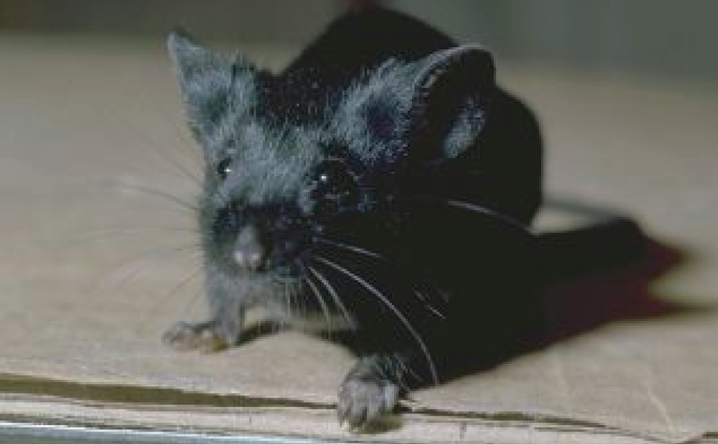
C57BL/6

Slide 3
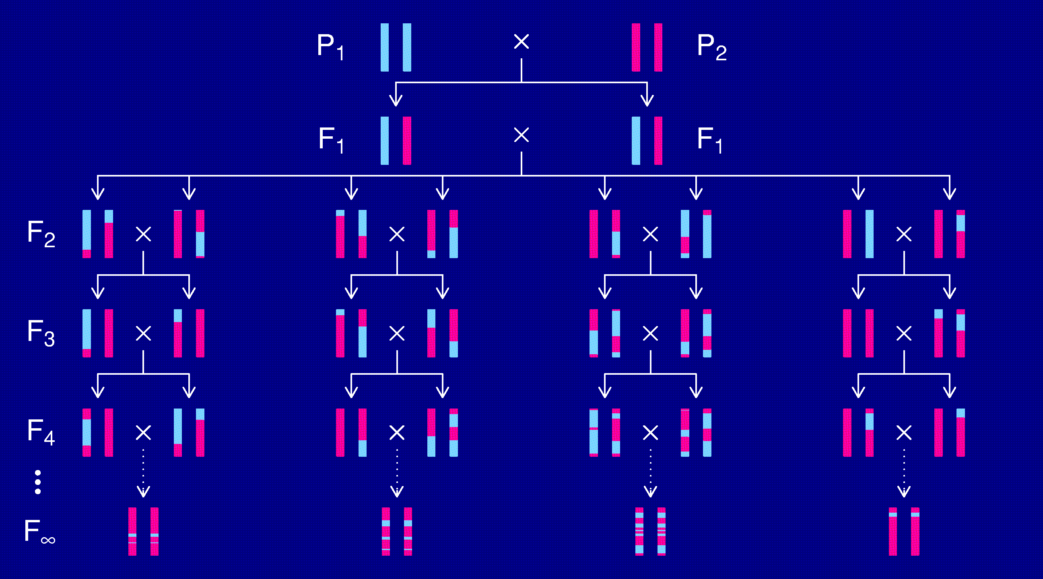
Recombinant inbred lines
(by sibling mating)

Slide 4
Advantages of RI lines
Each strain is an eternal resource.
  Only need to genotype once.
  Reduce individual variation by phenotyping multiple individuals from each strain.
  Study multiple phenotypes on the same genotype.
Greater mapping precision.
  More dense breakpoints on the RI chromosomes.

Slide 5
Recombinant inbred lines
(by sibling mating)

Slide 6
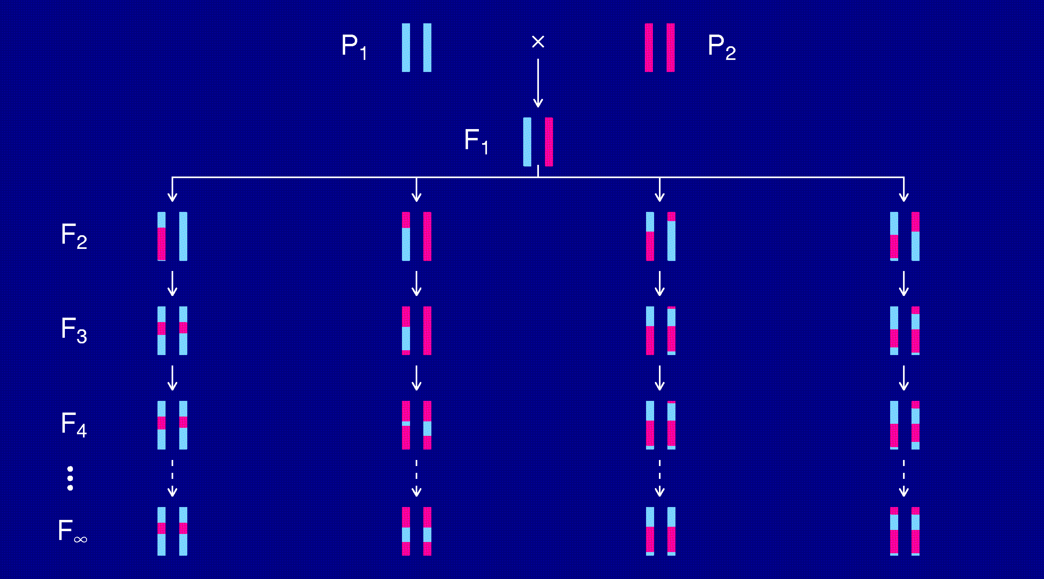
Recombinant inbred lines
(by selfing)

Slide 7
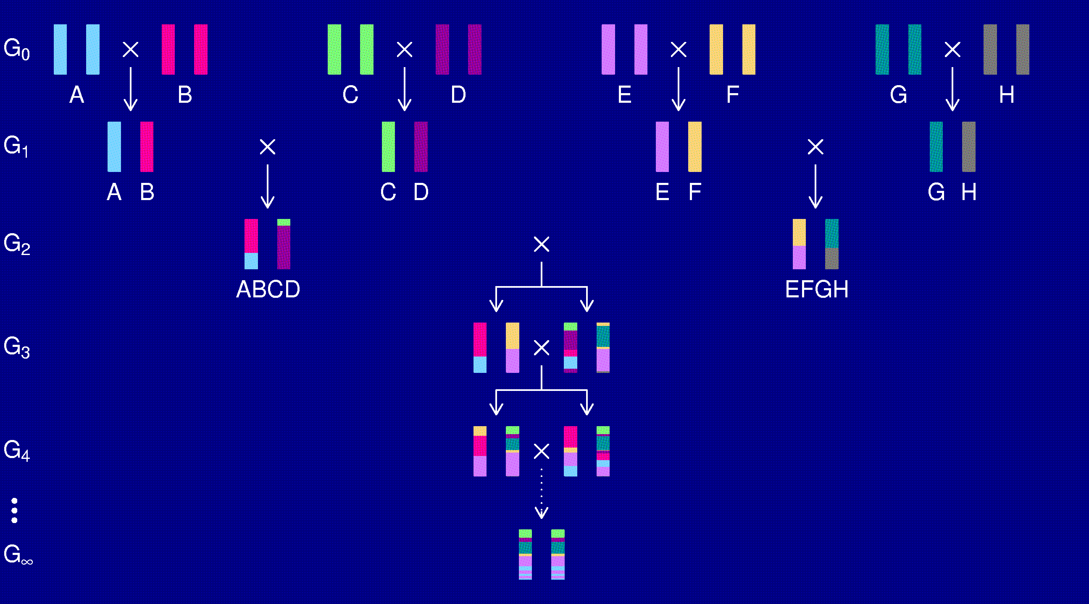
The “Collaborative Cross”

Slide 8
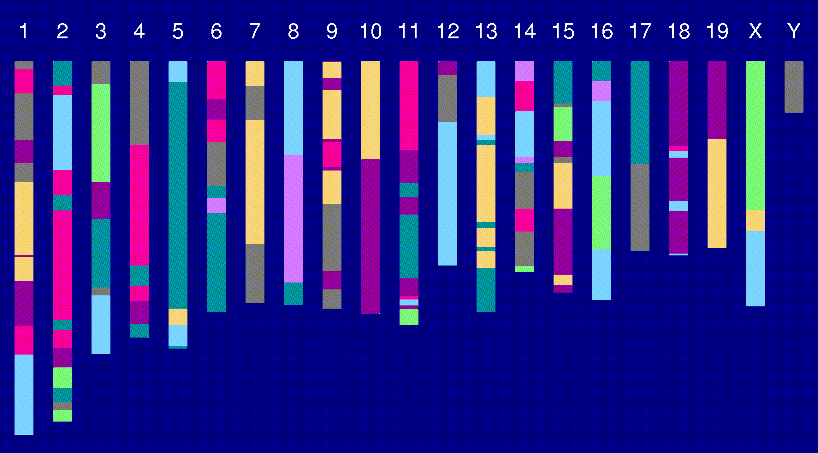
Genome of an 8-way RI

Slide 9
The goal
Characterize the breakpoint process along a chromosome in 8-way RILs.
  Understand the two-point haplotype probabilities.
  Study the clustering of the breakpoints, as a function of crossover interference in meiosis.

Slide 10
Why?
It’s interesting.
Later statistical analyses will require:
  The two-point probabilities.
  A model for the whole process.
Actually, we’ll probably just assume that:
  The breakpoints follow a Poisson process.
  The genotypes follow a Markov chain.

Slide 11
2 points in an RIL
1
2
r = recombination fraction = probability of a recombination in the interval in a random meiotic product.
R = analogous thing for the RIL = probability of different alleles at the two loci on a random RIL chromosome.

Slide 12
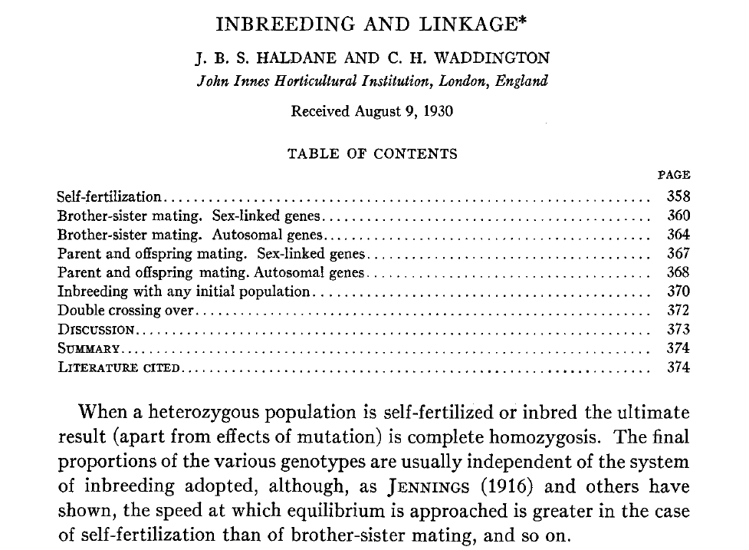
Haldane & Waddington 1931
Genetics 16:357-374

Slide 13
Recombinant inbred lines
(by selfing)

Slide 14
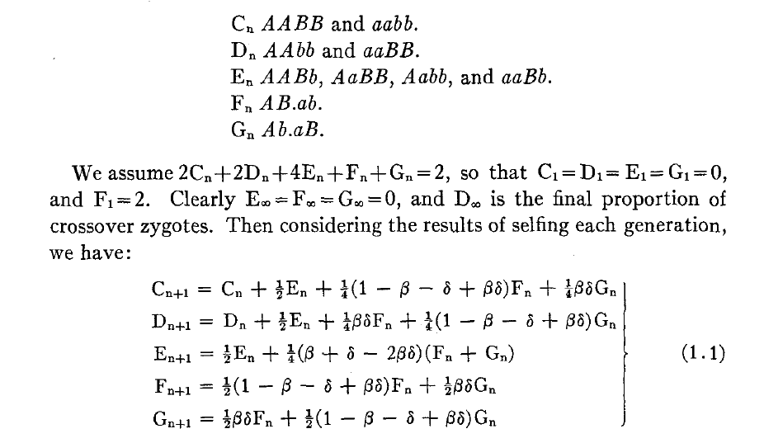
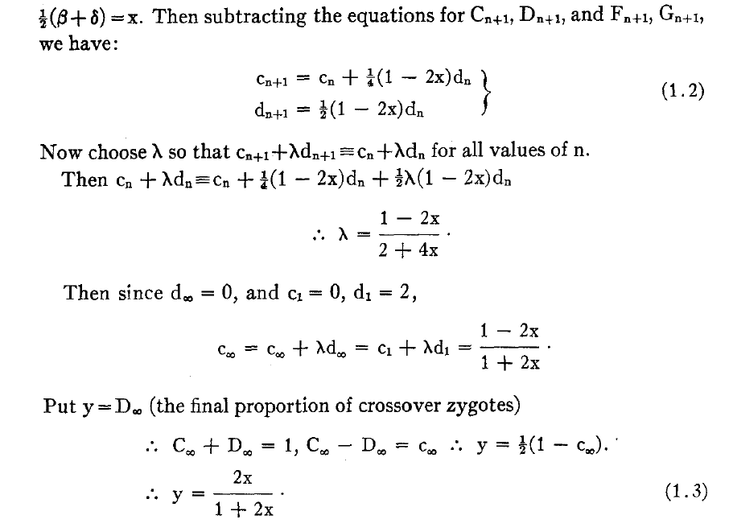
Equations for selfing

Slide 15
Absorption probabilities
Let P_{ij} = Pr(X_{n+1} = j | X_{n} = i) where X_{n} = state at generation n.
Consider the case of absorption into the state AA|AA.
Let h_{i} = probability, starting at i, eventually absorbed into AA|AA.
Then h_{AA|AA} = 1 and h_{AB|AB} = 0.
Condition on the first step: h_{i} = ∑_{k} P_{ik} h_{k}
For selfing, this gives a system of 3 linear equations.

Slide 16
Recombinant inbred lines
(by sibling mating)

Slide 17
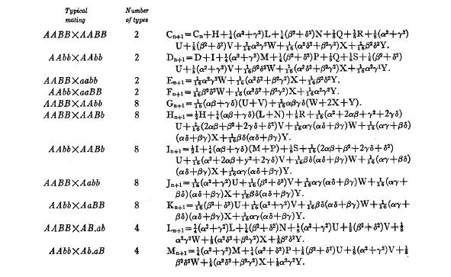
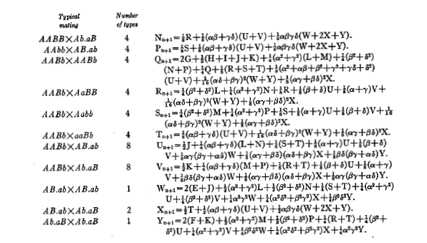
Equations for sib-mating

Slide 18
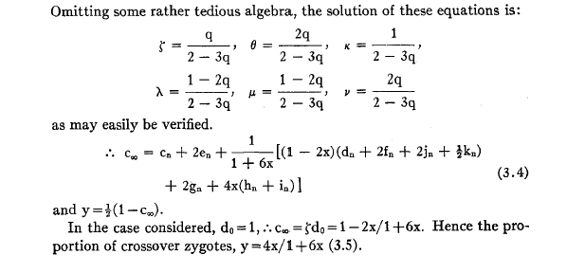
Result for sib-mating

Slide 19
The “Collaborative Cross”

Slide 20
8-way RILs
Autosomes
  Pr(G₁ = i) = 1/8
  Pr(G₂ = j | G₁ = i) = r / (1+6r) for i ≠ j
  Pr(G₂ ≠ G₁) = 7r / (1+6r)
X chromosome
  Pr(G₁=A) = Pr(G₁=B) = Pr(G₁=E) = Pr(G₁=F) =1/6
  Pr(G₁=C) = 1/3
  Pr(G₂=B | G₁=A) = r / (1+4r)
  Pr(G₂=C | G₁=A) = 2r / (1+4r)
  Pr(G₂=A | G₁=C) = r / (1+4r)
  Pr(G₂ ≠ G₁) = (14/3) r / (1+4r)

Slide 21
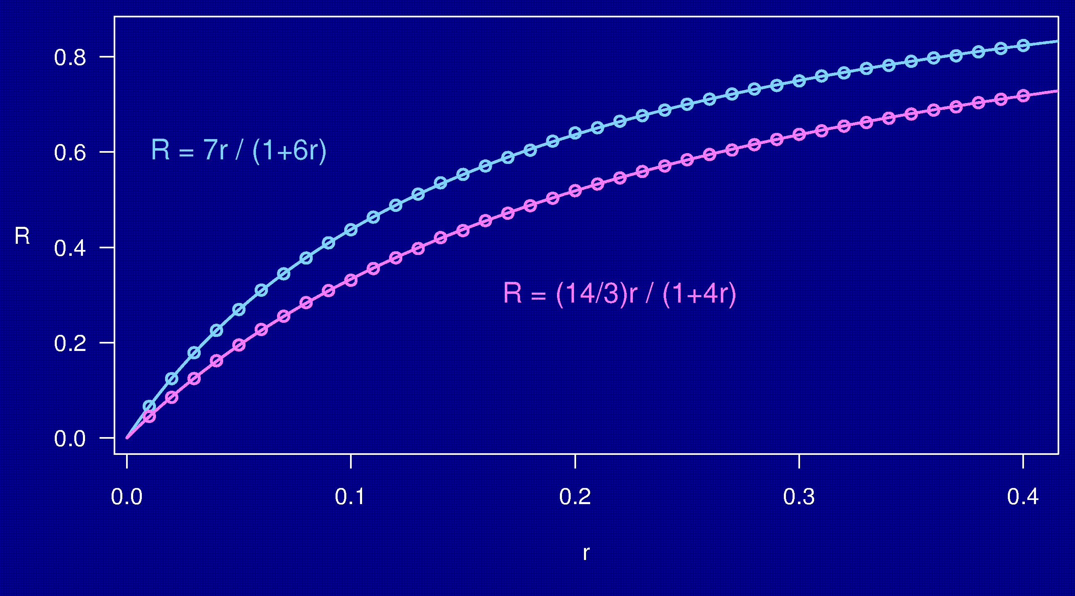
Computer simulations

Slide 22
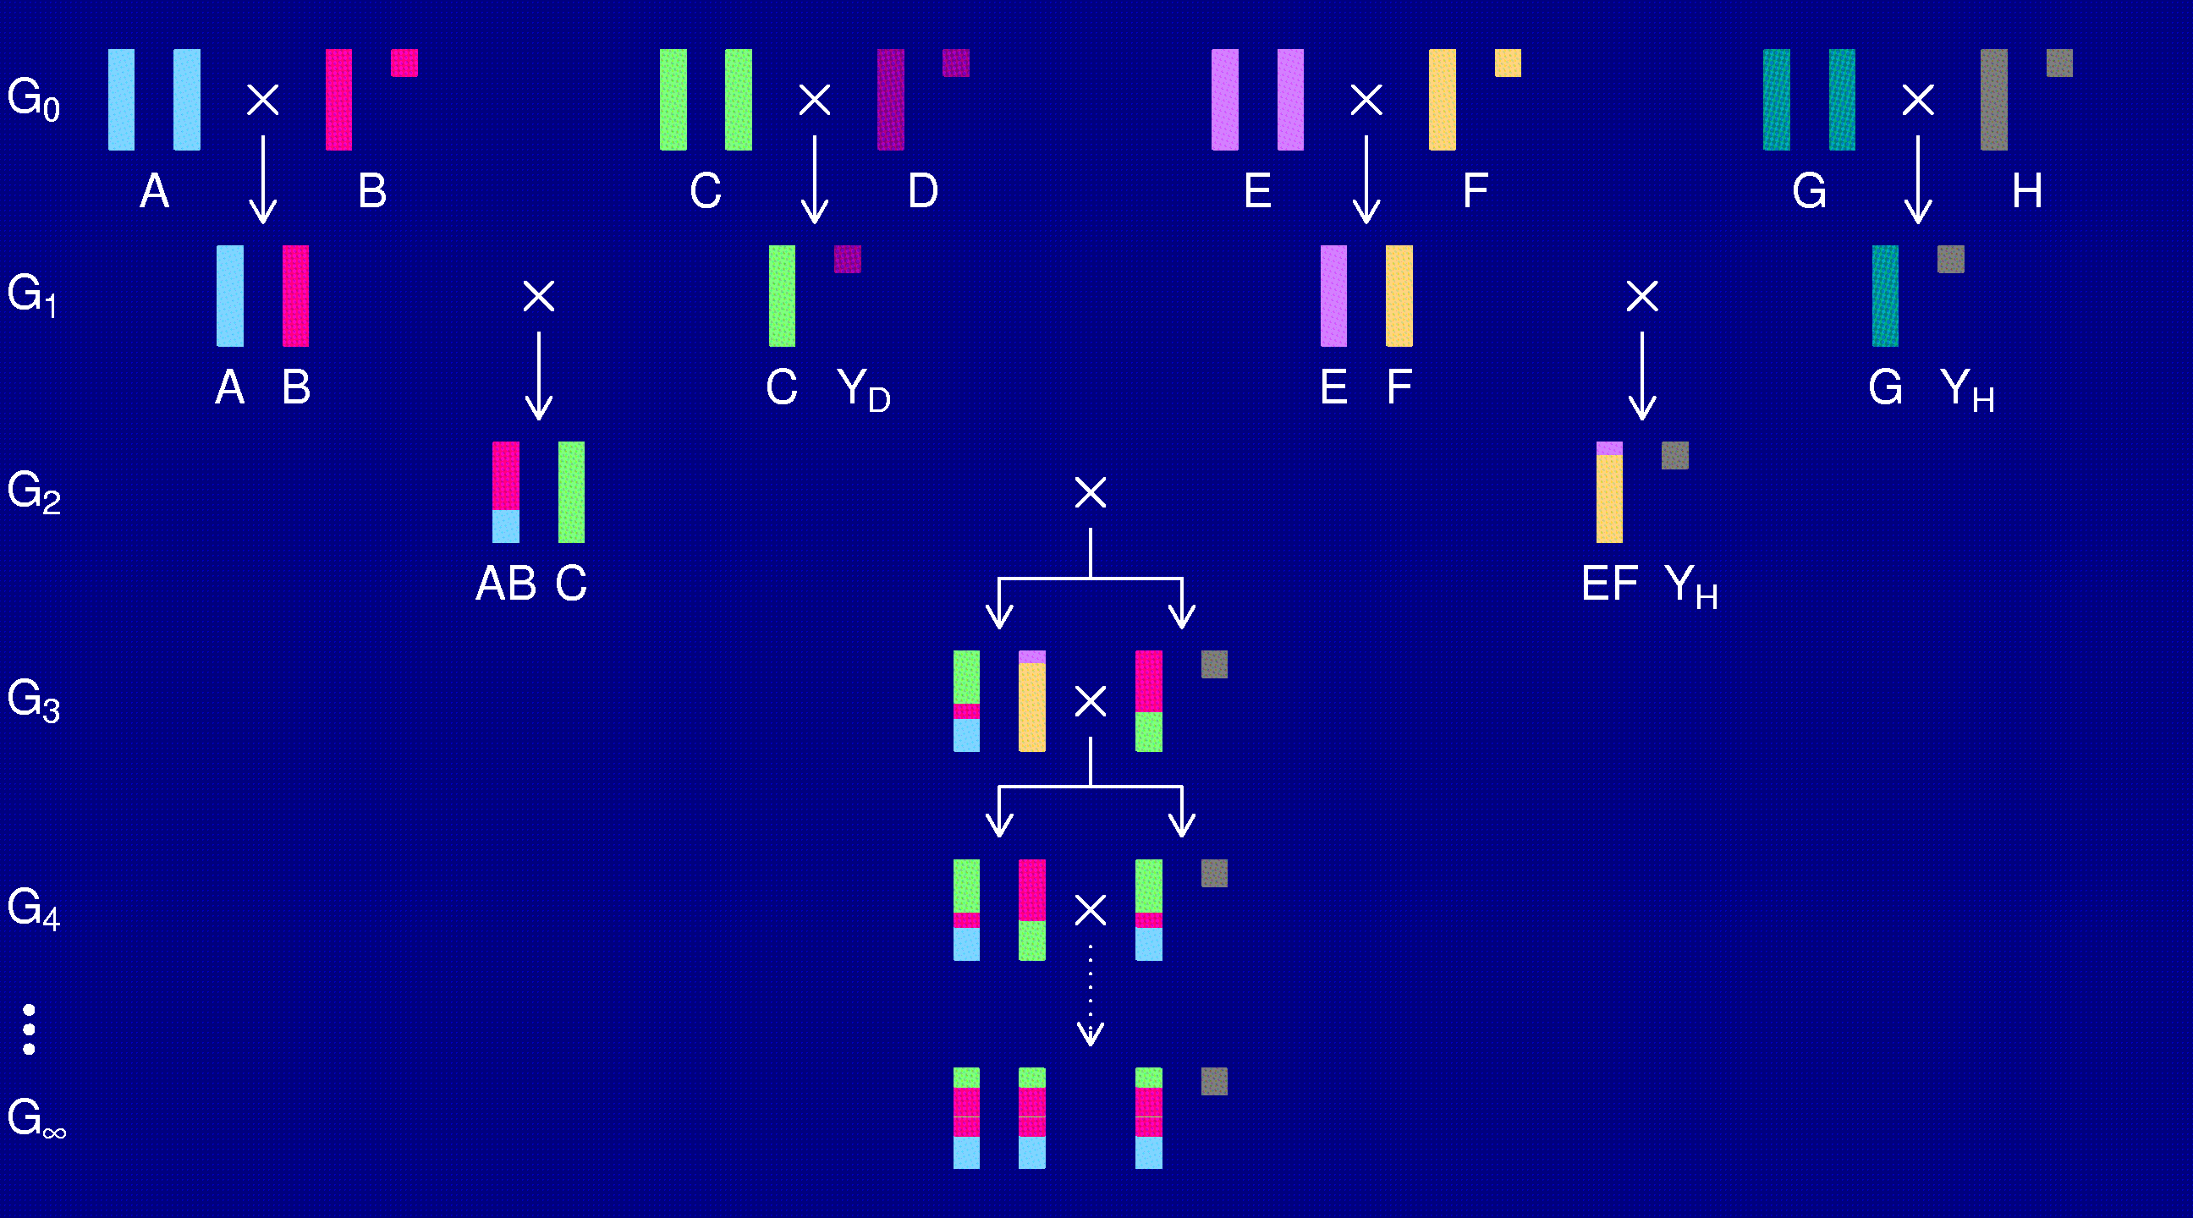
The X chromosome

Slide 23
3-point coincidence
1
2
3
r_{ij} = recombination fraction for interval i,j;
assume r₁₂ = r₂₃ = r
Coincidence = c = Pr(double recombinant) / r²
= Pr(rec’n in 23 | rec’n in 12) / Pr(rec’n in 23)
No interference → = 1
Positive interference → < 1
Negative interference → > 1
Generally c is a function of r.

Slide 24
3-points in 2-way RILs
1
2
3
r₁₃ = 2 r (1 – c r)
R = f(r); R₁₃ = f(r₁₃)
Pr(double recombinant in RIL) = { R + R – R₁₃ } / 2
Coincidence (in 2-way RIL) = { 2 R – R₁₃ } / { 2 R² }
Notes:
This is included at the end of Haldane & Waddington (1931).

Slide 25
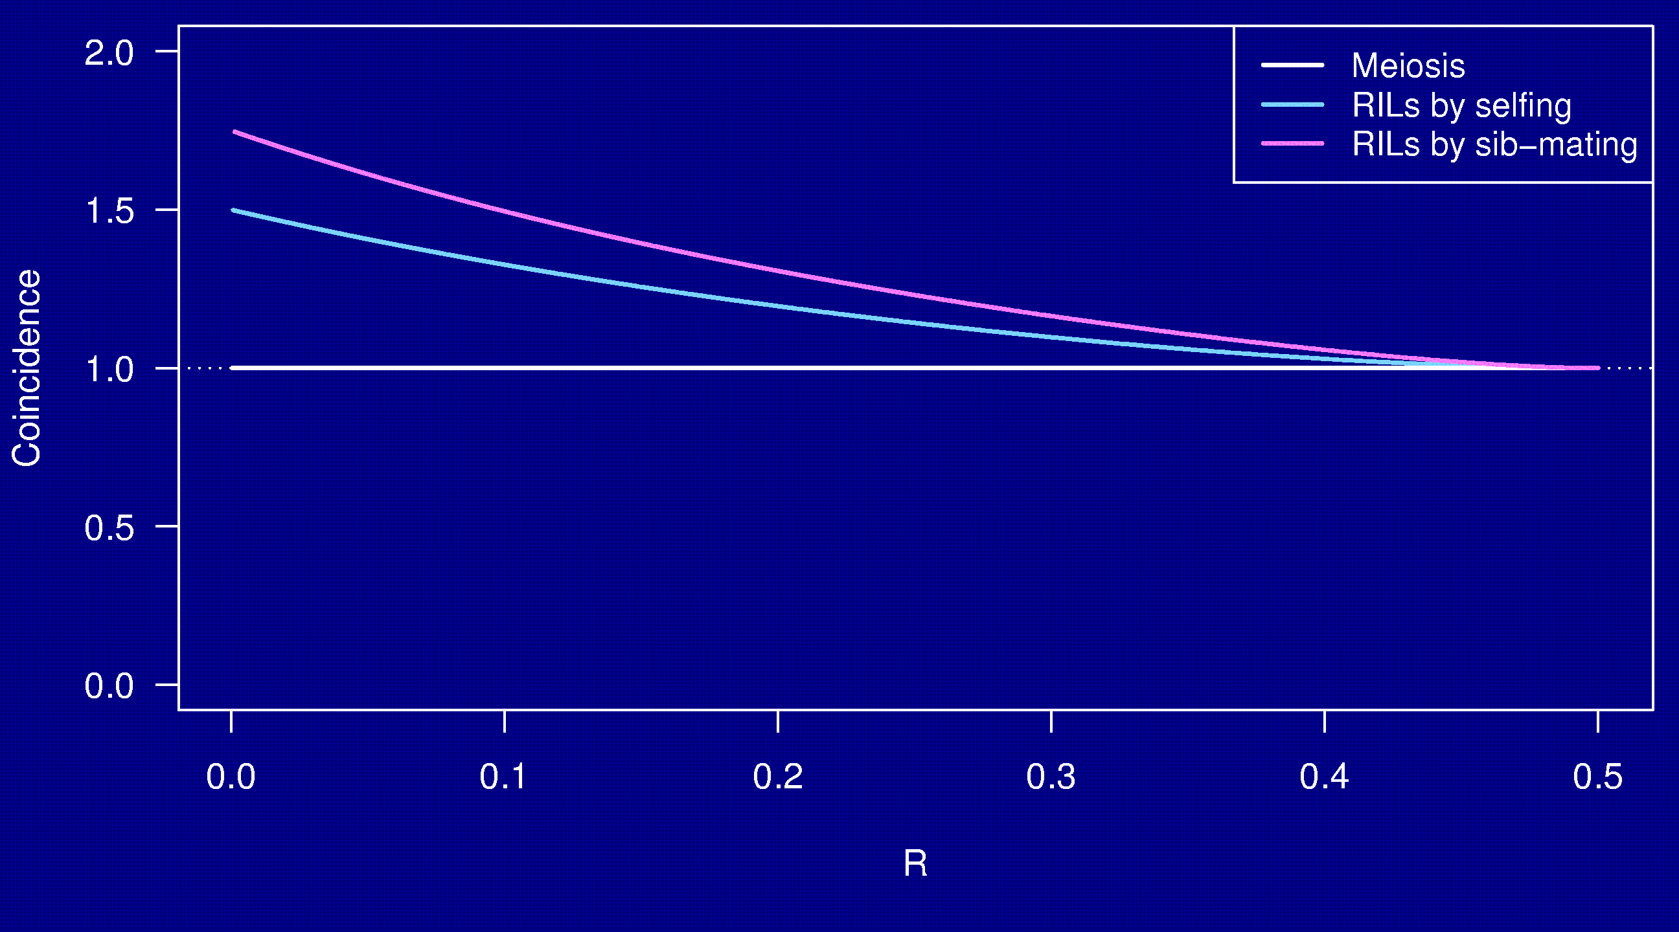
Coincidence
No interference

Slide 26
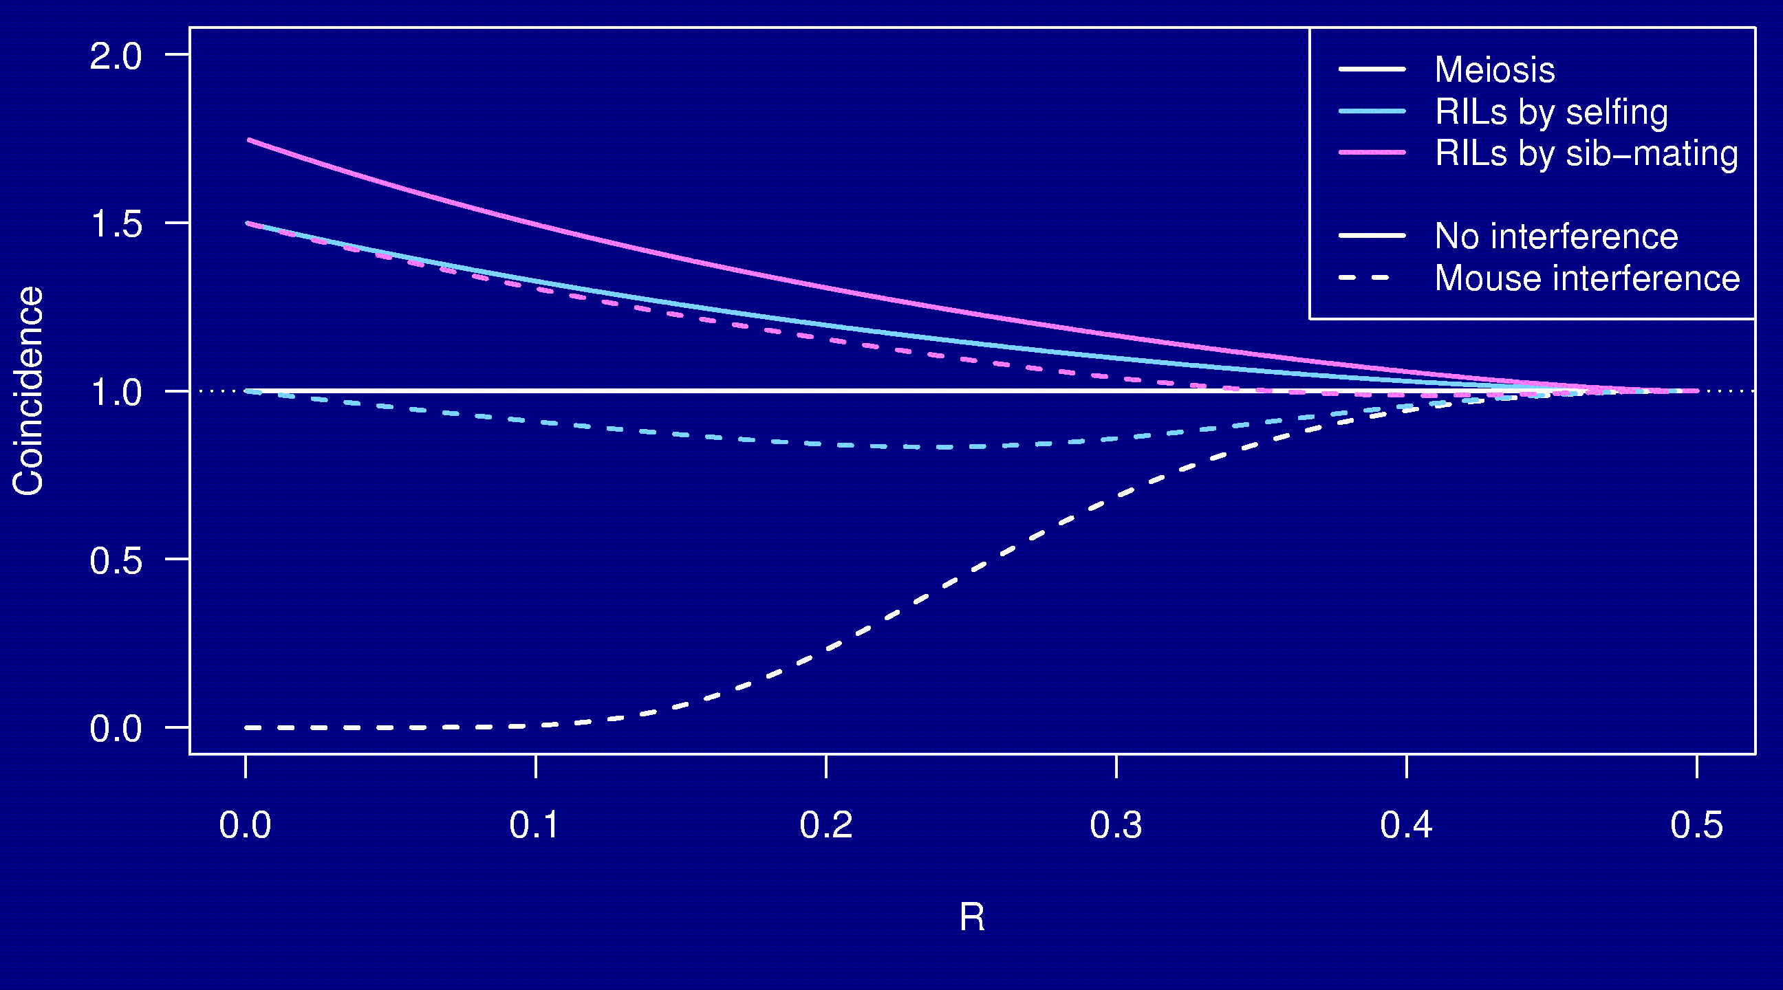
Coincidence

Slide 27
Why the clustering of breakpoints?
The really close breakpoints occur in different generations.
Breakpoints in later generations can occur only in regions that are not yet fixed.
The regions of heterozygosity are, of course, surrounded by breakpoints.

Slide 28
Coincidence in 8-way RILs
The trick that allowed us to get the coincidence for 2-way RILs doesn’t work for 8-way RILs.
It’s sufficient to consider 4-way RILs.
Calculations for 3 points in 4-way RILs is still astoundingly complex.
  2 points in 2-way RILs by sib-mating:
  55 parental types → 22 states by symmetry
  3 points in 4-way RILs by sib-mating:
  2,164,240 parental types → 137,488 states
Even counting the states was difficult.

Slide 29
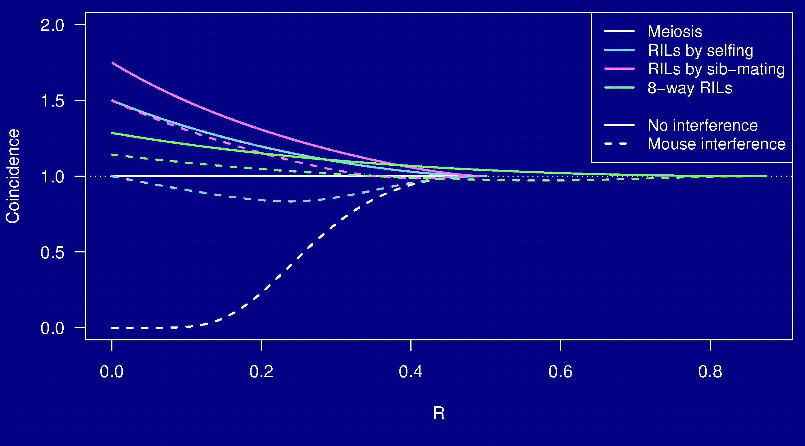
Coincidence

Slide 30
Whole genome simulations
2-way selfing, 2-way sib-mating, 8-way sib-mating
Mouse-like genome, 1665 cM
Strong positive crossover interference
Inbreed to complete fixation
10,000 simulation replicates

Slide 31
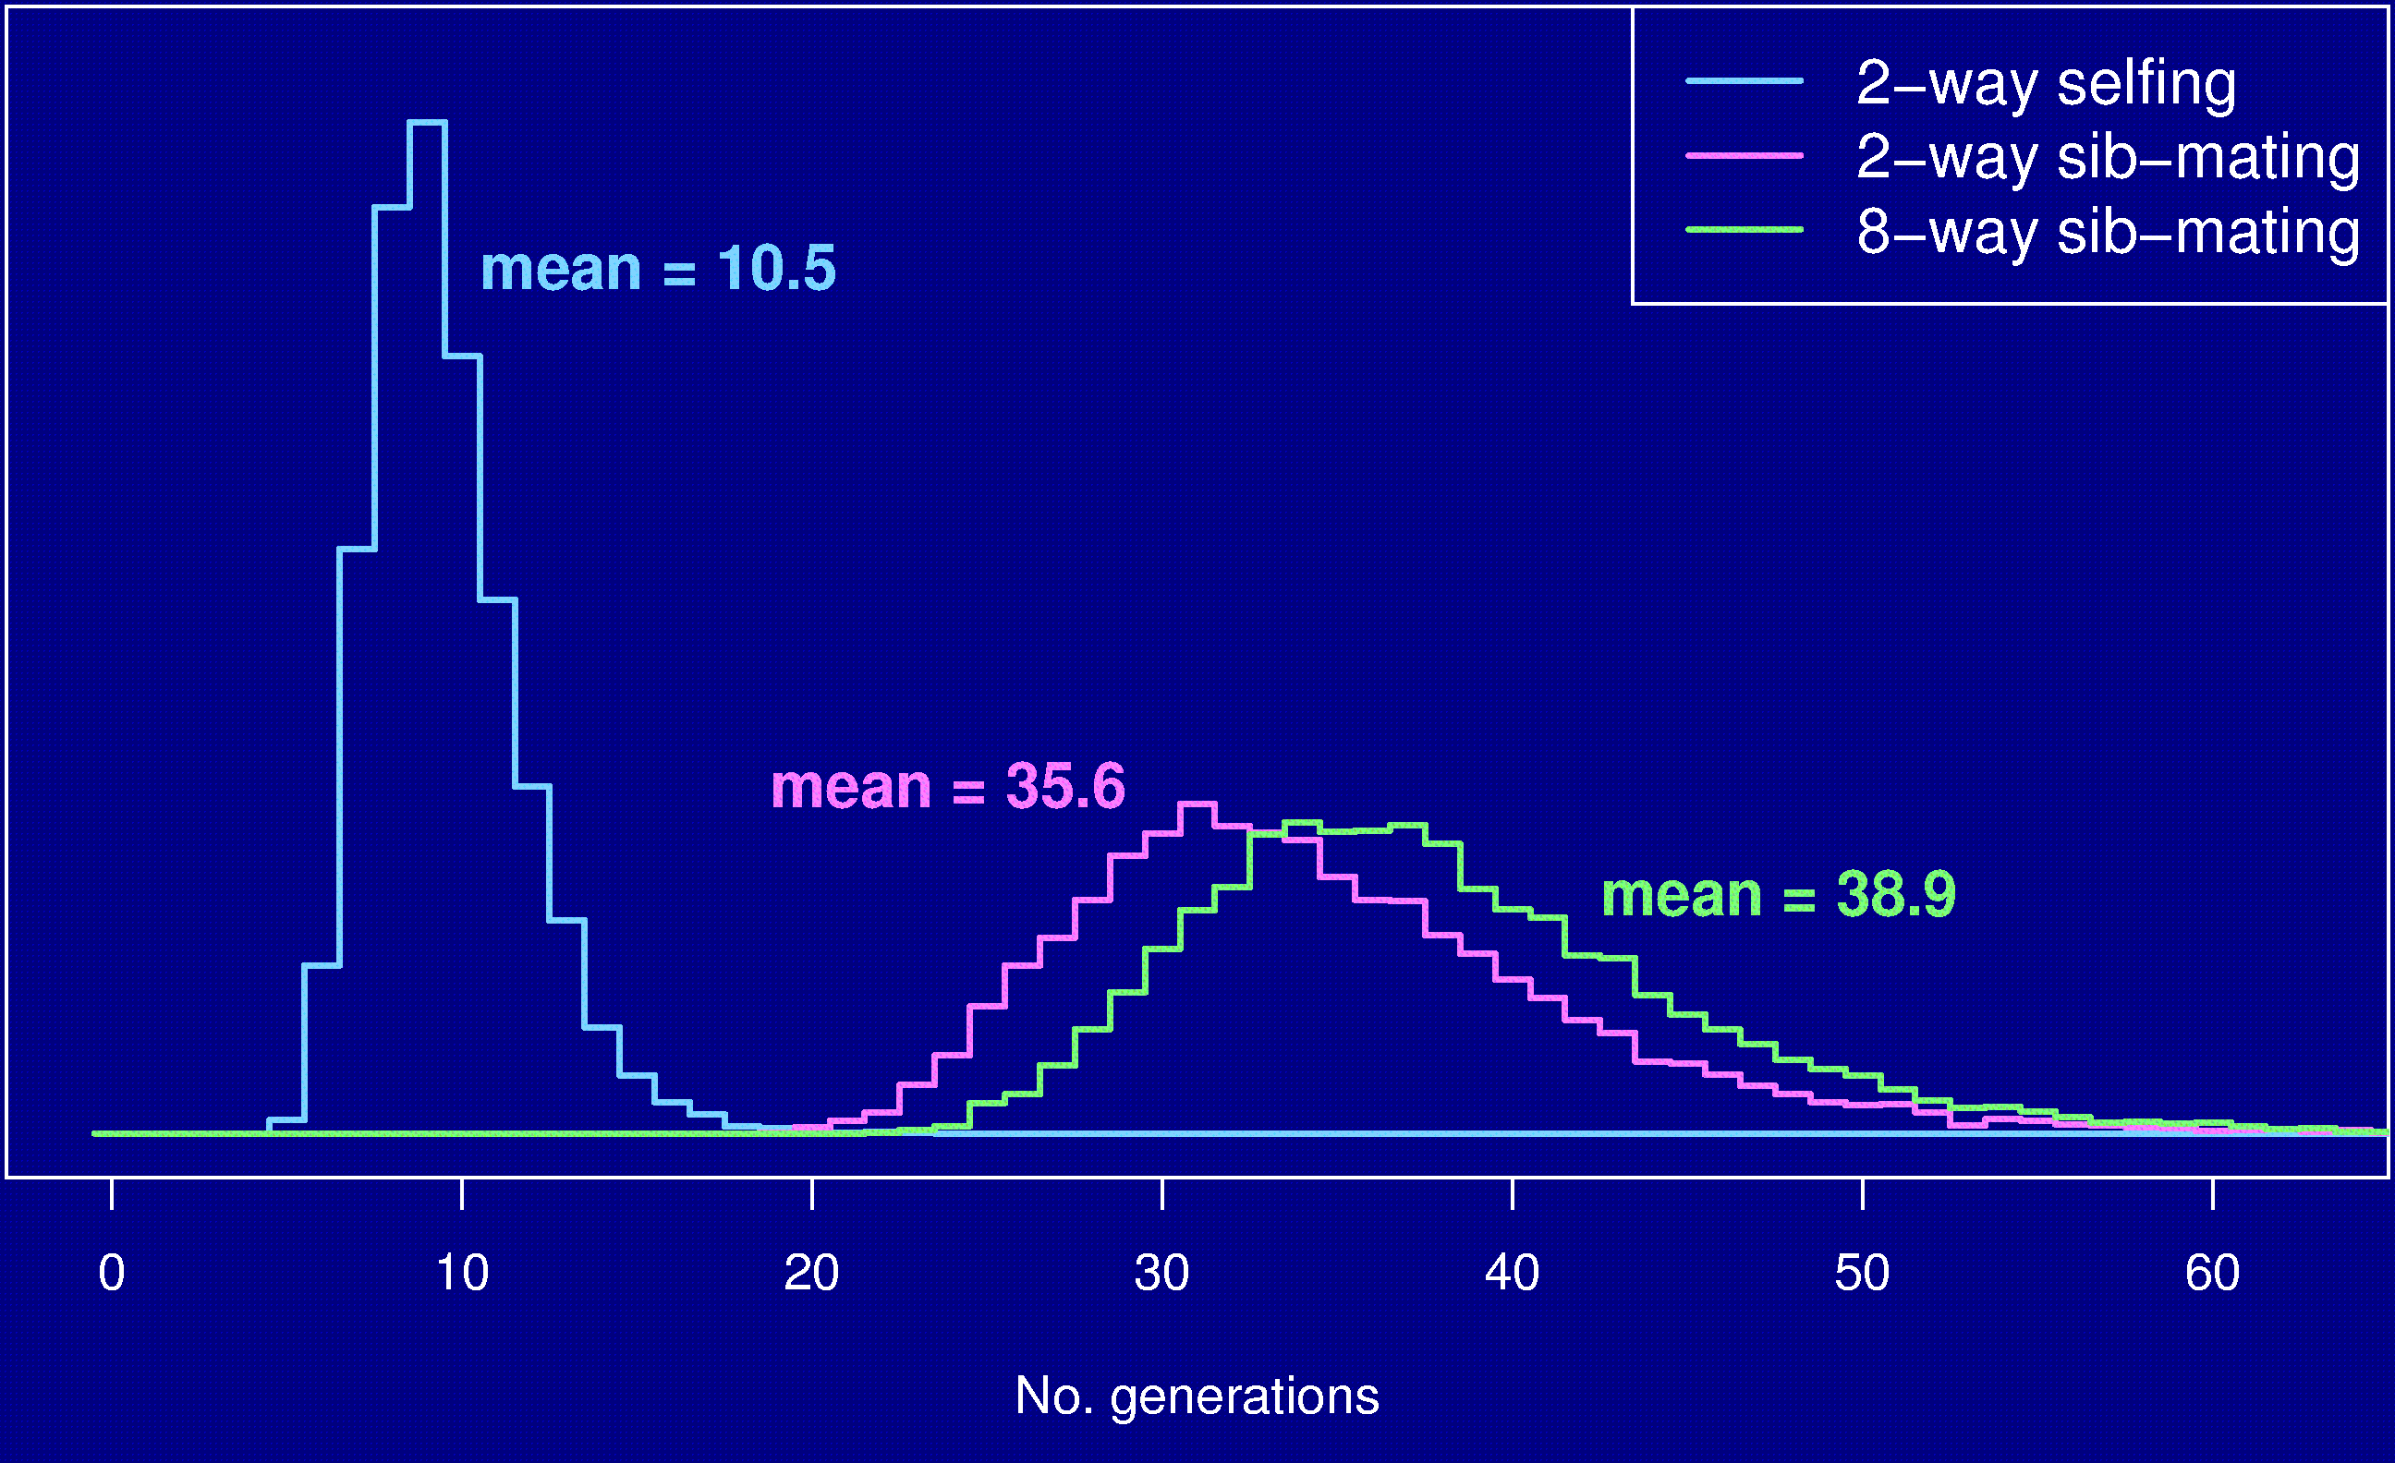
No. generations to fixation

Slide 32
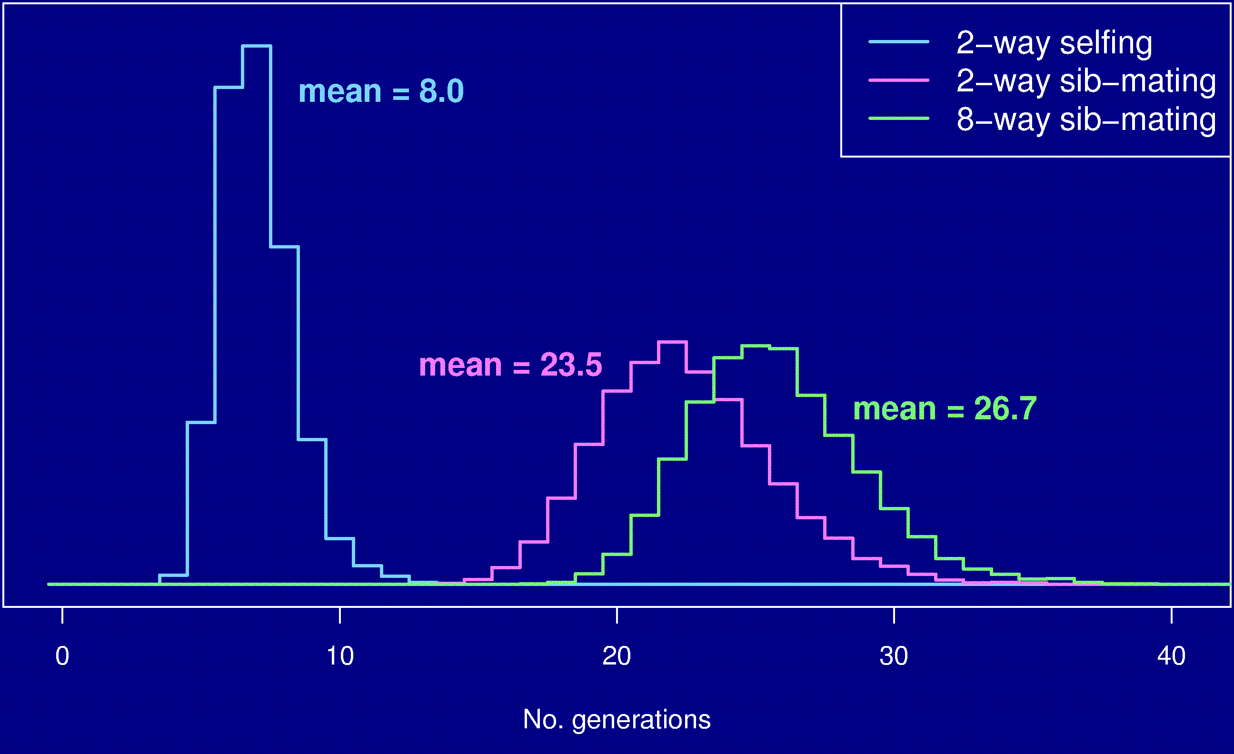
No. gen’s to 99% fixation

Slide 33
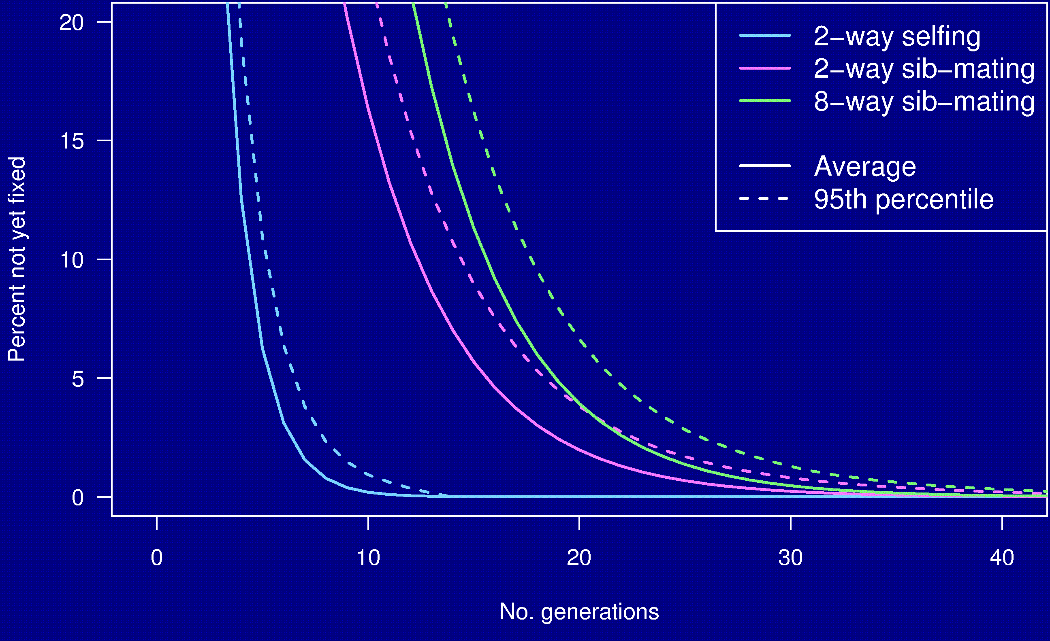
Percent genome not fixed

Slide 34
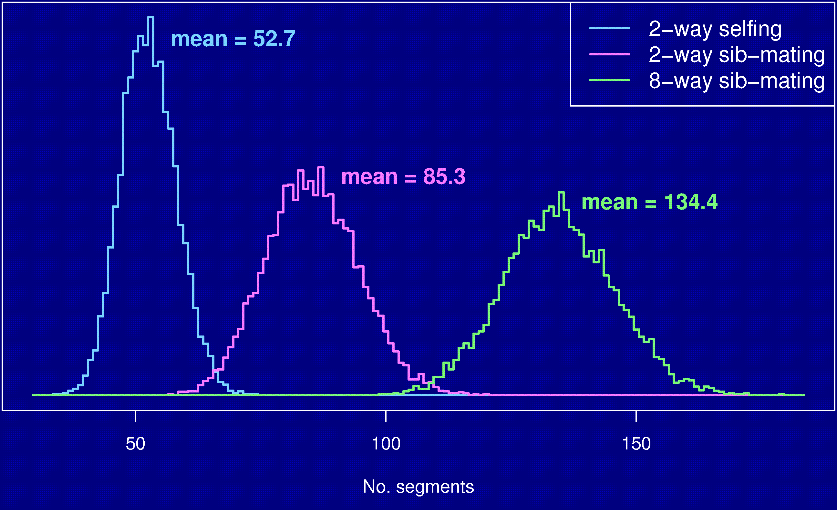
Number of segments

Slide 35
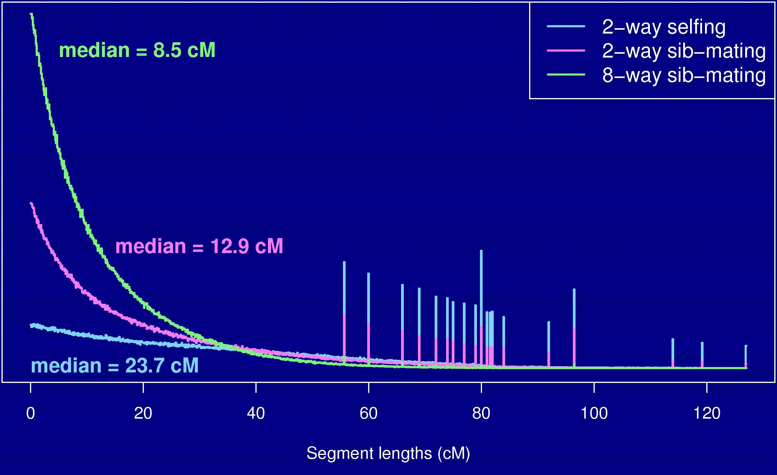
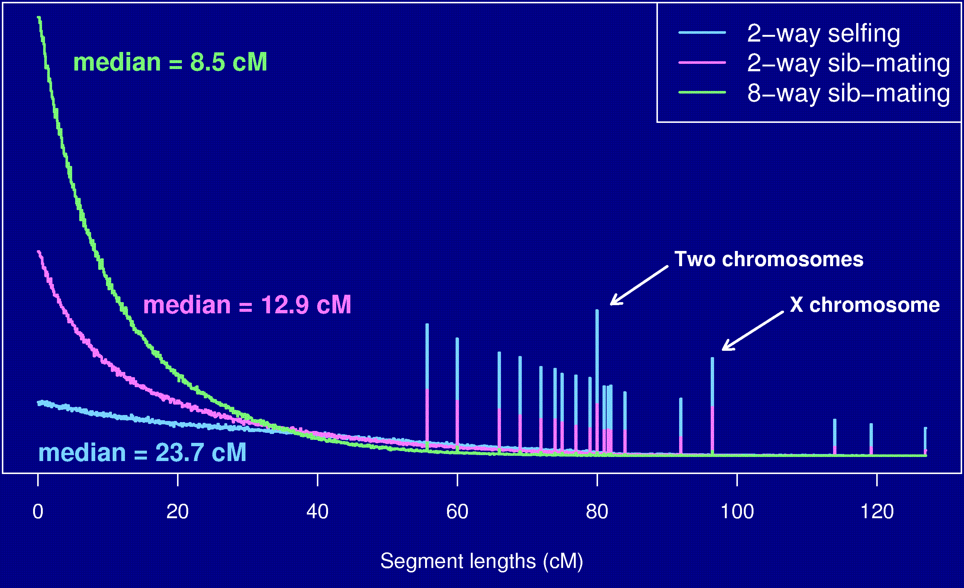
Segment lengths

Slide 36
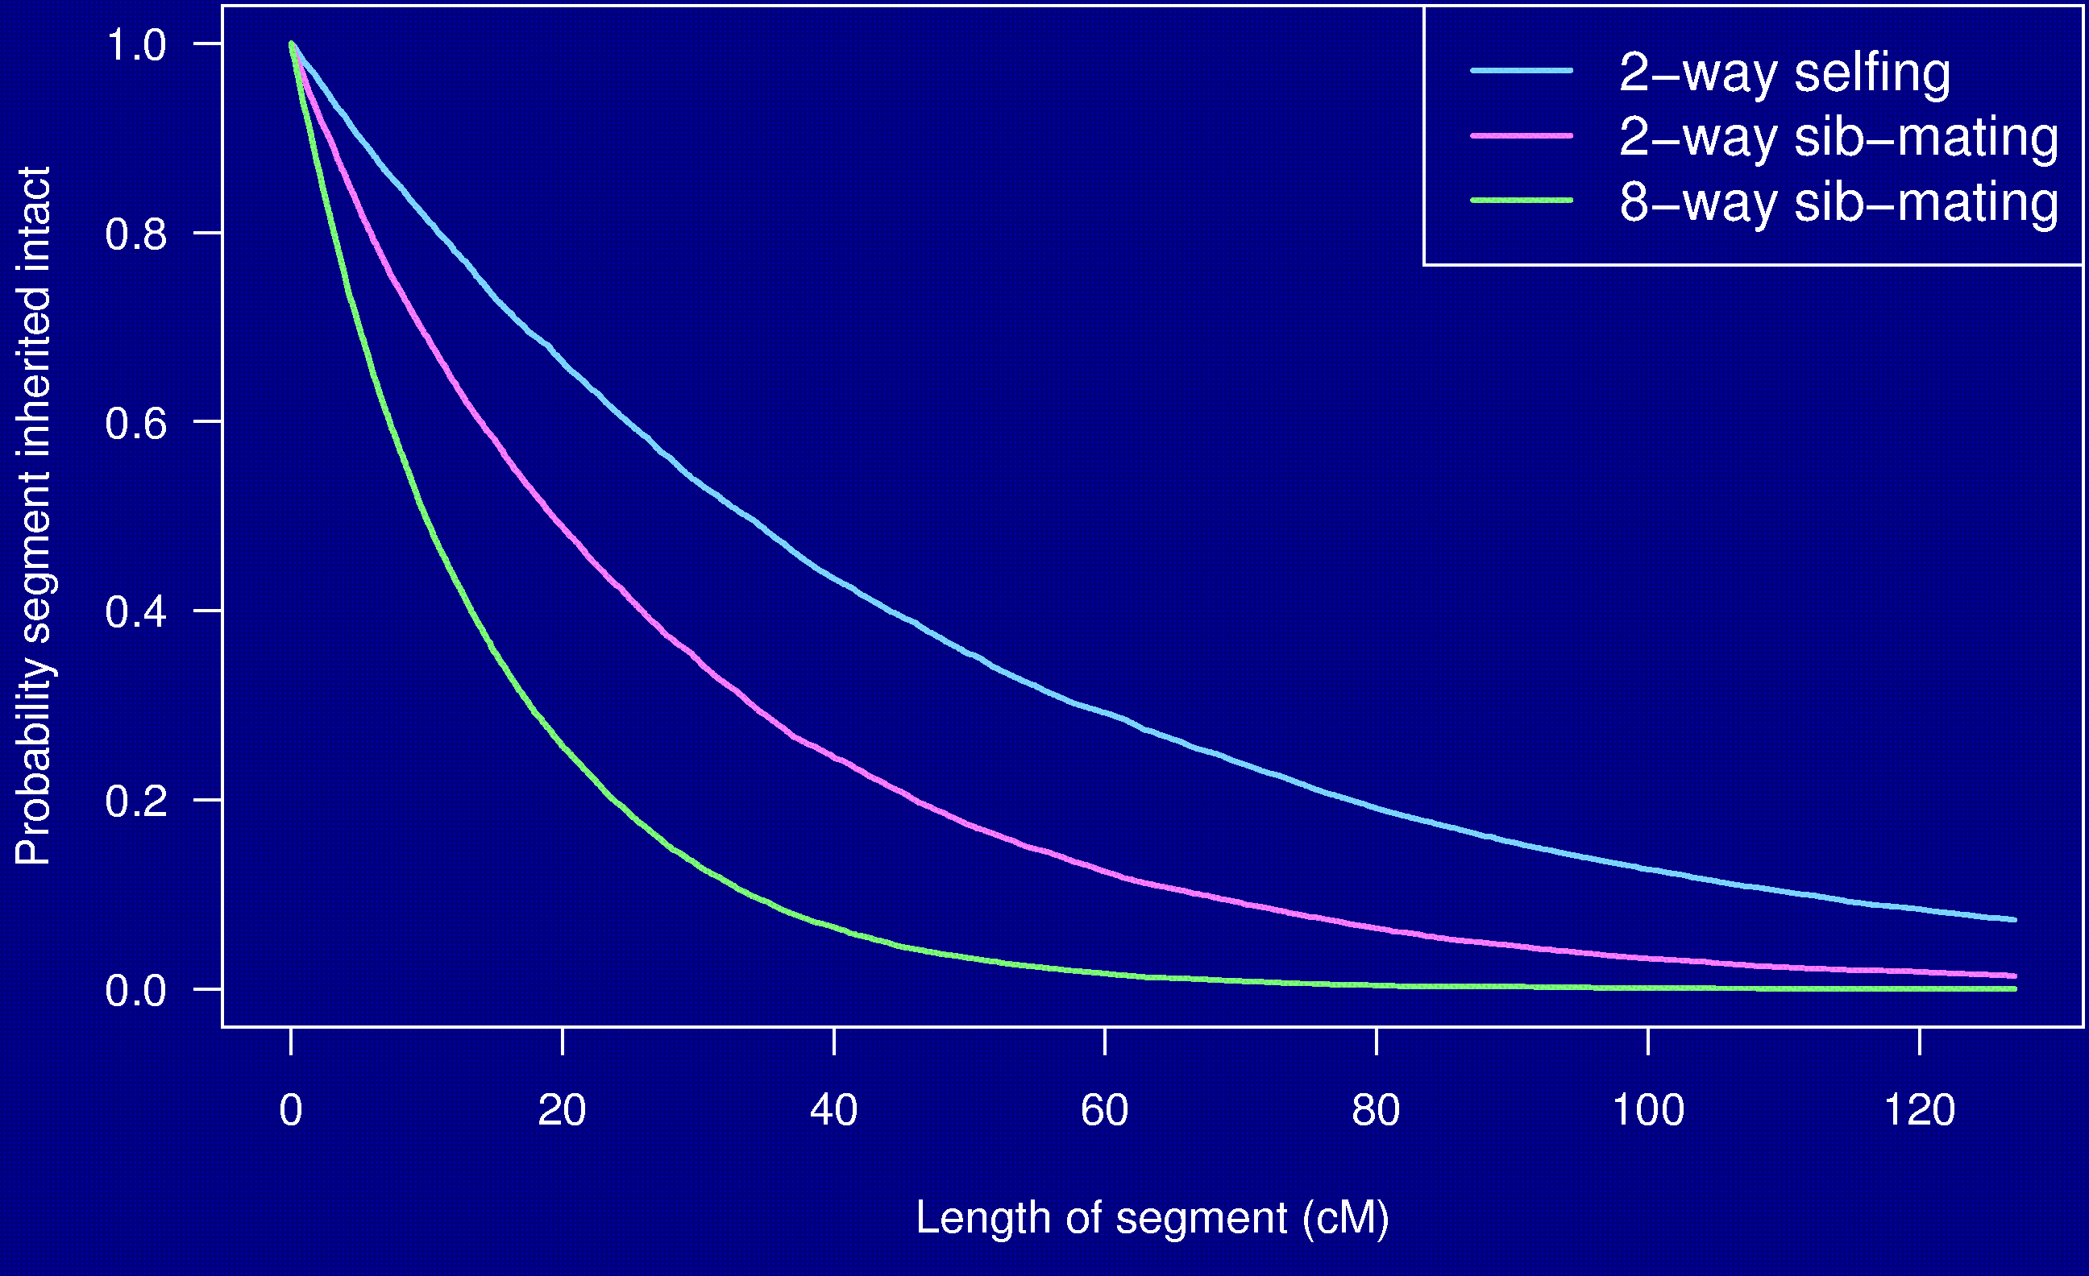
Probability a segment is inherited intact

Slide 37
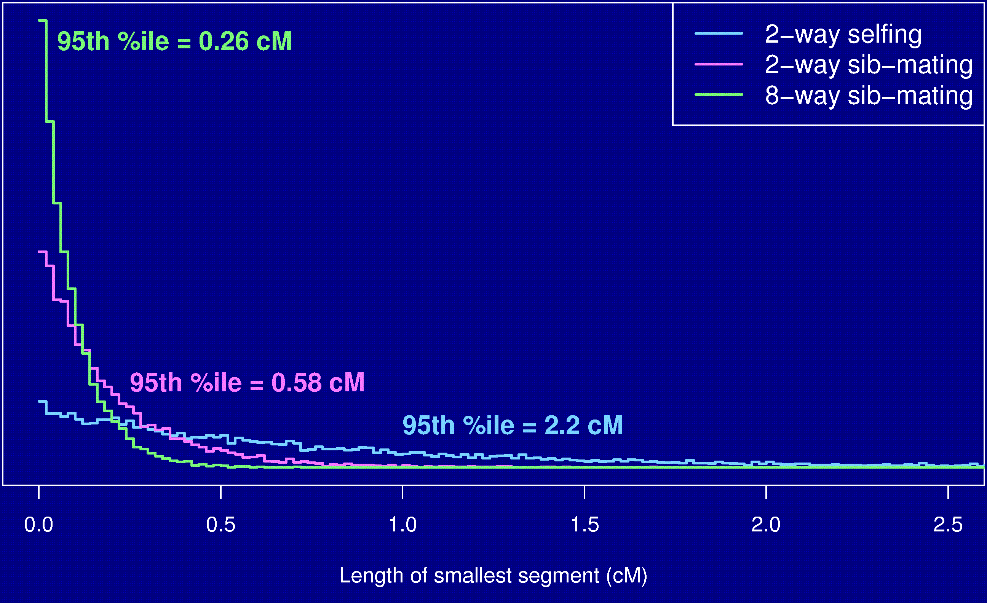
Length of smallest segment

Slide 38
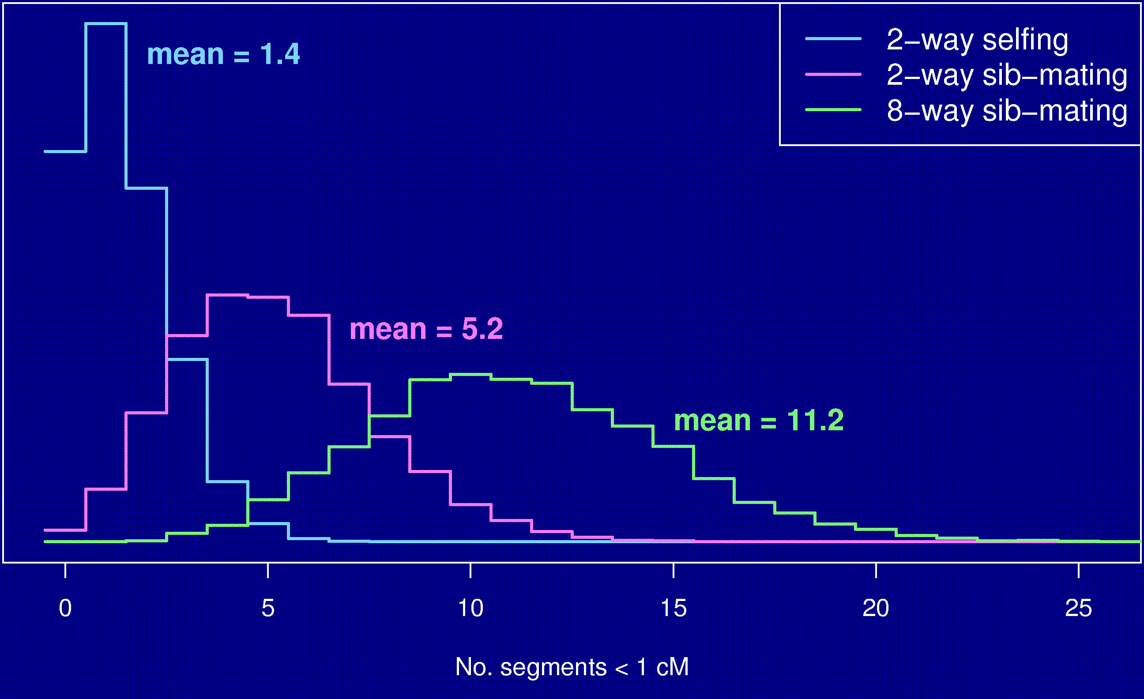
No. segments < 1 cM

Slide 39
Summary
RILs are useful.
The Collaborative Cross could provide “one-stop shopping” for gene mapping in the mouse.
Use of such 8-way RILs requires an understanding of the breakpoint process.
We’ve extended Haldane & Waddington’s results to the case of 8-way RILs.
We’ve shown clustering of breakpoints in RILs by sib-mating, even in the presence of strong crossover interference.
Formulae for the 3-point problem in 8-way RILs elude us,
but we can obtain numerical results.
We used simulations to study other features of RILs.

Slide 40
The key points
R = 7 r / (1 + 6 r)
2-point probabilities, for the autosomes of 8-way RILs, have all off-diagonal elements identical.
3-point coincidence on 8-way RIL is near 1.

