Slide 1
How to display data badly

Slide 2
Using Microsoft Excel to obscure your data and annoy your readers

Slide 3
Inspiration
This lecture was inspired by
H Wainer (1984) How to display data badly. American Statistician 38(2):137-147
Dr. Wainer was the first to elucidate the principles of the bad display of data.
The now widespread use of Microsoft Excel has resulted in remarkable advances in the field.

Slide 4
General principles
The aim of good data graphics:
  Display data accurately and clearly.
Some rules for displaying data badly:
  Display as little information as possible.
  Obscure what you do show (with chart junk).
  Use pseudo-3d and color gratuitously.
  Make a pie chart (preferably in color and 3d).
  Use a poorly chosen scale.
  Ignore sig figs.

Slide 5
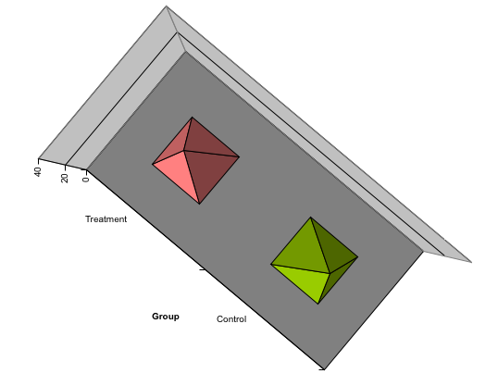
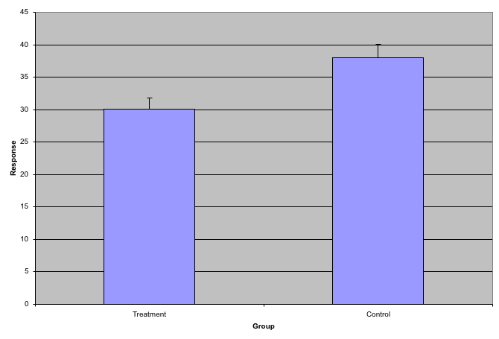
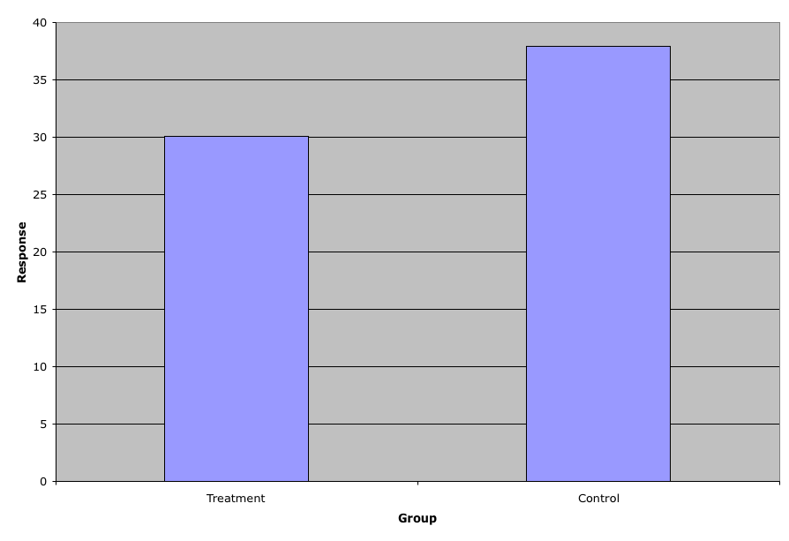
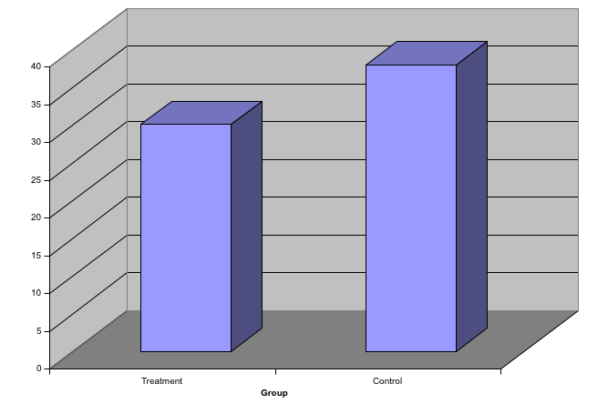
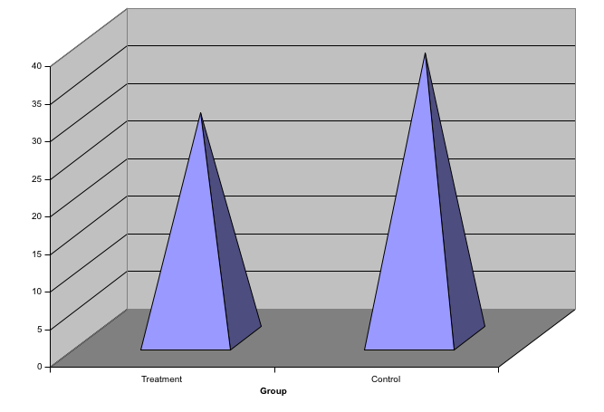
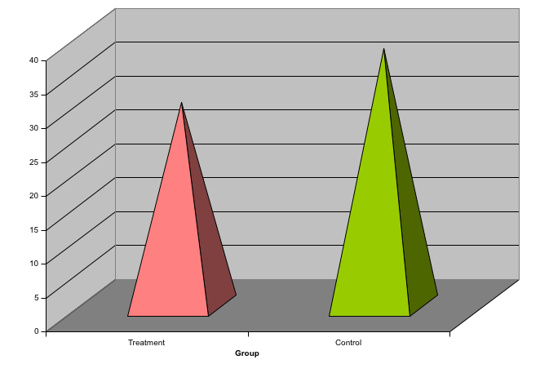
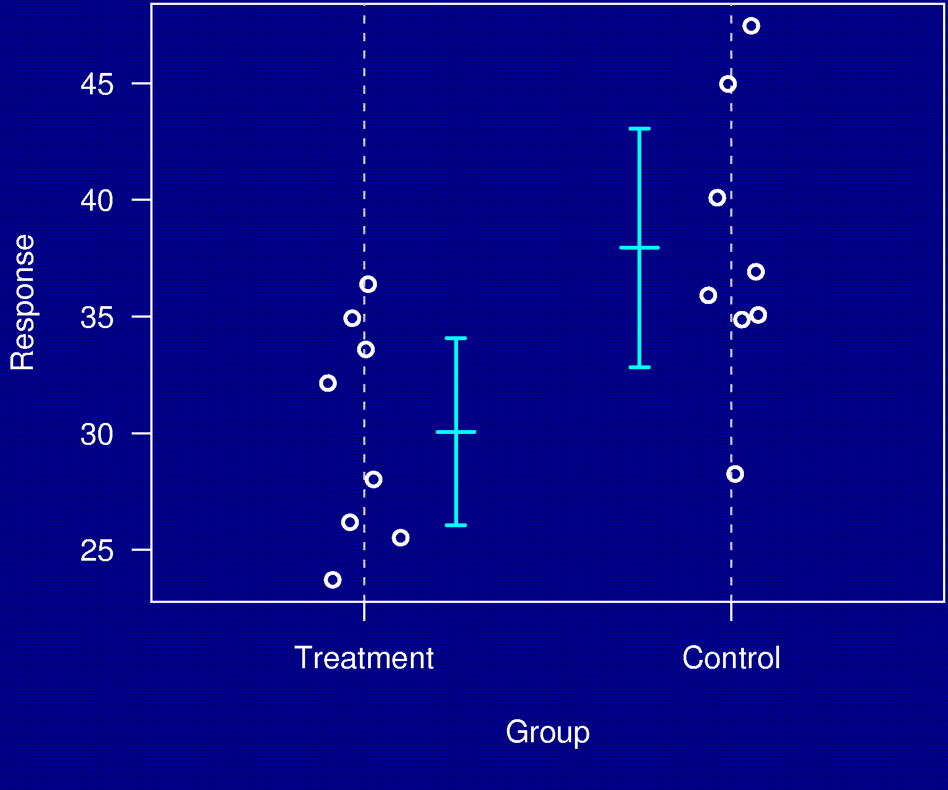
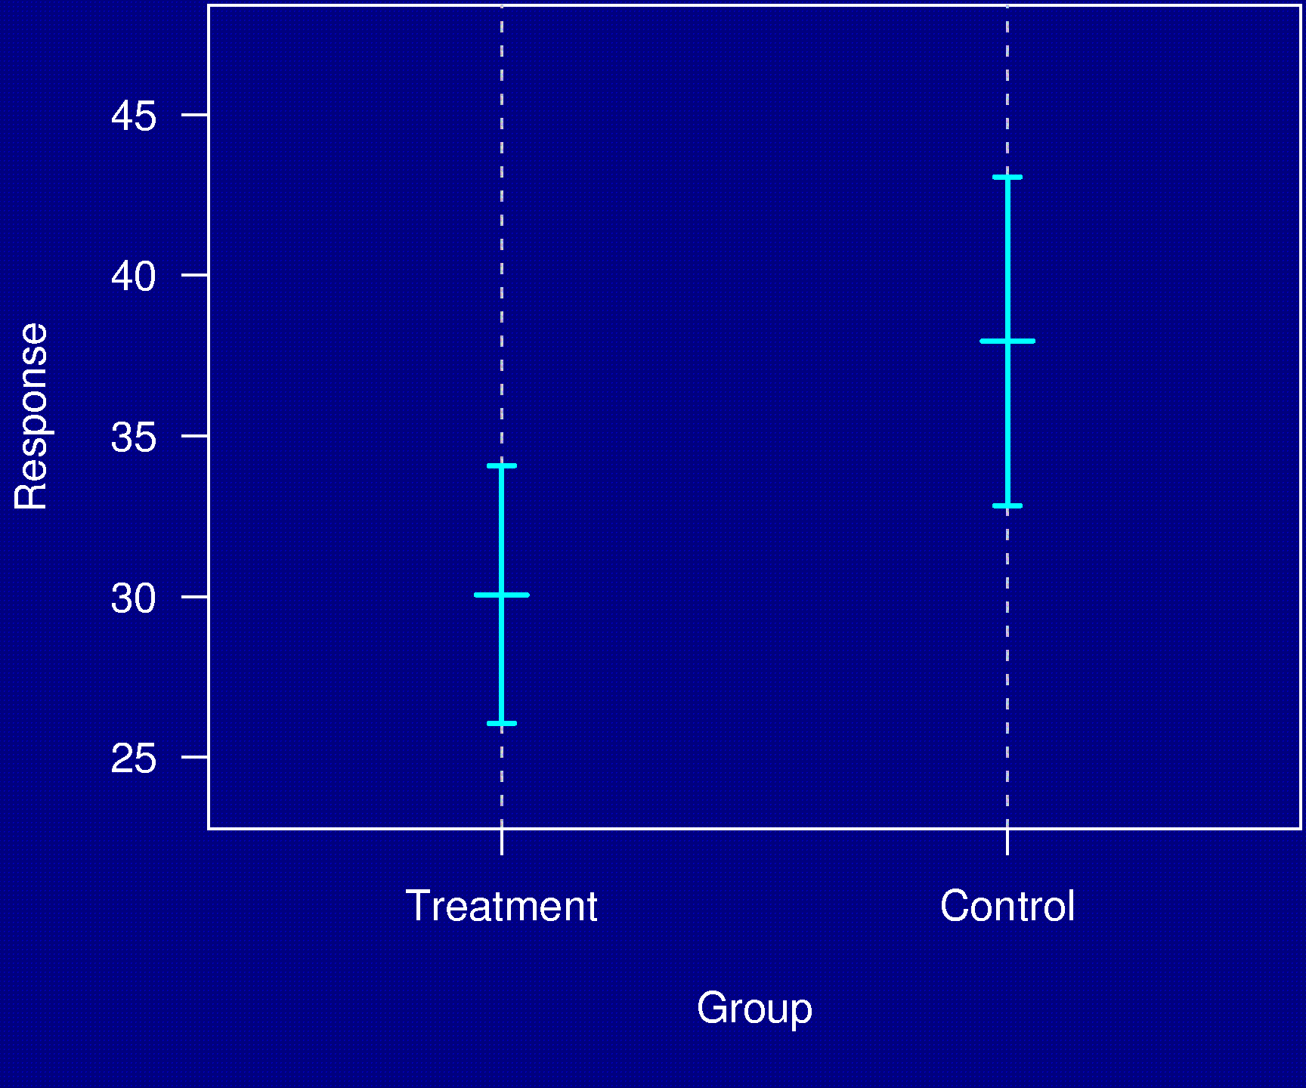
Example 1

Slide 6
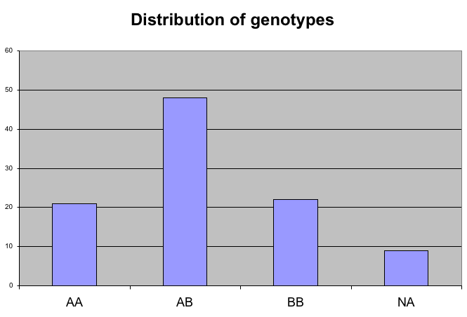
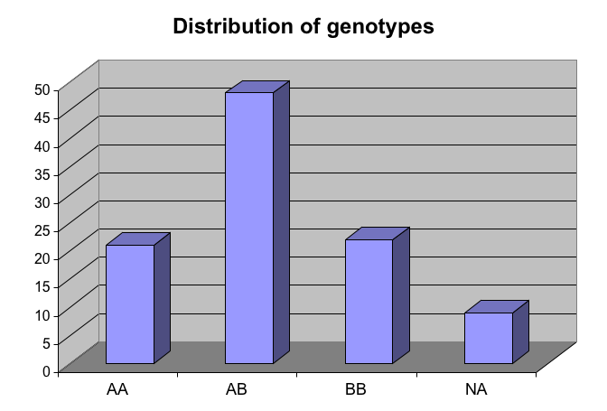
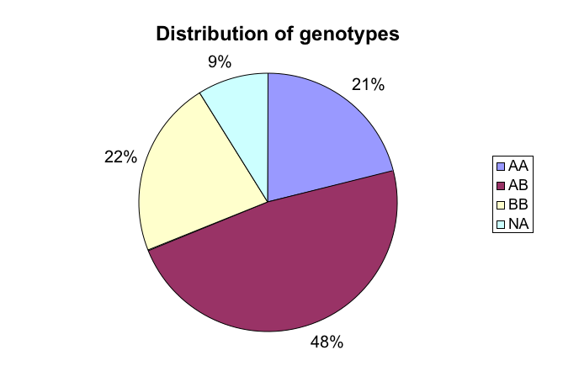
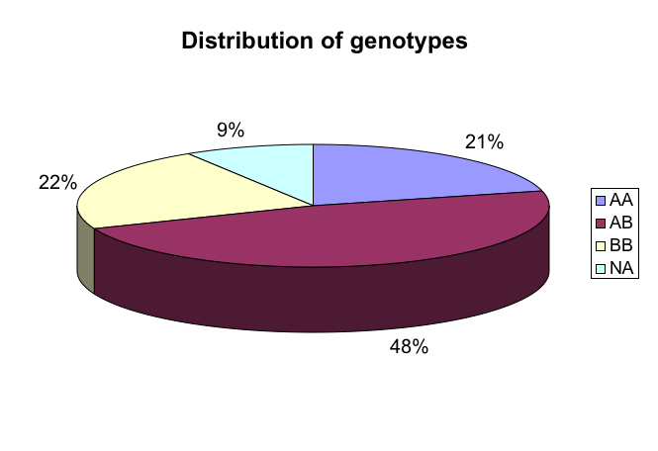
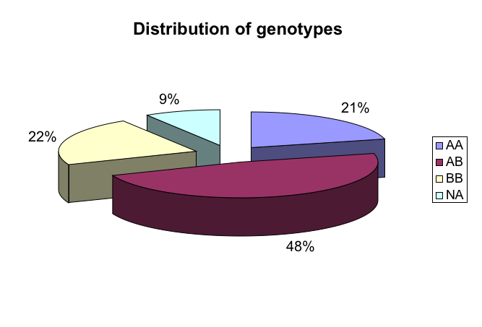
Example 2
Distribution of genotypes
AA 21%
AB 48%
BB 22%
missing 9%

Slide 7
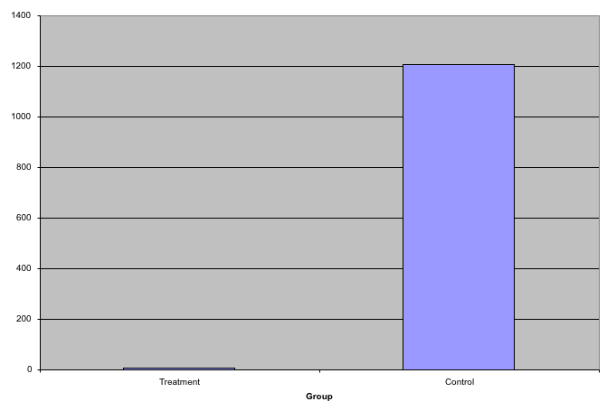
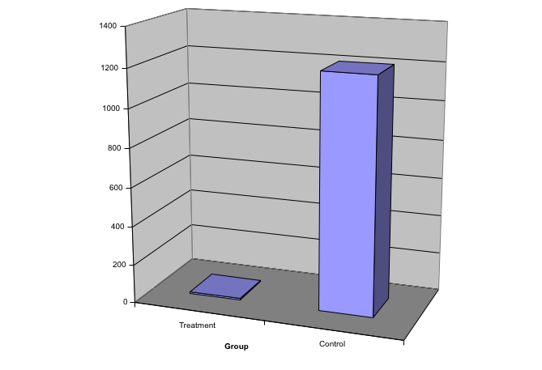
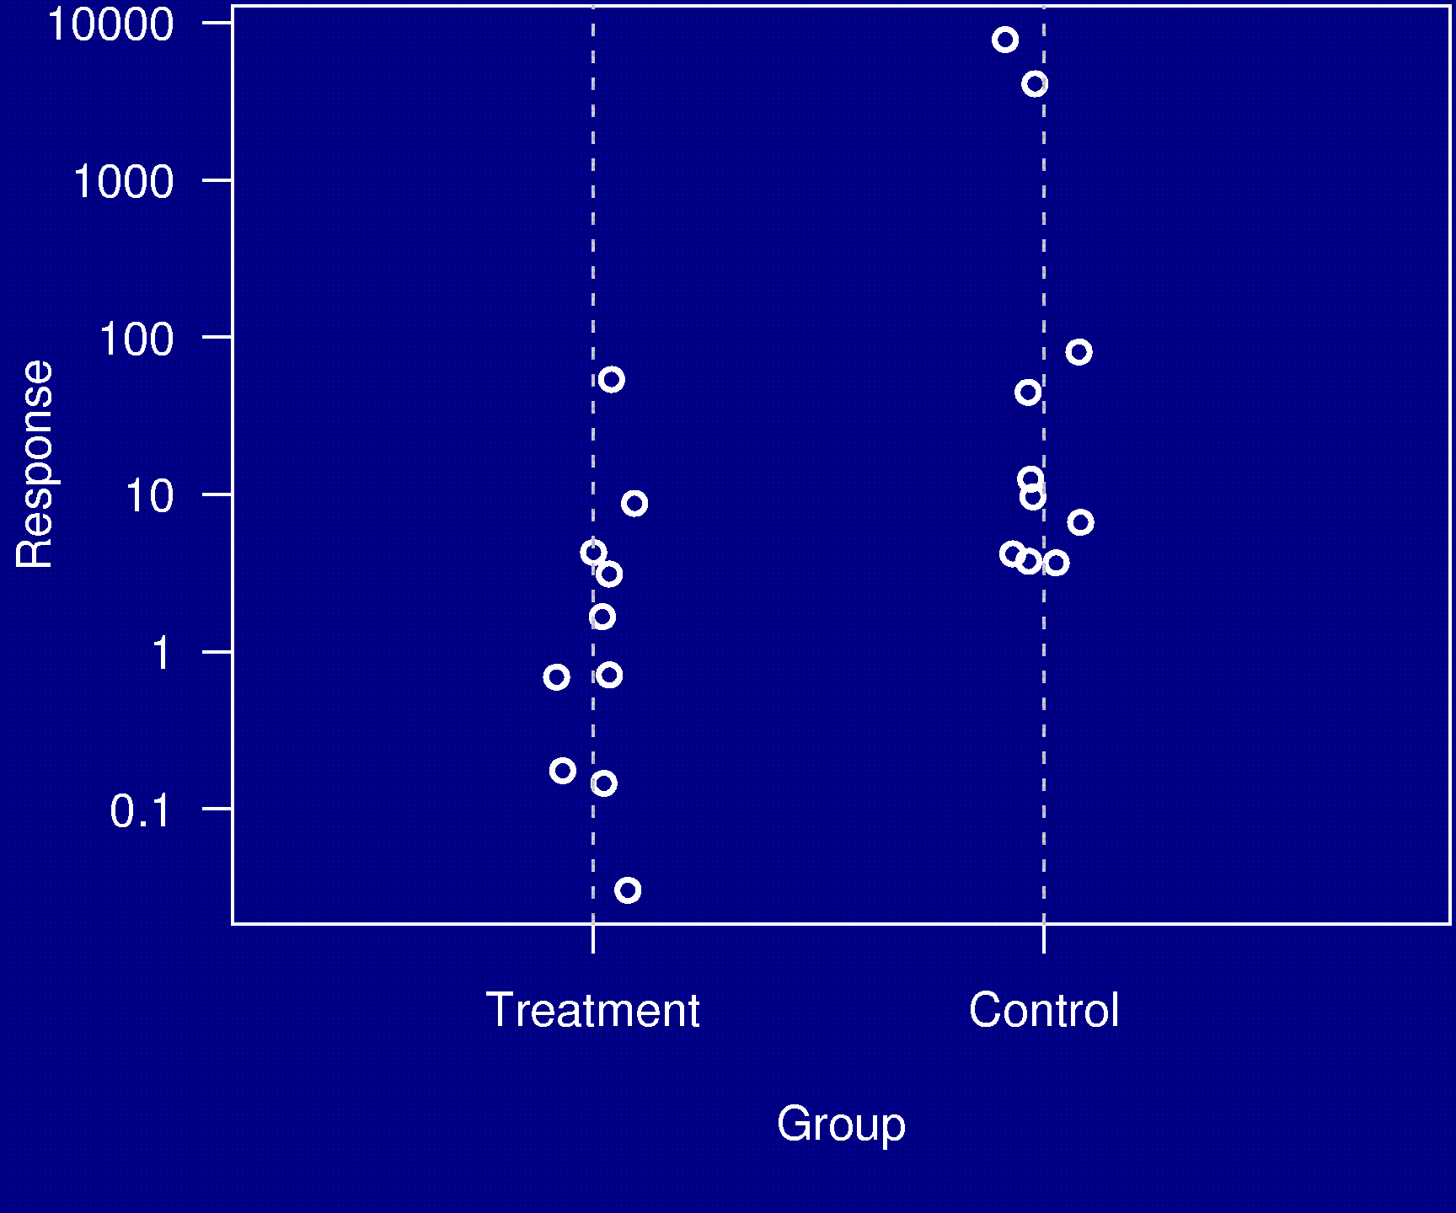
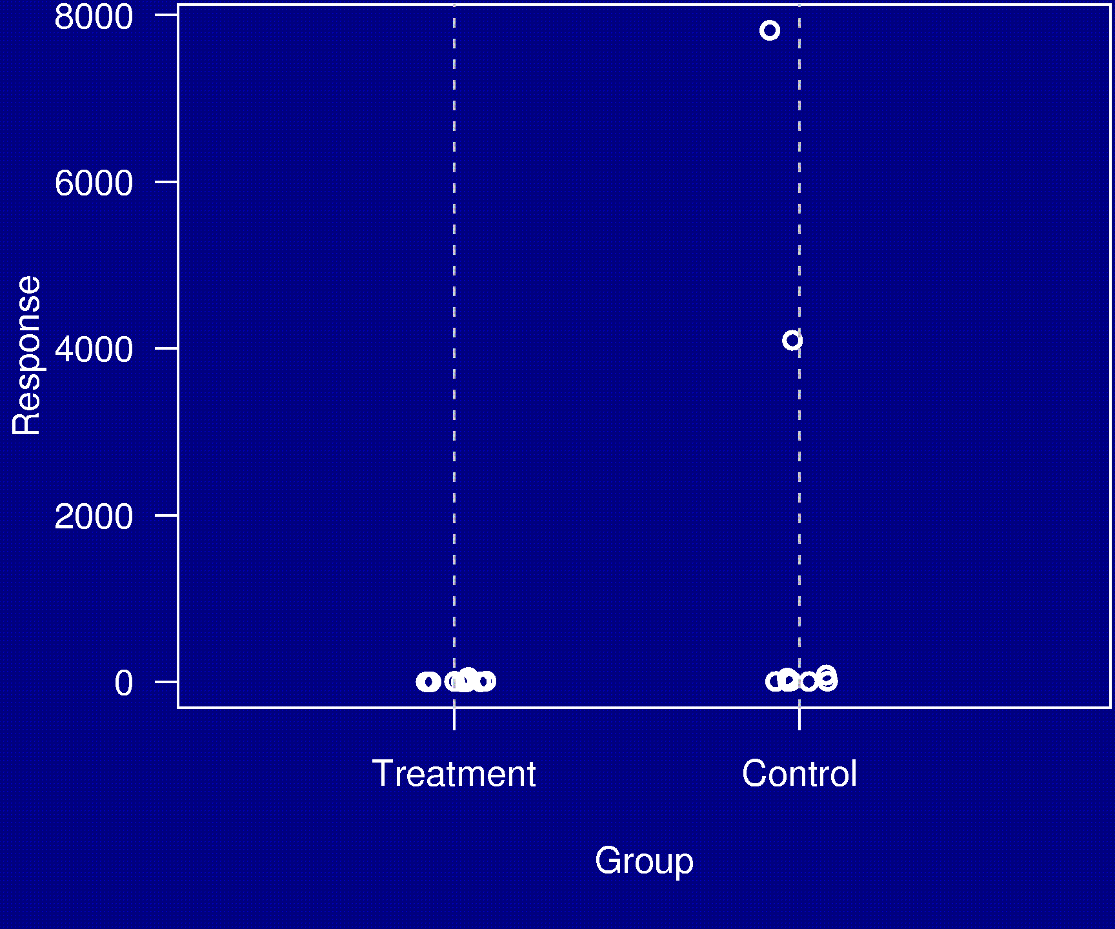
Example 3

Slide 8
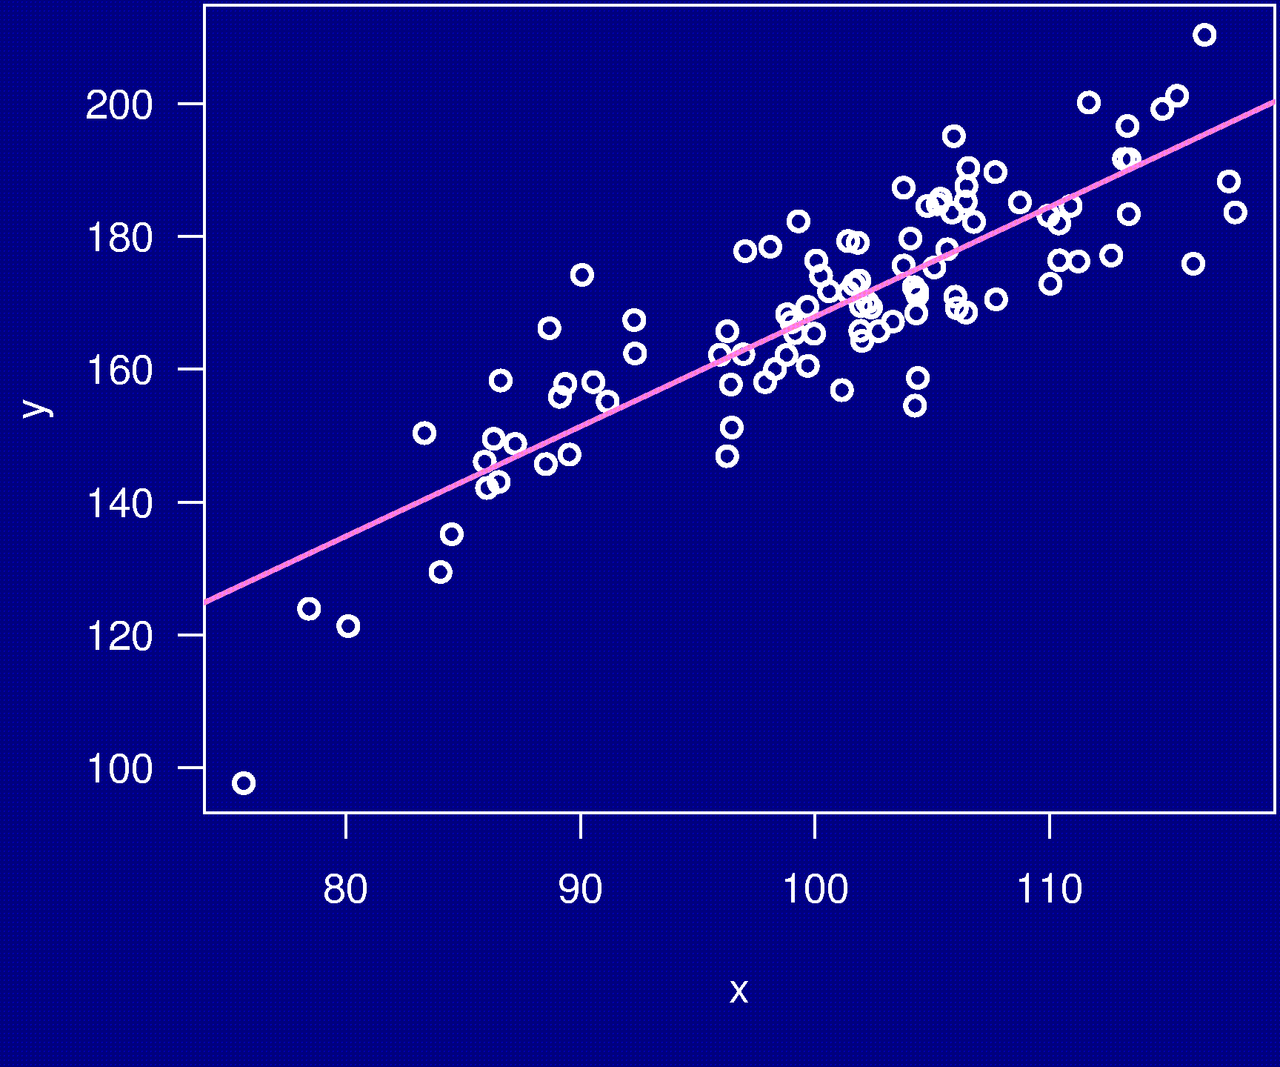
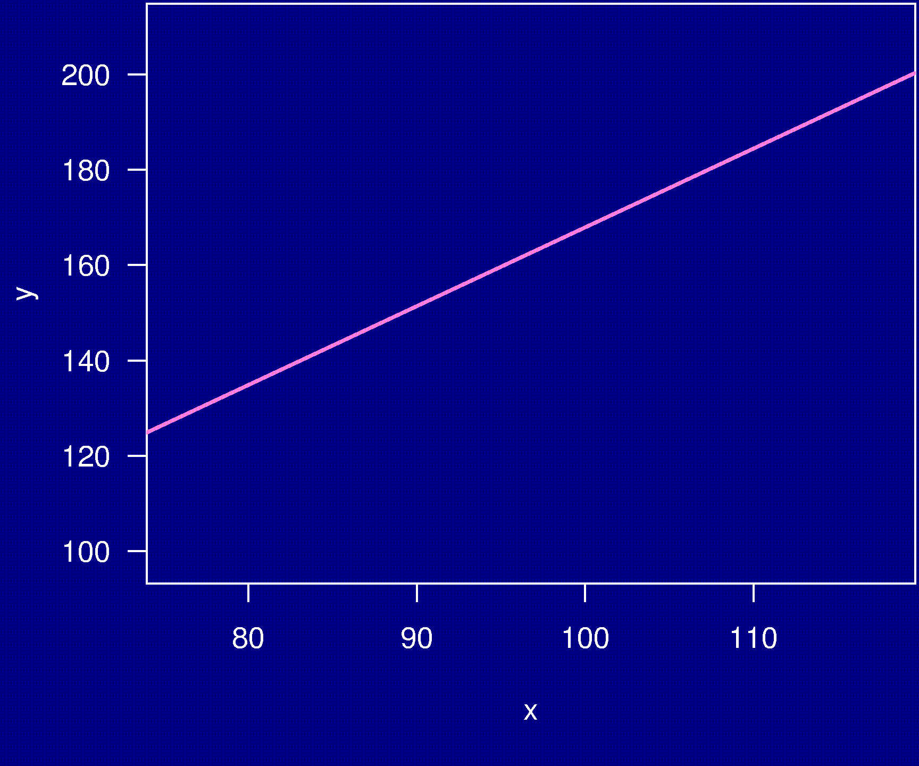
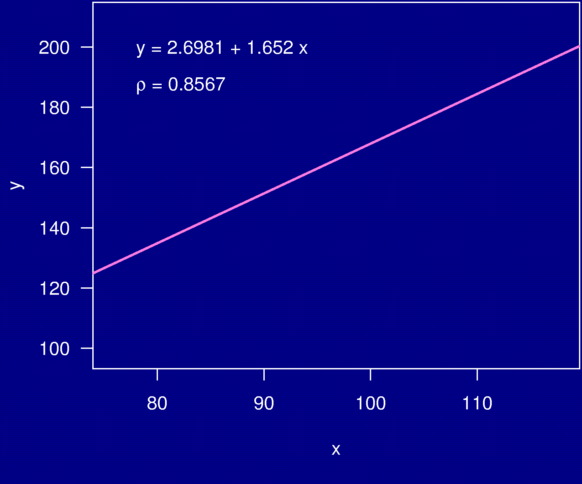
Example 4

Slide 9
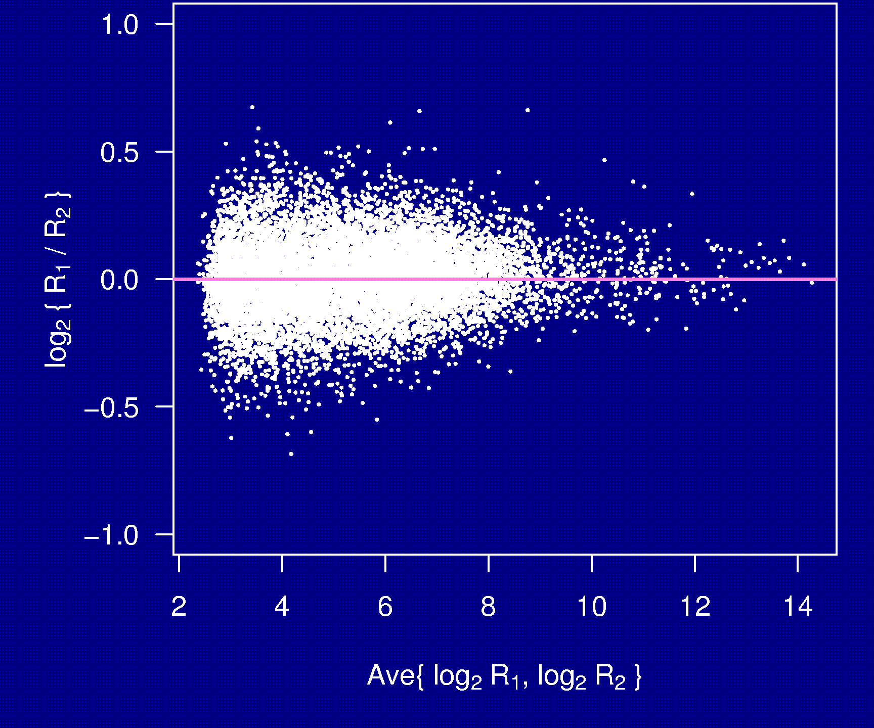
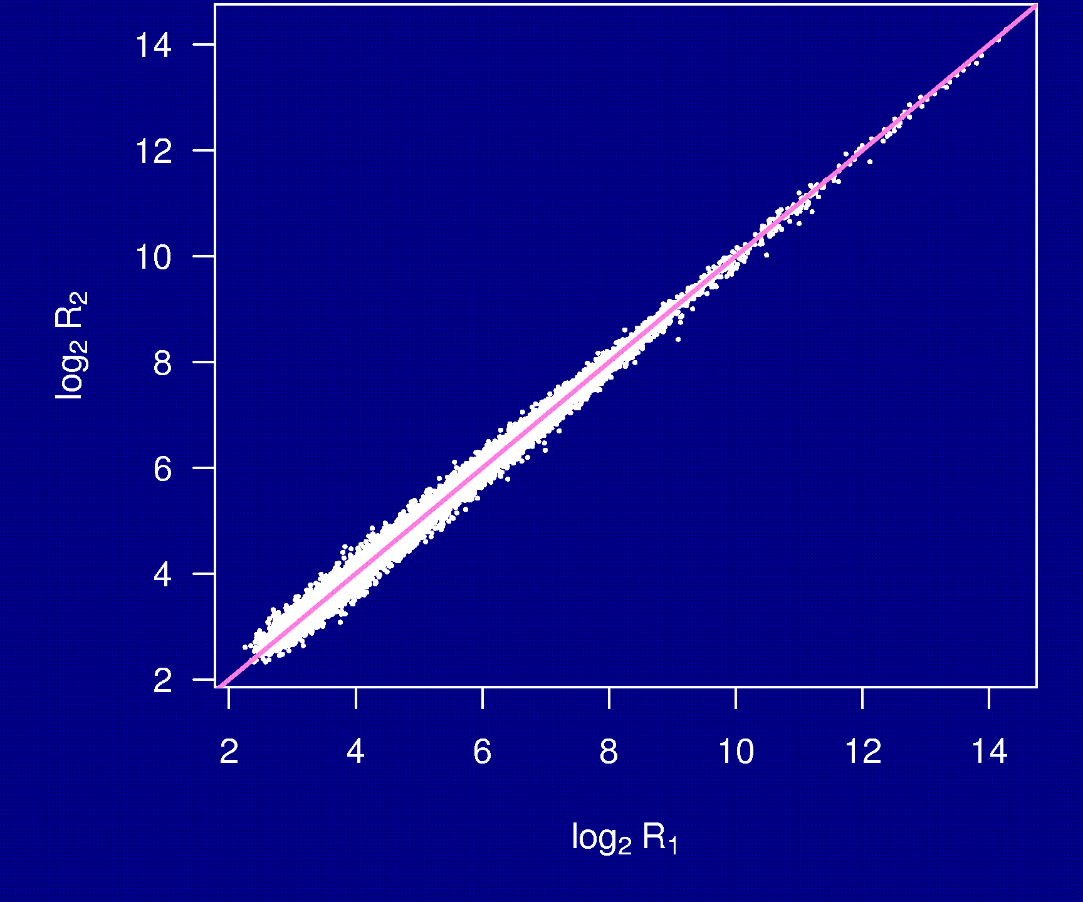
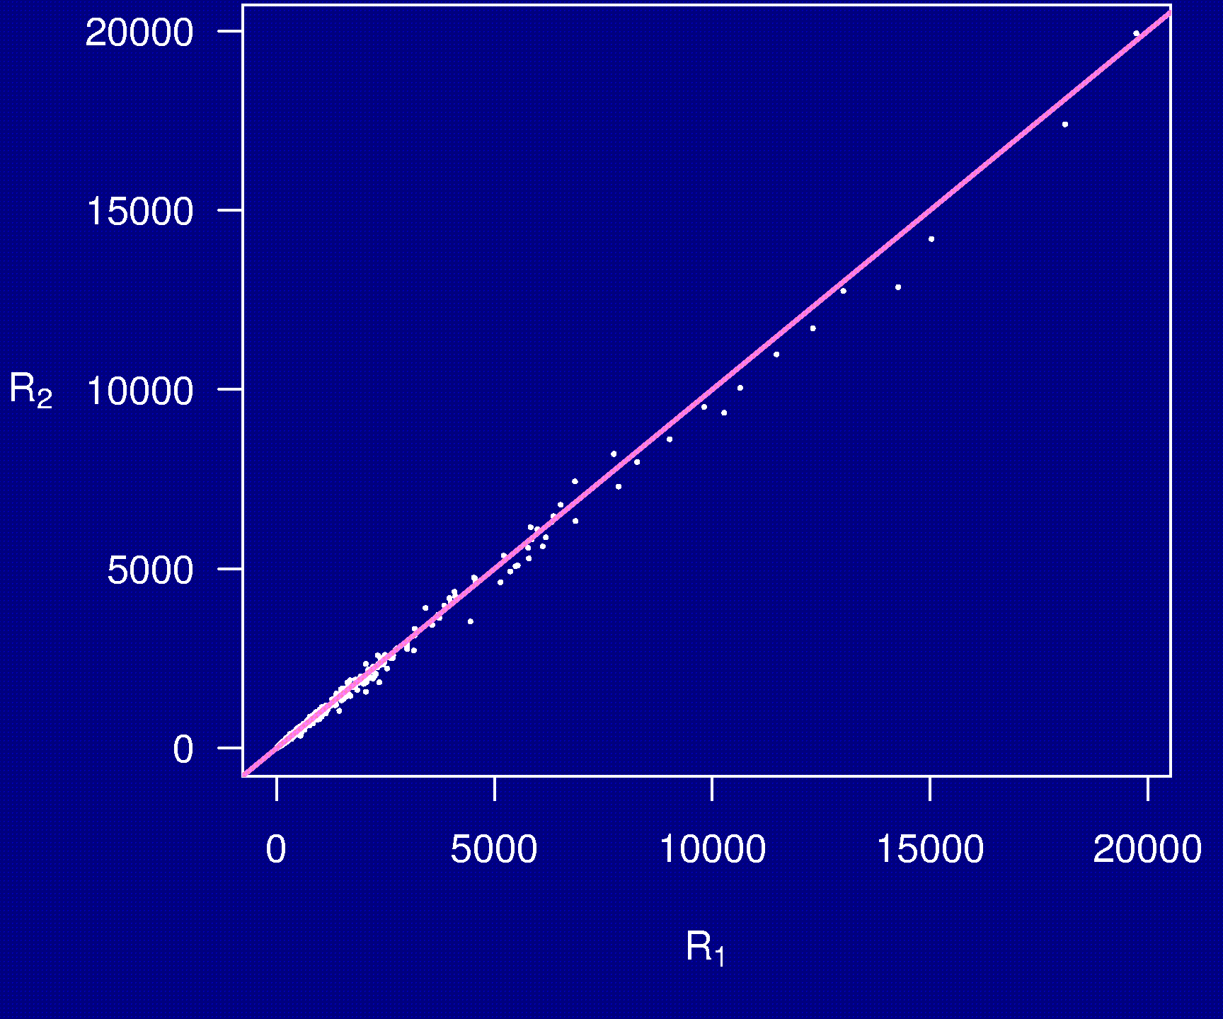
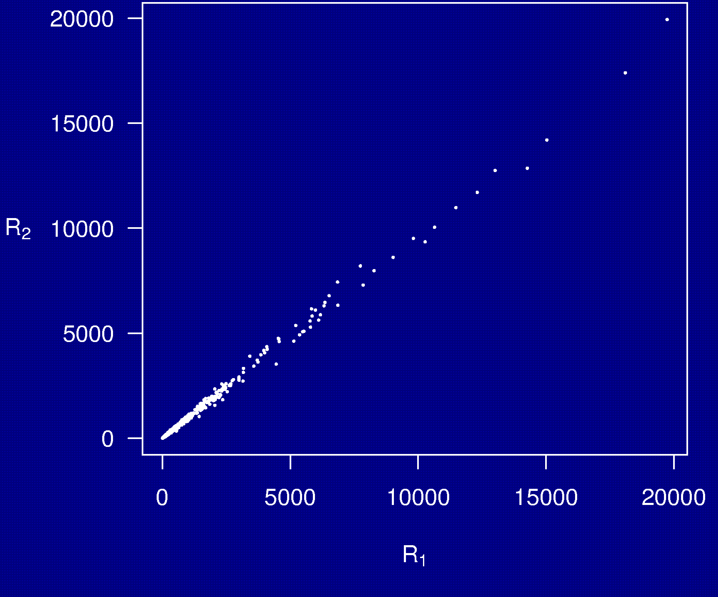
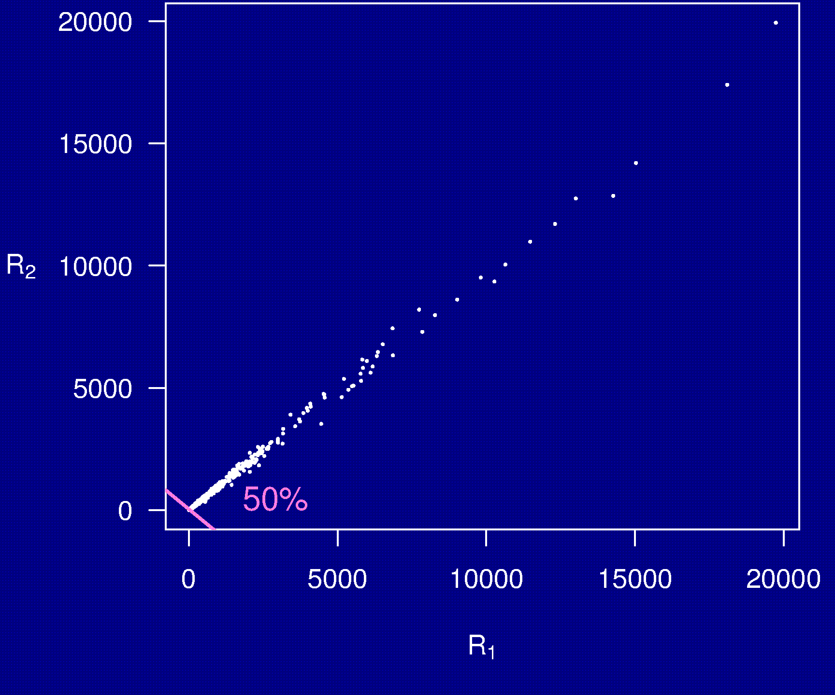
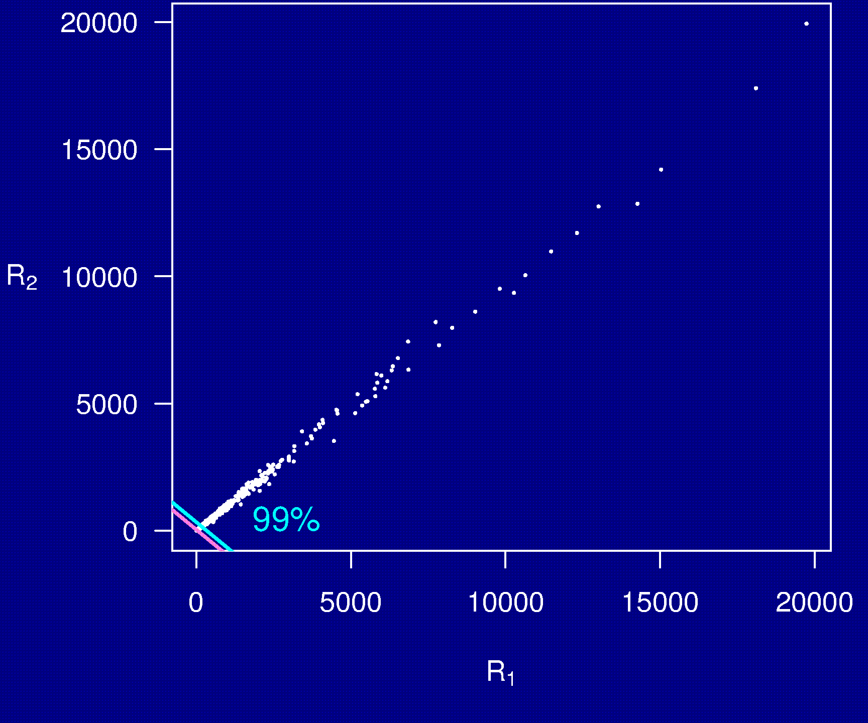
Example 5

Slide 10
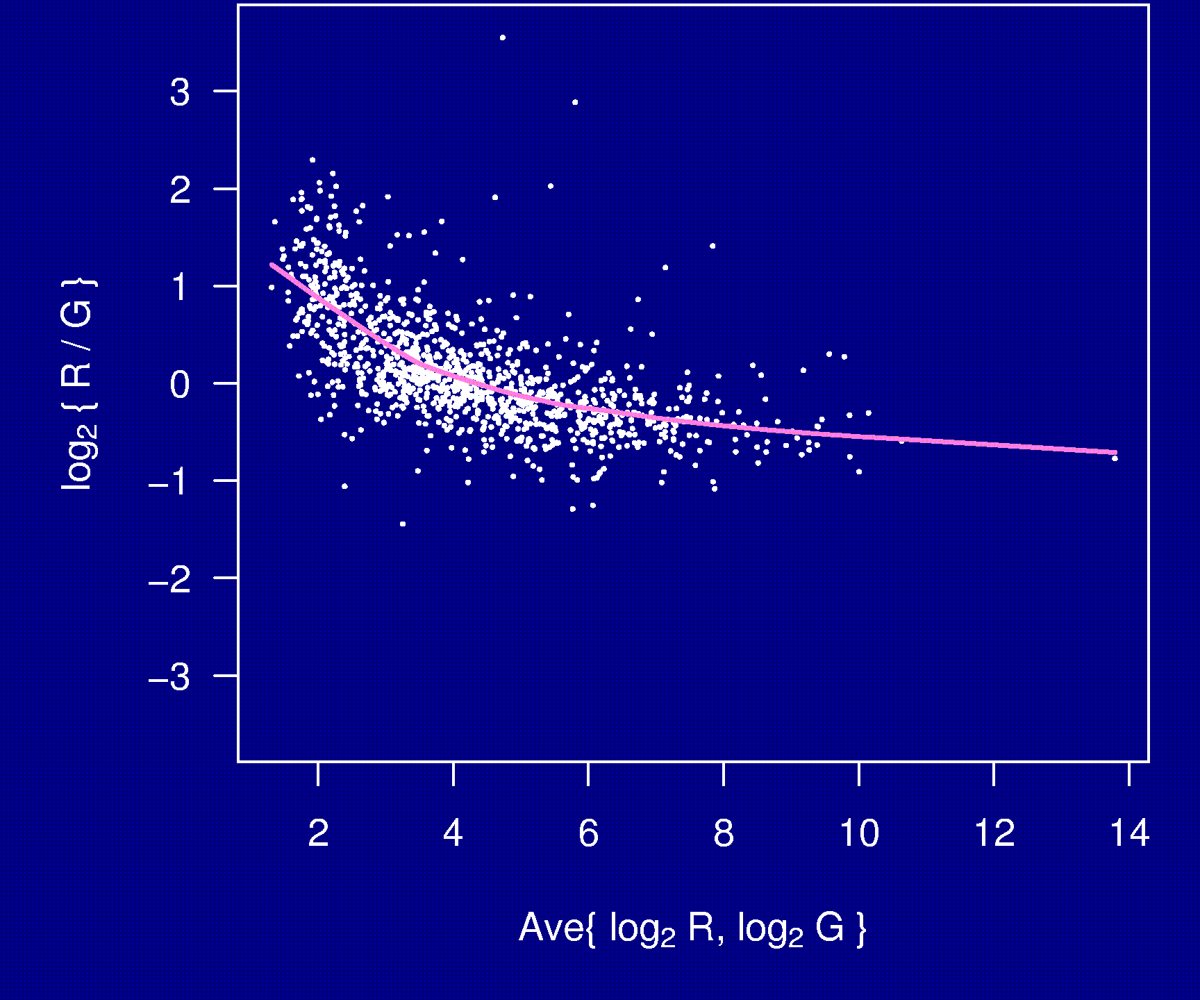
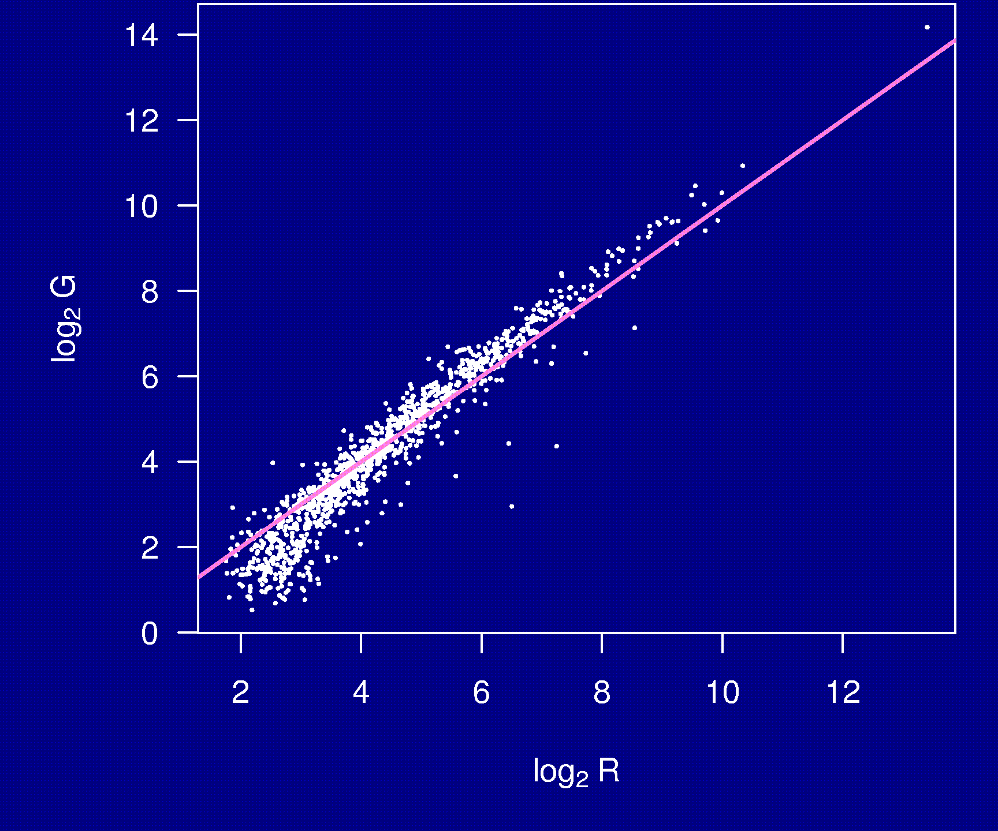
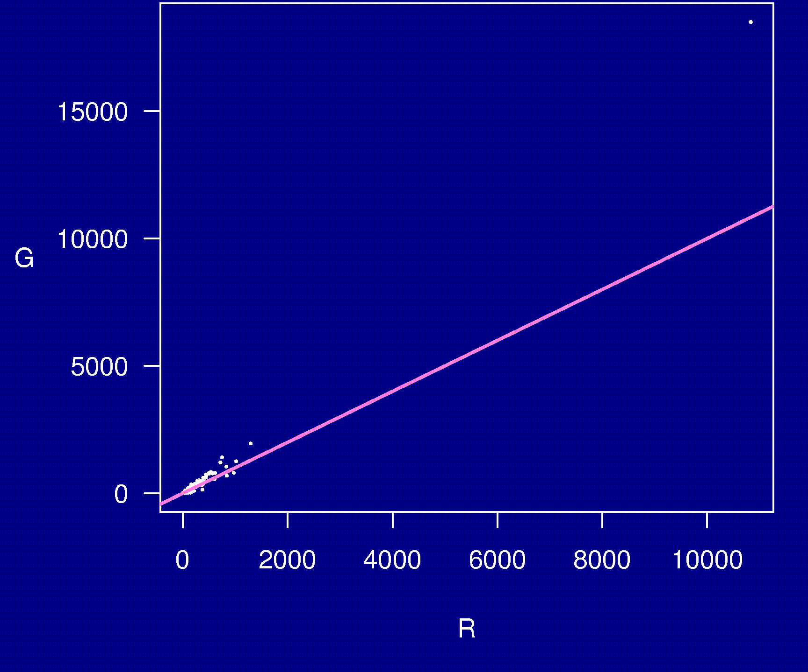
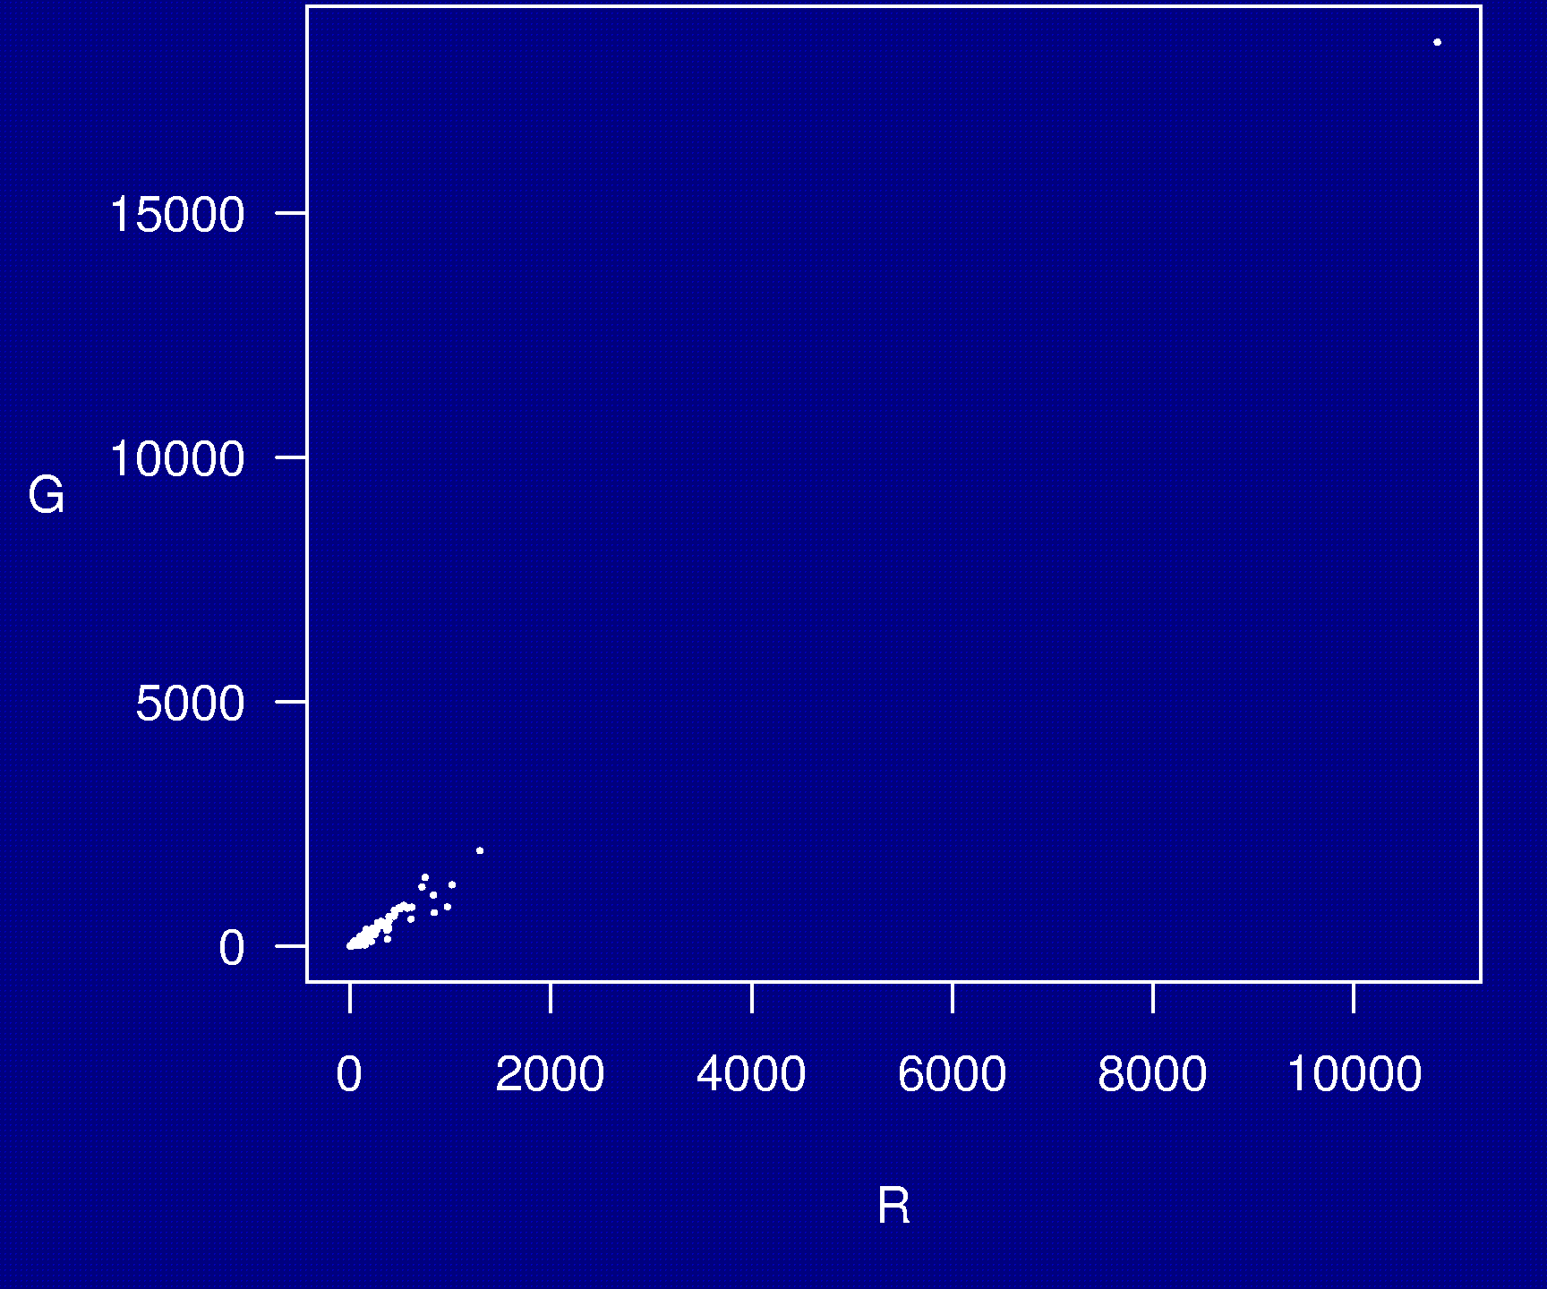
Example 6

Slide 11
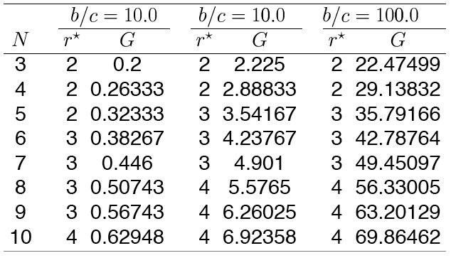
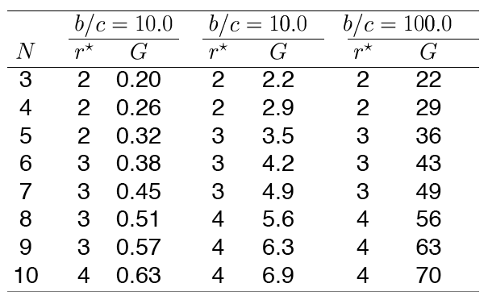
Example 7

Slide 12
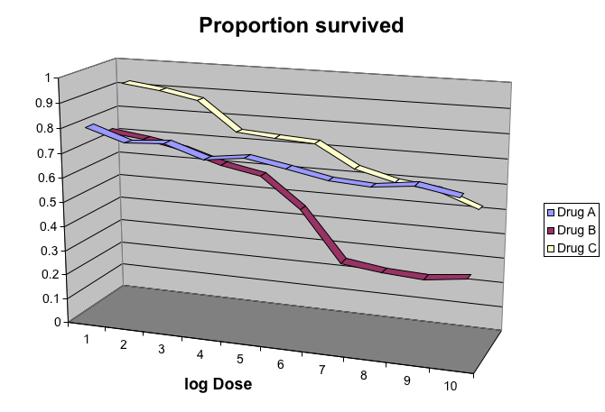
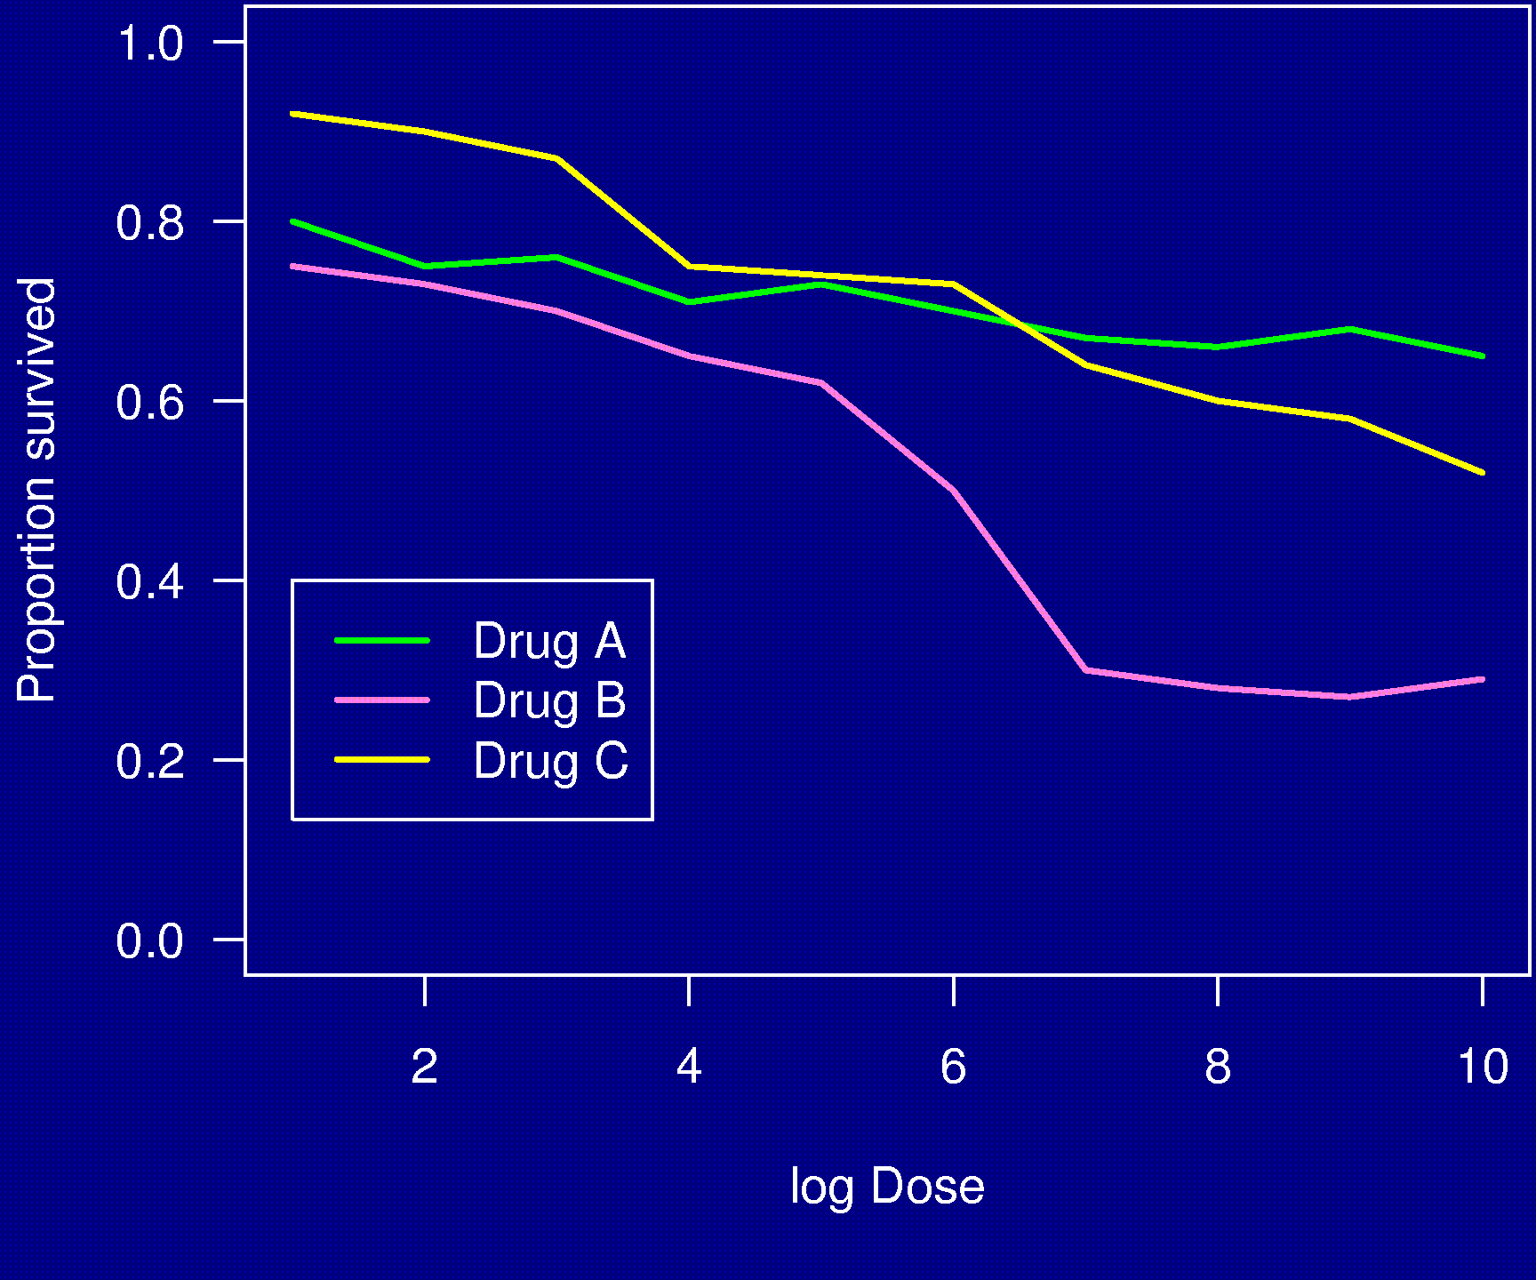
Example 8

Slide 13
Displaying data well
Be accurate and clear.
Let the data speak.
  Show as much information as possible, taking care not to obscure the message.
Science not sales.
  Avoid unnecessary frills — esp. gratuitous 3d.
In tables, every digit should be meaningful. Don’t drop ending 0’s.

Slide 14
Further reading
ER Tufte (1983) The visual display of quantitative information. Graphics Press.
ER Tufte (1990) Envisioning information. Graphics Press.
ER Tufte (1997) Visual explanations. Graphics Press.
WS Cleveland (1993) Visualizing data. Hobart Press.
WS Cleveland (1994) The elements of graphing data. CRC Press.

Slide 15
The top ten worst graphs
With apologies to the authors, we provide the following list of the top ten worst graphs in the scientific literature.
As these examples indicate, good scientists can make mistakes.

Slide 16
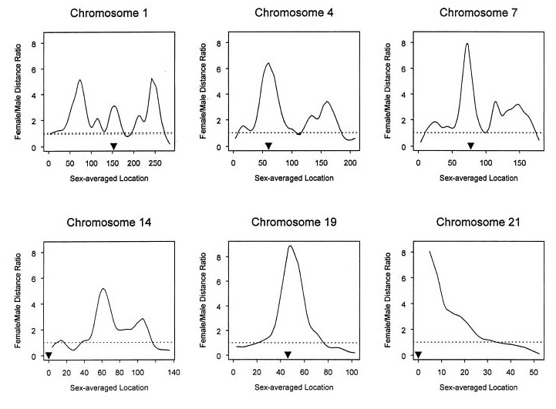
10
Broman et al., Am J Hum Genet 63:861-869, 1998, Fig. 1

Slide 17
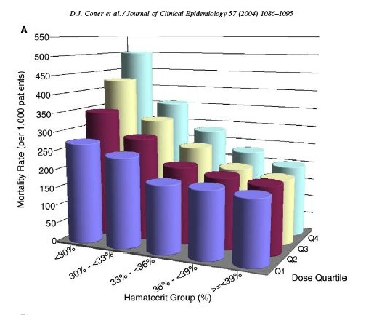
9
Cotter et al., J Clin Epidemiol 57:1086-1095, 2004, Fig 2

Slide 18
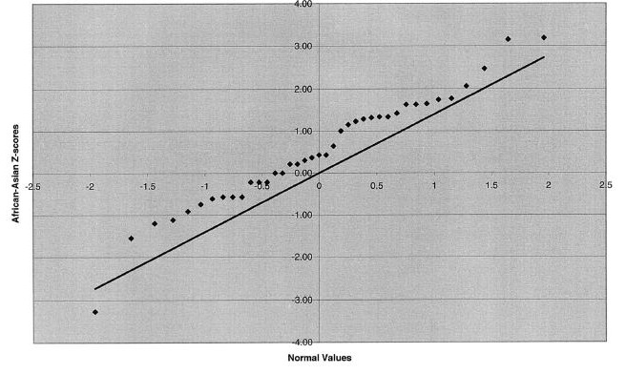
8
Jorgenson et al., Am J Hum Genet 76:276-290, 2005, Fig 2

Slide 19
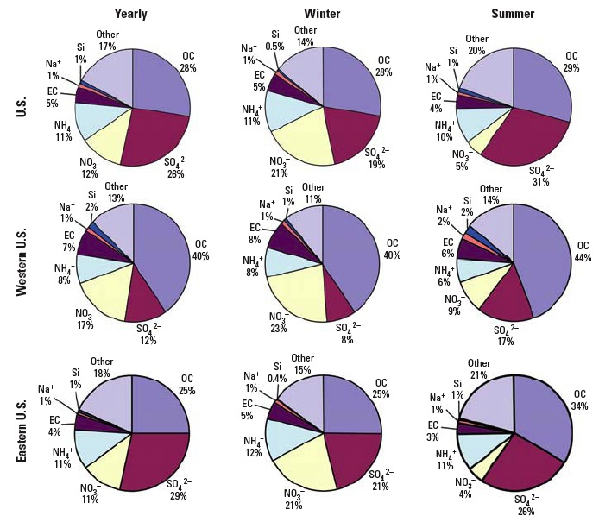
7
Bell et al., Env Health Persp 115:989-995, 2007, Fig 3

Slide 20
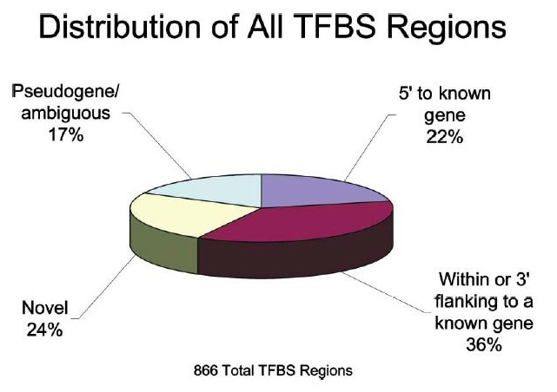
6
Cawley et al., Cell 116:499-509, 2004, Fig 1

Slide 21
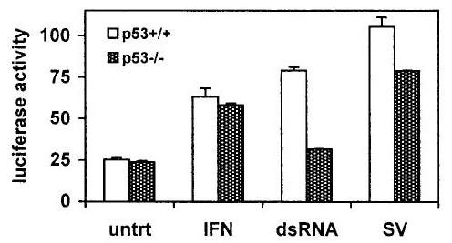
5
Hummer et al., J Virol 75:7774-7777, 2001, Fig 4

Slide 22
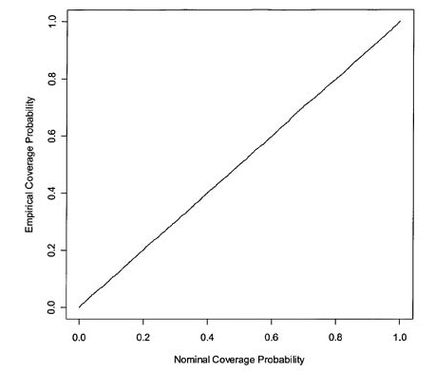
4
Epstein and Satten, Am J Hum Genet 73:1316-1329, 2003, Fig 1

Slide 23
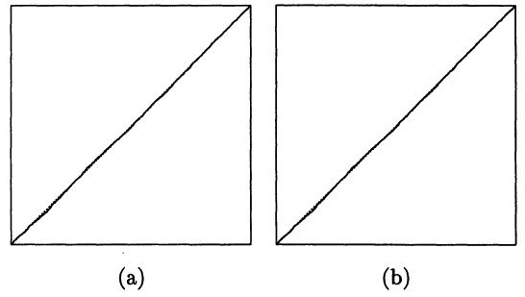
3
Mykland et al., J Am Stat Asso 90:233-241, 1995, Fig 1

Slide 24
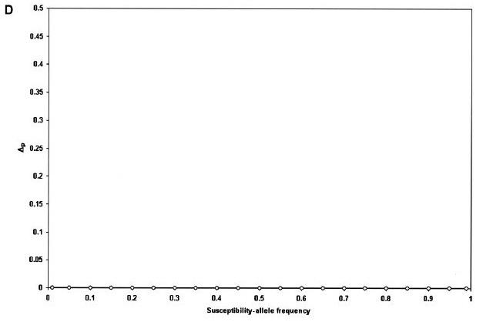
2
Wittke-Thompson et al., Am J Hum Genet 76:967-986, Fig 1

Slide 25
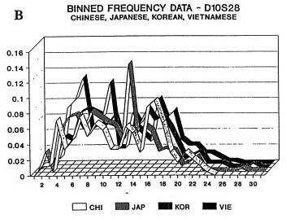
1
Roeder, Stat Sci 9:222-278, 1994, Fig 4

Slide 26


