Slide 1
How to display data badly

Slide 2
Using Microsoft Excel to obscure your data and annoy your readers

Slide 3
Inspiration
This lecture was inspired by
H Wainer (1984) How to display data badly. American Statistician 38(2):137-147
Dr. Wainer was the first to elucidate the principles of the bad display of data.
The now widespread use of Microsoft Excel has resulted in remarkable advances in the field.

Slide 4
General principles
The aim of good data graphics:
  Display data accurately and clearly.
Some rules for displaying data badly:
  Display as little information as possible.
  Obscure what you do show (with chart junk).
  Use pseudo-3d and color gratuitously.
  Make a pie chart (preferably in color and 3d).
  Use a poorly chosen scale.
  Ignore sig figs.

Slide 5
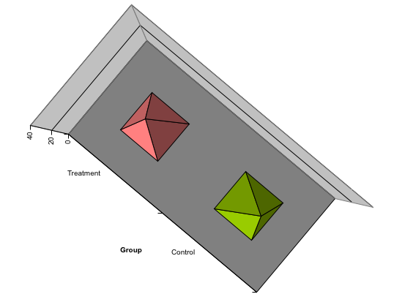
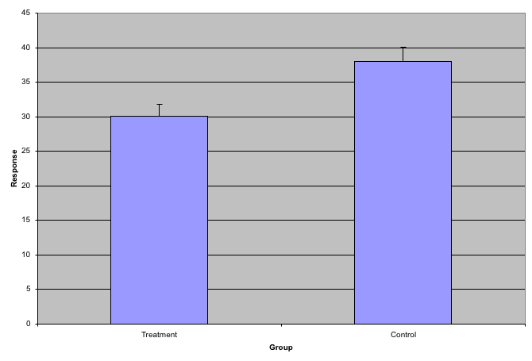
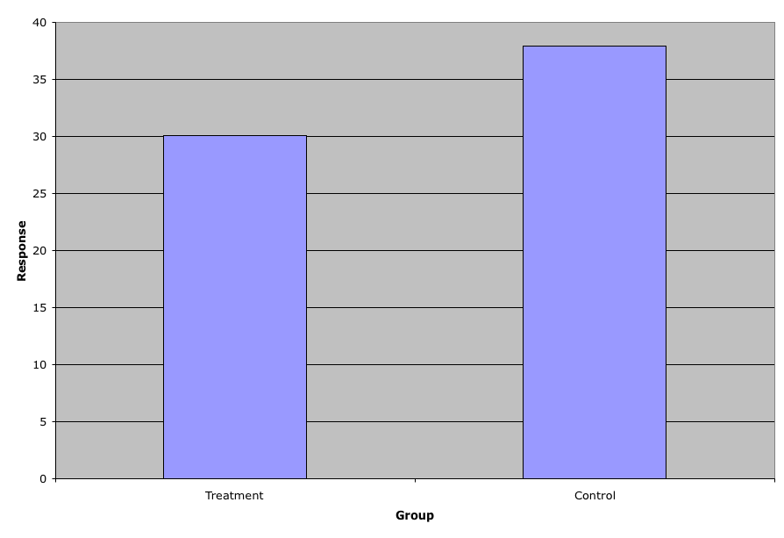
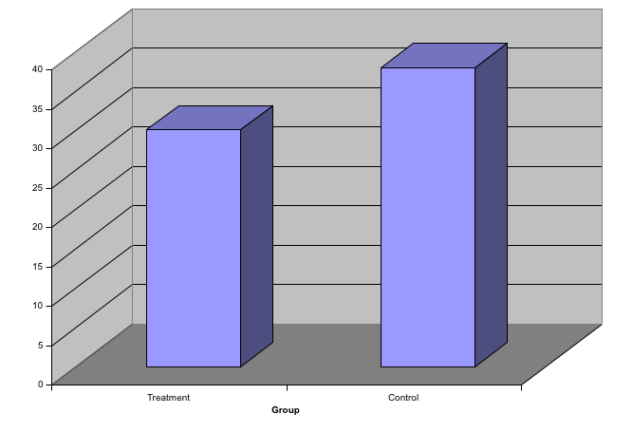
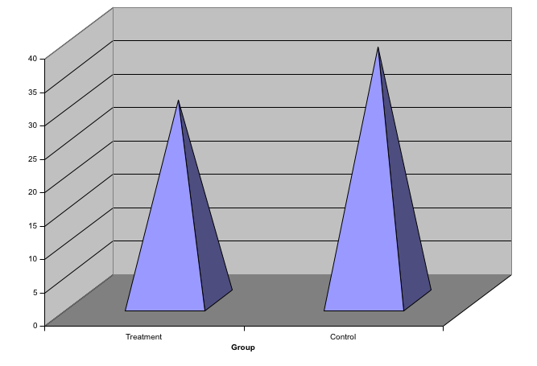
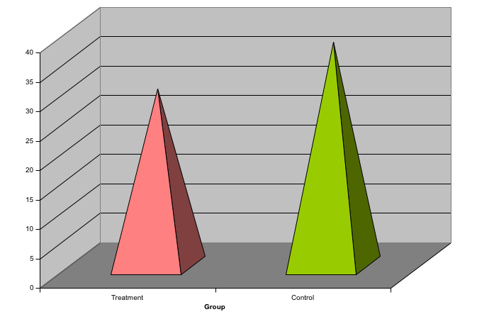
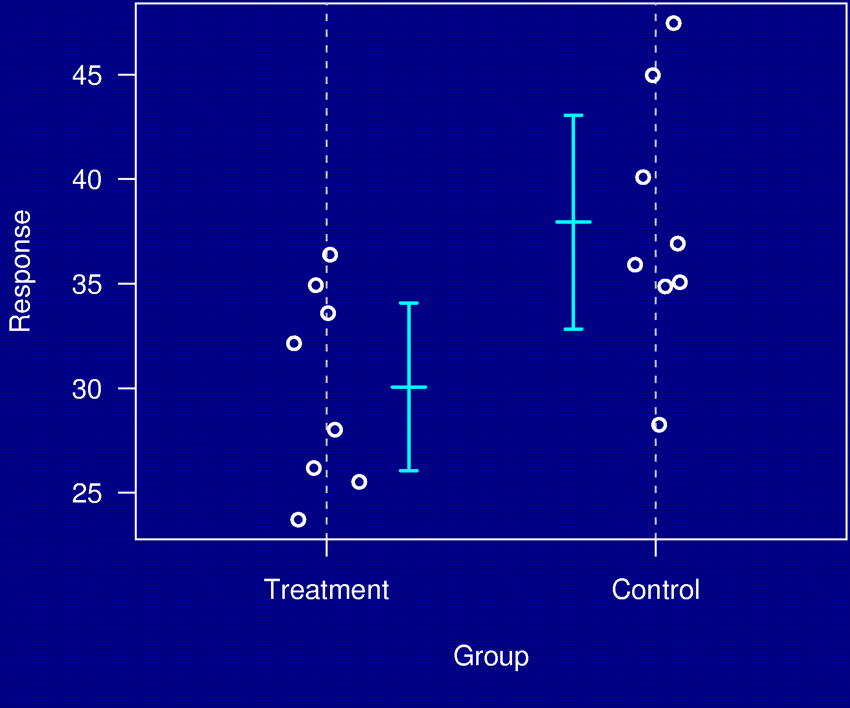
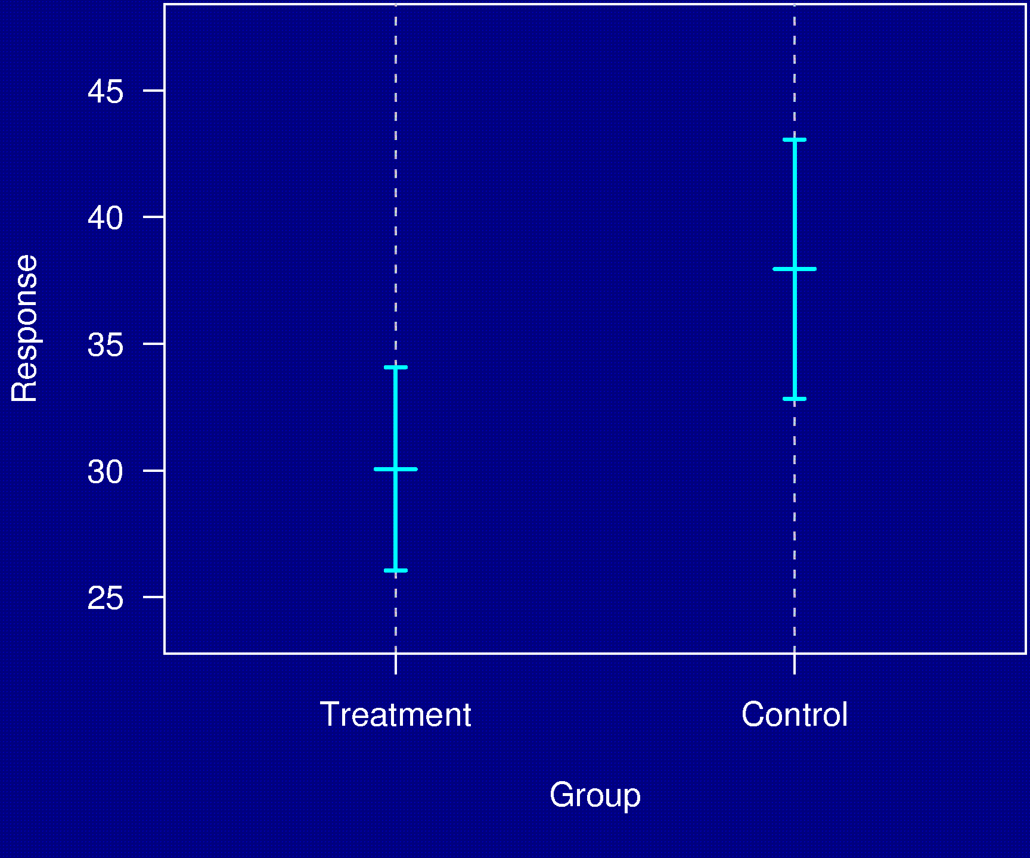
Example 1

Slide 6
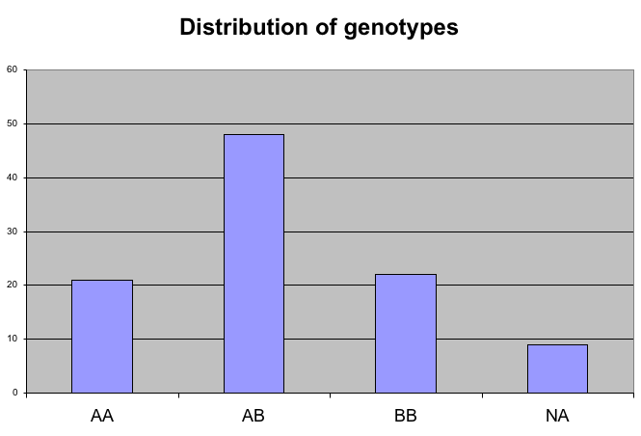
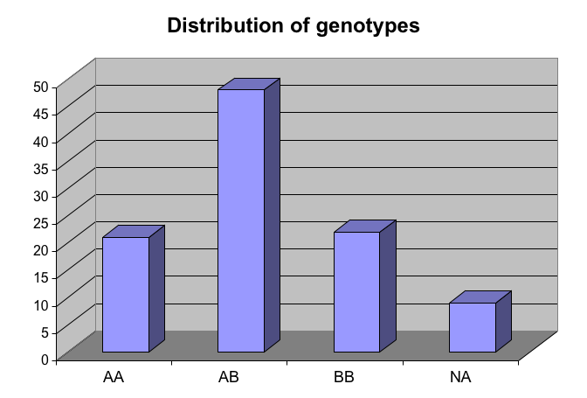
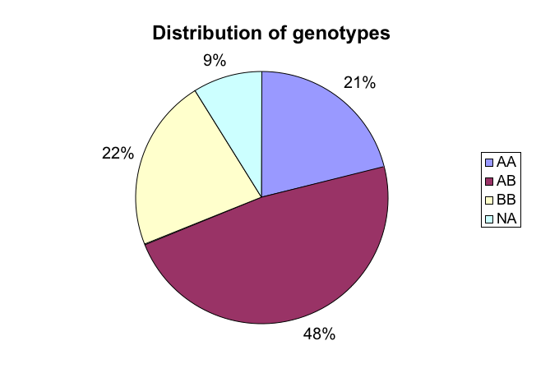
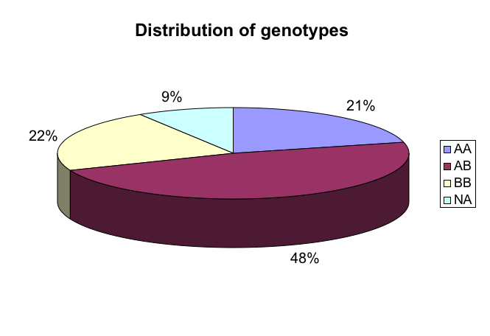
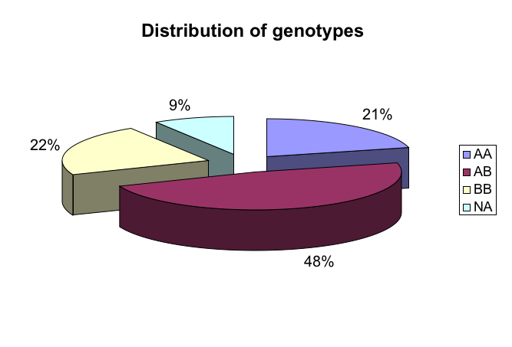
Example 2
Distribution of genotypes
AA 21%
AB 48%
BB 22%
missing 9%

Slide 7
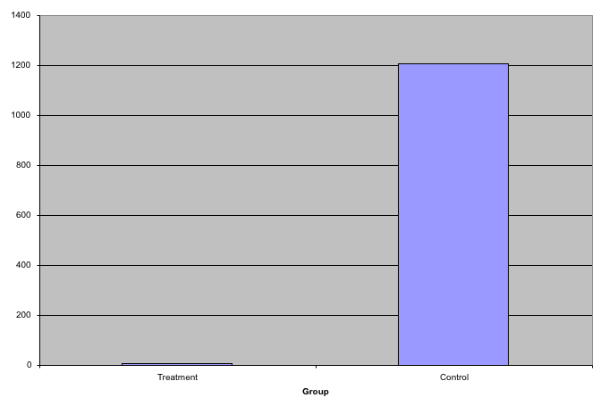
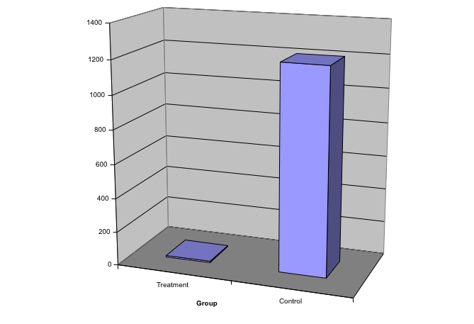
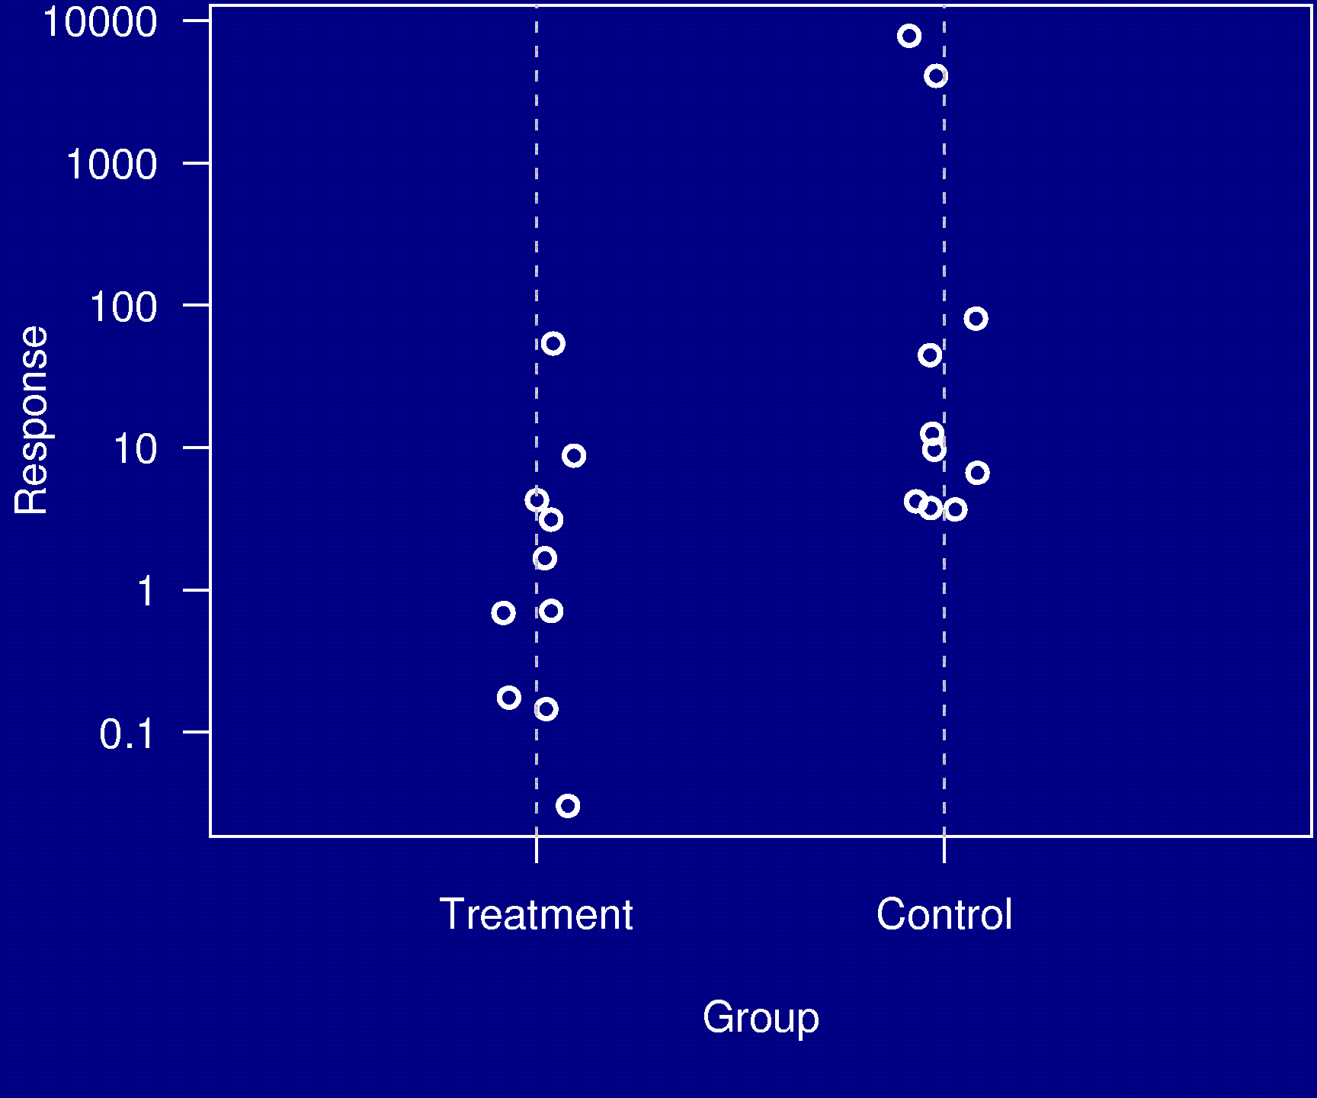
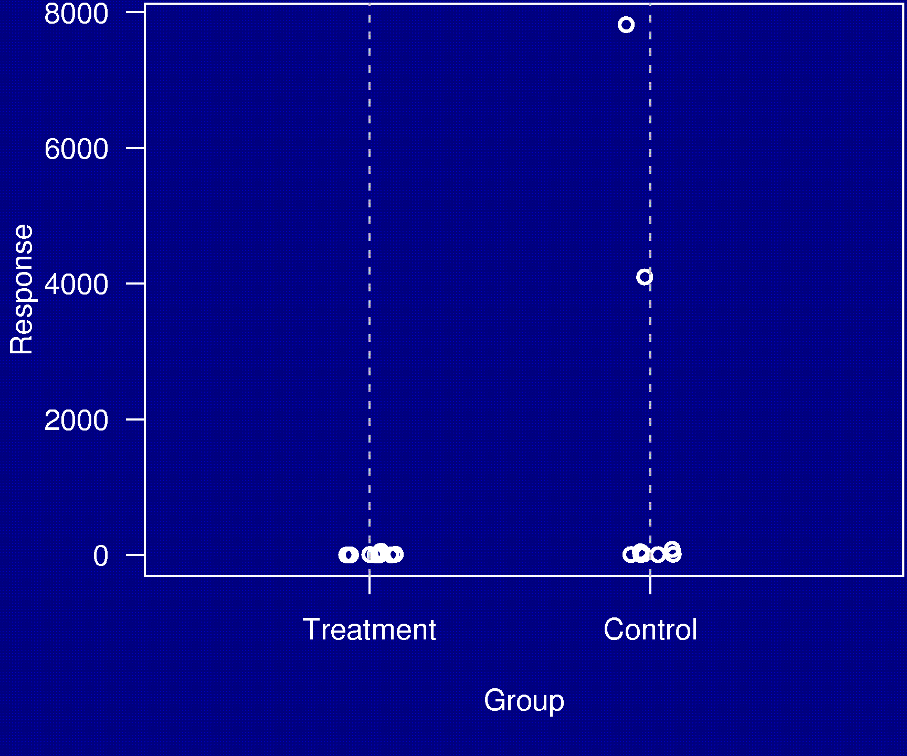
Example 3

Slide 8
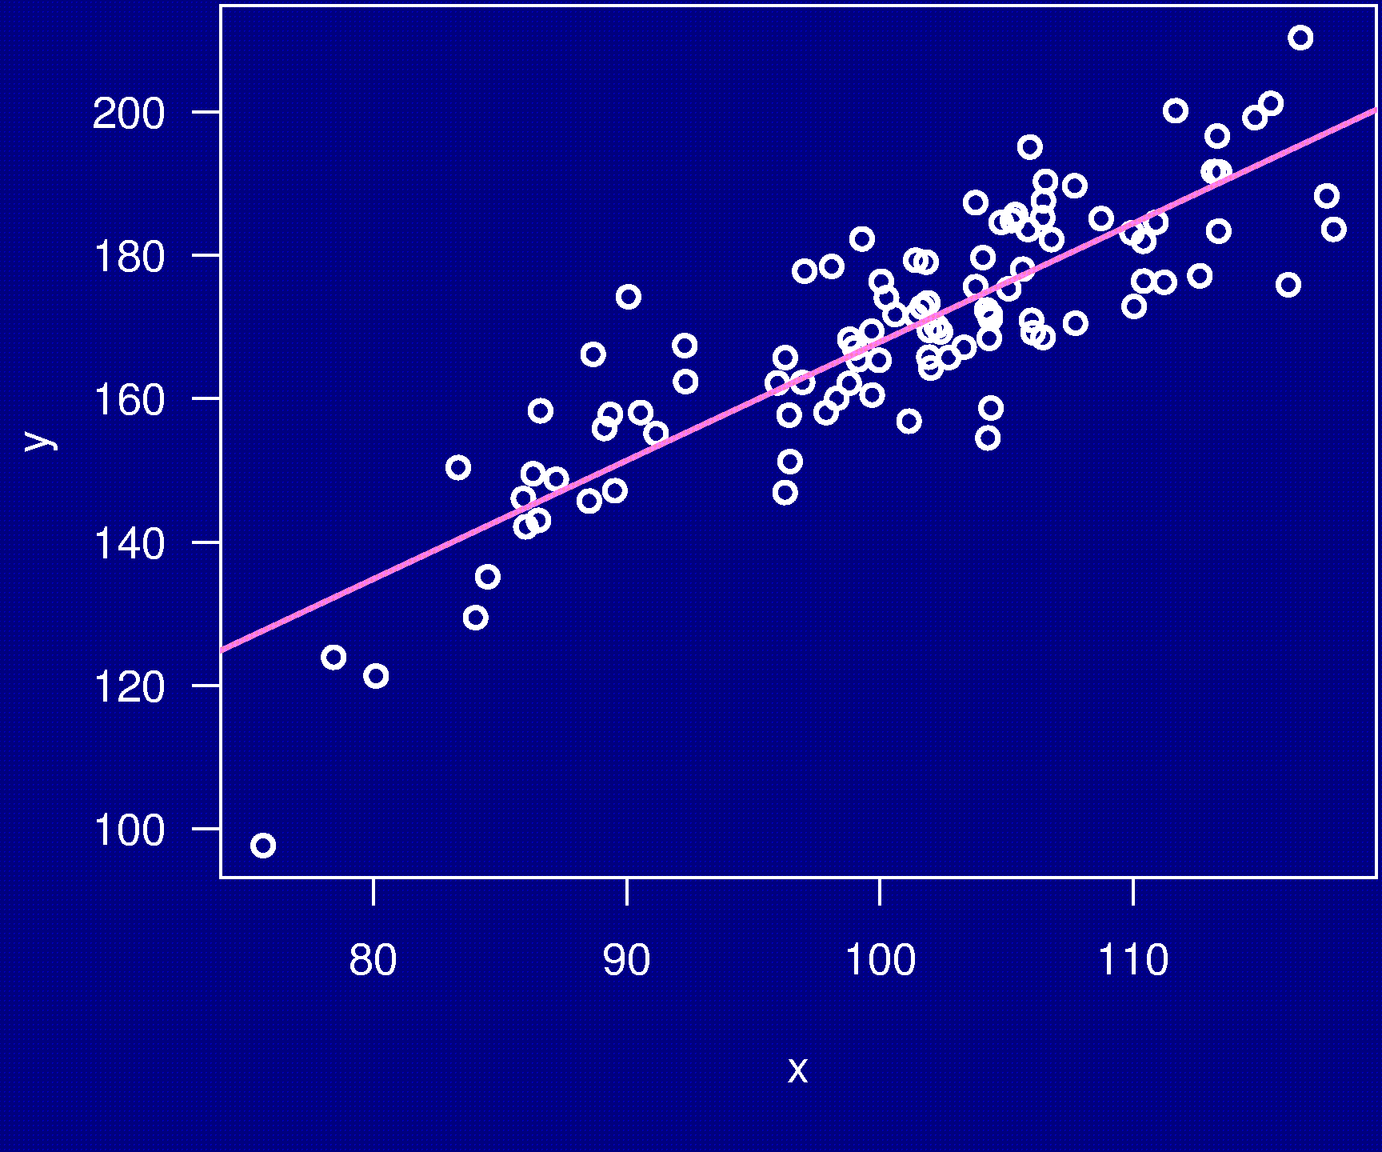
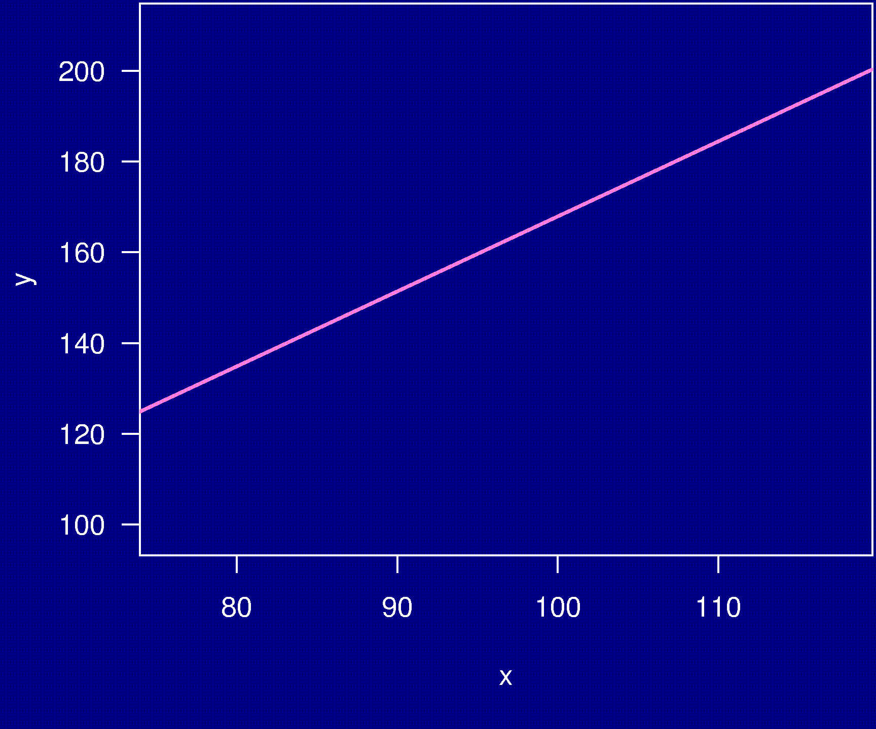
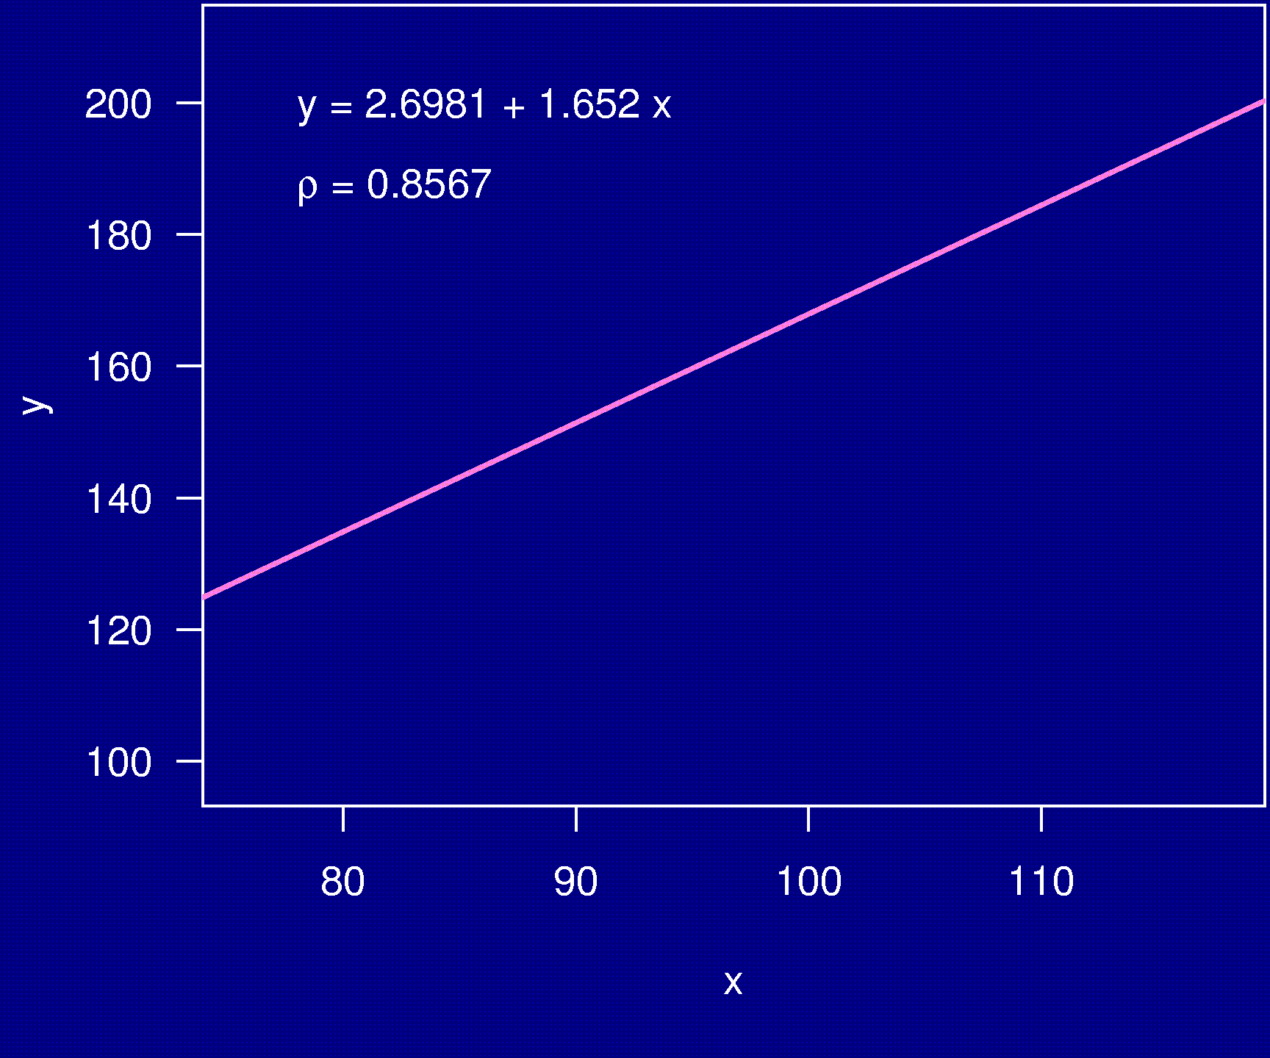
Example 4

Slide 9
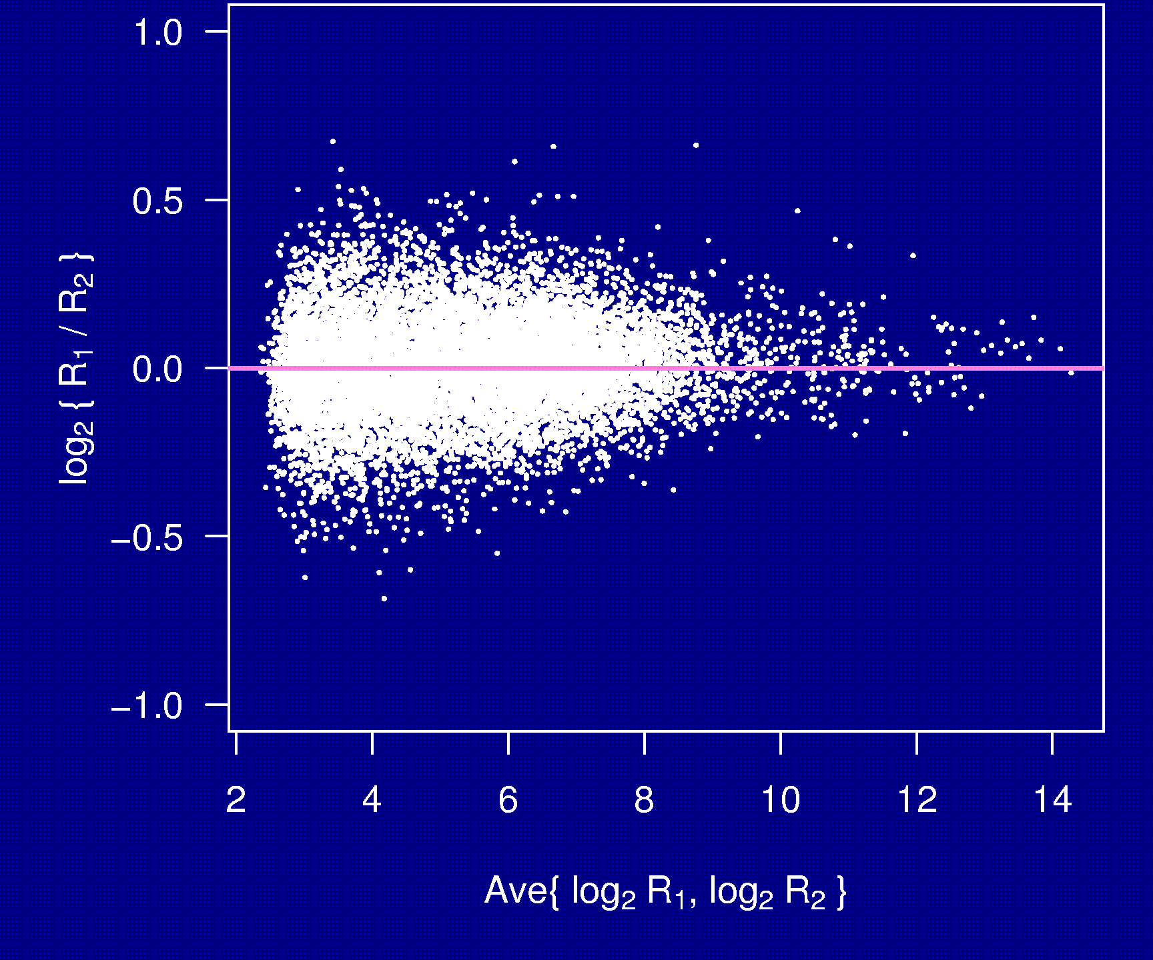
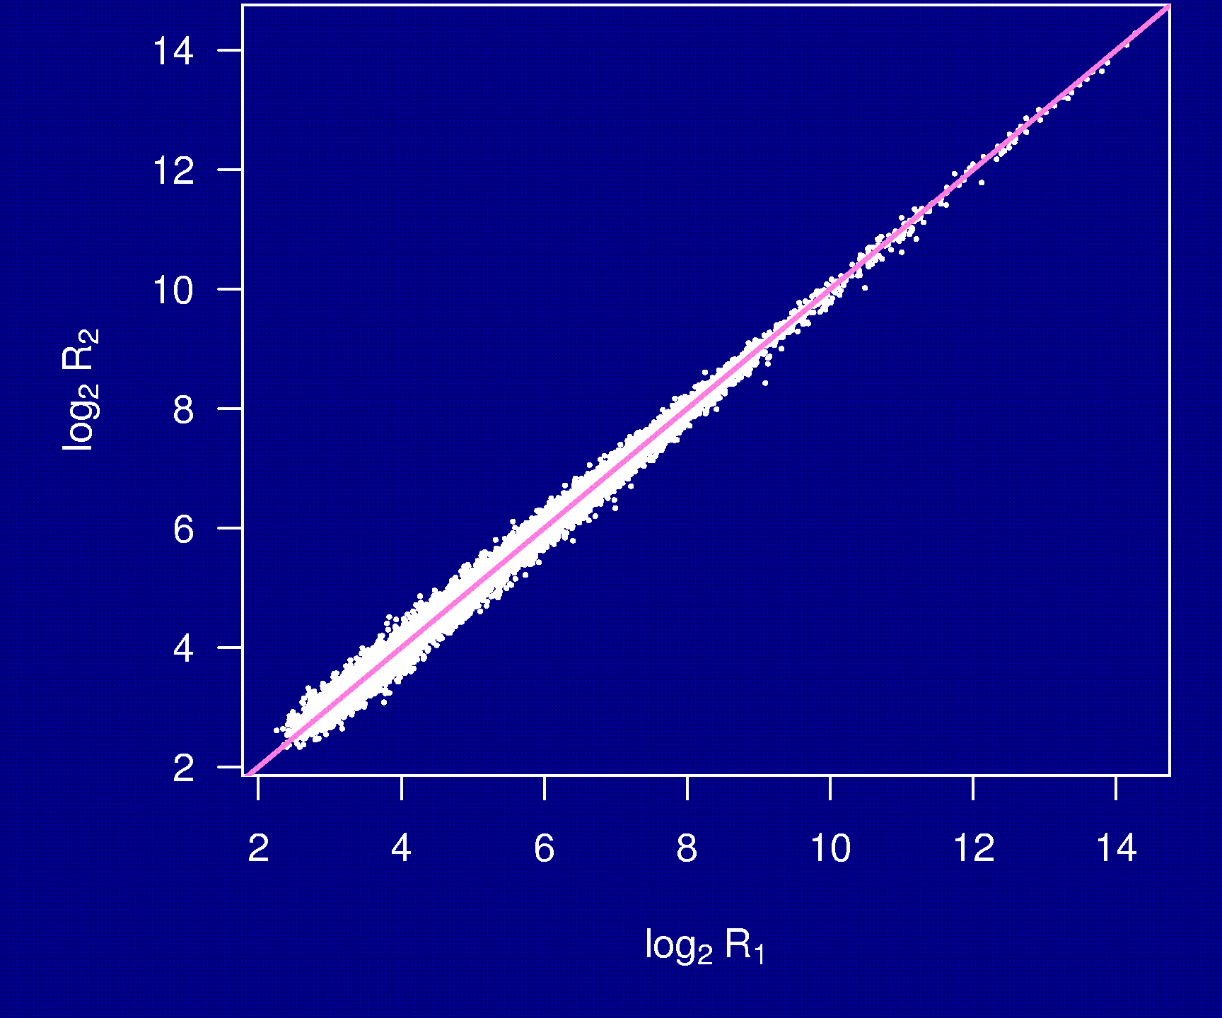
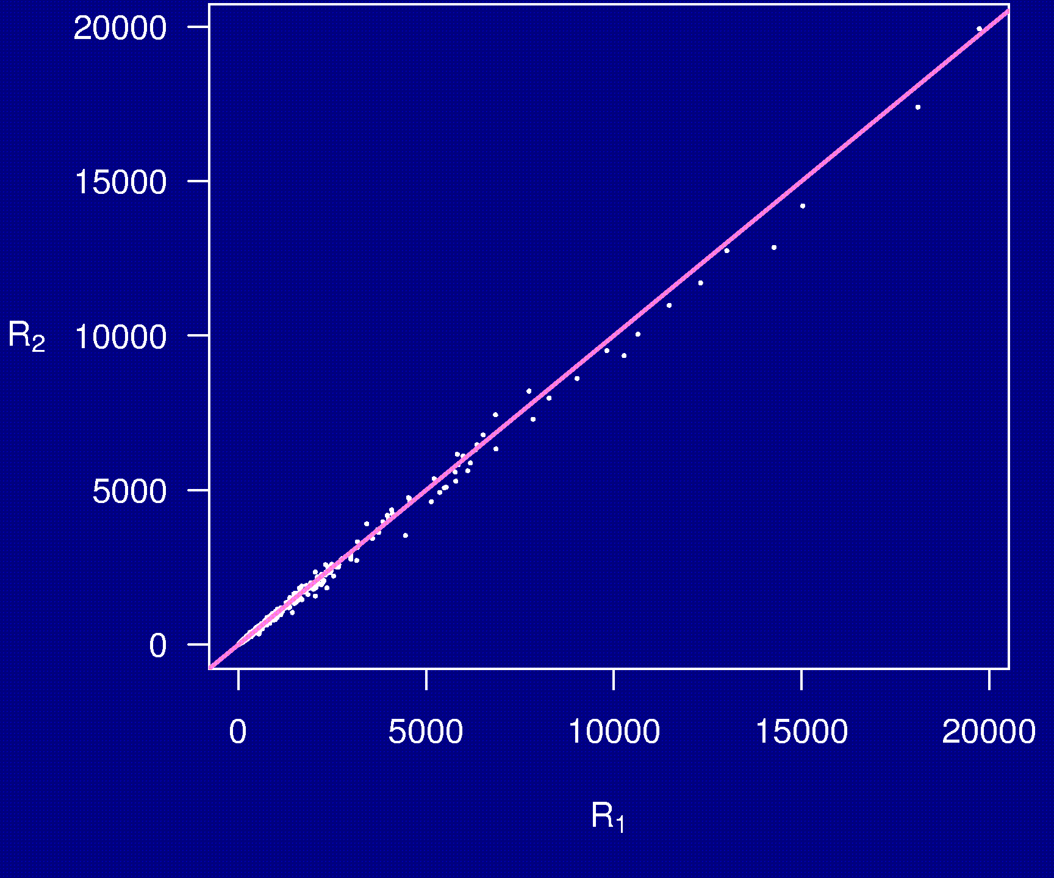
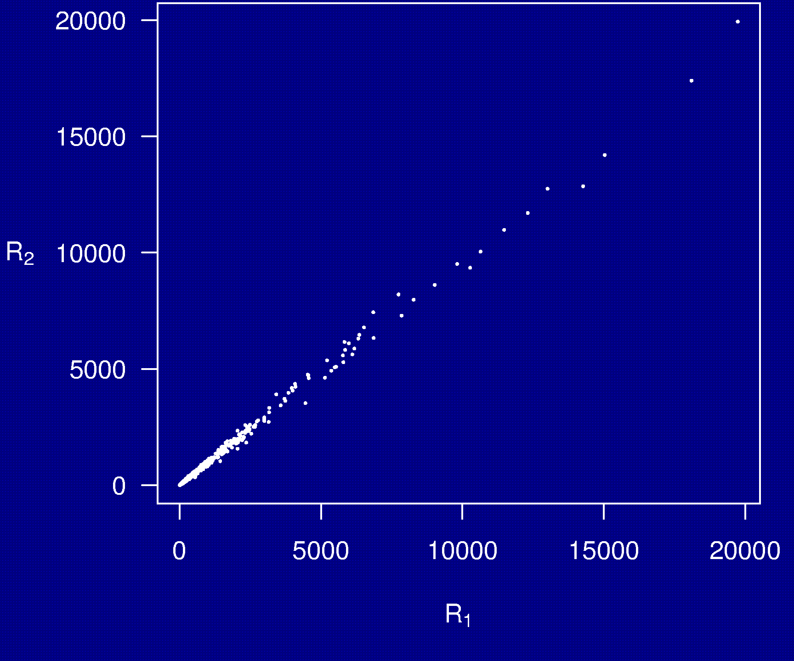
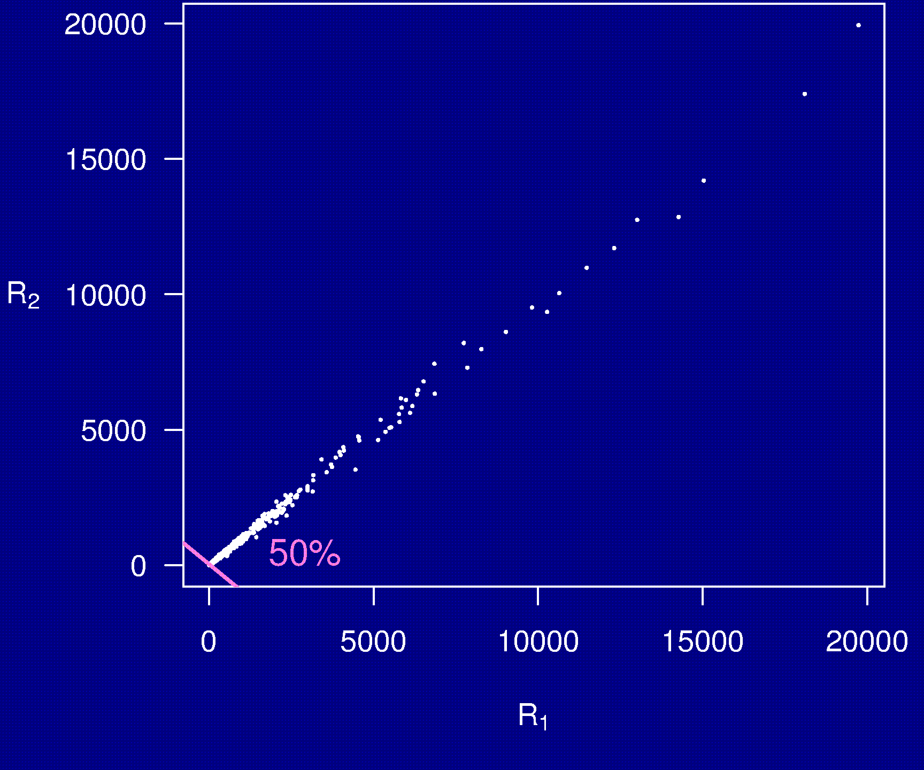
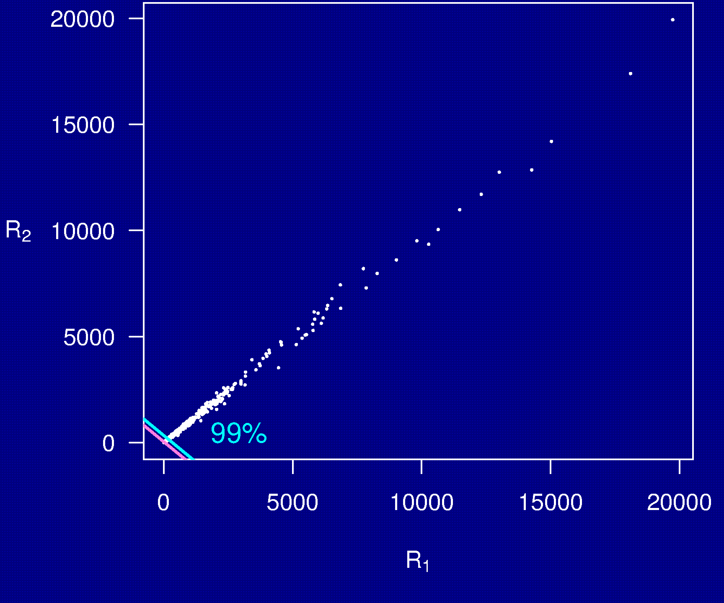
Example 5

Slide 10
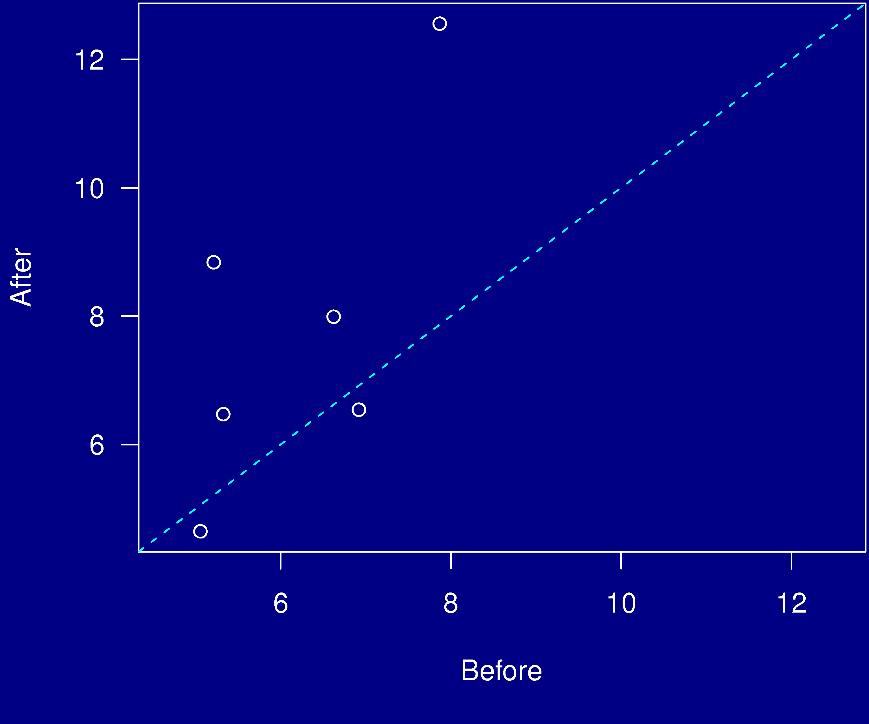
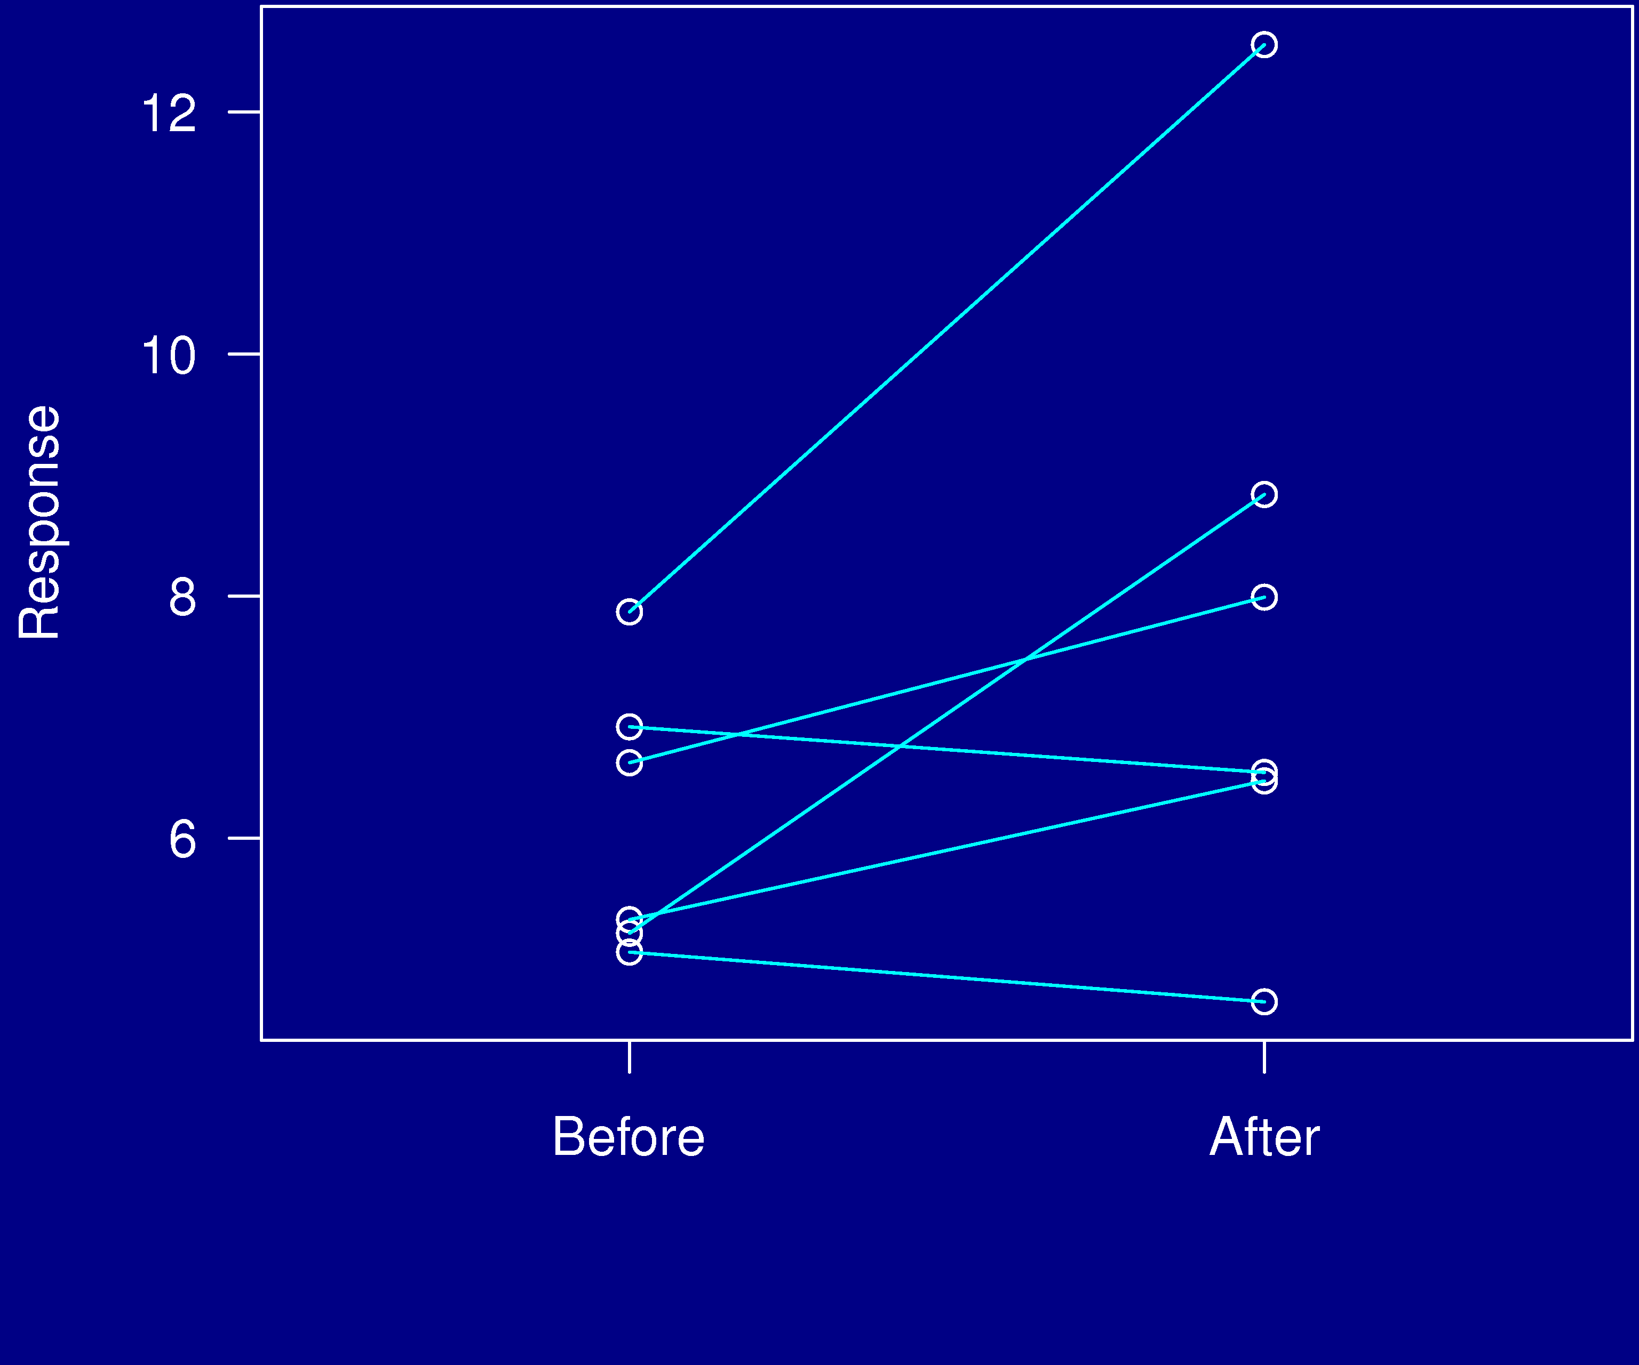
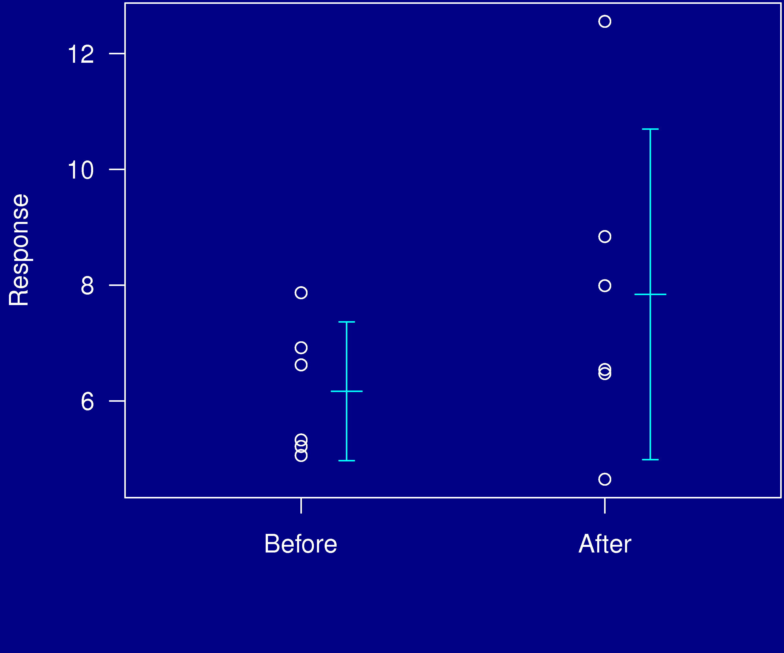
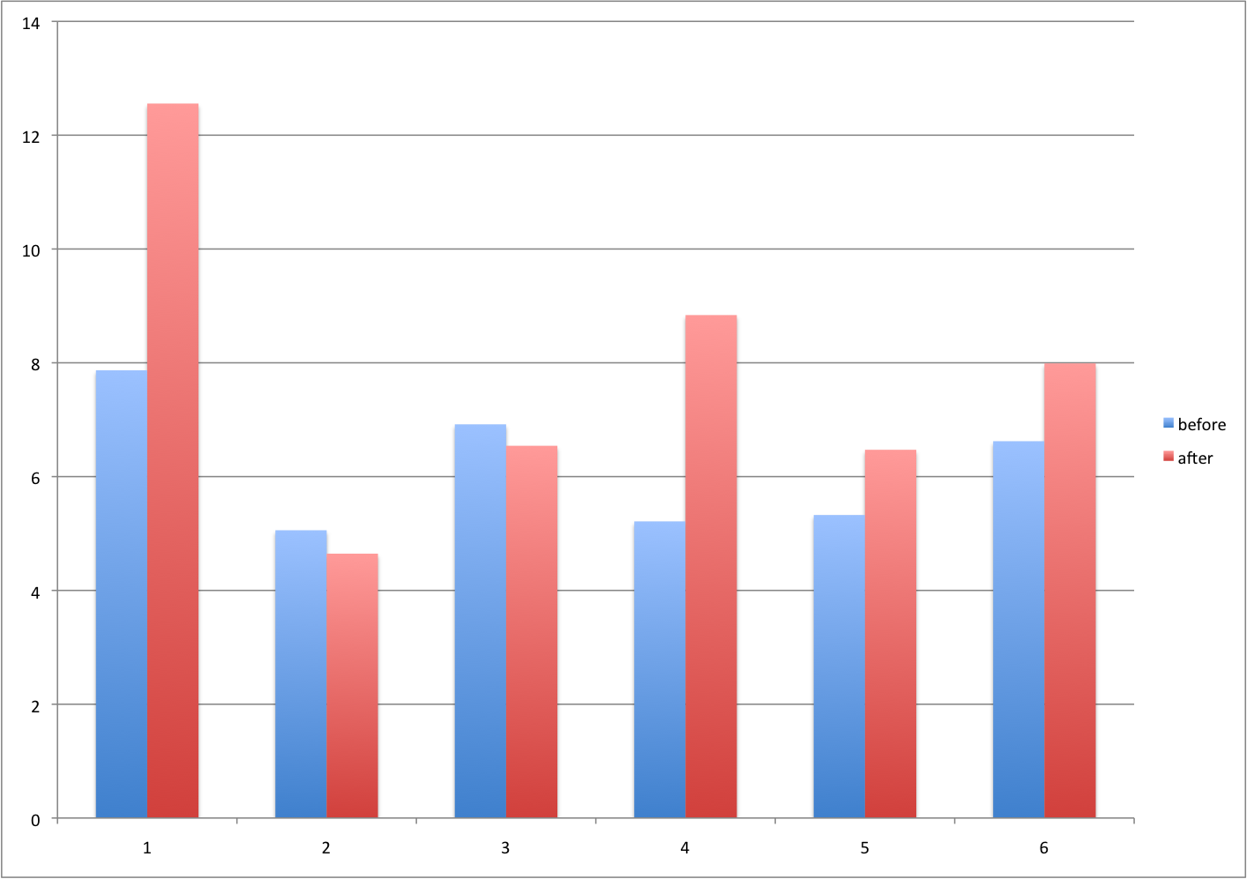
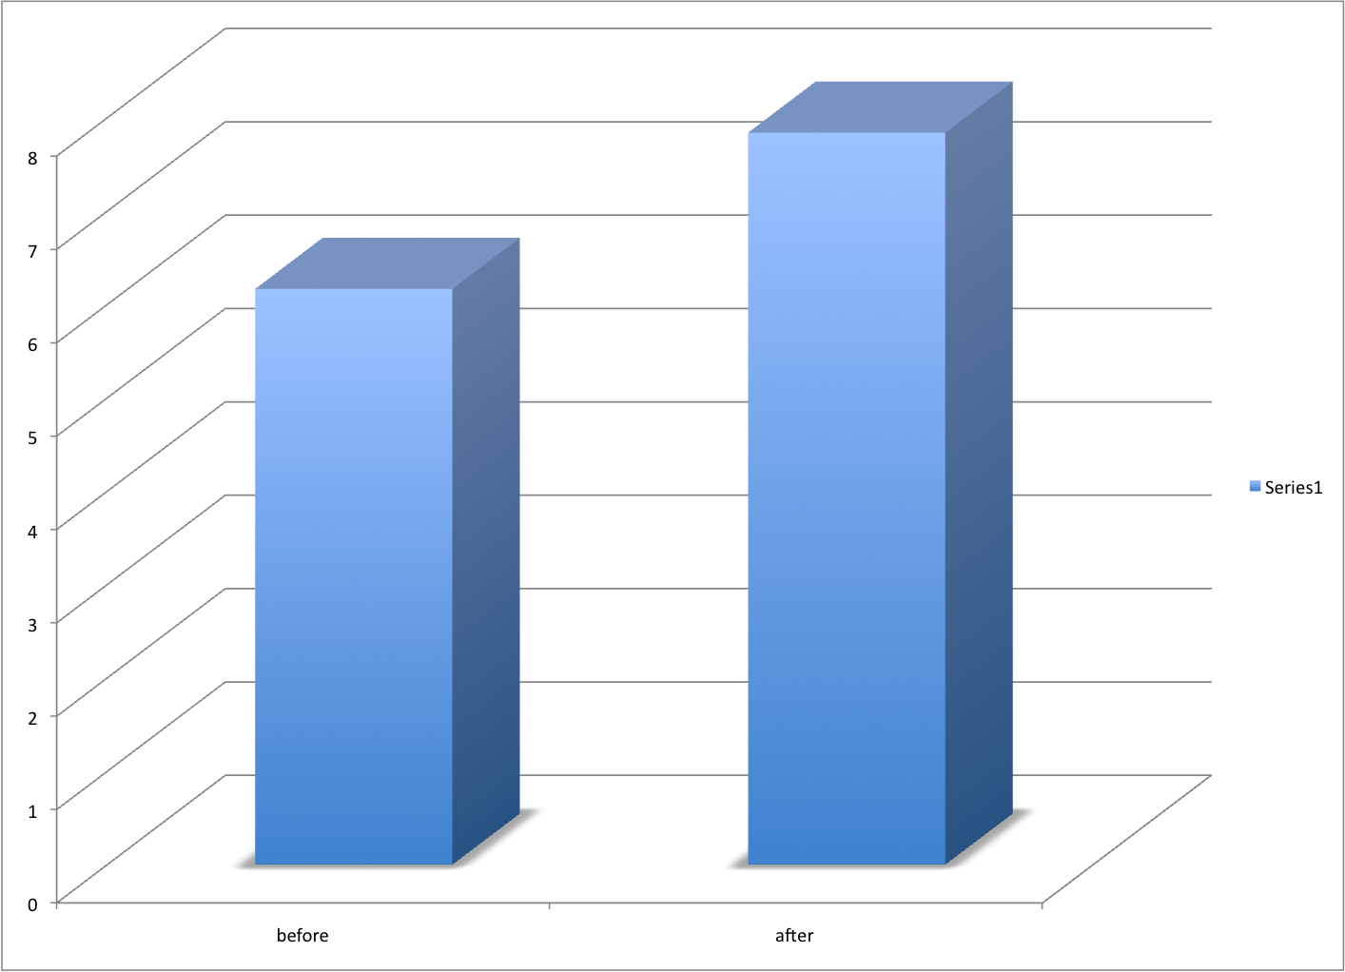
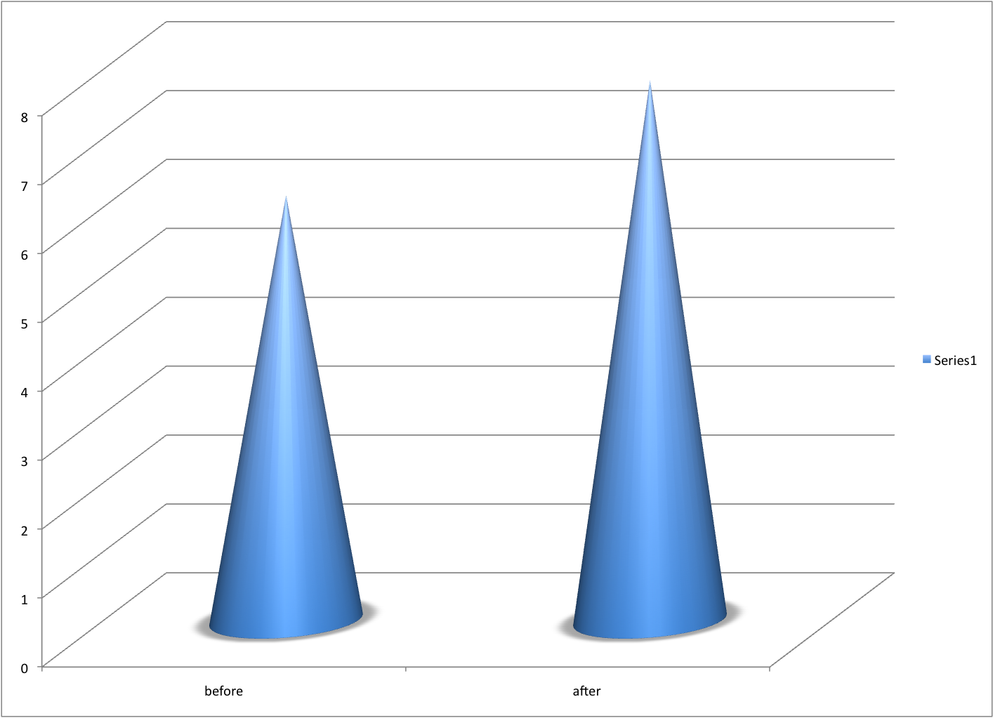
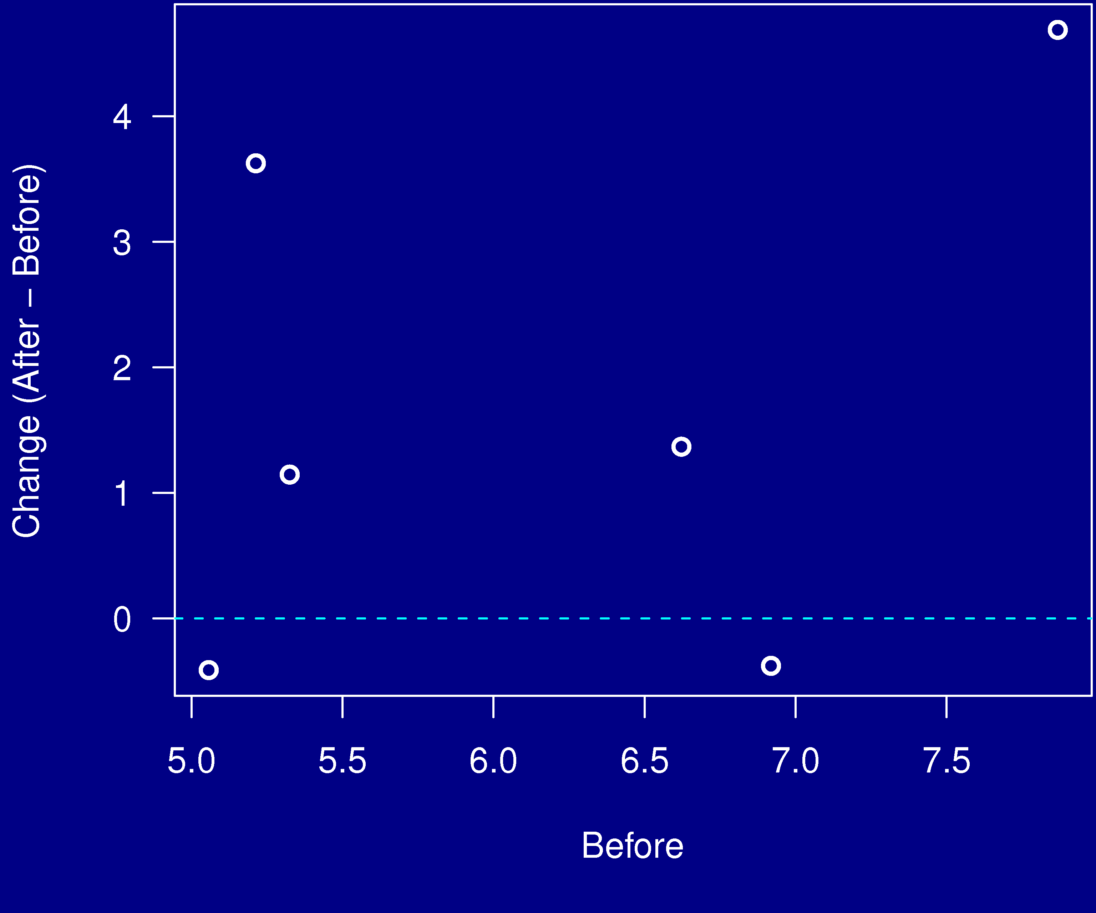
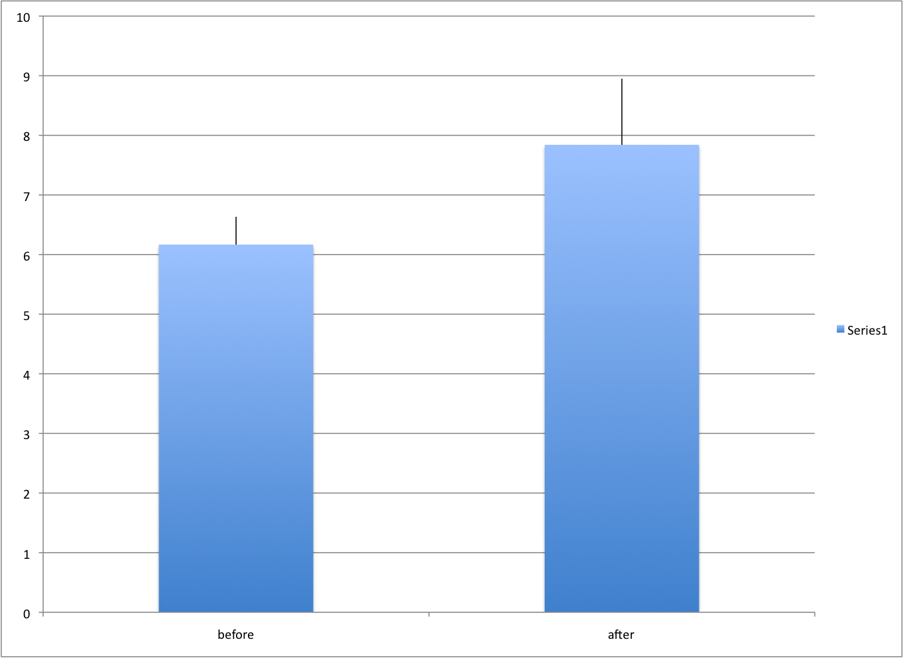
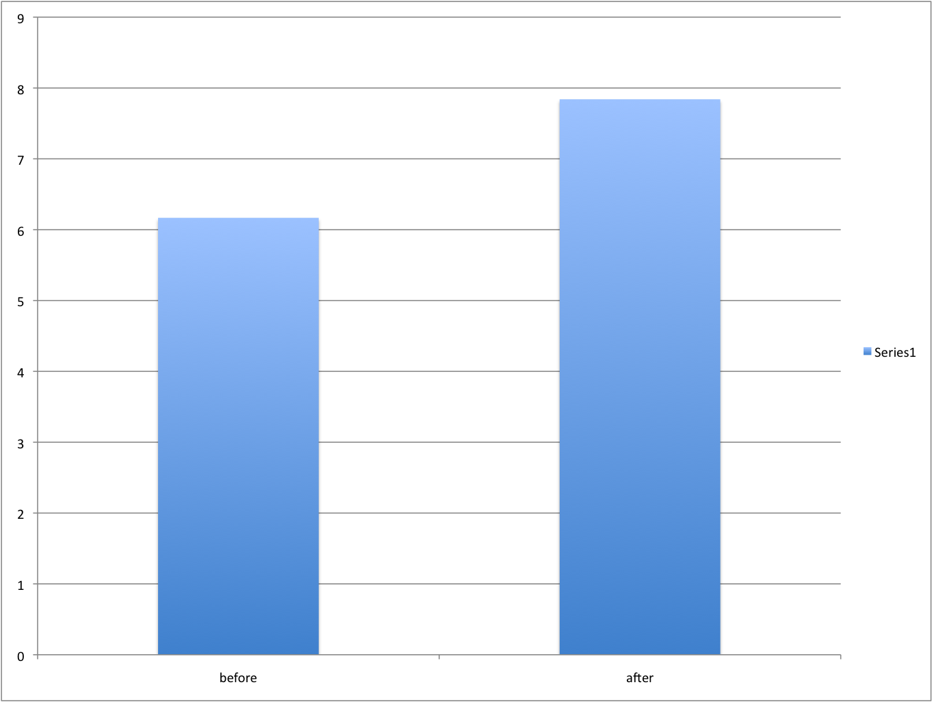
Example 6

Slide 11
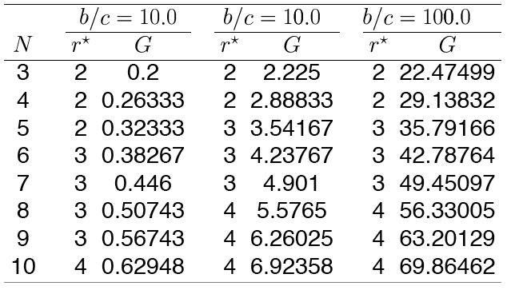
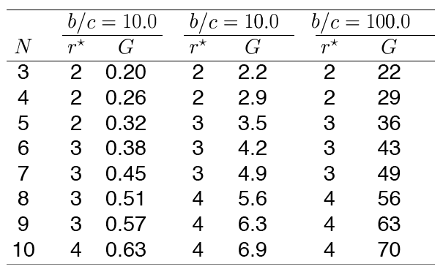
Example 7

Slide 12
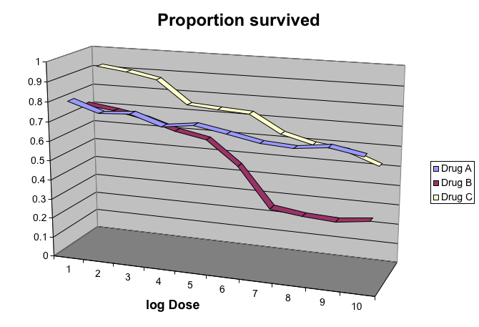
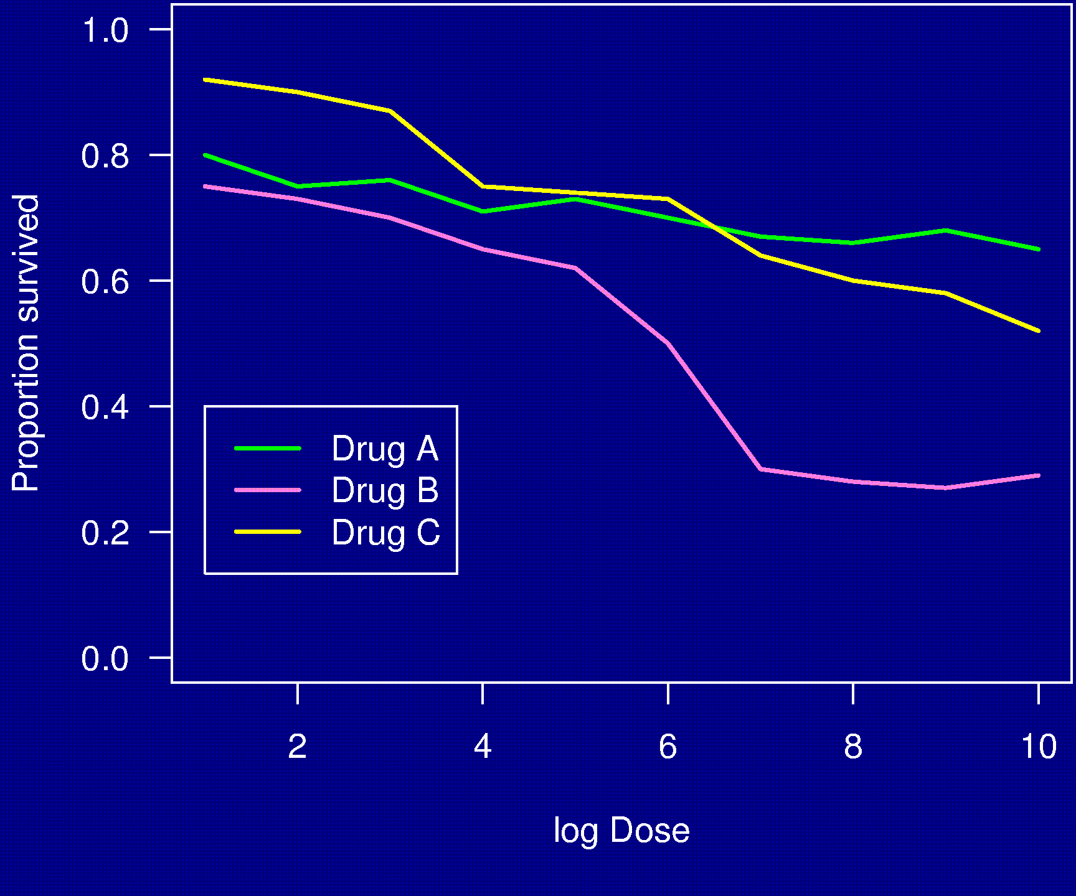
Example 8

Slide 13
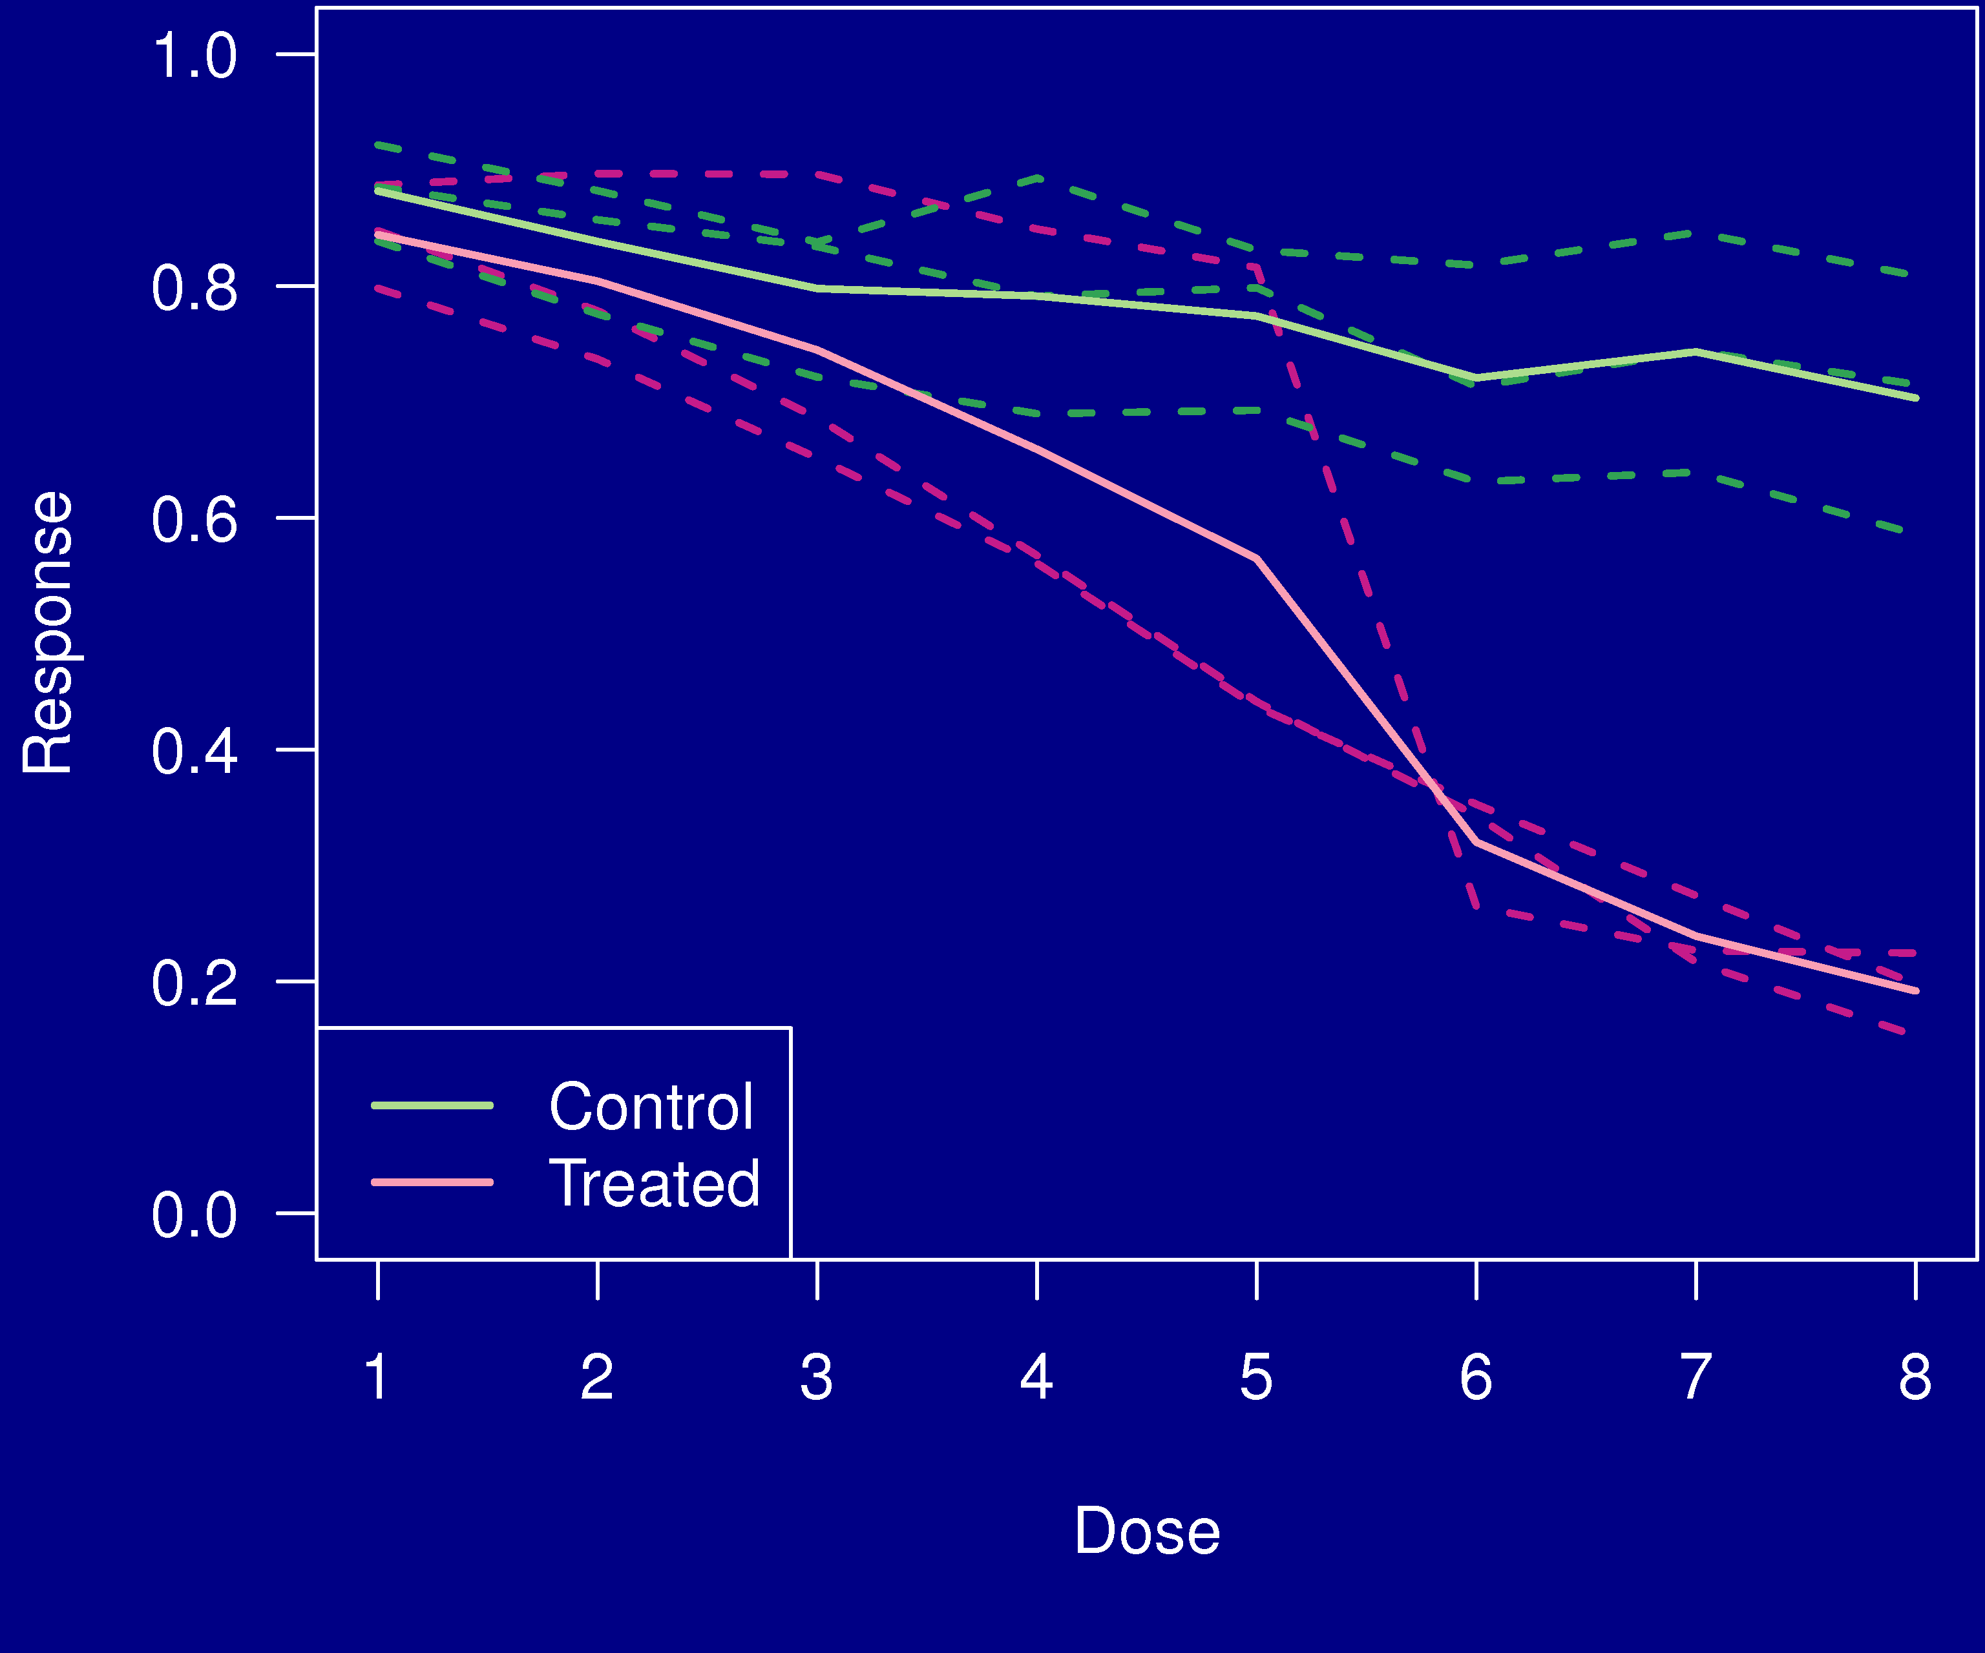
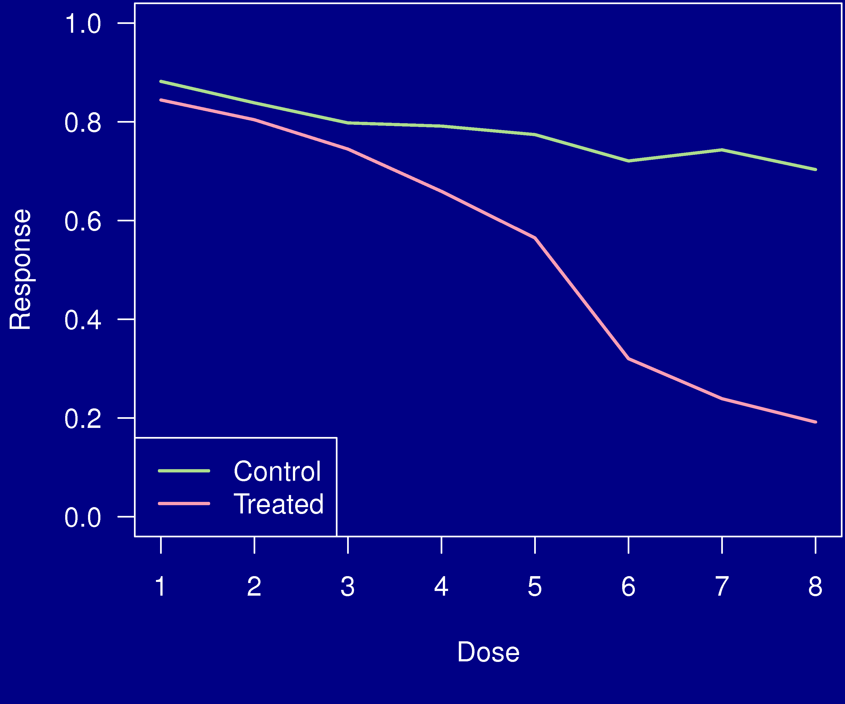
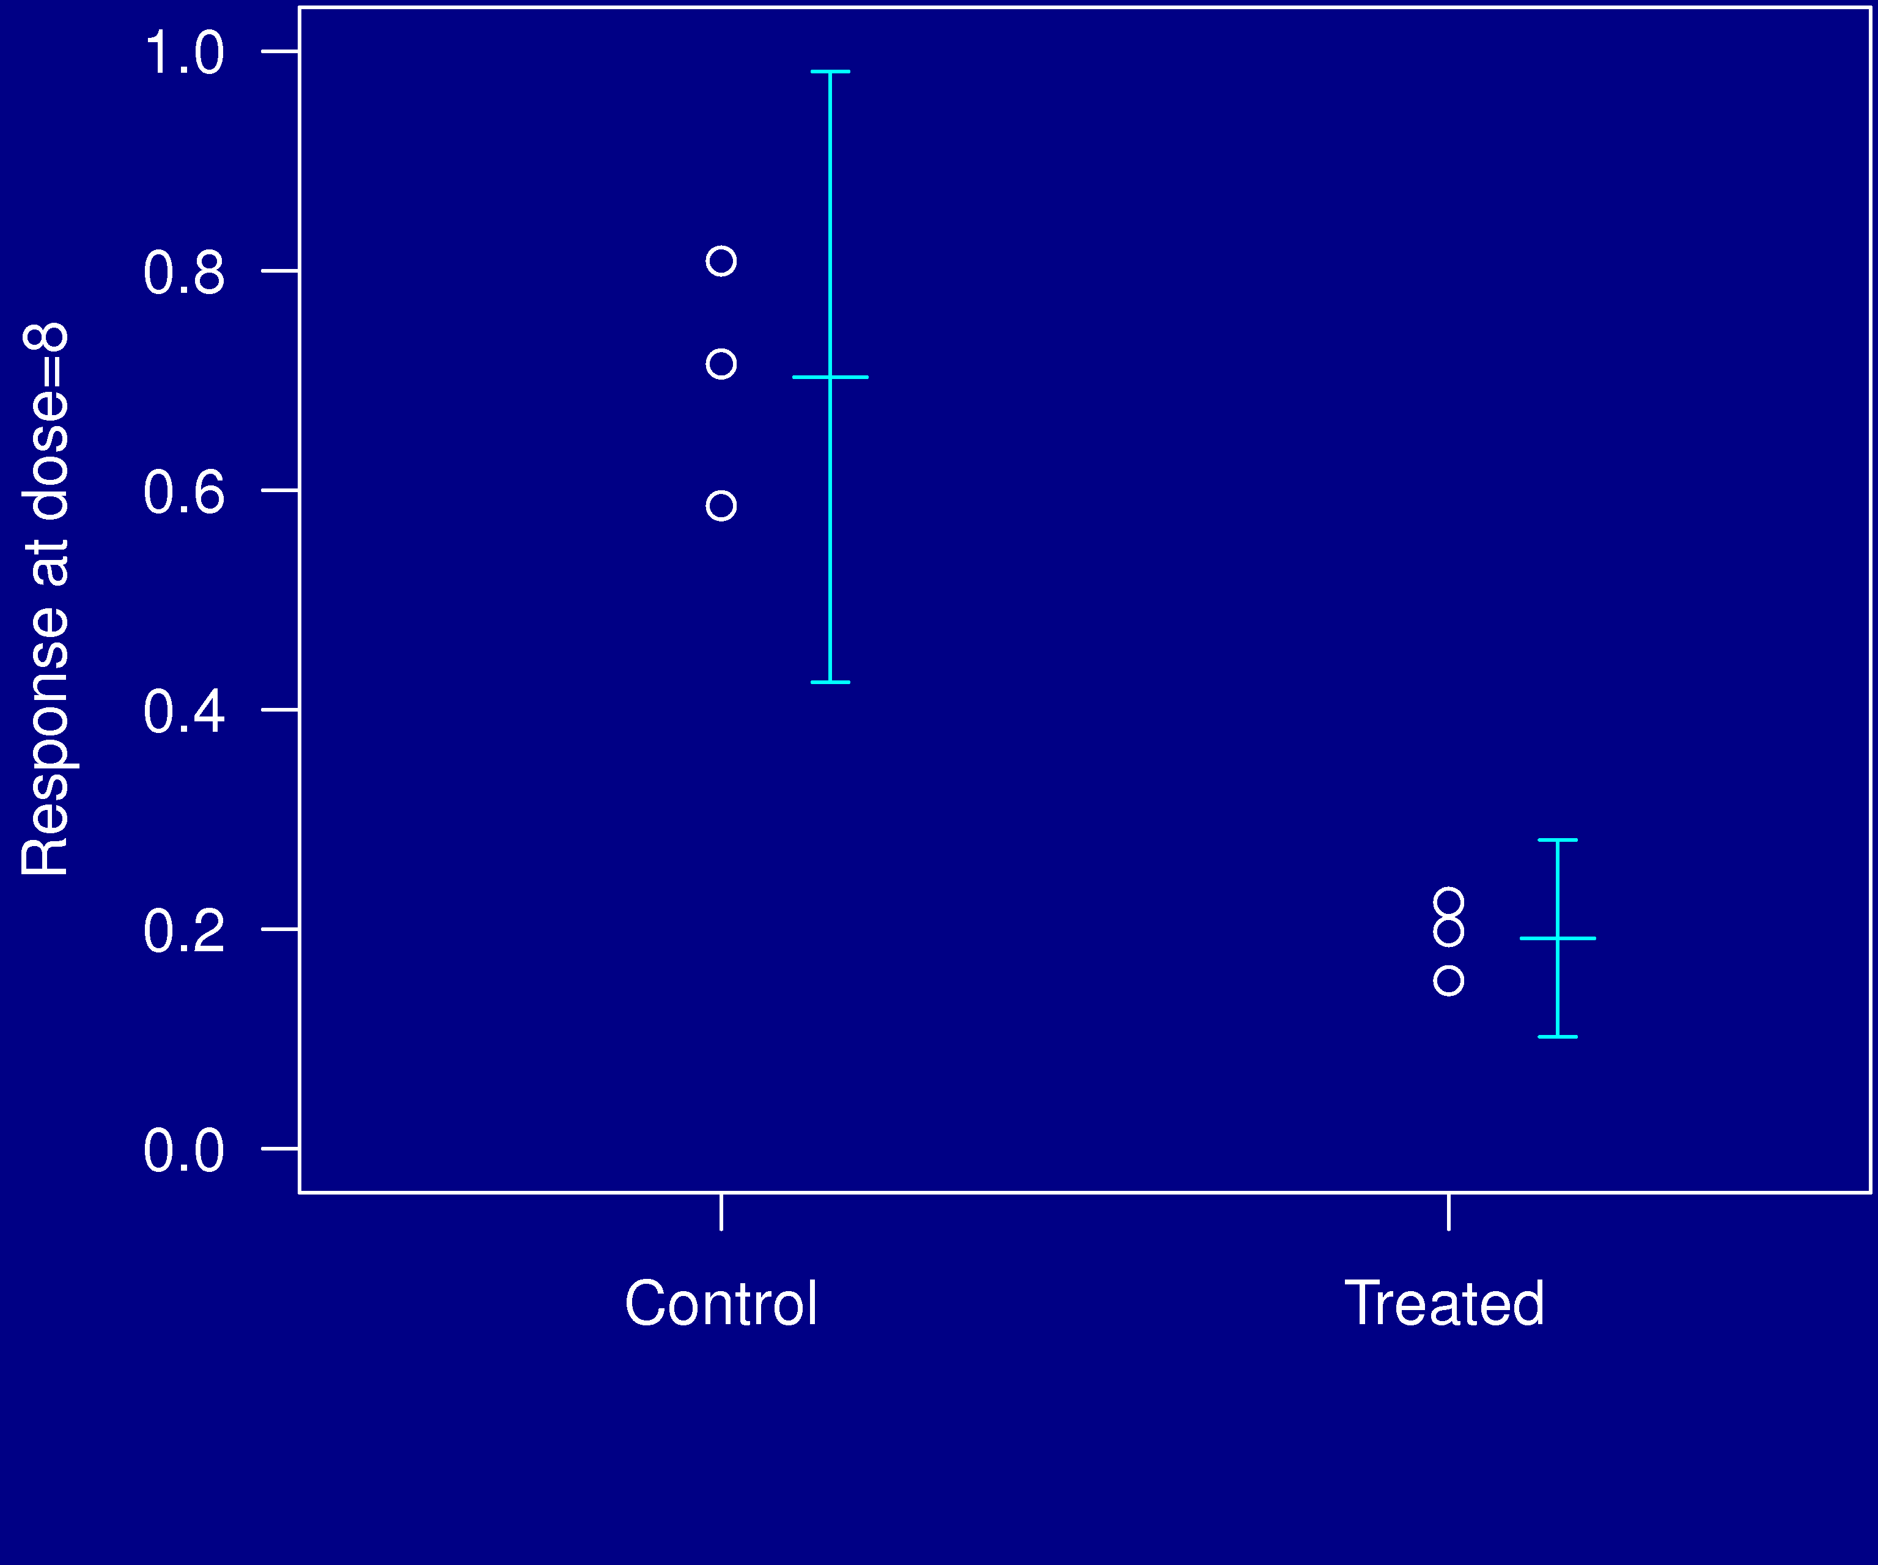
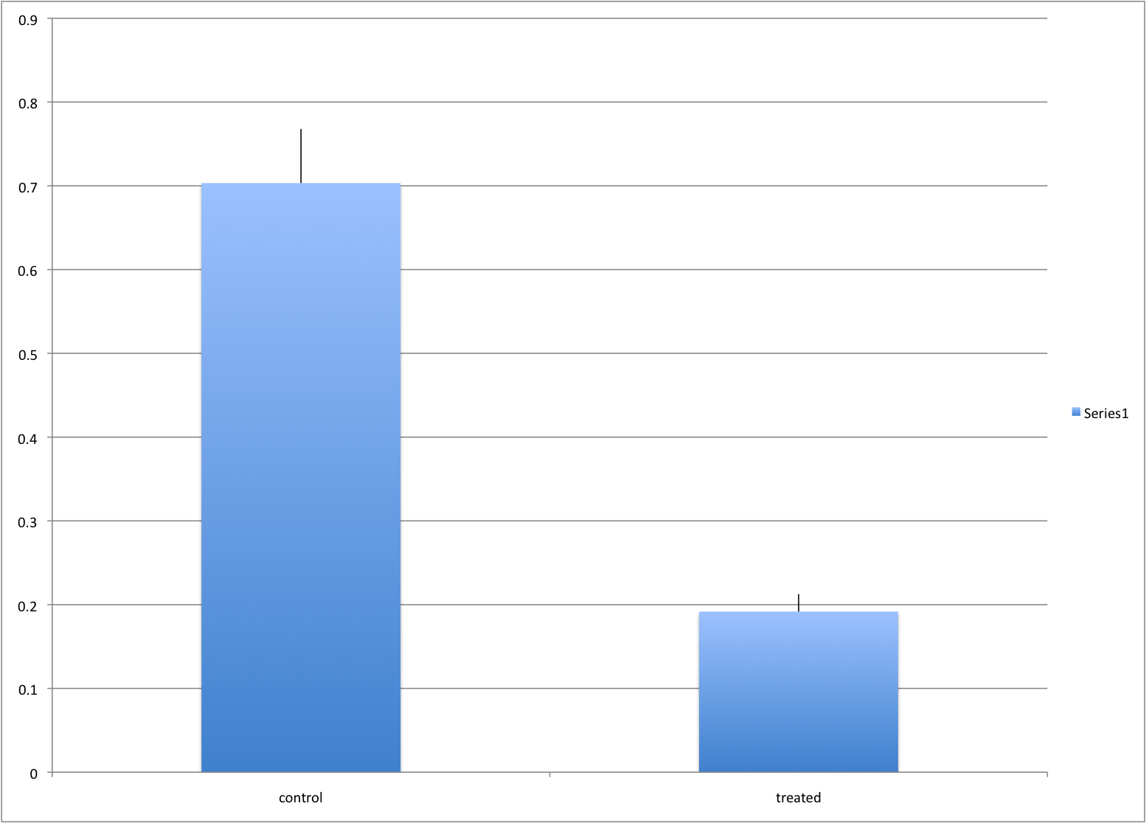
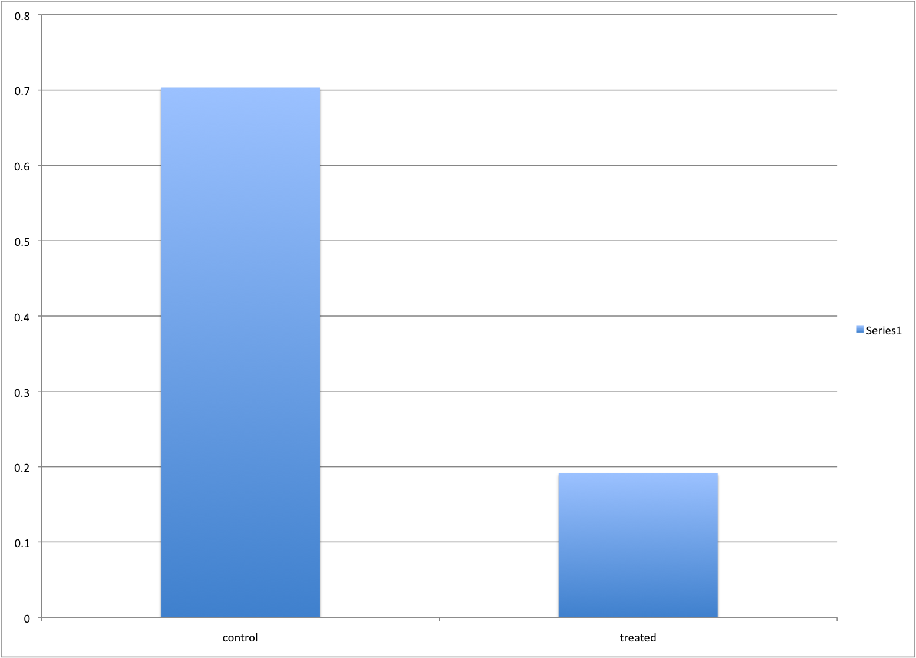
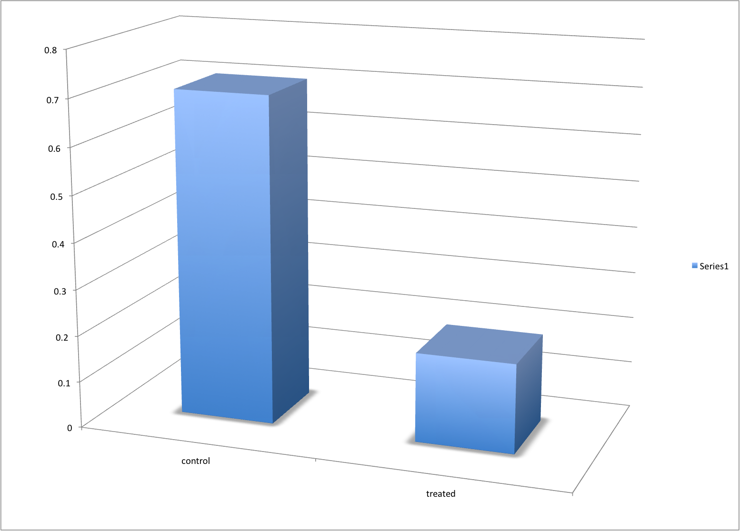
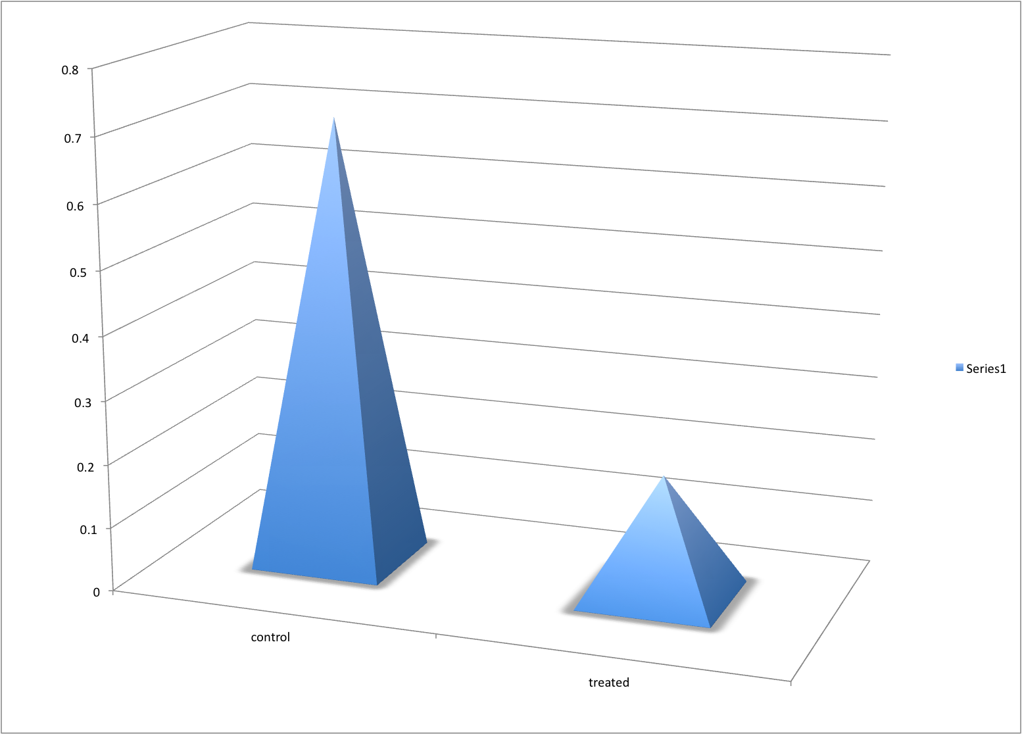
Example 9

Slide 14
Displaying data well
Be accurate and clear.
Let the data speak.
  Show as much information as possible, taking care not to obscure the message.
Science not sales.
  Avoid unnecessary frills — esp. gratuitous 3d.
In tables, every digit should be meaningful. Don’t drop ending 0’s.

Slide 15
Further reading
ER Tufte (1983) The visual display of quantitative information. Graphics Press.
ER Tufte (1990) Envisioning information. Graphics Press.
ER Tufte (1997) Visual explanations. Graphics Press.
WS Cleveland (1993) Visualizing data. Hobart Press.
WS Cleveland (1994) The elements of graphing data. CRC Press.
A Gelman, C Pasarica, R Dodhia (2002) Let's practice what we preach: Turning tables into graphs. The American Statistician 56:121-130
Robbins NB (2004) Creating more effective graphs. Wiley

Slide 16
The top ten worst graphs
With apologies to the authors, we provide the following list of the top ten worst graphs in the scientific literature.
As these examples indicate, good scientists can make mistakes.
http://www.biostat.wisc.edu/~kbroman/topten_worstgraphs

Slide 17
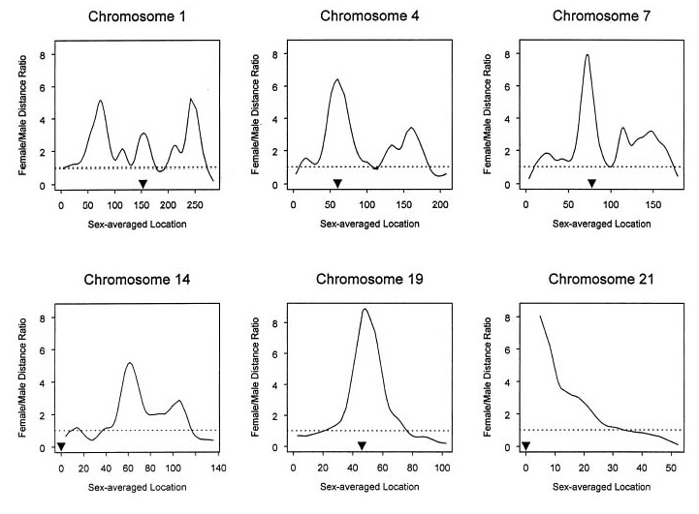
10
Broman et al., Am J Hum Genet 63:861-869, 1998, Fig. 1

Slide 18
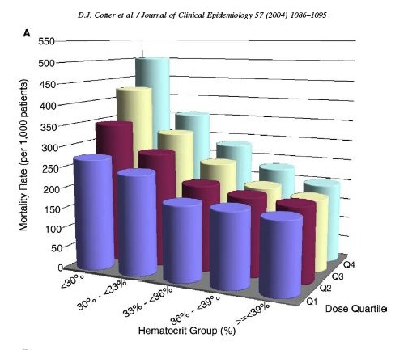
9
Cotter et al., J Clin Epidemiol 57:1086-1095, 2004, Fig 2

Slide 19
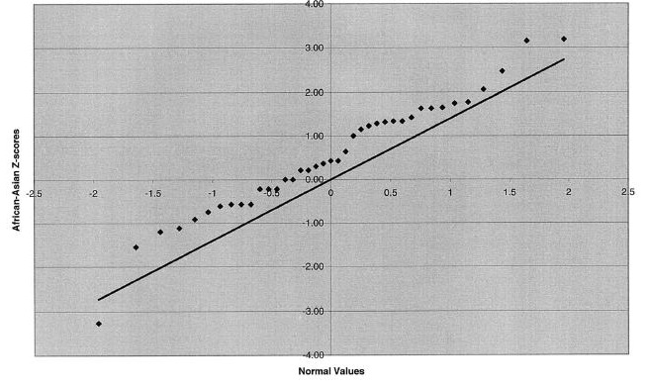
8
Jorgenson et al., Am J Hum Genet 76:276-290, 2005, Fig 2

Slide 20
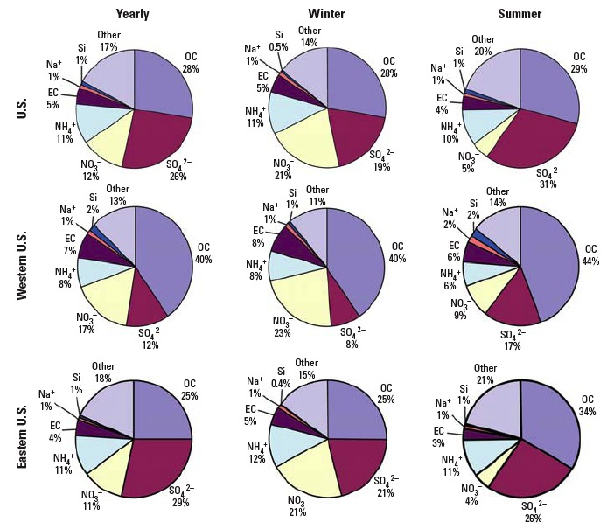
7
Bell et al., Env Health Persp 115:989-995, 2007, Fig 3

Slide 21

6
Cawley et al., Cell 116:499-509, 2004, Fig 1

Slide 22

5
Hummer et al., J Virol 75:7774-7777, 2001, Fig 4

Slide 23

4
Epstein and Satten, Am J Hum Genet 73:1316-1329, 2003, Fig 1

Slide 24

3
Mykland et al., J Am Stat Asso 90:233-241, 1995, Fig 1

Slide 25

2
Wittke-Thompson et al., Am J Hum Genet 76:967-986, Fig 1

Slide 26

1
Roeder, Stat Sci 9:222-278, 1994, Fig 4

