Slide 1
The genomes of recombinant inbred lines
Karl W Broman
Department of Biostatistics
Johns Hopkins University
http://www.biostat.jhsph.edu/~kbroman

Slide 2
Inbred mice

Slide 3
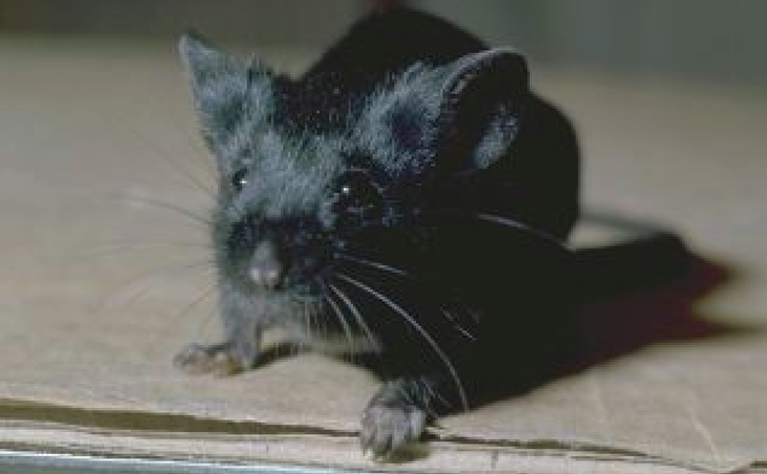
C57BL/6

Slide 4
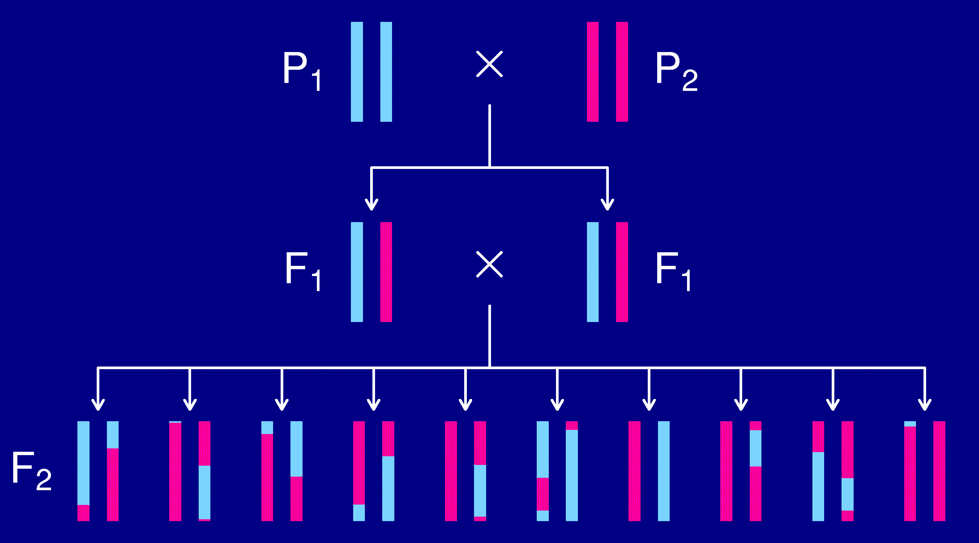
The intercross

Slide 5
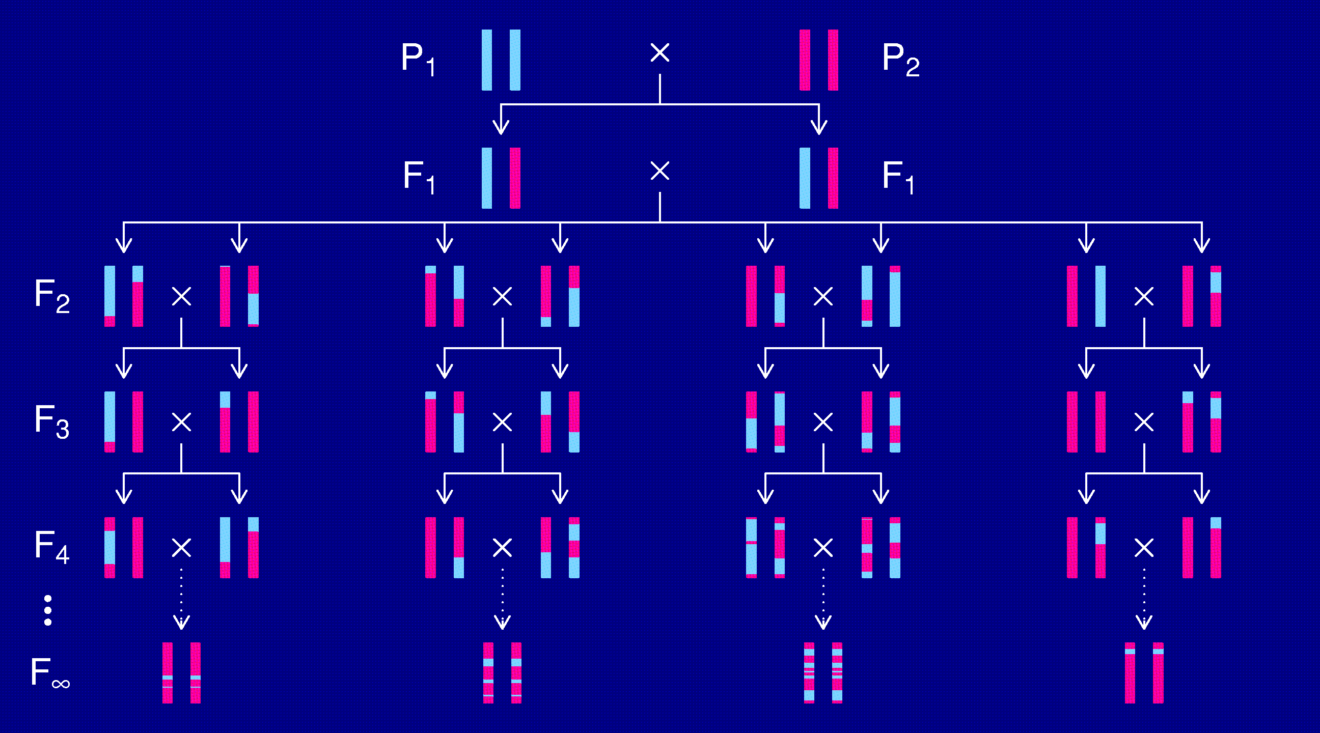
Recombinant inbred lines
(by sibling mating)

Slide 6
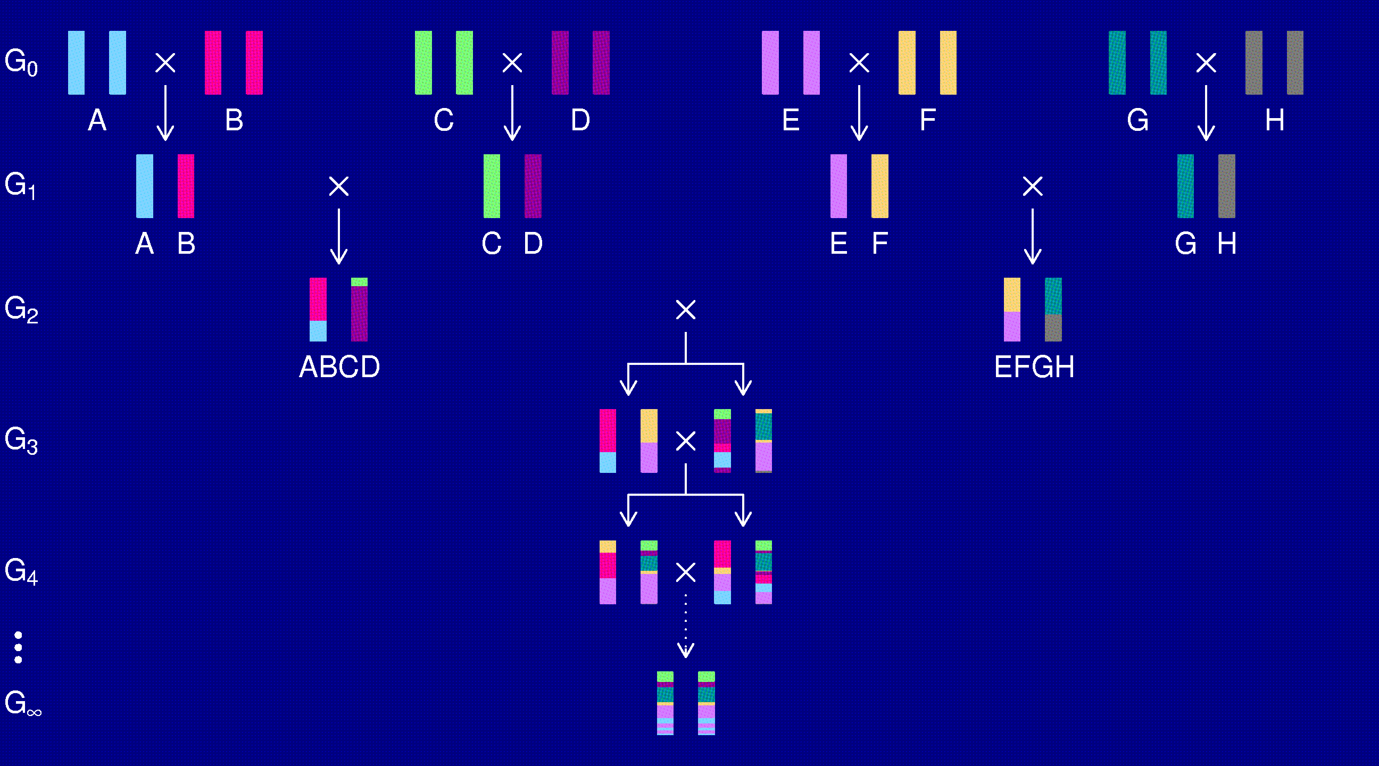
The “Collaborative Cross”

Slide 7
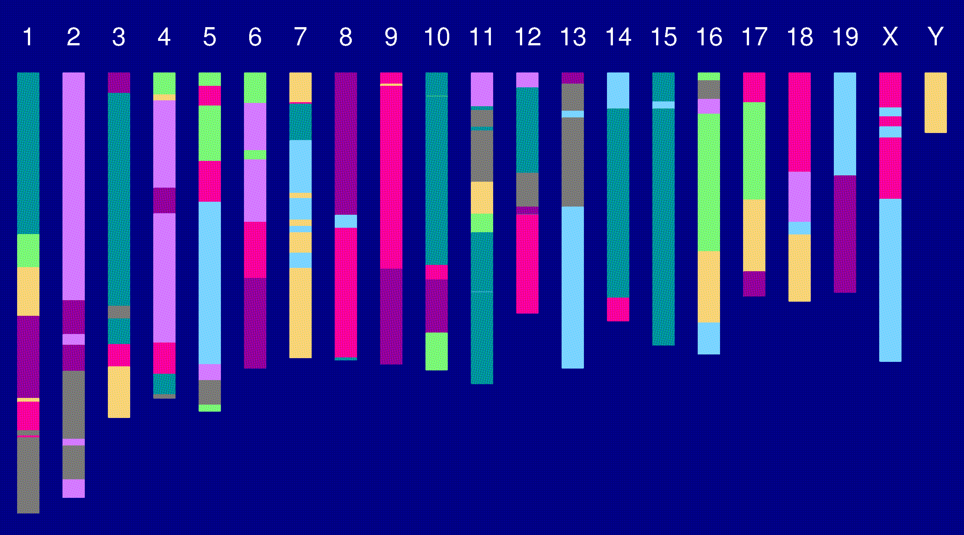
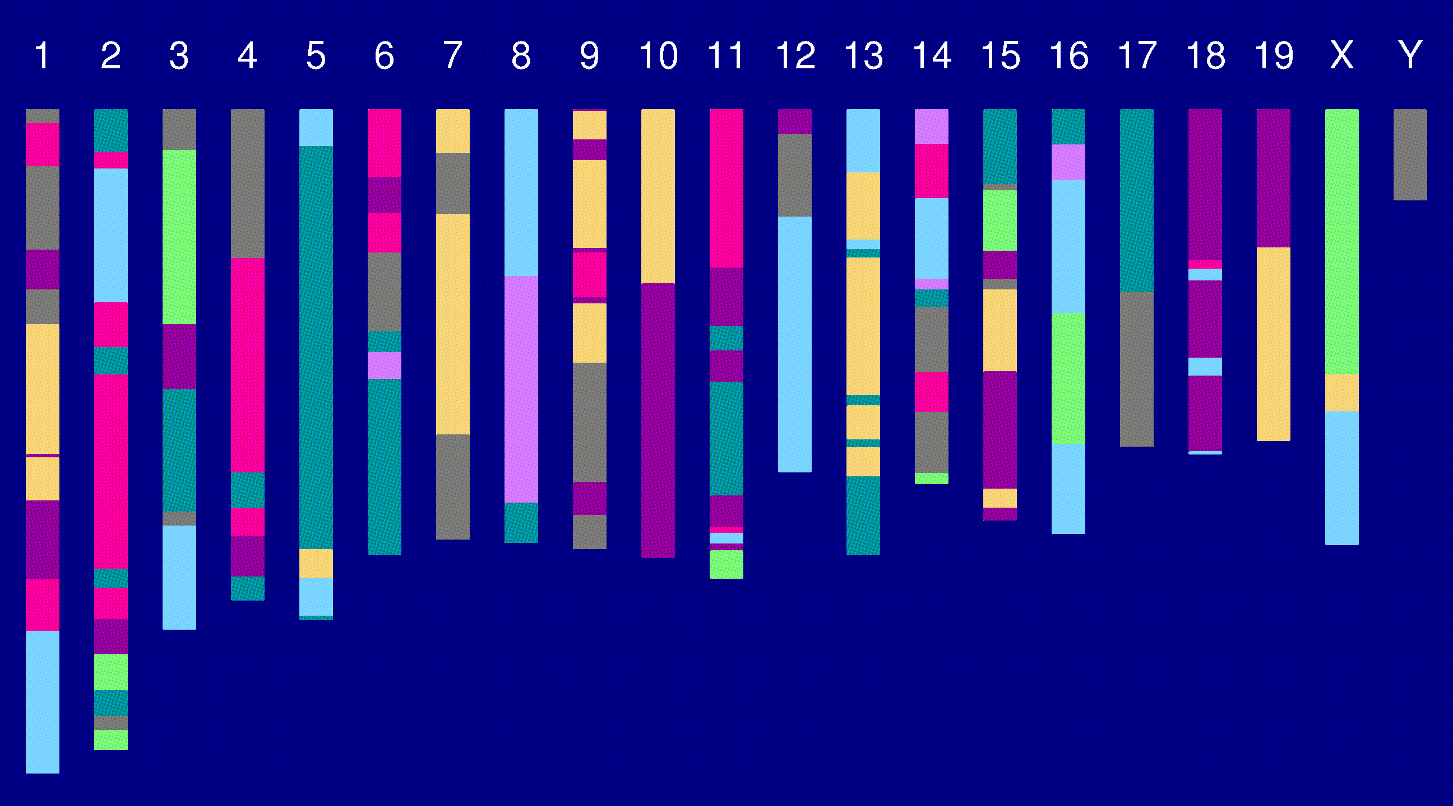
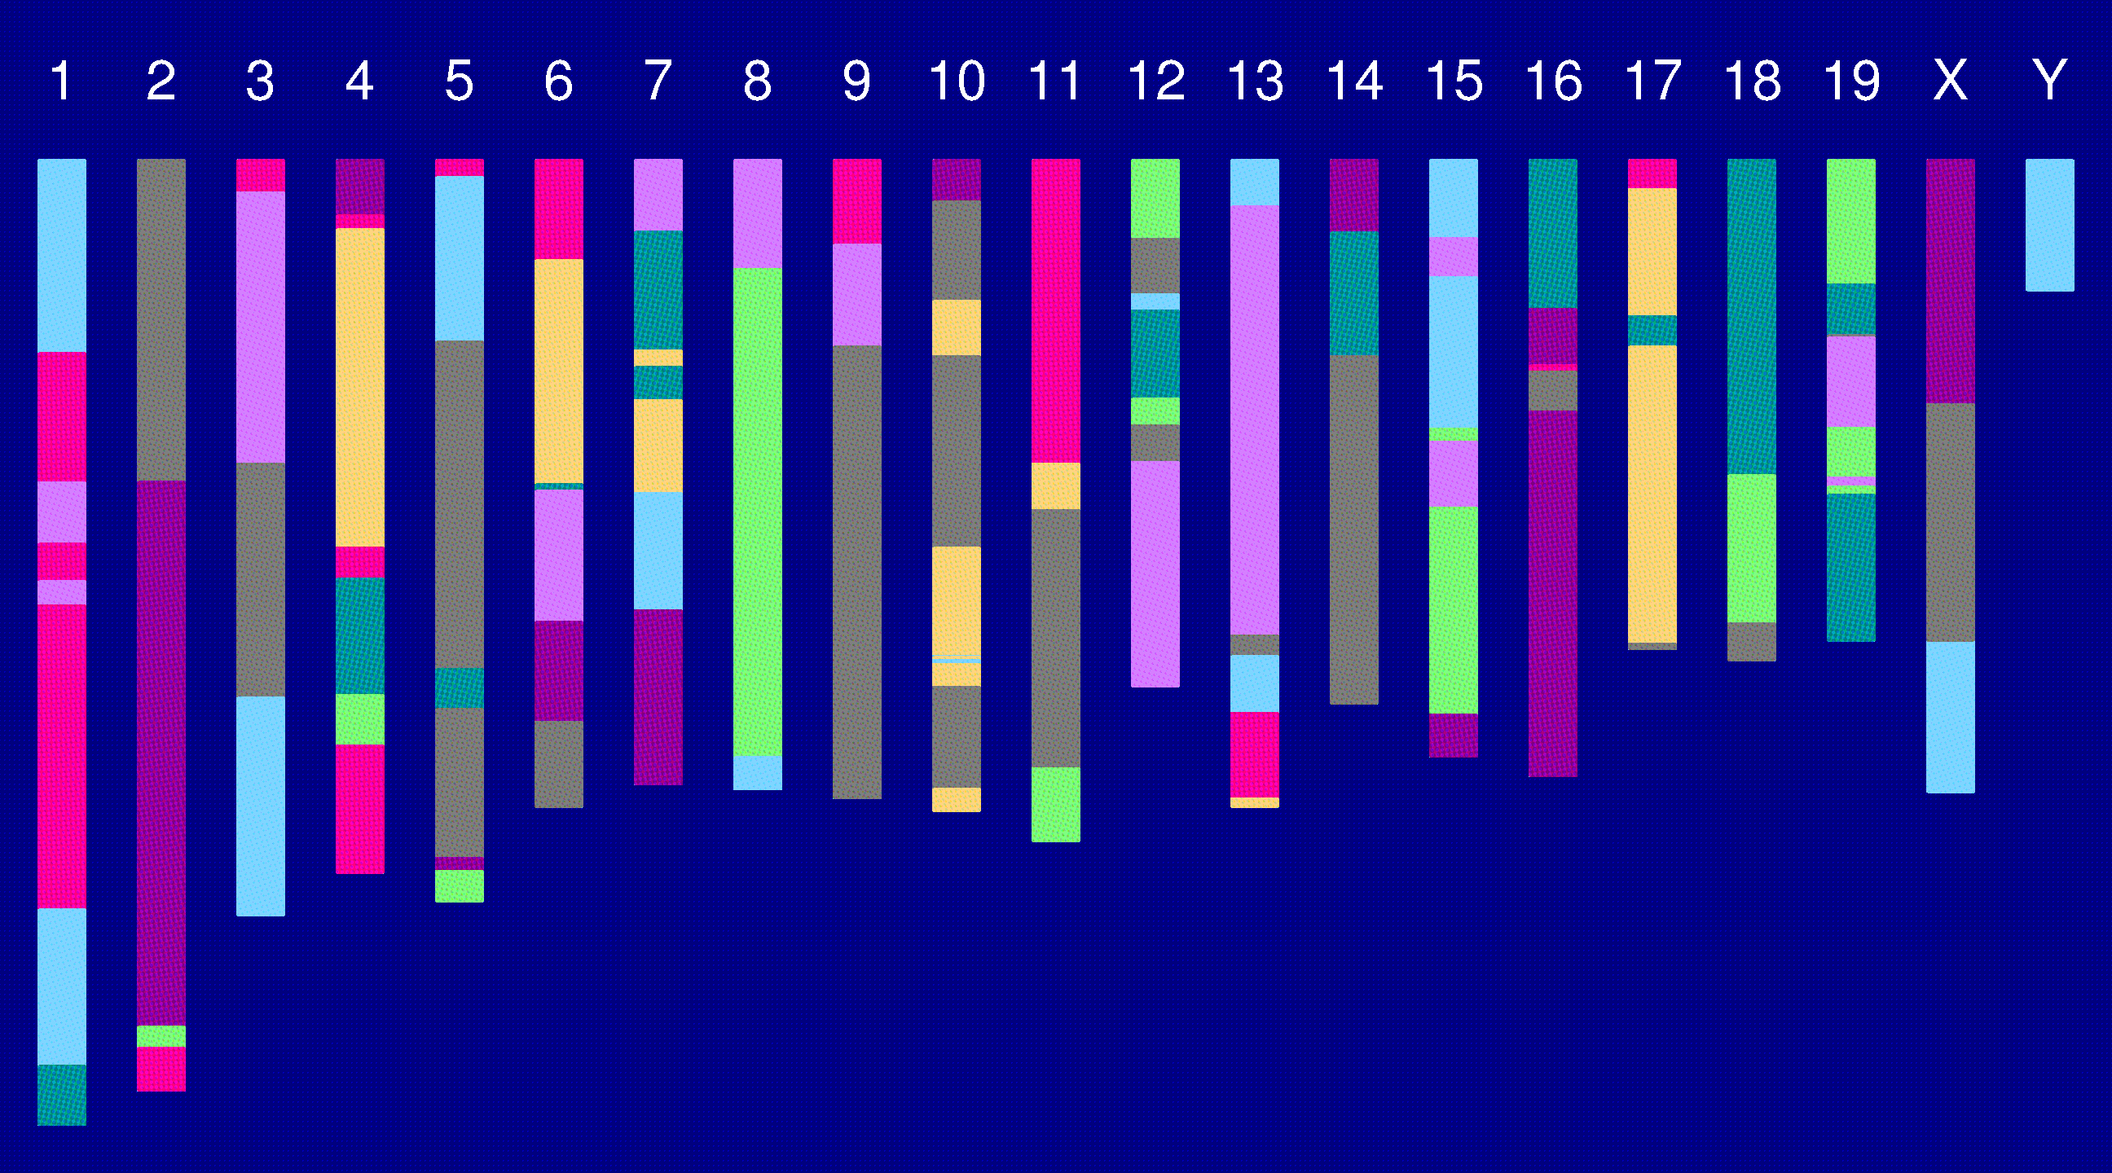
Genome of an 8-way RI

Slide 8
The goal
Characterize the breakpoint process along a chromosome in 8-way RILs.
  Understand the two-point haplotype probabilities.
  Study the clustering of the breakpoints, as a function of crossover interference in meiosis.

Slide 9
2 points in an RIL
1
2
r = recombination fraction = probability of a recombination in the interval in a random meiotic product.
R = analogous thing for the RIL = probability of different alleles at the two loci on a random RIL chromosome.

Slide 10
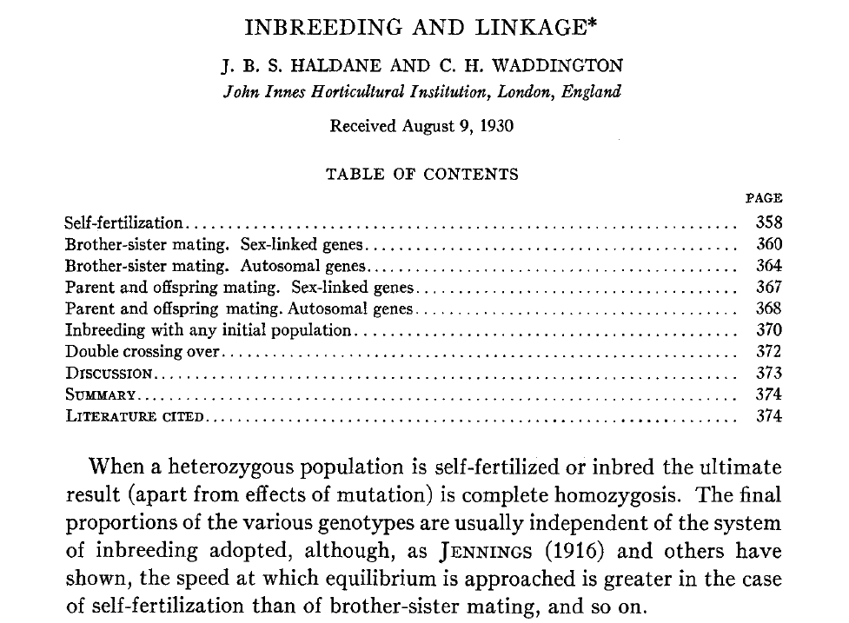
Haldane & Waddington 1931
Genetics 16:357-374

Slide 11
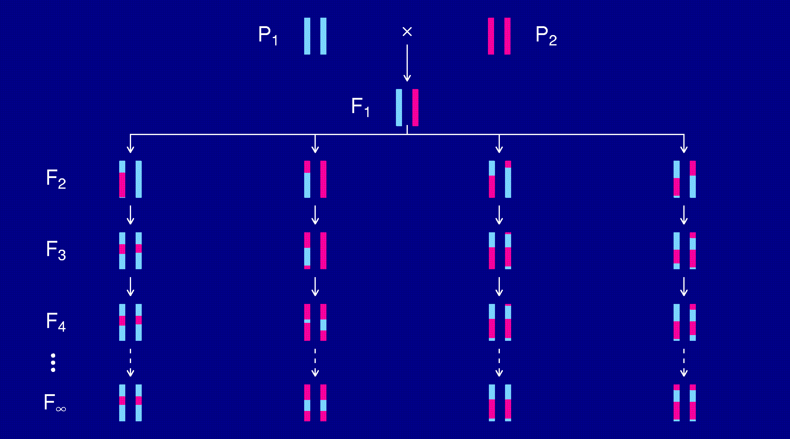
Recombinant inbred lines
(by selfing)

Slide 12
Markov chain
Sequence of random variables {X₀, X₁, X₂, …} satisfying
Pr(X_{n+1} | X₀, X₁, …, X_{n}) = Pr(X_{n+1} | X_{n})
Transition probabilities P_{ij} = Pr(X_{n+1}=j | X_{n}=i)
Here, X_{n} = “parental type” at generation n
We are interested in absorption probabilities
Pr(X_{n} → j | X₀)

Slide 13
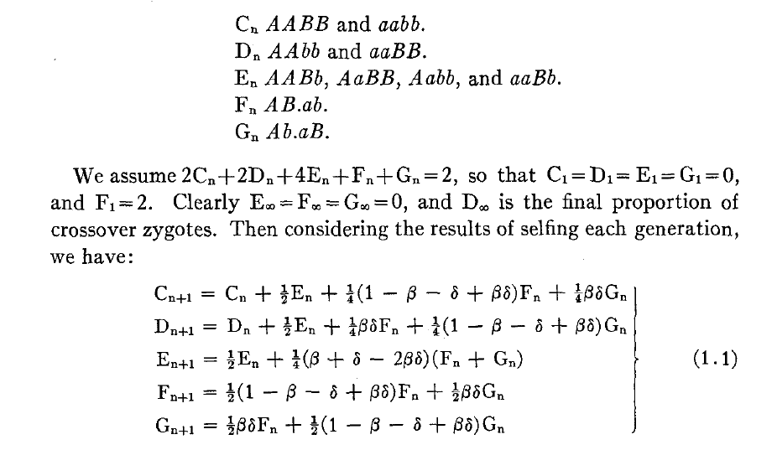
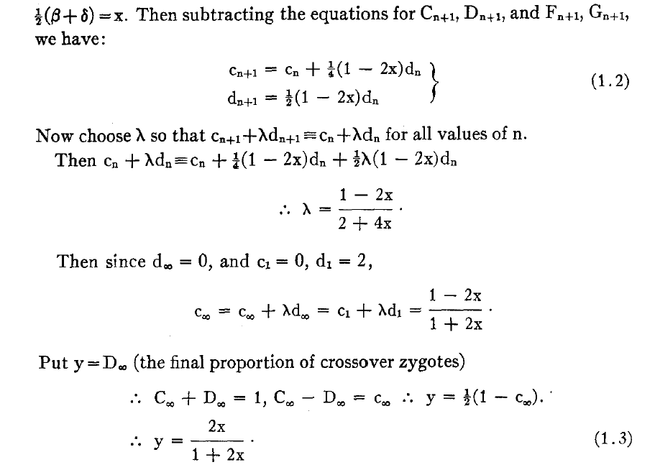
Equations for selfing

Slide 14
Absorption probabilities
Let P_{ij} = Pr(X_{n+1} = j | X_{n} = i) where X_{n} = state at generation n.
Consider the case of absorption into the state AA|AA.
Let h_{i} = probability, starting at i, eventually absorbed into AA|AA.
Then h_{AA|AA} = 1 and h_{AB|AB} = 0.
Condition on the first step: h_{i} = ∑_{k} P_{ik} h_{k}
For selfing, this gives a system of 3 linear equations.

Slide 15
Recombinant inbred lines
(by sibling mating)

Slide 16
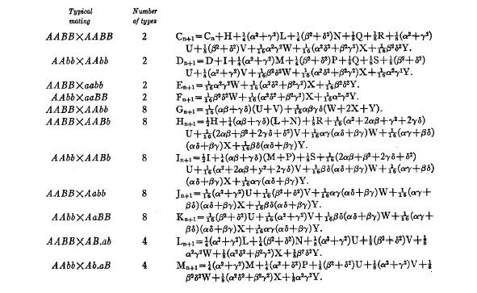
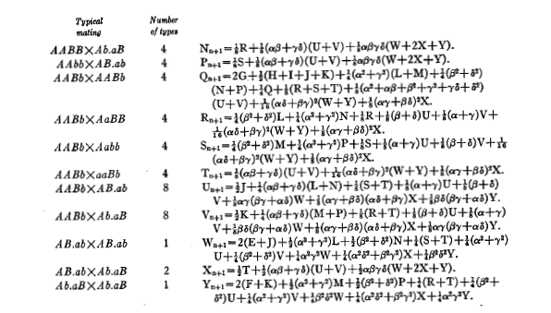
Equations for sib-mating

Slide 17
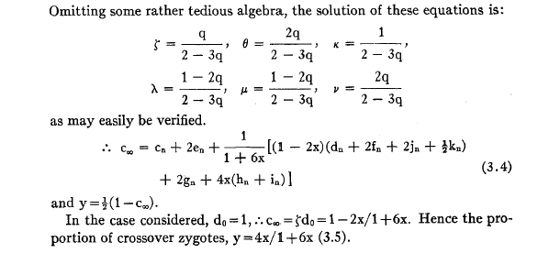
Result for sib-mating

Slide 18
The “Collaborative Cross”

Slide 19
8-way RILs
Autosomes
  Pr(G₁ = i) = 1/8
  Pr(G₂ = j | G₁ = i) = r / (1+6r) for i ≠ j
  Pr(G₂ ≠ G₁) = 7r / (1+6r)
X chromosome
  Pr(G₁=A) = Pr(G₁=B) = Pr(G₁=E) = Pr(G₁=F) =1/6
  Pr(G₁=C) = 1/3
  Pr(G₂=B | G₁=A) = r / (1+4r)
  Pr(G₂=C | G₁=A) = 2r / (1+4r)
  Pr(G₂=A | G₁=C) = r / (1+4r)
  Pr(G₂ ≠ G₁) = (14/3) r / (1+4r)

Slide 20
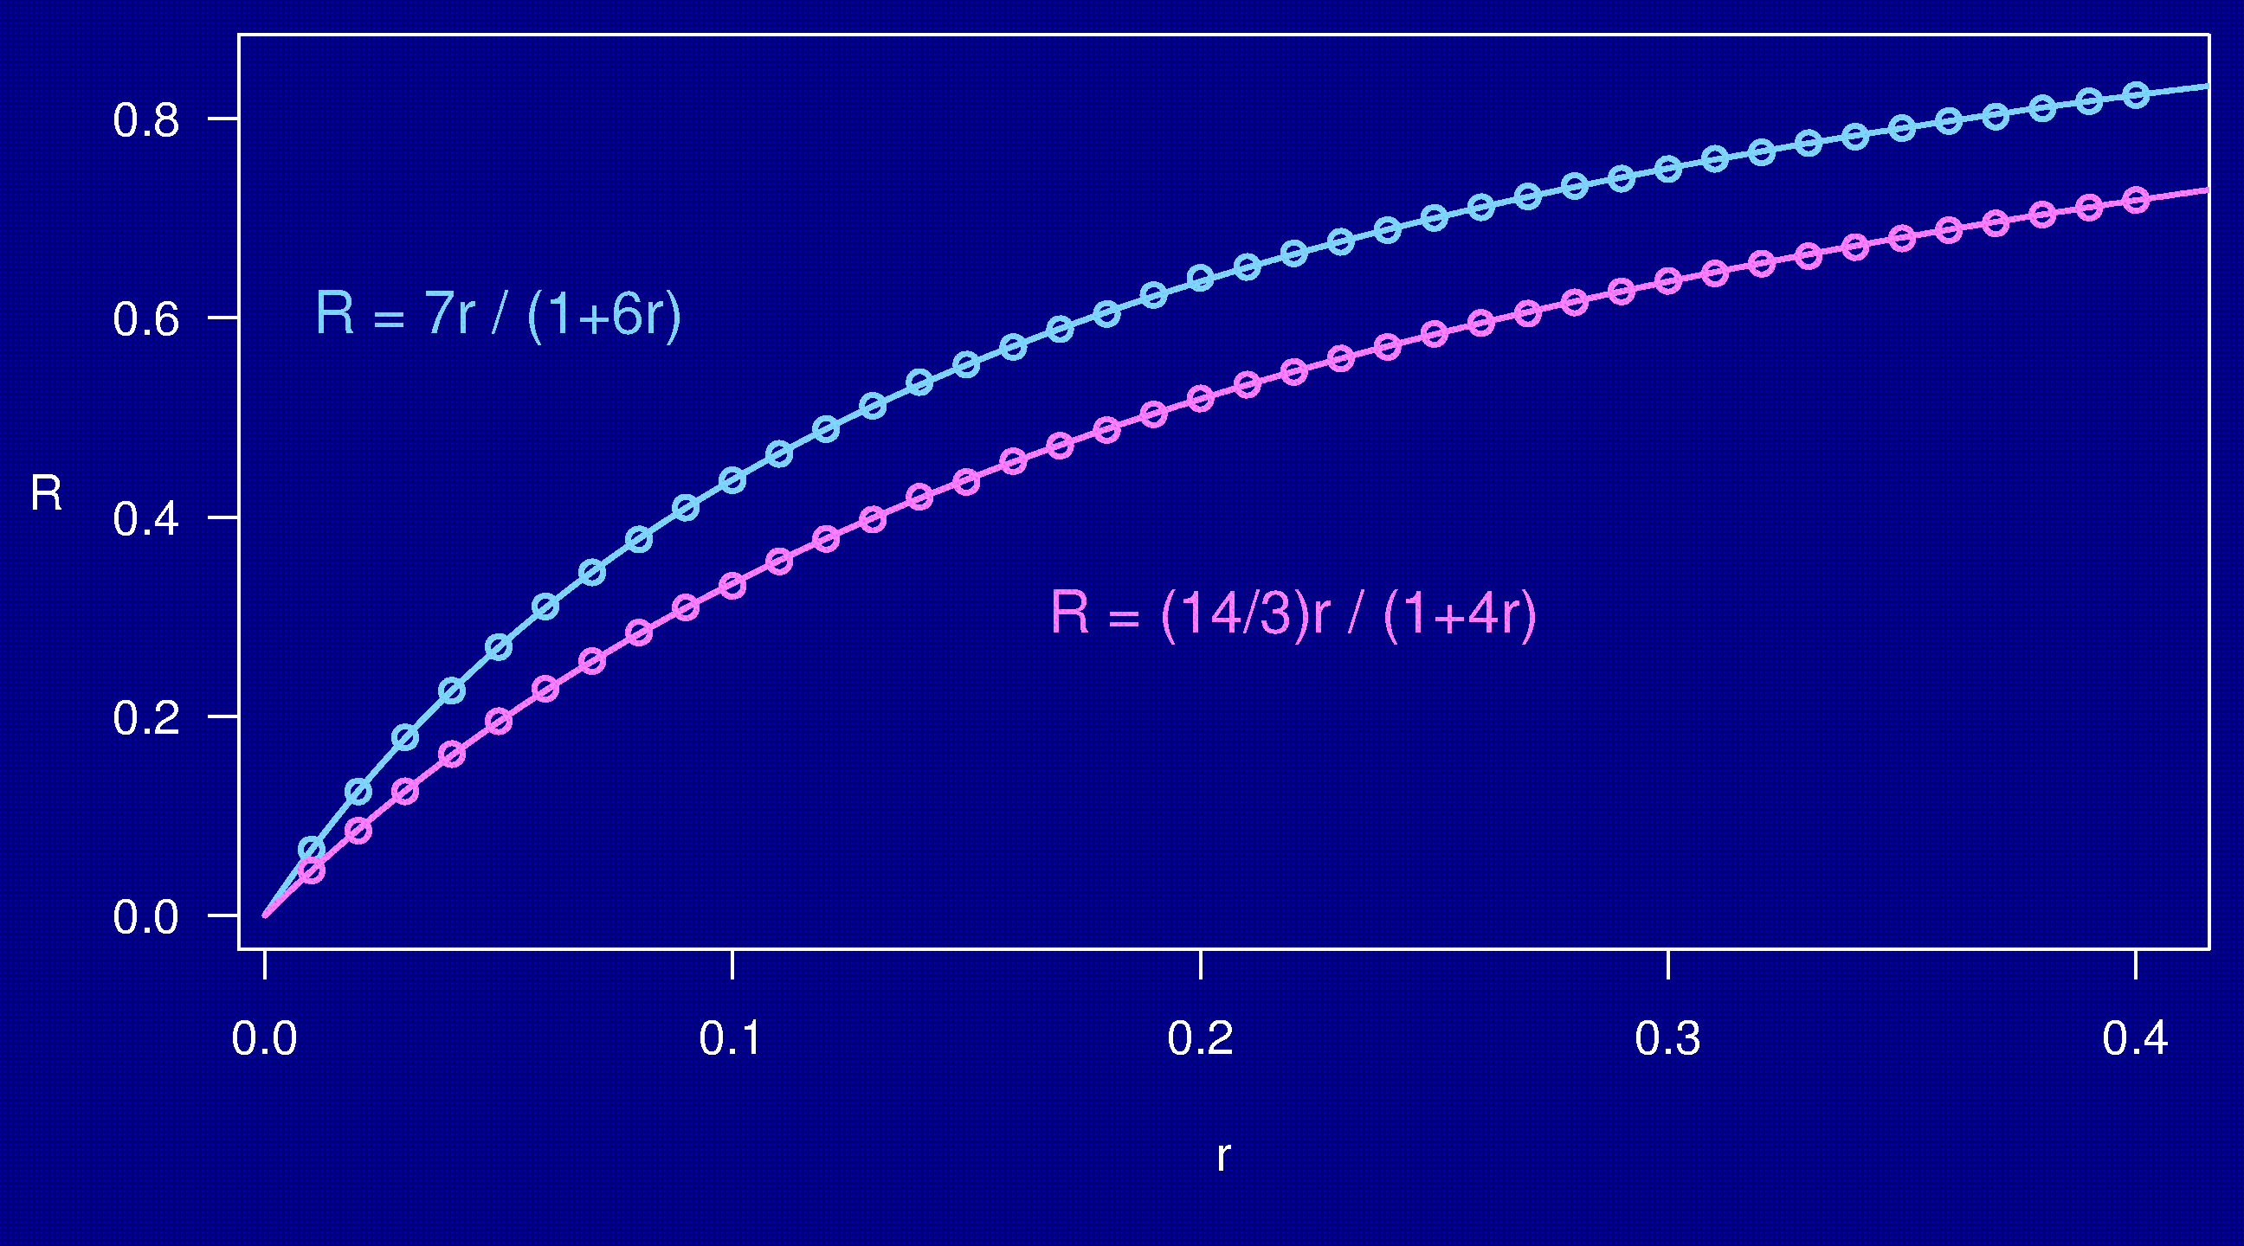
Computer simulations

Slide 21
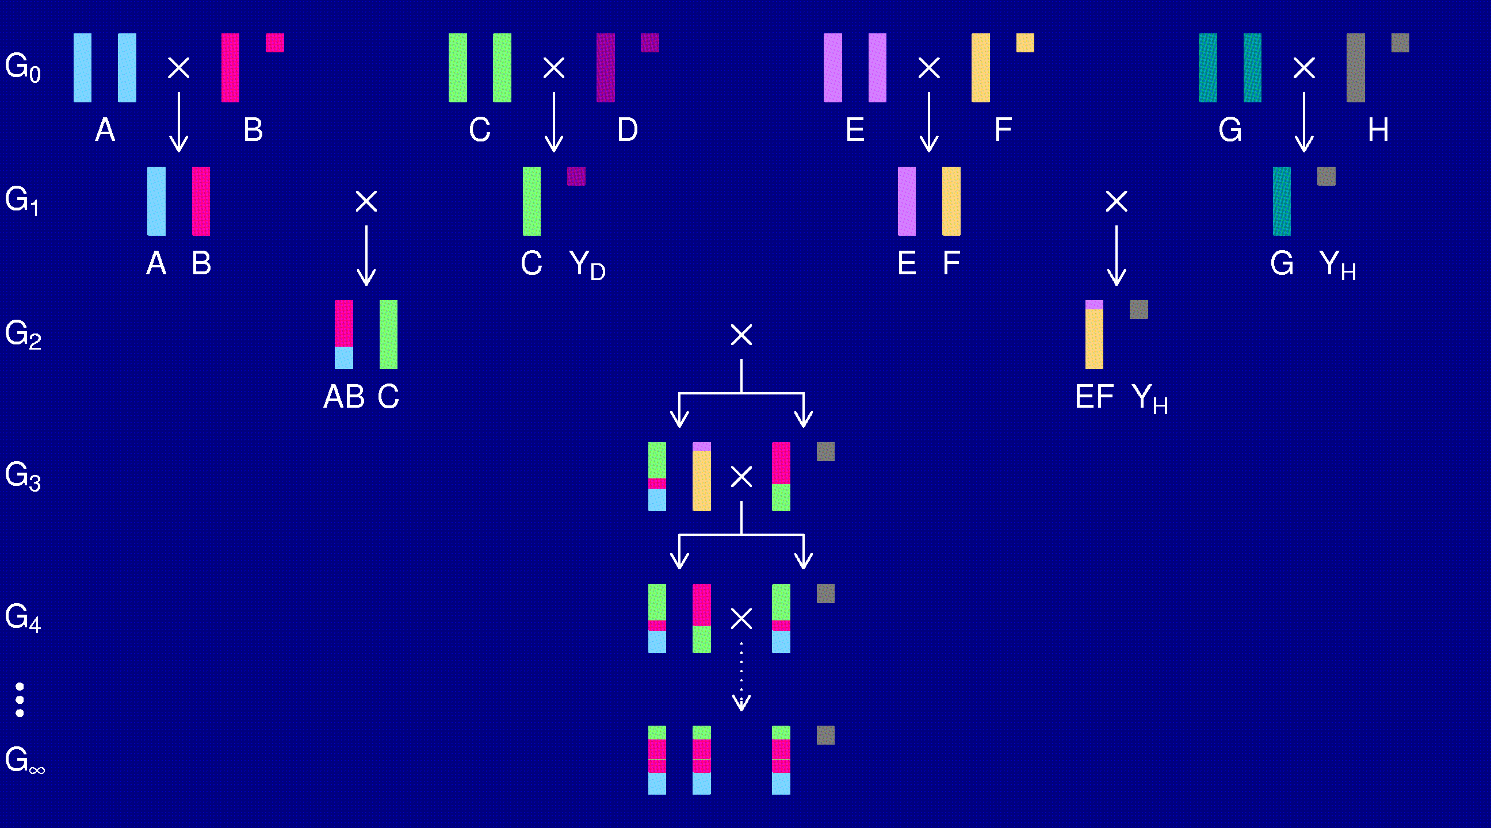
The X chromosome

Slide 22
3-point coincidence
1
2
3
r_{ij} = recombination fraction for interval i,j;
assume r₁₂ = r₂₃ = r
Coincidence = c = Pr(double recombinant) / r²
= Pr(rec’n in 23 | rec’n in 12) / Pr(rec’n in 23)
No interference → = 1
Positive interference → < 1
Negative interference → > 1
Generally c is a function of r.

Slide 23
3-points in 2-way RILs
1
2
3
r₁₃ = 2 r (1 – c r)
R = f(r); R₁₃ = f(r₁₃)
Pr(double recombinant in RIL) = { R + R – R₁₃ } / 2
Coincidence (in 2-way RIL) = { 2 R – R₁₃ } / { 2 R² }
Notes:
This is included at the end of Haldane & Waddington (1931).

Slide 24
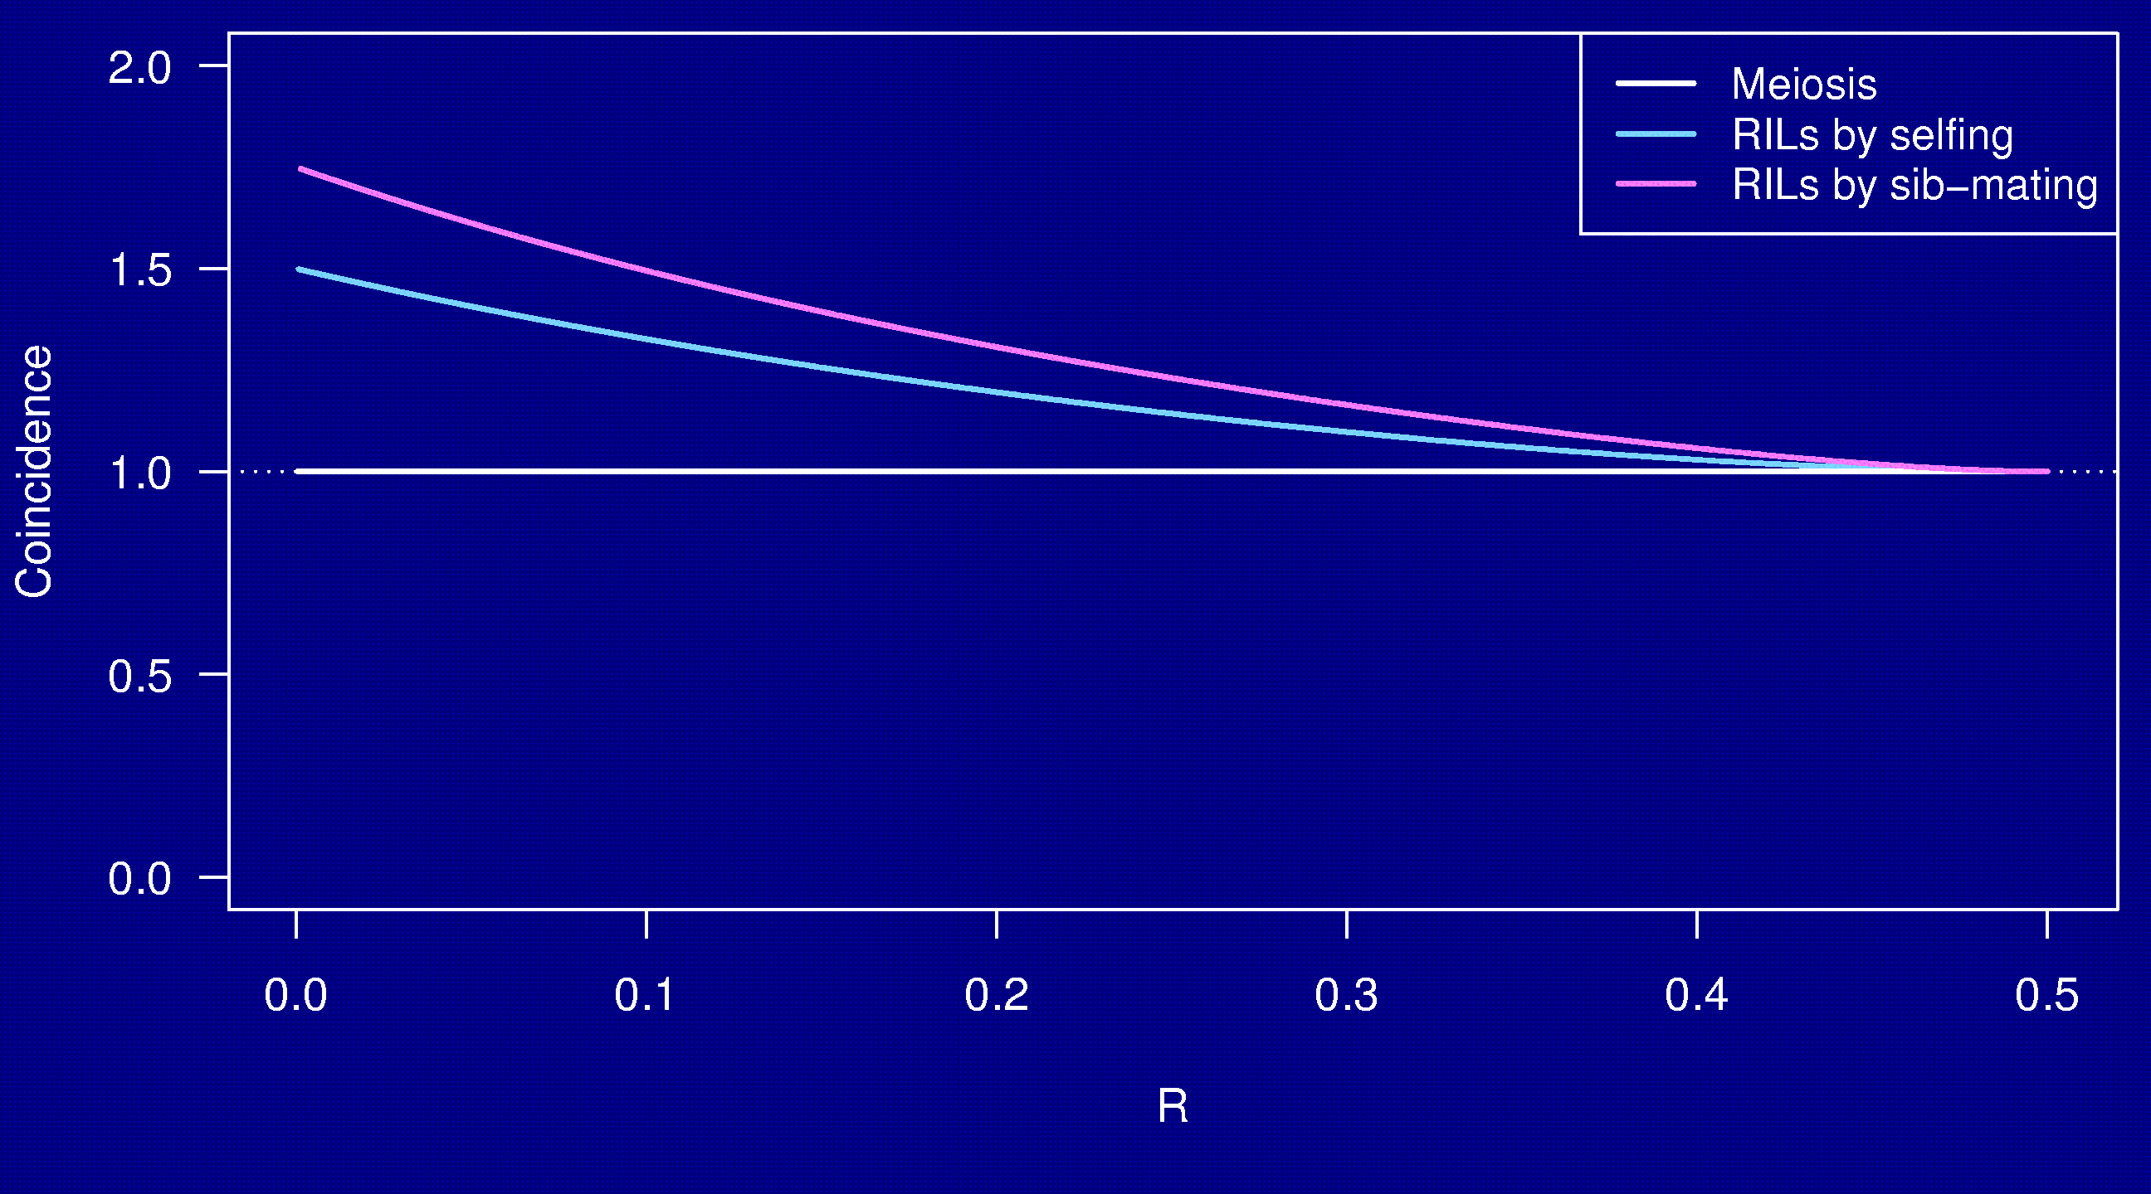
Coincidence
No interference

Slide 25
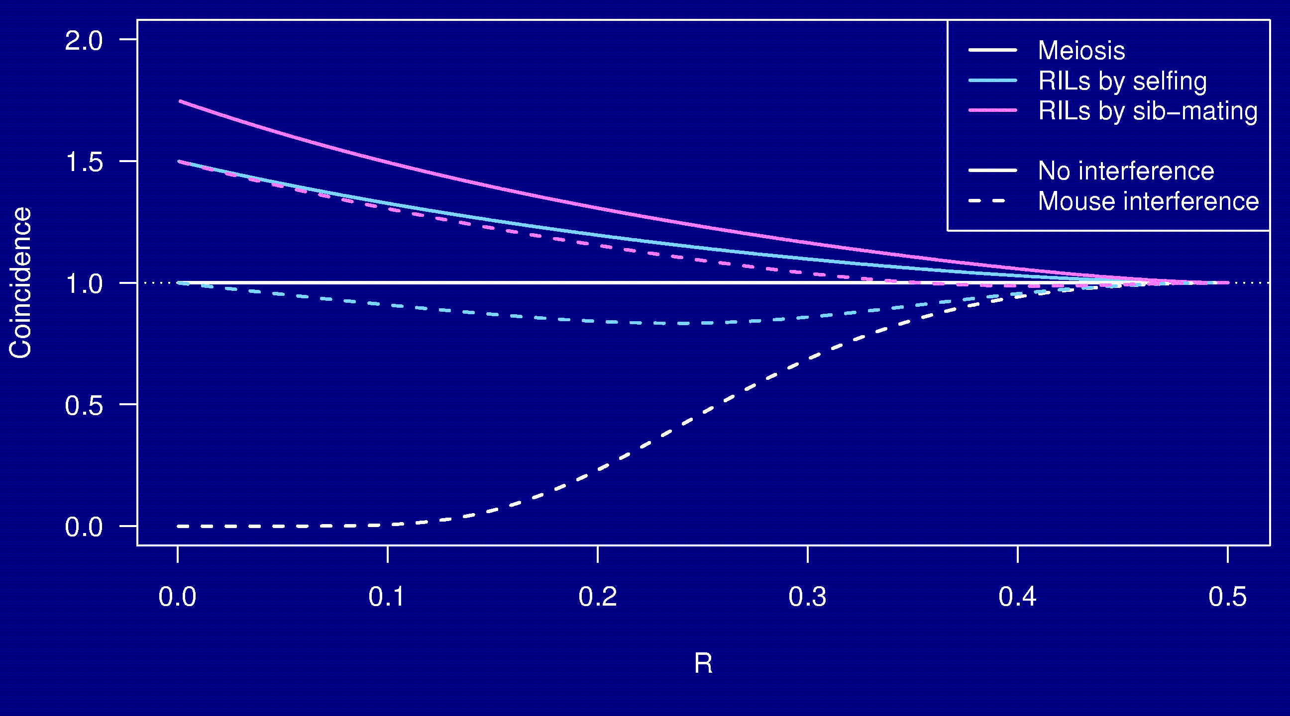
Coincidence

Slide 26
Why the clustering of breakpoints?
The really close breakpoints occur in different generations.
Breakpoints in later generations can occur only in regions that are not yet fixed.
The regions of heterozygosity are, of course, surrounded by breakpoints.

Slide 27
Coincidence in 8-way RILs
The trick that allowed us to get the coincidence for 2-way RILs doesn’t work for 8-way RILs.
It’s sufficient to consider 4-way RILs.
Calculations for 3 points in 4-way RILs is still astoundingly complex.
  2 points in 2-way RILs by sib-mating:
  55 parental types → 22 states by symmetry
  3 points in 4-way RILs by sib-mating:
  2,164,240 parental types → 137,488 states
Even counting the states was difficult.

Slide 28
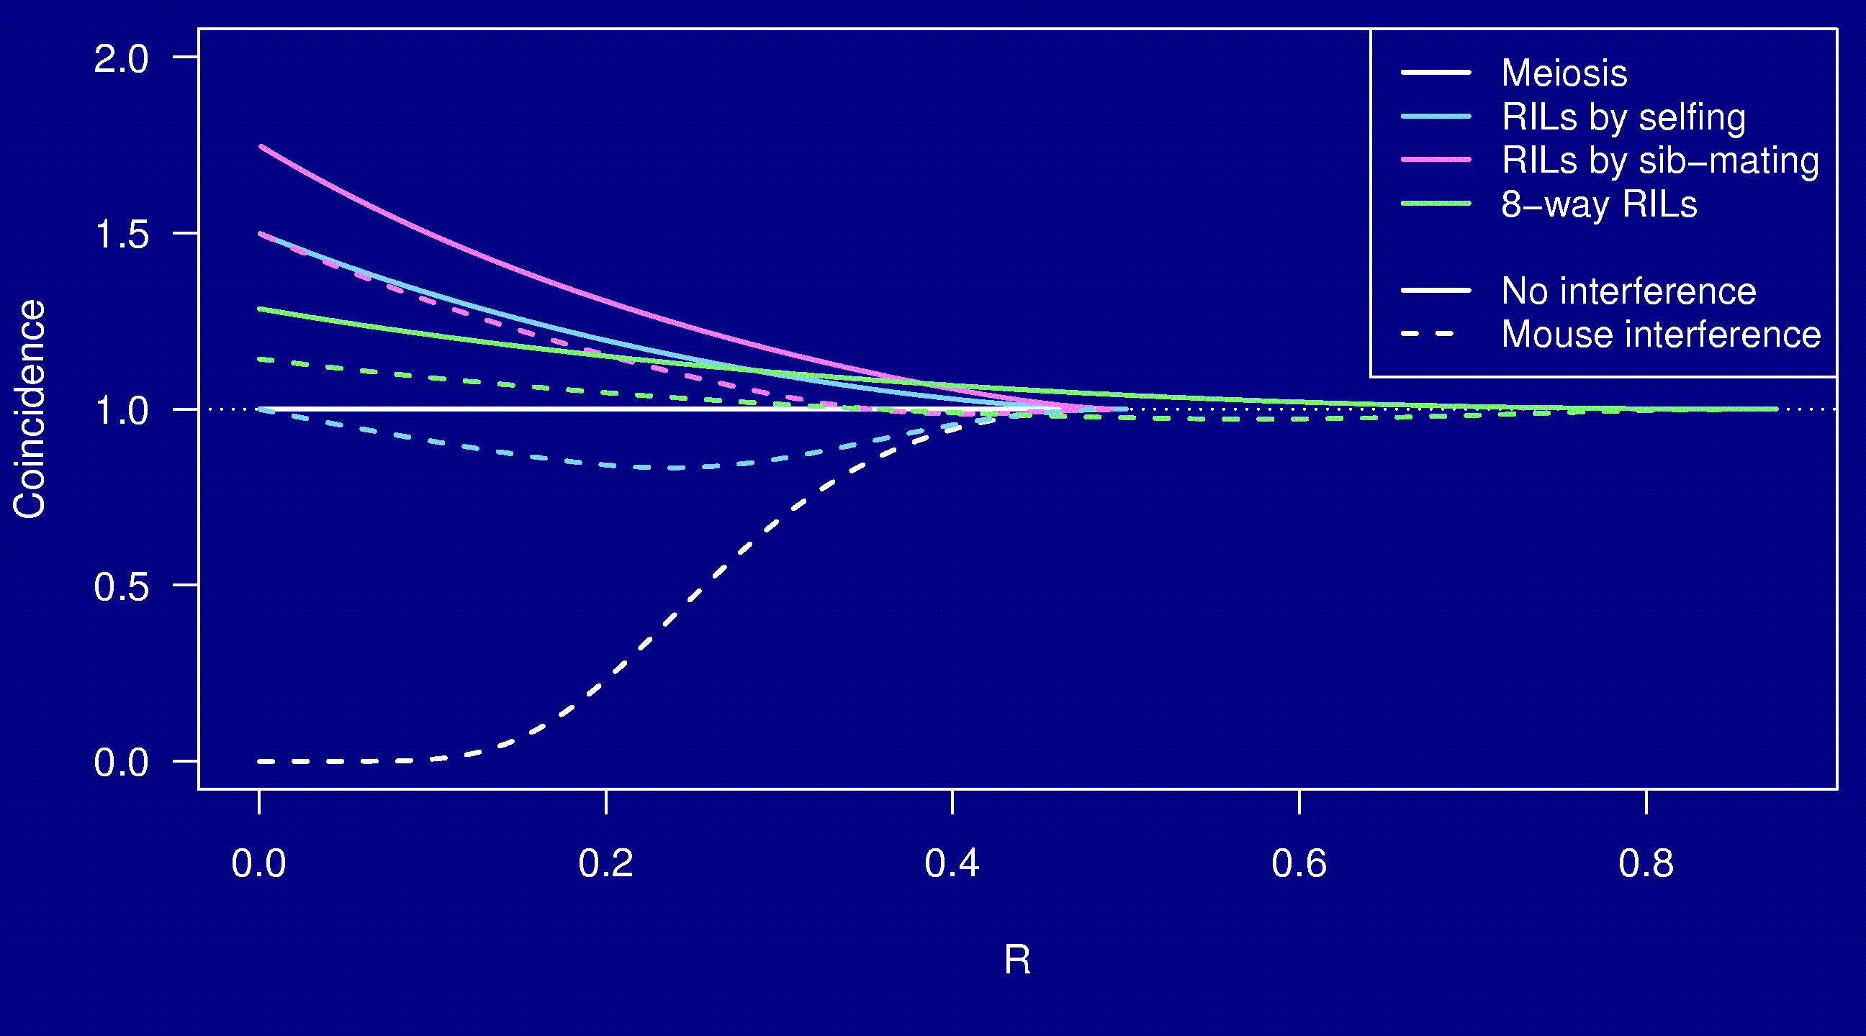
Coincidence

Slide 29
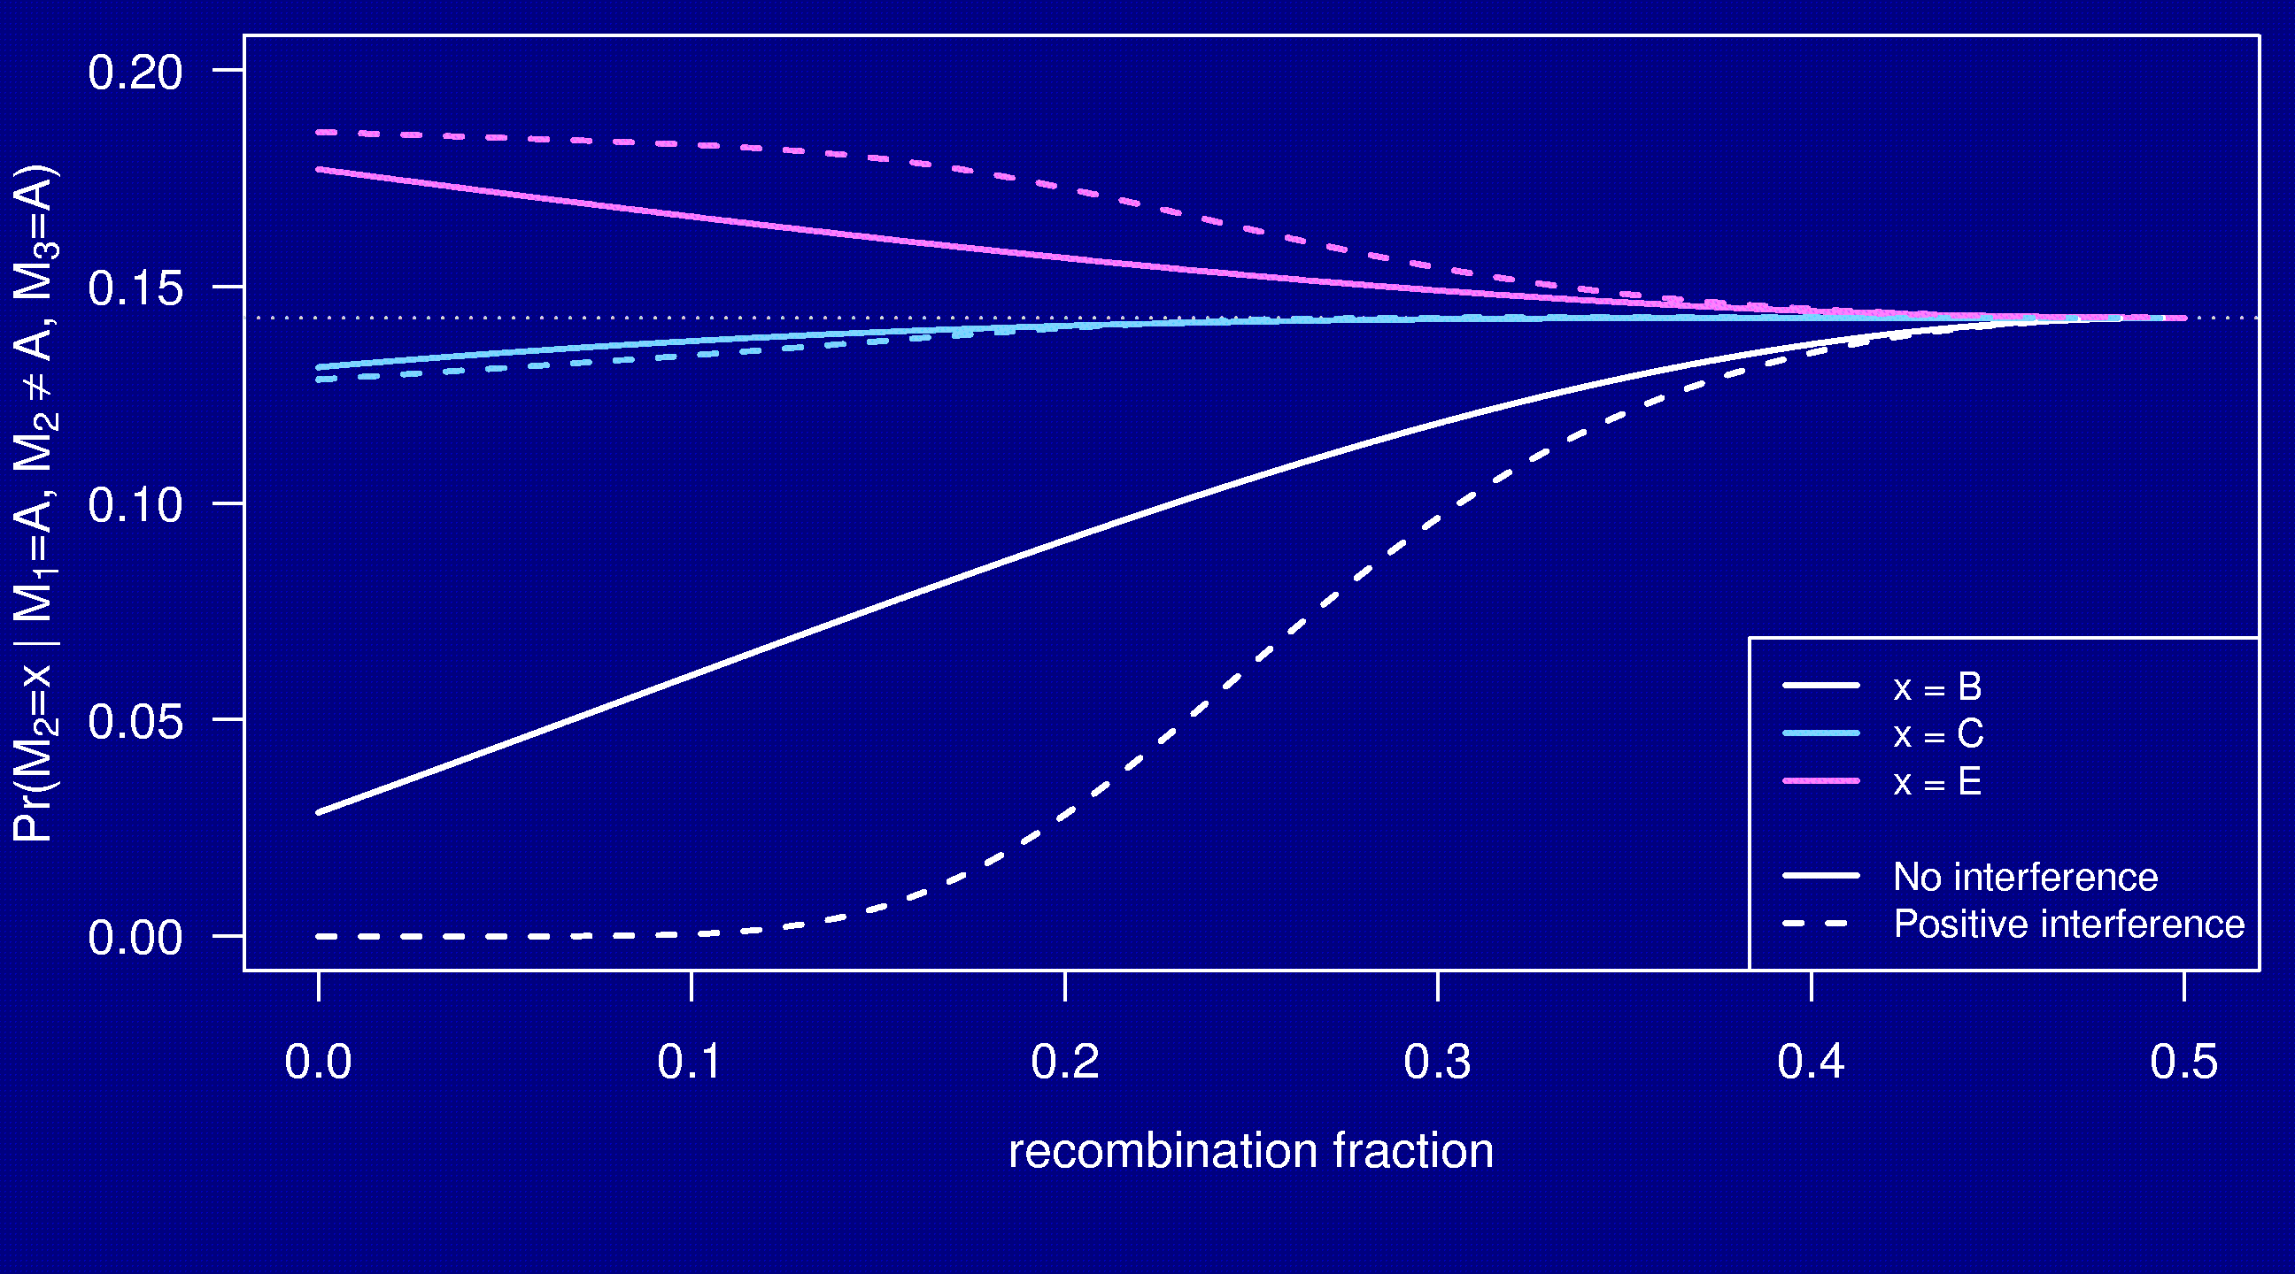
3-point symmetry

Slide 30
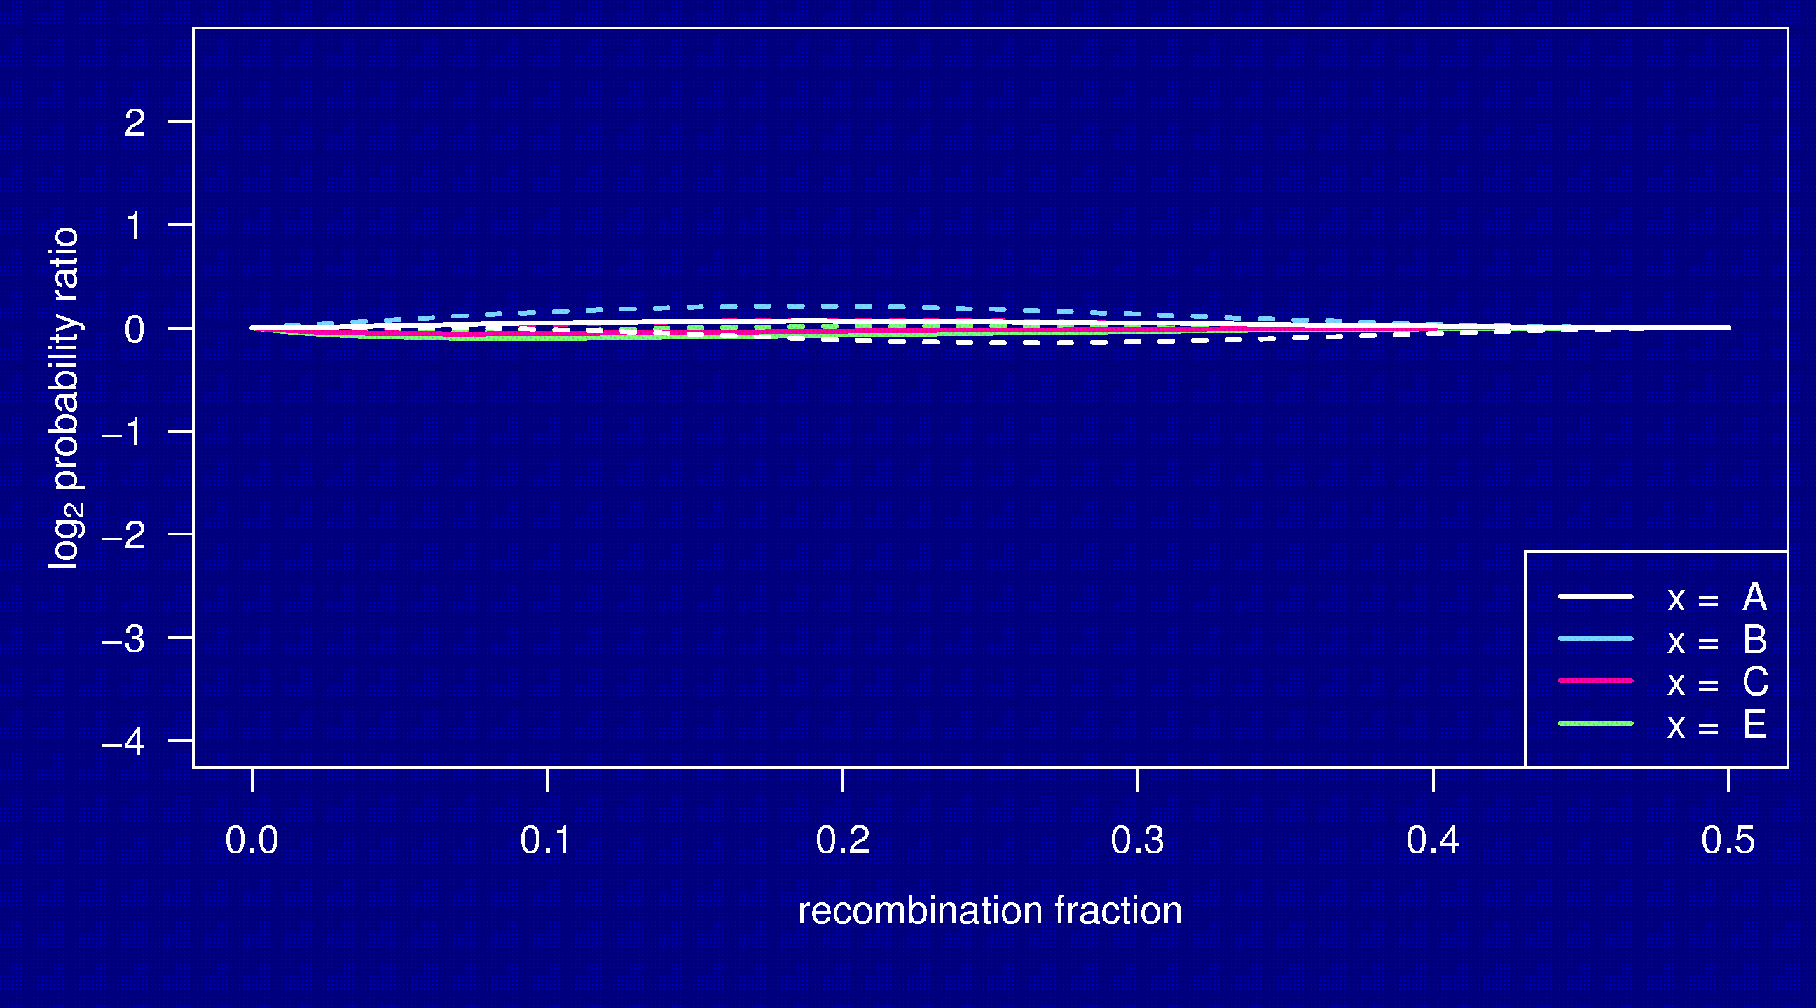
Markov property

Slide 31
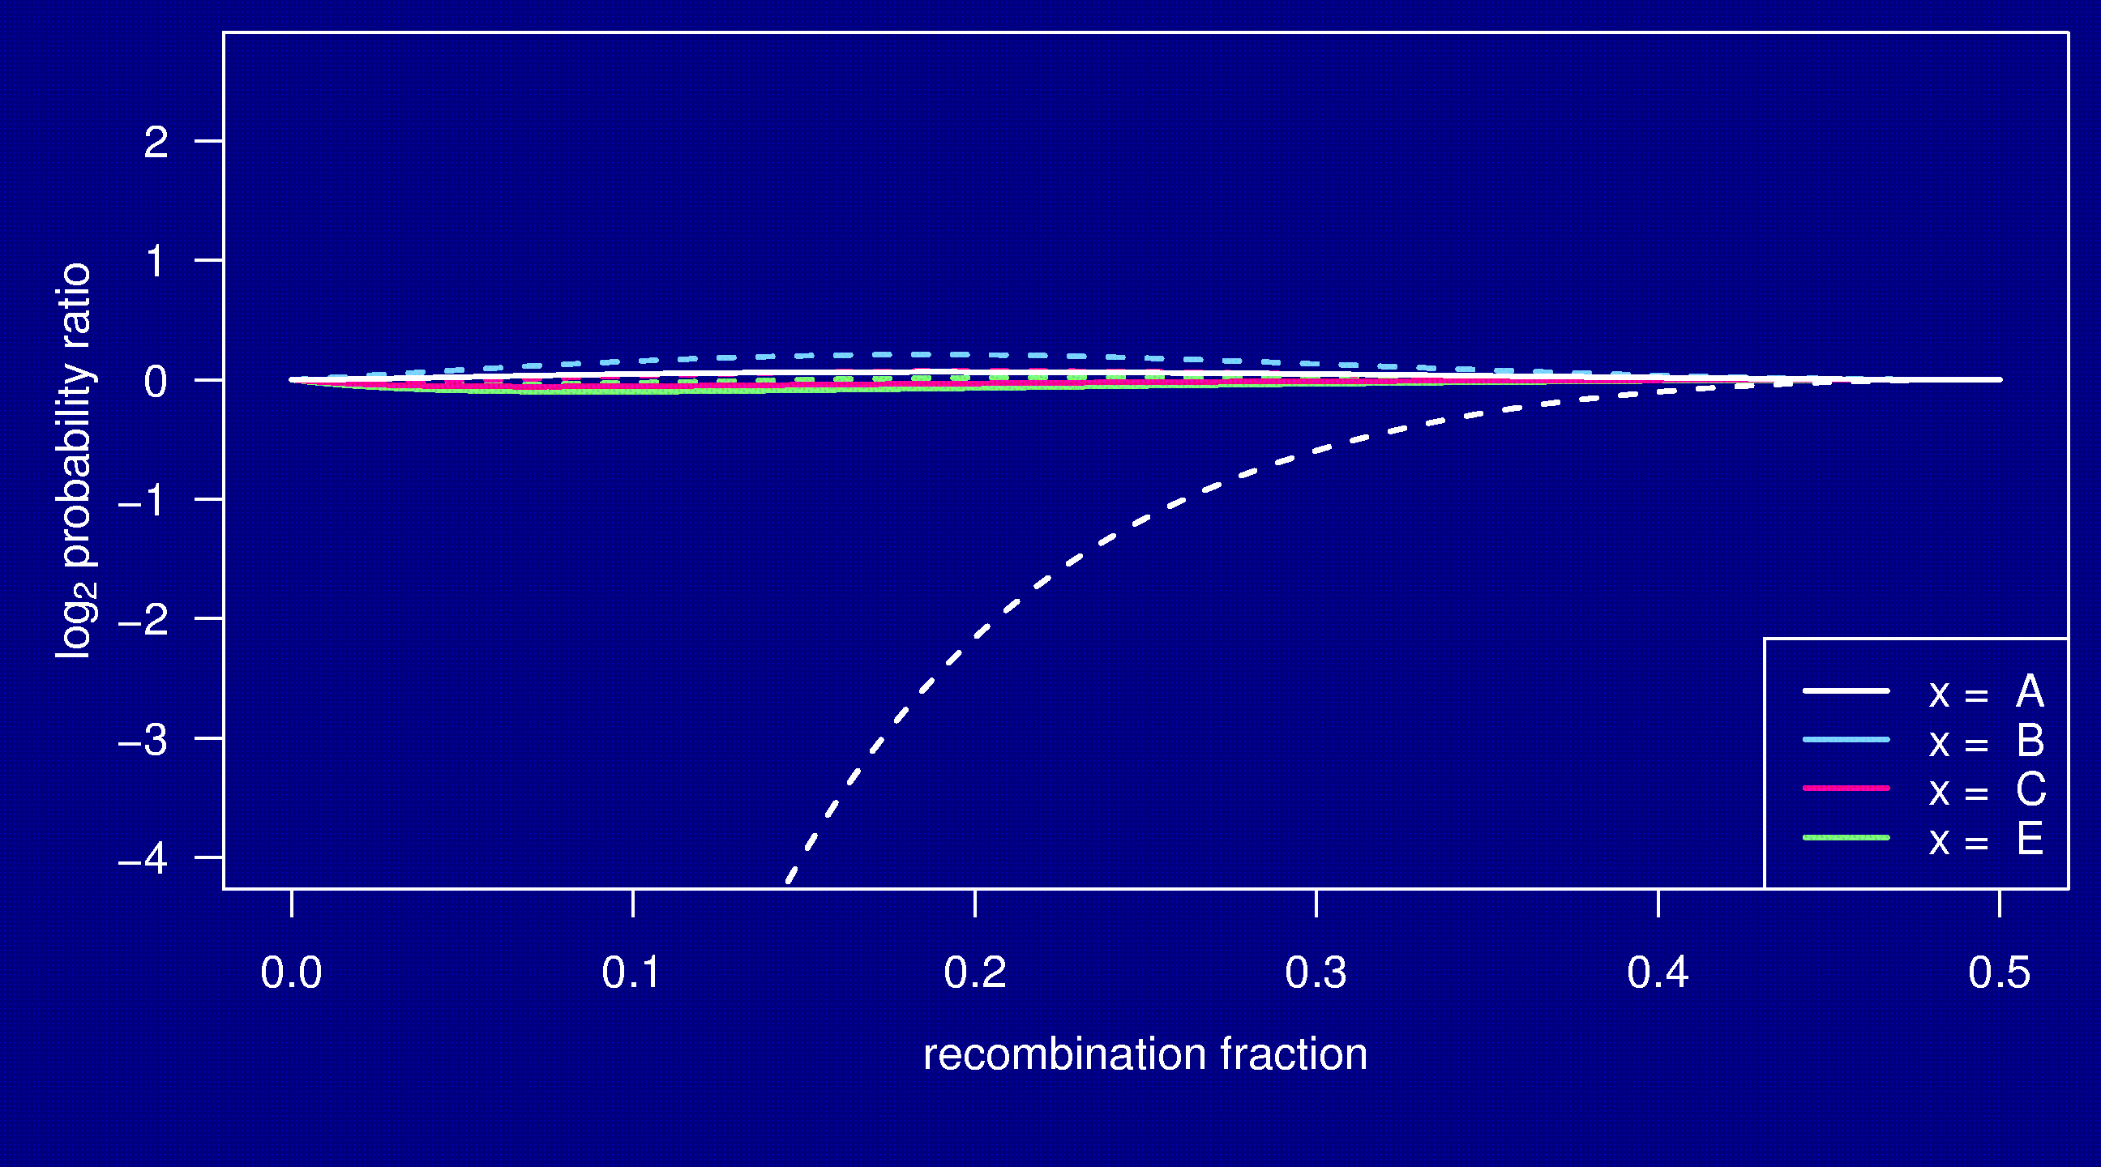
Markov property

Slide 32
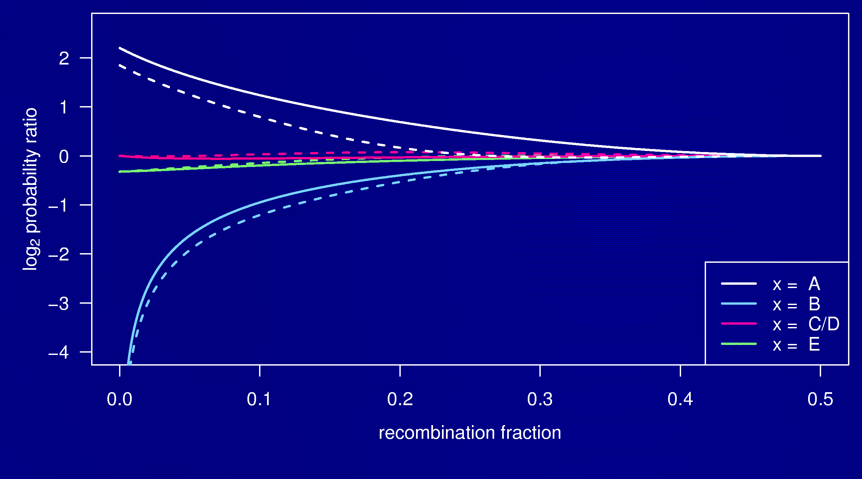
Markov property

Slide 33
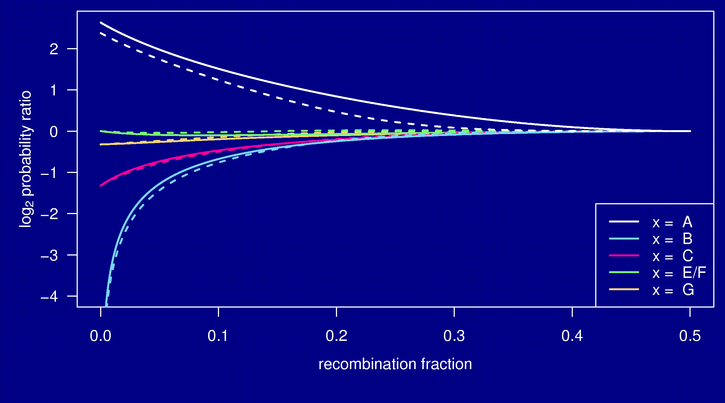
Markov property

Slide 34
Summary
The Collaborative Cross could provide “one-stop shopping” for gene mapping in the mouse.
Use of such 8-way RILs requires an understanding of the breakpoint process.
We’ve extended Haldane & Waddington’s results to the case of 8-way RILs: R = 7 r / (1 + 6 r).
We’ve shown clustering of breakpoints in RILs by sib-mating, even in the presence of strong crossover interference.
Broman KW (2005) The genomes of recombinant inbred lines. Genetics 169:1133-1146

