Slide 1
Understanding human disease via randomized mice

Slide 2
Is epidemiology necessary?
Karl W Broman
Department of Biostatistics
Johns Hopkins Bloomberg School of Public Health
http://www.biostat.jhsph.edu/~kbroman

Slide 3
Understanding human disease via randomized mice

Slide 4
Outline
Stuff that may be relevant to you.
Stuff that is likely irrelevant, but hopefully will entertain you.

Slide 5
Goal
Identify genes that contribute to common human diseases.

Slide 6
Inbred mice

Slide 7
Why genetics?
Phenotype → mechanism
Need not know anything in advance.
Genes may not be an important cause, but they can lead to
  Disease etiology (e.g., pathways)
  Possible drug targets

Slide 8
Approaches
Model organisms (e.g. mouse or rat)
  Mutagenesis
  Experimental crosses
  Association mapping
Linkage analysis in human pedigrees
  A few large pedigrees
  Many small families (e.g., sibling pairs)
Association analysis in human populations
  Isolated populations vs. outbred populations
  Whole genome vs. candidate genes/regions

Slide 9
Why mice?
Advantages
Small and cheap
Inbred lines
Simpler genetic architecture
Controlled environment
Large, controlled crosses
Experimental interventions
Knock-outs and knock-ins
Disadvantages
Is the model really at all like the corresponding human disease?
Still not as small (or as fast at breeding) as a fly.

Slide 10
The mouse as a model
Same genes?
  The genes involved in a phenotype in the mouse may also be involved in similar phenotypes in the human.
Similar complexity?
  The complexity of the etiology underlying a mouse phenotype provides some indication of the complexity of similar human phenotypes.
Transfer of statistical methods.
  The statistical methods developed for gene mapping in the mouse serve as a basis for similar methods applicable in direct human studies.

Slide 11
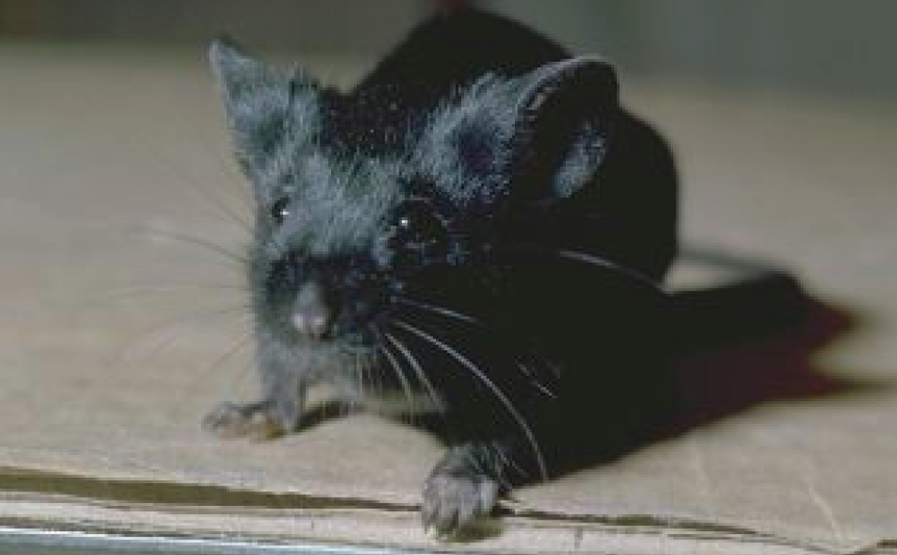
C57BL/6

Slide 12
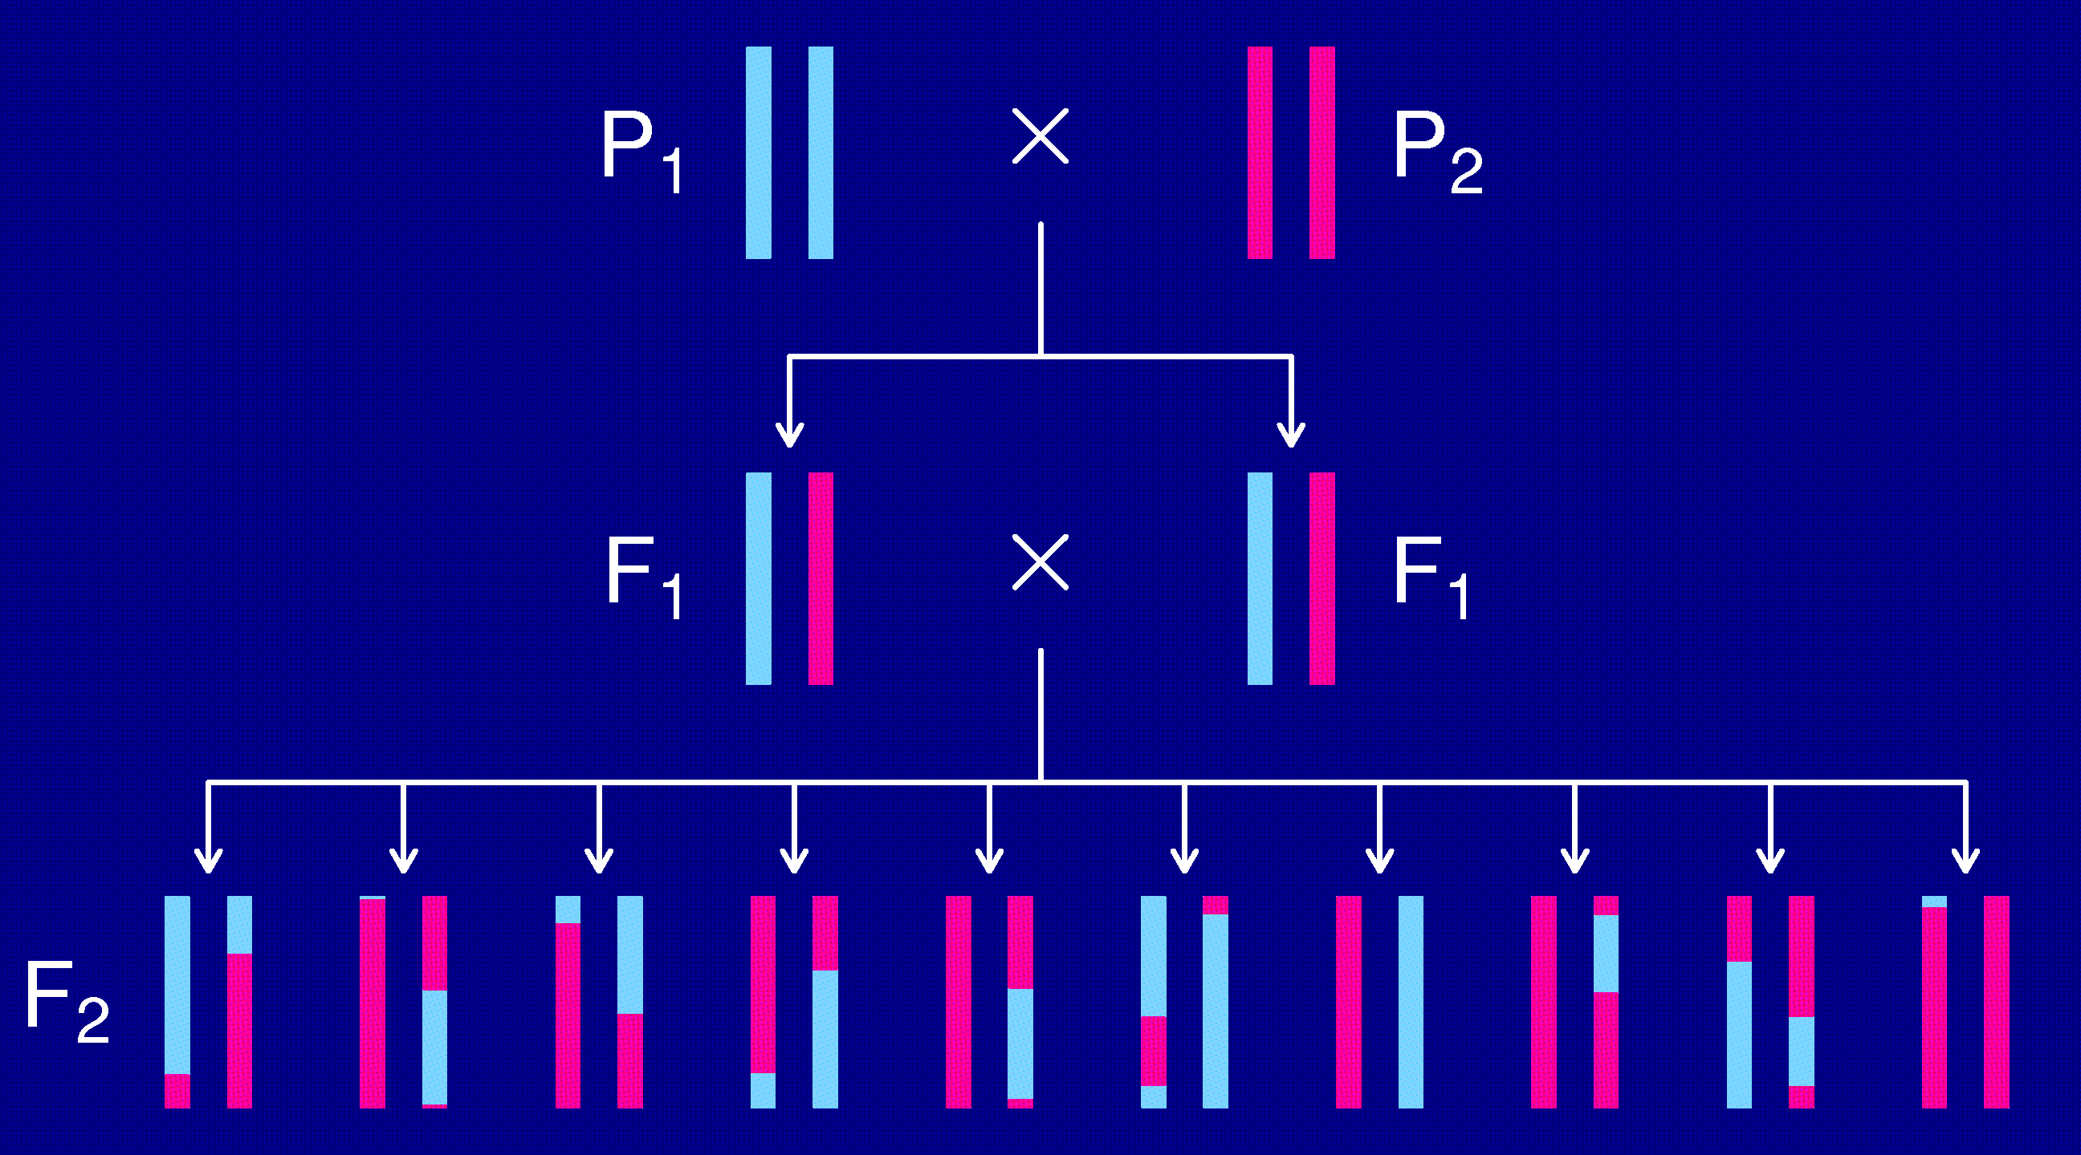
The intercross

Slide 13
Opportunities for improvement
Each individual is unique.
  Must genotype each mouse.
  Unable to obtain multiple invasive phenotypes (e.g., in multiple environmental conditions) on the same genotype.
Relatively low mapping precision.
Design a set of inbred mouse strains.
  Genotype once.
  Study multiple phenotypes on the same genotype.

Slide 14
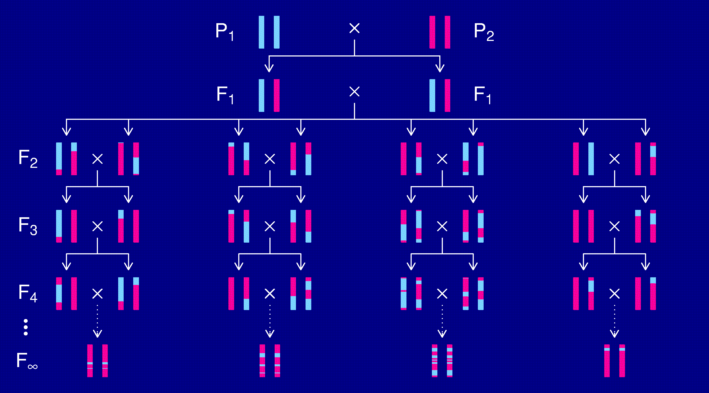
Recombinant inbred lines
(by sibling mating)

Slide 15
RI lines
Advantages
Each strain is a eternal resource.
  Only need to genotype once.
  Reduce individual variation by phenotyping multiple individuals from each strain.
  Study multiple phenotypes on the same genotype.
Greater mapping precision.
  More dense breakpoints on the RI chromosomes.
Disadvantages
Time and expense.
Available panels are generally too small (10-30 lines).
Can learn only about 2 particular alleles.
All individuals homozygous.

Slide 16
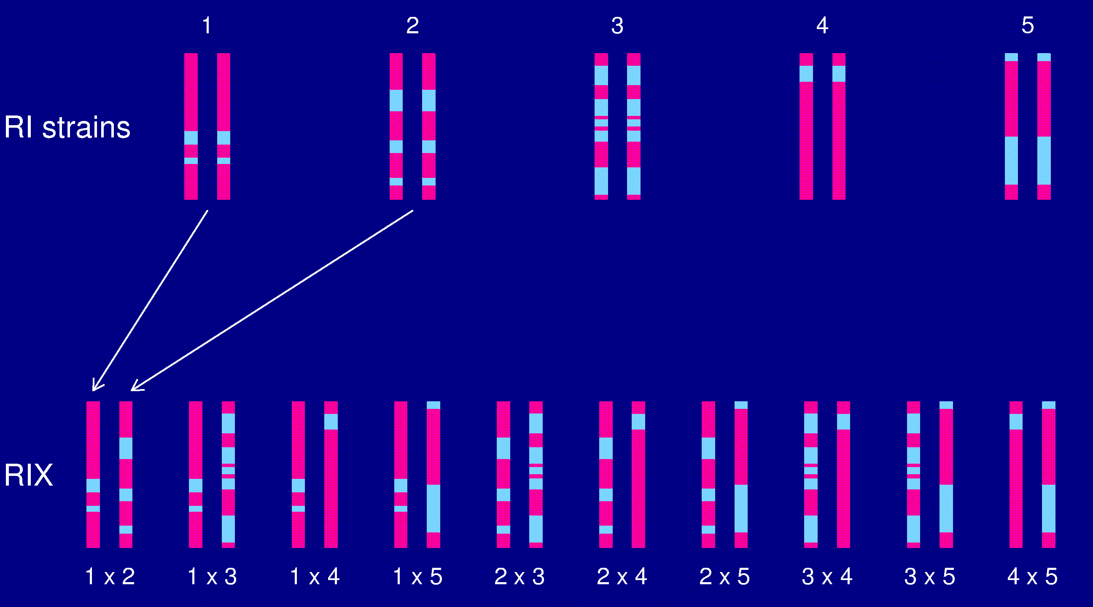
The RIX design

Slide 17
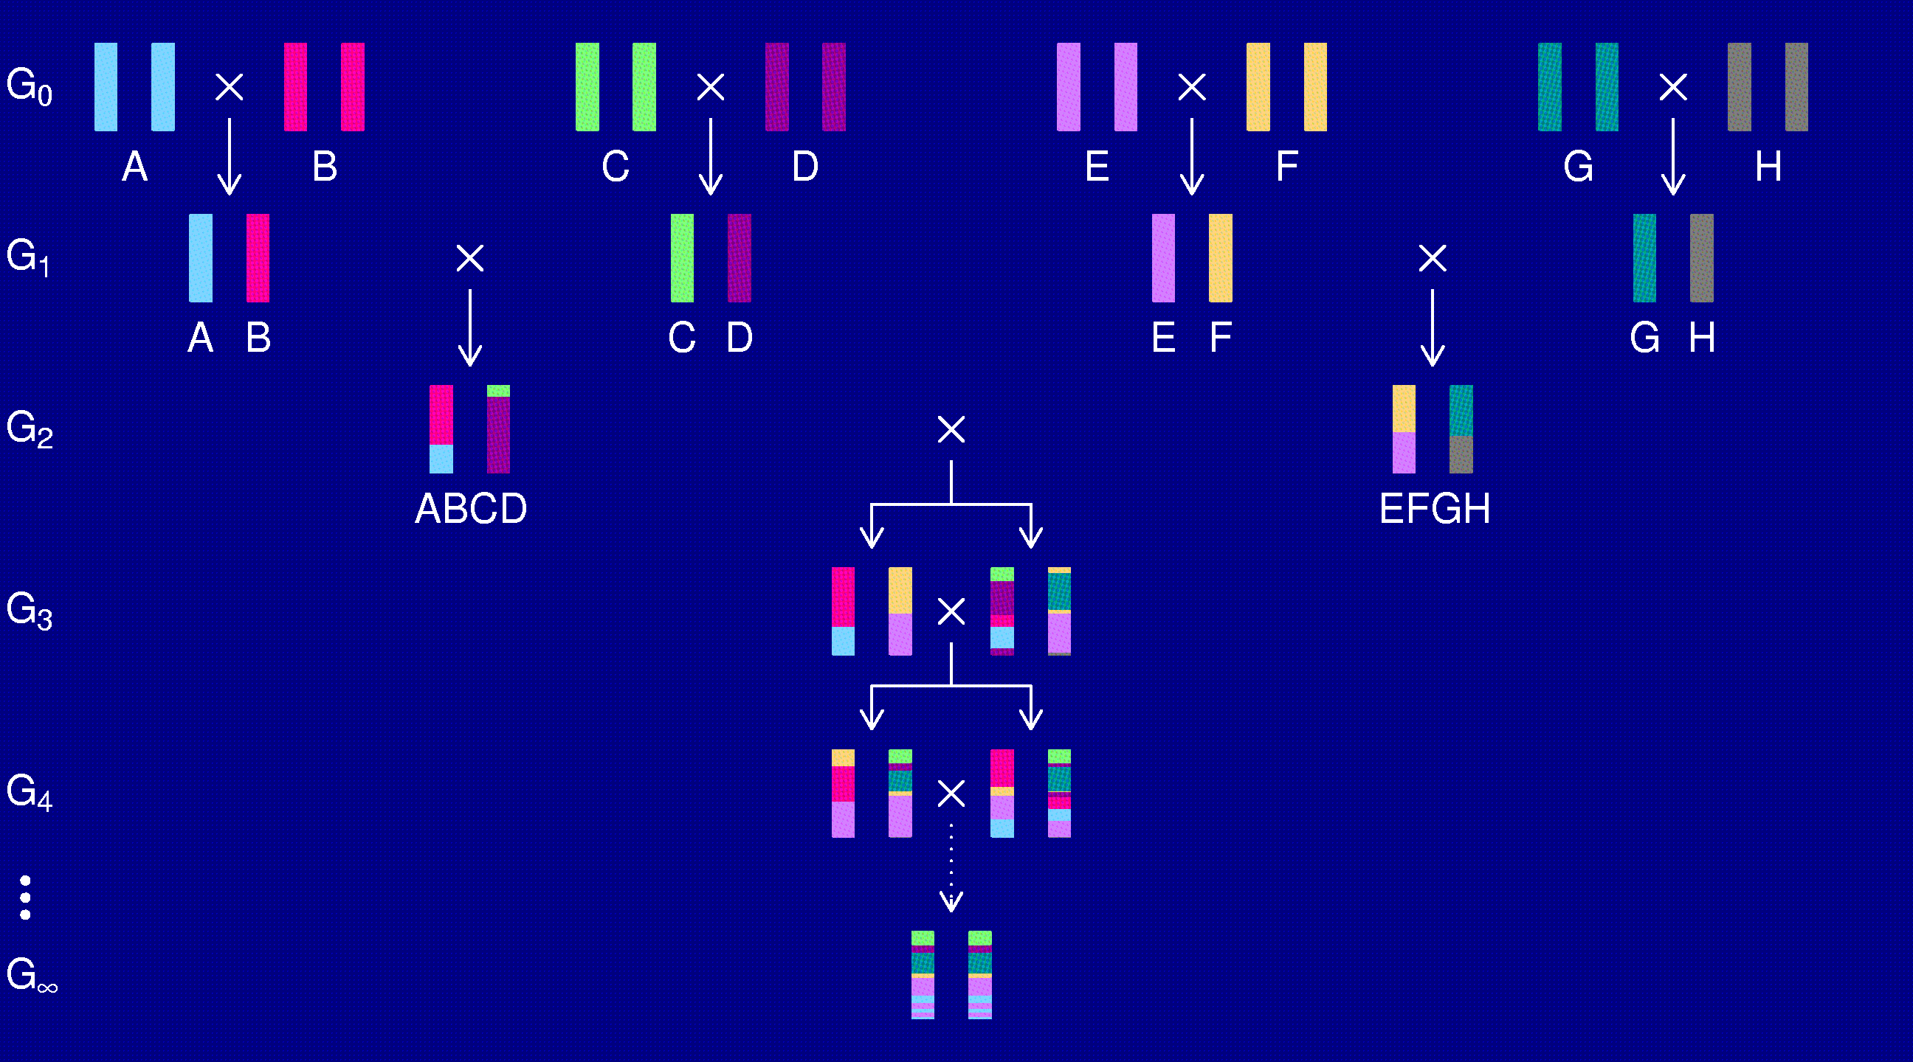
The Collaborative Cross
Complex Trait Consortium (2004) Nat Genet 36:1133-1137

Slide 18
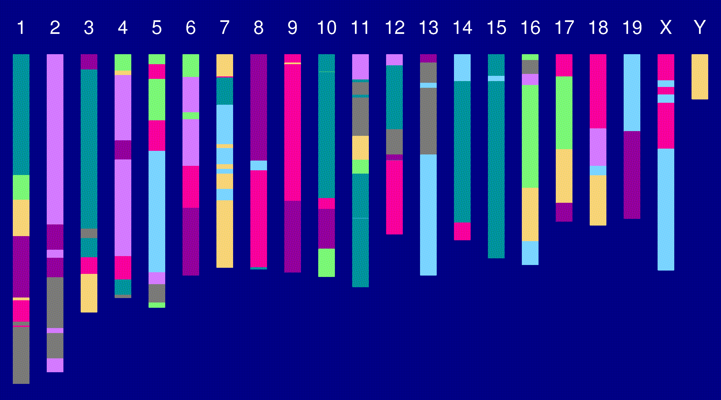
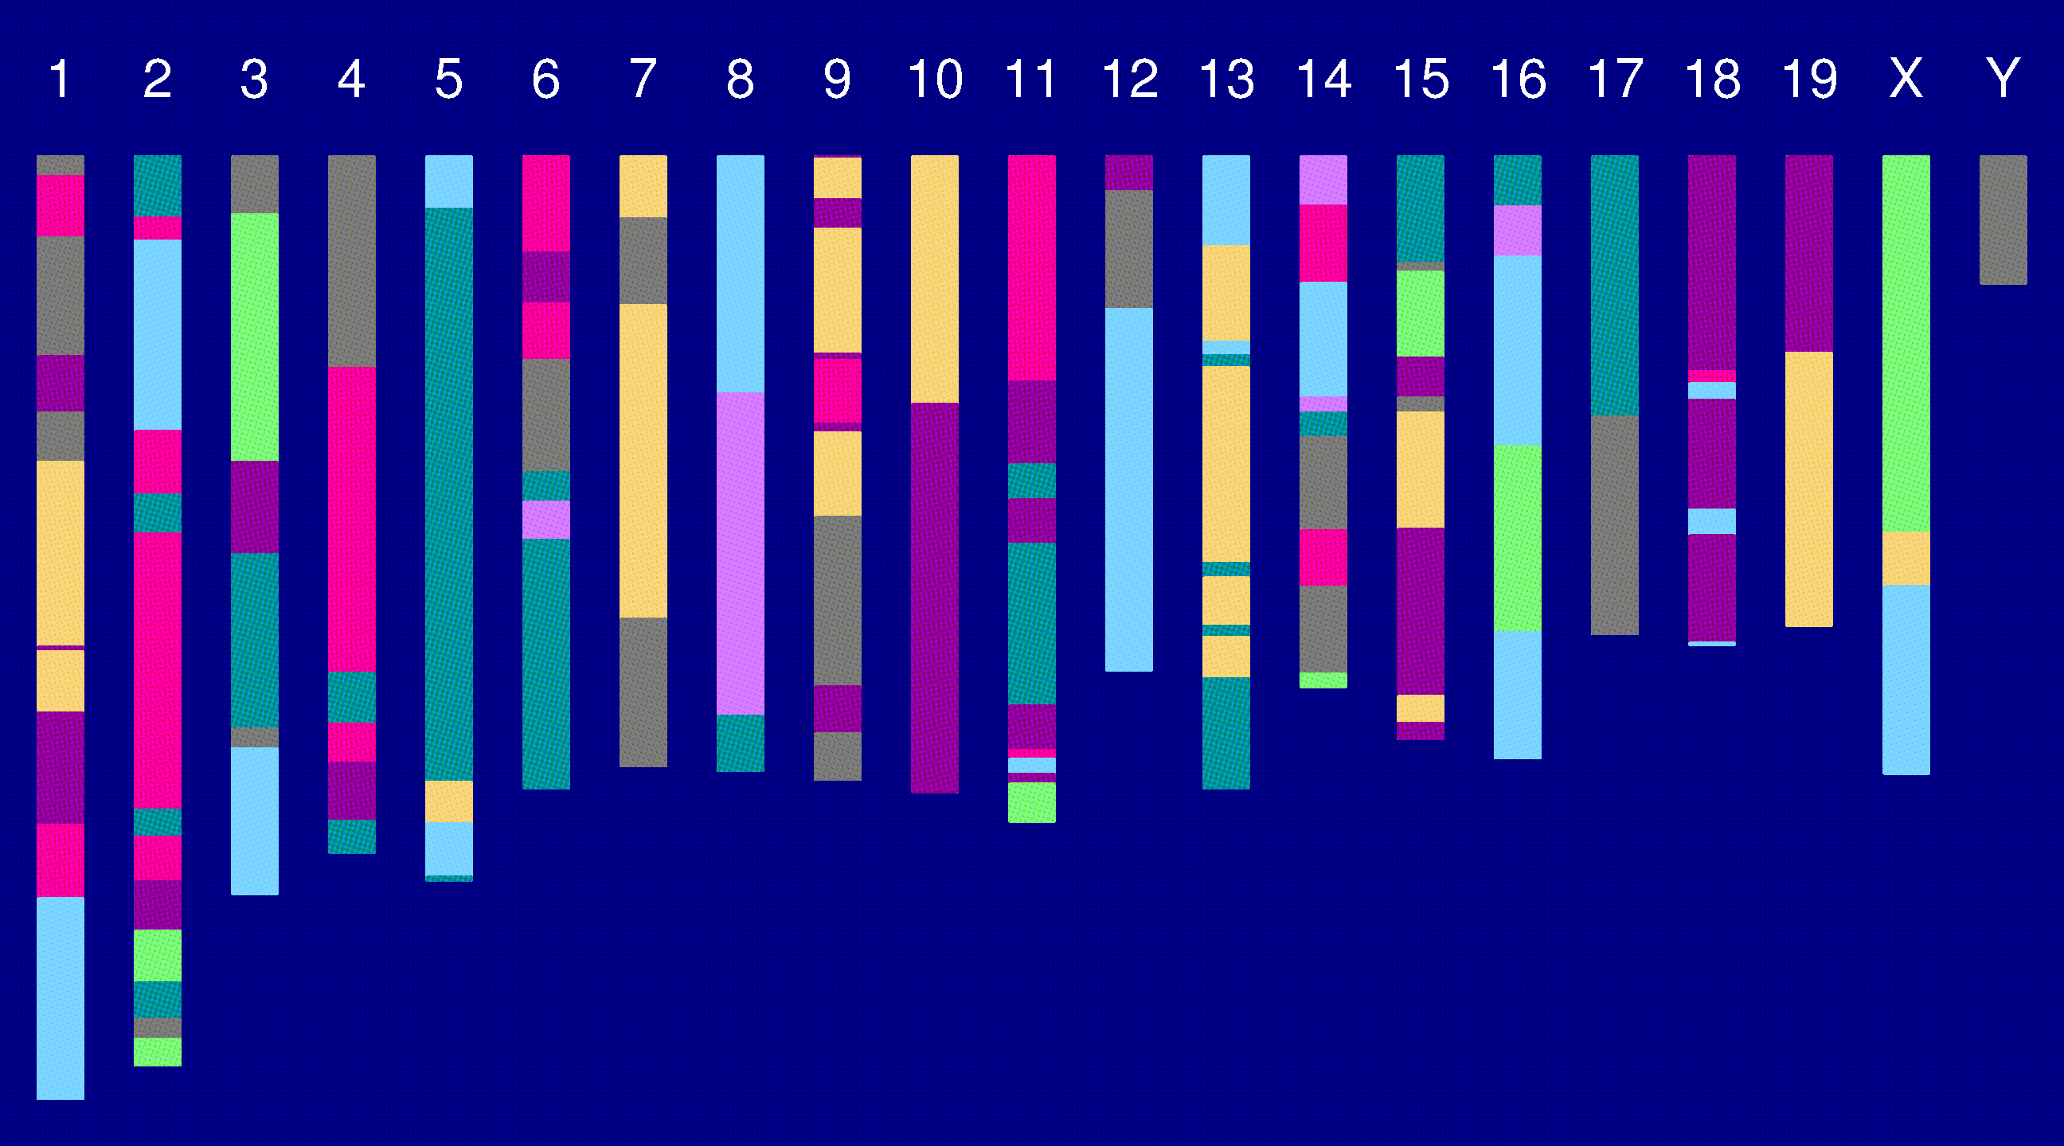
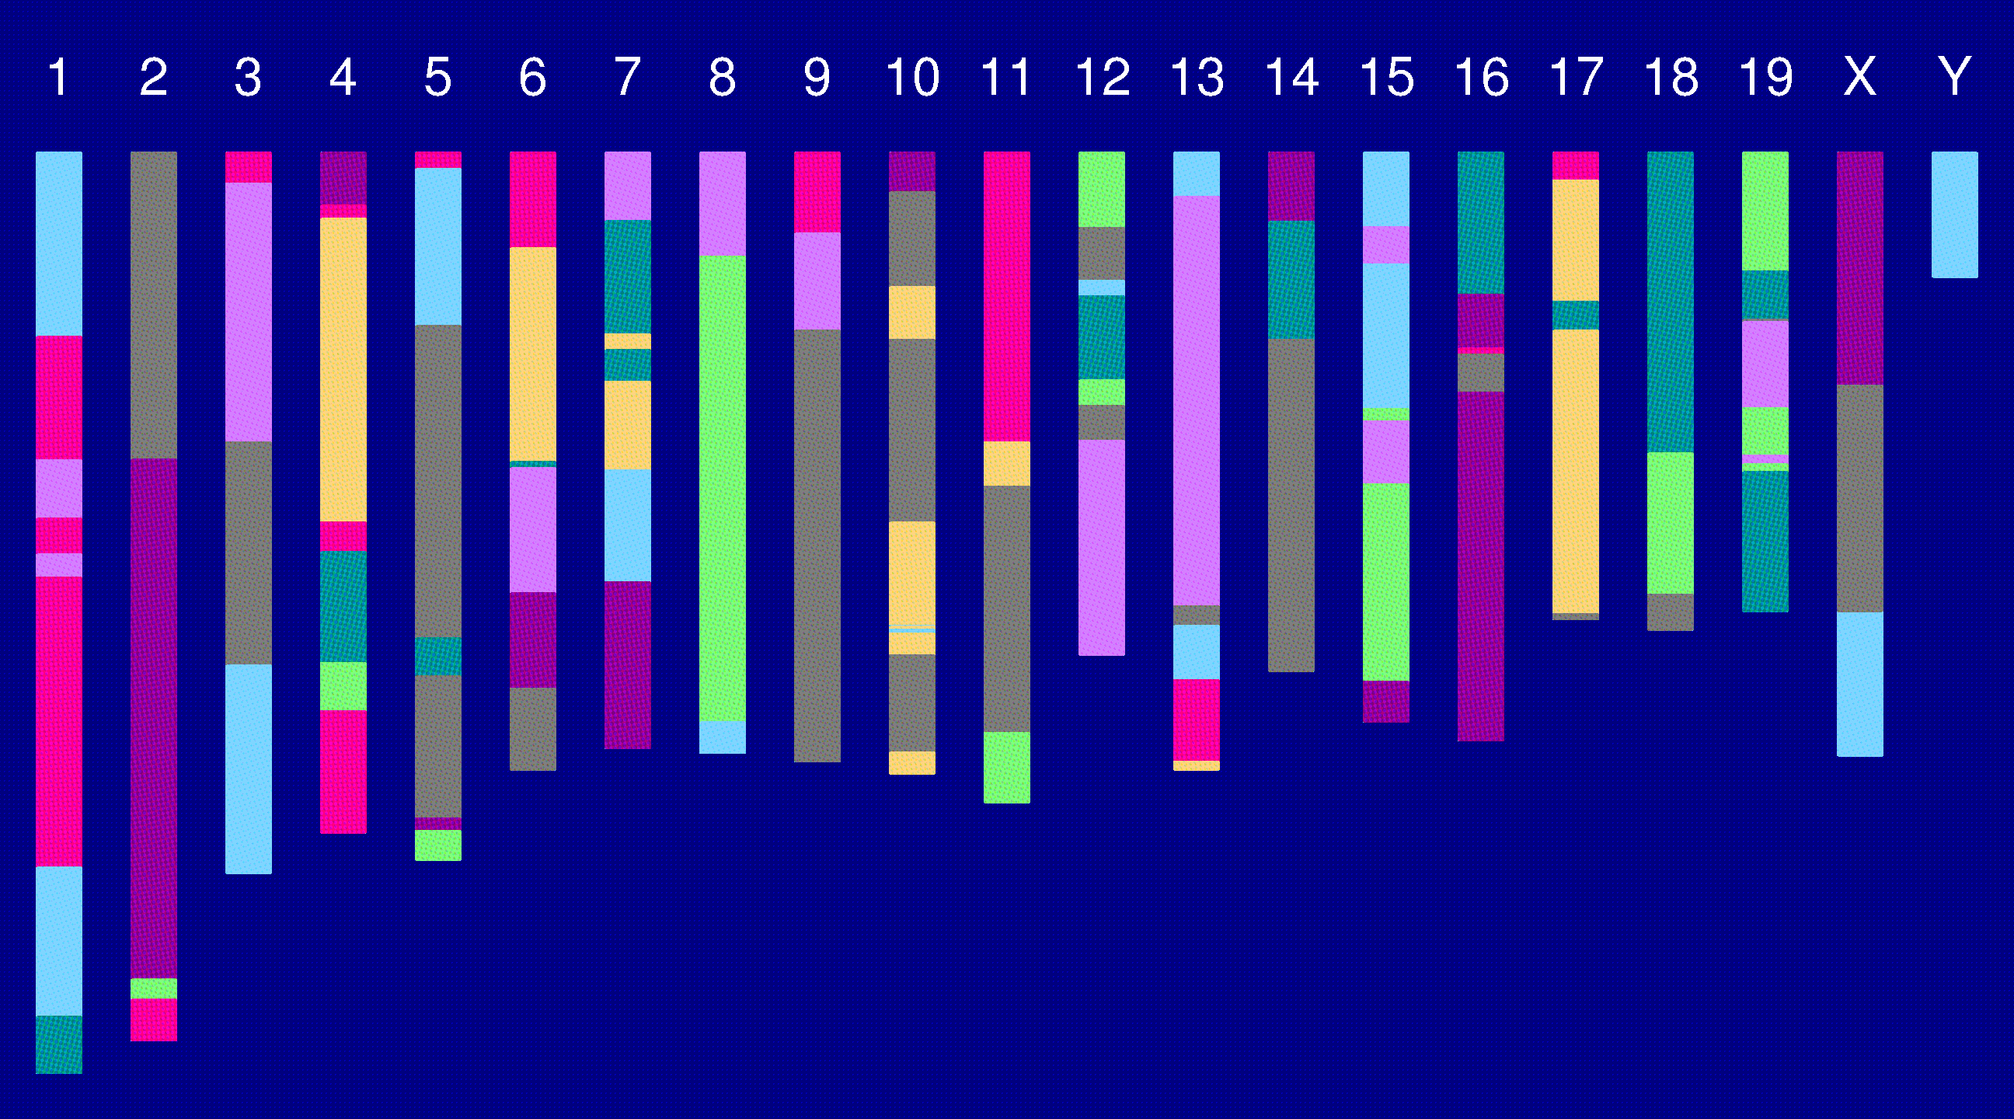
Genome of an 8-way RI

Slide 19
The Collaborative Cross
Advantages
Great mapping precision.
Eternal resource.
  Genotype only once.
  Study multiple invasive phenotypes on the same genotype.
Barriers
Advantages not widely appreciated.
  Ask one question at a time, or Ask many questions at once?
Time.
Expense.
Requires large-scale collaboration.

Slide 20
The Collaborative Cross
Complex Trait Consortium (2004) Nat Genet 36:1133-1137

Slide 21
The goal
(for the rest of this talk)
Characterize the breakpoint process along a chromosome in 8-way RILs.
  Understand the two-point haplotype probabilities.
  Study the clustering of the breakpoints, as a function of crossover interference in meiosis.

Slide 22
2 points in an RIL
1
2
r = recombination fraction = probability of a recombination in the interval in a random meiotic product.
R = analogous thing for the RIL = probability of different alleles at the two loci on a random RIL chromosome.

Slide 23
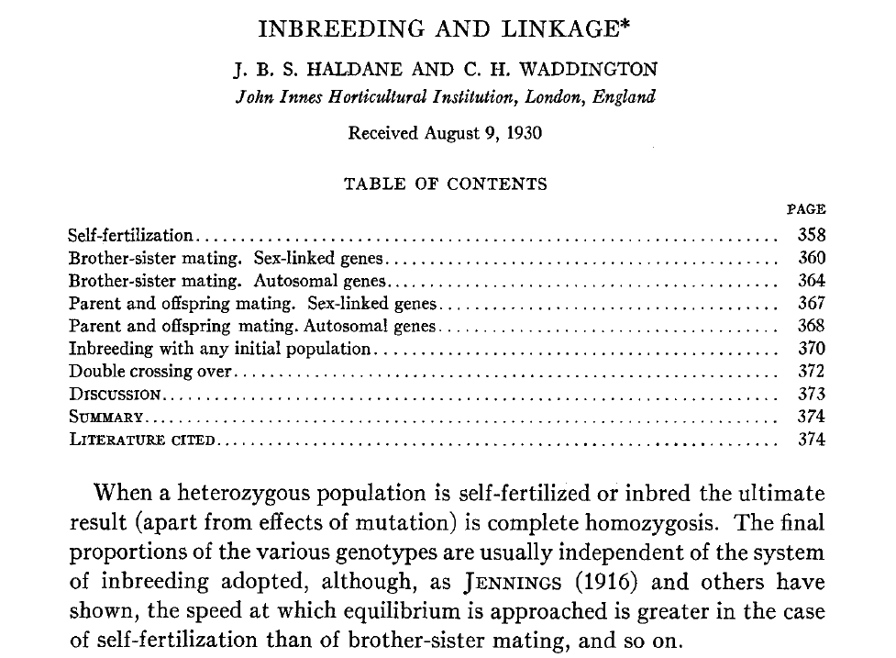
Haldane & Waddington 1931
Genetics 16:357-374

Slide 24
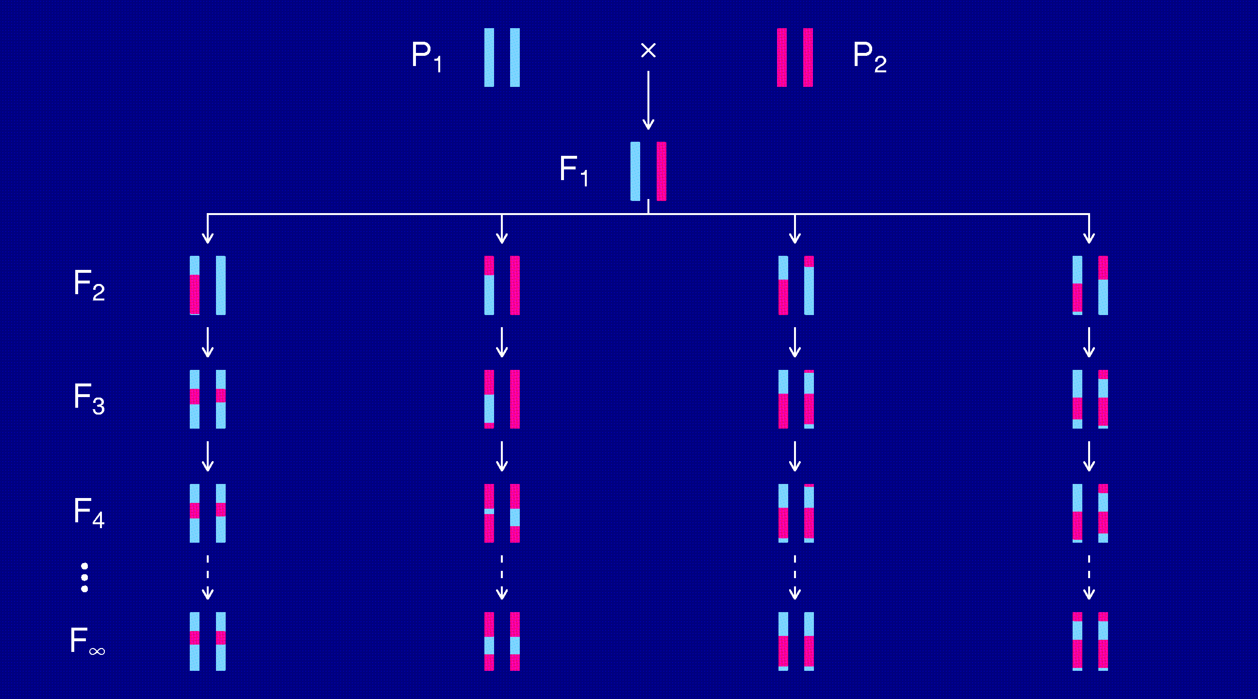
Recombinant inbred lines
(by selfing)

Slide 25
Markov chain
Sequence of random variables {X₀, X₁, X₂, …} satisfying
Pr(X_{n+1} | X₀, X₁, …, X_{n}) = Pr(X_{n+1} | X_{n})
Transition probabilities P_{ij} = Pr(X_{n+1}=j | X_{n}=i)
Here, X_{n} = “parental type” at generation n
We are interested in absorption probabilities
Pr(X_{n} → j | X₀)

Slide 26
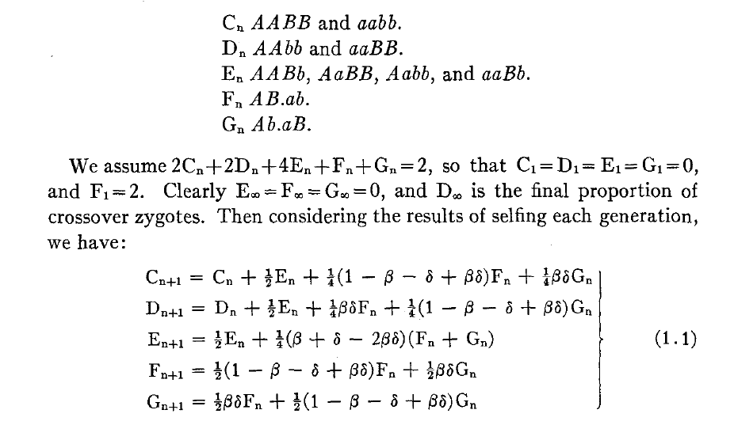
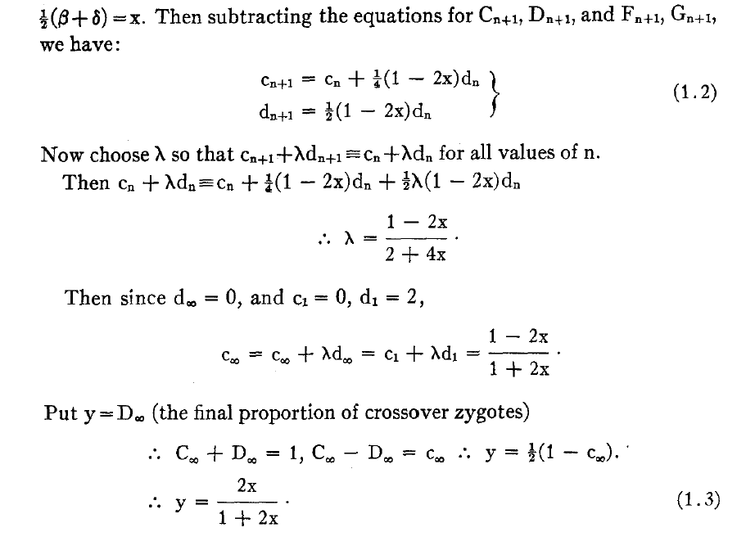
Equations for selfing

Slide 27
Absorption probabilities
Let P_{ij} = Pr(X_{n+1} = j | X_{n} = i) where X_{n} = state at generation n.
Consider the case of absorption into the state AA|AA.
Let h_{i} = probability, starting at i, eventually absorbed into AA|AA.
Then h_{AA|AA} = 1 and h_{AB|AB} = 0.
Condition on the first step: h_{i} = ∑_{k} P_{ik} h_{k}
For selfing, this gives a system of 3 linear equations.

Slide 28
Recombinant inbred lines
(by sibling mating)

Slide 29
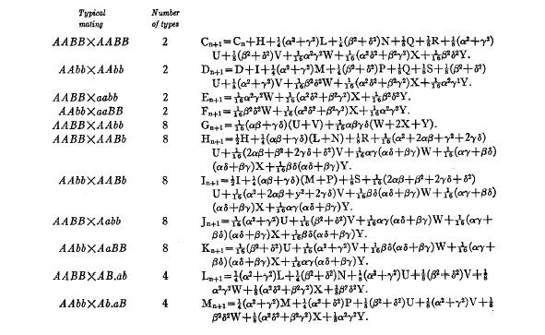
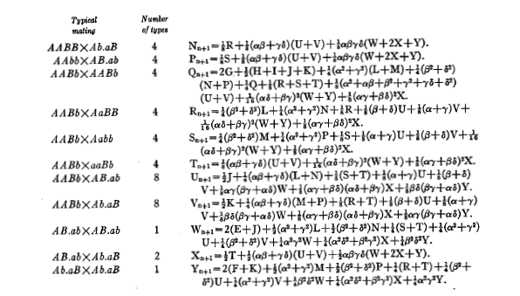
Equations for sib-mating

Slide 30
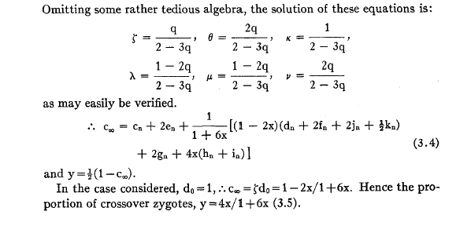
Result for sib-mating

Slide 31
The “Collaborative Cross”

Slide 32
8-way RILs
Autosomes
  Pr(G₁ = i) = 1/8
  Pr(G₂ = j | G₁ = i) = r / (1+6r) for i ≠ j
  Pr(G₂ ≠ G₁) = 7r / (1+6r)
X chromosome
  Pr(G₁=A) = Pr(G₁=B) = Pr(G₁=E) = Pr(G₁=F) =1/6
  Pr(G₁=C) = 1/3
  Pr(G₂=B | G₁=A) = r / (1+4r)
  Pr(G₂=C | G₁=A) = 2r / (1+4r)
  Pr(G₂=A | G₁=C) = r / (1+4r)
  Pr(G₂ ≠ G₁) = (14/3) r / (1+4r)

Slide 33
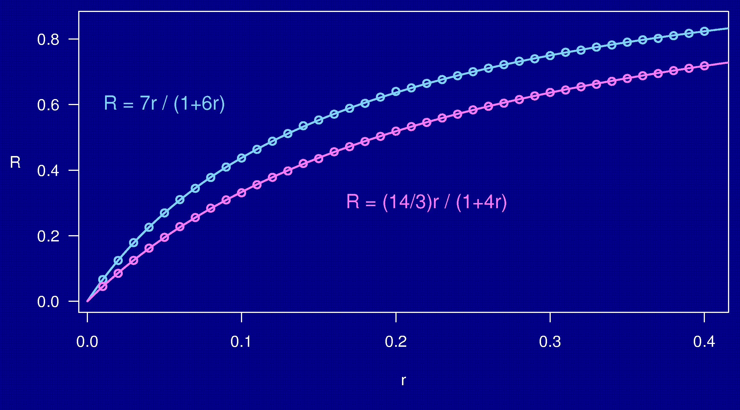
Computer simulations

Slide 34
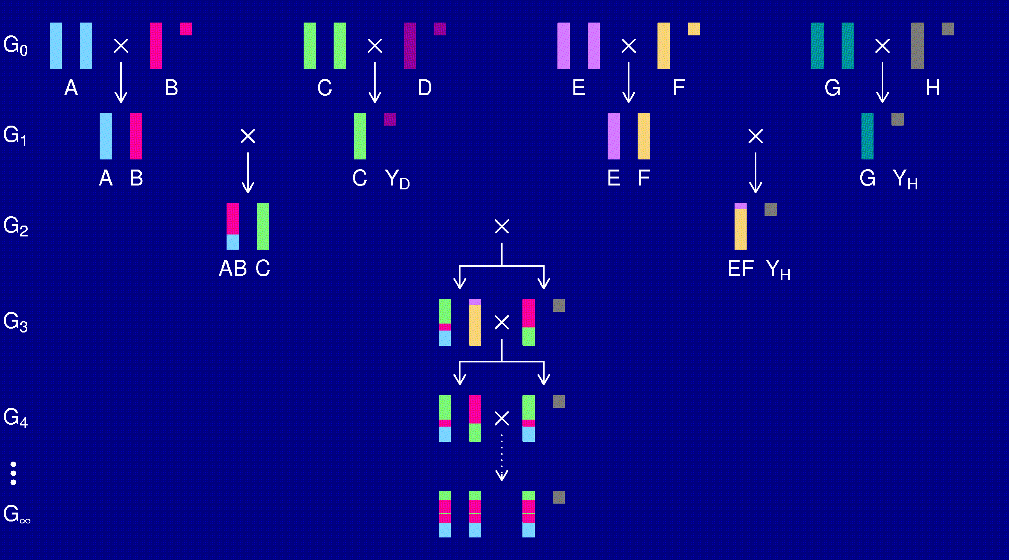
The X chromosome

Slide 35
3-point coincidence
1
2
3
r_{ij} = recombination fraction for interval i,j;
assume r₁₂ = r₂₃ = r
Coincidence = c = Pr(double recombinant) / r²
= Pr(rec’n in 23 | rec’n in 12) / Pr(rec’n in 23)
No interference → = 1
Positive interference → < 1
Negative interference → > 1
Generally c is a function of r.

Slide 36
3-points in 2-way RILs
1
2
3
r₁₃ = 2 r (1 – c r)
R = f(r); R₁₃ = f(r₁₃)
Pr(double recombinant in RIL) = { R + R – R₁₃ } / 2
Coincidence (in 2-way RIL) = { 2 R – R₁₃ } / { 2 R² }
Notes:
This is included at the end of Haldane & Waddington (1931).

Slide 37
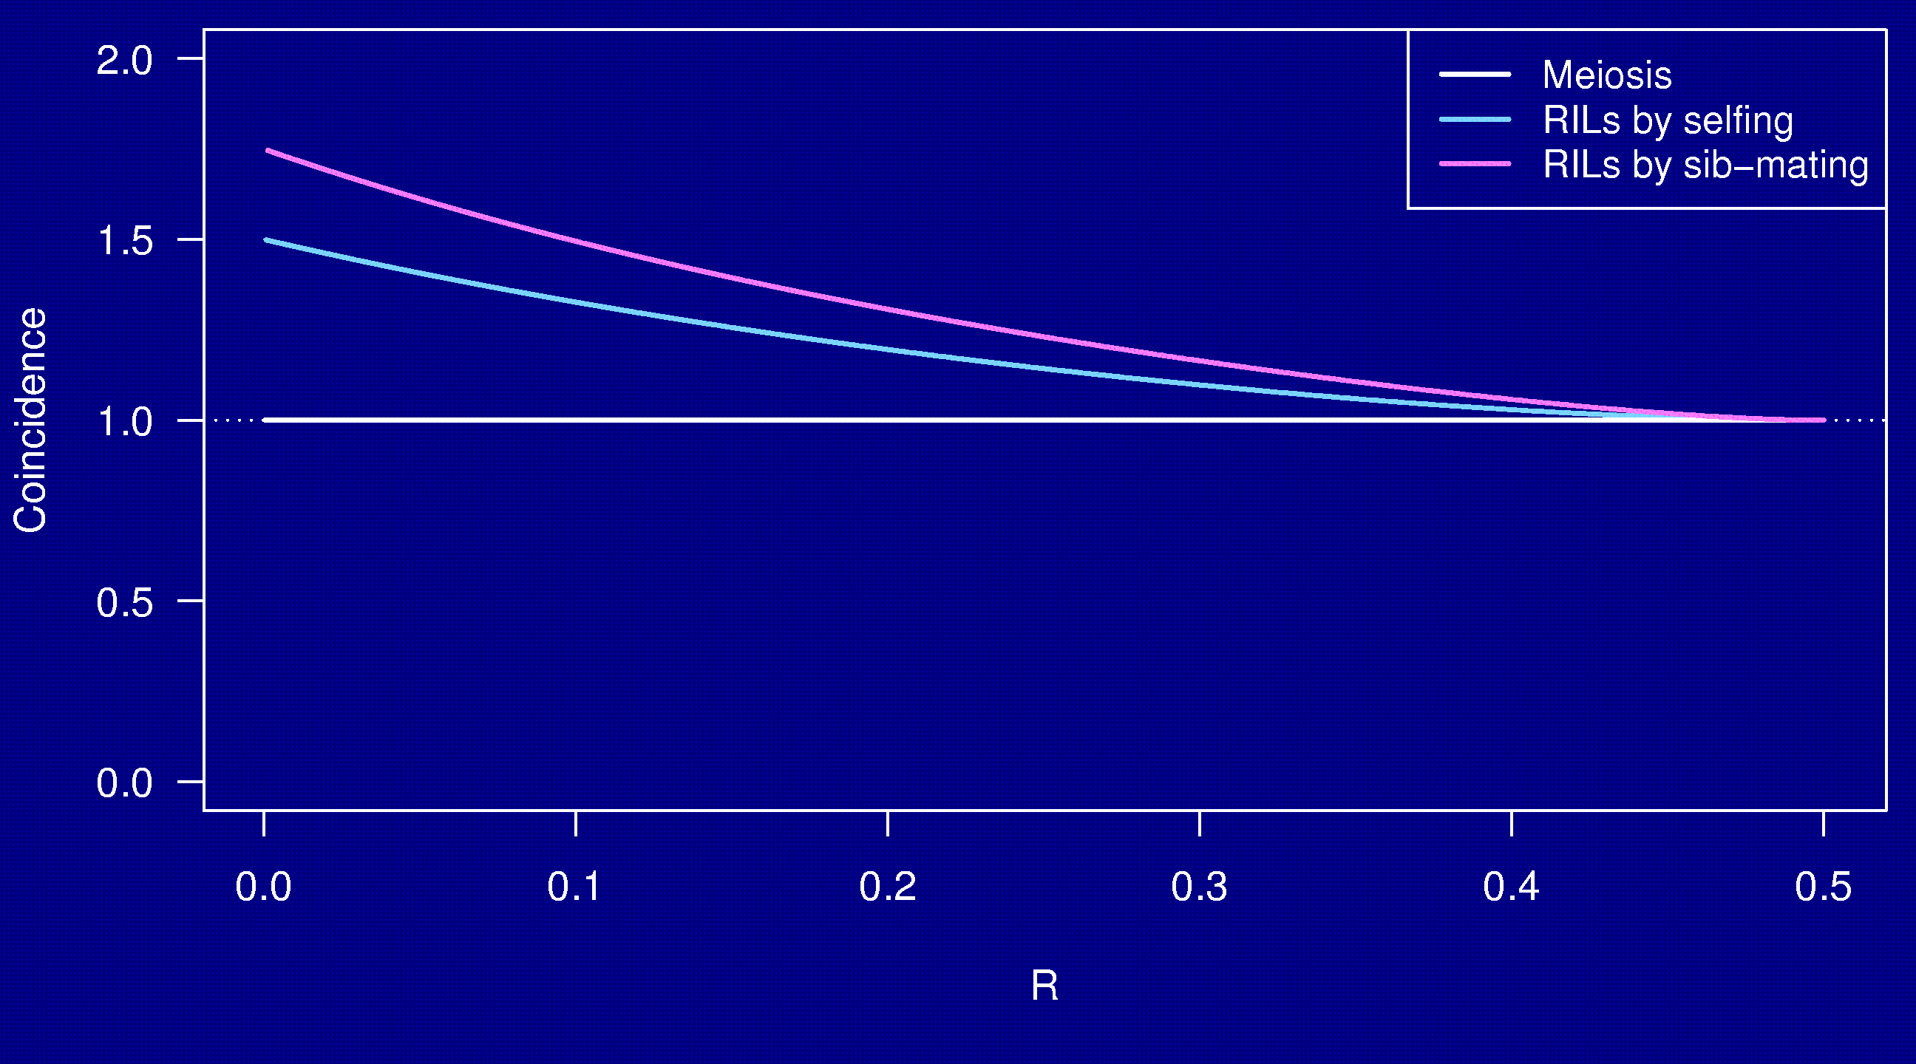
Coincidence
No interference

Slide 38
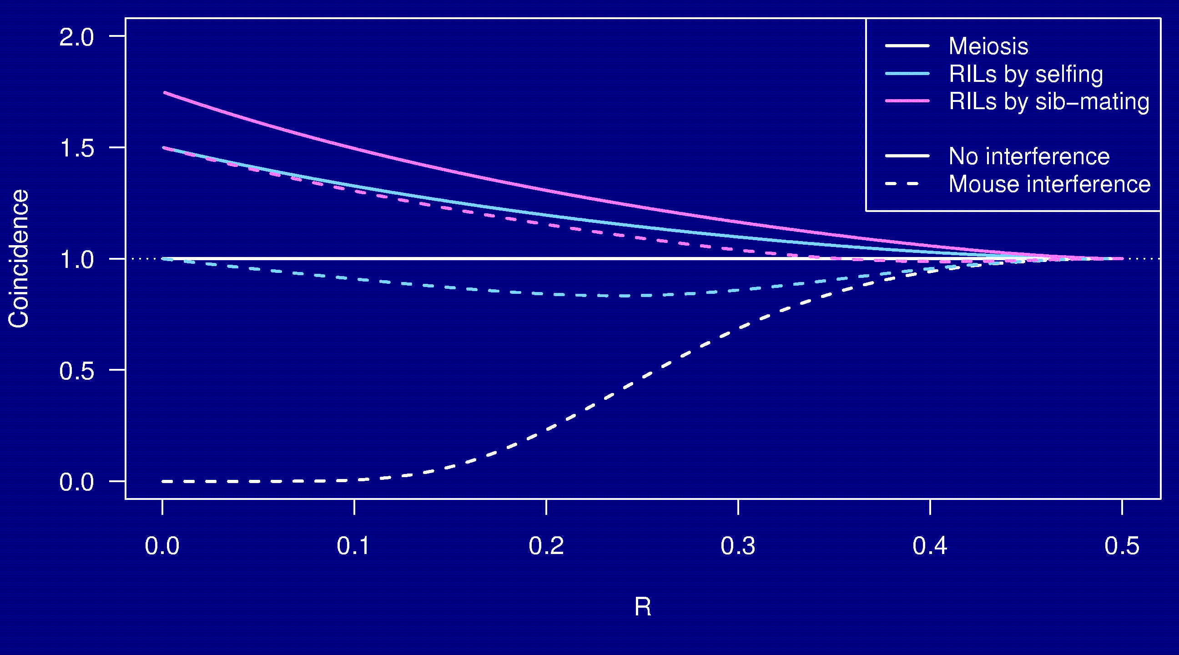
Coincidence

Slide 39
Why the clustering of breakpoints?
The really close breakpoints occur in different generations.
Breakpoints in later generations can occur only in regions that are not yet fixed.
The regions of heterozygosity are, of course, surrounded by breakpoints.

Slide 40
Coincidence in 8-way RILs
The trick that allowed us to get the coincidence for 2-way RILs doesn’t work for 8-way RILs.
It’s sufficient to consider 4-way RILs.
Calculations for 3 points in 4-way RILs is still astoundingly complex.
  2 points in 2-way RILs by sib-mating:
  55 parental types → 22 states by symmetry
  3 points in 4-way RILs by sib-mating:
  2,164,240 parental types → 137,488 states
Even counting the states was difficult.

Slide 41
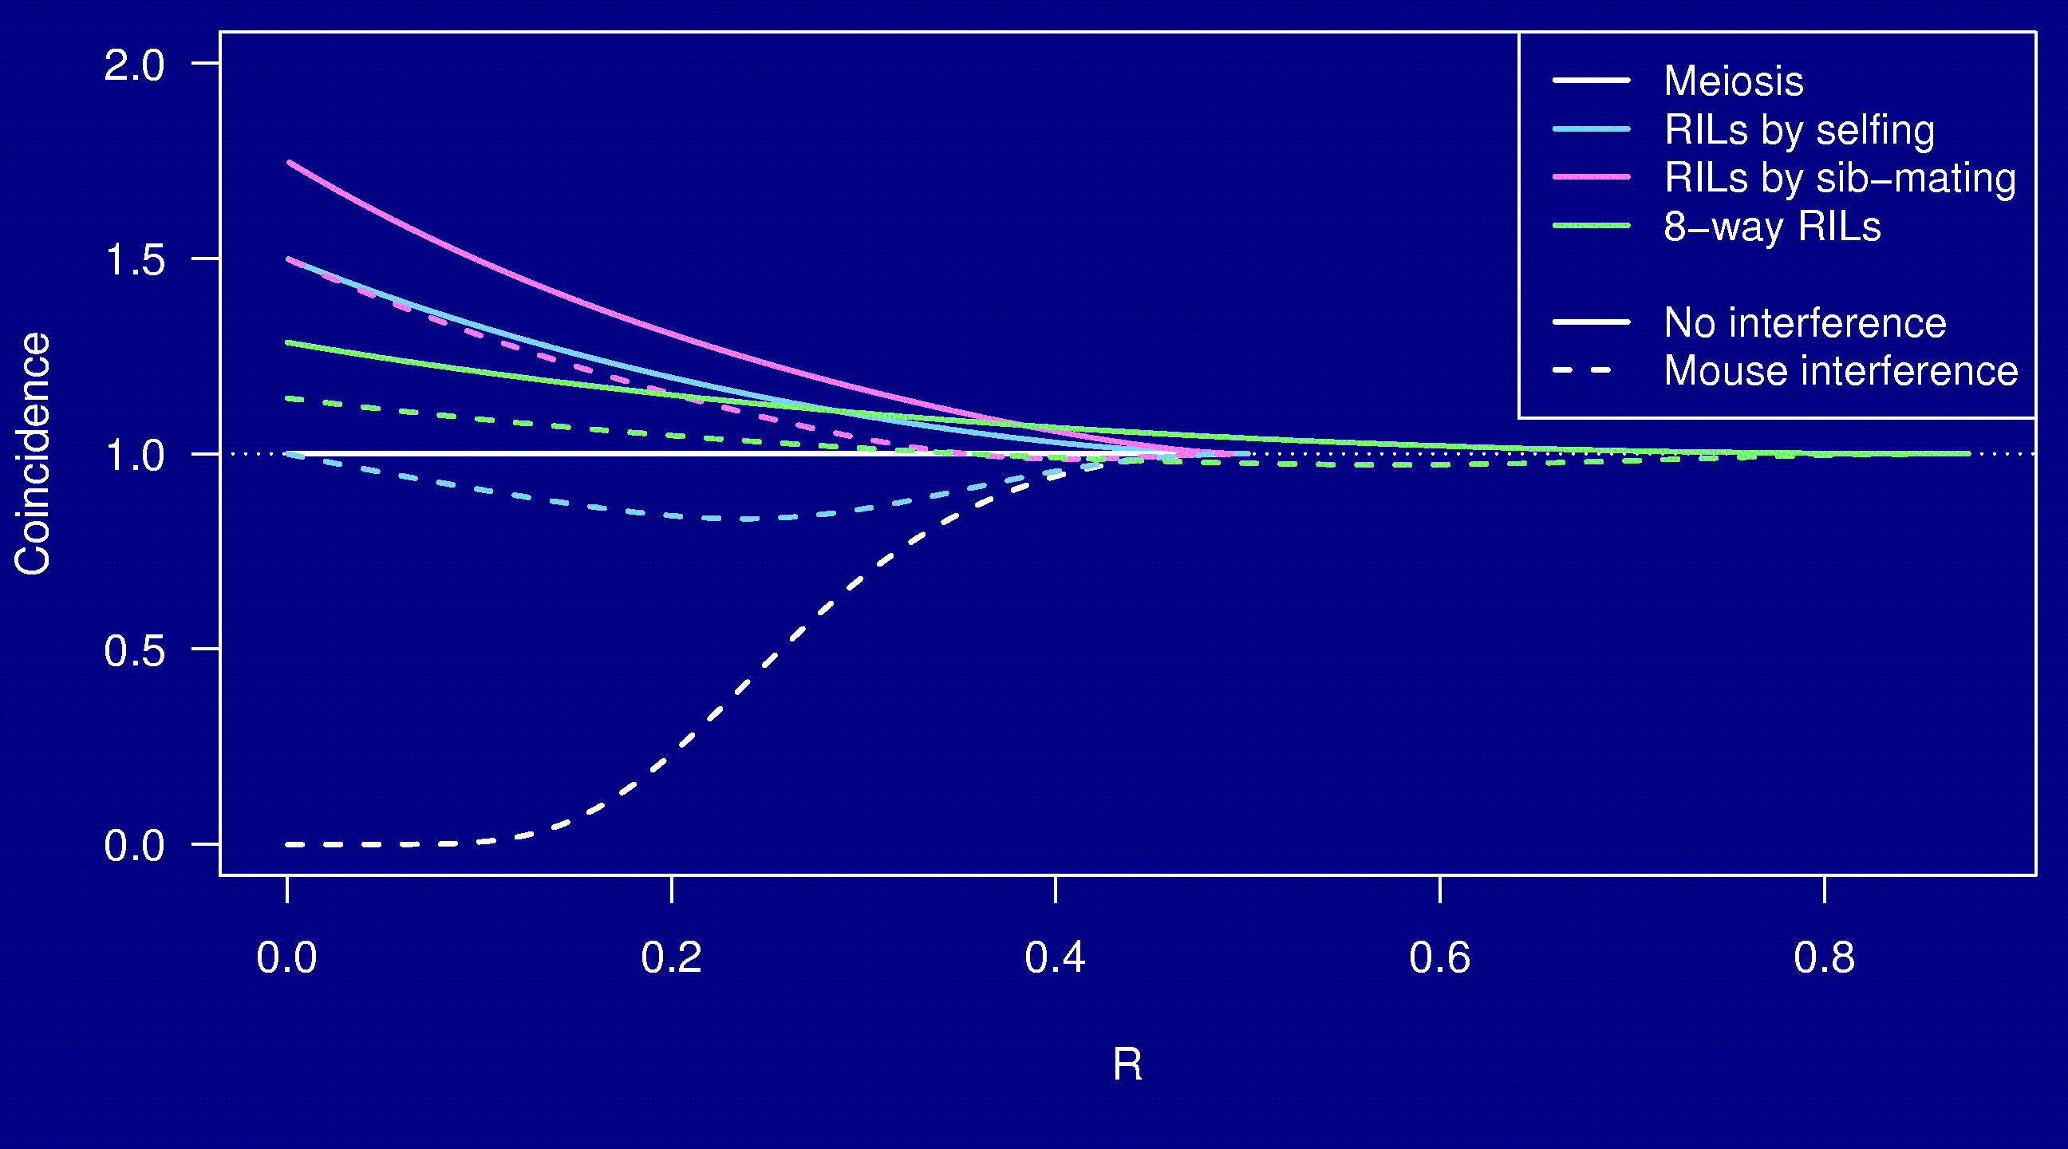
Coincidence

Slide 42
Summary
Mice are useful for learning about human disease.
The Collaborative Cross could provide “one-stop shopping” for gene mapping in the mouse.
Use of such 8-way RILs requires an understanding of the breakpoint process.
We’ve extended Haldane & Waddington’s results to the case of 8-way RILs: R = 7 r / (1 + 6 r).
We’ve shown clustering of breakpoints in RILs by sib-mating, even in the presence of strong crossover interference.
Broman KW (2005) The genomes of recombinant inbred lines. Genetics 169:1133-1146

