Slide 1
Super computing for
“classical” genetics

Slide 2
Inbred mice

Slide 3
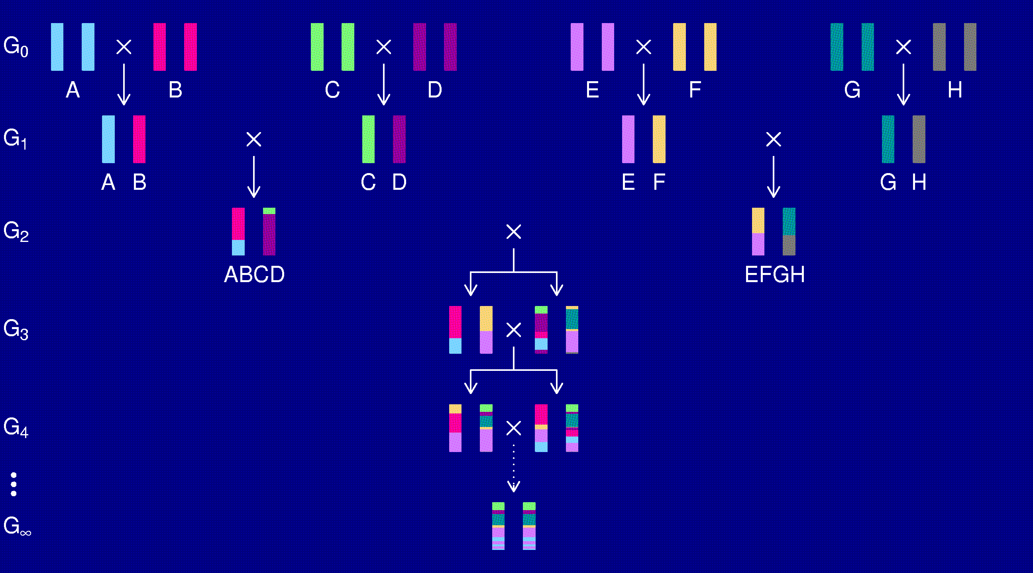
The Collaborative Cross
Complex Trait Consortium (2004) Nat Genet 36:1133-1137

Slide 4
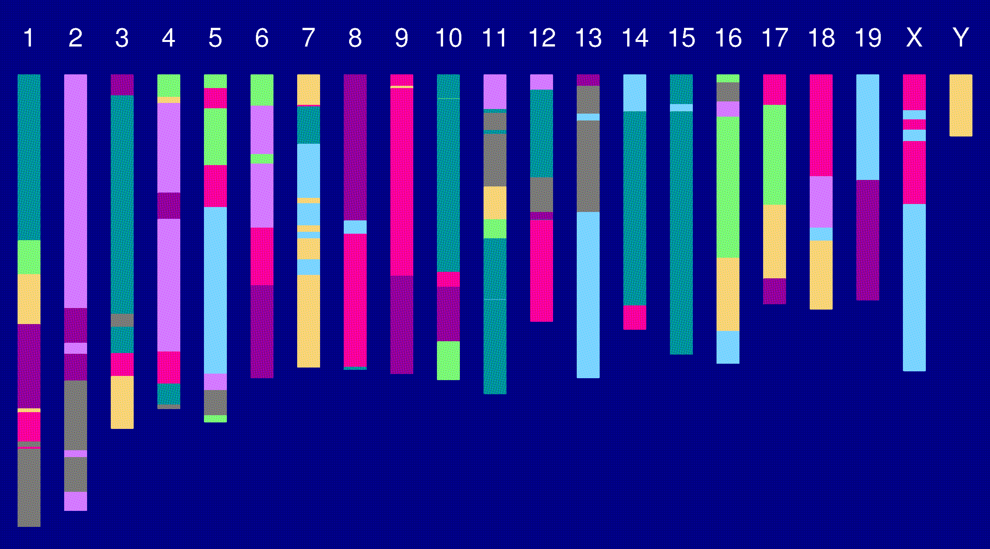
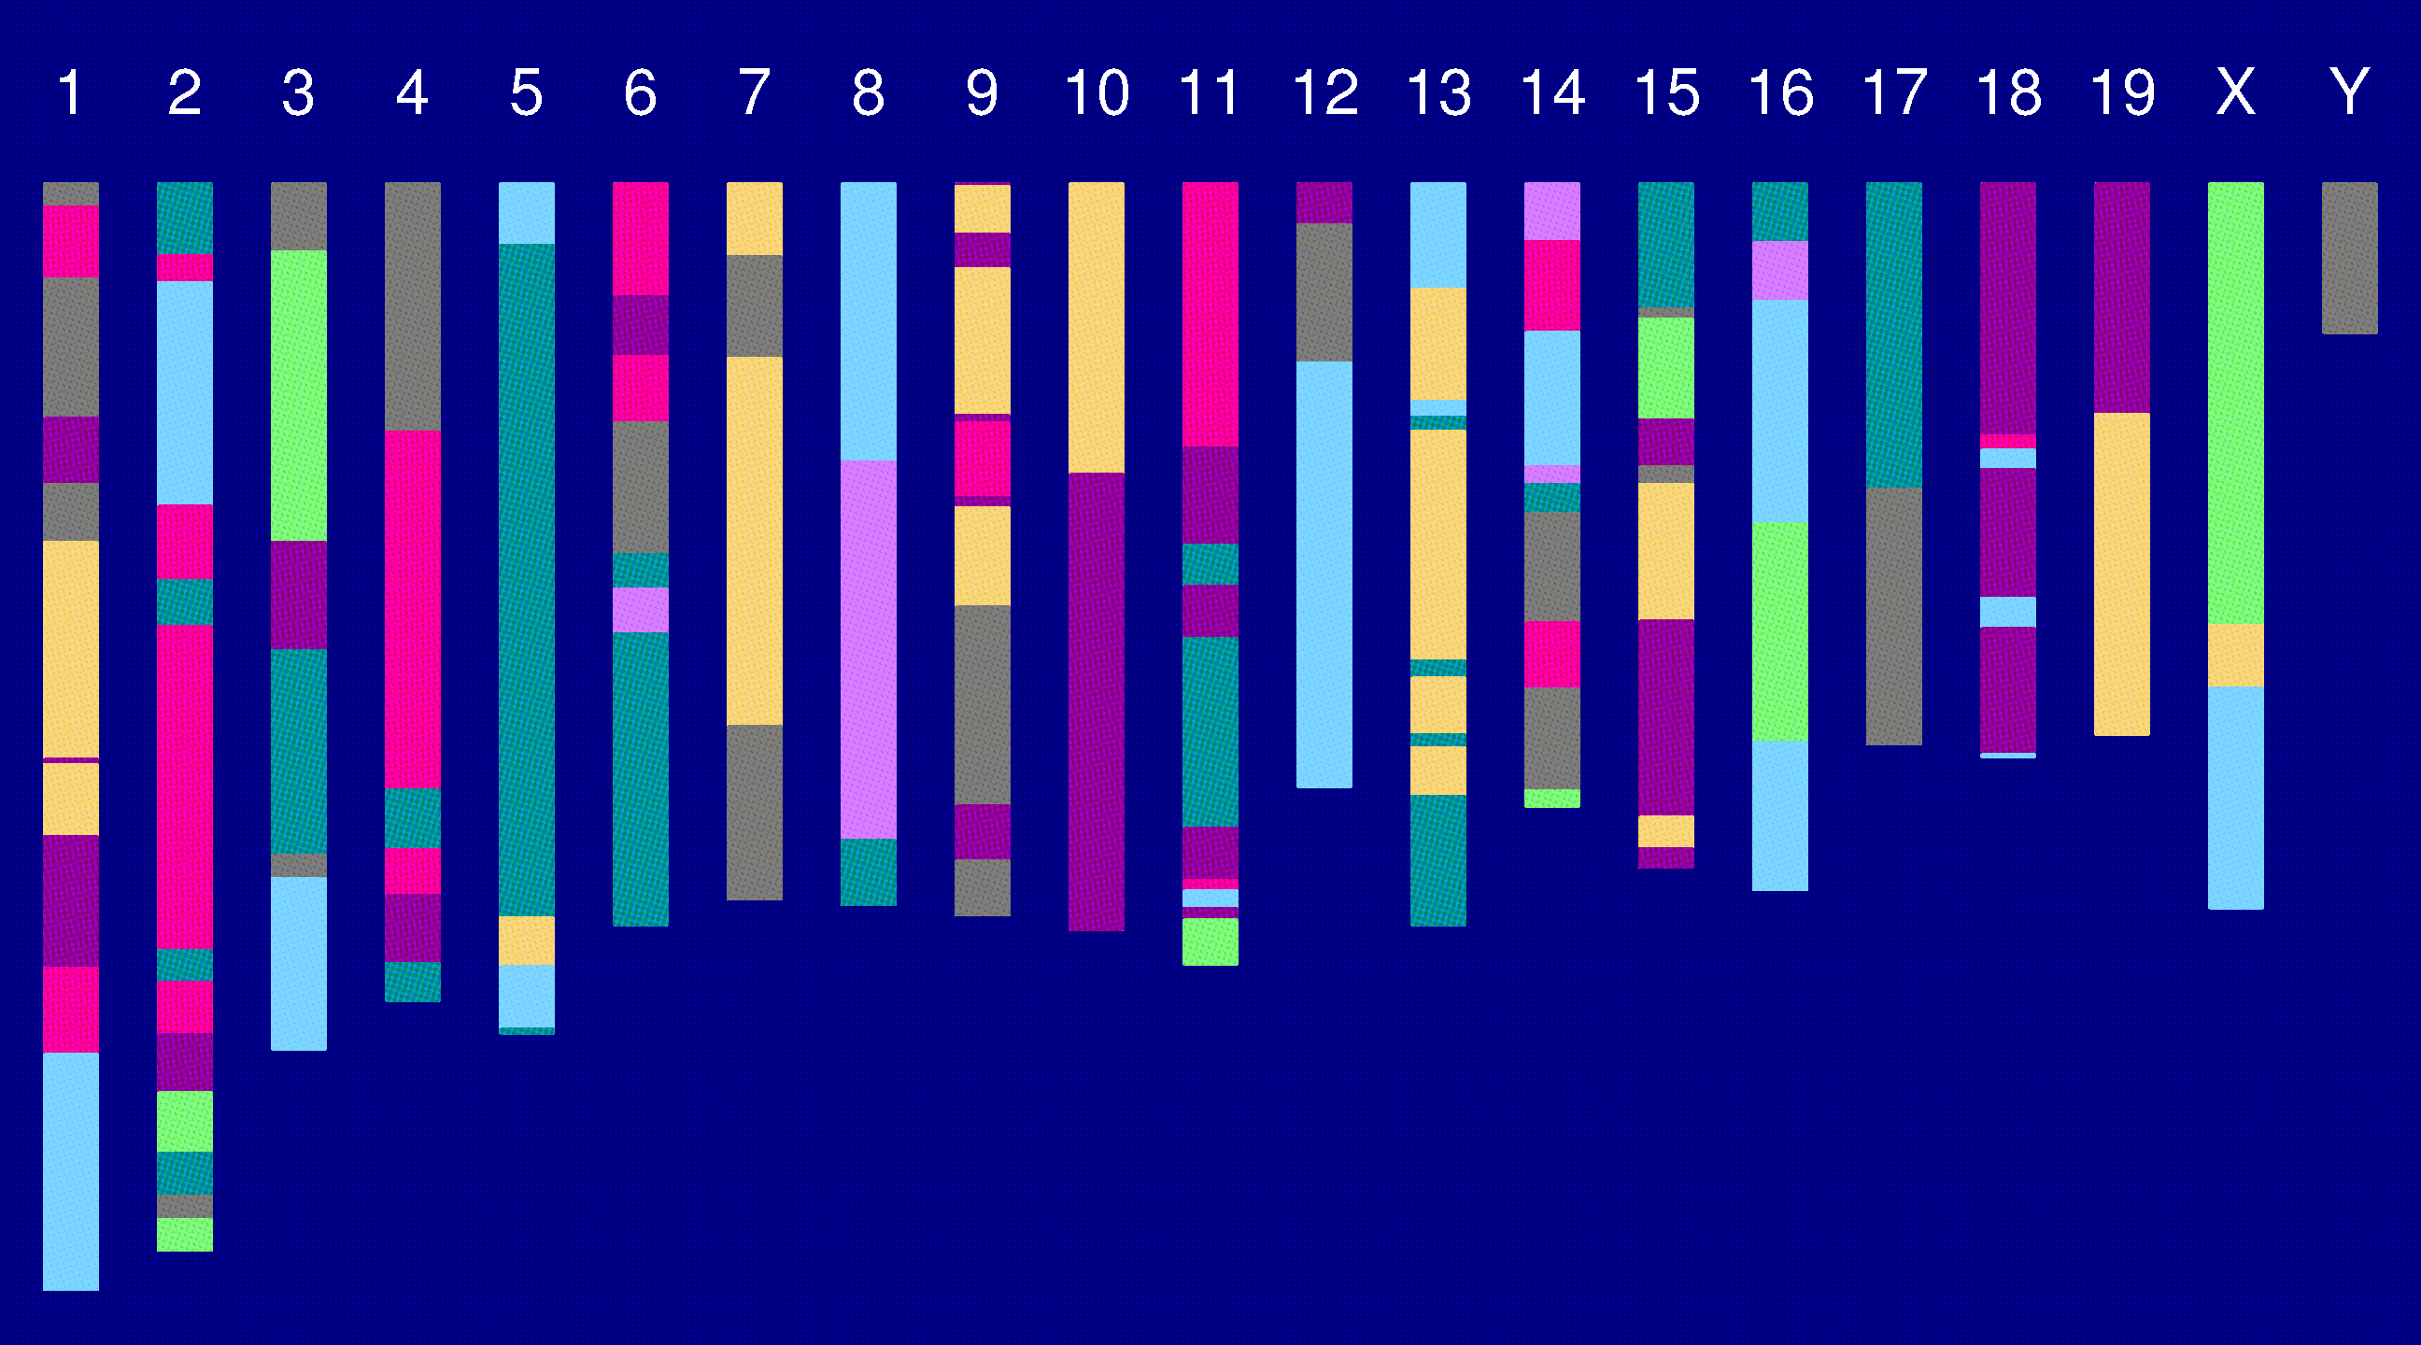
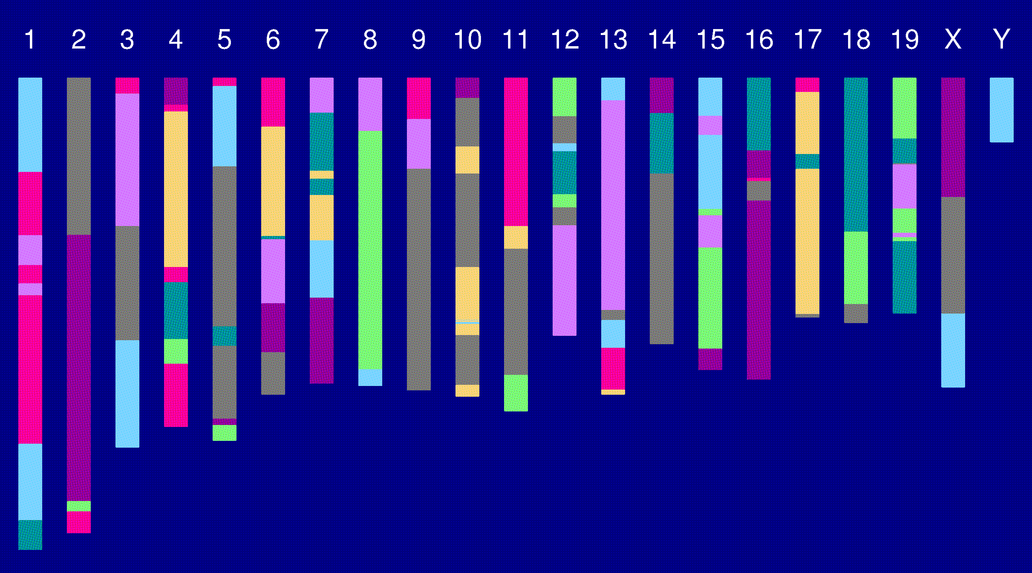
Genome of an 8-way RI

Slide 5
2 points in an RIL
1
2
r = recombination fraction = probability of a recombination in the interval in a random meiotic product.
R = analogous thing for the RIL = probability of different alleles at the two loci on a random RIL chromosome.

Slide 6
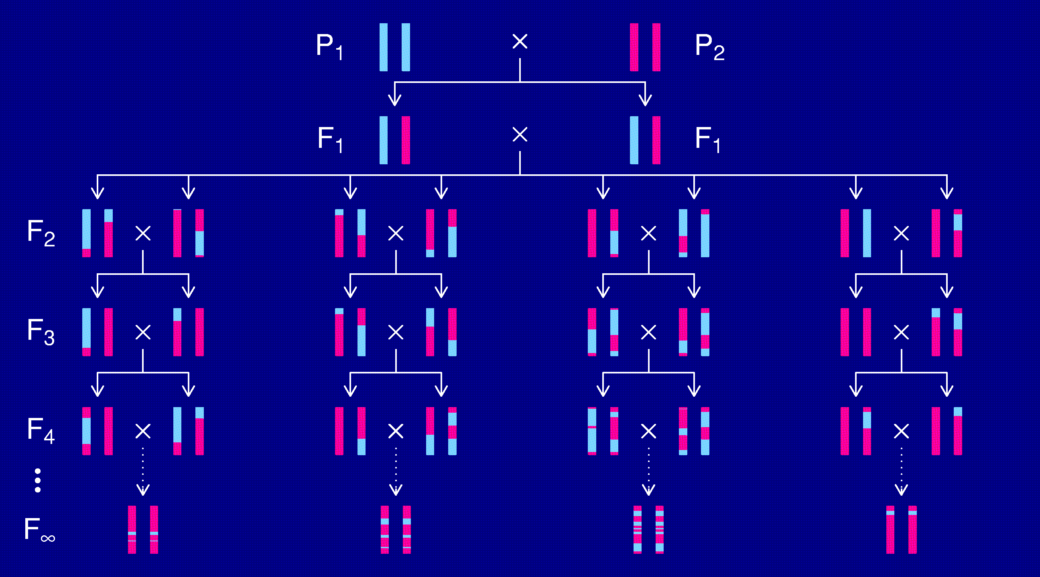
Recombinant inbred lines
(by sibling mating)

Slide 7
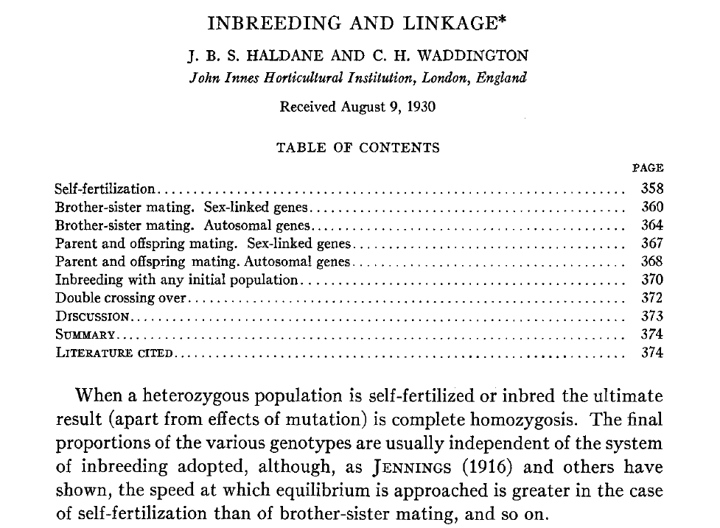
Haldane & Waddington 1931
Genetics 16:357-374

Slide 8
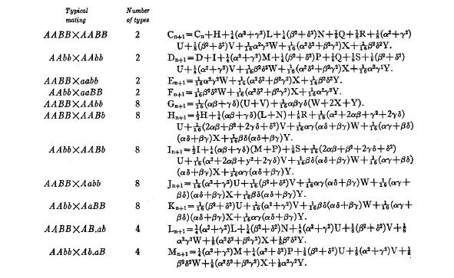
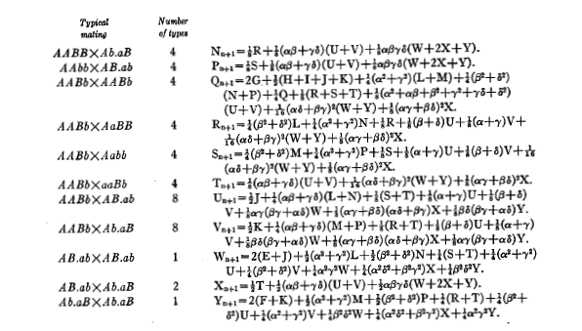
Equations for sib-mating

Slide 9
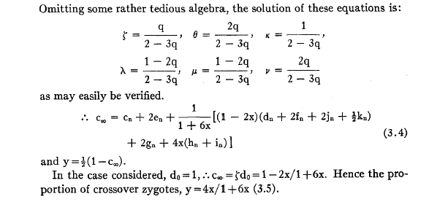
Result for sib-mating

Slide 10
The “Collaborative Cross”

Slide 11
8-way RILs
Autosomes
  Pr(G₁ = i) = 1/8
  Pr(G₂ = j | G₁ = i) = r / (1+6r) for i ≠ j
  Pr(G₂ ≠ G₁) = 7r / (1+6r)
X chromosome
  Pr(G₁=A) = Pr(G₁=B) = Pr(G₁=E) = Pr(G₁=F) =1/6
  Pr(G₁=C) = 1/3
  Pr(G₂=B | G₁=A) = r / (1+4r)
  Pr(G₂=C | G₁=A) = 2r / (1+4r)
  Pr(G₂=A | G₁=C) = r / (1+4r)
  Pr(G₂ ≠ G₁) = (14/3) r / (1+4r)

Slide 12
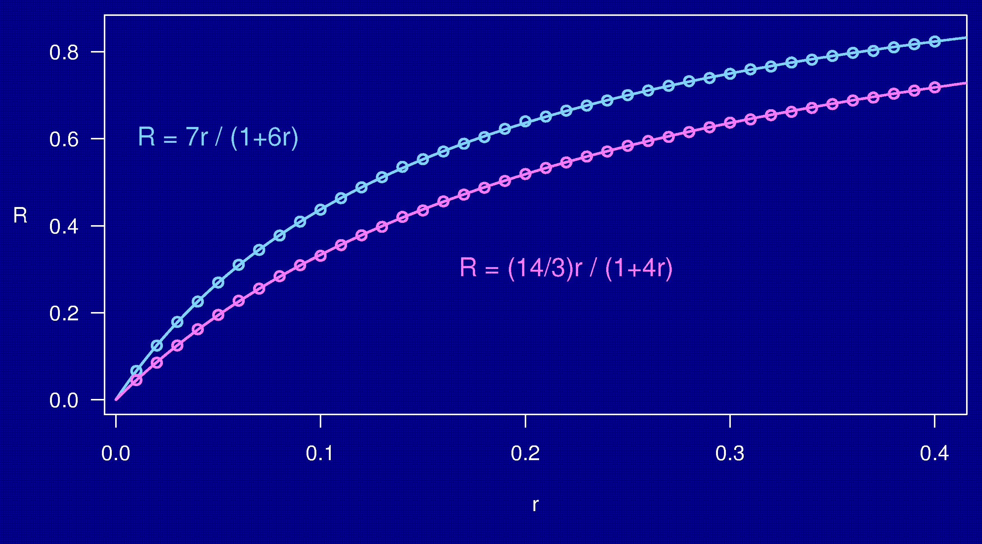
Computer simulations

Slide 13
3-point coincidence
1
2
3
r_{ij} = recombination fraction for interval i,j;
assume r₁₂ = r₂₃ = r
Coincidence = c = Pr(double recombinant) / r²
= Pr(rec’n in 23 | rec’n in 12) / Pr(rec’n in 23)
No interference → = 1
Positive interference → < 1
Negative interference → > 1
Generally c is a function of r.

Slide 14
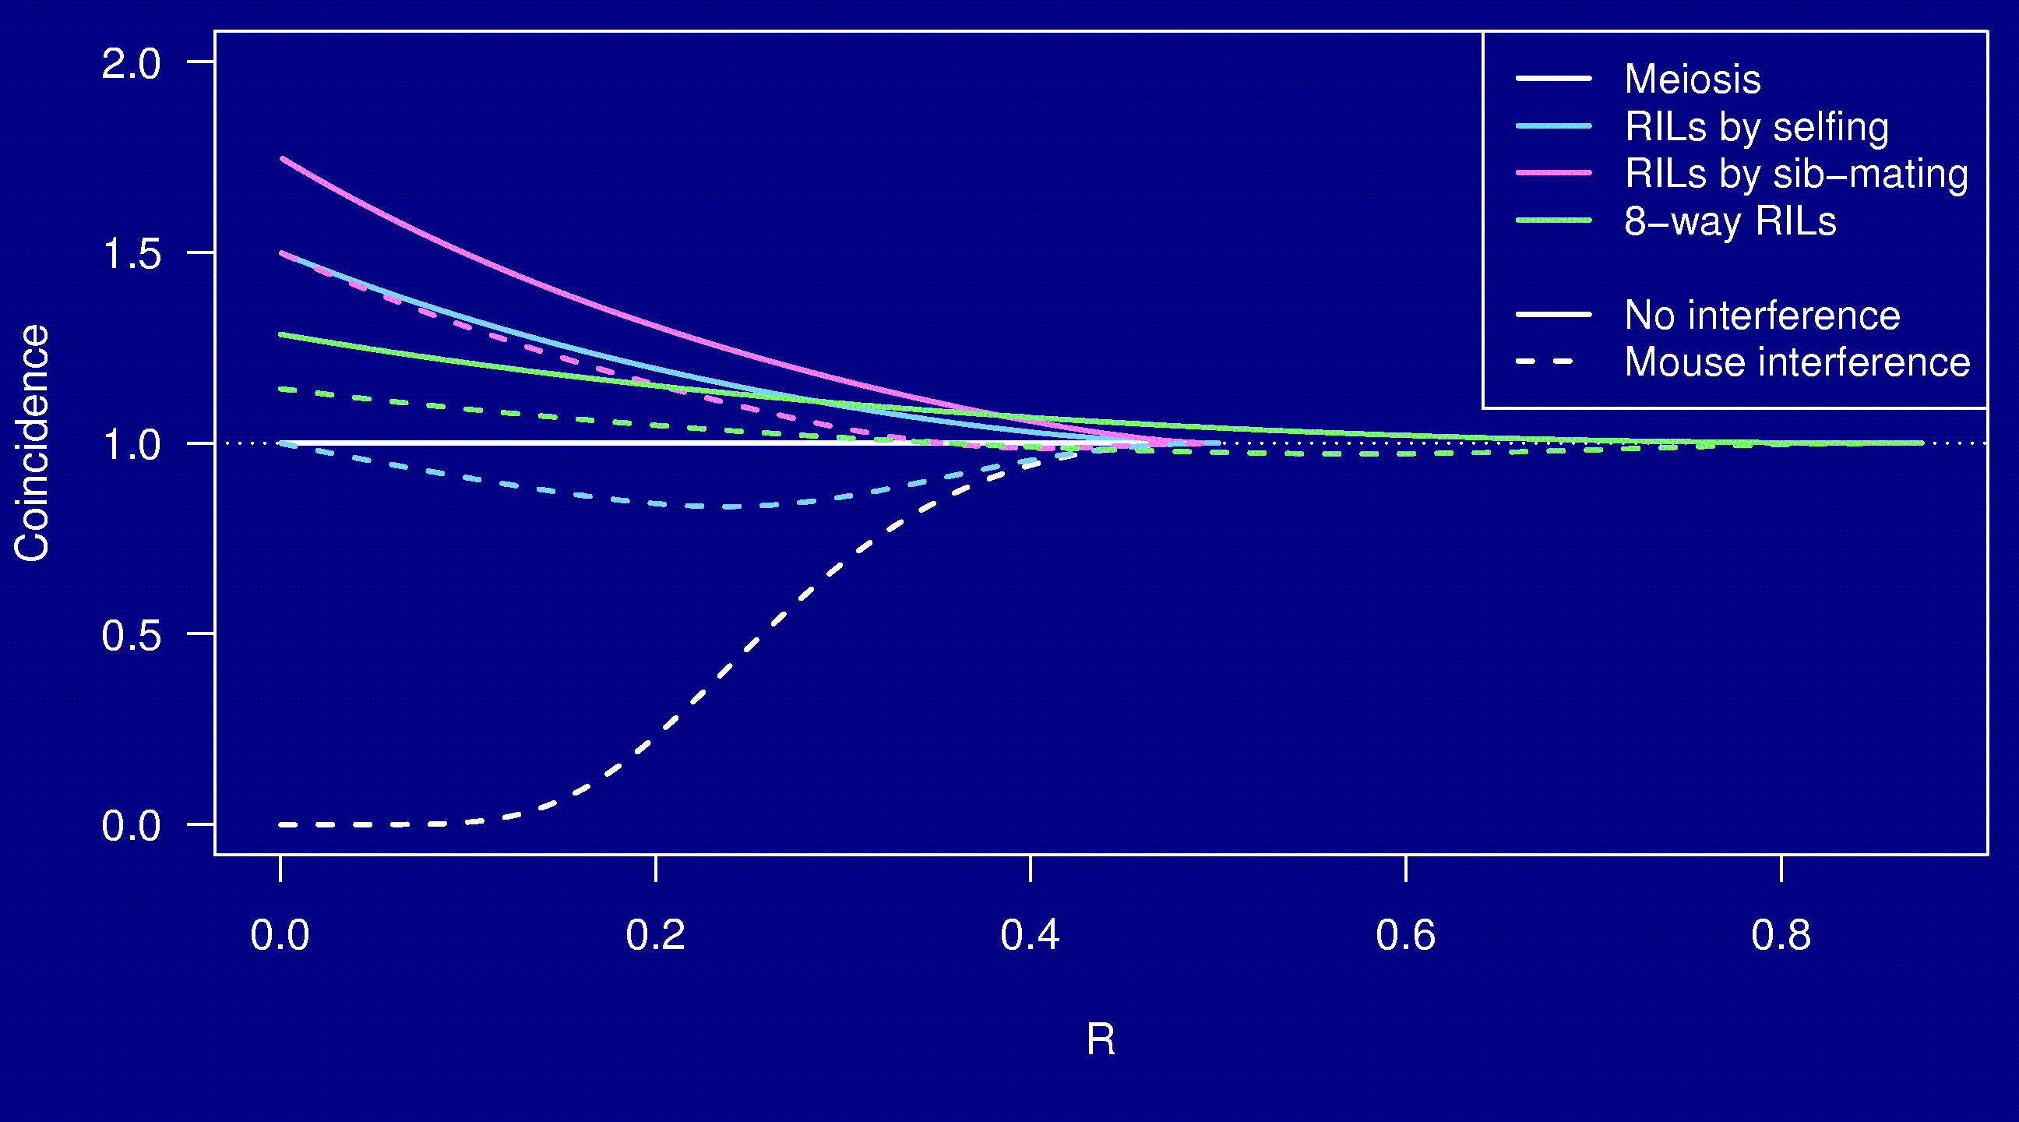
Coincidence

Slide 15
Summary
The Collaborative Cross could provide “one-stop shopping” for gene mapping in the mouse.
Use of such 8-way RILs requires an understanding of the breakpoint process.
We’ve extended Haldane & Waddington’s results to the case of 8-way RILs: R = 7 r / (1 + 6 r).
We’ve shown clustering of breakpoints in RILs by sib-mating, even in the presence of strong crossover interference.
Broman KW (2005) The genomes of recombinant inbred lines. Genetics 169:1133-1146

