Slide 1
The genetic dissection of complex traits

Slide 2
Goal
Identify genes that contribute to complex human diseases
Complex disease = one that’s hard to figure out
Many genes + environment + other
QTL = quantitative trait locus
Genomic region that affects a quantitative trait

Slide 3
The genetic approach
Start with the trait; find genes the influence it.
  Allelic differences at the genes result in phenotypic differences.
Value: Need not know anything in advance.
Goal
  Understanding the disease etiology (e.g., pathways)
  Identify possible drug targets

Slide 4
Approaches
Experimental crosses in model organisms
Mutagenesis in model organisms
Linkage analysis in human pedigrees
  A few large pedigrees
  Many small families (e.g., sibling pairs)
Association analysis in human populations
  Isolated populations vs. outbred populations
  Candidate genes vs. whole genome

Slide 5
Inbred mice

Slide 6
Advantages of the mouse
Small and cheap
Inbred lines
Disease has simpler genetic architecture
Controlled environment
Large, controlled crosses
Experimental interventions
Knock-outs and knock-ins

Slide 7
Disadvantages of the mouse
Is the model really at all like the corresponding human disease?
Still not as small (or as fast at breeding) as a fly.

Slide 8
The mouse as a model
Same genes?
  The genes involved in a phenotype in the mouse may also be involved in similar phenotypes in the human.
Similar complexity?
  The complexity of the etiology underlying a mouse phenotype provides some indication of the complexity of similar human phenotypes.
Transfer of statistical methods.
  The statistical methods developed for gene mapping in the mouse serve as a basis for similar methods applicable in direct human studies.

Slide 9
Mutagenesis
Advantages
Can find things
Genes at least indicate a pathway
Disadvantages
Need cheap phenotype screen
Mutations must have large effect
Genes found may not be relevant
Still need to map the mutation
Mutations with recessive effects are hard to see

Slide 10
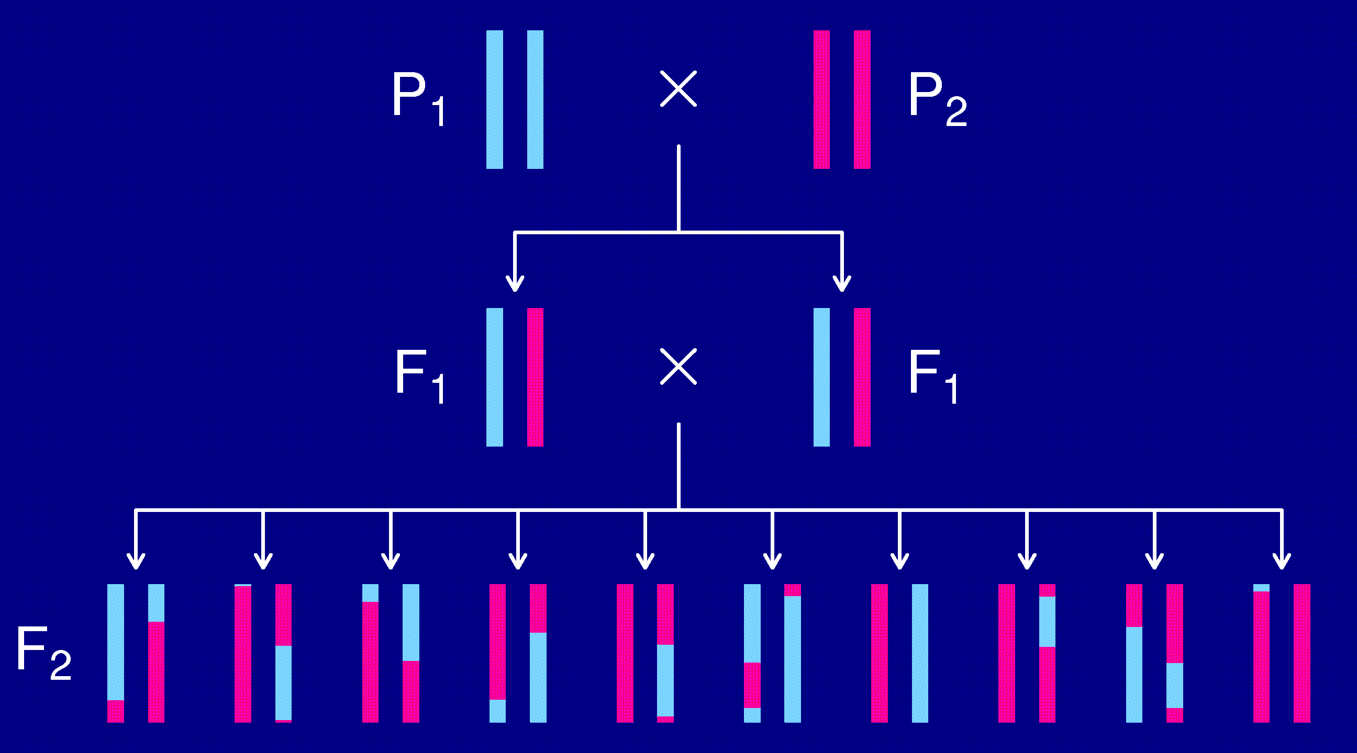
The intercross

Slide 11
The data
Phenotypes, y_{i}
Genotypes, x_{ij} = AA/AB/BB, at genetic markers
A genetic map, giving the locations of the markers.

Slide 12
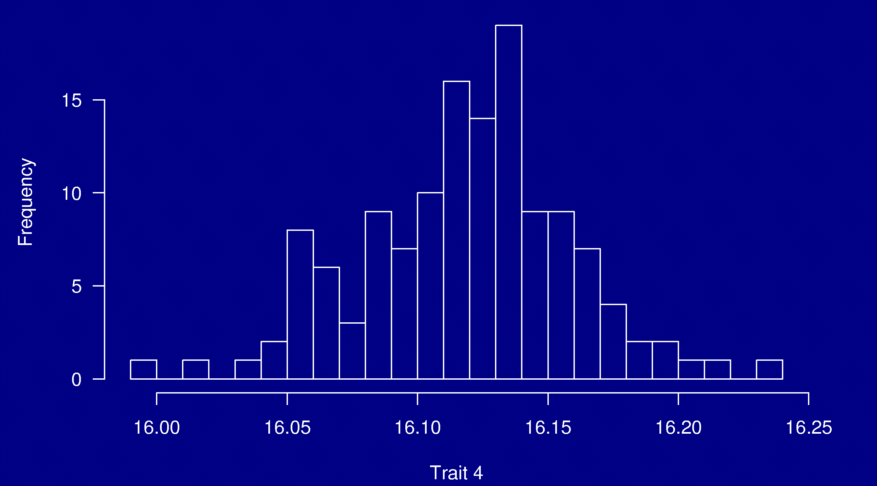
Phenotypes
133 females
(NOD × B6) × (NOD × B6)

Slide 13
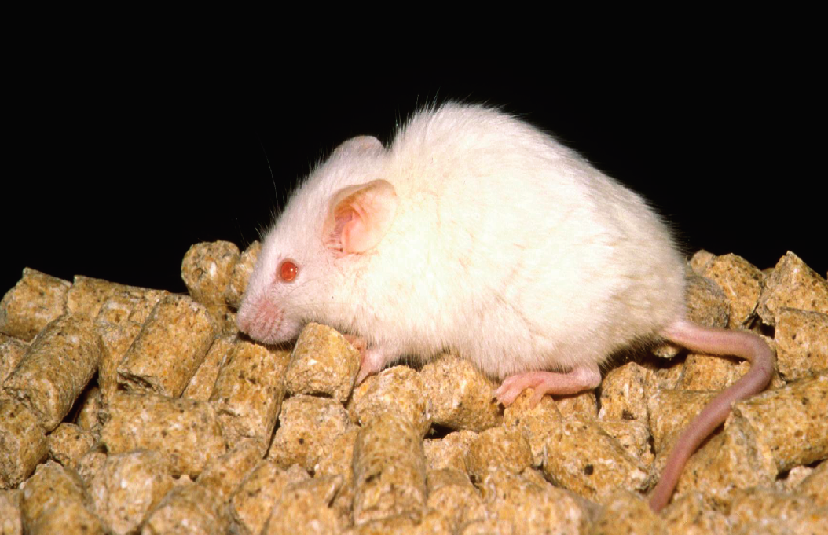
NOD

Slide 14
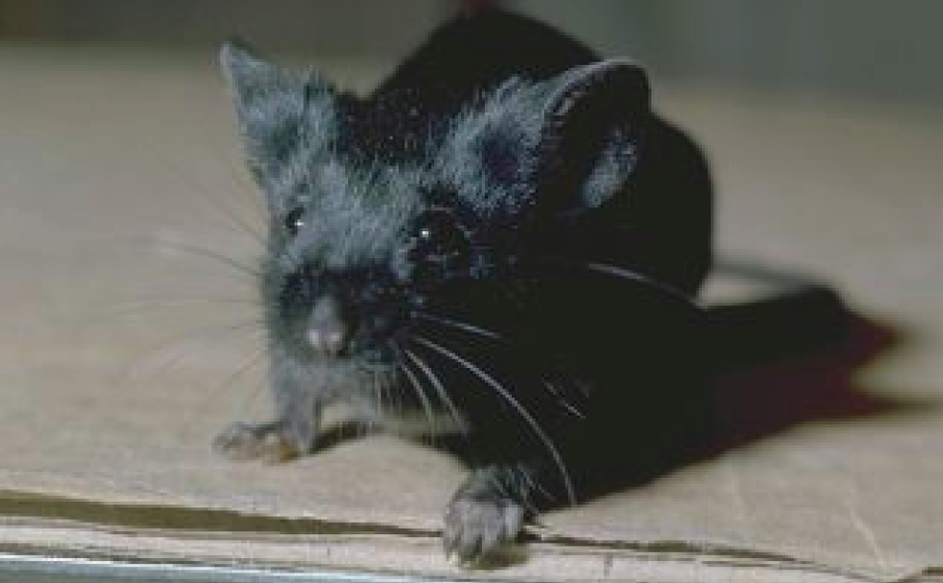
C57BL/6

Slide 15
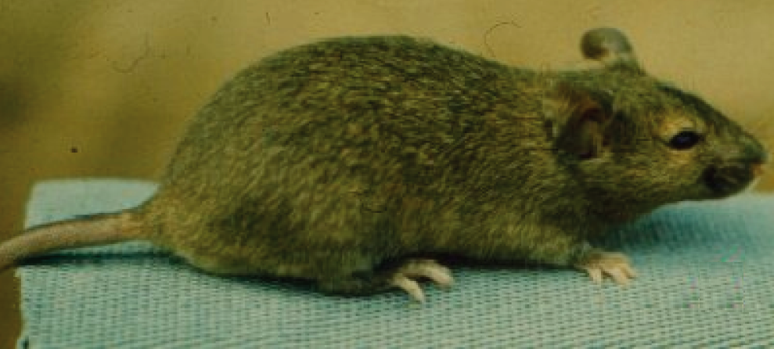
Agouti coat

Slide 16
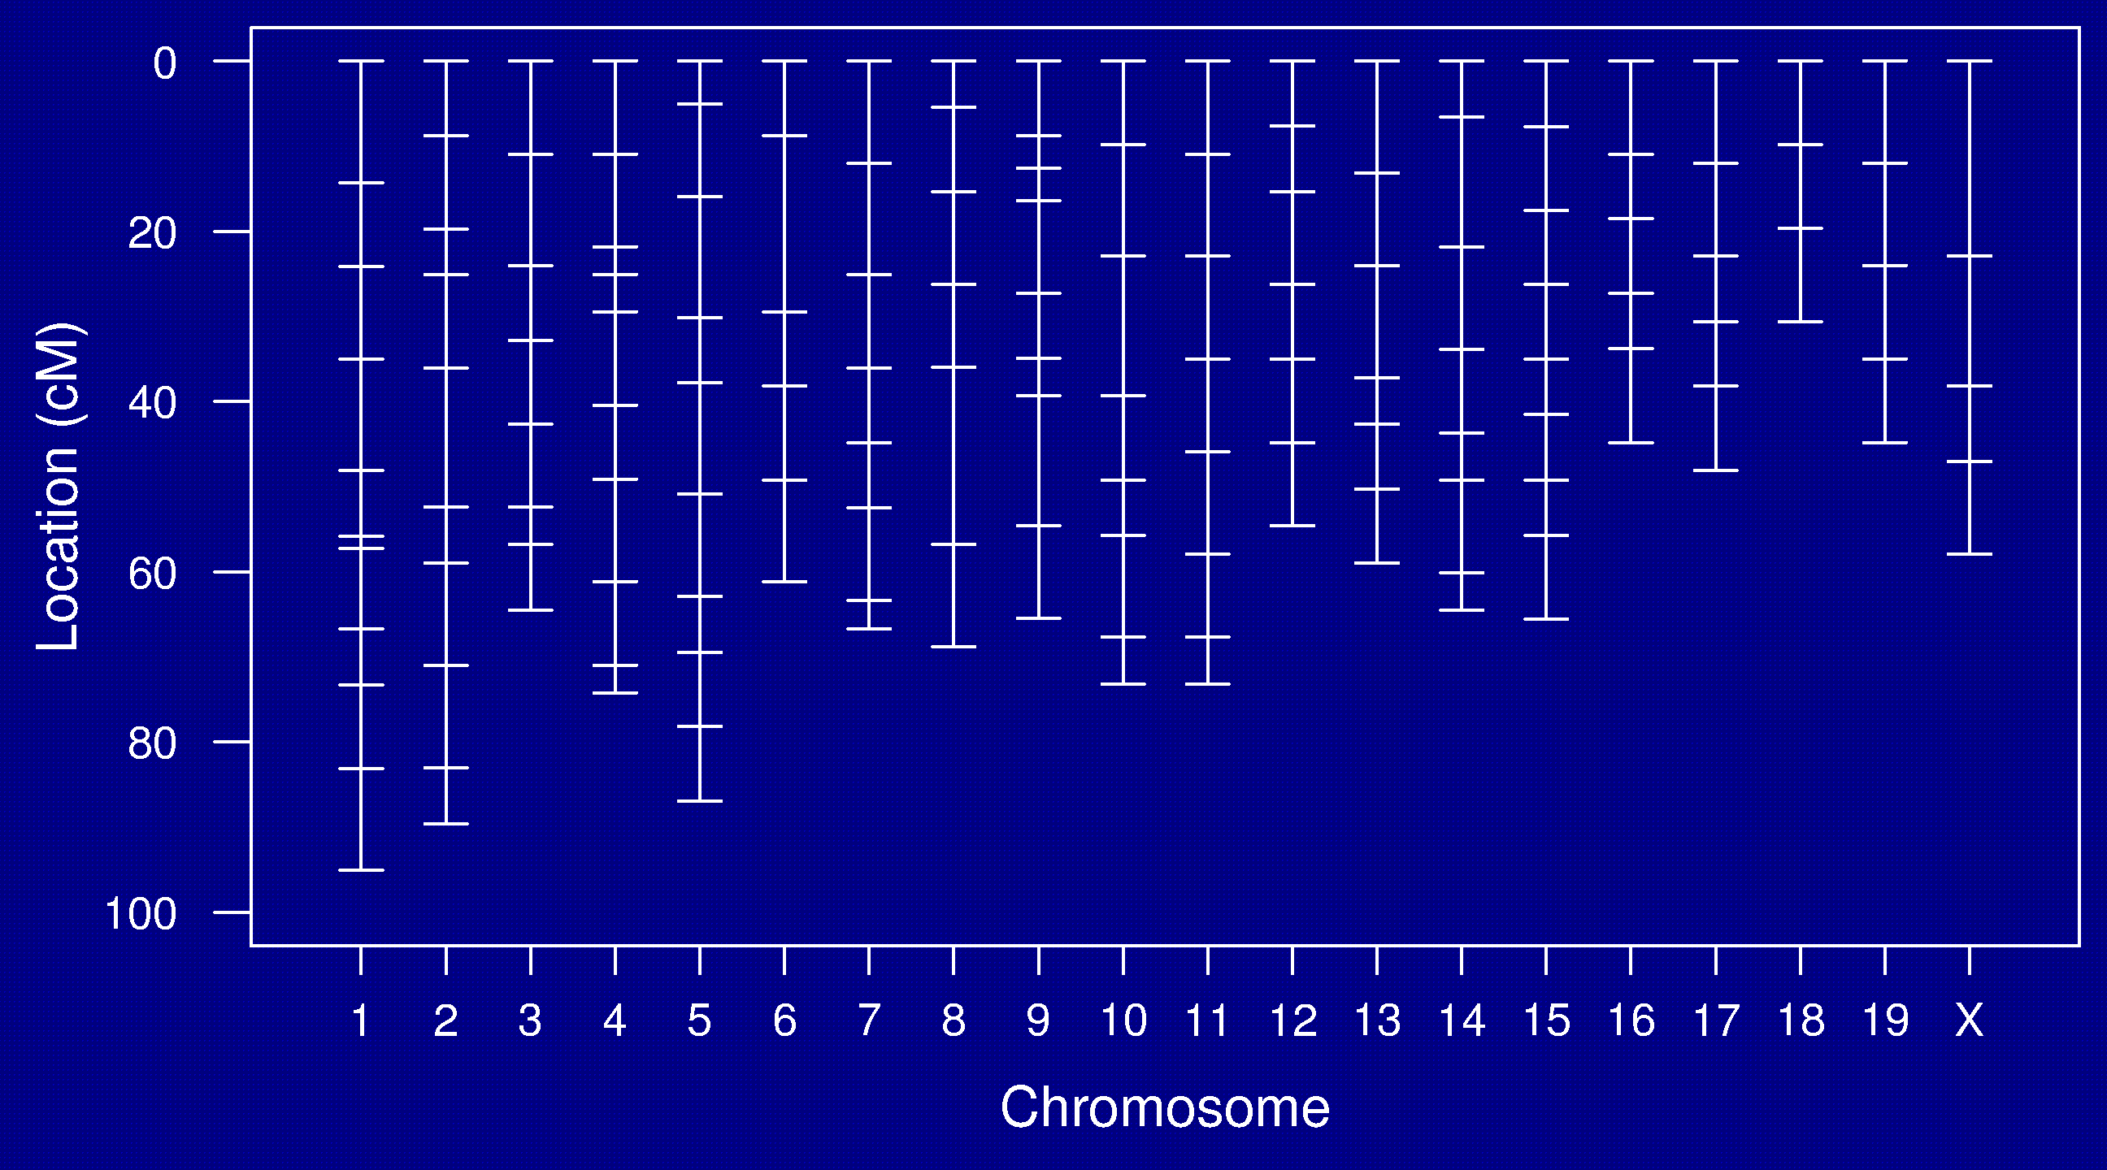
Genetic map

Slide 17
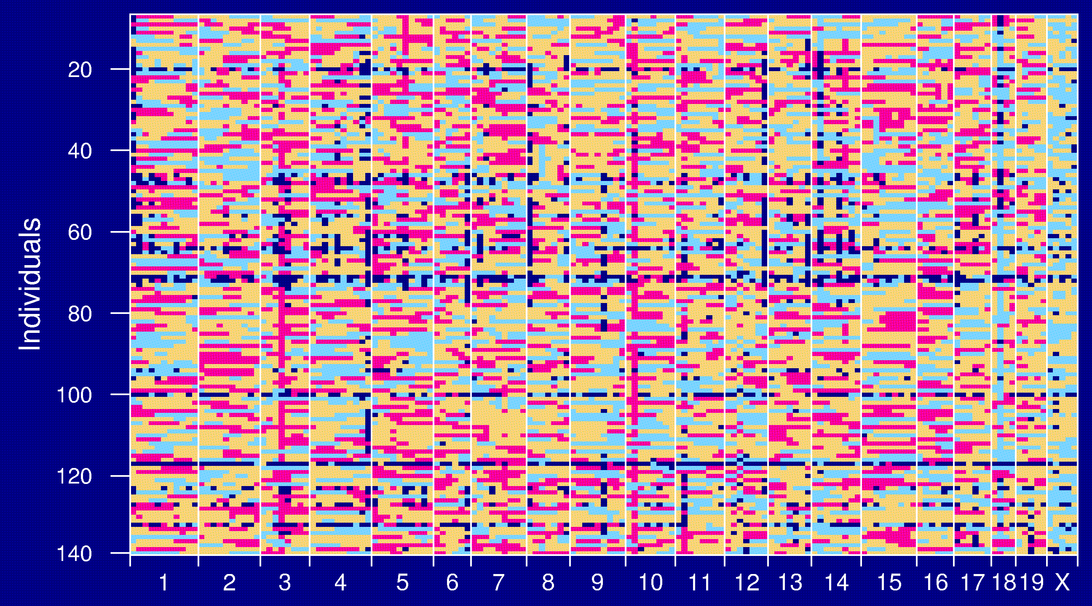
Genotype data

Slide 18
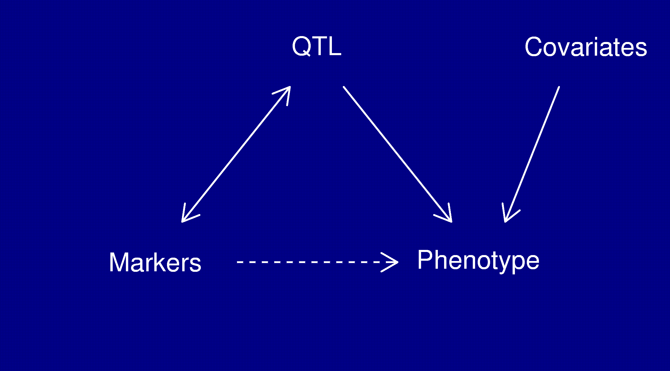
Statistical structure
Missing data: markers ↔ QTL
Model selection: genotypes ↔ phenotype

Slide 19
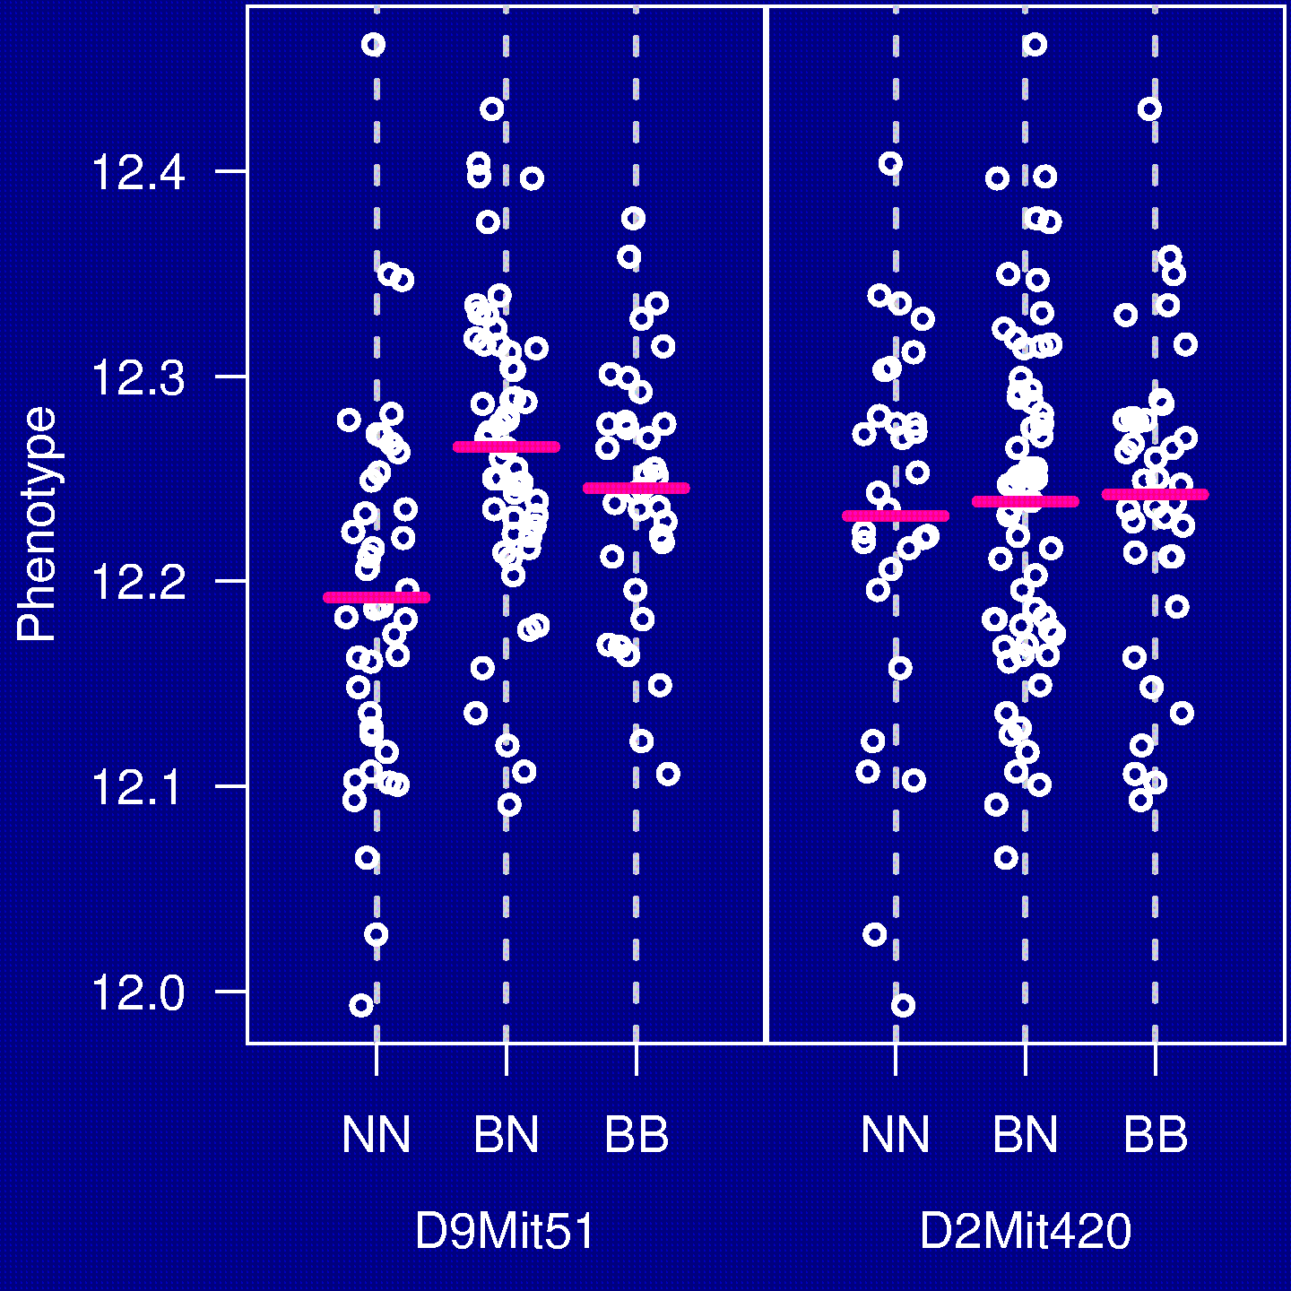
The simplest method
“Marker regression”
Consider a single marker
Split mice into groups according to their genotype at a marker
Do an ANOVA (or t-test)
Repeat for each marker

Slide 20
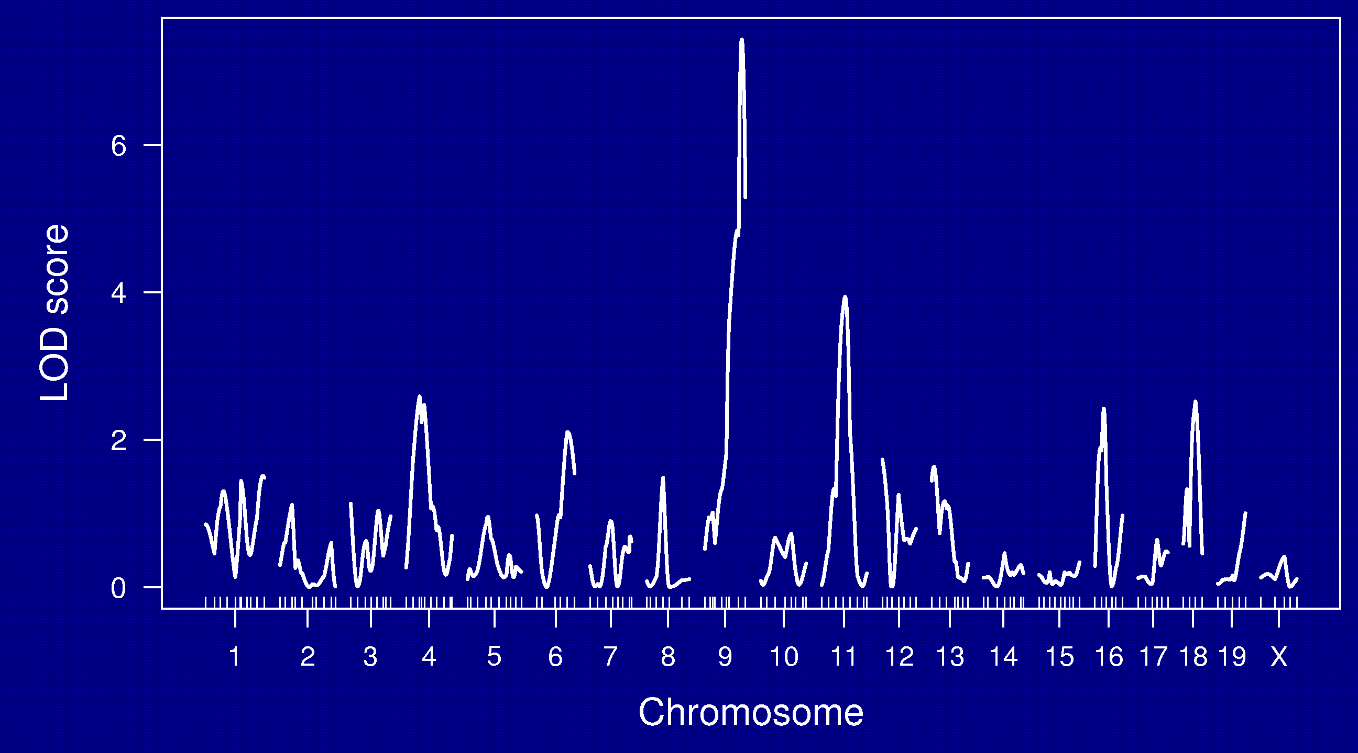
LOD curves

Slide 21
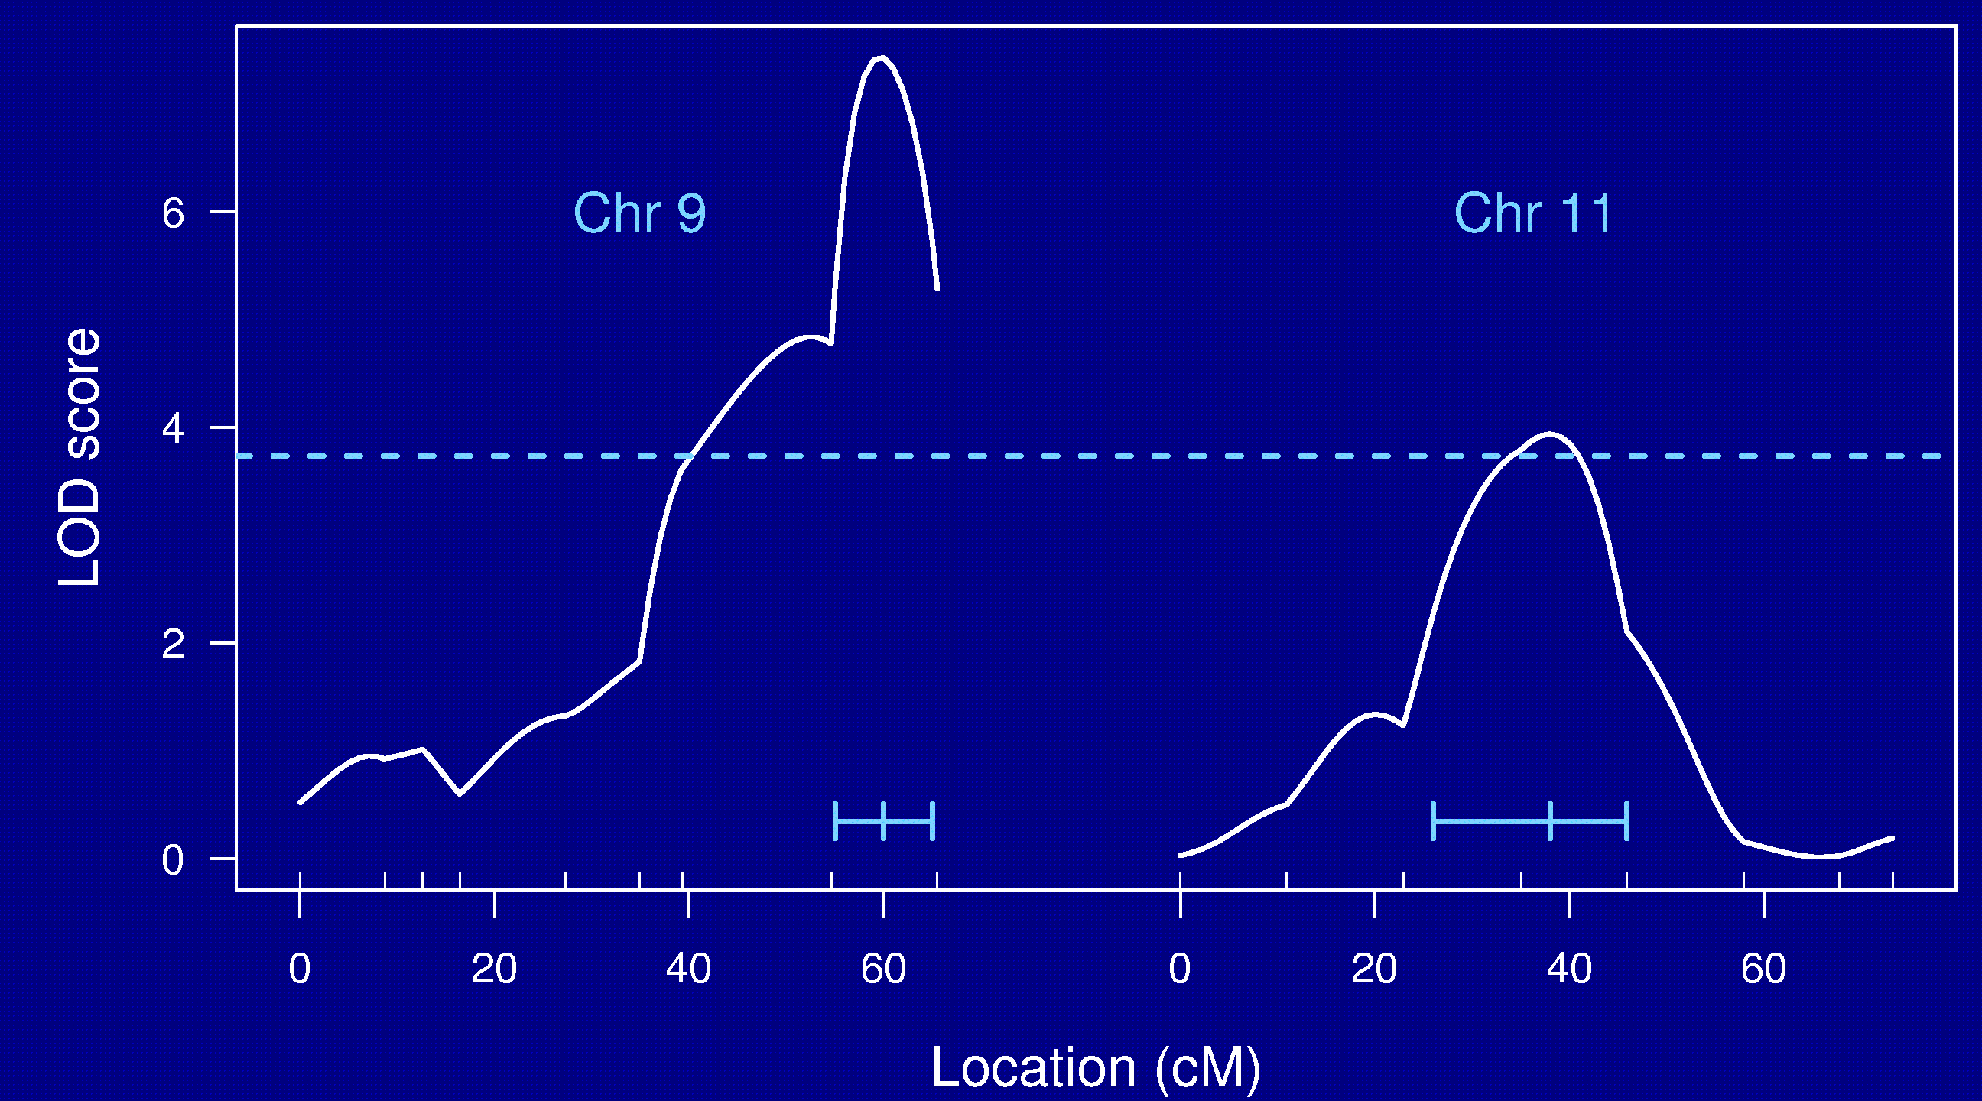
Chr 9 and 11

Slide 22
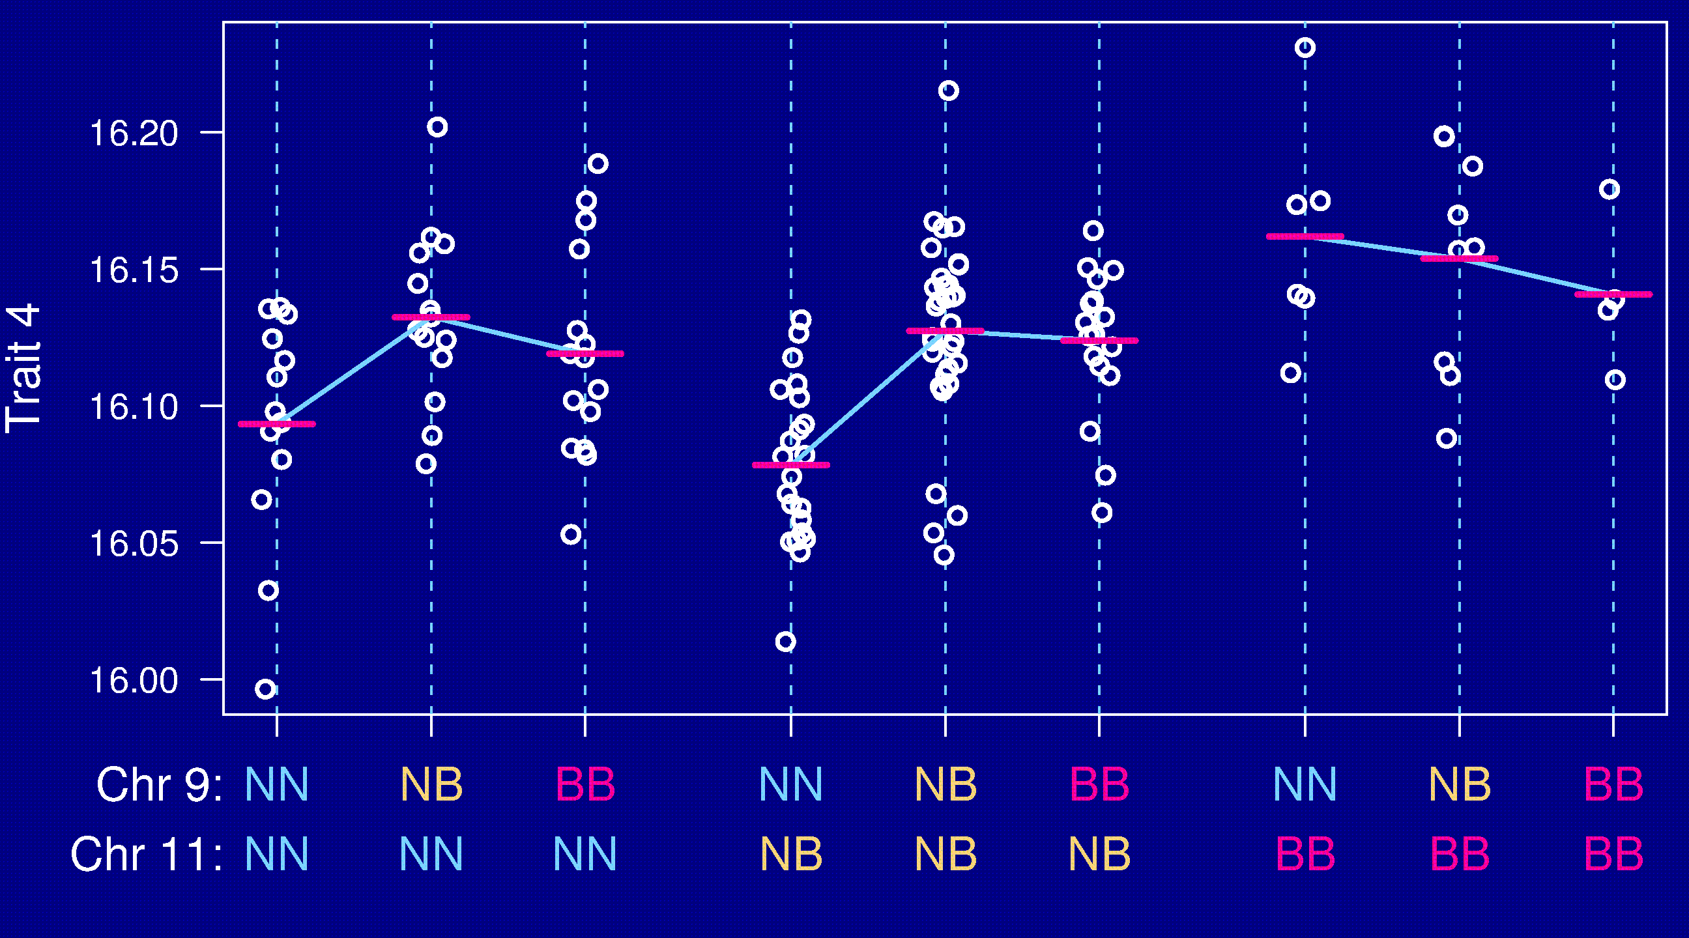
Epistasis

Slide 23
Back to the strategy
First: QTL mapping results in a 10-20 cM region
Next step: create congenics
Then: subcongenics
Then: test candidates
Finally: prove a gene is the gene

Slide 24
“Modern” approaches
Recombinant inbred lines (RILs)
Advanced intercross lines (AILs)
Heterogeneous stock (HS)
The Collaborative Cross (CC)
Partial advanced intercross (PAI)
Association mapping across mouse strains
Combining crosses, accounting for the history of the inbred strains
Gene expression microarrays

Slide 25
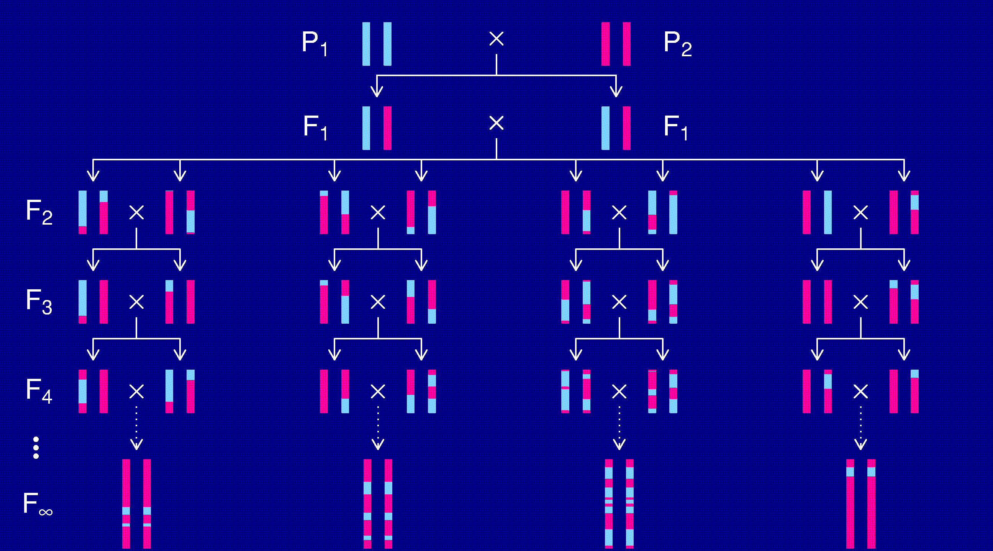
Recombinant inbred lines

Slide 26
RI lines
Advantages
Each strain is a eternal resource.
  Only need to genotype once.
  Reduce individual variation by phenotyping multiple individuals from each strain.
  Study multiple phenotypes on the same genotype.
Greater mapping precision.
Disadvantages
Time and expense.
Available panels are generally too small (10-30 lines).
Can learn only about 2 particular alleles.
All individuals homozygous.

Slide 27
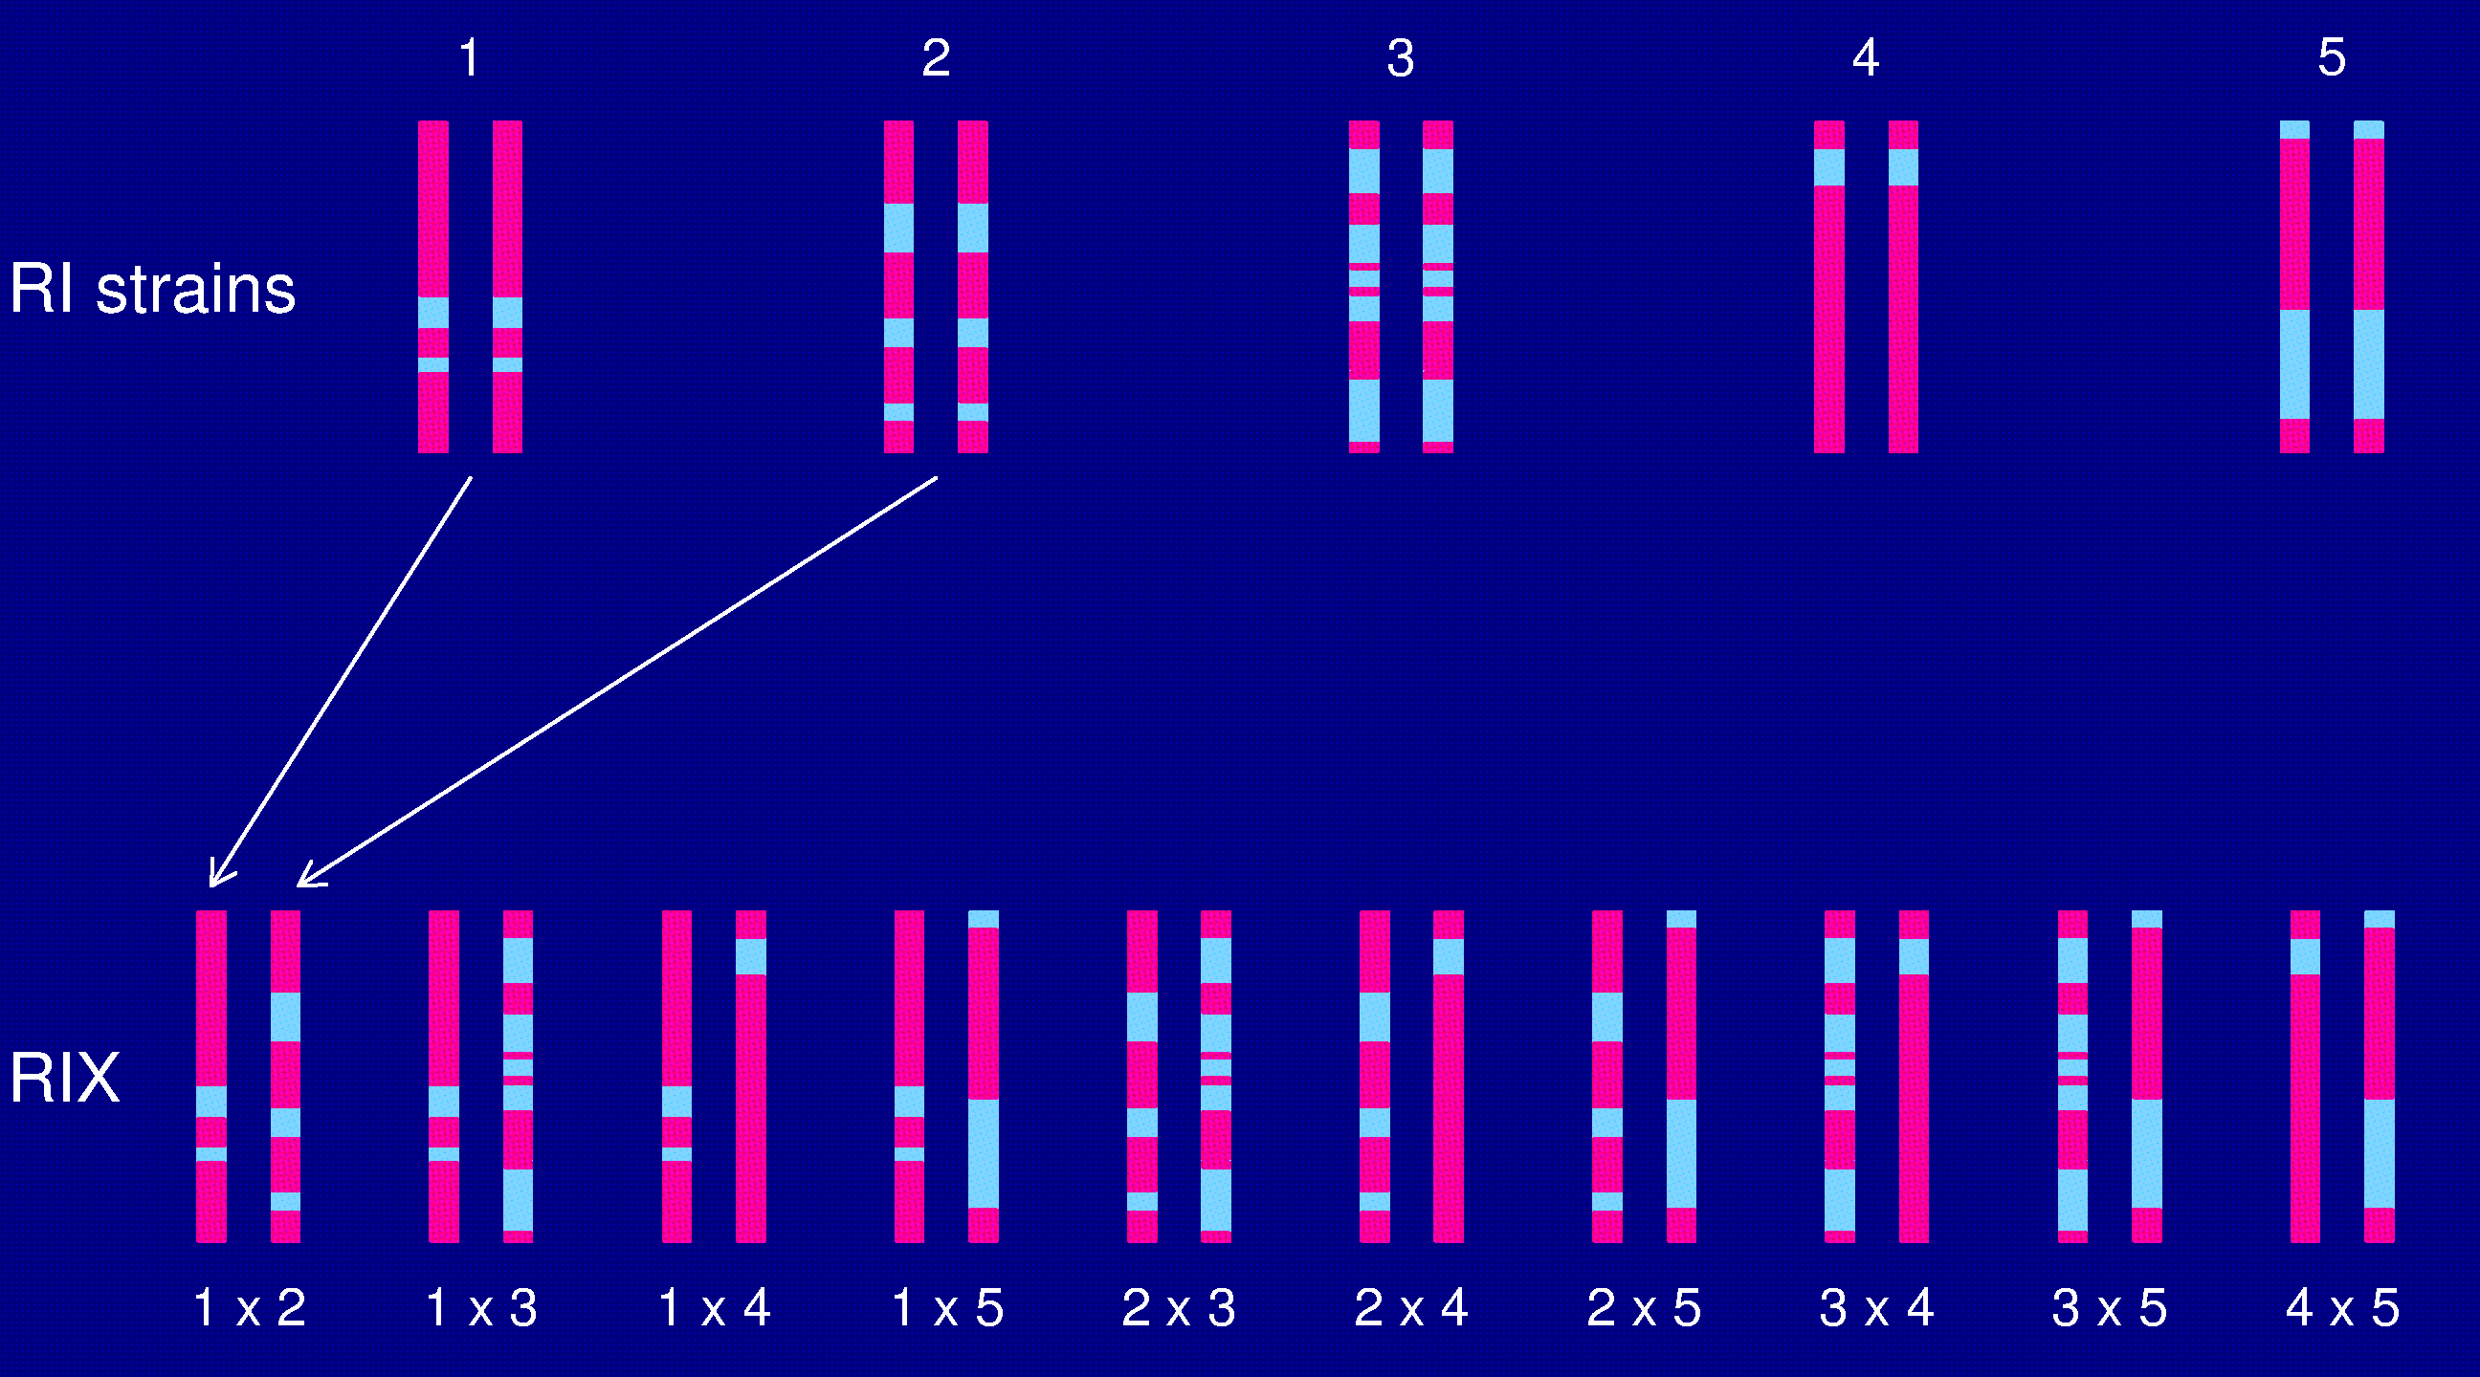
The RIX design

Slide 28
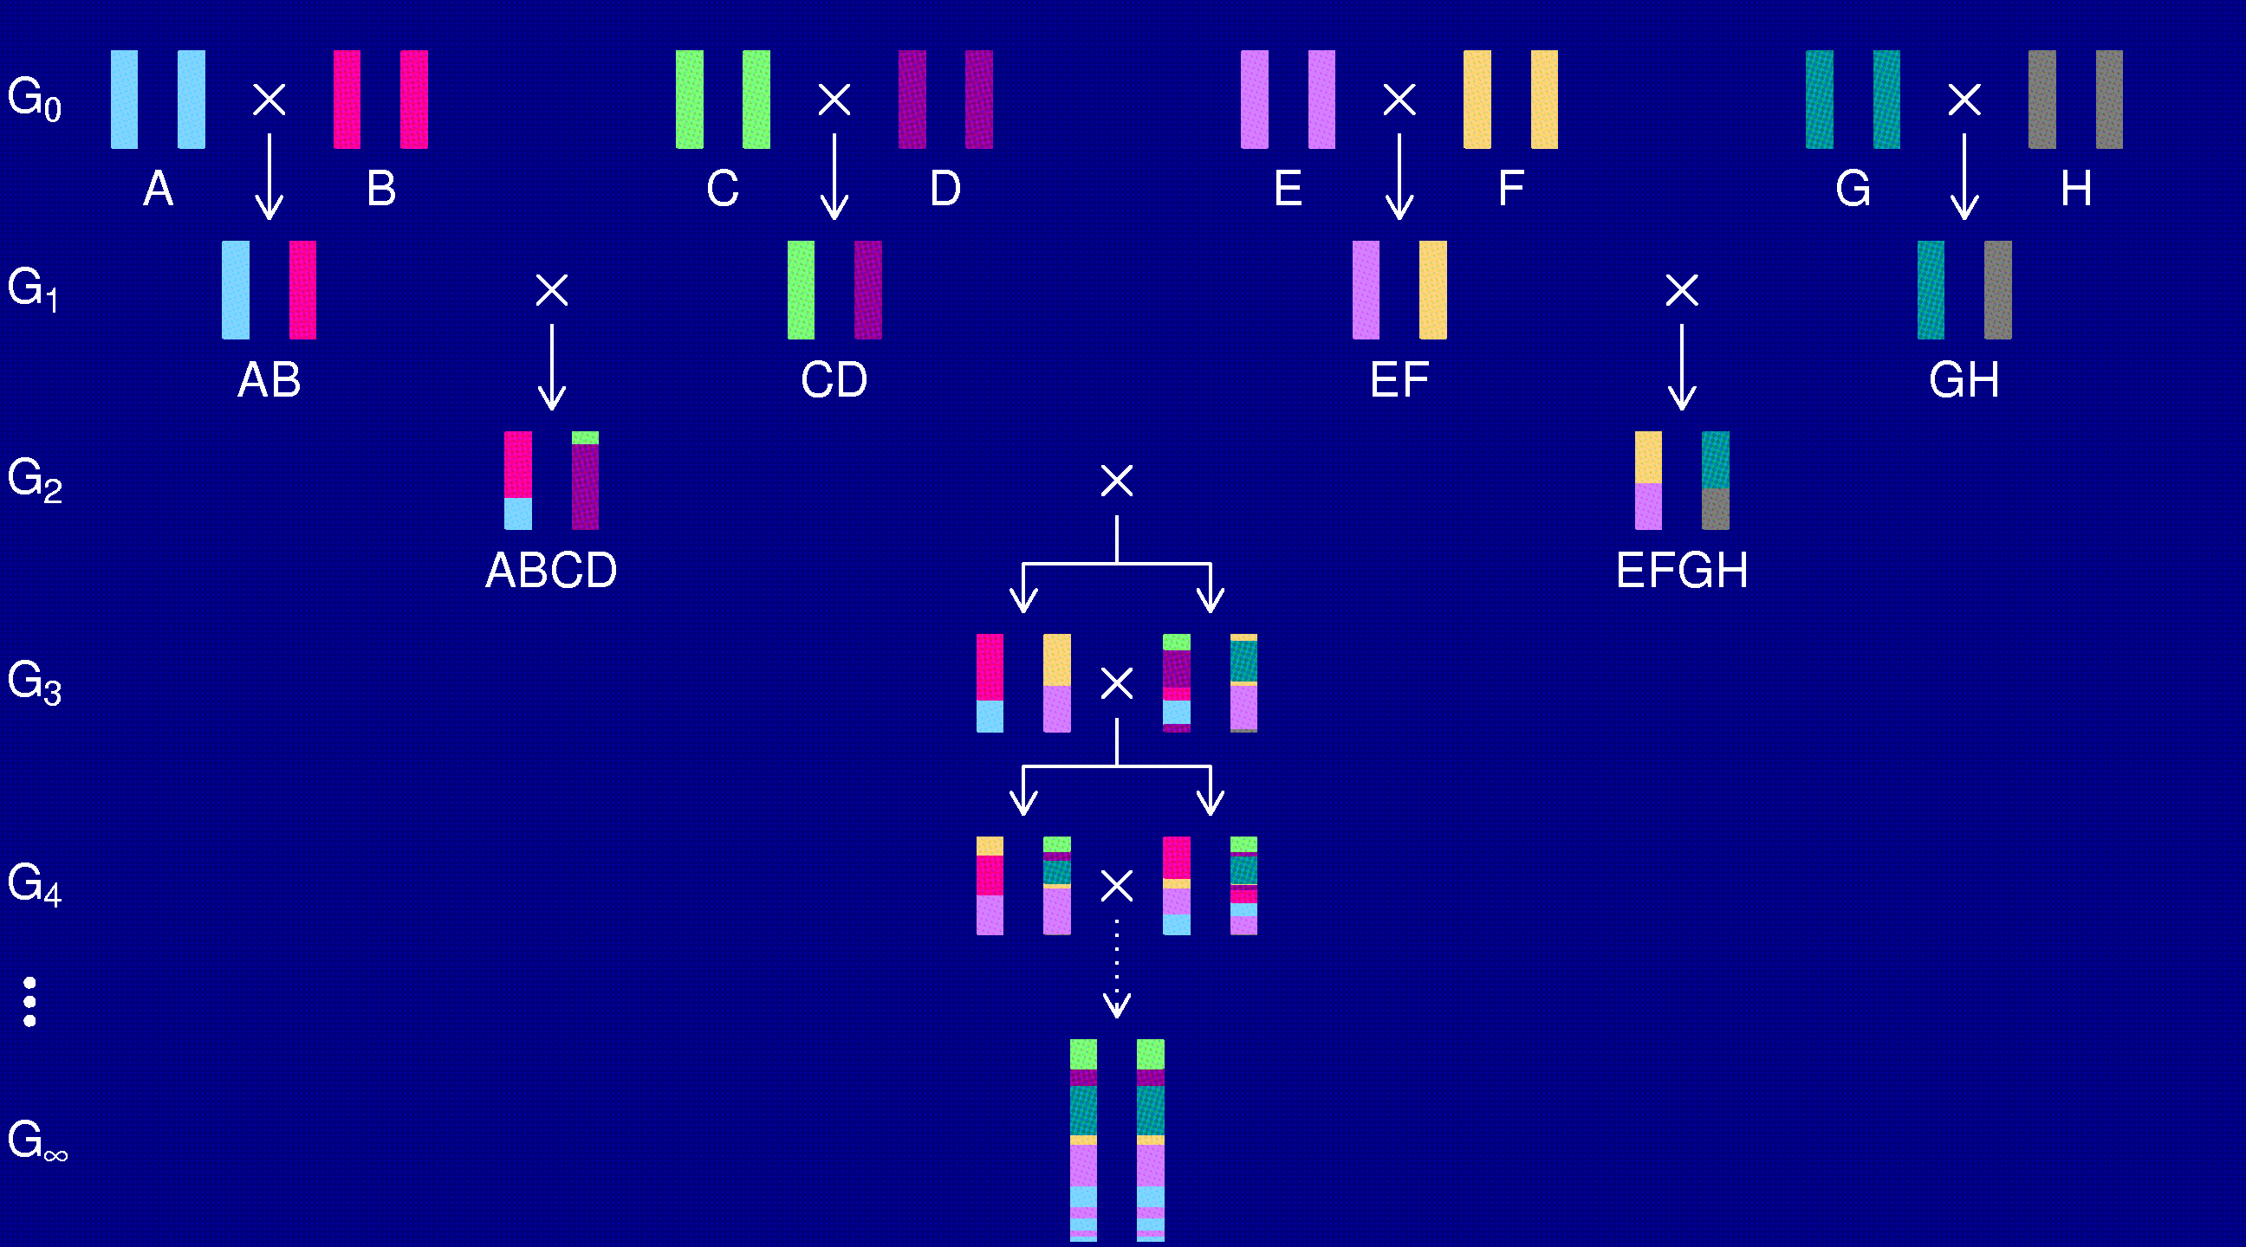
The “Collaborative Cross”

Slide 29
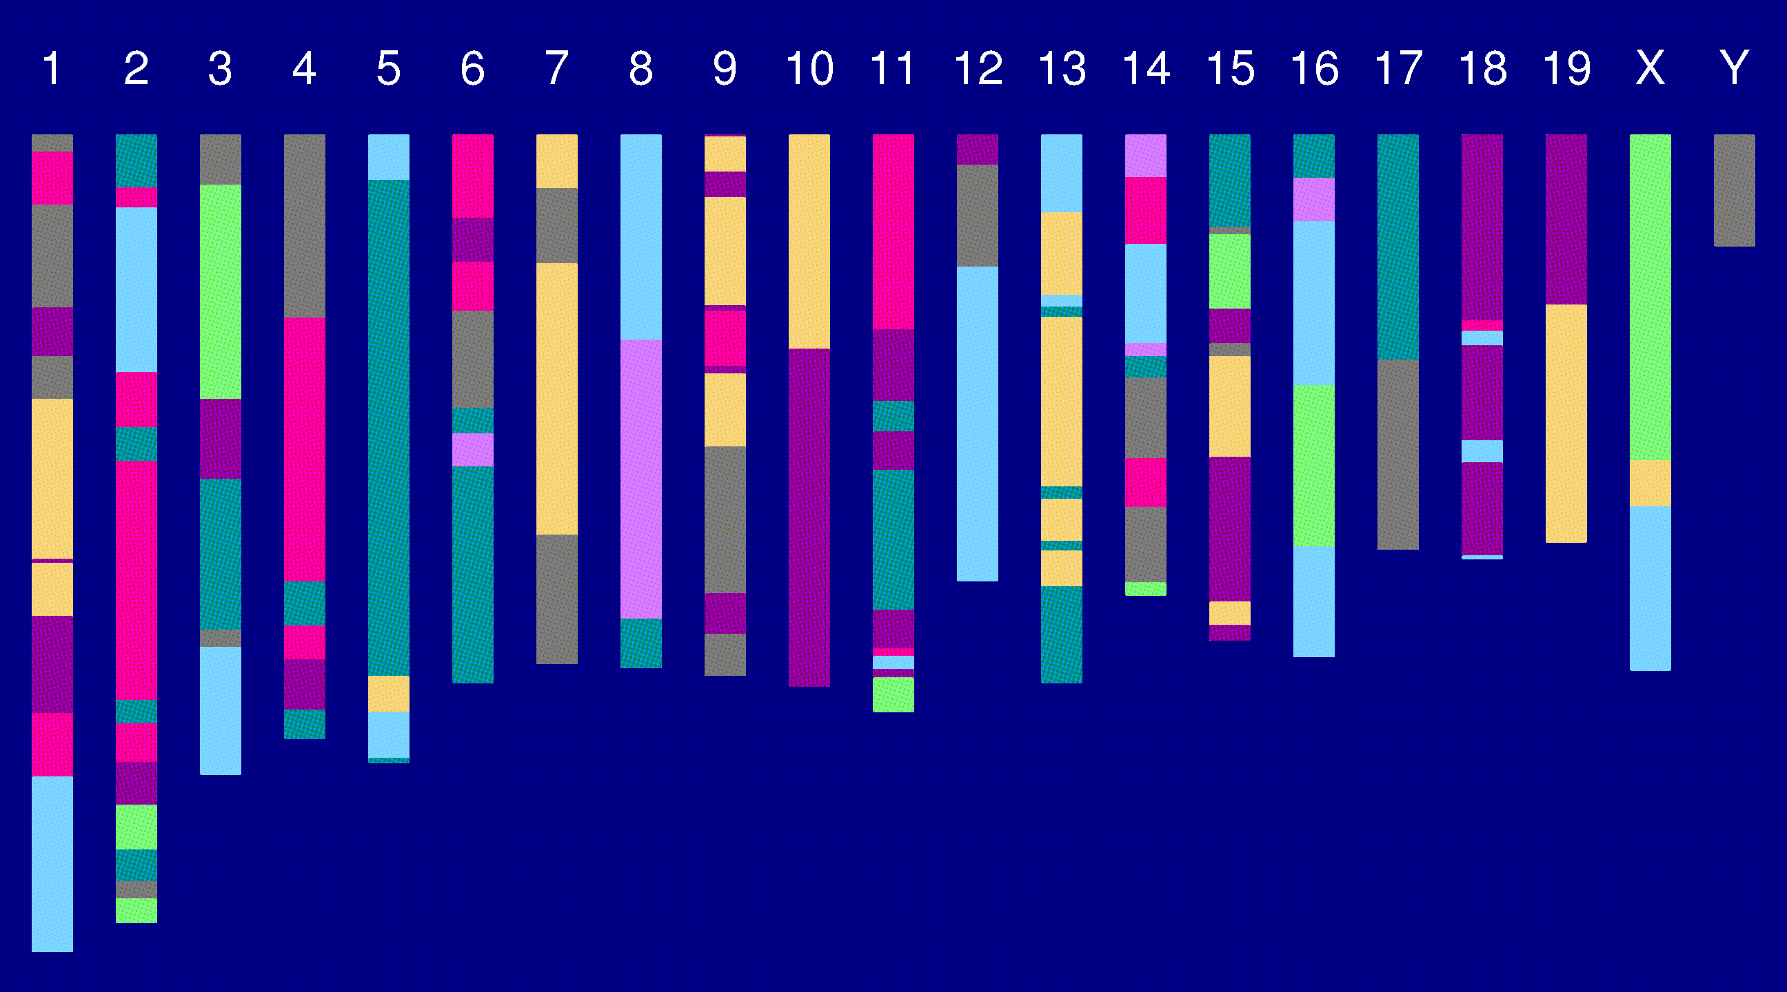
Genome of an 8-way RI

Slide 30
Heterogeneous stock
McClearn et al. (1970)
Mott et al. (2000); Mott and Flint (2002)
Start with 8 inbred strains.
Randomly breed 40 pairs.
Repeat the random breeding of 40 pairs for each of ~60 generations (30 years).
The genealogy (and protocol) is not completely known.
Note: AILs are similar, but start with 2 strains and don’t go as many generations

Slide 31
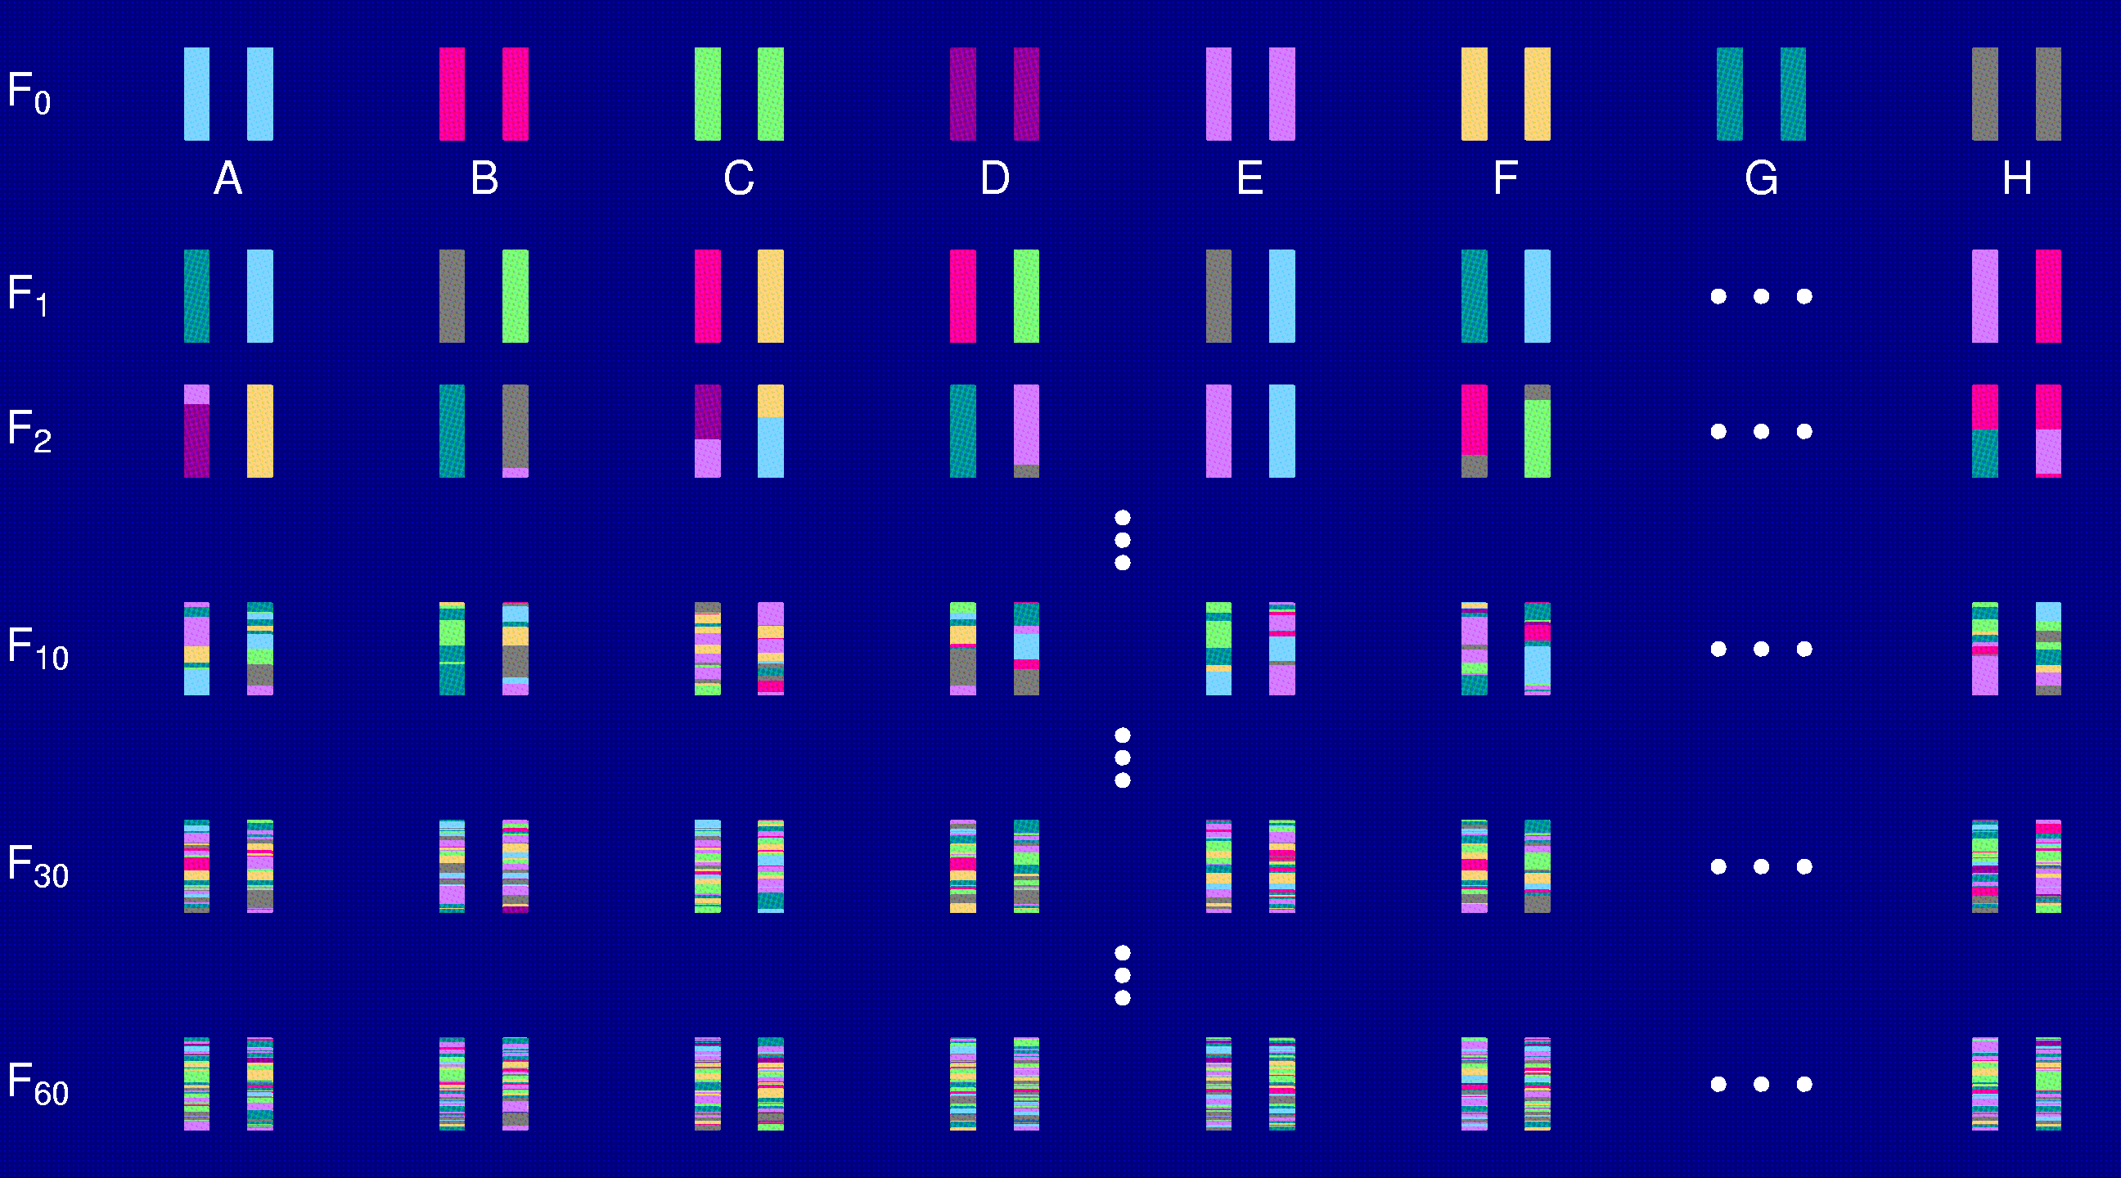
Heterogeneous stock

Slide 32
“Modern” approaches
Recombinant inbred lines (RILs)
Advanced intercross lines (AILs)
Heterogeneous stock (HS)
The Collaborative Cross (CC)
Partial advanced intercross (PAI)
Association mapping across mouse strains
Combining crosses, accounting for the history of the inbred strains

Slide 33
Towards proof
Gene has nonsynonymous mutation
Gene shows difference in expression between parental strains
Expression variation correlated with QTL genotype
RNA interference
Knock out/knock in

Slide 34
Summary
Experimental crosses in model organisms
  Cheap, fast, powerful, can do direct experiments
  The model may relevant to the human disease
Standard QTL mapping results in large regions with many genes
Fine mapping
  Congenics, AILs, RILs, HS, PAI, association mapping
  Expression differences
Proof
  RNA interference
  Knock outs/knock ins

