Slide 1
The genomes of recombinant inbred lines
Karl W Broman
Department of Biostatistics
Johns Hopkins University
http://www.biostat.jhsph.edu/~kbroman

Slide 2
Goal
Identify genes that contribute to complex human diseases
Complex disease = one that’s hard to figure out
Many genes + environment + other

Slide 3
Inbred mice

Slide 4
Advantages of the mouse
Small and cheap
Inbred lines
Disease has simpler genetic architecture
Controlled environment
Large, controlled crosses
Experimental interventions
Knock-outs and knock-ins

Slide 5
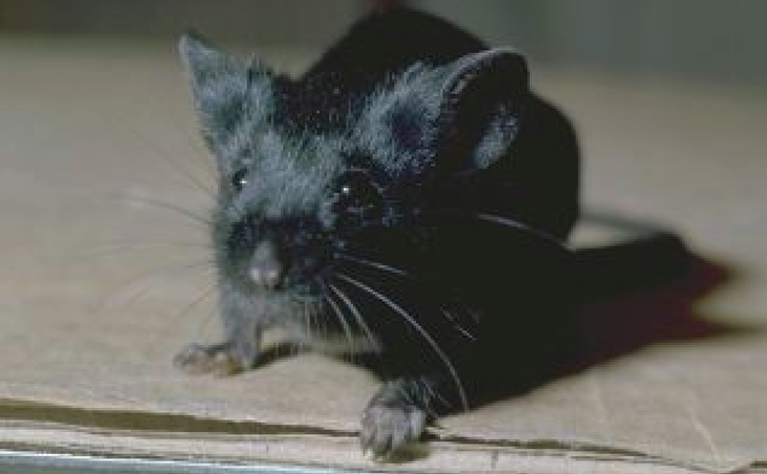
C57BL/6

Slide 6
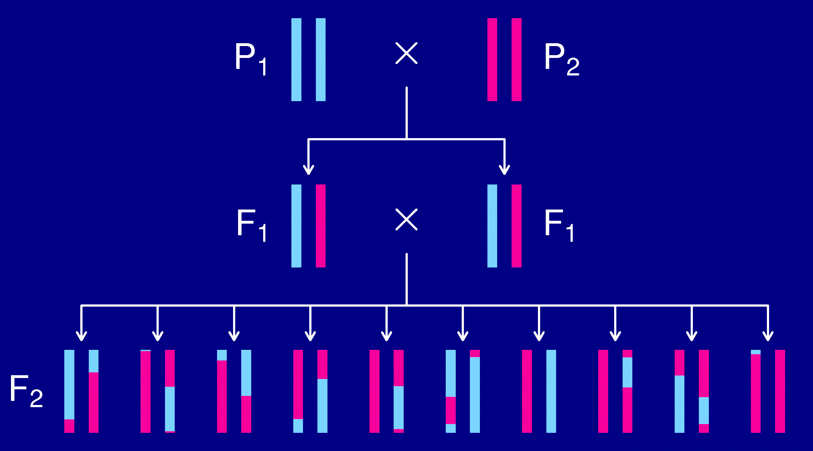
The intercross

Slide 7
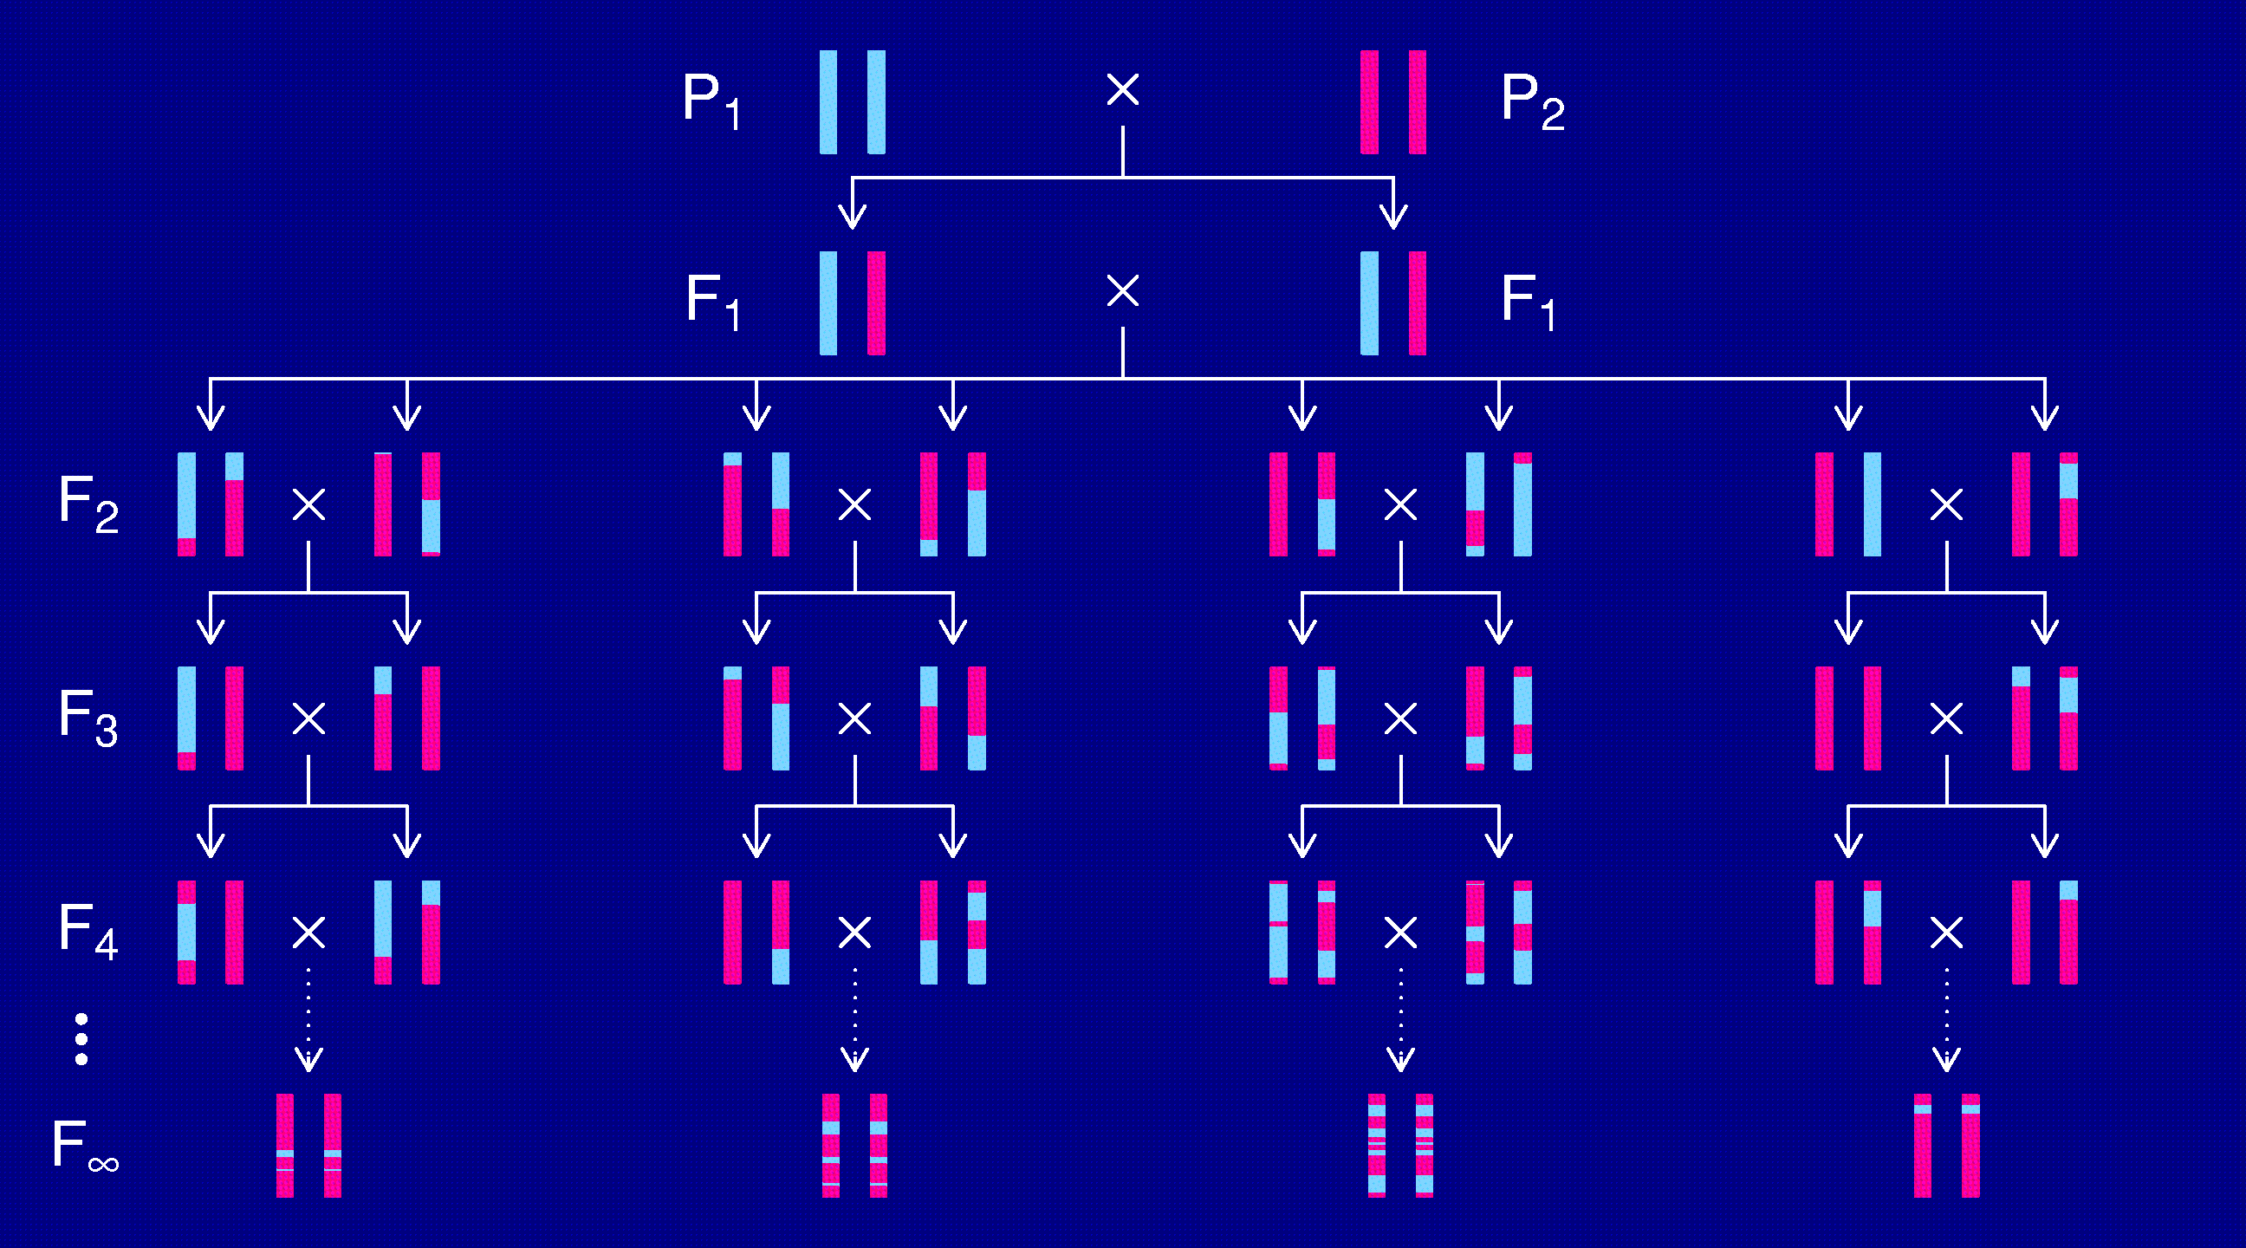
Recombinant inbred lines
(by sibling mating)

Slide 8
Advantages of RI lines
Each strain is an eternal resource.
  Only need to genotype once.
  Reduce individual variation by phenotyping multiple individuals from each strain.
  Study multiple phenotypes on the same genotype.
Greater mapping precision.
  More dense breakpoints on the RI chromosomes.

Slide 9
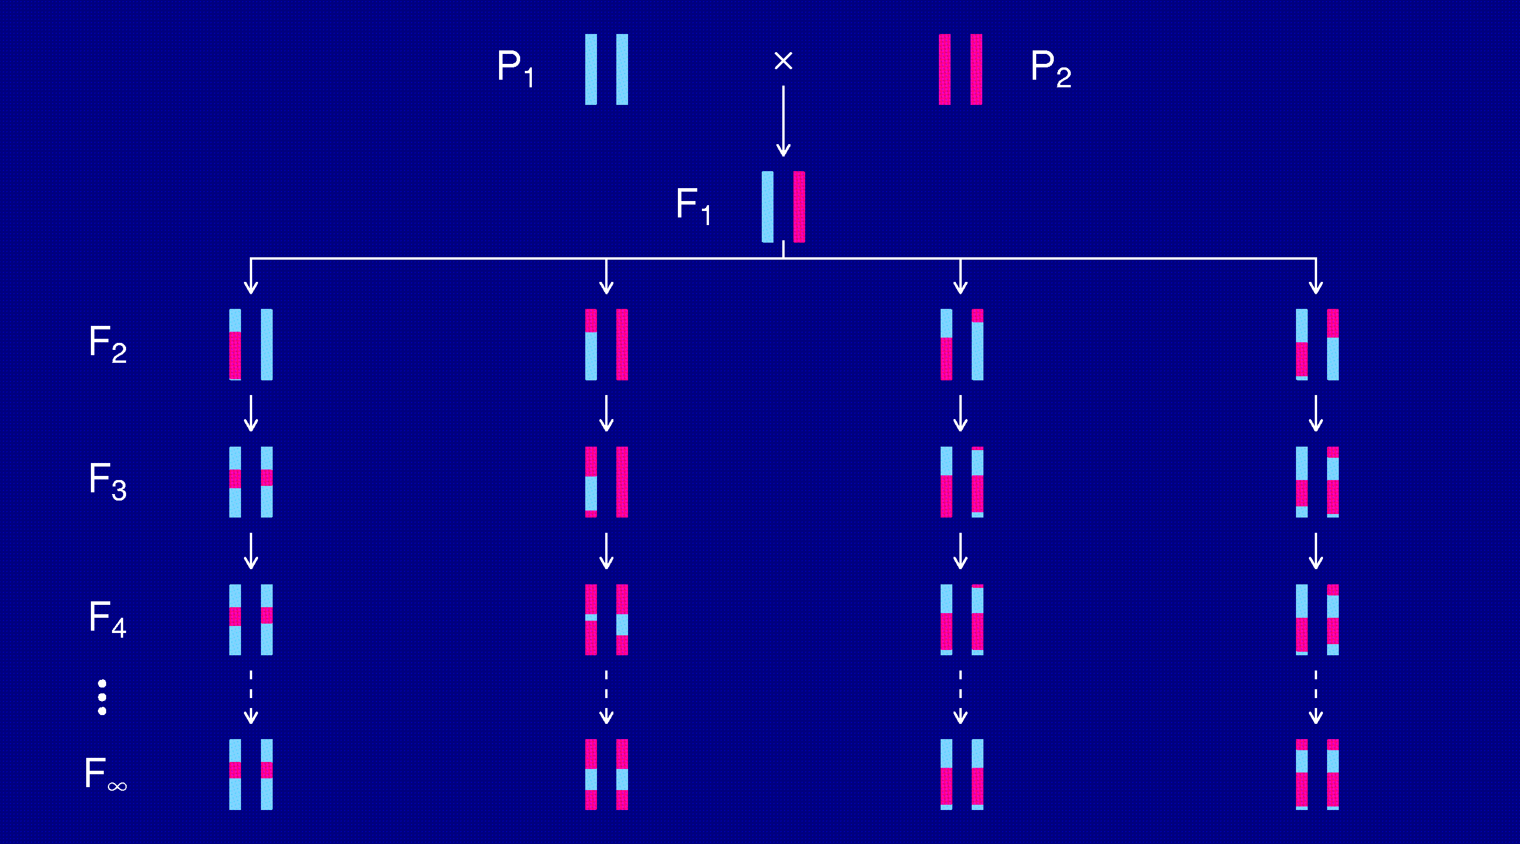
Recombinant inbred lines
(by selfing)

Slide 10
Disadvantages of RI lines
Time-consuming to create (5-6 years)
Available panels are small (10-30 lines)
Just 2 progenitor strains

Slide 11
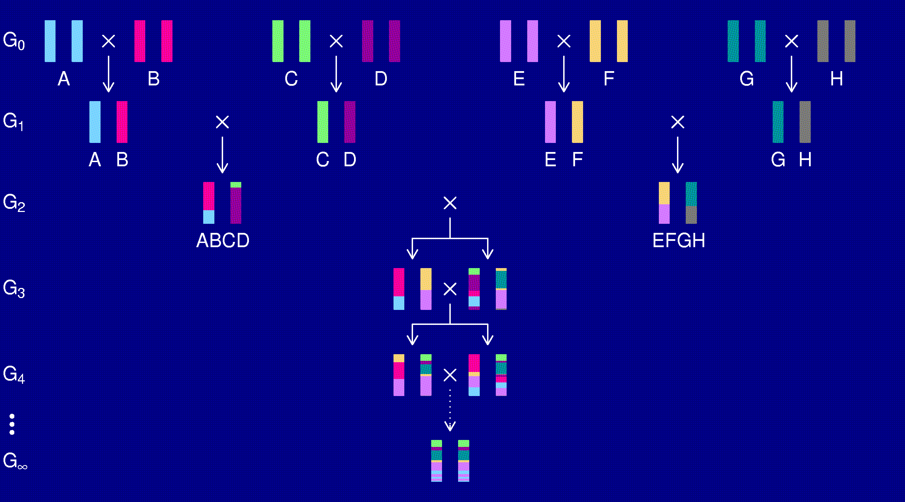
The “Collaborative Cross”

Slide 12
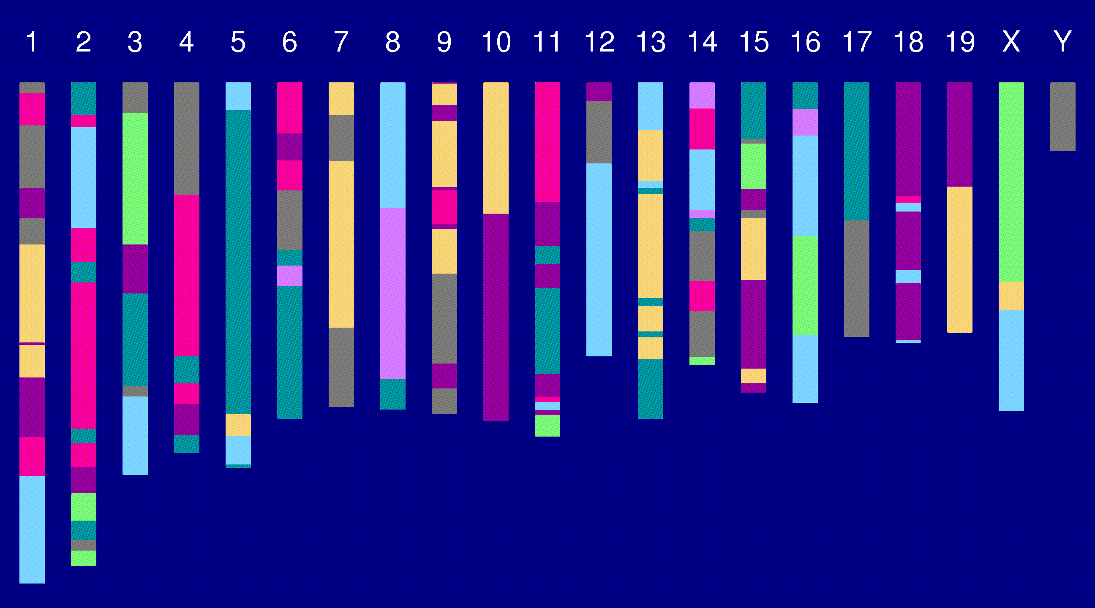
Genome of an 8-way RI

Slide 13
The goal
Characterize the breakpoint process along a chromosome in 8-way RILs.
  Understand the two-point haplotype probabilities.
  Study the clustering of the breakpoints, as a function of crossover interference in meiosis.

Slide 14
2 points in an RIL
1
2
r = recombination fraction = probability of a recombination in the interval in a random meiotic product.
R = analogous thing for the RIL = probability of different alleles at the two loci on a random RIL chromosome.

Slide 15
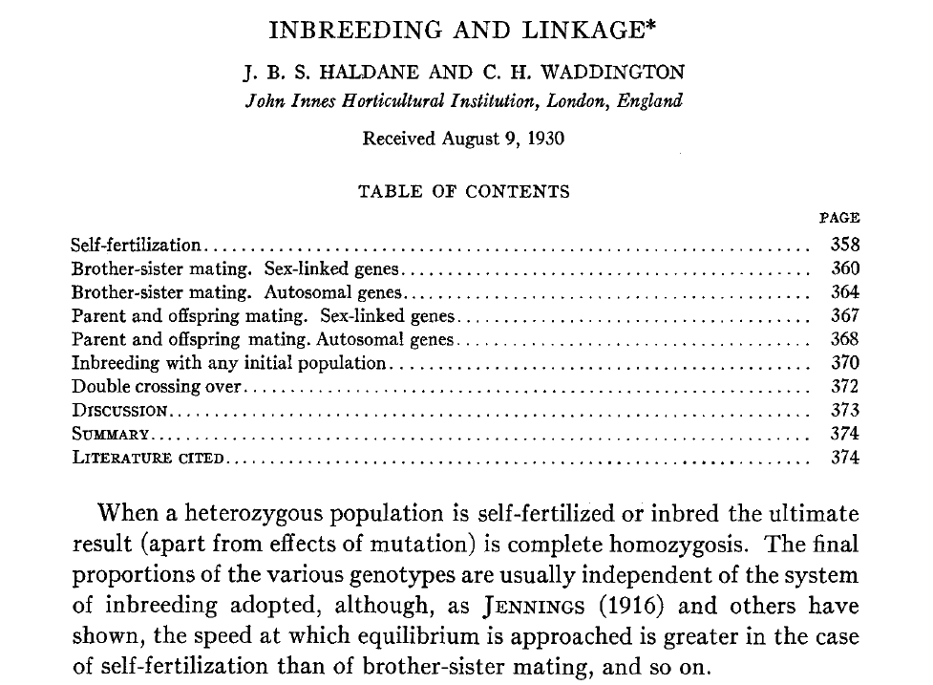
Haldane & Waddington 1931
Genetics 16:357-374

Slide 16
Recombinant inbred lines
(by selfing)

Slide 17
Markov chain
Sequence of random variables {X₀, X₁, X₂, …} satisfying
Pr(X_{n+1} | X₀, X₁, …, X_{n}) = Pr(X_{n+1} | X_{n})
Transition probabilities P_{ij} = Pr(X_{n+1}=j | X_{n}=i)
Here, X_{n} = “parental type” at generation n
We are interested in absorption probabilities
Pr(X_{n} → j | X₀)

Slide 18
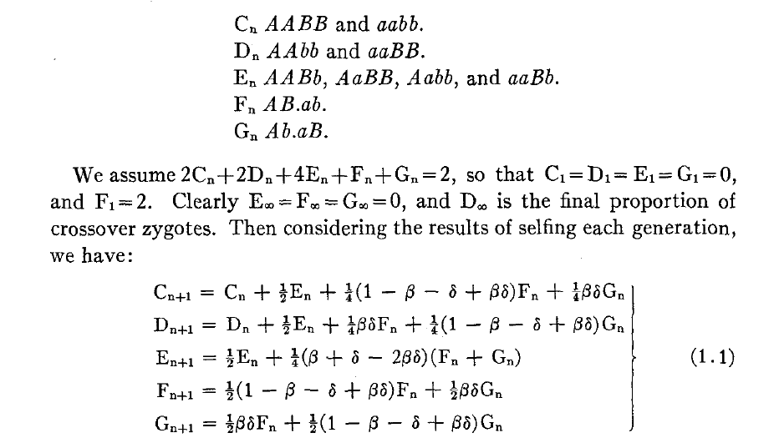
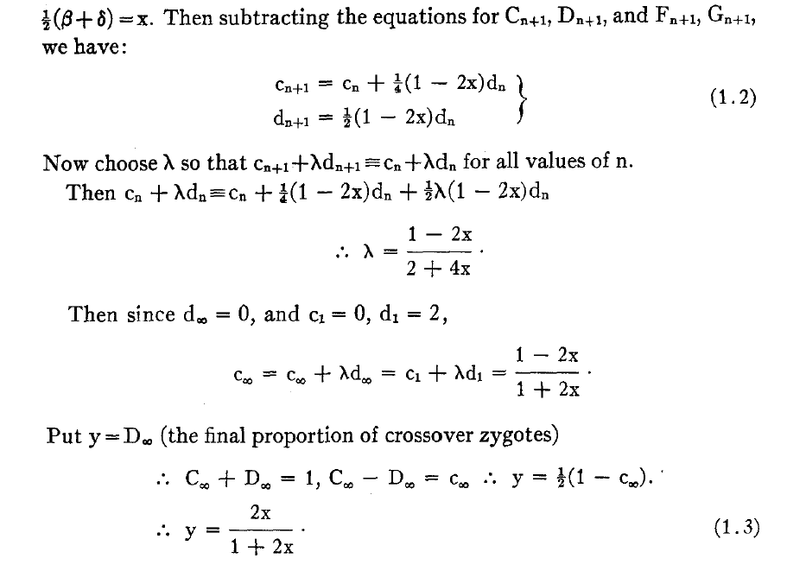
Equations for selfing

Slide 19
Absorption probabilities
Let P_{ij} = Pr(X_{n+1} = j | X_{n} = i) where X_{n} = state at generation n.
Consider the case of absorption into the state AA|AA.
Let h_{i} = probability, starting at i, eventually absorbed into AA|AA.
Then h_{AA|AA} = 1 and h_{AB|AB} = 0.
Condition on the first step: h_{i} = ∑_{k} P_{ik} h_{k}
For selfing, this gives a system of 3 linear equations.

Slide 20
Recombinant inbred lines
(by sibling mating)

Slide 21
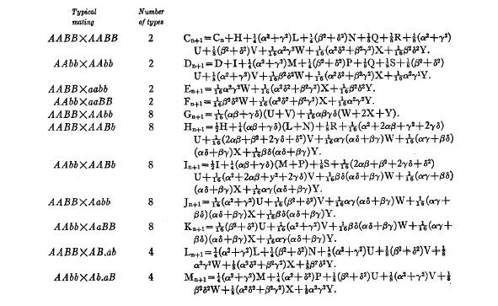
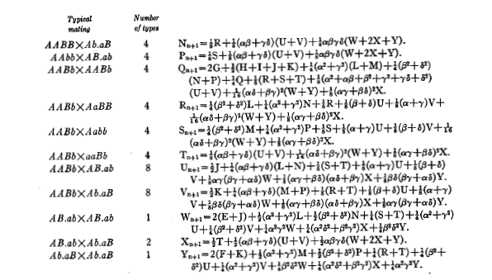
Equations for sib-mating

Slide 22
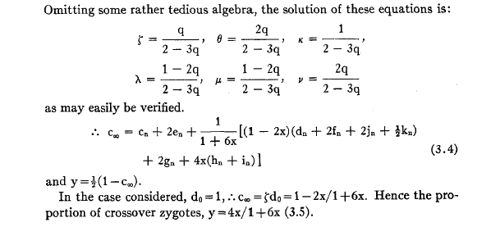
Result for sib-mating

Slide 23
The “Collaborative Cross”

Slide 24
8-way RILs
Autosomes
  Pr(G₁ = i) = 1/8
  Pr(G₂ = j | G₁ = i) = r / (1+6r) for i ≠ j
  Pr(G₂ ≠ G₁) = 7r / (1+6r)
X chromosome
  Pr(G₁=A) = Pr(G₁=B) = Pr(G₁=E) = Pr(G₁=F) =1/6
  Pr(G₁=C) = 1/3
  Pr(G₂=B | G₁=A) = r / (1+4r)
  Pr(G₂=C | G₁=A) = 2r / (1+4r)
  Pr(G₂=A | G₁=C) = r / (1+4r)
  Pr(G₂ ≠ G₁) = (14/3) r / (1+4r)

Slide 25
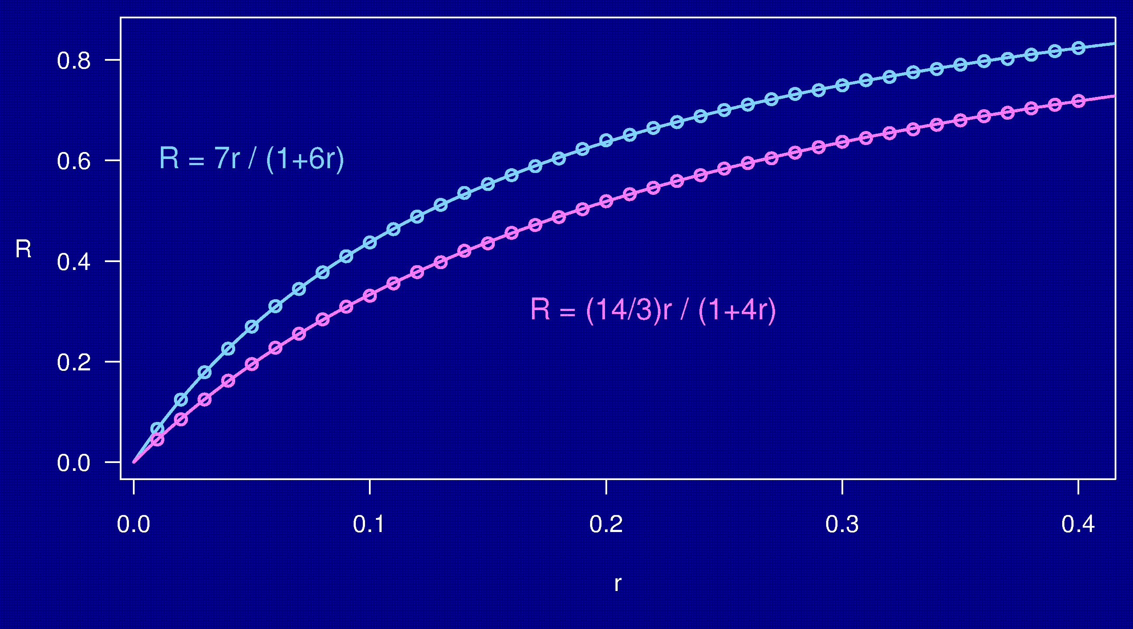
Computer simulations

Slide 26
3-point coincidence
1
2
3
r_{ij} = recombination fraction for interval i,j;
assume r₁₂ = r₂₃ = r
Coincidence = c = Pr(double recombinant) / r²
= Pr(rec’n in 2-3 | rec’n in 1-2) / Pr(rec’n in 2-3)
No interference → = 1
Positive interference → < 1
Negative interference → > 1
Generally c is a function of r.

Slide 27
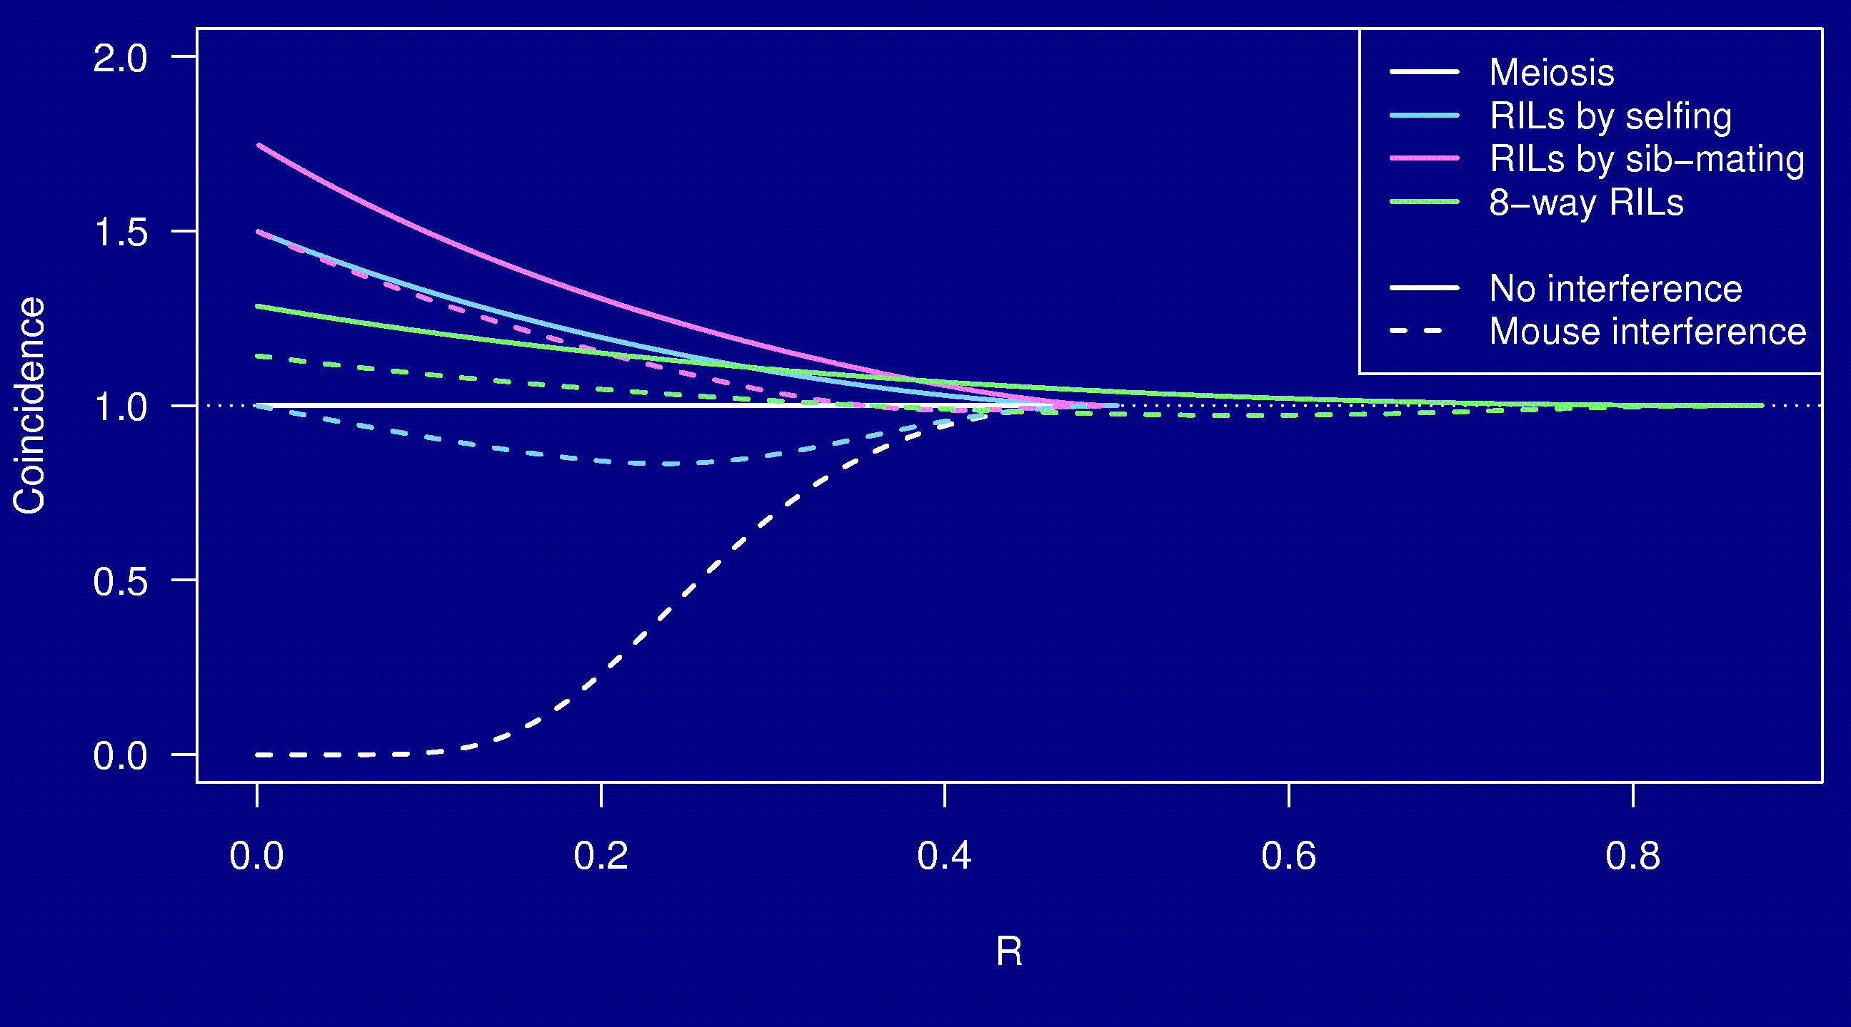
Coincidence on RIL chromosome

Slide 28
Why the clustering of breakpoints?
The really close breakpoints occur in different generations.
Breakpoints in later generations can occur only in regions that are not yet fixed.
The regions of heterozygosity are, of course, surrounded by breakpoints.

Slide 29
Summary
RILs are useful.
The Collaborative Cross could provide “one-stop shopping” for gene mapping in the mouse.
Use of such 8-way RILs requires an understanding of the breakpoint process.
We’ve extended Haldane & Waddington’s results to the case of 8-way RILs: R = 7 r / (1 + 6 r).
We’ve shown clustering of breakpoints in RILs by sib-mating, even in the presence of strong crossover interference.
Paper: Broman KW. The genomes of recombinant inbred lines. Genetics, in press

