Slide 1
What is regression?

Slide 2



Slide 3



Slide 4
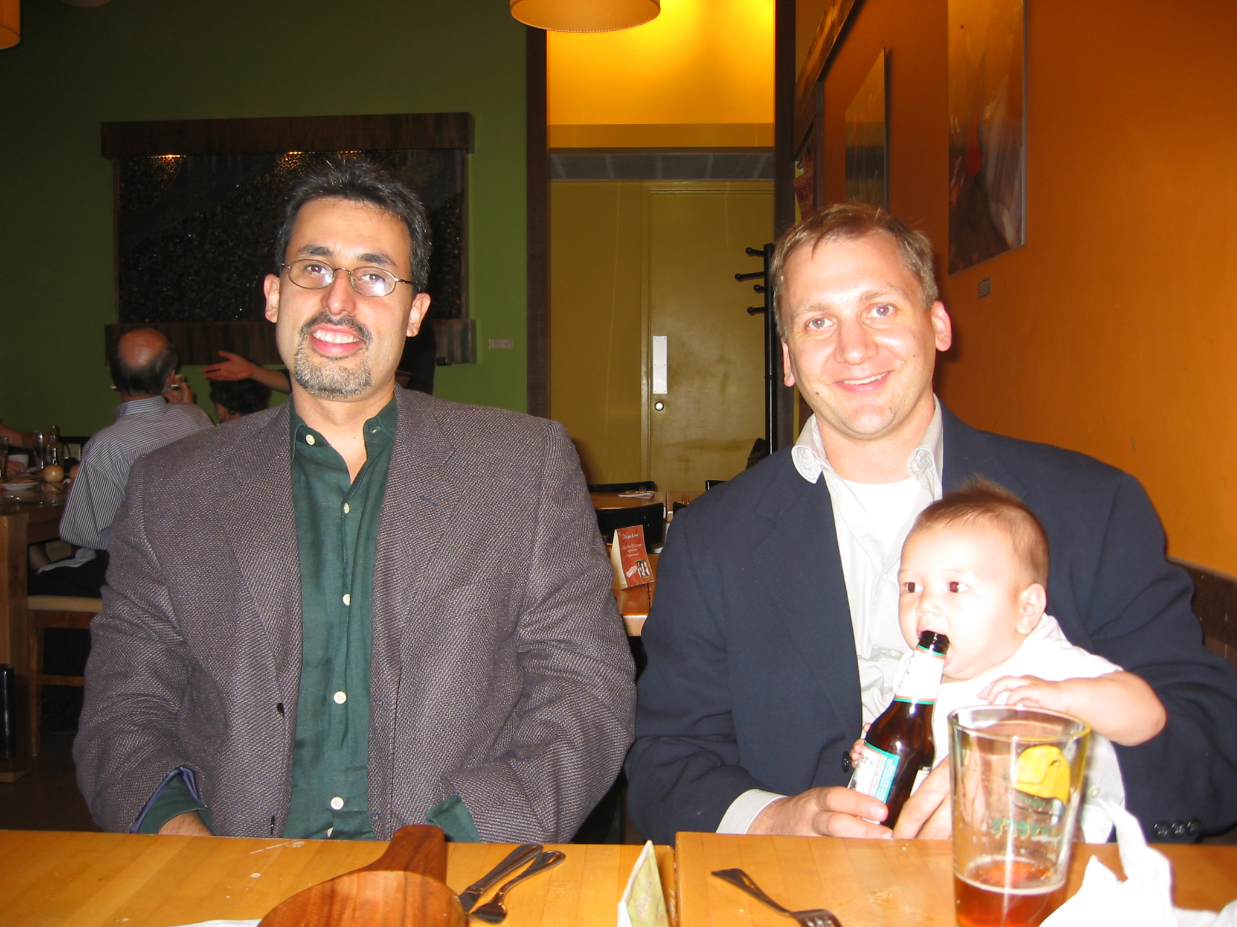

Slide 5


Slide 6


Slide 7
How tall will Caleb be?

Slide 8
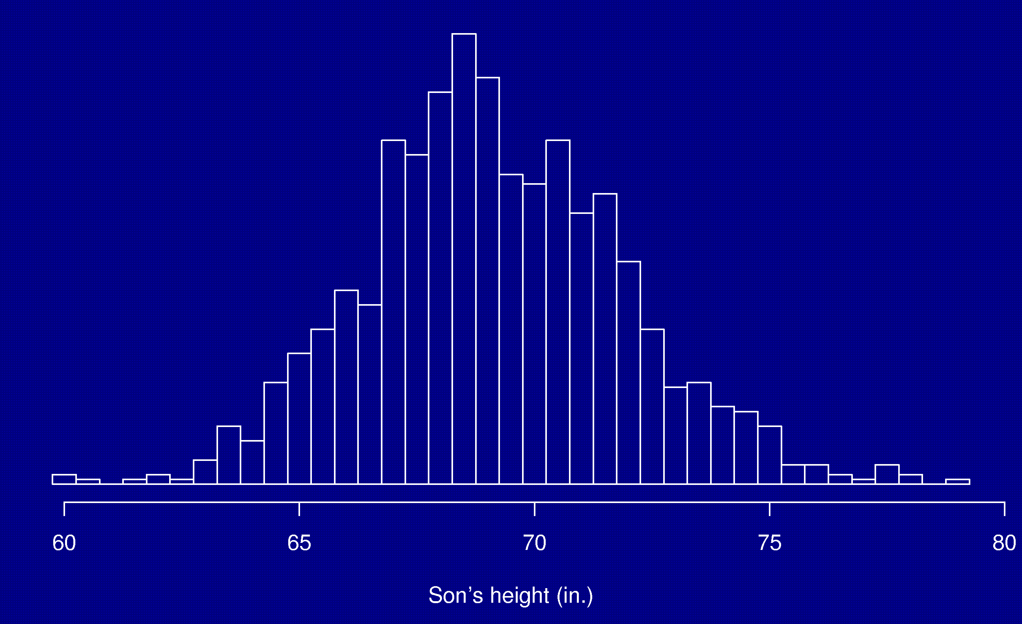
Heights of sons
Pearson & Lee, Biometrika 2:357-462, 1906
average = 69.2 in.

Slide 9
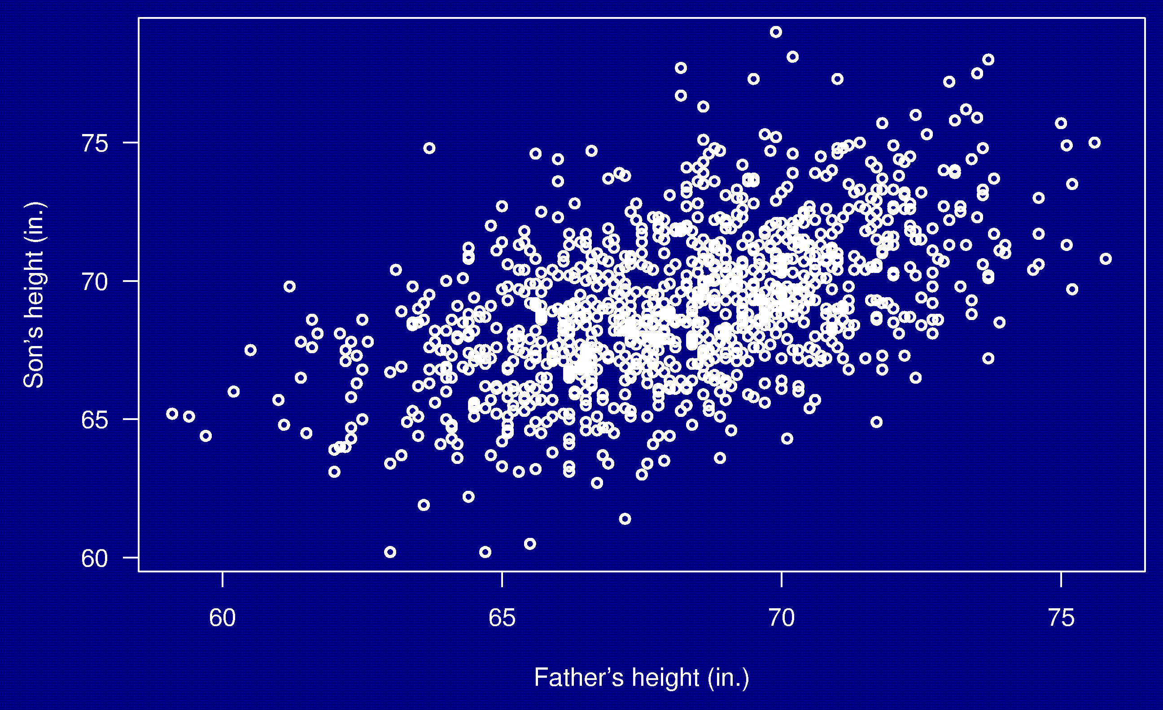
Heights of fathers and sons

Slide 10
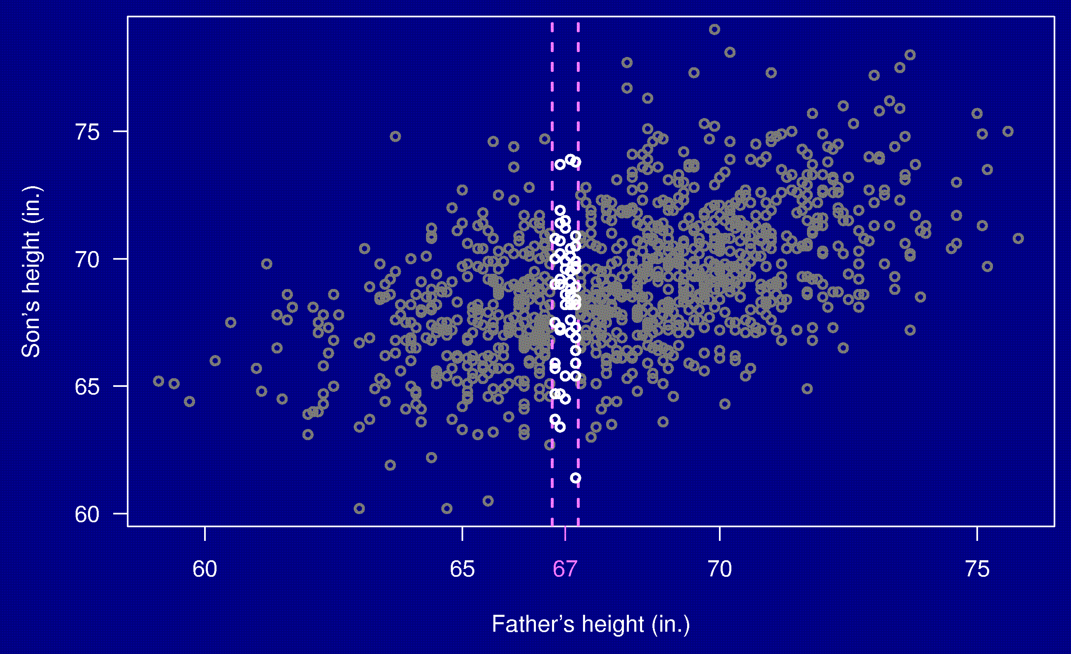
Heights of fathers and sons

Slide 11

Heights of fathers and sons
average = 68.4 in.

Slide 12

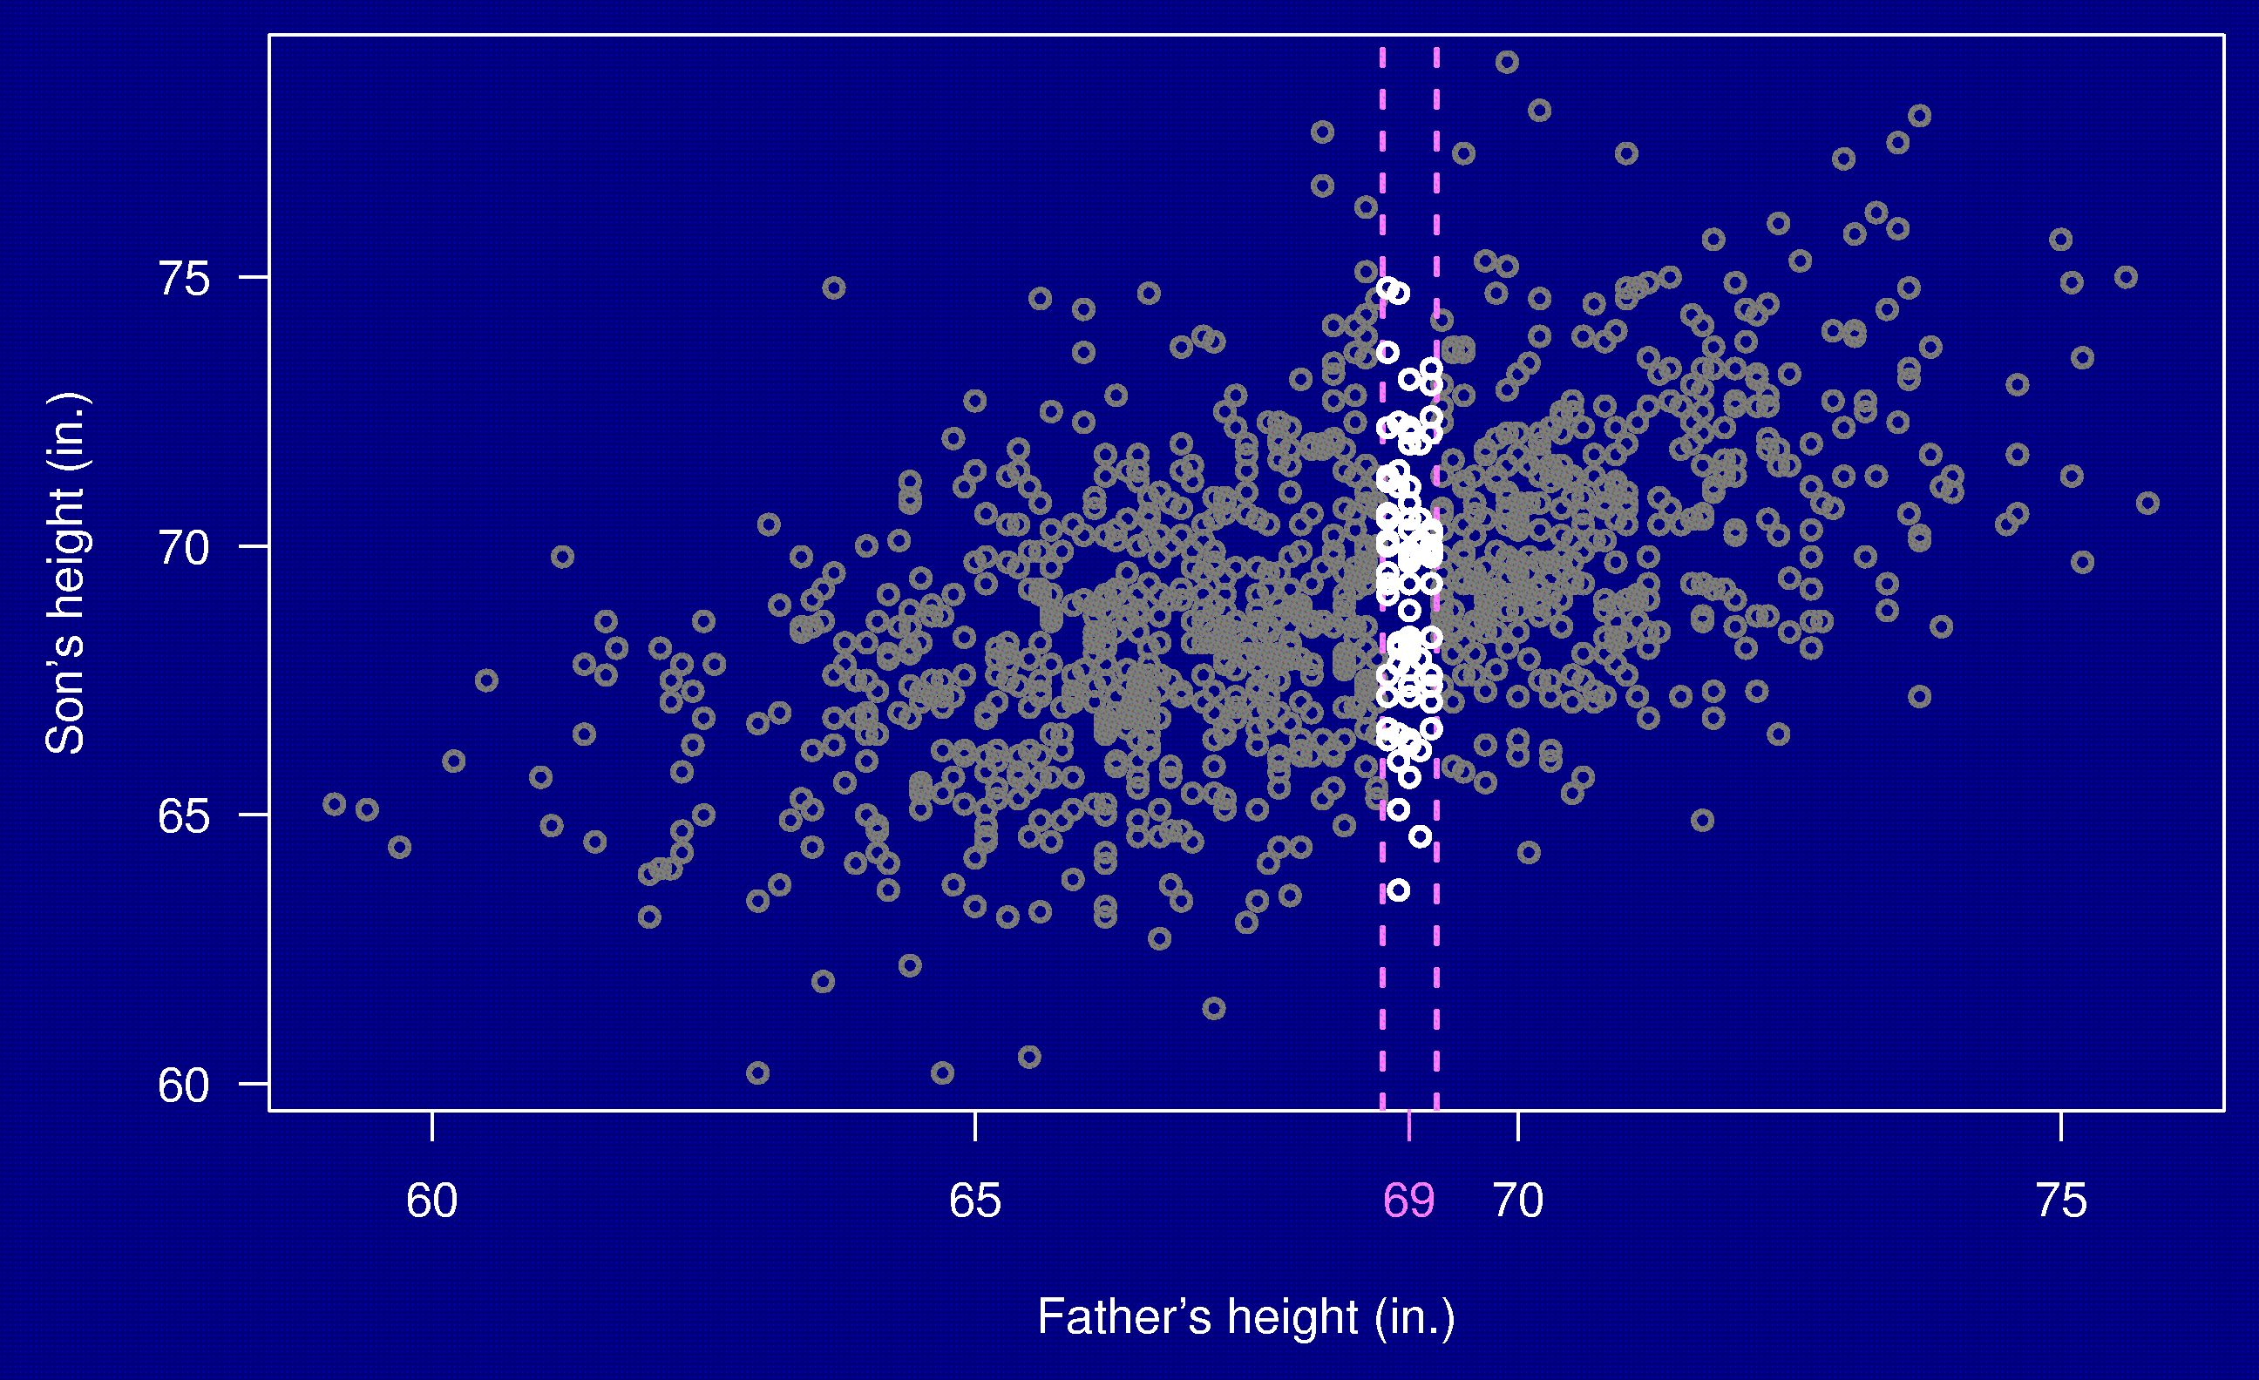
Heights of fathers and sons

Slide 13

Heights of fathers and sons
average = 69.5 in.

Slide 14
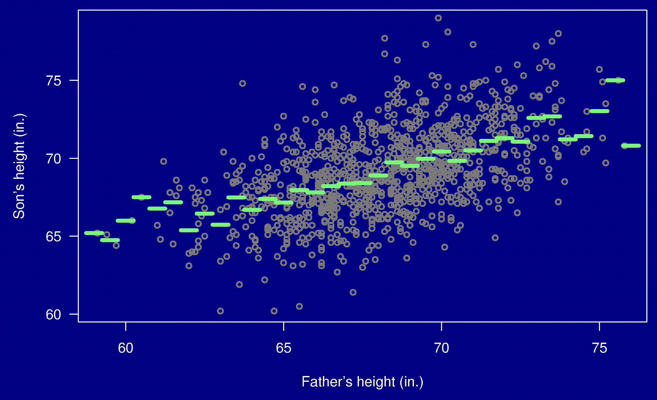
Heights of fathers and sons

Slide 15
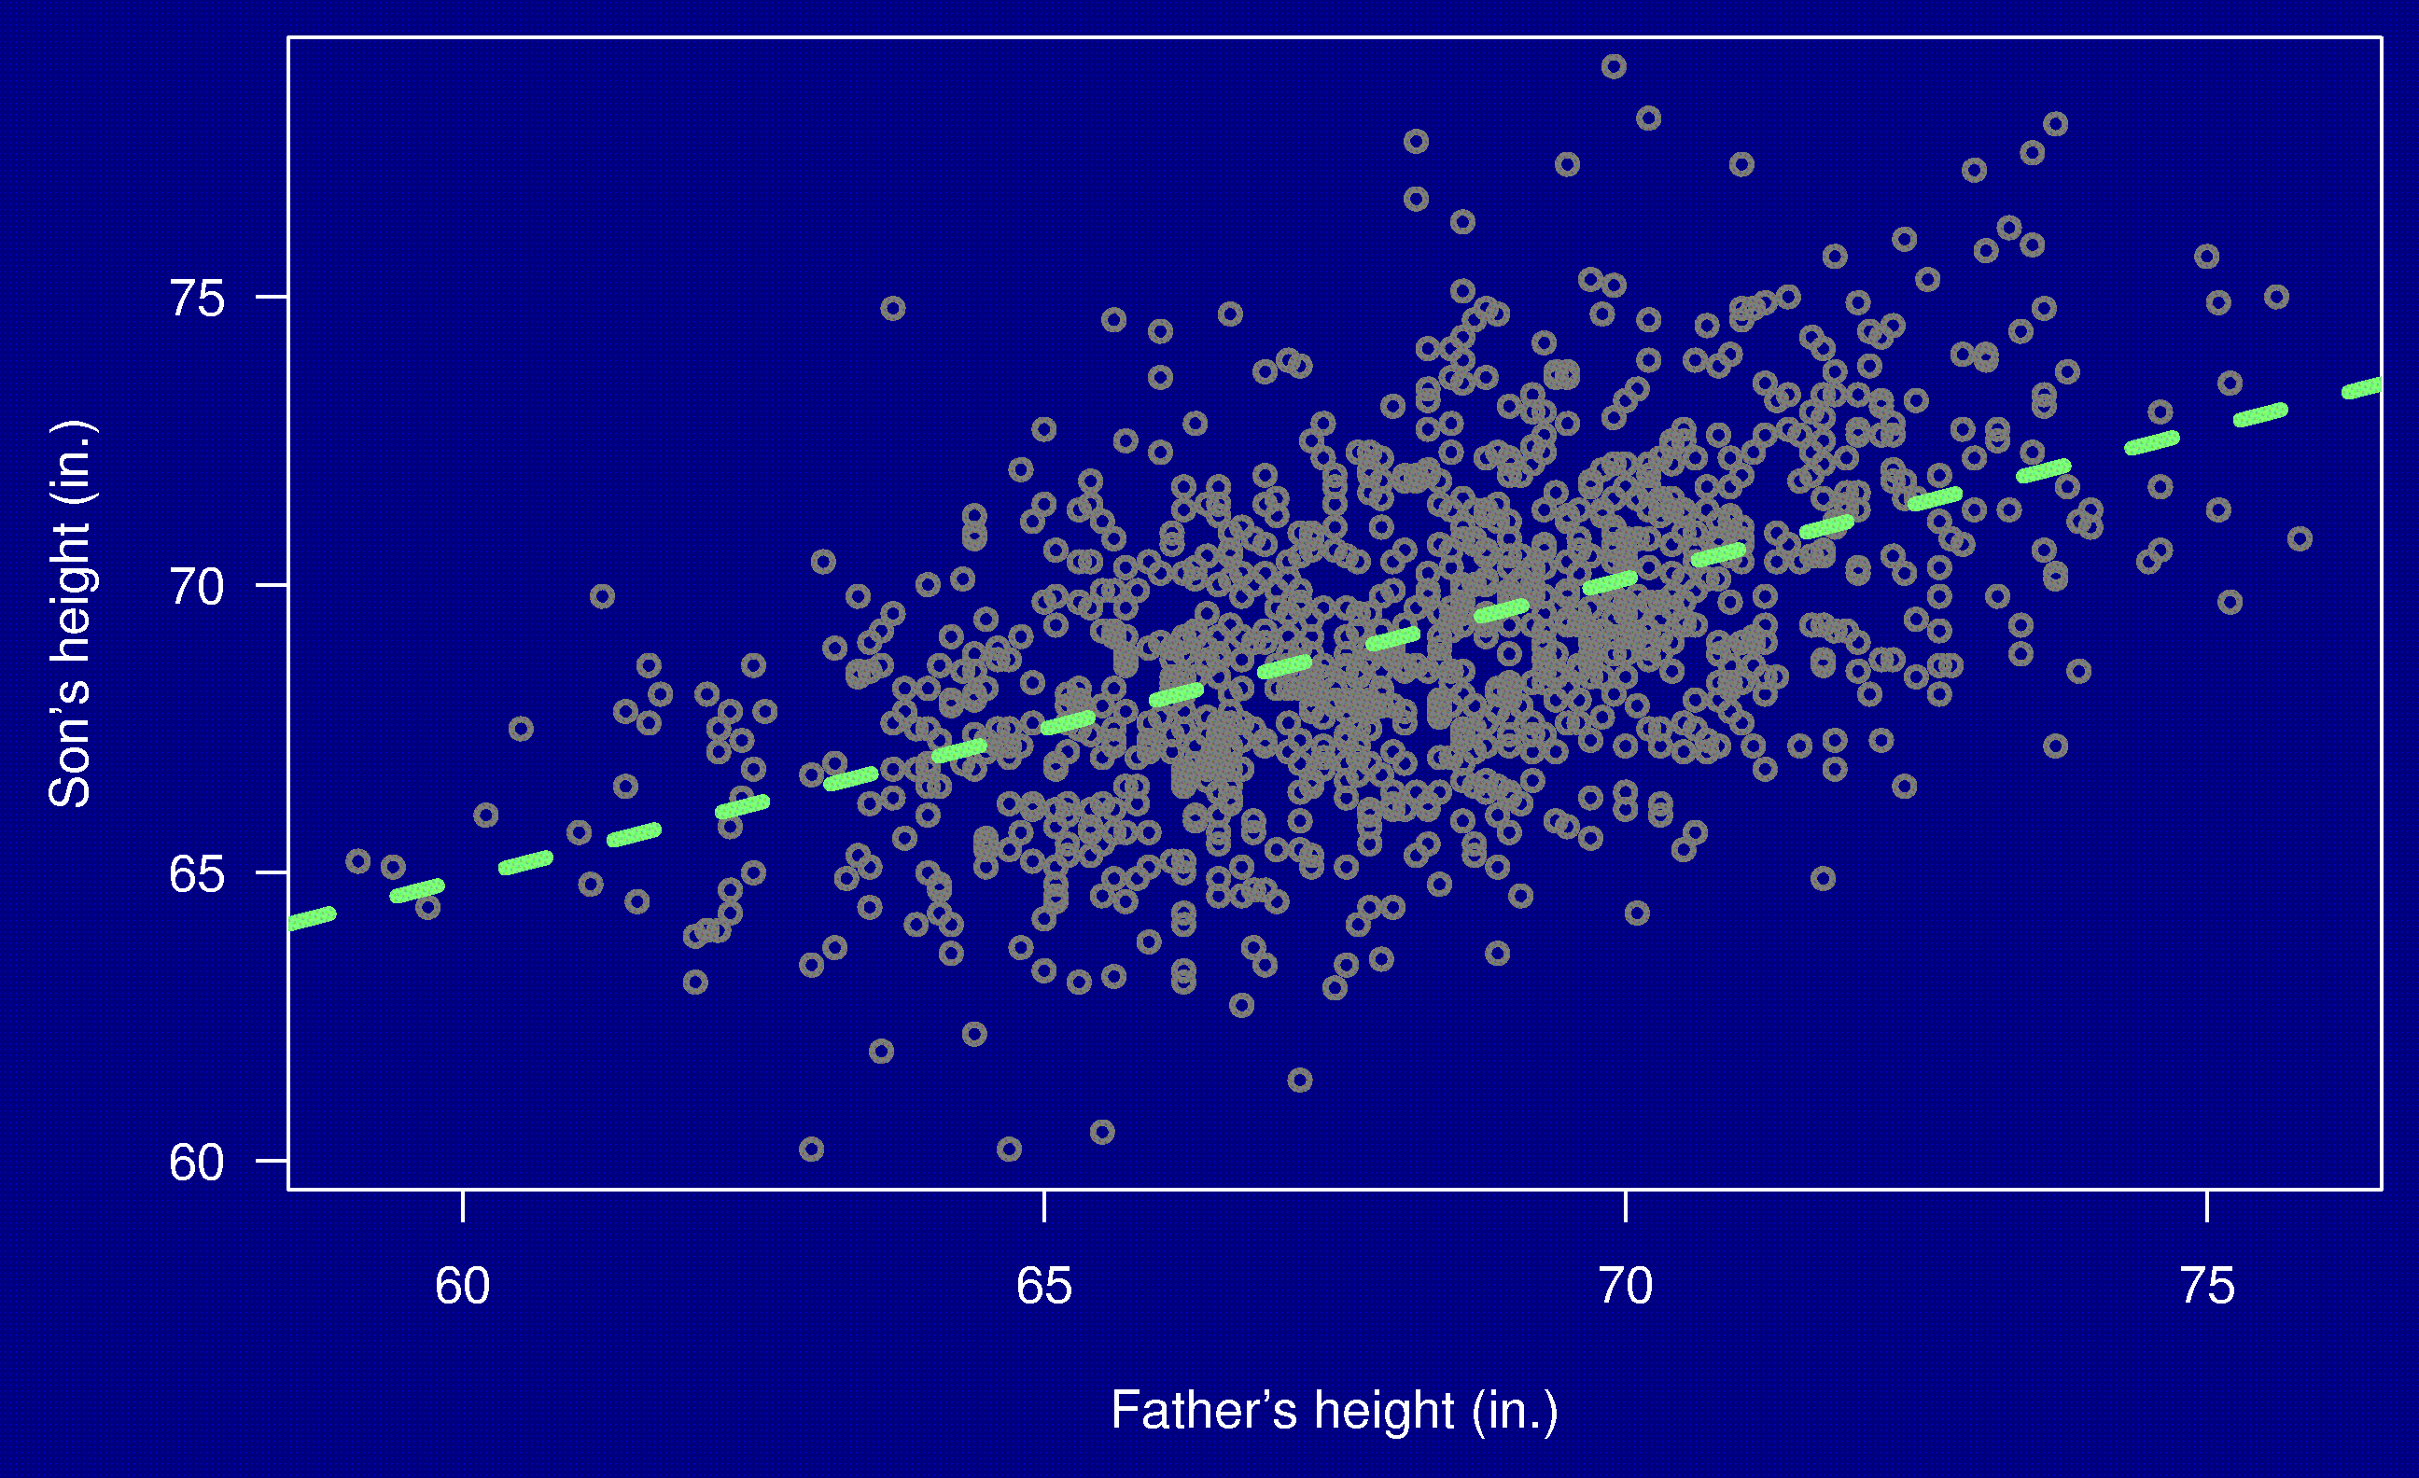
Heights of fathers and sons

Slide 16
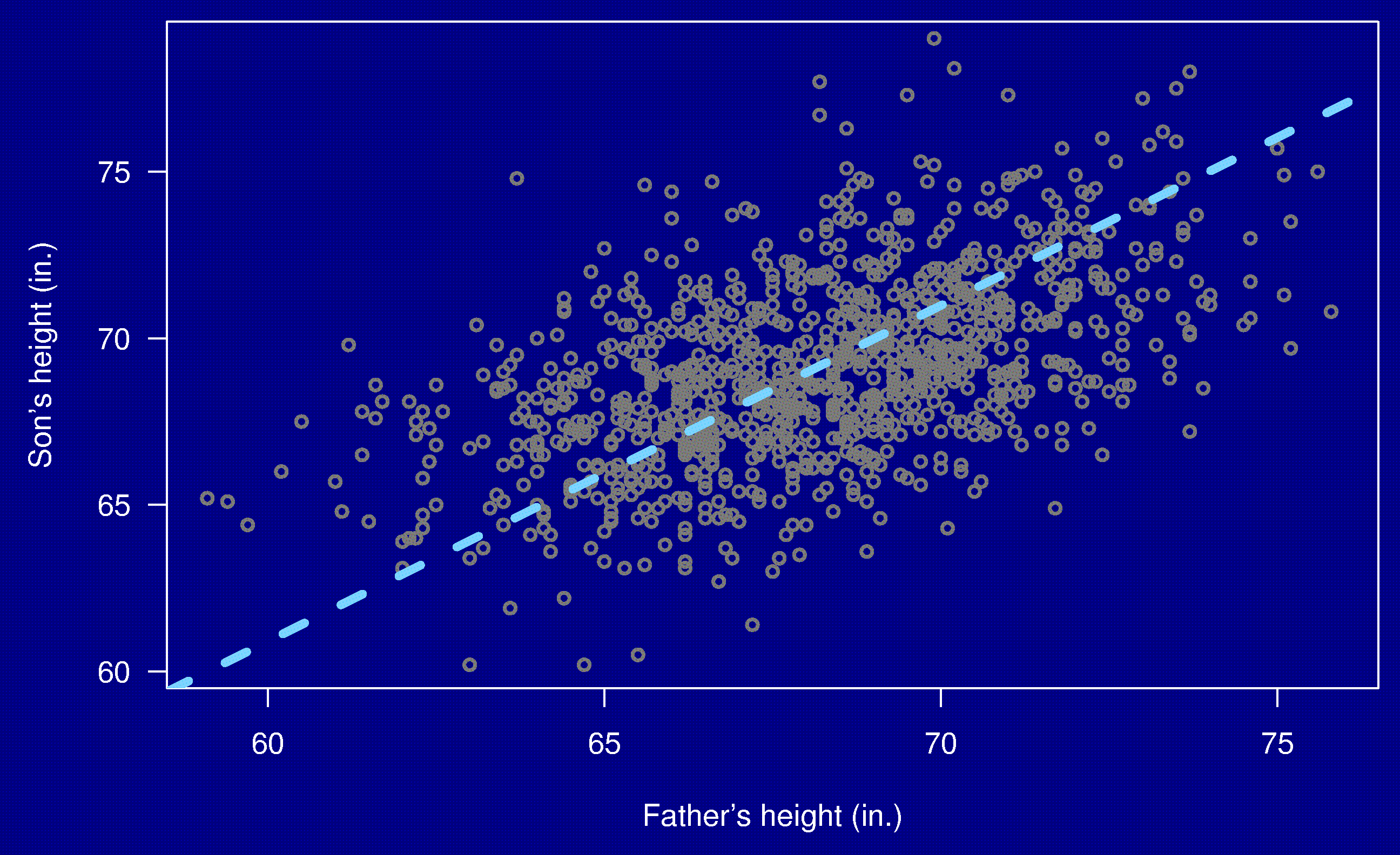
Heights of fathers and sons

Slide 17

Heights of fathers and sons

Slide 18

Heights of fathers and sons

Slide 19
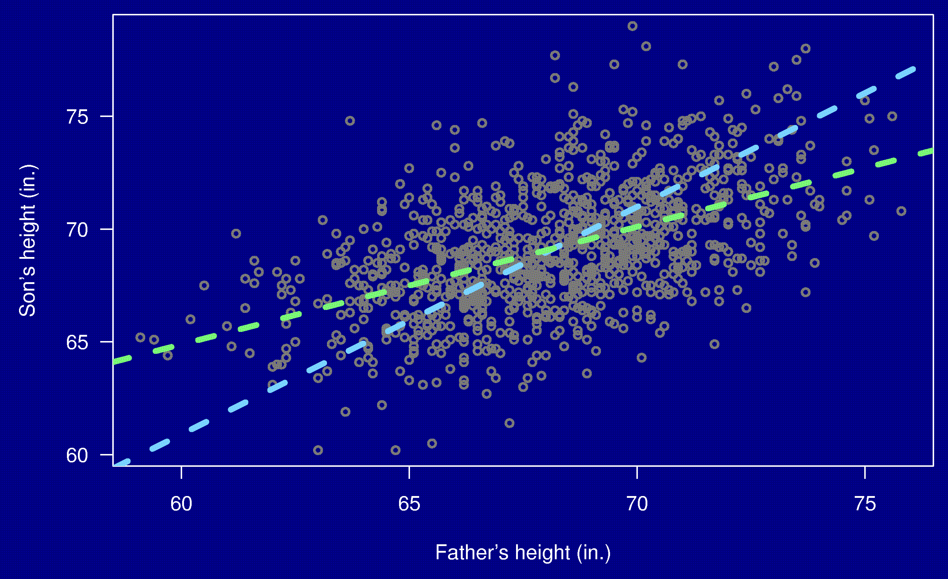
Heights of fathers and sons

Slide 20

Heights of fathers and sons

Slide 21
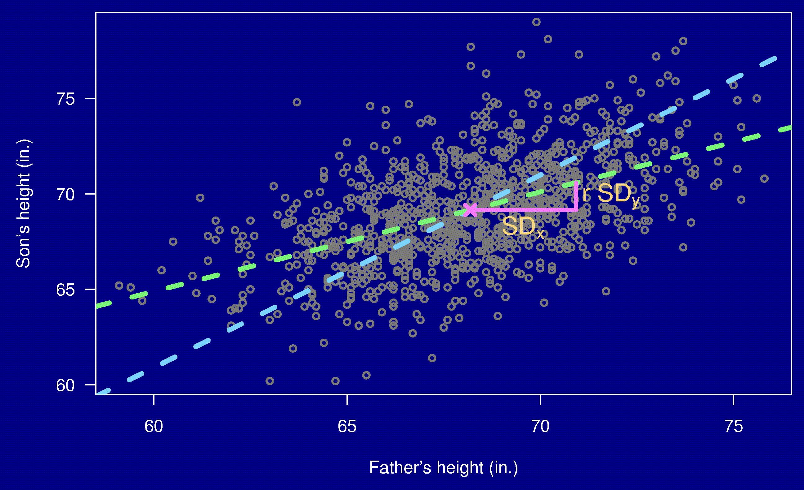
Heights of fathers and sons

Slide 22
Heights of fathers and sons

Slide 23
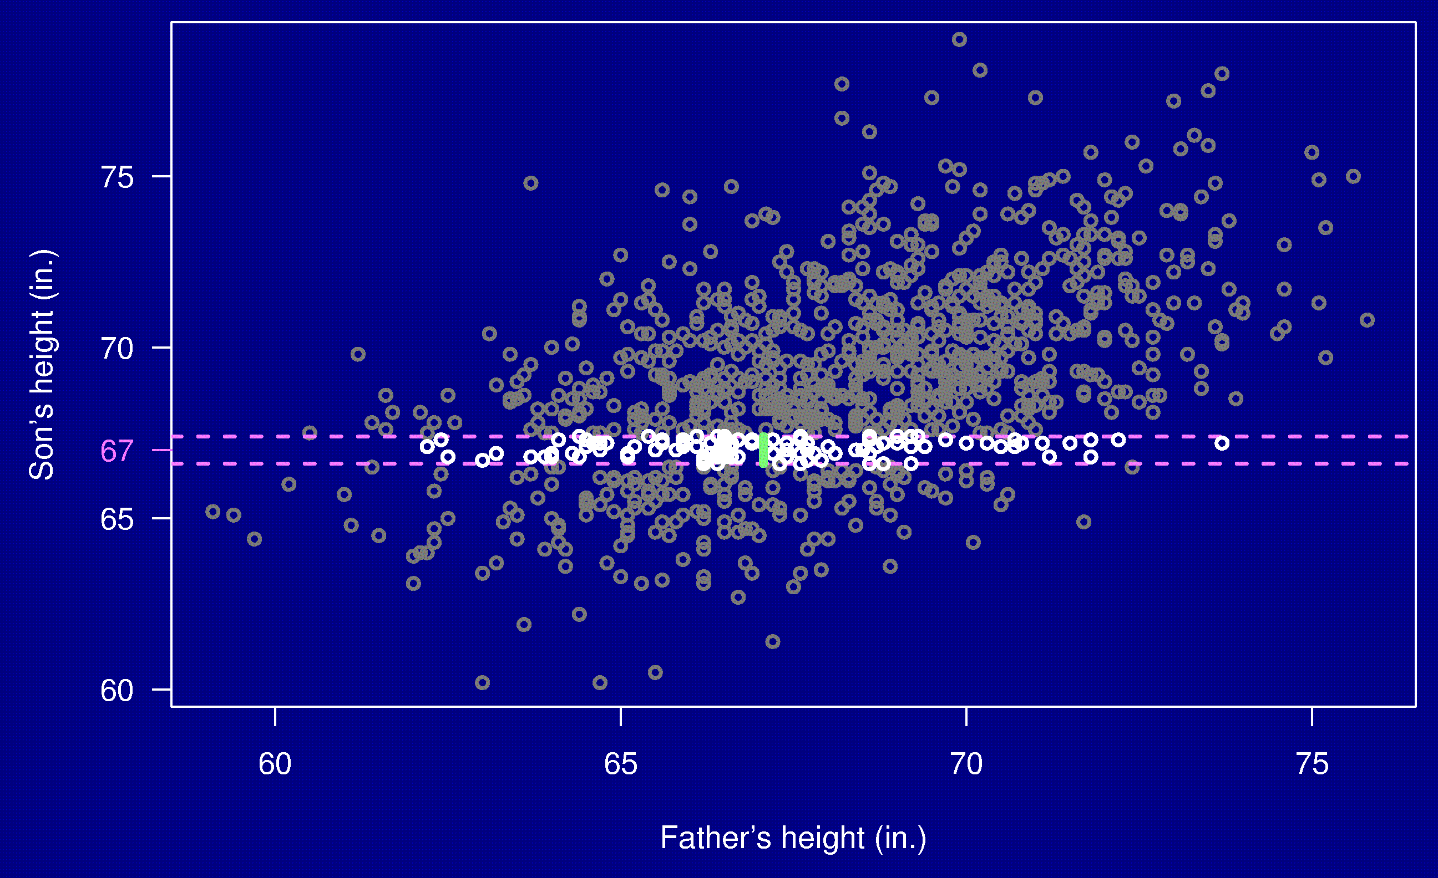
Heights of fathers and sons

Slide 24
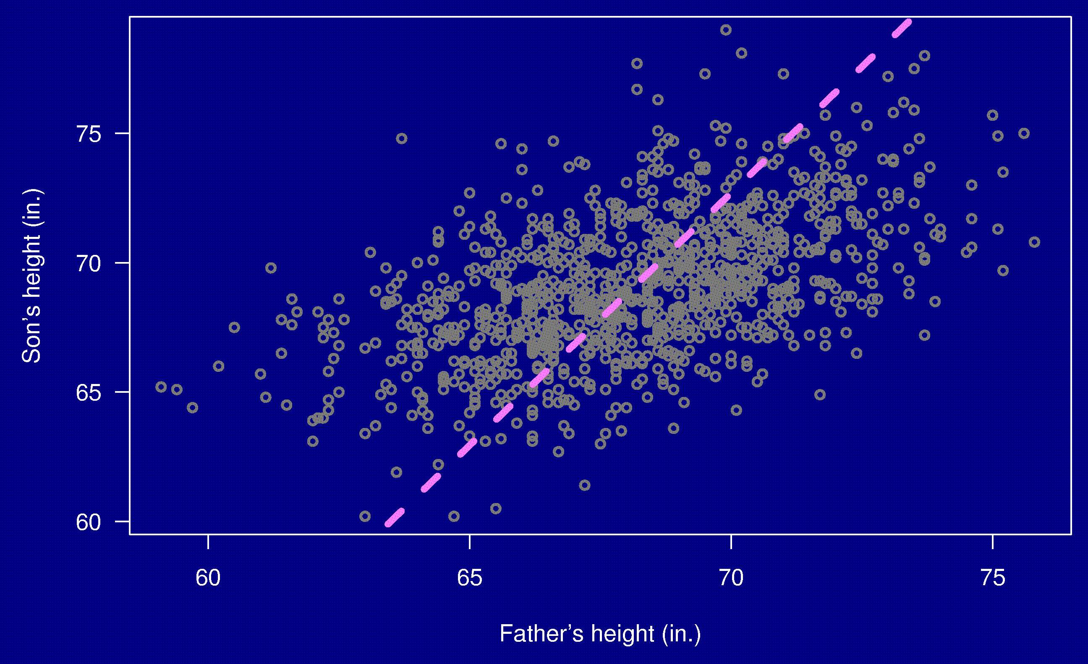
Heights of fathers and sons

Slide 25

Heights of fathers and sons

Slide 26
Summary
Regression concerns predicting Y from X.
There are two regression lines.
The regression effect:
  Tall fathers, on average, have sons who are not so tall.
  Short fathers, on ave., have sons who are not so short.
The regression fallacy: assigning some deeper (causal) meaning to the regression effect.

