Slide 1
The genomes of recombinant inbred lines

Slide 2
Inbred mice

Slide 3
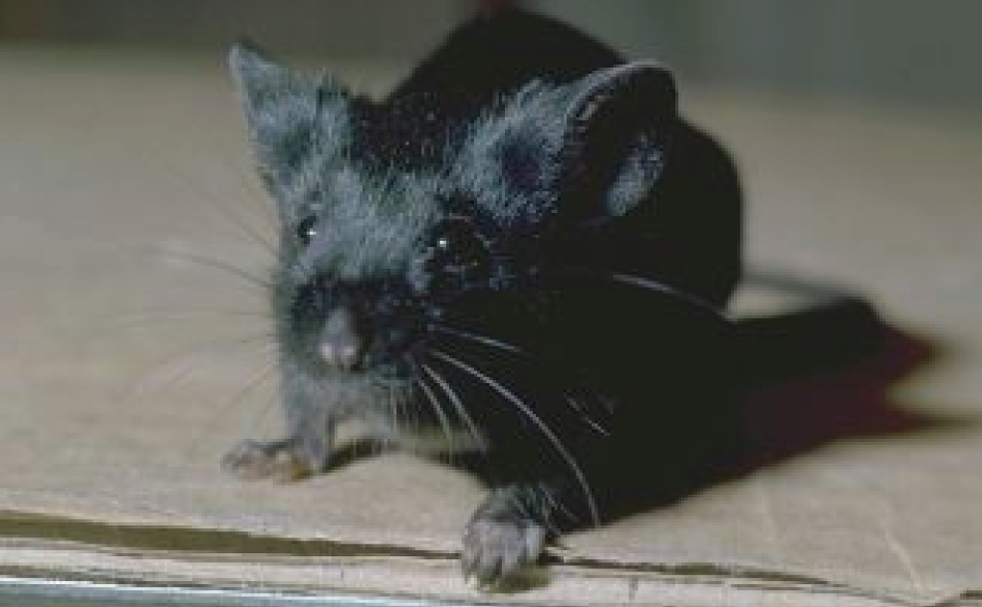
C57BL/6

Slide 4
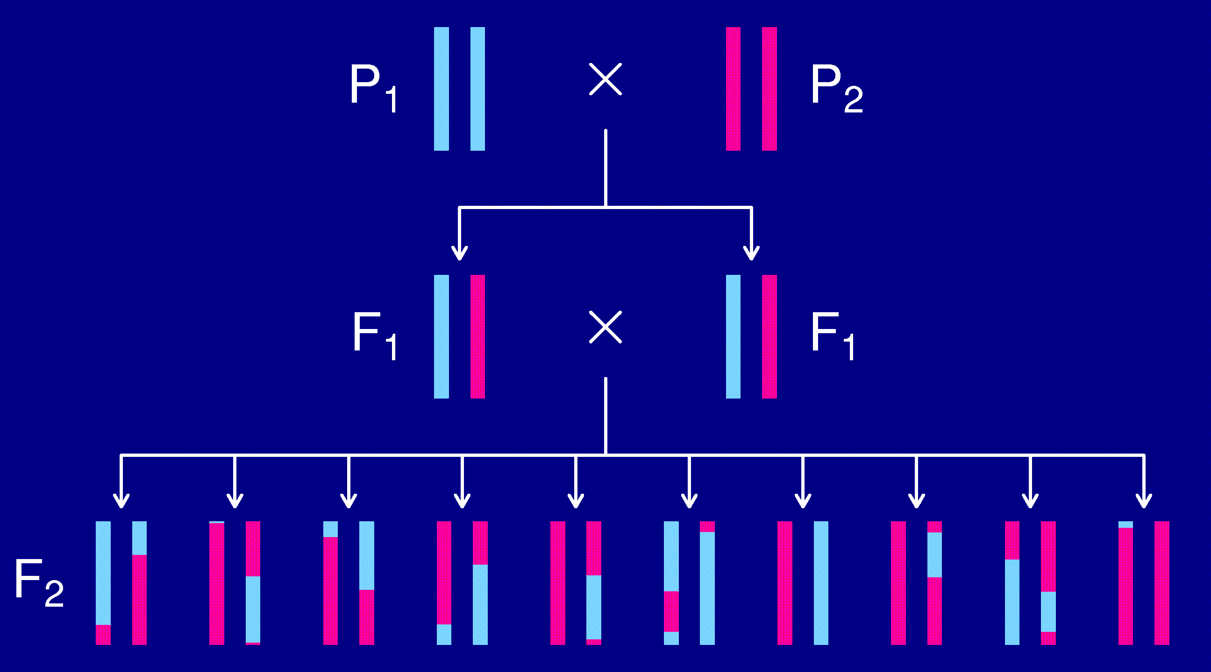
The intercross

Slide 5
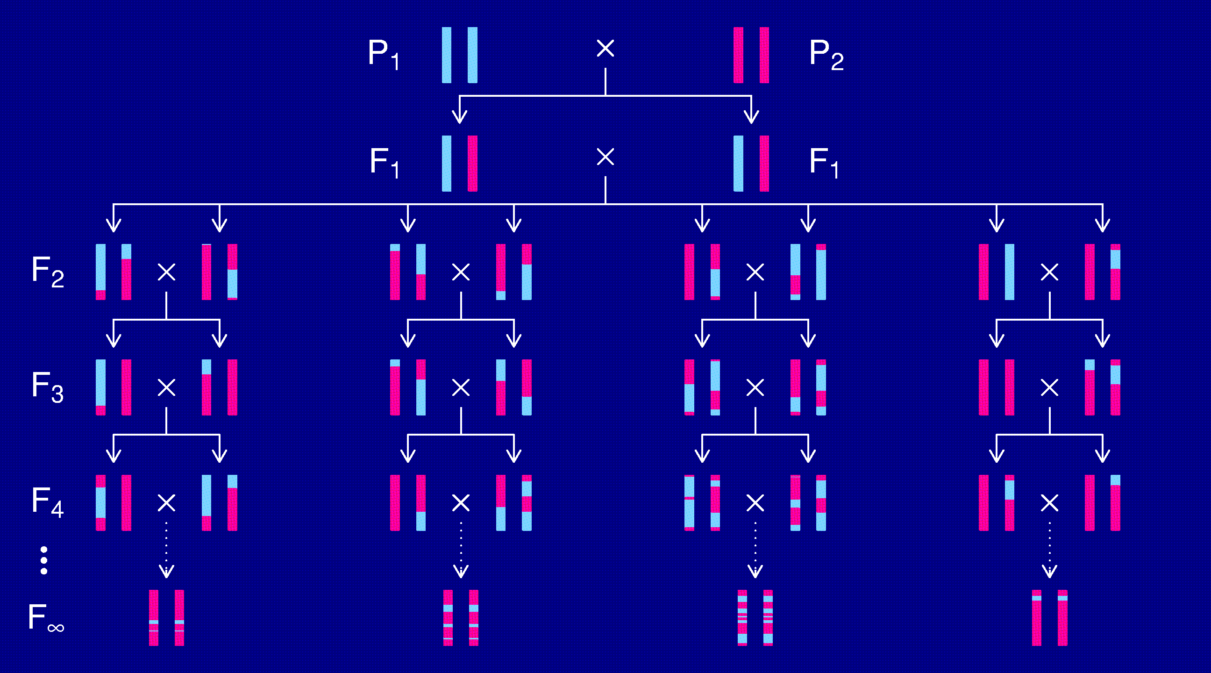
Recombinant inbred lines
(by sibling mating)

Slide 6
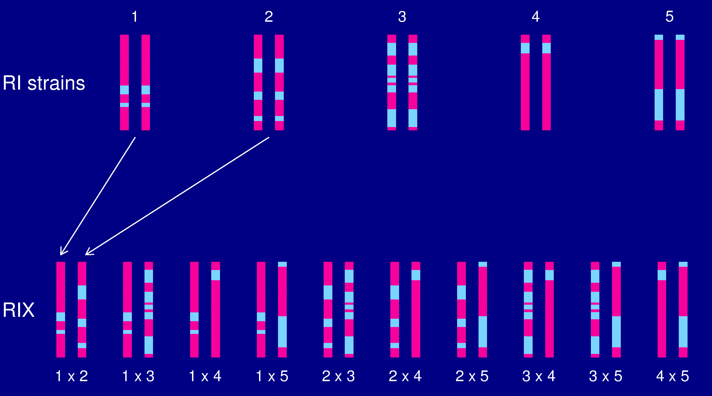
The RIX design

Slide 7
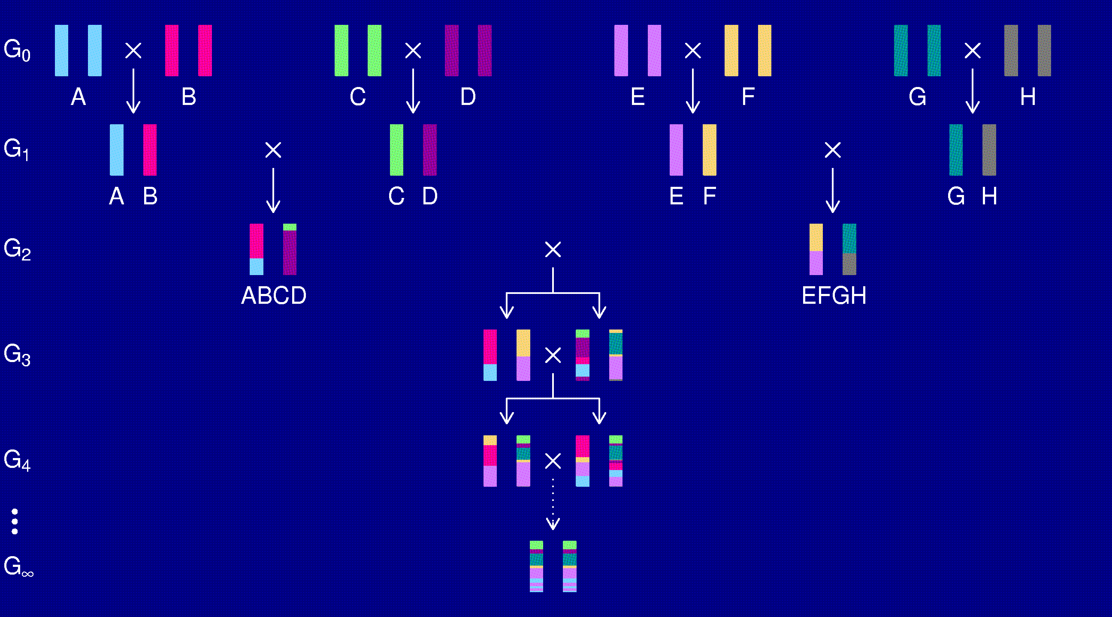
The Collaborative Cross
Complex Trait Consortium (2004) Nat Genet 36:1133-1137

Slide 8
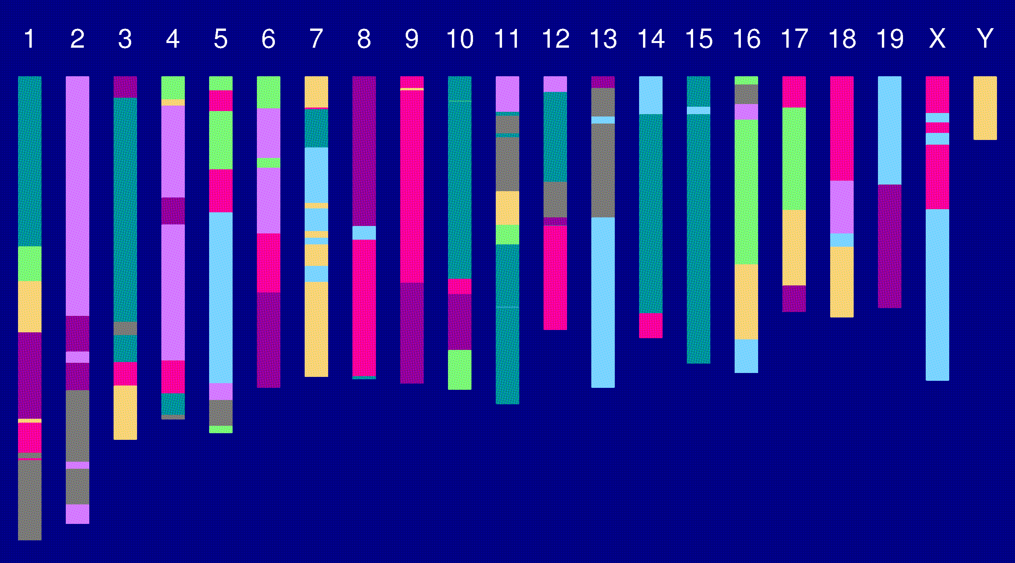
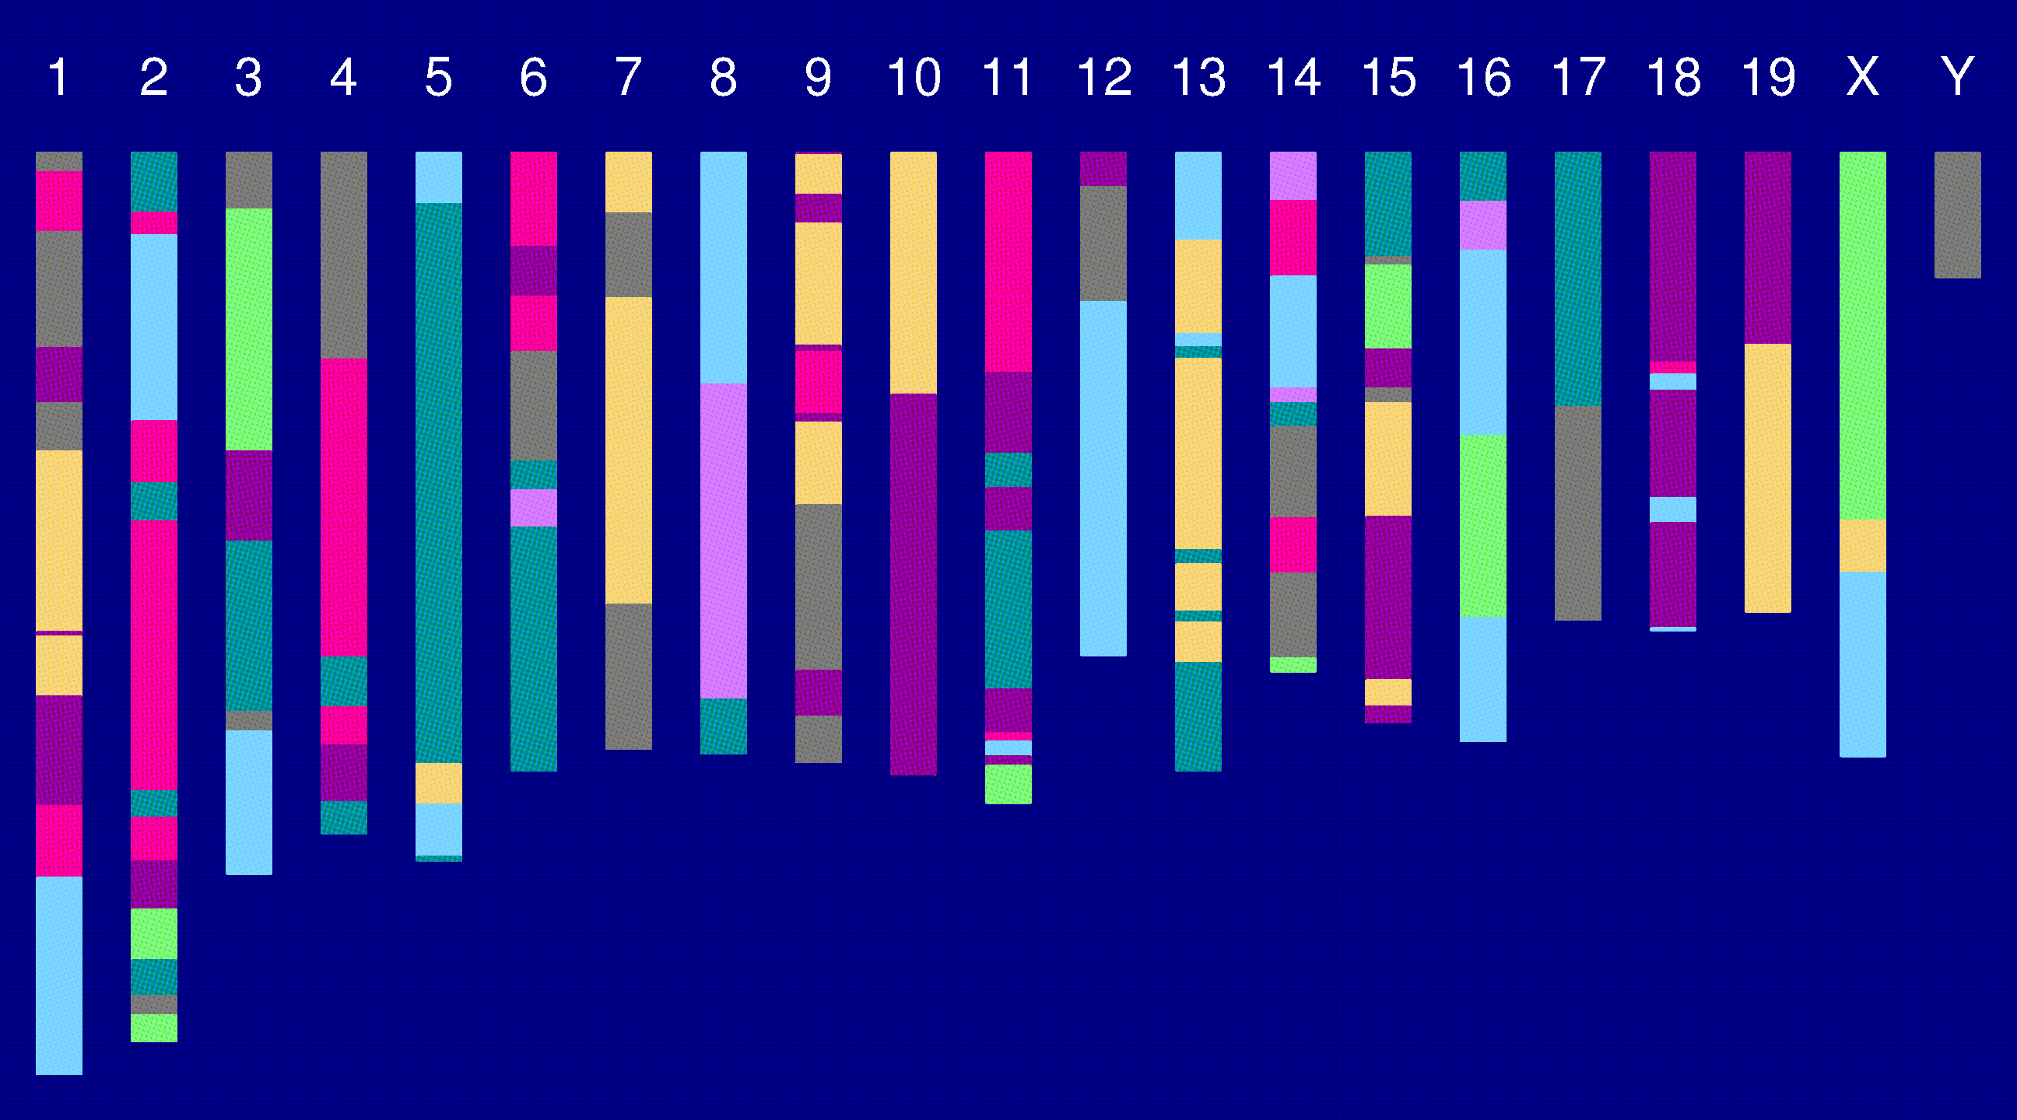
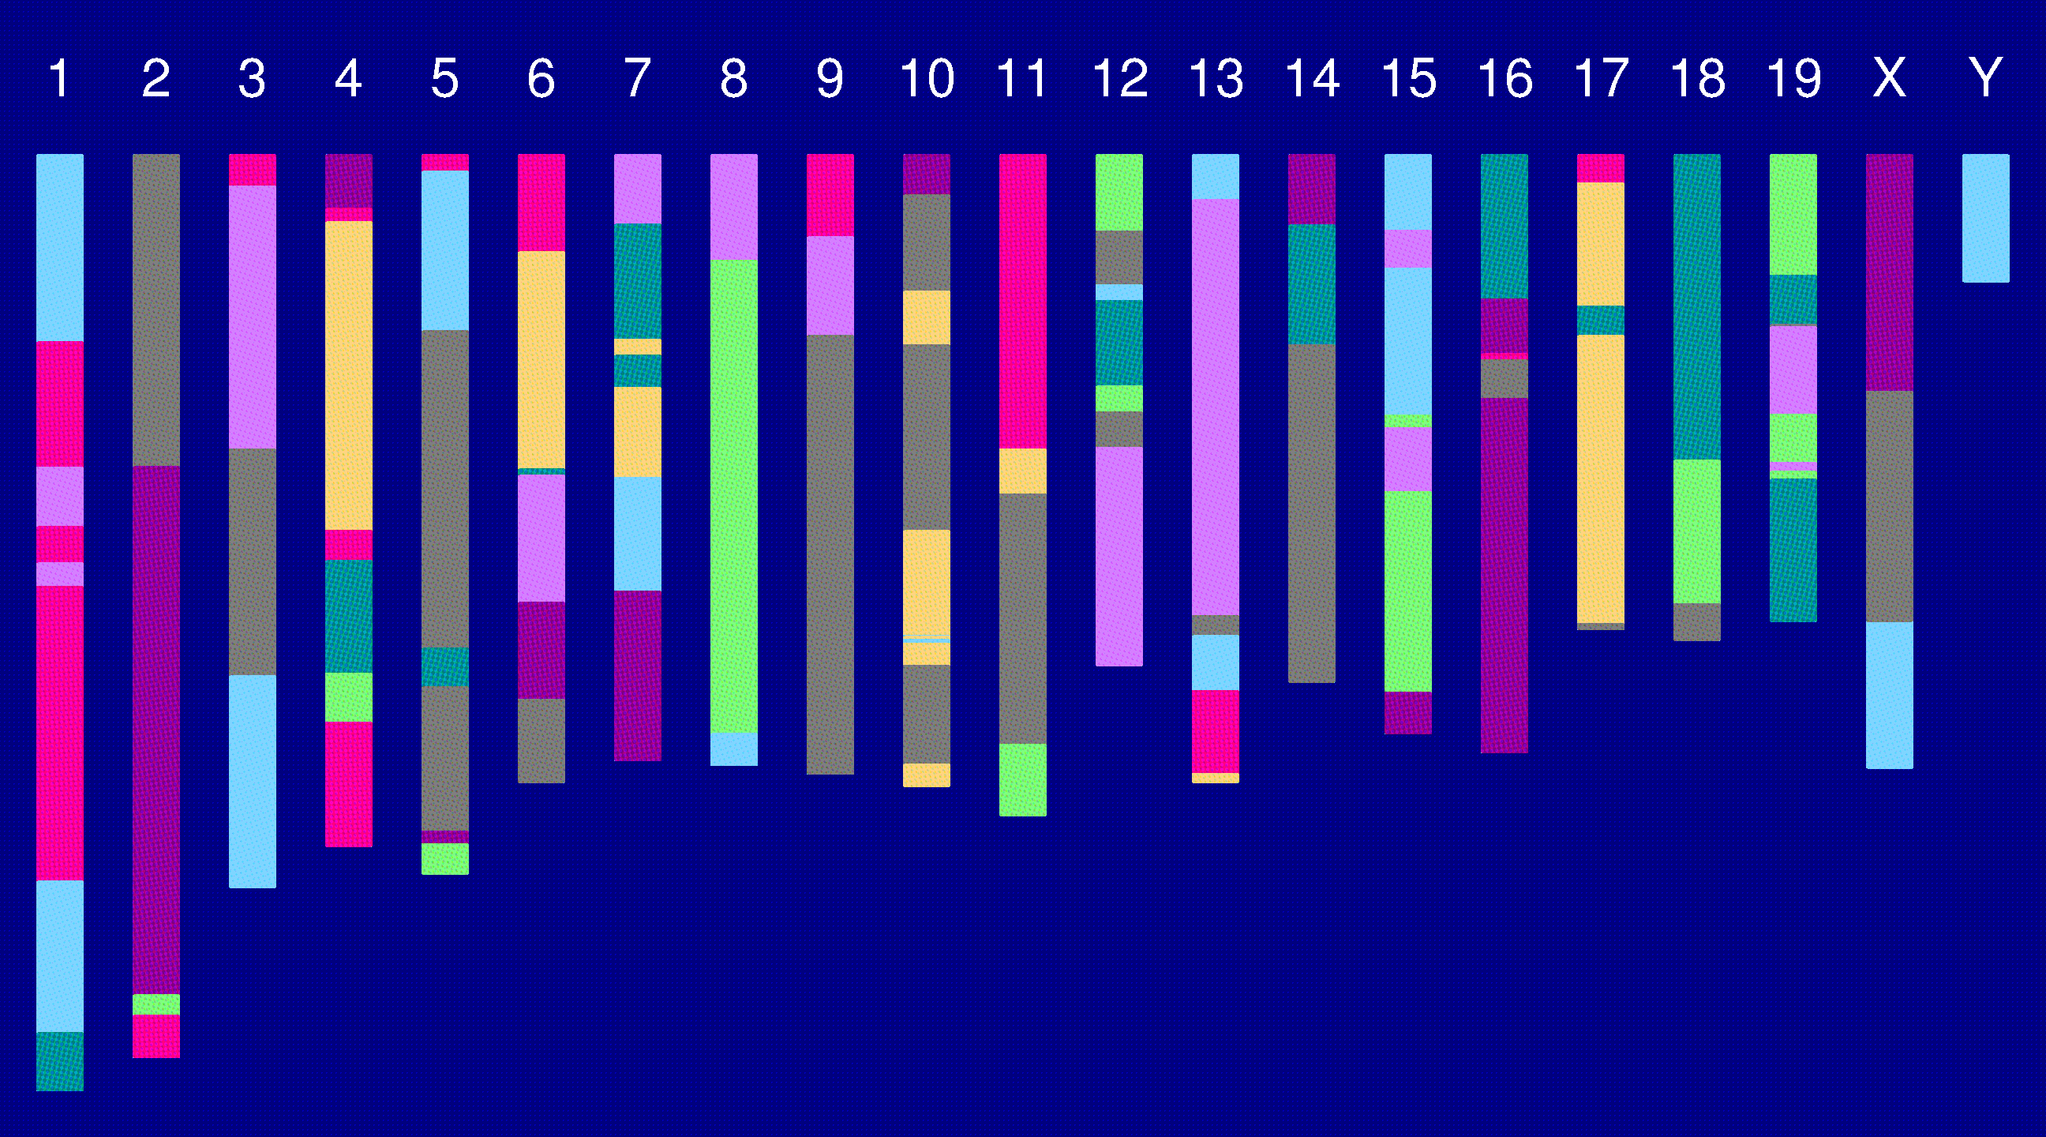
Genome of an 8-way RI

Slide 9
The Collaborative Cross
Complex Trait Consortium (2004) Nat Genet 36:1133-1137

Slide 10
The goal
(for the rest of this talk)
Characterize the breakpoint process along a chromosome in 8-way RILs.
  Understand the two-point haplotype probabilities.
  Study the clustering of the breakpoints, as a function of crossover interference in meiosis.

Slide 11
2 points in an RIL
1
2
r = recombination fraction = probability of a recombination in the interval in a random meiotic product.
R = analogous thing for the RIL = probability of different alleles at the two loci on a random RIL chromosome.

Slide 12
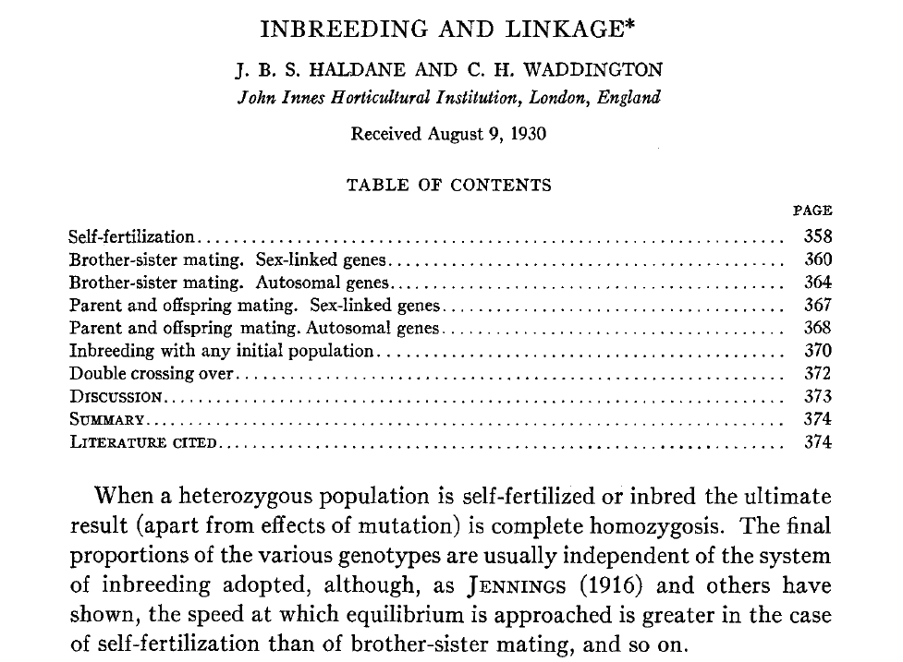
Haldane & Waddington 1931
Genetics 16:357-374

Slide 13
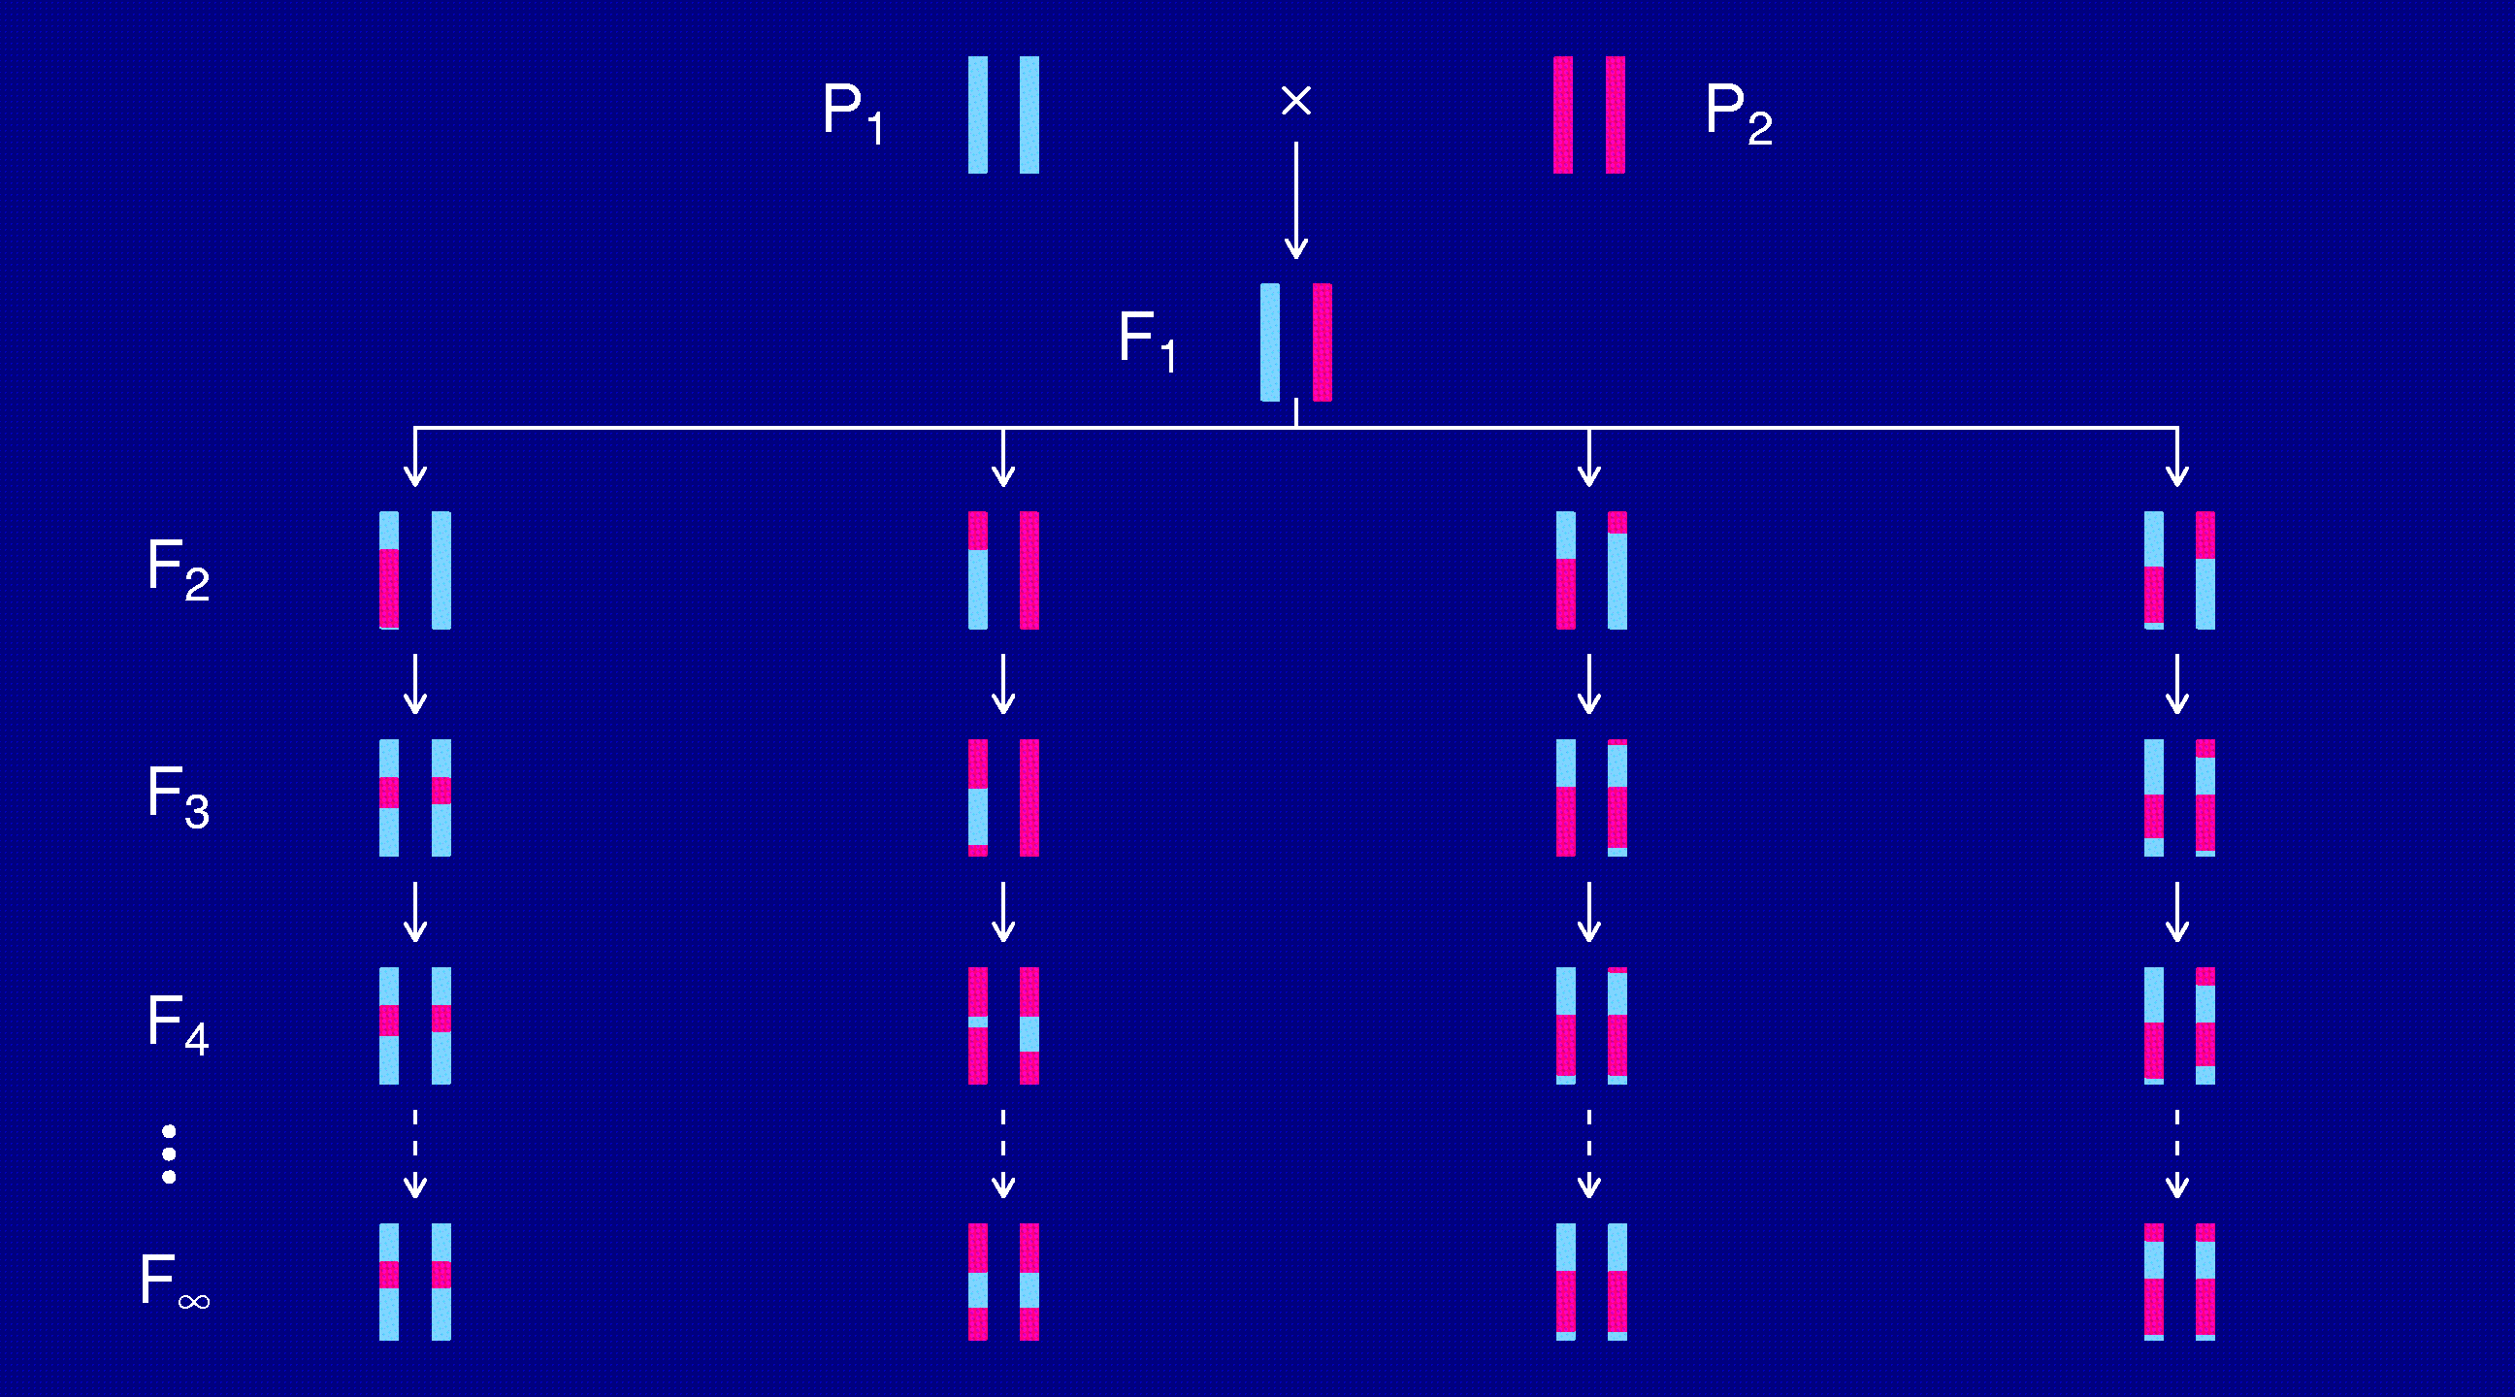
Recombinant inbred lines
(by selfing)

Slide 14
Markov chain
Sequence of random variables {X₀, X₁, X₂, …} satisfying
Pr(X_{n+1} | X₀, X₁, …, X_{n}) = Pr(X_{n+1} | X_{n})
Transition probabilities P_{ij} = Pr(X_{n+1}=j | X_{n}=i)
Here, X_{n} = “parental type” at generation n
We are interested in absorption probabilities
Pr(X_{n} → j | X₀)

Slide 15
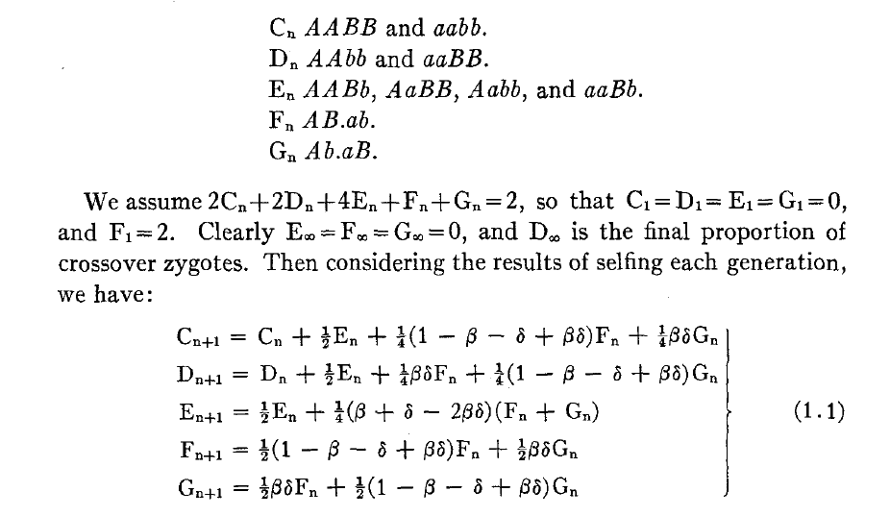
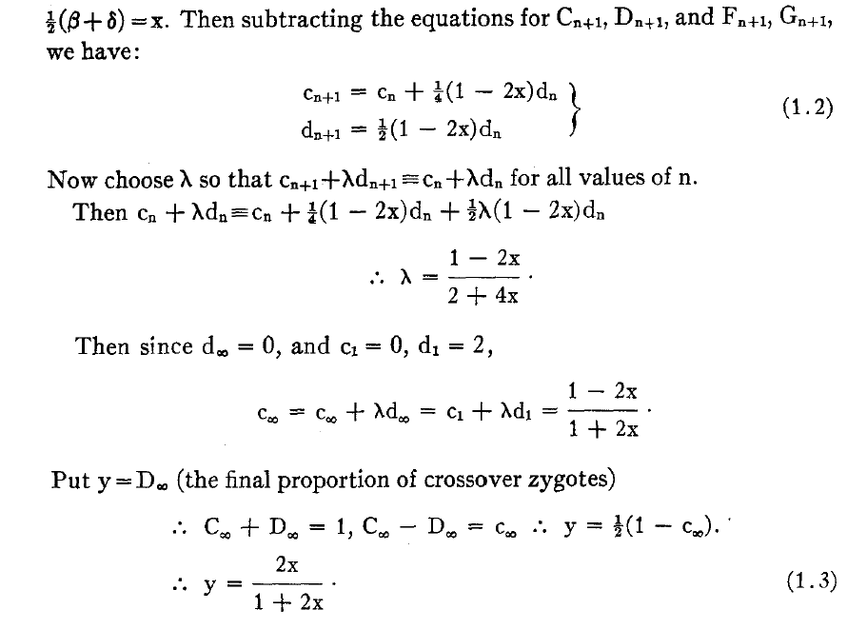
Equations for selfing

Slide 16
Absorption probabilities
Let P_{ij} = Pr(X_{n+1} = j | X_{n} = i) where X_{n} = state at generation n.
Consider the case of absorption into the state AA|AA.
Let h_{i} = probability, starting at i, eventually absorbed into AA|AA.
Then h_{AA|AA} = 1 and h_{AB|AB} = 0.
Condition on the first step: h_{i} = ∑_{k} P_{ik} h_{k}
For selfing, this gives a system of 3 linear equations.

Slide 17
Recombinant inbred lines
(by sibling mating)

Slide 18
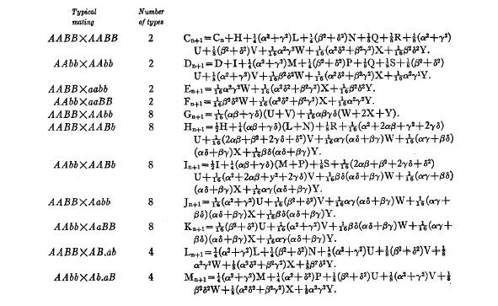
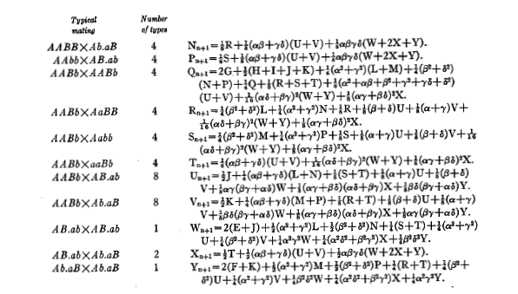
Equations for sib-mating

Slide 19
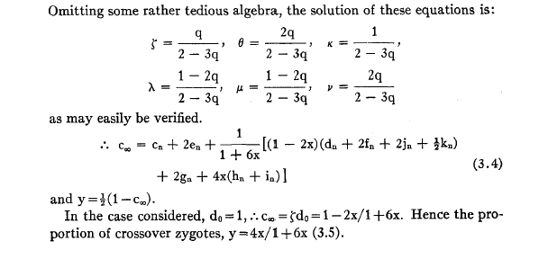
Result for sib-mating

Slide 20
The “Collaborative Cross”

Slide 21
8-way RILs
Autosomes
  Pr(G₁ = i) = 1/8
  Pr(G₂ = j | G₁ = i) = r / (1+6r) for i ≠ j
  Pr(G₂ ≠ G₁) = 7r / (1+6r)
X chromosome
  Pr(G₁=A) = Pr(G₁=B) = Pr(G₁=E) = Pr(G₁=F) =1/6
  Pr(G₁=C) = 1/3
  Pr(G₂=B | G₁=A) = r / (1+4r)
  Pr(G₂=C | G₁=A) = 2r / (1+4r)
  Pr(G₂=A | G₁=C) = r / (1+4r)
  Pr(G₂ ≠ G₁) = (14/3) r / (1+4r)

Slide 22
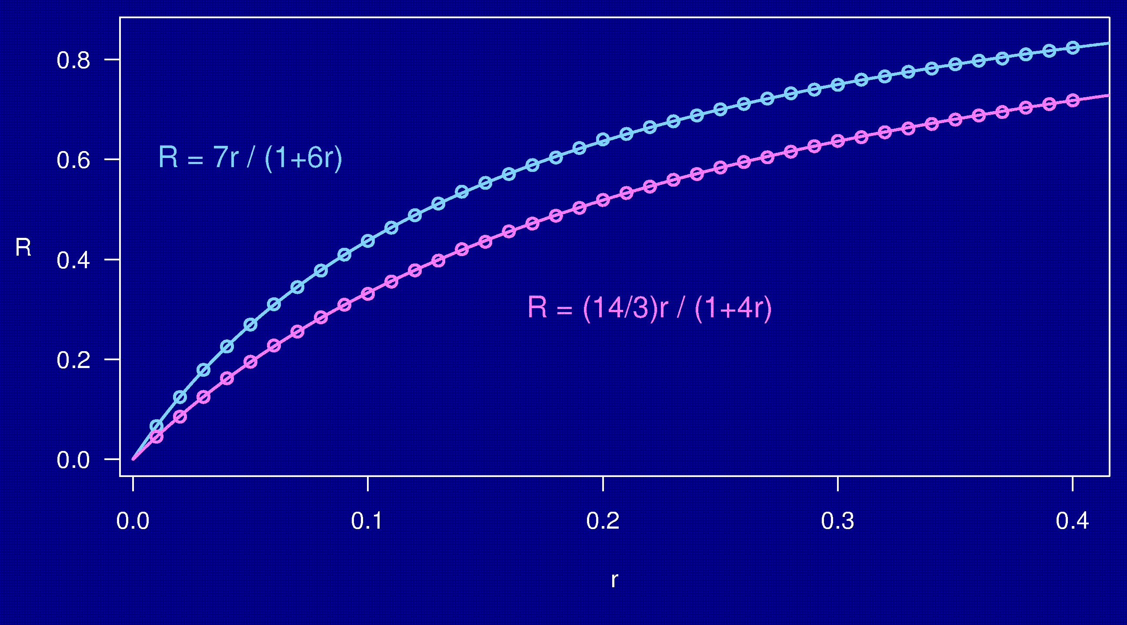
Computer simulations

Slide 23
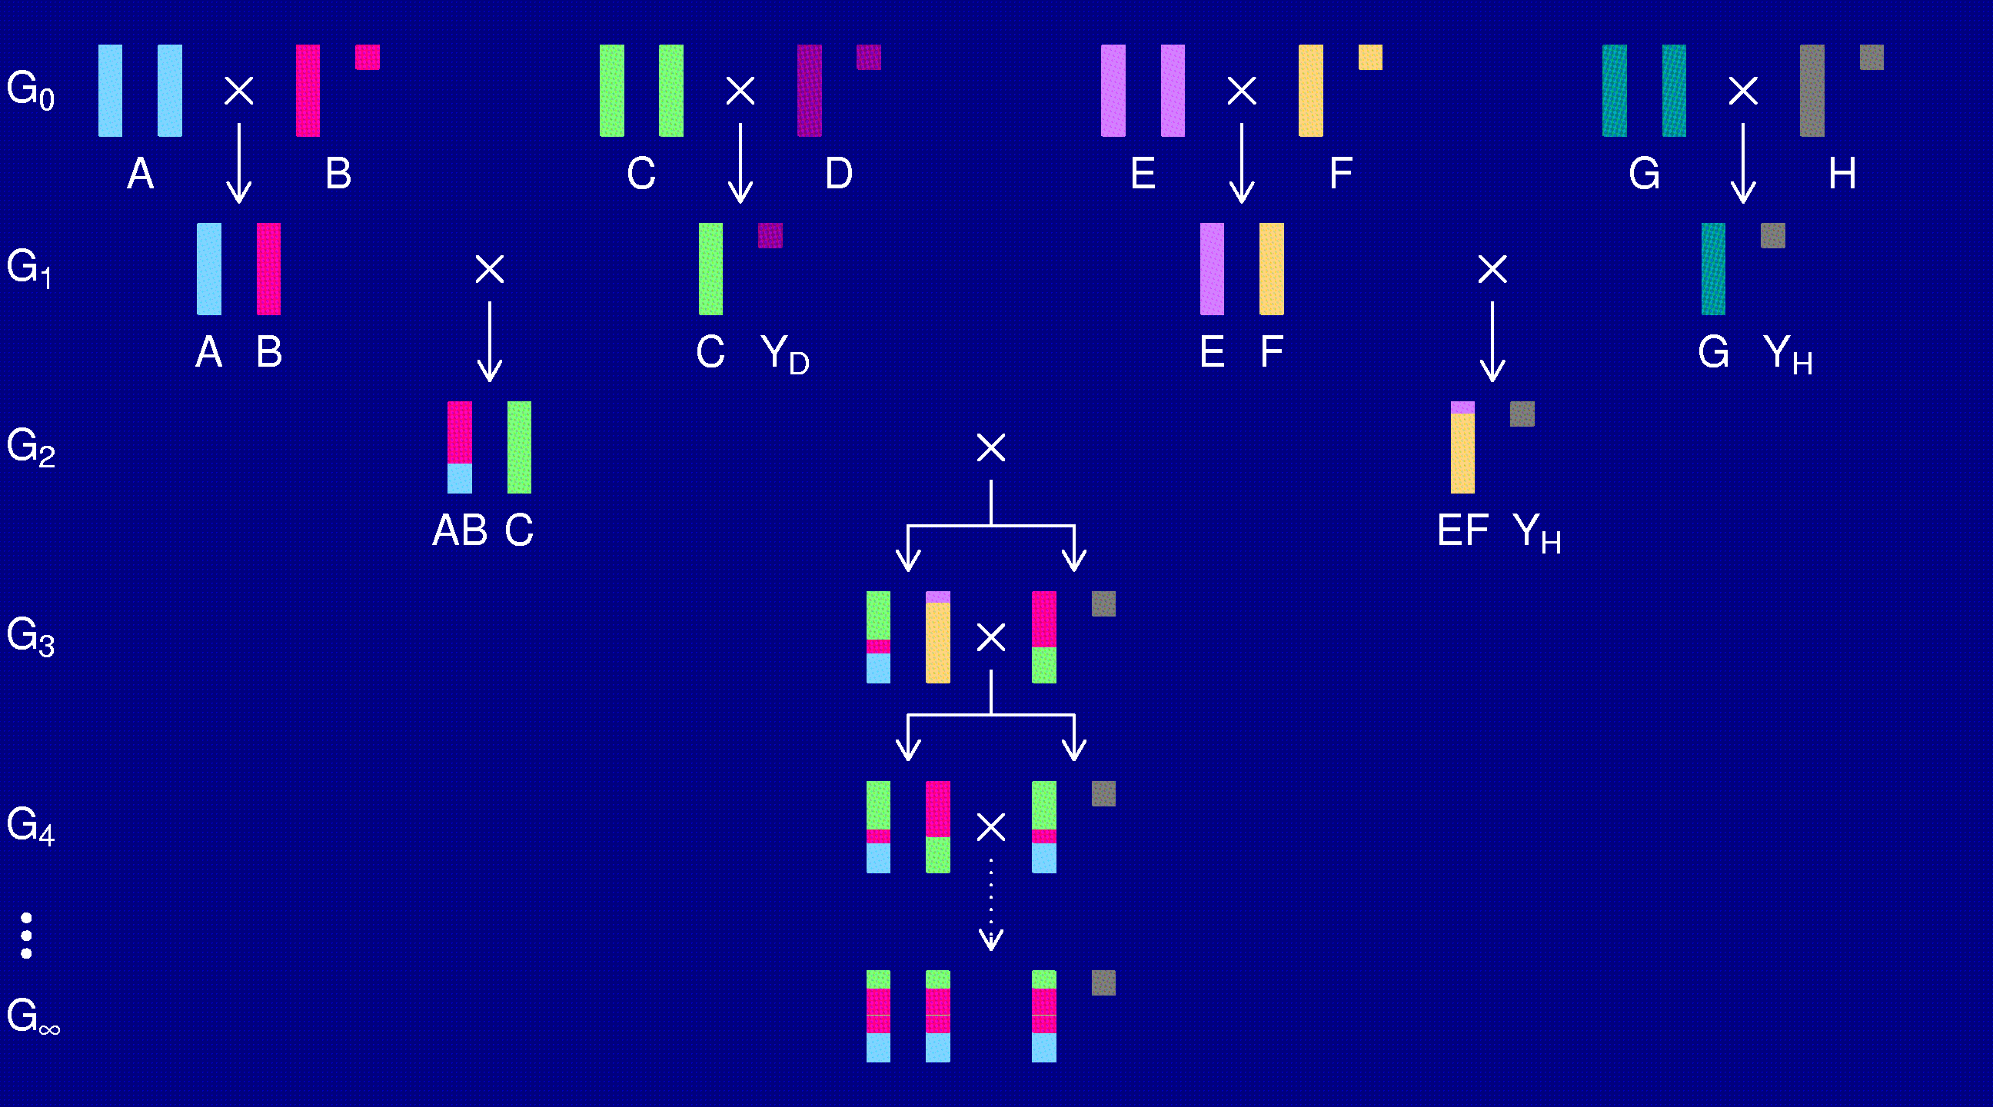
The X chromosome

Slide 24
3-point coincidence
1
2
3
r_{ij} = recombination fraction for interval i,j;
assume r₁₂ = r₂₃ = r
Coincidence = c = Pr(double recombinant) / r²
= Pr(rec’n in 23 | rec’n in 12) / Pr(rec’n in 23)
No interference → = 1
Positive interference → < 1
Negative interference → > 1
Generally c is a function of r.

Slide 25
3-points in 2-way RILs
1
2
3
r₁₃ = 2 r (1 – c r)
R = f(r); R₁₃ = f(r₁₃)
Pr(double recombinant in RIL) = { R + R – R₁₃ } / 2
Coincidence (in 2-way RIL) = { 2 R – R₁₃ } / { 2 R² }
Notes:
This is included at the end of Haldane & Waddington (1931).

Slide 26
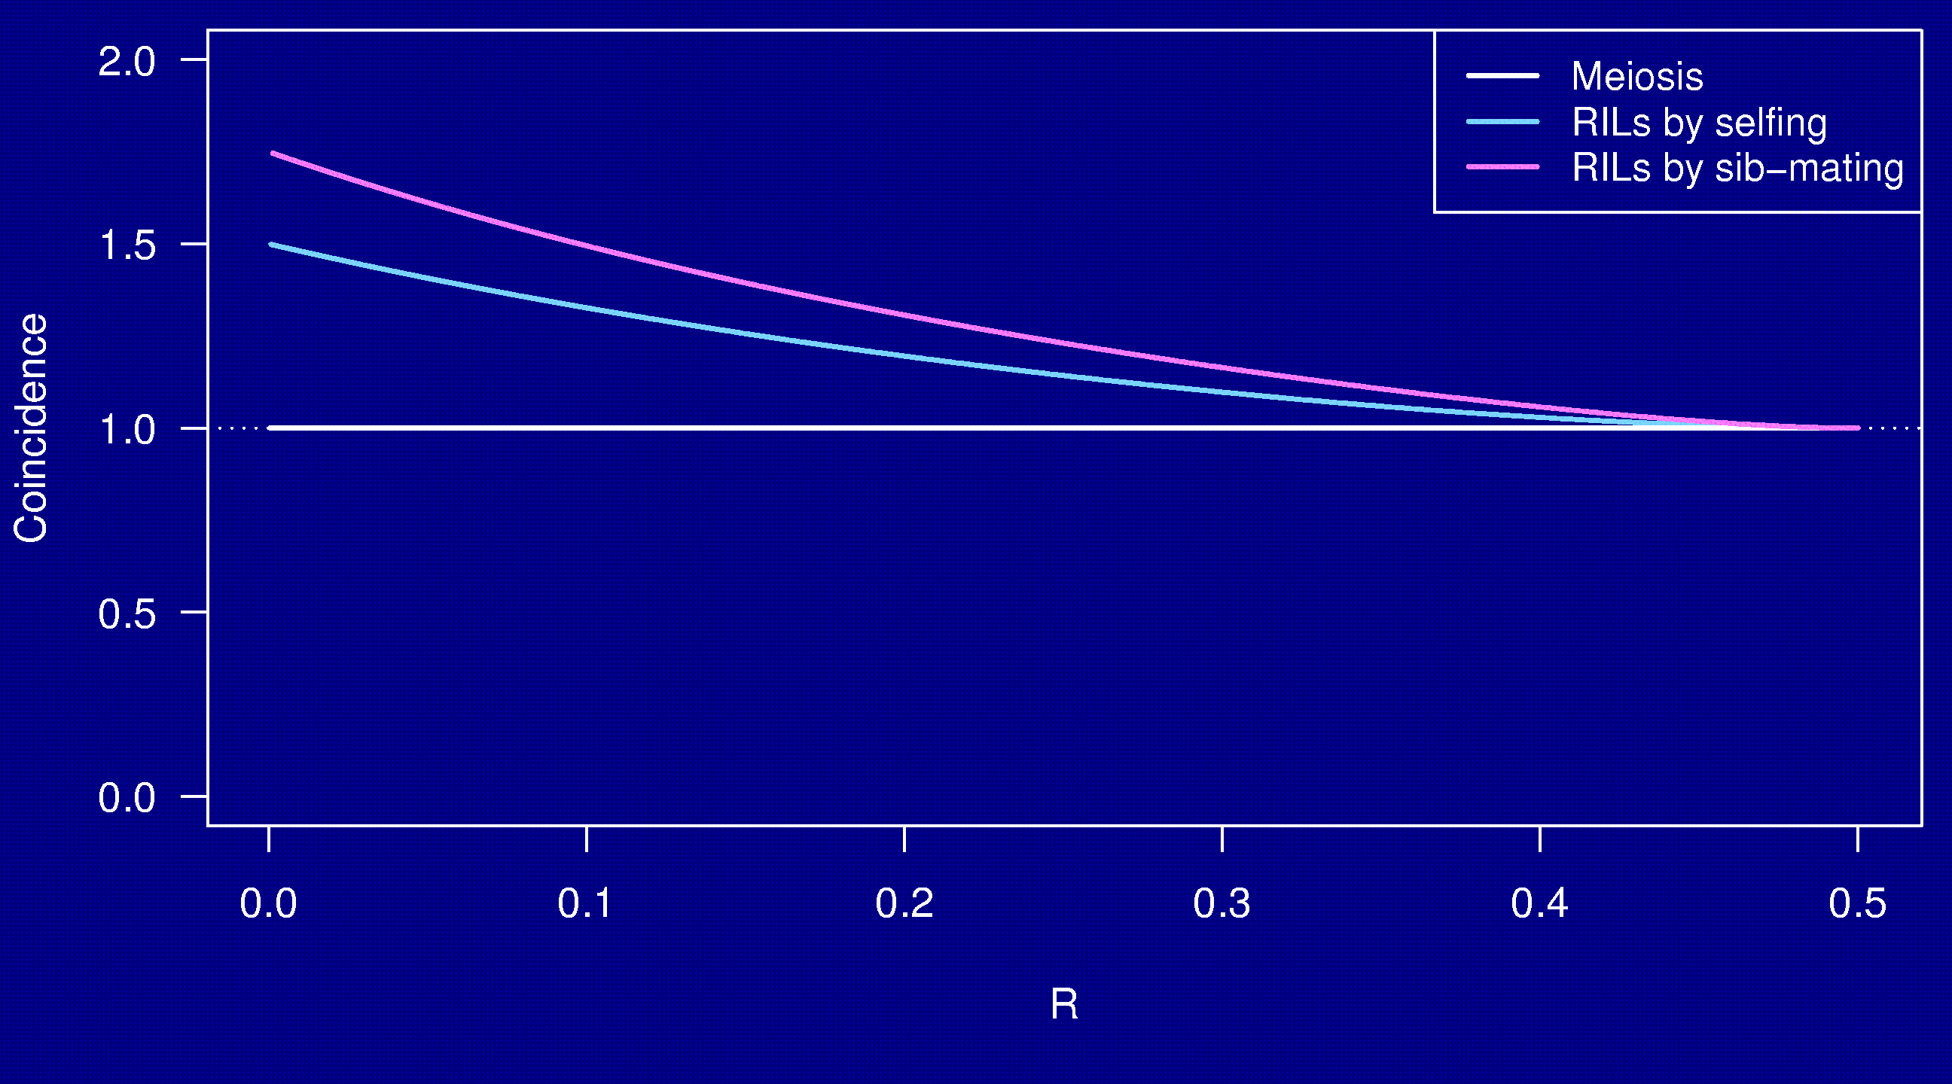
Coincidence
No interference

Slide 27
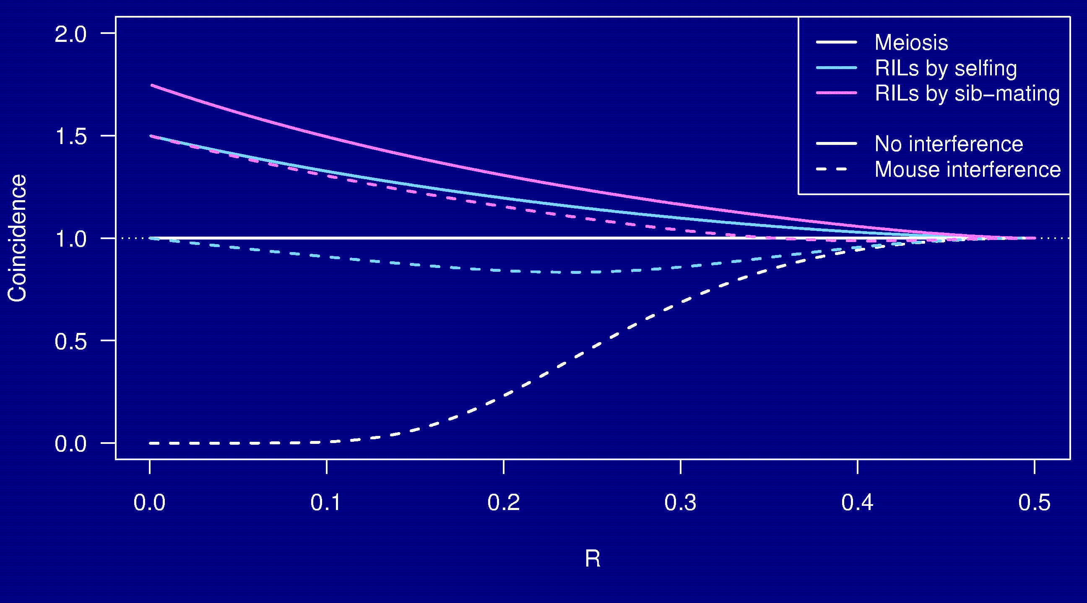
Coincidence

Slide 28
Why the clustering of breakpoints?
The really close breakpoints occur in different generations.
Breakpoints in later generations can occur only in regions that are not yet fixed.
The regions of heterozygosity are, of course, surrounded by breakpoints.

Slide 29
Coincidence in 8-way RILs
The trick that allowed us to get the coincidence for 2-way RILs doesn’t work for 8-way RILs.
It’s sufficient to consider 4-way RILs.
Calculations for 3 points in 4-way RILs is still astoundingly complex.
  2 points in 2-way RILs by sib-mating:
  55 parental types → 22 states by symmetry
  3 points in 4-way RILs by sib-mating:
  2,164,240 parental types → 137,488 states
Even counting the states was difficult.

Slide 30
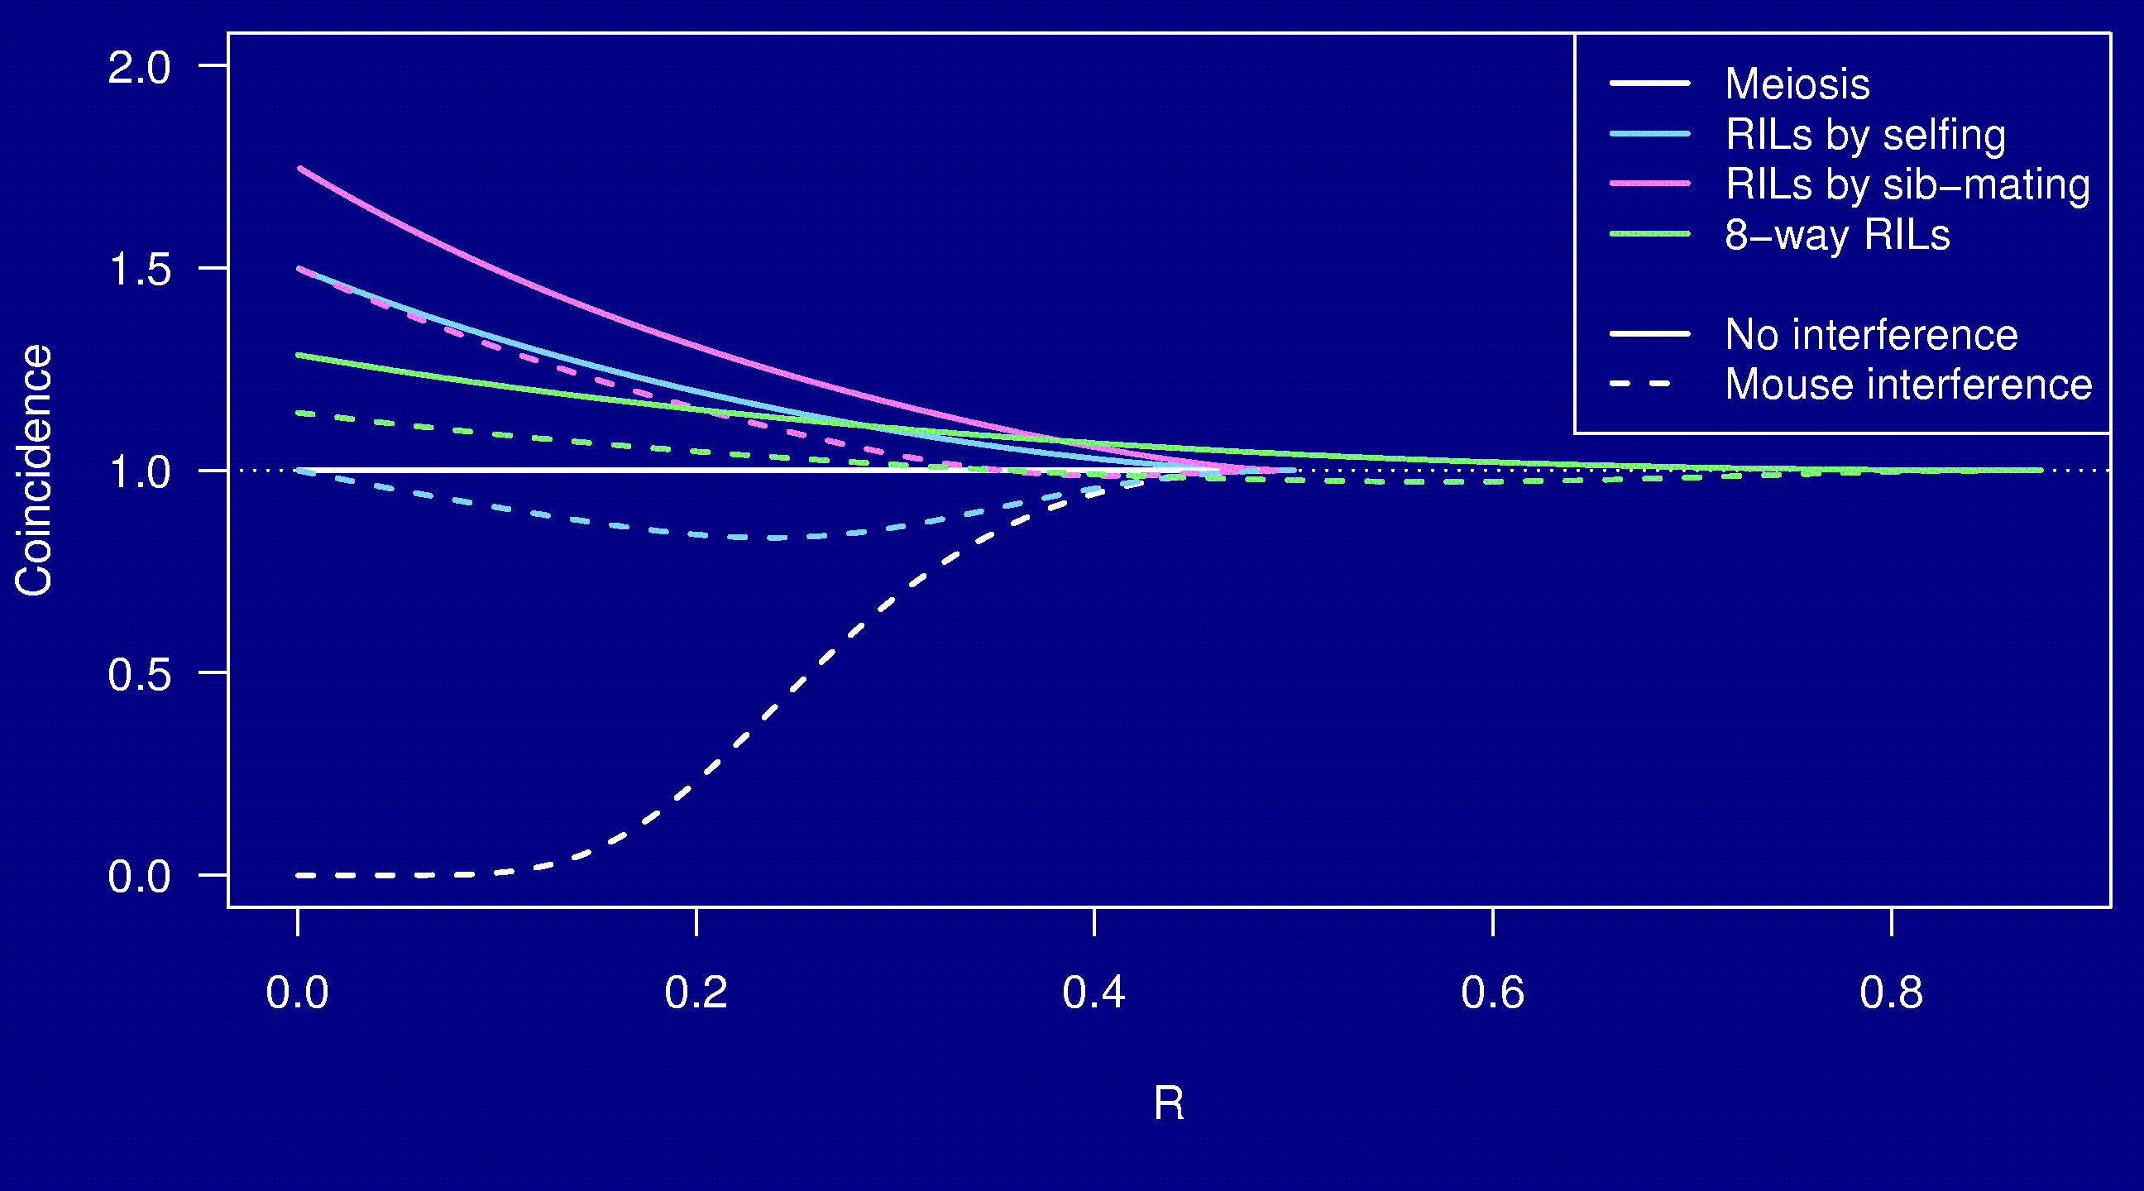
Coincidence

Slide 31
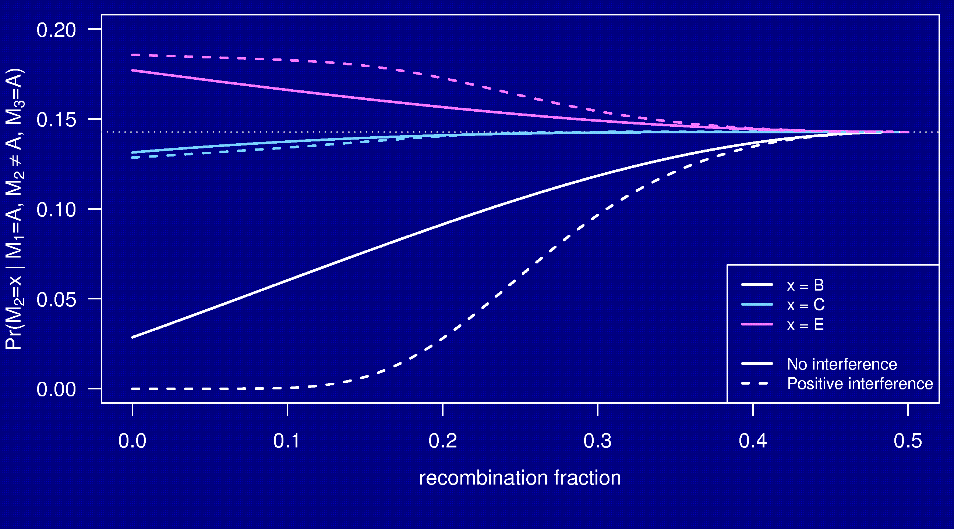
3-point symmetry

Slide 32
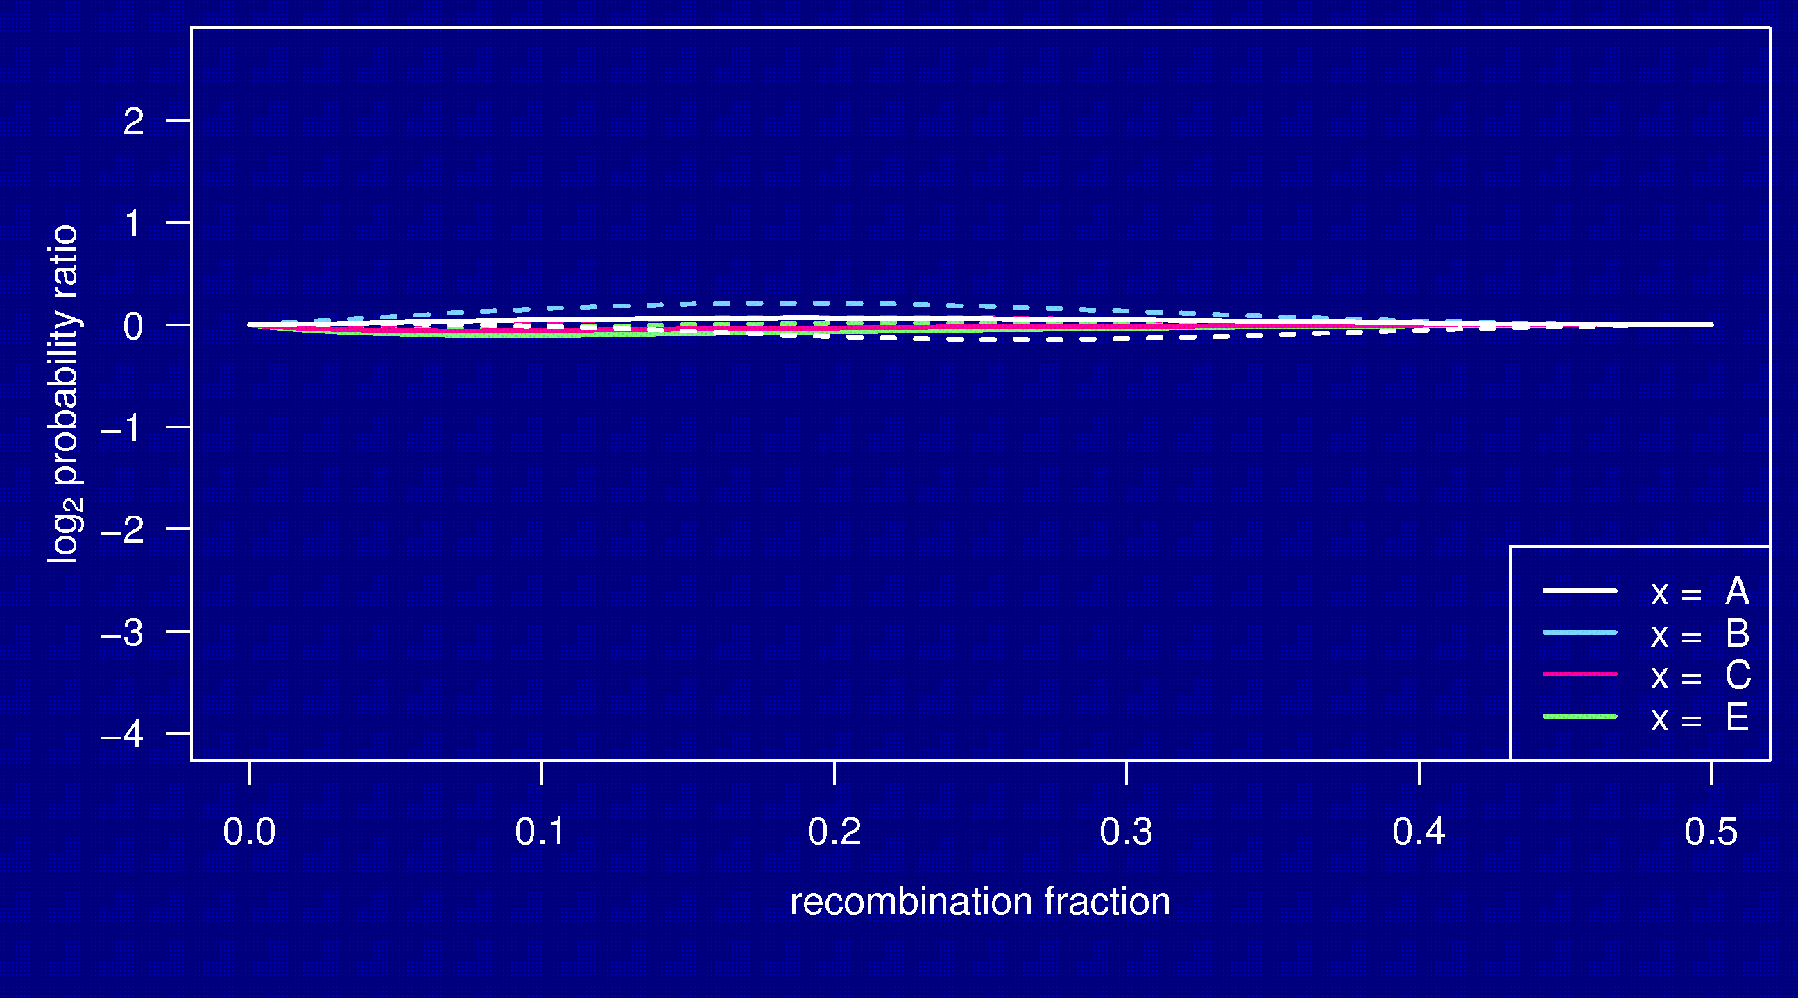
Markov property

Slide 33
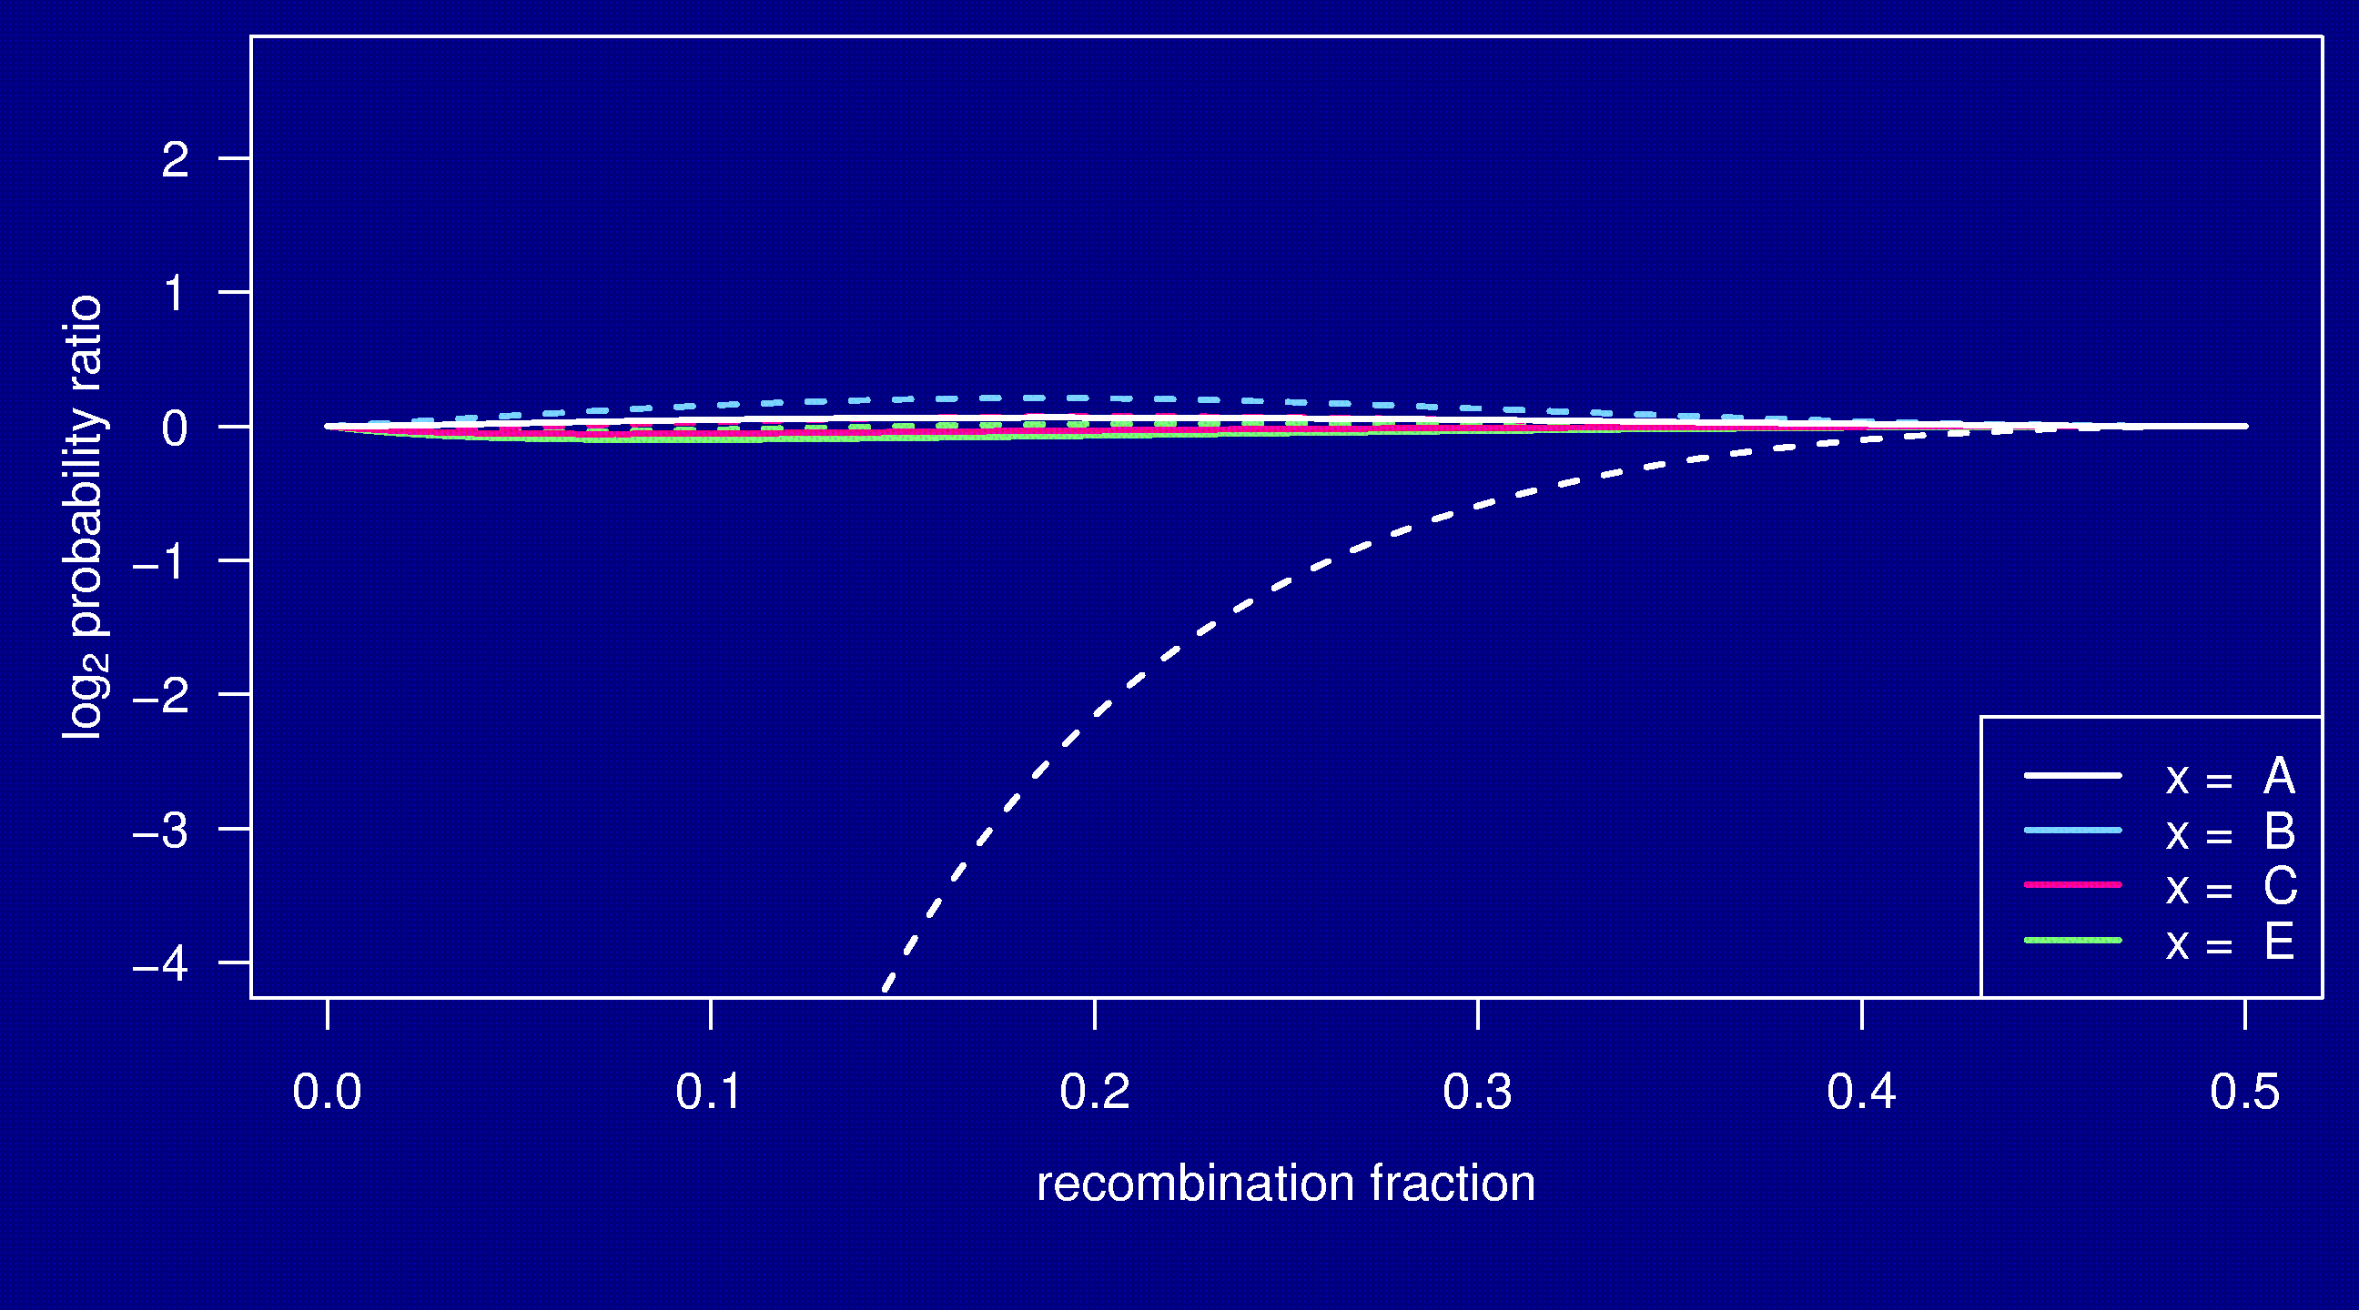
Markov property

Slide 34
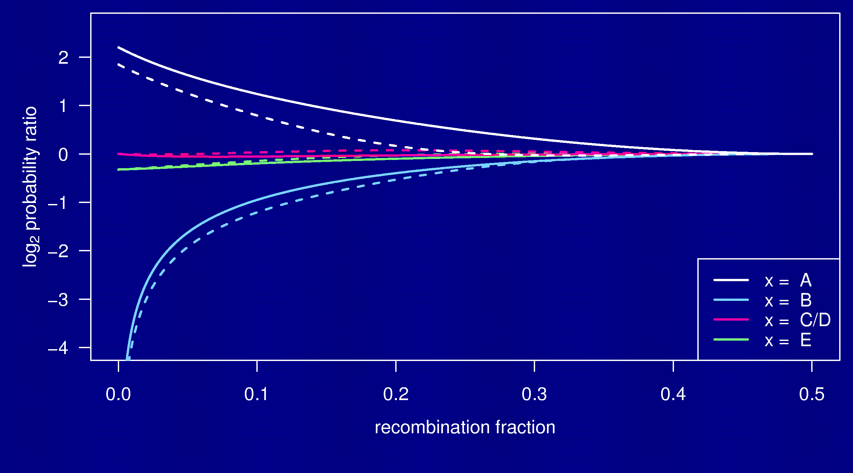
Markov property

Slide 35
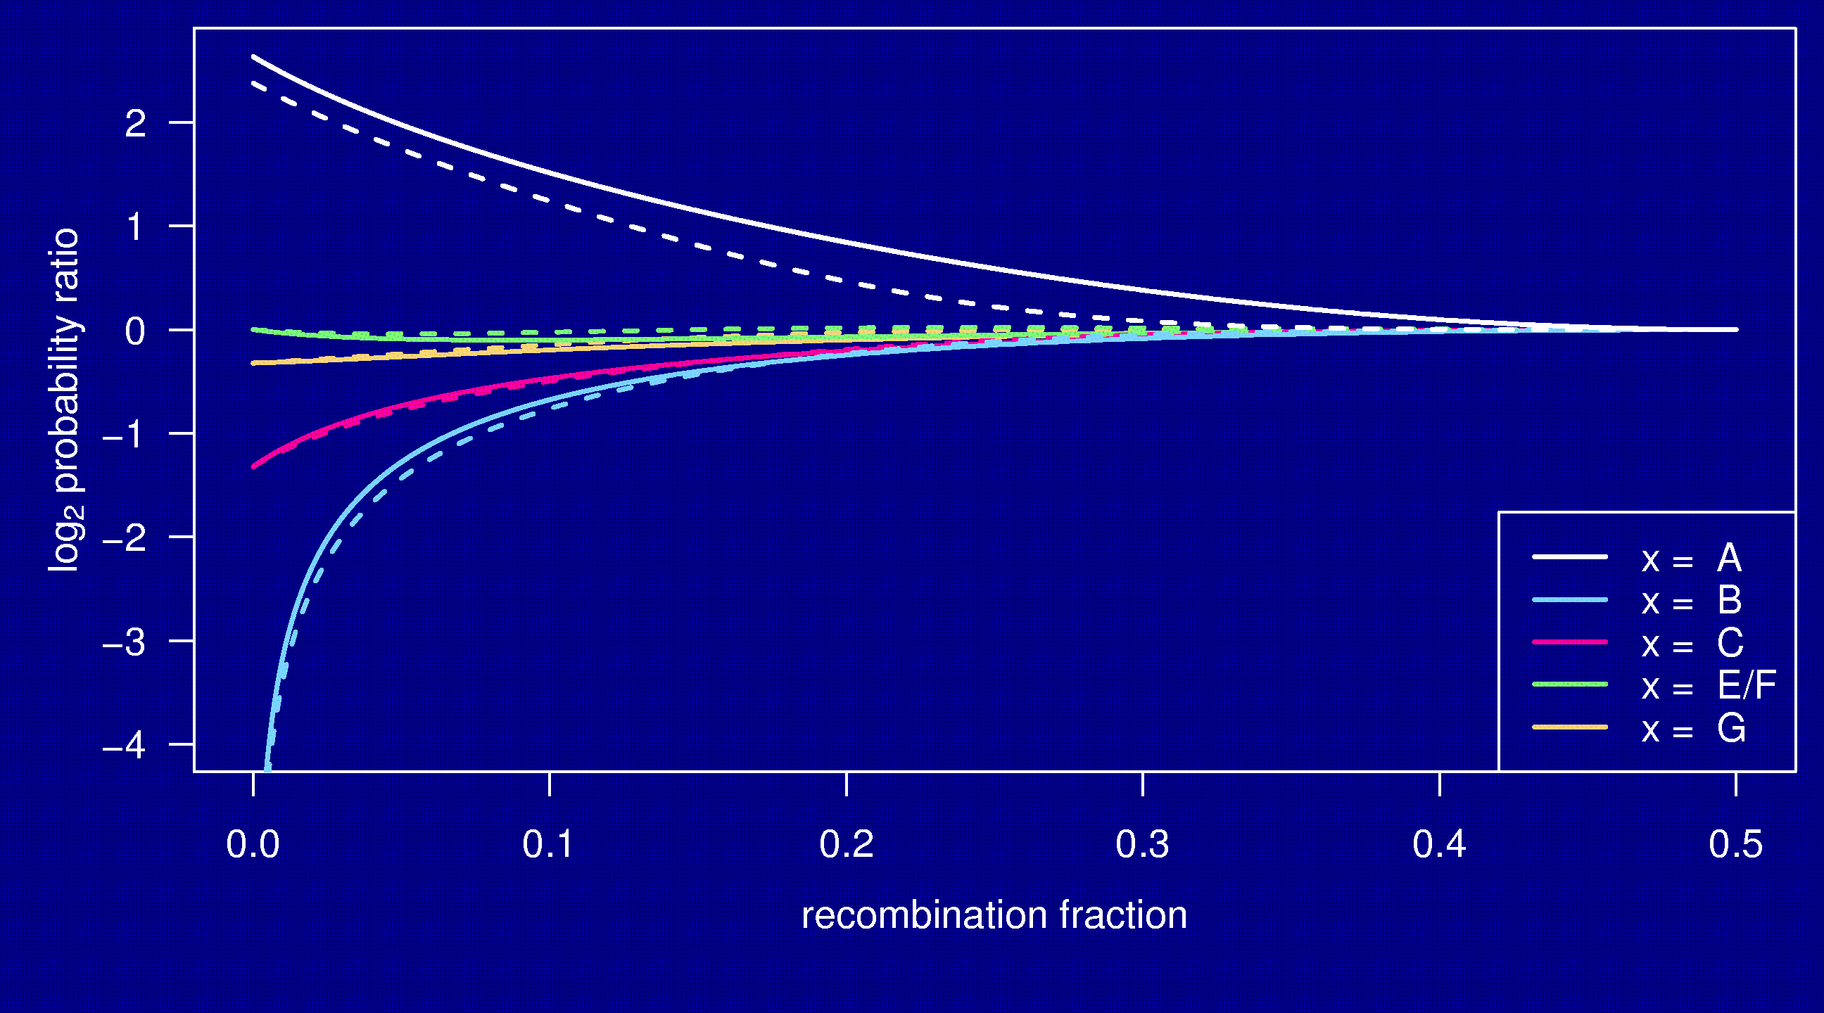
Markov property

Slide 36
Whole genome simulations
2-way selfing, 2-way sib-mating, 8-way sib-mating
Mouse-like genome, 1665 cM
Strong positive crossover interference
Inbreed to complete fixation
10,000 simulation replicates

Slide 37
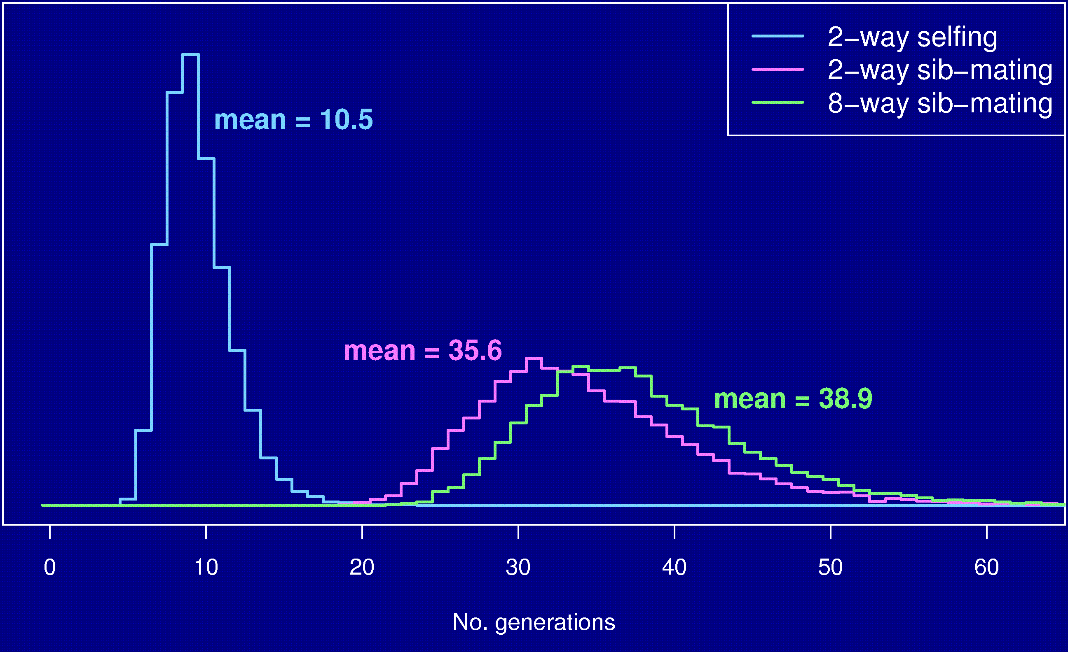
No. generations to fixation

Slide 38
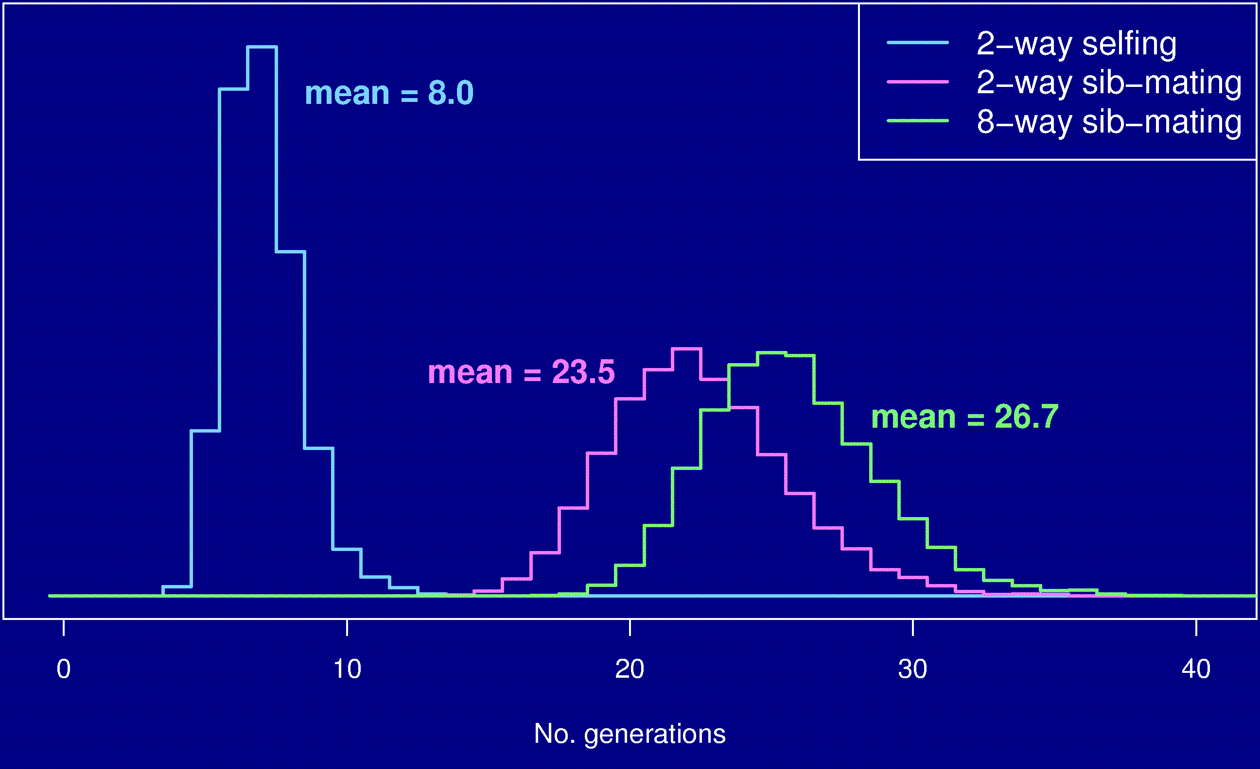
No. gen’s to 99% fixation

Slide 39
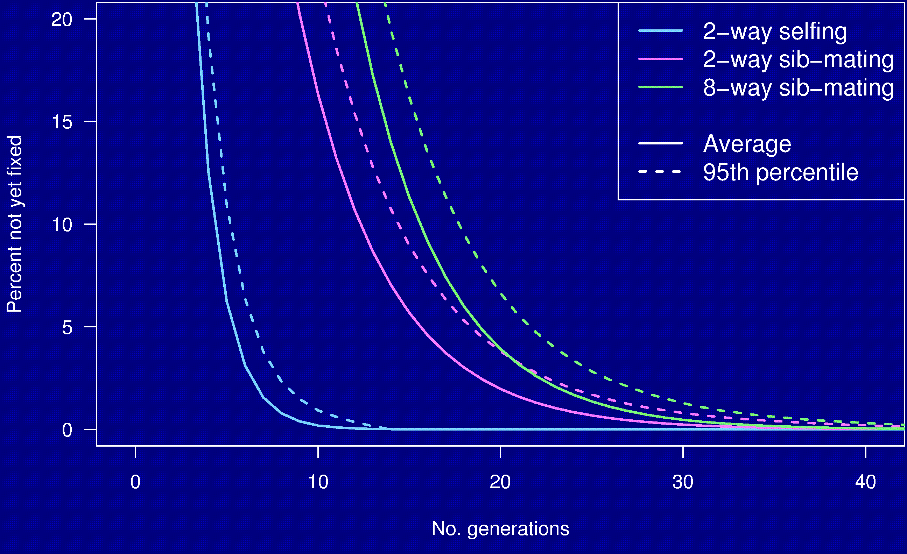
Percent genome not fixed

Slide 40
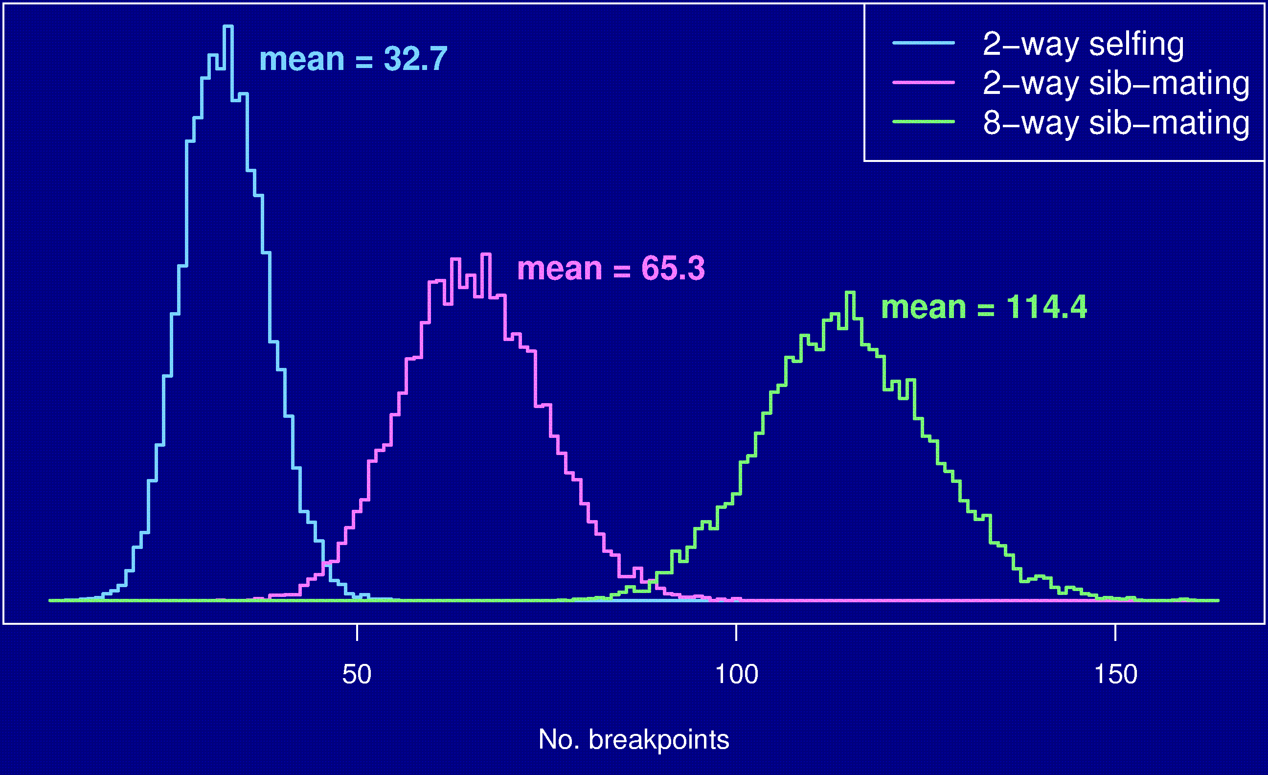
Number of breakpoints

Slide 41
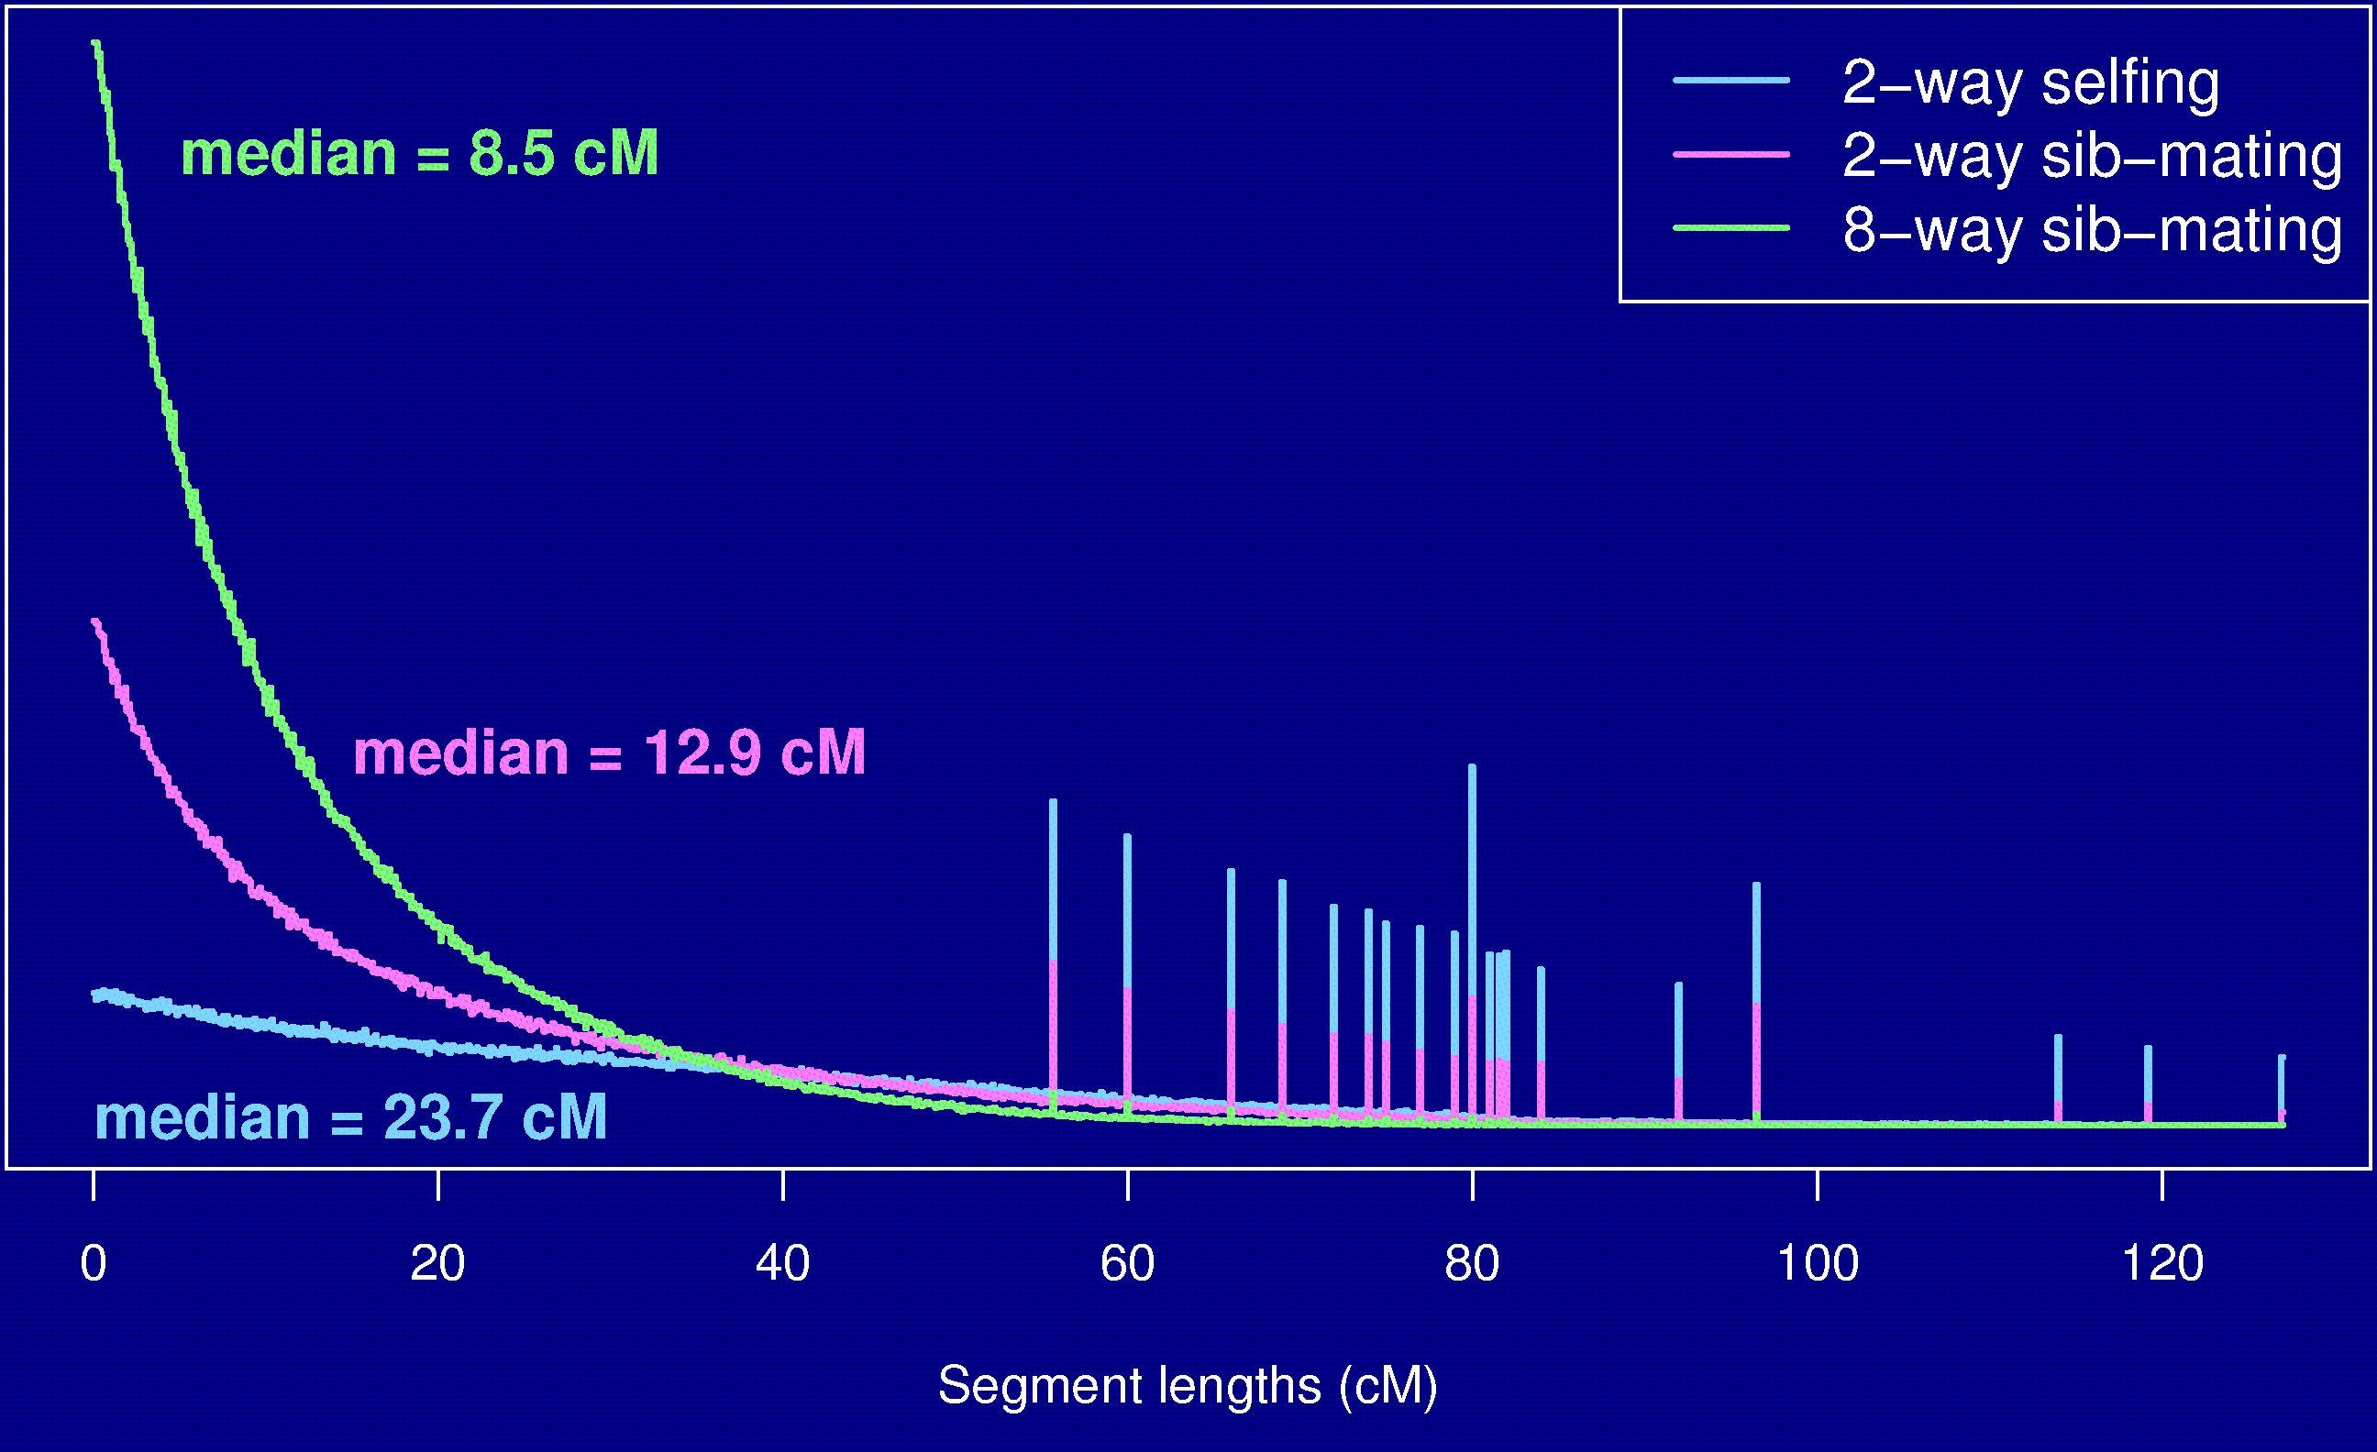
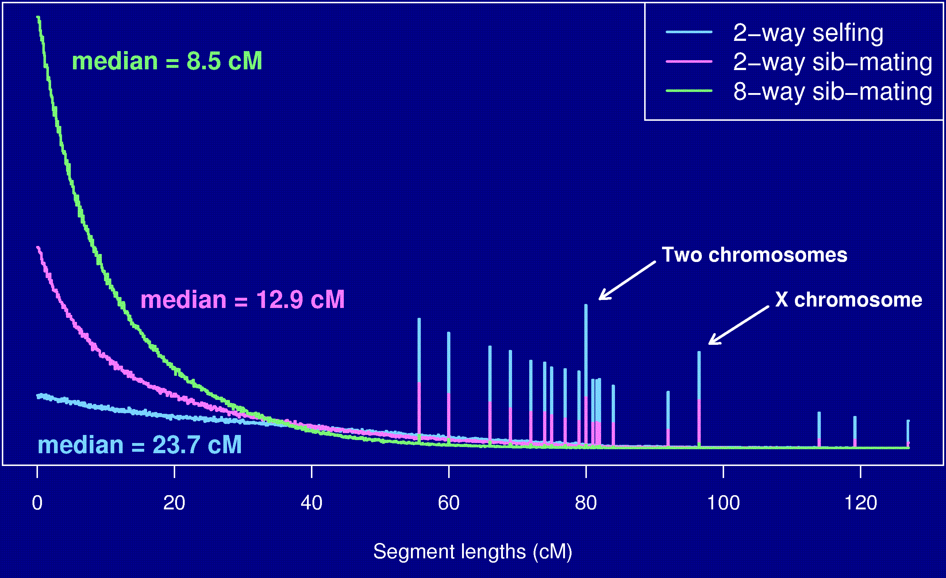
Segment lengths

Slide 42
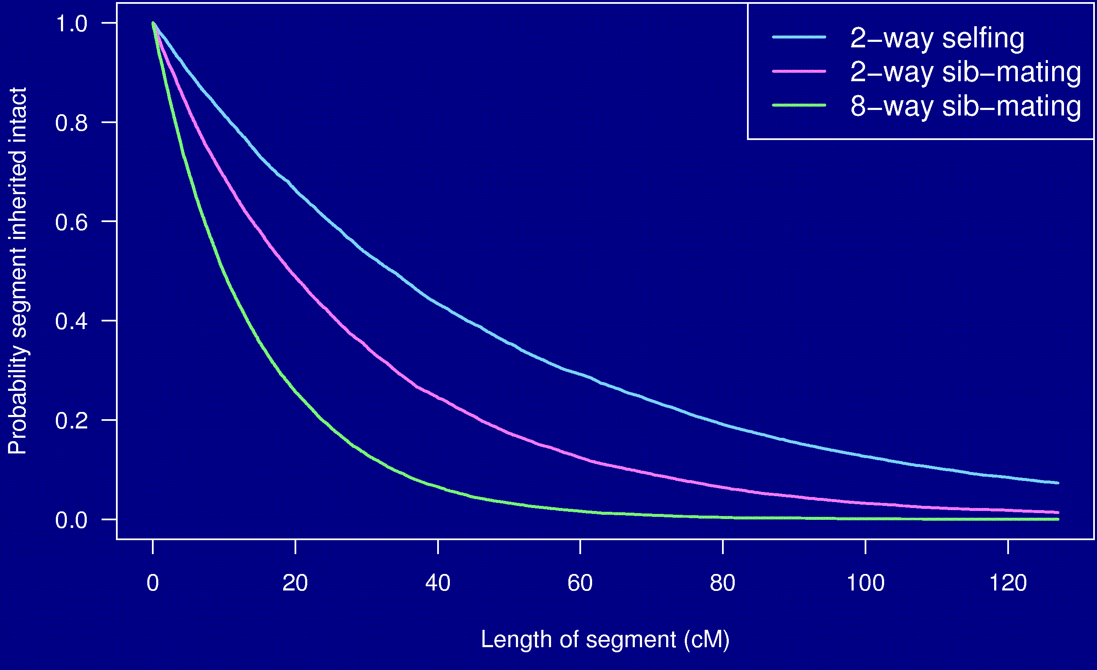
Probability a segment is inherited intact

Slide 43
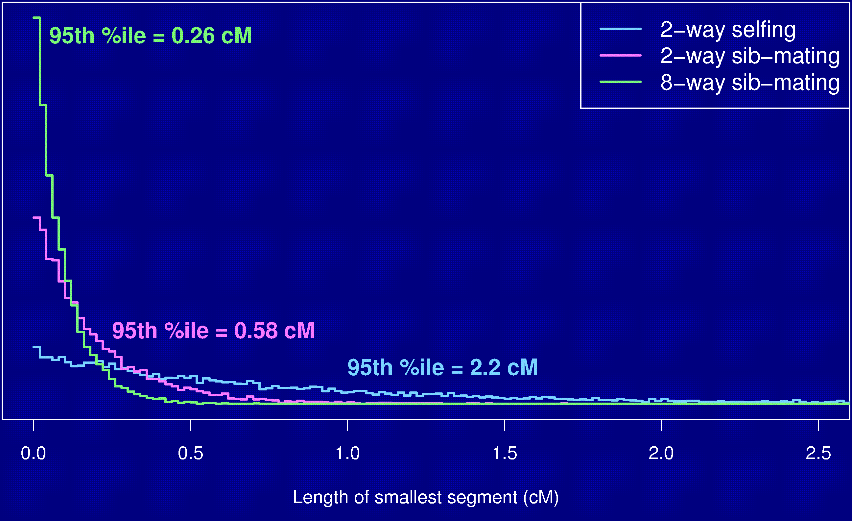
Length of smallest segment

Slide 44
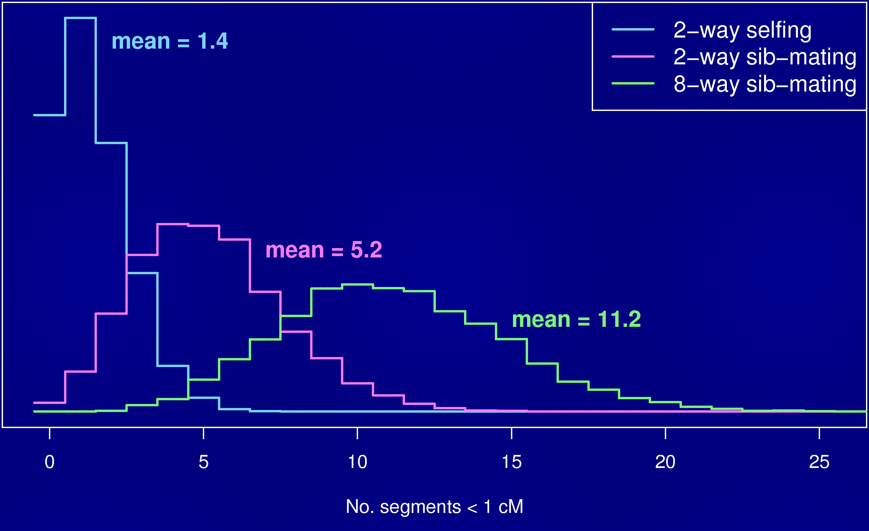
No. segments < 1 cM

Slide 45
Summary
The Collaborative Cross could provide “one-stop shopping” for gene mapping in the mouse.
Use of such 8-way RILs requires an understanding of the breakpoint process.
We’ve extended Haldane & Waddington’s results to the case of 8-way RILs: R = 7 r / (1 + 6 r).
We’ve shown clustering of breakpoints in RILs by sib-mating, even in the presence of strong crossover interference.
Broman KW (2005) The genomes of recombinant inbred lines. Genetics 169:1133-1146

