Slide 1
The genomes of recombinant inbred lines

Slide 2
Inbred mice

Slide 3
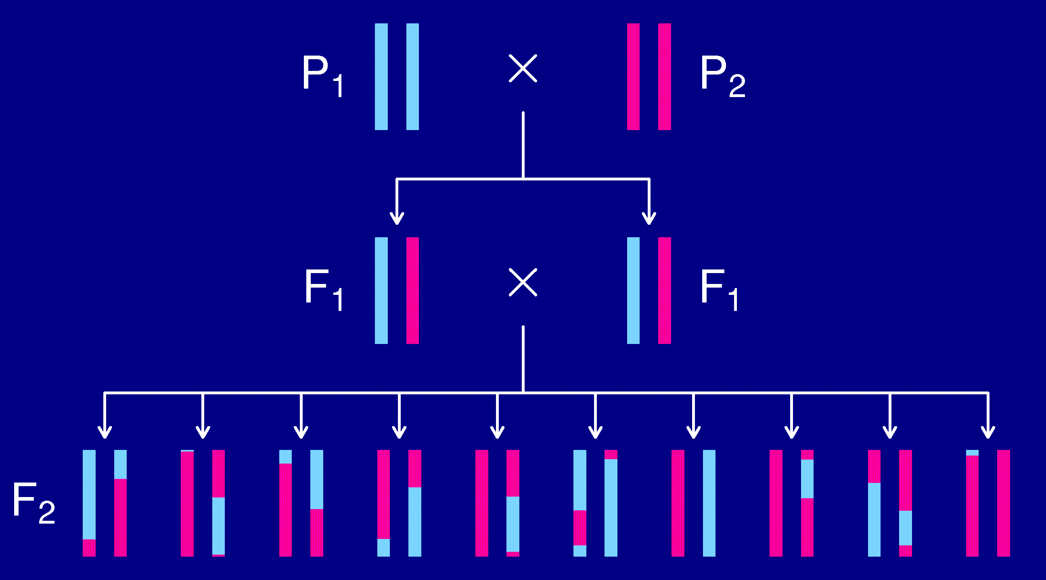
The intercross

Slide 4
Opportunities for improvement
Each individual is unique.
  Must genotype each mouse.
  Unable to obtain multiple invasive phenotypes (e.g., in multiple environmental conditions) on the same genotype.
Relatively low mapping precision.
Design a set of inbred mouse strains.
  Genotype once.
  Study multiple phenotypes on the same genotype.

Slide 5
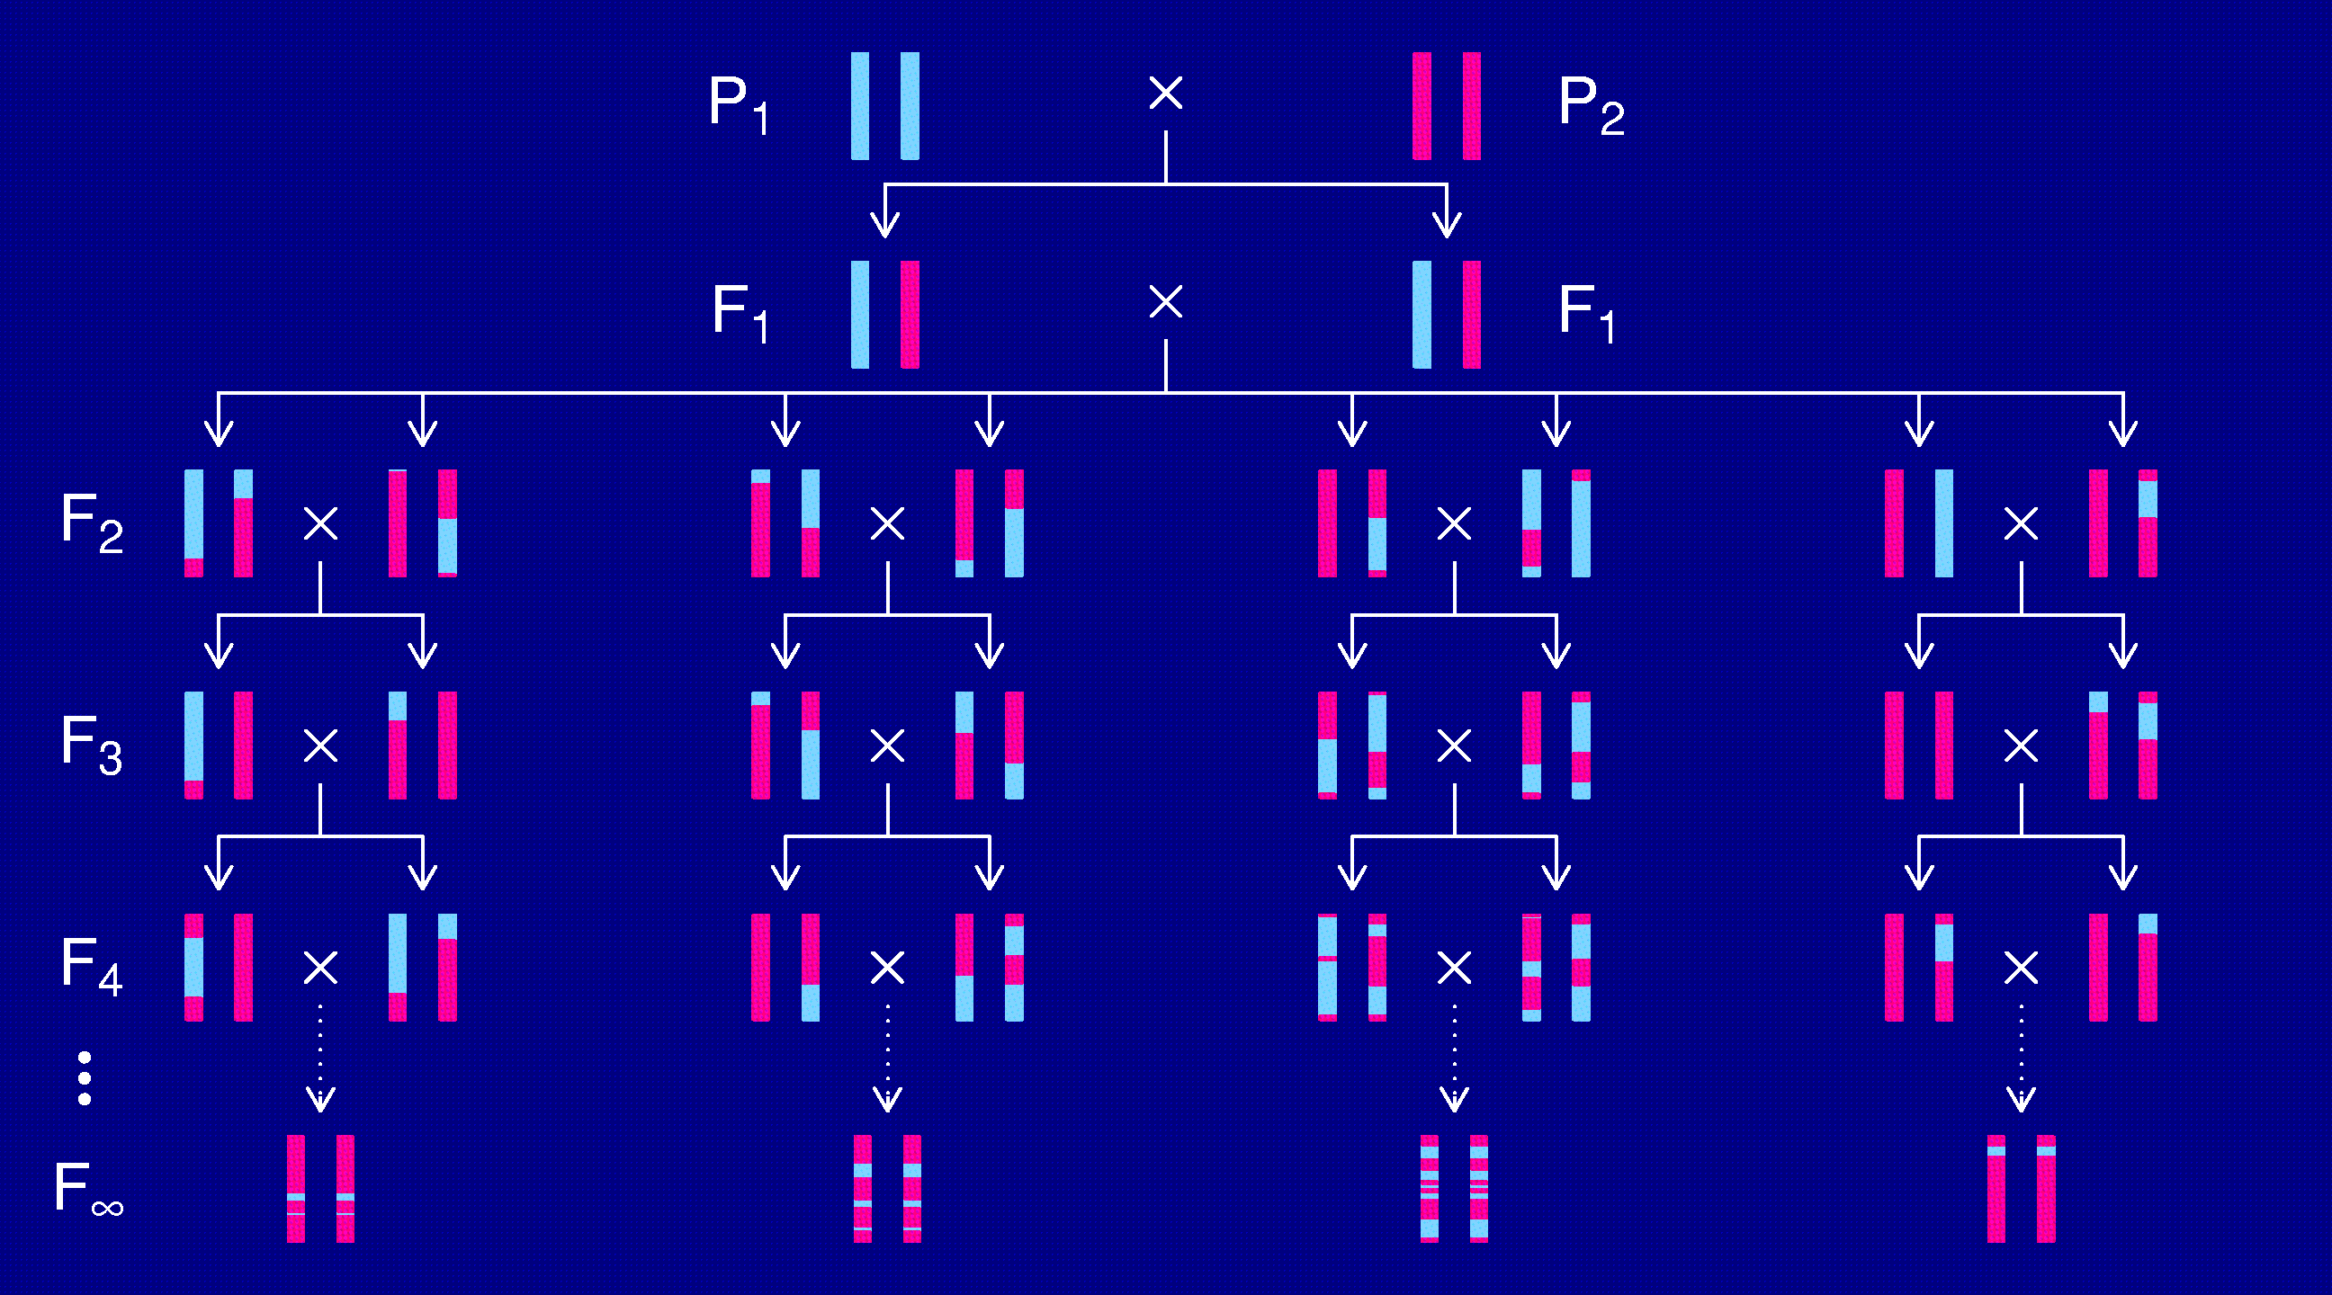
Recombinant inbred lines
(by sibling mating)

Slide 6
RI lines
Advantages
Each strain is a eternal resource.
  Only need to genotype once.
  Reduce individual variation by phenotyping multiple individuals from each strain.
  Study multiple phenotypes on the same genotype.
Greater mapping precision.
  More dense breakpoints on the RI chromosomes.
Disadvantages
Time and expense.
Available panels are generally too small (10-30 lines).
Can learn only about 2 particular alleles.
All individuals homozygous.

Slide 7
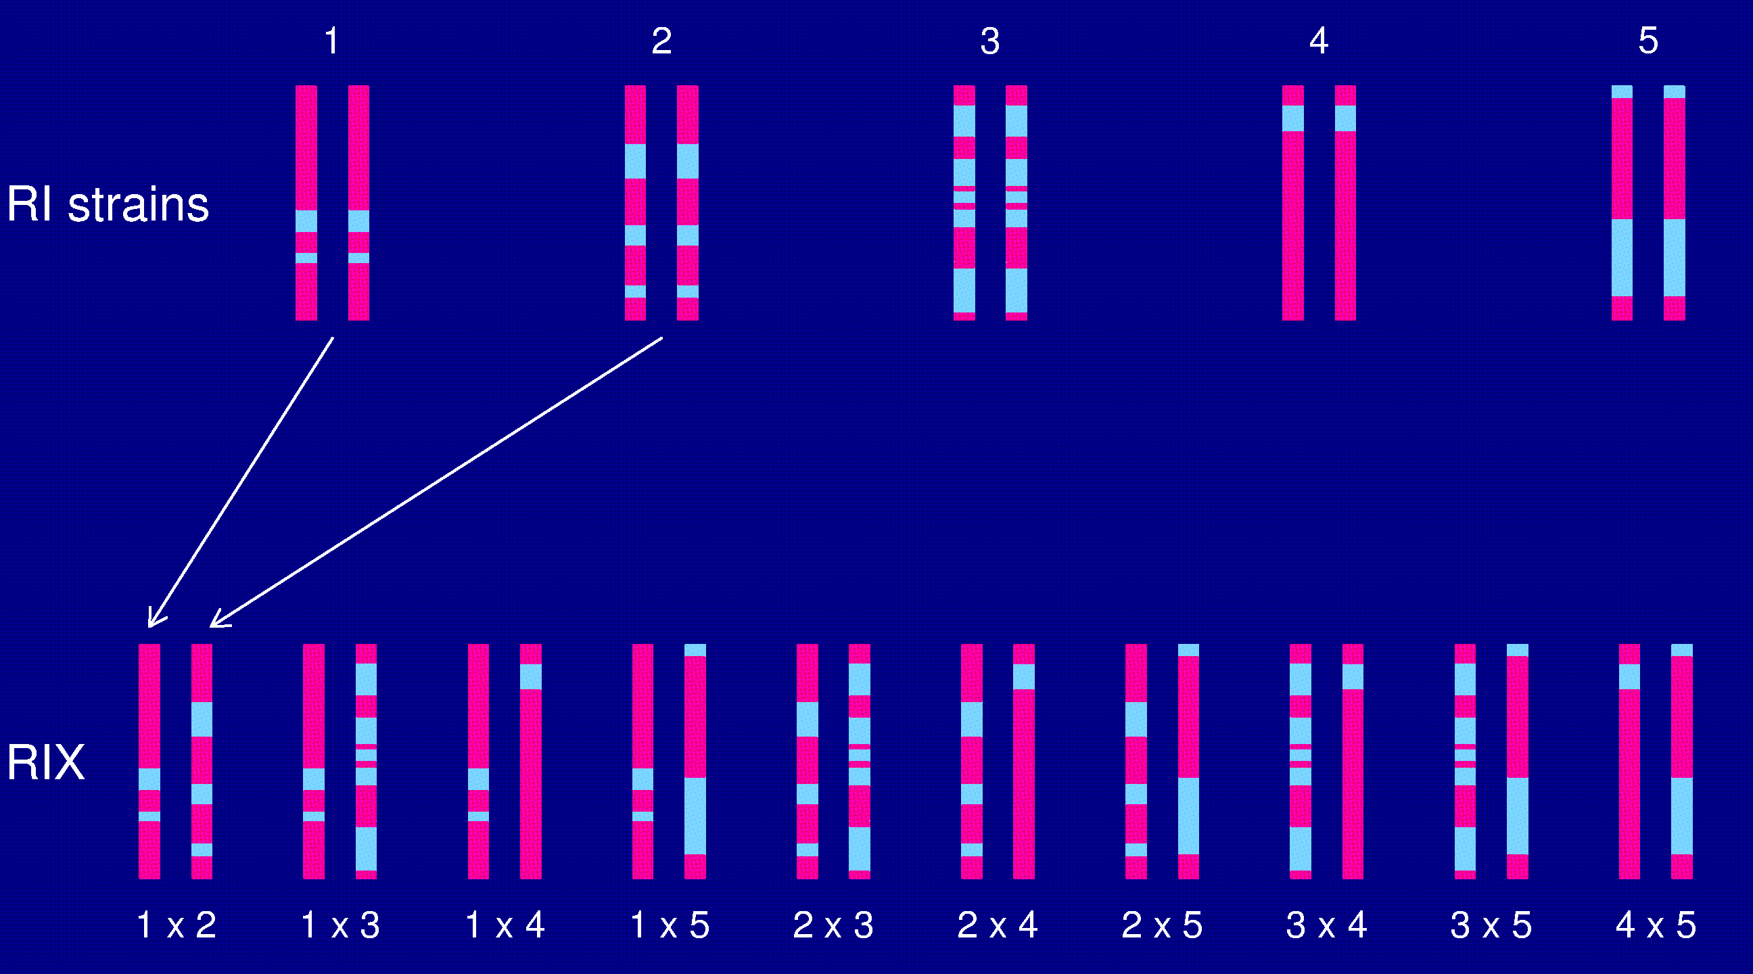
The RIX design

Slide 8
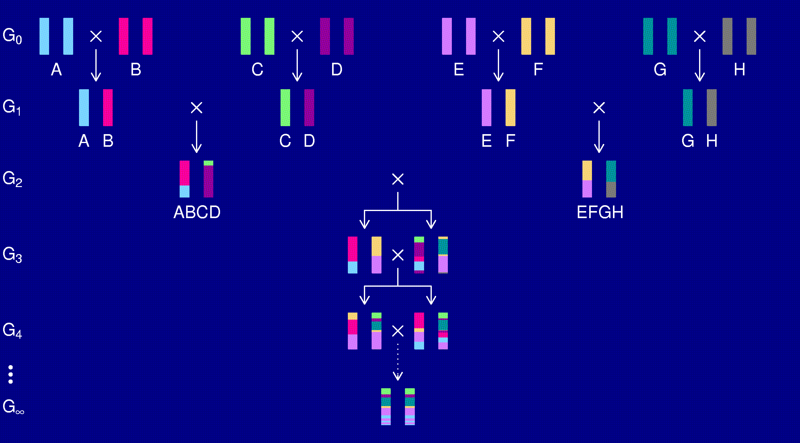
The Collaborative Cross
Complex Trait Consortium (2004) Nat Genet 36:1133-1137

Slide 9
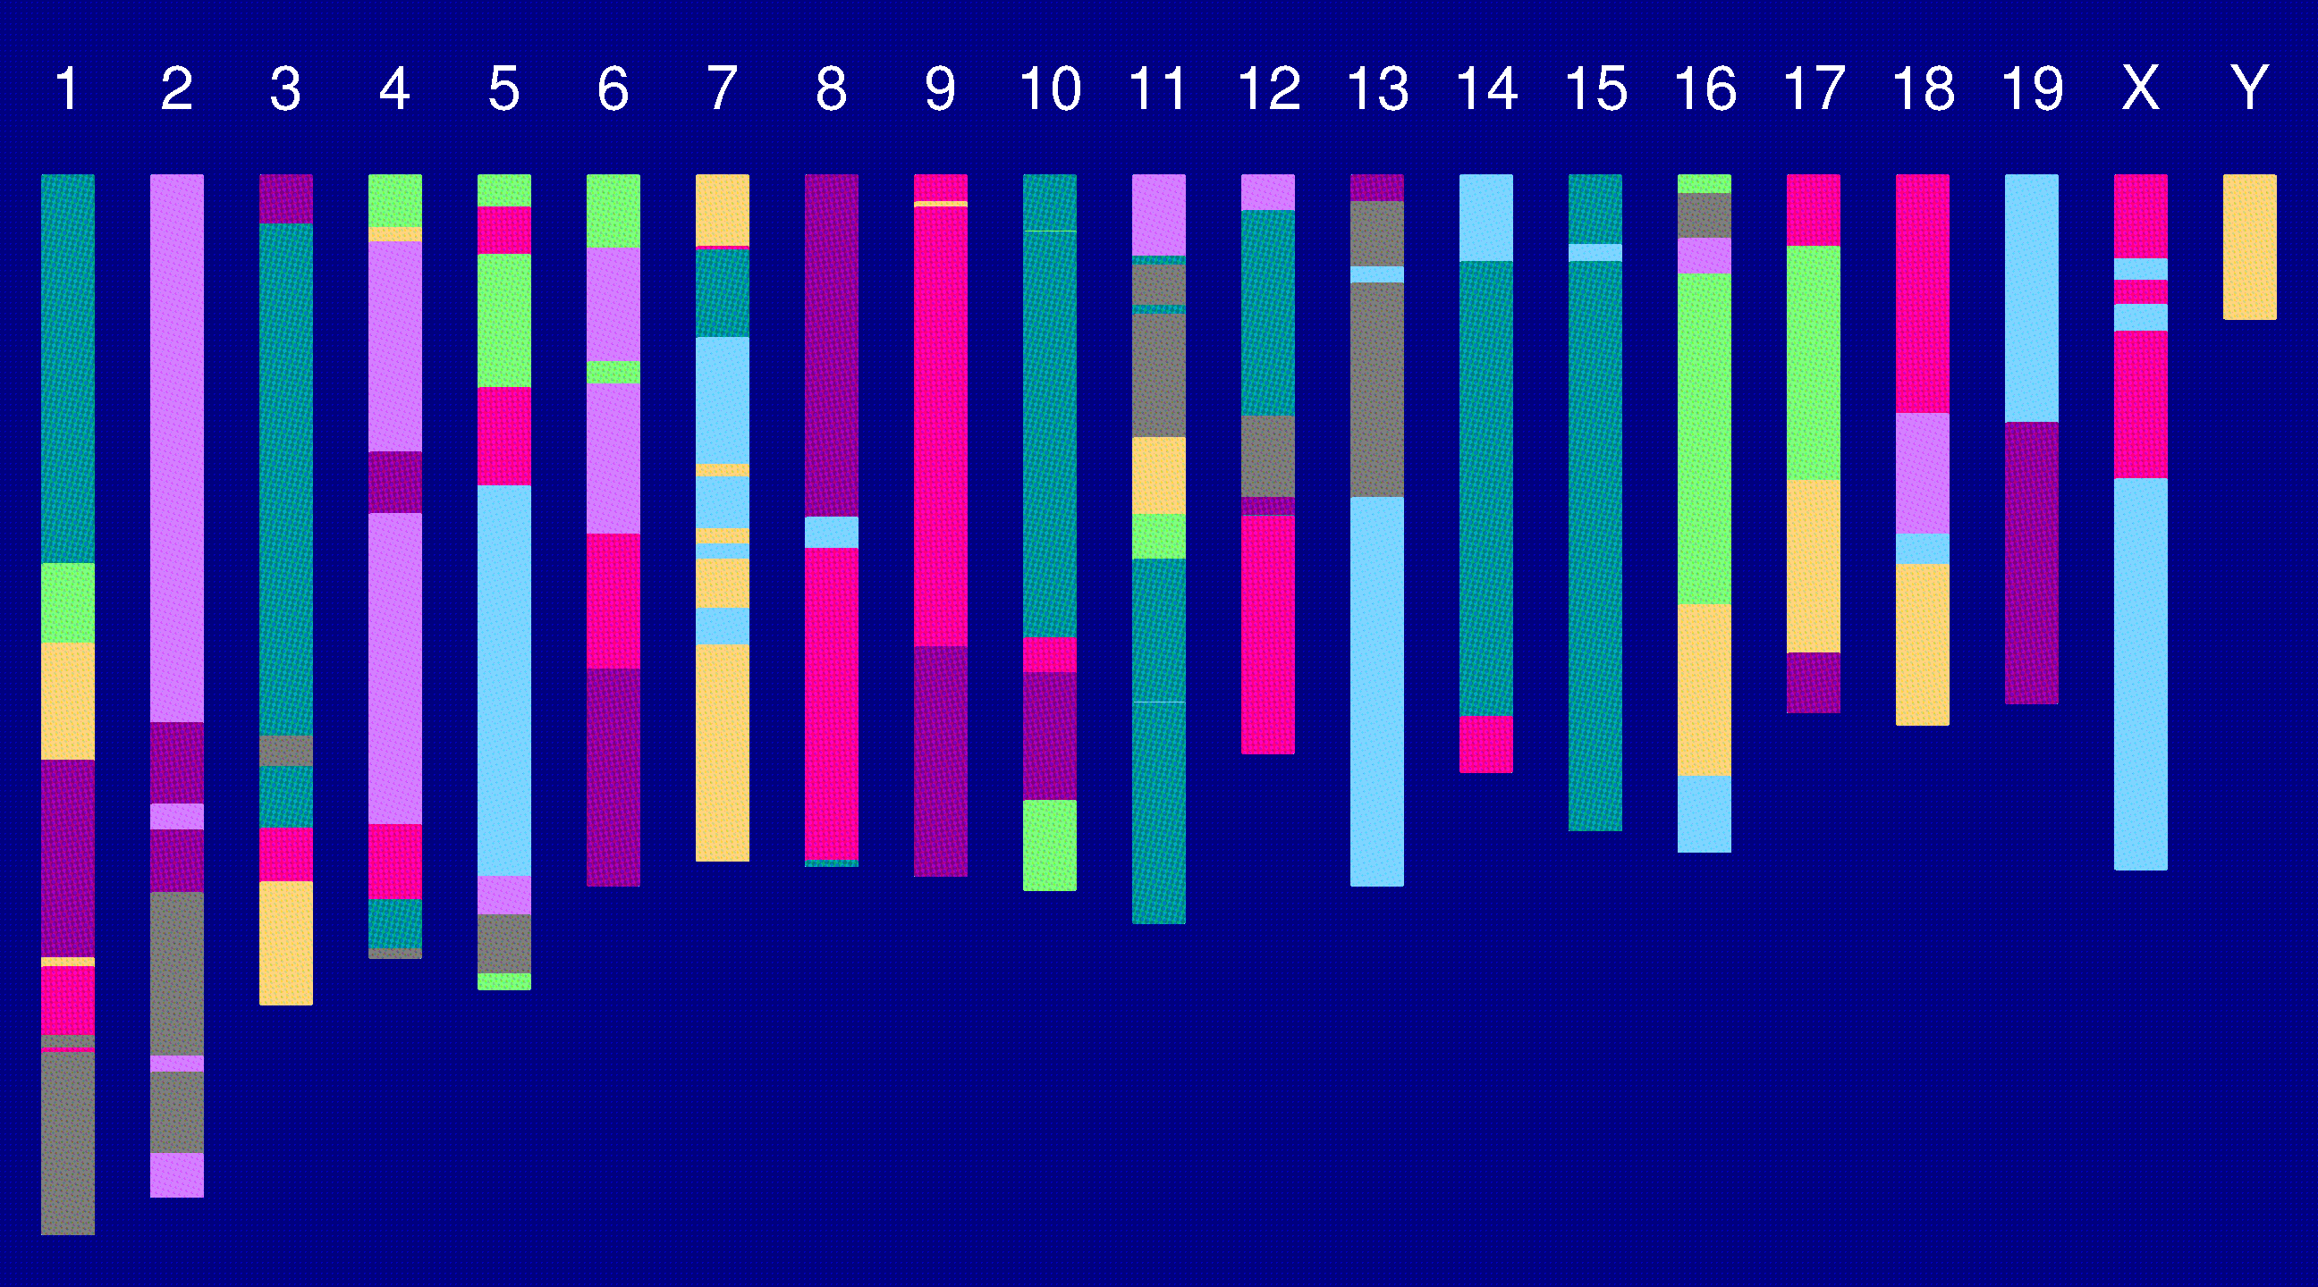
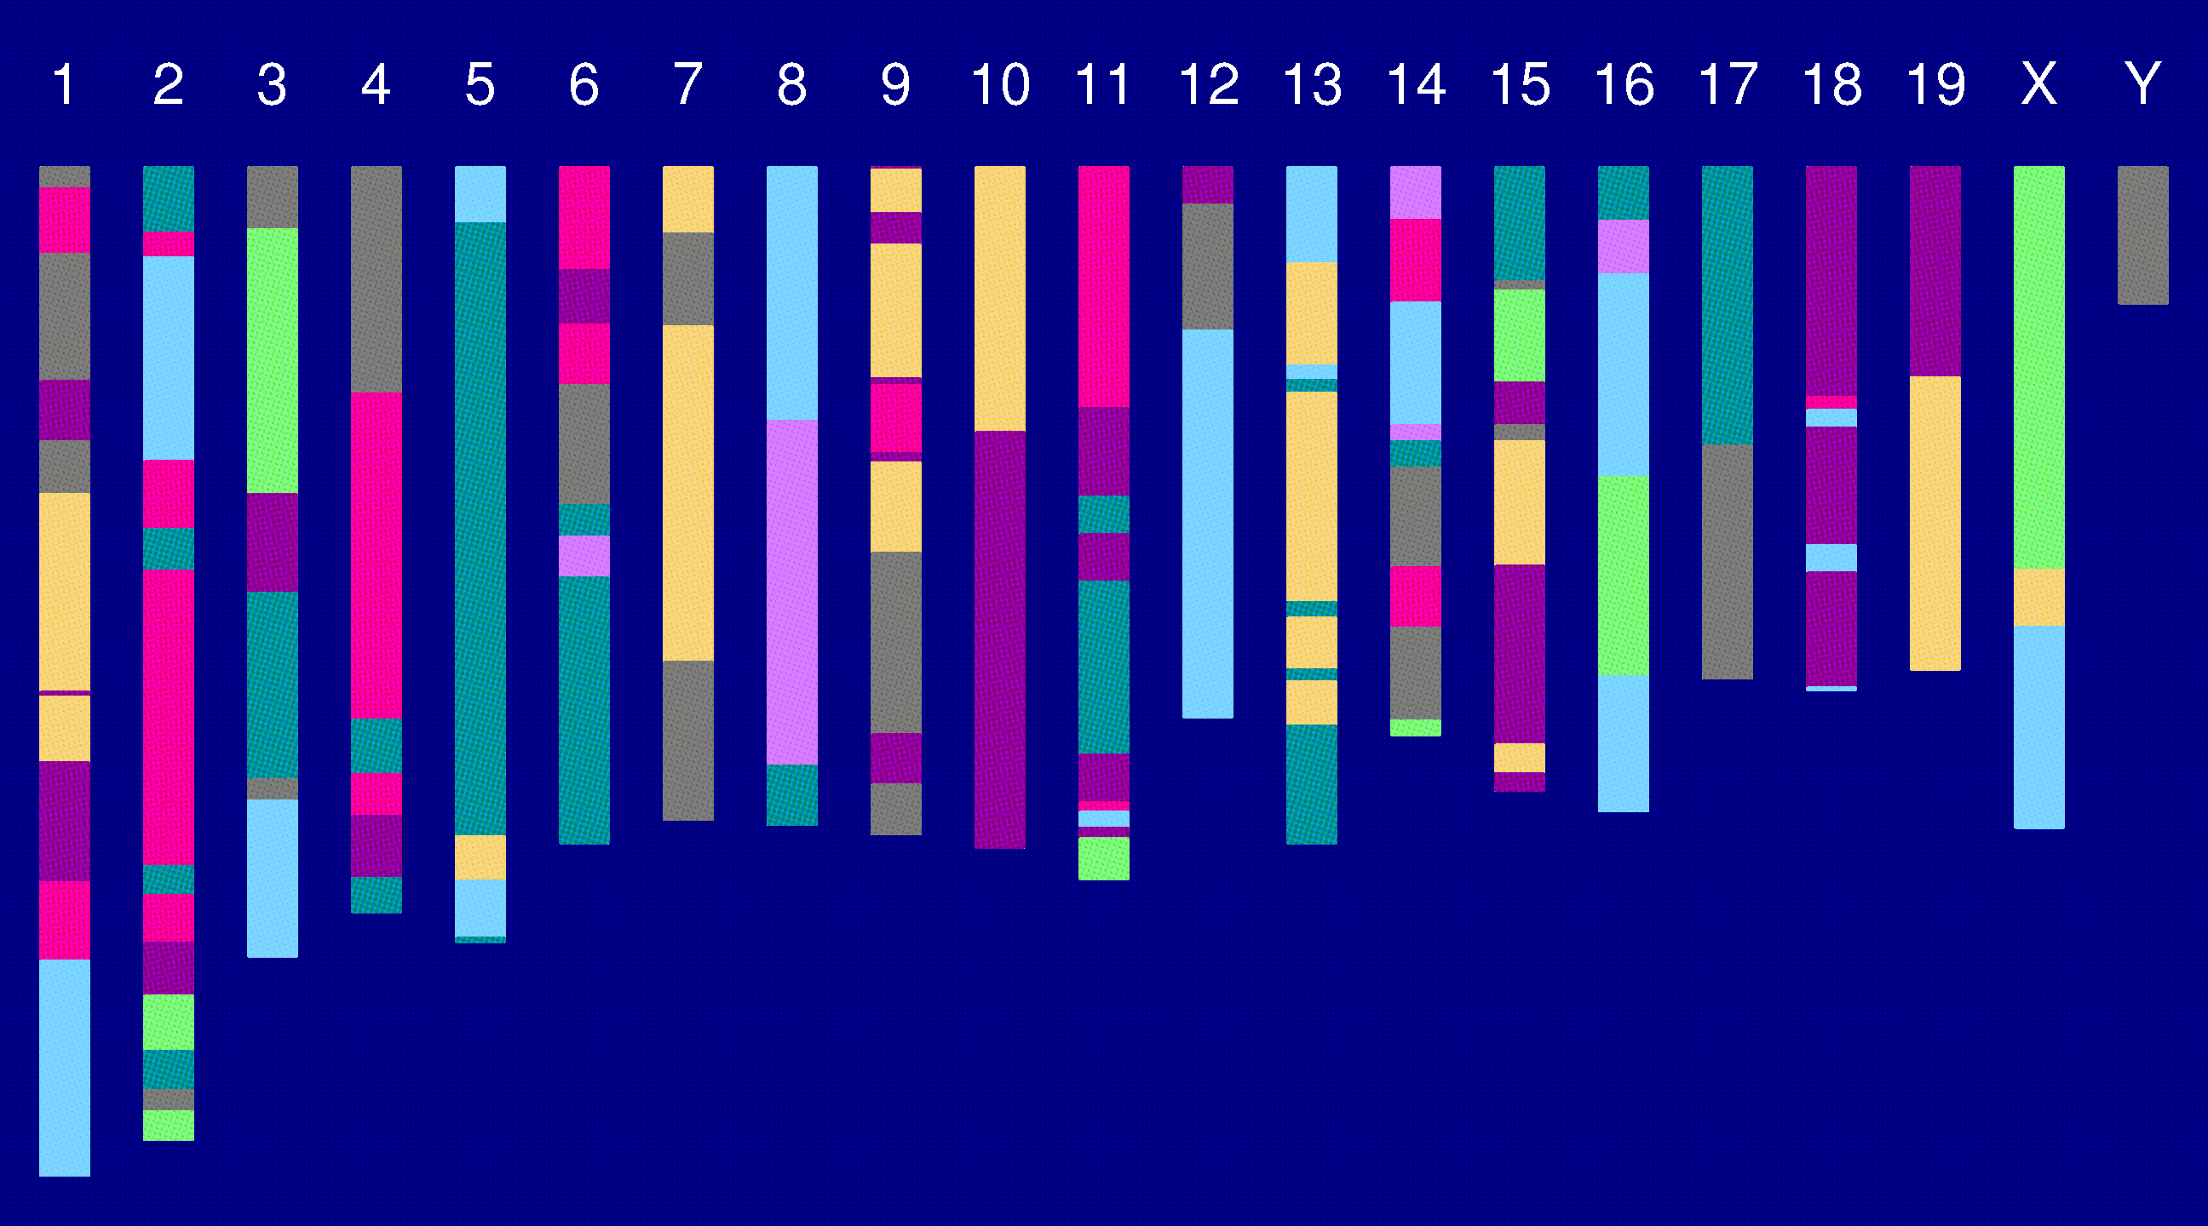
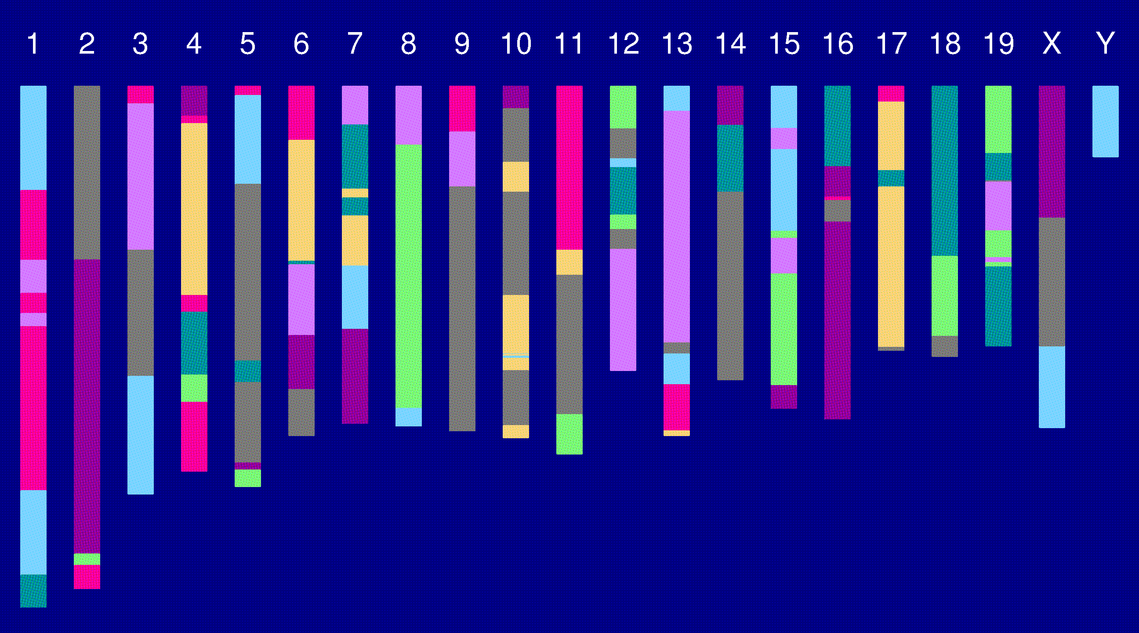
Genome of an 8-way RI

Slide 10
The Collaborative Cross
Advantages
Great mapping precision.
Eternal resource.
  Genotype only once.
  Study multiple invasive phenotypes on the same genotype.
Barriers
Advantages not widely appreciated.
  Ask one question at a time, or Ask many questions at once?
Time.
Expense.
Requires large-scale collaboration.

Slide 11
The Collaborative Cross
Complex Trait Consortium (2004) Nat Genet 36:1133-1137

Slide 12
The goal
(for the rest of this talk)
Characterize the breakpoint process along a chromosome in 8-way RILs.
  Understand the two-point haplotype probabilities.
  Study the clustering of the breakpoints, as a function of crossover interference in meiosis.

Slide 13
2 points in an RIL
1
2
r = recombination fraction = probability of a recombination in the interval in a random meiotic product.
R = analogous thing for the RIL = probability of different alleles at the two loci on a random RIL chromosome.

Slide 14
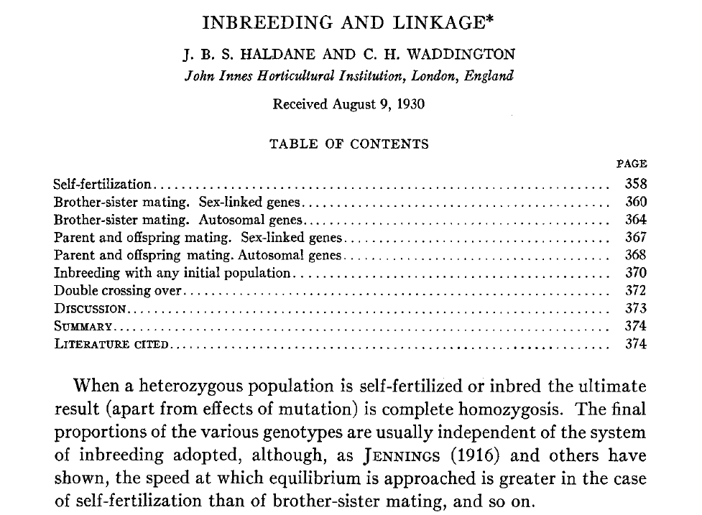
Haldane & Waddington 1931
Genetics 16:357-374

Slide 15
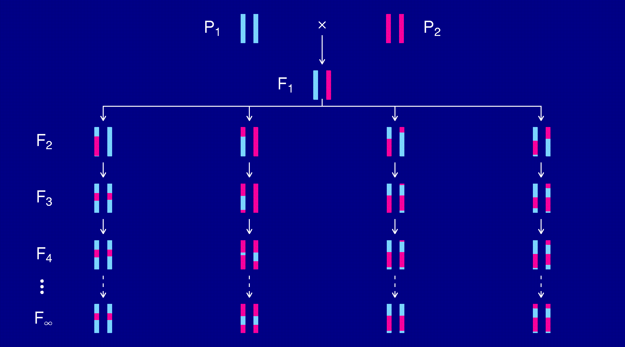
Recombinant inbred lines
(by selfing)

Slide 16
Markov chain
Sequence of random variables {X₀, X₁, X₂, …} satisfying
Pr(X_{n+1} | X₀, X₁, …, X_{n}) = Pr(X_{n+1} | X_{n})
Transition probabilities P_{ij} = Pr(X_{n+1}=j | X_{n}=i)
Here, X_{n} = “parental type” at generation n
We are interested in absorption probabilities
Pr(X_{n} → j | X₀)

Slide 17
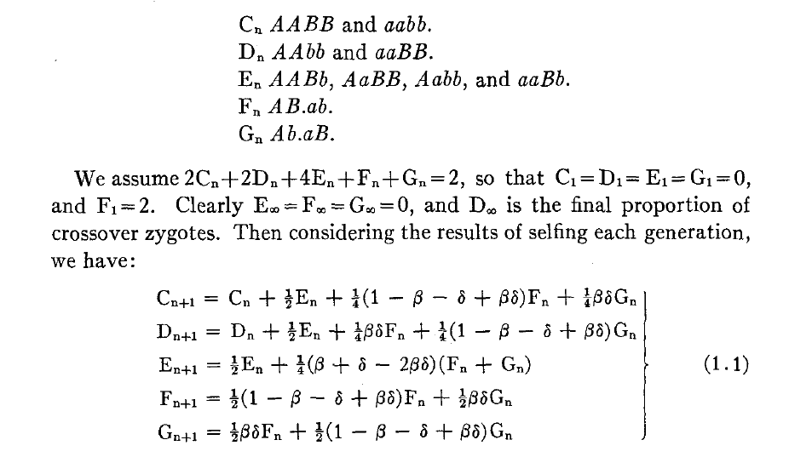
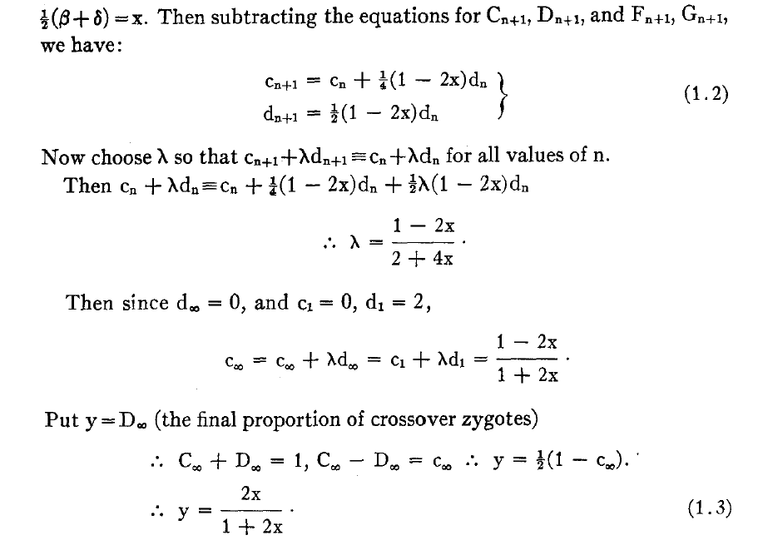
Equations for selfing

Slide 18
Absorption probabilities
Let P_{ij} = Pr(X_{n+1} = j | X_{n} = i) where X_{n} = state at generation n.
Consider the case of absorption into the state AA|AA.
Let h_{i} = probability, starting at i, eventually absorbed into AA|AA.
Then h_{AA|AA} = 1 and h_{AB|AB} = 0.
Condition on the first step: h_{i} = ∑_{k} P_{ik} h_{k}
For selfing, this gives a system of 3 linear equations.

Slide 19
Recombinant inbred lines
(by sibling mating)

Slide 20
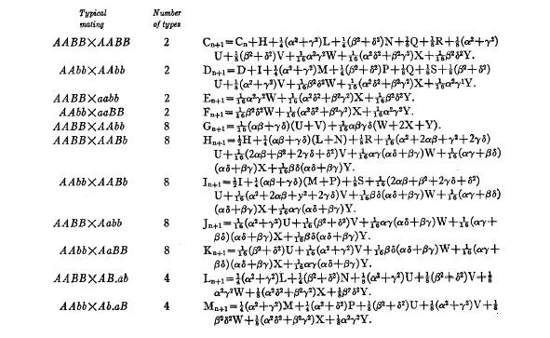
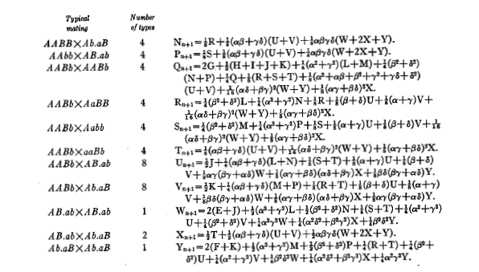
Equations for sib-mating

Slide 21
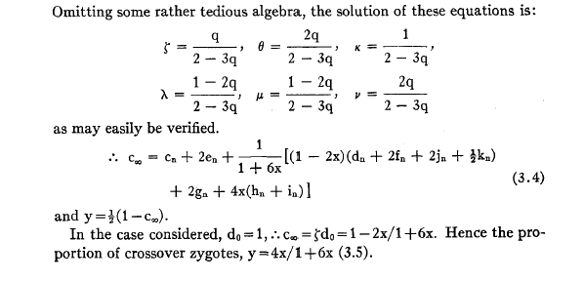
Result for sib-mating

Slide 22
The “Collaborative Cross”

Slide 23
8-way RILs
Autosomes
  Pr(G₁ = i) = 1/8
  Pr(G₂ = j | G₁ = i) = r / (1+6r) for i ≠ j
  Pr(G₂ ≠ G₁) = 7r / (1+6r)
X chromosome
  Pr(G₁=A) = Pr(G₁=B) = Pr(G₁=E) = Pr(G₁=F) =1/6
  Pr(G₁=C) = 1/3
  Pr(G₂=B | G₁=A) = r / (1+4r)
  Pr(G₂=C | G₁=A) = 2r / (1+4r)
  Pr(G₂=A | G₁=C) = r / (1+4r)
  Pr(G₂ ≠ G₁) = (14/3) r / (1+4r)

Slide 24
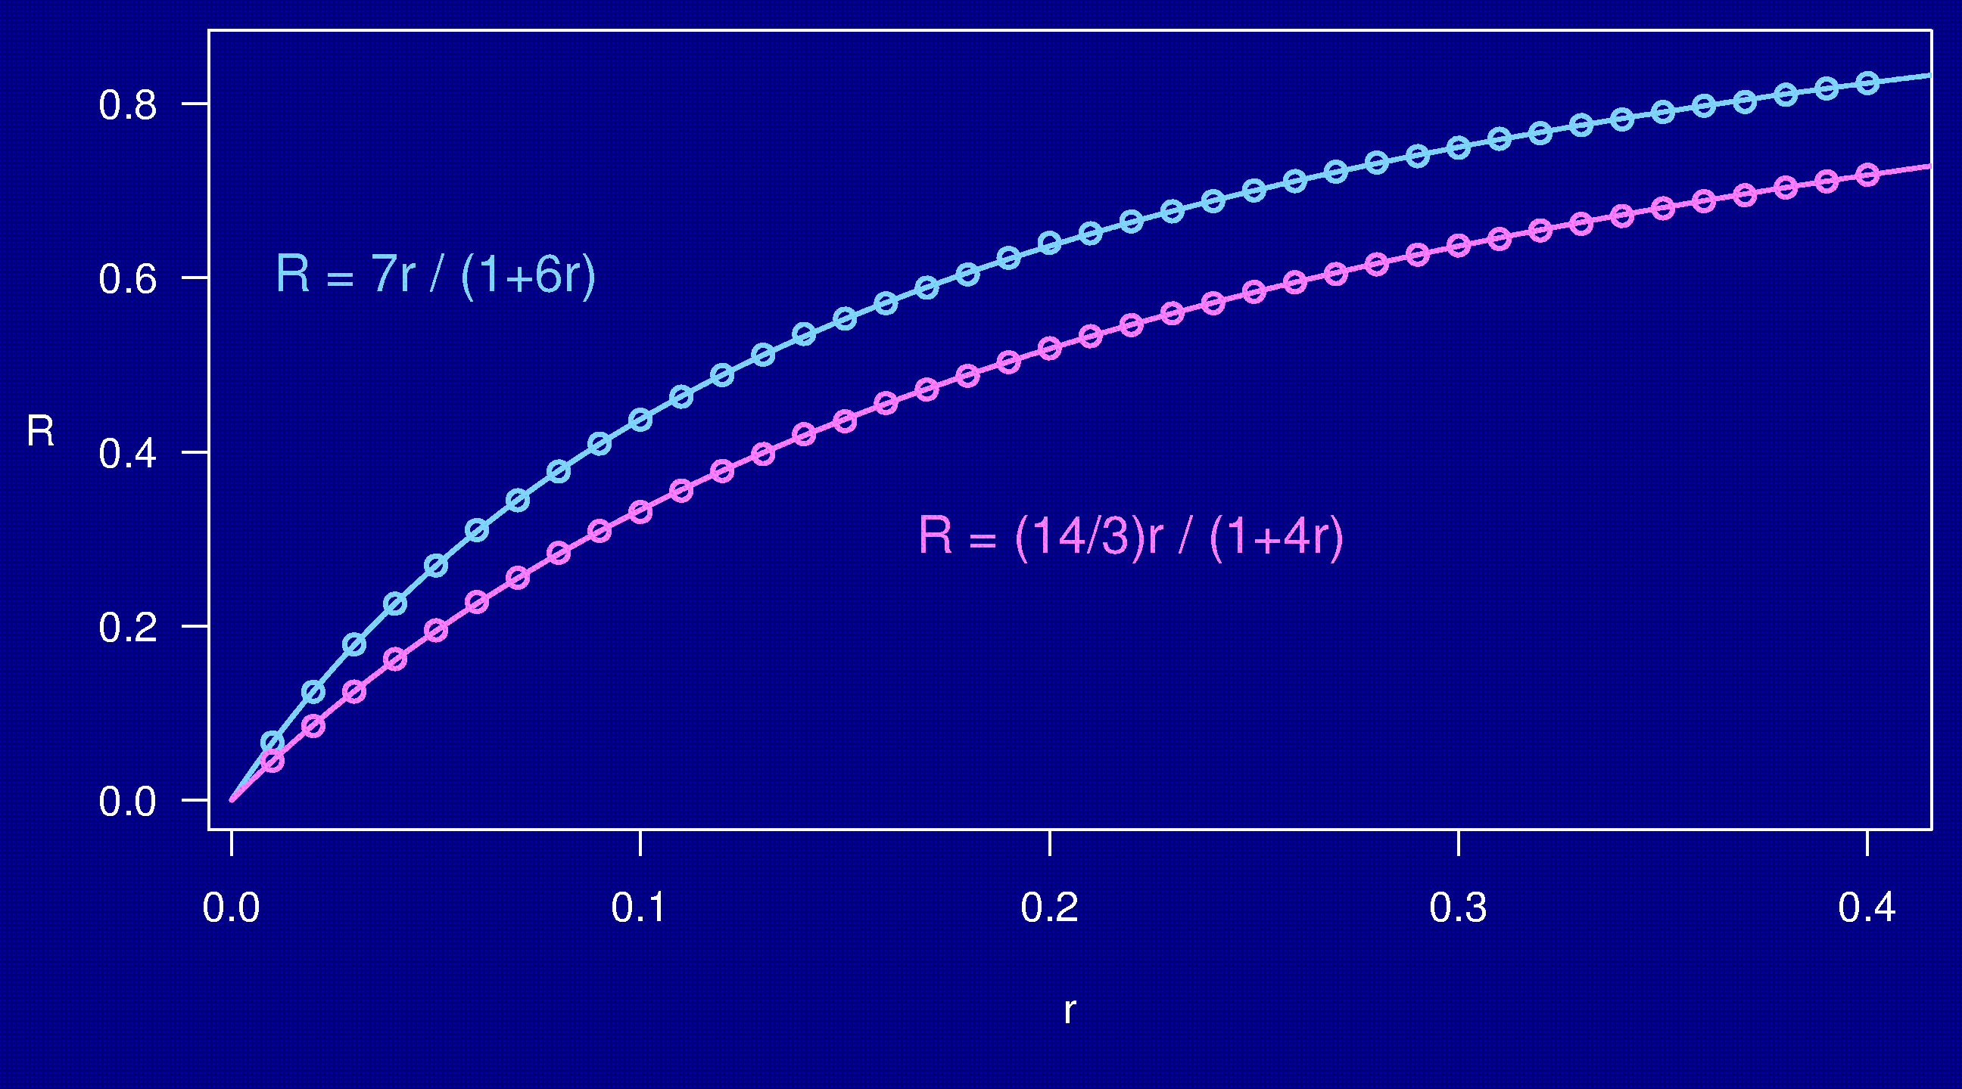
Computer simulations

Slide 25
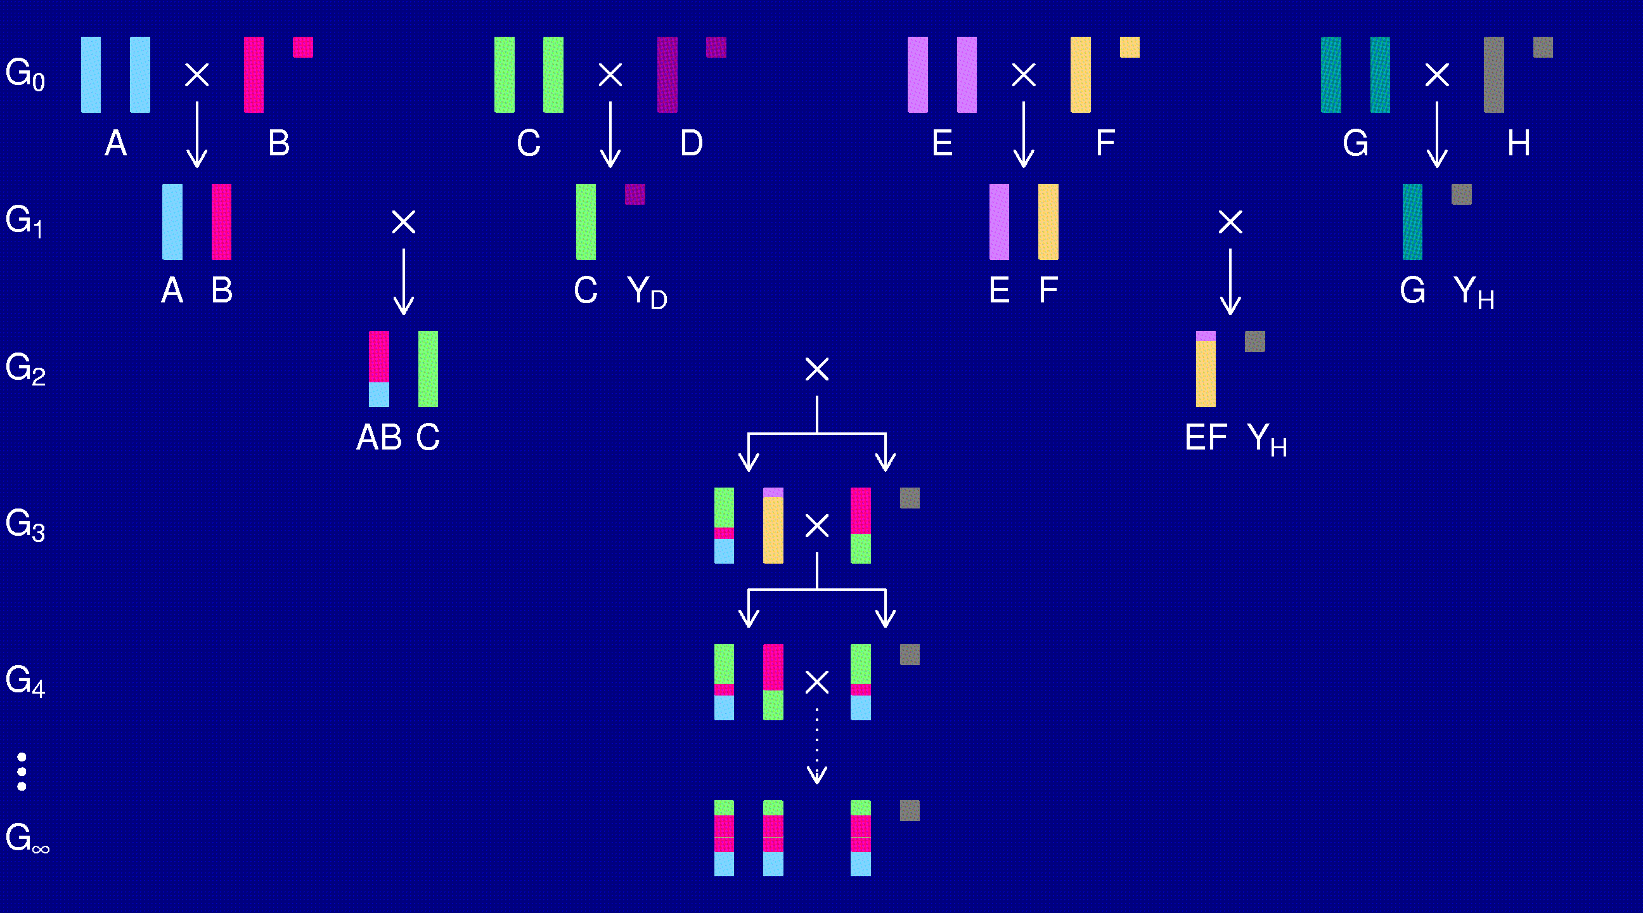
The X chromosome

Slide 26
3-point coincidence
1
2
3
r_{ij} = recombination fraction for interval i,j;
assume r₁₂ = r₂₃ = r
Coincidence = c = Pr(double recombinant) / r²
= Pr(rec’n in 23 | rec’n in 12) / Pr(rec’n in 23)
No interference → = 1
Positive interference → < 1
Negative interference → > 1
Generally c is a function of r.

Slide 27
3-points in 2-way RILs
1
2
3
r₁₃ = 2 r (1 – c r)
R = f(r); R₁₃ = f(r₁₃)
Pr(double recombinant in RIL) = { R + R – R₁₃ } / 2
Coincidence (in 2-way RIL) = { 2 R – R₁₃ } / { 2 R² }
Notes:
This is included at the end of Haldane & Waddington (1931).

Slide 28
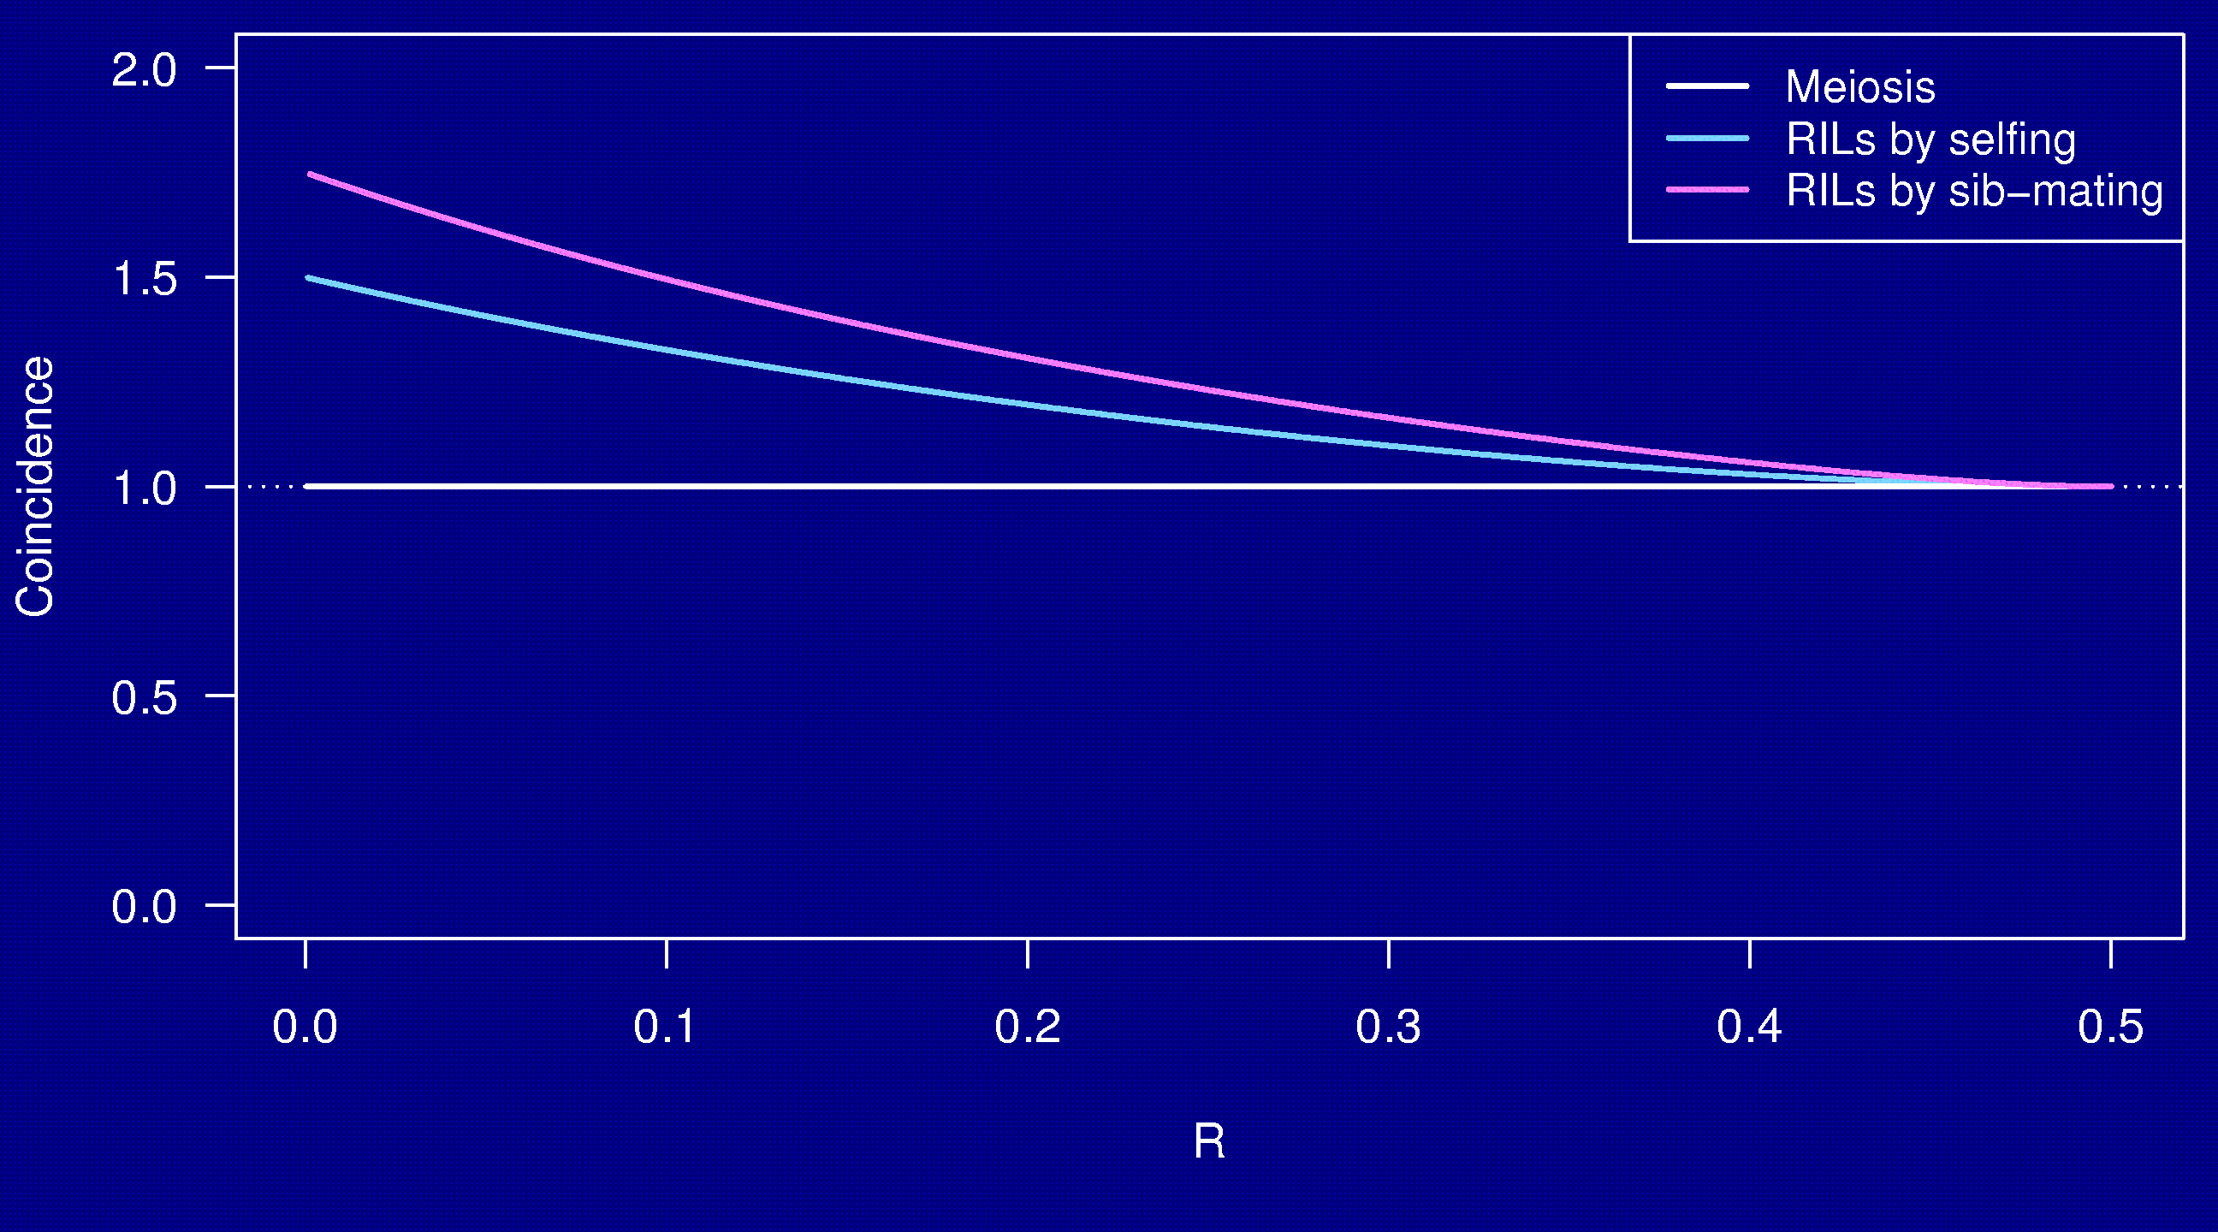
Coincidence
No interference

Slide 29
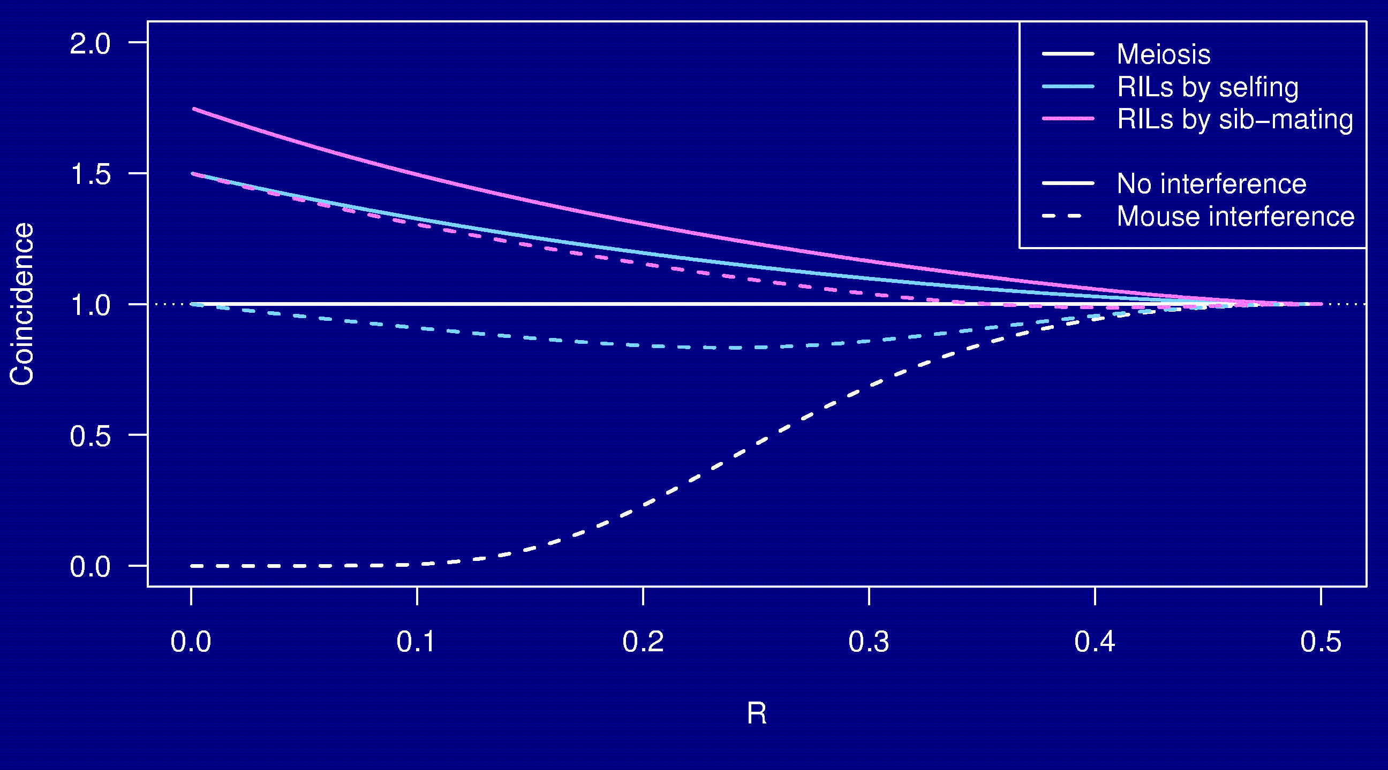
Coincidence

Slide 30
Why the clustering of breakpoints?
The really close breakpoints occur in different generations.
Breakpoints in later generations can occur only in regions that are not yet fixed.
The regions of heterozygosity are, of course, surrounded by breakpoints.

Slide 31
Coincidence in 8-way RILs
The trick that allowed us to get the coincidence for 2-way RILs doesn’t work for 8-way RILs.
It’s sufficient to consider 4-way RILs.
Calculations for 3 points in 4-way RILs is still astoundingly complex.
  2 points in 2-way RILs by sib-mating:
  55 parental types → 22 states by symmetry
  3 points in 4-way RILs by sib-mating:
  2,164,240 parental types → 137,488 states
Even counting the states was difficult.

Slide 32
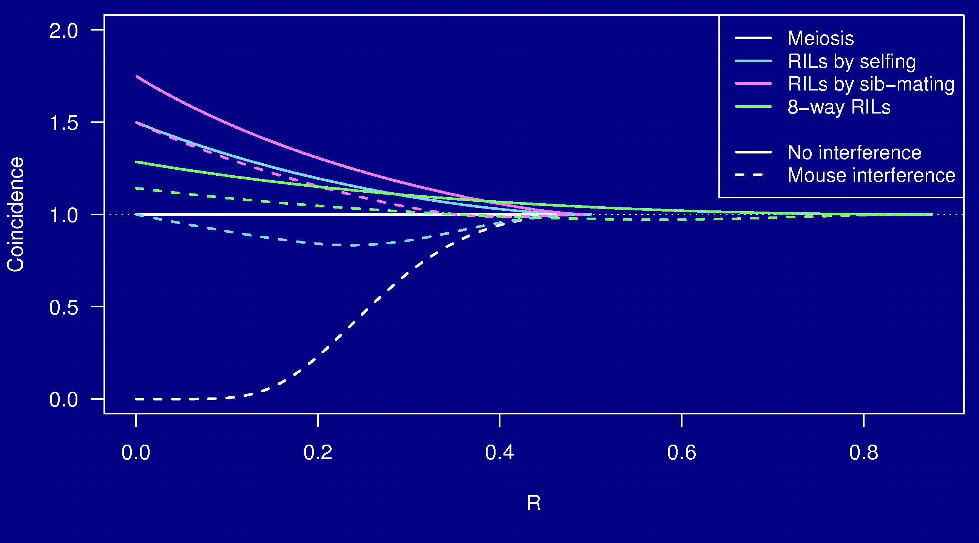
Coincidence

Slide 33
Whole genome simulations
2-way selfing, 2-way sib-mating, 8-way sib-mating
Mouse-like genome, 1665 cM
Strong positive crossover interference
Inbreed to complete fixation
10,000 simulation replicates

Slide 34
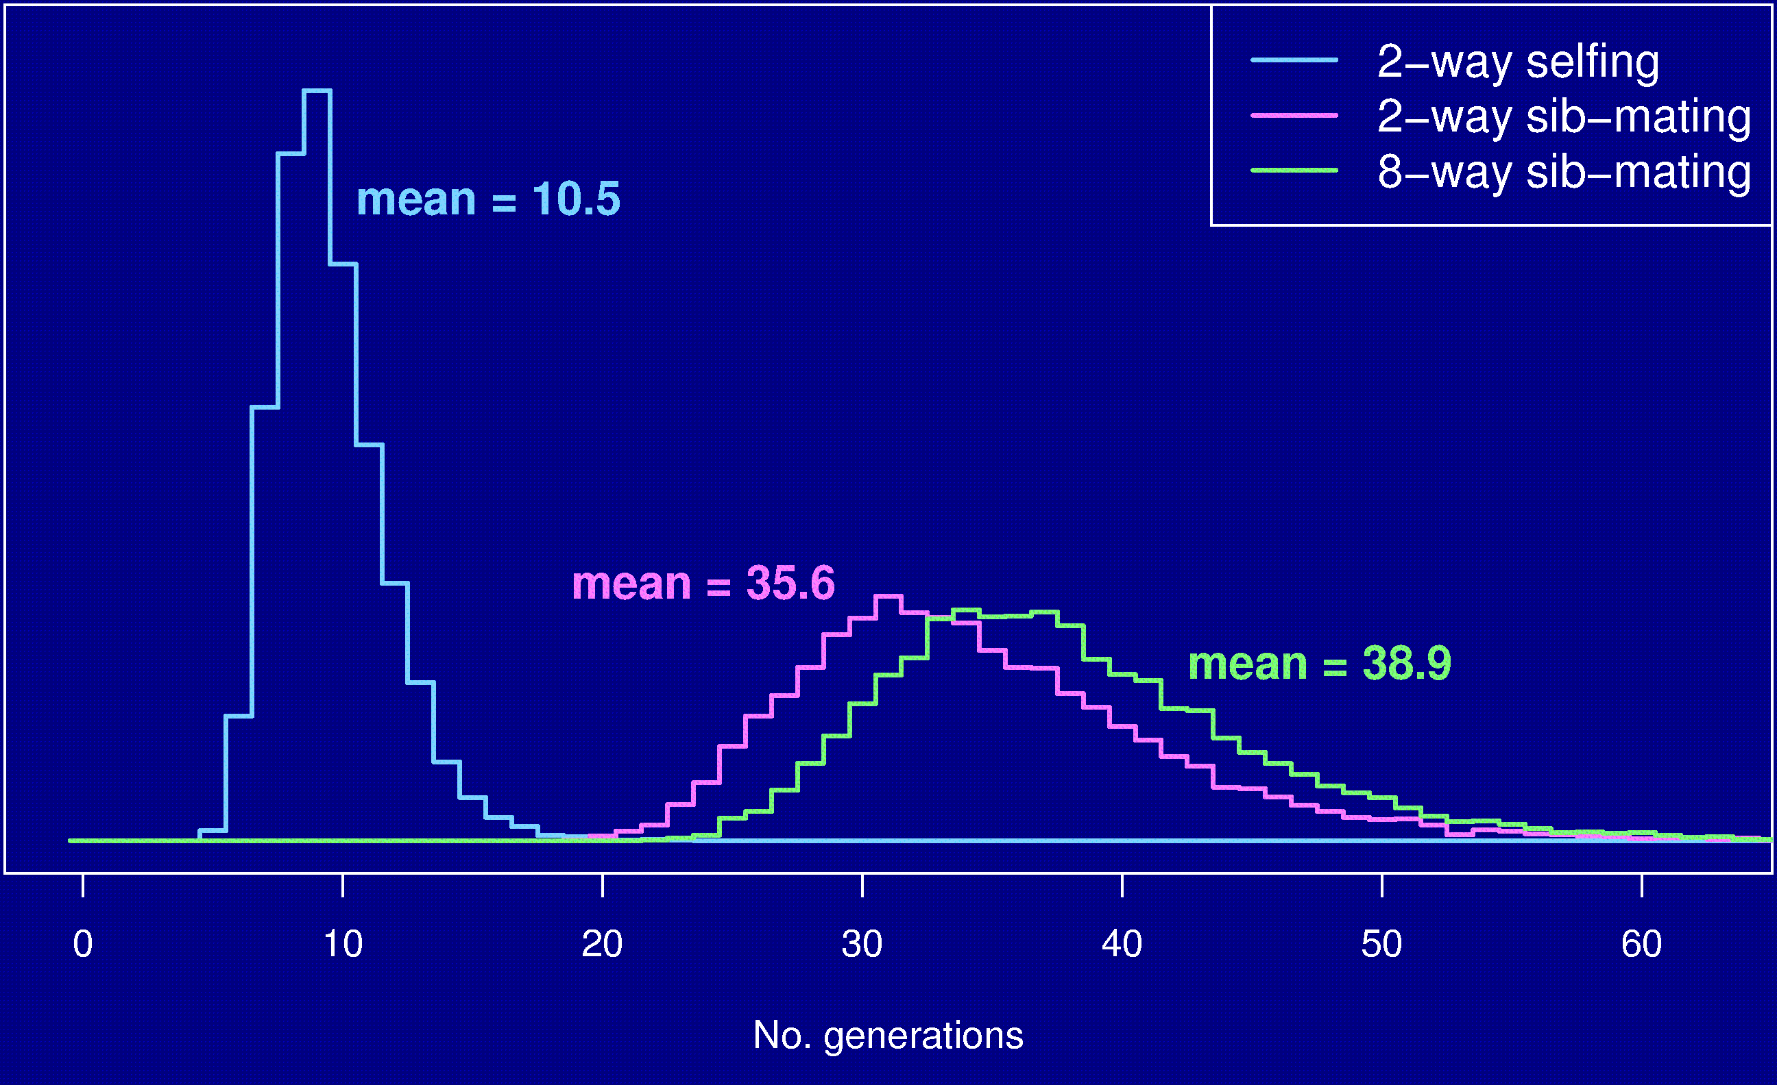
No. generations to fixation

Slide 35
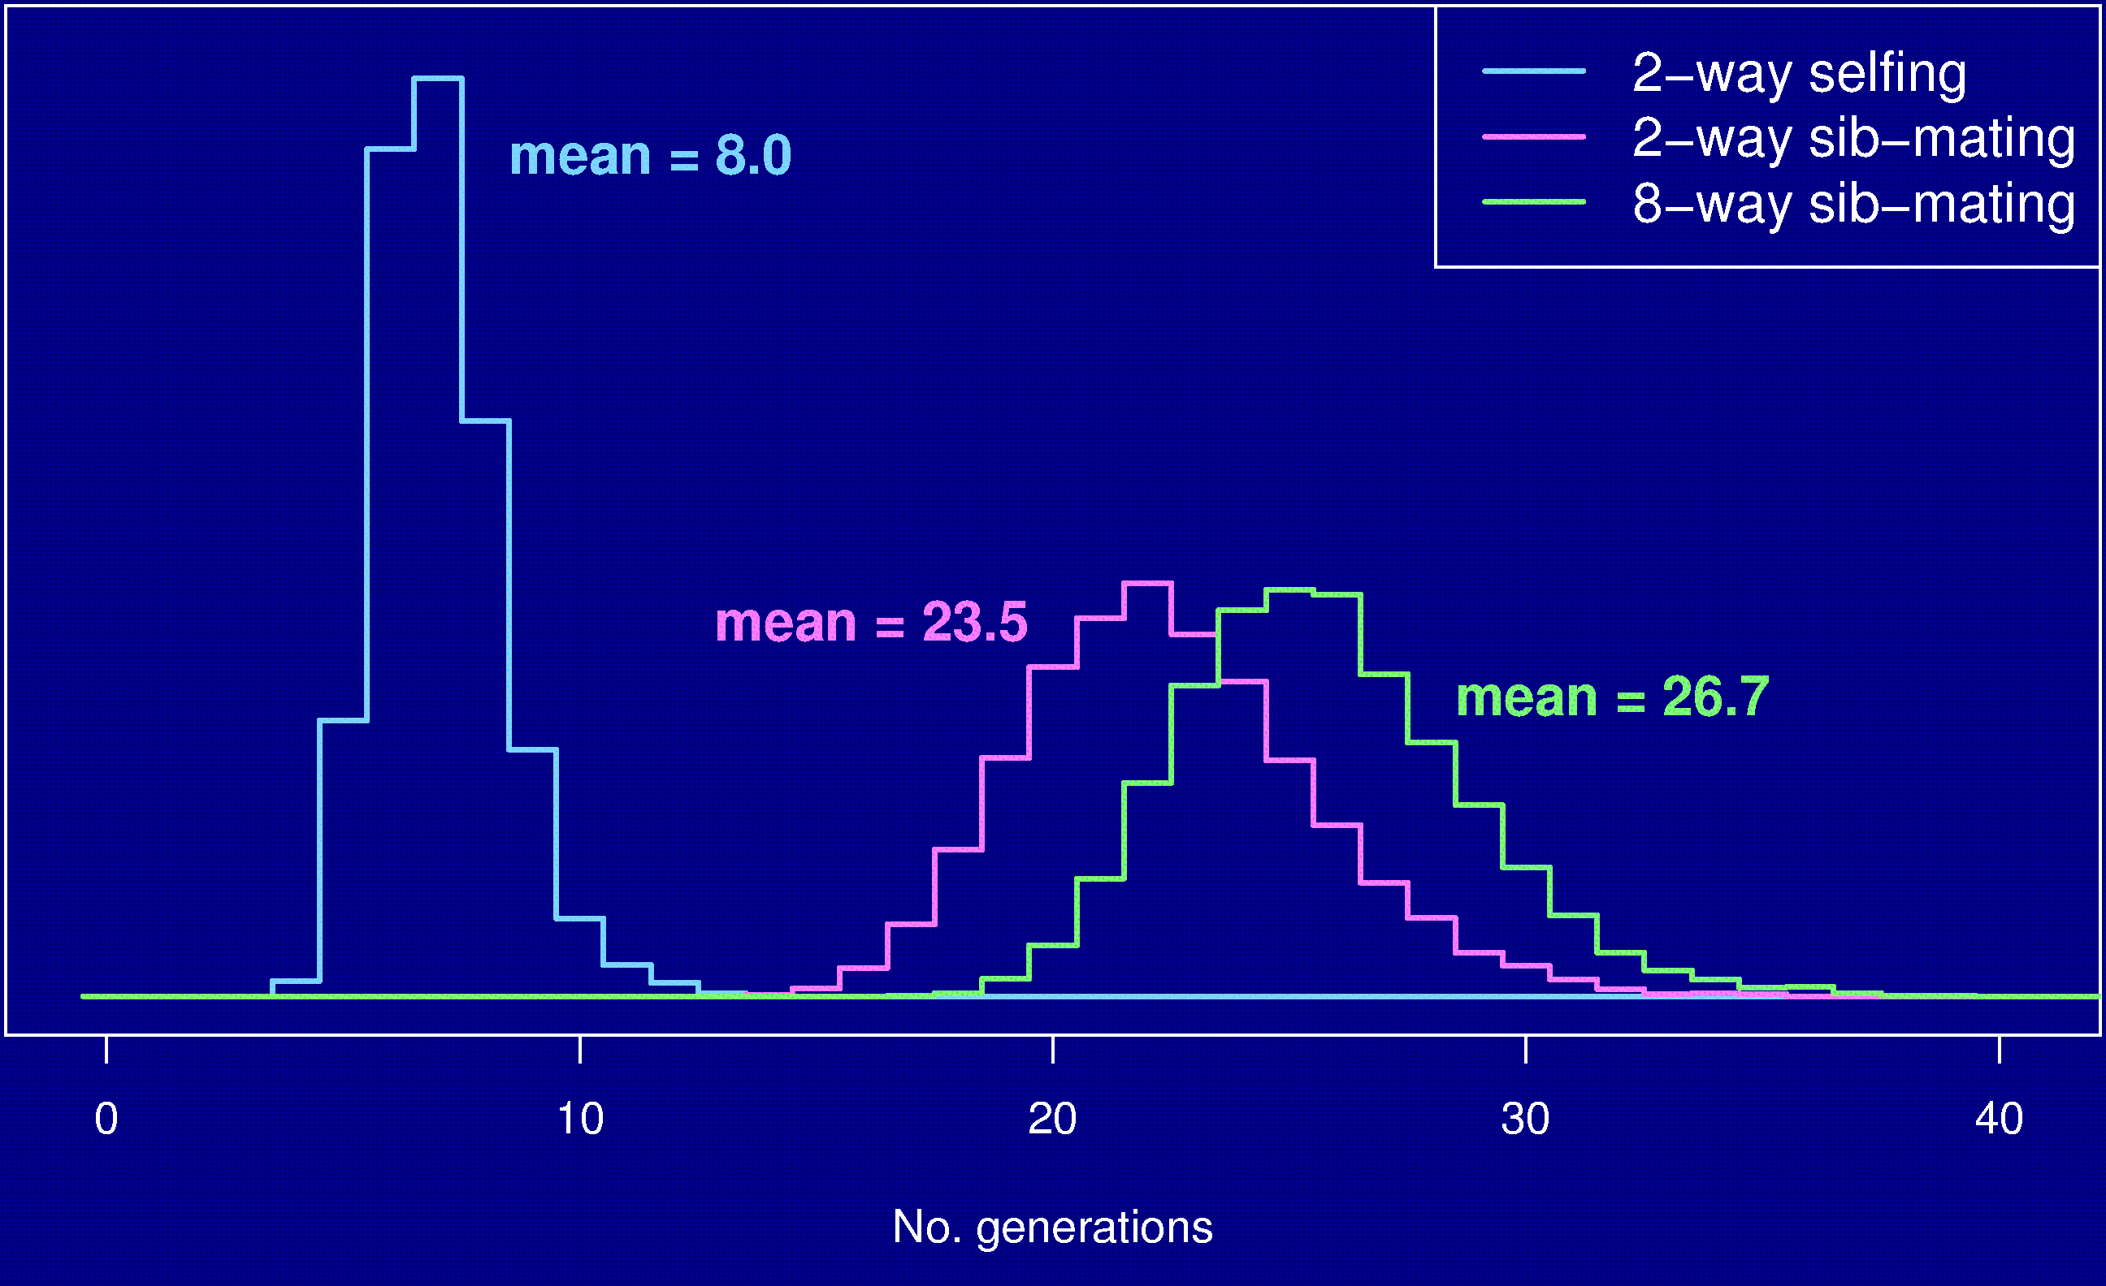
No. gen’s to 99% fixation

Slide 36
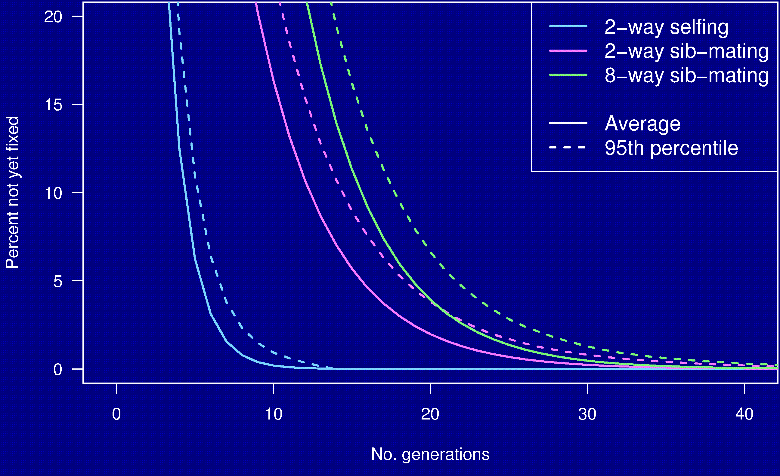
Percent genome not fixed

Slide 37
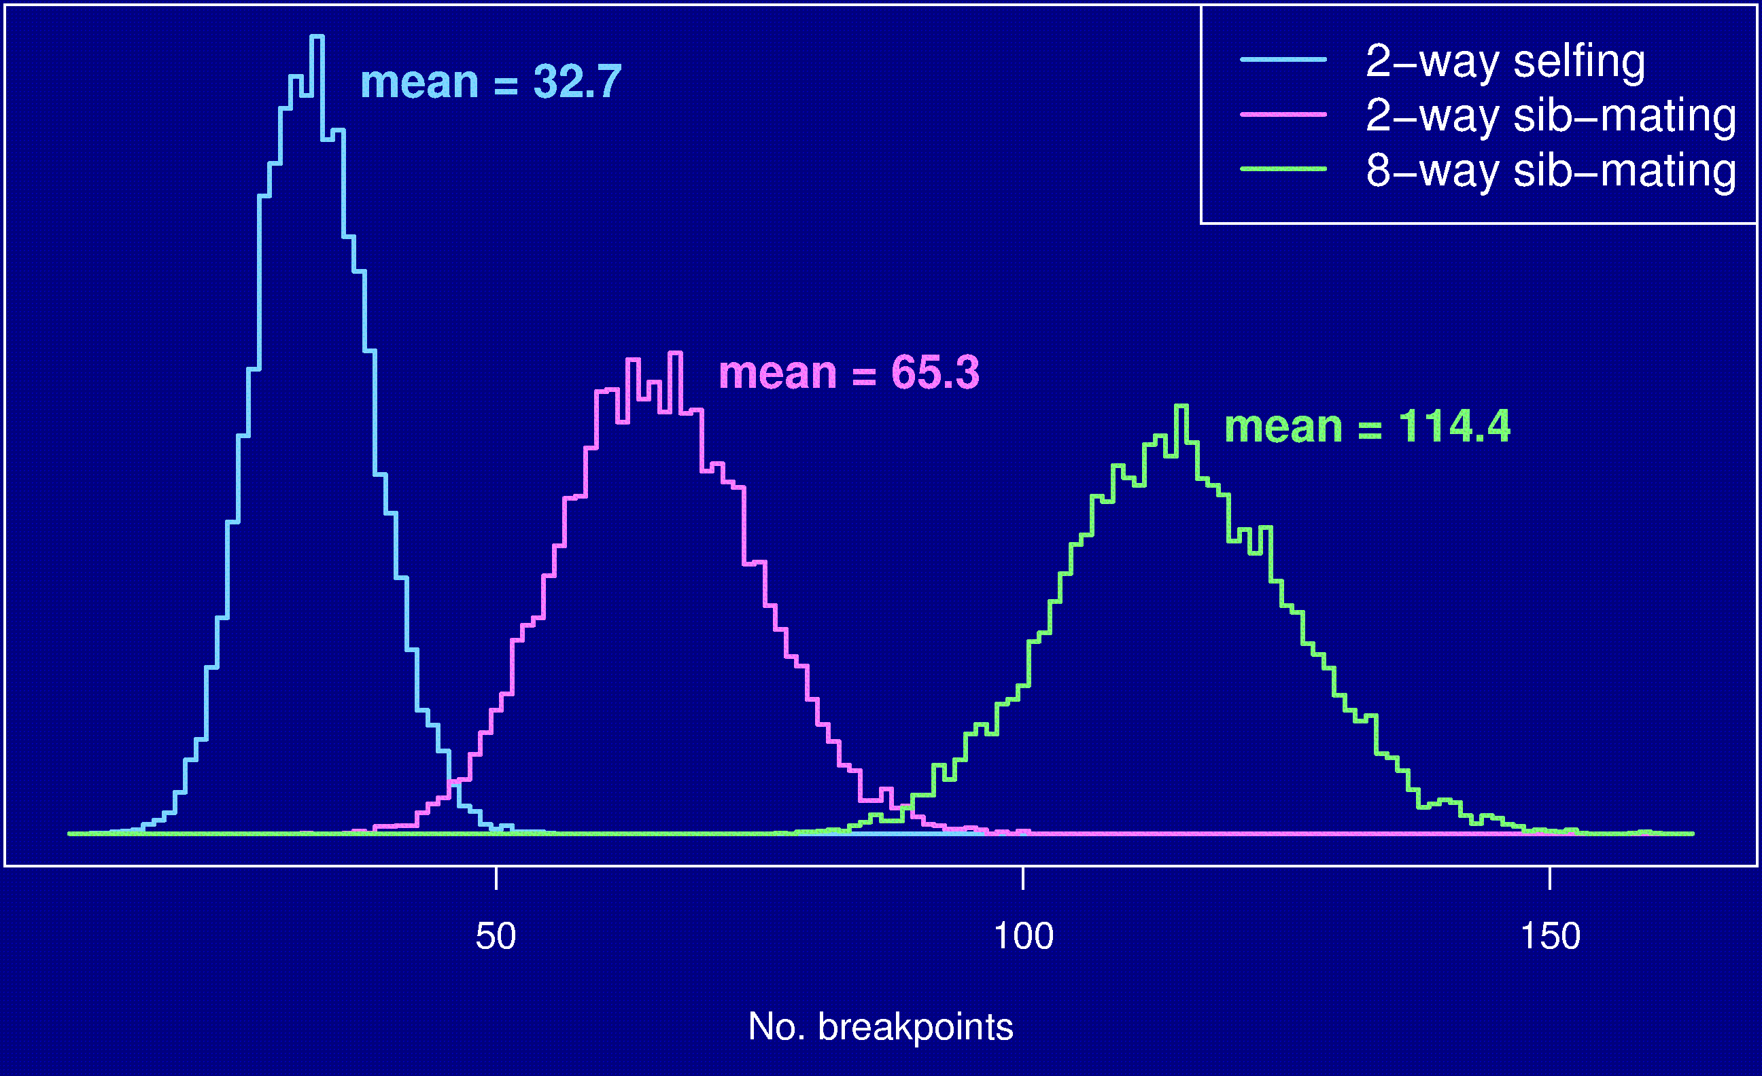
Number of breakpoints

Slide 38
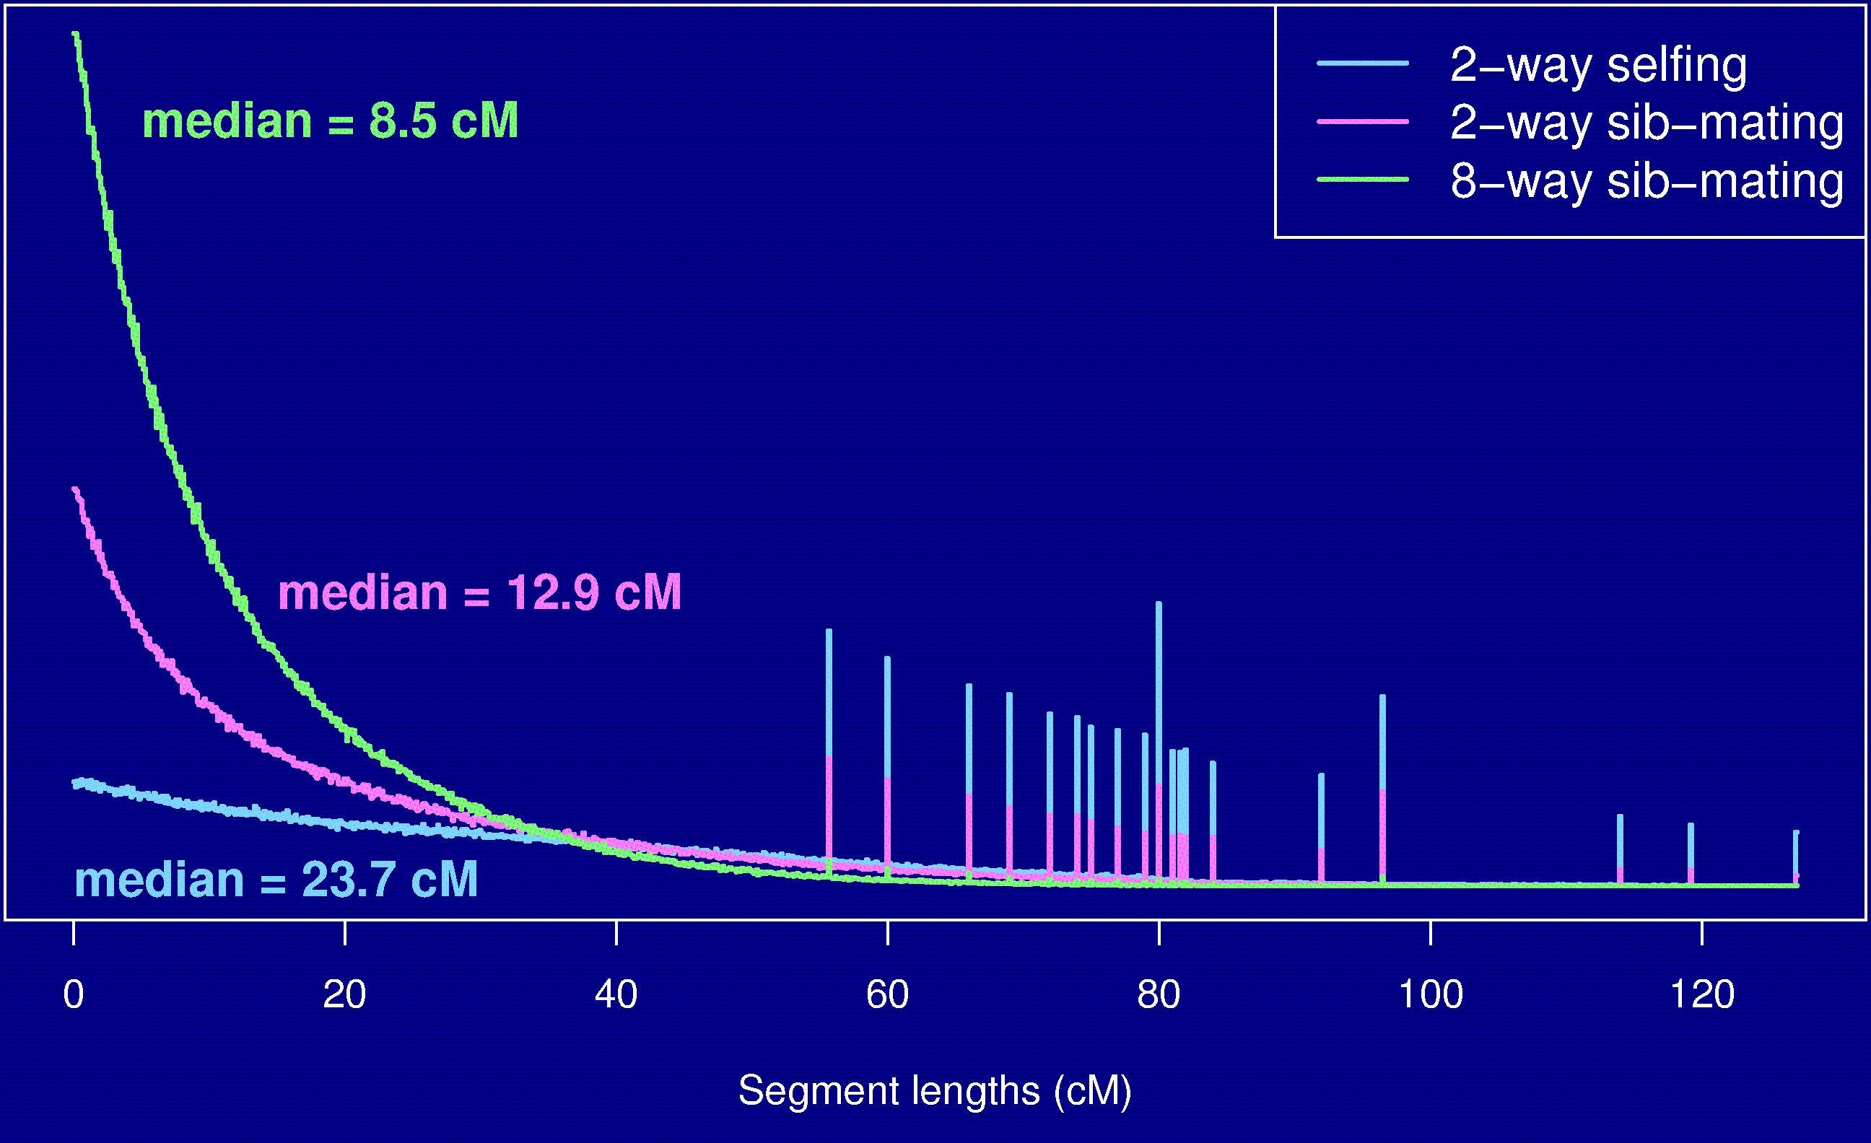
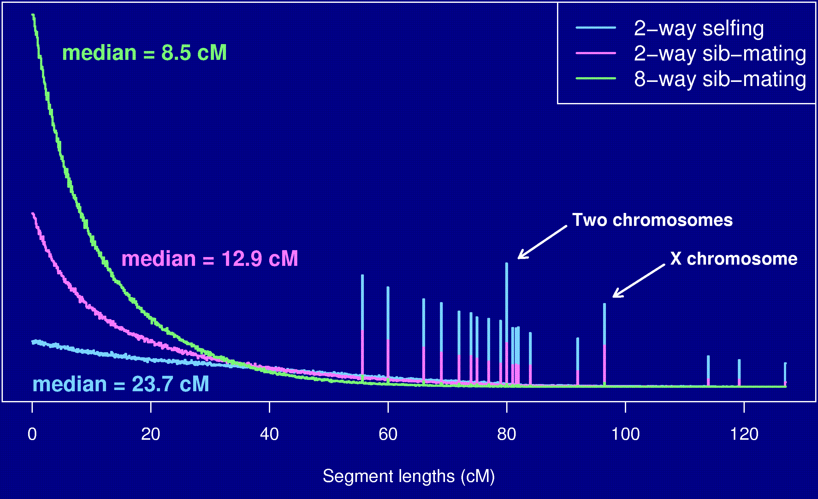
Segment lengths

Slide 39
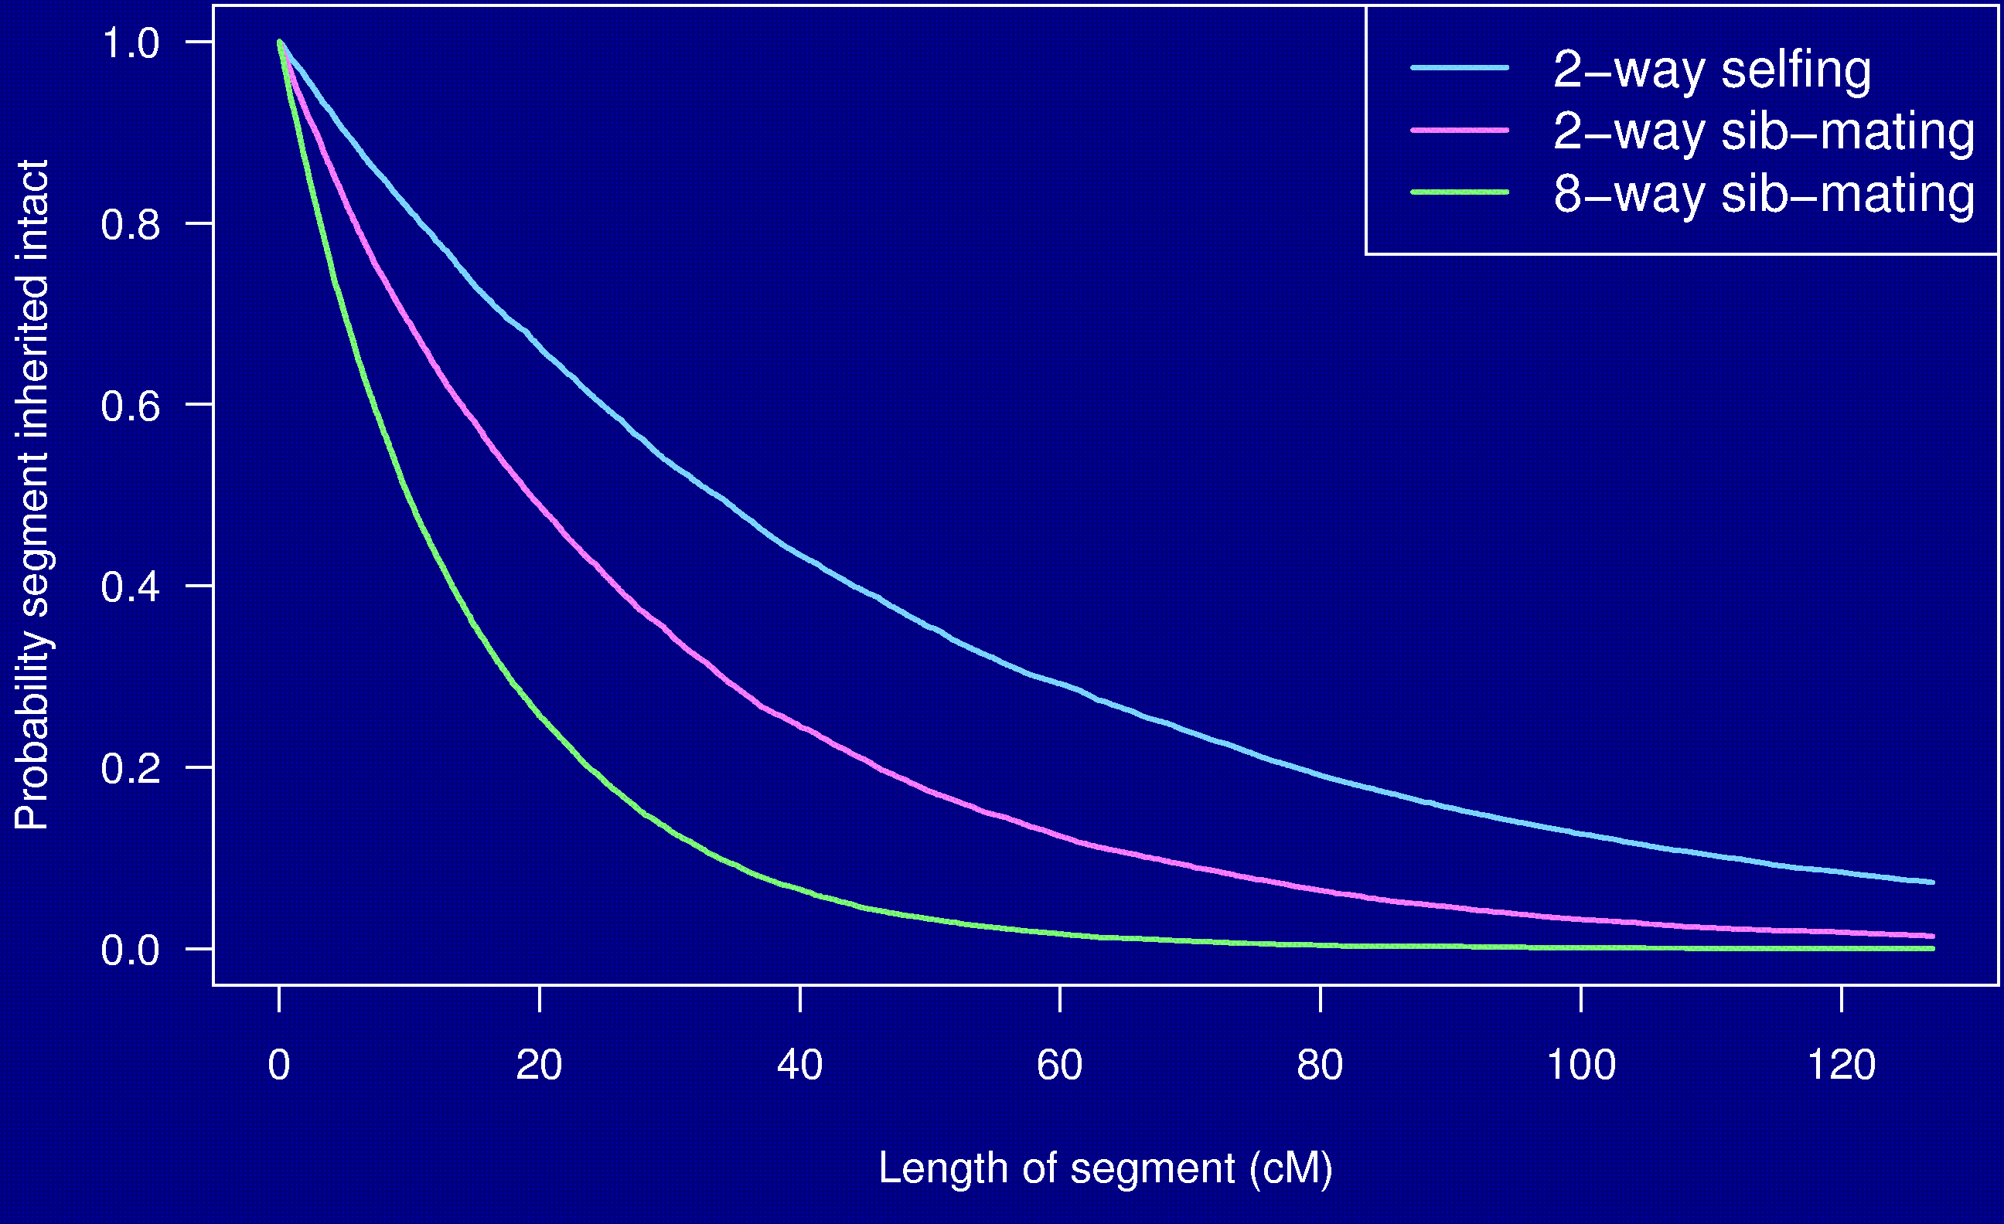
Probability a segment is inherited intact

Slide 40
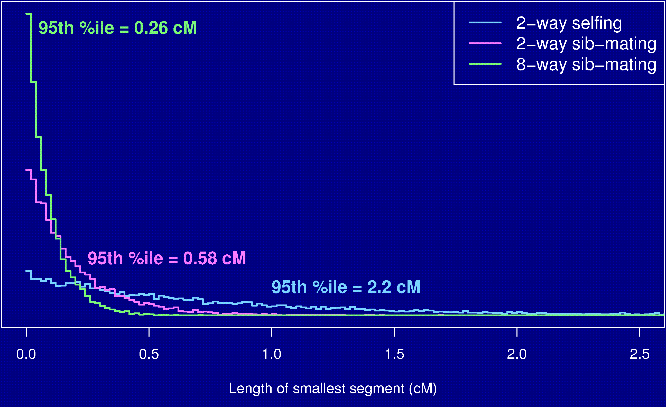
Length of smallest segment

Slide 41
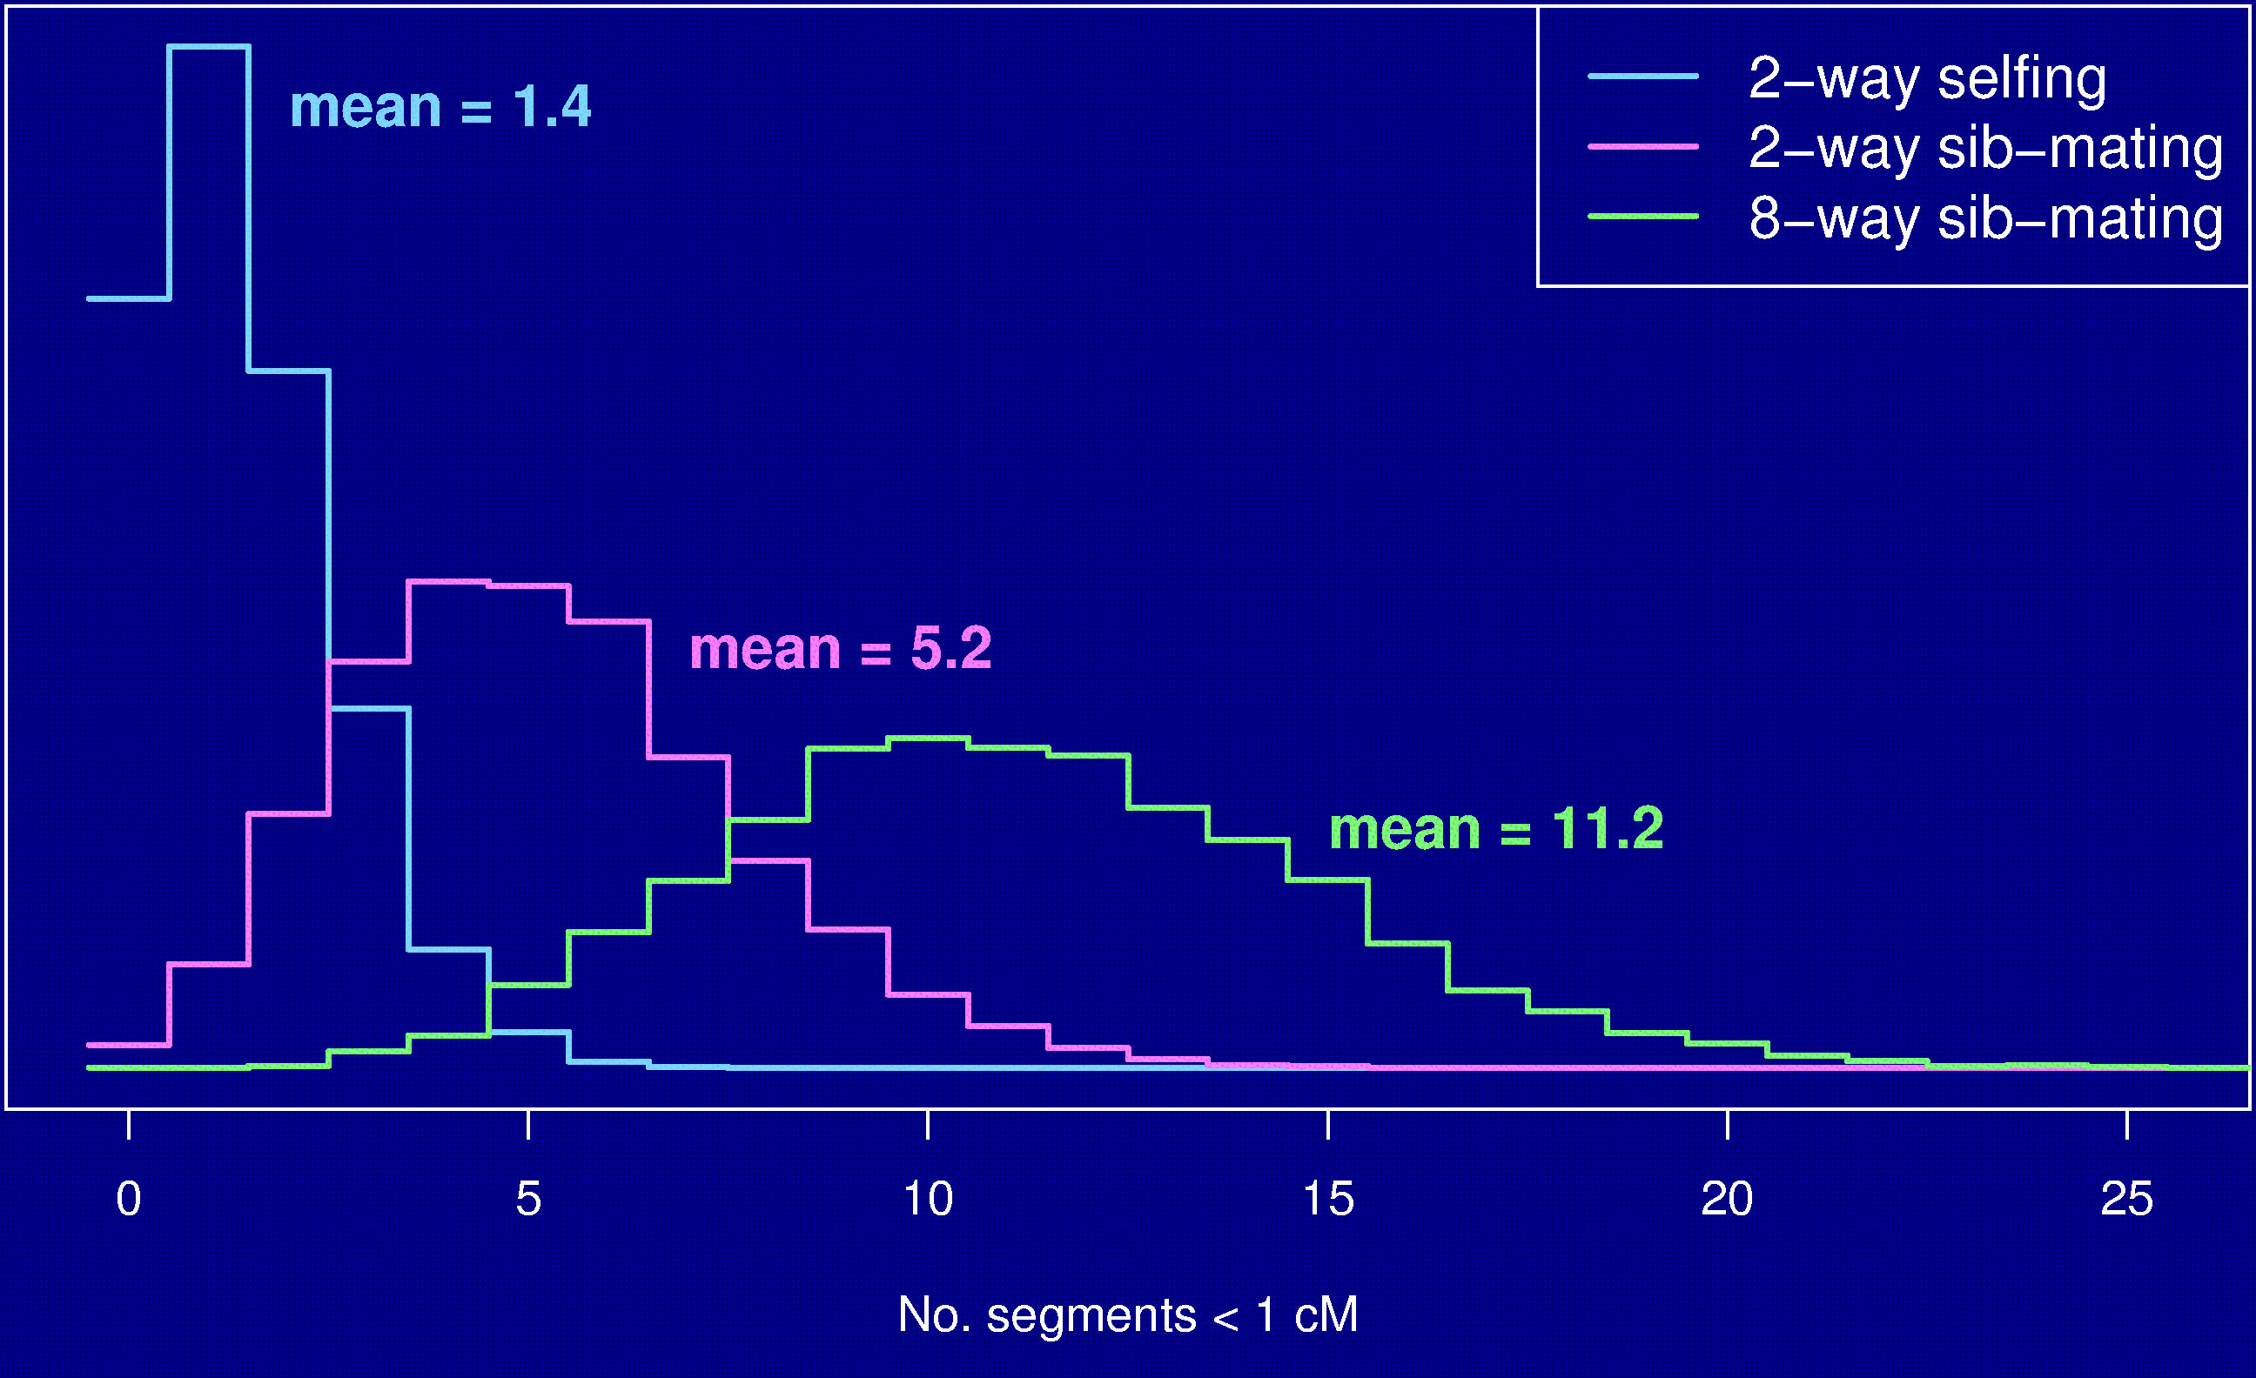
No. segments < 1 cM

Slide 42
Summary
The Collaborative Cross could provide “one-stop shopping” for gene mapping in the mouse.
Use of such 8-way RILs requires an understanding of the breakpoint process.
We’ve extended Haldane & Waddington’s results to the case of 8-way RILs: R = 7 r / (1 + 6 r).
We’ve shown clustering of breakpoints in RILs by sib-mating, even in the presence of strong crossover interference.
Broman KW (2005) The genomes of recombinant inbred lines. Genetics 169:1133-1146

