Slide 1
How to display data badly
Karl W Broman
Department of Biostatistics
http://www.biostat.wisc.edu/~kbroman

Slide 2
Using Microsoft Excel to obscure your data and annoy your readers
Karl W Broman
Department of Biostatistics
http://www.biostat.wisc.edu/~kbroman

Slide 3

Inspiration
This lecture was inspired by
H Wainer (1984) How to display data badly. American Statistician 38(2):137-147
Dr. Wainer was the first to elucidate the principles of the bad display of data.
The now widespread use of Microsoft Excel has resulted in remarkable advances in the field.

Slide 4
General principles
The aim of good data graphics:
  Display data accurately and clearly.
Some rules for displaying data badly:
  Display as little information as possible.
  Obscure what you do show (with chart junk).
  Use pseudo-3d and color gratuitously.
  Make a pie chart (preferably in color and 3d).
  Use a poorly chosen scale.
  Ignore sig figs.

Slide 5
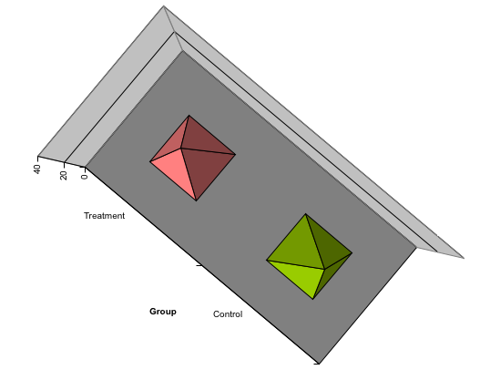
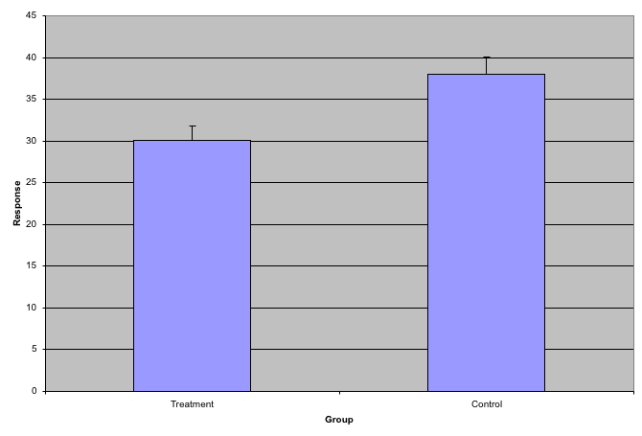
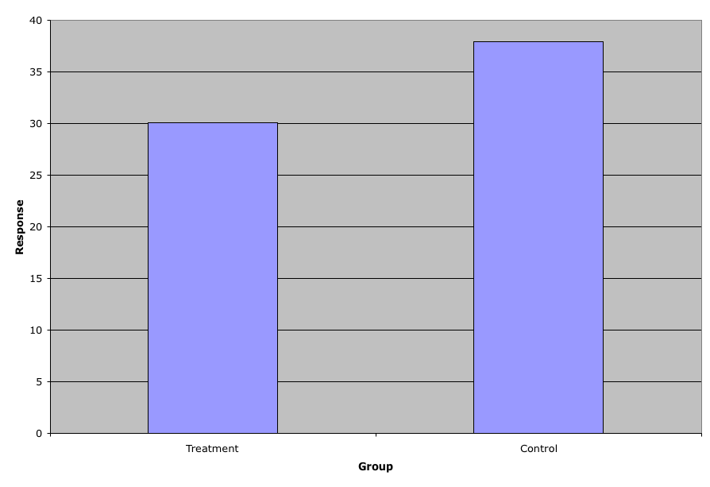
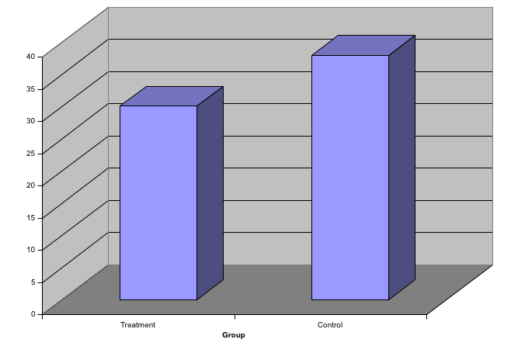
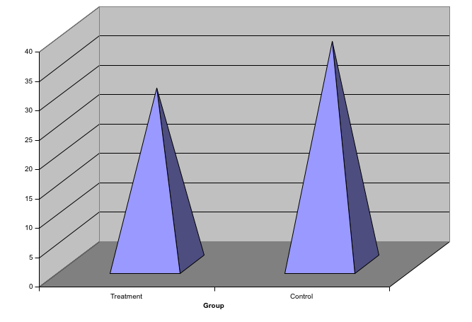
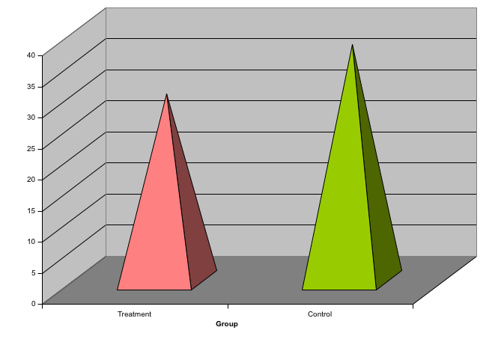
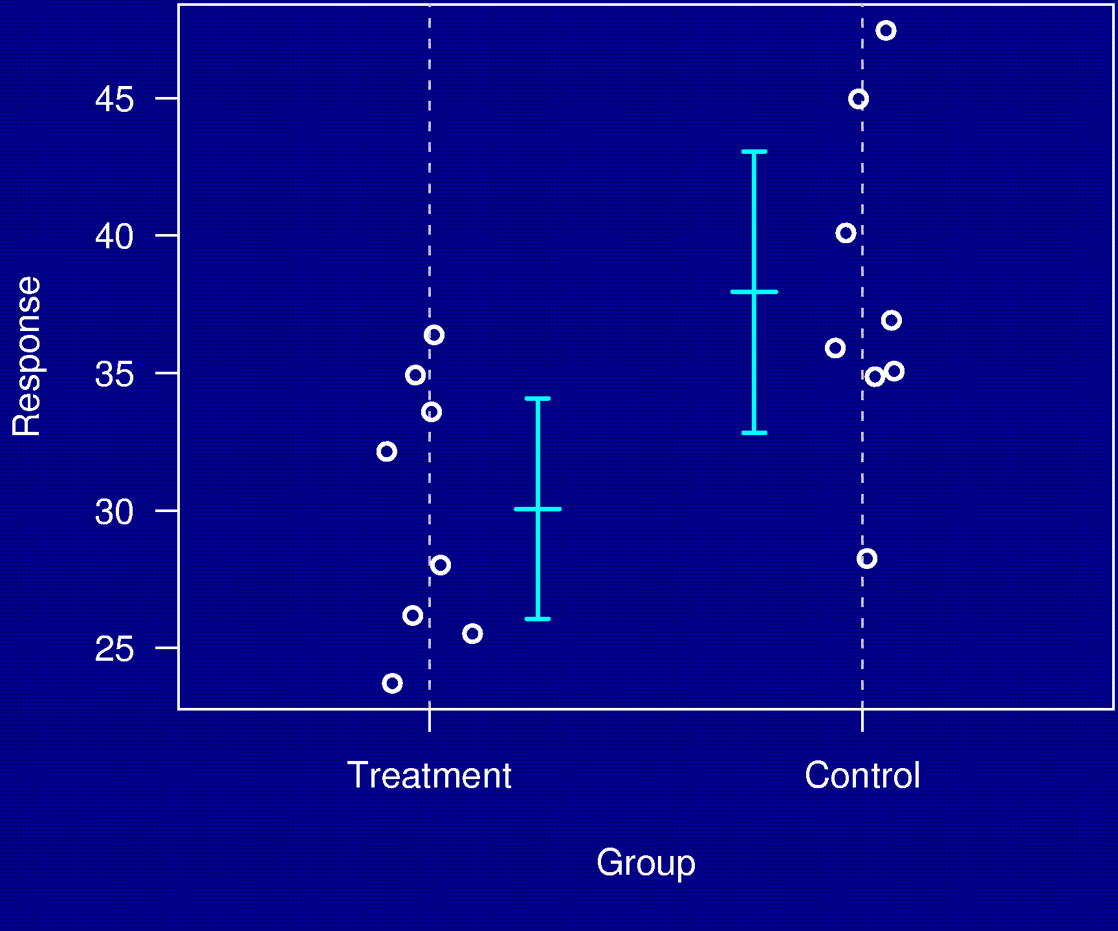
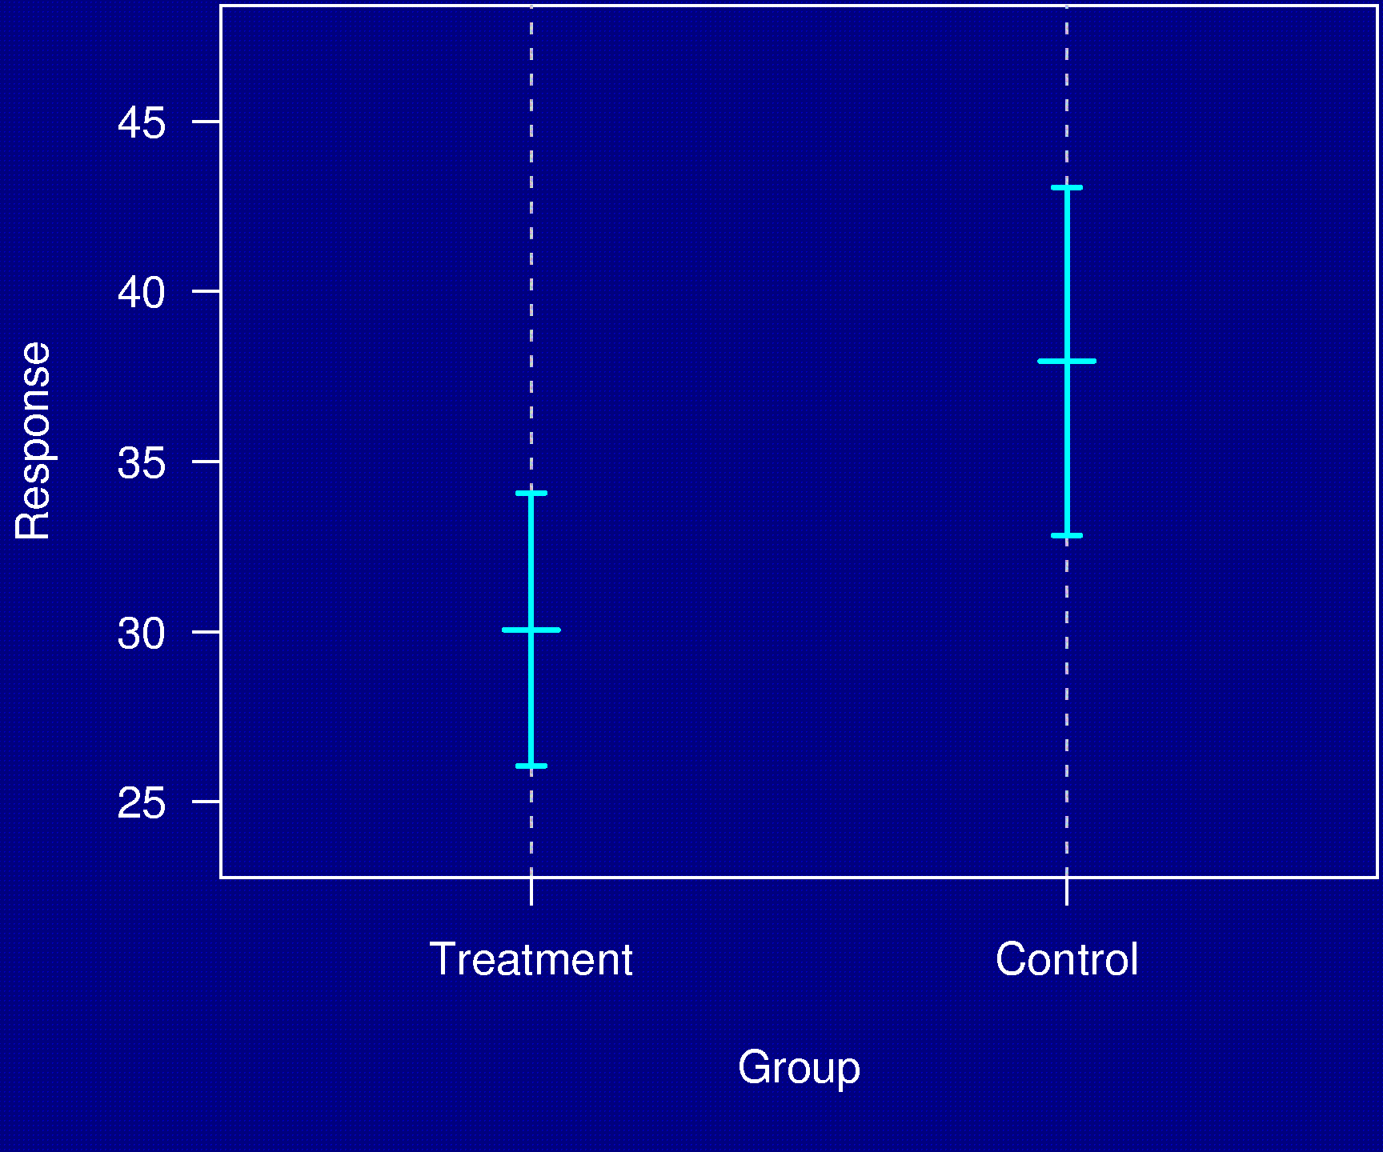
Example 1

Slide 6
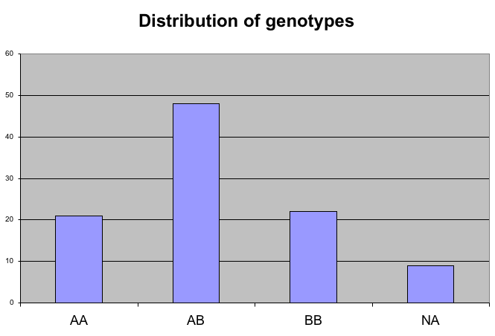
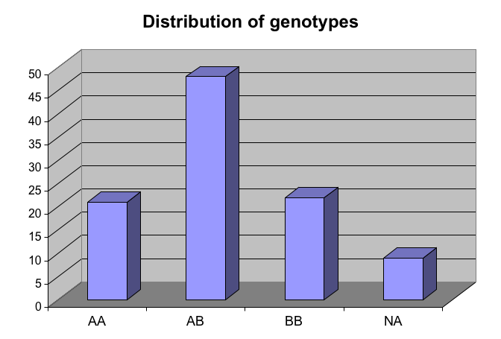
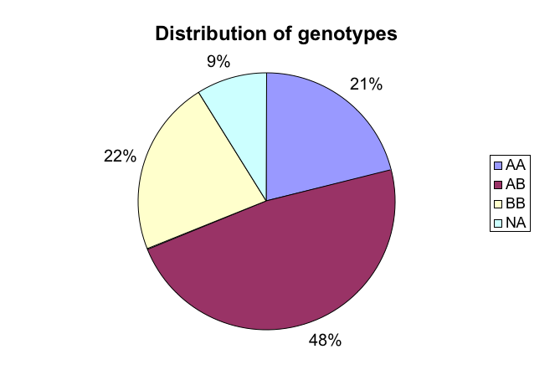
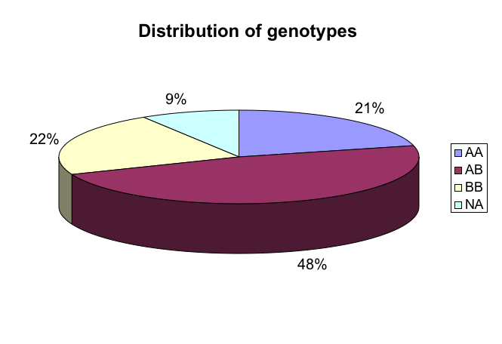
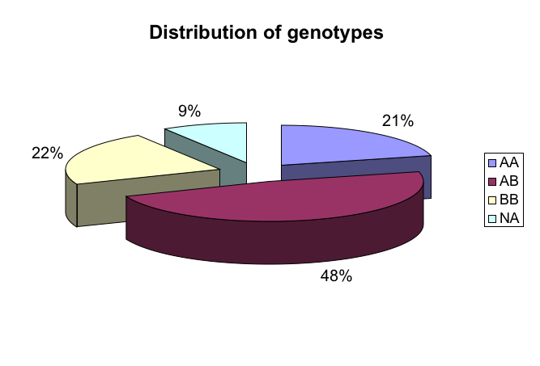
Example 2
Distribution of genotypes
AA 21%
AB 48%
BB 22%
missing 9%

Slide 7
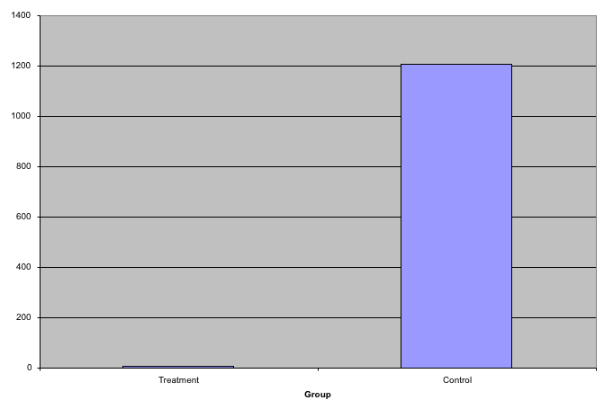
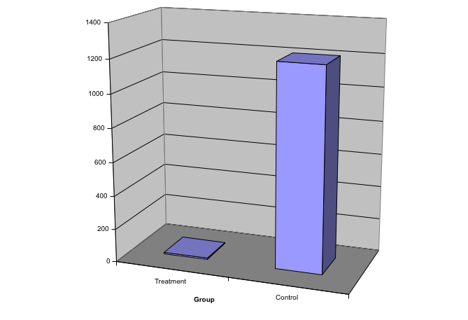
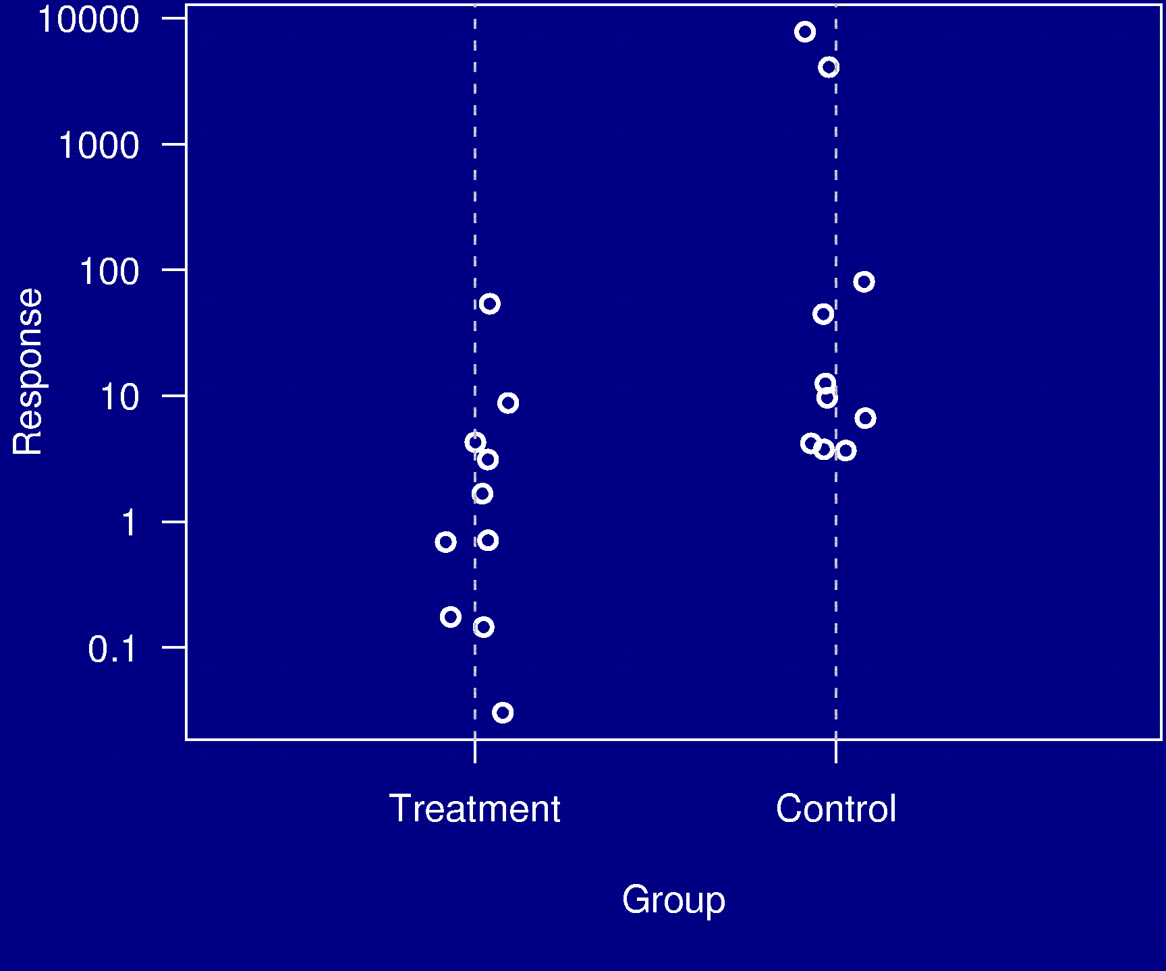
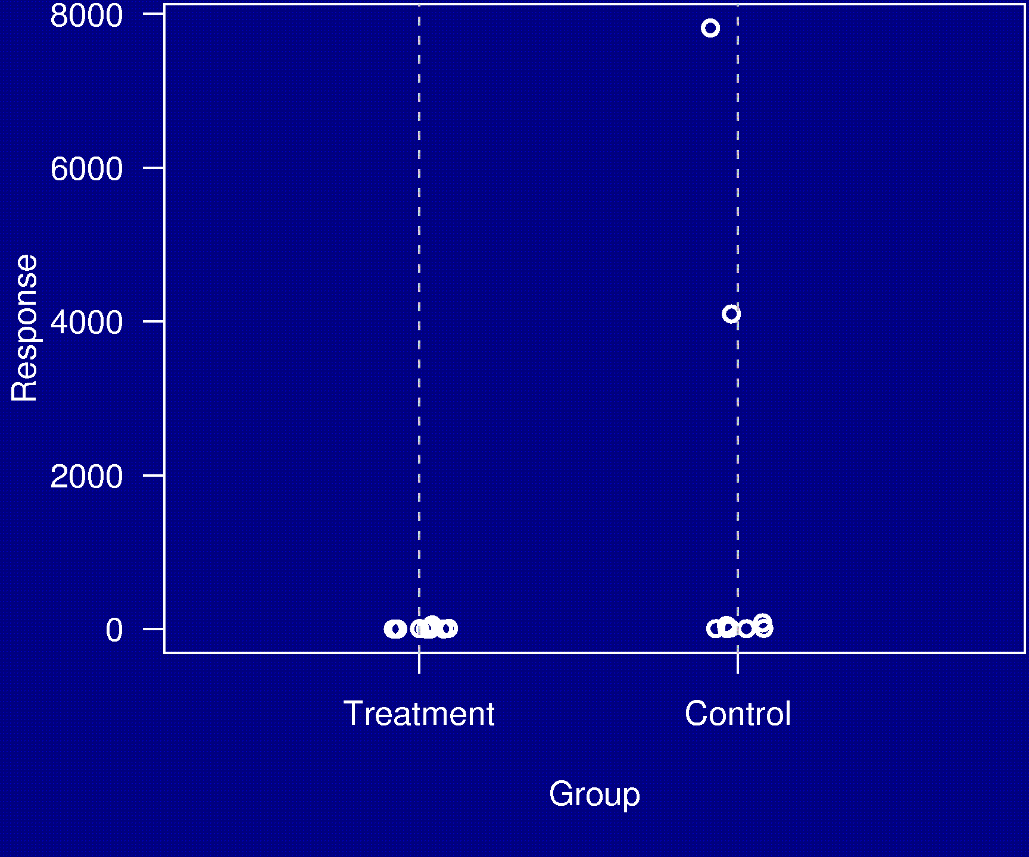
Example 3

Slide 8
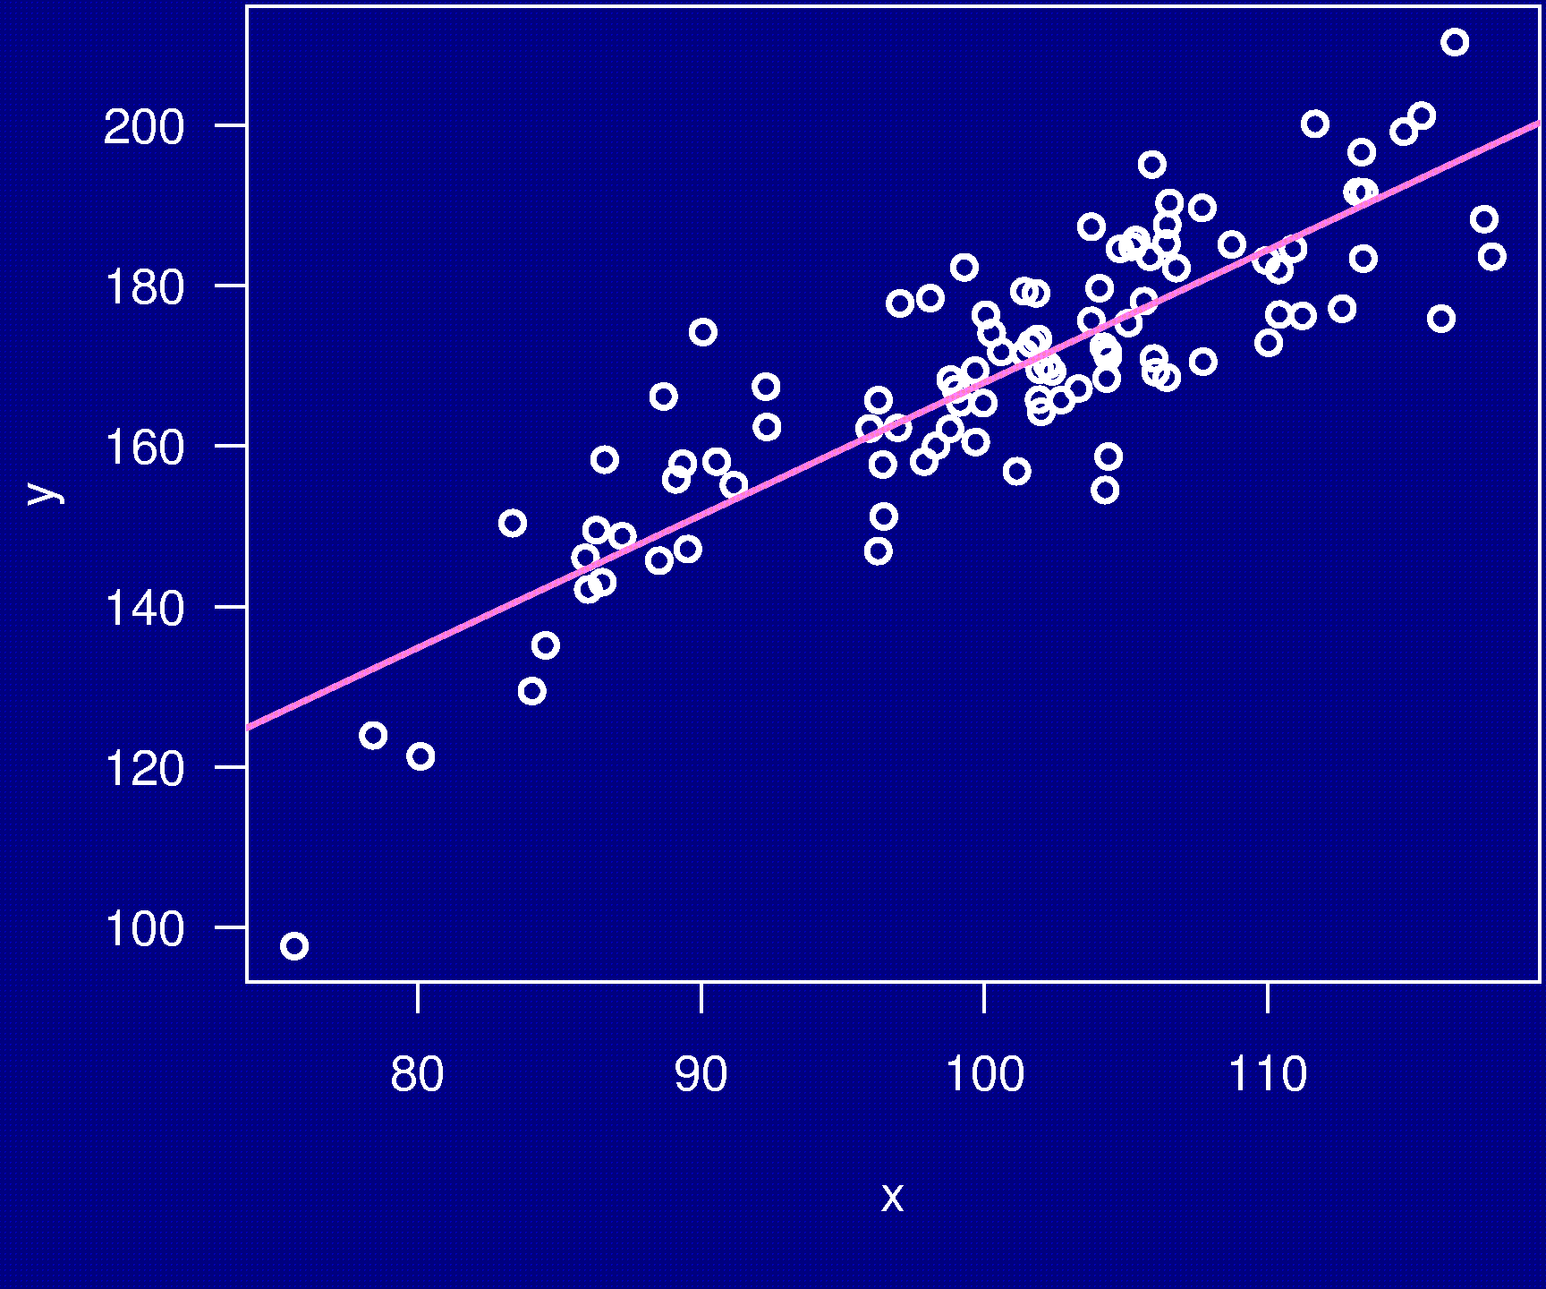
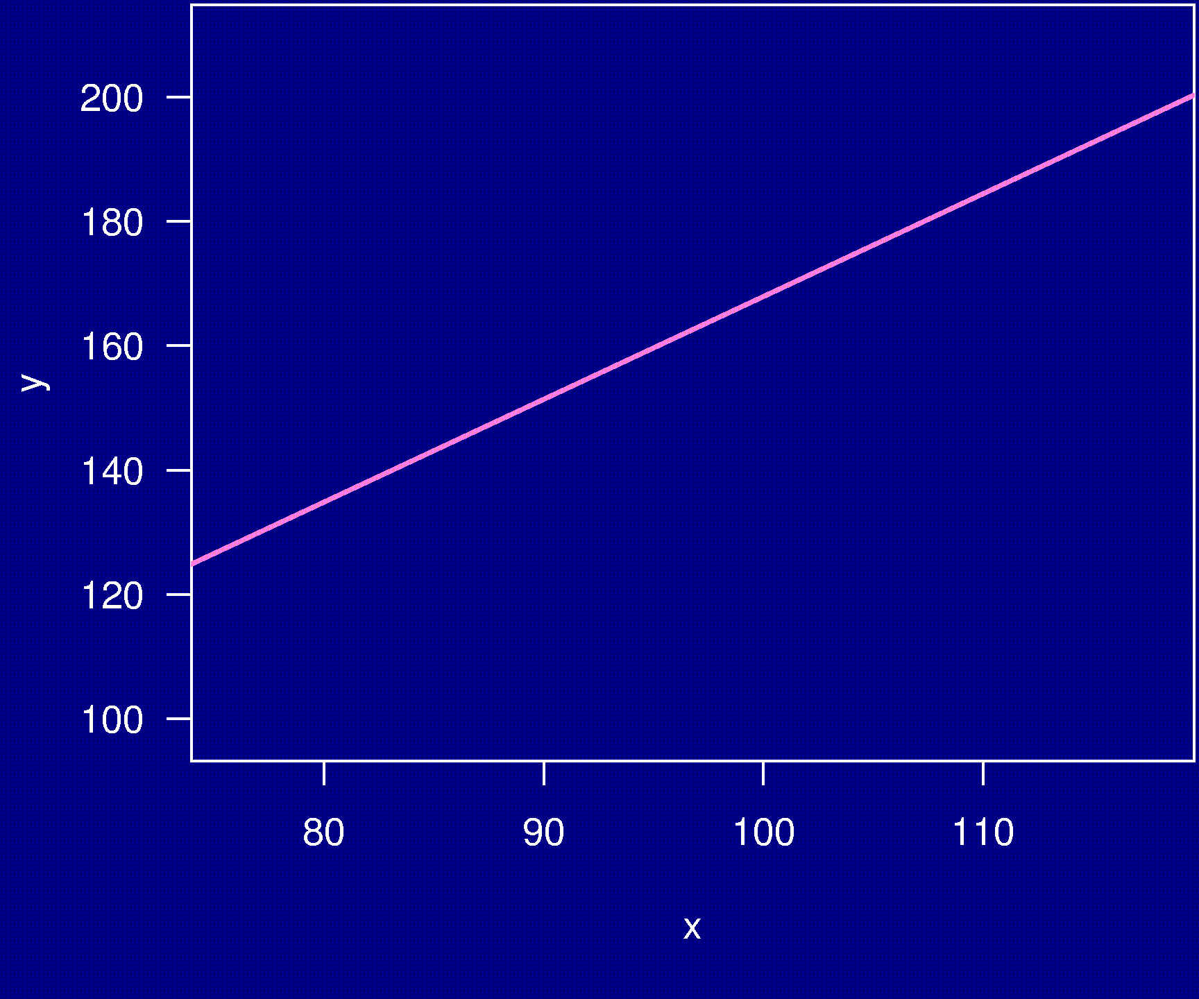
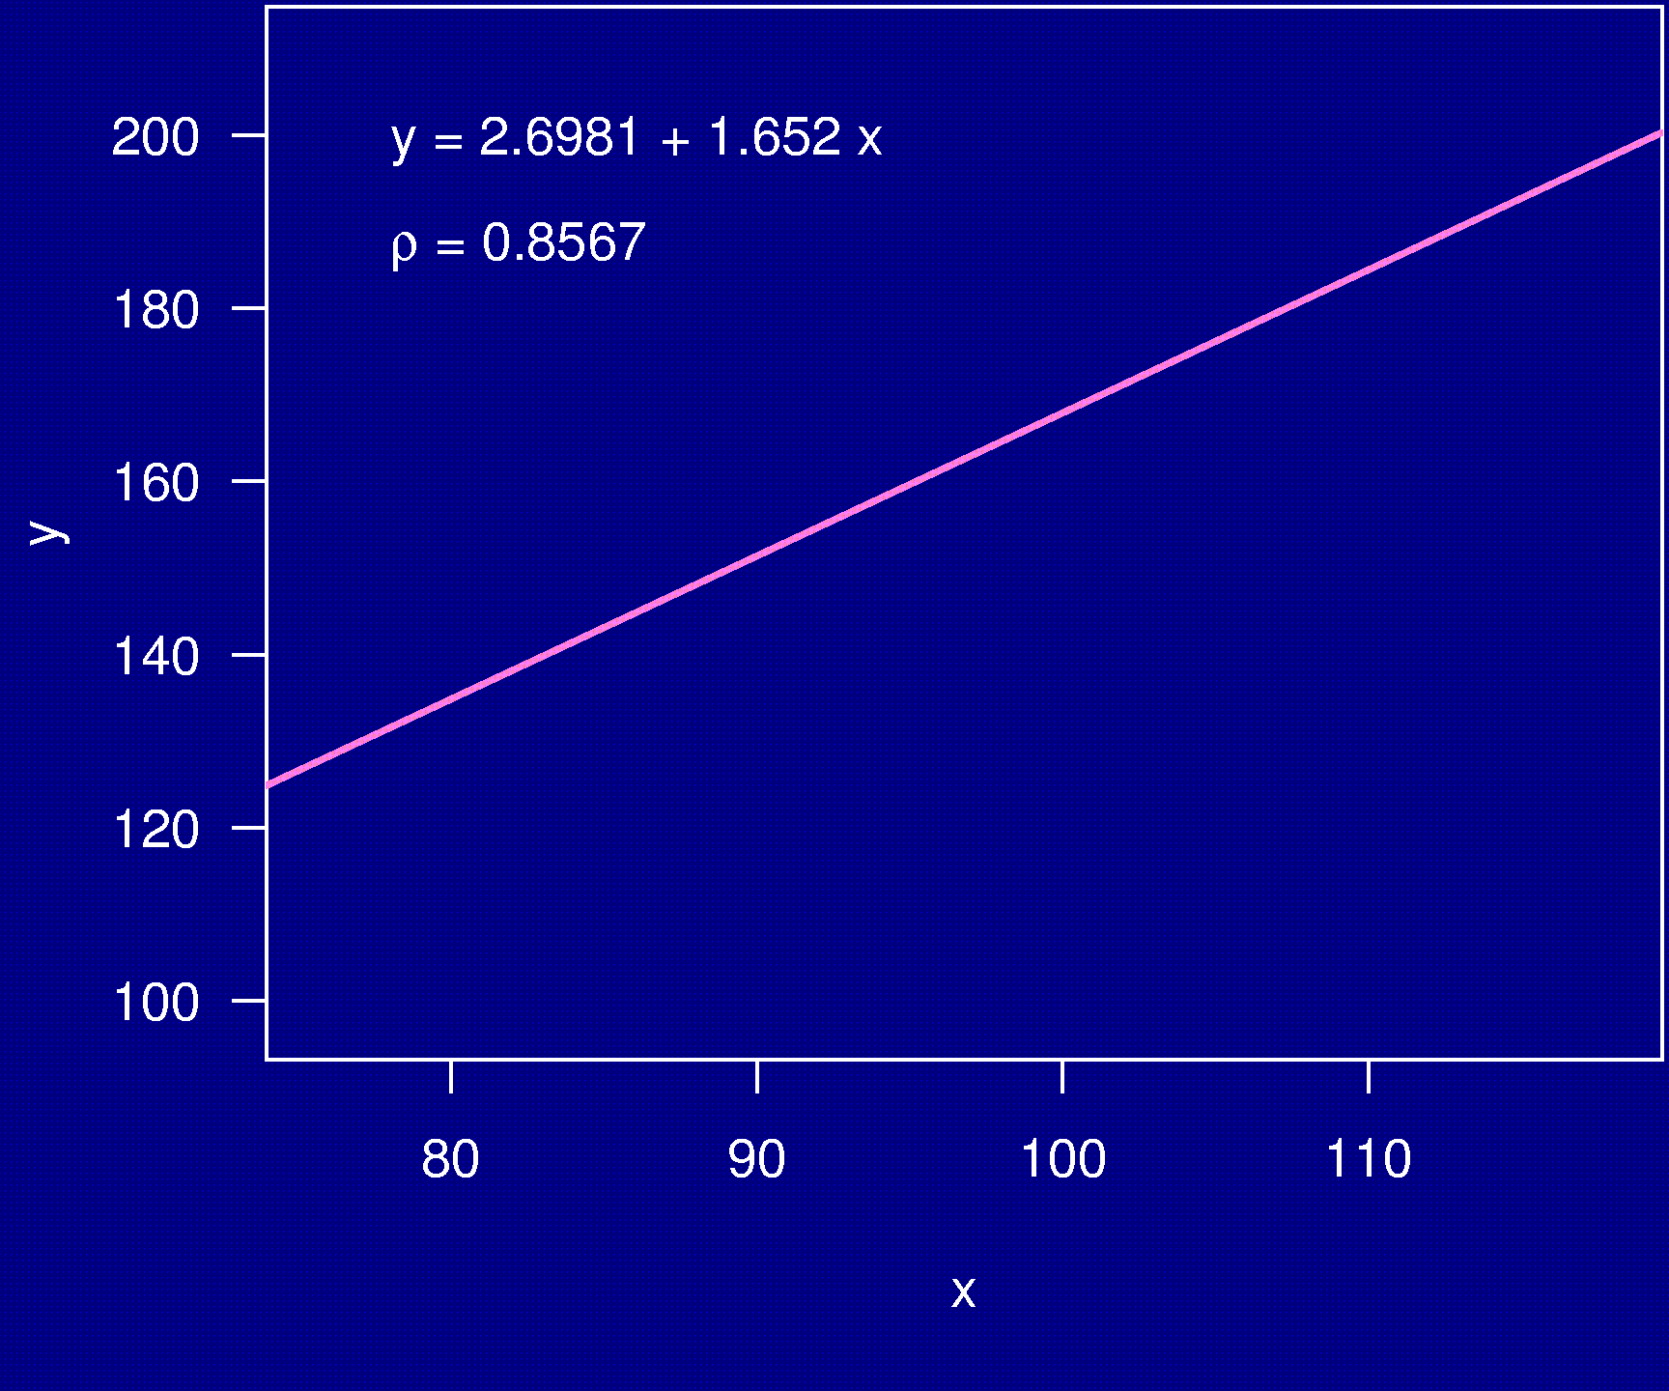
Example 4

Slide 9
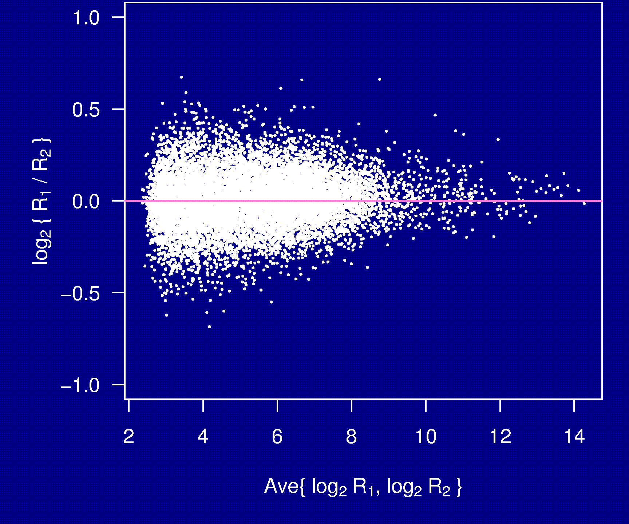
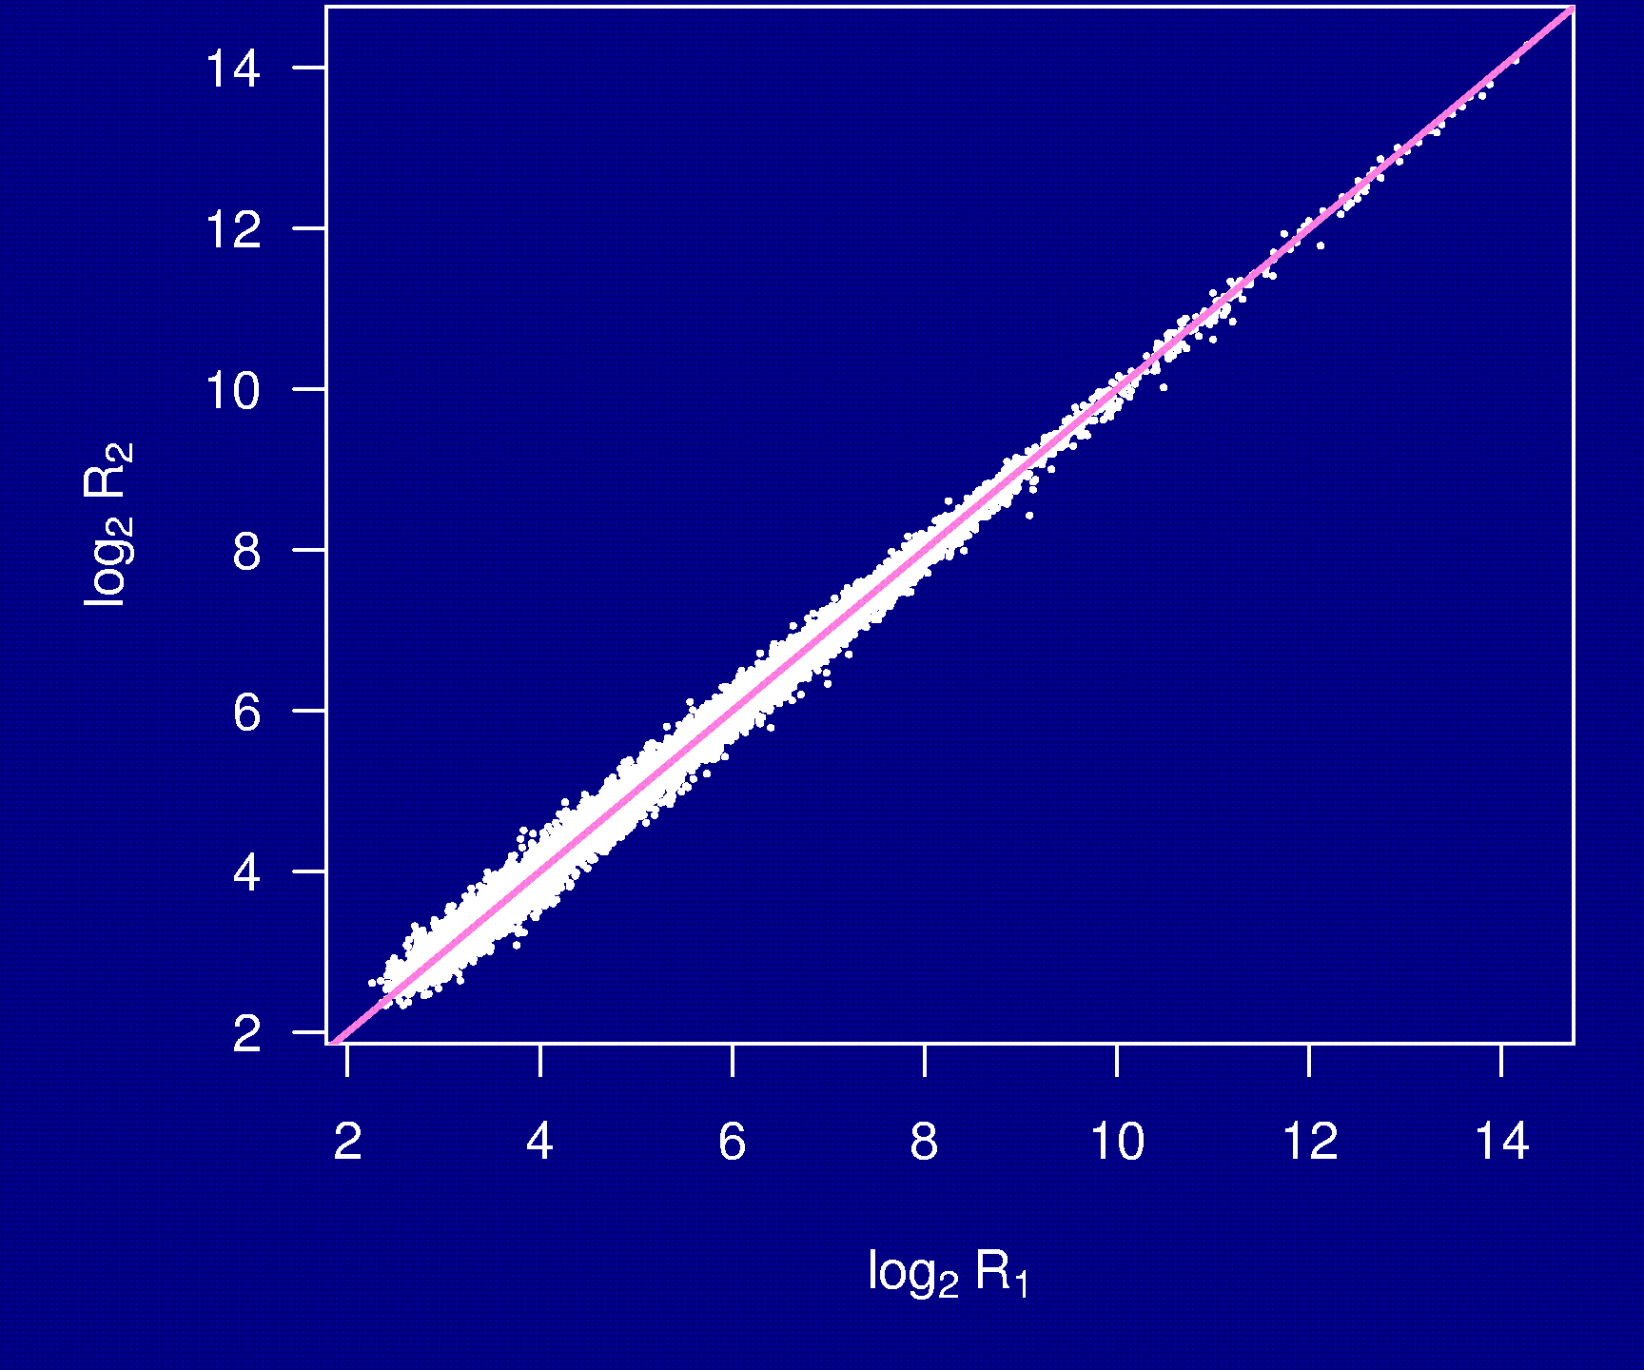
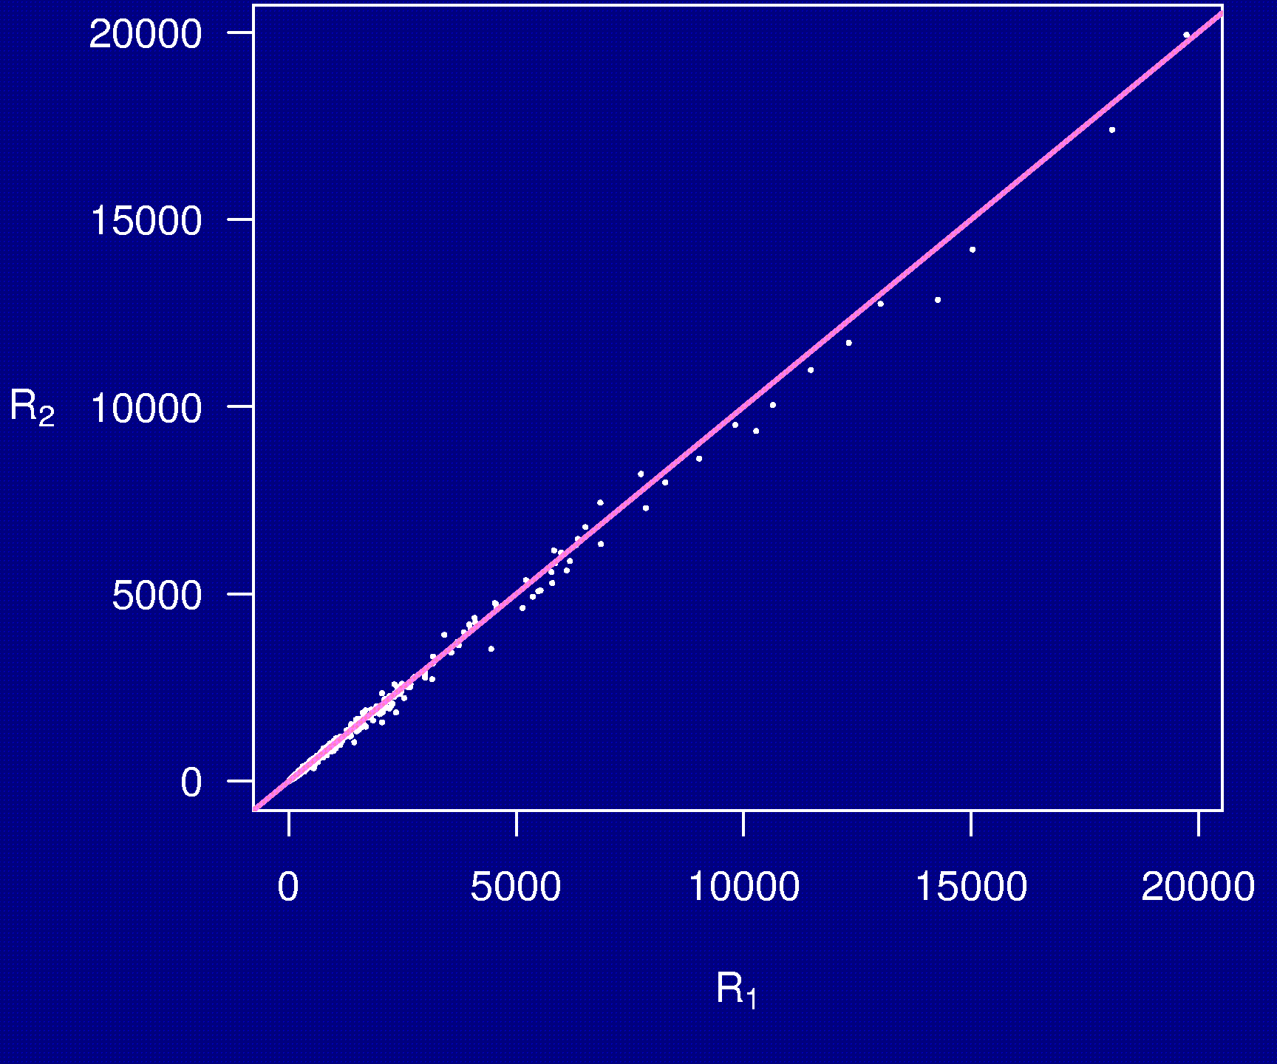
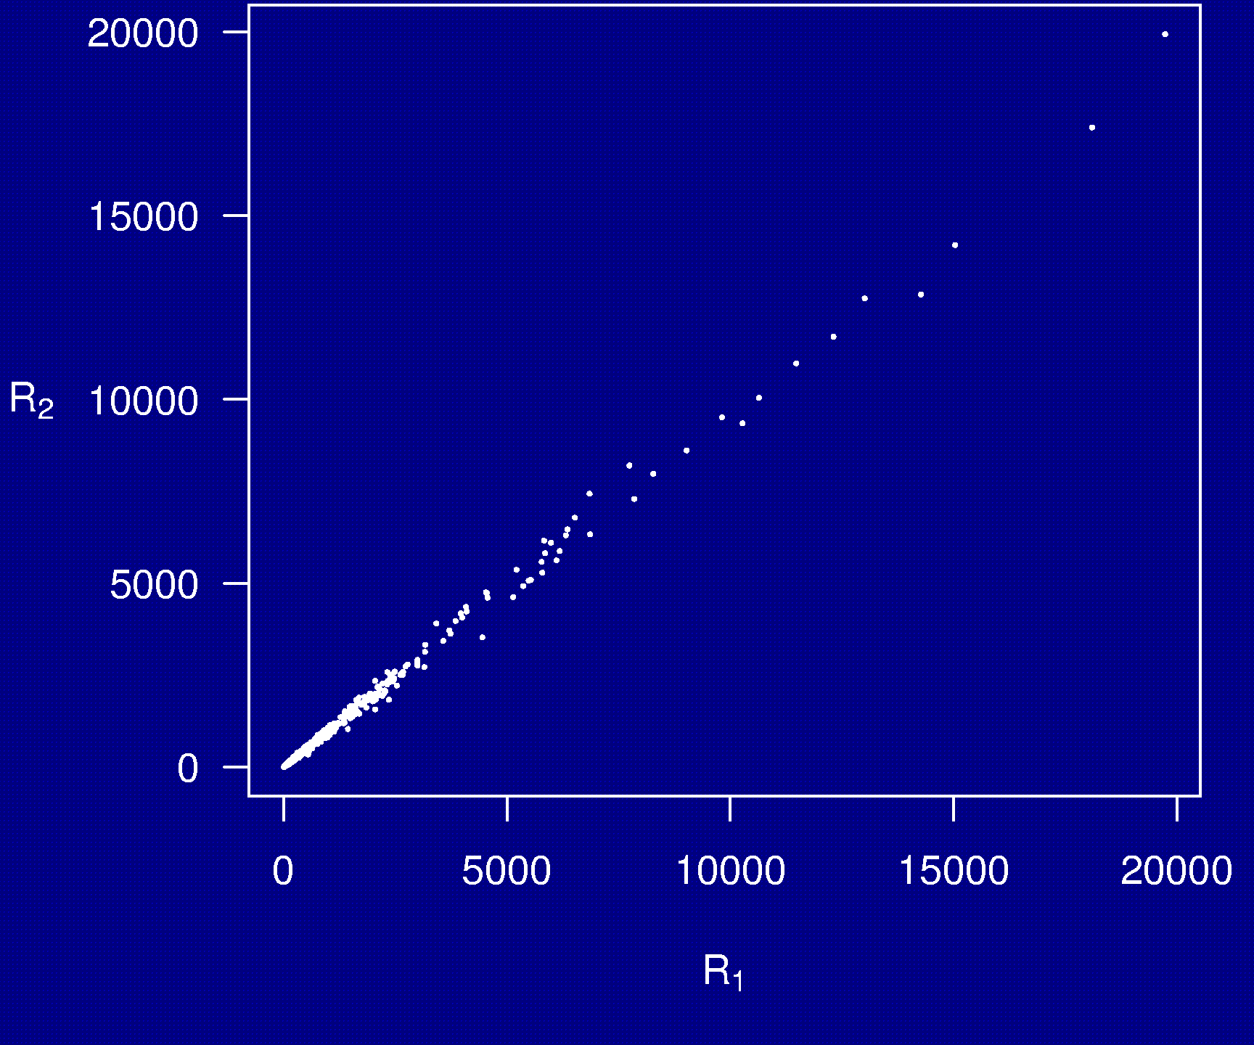
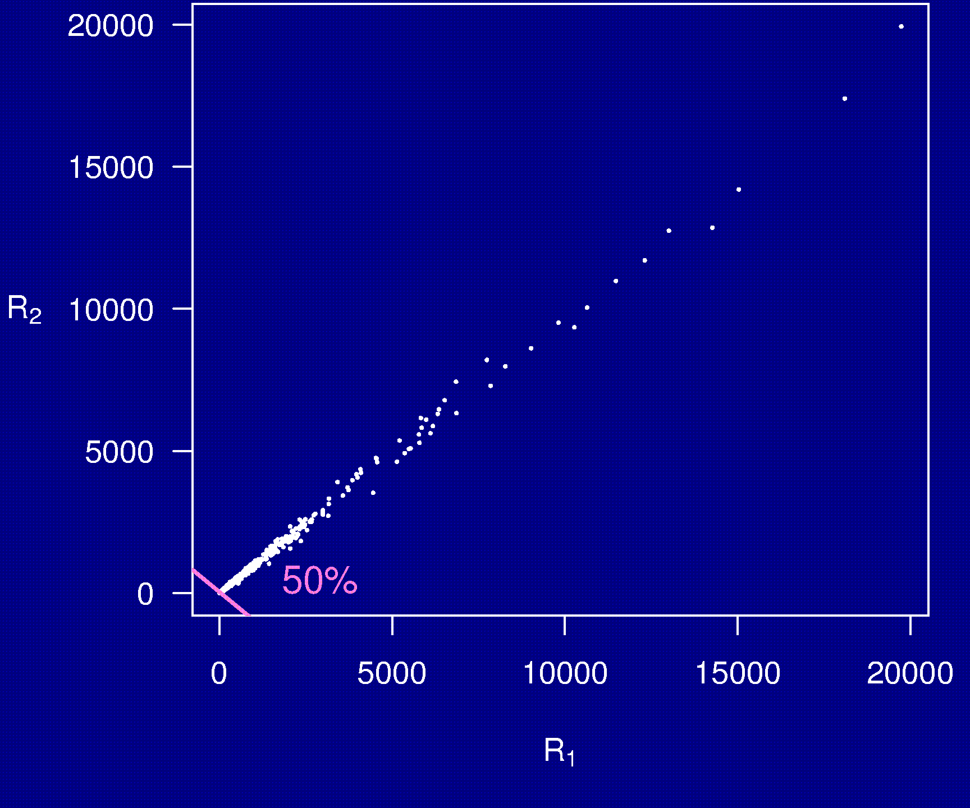
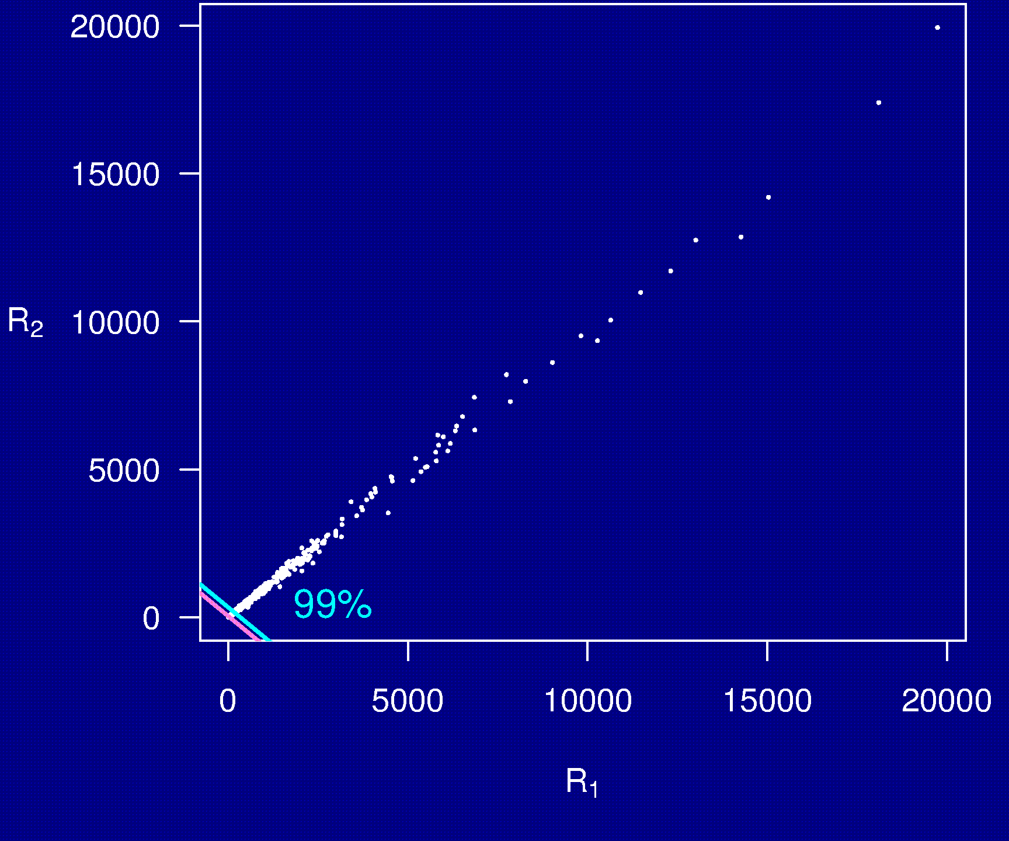
Example 5

Slide 10
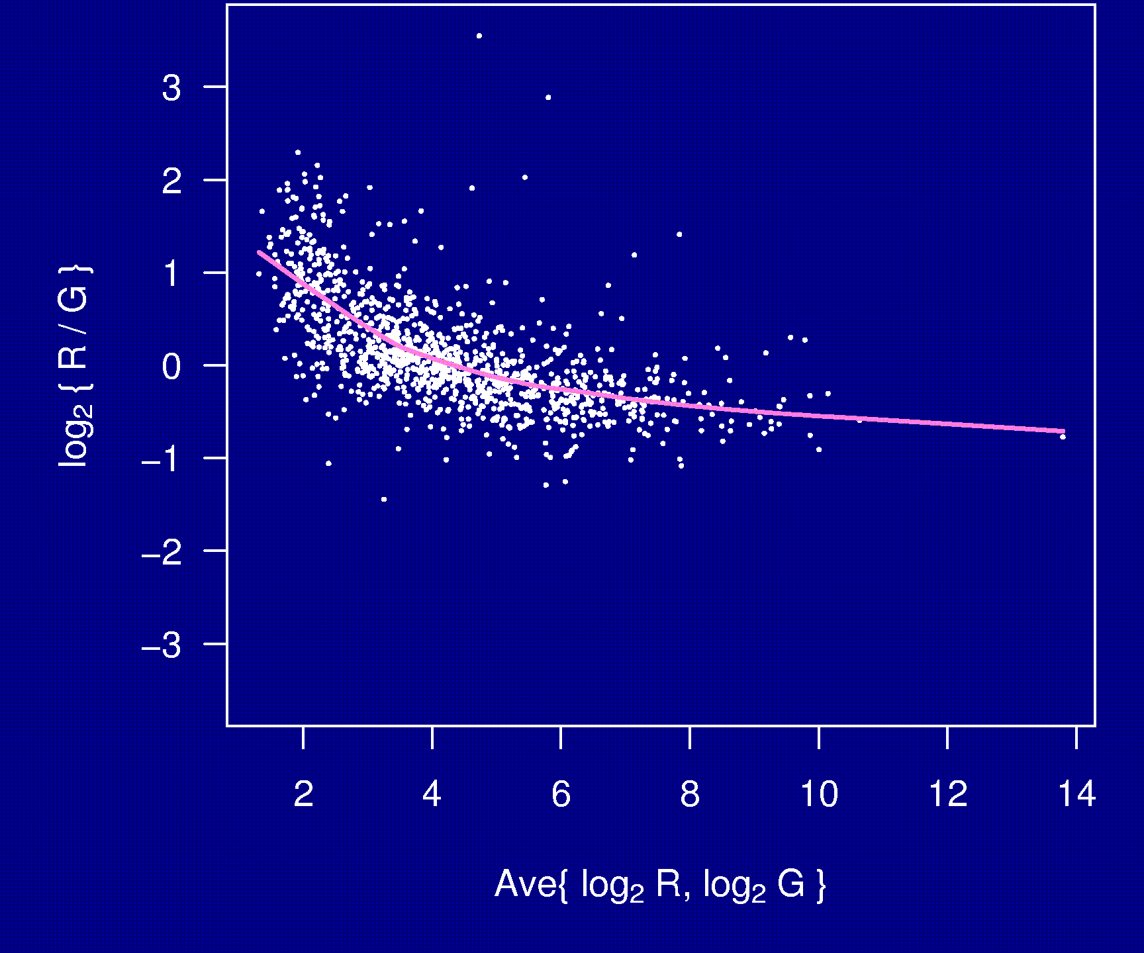
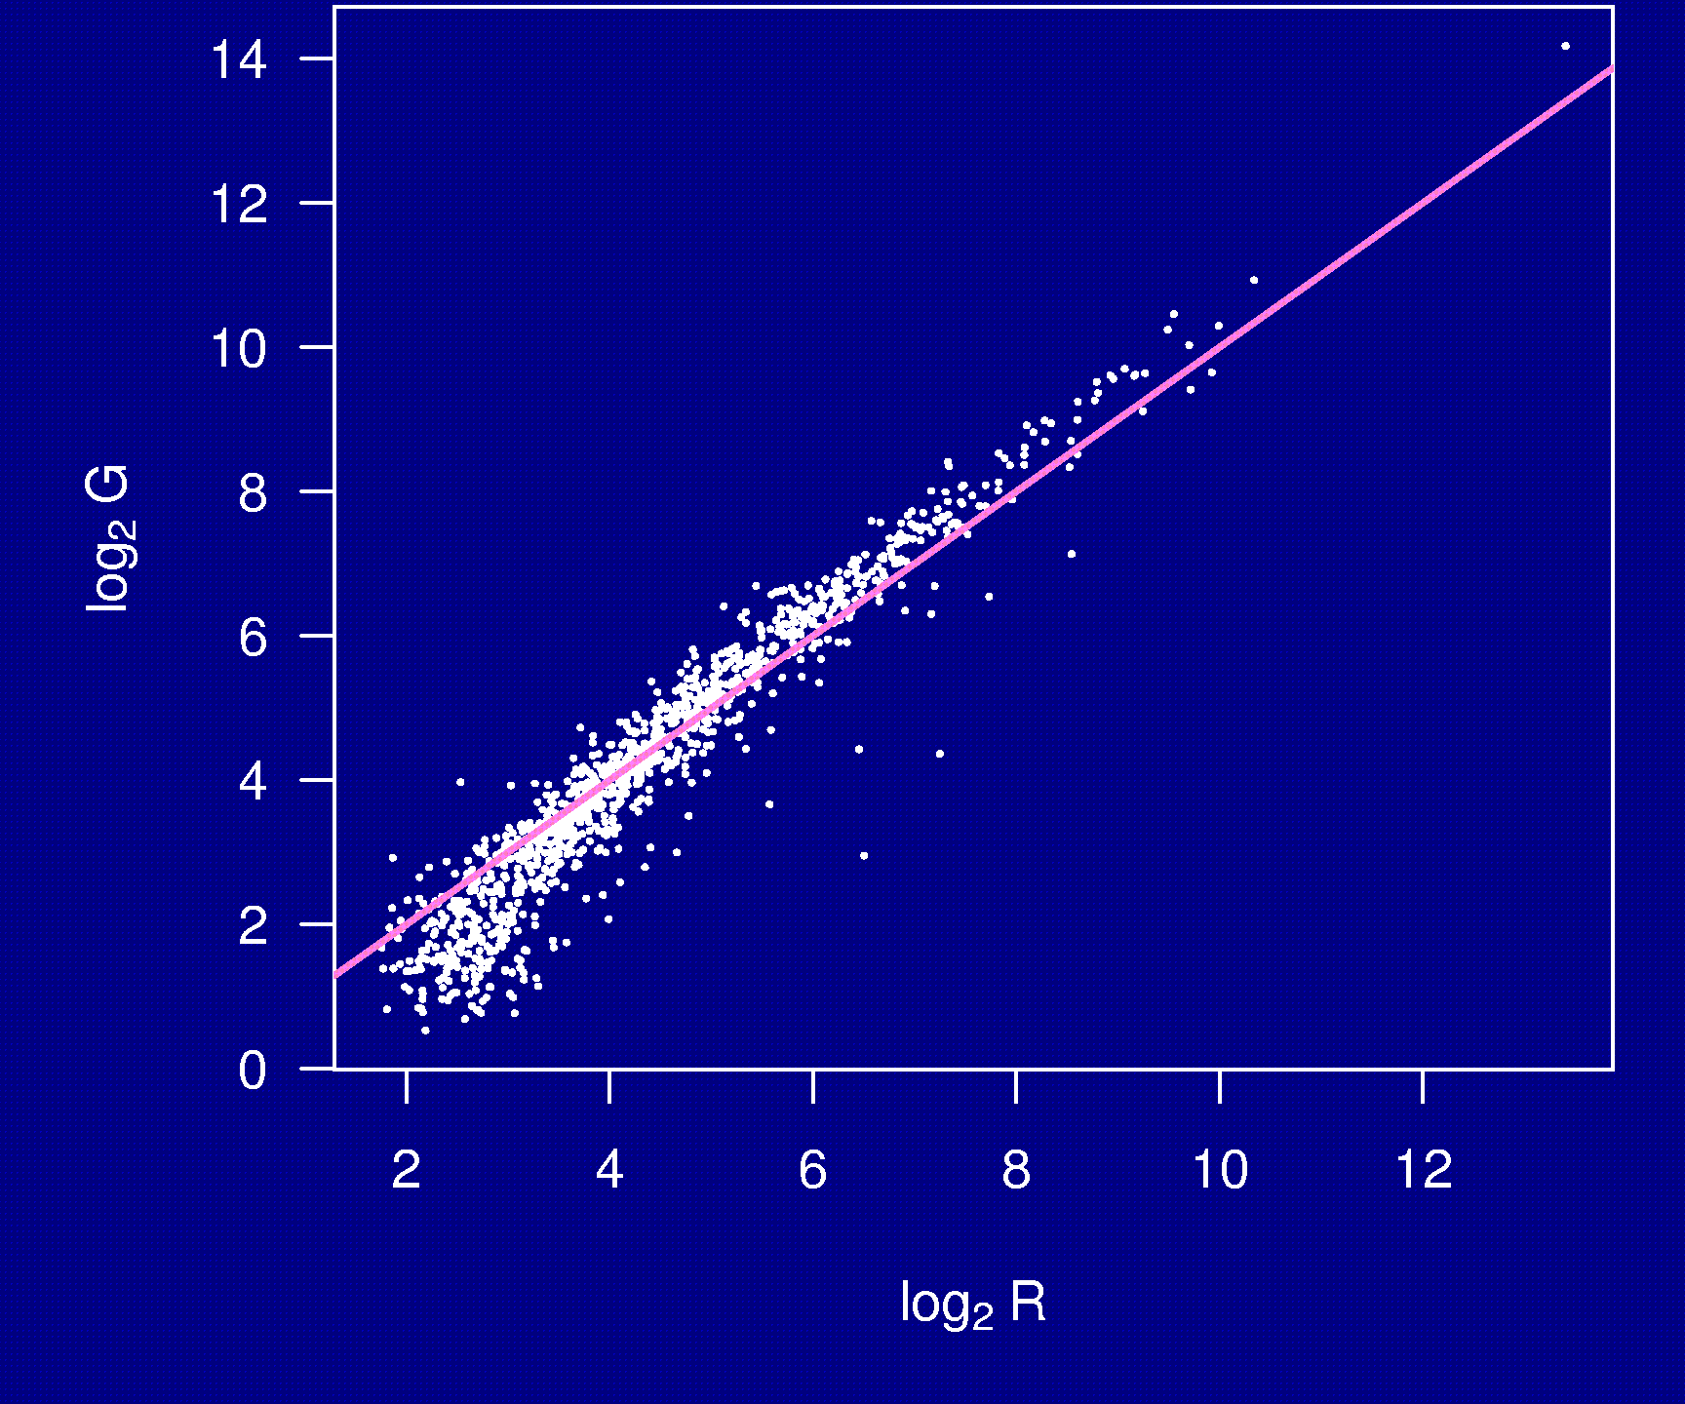
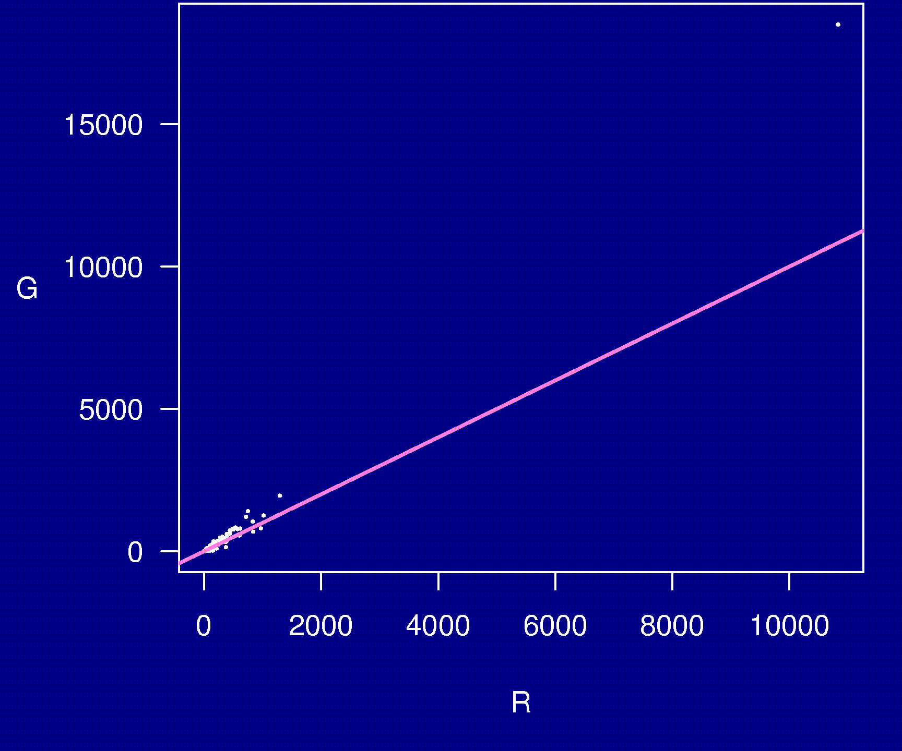
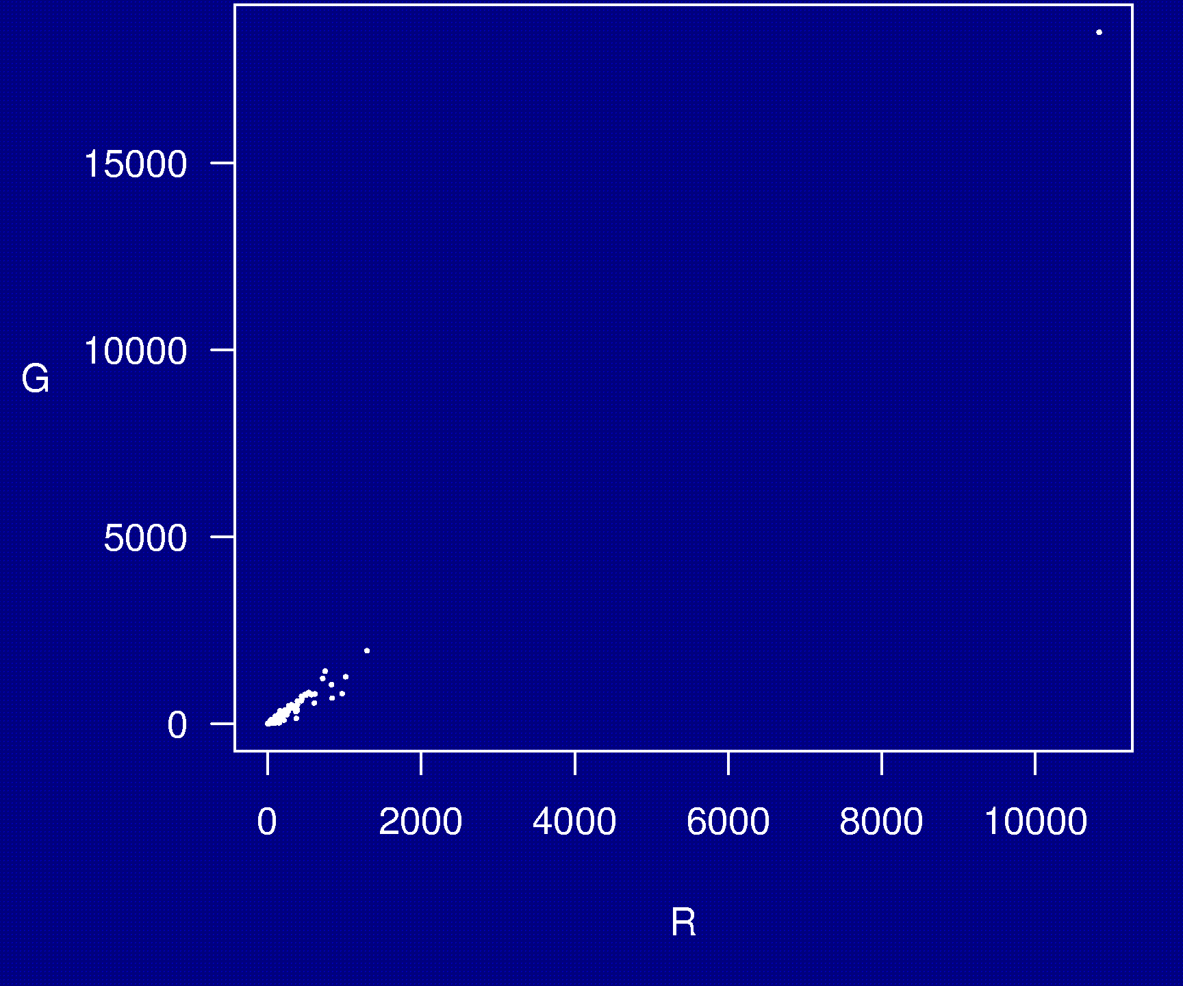
Example 6

Slide 11
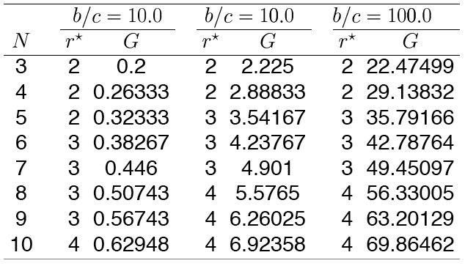
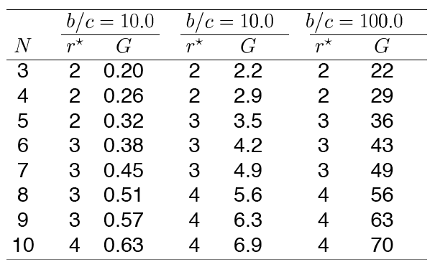
Example 7

Slide 12
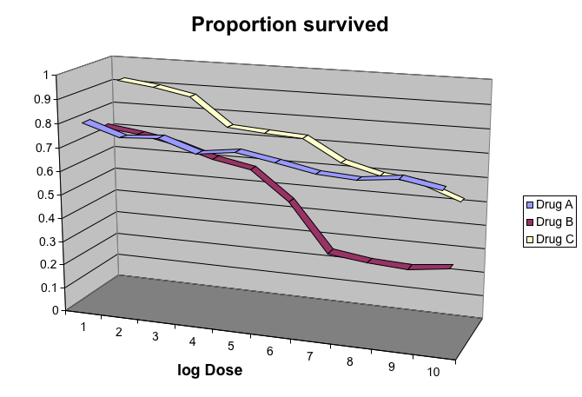
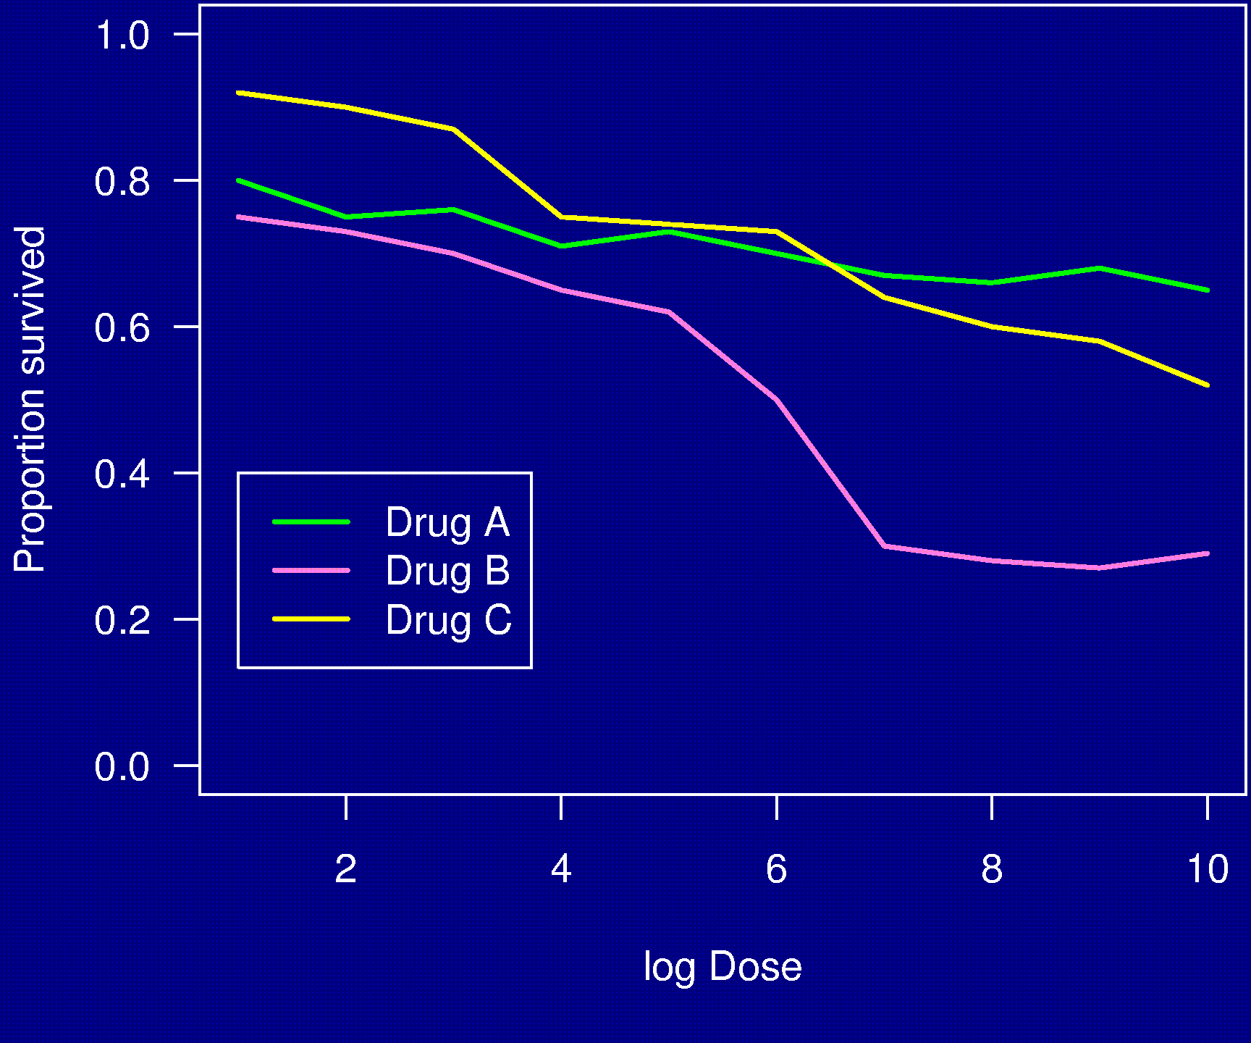
Example 8

Slide 13
Displaying data well
Be accurate and clear.
Let the data speak.
  Show as much information as possible, taking care not to obscure the message.
Science not sales.
  Avoid unnecessary frills — esp. gratuitous 3d.
In tables, every digit should be meaningful. Don’t drop ending 0’s.

Slide 14
Further reading
ER Tufte (1983) The visual display of quantitative information. Graphics Press.
ER Tufte (1990) Envisioning information. Graphics Press.
ER Tufte (1997) Visual explanations. Graphics Press.
WS Cleveland (1993) Visualizing data. Hobart Press.
WS Cleveland (1994) The elements of graphing data. CRC Press.

Slide 15


Slide 16
Example 1

Slide 17
Example 1

Slide 18
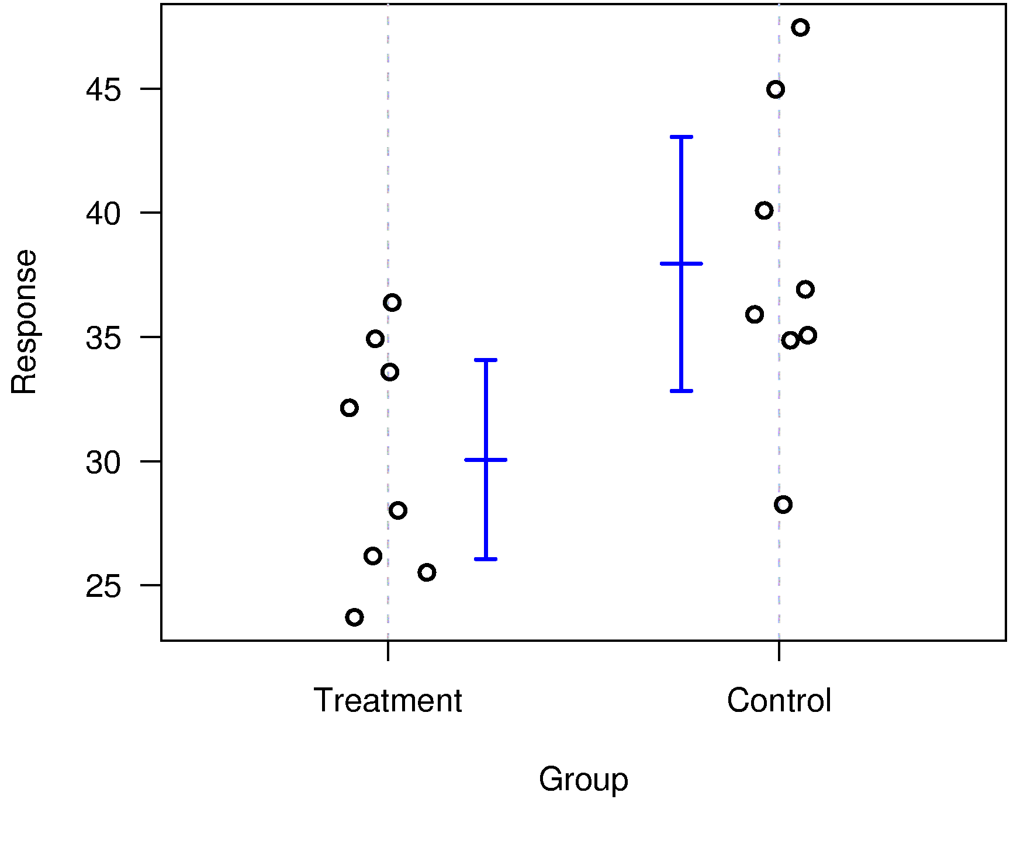
Example 1

Slide 19


