Slide 1
The genomes of recombinant inbred lines
Notes:
Obsession of mine from a couple of years ago.
Not of any practical use to any of you, but I hope you will find it interesting or at least entertaining.
I’m in a school of public health, and so my underlying goal is to improve human health.

Slide 2
Inbred mice
Notes:
Inbred mice:
- result of many generations of sibling mating
- genetically identical
- two genomes identical
- reproducible
Advantages of mice: cheap, inbred lines, controlled env’t, interventions, proof of cause (e.g. KO)

Slide 3
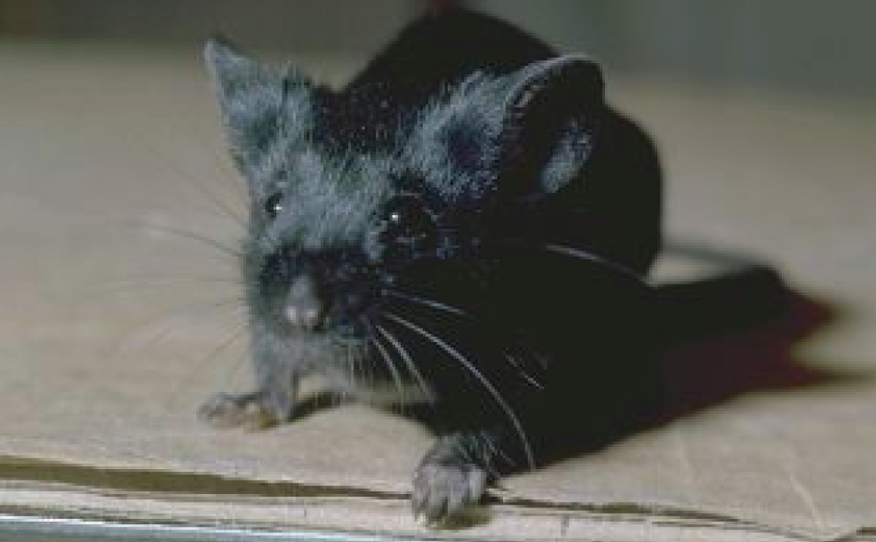
C57BL/6
Notes:
To do genetics, you need a second strain that differs from the first.
We look at some aspect of how this inbred strain differs from the previous one.
(e.g., coat color, or cuteness, or survival time following bacterial infection)
Can’t learn anything by just studying at these two strains; we do a cross.

Slide 4
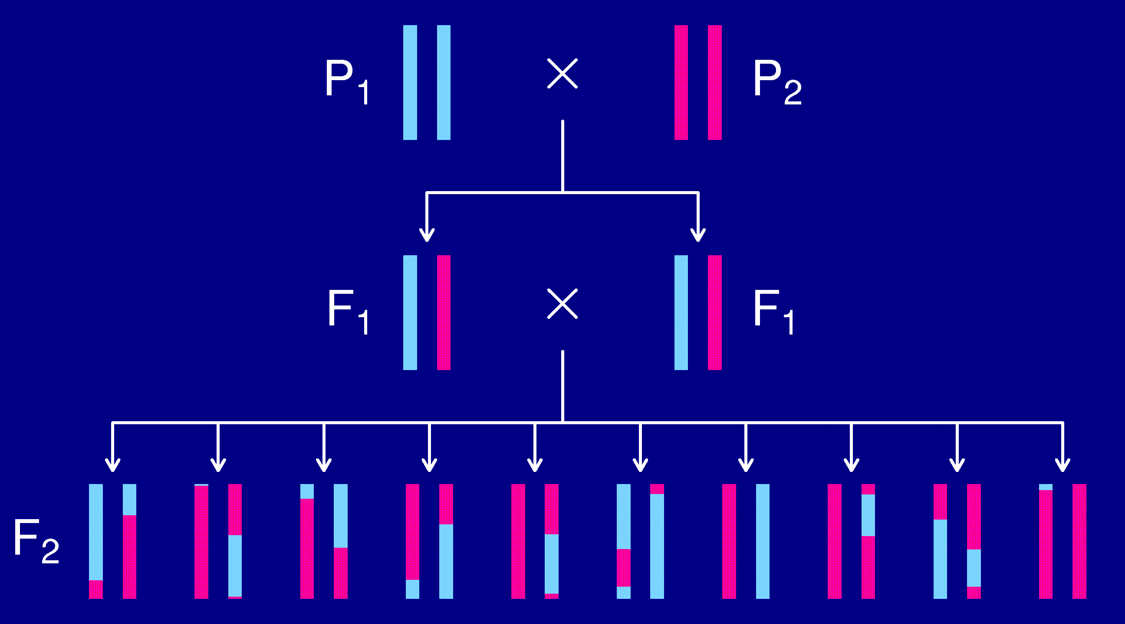
The intercross
Notes:
Explain how to do mapping in intercross
Advantages:
- simple and easy
- extensible
Disadvantages:
- must genotype each individual
- can only do one nasty thing to each mouse

Slide 5
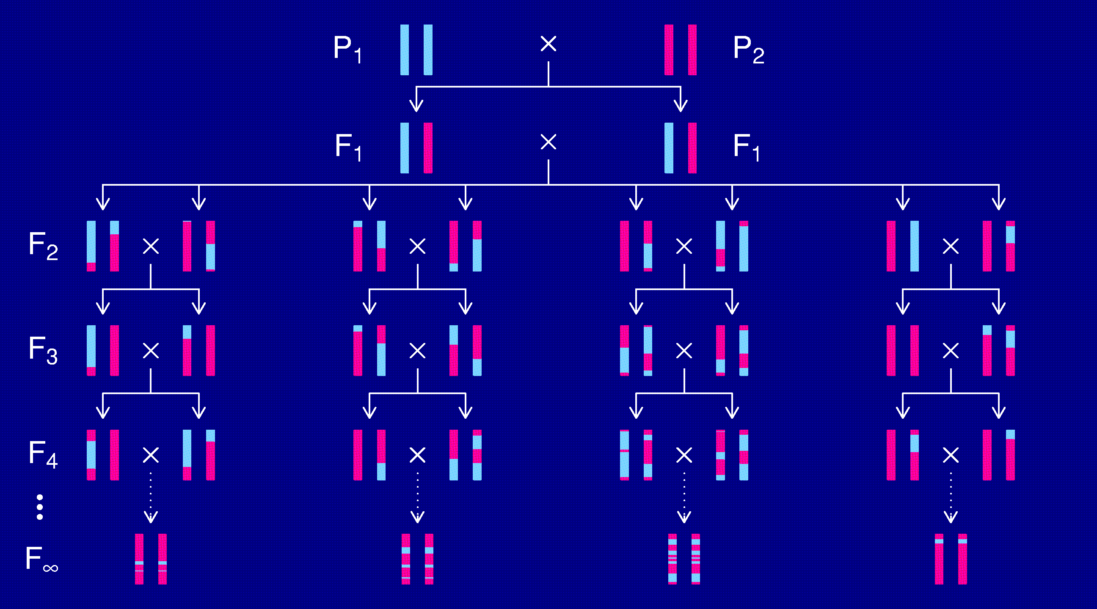
Recombinant inbred lines
(by sibling mating)
Notes:
Mapping here just like with intercross
Advantages:
- reduce individual variation by phenotyping multiple ind’ls from each strain
- multiple invasive phenotypes
- longitudinal data
- greater density of breakpoints
Disadv:
- time, cost
- inadequate panels available
- just two alleles, only homozygotes

Slide 6
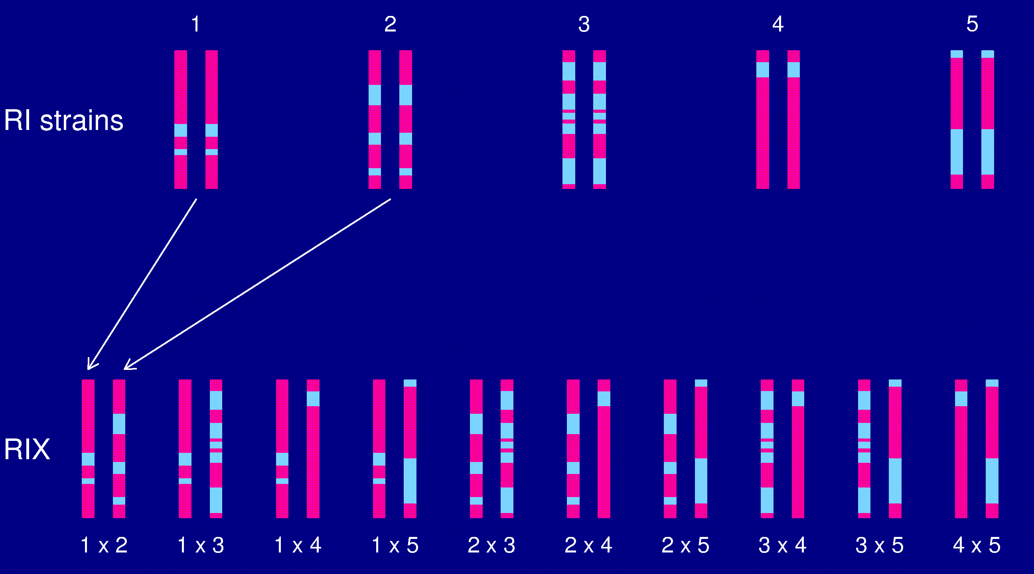
The RIX design
Notes:
Create heterozygotes; no further genotyping needed

Slide 7
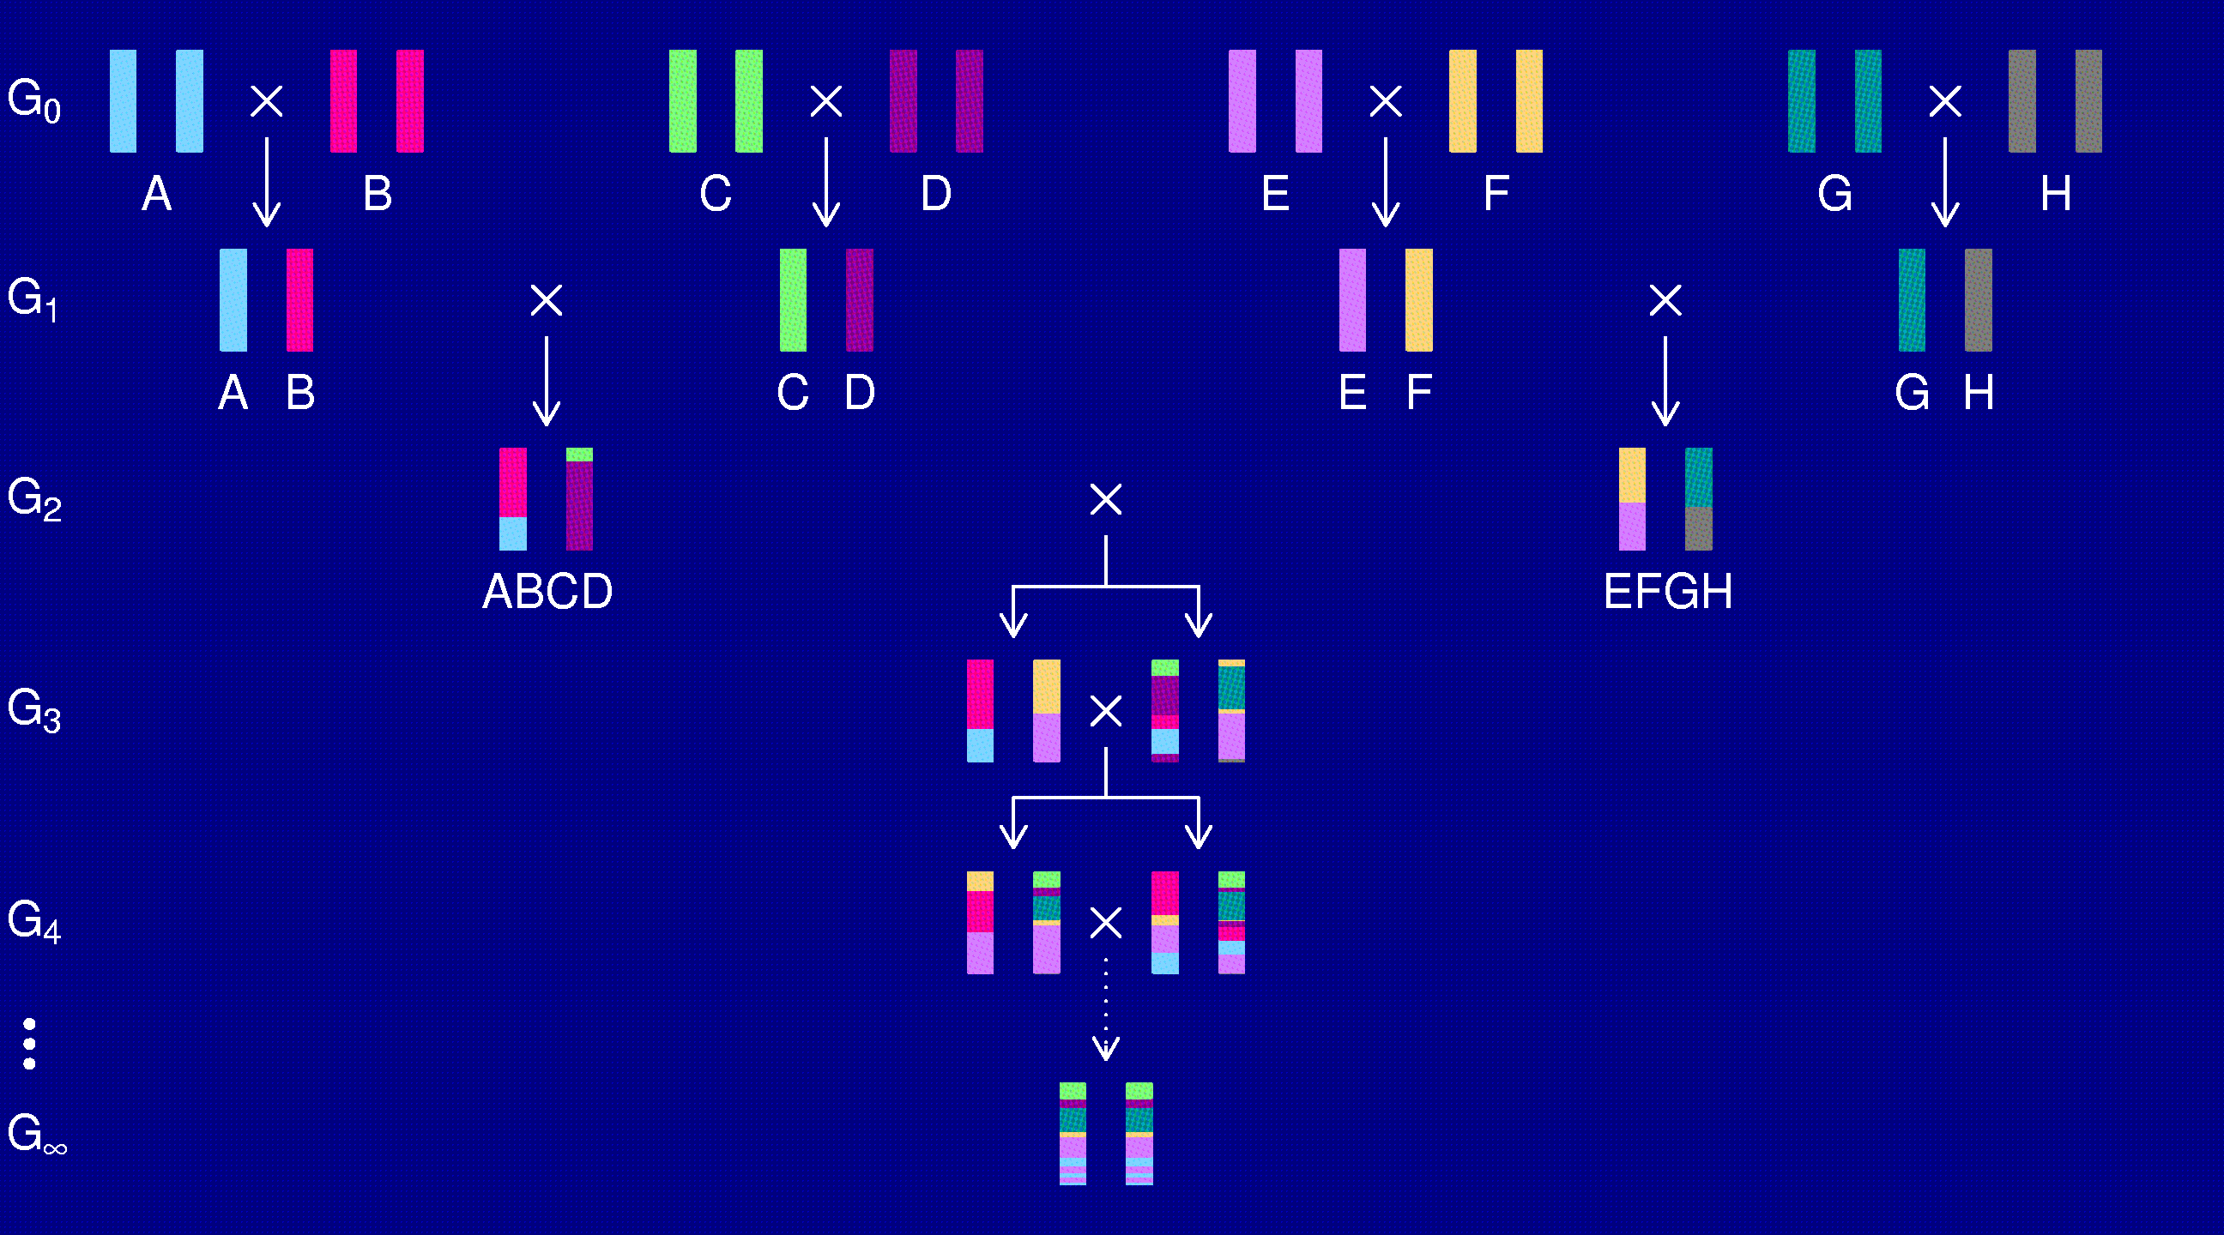
The Collaborative Cross
Complex Trait Consortium (2004) Nat Genet 36:1133-1137
Notes:
8-way recombinant inbred lines
Hope to obtain 1000 such lines (with initial crosses in varied orders)
A boon for mouse geneticists

Slide 8
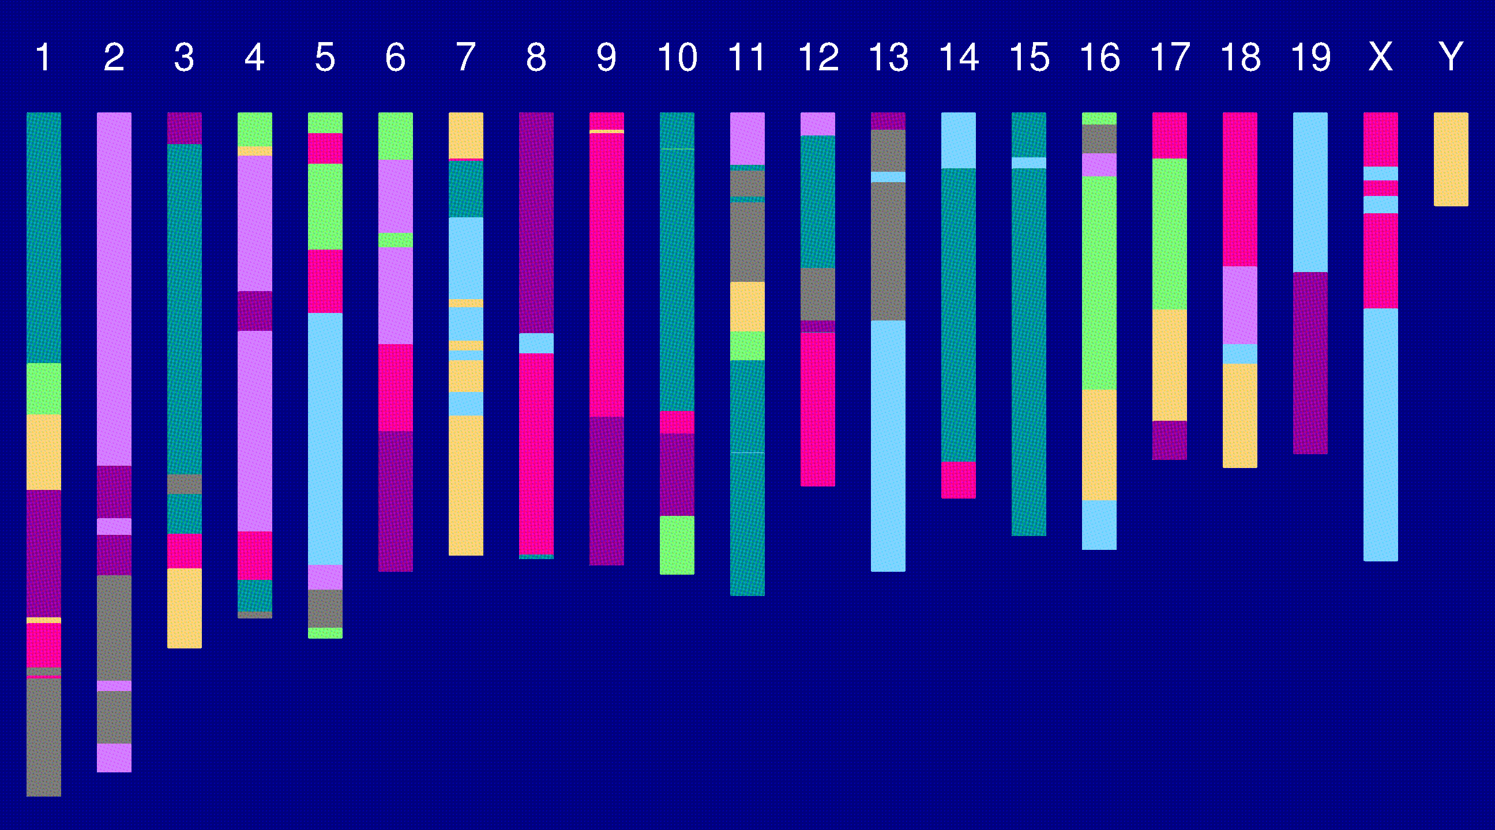
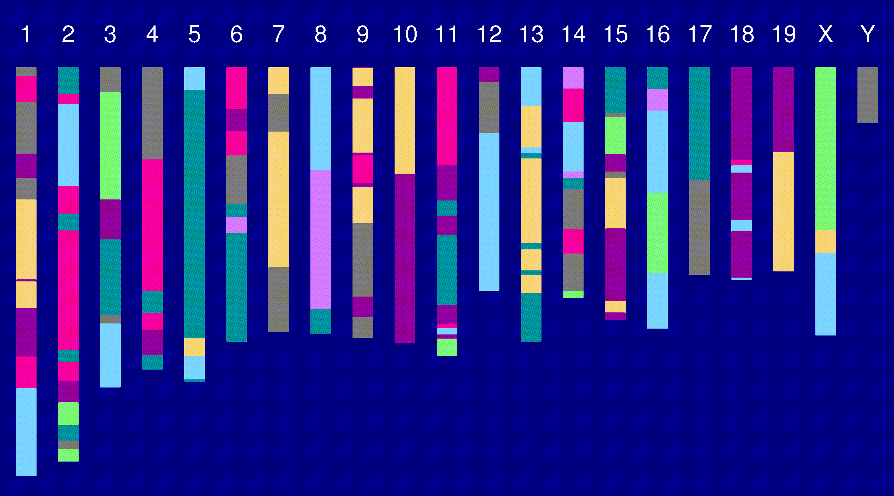
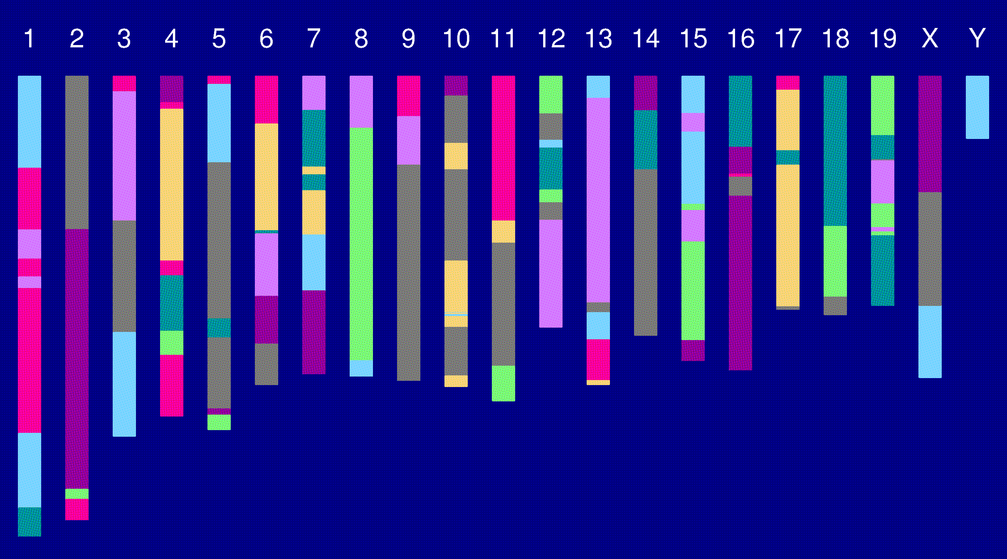
Genome of an 8-way RI

Slide 9
The goal
(for the rest of this talk)
Characterize the breakpoint process along a chromosome in 8-way RILs.
  Understand the two-point haplotype probabilities.
  Study the clustering of the breakpoints, as a function of crossover interference in meiosis.
Notes:
Why?
We’ll need to reconstruct the pattern of colors along each chromosome in each 8-way RIL.
Our data is likely to be genotypes at diallelic markers (such as SNPs).

Slide 10
2 points in an RIL
1
2
r = recombination fraction = probability of a recombination in the interval in a random meiotic product.
R = analogous thing for the RIL = probability of different alleles at the two loci on a random RIL chromosome.
Notes:
Start with the simplest problem.
One idea I had: If you are A at one point, you’re more (or less) like to be B at the next point than to be H.

Slide 11
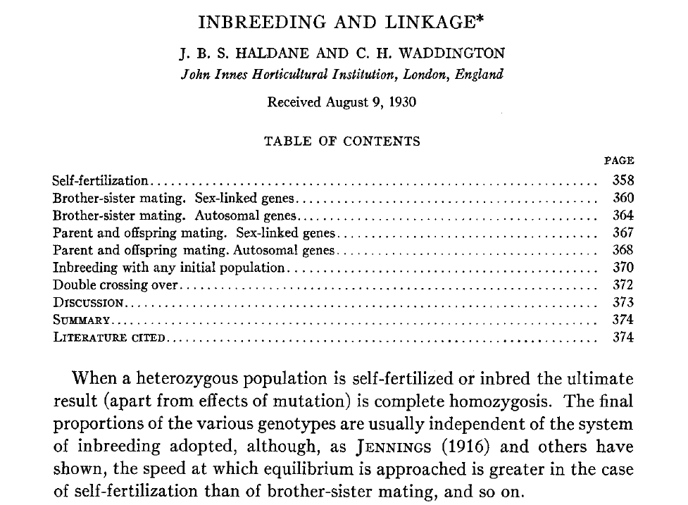
Haldane & Waddington 1931
Genetics 16:357-374
Notes:
Haldane and Waddington solved this for 2-way RILs in 1931.
The results are well known to those working with RILs,
but the manuscript has not been widely read.
You’ll see why in a moment.

Slide 12
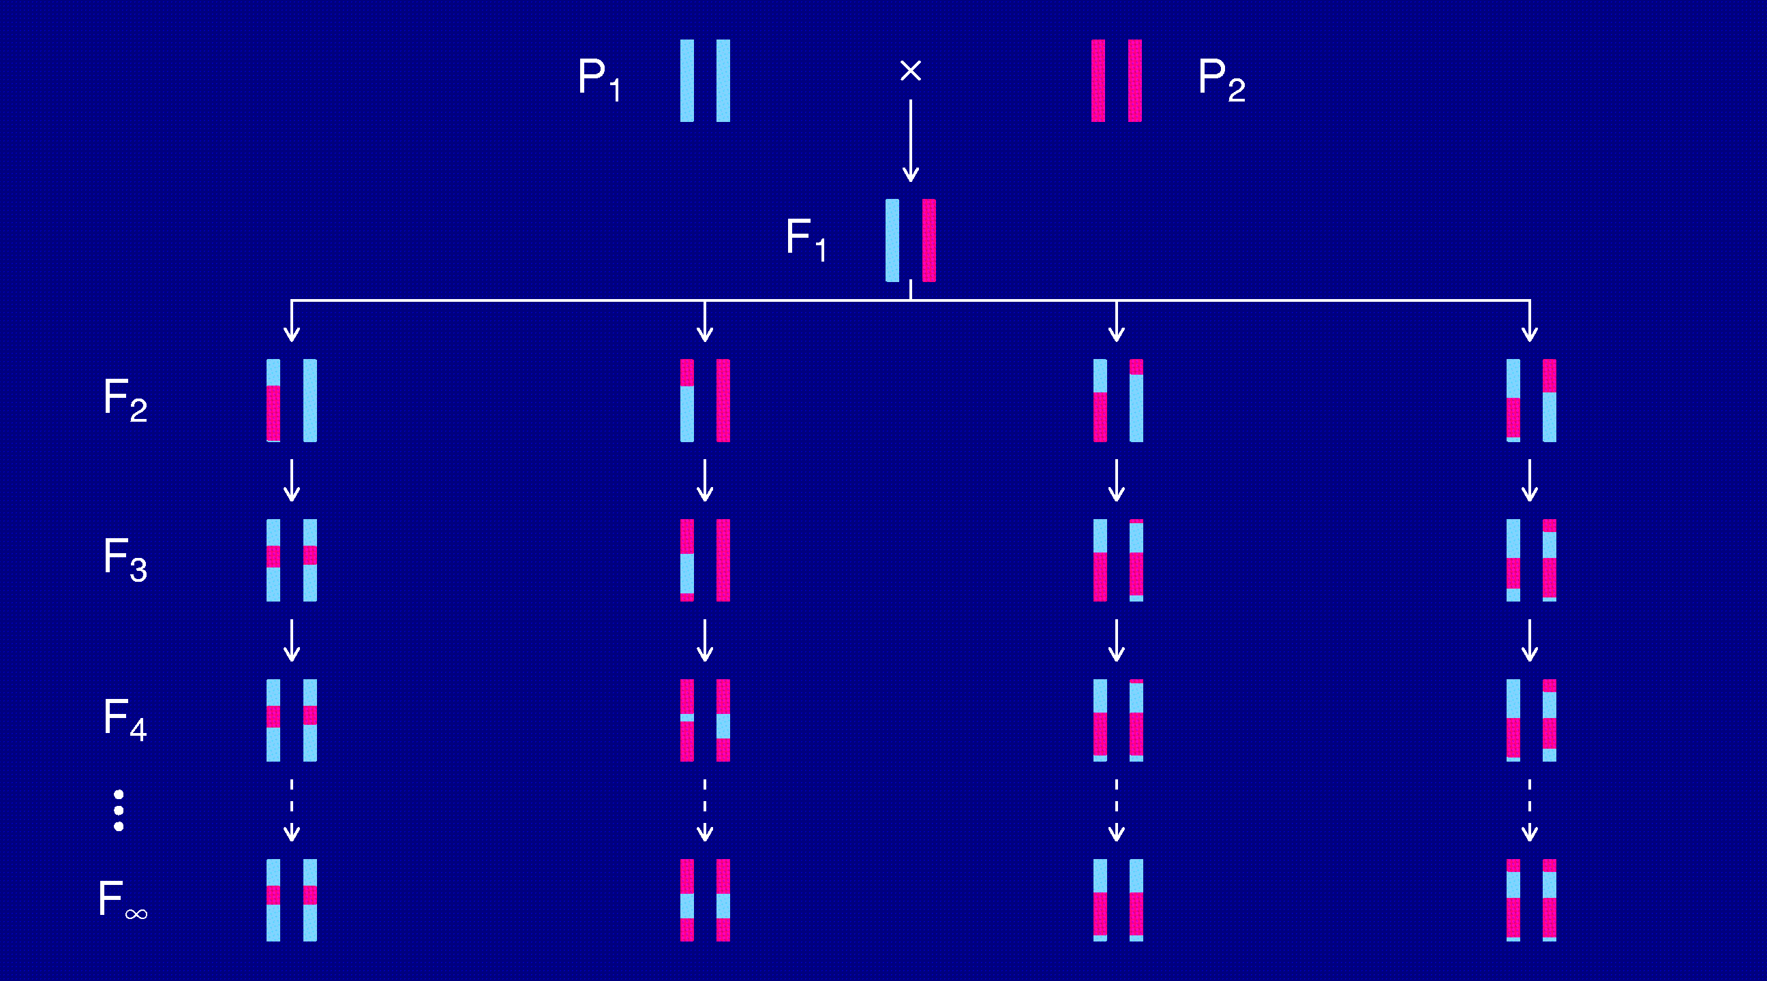
Recombinant inbred lines
(by selfing)
Notes:
Start with the simplest possible case: selfing.
Not possible in mice, but can be done in some plants:
Brush the pollen from a plant back onto the female parts of the same plant.

Slide 13
Markov chain
Sequence of random variables {X₀, X₁, X₂, …} satisfying
Pr(X_{n+1} | X₀, X₁, …, X_{n}) = Pr(X_{n+1} | X_{n})
Transition probabilities P_{ij} = Pr(X_{n+1}=j | X_{n}=i)
Here, X_{n} = “parental type” at generation n
We are interested in absorption probabilities
Pr(X_{n} → j | X₀)

Slide 14
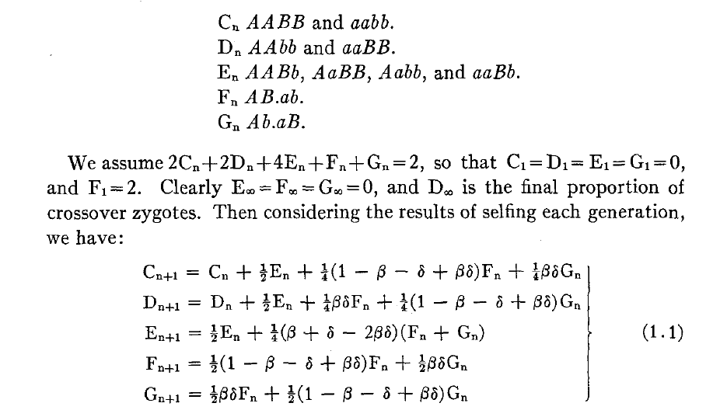
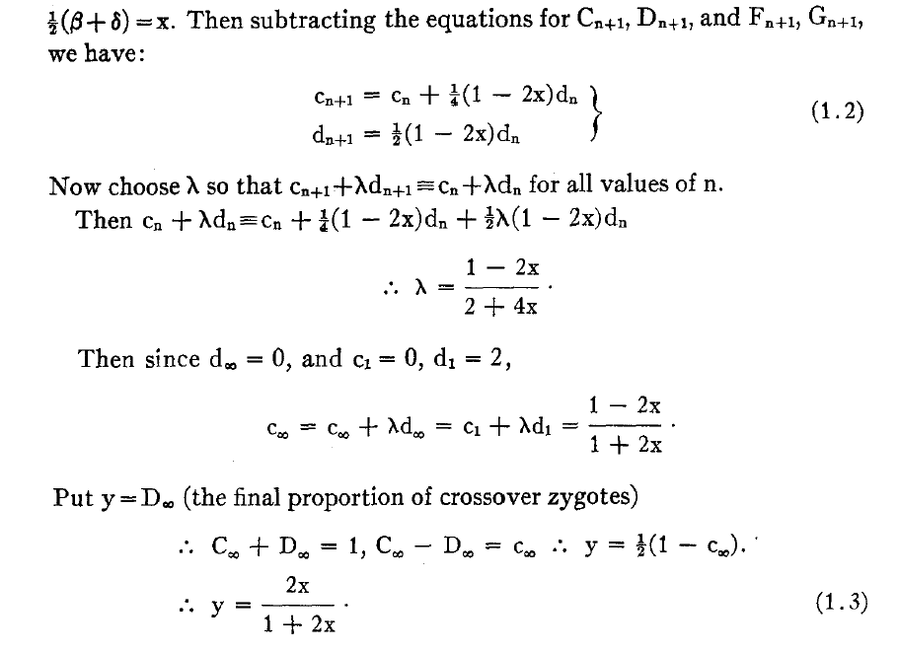
Equations for selfing
Notes:
2⁴=16 possible states.
Reduce to 10 states by the usual symmetries.
Reduce to 5 states by some further symmetries:
- switch orientation of chromosome
- switch A’s and B’s
Here, they give the transition matrix of the Markov chain.
Note that the result indicates a 2x map expansion.

Slide 15
Absorption probabilities
Let P_{ij} = Pr(X_{n+1} = j | X_{n} = i) where X_{n} = state at generation n.
Consider the case of absorption into the state AA|AA.
Let h_{i} = probability, starting at i, eventually absorbed into AA|AA.
Then h_{AA|AA} = 1 and h_{AB|AB} = 0.
Condition on the first step: h_{i} = ∑_{k} P_{ik} h_{k}
For selfing, this gives a system of 3 linear equations.

Slide 16
Recombinant inbred lines
(by sibling mating)
Notes:
Now we need to follow 4 chromosomes at each generation.
2 colors at each of 2 points on each of 4 chromosomes gives 2^8 =256 states

Slide 17
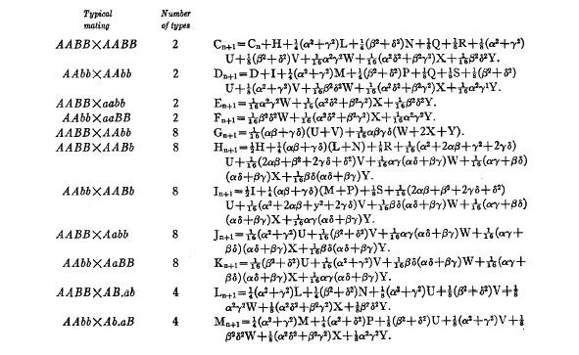
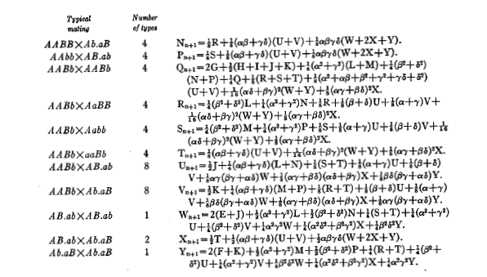
Equations for sib-mating
Notes:
Reduce the 256 states to 55 by the obvious symmetries
Then to 22 states by switching A’s and B’s and the orientation of the chromosome.
Here they give the transition matrix of the Markov chain.
A footnote on the first page of the manuscript thanks a funding source
for the mathematical typesetting of the paper.

Slide 18
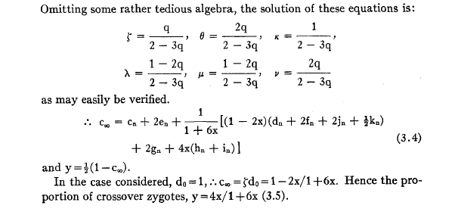
Result for sib-mating
Notes:
Relatively famous equation.
Given the previous slide, you may be a surprise to learn that tedious algebra was omitted.

Slide 19
The “Collaborative Cross”
Notes:
We now wish to do the same for the 8-way RILs.
8 possible colors a each of 2 points on each of 4 chromosomes
8^8, which is quite a bit bigger than 2^8

Slide 20
8-way RILs
Autosomes
  Pr(G₁ = i) = 1/8
  Pr(G₂ = j | G₁ = i) = r / (1+6r) for i ≠ j
  Pr(G₂ ≠ G₁) = 7r / (1+6r)
X chromosome
  Pr(G₁=A) = Pr(G₁=B) = Pr(G₁=E) = Pr(G₁=F) =1/6
  Pr(G₁=C) = 1/3
  Pr(G₂=B | G₁=A) = r / (1+4r)
  Pr(G₂=C | G₁=A) = 2r / (1+4r)
  Pr(G₂=A | G₁=C) = r / (1+4r)
  Pr(G₂ ≠ G₁) = (14/3) r / (1+4r)
Notes:
And here’s the answer.
Note the 7x map expansion.
Note that the 2-point transition matrix has all off-diagonal elements the same:
If you’re A at one point, and you’re to switch to something else, each of the other colors are equally likely.
The X chromosome is a bit more complicated (explain on the next slide).

Slide 21
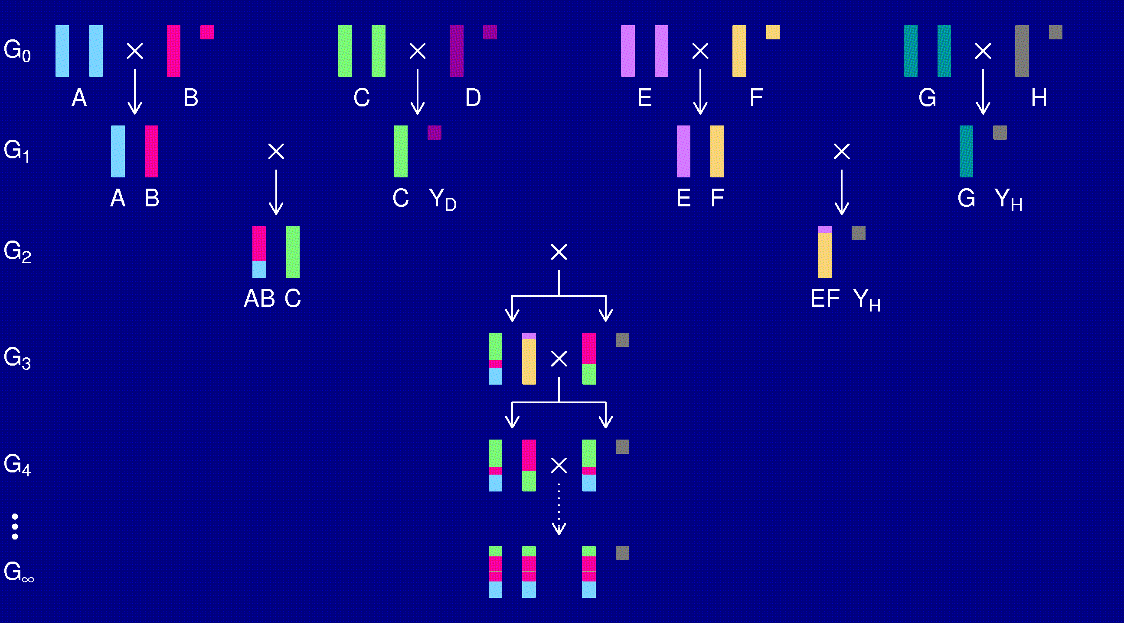
The X chromosome
Notes:
At generation G_2, one intact C chromosome plus recombinant AB and EF chromosomes.
So you get 1/3 C and 1/6 each of A, B, E, F.
No D, G, or H on X chromosome.
The Y chromosome comes from the H strain.

Slide 22
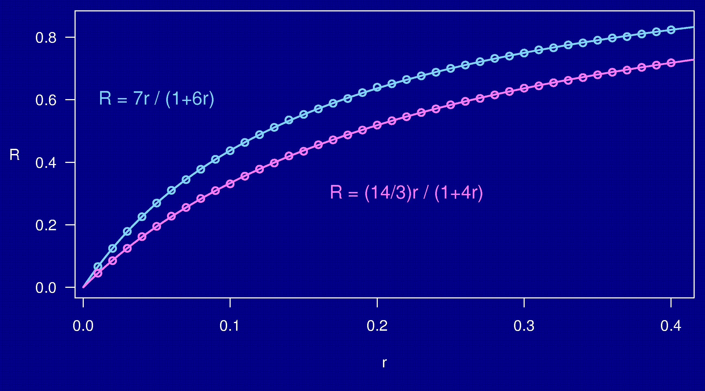
Computer simulations
Notes:
Here’s how I got the results:
- simulate the process for various values of r
- results form a smooth curve.
H&W had 2r/(1+2r) and 4r/(1+6r).
Maybe our result is a r / (1 + b r).
Use non-linear regression.
Rather dissatisfying.
But with a combination of perl and mathematica, I’ve since proven these results symbolically.

Slide 23
3-point coincidence
1
2
3
r_{ij} = recombination fraction for interval i,j;
assume r₁₂ = r₂₃ = r
Coincidence = c = Pr(double recombinant) / r²
= Pr(rec’n in 23 | rec’n in 12) / Pr(rec’n in 23)
No interference → = 1
Positive interference → < 1
Negative interference → > 1
Generally c is a function of r.
Notes:
But by that point, I was obsessed with the problem, and had to go on to the 3-point case.
Crossover interference and the 3-point coincidence.

Slide 24
3-points in 2-way RILs
1
2
3
r₁₃ = 2 r (1 – c r)
R = f(r); R₁₃ = f(r₁₃)
Pr(double recombinant in RIL) = { R + R – R₁₃ } / 2
Coincidence (in 2-way RIL) = { 2 R – R₁₃ } / { 2 R² }
Notes:
This is included at the end of Haldane & Waddington (1931)
(though I’m sure few readers got to this part; I read it only after rediscovering the trick).
With no extra effort, can get the 3-pt coincidence.

Slide 25
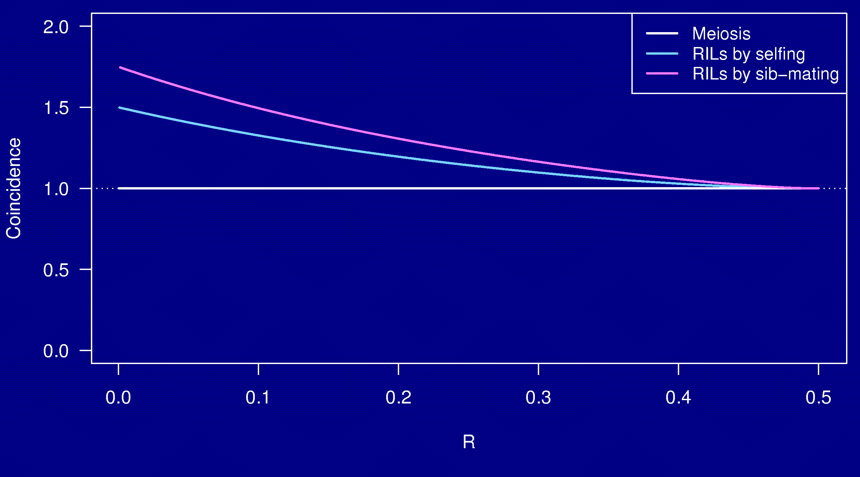
Coincidence
No interference
Notes:
Note these are entirely above 1, which indicates clustering of breakpoints:
If there’s a recombination event in the first interval, recombination in the 2nd interval is more likely.
Related to the banding pattern on RIL chromosomes (see slide 5).

Slide 26
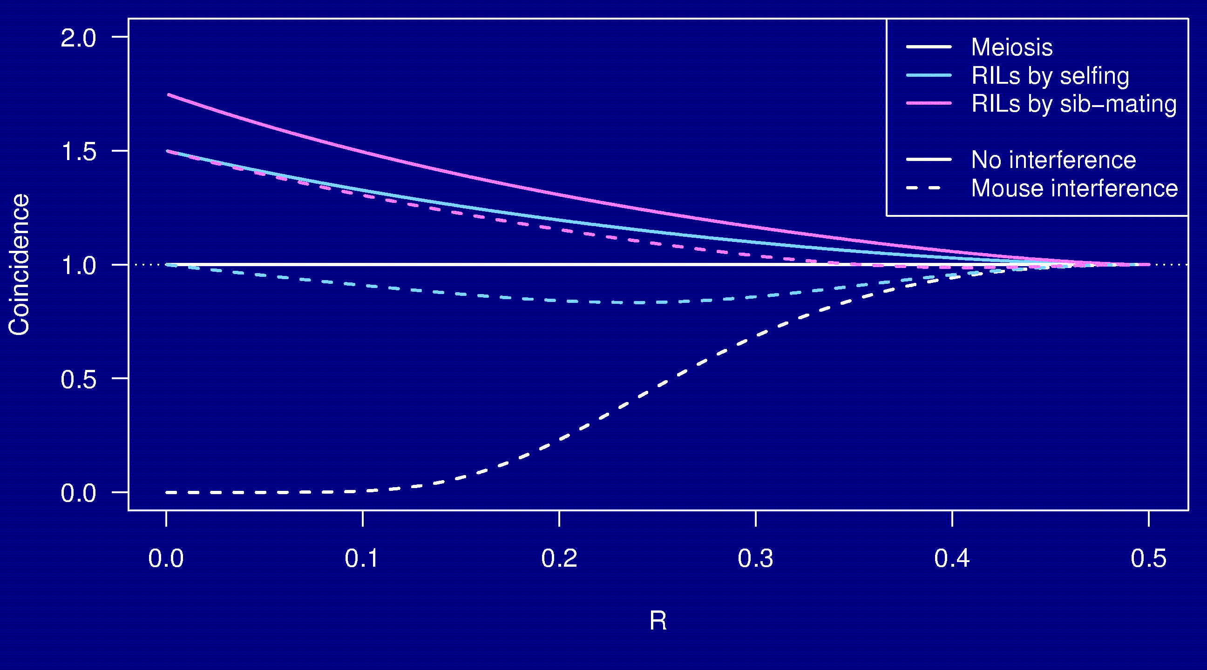
Coincidence
Notes:
Even in the case of very strong crossover interference,
RILs by sib mating show a clustering of breakpoints.

Slide 27
Why the clustering of breakpoints?
The really close breakpoints occur in different generations.
Breakpoints in later generations can occur only in regions that are not yet fixed.
The regions of heterozygosity are, of course, surrounded by breakpoints.

Slide 28
Coincidence in 8-way RILs
The trick that allowed us to get the coincidence for 2-way RILs doesn’t work for 8-way RILs.
It’s sufficient to consider 4-way RILs.
Calculations for 3 points in 4-way RILs is still astoundingly complex.
  2 points in 2-way RILs by sib-mating:
  55 parental types → 22 states by symmetry
  3 points in 4-way RILs by sib-mating:
  2,164,240 parental types → 137,488 states
Even counting the states was difficult.
Notes:
Getting the numbers 2 million & 137k required 1.5 days of computer time.

Slide 29
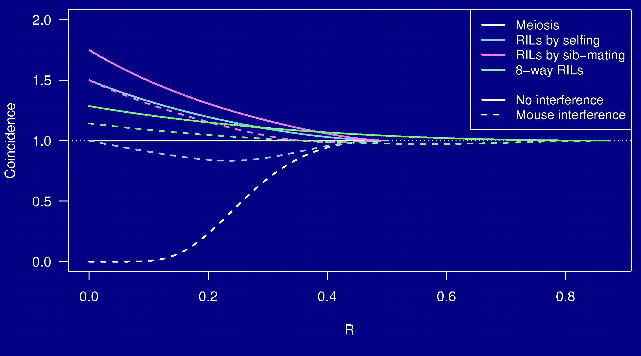
Coincidence
Notes:
But I did it.
Some clustering, but relatively close to 1, especially with high crossover interference.
I like smooth curves, so the two green curves each have 250 points.
Each point was about 1.5 days of computer time.
So that’s two years of computer time.
(But done in 3 months using 8 nodes of our Linux cluster.)
(I did crash our server twice while trying to find faster approaches,
due to some errors of multiple orders of magnitude in my estimates of memory and disk usage.
It turns out that the number of files allowed in /tmp is a not-too-large finite number.)

Slide 30
The formula
Friedrich Teuscher
Research Institute for the Biology of Farm Animals
Dummerstorf, Germany

Slide 31
Whole genome simulations
2-way selfing, 2-way sib-mating, 8-way sib-mating
Mouse-like genome, 1665 cM
Strong positive crossover interference
Inbreed to complete fixation
10,000 simulation replicates
Notes:
Some things are not amenable to analytic analysis: need simulations
how many generations to fixation?
How dense will markers need to be?

Slide 32
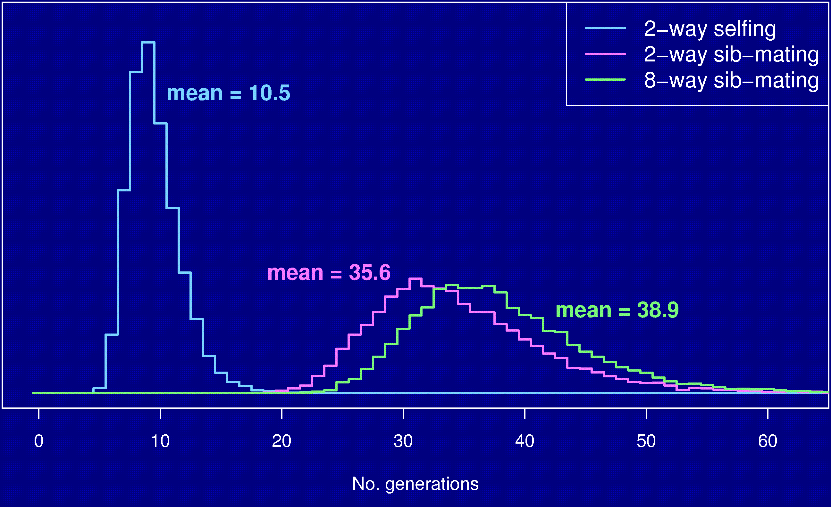
No. generations to fixation
Notes:
This was a bit of a surprise.
Usual answer is 8 generations for selfing and 20 for sib-mating.
Need 3 more for 8-way by sib-mating.

Slide 33
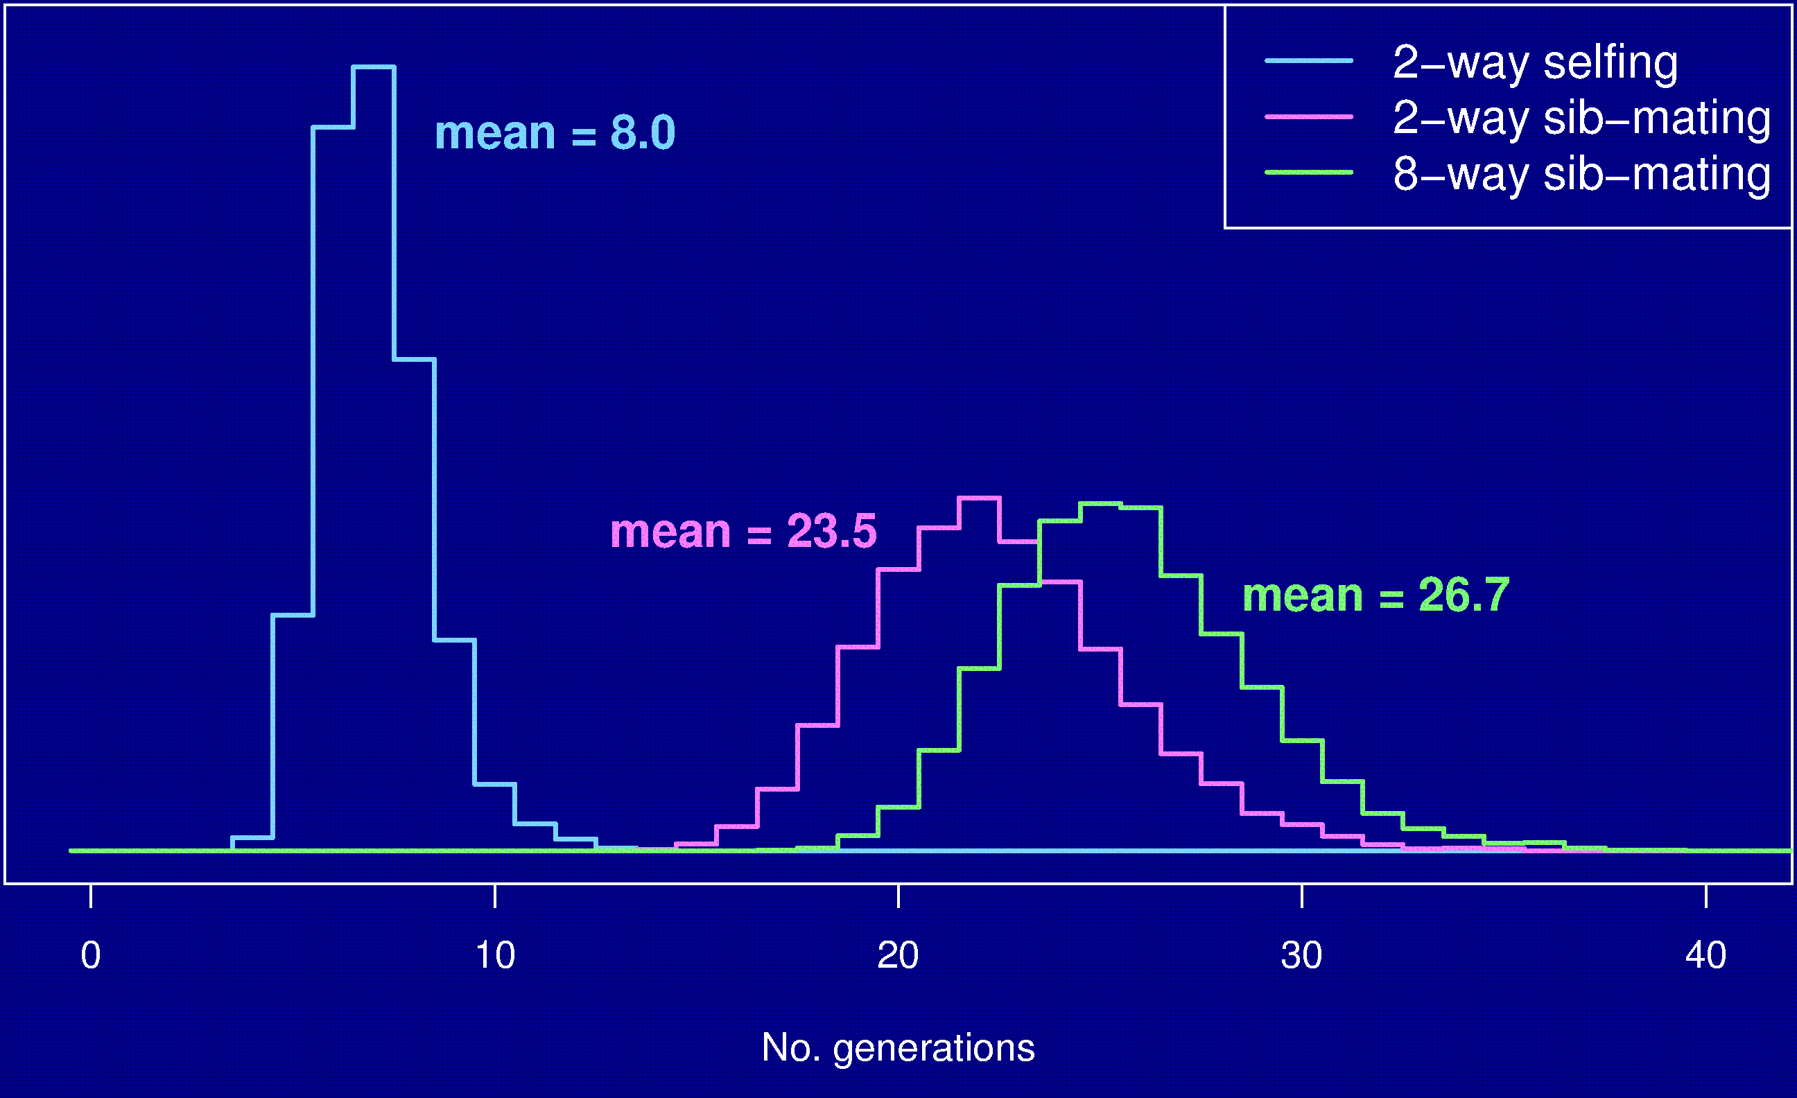
No. gen’s to 99% fixation
Notes:
This is probably where the 8 and 20 came from.

Slide 34
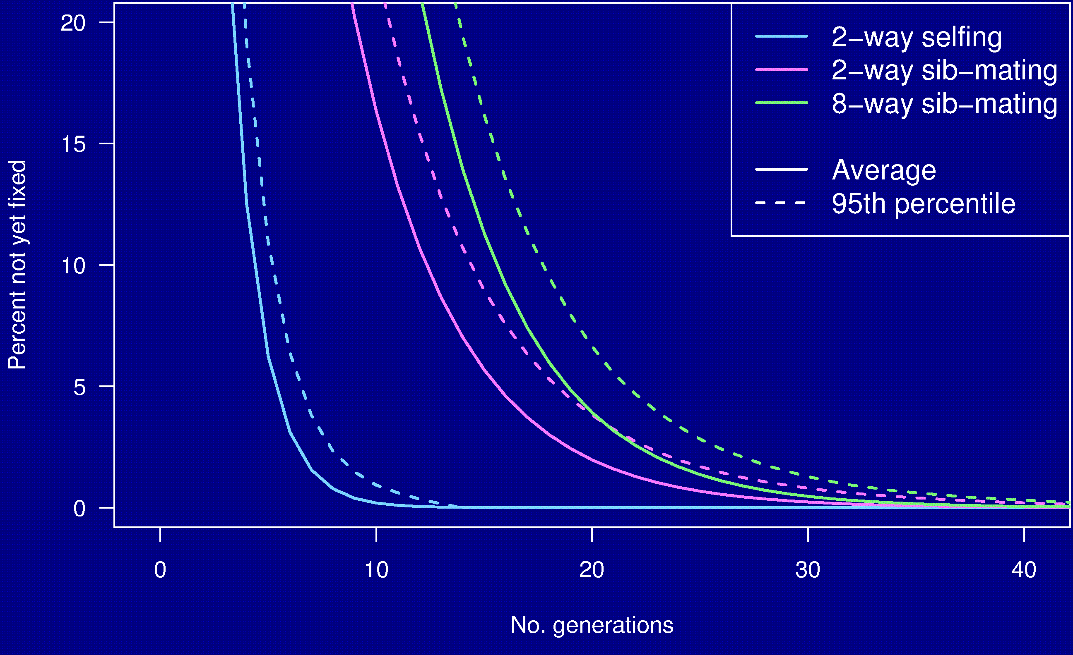
Percent genome not fixed

Slide 35
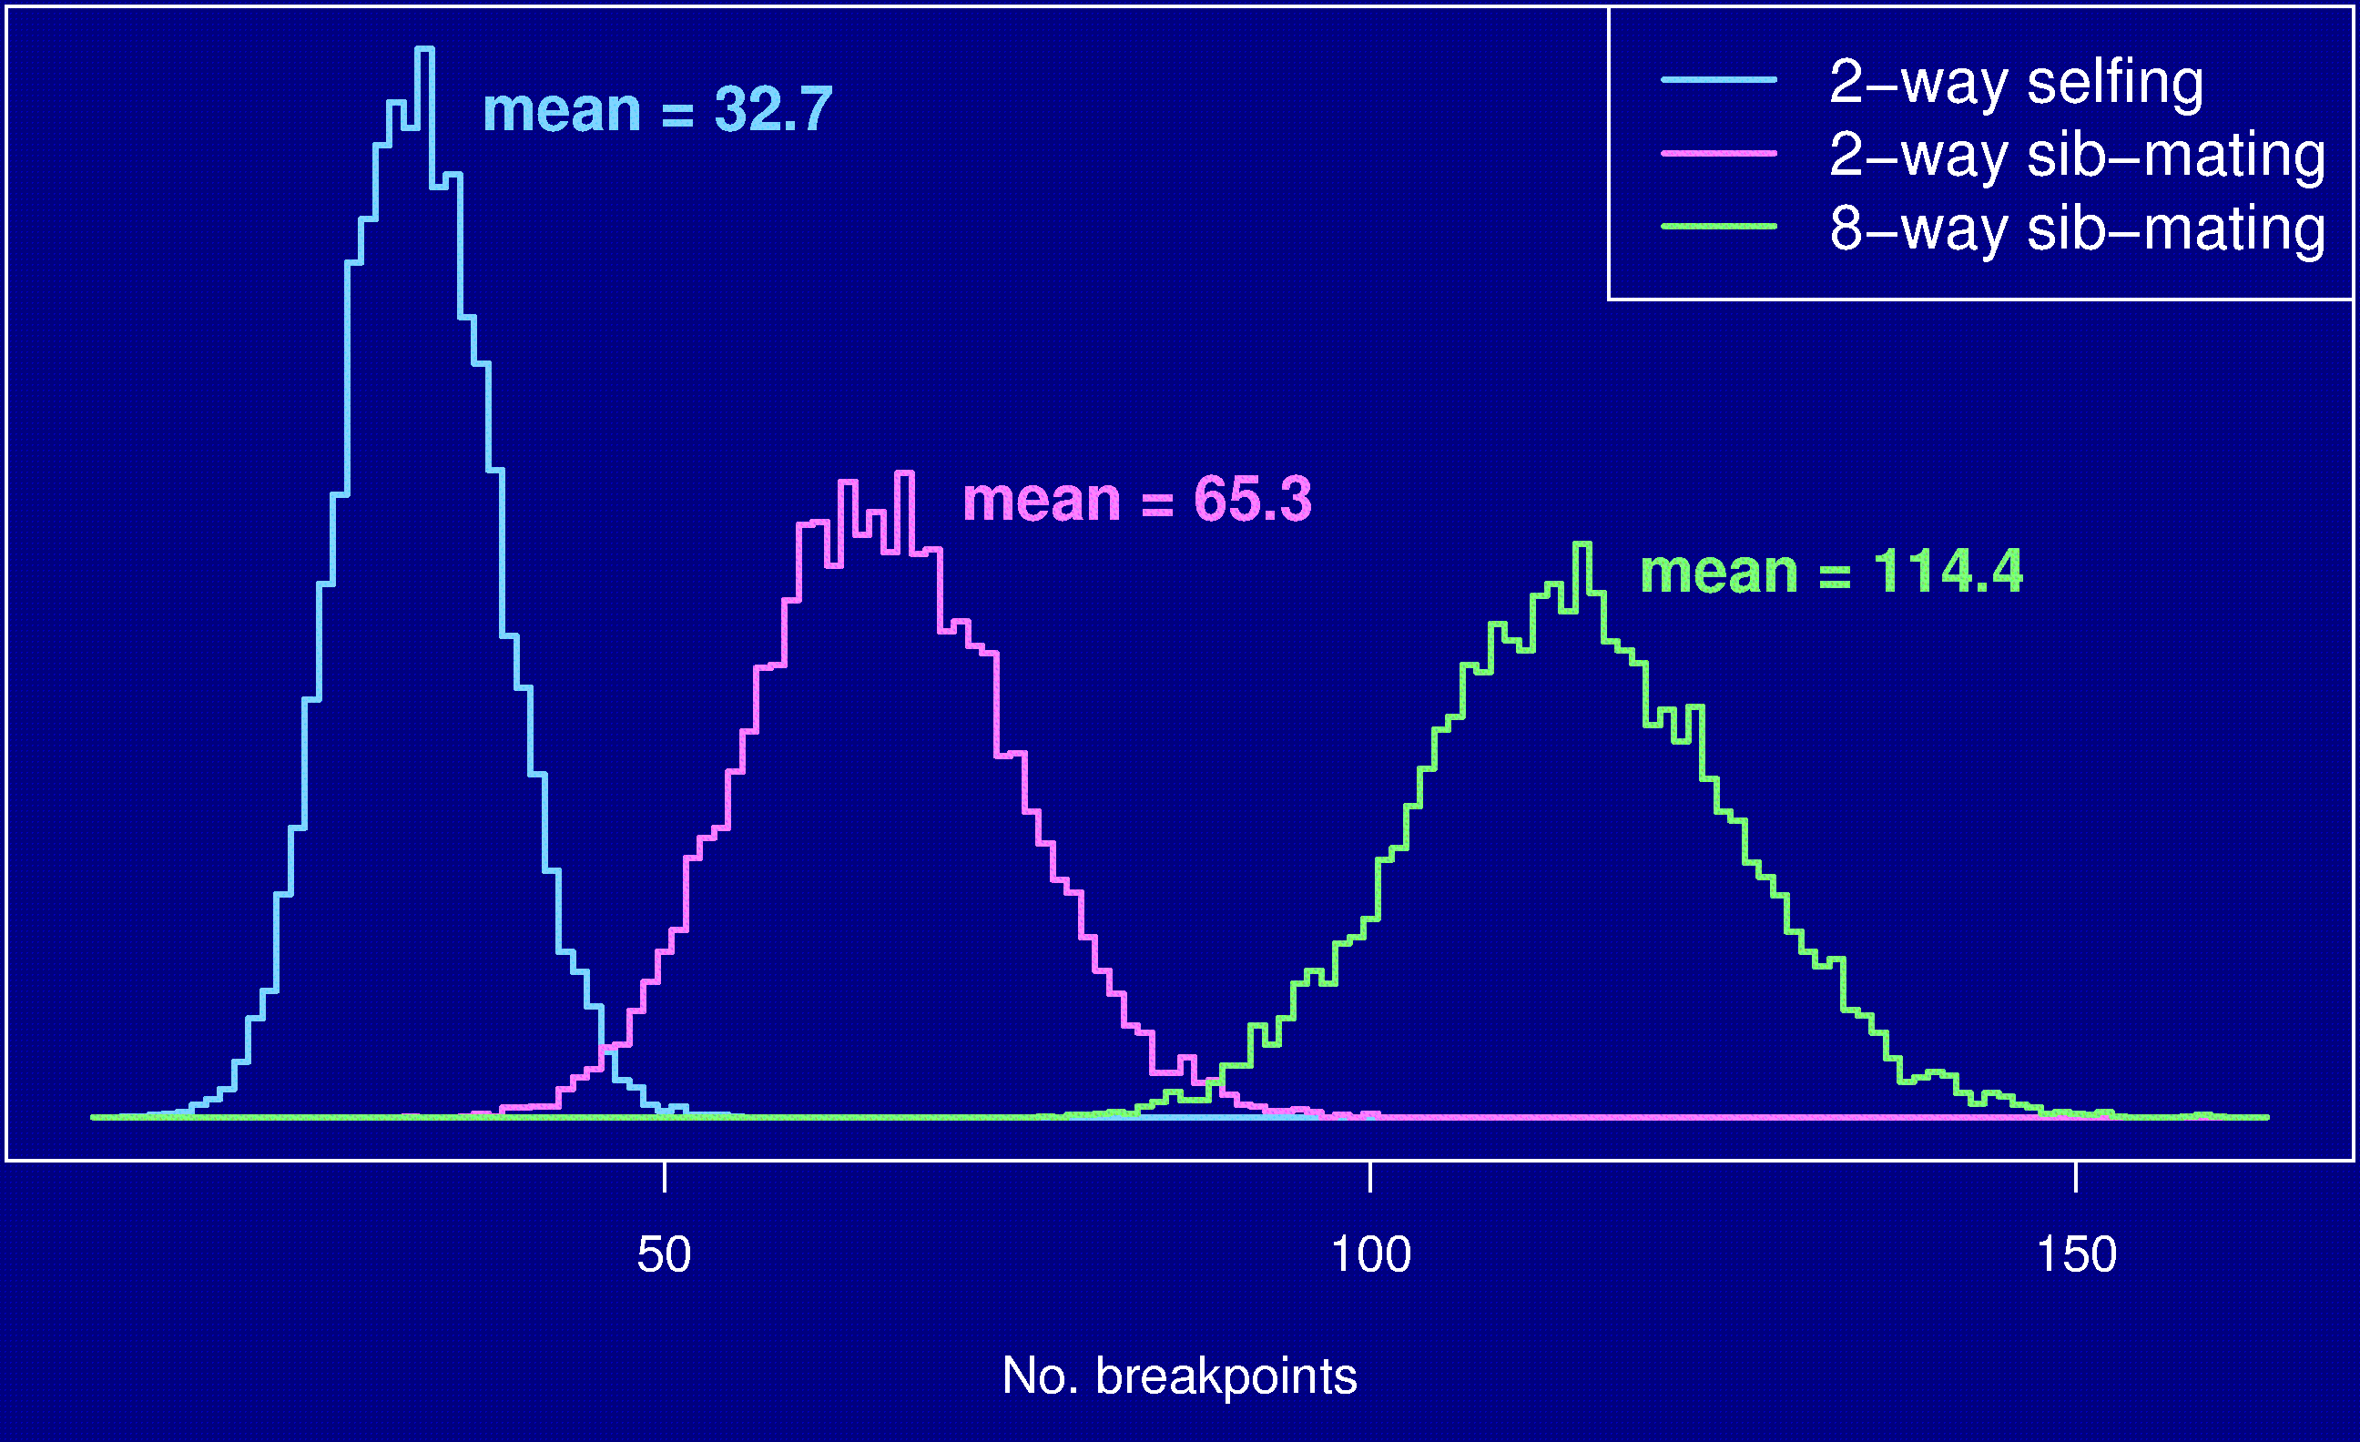
Number of breakpoints
Notes:
Number of breakpoints = 2x, 4x, 7x the genome size.

Slide 36
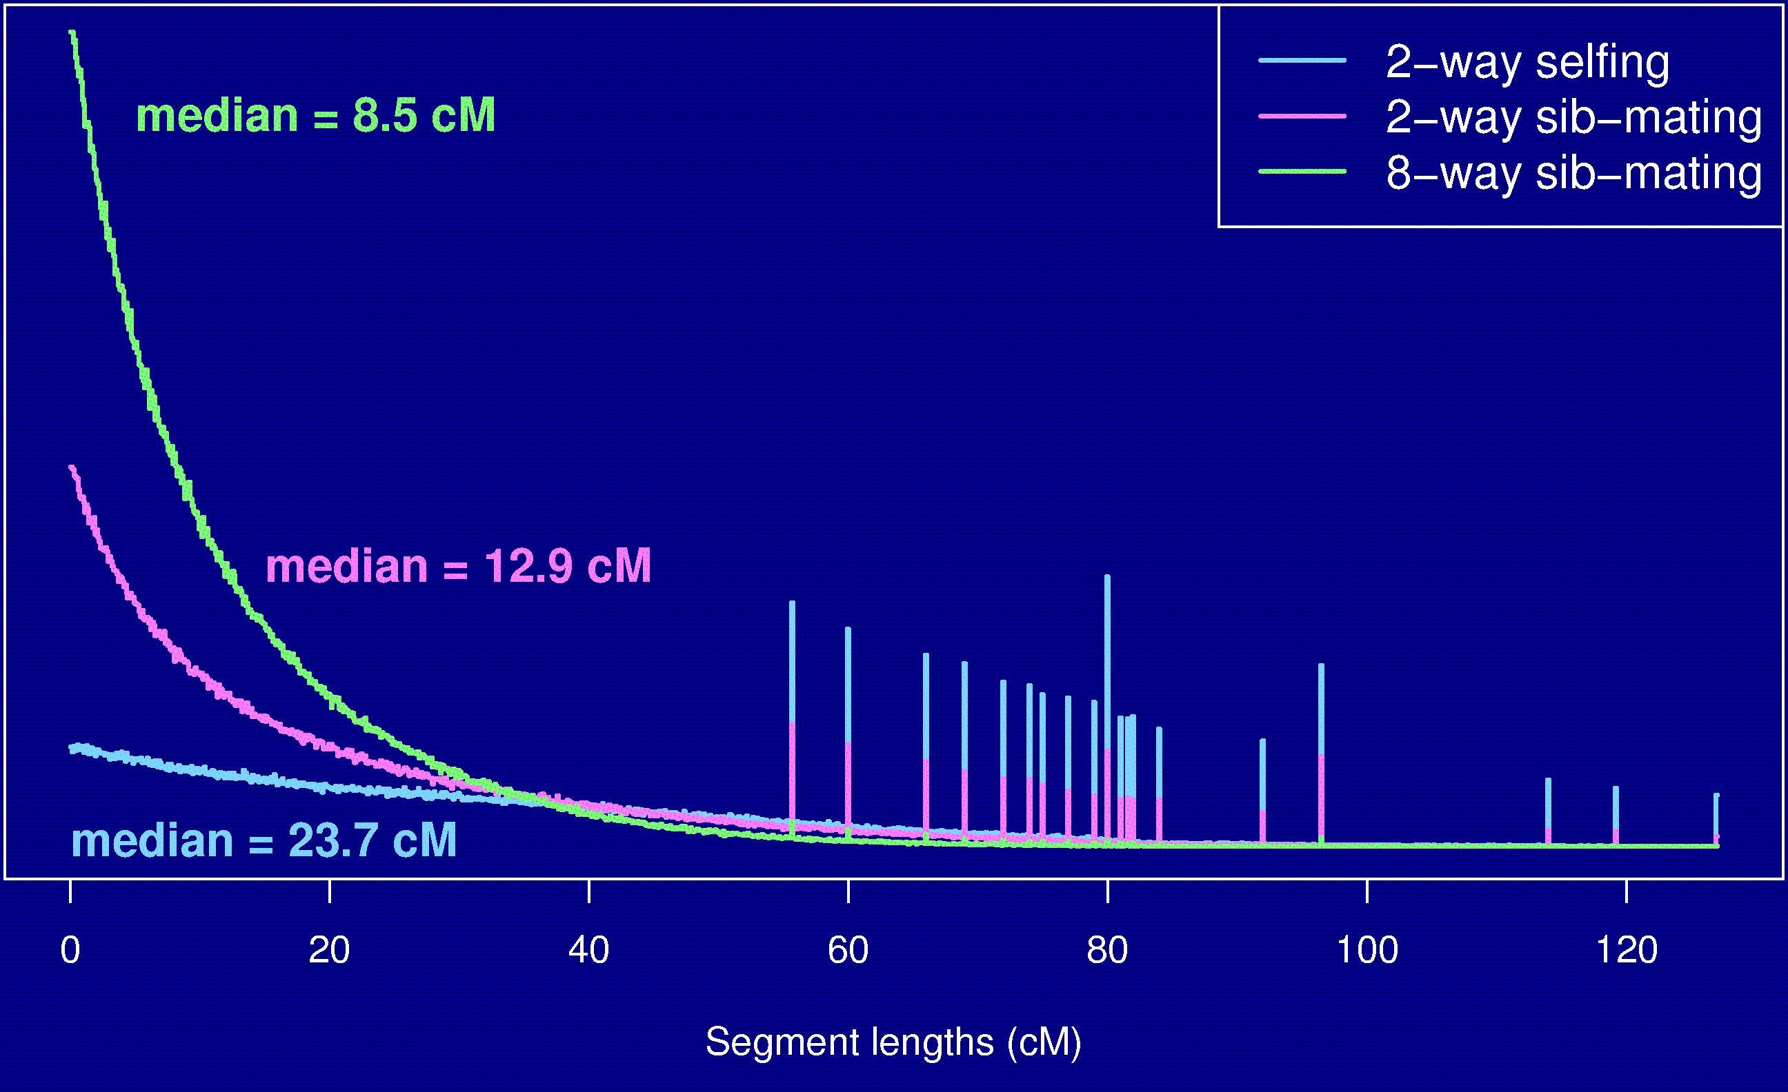
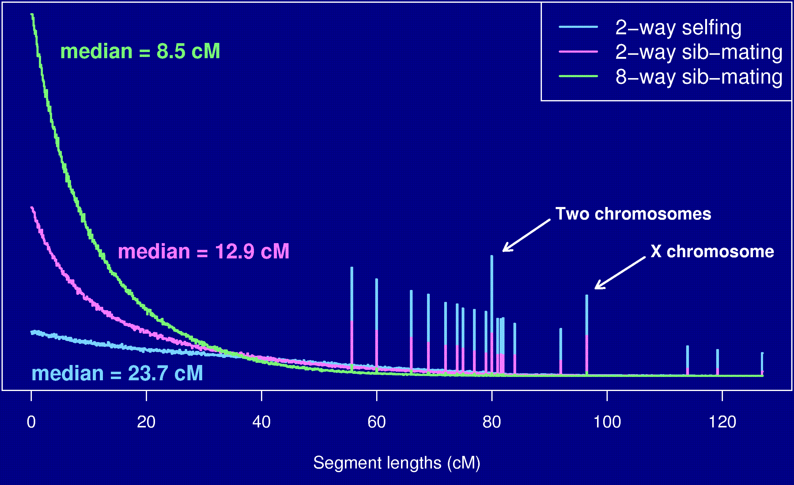
Segment lengths
Notes:
Spikes = whole chromosomes inherited intact.

Slide 37
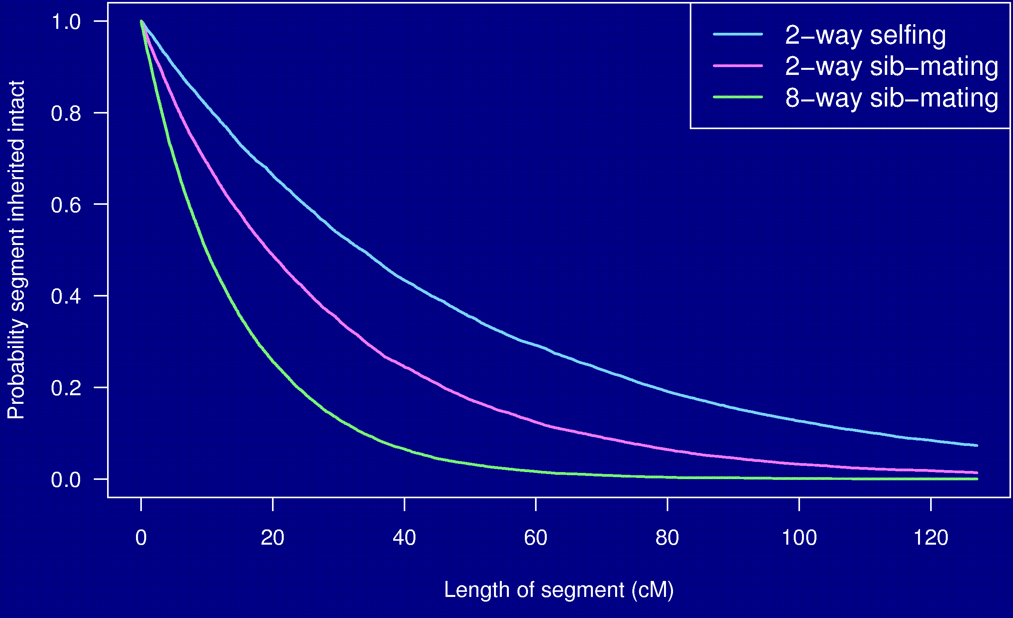
Probability a segment is inherited intact

Slide 38
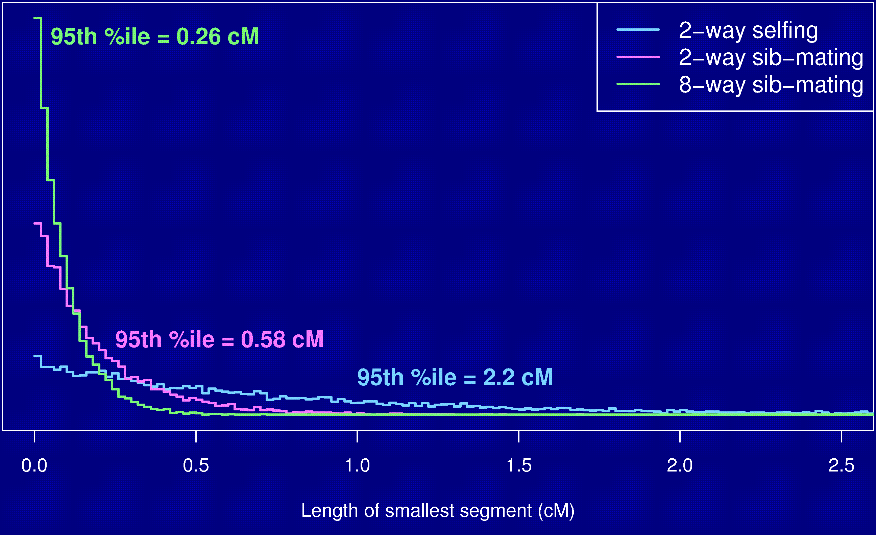
Length of smallest segment
Notes:
95 % of the time you have a segment that is < 1/4 cM.

Slide 39
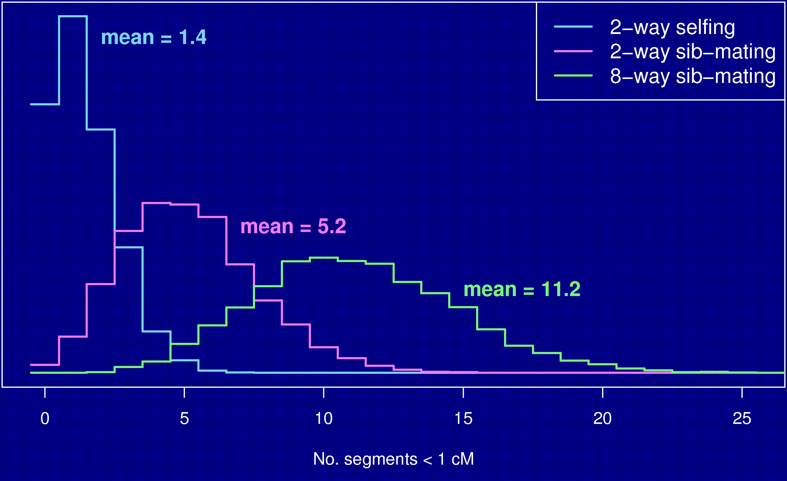
No. segments < 1 cM
Notes:
Thus we need very dense genotype data to discover all possible segments.

Slide 40
Summary
The Collaborative Cross could provide “one-stop shopping” for gene mapping in the mouse.
Use of such 8-way RILs requires an understanding of the breakpoint process.
We’ve extended Haldane & Waddington’s results to the case of 8-way RILs: R = 7 r / (1 + 6 r).
We’ve shown clustering of breakpoints in RILs by sib-mating, even in the presence of strong crossover interference.
Broman KW (2005) The genomes of recombinant inbred lines. Genetics 169:1133-1146

