Slide 1
How to display data badly

Slide 2
Using Microsoft Excel to obscure your data and annoy your readers

Slide 3
Inspiration
This lecture was inspired by
H Wainer (1984) How to display data badly. American Statistician 38(2):137-147
Dr. Wainer was the first to elucidate the principles of the bad display of data.
The now widespread use of Microsoft Excel has resulted in remarkable advances in the field.

Slide 4
General principles
The aim of good data graphics:
Display data accurately and clearly.
Some rules for displaying data badly:
Display as little information as possible.
Obscure what you do show (with chart junk).
Use pseudo-3d and color gratuitously.
Make a pie chart (preferably in color and 3d).
Use a poorly chosen scale.
Ignore sig figs.

Slide 5
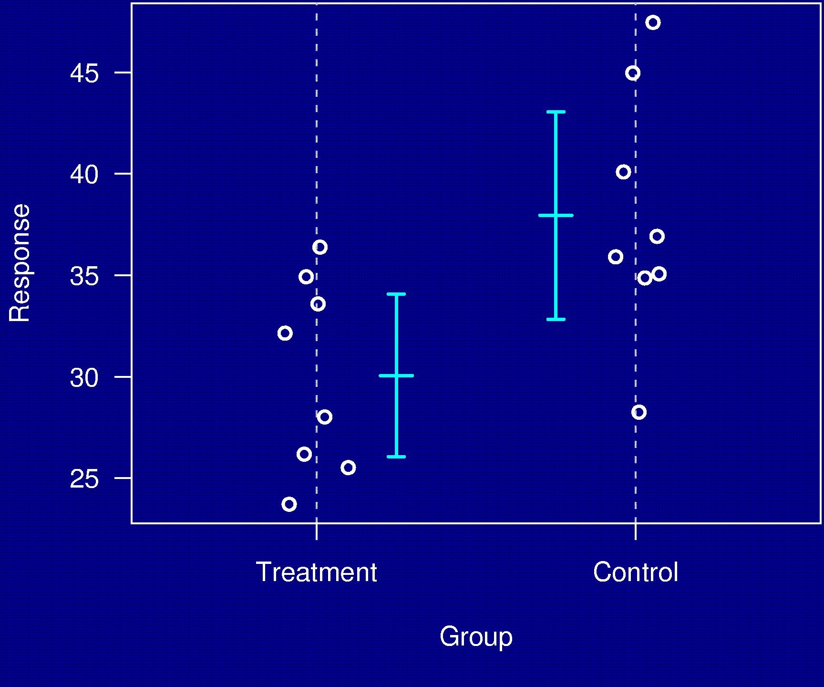
Example 1

Slide 6
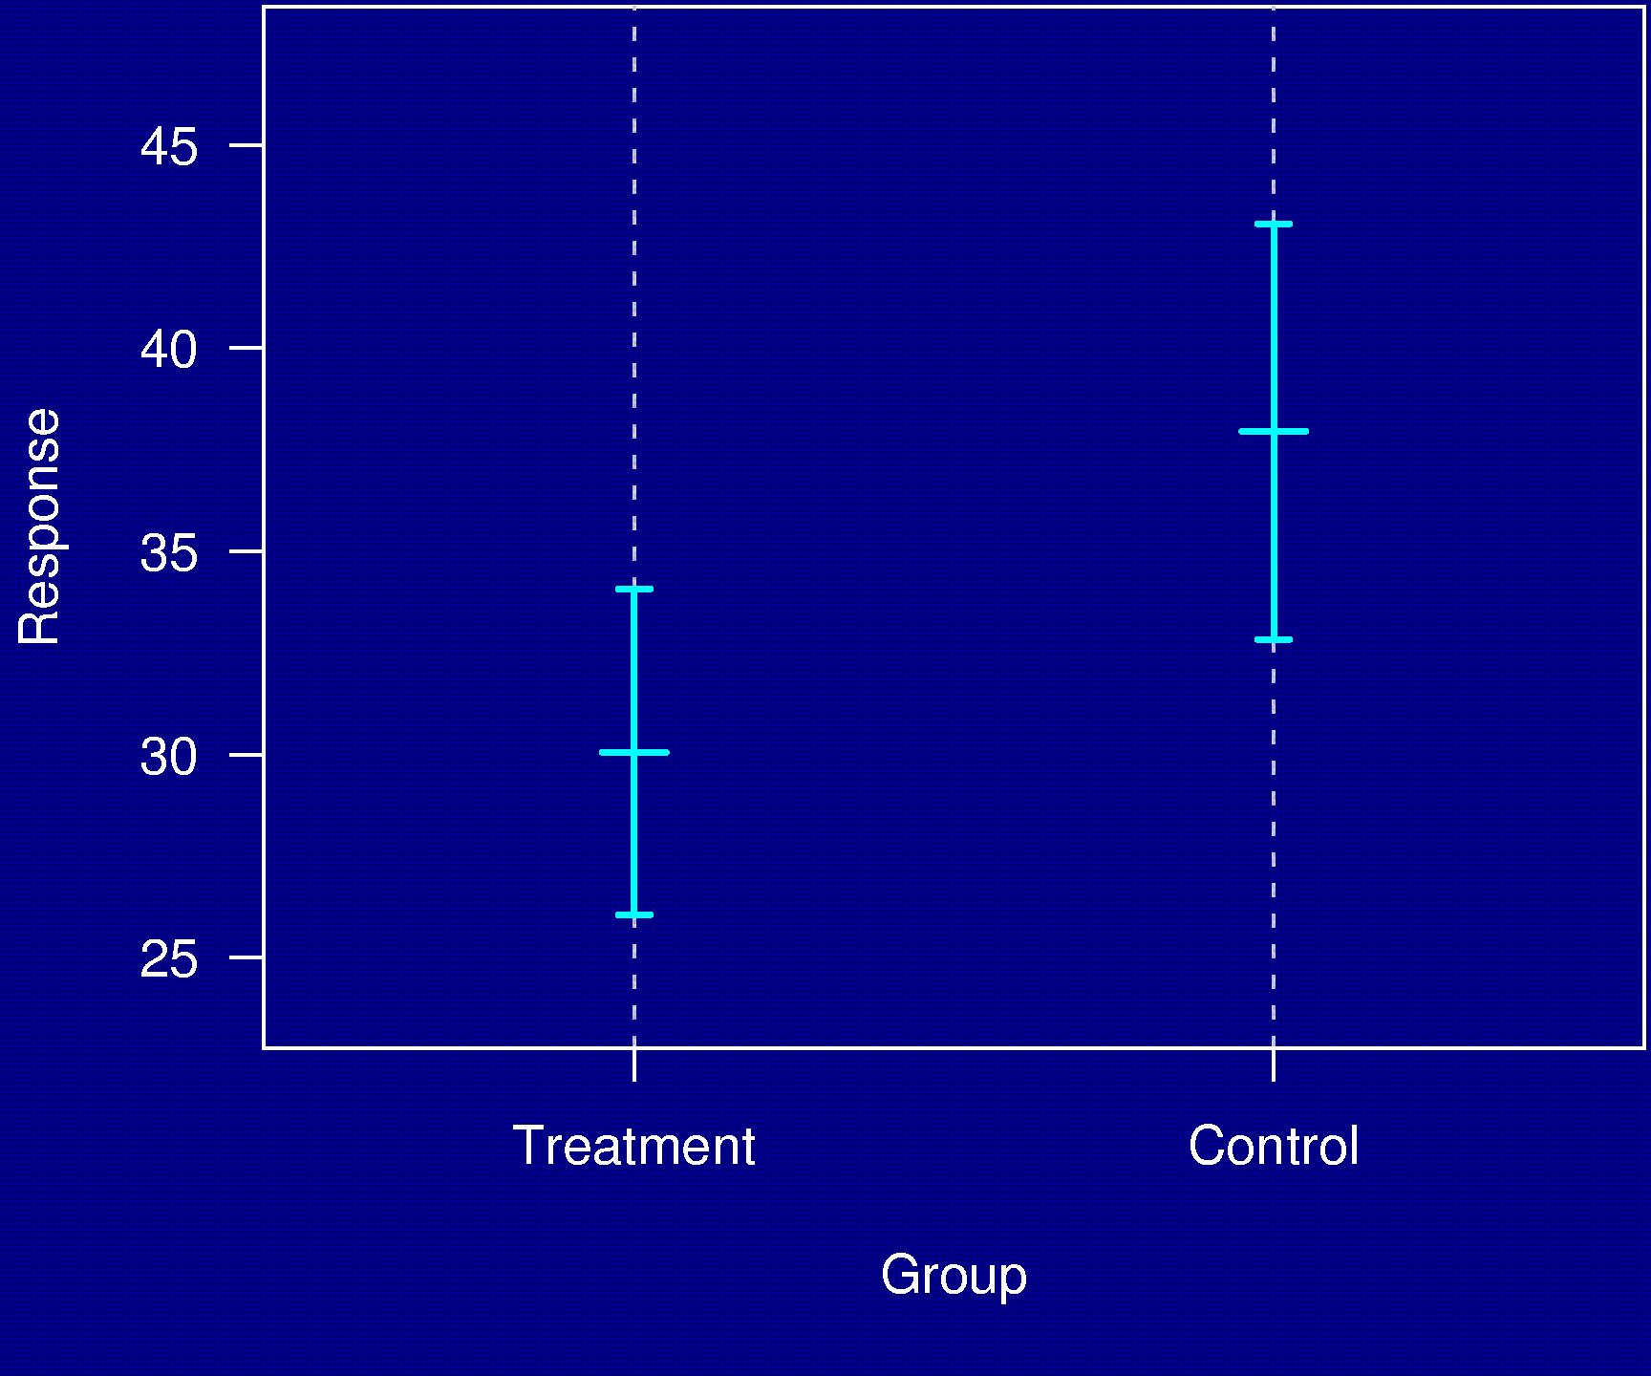
Example 1

Slide 7
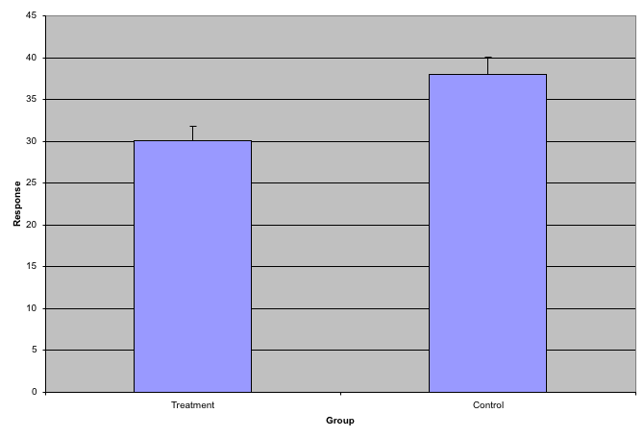
Example 1

Slide 8
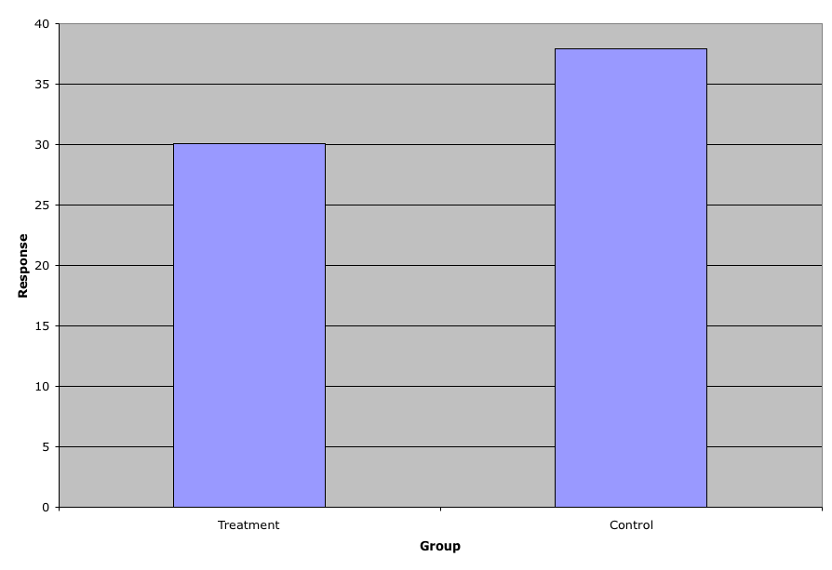
Example 1

Slide 9
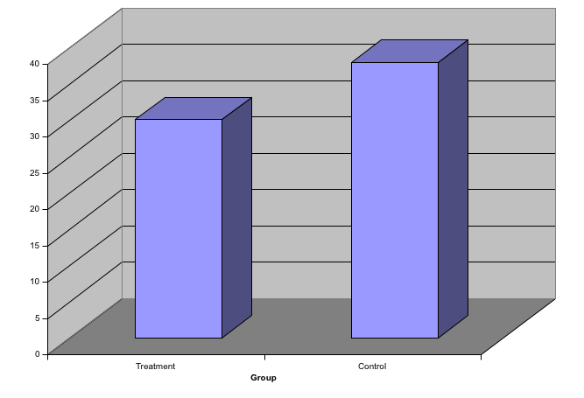
Example 1

Slide 10
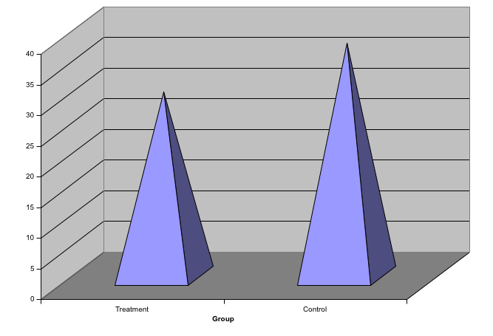
Example 1

Slide 11
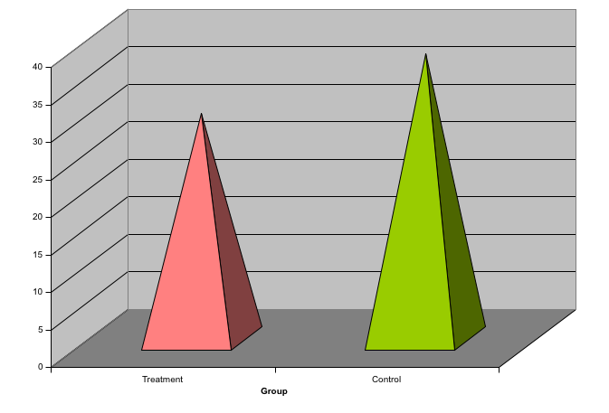
Example 1

Slide 12
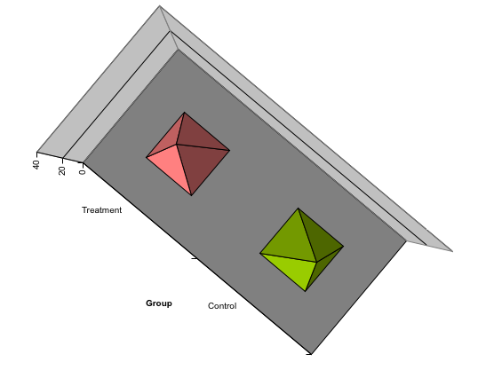
Example 1

Slide 13
Example 2
Distribution of genotypes
AA 21%
AB 48%
BB 22%
missing 9%

Slide 14
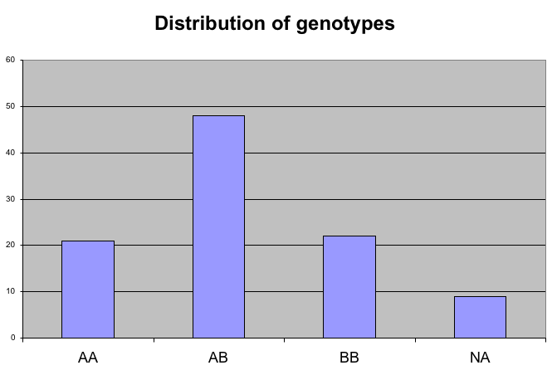
Example 2

Slide 15
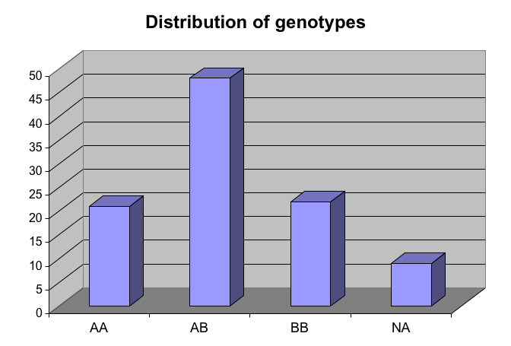
Example 2

Slide 16
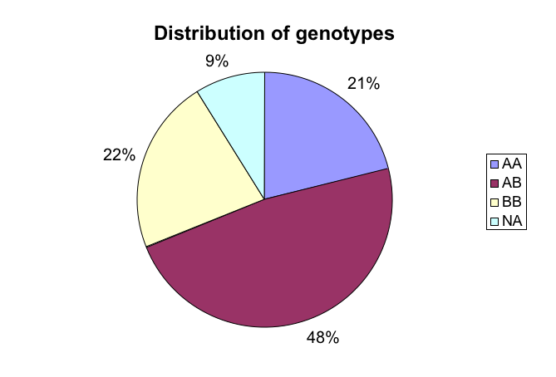
Example 2

Slide 17
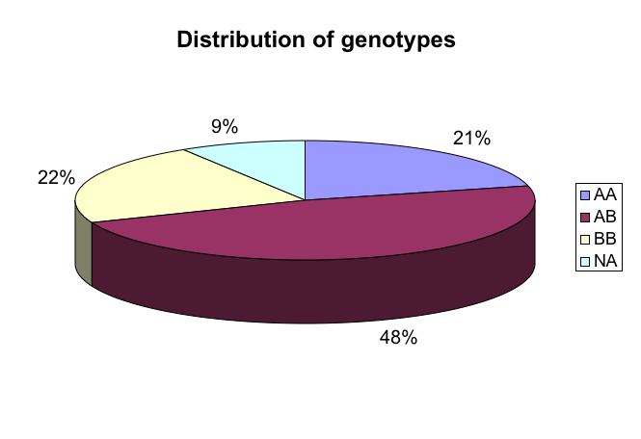
Example 2

Slide 18
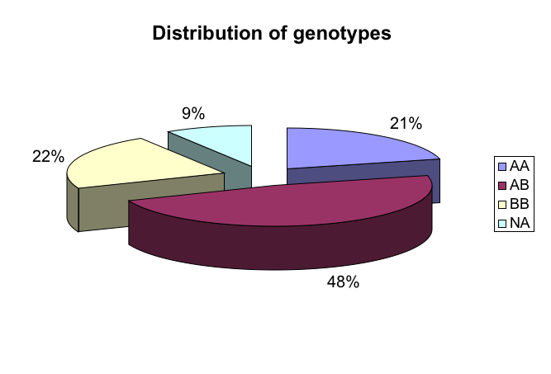
Example 2

Slide 19
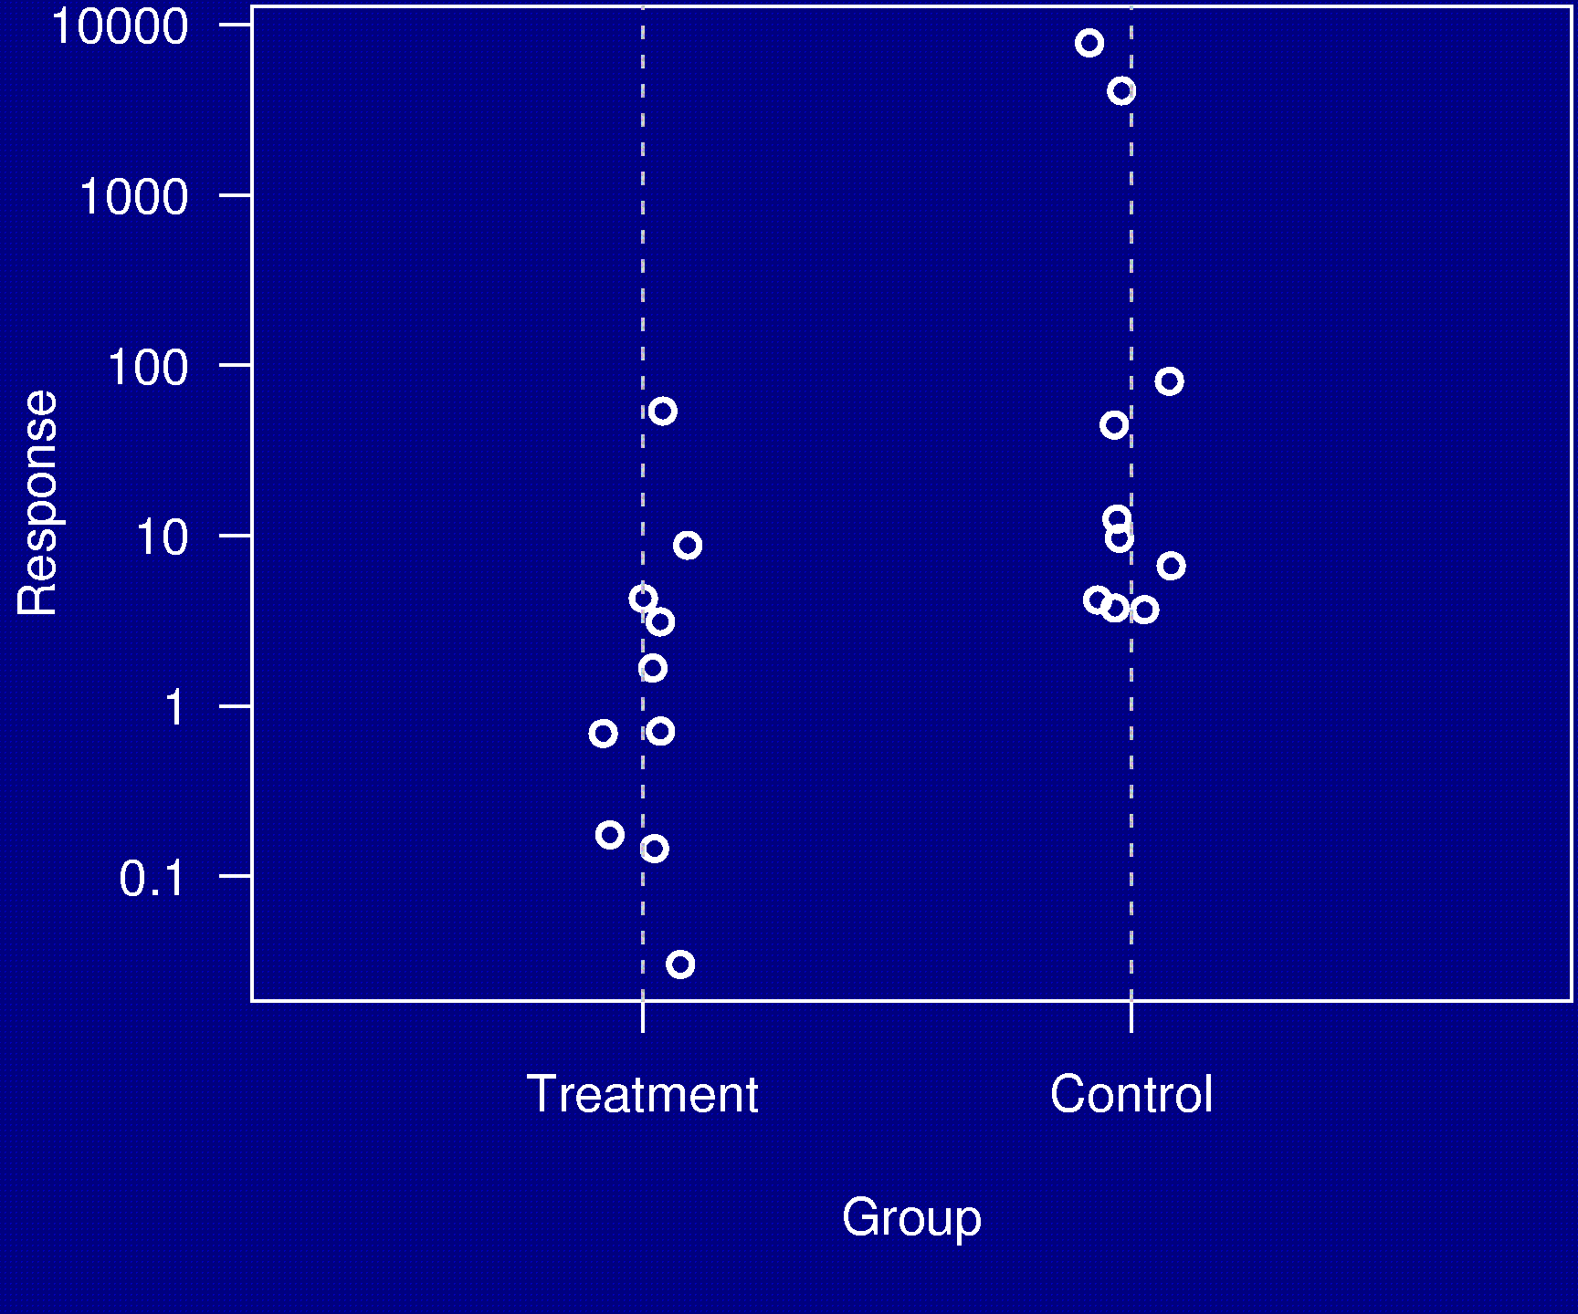
Example 3

Slide 20
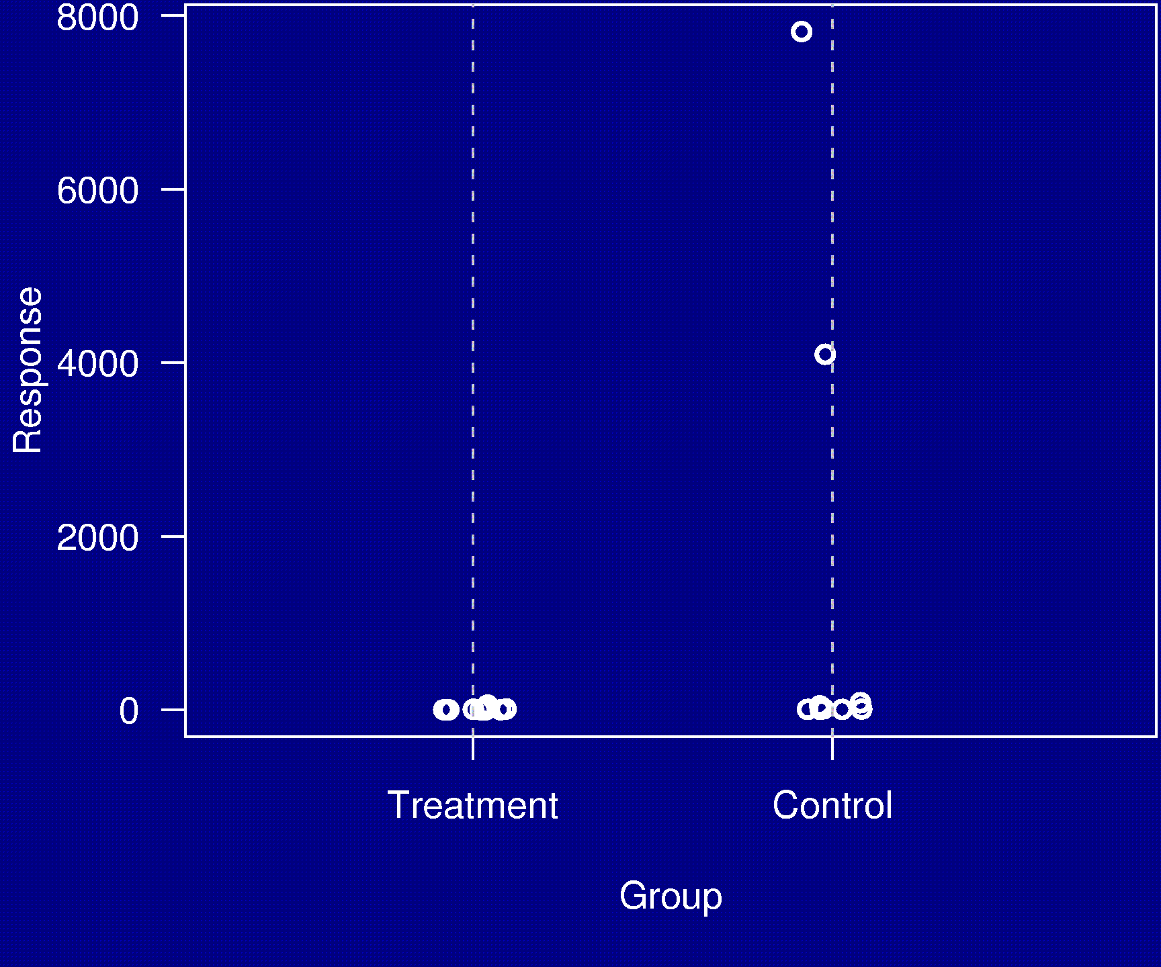
Example 3

Slide 21
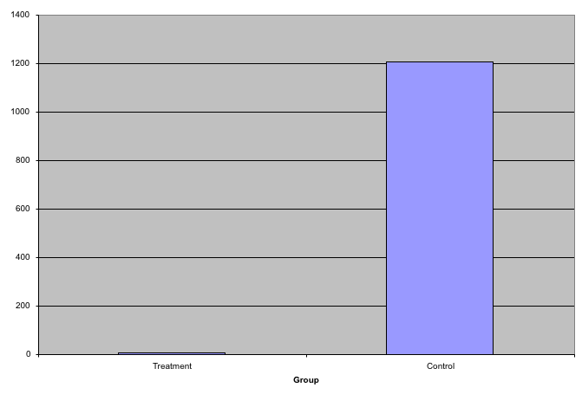
Example 3

Slide 22
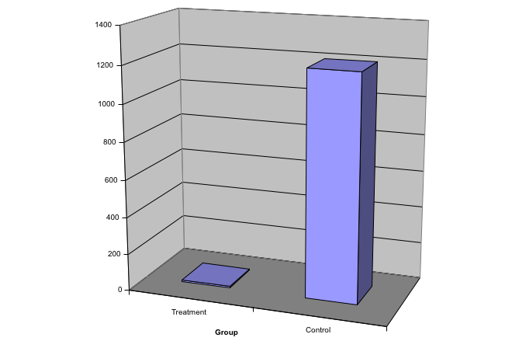
Example 3

Slide 23
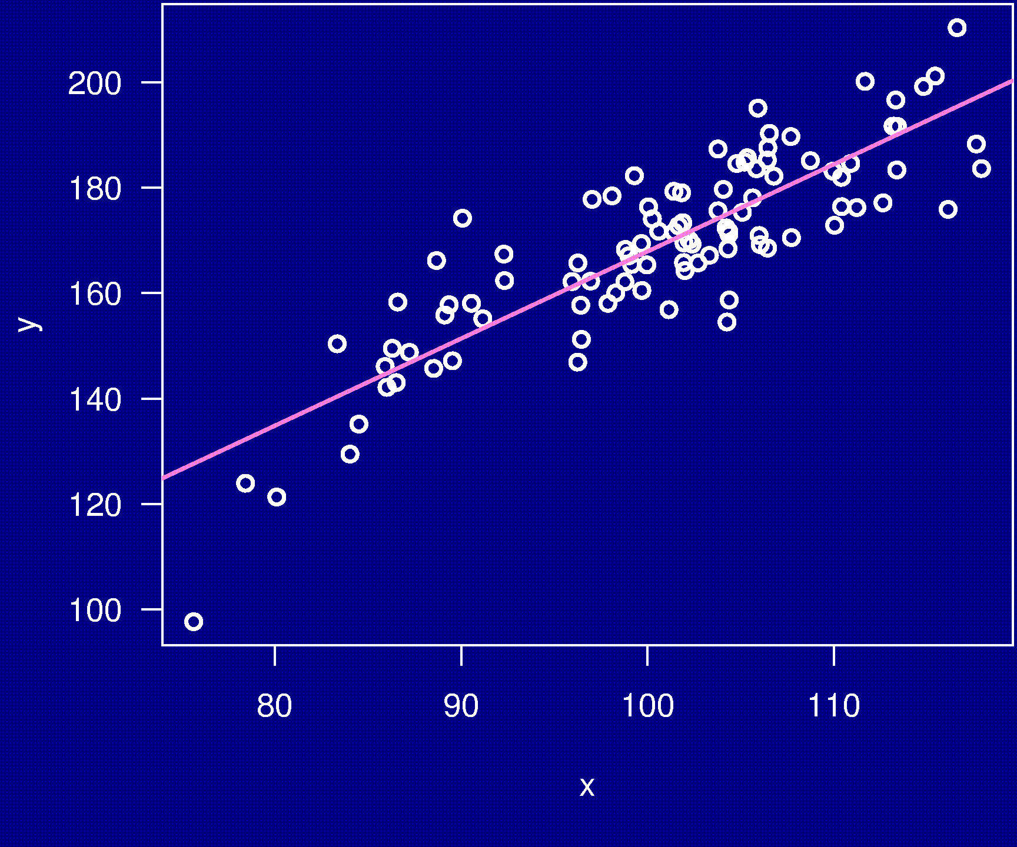
Example 4

Slide 24
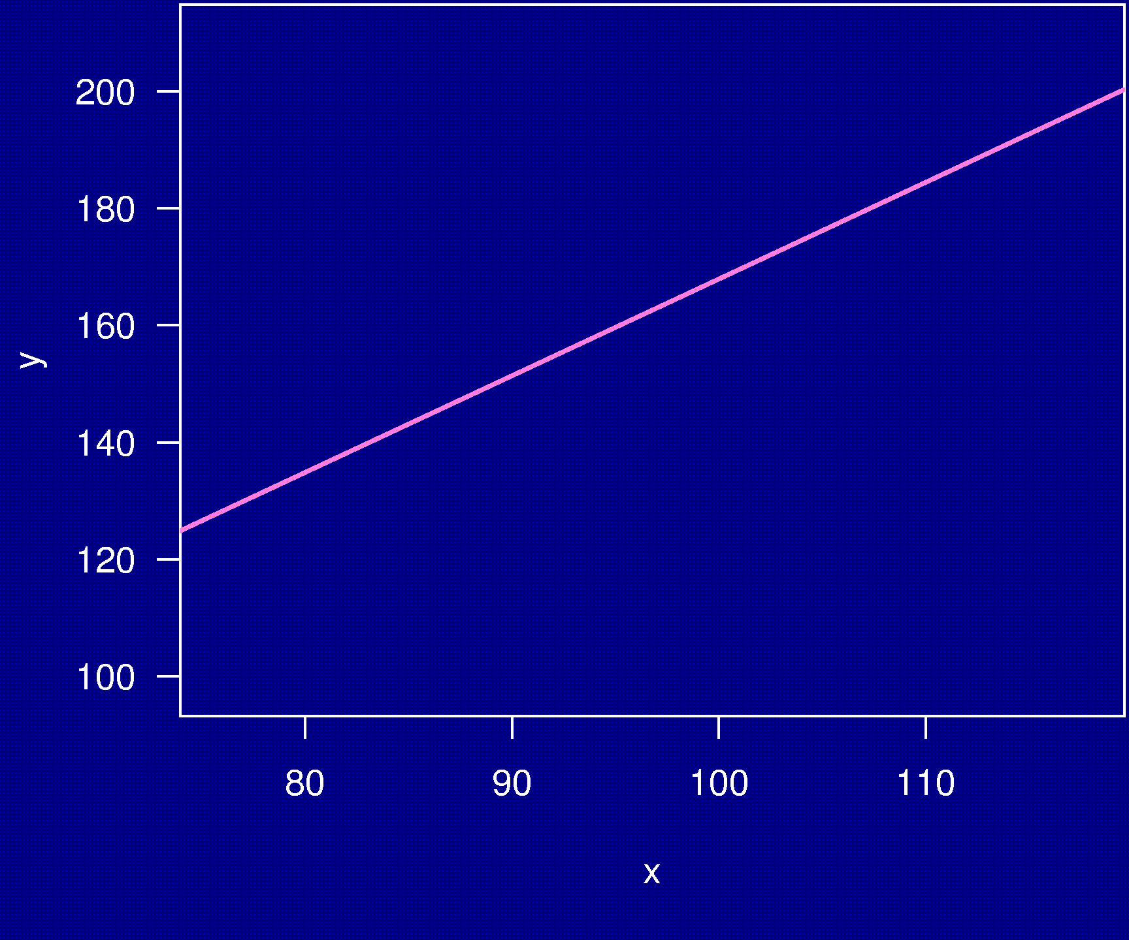
Example 4

Slide 25
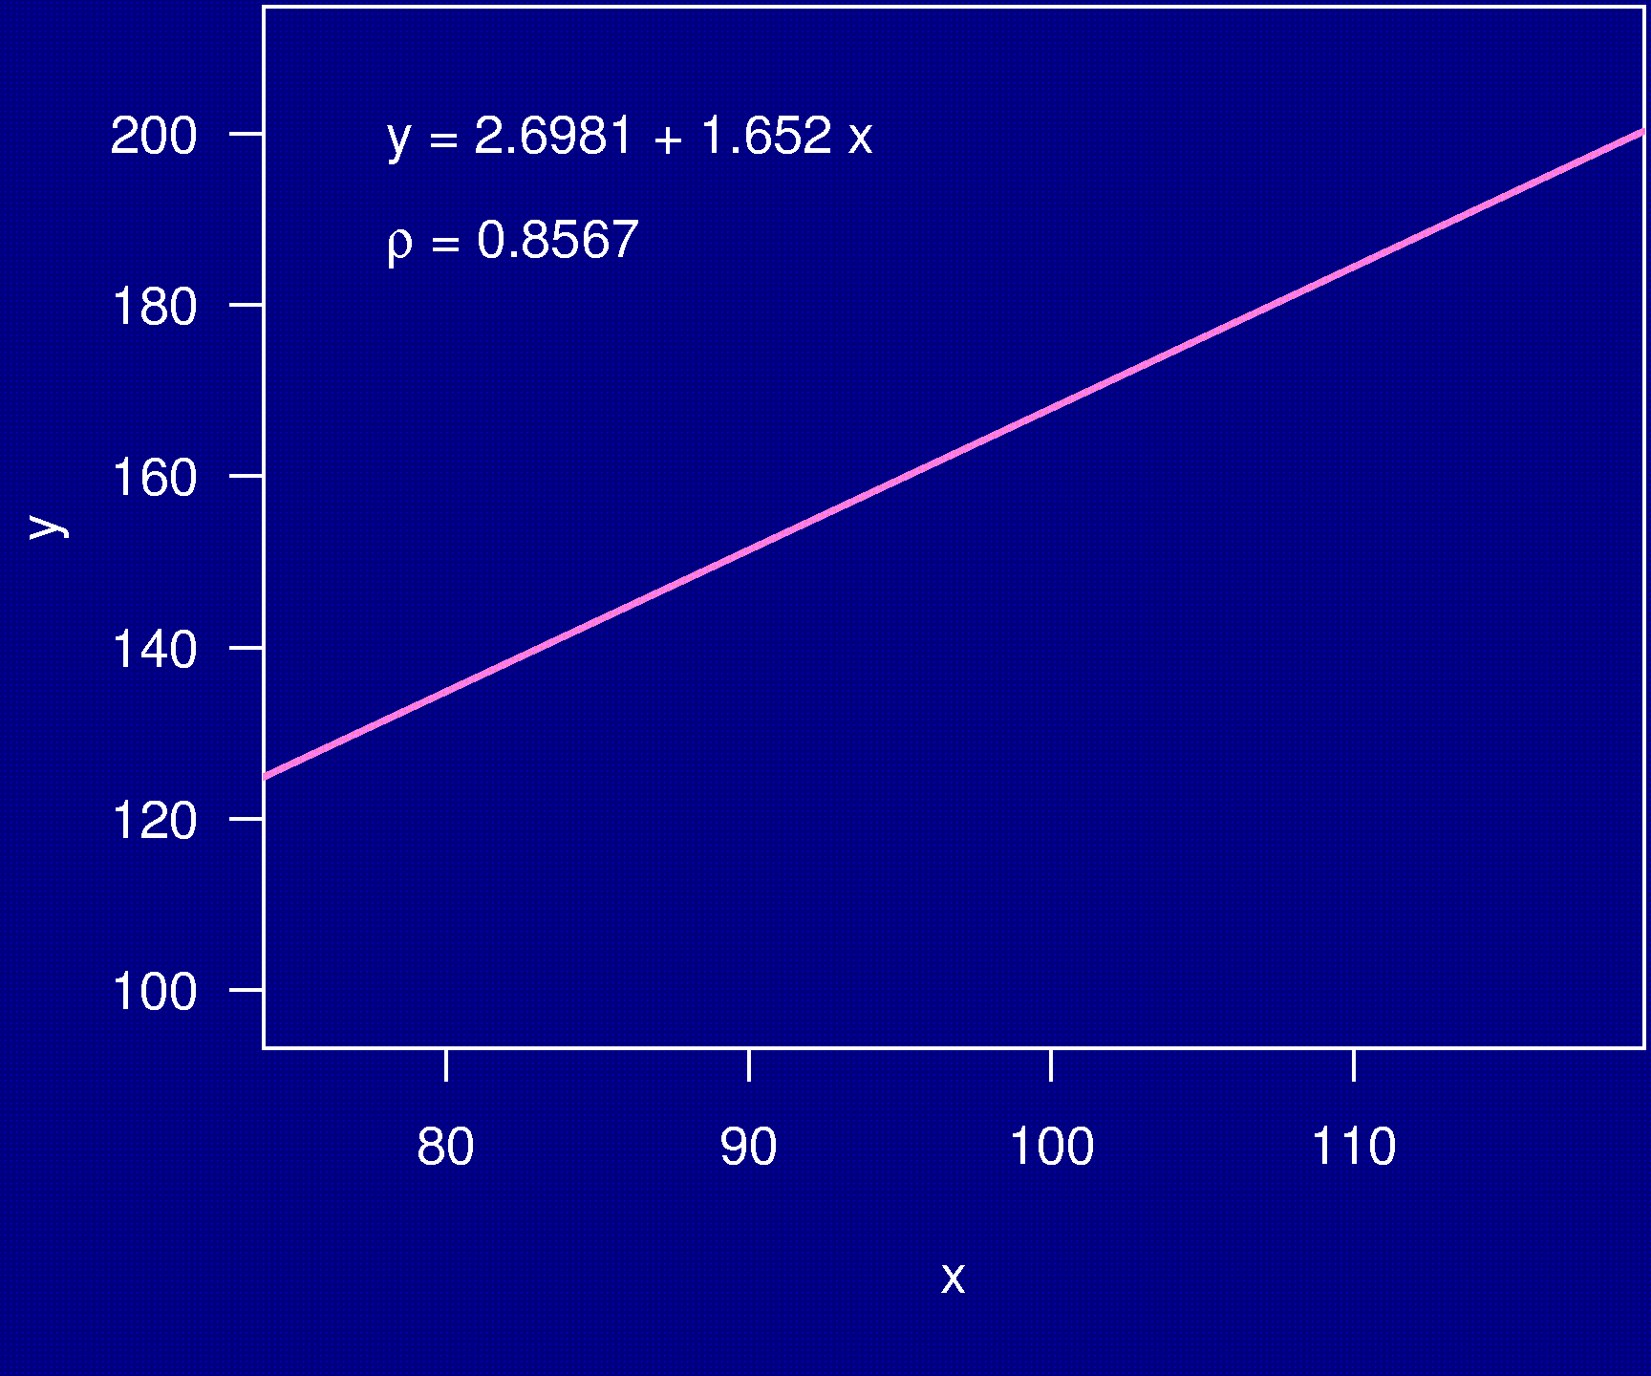
Example 4

Slide 26
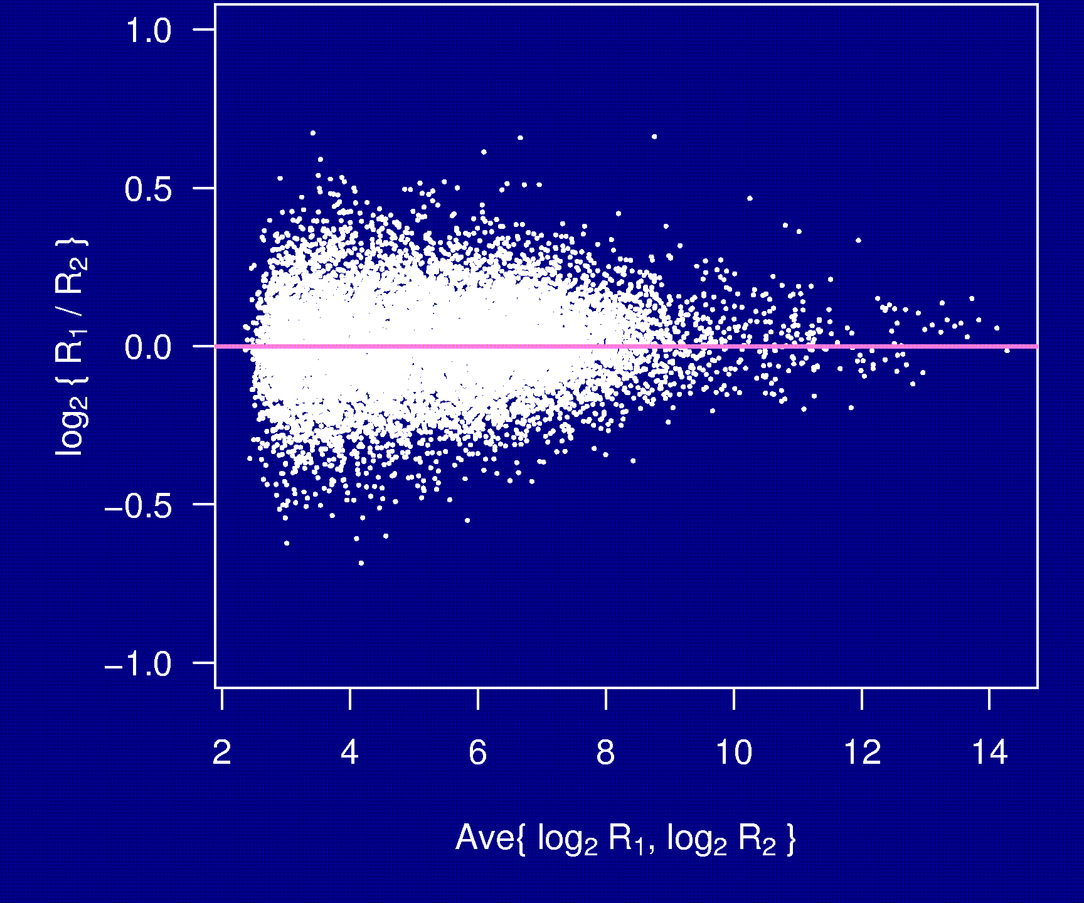
Example 5

Slide 27
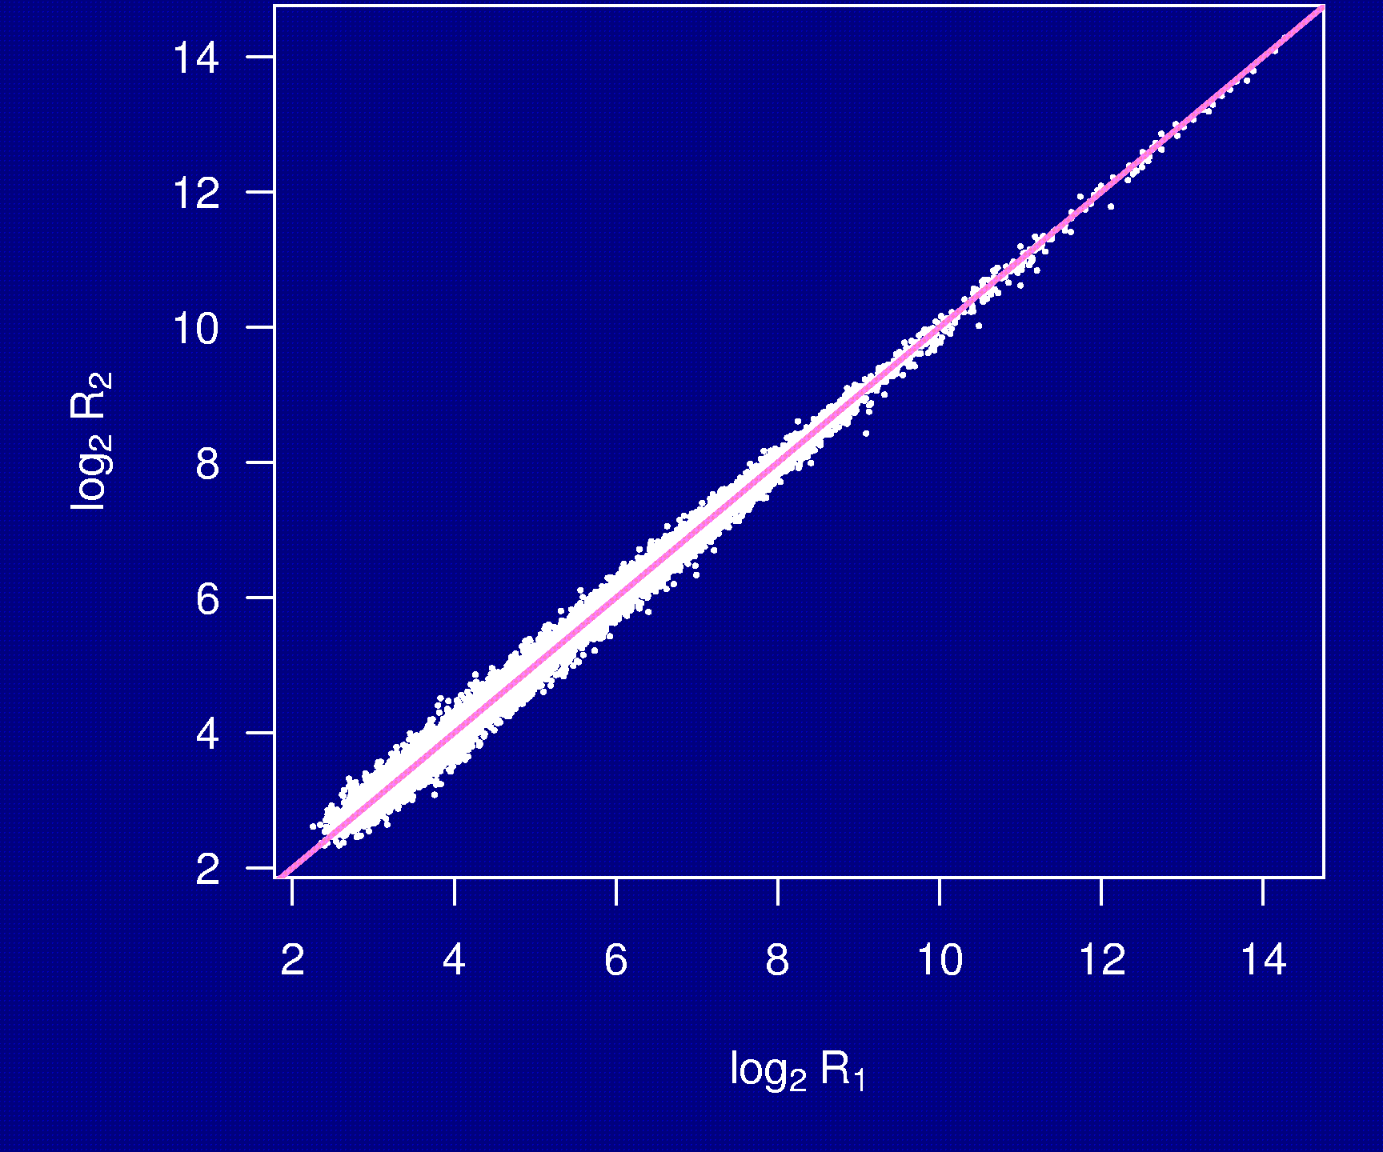
Example 5

Slide 28
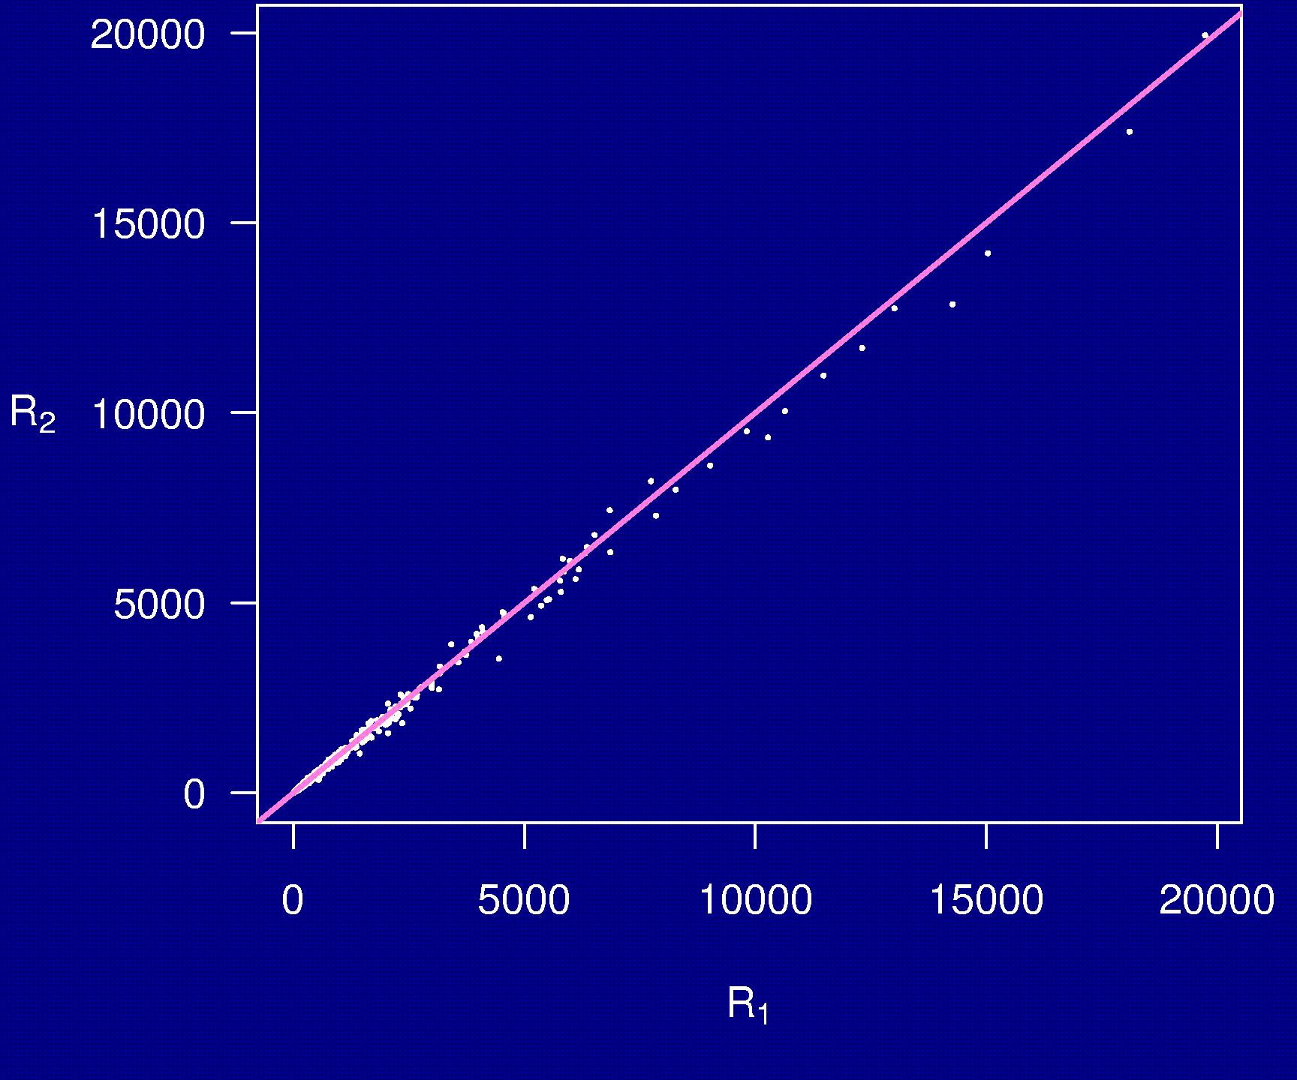
Example 5

Slide 29
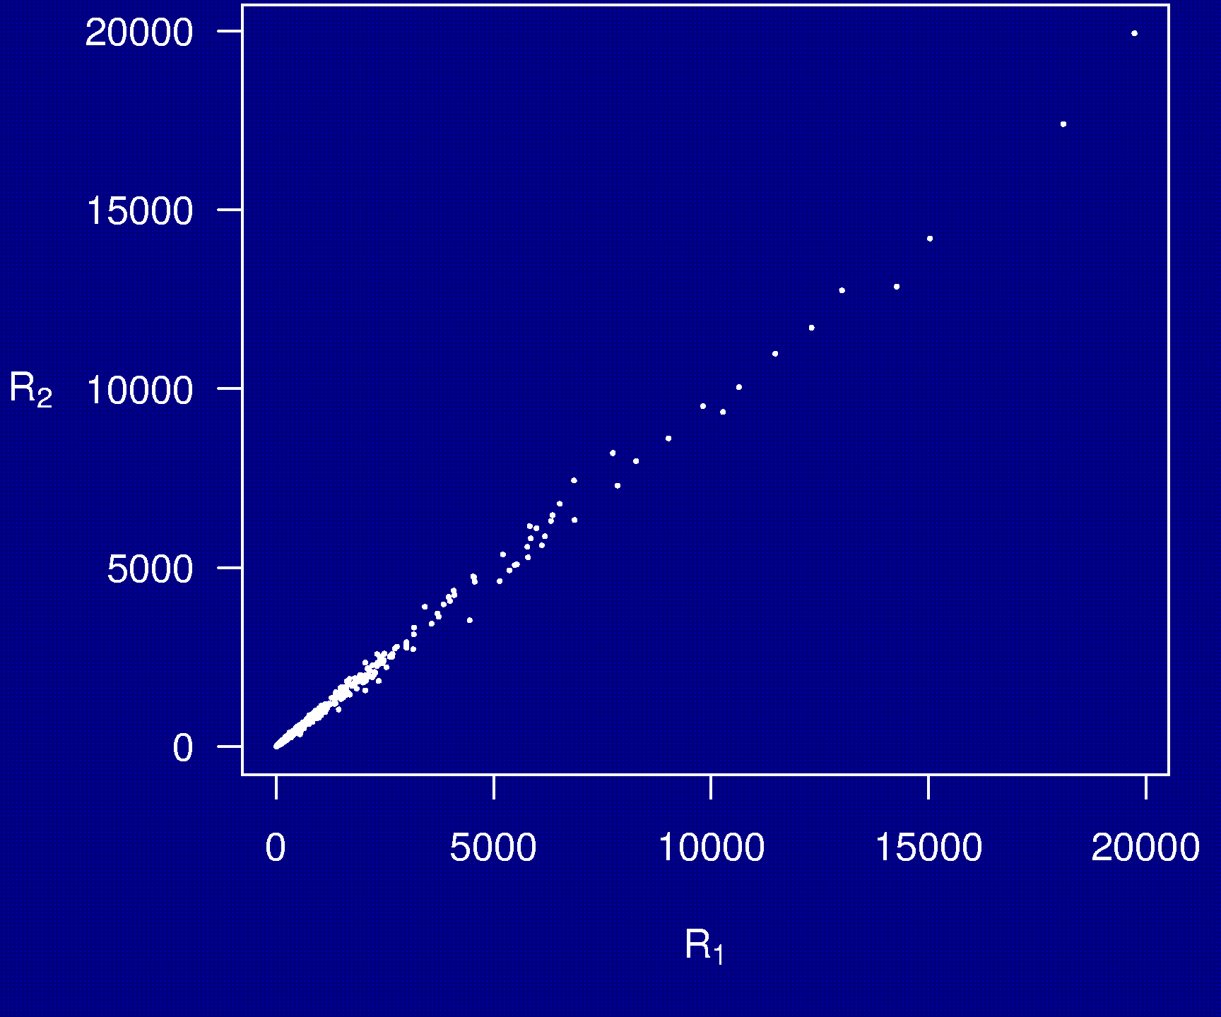
Example 5

Slide 30
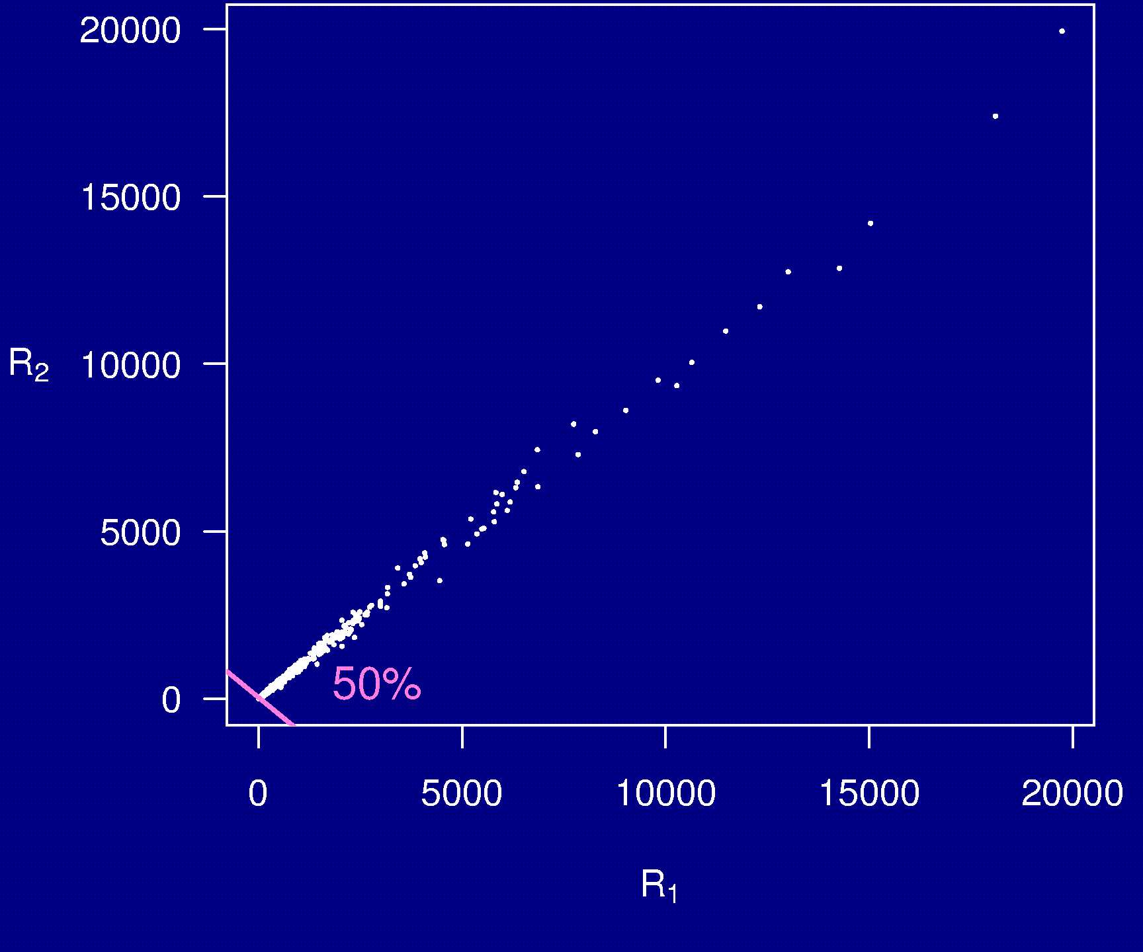
Example 5

Slide 31
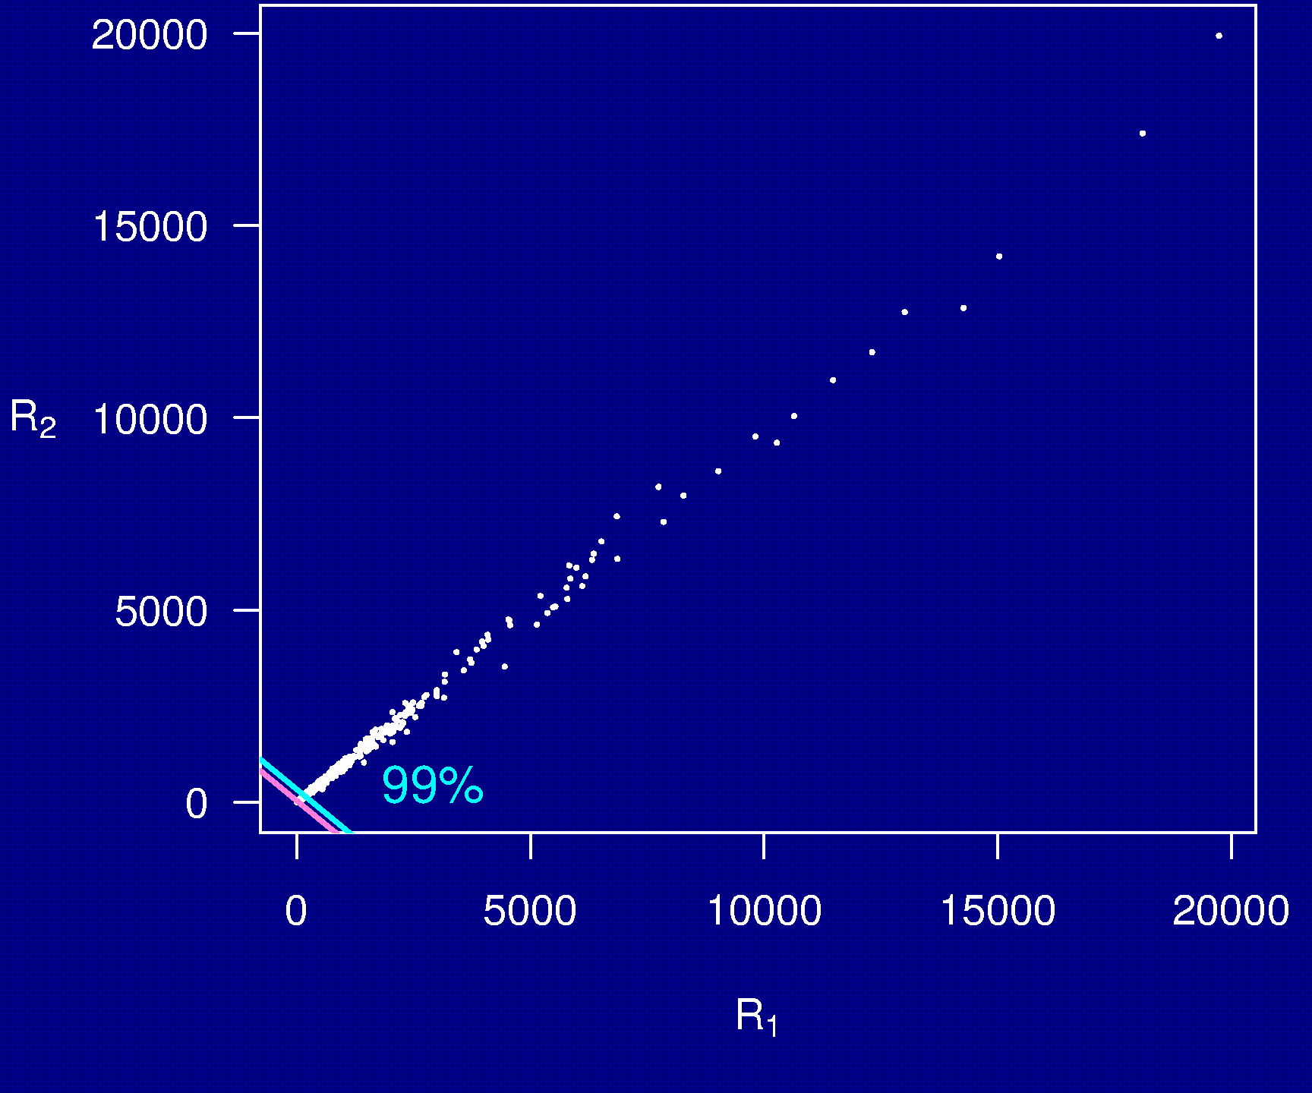
Example 5

Slide 32
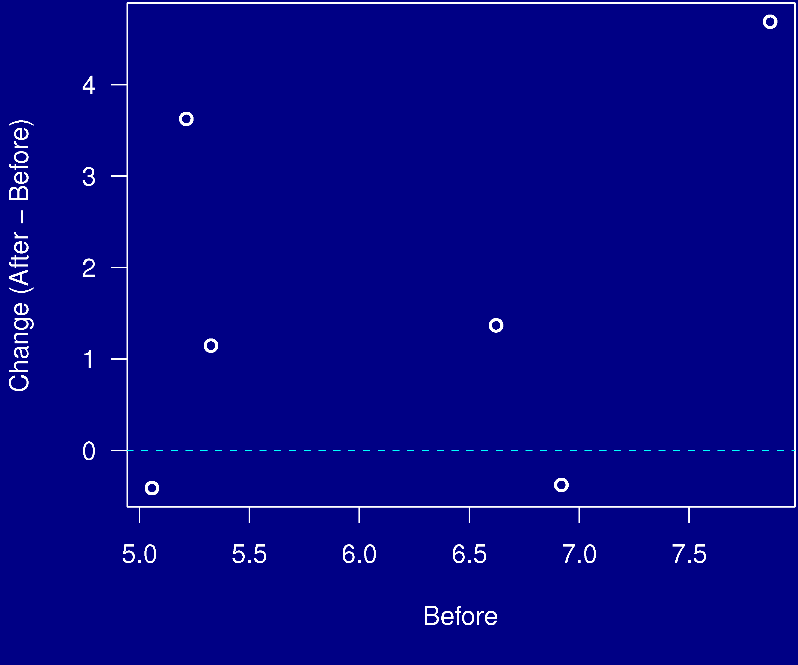
Example 6

Slide 33
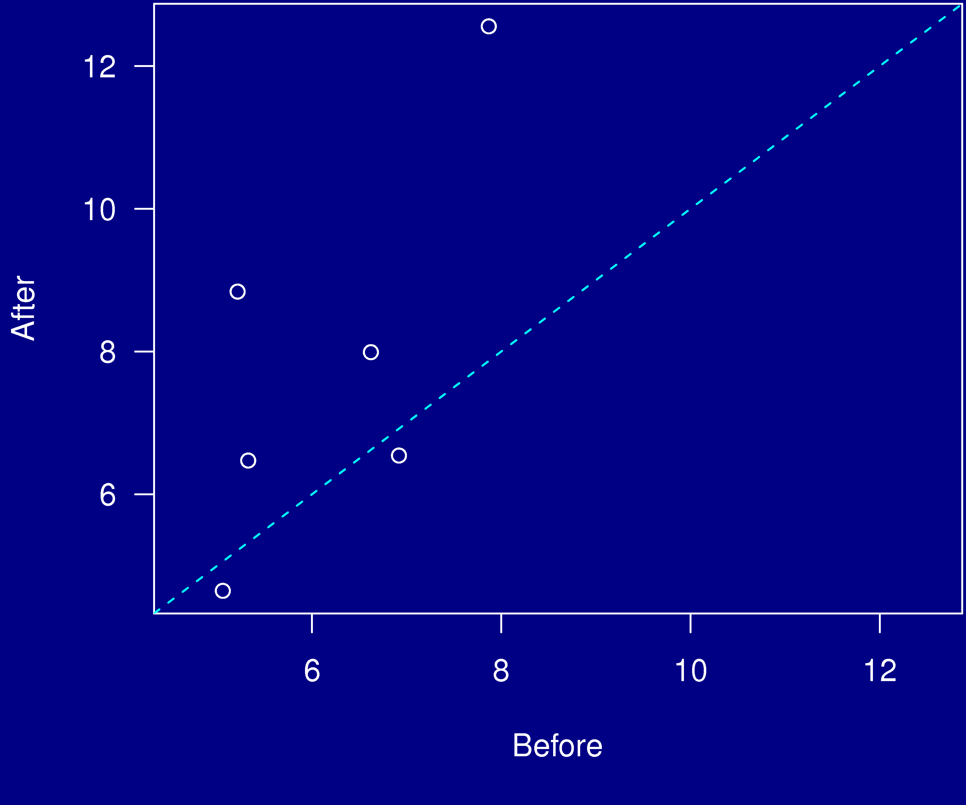
Example 6

Slide 34
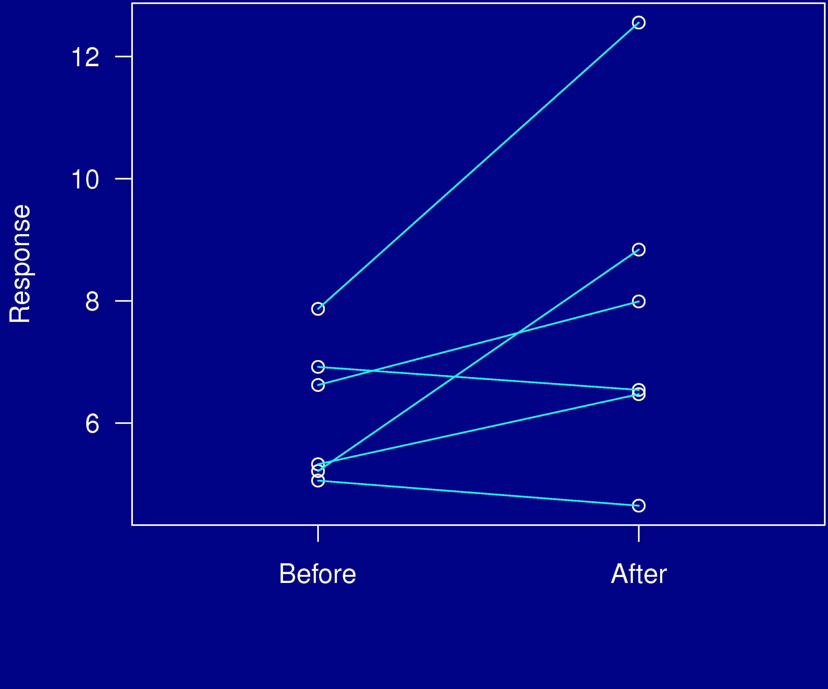
Example 6

Slide 35
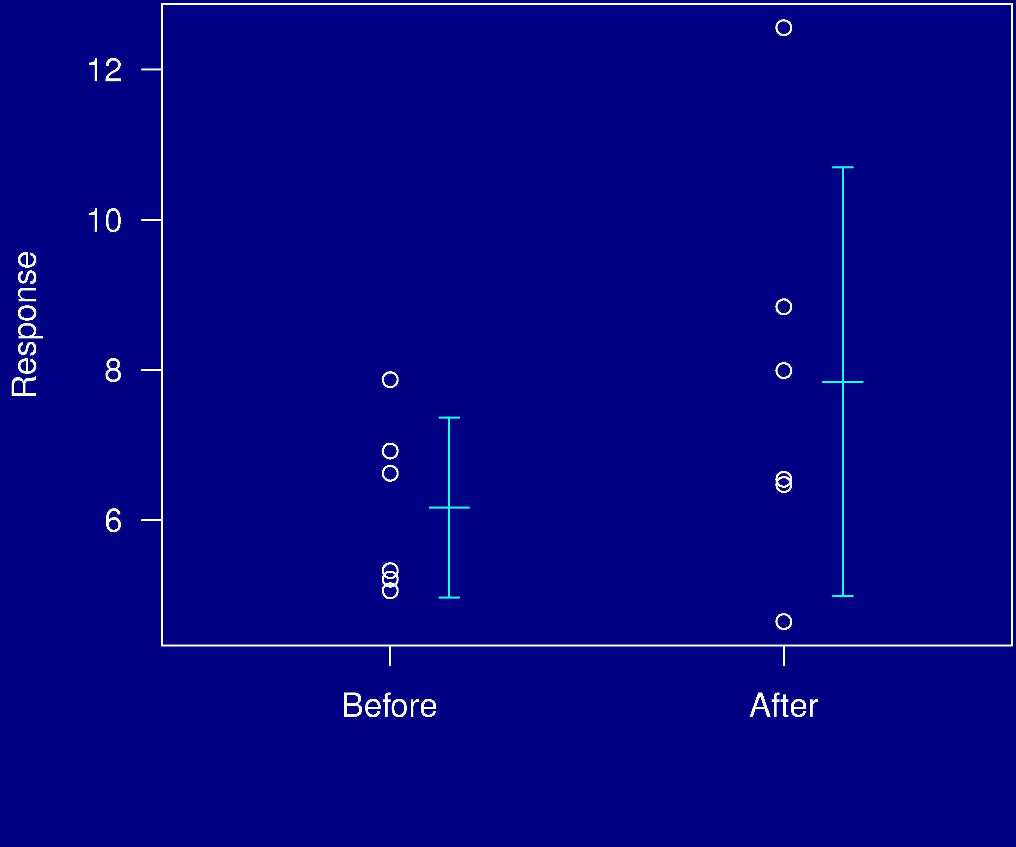
Example 6

Slide 36
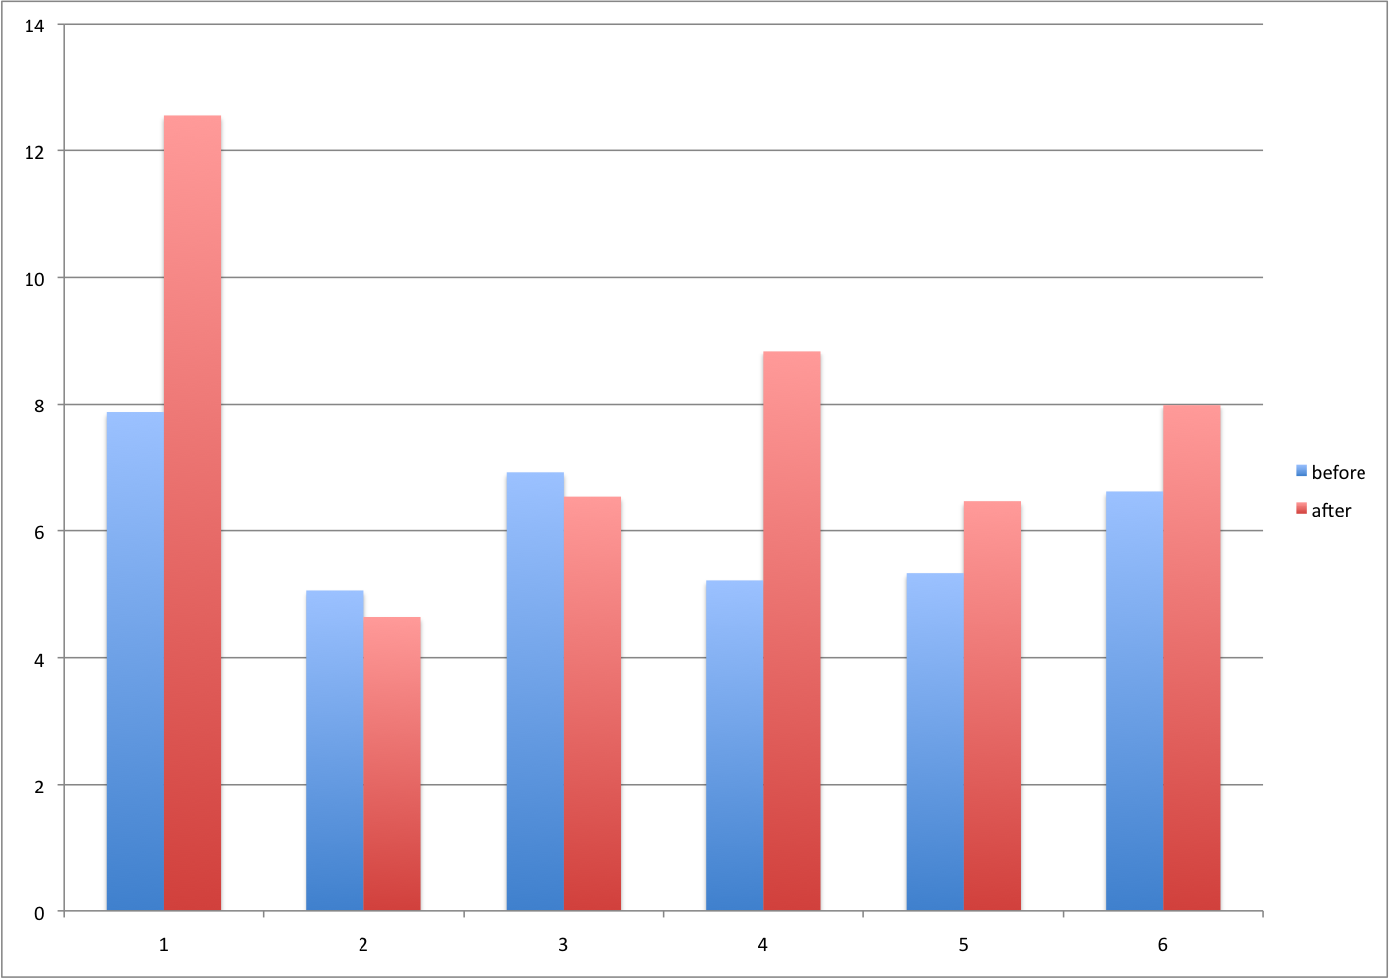
Example 6

Slide 37
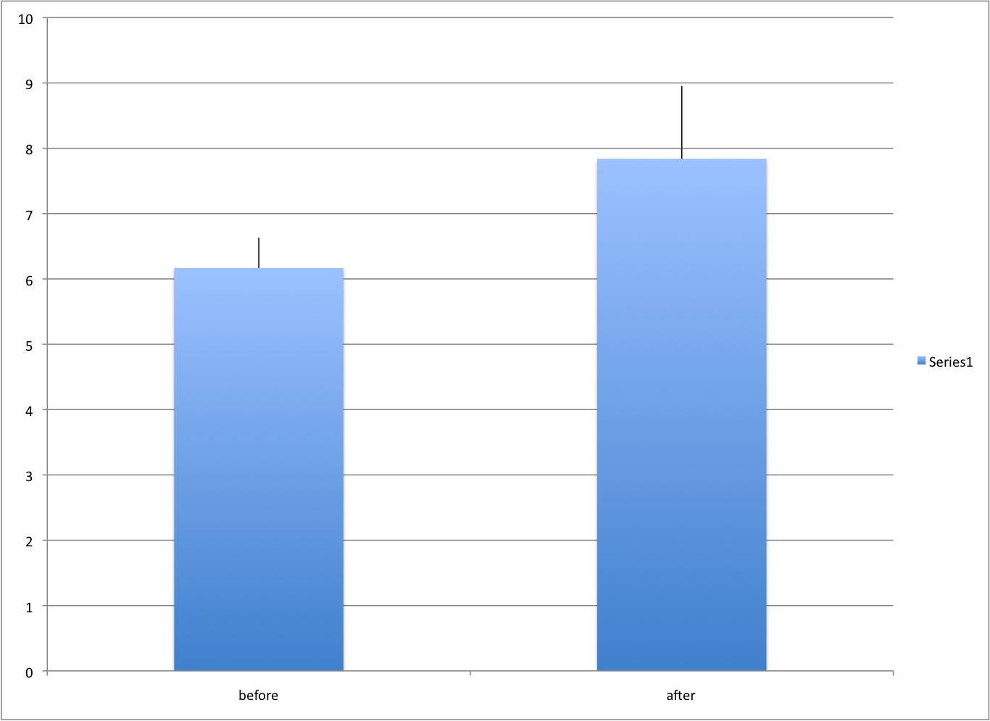
Example 6

Slide 38
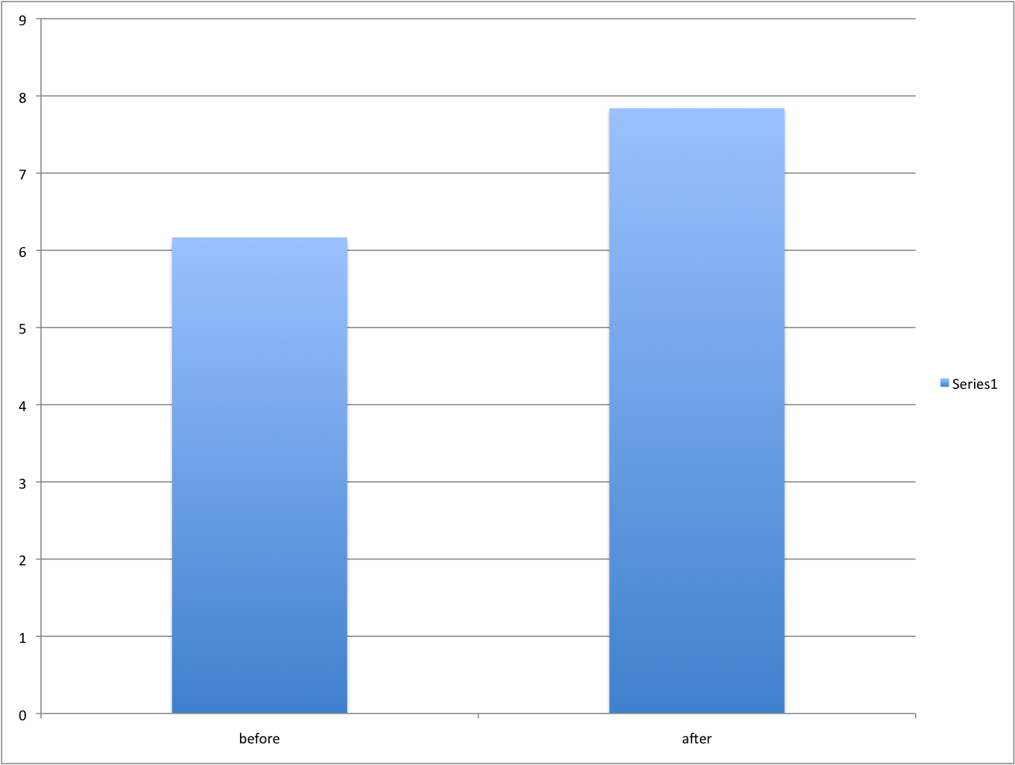
Example 6

Slide 39
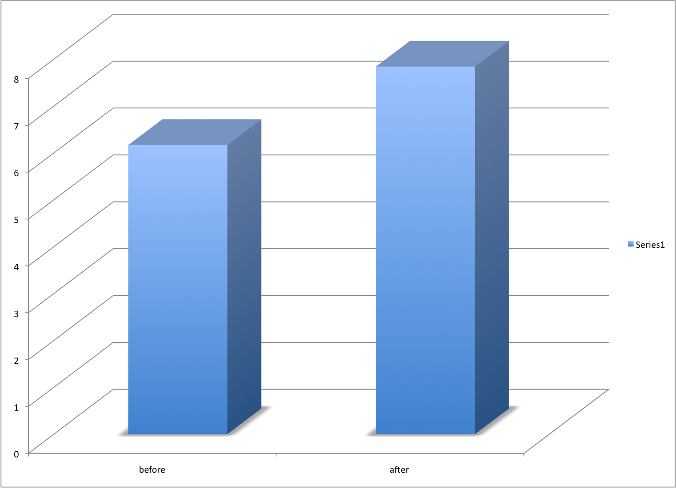
Example 6

Slide 40
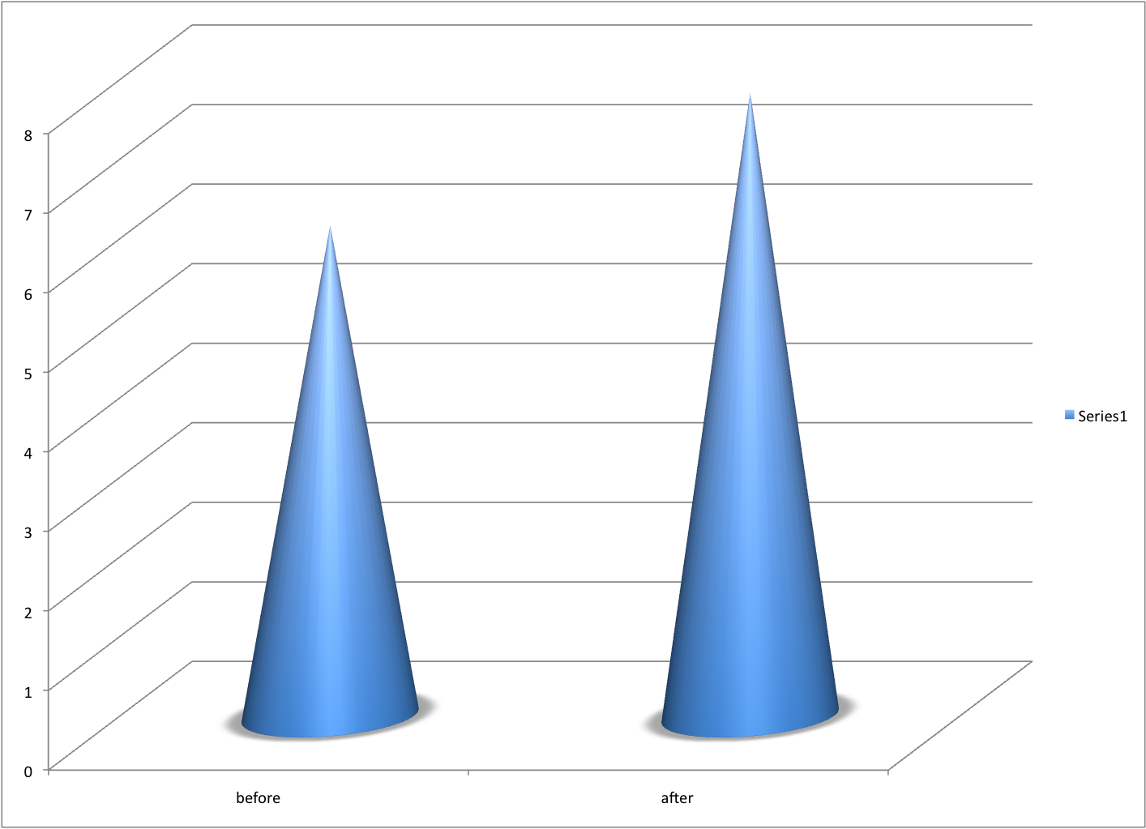
Example 6

Slide 41
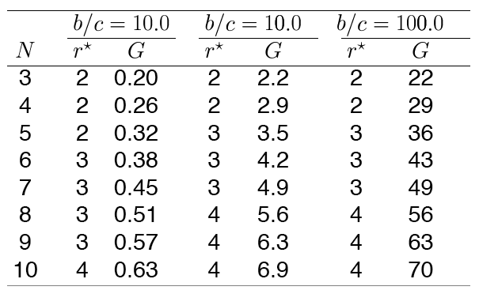
Example 7

Slide 42
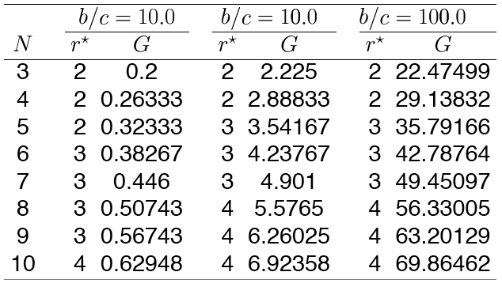
Example 7

Slide 43
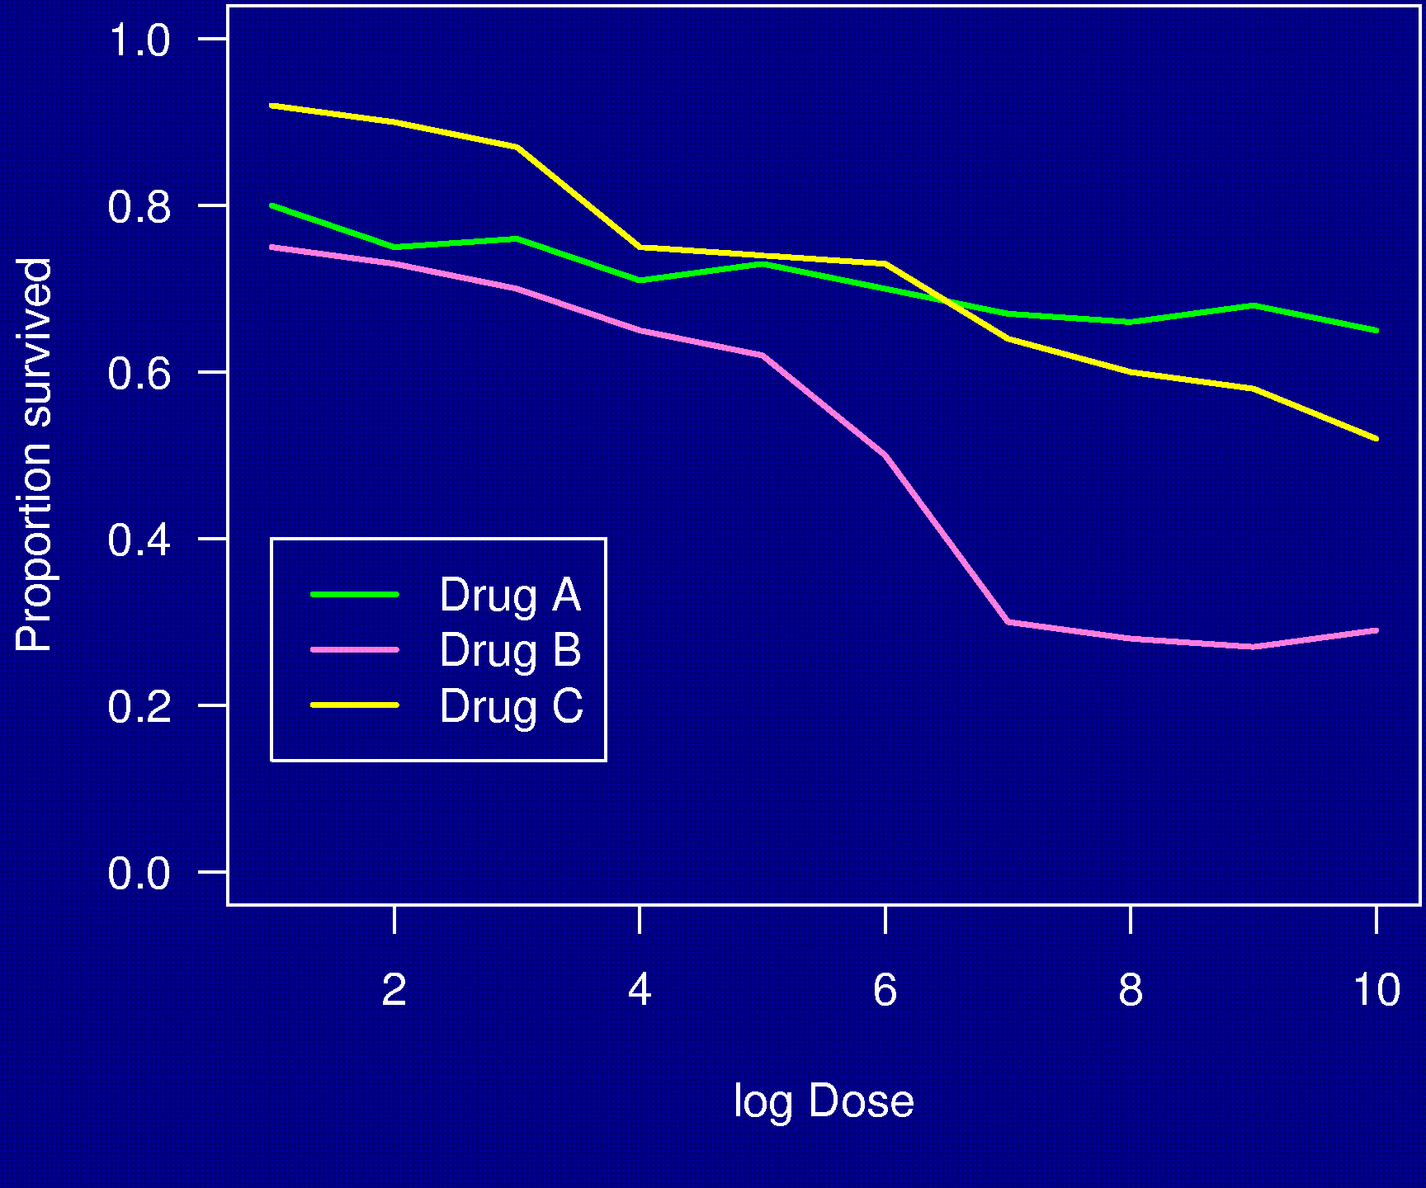
Example 8

Slide 44
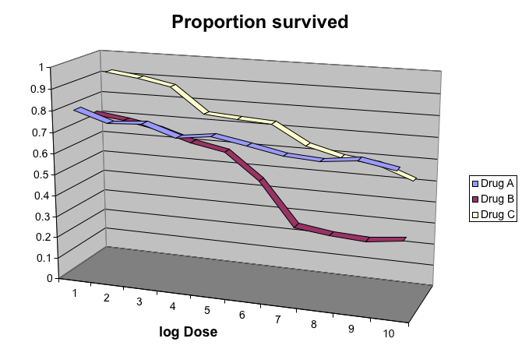
Example 8

Slide 45
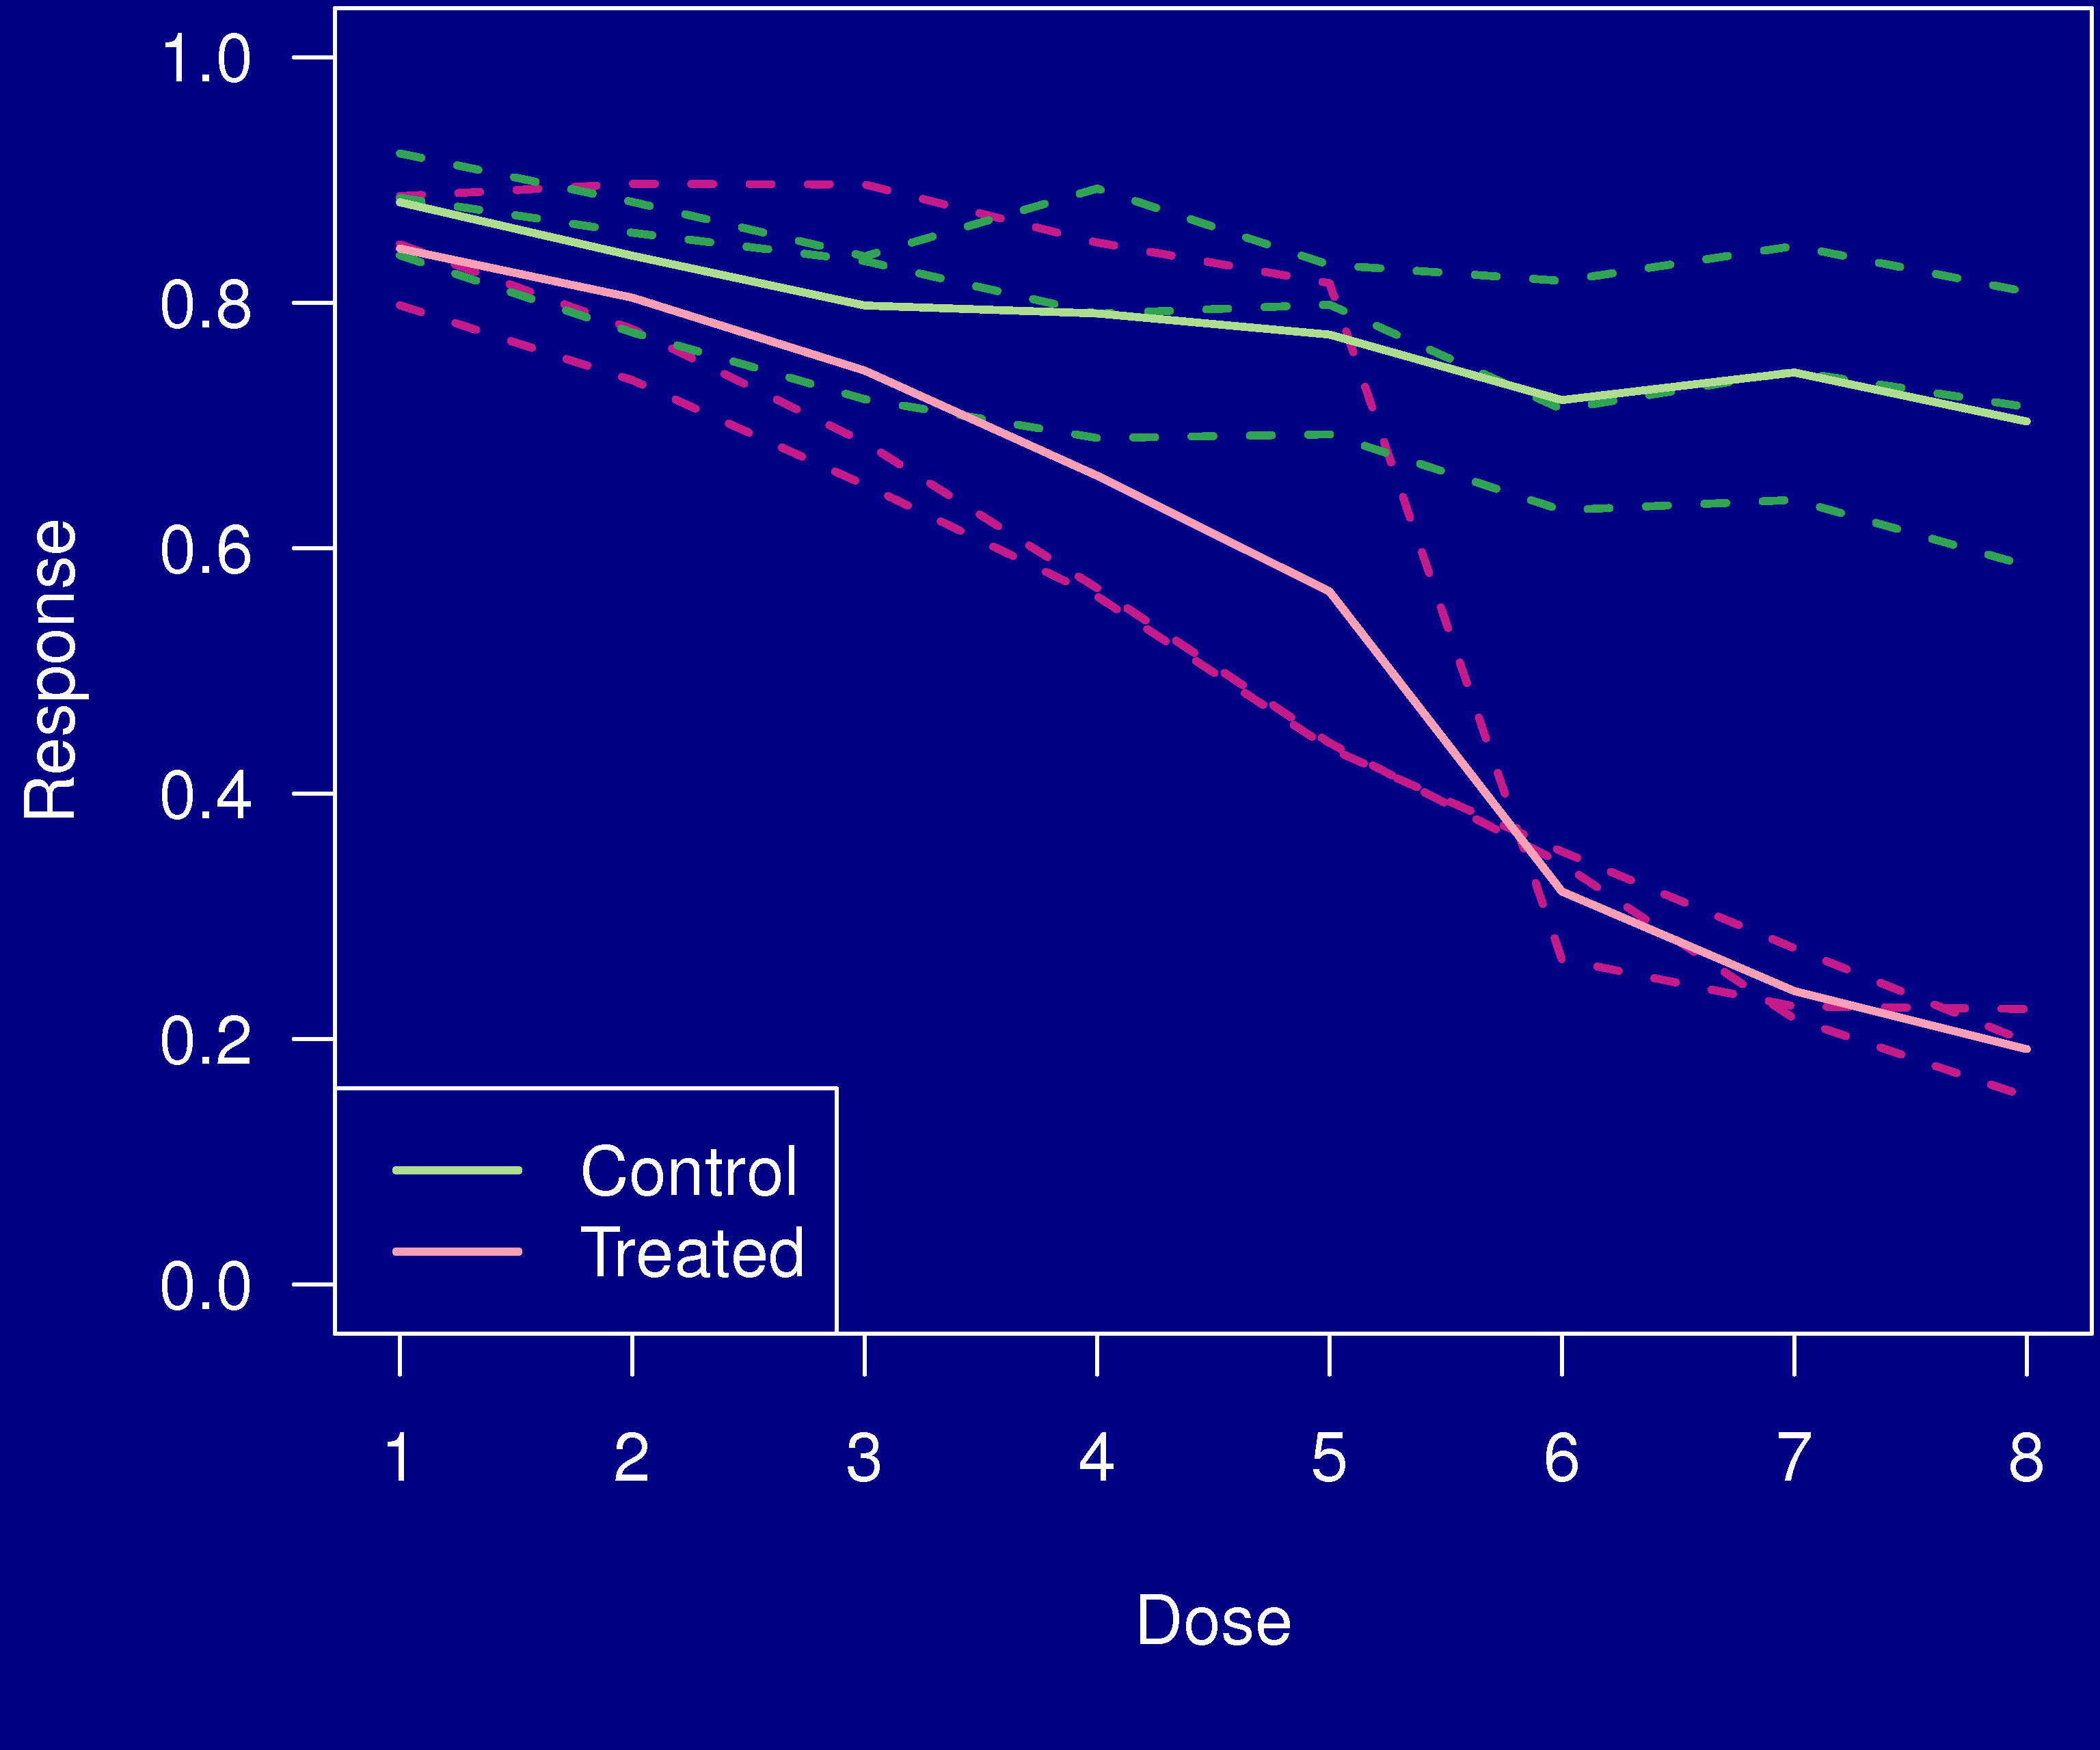
Example 9

Slide 46
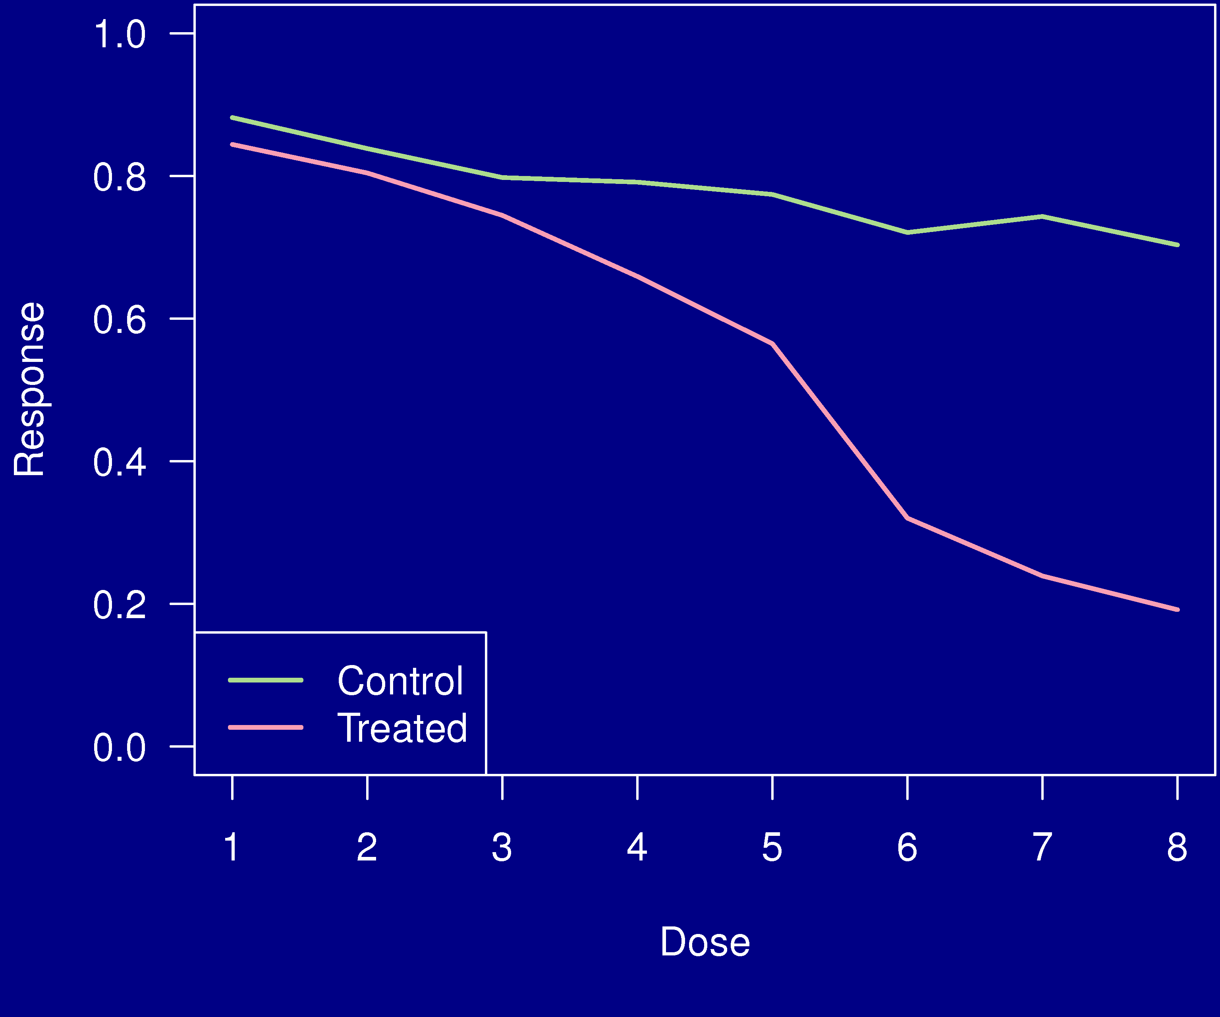
Example 9

Slide 47
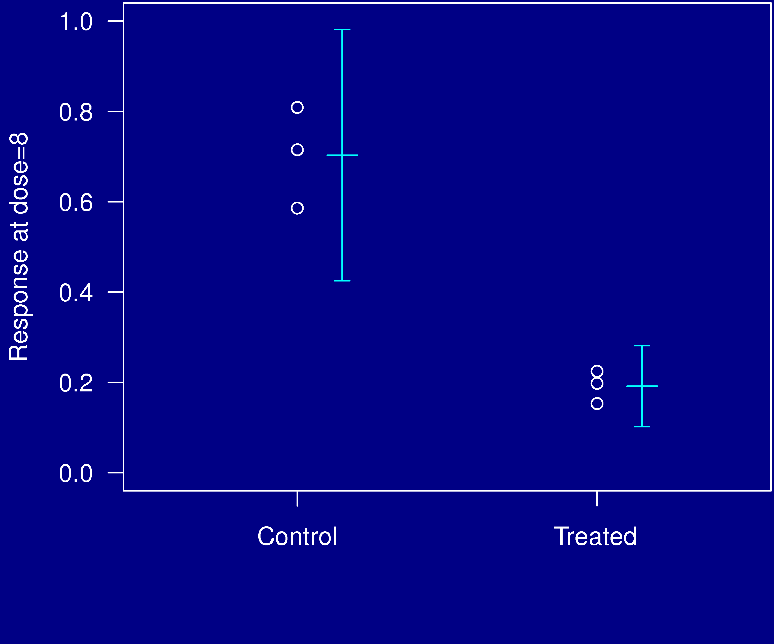
Example 9

Slide 48
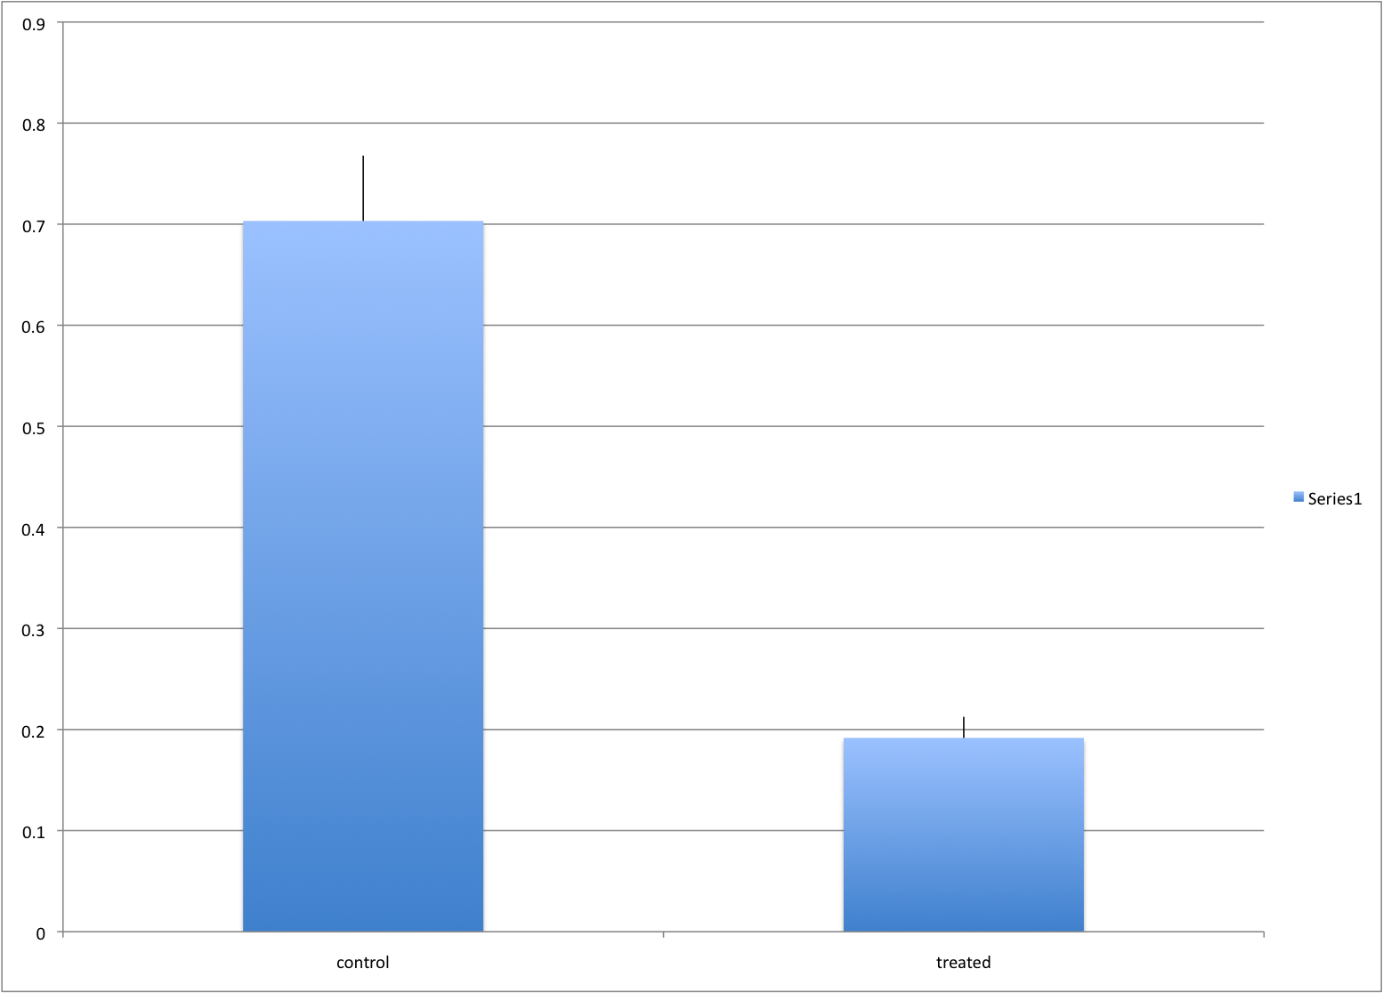
Example 9

Slide 49
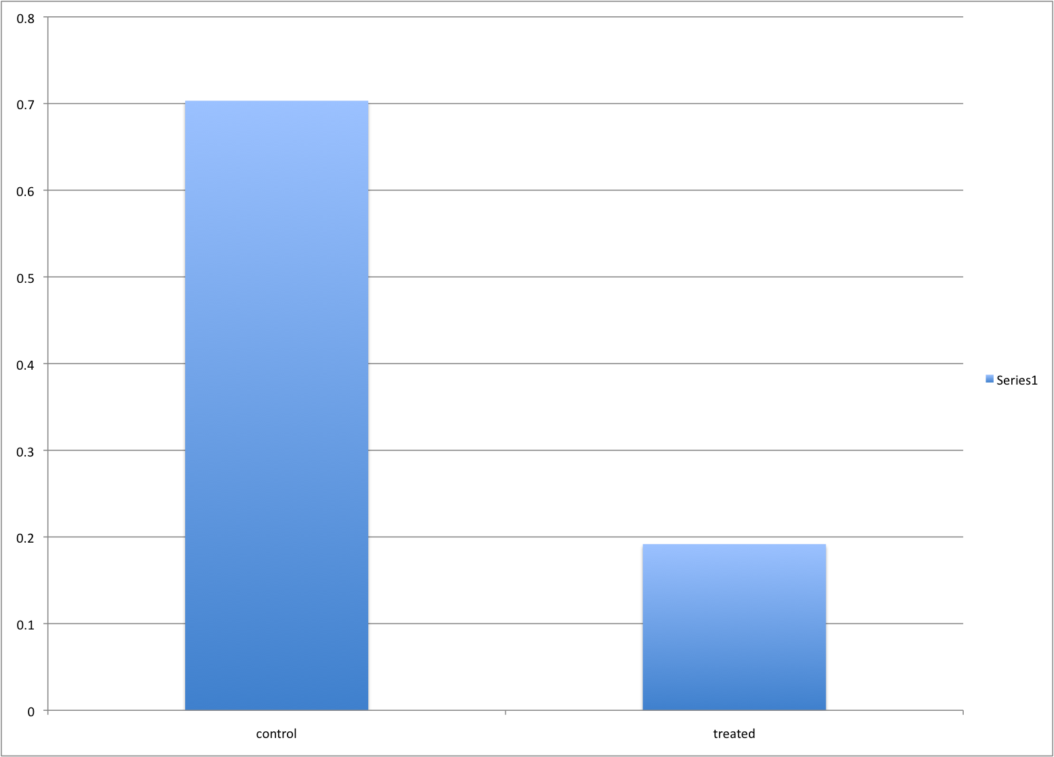
Example 9

Slide 50
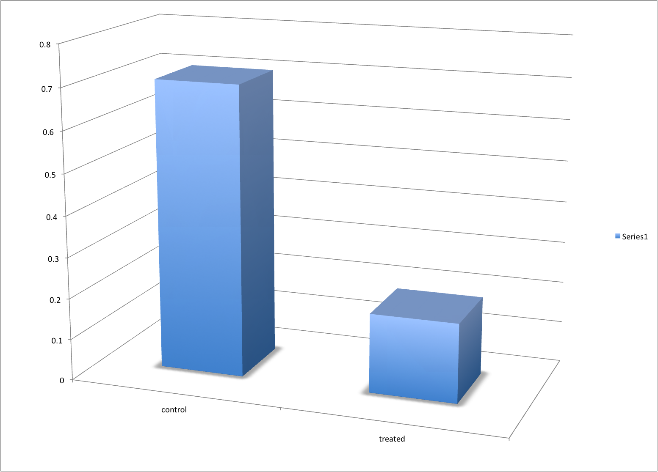
Example 9

Slide 51
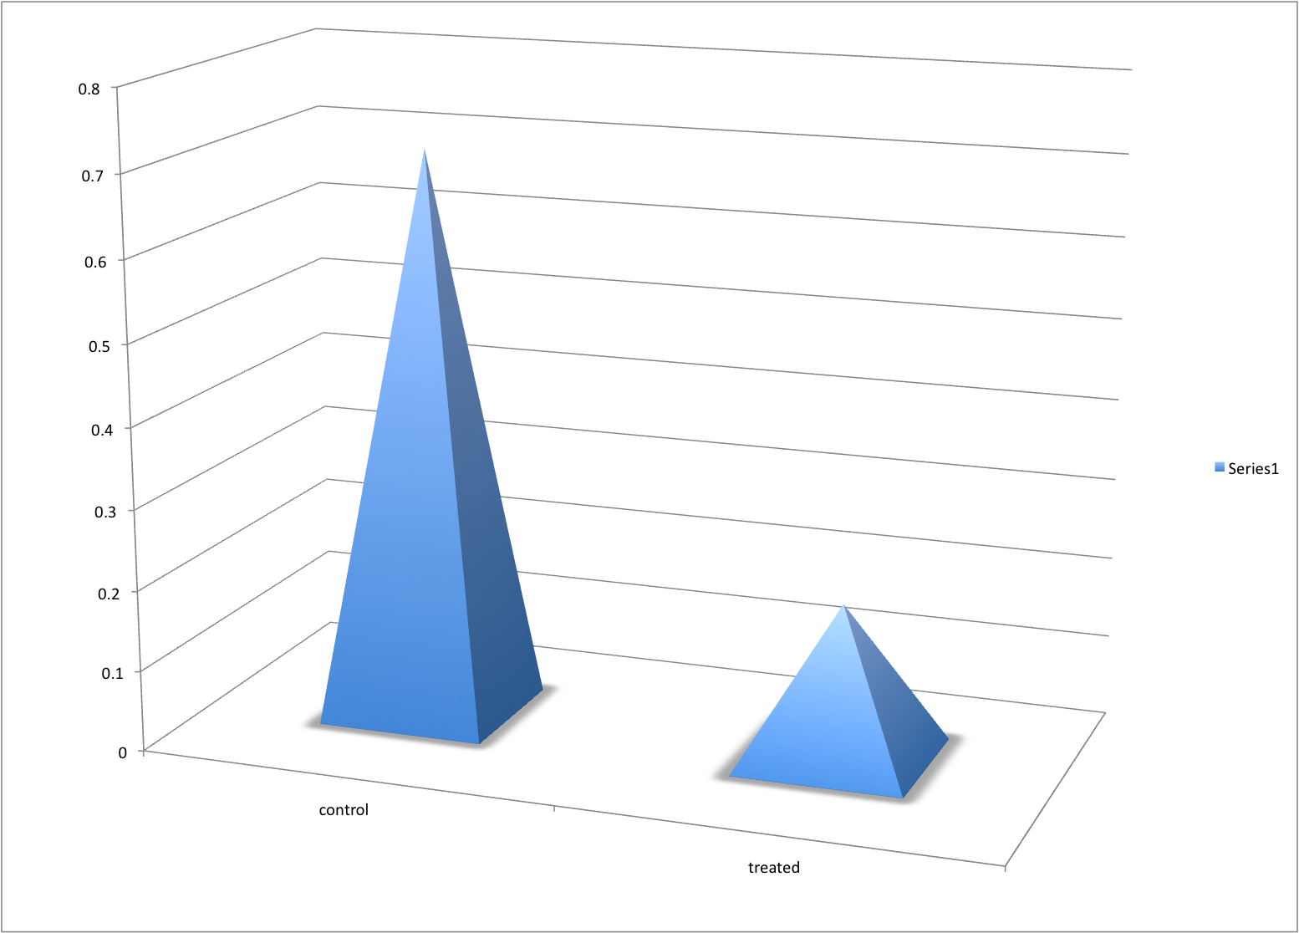
Example 9

Slide 52
Displaying data well
Be accurate and clear.
Let the data speak.
Show as much information as possible, taking care not to obscure the message.
Science not sales.
Avoid unnecessary frills — esp. gratuitous 3d.
In tables, every digit should be meaningful. Don’t drop ending 0’s.

Slide 53
Further reading
ER Tufte (1983) The visual display of quantitative information. Graphics Press.
ER Tufte (1990) Envisioning information. Graphics Press.
ER Tufte (1997) Visual explanations. Graphics Press.
WS Cleveland (1993) Visualizing data. Hobart Press.
WS Cleveland (1994) The elements of graphing data. CRC Press.
A Gelman, C Pasarica, R Dodhia (2002) Let's practice what we preach: Turning tables into graphs. The American Statistician 56:121-130
Robbins NB (2004) Creating more effective graphs. Wiley

Slide 54
The top ten worst graphs
With apologies to the authors, we provide the following list of the top ten worst graphs in the scientific literature.
As these examples indicate, good scientists can make mistakes.
http://www.biostat.wisc.edu/~kbroman/topten_worstgraphs

Slide 55
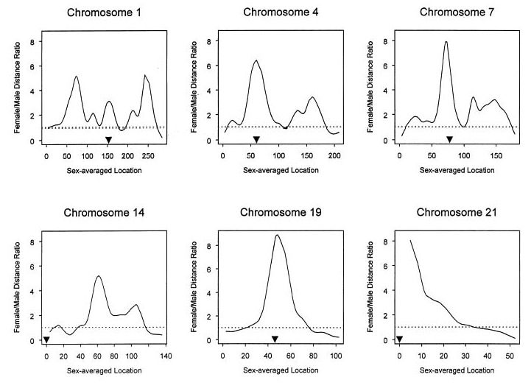
10
Broman et al., Am J Hum Genet 63:861-869, 1998, Fig. 1

Slide 56
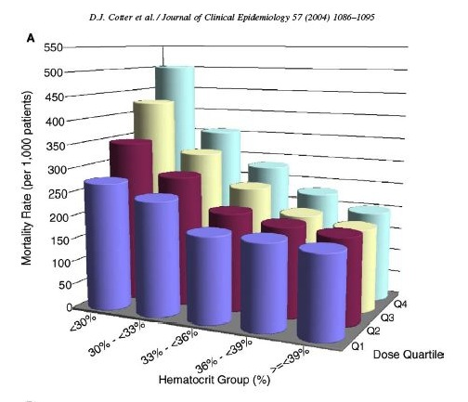
9
Cotter et al., J Clin Epidemiol 57:1086-1095, 2004, Fig 2

Slide 57
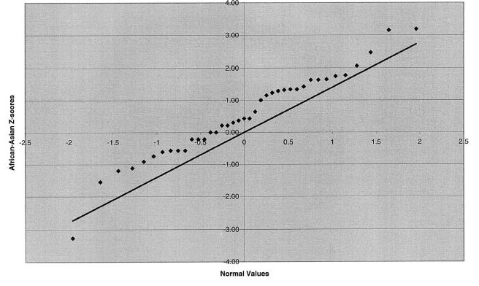
8
Jorgenson et al., Am J Hum Genet 76:276-290, 2005, Fig 2

Slide 58
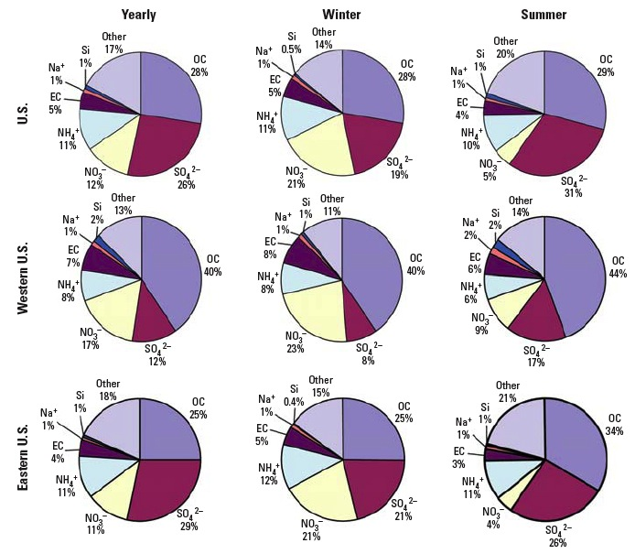
7
Bell et al., Env Health Persp 115:989-995, 2007, Fig 3

Slide 59

6
Cawley et al., Cell 116:499-509, 2004, Fig 1

Slide 60

5
Hummer et al., J Virol 75:7774-7777, 2001, Fig 4

Slide 61

4
Epstein and Satten, Am J Hum Genet 73:1316-1329, 2003, Fig 1

Slide 62

3
Mykland et al., J Am Stat Asso 90:233-241, 1995, Fig 1

Slide 63

2
Wittke-Thompson et al., Am J Hum Genet 76:967-986, Fig 1

Slide 64

1
Roeder, Stat Sci 9:222-278, 1994, Fig 4

