Slide 1
html
Karl W Broman
Department of Biostatistics
Johns Hopkins University
http://www.biostat.jhsph.edu/~kbroman

Slide 2
General principles
Simple is better
  Content over form
  Text before images
Look at others’ source
Be satisfied with what you get

Slide 3
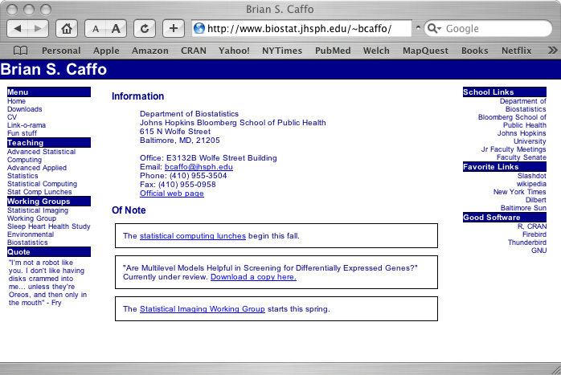
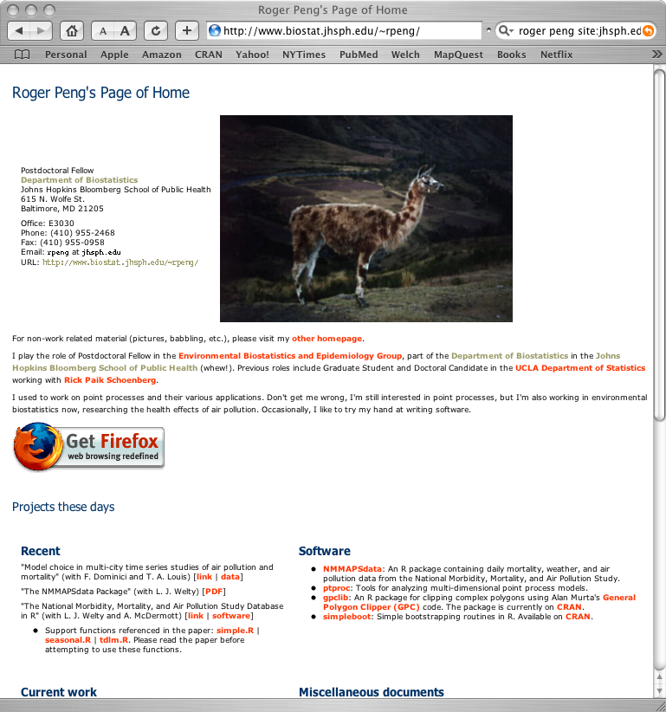
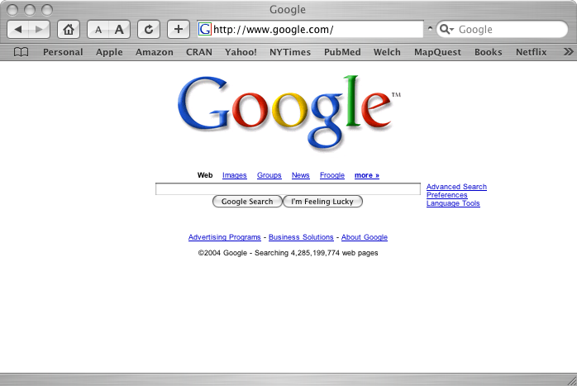
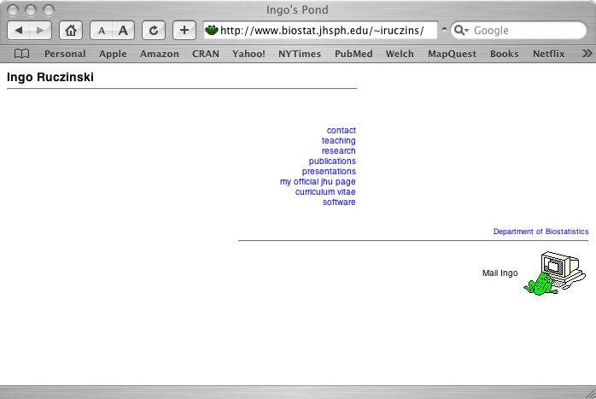
Good

Slide 4

Not so good

Slide 5
About html
html = hypertext markup language
Like LaTeX
  Plain text files
  Marked up to indicate content (e.g., italics surrounded by <i> and </i>)
  The browser interprets the marks to form the page
A good book:
  Musciano & Kennedy (2002) Html and xhtml: the definitive guide, 5th edition. O’Reilly.

Slide 6
At Hopkins Biostat
~/public_html
~ → /users/faculty/kbroman
/users/faculty/kbroman/public_html → /users/html/kbroman/public_html

Slide 7
Basic marks
<h1> … <h5> Headers of different sizes
<p> Start paragraph
<br> Line break
<hr> Horizontal rule

Slide 8
Marks can take arguments
<p align="left">
<p align="right">
<p align="center">

Slide 9
A basic page
<html><head><title>My example page</title>
</head><body>
<h2>This is an example page</h2>
<p>I can write a bunch of stuff here.
<p>And then create a new paragraph.<br>
Or I can just start a new line.
<hr>
<p align="right"><font size=2>Small stuff on the right</font>
</body></html>

Slide 10
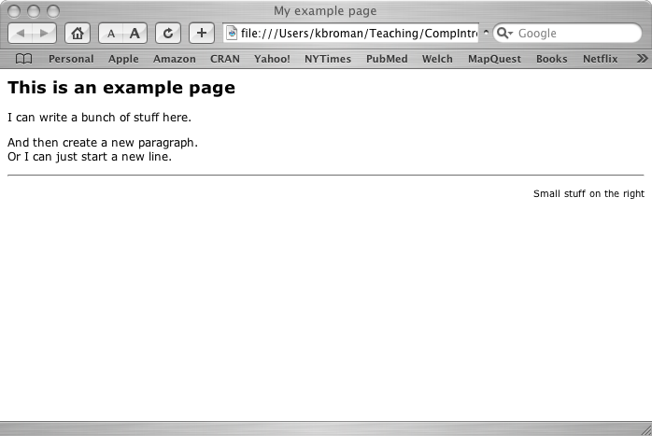
As seen in the browser

Slide 11
Links
<a href="http://www.biostat.jhsph.edu/~kbroman">My home page</a>
<a href="publications">My publications</a>
<a href="publications/mypaper.pdf">pdf (200k)</a>

Slide 12
Images
<a href="myphoto.jpg">A link to a picture</a>
<img="myphoto.jpg" alt="A description">

Slide 13
Fonts, etc.
<font color="red">Make this red.</font>
<b>This will be bold</b> but this won’t be.
<i>This will be in italics</i> but not this.

Slide 14
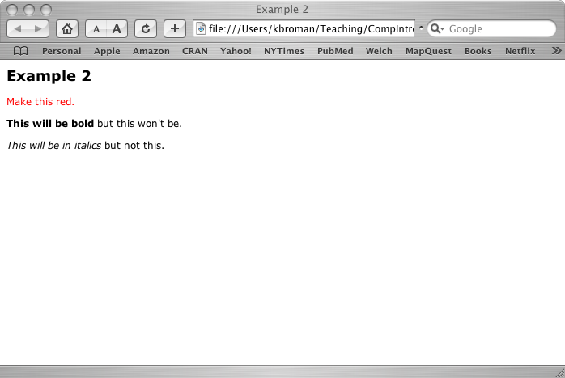
In the browser

Slide 15
Lists
<p>An ordered list:
<ol>
<li>The first item.
<li>The second item.
</ol>
<p>An unordered list with gaps between items:
<ul>
<li>The first item.</li><p>
<li>The second item.</li><p>
<li>The third item.</li>
</ul>

Slide 16
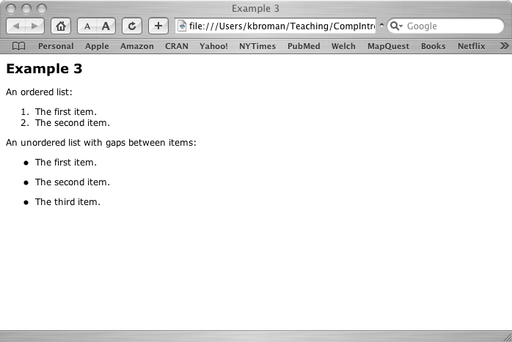
In the browser

Slide 17
More lists
<p>Fancier list:
<ol>
<li>The first item.
<ol type=“a”>
<li>Sub item one.
<li>Sub item two.
</ol>
<li>The second item.
</ol>

Slide 18
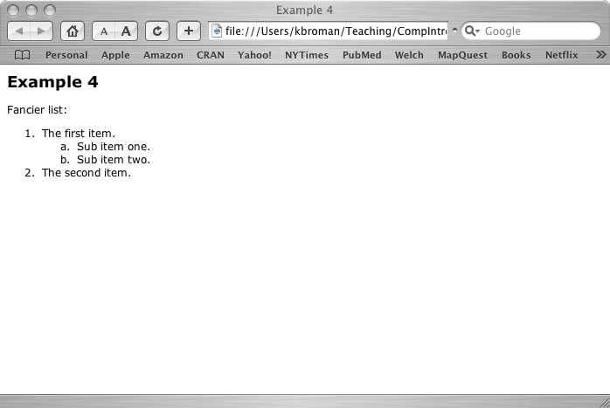
In the browser

Slide 19
Tables
<table noborder cellpadding=3 cellspacing=3>
<tr><td><b>Col 1</b>
<td><b>Col 2</b>
<td><b>Col 3</b>
<tr><td>The second row
<td>More here
<td>Yet more
<tr height=20><td>&nbsp; <!-- That’s a space -->
<tr><td>Row after a gap
<td colspan=2>Here’s a bunch of stuff covering two columns.
</table>

Slide 20
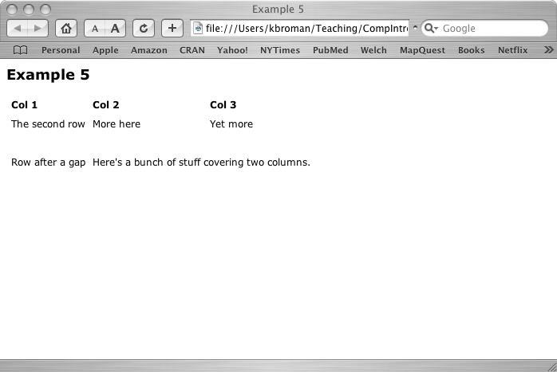
In the browser

Slide 21
A few more points
I often use <td valign="top"> in tables to get things to line up properly.
I often include extra empty columns to put bigger gaps between the non-empty columns.
You can use <td width=10%> or <td width=15> to refer to width relative to the browser or in pixels.
The <table> tag can also take a width argument.

Slide 22
Cascading style sheets
Make it easier to have a consistent style on all of your web pages.
Create a file like "myformat.css" containing various information about font types, sizes, and colors and such.
Include a reference to it in each html file.

Slide 23
kbroman.css
BODY {color: black; background-color: #ffe; font-family: arial; font-size: 14px}
H1 {color: #039; font-family: arial; font-size: 25px}
H2 {color: #039; font-family: arial; font-size: 22px}
H3 {color: #039; font-family: arial; font-size: 17px}
H4 {color: #039; font-family: arial; font-style: italic;
font-size: 14px; font-weight: normal}
H4.indent {color: #039; font-family: arial; font-style: italic; font-size: 14px; font-weight: normal; margin-left: 14px}
H5 {font-family: arial; font-size: 10px}
A {color: #90C; text-decoration: none}
A:link {color: #90C; text-decoration: none}
A:visited {color: #90C; text-decoration: none}

Slide 24
And more
P.vlarge {font-family: arial; font-size: 20px}
P.large {font-family: arial; font-size: 17px; margin-left: 14px}
P.lgnoindent {font-family: arial; font-size: 17px; margin-left: 0}
P.noindent {font-family: arial; font-size: 14px; margin-left: 0}
P.small {font-family: arial; font-size: 10px; margin-left: 0}
P {color: black; font-family: arial; font-size: 14px; margin-left: 14px}
CODE {color: blue; font-family: courier; font-size: 14px}
CODE.large {color: blue; font-family: courier; font-size: 17px} margin-left: 14px}
PRE {color: blue; font-family: courier; font-size: 14px}
PRE.indent {color: blue; font-family: courier; font-size: 14px;margin-left: 28px}

Slide 25
The top of my page
<html><head>
<title>Karl W Broman</title>
<meta name="description" content="Home page of Karl Broman, Associate Professor of Biostatistics at Johns Hopkins University">
<link rel=stylesheet type="text/css" href="kbroman.css">
</head>
<body>
<p class=noindent>

