Slide 1

Introduction to Perl

Slide 2



Your friendly tutors ;)
Lizbeth Sayavedra
lsayaved@mpi-bremen.de
Brandon Kwee Boon Seah
kbseah@mpi-bremen.de
Juliane Wippler
jwippler@mpi-bremen.de

Slide 3
Course Material
Course material will be shared via owncloud and github
slides
ipython notebooks
exercises
solutions to exercises
cheat sheets
scripts
you’ll get homework exercises each day
we will share the solutions to the exercises the next day

Slide 4
What you will learn in this course
Day 1
Intro & write first Perl program (Juliane)
Data structures: scalars (Juliane)
Control structures: if, else, elsif (Juliane)
Intro to regular expressions (Juliane)
More regular expressions (Liz)
Day2
Data structures: arrays (Liz)
Data structures: hashes (Liz)
Looping over arrays (Liz)
More control structures: while, for, foreach (Brandon)
Reading and writing files (Brandon)
Day 3
Subroutines and modularization (Brandon)
Executing external programs within Perl (Brandon)
Review of material, exercises, homework

Slide 5
What you will learn in this course
Day 1
Intro & write first Perl program (Juliane)
Data structures: scalars (Juliane)
Control structures: if, else, elsif (Juliane)
Intro to regular expressions (Juliane)
More regular expressions (Liz)
Day2
Data structures: arrays (Liz)
Data structures: hashes (Liz)
Looping over arrays (Liz)
More control structures: while, for, foreach (Brandon)
Reading and writing files (Brandon)
Day 3
Subroutines and modularization (Brandon)
Executing external programs within Perl (Brandon)
Review of material, exercises, homework
might be shifted Day1 -> Day2

Slide 6
The objectives of this course
Write simple (and later more sophisticated) Perl programs to perform tasks, like:
Analyze data in text form (fasta, fastq, blast output -> all text files!)
Most often:
Program 1 output -> Perl script to change format of output -> input for Program 2

Slide 7
The objectives of this course
Write simple (and later more sophisticated) Perl programs to perform tasks, like:
Analyze data in text form (fasta, fastq, blast output -> all text files!)
Most often:
Program 1 output -> Perl script to change format of output -> input for Program 2
Be able to pick up more Perl and other programming languages more easily

Slide 8
Why use Perl – Pros and Cons
Advantages:
code is kind of human-readable (at least in simpler scripts)

Slide 9
Why use Perl – Pros and Cons
Advantages:
code is kind of human-readable (at least in simpler scripts)
manipulating/analyzing data in text-form (e.g. fasta, sam, GenBank etc.) is easy

Slide 10
Why use Perl – Pros and Cons
Advantages:
code is kind of human-readable (at least in simpler scripts)
manipulating/analyzing data in text-form (e.g. fasta, sam, GenBank etc.) is easy
converting between/fixing file formats (=parsing) is easy

Slide 11
Why use Perl – Pros and Cons
Advantages:
code is kind of human-readable (at least in simpler scripts)
manipulating/analyzing data in text-form (e.g. fasta, sam, GenBank etc.) is easy
converting between/fixing file formats (=parsing) is easy
more powerful than shell tools like grep, sed, awk, …, but not as complicated and hard to learn as a low-level programming language such as C, C++ etc.

Slide 12
Why use Perl – Pros and Cons
Advantages:
code is kind of human-readable (at least in simpler scripts)
manipulating/analyzing data in text-form (e.g. fasta, sam, GenBank etc.) is easy
converting between/fixing file formats (=parsing) is easy
more powerful than shell tools like grep, sed, awk, …, but not as complicated and hard to learn as a low-level programming language such as C, C++ etc.
easy to fit Perl programs into typical command pipelines, e.g.:
<output from some program>|parse with Perl script| <input for some other program>

Slide 13
Why use Perl – Pros and Cons
Advantages:
code is kind of human-readable (at least in simpler scripts)
manipulating/analyzing data in text-form (e.g. fasta, sam, GenBank etc.) is easy
converting between/fixing file formats (=parsing) is easy
more powerful than shell tools like grep, sed, awk, …, but not as complicated and hard to learn as a low-level programming language such as C, C++ etc.
easy to fit Perl programs into typical command pipelines, e.g.:
<output from some program>|parse with Perl script| <input for some other program>
your code will run platform-independent

Slide 14
Why use Perl – Pros and Cons
Advantages:
code is kind of human-readable (at least in simpler scripts)
manipulating/analyzing data in text-form (e.g. fasta, sam, GenBank etc.) is easy
converting between/fixing file formats (=parsing) is easy
more powerful than shell tools like grep, sed, awk, …, but not as complicated and hard to learn as a low-level programming language such as C, C++ etc.
easy to fit Perl programs into typical command pipelines, e.g.:
<output from some program>|parse with Perl script| <input for some other program>
your code will run platform-independent
if you have Linux or Mac, Perl is already installed

Slide 15
Why use Perl – Pros and Cons
Advantages:
code is kind of human-readable (at least in simpler scripts)
manipulating/analyzing data in text-form (e.g. fasta, sam, GenBank etc.) is easy
converting between/fixing file formats (=parsing) is easy
more powerful than shell tools like grep, sed, awk, …, but not as complicated and hard to learn as a low-level programming language such as C, C++ etc.
easy to fit Perl programs into typical command pipelines, e.g.:
<output from some program>|parse with Perl script| <input for some other program>
your code will run platform-independent
if you have Linux or Mac, Perl is already installed
“There is more than one way to do it”

Slide 16
Why use Perl – Pros and Cons
Advantages:
code is kind of human-readable (at least in simpler scripts)
manipulating/analyzing data in text-form (e.g. fasta, sam, GenBank etc.) is easy
converting between/fixing file formats (=parsing) is easy
more powerful than shell tools like grep, sed, awk, …, but not as complicated and hard to learn as a low-level programming language such as C, C++ etc.
easy to fit Perl programs into typical command pipelines, e.g.:
<output from some program>|parse with Perl script| <input for some other program>
your code will run platform-independent
if you have Linux or Mac, Perl is already installed
“There is more than one way to do it”
Drawbacks:

Slide 17
Why use Perl – Pros and Cons
Advantages:
code is kind of human-readable (at least in simpler scripts)
manipulating/analyzing data in text-form (e.g. fasta, sam, GenBank etc.) is easy
converting between/fixing file formats (=parsing) is easy
more powerful than shell tools like grep, sed, awk, …, but not as complicated and hard to learn as a low-level programming language such as C, C++ etc.
easy to fit Perl programs into typical command pipelines, e.g.:
<output from some program>|parse with Perl script| <input for some other program>
your code will run platform-independent
if you have Linux or Mac, Perl is already installed
“There is more than one way to do it”
Drawbacks:
“There is more than one way to do it”

Slide 18
Why use Perl – Pros and Cons
Advantages:
code is kind of human-readable (at least in simpler scripts)
manipulating/analyzing data in text-form (e.g. fasta, sam, GenBank etc.) is easy
converting between/fixing file formats (=parsing) is easy
more powerful than shell tools like grep, sed, awk, …, but not as complicated and hard to learn as a low-level programming language such as C, C++ etc.
easy to fit Perl programs into typical command pipelines, e.g.:
<output from some program>|parse with Perl script| <input for some other program>
your code will run platform-independent
if you have Linux or Mac, Perl is already installed
“There is more than one way to do it”
Drawbacks:
“There is more than one way to do it”
processing files that aren’t text (images, audio files etc.) requires more advanced skills

Slide 19
Why use Perl – Pros and Cons
Advantages:
code is kind of human-readable (at least in simpler scripts)
manipulating/analyzing data in text-form (e.g. fasta, sam, GenBank etc.) is easy
converting between/fixing file formats (=parsing) is easy
more powerful than shell tools like grep, sed, awk, …, but not as complicated and hard to learn as a low-level programming language such as C, C++ etc.
easy to fit Perl programs into typical command pipelines, e.g.:
<output from some program>|parse with Perl script| <input for some other program>
your code will run platform-independent
if you have Linux or Mac, Perl is already installed
“There is more than one way to do it”
Drawbacks:
“There is more than one way to do it”
processing files that aren’t text (images, audio files etc.) requires more advanced skills
more people are starting to use Python – but don’t worry, if you know Perl, learning Python is much easier!

Slide 20

Perl resources
There are many, many online resources that help you learn and use Perl:
your question, the top hit usually is literally the answer to your Perl problem

Slide 21
Perl resources
There are many, many online resources that help you learn and use Perl:
your question, the top hit usually is literally the answer to your Perl problem
http://proquest.tech.safaribooksonline.de/ (login within MPI network) Free (!) widely-used and definitive books on virtually any computer topic (for Perl: Learning Perl, 7th edition, Randal L. Schwartz, Brian D. Fox, Tom Phoenix)

Slide 22
Perl resources
There are many, many online resources that help you learn and use Perl:
your question, the top hit usually is literally the answer to your Perl problem
http://proquest.tech.safaribooksonline.de/ (login within MPI network) Free (!) widely-used and definitive books on virtually any computer topic (for Perl: Learning Perl, 7th edition, Randal L. Schwartz, Brian D. Fox, Tom Phoenix)
comprehensive Perl Archive Database CPAN http://www.cpan.org/ Perl modules

Slide 23
Perl resources
There are many, many online resources that help you learn and use Perl:
your question, the top hit usually is literally the answer to your Perl problem
http://proquest.tech.safaribooksonline.de/ (login within MPI network) Free (!) widely-used and definitive books on virtually any computer topic (for Perl: Learning Perl, 7th edition, Randal L. Schwartz, Brian D. Fox, Tom Phoenix)
comprehensive Perl Archive Database CPAN http://www.cpan.org/ Perl modules
lots of great tutorials and forums for Perl: http://perldoc.perl.org https://perlmaven.com/perl-tutorial http://www.perlmonks.org https://www.tutorialspoint.com/perl/

Slide 24

Let‘s learn some Perl!

Slide 25
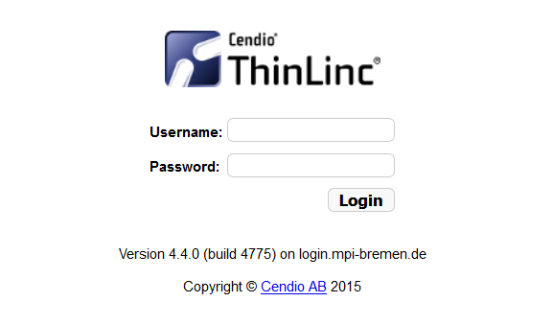
https://login.mpi-bremen.de

Slide 26
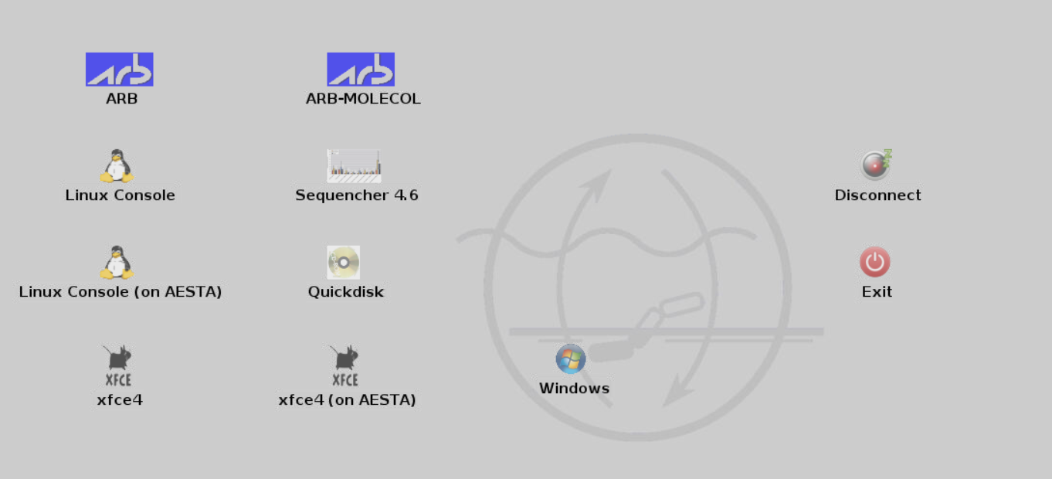
log in & open console

Slide 27
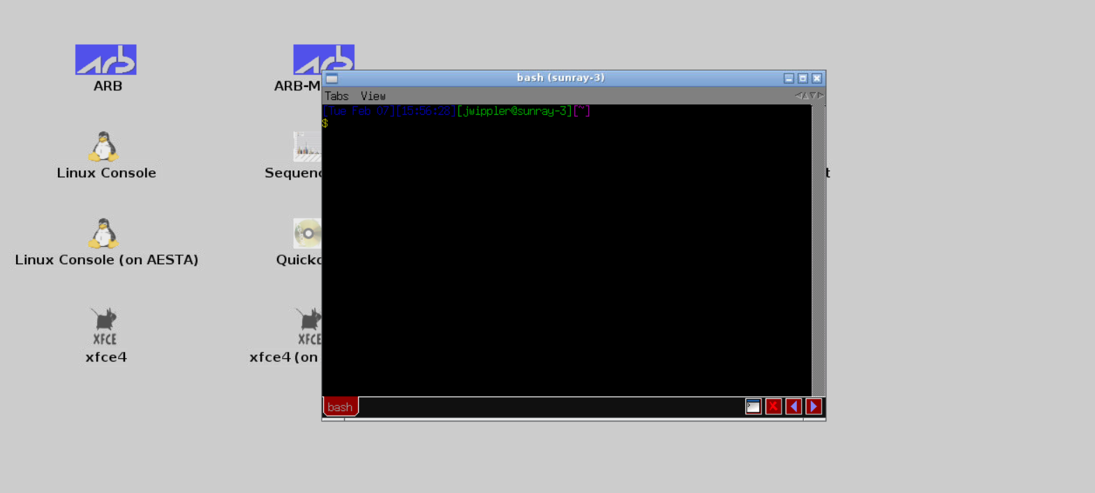
Open up a console

Slide 28
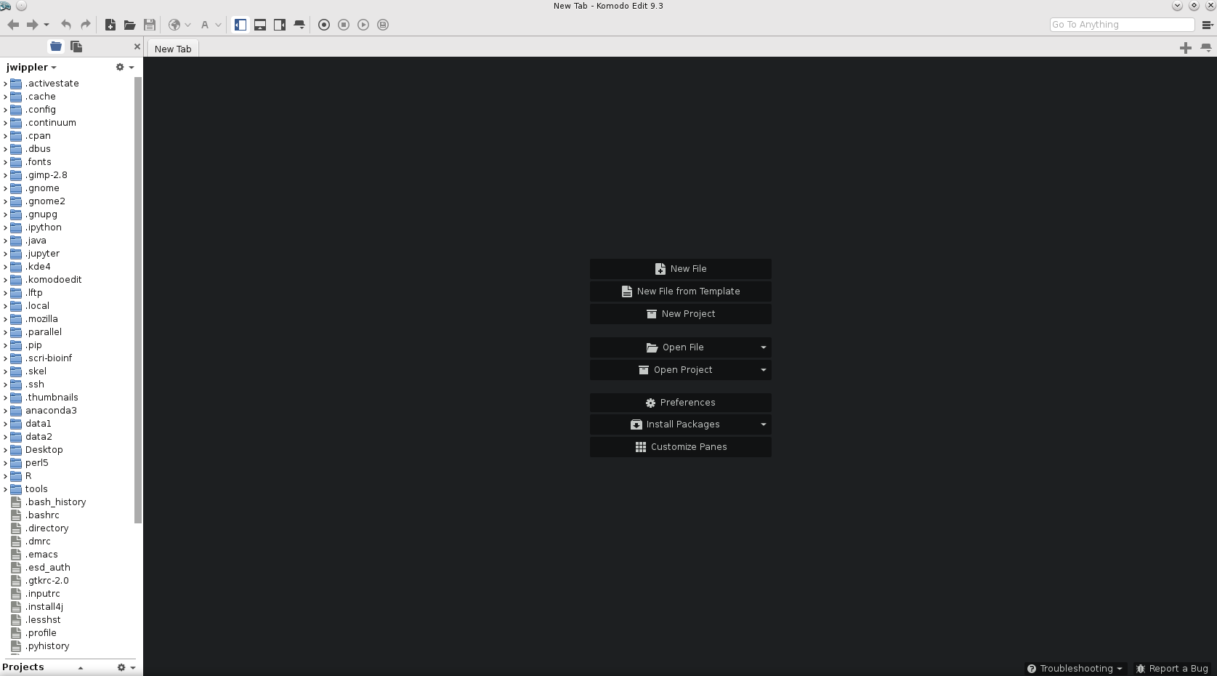
Open a text editor e.g. Komodo

Slide 29
Let’s write our very first Perl program!
Perl programs are simple text files, so open up your text editor (not word processor!) and type:
#!/usr/bin/perl

Slide 30
Let’s write our very first Perl program!
Perl programs are simple text files, so open up your text editor (not word processor!) and type:
#!/usr/bin/perl
This will ALWAYS be the very first line of any code you write
It tells the computer where to find the interpreter (perl) that actually executes your code
If you have a typo in this line, or perl is located in an unusual location, you will get the error message:
bad interpreter: No such file or directory

Slide 31
Say Hello! to the World
Now, let’s add some instructions:
#!/usr/bin/perl
print "Hello, World!\n";
Save the text file (e.g. helloworld.pl)
Make it executable:
chmod u+x helloworld.pl
Run the program helloworld.pl:
./helloworld.pl

Slide 32
The print Statement
What does each element in our script do?
#!/usr/bin/perl
print "Hello, World!\n";
\n is a newline character
(special symbol that denotes the beginning of a new line)
semicolons mark the end of each statement!
function that let‘s you print stuff to screen
double quotes ""
enclose the text you want to print

Slide 33
Perl Pragmas
Add these three lines to your code:
#!/usr/bin/perl
use strict;
use warnings;
use diagnostics;
print "Hello, World!\n";
Notes:
Pragma = module that tells the Perl interpreter how to act

Slide 34
Perl Pragmas
Add these three lines to your code:
#!/usr/bin/perl
use strict;
use warnings;
use diagnostics;
print "Hello, World!\n";
use strict = Perl pragma to restrict unsafe constructs
-> this will help you avoid “unsafe” code
use warnings = Perl pragma will show optional warnings that are otherwise disabled
-> this will help you de-bug your code, by giving out more info
use diagnostics = gives longer description of warnings
Notes:
Pragma = module that tells the Perl interpreter how to act

Slide 35
Commenting
Comment your code! Better comment too much than too little!
Anything behind a # will become a comment and is ignored by the interpreter, e.g.:
#!/usr/bin/perl
# written by Juliane Wippler 2016-02-08
use strict;
use warnings;
print "Hello, World!\n"; # print “Hello, World!” to screen

Slide 36
Small Exercises
Leave out the \n and run the script again. What changed and why?
Modify the script to output this text instead:
Hello
World
!

Slide 37
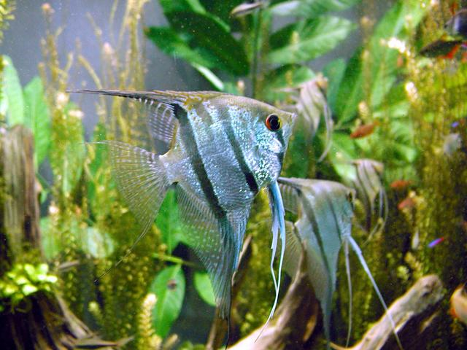
Scalar Data & Variables
Scalar data = single data values, like numbers and character strings,
e.g.: 5, 134, 1e-10, hello, scalar
Scalar variable = variable that stores a scalar value
The scalar – a popular pet fish
By mendel (Own work) [CC BY-SA 1.0 (http://creativecommons.org/licenses/by-sa/1.0)], via Wikimedia Commons

Slide 38
Scalar Variables
Variable = “container” that holds one or more values
Scalar variable: holds exactly one value
Non-scalar variables (arrays and hashes): can hold many values
The name of a variable is permanent
The value of a variable can change indefinitely:
$variable1 = 3;
$variable1 = 5;

Slide 39
Notation of a Scalar Variable
This is a scalar variable: $name
dollar sign
(sigil)
denotes a scalar variable
variable name =
Perl identifier

Slide 40
Naming Scalar Variables
Mandatory rules for variable naming:
may consist of alphanumeric characters and underscores
can‘t start with a number (you will later see why)
don’t start with underscore (you will later see why)
$sequence valid
$seq_ID valid
$sample3 valid
$3rd_sample not valid
$_ bad idea!

Slide 41
Naming Scalar Variables
Recommendations for variable naming:
names should be descriptive and meaningful: $r and $var1 are BAD names
names shouldn’t be endlessly long
Avoid ALLCAPS (these can have special meaning, like $ARGV)
Choose either underscores OR CamelCase, be consistent in style:
$fasta_sequence $fastaSequence
$seq_id $seqID

Slide 42
Initializing Variables
The first time you use a variable, it should be declared using “my”:
my $sequence;
my $GC_content;

Slide 43
Assign Values to Variables
Perl assignment operator is the equals sign:
my $sequence = "ATCGATGG";
my $Seq_ID = "contig_1";
my $GC_content = 54;

Slide 44
Assign Values to Variables
Perl assignment operator is the equals sign:
my $sequence = "ATCGATGG";
my $Seq_ID = "contig_1";
my $GC_content = 54;
Don‘t forget the semicolon to mark the end of a statement!

Slide 45
Scalar Data: Numbers
Numbers can be specified as:
integers (1, 2, 3, -5024) or
floating-point numbers = decimal numbers (1.35, 1.00, 7.5e4, -6.5e57, 1E-10)
Perl internally treats everything as double-precision floating-point values
(precision up to the 16th decimal)

Slide 46
Numeric Operators
Basic numeric operators work exactly as you would expect:
2 + 2; addition
7.5 – 3; subtraction
5 * 4; multiplication
9 / 3; division

Slide 47
Auto-increment/Auto-decrement
Perl can automatically increase/decrease the value of a variable by 1.
This is extremely useful, e.g. for variables that keep count of something (flags)!
Autoincrement operator:
my $count = 3;
$count++;
print "The value of \$count is $count\n";
Will print: The value of $count is 4

Slide 48
Auto-increment/Auto-decrement
Perl can automatically increase/decrease the value of a variable by 1.
This is extremely useful, e.g. for variables that keep count of something (flags)!
Autoincrement operator:
my $count = 3;
$count++;
print "The value of \$count is $count\n";
Will print: The value of $count is 4
the value of the variable is interpolated by Perl

Slide 49
Auto-increment/Auto-decrement
Perl can automatically increase/decrease the value of a variable by 1.
This is extremely useful, e.g. for variables that keep count of something
Autoincrement operator:
my $count = 3;
$count++;
print "The value of \$count is $count\n";
Will print: The value of $count is 4
the backslash escape allows literal printing of $

Slide 50
Auto-increment/Auto-decrement
Autodecrement operator:
my $count = 3;
$count--;
print "The value of \$count is $count\n";
Will print: The value of $count is 2

Slide 51
Scalar Data: Strings
Strings = sequences of characters ("hello", "R2D2", "I like trains!", "ACTGGTAAGG")
Characters can be letters, digits, punctuation, whitespaces
Can be any combination of any characters and of any length
The shortest string has zero characters (empty string, null string)
The longest string fills all of your available memory!

Slide 52
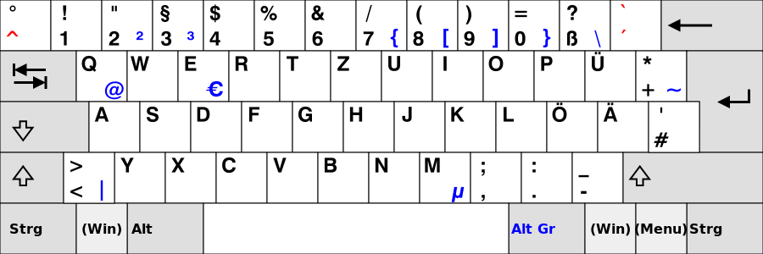
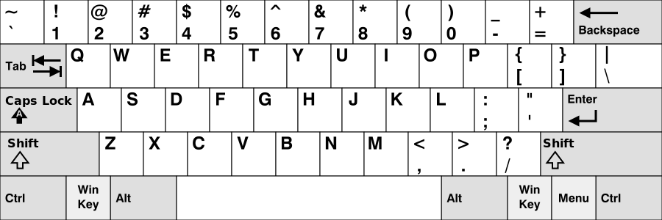
Single Quotes vs. Double Quotes
Single-quoted string literal: 'TCGGGTAATCGATTGCA'
Double-quoted string (interpolated) "TCGGGTAATCGATTGCA"
German keyboard
US keyboard

Slide 53
Single Quotes vs. Double Quotes
Single-quoted string literal: 'TCGGGTAATCGATTGCA'
Null string: ''
string

Slide 54
Single Quotes vs. Double Quotes
Single-quoted string literal: 'TCGGGTAATCGATTGCA'
Null string: ''
If ' and \ need to be part of a string, they need to be escaped
Escaping is done by adding a backslash \ in front:
string

Slide 55
Single Quotes vs. Double Quotes
Single-quoted string literal: 'TCGGGTAATCGATTGCA'
Null string: ''
If ' and \ need to be part of a string, they need to be escaped
Escaping is done by adding a backslash \ in front:
print 'Don\'t forget to escape the apostrophe with a backslash: \\';
will print: Don't forget to escape the apostrophe with a backslash: \
'\'\\'
will print:'\
string

Slide 56
Single Quotes vs. Double Quotes
Add the following line to your Perl script:
print 'Don\'t forget to escape the apostrophe with a backslash: \\\n‘;
print "Don\'t forget to escape the apostrophe with a backslash: \\\n“;
single quotes in first line
double quotes in second line
Run the script
Compare the output from the two print statements
What’s the difference?

Slide 57
Single Quotes vs. Double Quotes
Add the following line to your Perl script:
print 'Don\'t forget to escape the apostrophe with a backslash: \\\n'
print "Don\'t forget to escape the apostrophe with a backslash: \\\"
single quotes in first line
double quotes in second line
Run the script
Compare the output from the two print statements
What do you notice?
Backslash escapes like \n are ignored in single quotes!

Slide 58
Single Quotes vs. Double Quotes
Double quotes "" allow us to use special backslash escape characters:
Construct Meaning
\n Newline
\r Return
\t Tab
\f Formfeed
\b Backspace
\a Bell
\e Escape (ASCII escape character)
\007 Any octal ASCII value (here, 007 = bell)
\x7f Any two-digit, hex ASCII value (here, 7f = delete)
\cC A “control” character (here, Ctrl-C)
\\ Backslash
\\” Double quote
\l Lowercase next letter
\L Lowercase all following letters until \E
\u Uppercase next letter
\U Uppercase all following letters until \E
\Q Quote non-word characters by adding a backslash until \E
\E End \L, \U, or \Q

Slide 59
String Operators
Concatenation of strings using the . operator
"ATCG" . "CCCG" is the same as "ATCGCCCG"
"ATCG" . ' ' . "CCCG" is the same as "ATCG CCCG"
"ATCG" . "\n" is the same as "ATCG\n“

Slide 60
String Operators
Repetition of strings using the x operator
"ATCG" x 3 is the same as "ATCGATCGATCG"
"ATCG" x (4+1) is the same as "ATCGATCGATCGATCGATCG"
5 x 4 is the same as "5555"
4 x 5 is the same as "44444"

Slide 61
Numbers vs. Strings
Perl automatically converts between numbers and strings, depending on the operator:
5 x 4 is the same as "5555"
4 * 5 is the same as 20
"Z" . 4 * 5 is the same as "Z20"

Slide 62
Operators also work on Variables
my $GC = 36;
my $AT = 100 - $GC;
print "$AT\n";
will print: 64
$sequence = $sequence . "GGGGTTTT";
print "$sequence\n";
will print: ATCGATGGGGGGTTTT

Slide 63
Compound Assignment Operators
Compound assignment operators allow you to do this more concisely:
$sequence = $sequence . "GGGGTTTT";
is the same as:
$sequence .= "GGGGTTTT";
The same can be done with other operators, e.g.:
$number = $number + 1; is the same as $number += 1;
$number = $number * 2; is the same as $number *= 2;

Slide 64
Printing Variables
Sometimes you want to print something directly following a variable.
In that case, you can tell Perl explicitly where the variable name starts and ends:
print "${sequence}GGGGCTC\n";
will print: ATCGATGGGGGGTTTT
print "The GC content is ${GC}%\n";
will print: The GC content is 64%

Slide 65
Operator Precedence
Perl follows the common mathematical order: first multiplication, then addition
5 + 4 * 3
= 17
Parentheses have the highest precedence:
(5 + 4) * 3
= 60
Precedence of string operators is documented here: http://perldoc.perl.org/perlop.html#Operator-Precedence-and-Associativity

Slide 66
Operator Associativity
If operators with the same precedence level are resolved by associativity:
* and / have left associativity:
36 / 6 * 3 is the same as (36 / 6) * 3
** (exponentiation) has right associativity:
4 ** 3 ** 2 is the same as 4 ** (3 ** 2)
If you really need it, look up associativity here:
http://perldoc.perl.org/perlop.html#Operator-Precedence-and-Associativity

Slide 67
Comparison Operators
Numbers and strings can be compared using comparison operators:
Comparison Numeric String
Equal == eq
Not equal != ne
Less than < lt
Greater than > gt
Less than or equal to <= le
Greater than or equal to >= ge

Slide 68
Comparison Operators
Comparison operators return a TRUE or FALSE value:
35 != 34; is TRUE
35 != 30 + 5; is FALSE
35 == 35.0; is TRUE
'35' eq '35.0'; is FALSE
'ATCTCG' ne 'ACCCCG'; is TRUE
Boolean Values

Slide 69
Comparison Operators
Comparison operators return a TRUE or FALSE value:
35 != 34; is TRUE
35 != 30 + 5; is FALSE
35 == 35.0; is TRUE
'35' eq '35.0'; is FALSE
'ATCTCG' ne 'ACCCCG'; is TRUE
Boolean Values
note string context!

Slide 70
The if Clause
Perl can make decisions based on, e.g. the outcome of comparing two values:
if (condition) {
do something;
}

Slide 71
The if Clause
Perl can make decisions based on, e.g. the outcome of comparing two values:
if (condition) {
do something;
}
my $sequence_1 = "ATCG";
my $sequence_2 = "ATCG";
if ($sequence_1 eq $sequence_2) {
print "Sequences are identical\n";
}
Perl will execute an if statement, if the condition is TRUE

Slide 72
Perl Style Conventions: Indentation
if ($sequence_1 eq $sequence_2) {
print “Sequences are identical\n”;
}
indent the contents of the block
close braces on a separate line
&
align vertically with the beginning of the block

Slide 73
The else Clause
if (condition) {
do something;
} else {
do something else;
}
The else keyword let’s you define what happens if the condition isn’t met or is FALSE

Slide 74
The else Clause
my $sequence_1 = "ATCG";
my $sequence_2 = "ATCg";
if ($sequence_1 eq $sequence_2) {
print "Sequences are identical\n";
} else {
print "Sequences are not identical\n";
}
The else keyword let’s you define what happens if the condition isn’t met or is FALSE

Slide 75
Boolean Values in Variables
Boolean values can also be stored in a scalar variable:
my $compare1 = "ATCG" eq "ATCG";
my $compare2 = "ATCG" eq "AAAA";
Do something if Boolean value = TRUE:
if ($compare1) {
print "Sequences are identical\n";
}
will print: Sequences are identical

Slide 76
Boolean Values in Variables
Boolean values can also be stored in a scalar variable:
my $compare1 = "ATCG" eq "ATCG";
my $compare2 = "ATCG" eq "AAAA";
Do something if Boolean value = TRUE:
if ($compare1) {
print "Sequences are identical\n";
}
will print: Sequences are identical
Do Something if Boolean value = FALSE:
if (! $compare2) {
print "Sequences don’t match\n";
}
will print: Sequences don’t match

Slide 77
Logical Operators
Perl has logical operators to work with Boolean TRUE/FALSE values:
&& = AND
|| = OR

Slide 78
Logical Operators
Perl has logical operators to work with Boolean TRUE/FALSE values:
&& = AND
|| = OR
if (condition_1 && condition_2) {
print "Both conditions are true! ";
} elsif (condition_1 || condition_2) {
print "At least one or the other condition is true";
}

Slide 79
Logical Operators
Perl has logical operators to work with Boolean TRUE/FALSE values:
&& = AND
|| = OR
Example:
if ( ($GC >= 40) && ($GC <=60) ) {
print "GC content is between 40% and 60%\n";
}

Slide 80
The elsif Clause
This can be used to check a number of conditional expressions one by one:
if (condition 1) {
do something;
} elsif (condition 2){
do something else;
} elsif (condition 3){
do another thing;
} else {
do when all other conditions fail;
}

Slide 81
Variable Scope
my $var is valid within the enclosing block
If it‘s not enclosed in a block it is valid throughout the code
You can put your code into a “naked block” to limit the scope of the variable:
{
my $variable = 5;
print "$variable\n";
}

Slide 82
Regular Expressions
Regular expressions (RegEx) let us write patterns to match strings, so we can do things like:
Match each line that begins with an A and end with a T
Check if there is DNA sequence with non-standard characters
Check if I’m looking at a DNA or a protein sequence
Find any lines that contain the string “Bacillus subtilis” or “Bacillus anthracis”
Count all lines that have the string “recA” in them
RegEx are used for pattern matching

Slide 83
Regular Expressions
RegEx in Perl either match a string or they don‘t (no partial matches)

Slide 84
Regular Expressions
RegEx in Perl either match a string or they don‘t (no partial matches)
the leftmost, longest substring that satisfies the pattern is matched

Slide 85
Regular Expressions
RegExes in Perl either match a string or they don‘t (no partial matches)
the leftmost, longest substring that satisfies the pattern is matched
The easiest RegEx is one that literally matches a substring:
$_ = "AGGATAGGATATTA";
if (/GGA/) {
print "It matched!\n";
}

Slide 86
Regular Expressions
RegExes in Perl either match a string or they don‘t (no partial matches)
the leftmost, longest substring that satisfies the pattern is matched
The easiest RegEx is one that literally matches a substring:
$_ = "AGGATAGGATATTA";
if (/GGA/) {
print "It matched!\n";
}
What parts of the string will be matched?

Slide 87
Regular Expressions
RegExes in Perl either match a string or they don‘t (no partial matches)
the leftmost, longest substring that satisfies the pattern is matched
The easiest RegEx is one that literally matches a substring:
$_ = "AGGATAGGATATTA";
if (/GGA/) {
print "It matched!\n";
}
What parts of the string will be matched?
AGGATAGGATATTA
We‘ll learn about global matching later

Slide 88
Regular Expressions
RegEx pattern
special variable
that holds input values and values for pattern matching
$_ = “AGGATAGGATATTA”;
if (/GGA/) {
print “It matched!\n”;
}
match operator

Slide 89
Regular Expressions
Whitespaces matter!
/GGA/ ≠ /G GA/
Capitalization matters!
/GGA/ ≠ /gga/

Slide 90
Regular Expressions
The match operator // is similar to double quotes ""
Special backslash-escaped characters, like \n (newline), \t (tab), \s (whitespace) work:
/Hello\tWorld/ will match "Hello World"

Slide 91
Regular Expressions
The match operator // is similar to double quotes ""
Special backslash-escaped characters, like \n (newline), \t (tab), \s (whitespace) work:
/Hello\tWorld/ will match "Hello World"
Variables are interpolated:
my $word = "World";
/Hello\s${word}/ will match "Hello World"

Slide 92
Regular Expressions
Matching character types:
\w | matches any single character classified as a “word” character (alphanumeric or “_”)
\W | matches any non-“word” character
\s | matches any whitespace character (space, tab, newline)
\S | matches any non-whitespace character
\d | matches any digit character, equiv. to [0-9]
\D | matches any non-digit character

Slide 93
Regular Expressions
If you leave the match operator empty //, it will match any string!

Slide 94
Some RegExercises
First, write the following pattern matching program, save it as check_match.pl,
and make it executable:
#!/usr/bin/perl
use strict;
use warnings;
use diagnostics;
while (<STDIN>) {
chomp;
if (/YOUR_PATTERN_HERE/) {
print "Matched!\n";
} else {
print "No match :(\n";
}
}

Slide 95
Some RegExercises
First, write the following pattern matching program, save it as check_match.pl,
and make it executable:
#!/usr/bin/perl
use strict;
use warnings;
use diagnostics;
while (<STDIN>) {
chomp;
if (/YOUR_PATTERN_HERE/) {
print "Matched!\n";
} else {
print "No match :(\n";
}
}
This let‘s you read user input from the command line
(this will be explained more later)
This will remove the invisible newline character \n

Slide 96
check_match.pl
You can use this script by piping strings to match into it with echo:
echo “blablabla"|./check_match.pl
Or by reading text from a file into it:
./check_match.pl < file.txt

Slide 97
Some RegExercises
Work with example GenBank file: example_genbank.gbk
Modify your check_match.pl script to match the string "CDS"
How many CDS does the GenBank file contain?
(hint: use a count variable and autoincrement to count the number of matches)

Slide 98
RegEx Metacharacters
For building more sophisticated RegEx
If you need to use any of these as literals, use the backslash \ escape!
Metacharacter | Matches
^ | beginning of string
$ | end of string
. | any character except newline
* | match 0 or more times
+ | match at least once
? | match 0 or 1 times; or: shortest match
| | alternative
( ) | grouping; “storing”
[ ] | set of characters

Slide 99
Examples of Metacharacters in use
/^Hello/ matches "Hello, World!" but not "World, I say Hello"
/Hello$/ matches "World, I say Hello" but not “Hello, World!"
/H.llo/ matches "Hello“, "Hallo", "H3llo", and "H\sllo"
/Hel+o/ matches "Hello" and "Helo", but also "Helllllllllllo"
/Hel?o/ matches "Hello", "Helo", Heo"
/He|allo/ matches "Hello" and "Hallo"

Slide 100
RegEx Repetition Operators
Define how many time something should be matched:
Repetition operator | Matches
a* | zero or more a’s
a+ | one or more a’s
a? | zero or one a’s (i.e., optional a)
a{m} | exactly m a’s
a{m,} | at least m a’s
a{m,n} | at least m but at most n a’s

Slide 101
Examples of Repetition Operators
/Hel{2}o/ matches "Hello"
/Hel{2,}o/ matches "Hello", "Helllo", "Hellllo" etc.
/Hel{1,5}o/ matches "Helo", "Hello", "Helllo", "Hellllo", "Helllllo"

Slide 102
RegEx Grouping
/Hello+/ matches also “Hellooooooo”
Grouping helps to define what exactly should be matched one or more times:
/(Hello)+/ matches “HelloHelloHello”
capture group

Slide 103
RegEx Grouping
/Hello+/ matches also “Hellooooooo”
Grouping helps to define what exactly should be matched one or more times:
/(Hello)+/ matches “HelloHelloHello”
The string matched by a capture group will automatically be saved in special variables:
$1
$2
$3
…
according to the position in the RegEx pattern
capture group

Slide 104
RegExercise
Modify your check_match.pl script and read example_genbank.gbk file into it:
Enclose your pattern in parentheses (), e.g. /(C)DS/, and add the line
print "$1\n";
What is printed?
Add another capture group, e.g. /(C)D(S)/
print the values of each capture group

Slide 105
Back Referencing
Back reference (\1):
You can match the pattern in parentheses again, e.g. this will match any character that appears again right next to itself:
/(.)\1/
This matches "Hello", "deep sea" (= any character twice)

Slide 106
Back Referencing
Back reference (\1):
You can match the pattern in parentheses again, e.g. this will match any character that appears again right next to itself:
/(.)\1/
This matches "Hello", "deep sea" (= any character twice)
The back reference does not have to immediately follow:
/(ll)ow\s.{1,3}\1/
This matches "Yellow Mellow" and "fellow swallow"

Slide 107
Back Referencing
Back reference (\1):
You can match the pattern in parentheses again, e.g. this will match any character that appears again right next to itself:
/(.)\1/
This matches "Hello", "deep sea" (= any character twice)
The back reference does not have to immediately follow:
/(ll)ow\s.{1,3}\1/
This matches "Yellow Mellow" and "fellow swallow"
If you use multiple capture groups, each group gets it’s back reference (\1, \2, …)
similar to the $1, $2 etc. match variables

Slide 108
RegEx Character Classes
Character class | Matches
[characters] | any of the characters in the brackets
[\-] | hyphen character “-”
\n | newline character (others like \s, \d, \t work too)
\b | match word boundary, e.g. /word\b/ matches “word” but not “wordblub” or “blubword”
[^something] | any character except those that [something] denotes; that is, immediately after the leading “[”, the circumflex “^” means “not” applied to all of the rest
[a-zA-Z] | any lower case or upper case letter of the alphabet
[0-9] | any digits from zero to nine

Slide 109
Match Modifiers
Modifiers can be used to control the matching behavior:
Case insensitive matching: /RegEx/i
“.” now also matches newline character: /RegEx/s
Allow whitespaces in the pattern: /RegEx/x
Match modifiers can be combined, e.g. /RegEx/six
Match at beginning of line: /RegEx/A (same as ^)
Match at end of line: /RegEx/Z (same as $)

Slide 110
The Binding Operator
So far, we matched against the string contained in Perl’s special variable $_
However, we can also match pattern on the right to the string on the left:
string =~ /pattern/
For example:
if ($string =~ /[^ACTG$]+/){
print "String is a nucleotide sequence\n";
}

Slide 111
The Automatic Match Variables
We already know two types of special Perl variables for matching:
$_ Default storage of strings for matching
$1, $2 Storage of capture group values

Slide 112
The Automatic Match Variables
We already know two types of special Perl variables for matching:
$_ Default storage of strings for matching
$1, $2 Storage of capture group values
However, there are more special match variables:
$& Stores that part of the string that actually matched the pattern
$`(back tick) Stores the string before the matched portion
$'(single quote) Stores the string after the matched portion

Slide 113
Substring Manipulation
Substitution with s/// operator:
s/RegEx/REPLACEMENT/

Slide 114
Substring Manipulation
Substitution with s/// operator:
s/RegEx/REPLACEMENT/
$_ = "CDS";
s/CDS/cds/;
print "$_\n";
will print “cds”
Note that the value of the variable that holds the string will be changed!
Can be combined with match modifiers: /s /i /x etc.

Slide 115
Substring Manipulation
Substitution with s/// operator:
s/RegEx/REPLACEMENT/
$_ = "CDS";
s/CDS/cds/;
print "$_\n";
will print “cds”
Note that the value of the variable that holds the string will be changed!
Can be combined with match modifiers: /s /i /x
To replace all matches within a string use global replacement with /g
s/CDS/cds/g;

Slide 116
Substring Manipulation
Binding operator also works with substitutions to act on a string instead of $_:
$string =~ s/RegEx/REPLACEMENT/g;
We can use this e.g. to convert DNA to RNA:
my $sequence = "ATTTGACTATA";
print "DNA: $sequence\n";
$sequence =~ s/T/U/g;
print "RNA: $sequence\n";
Will print:
DNA: ATTTGACTATA
RNA: AUUUGACUAUA

Slide 117
Substring Manipulation
Binding operator also works with substitutions to act on a string instead of $_:
$string =~ s/RegEx/REPLACEMENT/g;

Slide 118
Substring Manipulation
Binding operator also works with substitutions to act on a string instead of $_:
$string =~ s/RegEx/REPLACEMENT/g;
Note: the variable $string is changed by this!

Slide 119
Homework Exercises

