Slide 1

Using Structured Failure Data for Reasoning of Failure Causes and Analysis of Factors Influencing Failure
AVIC China Aero-Polytechnology Establishment
Dec. 18, 2019

Slide 2
Report contents
1. Reasoning of failure causes
2. Analysis of factors influencing failure

Slide 3
Technical proposal
Reasoning of failure causes using structured failure data
The temperature is too high to be tolerated by the ferromagnetic fluid
Airspeed indicator stops/displays nothing
Sensor is broken
Airspeed indicator is too high/too low
Shell assembly has structural damage
Pilot/static tube leaks
Ground wire screw is fractured
Pilot/static tightness inspection reveals the leakage
Sensor’s copper tube is damaged
Replace the copper tube
Adjust the heating element’s power distribution
Replace the screw
Change the sensor model
Replace the shell assembly

Slide 4
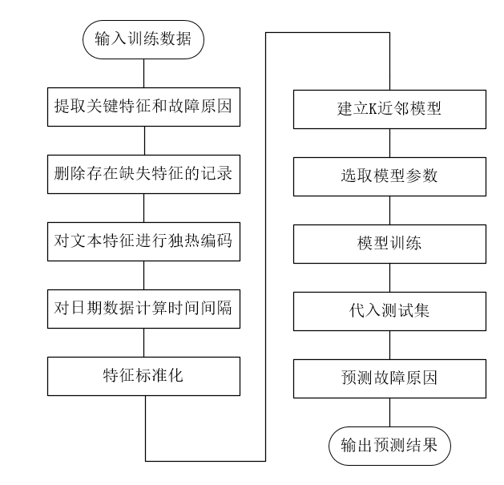
Technical proposal
Reasoning of failure causes using structured failure data
Input the training data
Extract key features and failure causes
Build a k-nearest neighbor model
Delete records with missing features
Select model parameters
Boolean coding of textual features
布尔
Model training
Calculate the time intervals for date data
Input the test set
Feature normalization
Failure cause prediction
Output the results

Slide 5
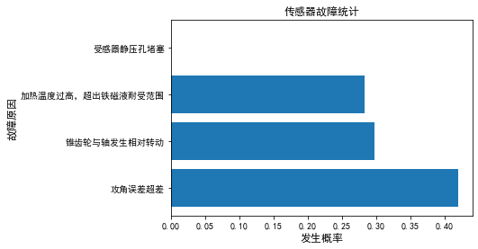
Technical proposal
Reasoning of failure causes using structured failure data
Date of failure | User type | Delivery date of faulty part | Working time of faulty part | Main fault symptom | Working calendar time
20190516 | China Southern Airlines | April 1, 2015 | 204:58 | Airspeed indicator is too high/too low | 1506
Feature extraction from entity attributes
Failure cause/remedial action and probability
Sensor’s static vent is blocked
Timing: Quarter
User type: Airline
Working time: hours (h)
Working calendar time: hours (h)
Fault symptom: text description
The temperature is too high to be tolerated by the ferromagnetic fluid
0.28
Failure cause
Reasoning
故障原因
Adjust the heating element’s power distribution
Bevel gear rotates relative to the shaft
0.30
Add a buffer structure to separate the bevel gear from limit bushing
Out-of-tolerance deviation in angle of attack
0.42
Replace the rotary transformer
Probability

Slide 6
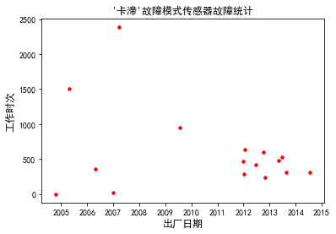
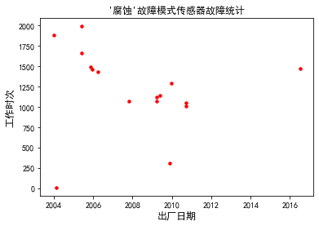
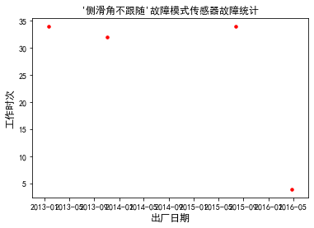
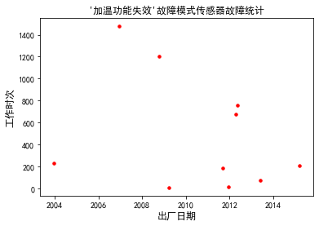
Technical proposal
Analysis of factors influencing failure using structured failure data
Failure statistics of sensors whose failure mode is “Stuck”
Failure statistics of sensors whose failure mode is “Corrosion”
Reasons behind the concentration of delivery rates can be examined from the perspectives of batch manufacturing, batch delivery to users, etc. Reasons behind the concentration of working times can be analyzed in terms of design, materials, stress in specific operating conditions, etc.
The delivery dates of 57% of the sensors are concentrated in the range from 2012 to 2013; and 70% of sensors have working times of between 250-650 h.
Working time
Working time
Working time
工作时次
工作时次
The delivery dates of 75% of the sensors fall within two ranges: from the 2nd quarter of 2005 to the 1st quarter of 2006 and from 2009 to 2010; the working times of 70% of the sensors are concentrated in the range of 1000-1500 h.
Delivery date
Delivery date
Failure statistics of sensors whose failure mode is ‘Sideslip angle does not follow’
Failure statistics of sensors whose failure mode is “Heating failure”
Working time
Working time
The delivery dates of 40% of the sensors are between the second half of 2011 and the first half of 2012; 60% of the sensors have working times less than 250 h.
工作时次
工作时次
Working times of all sensors are less than 35 h, which is characteristic of early failure.
Delivery date
Delivery date

Slide 7
Thanks for listening!

