Slide 1

Tentative Approaches to Ontology-based Semantic Search and Failure Cause Reasoning
AVIC China Aero-Polytechnology Establishment
Dec. 18, 2019

Slide 2
Report contents
1. Ontology-based semantic search
2. Ontology-based failure cause reasoning

Slide 3


Technical proposal
Ontology-based semantic search
Universal joint
Sensor vibrates and generates abnormal noise
User initiates a search request
Universal joint stuck
Universal joint stuck
Stuck
Enter search terms
User
Create search
Failure mode
Semantic understanding
Failure mode
Semantic understanding of search terms
Guide ring stuck
Stuck
Failure mode
Word segmentation, entity recognition, and relationship search
Stuck
Cause
Search in graphs
Failure mode
Cause
Guide ring limit stuck
Universal joint stuck
Screw loosening
Reasoning based on TransE model
Universal joint stuck
Return search results in order
Failure mode: stuck
Corrective action
Cause
Possible cause: screw loosening
Corrective action
Development based on the graph database Neo4j
Corrective action
Screw loosening
Tighten the screw and take preventive measures against loosening
Manually restore the guide ring to its original position
Visual display of results
……
Tighten the screw and take preventive measures against loosening
Return search results
Visual display (based on the graph database Neo4j)
Representation learning and reasoning based on TransE model

Slide 4
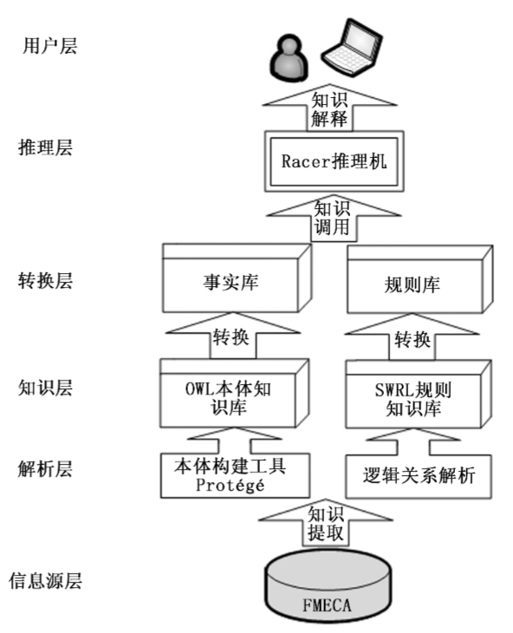
Technical proposal
Ontology-based failure cause reasoning — Approach 1: Use of SWRL rules
User layer
Knowledge interpretation
Reasoning layer
Racer reasoner
Knowledge invocation
Conversion layer
Fact base
Rule base
Conversion
Conversion
Knowledge layer
OWL ontology knowledge base
SWL rule knowledge base
Analysis layer
Automatic ontology construction
Logical relationship analysis
Knowledge extraction
Source layer
Failure data

Slide 5
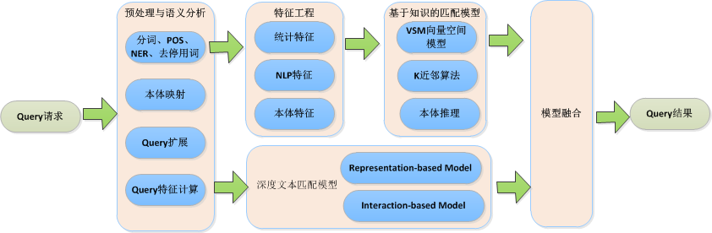
Technical proposal
Ontology-based failure cause reasoning
— Approach 2: Comprehensive use of knowledge-based matching and deep text matching
Preprocessing and semantic analysis
Feature engineering
Knowledge-based matching models
Statistical features
VSM (vector space model)
Word segmentation, POS, NER, and stop words removal
NLP features
K-nearest neighbor
Ontology mapping
Query request
Ontological features
Ontology reasoning
Model merging
Query results
Query expansion
Query feature calculation
Models for deep text matching

Slide 6
Thanks for listening!

