Slide 1

Application of Ontology in Aviation Quality and Reliability Data and Knowledge System Technical Proposal and Progress
AVIC China Aero-Polytechnology Establishment
Dec. 17, 2019

Slide 2
Report contents
1. Implementation plan
2. Current progress

Slide 3
Technical proposal
Research subjects
1）Architectural analysis of ontology model data for intelligent aviation safety information system and other tools
2) Feature analysis of aviation product quality and reliability (APQR) data
3）Ontology modeling techniques for the APQR domain
航空产品质量可靠性数据本体建模技术研究
Techniques for extracting key information from textual data on APQR
1）Creation of domain data dictionary
2）Optimization of Chinese word segmentation
3）Applications of named entity recognition （NER)/semantic annotation
4）Determination of extraction rules
Ontology modeling techniques for APQR data
1
2
1）Selecting application objects for typical aviation products and collecting textual records/reports on quality problems/failure
2）Ontology modeling for typical aviation products
quality and reliability (APQR)
3）Building examples/Cases of applications to QR knowledge management
4）Building examples of applications to support decision-making on reliability improvement
1）Construction of domain knowledge base
2）Construction of knowledge search framework
3）Failure cause analysis and corrective action recommendation
4）Development of prototype ontology-based APQR knowledge system
Example/Case applications of APQR knowledge system to product quality and reliability improvement
Construction of ontology-based APQR knowledge system
4
3

Slide 4





Technical proposal
Research subject 1-1: Architectural analysis of ontology model data for intelligent aviation safety
information system and other tools
Study of basic methodology
Architectural analysis of INBAS
Architectural analysis of SISEL
Architectural applicability analysis
UFO (Unified foundational ontology)
INBAS (Indicator-based safety reporting tool) analysis
SISEL (Intelligent aviation safety information system)
Object applicability analysis
OntoUML (Conceptual modeling language)
Analysis of core ontology classes and relationships
Analysis of tool functions and application scenarios
Analysis of core ontology classes and relationships
Analysis of tool functions and application scenarios
Scenario applicability analysis
ORSD（Ontological requirements specification）
Determination of ontological requirements specification
Class and attribute applicability analysis

Slide 5

Technical proposal
Research subject 1-2: Feature analysis of APQR data
Arrangement of existing data specifications
Field quality information data
Test data
Quality audit data
Basic data of quality staff
Failure analysis data
Data on quality competitiveness index in the manufacturing industry
Aircraft configuration data
Investigation of data specifications to be received
Use, maintenance, and support data
General quality characteristic data
Quality input data
Manufacturing capacity data
……
Analysis of data source types
Analyze the textual data on fault symptoms, causes, and corrective actions to determine their constituent elements, original/Raw corpus sources, and the type of data for information extraction or normalization
Analysis of relationships between data types
Analyze the relationships between various data types according to the requirements of different applications, such as QR-oriented knowledge graph display, knowledge search, failure cause analysis and corrective action recommendation, etc.

Slide 6
Technical proposal
Research subject 1-3: Ontology modeling techniques for the APQR domain
protégé
Original/Raw data source for ontology modeling
Determine the name and scope of ontology (RDF file)
Determine ontology classes, object attribute, data attribute, annotation attribute and other factors
Domain ontology (RDF file)
Reading ontology classes, attributes, and instances
Ontology architecture design
Automatic triplet generation
Convert fields to classes
Convert records to instances
Determine the fields/metadata in data acquisition form for ontology modeling
Algorithm for ontology instance automatic expansion
Ontology analysis algorithm
Artificial structuring /normalization
Data cleansing
Semantic transformation
Normalized form for ontology modeling data
Key information extraction algorithm
Jena
Semantic recognition and triplet extraction
Reading data records for ontology modeling

Slide 7
Technical proposal
Research subject 2-1: Building of domain data dictionary
Summary of grammatical structure and descriptive characteristics
Original quality text corpus
APQR domain-specific vocabulary (for NER）
Artificial sorting/refinement/ summary
Analysis of object attribute and so on
Artificial sorting/refinement/ summary
Written in a format compatible with
Onto_Gazetteer under the framework of Gate
GATE
Indexes + words/phrases
Words (phrases) related to aviation product development and use
Words (phrases) related to failure/quality issues
Words （phrases） related to QR
Words (phrases) and tags in the QR domain
Words related to degree, judgment, temporal and spatial relationships, logical connection, etc.
Jieba (word bank)
Tagging
Written in a format compatible with
Onto_Gazetteer under the framework of Gate
GATE
Written in a format compatible with Jieba
APQR domain-specific vocabulary （for Chinese word segmentation）
Artificial ontology and semantic annotation
(Classes, object attribute, and data attribute)
APQR domain-semantic vocabulary (for NER)

Slide 8
Technical proposal
Research subject 2-2: Optimization of Chinese word segmentation
Domain-specific vocabulary
Results of Chinese word segmentation
Add user defined dictionary
Corpus in plain text format (.csv/.txt)
Raw quality text corpus
Word segmentation of corpus
Results of (part of speech)POS tagging
Jieba
Format conversion
Generic NER for corpus
Jieba general dictionary

Slide 9

Technical proposal
Research subject 2-3&4: Applications of named entity recognition/semantic annotation
& Determination of extraction rules
Pilot/Wang/reported/than/the undercarriage/failed to/retract/after/taking off/.
Time of failure (*)+product name+judgment word+function → fault symptom
Subclass“XX chief”, matched class “Model”, Instance“XXX”
Class “Model”, instance “XXX”, matched class “Manufacturer”, instance “XX company”
Domain-specific vocabulary
Results of Chinese word segmentation /POS tagging of corpus
Domain-specific semantic vocabulary
Expression pattern matching
Feature analysis of annotation object
XXX: instance of class “Model”
XX company: instance of class “Manufacturer”
Vocabulary /ontology keyword search
NER
Ontology and semantic annotation
Rules for extracting expression pattern
Rules for inferring implicit information
Supplementing implicit information
Pilot: subclass of class “Informant”
Wang: instance of subclass “XX chief”
Taking off: instance of class “Time of failure”
Undercarriage: instance of class “Product name”
Retract: instance of class “Product function”
Fault symptom: the undercarriage failed to retract after taking off
Informant: Wang
Model: XXX
Manufacturer: XX company
Product name: undercarriage
Time of failure : taking off
Jena
SPARQL
Fail: judgment word
Domain ontology
Results of ontology annotation
Results of semantic annotation
Jape
Jena
SPARQL
Domain ontology

Slide 10
Technical proposal
Research subject 3-1&2: Construction of domain knowledge base & knowledge search framework
Semantic model
Data resource
Query
building
Keyword
Natural language
Formal language
Structured data
Query
processing
IR-style matching and sorting
KG-style matching and reasoning/inferring/deducing
Documents
Result
display
Query visualization
Document and data display
Query optimization
Implicit feedback
Explicit feedback

Slide 11


Technical proposal
Research subject 3-1&2: Construction of domain knowledge base & knowledge search framework (continued)
Universal joint
Universal joint stuck
Universal joint stuck
Sensor vibrates and generates abnormal noise
Stuck
User
Create search
Semantic understanding
Failure mode
Failure mode
Guide ring stuck
Failure mode
Stuck
Cause
Cause
Stuck
Guide ring limit stuck
Failure mode
Screw loosening
Universal joint stuck
Universal joint stuck
Failure mode: stuck
Corrective action
Cause
Corrective action
Possible cause: screw loosening
Corrective action
Screw loosening
Manually restore the guide ring to its original position
Tighten the screw and take preventive measures against loosening
Tighten the screw and take preventive measures against loosening
……
Return search results
Visual display (Based on the graph database Neo4j)
Representation learning and reasoning based on TransE model

Slide 12
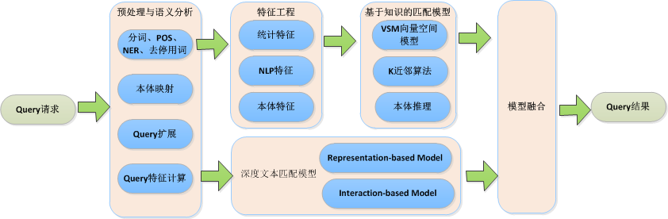
Technical proposal
Research subject 3-3: Failure cause analysis and corrective action recommendation
Preprocessing and semantic analysis
Feature engineering
Knowledge-based matching models
Statistical features
VSM (vector space model)
Word segmentation, POS, NER, and stop words removal
NLP features
K-nearest neighbor
Ontology mapping
Query request
Ontological features
Ontology reasoning
Model merging
Query results
Query expansion
Query feature calculation
Models for deep text matching

Slide 13
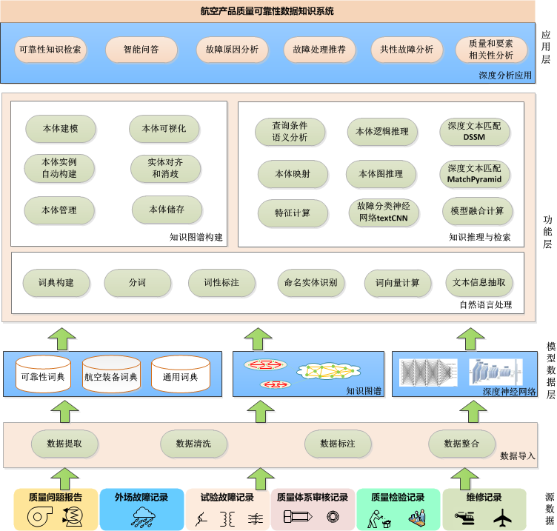
Technical proposal
Research subject 3-4: Development of prototype ontology-based APQR knowledge system
APQR data and knowledge system
Application layer
Reliability knowledge search
Intelligent Q&A
Failure cause analysis
Corrective action recommendation
Common failure analysis
Analysis of correlation between quality and factors
Deep analysis application
Ontology modeling
Ontology visualization
Semantic analysis of query condition
Logical reasoning of ontology
Deep text matching (DSSM)
Automatic ontology instance creation
Entity alignment and disambiguation
Ontology mapping
Graph-based reasoning of ontology
Deep text matching (MatchPyramid)
Ontology management
Ontology storage
Feature calculation
Neural network for fault classification (textCNN)
Model merging and calculation
Function layer
Knowledge graph building
Knowledge reasoning and search
Dictionary creation
Word segmentation
POS tagging
NER
Word vector calculation
Text information extraction
Natural language processing
Model data layer
Reliability dictionary
Dictionary of aviation equipment
General dictionary
Knowledge graph
Deep neural network
Data extraction
Data cleansing
Data annotation
Data integration
Data import
Quality problem reports
Field failure records
Test failure records
Quality system audit records
Quality inspection records
Repair records
Source data

Slide 14
Technical proposal
Research subject 3-4: Development of prototype ontology-based APQR knowledge system
Underlying technical framework
Well-developed open-source products are used as underlying technical support for software
Knowledge graph：Neo4J
Database: MySql
Ontology management: Protégé
Ontology query and logical reasoning: Jena
Word segmentation: Jieba
Neural networks: Gensim and tensorflow

Slide 15
Technical proposal
Research subject 3-4: Development of prototype ontology-based APQR knowledge system
Independently developed algorithms
Neural network for fault classification
Deep neural network for text matching
Graph-based reasoning of ontology
Semantic analysis of query condition
Ontology mapping
Feature calculation
Automatic ontology instance creation
Model merging and calculation
Deep analysis application

Slide 16
Technical proposal
Research subject 4: Example applications of knowledge system to product quality and reliability improvement
Topics discussed in the cooperation meeting with the Inspection and Testing Department of AVIC Chengfei:
1）The need for data analysis in quality-related work
2）The product objects and scope of data provided (China)
3）The product objects and scope of data provided (Czech Republic)
Topics discussed in the cooperation meetings with Czech Republic:
1）Czech Technical University: The specific functional requirements for the example verification applications;
2）Blue Sky Aviation: The specific types of use and maintenance data of the small civil aircrafts it provides, and its needs associated with operational safety, maintenance decision aid, etc.
Verification on China’s and Czech Republic’s desired functions based on the development of prototype ontology-based APQR knowledge system and build example applications that include data, software tools, work process and results.

Slide 17
Current progress
Progress of technical research
No. | Research subject | Current progress
1-1 | Architectural analysis of ontology model data | The functions, as well as ontology classes and attributes, of INBAS are being analyzed.
1-2 | Feature analysis of APQR data | Some fields from the field quality information data have been analyzed.
1-3 | Ontology modeling techniques for the APQR domain | The principles, process, and algorithm for domain ontology modeling have been worked out and a sample ontology architecture has been designed.
2-1 | Creation of domain data dictionary | Word segmentation dictionaries have been created for some products used in the avionics system, and relevant failure modes have been annotated.
2-2 | Optimization of Chinese word segmentation | The principles, process, and algorithm for Chinese word segmentation have been worked out.
2-3 | Applications of named entity recognition/semantic annotation | To be further studied.
2-4 | Determination of extraction rules | To be further studied.
3-1 | Construction of domain knowledge base | WebVOWL-based ontology visualization has been achieved.
3-2 | Construction of knowledge search framework | To be further studied.
3-3 | Failure cause analysis and corrective action recommendation | A prediction algorithm based on k-nearest neighbor has been developed and rule-based approaches remain to be studied.
3-4 | Development of prototype ontology-based APQR knowledge system | To be developed
4 | Example applications of knowledge system to product quality improvement | To be validated through subsequent applications

Slide 18
Current progress
Progress of demonstration system development
Chinese word segmentation Demonstration

Slide 19
Current progress
Progress of demonstration system development
Word vector demonstration

Slide 20
Current progress
Progress of demonstration system development
Demonstration of failure mode classification

Slide 21
Current progress
Progress of demonstration system development
Automatic ontology modeling with structured data

Slide 22
Current progress
Progress of demonstration system development
Ontology model visualization

Slide 23
Thanks for listening

