Slide 1
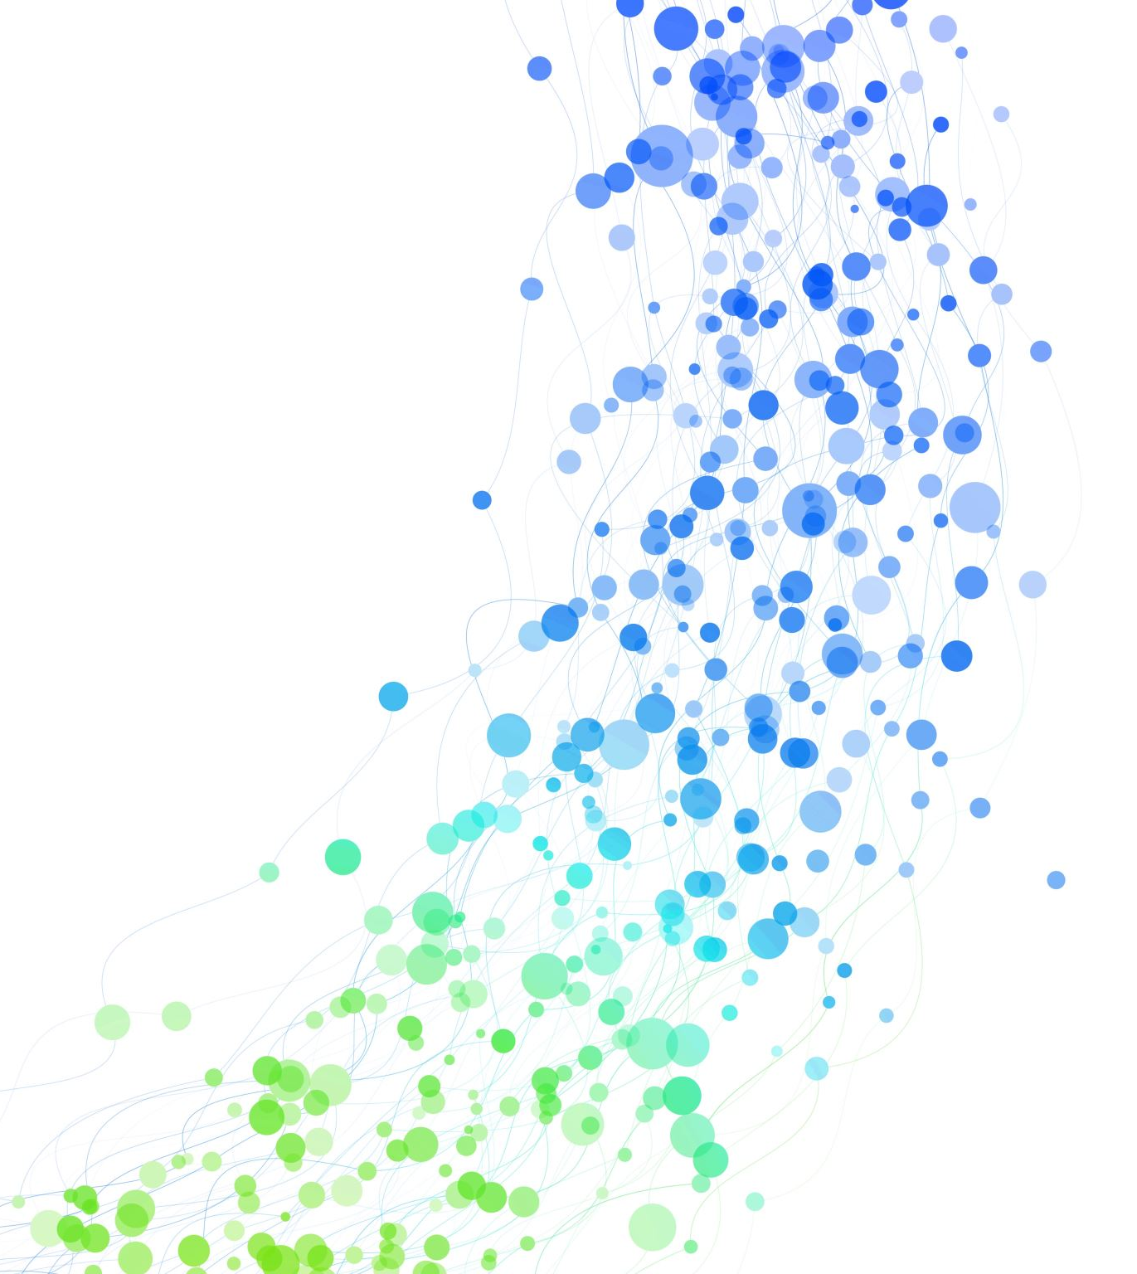
ME536 FINAL PROJECT
Kemal Barış Tanrıverdi
2578995

Slide 2
What to Talk About
Main Problem
General Look at the Solution
Dataset
Image Pre-processing
Convolutional Feature Extractor
Statistical Calculations
User Interface (UI)
Algorithm Workflow
Demonstration
Possible Improvements

Slide 3
Main Problem
Can we cluster aircrafts by using statistical methods? Can we detect novelty and cluster accordingly?
What happens if we had data for a single type of aircraft, but suddenly data from other aircraft types starts to come. This project aims to decide that the new data is not from the previously known cluster and create a similarity metric so that similar data will be clustered accordingly.

Slide 4
General Look at the Solution
Image Preprocessing
Feature Vectors from CNN
Statistical Methods for Clustering
Detecting and Learning Novelty

Slide 5
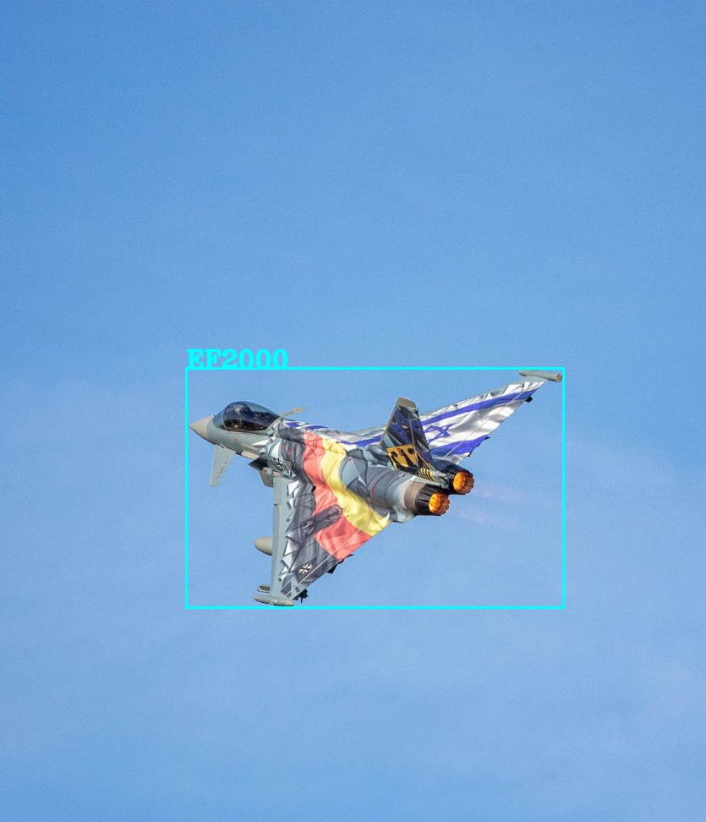
Dataset
FGVC (fine-grained visual classification) Aircraft Benchmark
Multiple aircraft types labelled properly

Slide 6
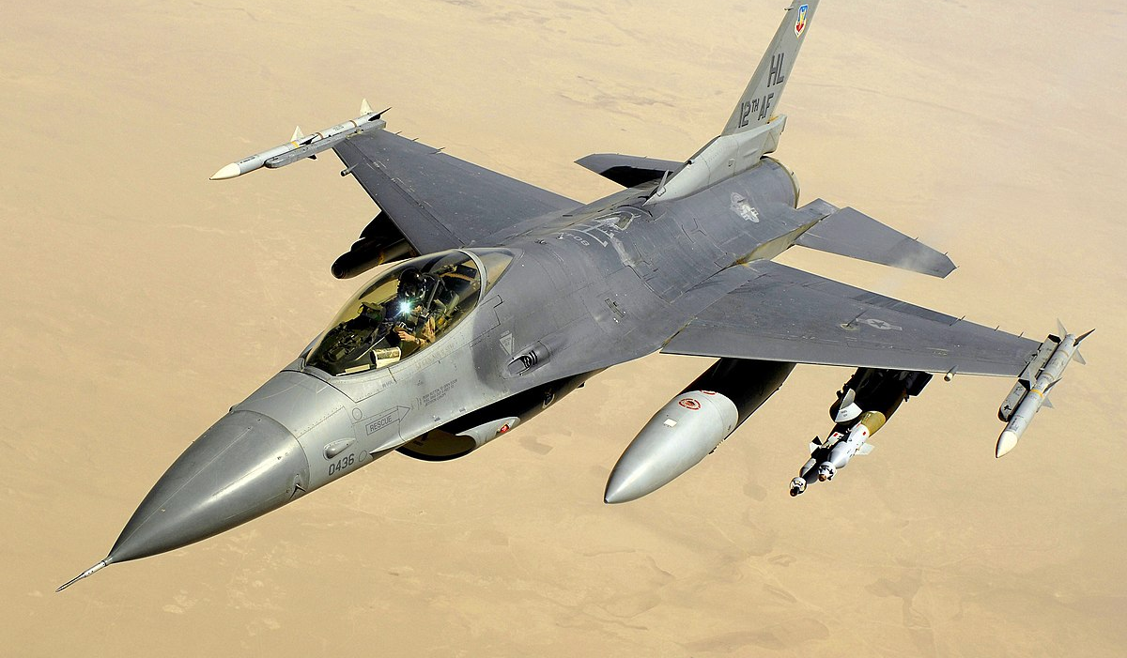
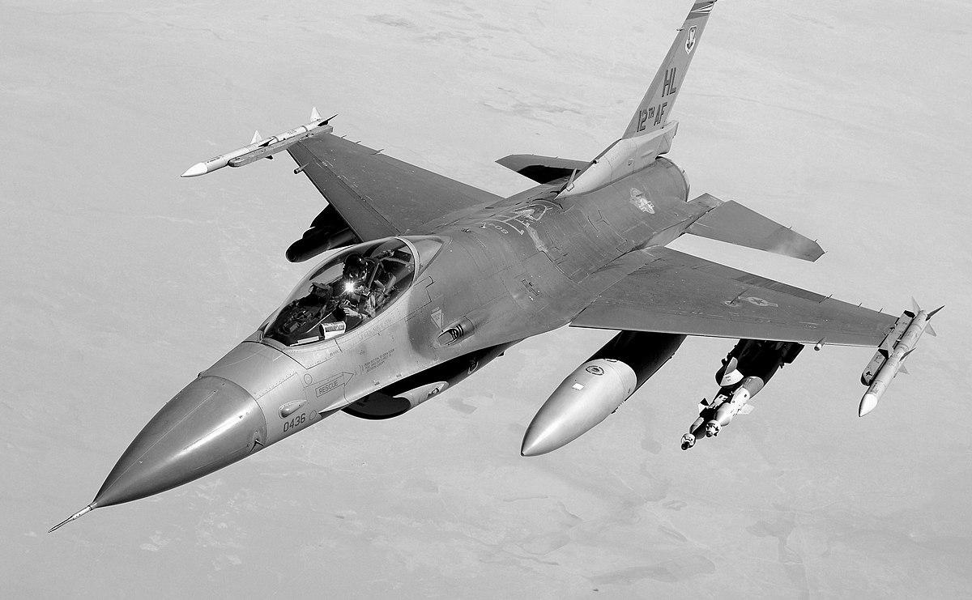
Image Pre-processing
Resize to scale
Gray scale conversion
Background-Foreground masks
Image augmentation
Noise
Gaussian Blur
Horizontal and Vertical Flip

Slide 7
Convolutional Feature Extractor
24 layers
Maxpooling every fourth layer
7x7 and 3x3 kernels
64 and 128 filters
Leaky ReLU activation
2048 dimensional vector

Slide 8

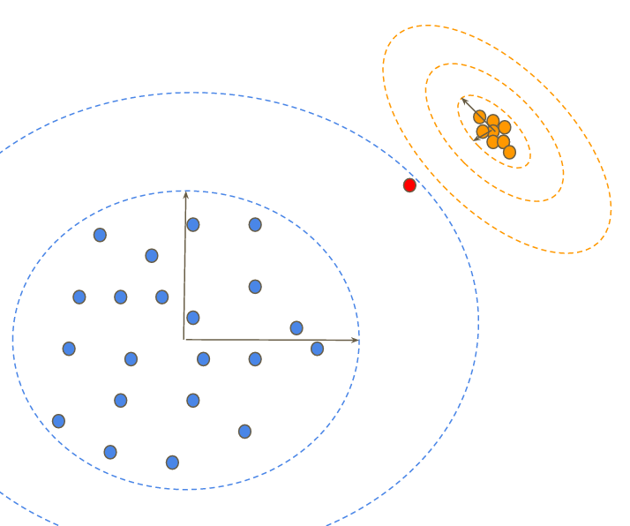
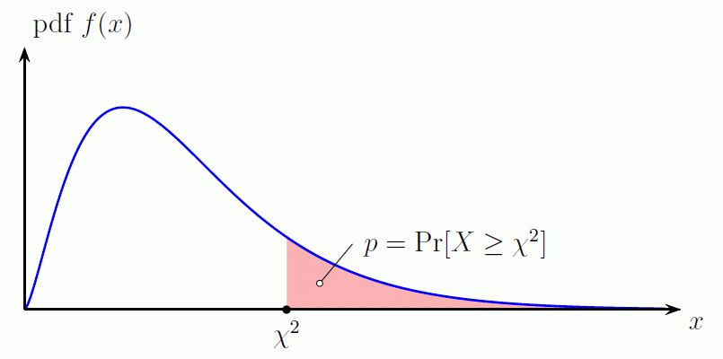
Statistical Calculations
Mean
Standard deviation
Mahalanobis distance
χ2 test for threshold determination

Slide 9
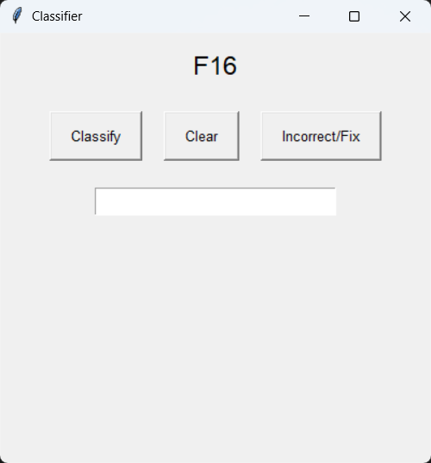
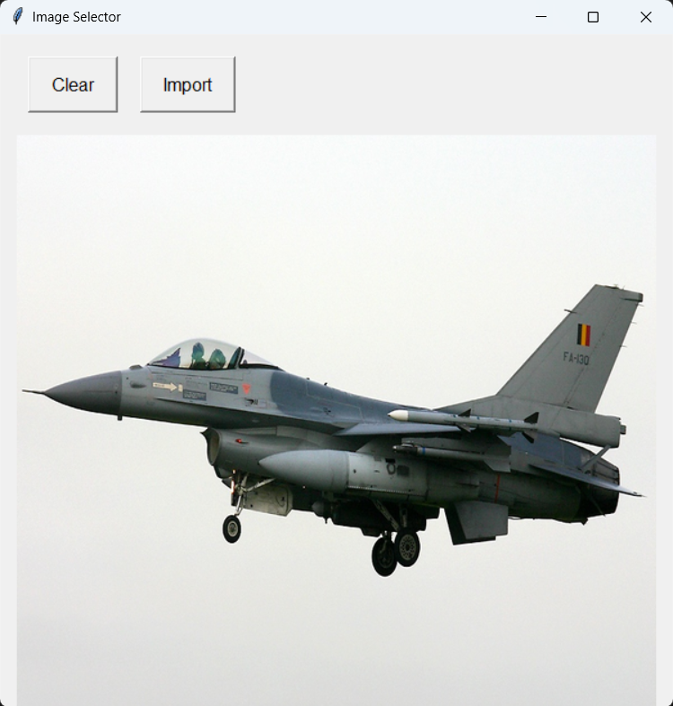
User Interface (UI)
Easy interaction with code

Slide 10
Algorithm Workflow
Process F16 images to yield mean/deviation vector
Save training vector as a cluster
Process different image to get feature vector
Calculate mean and standard deviation
Calculate Mahalanobis distance to clusters
Decide closeness from chi-square test
If doesn’t exist => new cluster

Slide 11
How About a Demonstration?

Slide 12
Possible Improvements
Better dynamic limit instead of chi-square
Trying different CNN architectures
Adding correctly clustered data into cluster parameter calculations
Better image filtering and processing

Slide 13

Thank You for Listening

Slide 14
References
Fine-Grained Visual Classification of Aircraft, S. Maji, J. Kannala, E. Rahtu, M. Blaschko, A. Vedaldi, arXiv.org, 2013
Lecture Notes, A. B. Koku, www.odtuclass.metu.edu.tr, accessed in 2025
"Reprint of: Mahalanobis, P.C. (1936) "On the Generalised Distance in Statistics.", A. Sankhya, 80 (1): 1–7. 2018-12-01, doi:10.1007/s13171-019-00164-5, ISSN 0976-8378

