Slide 1
CFD Code
Optimizer
Current:
Cost Functions
Sensitivities
Design Variables
New:
Design Variables

Slide 2
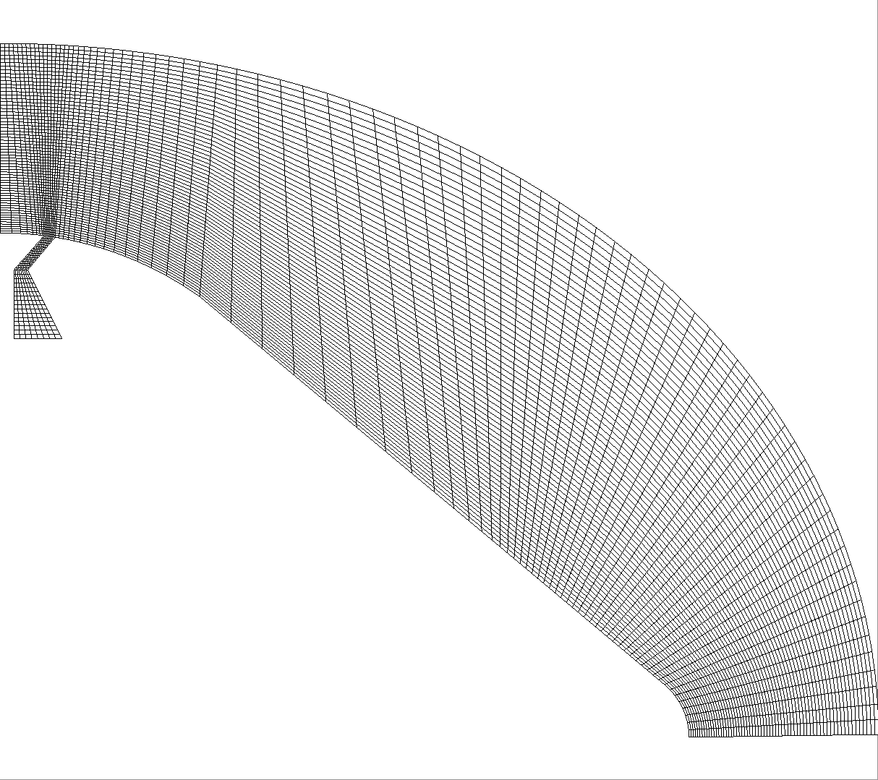
Flow Direction

