Slide 1
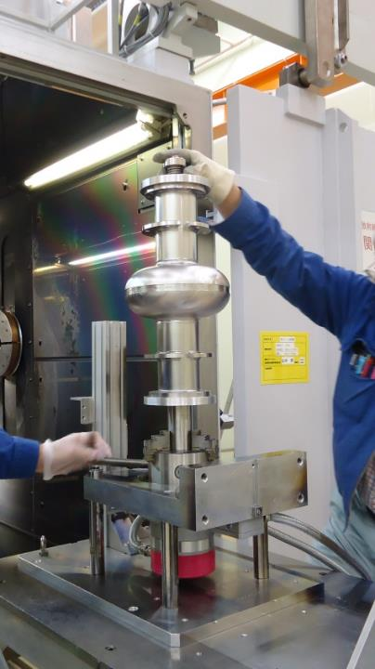
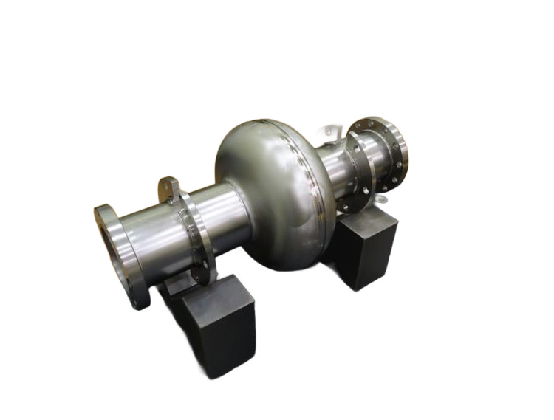
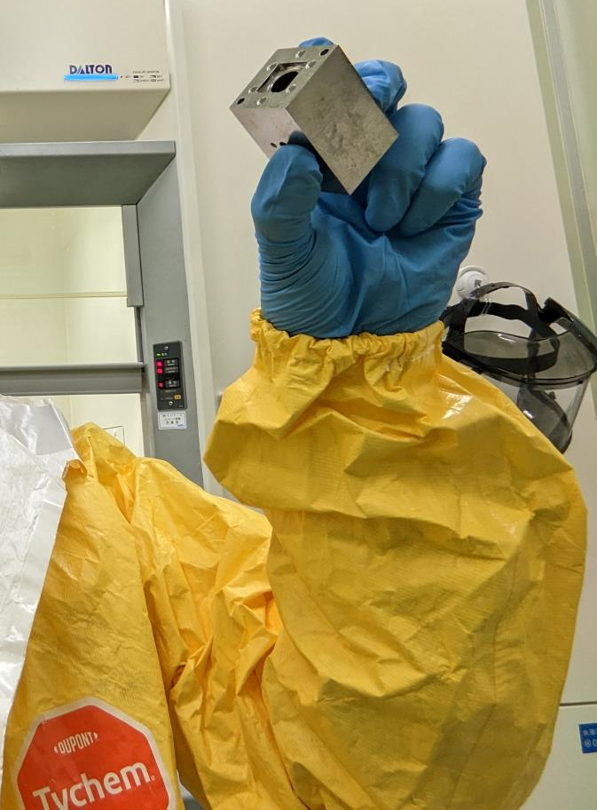
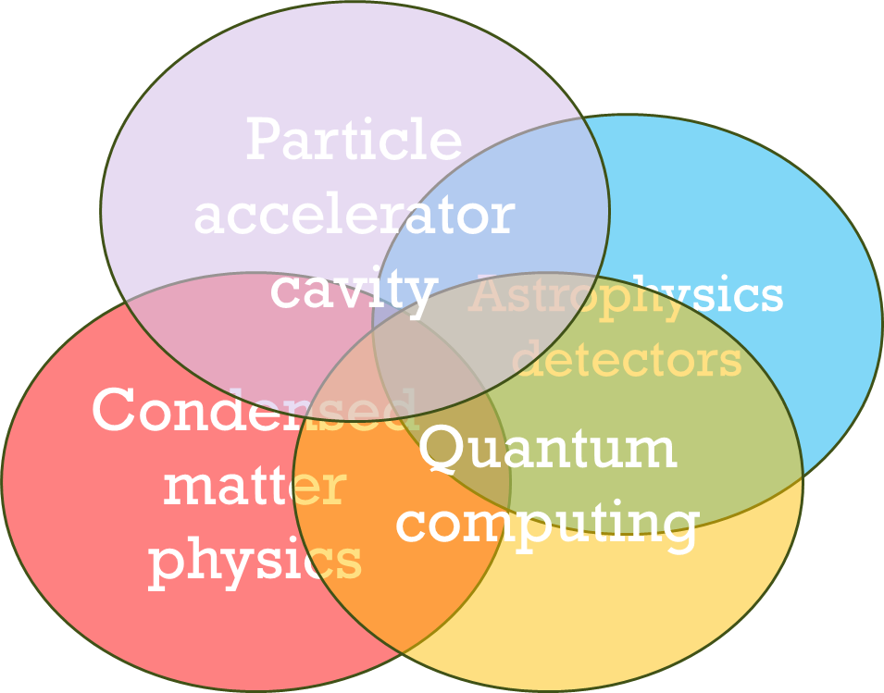
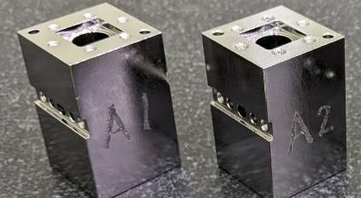
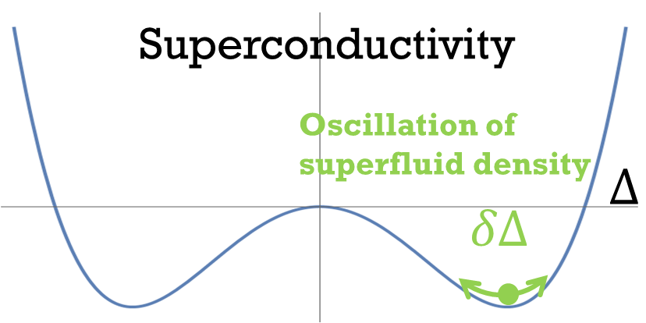
International Workshop on Intrinsic Josephson Junctions and Nanostructured Superconducting Physics (Dec. 6, 2025)
Superconducting Resonators: a Crossroads of
High-Energy Accelerators, Astrophysical Detectors,
Condensed Matter Theory, and Quantum Computing
High energy Accelerator Research Organization (KEK)
Innovation Center for Applied Superconducting Accelerators (iCASA)
Takayuki Kubo

Slide 2
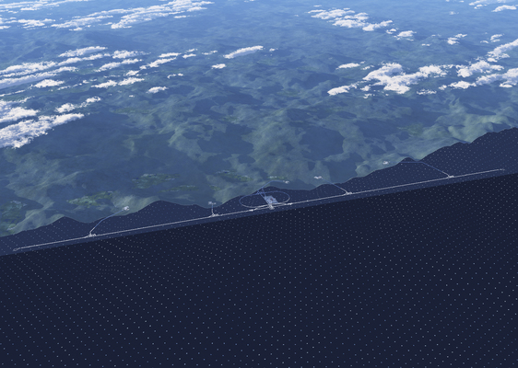
Here we use the International Linear Collider (ILC), an electron–positron Higgs factory, as an example, but the European X-ray Free-Electron Laser (European XFEL) in Germany and the Linac Coherent Light Source II (LCLS-II) at SLAC in California are also based on similar superconducting RF linac technology.
https://linearcollider.org/conditions-for-material-usage/

Slide 3
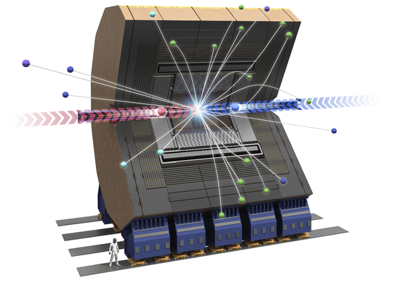
https://linearcollider.org/conditions-for-material-usage/

Slide 4
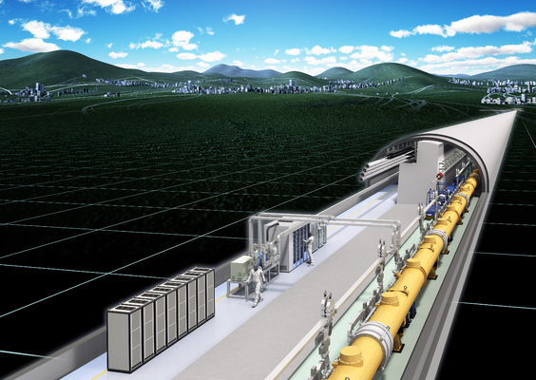
https://linearcollider.org/conditions-for-material-usage/

Slide 5
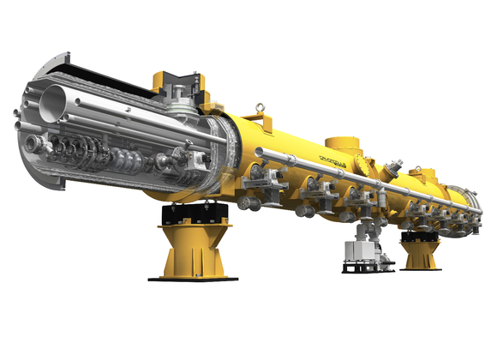
Cryomodule
https://linearcollider.org/conditions-for-material-usage/

Slide 6
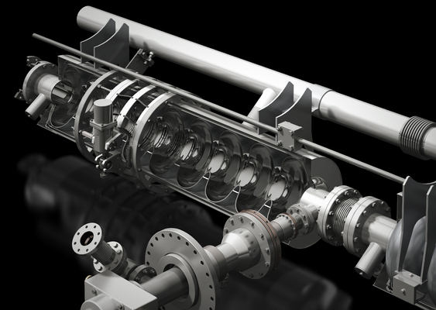

Cryomodule
$$T=2K$$
9-cell Nb Accelerator
Cavity (1.3 GHz)
https://linearcollider.org/conditions-for-material-usage/

Slide 7
Single-cell Nb accelerator cavity (1.3 GHz)
9-cell Nb Accelerator
Cavity (1.3 GHz)

Slide 8
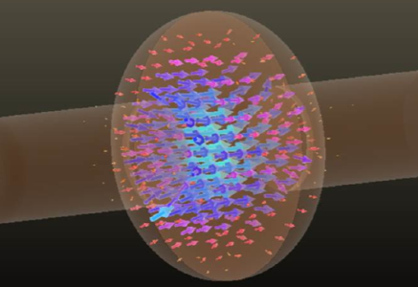

Electric field
distribution
$$E$$
Single-cell Nb accelerator cavity (1.3 GHz)

Slide 9
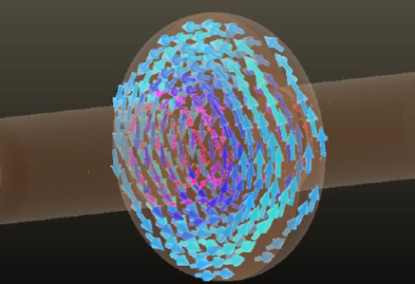

Electric field
distribution
Magnetic field
distribution
$$B$$
$$E$$
Single-cell Nb accelerator cavity (1.3 GHz)

Slide 10
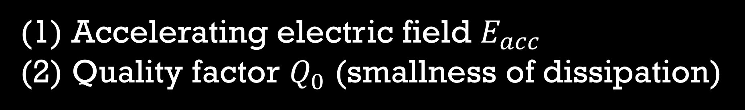
Electric field
distribution
Magnetic field
distribution
$$B$$
$$E$$
Single-cell Nb accelerator cavity (1.3 GHz)
There are two key performance metrics
Accelerating electric field $E_{acc}$
Quality factor $Q_{0}$ (smallness of dissipation)

Slide 11
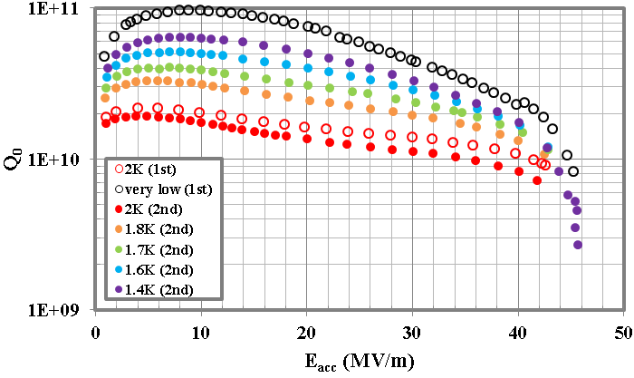
Electric field
distribution
Magnetic field
distribution
Nb
$$B$$
$$E$$
Single-cell Nb accelerator cavity (1.3 GHz)
T Kubo et al., IPAC2014, Dresden, Germany, WEPRI022, p.2519
https://doi.org/10.18429/JACoW-IPAC2014-WEPRI022
There are two key performance metrics
Accelerating electric field $E_{acc}$
Quality factor $Q_{0}$ (smallness of dissipation)

Slide 12
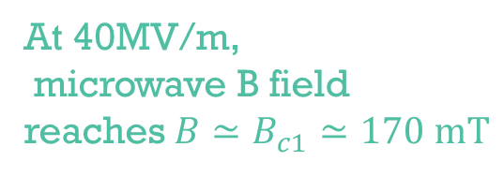
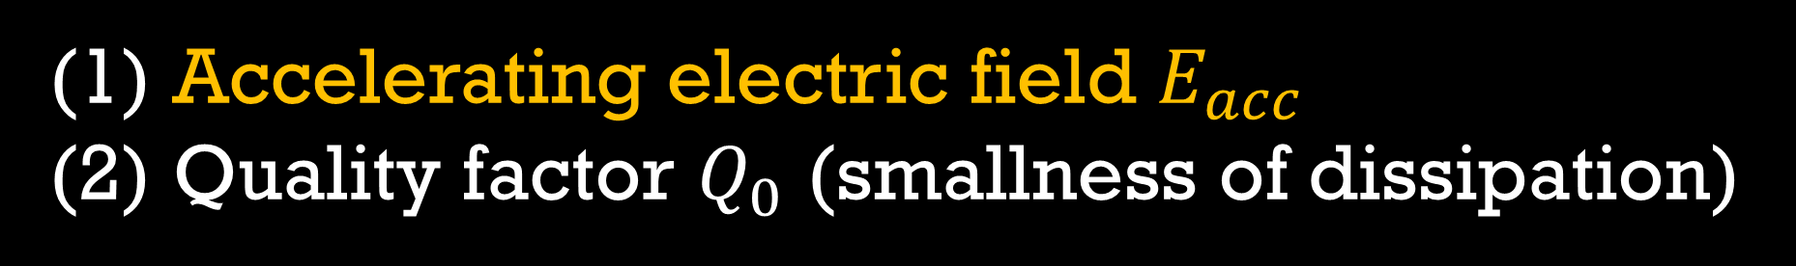
Electric field
distribution
Magnetic field
distribution
Nb
$$B$$
$$E$$
T Kubo et al., IPAC2014, Dresden, Germany, WEPRI022, p.2519
https://doi.org/10.18429/JACoW-IPAC2014-WEPRI022
There are two key performance metrics
At 40MV/m,
microwave B field
reaches $B≃B_{c1}≃170 mT$
Accelerating electric field $E_{acc}$
Quality factor $Q_{0}$ (smallness of dissipation)

Slide 13
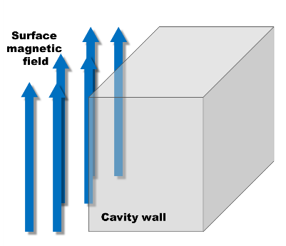
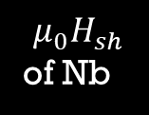



Electric field
distribution
Magnetic field
distribution
Nb
$$B$$
T Kubo et al., IPAC2014, Dresden, Germany, WEPRI022, p.2519
https://doi.org/10.18429/JACoW-IPAC2014-WEPRI022
Low field (Meissner state)
Note: Cavities are operated under the Meissner state
40
MV/m
50
MV/m
0 MV/m
20 MV/m
$$E_{acc}$$
0mT
85mT
170mT
210mT
$$μ_{0}H_{sh}$$
of Nb
$$B_{rf}$$
$≃μ_{0}H_{c1}$ of Nb
(⌐■_■) good

Slide 14
Electric field
distribution
Magnetic field
distribution
Nb
$$B$$
T Kubo et al., IPAC2014, Dresden, Germany, WEPRI022, p.2519
https://doi.org/10.18429/JACoW-IPAC2014-WEPRI022
Low field (Meissner state)
Note: Cavities are operated under the Meissner state
40
MV/m
50
MV/m
0 MV/m
20 MV/m
$$E_{acc}$$
0mT
85mT
170mT
210mT
$$μ_{0}H_{sh}$$
of Nb
$$B_{rf}$$
$≃μ_{0}H_{c1}$ of Nb
(⌐■_■) good

Slide 15
Electric field
distribution
Magnetic field
distribution
Nb
$$B$$
T Kubo et al., IPAC2014, Dresden, Germany, WEPRI022, p.2519
https://doi.org/10.18429/JACoW-IPAC2014-WEPRI022
Low field (Meissner state)
Note: Cavities are operated under the Meissner state
40
MV/m
50
MV/m
0 MV/m
20 MV/m
$$E_{acc}$$
0mT
85mT
170mT
210mT
$$μ_{0}H_{sh}$$
of Nb
$$B_{rf}$$
$≃μ_{0}H_{c1}$ of Nb
(⌐■_■) good

Slide 16
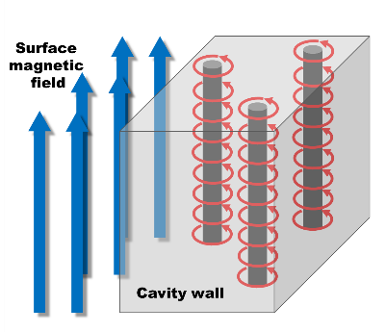
Electric field
distribution
Magnetic field
distribution
Nb
$$B$$
T Kubo et al., IPAC2014, Dresden, Germany, WEPRI022, p.2519
https://doi.org/10.18429/JACoW-IPAC2014-WEPRI022
High field (vortex state)
Note: Cavities are operated under the Meissner state
40
MV/m
50
MV/m
0 MV/m
20 MV/m
$$E_{acc}$$
0mT
85mT
170mT
210mT
$$μ_{0}H_{sh}$$
of Nb
$$B_{rf}$$
$≃μ_{0}H_{c1}$ of Nb
＼(^o^)／ｵﾜﾀ
I’m doomed

Slide 17
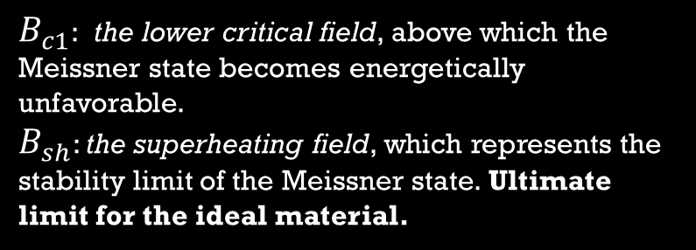

Electric field
distribution
Magnetic field
distribution
Nb
$$B$$
T Kubo et al., IPAC2014, Dresden, Germany, WEPRI022, p.2519
https://doi.org/10.18429/JACoW-IPAC2014-WEPRI022
Note: Cavities are operated under the Meissner state
$B_{c1}$:​ the lower critical field, above which the Meissner state becomes energetically unfavorable. $B_{sh}$: the superheating field, which represents the stability limit of the Meissner state. Ultimate limit for the ideal material.
40
MV/m
50
MV/m
0 MV/m
20 MV/m
$$E_{acc}$$
0mT
85mT
170mT
210mT
$$μ_{0}H_{sh}$$
of Nb
$$B_{rf}$$
$≃μ_{0}H_{c1}$ of Nb
G. Catelani and J. P. Sethna,
Phys. Rev. B 78, 224509 (2008)
F. Pei-Jen Lin and A. Gurevich,
Phys. Rev. B 85, 054513 (2012)
T. Kubo, Phys. Rev. Research 2, 033203 (2020)
T. Kubo, Supercond.Sci. Tecnol. 34, 045006 (2021)
$$B_{c1}≤B_{0}^{max}<B_{sh}$$

Slide 18

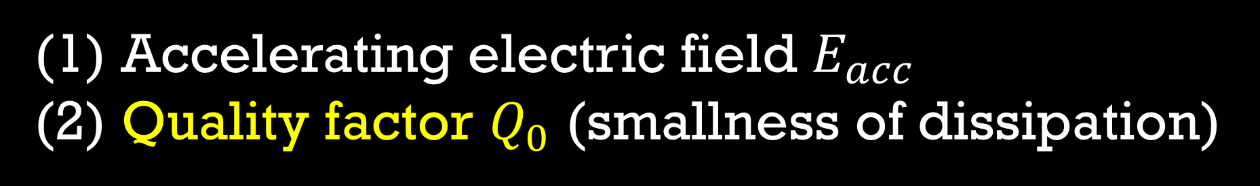
Electric field
distribution
Magnetic field
distribution
Nb
$$B$$
$$E$$
$$E$$
T Kubo et al., IPAC2014, Dresden, Germany, WEPRI022, p.2519
https://doi.org/10.18429/JACoW-IPAC2014-WEPRI022
There are two key performance metrics
Accelerating electric field $E_{acc}$
Quality factor $Q_{0}$ (smallness of dissipation)

Slide 19
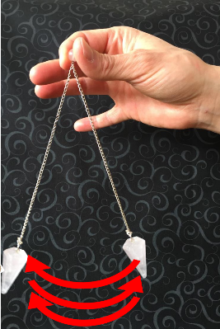
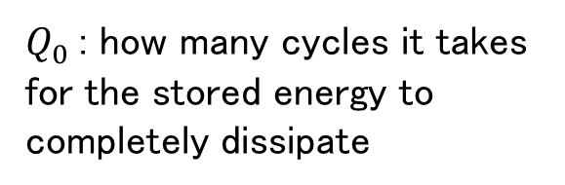

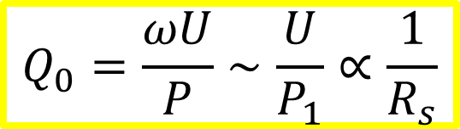
Electric field
distribution
Magnetic field
distribution
Nb
$$B$$
$$E$$
$$E$$
T Kubo et al., IPAC2014, Dresden, Germany, WEPRI022, p.2519
https://doi.org/10.18429/JACoW-IPAC2014-WEPRI022
There are two key performance metrics
$$Q_{0}=\frac{ωU}{P}∼\frac{U}{P_{1}}∝\frac{1}{R_{s}}$$
Accelerating electric field $E_{acc}$
Quality factor $Q_{0}$ (smallness of dissipation)
$P_{1}$ : dissipation per RF cycle
$Q_{0}$: how many cycles it takes for the stored energy to completely dissipate
This is the key parameter common to all superconducting resonators.

Slide 20
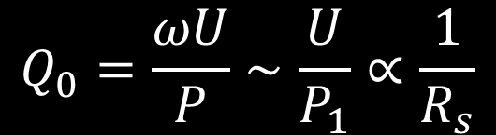
Overview of
energy dissipation mechanisms in superconducting resonators
$$Q_{0}=\frac{ωU}{P}∼\frac{U}{P_{1}}∝\frac{1}{R_{s}}$$
What are the causes of dissipation?

Slide 21
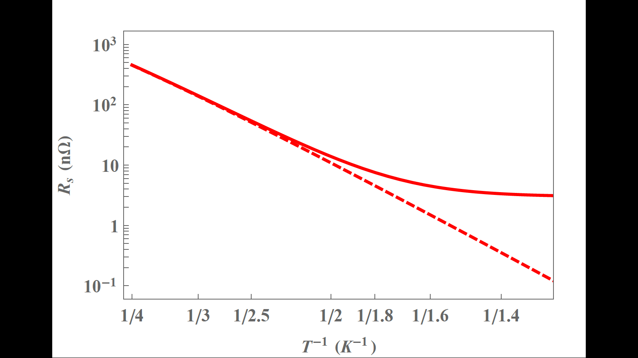
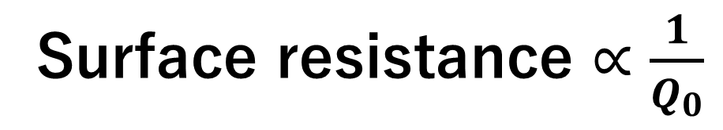
Surface resistance $∝\frac{1}{Q_{0}}$
e.g., bulk Nb
1.3GHz Nb cavity
Higher T
Lower T

Slide 22
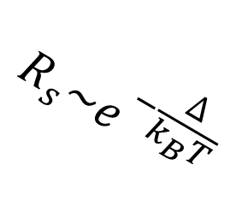
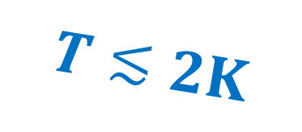

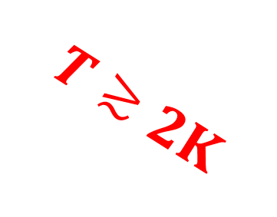
Surface resistance $∝\frac{1}{Q_{0}}$
e.g., bulk Nb
$$R_{s}\sim e^{−\frac{∆}{k_{B}T}}$$
$$T≳2K$$
$$T≲2K$$
$$R_{res}$$
1.3GHz Nb cavity
Higher T
Lower T

Slide 23
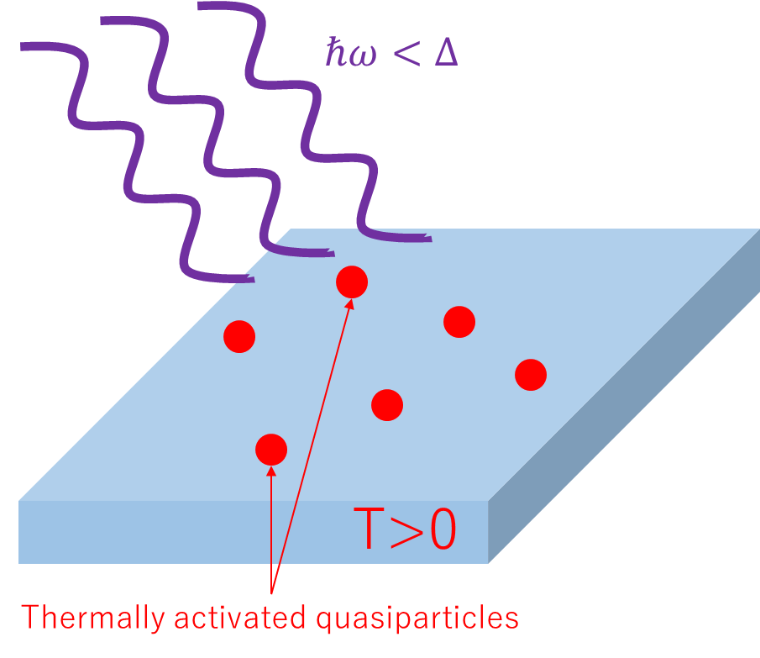
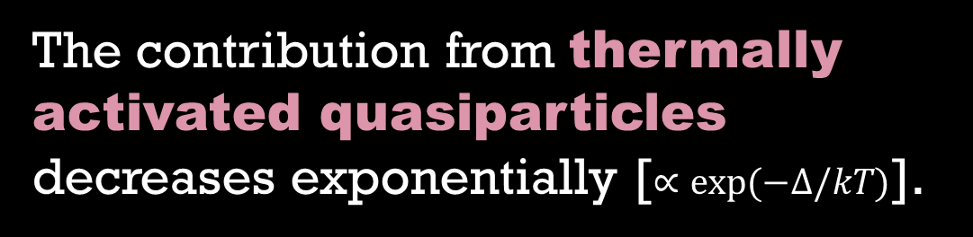
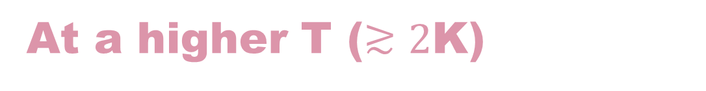
At a higher T ($≳2$K)
Surface resistance $∝\frac{1}{Q_{0}}$
e.g., bulk Nb
$$R_{s}\sim e^{−\frac{∆}{k_{B}T}}$$
$$T≳2K$$
1.3GHz Nb cavity
The contribution from thermally activated quasiparticles decreases exponentially [$∝exp⁡(−Δ/kT)$].
Higher T
Lower T

Slide 24
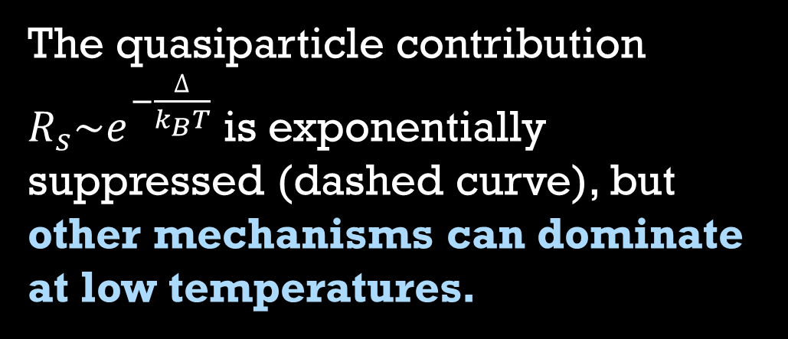
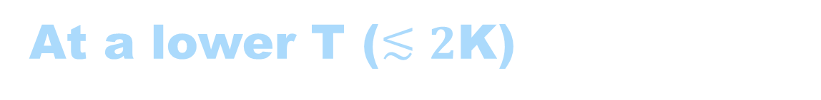
At a lower T ($≲2$K)
Surface resistance $∝\frac{1}{Q_{0}}$
The quasiparticle contribution $R_{s}\sim e^{−\frac{∆}{k_{B}T}}$ is exponentially suppressed (dashed curve), but other mechanisms can dominate at low temperatures.
$$T≲2K$$
$$R_{res}$$
1.3GHz Nb cavity
Higher T
Lower T

Slide 25
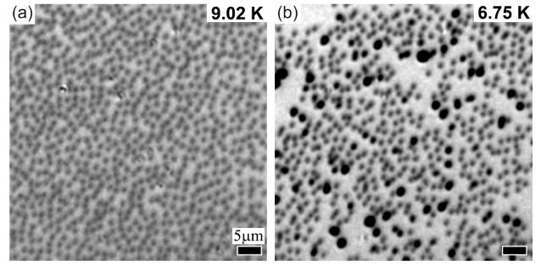
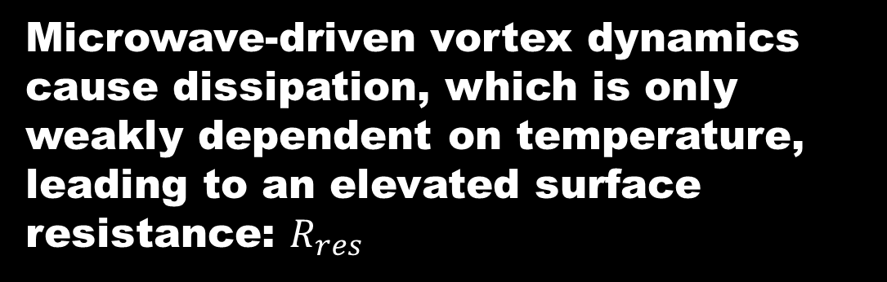
Dominant cause of $R_{res}$ in SRF cavities is
Vortices trapped during cool down
microwave
current
vortex
Vortex
current
Figures adapted from Ooi et al., PRB 111, 094519 (2025)
© American Physical Society.
Videos of vortex dynamics in cavity-grade Nb (RRR>300) can be found in Ooi et al., PRB 111, 094519 (2025)
See also,
A. Gurevich and G. Ciovati, PRB 87, 054502 (2013)
A. Romanenko et al., Appl. Phys. Lett. 105, 234103 (2014).
S. Huang eta al., Phys. Rev. Accelerators and Beams 19, 082001 (2016).
S. Posen et al., J. Appl. Phys. 119, 213903 (2016).
S. Ooi et al., Physical Review B 104, 064504 (2021).
S. Ooi et al., Physical Review B 111, 094519 (2025)
Microwave-driven vortex dynamics cause dissipation, which is only weakly dependent on temperature, leading to an elevated surface resistance: $R_{res}$

Slide 26
Two-level system defects
Vortices trapped during cool down
microwave
current
vortex
Tunneling
atom
Vortex
current
See also a review:
Müller et al Rep. Prog. Phys. 82, 124501 (2019)
See also,
A. Gurevich and G. Ciovati, PRB 87, 054502 (2013)
A. Romanenko et al., Appl. Phys. Lett. 105, 234103 (2014).
S. Huang eta al., Phys. Rev. Accelerators and Beams 19, 082001 (2016).
S. Posen et al., J. Appl. Phys. 119, 213903 (2016).
S. Ooi et al., Physical Review B 104, 064504 (2021).
S. Ooi et al., Physical Review B 111, 094519 (2025)

Slide 27
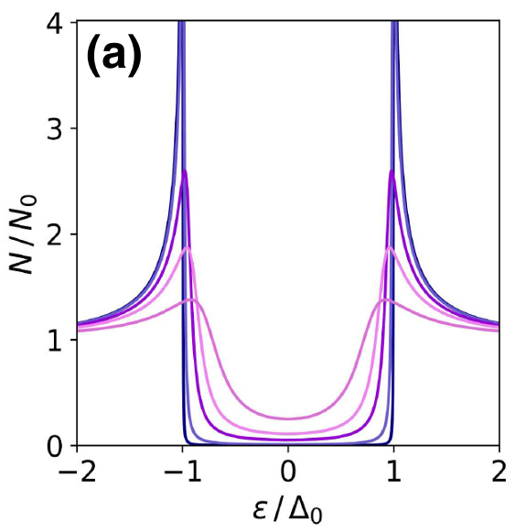
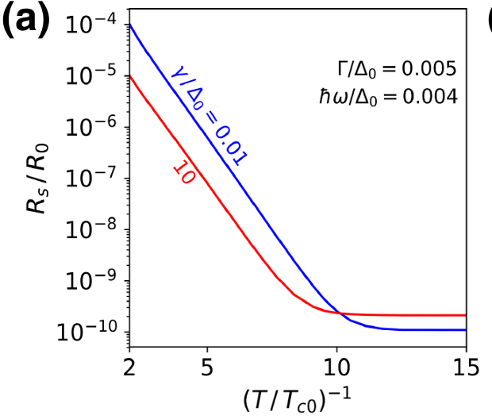
Two-level system defects
Vortices trapped during cool down
microwave
current
vortex
Tunneling
atom
Vortex
current
Subgap states
See also a review:
Müller et al Rep. Prog. Phys. 82, 124501 (2019)
See also,
A. Gurevich and G. Ciovati, PRB 87, 054502 (2013)
A. Romanenko et al., Appl. Phys. Lett. 105, 234103 (2014).
S. Huang eta al., Phys. Rev. Accelerators and Beams 19, 082001 (2016).
S. Posen et al., J. Appl. Phys. 119, 213903 (2016).
S. Ooi et al., Physical Review B 104, 064504 (2021).
S. Ooi et al., Physical Review B 111, 094519 (2025)
Long MFP
Short MFP
Figures adapted from T. Kubo, Physical Review Applied 17, 014018 (2022)
© American Physical Society.
See also, A Gurevich and T Kubo, Physical Review B 96, 184515 (2017)

Slide 28
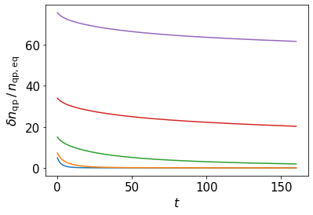


Two-level system defects
Vortices trapped during cool down
microwave
current
vortex
Tunneling
atom
Vortex
current
Subgap states
Nonequilibrium quasi particles and Nonequilibrium distribution function
See also a review:
Müller et al Rep. Prog. Phys. 82, 124501 (2019)
Long MFP
Short MFP
$$δh$$
Figures adapted from T. Kubo, Physical Review Applied 17, 014018 (2022)
© American Physical Society.
$$ε/Δ_{0}$$
See also, A Gurevich and T Kubo, Physical Review B 96, 184515 (2017)
T. Kubo (2020) not published
t/tau (tau ~ 0.2ns for Nb)

Slide 29
In such a seemingly complex situation,
how do accelerator researchers extract
high cavity performance?
The accelerator community can build
the best cavities on the planet — achieving $Q∼{10}^{11}$.
← This is not special but typical in accelerator experiments
T Kubo et al., In-house production of a large-grain single-cell cavity at cavity fabrication facility and results of performance tests, IPAC2014, Dresden, Germany, WEPRI022, p.2519
https://doi.org/10.18429/JACoW-IPAC2014-WEPRI022
ILC recipe

Slide 30
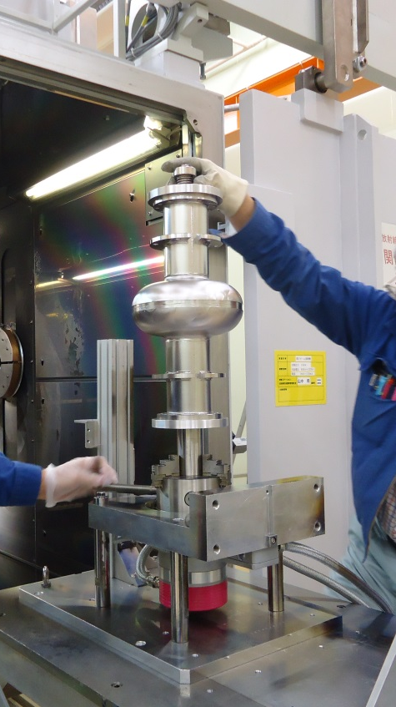
Nb cavity technology
for accelerators:
Classical ILC recipe as a representative example
2013 T. Kubo

Slide 31
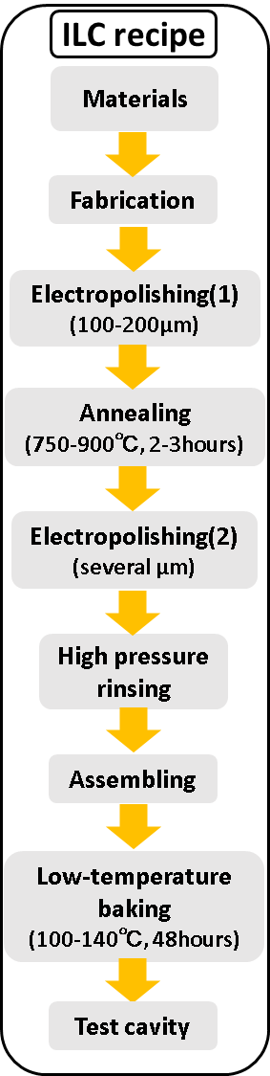
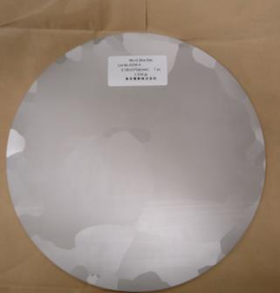
RRR>300
High purity Nb
270 mm

Slide 32
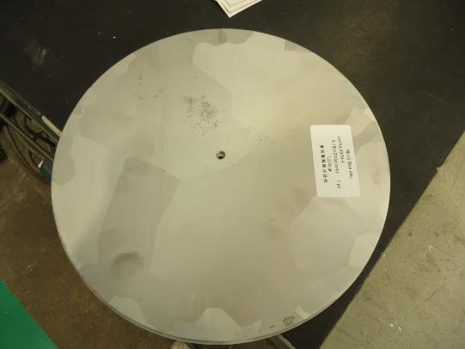
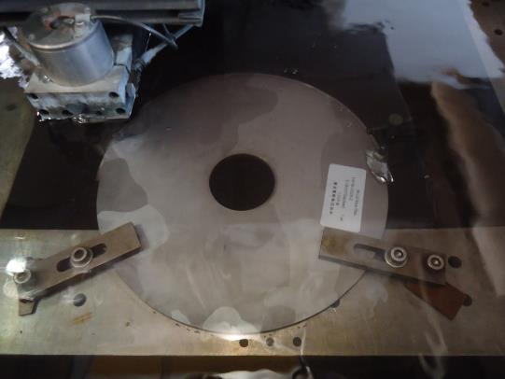
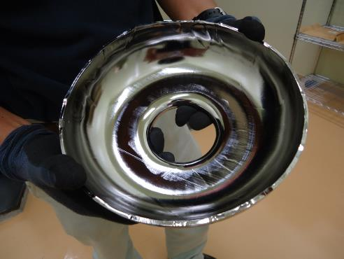
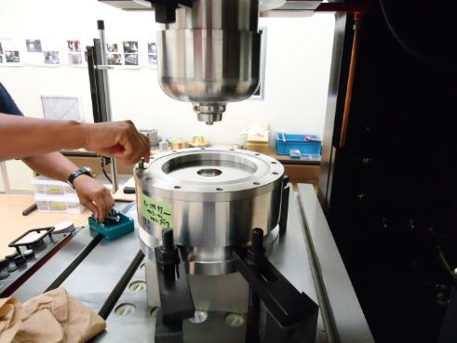
Let’s start fabrication.
Wire-EDM
(Electrical discharge machining)

Slide 33
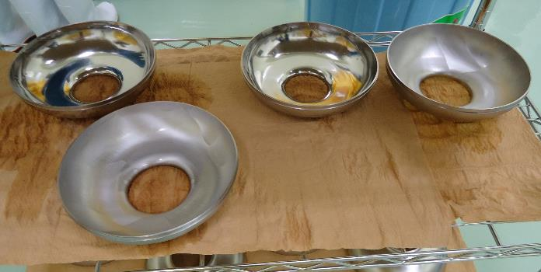

Half cells
Electron beam welding
Cavity material quality is maintained
Half cell + beam pipe

Slide 34



Electron gun
Inside the chamber

Slide 35

Electron gun
Electron beam

Slide 36

Electron beam

Slide 37




Electropolishing (EP)
The electrolyte is a mixture of (9:1) sulfuric acid and hydrofluoric acid (HF).
A DC voltage is applied with Nb as the anode and aluminum as the cathode.
Niobium is oxidized to form Nb₂O₅.
This oxide layer is dissolved and polished away by HF​ present in the electrolyte.

Slide 38

Electropolishing (EP)
The electrolyte is a mixture of (9:1) sulfuric acid and hydrofluoric acid (HF).
A DC voltage is applied with Nb as the anode and aluminum as the cathode.
Niobium is oxidized to form Nb₂O₅.
This oxide layer is dissolved and polished away by HF​ present in the electrolyte.

Slide 39


Annealing
To degas hydrogen — prevents hydrogen Q-disease (requires >700 ℃)
“Q-disease” due to niobium hydride
B. Aune et al.,
in proceedings of LINAC1990, Albuquerque, New Mexico, USA (1990)

Slide 40

Annealing
To degas hydrogen — prevents hydrogen Q-disease (requires >700 ℃)
To reduce pinning centers — minimizes trapped flux (requires ~900 ℃)
S. Posen et al., J. Appl. Phys. 119, 213903 (2016).
https://doi.org/10.1063/1.4953087
“Q-disease” due to niobium hydride
B. Aune et al.,
in proceedings of LINAC1990, Albuquerque, New Mexico, USA (1990)

Slide 41
A second EP step, removing only a few microns.

Slide 42



H. Sakai et al.,
Phys. Rev. Accel. Beams 22,022002 (2019)
https://doi.org/10.1103/PhysRevAccelBeams.22.022002
P. Bernard et al., In proceedings of EPAC1992, Berlin, Germany (1992)
Courtesy of Mathieu Omet (KEK)

Slide 43



120℃ー48h bake
L. Lilje et al., in Proceedings of SRF1999, Santa Fe, New Mexico, USA (1999), p. 74, TUA001.
Without baking
High field
Q-drop
With
baking
Courtesy of Mathieu Omet (KEK)
Spatial variation of the mean free path on the scale of the penetration depth suppresses the surface current, thereby increasing the maximum achievable field.
T. Kubo, Supercond. Sci. and Technol. 30, 023001 (2017); Sci. and Technol. 34, 045006 (2021)
V. Ngampruetikorn and J. A. Sauls, Phys. Rev. Research 1, 012015(R) (2019)

Slide 44
120℃ー48h bake
L. Lilje et al., in Proceedings of SRF1999, Santa Fe, New Mexico, USA (1999), p. 74, TUA001.
Without baking
Labs in Japan and the US traditionally applied a 100℃ bake to remove residual water after high-pressure rinsing. In contrast, labs in Germany and France did not adopt this step — and continued to suffer from the so-called Q-drop.
At the time, the reason was unknown, and the phenomenon was even nicknamed the "European disease.“ It wasn’t until the late 1990s that the community realized the low-temperature bake was the key. This is a prime example of the serendipitous discoveries that have accumulated over the past few decades.
High field
Q-drop
With
baking
Courtesy of Mathieu Omet (KEK)
Spatial variation of the mean free path on the scale of the penetration depth suppresses the surface current, thereby increasing the maximum achievable field.
T. Kubo, Supercond. Sci. and Technol. 30, 023001 (2017); Sci. and Technol. 34, 045006 (2021)
V. Ngampruetikorn and J. A. Sauls, Phys. Rev. Research 1, 012015(R) (2019)

Slide 45



Slide 46
T Kubo et al., IPAC2014, Dresden, Germany, WEPRI022, p.2519
https://doi.org/10.18429/JACoW-IPAC2014-WEPRI022

Slide 47


Many modern recipes exist: N-doping, N-infusion, two-step bake, mid-T bakes, etc. They are all variants of the classical recipe, with some steps replaced or modified.
Mid-T bake
Mid-T bake
T=2K
2K
2K
ILC recipe
T Kubo et al., In-house production of a large-grain single-cell cavity at cavity fabrication facility and results of performance tests, IPAC2014, Dresden, Germany, WEPRI022, p.2519
https://doi.org/10.18429/JACoW-IPAC2014-WEPRI022
S. Posen et al., Ultralow Surface Resistance via Vacuum Heat Treatment of Superconducting Radio-Frequency Cavities,
Phys. Rev. Applied 13, 014024 (2020)
https://doi.org/10.1103/PhysRevApplied.13.014024
H. Ito et al., Influence of furnace baking on Q–E behavior of superconducting accelerating cavities,
Prog. Theor. Exp. Phys. 2021, 071G01 (2021)
https://doi.org/10.1093/ptep/ptab056

Slide 48

The accelerator community can build
the best cavities on the planet — achieving $Q>{10}^{11}$.
Mid-T bake
Mid-T bake
T=2K
2K
ILC recipe
T Kubo et al., In-house production of a large-grain single-cell cavity at cavity fabrication facility and results of performance tests, IPAC2014, Dresden, Germany, WEPRI022, p.2519
https://doi.org/10.18429/JACoW-IPAC2014-WEPRI022
S. Posen et al., Ultralow Surface Resistance via Vacuum Heat Treatment of Superconducting Radio-Frequency Cavities,
Phys. Rev. Applied 13, 014024 (2020)
https://doi.org/10.1103/PhysRevApplied.13.014024
H. Ito et al., Influence of furnace baking on Q–E behavior of superconducting accelerating cavities,
Prog. Theor. Exp. Phys. 2021, 071G01 (2021)
https://doi.org/10.1093/ptep/ptab056
So why not make use of this technology
in other applications?

Slide 49

Quantum applications
Quantum memory cavity
for quantum computing
Accelerator cavity
Brock et al., Nature 641, 612 (2025)
https://doi.org/10.1038/s41586-025-08899-y

Slide 50






High-Q superconducting cavities allow us to store quantum information redundantly, enabling bosonic error correction.
Brock et al., Nature 641, 612 (2025)
https://doi.org/10.1038/s41586-025-08899-y
Known to reduce the required number of qubits by one to two orders of magnitude.
e.g. binomial code
$${\left.|0\right\rangle }_{L}=\frac{|\left.0\right\rangle +\sqrt{3} |\left.6\right\rangle }{2}$$
$$\left.|5\right\rangle$$
$$\left.|4\right\rangle$$
1 photon loss
1 photon loss
$${\left.|1\right\rangle }_{L}=\frac{\sqrt{3}|\left.3\right\rangle +|\left.9\right\rangle }{2}$$
$$\frac{|\left.2\right\rangle +|\left.8\right\rangle }{\sqrt{2}}$$
$$\frac{|\left.1\right\rangle +2|\left.7\right\rangle }{\sqrt{3}}$$
correct
a remainder of 2
when divided by 3
a remainder of 1
when divided by 3
correct

Slide 51

3D coaxial cavity progress
Brock et al., Nature 641, 612 (2025)
https://doi.org/10.1038/s41586-025-08899-y
Yale University
Reagor et al., Phys. Rev. B 94, 014506 (2016)
Aluminum,
$Q=7×{10}^{7}$ (single photon level)

Slide 52

3D coaxial cavity progress
Brock et al., Nature 641, 612 (2025)
https://doi.org/10.1038/s41586-025-08899-y
Yale University
Reagor et al., Phys. Rev. B 94, 014506 (2016)
Aluminum,
$Q=7×{10}^{7}$ (single photon level)
Heidler et al., Phys. Rev. Applied 16, 034024 (2021)
Niobium (1:1:1 buffered chemical polishing at 0-5℃),
$Q=5×{10}^{8}$ (single photon level)
University of Innsbruck

Slide 53

3D coaxial cavity progress
Brock et al., Nature 641, 612 (2025)
https://doi.org/10.1038/s41586-025-08899-y
Yale University
Reagor et al., Phys. Rev. B 94, 014506 (2016)
Aluminum,
$Q=7×{10}^{7}$ (single photon level)
Heidler et al., Phys. Rev. Applied 16, 034024 (2021)
Niobium (1:1:1 buffered chemical polishing at 0-5℃),
$Q=5×{10}^{8}$ (single photon level)
Oriani et al., Phys. Rev. Applied 24, 044080 (2025)
Niobium (1:1:2 water buffered chemical polishing below 10℃),
$Q=1.4×{10}^{9}$ (single photon level)
University of Innsbruck
University of Chicago
↑
The world record (as of 2024)

Slide 54
Why don't we give it a shot?
cavity→
T. Kubo
↓

Slide 55


Why don't we give it a shot?
T. Takenaka, T. Kubo et al.,
arXiv:2510.01819.
Nb coaxial cavity of KEK-NTT collaboration
cavity→
T. Kubo
↓

Slide 56

Why don't we give it a shot?
T. Takenaka, T. Kubo et al.,
arXiv:2510.01819.
Nb coaxial cavity of KEK-NTT collaboration
cavity→
T. Kubo
↓
20mK & Single photon level
We broke
the world record!!!→
Corresponding to
photon lifetime of
~0.1 sec.
T. Takenaka, T. Kubo et al.,
arXiv:2510.01819.

Slide 57

3D coaxial cavity progress
Brock et al., Nature 641, 612 (2025)
https://doi.org/10.1038/s41586-025-08899-y
Yale University
Reagor et al., Phys. Rev. B 94, 014506 (2016)
Aluminum,
$Q=7×{10}^{7}$ (single photon level)
Heidler et al., Phys. Rev. Applied 16, 034024 (2021)
Niobium (1:1:1 buffered chemical polishing at 0-5℃),
$Q=5×{10}^{8}$ (single photon level)
Oriani et al., Phys. Rev. Applied 24, 044080 (2025)
Niobium (1:1:2 water buffered chemical polishing below 10℃),
$Q=1.4×{10}^{9}$ (single photon level)
T. Takenaka, T. Kubo et al., arXiv:2510.01819 (2025)
Niobium (1:1:1 BCP at 25℃ + 900℃ anneal
+ 1:1:1 BCP flush at 25℃ + 600℃ anneal)
Q=3×10⁹ (single photon level)
University of Innsbruck
University of Chicago
KEK&NTT
T. Takenaka, T. Kubo et al.,
arXiv:2510.01819.
The world record

Slide 58

Understanding more about physics of Q factor

Slide 59


Dissipation mainly comes from thermally excited quasiparticles at $T≳2 K$
$$T=2 K$$
Thermally excited
quasiparticles dominate
T Kubo et al., In-house production of a large-grain single-cell cavity at cavity fabrication facility and results of performance tests, IPAC2014, Dresden, Germany, WEPRI022, p.2519
https://doi.org/10.18429/JACoW-IPAC2014-WEPRI022

Slide 60



$$T<1.6 K$$
Dissipation mainly comes from thermally excited quasiparticles at $T≳2 K$
and
some others at $T≲2 K$
$$T=2 K$$
Thermally excited
quasiparticles dominate
T Kubo et al., In-house production of a large-grain single-cell cavity at cavity fabrication facility and results of performance tests, IPAC2014, Dresden, Germany, WEPRI022, p.2519
https://doi.org/10.18429/JACoW-IPAC2014-WEPRI022

Slide 61





TLS model explains low-T and low-E_{acc} nonlinear Q evolution.
$$T<1.6 K$$
$$T=1.5−1.6 K$$
$$T=2 K$$
Thermally excited
quasiparticles dominate
A. Romanenko and D. I. Schuster, Understanding Quality Factor Degradation in Superconducting Niobium Cavities at Low Microwave Field Amplitudes, Phys. Rev. Lett. 119, 264801 (2017)
https://doi.org/10.1103/PhysRevLett.119.264801
T Kubo et al., In-house production of a large-grain single-cell cavity at cavity fabrication facility and results of performance tests, IPAC2014, Dresden, Germany, WEPRI022, p.2519
https://doi.org/10.18429/JACoW-IPAC2014-WEPRI022

Slide 62


TLS model explains low-T and low-E_{acc} nonlinear Q evolution.
$$T<1.6 K$$
The same is true for the quantum regime
($T≃20$ mK and a tiny photon number)
$$T=2 K$$
TLS fit
Thermally excited
quasiparticles dominate
T. Takenaka, T. Kubo et al., arXiv:2510.01819.
https://doi.org/10.48550/arXiv.2510.01819
T Kubo et al., In-house production of a large-grain single-cell cavity at cavity fabrication facility and results of performance tests, IPAC2014, Dresden, Germany, WEPRI022, p.2519
https://doi.org/10.18429/JACoW-IPAC2014-WEPRI022

Slide 63


What about the dissipation mechanisms inherent to superconductors?
$$T<1.6 K$$
$$T=2 K$$
Thermally excited
quasiparticles dominate
T Kubo et al., In-house production of a large-grain single-cell cavity at cavity fabrication facility and results of performance tests, IPAC2014, Dresden, Germany, WEPRI022, p.2519
https://doi.org/10.18429/JACoW-IPAC2014-WEPRI022

Slide 64



What about the dissipation mechanisms inherent to superconductors?
$$T<1.6 K$$
1.3GHz
$$∝1/Q$$
$$T=2 K$$
Thermally excited
quasiparticles dominate
$$∝E_{acc}$$
M. Martinello et al., Phys. Rev. Lett. 121, 224801 (2018)
DOI: https://doi.org/10.1103/PhysRevLett.121.224801
T Kubo et al., In-house production of a large-grain single-cell cavity at cavity fabrication facility and results of performance tests, IPAC2014, Dresden, Germany, WEPRI022, p.2519
https://doi.org/10.18429/JACoW-IPAC2014-WEPRI022

Slide 65


Temperature
$$T_{c}$$
Mean
free
path
0
$$ξ_{0}$$

Slide 66

Temperature
$$T_{c}$$
Ginzburg-Landau ($T≃T_{c}$)
Mean
free
path
0
$$ξ_{0}$$

Slide 67
Temperature
$$T_{c}$$
Ginzburg-Landau ($T≃T_{c}$)
Eilenberger
Formalism
Applicable to
Any temperature
Any mean free path
Mean
free
path
0
$$ξ_{0}$$

Slide 68

Temperature
$$T_{c}$$
Ginzburg-Landau ($T≃T_{c}$)
Usadel
Formalism
Applicable to
Any temperature
$$mfp<ξ_{0}$$
Eilenberger
Formalism
Applicable to
Any temperature
Any mean free path
Mean
free
path
0
$$ξ_{0}$$

Slide 69

Under the ac field
Thermal Equilibrium
Driving force of
Nonequilibrium
Dynamics
(e.g, strength of microwave)

Slide 70
Under the ac field
Thermal Equilibrium
Linear response
regime
Driving force of
Nonequilibrium
Dynamics
(e.g, strength of microwave)

Slide 71
Under the ac field
Mattis-Bardeen
Theory
Thermal Equilibrium
Linear response
regime
Driving force of
Nonequilibrium
Dynamics
(e.g, strength of microwave)

Slide 72
Under the ac field
Mattis-Bardeen
Theory
Thermal Equilibrium
Nonlinear response
Regime
Linear response
regime
Driving force of
Nonequilibrium
Dynamics
(e.g, strength of microwave)

Slide 73
Under the ac field
Unfortunately, this is
the SRF accelerator regime
Mattis-Bardeen
Theory
Thermal Equilibrium
Nonlinear response
Regime
Linear response
regime
Driving force of
Nonequilibrium
Dynamics
(e.g, strength of microwave)

Slide 74
Under the ac field
Unfortunately, this is
the SRF accelerator regime
Mattis-Bardeen
Theory
Thermal Equilibrium
Nonlinear response
Regime
Linear response
regime
Keldysh
Eilenberger
Driving force of
Nonequilibrium
Dynamics
(e.g, strength of microwave)

Slide 75
Under the ac field
Unfortunately, this is
the SRF accelerator regime
Mattis-Bardeen
Theory
Thermal Equilibrium
Nonlinear response
Regime
Linear response
regime
Keldysh
Eilenberger
Driving force of
Nonequilibrium
Dynamics
(e.g, strength of microwave)

Slide 76
Under the ac field
Unfortunately, this is
the SRF accelerator regime
Mattis-Bardeen
Theory
Thermal Equilibrium
Nonlinear response
Regime
Linear response
regime
Keldysh
Eilenberger
Driving force of
Nonequilibrium
Dynamics
(e.g, strength of microwave)

Slide 77
Under the ac field
Unfortunately, this is
the SRF accelerator regime
Mattis-Bardeen
Theory
Thermal Equilibrium
Nonlinear response
Regime
Linear response
regime
Keldysh
Eilenberger
Keldysh-Usadel
Driving force of
Nonequilibrium
Dynamics
(e.g, strength of microwave)

Slide 78
Under the ac field
Unfortunately, this is
the SRF accelerator regime
Mattis-Bardeen
Theory
Thermal Equilibrium
Nonlinear response
Regime
Linear response
regime
Keldysh
Eilenberger
Keldysh-Usadel
Driving force of
Nonequilibrium
Dynamics
(e.g, strength of microwave)

Slide 79
Under the ac field
Unfortunately, this is
the SRF accelerator regime
Mattis-Bardeen
Theory
Thermal Equilibrium
Nonlinear response
Regime
Linear response
regime
Keldysh
Eilenberger
Keldysh-Usadel
Driving force of
Nonequilibrium
Dynamics
(e.g, strength of microwave)

Slide 81

The SRF accelerator regime
Linear response
regime
Nonlinear response
Regime
Thermal Equilibrium
Keldysh
Eilenberger
Keldysh-Usadel
Nonequilibrium
Dynamics
(e.g, strength of microwave)

Slide 82
Let us start from
the linear response
Linear response
regime
Thermal Equilibrium
Keldysh
Eilenberger
Keldysh-Usadel
Nonequilibrium
Dynamics
(e.g, strength of microwave)

Slide 83
Start from the Keldysh-Eilenberger equations (a set of equations for Green‘s functions and pair potential $Δ$)
D. Rainer and J. A. Sauls,
Strong coupling theory of superconductivity, in Superconductivity: From Basic Physics to the Latest Developments, edited by P. N. Butcher and Y. Lu (World Scientic, Singapore, 1995), p. 45.

Slide 84



Start from the Keldysh-Eilenberger equations (a set of equations for Green‘s functions and pair potential $Δ$)
D. Rainer and J. A. Sauls,
Strong coupling theory of superconductivity, in Superconductivity: From Basic Physics to the Latest Developments, edited by P. N. Butcher and Y. Lu (World Scientic, Singapore, 1995), p. 45.
We apply a small ac electromagnetic field and calculate the first-order perturbation to the current.
$$J∼A×●∼$$
Some
factor
$$A$$

Slide 85


Start from the Keldysh-Eilenberger equations (a set of equations for Green‘s functions and pair potential $Δ$)
D. Rainer and J. A. Sauls,
Strong coupling theory of superconductivity, in Superconductivity: From Basic Physics to the Latest Developments, edited by P. N. Butcher and Y. Lu (World Scientic, Singapore, 1995), p. 45.
We apply a small ac electromagnetic field and calculate the first-order perturbation to the current.
$$J∼A×●∼$$
Some
factor
$$A$$
Then,
the complex conductivity is given by
Some
factor
$$A$$
$$σ=\frac{J}{E}∼\frac{ }{A}$$

Slide 86


Complex conductivity formula for arbitrary MFP (for $λ≫ξ$)
W. Zimmermann, E. Brandt, M. Bauer, E. Seider, and L. Genzel, Optical conductivity of BCS superconductors with arbitrary purity, Physica C 183, 99 (1991).
D. Rainer and J. A. Sauls, Strong coupling theory of superconductivity, in Superconductivity: From Basic Physics to the Latest Developments, edited by P. N. Butcher and Y. Lu (World Scientic, Singapore, 1995), p. 45.
T. Kubo, Effects of Nonmagnetic Impurities and Subgap States on the Kinetic Inductance, Complex Conductivity, Quality Factor, and Depairing Current Density, Physical Review Applied 17, 014018 (2022)

Slide 87




Complex conductivity formula for arbitrary MFP (for $λ≫ξ$)
W. Zimmermann, E. Brandt, M. Bauer, E. Seider, and L. Genzel, Optical conductivity of BCS superconductors with arbitrary purity, Physica C 183, 99 (1991).
D. Rainer and J. A. Sauls, Strong coupling theory of superconductivity, in Superconductivity: From Basic Physics to the Latest Developments, edited by P. N. Butcher and Y. Lu (World Scientic, Singapore, 1995), p. 45.
T. Kubo, Effects of Nonmagnetic Impurities and Subgap States on the Kinetic Inductance, Complex Conductivity, Quality Factor, and Depairing Current Density, Physical Review Applied 17, 014018 (2022)
In the dirty limit
($mfp≪ξ_{0}$)
The well-known
dirty-limit Mattis-Bardeen formula
$$ε^{′}≔ε+ℏω$$

Slide 88
Leading order
nonlinear
correction
Linear response
regime
Thermal Equilibrium
Keldysh
Eilenberger
Keldysh-Usadel
Nonequilibrium
Dynamics
(e.g, strength of microwave)

Slide 89



Keldysh–Usadel Equation for SC under a strong ac field
arXiv:2509.09766
To be published in Phys. Rev. Applied https://doi.org/10.1103/8fh8-nknj
We solve these equations to obtain the nonequilibrium corrections ($δ{\hat{g}}^{R, A, K}$ and $δΔ$).

Slide 90




Keldysh–Usadel Equation for SC under a strong ac field
arXiv:2509.09766
To be published in Phys. Rev. Applied https://doi.org/10.1103/8fh8-nknj
We solve these equations to obtain the nonequilibrium corrections ($δ{\hat{g}}^{R, A, K}$ and $δΔ$).
To obtain the current response,
we substitute the solutions ($δ{\hat{g}}^{R, A, K}$, $δΔ$) into
← Linear response
← Nonlinear correction of $𝒪(A^{3})$

Slide 91

Schematically, the results can be illustrated as
$$J∼Agg+Agδg$$
Linear
response
Nonlinear corrections
← Linear response
← Nonlinear correction of $𝒪(A^{3})$

Slide 92
Schematically, the results can be illustrated as
$$J∼Agg+Agδg$$
Linear
response
Nonlinear corrections
← Linear response
← Nonlinear correction of $𝒪(A^{3})$

Slide 93

Schematically, the results can be illustrated as
$$J∼Agg+Agδg$$
Linear
response
Nonlinear corrections

Slide 94

Schematically, the results can be illustrated as
$$J∼Agg+Agδg$$
$δg∼A^{2}+δΔ$ and $δΔ∼Ψ$ $A^{2}$
Linear
response
Nonlinear corrections

Slide 95



Schematically, the results can be illustrated as
$$J∼Agg+Agδg$$
$δg∼A^{2}+δΔ$ and $δΔ∼Ψ$ $A^{2}$
Linear
response
Nonlinear corrections
$$+$$
Contribution mediated
by the nonequilibrium
pair-potential variation
AAA contribution

Slide 96


Schematically, the results can be illustrated as
$$J∼Agg+Agδg$$
$δg∼A^{2}+δΔ$ and $δΔ∼Ψ$ $A^{2}$
Linear
response
Nonlinear corrections
$$+$$
Contribution mediated
by the nonequilibrium
pair-potential variation
AAA contribution
Note: This theory automatically includes
the Eliashberg effect (microwave-induced gap enhancement) as well as the Higgs-mode contribution.
Time averaged $δΔ$:
Eliashberg effect
Time dependent $δΔ$:
Higgs

Slide 97
Eliashberg effect?
Higgs?

Slide 98

Eliashberg effect?
Higgs?
The variation of order parameter $δΔ$ does not appear in standard linear-response theories such as Mattis–Bardeen theory because $δΔ$ is an $𝒪\left(A^{2}\right)$ effect, but it does emerge in nonlinear response.
$$δΔ∝A_{0}^{2}\cos^{2}{ωt}$$

Slide 99

Eliashberg effect?
Higgs?
The variation of order parameter $δΔ$ does not appear in standard linear-response theories such as Mattis–Bardeen theory because $δΔ$ is an $𝒪\left(A^{2}\right)$ effect, but it does emerge in nonlinear response.
$$δΔ∝A_{0}^{2}\cos^{2}{ωt}$$
$$∝1+\cos{2ωt}$$

Slide 100
Eliashberg effect?
Higgs?
The variation of order parameter $δΔ$ does not appear in standard linear-response theories such as Mattis–Bardeen theory because $δΔ$ is an $𝒪\left(A^{2}\right)$ effect, but it does emerge in nonlinear response.
$$δΔ∝A_{0}^{2}\cos^{2}{ωt}$$
$$∝1+\cos{2ωt}$$
Time-averaged nonequilibrium gap variation

Slide 101
Eliashberg effect?
Higgs?
The variation of order parameter $δΔ$ does not appear in standard linear-response theories such as Mattis–Bardeen theory because $δΔ$ is an $𝒪\left(A^{2}\right)$ effect, but it does emerge in nonlinear response.
$$δΔ∝A_{0}^{2}\cos^{2}{ωt}$$
$$∝1+\cos{2ωt}$$
Time-averaged nonequilibrium gap variation
Time dependent nonequilibrium gap variation

Slide 102

Eliashberg effect?
Higgs?
The variation of order parameter $δΔ$ does not appear in standard linear-response theories such as Mattis–Bardeen theory because $δΔ$ is an $𝒪\left(A^{2}\right)$ effect, but it does emerge in nonlinear response.
$$δΔ∝A_{0}^{2}\cos^{2}{ωt}$$
$$∝1+\cos{2ωt}$$
Time-averaged nonequilibrium gap variation
Time dependent nonequilibrium gap variation
qausiparticles
$$Δ$$

Slide 103


Eliashberg effect?
Higgs?
The variation of order parameter $δΔ$ does not appear in standard linear-response theories such as Mattis–Bardeen theory because $δΔ$ is an $𝒪\left(A^{2}\right)$ effect, but it does emerge in nonlinear response.
$$δΔ∝A_{0}^{2}\cos^{2}{ωt}$$
$$∝1+\cos{2ωt}$$
Time-averaged nonequilibrium gap variation
Time dependent nonequilibrium gap variation
qausiparticles
$$δΔ$$
Microwave induced
gap enhancement
$$Δ$$
$$Δ$$

Slide 104

Eliashberg effect?
Higgs?
The variation of order parameter $δΔ$ does not appear in standard linear-response theories such as Mattis–Bardeen theory because $δΔ$ is an $𝒪\left(A^{2}\right)$ effect, but it does emerge in nonlinear response.
$$δΔ∝A_{0}^{2}\cos^{2}{ωt}$$
$$∝1+\cos{2ωt}$$
Time-averaged nonequilibrium gap variation
Time dependent nonequilibrium gap variation
$$δΔ$$
Microwave induced
gap enhancement
$$Δ$$
$$Δ$$

Slide 105

Nonlinear correction
arXiv:2509.09766
To be published in Phys. Rev. Applied https://doi.org/10.1103/8fh8-nknj

Slide 106



Nonlinear correction
arXiv:2509.09766
To be published in Phys. Rev. Applied https://doi.org/10.1103/8fh8-nknj

Slide 107




Nonlinear correction
arXiv:2509.09766
To be published in Phys. Rev. Applied https://doi.org/10.1103/8fh8-nknj
Higgs
Contribution:
Time dependent $δΔ$
Eliashberg
Contribution:
Time averaged $δΔ$

Slide 108

Results
arXiv:2509.09766
To be published in Phys. Rev. Applied https://doi.org/10.1103/8fh8-nknj

Slide 109
Results
The resonance peak at Δ
comes from the Higgs mode
arXiv:2509.09766
To be published in Phys. Rev. Applied https://doi.org/10.1103/8fh8-nknj

Slide 110

Results
The resonance peak at Δ
comes from the Higgs mode
At lower frequencies,
$σ_{1}+δσ_{1}$ can be a decreasing function of the ac amplitude (q).
arXiv:2509.09766
To be published in Phys. Rev. Applied https://doi.org/10.1103/8fh8-nknj

Slide 111

Results
The resonance peak at Δ
comes from the Higgs mode
At lower frequencies,
$σ_{1}+δσ_{1}$ can be a decreasing function of the ac amplitude (q).
The AAA term is
the dominant contributor
at low frequencies
arXiv:2509.09766
To be published in Phys. Rev. Applied https://doi.org/10.1103/8fh8-nknj

Slide 112



ac amplitude dependent dissipative conductivity
Dirty limit ($ℓ≪ξ_{0}$)
360MHz for Nb
720MHz for Nb
$$Γ/{Δ_{0}={10}^{−3}}$$
1.8GHz for Nb
3.6GHz for Nb
arXiv:2509.09766
To be published in Phys. Rev. Applied https://doi.org/10.1103/8fh8-nknj
Note: this corresponds to a few (mT)

Slide 113


ac amplitude dependent dissipative conductivity
Dirty limit ($ℓ≪ξ_{0}$)
360MHz for Nb
Experiments:
Moderately dirty ($ℓ∼ξ_{0}$)
M. Martinello et al., PRL. 121, 224801 (2018)
P. Dhakal et al., PRAB 27, 062001 (2024)
720MHz for Nb
$$Γ/{Δ_{0}={10}^{−3}}$$
1.8GHz for Nb
3.6GHz for Nb
arXiv:2509.09766
To be published in Phys. Rev. Applied https://doi.org/10.1103/8fh8-nknj
M. Martinello et al., Phys. Rev. Lett. 121, 224801 (2018)
DOI: https://doi.org/10.1103/PhysRevLett.121.224801
Note: this corresponds to a few (mT)

Slide 114
ac amplitude dependent dissipative conductivity
Dirty limit ($ℓ≪ξ_{0}$)
360MHz for Nb
Experiments:
Moderately dirty ($ℓ∼ξ_{0}$)
M. Martinello et al., PRL. 121, 224801 (2018)
P. Dhakal et al., PRAB 27, 062001 (2024)
720MHz for Nb
$$Γ/{Δ_{0}={10}^{−3}}$$
1.8GHz for Nb
3.6GHz for Nb
arXiv:2509.09766
To be published in Phys. Rev. Applied https://doi.org/10.1103/8fh8-nknj
M. Martinello et al., Phys. Rev. Lett. 121, 224801 (2018)
DOI: https://doi.org/10.1103/PhysRevLett.121.224801
Note: this corresponds to a few (mT)

Slide 115
ac amplitude dependent dissipative conductivity
Experiments:
Moderately dirty ($ℓ∼ξ_{0}$)
M. Martinello et al., PRL. 121, 224801 (2018)
P. Dhakal et al., PRAB 27, 062001 (2024)
To deal with the red-framed region, the theory must be extended nonperturbatively to capture the quasiparticle spectrum modified by strong AC currents (DOS smearing).
Gurevich, PRL 113, 087001 (2014)
Kubo-Gurevich, PRB 100, 064522 (2019)
M. Martinello et al., Phys. Rev. Lett. 121, 224801 (2018)
DOI: https://doi.org/10.1103/PhysRevLett.121.224801

Slide 116
T. Kubo, arXiv:2509.09766
To be published in Phys. Rev. Applied https://doi.org/10.1103/8fh8-nknj
Linear
response
regime
Leading order
nonlinear
correction
Thermal Equilibrium
Keldysh
Eilenberger
Keldysh-Usadel
Nonequilibrium
Dynamics
(e.g, strength of microwave)

Slide 117
T. Kubo, arXiv:2509.09766
To be published in Phys. Rev. Applied https://doi.org/10.1103/8fh8-nknj
Linear
response
regime
Leading order
nonlinear
correction
Thermal Equilibrium
The SRF theory
(Deep Nonlinear Regime)
Keldysh
Eilenberger
Keldysh-Usadel
Nonequilibrium
Dynamics
(e.g, strength of microwave)

Slide 118
T. Kubo, arXiv:2509.09766 (2025)
Nonperturbative treatment (DOS smearing et al.)
Linear
response
regime
Kubo, arXiv:2509.09766
Gurevich, PRL 113, 087001 (2014)
Kubo-Gurevich, PRB 100, 064522 (2019)
Leading order
nonlinear
correction
Thermal Equilibrium
The SRF theory
(Deep Nonlinear Regime)
Keldysh
Eilenberger
Keldysh-Usadel
Nonequilibrium
Dynamics
(e.g, strength of microwave)

Slide 119

dc + ac

Slide 120


If the AC field is absent, this reduces to a problem of equilibrium superconductivity.
That case was already well understood decades ago.
T. Kubo, Phys. Rev. Applied 22, 044042 (2024) DOI: https://doi.org/10.1103/PhysRevApplied.22.044042
See also, T. Kubo, Phys. Rev. Research 2, 033203 (2020); F. Pei-Jen Lin and A. Gurevich, Phys. Rev. B 85, 054513 (2012)

Slide 121

If the AC field is absent, this reduces to a problem of equilibrium superconductivity.
That case was already well understood decades ago.
T. Kubo, Phys. Rev. Applied 22, 044042 (2024) DOI: https://doi.org/10.1103/PhysRevApplied.22.044042
See also, T. Kubo, Phys. Rev. Research 2, 033203 (2020); F. Pei-Jen Lin and A. Gurevich, Phys. Rev. B 85, 054513 (2012)

Slide 122

If the AC field is absent, this reduces to a problem of equilibrium superconductivity.
That case was already well understood decades ago.
T. Kubo, Phys. Rev. Applied 22, 044042 (2024) DOI: https://doi.org/10.1103/PhysRevApplied.22.044042
See also, T. Kubo, Phys. Rev. Research 2, 033203 (2020); F. Pei-Jen Lin and A. Gurevich, Phys. Rev. B 85, 054513 (2012)

Slide 123


However, once an AC field is present, the problem becomes much more complicated. In that case, we need to use the theory of nonequilibrium superconductivity.
A. Moor et al., Phys. Rev. Lett. 118, 047001 (2017)
T. Jujo, J. Phys. Soc. Jpn. 91, 074711 (2022)
T. Kubo, Phys. Rev. Applied 22, 044042 (2024)
T. Kubo, Phys. Rev. Applied 23, 054091 (2025)
The Keldysh-Eilenberger theory is a microscopic theory of nonequilibrium superconductivity. It is applicable at any temperature ($0≤T≤T_{c}$) and for arbitrary mean free path.
The Keldysh–Usadel theory represents the dirty-limit reduction of the Keldysh–Eilenberger theory of nonequilibrium superconductivity, applicable at any T ($0≤T≤T_{c}$).

Slide 124



Keldysh–Usadel Equation: DC Current with AC Perturbation
T. Kubo, Phys. Rev. Applied 22, 044042 (2024) DOI: https://doi.org/10.1103/PhysRevApplied.22.044042
T. Kubo, Phys. Rev. Applied 23, 054091 (2025)
Higgs
↓
We solve these equations to obtain the AC-induced nonequilibrium corrections ($δ{\hat{g}}^{R, A, K}$ and $δΔ$).

Slide 125


Keldysh–Usadel Equation: DC Current with AC Perturbation
T. Kubo, Phys. Rev. Applied 22, 044042 (2024) DOI: https://doi.org/10.1103/PhysRevApplied.22.044042
T. Kubo, Phys. Rev. Applied 23, 054091 (2025)
Higgs
↓
We solve these equations to obtain the AC-induced nonequilibrium corrections ($δ{\hat{g}}^{R, A, K}$ and $δΔ$).
To obtain the ac response,
we substitute the solutions ($δ{\hat{g}}^{R, A, K}$, $δΔ$) into

Slide 126

Instead of showing the rigorous algebraic calculations, we will look at schematic illustrations that represent the final results.
$$J∼Agg+A_{dc}gδg$$
T. Kubo, Phys. Rev. Applied 22, 044042 (2024) DOI: https://doi.org/10.1103/PhysRevApplied.22.044042
T. Kubo, Phys. Rev. Applied 23, 054091 (2025)

Slide 127
Instead of showing the rigorous algebraic calculations, we will look at schematic illustrations that represent the final results.
$$J∼Agg+A_{dc}gδg$$
T. Kubo, Phys. Rev. Applied 22, 044042 (2024) DOI: https://doi.org/10.1103/PhysRevApplied.22.044042
T. Kubo, Phys. Rev. Applied 23, 054091 (2025)

Slide 128

Instead of showing the rigorous algebraic calculations, we will look at schematic illustrations that represent the final results.
$$J∼Agg+A_{dc}gδg$$
$δg∼A_{dc}∙A+δΔ$ and $δΔ∼Ψ$ $A_{dc}∙A$
T. Kubo, Phys. Rev. Applied 22, 044042 (2024) DOI: https://doi.org/10.1103/PhysRevApplied.22.044042
T. Kubo, Phys. Rev. Applied 23, 054091 (2025)

Slide 129



Instead of showing the rigorous algebraic calculations, we will look at schematic illustrations that represent the final results.
$$J∼Agg+A_{dc}gδg$$
$δg∼A_{dc}∙A+δΔ$ and $δΔ∼Ψ$ $A_{dc}∙A$
$$+$$
AAA cotribution
T. Kubo, Phys. Rev. Applied 22, 044042 (2024) DOI: https://doi.org/10.1103/PhysRevApplied.22.044042
T. Kubo, Phys. Rev. Applied 23, 054091 (2025)

Slide 130



Instead of showing the rigorous algebraic calculations, we will look at schematic illustrations that represent the final results.
$$J∼Agg+A_{dc}gδg$$
$δg∼A_{dc}∙A+δΔ$ and $δΔ∼Ψ$ $A_{dc}∙A$
$$+$$
AAA cotribution
$$∝A_{dc}∙A$$
$$∝A_{dc}∙A$$
Nonequilibrium corrections due to the Doppler fluctuation of flow $∝A_{dc}∙A$
T. Kubo, Phys. Rev. Applied 22, 044042 (2024) DOI: https://doi.org/10.1103/PhysRevApplied.22.044042
T. Kubo, Phys. Rev. Applied 23, 054091 (2025)

Slide 131


Instead of showing the rigorous algebraic calculations, we will look at schematic illustrations that represent the final results.
$$J∼Agg+A_{dc}gδg$$
$δg∼A_{dc}∙A+δΔ$ and $δΔ∼Ψ$ $A_{dc}∙A$
$$+$$
AAA cotribution
Then, the complex conductivity is given by
$$σ=\frac{J}{E}∼\frac{ + + }{A}$$
T. Kubo, Phys. Rev. Applied 22, 044042 (2024) DOI: https://doi.org/10.1103/PhysRevApplied.22.044042
T. Kubo, Phys. Rev. Applied 23, 054091 (2025)

Slide 132











Complex conductivity formula
T. Kubo, Phys. Rev. Applied 22, 044042 (2024)
T. Kubo, Phys. Rev. Applied 23, 054091 (2025)
$ac∥dc$ case
$$σ=σ^{(0)}+σ^{(1)}+σ^{(2)}$$
AAA
contribution
$$∝A_{dc}∙A$$
Higgs
mediated contribution
Nonequilibrium corrections due to the Doppler fluctuation of flow $∝A_{dc}∙A$
$$∝A_{dc}∙A$$

Slide 133




Complex conductivity formula
T. Kubo, Phys. Rev. Applied 22, 044042 (2024)
T. Kubo, Phys. Rev. Applied 23, 054091 (2025)
$ac∥dc$ case
$ac⊥dc$ case
$$σ=σ^{(0)}+σ^{(1)}+σ^{(2)}$$
$$σ=σ^{(0)}$$
$$∼$$
AAA
contribution
No Doppler fluctuation
$$∝A_{dc}∙A$$
Higgs
mediated contribution
Nonequilibrium corrections due to the Doppler fluctuation of flow $∝A_{dc}∙A$
$$∝A_{dc}∙A$$

Slide 134



ac $⊥$ dc
T. Kubo, Phys. Rev. Applied 22, 044042 (2024)
T. Kubo, Phys. Rev. Applied 23, 054091 (2025)

Slide 135



ac $∥$ dc
ac $⊥$ dc
Resonance peak due to the Higgs mode.
Already observed in experiments!
S. Nakamura et al.,
PRL 122, 257001 (2019)
T. Kubo, Phys. Rev. Applied 22, 044042 (2024)
T. Kubo, Phys. Rev. Applied 23, 054091 (2025)
T. Kubo, Phys. Rev. Applied 22, 044042 (2024)
T. Kubo, Phys. Rev. Applied 23, 054091 (2025)

Slide 136




Insight for lower frequencies
To calculate the kinetic inductance, we just go back to its definition.
$$L_{k}\left(J\right)=L_{k}(0)\left\{1+C{\left(\frac{J}{J_{dp}}\right)}^{2}+…\right\}$$
$$L_{k}=\frac{E}{\dot{J_{s}}}$$
$$J_{s}∝e^{−iωt}$$
$$L_{k}=\frac{1}{ωσ_{2}}$$
For $\left(T, ω\right)→(0, 0)$, we can analytically calculate the coefficient C

Slide 137



Insight for lower frequencies
To calculate the kinetic inductance, we just go back to its definition.
$$L_{k}\left(J\right)=L_{k}(0)\left\{1+C{\left(\frac{J}{J_{dp}}\right)}^{2}+…\right\}$$
$$L_{k}=\frac{E}{\dot{J_{s}}}$$
$$J_{s}∝e^{−iωt}$$
$$L_{k}=\frac{1}{ωσ_{2}}$$
For $\left(T, ω\right)→(0, 0)$, we can analytically calculate the coefficient C
$ac⊥dc$
case
$$C=C^{(0)}≃0.136$$

Slide 138




Insight for lower frequencies
To calculate the kinetic inductance, we just go back to its definition.
$$L_{k}\left(J\right)=L_{k}(0)\left\{1+C{\left(\frac{J}{J_{dp}}\right)}^{2}+…\right\}$$
$$L_{k}=\frac{E}{\dot{J_{s}}}$$
$$J_{s}∝e^{−iωt}$$
$$L_{k}=\frac{1}{ωσ_{2}}$$
For $\left(T, ω\right)→(0, 0)$, we can analytically calculate the coefficient C
$ac⊥dc$
case
$$C=C^{(0)}≃0.136$$
$ac∥dc$
case
$$C=C^{(0)}+C^{(1)}+C^{(2)}≃0.409$$
AAA
Higgs
$$≃0.136$$
$$≃0.0956$$
$$≃0.177$$
(23%)
(43%)

Slide 139
Insight for lower frequencies
To calculate the kinetic inductance, we just go back to its definition.
$$L_{k}\left(J\right)=L_{k}(0)\left\{1+C{\left(\frac{J}{J_{dp}}\right)}^{2}+…\right\}$$
$$L_{k}=\frac{E}{\dot{J_{s}}}$$
$$J_{s}∝e^{−iωt}$$
$$L_{k}=\frac{1}{ωσ_{2}}$$
For $\left(T, ω\right)→(0, 0)$, we can analytically calculate the coefficient C
Microscopic theory of
nonequilibrium superconductivity
T. Kubo, Phys. Rev. Applied 22, 044042 (2024)
T. Kubo, Phys. Rev. Applied 23, 054091 (2025)
$ac⊥dc$
case
$$C=C^{(0)}≃0.136$$
$ac∥dc$
case
$$C=C^{(0)}+C^{(1)}+C^{(2)}≃0.409$$
AAA
Higgs
$$≃0.136$$
$$≃0.0956$$
$$≃0.177$$
(23%)
(43%)

Slide 140
Insight for lower frequencies
To calculate the kinetic inductance, we just go back to its definition.
$$L_{k}\left(J\right)=L_{k}(0)\left\{1+C{\left(\frac{J}{J_{dp}}\right)}^{2}+…\right\}$$
$$L_{k}=\frac{E}{\dot{J_{s}}}$$
$$J_{s}∝e^{−iωt}$$
$$L_{k}=\frac{1}{ωσ_{2}}$$
For $\left(T, ω\right)→(0, 0)$, we can analytically calculate the coefficient C
Microscopic theory of
nonequilibrium superconductivity
Semi-phenomenological
T. Kubo, Phys. Rev. Applied 22, 044042 (2024)
T. Kubo, Phys. Rev. Applied 23, 054091 (2025)
J. R. Clem and V. G. Kogan, Phys. Rev. B 86, 174521 (2012).
T. Kubo, Physical Review Research 2, 033203 (2020).
$ac⊥dc$
case
$$C=C^{(0)}≃0.136$$
$ac∥dc$
case
$$C=C^{(0)}+C^{(1)}+C^{(2)}≃0.409$$
AAA
Higgs
$$≃0.136$$
$$≃0.0956$$
$$≃0.177$$
(23%)
(43%)

Slide 141


Insight for lower frequencies
To calculate the kinetic inductance, we just go back to its definition.
$$L_{k}\left(J\right)=L_{k}(0)\left\{1+C{\left(\frac{J}{J_{dp}}\right)}^{2}+…\right\}$$
$$L_{k}=\frac{E}{\dot{J_{s}}}$$
$$J_{s}∝e^{−iωt}$$
$$L_{k}=\frac{1}{ωσ_{2}}$$
For $\left(T, ω\right)→(0, 0)$, we can analytically calculate the coefficient C
Microscopic theory of
nonequilibrium superconductivity
Semi-phenomenological
T. Kubo, Phys. Rev. Applied 22, 044042 (2024)
T. Kubo, Phys. Rev. Applied 23, 054091 (2025)
J. R. Clem and V. G. Kogan, Phys. Rev. B 86, 174521 (2012).
T. Kubo, Physical Review Research 2, 033203 (2020).
$ac⊥dc$
case
Fast experiment (Frozen $n_{s}$)
$$C=C^{(0)}≃0.136$$
$$C≃0.136$$
$ac∥dc$
case
$$C=C^{(0)}+C^{(1)}+C^{(2)}≃0.409$$
AAA
Higgs
$$≃0.136$$
$$≃0.0956$$
$$≃0.177$$
(23%)
(43%)

Slide 142


Insight for lower frequencies
To calculate the kinetic inductance, we just go back to its definition.
$$L_{k}\left(J\right)=L_{k}(0)\left\{1+C{\left(\frac{J}{J_{dp}}\right)}^{2}+…\right\}$$
$$L_{k}=\frac{E}{\dot{J_{s}}}$$
$$J_{s}∝e^{−iωt}$$
$$L_{k}=\frac{1}{ωσ_{2}}$$
For $\left(T, ω\right)→(0, 0)$, we can analytically calculate the coefficient C
Microscopic theory of
nonequilibrium superconductivity
Semi-phenomenological
T. Kubo, Phys. Rev. Applied 22, 044042 (2024)
T. Kubo, Phys. Rev. Applied 23, 054091 (2025)
J. R. Clem and V. G. Kogan, Phys. Rev. B 86, 174521 (2012).
T. Kubo, Physical Review Research 2, 033203 (2020).
$ac⊥dc$
case
Fast experiment (Frozen $n_{s}$)
$$C=C^{(0)}≃0.136$$
$$C≃0.136$$
$ac∥dc$
case
Slow experiment (Oscillating $n_{s}$）
$$C=C^{(0)}+C^{(1)}+C^{(2)}≃0.409$$
$$C≃0.409$$
AAA
Higgs
$$≃0.136$$
$$≃0.0956$$
$$≃0.177$$
(23%)
(43%)

Slide 143









“C” from the Keldysh-Eilenberger theory, which is a microscopic theory of nonequilibrium superconductivity and is applicable at any temperature ($0≤T≤T_{c}$) and for arbitrary mean free path.
$$L_{k}\left(J_{b}\right)=L_{k}(0)\left\{1+C{\left(\frac{J_{b}}{J_{dp}}\right)}^{2}+…\right\}$$
$$C≃0.4$$
$$ac∥dc$$
Consistent with the dirty limit result
obtained from the Keldysh-Usadel
$$C≃0.14$$
$$ac⊥dc$$
T. Kubo, Phys. Rev. Applied 22, 044042 (2024)
DOI: https://doi.org/10.1103/PhysRevApplied.22.044042

Slide 144


We have finally come to understand the true meaning of the semi-phenomenological approach: frozen and oscillating $n_{s}$
[When Does it happen?]
What has long been believed
The ac frequency is so fast that
the superfluid density cannot follow it.
(Fast experiment)
Frozen $n_{s}$

Slide 145

We have finally come to understand the true meaning of the semi-phenomenological approach: frozen and oscillating $n_{s}$
[When Does it happen?]
What has long been believed
The ac frequency is so fast that
the superfluid density cannot follow it.
(Fast experiment)
Frozen $n_{s}$
Oscillating $n_{s}$
The ac frequency is so slow that the superfluid density can follow it.
(Slow experiment)

Slide 146
We have finally come to understand the true meaning of the semi-phenomenological approach: frozen and oscillating $n_{s}$
[When Does it happen?]
[When Does it happen?]
What has been revealed
by the microscopic theory of nonequilibrum superconductivity
What has long been believed
The ac frequency is so fast that
the superfluid density cannot follow it.
(Fast experiment)
Frozen $n_{s}$
Oscillating $n_{s}$
The ac frequency is so slow that the superfluid density can follow it.
(Slow experiment)

Slide 147


We have finally come to understand the true meaning of the semi-phenomenological approach: frozen and oscillating $n_{s}$
[When Does it happen?]
[When Does it happen?]
What has been revealed
by the microscopic theory of nonequilibrum superconductivity
What has long been believed
The ac frequency is so fast that
the superfluid density cannot follow it.
(Fast experiment)
Frozen $n_{s}$
$$ac⊥dc$$
Oscillating $n_{s}$
The ac frequency is so slow that the superfluid density can follow it.
(Slow experiment)
$$ac∥dc$$
(AAA and Higgs contribution)
wrong

Slide 148







The microscopic theory of current dependent
kinetic inductance is established.
$$L_{k}\left(J\right)=L_{k}(0)\left\{1+C{\left(\frac{J}{J_{dp}}\right)}^{2}+…\right\}$$
T. Kubo, Phys. Rev. Applied 22, 044042 (2024)
T. Kubo, Phys. Rev. Applied 23, 054091 (2025)
$ac⊥dc$
case
$$C=C^{(0)}≃0.136$$
$ac∥dc$
case
$$C=C^{(0)}+C^{(1)}+C^{(2)}≃0.409$$
AAA
Higgs
$$≃0.136$$
$$≃0.0956$$
$$≃0.177$$
(23%)
(43%)
The Higgs mode is ubiquitous in superconducting devices.
The current dependence of the kinetic inductance is a representative example.

Slide 149
Summary
Research and development of superconducting resonators, which lie at the intersection of various fields, represent one of the most important efforts to pioneer 21st-century physics.
Particle accelerator cavity
cavity→
Astrophysics detectors
Condensed matter physics
Quantum computing
Me
↓
T. Kubo (2013)
T. Kubo (2024)

Slide 151
Appendix (1)

Slide 152







Current dependent
$σ_{1}(J_{b})$ curve
in ac+dc system
$${ℏω}/{Δ_{0}}=0.02$$
$$0.04$$
$$0.1$$
dc: arbitrary strength
ac: perturbation
$ℓ/{ξ_{0}}=0.31$ (dirty)
$$T/{T_{c}}=0.217$$
T. Kubo, Phys. Rev. Applied 22, 044042 (2024)

Slide 153

Let’s see the orange curves (${ℏω}/{Δ_{0}}=0.02$),which correspond to 7GHz for Nb.
7GHz for Nb
$${ℏω}/{Δ_{0}}=0.02$$
$$0.04$$
$$0.1$$
$ℓ/{ξ_{0}}=0.31$ (dirty)
$$T/{T_{c}}=0.217$$
T. Kubo, Phys. Rev. Applied 22, 044042 (2024)

Slide 154

Let’s see the orange curves (${ℏω}/{Δ_{0}}=0.02$),which correspond to 7GHz for Nb.
$${ℏω}/{Δ_{0}}=0.02$$
Dotted curve:
$$Re[σ^{\left(0\right)}]$$
$$0.04$$
$$0.1$$
$ℓ/{ξ_{0}}=0.31$ (dirty)
$$T/{T_{c}}=0.217$$
T. Kubo, Phys. Rev. Applied 22, 044042 (2024)

Slide 155


Let’s see the orange curves (${ℏω}/{Δ_{0}}=0.02$),which correspond to 7GHz for Nb.
$${ℏω}/{Δ_{0}}=0.02$$
Dotted curve:
$$Re[σ^{\left(0\right)}]$$
$$0.04$$
$$0.1$$
Dashed curve:
Re[$σ^{(0)}+σ^{(1)}]$
$ℓ/{ξ_{0}}=0.31$ (dirty)
$$T/{T_{c}}=0.217$$
Significant contribution from
the direct AAA action term $σ^{(1)}$
T. Kubo, Phys. Rev. Applied 22, 044042 (2024)

Slide 156

Let’s see the orange curves (${ℏω}/{Δ_{0}}=0.02$),which correspond to 7GHz for Nb.
$${ℏω}/{Δ_{0}}=0.02$$
Dotted curve:
$$Re[σ^{\left(0\right)}]$$
$$0.04$$
$$0.1$$
Dashed curve:
Re[$σ^{(0)}+σ^{(1)}]$
Solid curve:
Re[$σ^{(0)}+σ^{(1)}+σ^{(2)}]$
$ℓ/{ξ_{0}}=0.31$ (dirty)
$$T/{T_{c}}=0.217$$
Significant contribution from
the direct AAA action term $σ^{(1)}$
T. Kubo, Phys. Rev. Applied 22, 044042 (2024)

Slide 157











The current-induced reduction of $σ_{1}(J_{b})$ is pronounced as the frequency increases
1.8 GHz for Nb
3.6 GHz for Nb
14 GHz for Nb
$${ℏω}/{Δ_{0}}=0.005$$
$$0.2$$
$$0.01$$
7 GHz for Nb
$$0.02$$
$$0.04$$
The key player is the direct AAA photon action
36 GHz for Nb
$$0.1$$
$$σ=σ^{(0)}+σ^{(1)}+σ^{(2)}$$
$ℓ/{ξ_{0}}=0.31$ (dirty)
$$T/{T_{c}}=0.217$$
Big clue to understand the pronounced anti Q-slope with increasing frequency
T. Kubo, Phys. Rev. Applied 22, 044042 (2024)

Slide 158
Appendix (2)

Slide 159














Summary of the superheating field
Intrinsic $\frac{λ_{0}}{ξ_{0}}$
Purity
(mfp $ℓ$)
Theory
(applicable to $T≪T_{c}$)
$$H_{sh}(0)=0.84H_{c}(0)$$
Analytical result for T=0.
V. P. Galaiko, Sov. Phys. JETP 23, 475 (1966)
$\frac{λ_{0}}{ξ_{0}}≫1$
$ℓ≫ξ_{0}$
(clean)
$H_{sh}\left(T\right)$ for $0≤T≤T_{c}$
G. Catelani and J. P. Sethna,
Phys. Rev. B 78, 224509 (2008)
F. Pei-Jen Lin and A. Gurevich,
Phys. Rev. B 85, 054513 (2012)
(e.g., Nb₃Sn,
NbN, NbTiN etc.)
any $ℓ$
(from clean limit
to dirty limit)
$H_{sh}\left(T\right)$ for $0≤T≤T_{c}$
F. Pei-Jen Lin and A. Gurevich,
Phys. Rev. B 85, 054513 (2012)
F. Pei-Jen Lin and A. Gurevich,
Phys. Rev. B 85, 054513 (2012)
T. Kubo, Phys. Rev. Research 2, 033203 (2020)
$H_{sh}\left(T\right)$ for $0≤T≤T_{c}$
$ℓ≪ξ_{0}$
(dirty)
$$\frac{λ_{0}}{ξ_{0}}≲1$$
Analytical result for T=0.
T. Kubo, Phys. Rev. Research 2, 033203 (2020)
T. Kubo, Supercond.Sci. Tecnol. 34, 045006 (2021)
$$H_{sh}(0)=0.795H_{c}(0)$$
any $ℓ$
(from clean limit
to dirty limit)
(e.g., Nb)
N/A

Slide 160
Appendix (3)

Slide 161



Maximum field achieved so far
Already close to the theoretical limit?
The answer: we currently have no reliable estimate, because there is no theory of $H_{sh}$ applicable to clean Nb at $T≪T_{c}$.
T. Kubo, Jpn. J. Appl. Phys. 64, 018002 (2025)

Slide 162

Maximum field achieved so far
Already close to the theoretical limit?
The answer: we currently have no reliable estimate, because there is no theory of $H_{sh}$ applicable to clean Nb at $T≪T_{c}$.
Ginzburg–Landau (GL) theory, valid near $T≈T_{c}$, gives
$$B_{sh}\left(T\right){\left.​\right|}_{T≃T_{c}}=1.26B_{c}\left(T\right){\left.​\right|}_{{T≃T}_{c}}$$
$$\left(κ=\frac{λ}{ξ}=1\right)$$
T. Kubo, Jpn. J. Appl. Phys. 64, 018002 (2025)
A. J. Dolgert et al., Phys. Rev. B 53, 5650 (1996)
M. K. Transtrum et al., Phys. Rev. B 83, 094505 (2011)

Slide 163

Maximum field achieved so far
Already close to the theoretical limit?
The answer: we currently have no reliable estimate, because there is no theory of $H_{sh}$ applicable to clean Nb at $T≪T_{c}$.
Ginzburg–Landau (GL) theory, valid near $T≈T_{c}$, gives
$$B_{sh}\left(T\right){\left.​\right|}_{T≃T_{c}}=1.26B_{c}\left(T\right){\left.​\right|}_{{T≃T}_{c}}$$
$$\left(κ=\frac{λ}{ξ}=1\right)$$
If we naively extrapolate this to low temperatures — not theoretically justified — we obtain the rough estimate
$B_{sh}\left(0\right)=1.26B_{c}\left(0\right)$ ?
$=250$ mT ?
T. Kubo, Jpn. J. Appl. Phys. 64, 018002 (2025)
A. J. Dolgert et al., Phys. Rev. B 53, 5650 (1996)
M. K. Transtrum et al., Phys. Rev. B 83, 094505 (2011)

Slide 164



If we believe this rough
estimate of $B_{sh}$ based on GL, we get
T. Kubo, Jpn. J. Appl. Phys. 64, 018002 (2025)
T. Kubo, Jpn. J. Appl. Phys. 64, 018002 (2025)
Note: To achieve $B_{sh}$, it is necessary to eliminate all surface defects. However, this alone is not sufficient to reach $B_{sh}$; it is also essential to ensure that the thermal runaway field $B_{run}$ exceeds $B_{sh}$.
This condition is not always satisfied, particularly at 2 K. It is better to test the cavity at lower temperatures (e.g., 1.8K or 1.6K) to ensure that the condition $B_{run}>B_{sh}$ is satisfied.

Slide 165
Appendix (4)

Slide 166






The biggest differences between cavities for accelerators and those for quantum applications
Accelerators
T. Kubo et al.,
IPAC2014, Dresden, Germany,
WEPRI022, p.2519
Electric field
distribution
photon number $\left\langle n\right\rangle ∼{10}^{25}$
$T≃2$ K
Quantum computing
T. Takenaka, T. Kubo et al.,
arXiv:2510.01819.
photon number $\left\langle n\right\rangle ∼1$
$T≃20$ mK

