Slide 1
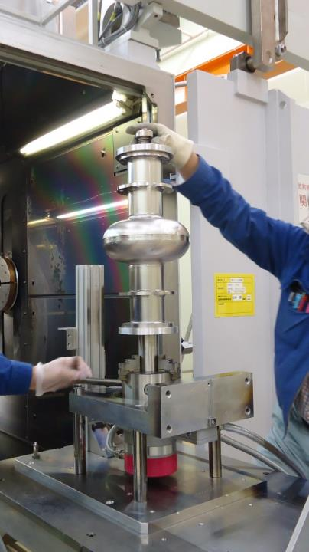
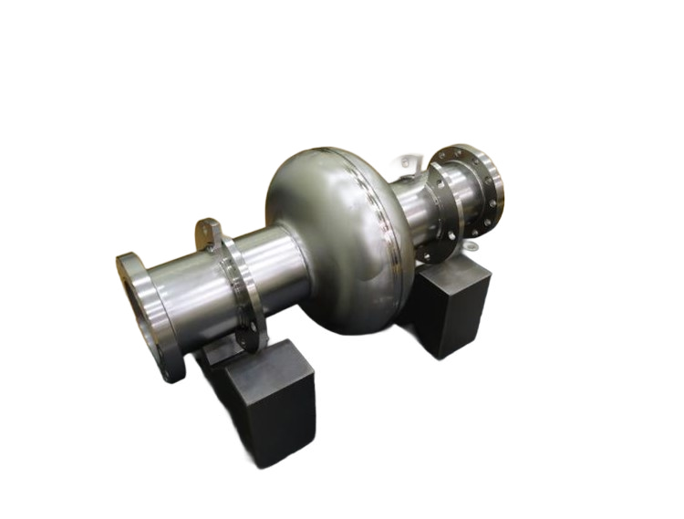
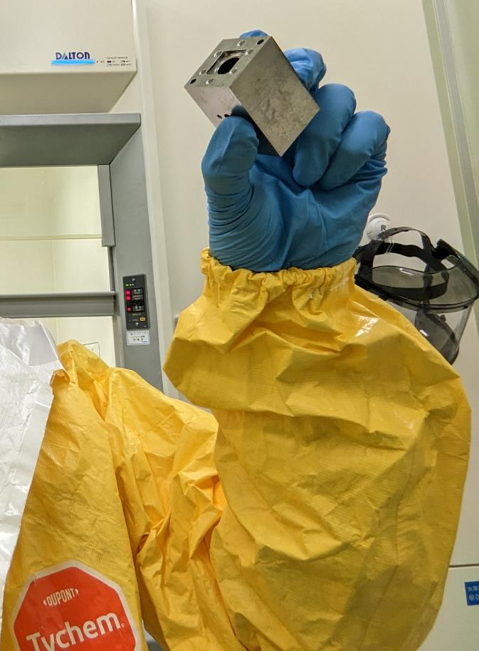
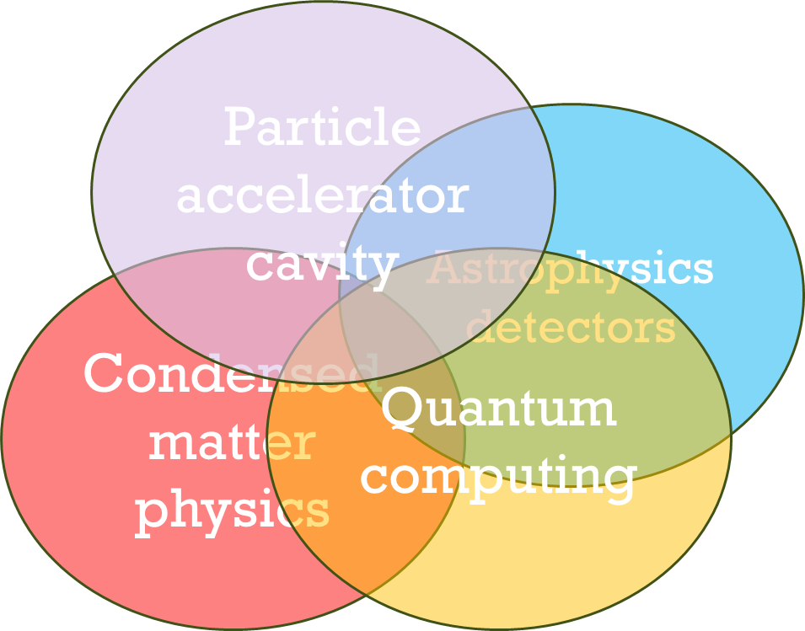
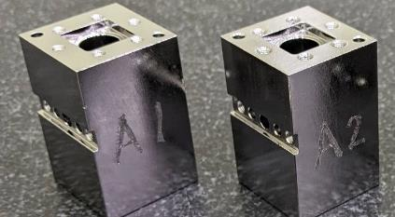
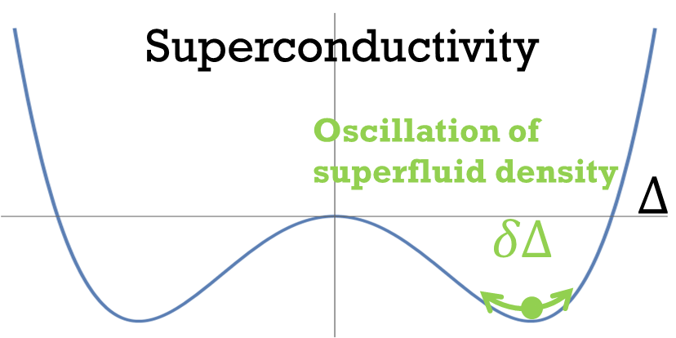
University of Hawaii Manoa (Nov. 5, 2026)
Superconducting Cavities and Their Physics:
From Particle Accelerators to Quantum Technologies
High energy Accelerator Research Organization (KEK)
Innovation Center for Applied Superconducting Accelerators (iCASA)
Takayuki Kubo
https://kbtkphys.github.io/
https://scholar.google.com/citations?user=MN4RQIsAAAAJ

Slide 2
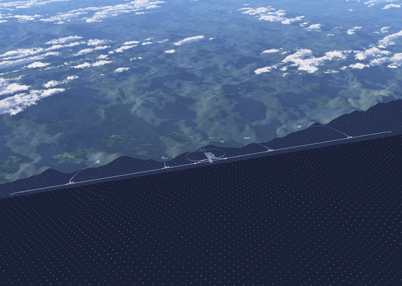
Here we use the International Linear Collider (ILC), an electron–positron Higgs factory, as an example, but the European X-ray Free-Electron Laser (European XFEL) in Germany and the Linac Coherent Light Source II (LCLS-II) at SLAC in California are also based on similar superconducting RF linac technology.
https://linearcollider.org/conditions-for-material-usage/

Slide 3
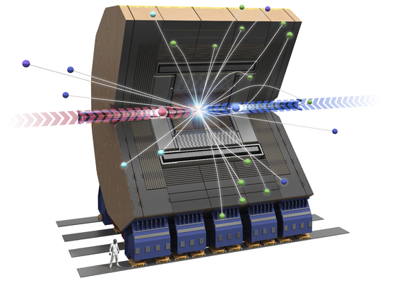
https://linearcollider.org/conditions-for-material-usage/

Slide 4
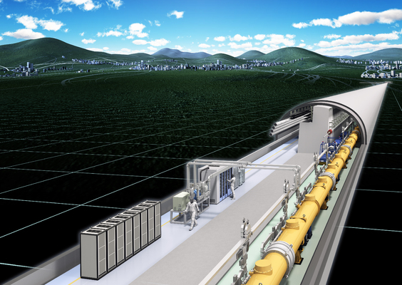
https://linearcollider.org/conditions-for-material-usage/

Slide 5
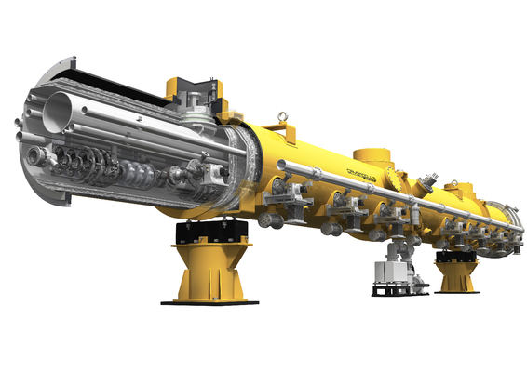
Cryomodule
https://linearcollider.org/conditions-for-material-usage/

Slide 6
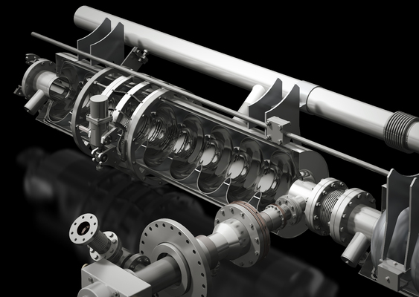

Cryomodule
$$T=2K$$
9-cell Nb Accelerator
Cavity (1.3 GHz)
https://linearcollider.org/conditions-for-material-usage/

Slide 7
Single-cell Nb accelerator cavity (1.3 GHz)
9-cell Nb Accelerator
Cavity (1.3 GHz)

Slide 8
Overview

Slide 9
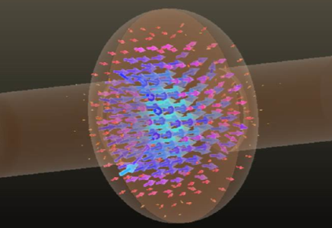

Electric field
distribution
$$E$$
Single-cell Nb accelerator cavity (1.3 GHz)

Slide 10
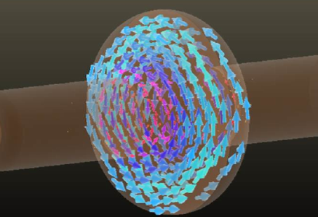


Electric field
distribution
Magnetic field
distribution
$$B$$
$$E$$
$$\frac{B}{mT}=4.26\frac{E_{acc}}{MV/m}$$
Single-cell Nb accelerator cavity (1.3 GHz)

Slide 11
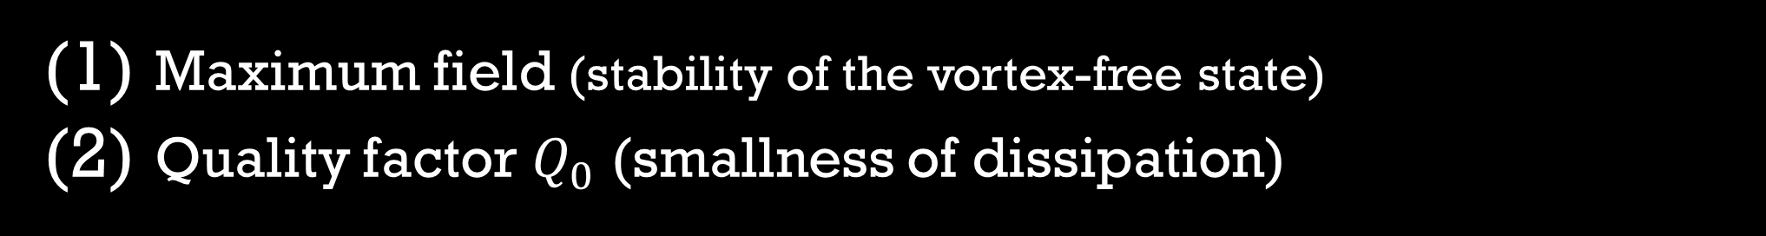
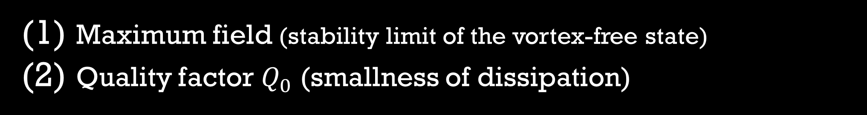
Electric field
distribution
Magnetic field
distribution
$$B$$
$$E$$
$$\frac{B}{mT}=4.26\frac{E_{acc}}{MV/m}$$
Single-cell Nb accelerator cavity (1.3 GHz)
There are two key performance metrics
Maximum field (stability limit of the vortex-free state)
Quality factor $Q_{0}$ (smallness of dissipation)

Slide 12
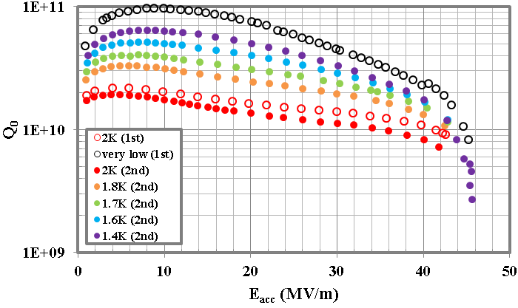
Electric field
distribution
Magnetic field
distribution
Nb
$$B$$
$$E$$
$$\frac{B}{mT}=4.26\frac{E_{acc}}{MV/m}$$
Single-cell Nb accelerator cavity (1.3 GHz)
T Kubo et al., IPAC2014, Dresden, Germany, WEPRI022, p.2519
https://doi.org/10.18429/JACoW-IPAC2014-WEPRI022
There are two key performance metrics
Maximum field (stability limit of the vortex-free state)
Quality factor $Q_{0}$ (smallness of dissipation)

Slide 13
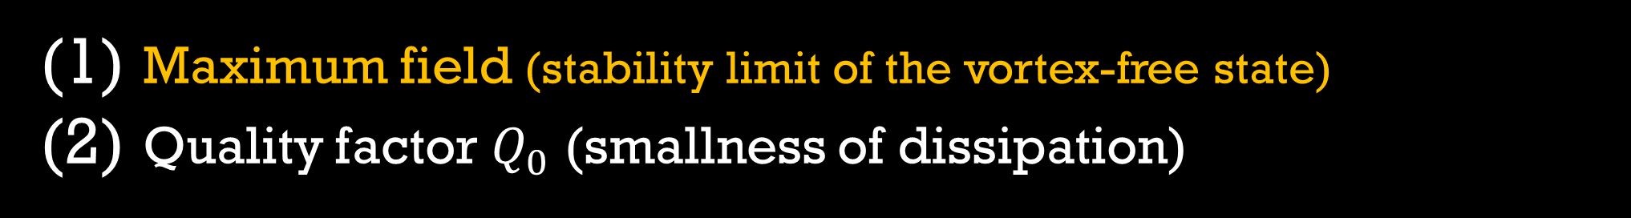
Electric field
distribution
Magnetic field
distribution
Nb
$$B$$
$$E$$
$$\frac{B}{mT}=4.26\frac{E_{acc}}{MV/m}$$
T Kubo et al., IPAC2014, Dresden, Germany, WEPRI022, p.2519
https://doi.org/10.18429/JACoW-IPAC2014-WEPRI022
There are two key performance metrics
Maximum field (stability limit of the vortex-free state)
Quality factor $Q_{0}$ (smallness of dissipation)

Slide 14
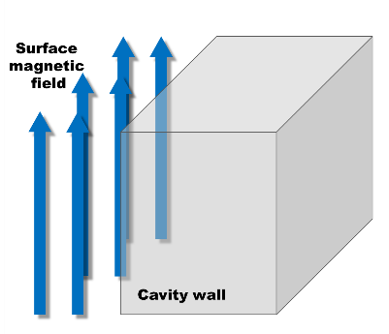
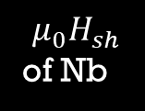



Electric field
distribution
Magnetic field
distribution
Nb
$$B$$
$$\frac{B}{mT}=4.26\frac{E_{acc}}{MV/m}$$
T Kubo et al., IPAC2014, Dresden, Germany, WEPRI022, p.2519
https://doi.org/10.18429/JACoW-IPAC2014-WEPRI022
Low field (Meissner state)
Note: Cavities are operated under the Meissner state
40
MV/m
50
MV/m
0 MV/m
20 MV/m
$$E_{acc}$$
0mT
85mT
170mT
210mT
$$μ_{0}H_{sh}$$
of Nb
$$B_{rf}$$
$≃μ_{0}H_{c1}$ of Nb
(⌐■_■) good

Slide 15
Electric field
distribution
Magnetic field
distribution
Nb
$$B$$
$$\frac{B}{mT}=4.26\frac{E_{acc}}{MV/m}$$
T Kubo et al., IPAC2014, Dresden, Germany, WEPRI022, p.2519
https://doi.org/10.18429/JACoW-IPAC2014-WEPRI022
Low field (Meissner state)
Note: Cavities are operated under the Meissner state
40
MV/m
50
MV/m
0 MV/m
20 MV/m
$$E_{acc}$$
0mT
85mT
170mT
210mT
$$μ_{0}H_{sh}$$
of Nb
$$B_{rf}$$
$≃μ_{0}H_{c1}$ of Nb
(⌐■_■) good

Slide 16
Electric field
distribution
Magnetic field
distribution
Nb
$$B$$
$$\frac{B}{mT}=4.26\frac{E_{acc}}{MV/m}$$
T Kubo et al., IPAC2014, Dresden, Germany, WEPRI022, p.2519
https://doi.org/10.18429/JACoW-IPAC2014-WEPRI022
Low field (Meissner state)
Note: Cavities are operated under the Meissner state
40
MV/m
50
MV/m
0 MV/m
20 MV/m
$$E_{acc}$$
0mT
85mT
170mT
210mT
$$μ_{0}H_{sh}$$
of Nb
$$B_{rf}$$
$≃μ_{0}H_{c1}$ of Nb
(⌐■_■) good

Slide 17
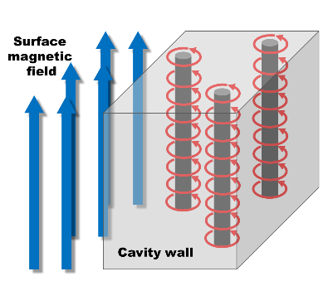
Electric field
distribution
Magnetic field
distribution
Nb
$$B$$
$$\frac{B}{mT}=4.26\frac{E_{acc}}{MV/m}$$
T Kubo et al., IPAC2014, Dresden, Germany, WEPRI022, p.2519
https://doi.org/10.18429/JACoW-IPAC2014-WEPRI022
High field (vortex state)
Note: Cavities are operated under the Meissner state
40
MV/m
50
MV/m
0 MV/m
20 MV/m
$$E_{acc}$$
0mT
85mT
170mT
210mT
$$μ_{0}H_{sh}$$
of Nb
$$B_{rf}$$
$≃μ_{0}H_{c1}$ of Nb
＼(^o^)／ｵﾜﾀ
I’m doomed

Slide 18
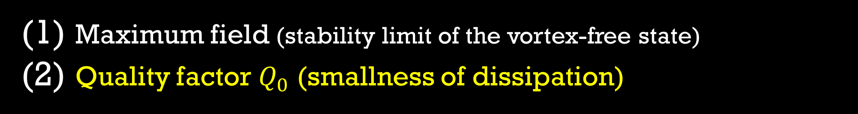

Electric field
distribution
Magnetic field
distribution
Nb
$$B$$
$$E$$
$$E$$
$$\frac{B}{mT}=4.26\frac{E_{acc}}{MV/m}$$
T Kubo et al., IPAC2014, Dresden, Germany, WEPRI022, p.2519
https://doi.org/10.18429/JACoW-IPAC2014-WEPRI022
There are two key performance metrics
Maximum field (stability limit of the vortex-free state)
Quality factor $Q_{0}$ (smallness of dissipation)

Slide 19
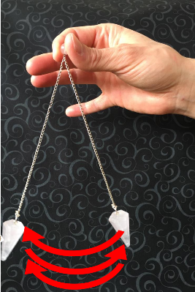

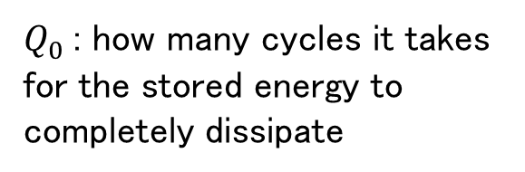

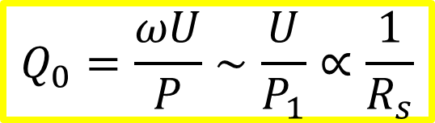
$$Q_{0}=\frac{ωU}{P}∼\frac{U}{P_{1}}∝\frac{1}{R_{s}}$$
Nb
$$E$$
$P_{1}$ : dissipation per RF cycle
$Q_{0}$: how many cycles it takes for the stored energy to completely dissipate
T Kubo et al., IPAC2014, Dresden, Germany, WEPRI022, p.2519
https://doi.org/10.18429/JACoW-IPAC2014-WEPRI022
There are two key performance metrics
Maximum field (stability limit of the vortex-free state)
Quality factor $Q_{0}$ (smallness of dissipation)

Slide 20
$$Q_{0}=\frac{ωU}{P}∼\frac{U}{P_{1}}∝\frac{1}{R_{s}}$$
Nb
$$E$$
$P_{1}$ : dissipation per RF cycle
$Q_{0}$: how many cycles it takes for the stored energy to completely dissipate
T Kubo et al., IPAC2014, Dresden, Germany, WEPRI022, p.2519
https://doi.org/10.18429/JACoW-IPAC2014-WEPRI022
What are the causes of dissipation?
There are two key performance metrics
Maximum field (stability limit of the vortex-free state)
Quality factor $Q_{0}$ (smallness of dissipation)

Slide 21
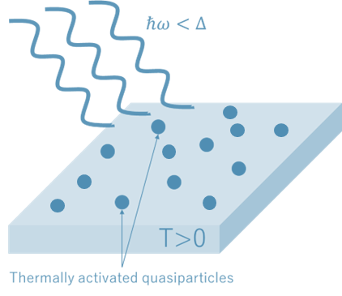
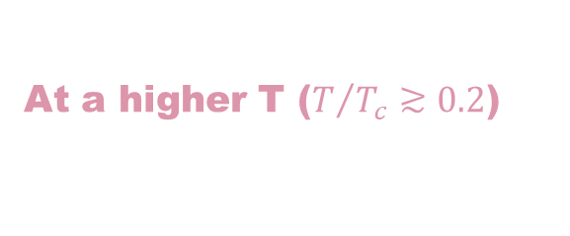
$$Q_{0}=\frac{ωU}{P}∼\frac{U}{P_{1}}∝\frac{1}{R_{s}}$$
Nb
$$E$$
$P_{1}$ : dissipation per RF cycle
$Q_{0}$: how many cycles it takes for the stored energy to completely dissipate
T Kubo et al., IPAC2014, Dresden, Germany, WEPRI022, p.2519
https://doi.org/10.18429/JACoW-IPAC2014-WEPRI022
What are the causes of dissipation?
There are two different temperature regimes
At a higher T ($T/{T_{c}}≳0.2$)
thermally activated quasiparticles

Slide 22
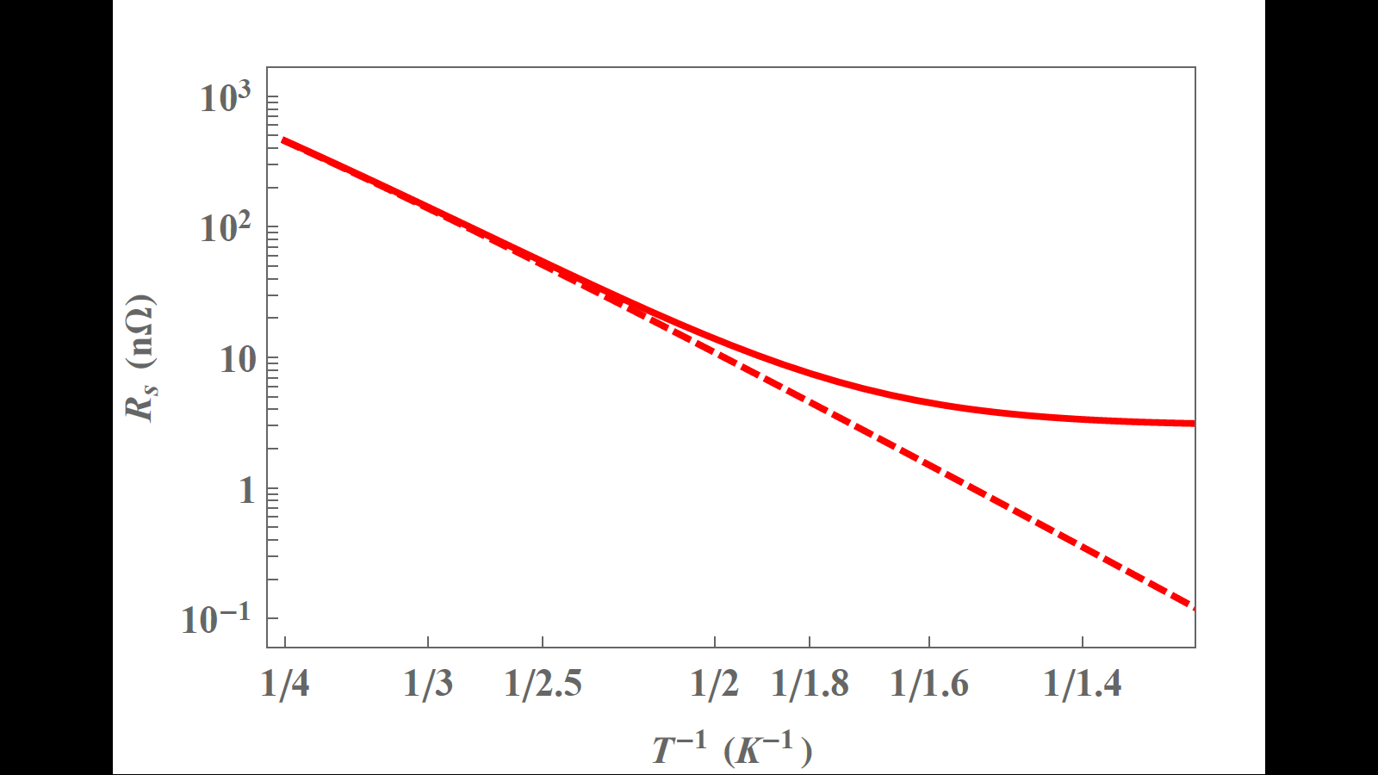
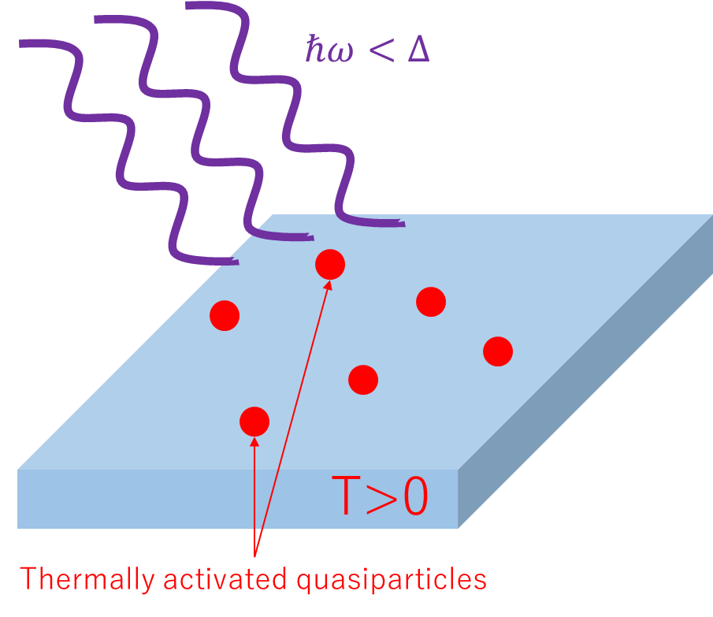
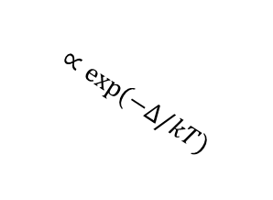
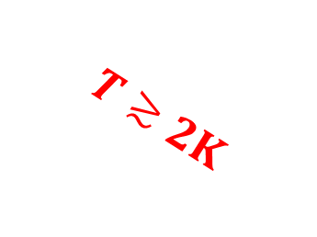
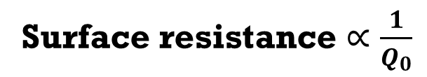
$$Q_{0}=\frac{ωU}{P}∼\frac{U}{P_{1}}∝\frac{1}{R_{s}}$$
Surface resistance $∝\frac{1}{Q_{0}}$
$$T≳2K$$
$P_{1}$ : dissipation per RF cycle
$Q_{0}$: how many cycles it takes for the stored energy to completely dissipate
$$∝exp⁡(−Δ/kT)$$
e.g., bulk Nb
What are the causes of dissipation?
22
There are two different temperature regimes
22
Higher T
Lower T
At a higher T ($T/{T_{c}}≳0.2$)
The contribution from thermally activated quasiparticles decreases exponentially [$∝exp⁡(−Δ/kT)$].

Slide 23
$$Q_{0}=\frac{ωU}{P}∼\frac{U}{P_{1}}∝\frac{1}{R_{s}}$$
Surface resistance $∝\frac{1}{Q_{0}}$
$$T≳2K$$
$P_{1}$ : dissipation per RF cycle
$Q_{0}$: how many cycles it takes for the stored energy to completely dissipate
$$∝exp⁡(−Δ/kT)$$
e.g., bulk Nb
What are the causes of dissipation?
23
There are two different temperature regimes
23
Higher T
Lower T
The contribution from thermally activated quasiparticles decreases exponentially [$∝exp⁡(−Δ/kT)$].

Slide 24

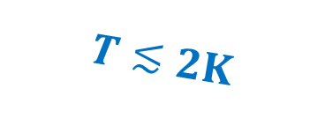
$$Q_{0}=\frac{ωU}{P}∼\frac{U}{P_{1}}∝\frac{1}{R_{s}}$$
Surface resistance $∝\frac{1}{Q_{0}}$
$$T≳2K$$
$P_{1}$ : dissipation per RF cycle
$$T≲2K$$
$Q_{0}$: how many cycles it takes for the stored energy to completely dissipate
$$∝exp⁡(−Δ/kT)$$
$$R_{res}$$
e.g., bulk Nb
What are the causes of dissipation?
24
There are two different temperature regimes
24
Higher T
Lower T
The contribution from thermally activated quasiparticles decreases exponentially [$∝exp⁡(−Δ/kT)$].

Slide 25
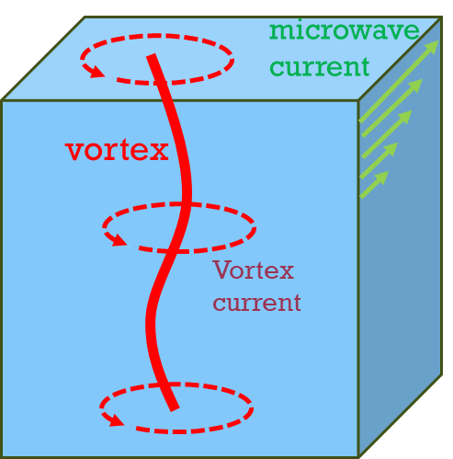
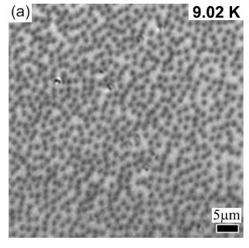
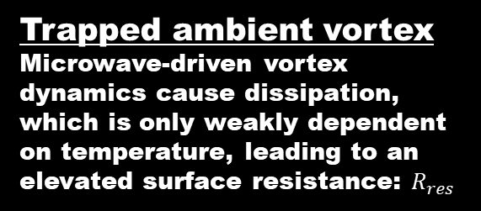
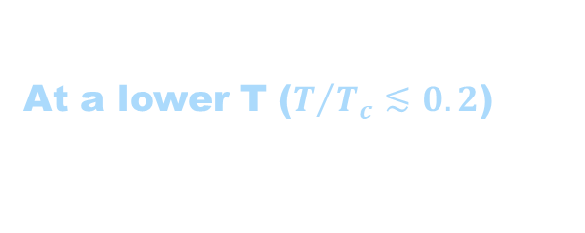
$$Q_{0}=\frac{ωU}{P}∼\frac{U}{P_{1}}∝\frac{1}{R_{s}}$$
Surface resistance $∝\frac{1}{Q_{0}}$
$$T≳2K$$
$P_{1}$ : dissipation per RF cycle
$$T≲2K$$
$Q_{0}$: how many cycles it takes for the stored energy to completely dissipate
$$∝exp⁡(−Δ/kT)$$
$$R_{res}$$
e.g., bulk Nb
What are the causes of dissipation?
25
There are two different temperature regimes
25
Higher T
Lower T
At a lower T ($T/{T_{c}}≲0.2$)
Trapped ambient vortex
Microwave-driven vortex dynamics cause dissipation, which is only weakly dependent on temperature, leading to an elevated surface resistance: $R_{res}$
Figures adapted from Ooi et al., PRB 111, 094519 (2025)
© American Physical Society.
See also,
A. Gurevich and G. Ciovati, PRB 87, 054502 (2013)
A. Romanenko et al., Appl. Phys. Lett. 105, 234103 (2014).
S. Huang eta al., Phys. Rev. Accelerators and Beams 19, 082001 (2016).
S. Posen et al., J. Appl. Phys. 119, 213903 (2016).
S. Ooi et al., Physical Review B 104, 064504 (2021).
S. Ooi et al., Physical Review B 111, 094519 (2025)
Videos of vortex dynamics in cavity-grade Nb (RRR>300) can be found in Ooi et al., PRB 111, 094519 (2025)

Slide 26
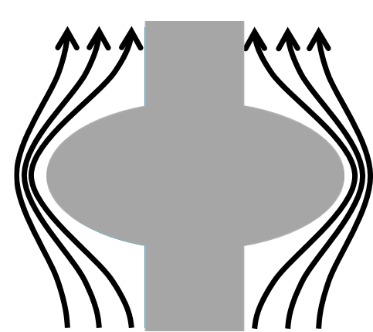
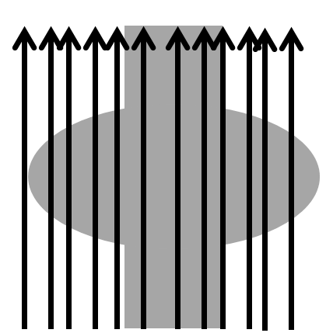
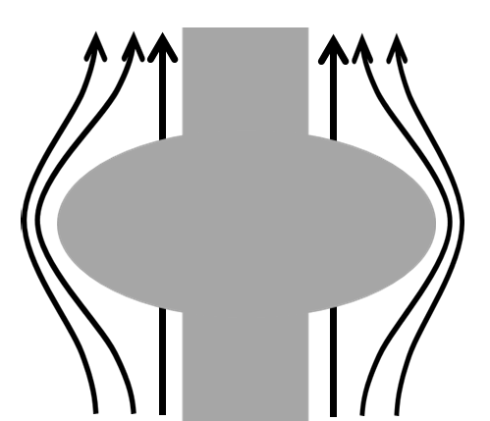
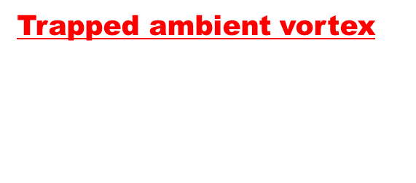
$$Q_{0}=\frac{ωU}{P}∼\frac{U}{P_{1}}∝\frac{1}{R_{s}}$$
Surface resistance $∝\frac{1}{Q_{0}}$
$$T≳2K$$
$P_{1}$ : dissipation per RF cycle
$$T≲2K$$
$Q_{0}$: how many cycles it takes for the stored energy to completely dissipate
$$∝exp⁡(−Δ/kT)$$
$$R_{res}$$
e.g., bulk Nb
What are the causes of dissipation?
26
There are two different temperature regimes
26
Higher T
Lower T
At a lower T ($T/{T_{c}}≲0.2$)
T>Tc
(normal conducting)
Trapped ambient vortex
Microwave-driven vortex dynamics cause dissipation, which is only weakly dependent on temperature, leading to an elevated surface resistance: $R_{res}$
Ideal case
T<Tc
See also,
A. Gurevich and G. Ciovati, PRB 87, 054502 (2013)
A. Romanenko et al., Appl. Phys. Lett. 105, 234103 (2014).
S. Huang eta al., Phys. Rev. Accelerators and Beams 19, 082001 (2016).
S. Posen et al., J. Appl. Phys. 119, 213903 (2016).
S. Ooi et al., Physical Review B 104, 064504 (2021).
S. Ooi et al., Physical Review B 111, 094519 (2025)
Real
Figures adapted from Ooi et al., PRB 111, 094519 (2025)
© American Physical Society.
Videos of vortex dynamics in cavity-grade Nb (RRR>300) can be found in Ooi et al., PRB 111, 094519 (2025)
Trapped vortices

Slide 27
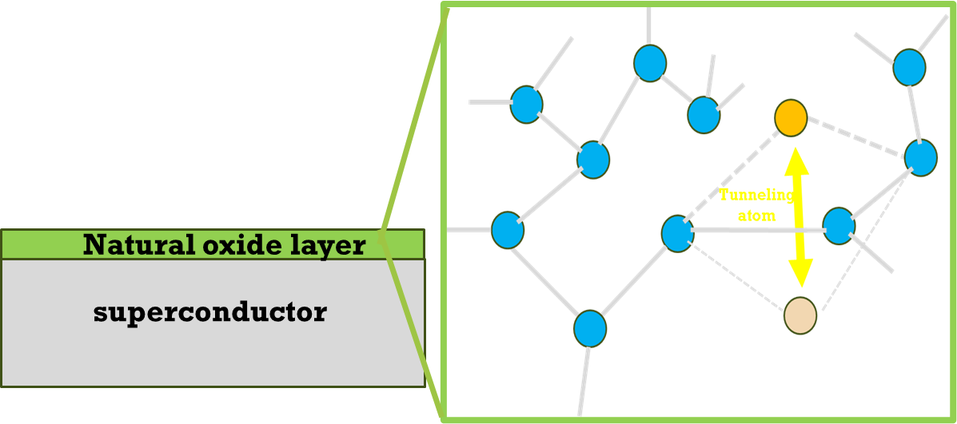
$$Q_{0}=\frac{ωU}{P}∼\frac{U}{P_{1}}∝\frac{1}{R_{s}}$$
Surface resistance $∝\frac{1}{Q_{0}}$
$$T≳2K$$
$P_{1}$ : dissipation per RF cycle
$$T≲2K$$
$Q_{0}$: how many cycles it takes for the stored energy to completely dissipate
$$∝exp⁡(−Δ/kT)$$
$$R_{res}$$
e.g., bulk Nb
What are the causes of dissipation?
27
There are two different temperature regimes
27
Higher T
Lower T
At a lower T ($T/{T_{c}}≲0.2$)
Two-level system (TLS) defects on the natural oxide layer also contributes to the dissipation
Trapped ambient vortex
Microwave-driven vortex dynamics cause dissipation, which is only weakly dependent on temperature, leading to an elevated surface resistance: $R_{res}$
Figures adapted from Ooi et al., PRB 111, 094519 (2025)
© American Physical Society.
See also,
A. Gurevich and G. Ciovati, PRB 87, 054502 (2013)
A. Romanenko et al., Appl. Phys. Lett. 105, 234103 (2014).
S. Huang eta al., Phys. Rev. Accelerators and Beams 19, 082001 (2016).
S. Posen et al., J. Appl. Phys. 119, 213903 (2016).
S. Ooi et al., Physical Review B 104, 064504 (2021).
S. Ooi et al., Physical Review B 111, 094519 (2025)
Videos of vortex dynamics in cavity-grade Nb (RRR>300) can be found in Ooi et al., PRB 111, 094519 (2025)
See also a review:
Müller et al Rep. Prog. Phys. 82, 124501 (2019)

Slide 28
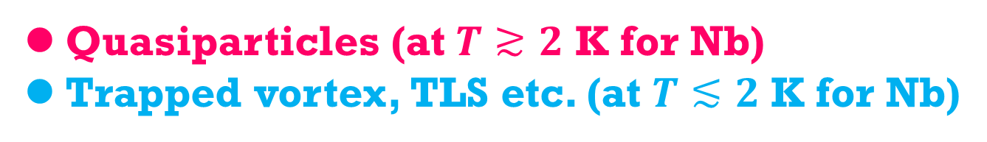

Summary
of this part
Nb
T Kubo et al., IPAC2014, Dresden, Germany, WEPRI022, p.2519
https://doi.org/10.18429/JACoW-IPAC2014-WEPRI022
There are two key performance metrics
Maximum field (stability of the vortex-free state)
Quality factor $Q_{0}$ (smallness of dissipation)
Quasiparticles (at $T≳2$ K for Nb)
Trapped vortex, TLS etc. (at $T≲2$ K for Nb)

Slide 29
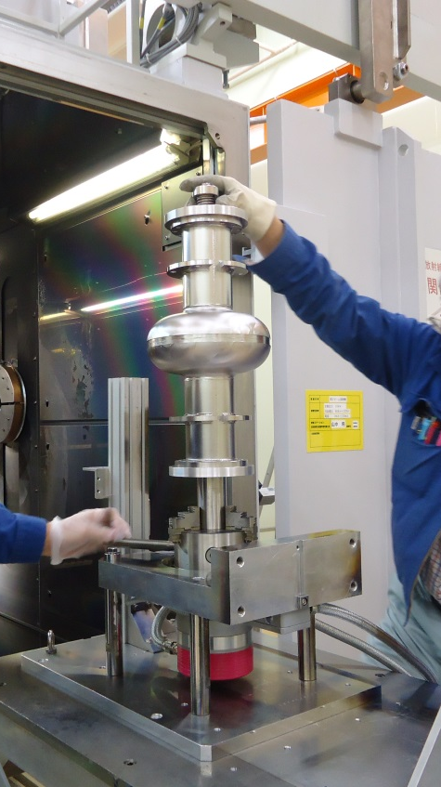
Nb cavity technology
for accelerators:
Classical ILC recipe as a representative example
2013 T. Kubo

Slide 30
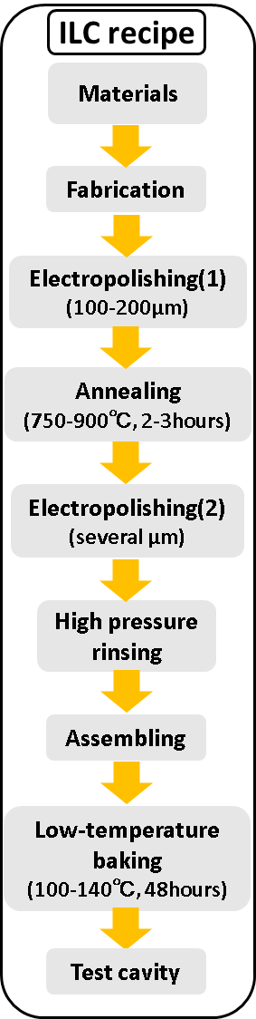
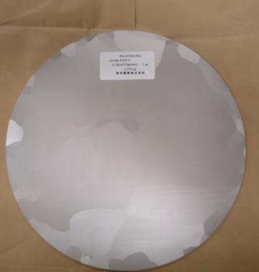
RRR>300
High purity Nb
270 mm

Slide 31
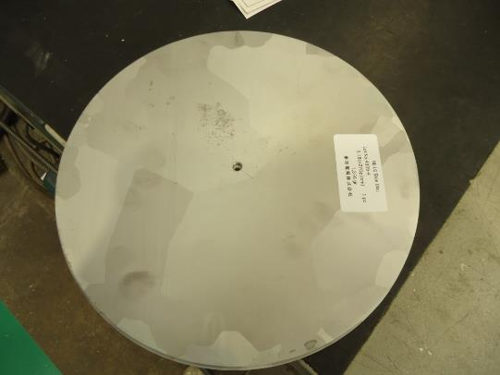
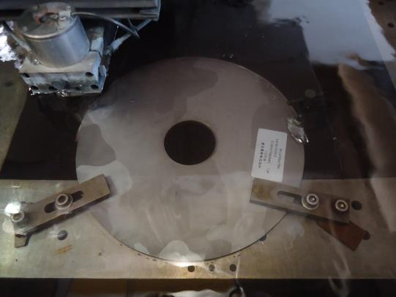
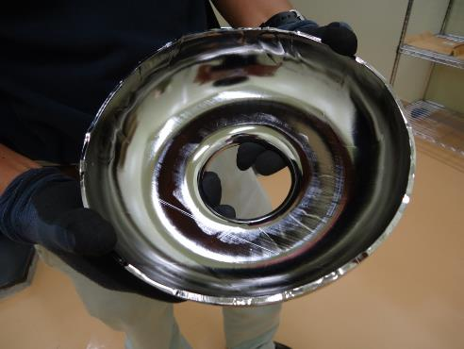
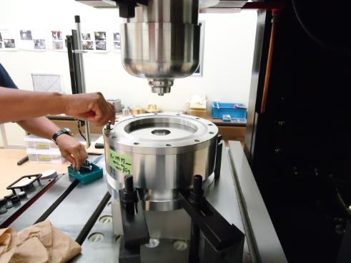
Let’s start fabrication.
Wire-EDM
(Electrical discharge machining)

Slide 32
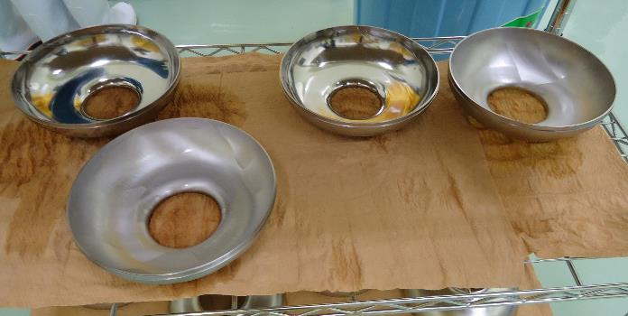

Half cells
Electron beam welding
Cavity material quality is maintained
Half cell + beam pipe

Slide 33



Electron gun
Inside the chamber

Slide 34

Electron gun
Electron beam

Slide 35

Electron beam

Slide 36




Electropolishing (EP)
The electrolyte is a mixture of (9:1) sulfuric acid and hydrofluoric acid (HF).
A DC voltage is applied with Nb as the anode and aluminum as the cathode.
Niobium is oxidized to form Nb₂O₅.
This oxide layer is dissolved and polished away by HF​ present in the electrolyte.

Slide 37

Electropolishing (EP)
The electrolyte is a mixture of (9:1) sulfuric acid and hydrofluoric acid (HF).
A DC voltage is applied with Nb as the anode and aluminum as the cathode.
Niobium is oxidized to form Nb₂O₅.
This oxide layer is dissolved and polished away by HF​ present in the electrolyte.

Slide 38


Annealing
To degas hydrogen — prevents hydrogen Q-disease (requires >700 ℃)
“Q-disease” due to niobium hydride
B. Aune et al.,
in proceedings of LINAC1990, Albuquerque, New Mexico, USA (1990)

Slide 39

Annealing
To degas hydrogen — prevents hydrogen Q-disease (requires >700 ℃)
To reduce pinning centers — minimizes trapped flux (requires ~900 ℃)
S. Posen et al., J. Appl. Phys. 119, 213903 (2016).
https://doi.org/10.1063/1.4953087
“Q-disease” due to niobium hydride
B. Aune et al.,
in proceedings of LINAC1990, Albuquerque, New Mexico, USA (1990)

Slide 40
A second EP step, removing only a few microns.

Slide 41



H. Sakai et al.,
Phys. Rev. Accel. Beams 22,022002 (2019)
https://doi.org/10.1103/PhysRevAccelBeams.22.022002
P. Bernard et al., In proceedings of EPAC1992, Berlin, Germany (1992)
Courtesy of Mathieu Omet (KEK)

Slide 42



120℃ー48h bake
L. Lilje et al., in Proceedings of SRF1999, Santa Fe, New Mexico, USA (1999), p. 74, TUA001.
Without baking
High field
Q-drop
With
baking
Courtesy of Mathieu Omet (KEK)
Spatial variation of the mean free path on the scale of the penetration depth suppresses the surface current, thereby increasing the maximum achievable field.
T. Kubo, Supercond. Sci. and Technol. 30, 023001 (2017); Supercond Sci. and Technol. 34, 045006 (2021)
V. Ngampruetikorn and J. A. Sauls, Phys. Rev. Research 1, 012015(R) (2019)

Slide 43



Slide 44
T Kubo et al., IPAC2014, Dresden, Germany, WEPRI022, p.2519
https://doi.org/10.18429/JACoW-IPAC2014-WEPRI022

Slide 45


Many modern recipes exist: N-doping, N-infusion, two-step bake, mid-T bakes, etc. They are all variants of the classical recipe, with some steps replaced or modified.
Mid-T bake
Mid-T bake
T=2K
2K
2K
ILC recipe
T Kubo et al., In-house production of a large-grain single-cell cavity at cavity fabrication facility and results of performance tests, IPAC2014, Dresden, Germany, WEPRI022, p.2519
https://doi.org/10.18429/JACoW-IPAC2014-WEPRI022
S. Posen et al., Ultralow Surface Resistance via Vacuum Heat Treatment of Superconducting Radio-Frequency Cavities,
Phys. Rev. Applied 13, 014024 (2020)
https://doi.org/10.1103/PhysRevApplied.13.014024
H. Ito et al., Influence of furnace baking on Q–E behavior of superconducting accelerating cavities,
Prog. Theor. Exp. Phys. 2021, 071G01 (2021)
https://doi.org/10.1093/ptep/ptab056

Slide 46

Understanding more about physics of Q factor

Slide 47


In the accelerator regime (T~2K), the quality factor is largely determined by quasiparticle dissipation.
$$T=2 K$$
Thermally excited
quasiparticles dominate
T Kubo et al., In-house production of a large-grain single-cell cavity at cavity fabrication facility and results of performance tests, IPAC2014, Dresden, Germany, WEPRI022, p.2519
https://doi.org/10.18429/JACoW-IPAC2014-WEPRI022

Slide 48



In the accelerator regime (T~2K), the quality factor is largely determined by quasiparticle dissipation.
$$∝1/Q$$
$$∝E_{acc}$$
M. Martinello et al., Phys. Rev. Lett. 121, 224801 (2018)
DOI: https://doi.org/10.1103/PhysRevLett.121.224801
Actually, this is
a very challenging problem

Slide 49


Temperature
$$T_{c}$$
Mean
free
path
0
$$ξ_{0}$$

Slide 50

Temperature
$$T_{c}$$
Ginzburg-Landau ($T≃T_{c}$)
Mean
free
path
0
$$ξ_{0}$$

Slide 51
Temperature
$$T_{c}$$
Ginzburg-Landau ($T≃T_{c}$)
Eilenberger
Formalism
Applicable to
Any temperature
Any mean free path
Mean
free
path
0
$$ξ_{0}$$

Slide 52

Temperature
$$T_{c}$$
Ginzburg-Landau ($T≃T_{c}$)
Usadel
Formalism
Applicable to
Any temperature
$$mfp<ξ_{0}$$
Eilenberger
Formalism
Applicable to
Any temperature
Any mean free path
Mean
free
path
0
$$ξ_{0}$$

Slide 53

Under the ac field
Thermal Equilibrium
Driving force of
Nonequilibrium
Dynamics
(e.g, strength of microwave)

Slide 54
Under the ac field
Thermal Equilibrium
Linear response
regime
Driving force of
Nonequilibrium
Dynamics
(e.g, strength of microwave)

Slide 55
Under the ac field
Mattis-Bardeen
Theory
Thermal Equilibrium
Linear response
regime
Driving force of
Nonequilibrium
Dynamics
(e.g, strength of microwave)

Slide 56
Under the ac field
Mattis-Bardeen
Theory
Thermal Equilibrium
Nonlinear response
Regime
Linear response
regime
Driving force of
Nonequilibrium
Dynamics
(e.g, strength of microwave)

Slide 57
Under the ac field
Unfortunately, this is
the SRF accelerator regime
Mattis-Bardeen
Theory
Thermal Equilibrium
Nonlinear response
Regime
Linear response
regime
Driving force of
Nonequilibrium
Dynamics
(e.g, strength of microwave)

Slide 58
Under the ac field
Unfortunately, this is
the SRF accelerator regime
Mattis-Bardeen
Theory
Thermal Equilibrium
Nonlinear response
Regime
Linear response
regime
Keldysh
Eilenberger
Driving force of
Nonequilibrium
Dynamics
(e.g, strength of microwave)

Slide 59
Under the ac field
Unfortunately, this is
the SRF accelerator regime
Mattis-Bardeen
Theory
Thermal Equilibrium
Nonlinear response
Regime
Linear response
regime
Keldysh
Eilenberger
Driving force of
Nonequilibrium
Dynamics
(e.g, strength of microwave)

Slide 60
Under the ac field
Unfortunately, this is
the SRF accelerator regime
Mattis-Bardeen
Theory
Thermal Equilibrium
Nonlinear response
Regime
Linear response
regime
Keldysh
Eilenberger
Driving force of
Nonequilibrium
Dynamics
(e.g, strength of microwave)

Slide 61
Under the ac field
Unfortunately, this is
the SRF accelerator regime
Mattis-Bardeen
Theory
Thermal Equilibrium
Nonlinear response
Regime
Linear response
regime
Keldysh
Eilenberger
Keldysh-Usadel
Driving force of
Nonequilibrium
Dynamics
(e.g, strength of microwave)

Slide 62
Under the ac field
Unfortunately, this is
the SRF accelerator regime
Mattis-Bardeen
Theory
Thermal Equilibrium
Nonlinear response
Regime
Linear response
regime
Keldysh
Eilenberger
Keldysh-Usadel
Driving force of
Nonequilibrium
Dynamics
(e.g, strength of microwave)

Slide 63
Under the ac field
Unfortunately, this is
the SRF accelerator regime
Mattis-Bardeen
Theory
Thermal Equilibrium
Nonlinear response
Regime
Linear response
regime
Keldysh
Eilenberger
Keldysh-Usadel
Driving force of
Nonequilibrium
Dynamics
(e.g, strength of microwave)

Slide 64

Let us start from the linear response
(Mattis-Bardeen)

Slide 65


Let us start from the linear response
The theory was established decades ago. We just need to plug in parameters such as temperature.
(Mattis-Bardeen)
W. Zimmermann, E. Brandt, M. Bauer, E. Seider, and L. Genzel, Optical conductivity of BCS superconductors with arbitrary purity, Physica C 183, 99 (1991).
D. Rainer and J. A. Sauls, Strong coupling theory of superconductivity, in Superconductivity: From Basic Physics to the Latest Developments, edited by P. N. Butcher and Y. Lu (World Scientic, Singapore, 1995), p. 45.
T. Kubo, Effects of Nonmagnetic Impurities and Subgap States on the Kinetic Inductance, Complex Conductivity, Quality Factor, and Depairing Current Density, Physical Review Applied 17, 014018 (2022)

Slide 66

T Kubo et al., In-house production of a large-grain single-cell cavity at cavity fabrication facility and results of performance tests, IPAC2014, Dresden, Germany, WEPRI022, p.2519
https://doi.org/10.18429/JACoW-IPAC2014-WEPRI022
(Mattis-Bardeen)
However, it is only valid in the limit $E_{acc}→0$
W. Zimmermann, E. Brandt, M. Bauer, E. Seider, and L. Genzel, Optical conductivity of BCS superconductors with arbitrary purity, Physica C 183, 99 (1991).
D. Rainer and J. A. Sauls, Strong coupling theory of superconductivity, in Superconductivity: From Basic Physics to the Latest Developments, edited by P. N. Butcher and Y. Lu (World Scientic, Singapore, 1995), p. 45.
T. Kubo, Effects of Nonmagnetic Impurities and Subgap States on the Kinetic Inductance, Complex Conductivity, Quality Factor, and Depairing Current Density, Physical Review Applied 17, 014018 (2022)

Slide 67

The leading-order nonlinear correction allows us to calculate the field dependence in the weak-field regime.

Slide 68







Keldysh–Usadel Equation for SC under a strong ac field
T. Kubo,
Phys. Rev. Applied 24, 064061 (2025)
https://doi.org/10.1103/8fh8-nknj
We solve these equations to obtain the nonequilibrium corrections ($δ{\hat{g}}^{R, A, K}$ and $δΔ$).
To obtain the current response,
we substitute the solutions ($δ{\hat{g}}^{R, A, K}$, $δΔ$) into
← Linear response
← Nonlinear correction of $𝒪(A^{3})$

Slide 69


Schematically, the results can be illustrated as
Linear
response
Nonlinear corrections
$$J∼Agg+Agδg$$
Current
$δg∼A^{2}+δΔ$ and $δΔ∼Ψ$ $A^{2}$

Slide 70

Schematically, the results can be illustrated as
Linear
response
Nonlinear corrections
$$J∼Agg+Agδg$$
Current
$δg∼A^{2}+δΔ$ and $δΔ∼Ψ$ $A^{2}$
$$∼A(A^{2}+δΔ)$$

Slide 71


Schematically, the results can be illustrated as
Linear
response
Nonlinear corrections
$$J∼Agg+Agδg$$
Current
$δg∼A^{2}+δΔ$ and $δΔ∼Ψ$ $A^{2}$
$$∼A(A^{2}+δΔ)$$
Time averaged $δΔ$:
Eliashberg effect
Time dependent $δΔ$:
Higgs mode
Note: This theory automatically includes the Eliashberg effect (microwave-induced gap enhancement) as well as the Higgs-mode contribution.

Slide 72
Eliashberg effect?
Higgs mode?

Slide 73

Eliashberg effect?
Higgs mode?
The variation of order parameter $δΔ$ does not appear in standard linear-response theories such as Mattis–Bardeen theory because $δΔ$ is an $𝒪\left(A^{2}\right)$ effect, but it does emerge in nonlinear response.
$$δΔ∝A_{0}^{2}\cos^{2}{ωt}$$

Slide 74

Eliashberg effect?
Higgs mode?
The variation of order parameter $δΔ$ does not appear in standard linear-response theories such as Mattis–Bardeen theory because $δΔ$ is an $𝒪\left(A^{2}\right)$ effect, but it does emerge in nonlinear response.
$$δΔ∝A_{0}^{2}\cos^{2}{ωt}$$
$$∝1+\cos{2ωt}$$

Slide 75
Eliashberg effect?
Higgs mode?
The variation of order parameter $δΔ$ does not appear in standard linear-response theories such as Mattis–Bardeen theory because $δΔ$ is an $𝒪\left(A^{2}\right)$ effect, but it does emerge in nonlinear response.
$$δΔ∝A_{0}^{2}\cos^{2}{ωt}$$
$$∝1+\cos{2ωt}$$
Time-averaged nonequilibrium gap variation

Slide 76
Eliashberg effect?
Higgs mode?
The variation of order parameter $δΔ$ does not appear in standard linear-response theories such as Mattis–Bardeen theory because $δΔ$ is an $𝒪\left(A^{2}\right)$ effect, but it does emerge in nonlinear response.
$$δΔ∝A_{0}^{2}\cos^{2}{ωt}$$
$$∝1+\cos{2ωt}$$
Time-averaged nonequilibrium gap variation
Time dependent nonequilibrium gap variation

Slide 77

Eliashberg effect?
Higgs mode?
The variation of order parameter $δΔ$ does not appear in standard linear-response theories such as Mattis–Bardeen theory because $δΔ$ is an $𝒪\left(A^{2}\right)$ effect, but it does emerge in nonlinear response.
$$δΔ∝A_{0}^{2}\cos^{2}{ωt}$$
$$∝1+\cos{2ωt}$$
Time-averaged nonequilibrium gap variation
Time dependent nonequilibrium gap variation
qausiparticles
$$Δ$$

Slide 78



Eliashberg effect?
Higgs mode?
The variation of order parameter $δΔ$ does not appear in standard linear-response theories such as Mattis–Bardeen theory because $δΔ$ is an $𝒪\left(A^{2}\right)$ effect, but it does emerge in nonlinear response.
$$δΔ∝A_{0}^{2}\cos^{2}{ωt}$$
$$∝1+\cos{2ωt}$$
Time-averaged nonequilibrium gap variation
Time dependent nonequilibrium gap variation
qausiparticles
$$δΔ$$
Microwave induced
gap enhancement
$$Δ$$
$$Δ$$

Slide 79

Eliashberg effect?
Higgs mode?
The variation of order parameter $δΔ$ does not appear in standard linear-response theories such as Mattis–Bardeen theory because $δΔ$ is an $𝒪\left(A^{2}\right)$ effect, but it does emerge in nonlinear response.
$$δΔ∝A_{0}^{2}\cos^{2}{ωt}$$
$$∝1+\cos{2ωt}$$
Time-averaged nonequilibrium gap variation
Time dependent nonequilibrium gap variation
$$δΔ$$
Microwave induced
gap enhancement
$$Δ$$
$$Δ$$

Slide 80

Nonlinear
correction
$$δJ∼A\left(A^{2}+δΔ\right)$$
T. Kubo,
Phys. Rev. Applied 24, 064061 (2025)
https://doi.org/10.1103/8fh8-nknj

Slide 81

Nonlinear
correction
$$δσ∼\frac{δJ}{A}∼A^{2}+δΔ$$
$$δJ∼A\left(A^{2}+δΔ\right)$$
T. Kubo,
Phys. Rev. Applied 24, 064061 (2025)
https://doi.org/10.1103/8fh8-nknj

Slide 82








Nonlinear
correction
$$δσ∼\frac{δJ}{A}∼A^{2}+δΔ$$
$$δJ∼A\left(A^{2}+δΔ\right)$$
T. Kubo,
Phys. Rev. Applied 24, 064061 (2025)
https://doi.org/10.1103/8fh8-nknj
Higgs
Contribution:
Time dependent $δΔ$
Eliashberg
Contribution:
Time averaged $δΔ$

Slide 83

Results
T. Kubo,
Phys. Rev. Applied 24, 064061 (2025)
https://doi.org/10.1103/8fh8-nknj

Slide 84
Results
The resonance peak at Δ
comes from the Higgs mode
T. Kubo,
Phys. Rev. Applied 24, 064061 (2025)
https://doi.org/10.1103/8fh8-nknj

Slide 85

Results
The resonance peak at Δ
comes from the Higgs mode
At lower frequencies,
$σ_{1}+δσ_{1}$ can be a decreasing function of the ac amplitude (q).
T. Kubo,
Phys. Rev. Applied 24, 064061 (2025)
https://doi.org/10.1103/8fh8-nknj

Slide 86

Results
The resonance peak at Δ
comes from the Higgs mode
At lower frequencies,
$σ_{1}+δσ_{1}$ can be a decreasing function of the ac amplitude (q).
The AAA term is
the dominant contributor
at low frequencies
T. Kubo,
Phys. Rev. Applied 24, 064061 (2025)
https://doi.org/10.1103/8fh8-nknj

Slide 87



ac amplitude dependent dissipative conductivity
Dirty limit ($ℓ≪ξ_{0}$)
360MHz for Nb
720MHz for Nb
$$Γ/{Δ_{0}={10}^{−3}}$$
1.8GHz for Nb
3.6GHz for Nb
T. Kubo,
Phys. Rev. Applied 24, 064061 (2025)
https://doi.org/10.1103/8fh8-nknj
Note: this corresponds to a few (mT)

Slide 88


ac amplitude dependent dissipative conductivity
Dirty limit ($ℓ≪ξ_{0}$)
360MHz for Nb
Experiments:
Moderately dirty ($ℓ∼ξ_{0}$)
M. Martinello et al., PRL. 121, 224801 (2018)
P. Dhakal et al., PRAB 27, 062001 (2024)
720MHz for Nb
$$Γ/{Δ_{0}={10}^{−3}}$$
1.8GHz for Nb
3.6GHz for Nb
T. Kubo,
Phys. Rev. Applied 24, 064061 (2025)
https://doi.org/10.1103/8fh8-nknj
M. Martinello et al., Phys. Rev. Lett. 121, 224801 (2018)
DOI: https://doi.org/10.1103/PhysRevLett.121.224801
Note: this corresponds to a few (mT)

Slide 89
ac amplitude dependent dissipative conductivity
Dirty limit ($ℓ≪ξ_{0}$)
360MHz for Nb
Experiments:
Moderately dirty ($ℓ∼ξ_{0}$)
M. Martinello et al., PRL. 121, 224801 (2018)
P. Dhakal et al., PRAB 27, 062001 (2024)
720MHz for Nb
$$Γ/{Δ_{0}={10}^{−3}}$$
1.8GHz for Nb
3.6GHz for Nb
T. Kubo,
Phys. Rev. Applied 24, 064061 (2025)
https://doi.org/10.1103/8fh8-nknj
M. Martinello et al., Phys. Rev. Lett. 121, 224801 (2018)
DOI: https://doi.org/10.1103/PhysRevLett.121.224801
Note: this corresponds to a few (mT)

Slide 90
ac amplitude dependent dissipative conductivity
Experiments:
Moderately dirty ($ℓ∼ξ_{0}$)
M. Martinello et al., PRL. 121, 224801 (2018)
P. Dhakal et al., PRAB 27, 062001 (2024)
To deal with the red-framed region, the theory must be extended nonperturbatively to capture the quasiparticle spectrum modified by strong AC currents (DOS smearing).
Gurevich, PRL 113, 087001 (2014)
Kubo-Gurevich, PRB 100, 064522 (2019)
M. Martinello et al., Phys. Rev. Lett. 121, 224801 (2018)
DOI: https://doi.org/10.1103/PhysRevLett.121.224801

Slide 91
T. Kubo,
Phys. Rev. Applied
24, 064061 (2025)
Linear
response
regime
Leading order
nonlinear
correction
Thermal Equilibrium
Keldysh
Eilenberger
Keldysh-Usadel
Nonequilibrium
Dynamics
(e.g, strength of microwave)

Slide 92
T. Kubo,
Phys. Rev. Applied
24, 064061 (2025)
Linear
response
regime
I’m addressing it now
(Nonperturbative treatment of nonequilibrium nonlinear response)
Leading order
nonlinear
correction
Thermal Equilibrium
The SRF theory
(Deep Nonlinear Regime)
Keldysh
Eilenberger
Keldysh-Usadel
Nonequilibrium
Dynamics
(e.g, strength of microwave)

Slide 93




Summary
of this part

Slide 94

100GHz Nb waveguide
T. Nakajima et al., Propagation in Superconducting Niobium Rectangular Waveguide in the 100 GHz band,
J. Phys.: Conf. Ser. 2545, 012021 (2023)
DOI : 10.1088/1742-6596/2545/1/012021
1.27 mm × 2.54 mm
(the so-called WR10)
Non-accelerator application (1)
Millimeter wave and THz
superconducting waveguide
Why superconducting waveguides?
Ultra-low-loss transmission at millimetre-wave and sub-terahertz frequencies
→ Higher-sensitivity receiver systems for astronomy (Waveguide multiplexer) and Improved detection of extremely weak astronomical signals
→ Potential applications to atmospheric remote sensing
→ Possible applications to high-frequency communication systems above 100 GHz

Slide 95





Attenuation at different frequencies and for different material purities
Linear response
T. Kubo, Power attenuation in millimeter-wave and terahertz superconducting rectangular waveguides: linear response, two-level-system loss, and Higgs-mode nonlinearity, Supercond. Sci. Technol. 39, 075036 (2026)

Slide 96

Attenuation at different frequencies and for different material purities
Linear response
High frequency: higher purity is better
Low frequency: higher purity is not always better
T. Kubo, Power attenuation in millimeter-wave and terahertz superconducting rectangular waveguides: linear response, two-level-system loss, and Higgs-mode nonlinearity, Supercond. Sci. Technol. 39, 075036 (2026)

Slide 97




Attenuation at different frequencies and for different material purities
T. Nakajima et al., Propagation in Superconducting Niobium Rectangular Waveguide in the 100 GHz band, J. Phys.: Conf. Ser. 2545, 012021 (2023);
DOI : 10.1088/1742-6596/2545/1/012021
High frequency: higher purity is better
Low frequency: higher purity is not always better
100GHz waveguides
WR10
WR10
WR10
$5×{10}^{−4}$ dB/cm
(Same order of magnitude
as theory $≃2×{10}^{−4}$ dB/cm)
$2.6×{10}^{−2}$ dB/cm
T. Kubo, Power attenuation in millimeter-wave and terahertz superconducting rectangular waveguides: linear response, two-level-system loss, and Higgs-mode nonlinearity, Supercond. Sci. Technol. 39, 075036 (2026)
$1.1×{10}^{−2}$ dB/cm

Slide 98



Attenuation at different frequencies and for different material purities
Higher-gap materials are needed toward the THz range.
Nb3Sn: gap frequency
$f_{g}={2Δ}/h≃$ 1.4 THz
Nb: gap frequency
$f_{g}={2Δ}/h≃$ 720 GHz
T. Kubo,
Power attenuation in millimeter-wave and terahertz superconducting rectangular waveguides: linear response, two-level-system loss, and Higgs-mode nonlinearity,
Supercond. Sci. Technol. 39, 075036 (2026)

Slide 99



Strong-signal regime:
nonlinear electrodynamics and Higgs-mode signatures
Higgs
Higgs
T. Kubo, Supercond. Sci. Technol. 39, 075036 (2026)
T. Kubo, Phys. Rev. Applied 24, 064061 (2025)

Slide 100
Low-temperature Q factor

Slide 101





Accelerator regime
$$T≳2K$$
Surface resistance $∝\frac{1}{Q_{0}}$
$$T≳2K$$
$$T≲2K$$
$$R_{res}$$
e.g., bulk Nb
101
Higher T
Lower T

Slide 102

Accelerator regime
Can accelerator technologies be useful beyond the accelerator regime?
$$T≳2K$$
$$T≲2K$$
Surface resistance $∝\frac{1}{Q_{0}}$
Non-accelerator regime
Including quantum regime (~10mK)
$$T≳2K$$
Trapped vortices
TLS defects
$$T≲2K$$
$$R_{res}$$
e.g., bulk Nb
102
Higher T
Lower T

Slide 103

Acutually, the accelerator community can build
the best cavities on the planet
— achieving $Q≳{10}^{11}$ at $T=1$-2 K.
Mid-T bake
2K
ILC recipe
T Kubo et al., In-house production of a large-grain single-cell cavity at cavity fabrication facility and results of performance tests, IPAC2014, Dresden, Germany, WEPRI022, p.2519
https://doi.org/10.18429/JACoW-IPAC2014-WEPRI022
S. Posen et al., Ultralow Surface Resistance via Vacuum Heat Treatment of Superconducting Radio-Frequency Cavities,
Phys. Rev. Applied 13, 014024 (2020)
https://doi.org/10.1103/PhysRevApplied.13.014024
But they do not assure the performace at $T<1$ K.

Slide 104

Non-accelerator application (2)
Quantum applications
Cavities for quantum computing
Brock et al., Nature 641, 612 (2025)
https://doi.org/10.1038/s41586-025-08899-y

Slide 105


Superconducting Cavities in Quantum Technologies
Superconducting cavities offer a promising approach to hardware-efficient quantum information processing, potentially reducing the overhead of quantum error correction.
Various bosonic encodings are being explored, including cat codes, GKP codes, and dual-rail encoding.
Startups are actively developing cavity-based quantum computing architectures.
cavity
cavities
Brock et al., Nature 641, 612 (2025)
D-Wave Quantum Inc., Nature 656, 47 (2026)
Yale University
Quantum Circuits, Inc.

Slide 106



e.g., Dual-Rail Cavity Qubit
Two superconducting cavities: Store a single photon encoding one qubit, $\left.|0_{L}\right\rangle =|\left.10\right\rangle$, $\left.|1_{L}\right\rangle =|\left.01\right\rangle$.
Tunable cavity-cavity coupler: Enables coherent photon exchange and single-qubit gates.
Ancilla transmon: Enables state preparation, logical readout, and detection of photon-loss errors.
Key advantage: Photon loss can be detected and converted into a located erasure error, making quantum error correction more efficient.
$$\left.|0_{L}\right\rangle =|\left.10\right\rangle$$
$$\left.|1_{L}\right\rangle =|\left.01\right\rangle$$
cavities
D-Wave Quantum Inc., Nature 656, 47 (2026)
Quantum Circuits, Inc.

Slide 107






Brock et al., Nature 641, 612 (2025)
https://doi.org/10.1038/s41586-025-08899-y
e.g. binomial code
$${\left.|0\right\rangle }_{L}=\frac{|\left.0\right\rangle +\sqrt{3} |\left.6\right\rangle }{2}$$
$$\left.|5\right\rangle$$
$$\left.|4\right\rangle$$
1 photon loss
1 photon loss
$${\left.|1\right\rangle }_{L}=\frac{\sqrt{3}|\left.3\right\rangle +|\left.9\right\rangle }{2}$$
$$\frac{|\left.2\right\rangle +|\left.8\right\rangle }{\sqrt{2}}$$
$$\frac{|\left.1\right\rangle +2|\left.7\right\rangle }{\sqrt{3}}$$
correct
a remainder of 1
when divided by 3
a remainder of 2
when divided by 3
correct

Slide 108

3D coaxial cavity progress
Brock et al., Nature 641, 612 (2025)
https://doi.org/10.1038/s41586-025-08899-y
Yale University
Reagor et al., Phys. Rev. B 94, 014506 (2016)
Aluminum,
$Q=7×{10}^{7}$ (single photon level)

Slide 109

3D coaxial cavity progress
Brock et al., Nature 641, 612 (2025)
https://doi.org/10.1038/s41586-025-08899-y
Yale University
Reagor et al., Phys. Rev. B 94, 014506 (2016)
Aluminum,
$Q=7×{10}^{7}$ (single photon level)
Heidler et al., Phys. Rev. Applied 16, 034024 (2021)
Niobium (1:1:1 buffered chemical polishing at 0-5℃),
$Q=5×{10}^{8}$ (single photon level)
University of Innsbruck

Slide 110

3D coaxial cavity progress
Brock et al., Nature 641, 612 (2025)
https://doi.org/10.1038/s41586-025-08899-y
Yale University
Reagor et al., Phys. Rev. B 94, 014506 (2016)
Aluminum,
$Q=7×{10}^{7}$ (single photon level)
Heidler et al., Phys. Rev. Applied 16, 034024 (2021)
Niobium (1:1:1 buffered chemical polishing at 0-5℃),
$Q=5×{10}^{8}$ (single photon level)
Oriani et al., Phys. Rev. Applied 24, 044080 (2025)
Niobium (1:1:2 water buffered chemical polishing below 10℃),
$Q=1.4×{10}^{9}$ (single photon level)
University of Innsbruck
University of Chicago
↑
The world record (as of 2024)

Slide 111

Let’s break the world record
Nb coaxial cavity of KEK-NTT collaboration
cavity→
T. Kubo (2024)

Slide 112


The greatest enemy of SRF technology in quantum applications is TLS defects—that is, a problem originating outside the superconductor itself.
Most amorphous solids (e.g. glass) show universal behavior at temperatures below a few kelvin. This behavior can be explained by the well-established “standard tunneling model”.
Two-level system (TLS) defects
Natural oxide layer
superconductor
See also a review paper:
Müller et al Rep. Prog. Phys. 82, 124501 (2019)

Slide 113

TLSs live in the oxide layer on the inner surface of the niobium cavity.
Romanenko, PRL 119, 264801 (2017)

Slide 114

TLSs live in the oxide layer on the inner surface of the niobium cavity.
The oxide inevitably regrows after any surface treatment.
Whether TLSs can be reduced by surface treatment is not obvious.
Romanenko, PRL 119, 264801 (2017)
Oriani et al., arXiv:2403.00286

Slide 115



We applied accelerator-type surface treatments to the quantum cavity, while omitting processes intended for high-gradient operation.
Prior work suggests a possible route: despite inevitable regrowth,
a mid-temperature bake that disrupts the oxide may help.
A. Romanenko et al.,
Phys. Rev. Applied 13, 034032 (2020)
H. Ito et al.,
PTEP 2021, 071G01 (2021)

Slide 116



Ultrasonic cleansing
Buffered Chemical Polishing (BCP)

Slide 117

comparable to
the world record→
T. Takenaka, T. Kubo et al.,
Phys. Rev. Applied 25, 034076 (2026).

Slide 118

Room temperature
wBCP (1:1:1) flush
comparable to
the world record→
wBCP=water buffered CP
T. Takenaka, T. Kubo et al.,
Phys. Rev. Applied 25, 034076 (2026).

Slide 119


comparable to
the world record→
Cold (5℃)
wBCP (1:1:2) flush
wBCP=water buffered CP
T. Takenaka, T. Kubo et al.,
Phys. Rev. Applied 25, 034076 (2026).

Slide 120

We broke
the world record!!!→
Corresponding to
photon lifetime of ~0.1 sec.
T. Takenaka, T. Kubo et al.,
Phys. Rev. Applied 25, 034076 (2026).

Slide 121

3D coaxial cavity progress
Brock et al., Nature 641, 612 (2025)
https://doi.org/10.1038/s41586-025-08899-y
Yale University
Reagor et al., Phys. Rev. B 94, 014506 (2016)
Aluminum,
$Q=7×{10}^{7}$ (single photon level)
Heidler et al., Phys. Rev. Applied 16, 034024 (2021)
Niobium (1:1:1 buffered chemical polishing at 0-5℃),
$Q=5×{10}^{8}$ (single photon level)
Oriani et al., Phys. Rev. Applied 24, 044080 (2025)
Niobium (1:1:2 water buffered chemical polishing below 10℃),
$Q=1.4×{10}^{9}$ (single photon level)
T. Takenaka, T. Kubo et al., Phys. Rev. Applied 25, 034076 (2026).
Niobium (1:1:1 BCP at 25℃ + 900℃ anneal
+ 1:1:1 BCP flush at 25℃ + 600℃ anneal)
Q=3×10⁹ (single photon level)
University of Innsbruck
University of Chicago
KEK&NTT
T. Takenaka, T. Kubo et al.,
Phys. Rev. Applied 25, 034076 (2026).
The world record

Slide 122
Stability of the vortex-free state
(very short introduction)

Slide 123
Electric field
distribution
Magnetic field
distribution
Nb
$$B$$
T Kubo et al., IPAC2014, Dresden, Germany, WEPRI022, p.2519
https://doi.org/10.18429/JACoW-IPAC2014-WEPRI022
Low field (Meissner state)
Note: Cavities are operated under the Meissner state
40
MV/m
50
MV/m
0 MV/m
20 MV/m
$$E_{acc}$$
0mT
85mT
170mT
210mT
$$μ_{0}H_{sh}$$
of Nb
$$B_{rf}$$
$≃μ_{0}H_{c1}$ of Nb
(⌐■_■) good

Slide 124
Electric field
distribution
Magnetic field
distribution
Nb
$$B$$
T Kubo et al., IPAC2014, Dresden, Germany, WEPRI022, p.2519
https://doi.org/10.18429/JACoW-IPAC2014-WEPRI022
High field (vortex state)
Note: Cavities are operated under the Meissner state
40
MV/m
50
MV/m
0 MV/m
20 MV/m
$$E_{acc}$$
0mT
85mT
170mT
210mT
$$μ_{0}H_{sh}$$
of Nb
$$B_{rf}$$
$≃μ_{0}H_{c1}$ of Nb
＼(^o^)／ｵﾜﾀ
I’m doomed

Slide 125

What is the fundamental theoretical limit?
Bulk
$$B>B_{sh}>B_{c1}$$

Slide 126



What is the fundamental theoretical limit?
Actually, this is a common fundamental problem in superconducting devices.
Narrow
thin film
Bulk
$$B>B_{s}>B_{c1}$$
$$B>B_{sh}>B_{c1}$$

Slide 127


What is the fundamental theoretical limit?
Actually, this is a common fundamental problem in superconducting devices.
Phenomenological-theory
Narrow
thin film
$$B>B_{s}>B_{c1}$$
See, e.g.,
T. Kubo, Phys. Rev. Applied
20, 034033 (2023)
$$B=B_{s}$$
Barrier disappears

Slide 128






What is the fundamental theoretical limit?
Actually, this is a common fundamental problem in superconducting devices.
$$B<B_{c1}$$
Bulk
Phenomenological-theory
$$B=B_{c1}$$
$$B>B_{sh}>B_{c1}$$
$$B=B_{sh}$$
Barrier disappears

Slide 129


These discussions based on the “edge barrier” and “Bean–Livingston barrier” are phenomenological and are not always quantitatively—or even qualitatively—correct.
We need a stability analysis
based on the microscopic theory of superconductivity
T. Kubo, arXiv:2608.04508 (2026)
and
T. Kubo, Phys. Rev. Accel. Beams (accepted as a Letter article) arXiv:2606.10420 (2026)

Slide 130
















Microscopic theory of the superheating field
Intrinsic $\frac{λ_{0}}{ξ_{0}}$
Purity
(mfp $ℓ$)
Theory
(applicable to SRF temperature $T≪T_{c}$)
$$H_{sh}(0)=0.84H_{c}(0)$$
Analytical result for T=0.
V. P. Galaiko, Sov. Phys. JETP 23, 475 (1966)
$\frac{λ_{0}}{ξ_{0}}≫1$
$ℓ≫ξ_{0}$
(clean)
$H_{sh}\left(T\right)$ for $0≤T≤T_{c}$
G. Catelani and J. P. Sethna,
Phys. Rev. B 78, 224509 (2008)
F. Pei-Jen Lin and A. Gurevich,
Phys. Rev. B 85, 054513 (2012)
(e.g., Nb₃Sn,
NbN, NbTiN etc.)
any $ℓ$
(from clean limit
to dirty limit)
$H_{sh}\left(T\right)$ for $0≤T≤T_{c}$
F. Pei-Jen Lin and A. Gurevich,
Phys. Rev. B 85, 054513 (2012)
F. Pei-Jen Lin and A. Gurevich,
Phys. Rev. B 85, 054513 (2012)
T. Kubo, Phys. Rev. Research 2, 033203 (2020)
$H_{sh}\left(T\right)$ for $0≤T≤T_{c}$
$ℓ≪ξ_{0}$
(dirty)
Analytical result for T=0.
T. Kubo, Phys. Rev. Research 2, 033203 (2020)
T. Kubo, Supercond.Sci. Tecnol. 34, 045006 (2021)
$$\frac{λ_{0}}{ξ_{0}}≲1$$
$$H_{sh}(0)=0.795H_{c}(0)$$
any $ℓ$
N/A
(e.g., Nb)
$ℓ≫ξ_{0}$
(clean)
T. Kubo, Phys. Rev. Accel. Beams (accepted as a Letter article) arXiv:2606.10420 (2026)
$H_{sh}\left(T\right)$ for $0.1≤T≤T_{c}$

Slide 131


There is still room for performance improvement
Theoretical
maximum
of Nb cavity
290
T. Kubo, Phys. Rev. Accel. Beams (accepted as a Letter article) arXiv:2606.10420 (2026)

Slide 132
Summary
Superconducting resonators lie at the intersection of accelerator physics, astronomy, and quantum technologies, opening new opportunities for scientific discovery. We have been at the forefront of research on superconducting RF cavities for particle accelerators. We are now extending our expertise in superconducting physics and technology to various fields.
Particle accelerator cavity
cavity→
Astrophysics detectors
cavity→
Condensed matter physics
Quantum computing
T. Kubo (2013)
T. Kubo (2024)

Slide 135
Appendix

Slide 136

Non-accelerator application (3)
Kinetic inductance

Slide 137


If the AC field is absent, this reduces to a problem of equilibrium superconductivity.
That case was already well understood decades ago.
T. Kubo, Phys. Rev. Applied 22, 044042 (2024) DOI: https://doi.org/10.1103/PhysRevApplied.22.044042
See also, T. Kubo, Phys. Rev. Research 2, 033203 (2020); F. Pei-Jen Lin and A. Gurevich, Phys. Rev. B 85, 054513 (2012)

Slide 138

If the AC field is absent, this reduces to a problem of equilibrium superconductivity.
That case was already well understood decades ago.
T. Kubo, Phys. Rev. Applied 22, 044042 (2024) DOI: https://doi.org/10.1103/PhysRevApplied.22.044042
See also, T. Kubo, Phys. Rev. Research 2, 033203 (2020); F. Pei-Jen Lin and A. Gurevich, Phys. Rev. B 85, 054513 (2012)

Slide 139

If the AC field is absent, this reduces to a problem of equilibrium superconductivity.
That case was already well understood decades ago.
T. Kubo, Phys. Rev. Applied 22, 044042 (2024) DOI: https://doi.org/10.1103/PhysRevApplied.22.044042
See also, T. Kubo, Phys. Rev. Research 2, 033203 (2020); F. Pei-Jen Lin and A. Gurevich, Phys. Rev. B 85, 054513 (2012)

Slide 140


However, once an AC field is present, the problem becomes much more complicated. In that case, we need to use the theory of nonequilibrium superconductivity.
A. Moor et al., Phys. Rev. Lett. 118, 047001 (2017)
T. Jujo, J. Phys. Soc. Jpn. 91, 074711 (2022)
T. Kubo, Phys. Rev. Applied 22, 044042 (2024)
T. Kubo, Phys. Rev. Applied 23, 054091 (2025)
The Keldysh-Eilenberger theory is a microscopic theory of nonequilibrium superconductivity. It is applicable at any temperature ($0≤T≤T_{c}$) and for arbitrary mean free path.
The Keldysh–Usadel theory represents the dirty-limit reduction of the Keldysh–Eilenberger theory of nonequilibrium superconductivity, applicable at any T ($0≤T≤T_{c}$).

Slide 141



Keldysh–Usadel Equation: DC Current with AC Perturbation
T. Kubo, Phys. Rev. Applied 22, 044042 (2024) DOI: https://doi.org/10.1103/PhysRevApplied.22.044042
T. Kubo, Phys. Rev. Applied 23, 054091 (2025)
Higgs
↓
We solve these equations to obtain the AC-induced nonequilibrium corrections ($δ{\hat{g}}^{R, A, K}$ and $δΔ$).

Slide 142


Keldysh–Usadel Equation: DC Current with AC Perturbation
T. Kubo, Phys. Rev. Applied 22, 044042 (2024) DOI: https://doi.org/10.1103/PhysRevApplied.22.044042
T. Kubo, Phys. Rev. Applied 23, 054091 (2025)
Higgs
↓
We solve these equations to obtain the AC-induced nonequilibrium corrections ($δ{\hat{g}}^{R, A, K}$ and $δΔ$).
To obtain the ac response,
we substitute the solutions ($δ{\hat{g}}^{R, A, K}$, $δΔ$) into

Slide 143

Instead of showing the rigorous algebraic calculations, we will look at schematic illustrations that represent the final results.
$$J∼Agg+A_{dc}gδg$$
T. Kubo, Phys. Rev. Applied 22, 044042 (2024) DOI: https://doi.org/10.1103/PhysRevApplied.22.044042
T. Kubo, Phys. Rev. Applied 23, 054091 (2025)

Slide 144

Instead of showing the rigorous algebraic calculations, we will look at schematic illustrations that represent the final results.
$$J∼Agg+A_{dc}gδg$$
T. Kubo, Phys. Rev. Applied 22, 044042 (2024) DOI: https://doi.org/10.1103/PhysRevApplied.22.044042
T. Kubo, Phys. Rev. Applied 23, 054091 (2025)

Slide 145

Instead of showing the rigorous algebraic calculations, we will look at schematic illustrations that represent the final results.
$$J∼Agg+A_{dc}gδg$$
$δg∼A_{dc}∙A+δΔ$ and $δΔ∼Ψ$ $A_{dc}∙A$
T. Kubo, Phys. Rev. Applied 22, 044042 (2024) DOI: https://doi.org/10.1103/PhysRevApplied.22.044042
T. Kubo, Phys. Rev. Applied 23, 054091 (2025)

Slide 146



Instead of showing the rigorous algebraic calculations, we will look at schematic illustrations that represent the final results.
$$J∼Agg+A_{dc}gδg$$
$δg∼A_{dc}∙A+δΔ$ and $δΔ∼Ψ$ $A_{dc}∙A$
$$+$$
AAA cotribution
T. Kubo, Phys. Rev. Applied 22, 044042 (2024) DOI: https://doi.org/10.1103/PhysRevApplied.22.044042
T. Kubo, Phys. Rev. Applied 23, 054091 (2025)

Slide 147



Instead of showing the rigorous algebraic calculations, we will look at schematic illustrations that represent the final results.
$$J∼Agg+A_{dc}gδg$$
$δg∼A_{dc}∙A+δΔ$ and $δΔ∼Ψ$ $A_{dc}∙A$
$$+$$
AAA cotribution
$$∝A_{dc}∙A$$
$$∝A_{dc}∙A$$
Nonequilibrium corrections due to the Doppler fluctuation of flow $∝A_{dc}∙A$
T. Kubo, Phys. Rev. Applied 22, 044042 (2024) DOI: https://doi.org/10.1103/PhysRevApplied.22.044042
T. Kubo, Phys. Rev. Applied 23, 054091 (2025)

Slide 148


Instead of showing the rigorous algebraic calculations, we will look at schematic illustrations that represent the final results.
$$J∼Agg+A_{dc}gδg$$
$δg∼A_{dc}∙A+δΔ$ and $δΔ∼Ψ$ $A_{dc}∙A$
$$+$$
AAA cotribution
Then, the complex conductivity is given by
$$σ=\frac{J}{E}∼\frac{ + + }{A}$$
T. Kubo, Phys. Rev. Applied 22, 044042 (2024) DOI: https://doi.org/10.1103/PhysRevApplied.22.044042
T. Kubo, Phys. Rev. Applied 23, 054091 (2025)

Slide 149











Complex conductivity formula
T. Kubo, Phys. Rev. Applied 22, 044042 (2024)
T. Kubo, Phys. Rev. Applied 23, 054091 (2025)
$ac∥dc$ case
$$σ=σ^{(0)}+σ^{(1)}+σ^{(2)}$$
AAA
contribution
$$∝A_{dc}∙A$$
Higgs
mediated contribution
Nonequilibrium corrections due to the Doppler fluctuation of flow $∝A_{dc}∙A$
$$∝A_{dc}∙A$$

Slide 150




Complex conductivity formula
T. Kubo, Phys. Rev. Applied 22, 044042 (2024)
T. Kubo, Phys. Rev. Applied 23, 054091 (2025)
$ac∥dc$ case
$ac⊥dc$ case
$$σ=σ^{(0)}+σ^{(1)}+σ^{(2)}$$
$$σ=σ^{(0)}$$
$$∼$$
AAA
contribution
No Doppler fluctuation
$$∝A_{dc}∙A$$
Higgs
mediated contribution
Nonequilibrium corrections due to the Doppler fluctuation of flow $∝A_{dc}∙A$
$$∝A_{dc}∙A$$

Slide 151



ac $⊥$ dc
T. Kubo, Phys. Rev. Applied 22, 044042 (2024)
T. Kubo, Phys. Rev. Applied 23, 054091 (2025)

Slide 152



ac $∥$ dc
ac $⊥$ dc
Resonance peak due to the Higgs mode.
Already observed in experiments!
S. Nakamura et al.,
PRL 122, 257001 (2019)
T. Kubo, Phys. Rev. Applied 22, 044042 (2024)
T. Kubo, Phys. Rev. Applied 23, 054091 (2025)
T. Kubo, Phys. Rev. Applied 22, 044042 (2024)
T. Kubo, Phys. Rev. Applied 23, 054091 (2025)

Slide 153




Insight for lower frequencies
To calculate the kinetic inductance, we just go back to its definition.
$$L_{k}\left(J\right)=L_{k}(0)\left\{1+C{\left(\frac{J}{J_{dp}}\right)}^{2}+…\right\}$$
$$L_{k}=\frac{E}{\dot{J_{s}}}$$
$$J_{s}∝e^{−iωt}$$
$$L_{k}=\frac{1}{ωσ_{2}}$$
For $\left(T, ω\right)→(0, 0)$, we can analytically calculate the coefficient C

Slide 154



Insight for lower frequencies
To calculate the kinetic inductance, we just go back to its definition.
$$L_{k}\left(J\right)=L_{k}(0)\left\{1+C{\left(\frac{J}{J_{dp}}\right)}^{2}+…\right\}$$
$$L_{k}=\frac{E}{\dot{J_{s}}}$$
$$J_{s}∝e^{−iωt}$$
$$L_{k}=\frac{1}{ωσ_{2}}$$
For $\left(T, ω\right)→(0, 0)$, we can analytically calculate the coefficient C
$ac⊥dc$
case
$$C=C^{(0)}≃0.136$$

Slide 155




Insight for lower frequencies
To calculate the kinetic inductance, we just go back to its definition.
$$L_{k}\left(J\right)=L_{k}(0)\left\{1+C{\left(\frac{J}{J_{dp}}\right)}^{2}+…\right\}$$
$$L_{k}=\frac{E}{\dot{J_{s}}}$$
$$J_{s}∝e^{−iωt}$$
$$L_{k}=\frac{1}{ωσ_{2}}$$
For $\left(T, ω\right)→(0, 0)$, we can analytically calculate the coefficient C
$ac⊥dc$
case
$$C=C^{(0)}≃0.136$$
$ac∥dc$
case
$$C=C^{(0)}+C^{(1)}+C^{(2)}≃0.409$$
AAA
Higgs
$$≃0.136$$
$$≃0.0956$$
$$≃0.177$$
(23%)
(43%)

Slide 156
Insight for lower frequencies
To calculate the kinetic inductance, we just go back to its definition.
$$L_{k}\left(J\right)=L_{k}(0)\left\{1+C{\left(\frac{J}{J_{dp}}\right)}^{2}+…\right\}$$
$$L_{k}=\frac{E}{\dot{J_{s}}}$$
$$J_{s}∝e^{−iωt}$$
$$L_{k}=\frac{1}{ωσ_{2}}$$
For $\left(T, ω\right)→(0, 0)$, we can analytically calculate the coefficient C
Microscopic theory of
nonequilibrium superconductivity
T. Kubo, Phys. Rev. Applied 22, 044042 (2024)
T. Kubo, Phys. Rev. Applied 23, 054091 (2025)
$ac⊥dc$
case
$$C=C^{(0)}≃0.136$$
$ac∥dc$
case
$$C=C^{(0)}+C^{(1)}+C^{(2)}≃0.409$$
AAA
Higgs
$$≃0.136$$
$$≃0.0956$$
$$≃0.177$$
(23%)
(43%)

Slide 157
Insight for lower frequencies
To calculate the kinetic inductance, we just go back to its definition.
$$L_{k}\left(J\right)=L_{k}(0)\left\{1+C{\left(\frac{J}{J_{dp}}\right)}^{2}+…\right\}$$
$$L_{k}=\frac{E}{\dot{J_{s}}}$$
$$J_{s}∝e^{−iωt}$$
$$L_{k}=\frac{1}{ωσ_{2}}$$
For $\left(T, ω\right)→(0, 0)$, we can analytically calculate the coefficient C
Microscopic theory of
nonequilibrium superconductivity
Semi-phenomenological
T. Kubo, Phys. Rev. Applied 22, 044042 (2024)
T. Kubo, Phys. Rev. Applied 23, 054091 (2025)
J. R. Clem and V. G. Kogan, Phys. Rev. B 86, 174521 (2012).
T. Kubo, Physical Review Research 2, 033203 (2020).
$ac⊥dc$
case
$$C=C^{(0)}≃0.136$$
$ac∥dc$
case
$$C=C^{(0)}+C^{(1)}+C^{(2)}≃0.409$$
AAA
Higgs
$$≃0.136$$
$$≃0.0956$$
$$≃0.177$$
(23%)
(43%)

Slide 158


Insight for lower frequencies
To calculate the kinetic inductance, we just go back to its definition.
$$L_{k}\left(J\right)=L_{k}(0)\left\{1+C{\left(\frac{J}{J_{dp}}\right)}^{2}+…\right\}$$
$$L_{k}=\frac{E}{\dot{J_{s}}}$$
$$J_{s}∝e^{−iωt}$$
$$L_{k}=\frac{1}{ωσ_{2}}$$
For $\left(T, ω\right)→(0, 0)$, we can analytically calculate the coefficient C
Microscopic theory of
nonequilibrium superconductivity
Semi-phenomenological
T. Kubo, Phys. Rev. Applied 22, 044042 (2024)
T. Kubo, Phys. Rev. Applied 23, 054091 (2025)
J. R. Clem and V. G. Kogan, Phys. Rev. B 86, 174521 (2012).
T. Kubo, Physical Review Research 2, 033203 (2020).
$ac⊥dc$
case
Fast experiment (Frozen $n_{s}$)
$$C=C^{(0)}≃0.136$$
$$C≃0.136$$
$ac∥dc$
case
$$C=C^{(0)}+C^{(1)}+C^{(2)}≃0.409$$
AAA
Higgs
$$≃0.136$$
$$≃0.0956$$
$$≃0.177$$
(23%)
(43%)

Slide 159


Insight for lower frequencies
To calculate the kinetic inductance, we just go back to its definition.
$$L_{k}\left(J\right)=L_{k}(0)\left\{1+C{\left(\frac{J}{J_{dp}}\right)}^{2}+…\right\}$$
$$L_{k}=\frac{E}{\dot{J_{s}}}$$
$$J_{s}∝e^{−iωt}$$
$$L_{k}=\frac{1}{ωσ_{2}}$$
For $\left(T, ω\right)→(0, 0)$, we can analytically calculate the coefficient C
Microscopic theory of
nonequilibrium superconductivity
Semi-phenomenological
T. Kubo, Phys. Rev. Applied 22, 044042 (2024)
T. Kubo, Phys. Rev. Applied 23, 054091 (2025)
J. R. Clem and V. G. Kogan, Phys. Rev. B 86, 174521 (2012).
T. Kubo, Physical Review Research 2, 033203 (2020).
$ac⊥dc$
case
Fast experiment (Frozen $n_{s}$)
$$C=C^{(0)}≃0.136$$
$$C≃0.136$$
$ac∥dc$
case
Slow experiment (Oscillating $n_{s}$）
$$C=C^{(0)}+C^{(1)}+C^{(2)}≃0.409$$
$$C≃0.409$$
AAA
Higgs
$$≃0.136$$
$$≃0.0956$$
$$≃0.177$$
(23%)
(43%)

Slide 160









“C” from the Keldysh-Eilenberger theory, which is a microscopic theory of nonequilibrium superconductivity and is applicable at any temperature ($0≤T≤T_{c}$) and for arbitrary mean free path.
$$L_{k}\left(J_{b}\right)=L_{k}(0)\left\{1+C{\left(\frac{J_{b}}{J_{dp}}\right)}^{2}+…\right\}$$
$$C≃0.4$$
$$ac∥dc$$
Consistent with the dirty limit result
obtained from the Keldysh-Usadel
$$C≃0.14$$
$$ac⊥dc$$
T. Kubo, Phys. Rev. Applied 22, 044042 (2024)
DOI: https://doi.org/10.1103/PhysRevApplied.22.044042

Slide 161


We have finally come to understand the true meaning of the semi-phenomenological approach: frozen and oscillating $n_{s}$
[When Does it happen?]
What has long been believed
The ac frequency is so fast that
the superfluid density cannot follow it.
(Fast experiment)
Frozen $n_{s}$

Slide 162

We have finally come to understand the true meaning of the semi-phenomenological approach: frozen and oscillating $n_{s}$
[When Does it happen?]
What has long been believed
The ac frequency is so fast that
the superfluid density cannot follow it.
(Fast experiment)
Frozen $n_{s}$
Oscillating $n_{s}$
The ac frequency is so slow that the superfluid density can follow it.
(Slow experiment)

Slide 163
We have finally come to understand the true meaning of the semi-phenomenological approach: frozen and oscillating $n_{s}$
[When Does it happen?]
[When Does it happen?]
What has been revealed
by the microscopic theory of nonequilibrum superconductivity
What has long been believed
The ac frequency is so fast that
the superfluid density cannot follow it.
(Fast experiment)
Frozen $n_{s}$
Oscillating $n_{s}$
The ac frequency is so slow that the superfluid density can follow it.
(Slow experiment)

Slide 164


We have finally come to understand the true meaning of the semi-phenomenological approach: frozen and oscillating $n_{s}$
[When Does it happen?]
[When Does it happen?]
What has been revealed
by the microscopic theory of nonequilibrum superconductivity
What has long been believed
The ac frequency is so fast that
the superfluid density cannot follow it.
(Fast experiment)
Frozen $n_{s}$
$$ac⊥dc$$
Oscillating $n_{s}$
The ac frequency is so slow that the superfluid density can follow it.
(Slow experiment)
$$ac∥dc$$
(AAA and Higgs contribution)
wrong

Slide 165







The microscopic theory of current dependent
kinetic inductance is established.
$$L_{k}\left(J\right)=L_{k}(0)\left\{1+C{\left(\frac{J}{J_{dp}}\right)}^{2}+…\right\}$$
T. Kubo, Phys. Rev. Applied 22, 044042 (2024)
T. Kubo, Phys. Rev. Applied 23, 054091 (2025)
$ac⊥dc$
case
$$C=C^{(0)}≃0.136$$
$ac∥dc$
case
$$C=C^{(0)}+C^{(1)}+C^{(2)}≃0.409$$
AAA
Higgs
$$≃0.136$$
$$≃0.0956$$
$$≃0.177$$
(23%)
(43%)
The Higgs mode is ubiquitous in superconducting devices.
The current dependence of the kinetic inductance is a representative example.

Slide 167






High-Q superconducting cavities allow us to store quantum information redundantly, enabling bosonic error correction.
Brock et al., Nature 641, 612 (2025)
https://doi.org/10.1038/s41586-025-08899-y
Known to reduce the required number of qubits by one to two orders of magnitude.
e.g. binomial code
$${\left.|0\right\rangle }_{L}=\frac{|\left.0\right\rangle +\sqrt{3} |\left.6\right\rangle }{2}$$
$$\left.|5\right\rangle$$
$$\left.|4\right\rangle$$
1 photon loss
1 photon loss
$${\left.|1\right\rangle }_{L}=\frac{\sqrt{3}|\left.3\right\rangle +|\left.9\right\rangle }{2}$$
$$\frac{|\left.2\right\rangle +|\left.8\right\rangle }{\sqrt{2}}$$
$$\frac{|\left.1\right\rangle +2|\left.7\right\rangle }{\sqrt{3}}$$
correct
a remainder of 2
when divided by 3
a remainder of 1
when divided by 3
correct

Slide 168







The biggest differences between cavities for accelerators and those for quantum applications
Accelerators
T. Kubo et al.,
IPAC2014, Dresden, Germany,
WEPRI022, p.2519
Electric field
distribution
photon number $\left\langle n\right\rangle ∼{10}^{25}$
$T≃2$ K
Quantum computing
T. Takenaka, T. Kubo et al.,
arXiv:2510.01819.
photon number $\left\langle n\right\rangle ∼1$
$T≃20$ mK

Slide 169

Nb₃Sn cavity
Courtesy of Hayato Ito (KEK)

Slide 170

Q(Nb)~10¹⁰
at 2 K
Q(Nb₃Sn)~10¹⁰
at 4K
Thanks to its higher Tc, Nb₃Sn achieves Q(4 K) comparable to Nb at 2 K.
Note that cryogenic efficiency at 4 K is approximately 3 to 4 times higher than at 2 K.
S. Posen and D. L. Hall,
Supercond. Sci. Technol. 30, 033004 (2017)
4 K Accelerator Operation with Cryocoolers

Slide 171



Vapor diffusion method
Courtesy of Hayato Ito (KEK)
Φ 305 mm
Nb tube: 2.272 m
Heating zone: 1 m
Courtesy of Hayato Ito (KEK)
Courtesy of Hayato Ito (KEK)

Slide 172


The best Nb3Sn cavity ever
S. Posen et al.,
Supercond. Sci. Technol. 34, 025007 (2021)

Slide 173




Nb₃Sn has a much higher H_{c2}​ than Nb, allowing it to remain superconducting in the vortex state under strong DC magnetic fields.
This makes it a promising material for cavities operated in magnetic fields — for example, in axion dark matter searches.
$Q_{0}=5.3×{10}^{5}$ at 6T
3.9 GHz, T=4.2K
S. Posen, et al., Phys. Rev. Applied 20, 034004 (2023)

Slide 174







Current dependent
$σ_{1}(J_{b})$ curve
in ac+dc system
$${ℏω}/{Δ_{0}}=0.02$$
$$0.04$$
$$0.1$$
dc: arbitrary strength
ac: perturbation
$ℓ/{ξ_{0}}=0.31$ (dirty)
$$T/{T_{c}}=0.217$$
T. Kubo, Phys. Rev. Applied 22, 044042 (2024)

Slide 175

Let’s see the orange curves (${ℏω}/{Δ_{0}}=0.02$),which correspond to 7GHz for Nb.
7GHz for Nb
$${ℏω}/{Δ_{0}}=0.02$$
$$0.04$$
$$0.1$$
$ℓ/{ξ_{0}}=0.31$ (dirty)
$$T/{T_{c}}=0.217$$
T. Kubo, Phys. Rev. Applied 22, 044042 (2024)

Slide 176

Let’s see the orange curves (${ℏω}/{Δ_{0}}=0.02$),which correspond to 7GHz for Nb.
$${ℏω}/{Δ_{0}}=0.02$$
Dotted curve:
$$Re[σ^{\left(0\right)}]$$
$$0.04$$
$$0.1$$
$ℓ/{ξ_{0}}=0.31$ (dirty)
$$T/{T_{c}}=0.217$$
T. Kubo, Phys. Rev. Applied 22, 044042 (2024)

Slide 177


Let’s see the orange curves (${ℏω}/{Δ_{0}}=0.02$),which correspond to 7GHz for Nb.
$${ℏω}/{Δ_{0}}=0.02$$
Dotted curve:
$$Re[σ^{\left(0\right)}]$$
$$0.04$$
$$0.1$$
Dashed curve:
Re[$σ^{(0)}+σ^{(1)}]$
$ℓ/{ξ_{0}}=0.31$ (dirty)
$$T/{T_{c}}=0.217$$
Significant contribution from
the direct AAA action term $σ^{(1)}$
T. Kubo, Phys. Rev. Applied 22, 044042 (2024)

Slide 178

Let’s see the orange curves (${ℏω}/{Δ_{0}}=0.02$),which correspond to 7GHz for Nb.
$${ℏω}/{Δ_{0}}=0.02$$
Dotted curve:
$$Re[σ^{\left(0\right)}]$$
$$0.04$$
$$0.1$$
Dashed curve:
Re[$σ^{(0)}+σ^{(1)}]$
Solid curve:
Re[$σ^{(0)}+σ^{(1)}+σ^{(2)}]$
$ℓ/{ξ_{0}}=0.31$ (dirty)
$$T/{T_{c}}=0.217$$
Significant contribution from
the direct AAA action term $σ^{(1)}$
T. Kubo, Phys. Rev. Applied 22, 044042 (2024)

Slide 179











The current-induced reduction of $σ_{1}(J_{b})$ is pronounced as the frequency increases
1.8 GHz for Nb
3.6 GHz for Nb
14 GHz for Nb
$${ℏω}/{Δ_{0}}=0.005$$
$$0.2$$
$$0.01$$
7 GHz for Nb
$$0.02$$
$$0.04$$
The key player is the direct AAA photon action
36 GHz for Nb
$$0.1$$
$$σ=σ^{(0)}+σ^{(1)}+σ^{(2)}$$
$ℓ/{ξ_{0}}=0.31$ (dirty)
$$T/{T_{c}}=0.217$$
Big clue to understand the pronounced anti Q-slope with increasing frequency
T. Kubo, Phys. Rev. Applied 22, 044042 (2024)

