Slide 1
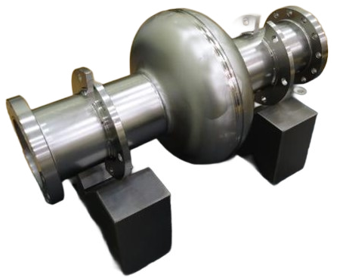
Theoretical perspective of SRF performance
Nov. 12, 2025
SRF Frontiers Workshop
T. Kubo
(2013)
High energy Accelerator Research Organization (KEK)
Innovation Center for Applied Superconducting Accelerators (iCASA)
Takayuki Kubo

Slide 2
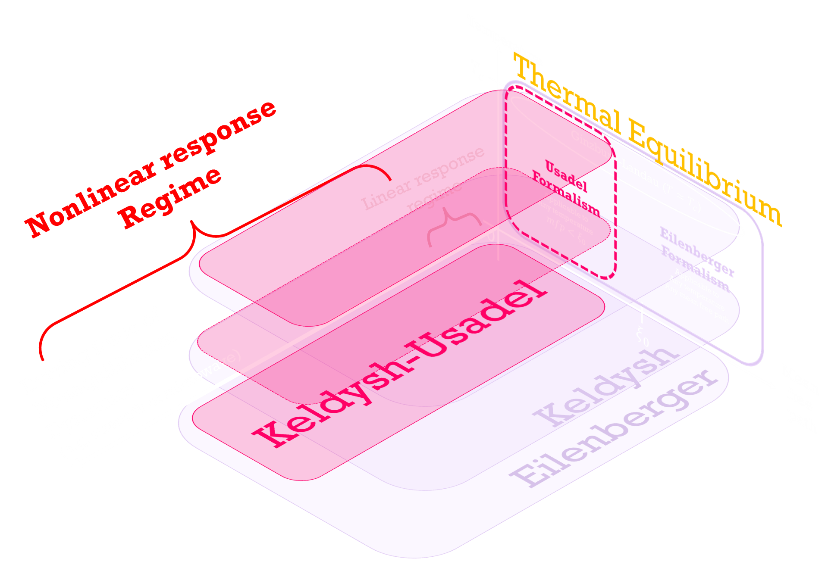
Overview of
the theoretical frameworks

Slide 3


Temperature
$$T_{c}$$
Mean
free
path
0
$$ξ_{0}$$

Slide 4

Temperature
$$T_{c}$$
Ginzburg-Landau ($T≃T_{c}$)
Mean
free
path
0
$$ξ_{0}$$

Slide 5
Temperature
$$T_{c}$$
Ginzburg-Landau ($T≃T_{c}$)
Eilenberger
Formalism
Applicable to
Any temperature
Any mean free path
Mean
free
path
0
$$ξ_{0}$$

Slide 6

Temperature
$$T_{c}$$
Ginzburg-Landau ($T≃T_{c}$)
Usadel
Formalism
Applicable to
Any temperature
$$mfp<ξ_{0}$$
Eilenberger
Formalism
Applicable to
Any temperature
Any mean free path
Mean
free
path
0
$$ξ_{0}$$

Slide 7
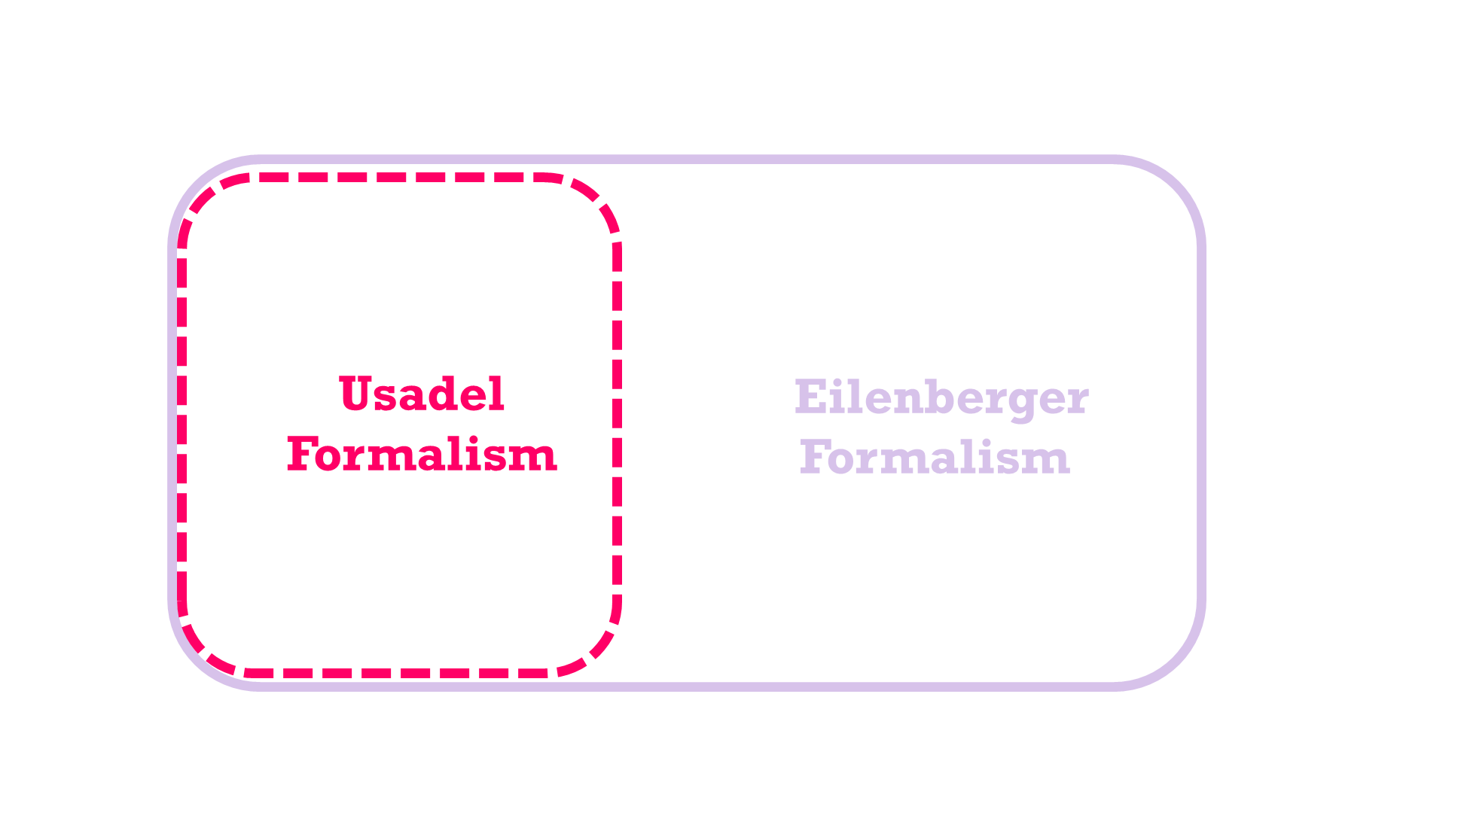
Under the ac field
Thermal Equilibrium
Driving force of
Nonequilibrium
Dynamics
(e.g, strength of microwave)

Slide 8
Under the ac field
Thermal Equilibrium
Linear response
regime
Driving force of
Nonequilibrium
Dynamics
(e.g, strength of microwave)

Slide 9
Under the ac field
Mattis-Bardeen
Theory
Thermal Equilibrium
Linear response
regime
Driving force of
Nonequilibrium
Dynamics
(e.g, strength of microwave)

Slide 10
Under the ac field
Mattis-Bardeen
Theory
Thermal Equilibrium
Nonlinear response
Regime
Linear response
regime
Driving force of
Nonequilibrium
Dynamics
(e.g, strength of microwave)

Slide 11
Under the ac field
Unfortunately, this is
the SRF accelerator regime
Mattis-Bardeen
Theory
Thermal Equilibrium
Nonlinear response
Regime
Linear response
regime
Driving force of
Nonequilibrium
Dynamics
(e.g, strength of microwave)

Slide 12
Under the ac field
Unfortunately, this is
the SRF accelerator regime
Mattis-Bardeen
Theory
Thermal Equilibrium
Nonlinear response
Regime
Linear response
regime
Keldysh
Eilenberger
Driving force of
Nonequilibrium
Dynamics
(e.g, strength of microwave)

Slide 13
Under the ac field
Unfortunately, this is
the SRF accelerator regime
Mattis-Bardeen
Theory
Thermal Equilibrium
Nonlinear response
Regime
Linear response
regime
Keldysh
Eilenberger
Driving force of
Nonequilibrium
Dynamics
(e.g, strength of microwave)

Slide 14
Under the ac field
Unfortunately, this is
the SRF accelerator regime
Mattis-Bardeen
Theory
Thermal Equilibrium
Nonlinear response
Regime
Linear response
regime
Keldysh
Eilenberger
Driving force of
Nonequilibrium
Dynamics
(e.g, strength of microwave)

Slide 15
Under the ac field
Unfortunately, this is
the SRF accelerator regime
Mattis-Bardeen
Theory
Thermal Equilibrium
Nonlinear response
Regime
Linear response
regime
Keldysh
Eilenberger
Keldysh-Usadel
Driving force of
Nonequilibrium
Dynamics
(e.g, strength of microwave)

Slide 16
Under the ac field
Unfortunately, this is
the SRF accelerator regime
Mattis-Bardeen
Theory
Thermal Equilibrium
Nonlinear response
Regime
Linear response
regime
Keldysh
Eilenberger
Keldysh-Usadel
Driving force of
Nonequilibrium
Dynamics
(e.g, strength of microwave)

Slide 17
Under the ac field
Unfortunately, this is
the SRF accelerator regime
Mattis-Bardeen
Theory
Thermal Equilibrium
Nonlinear response
Regime
Linear response
regime
Keldysh
Eilenberger
Keldysh-Usadel
Driving force of
Nonequilibrium
Dynamics
(e.g, strength of microwave)

Slide 18
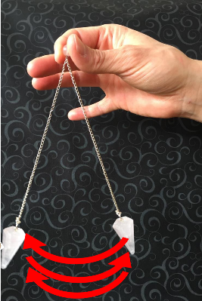

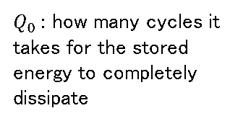
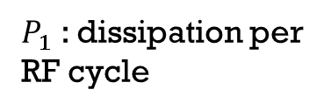
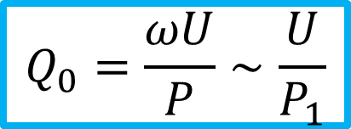
Quality factor $Q_{0}$
$$Q_{0}=\frac{ωU}{P}∼\frac{U}{P_{1}}$$
$P_{1}$ : dissipation per RF cycle
$Q_{0}$: how many cycles it takes for the stored energy to completely dissipate

Slide 19

The SRF accelerator regime
Linear response
regime
Nonlinear response
Regime
Thermal Equilibrium
Keldysh
Eilenberger
Keldysh-Usadel
Nonequilibrium
Dynamics
(e.g, strength of microwave)

Slide 20
Let us start from
the linear response
Linear response
regime
Thermal Equilibrium
Keldysh
Eilenberger
Keldysh-Usadel
Nonequilibrium
Dynamics
(e.g, strength of microwave)

Slide 21
Start from the Keldysh-Eilenberger equations (a set of equations for Green‘s functions and pair potential $Δ$)
D. Rainer and J. A. Sauls,
Strong coupling theory of superconductivity, in Superconductivity: From Basic Physics to the Latest Developments, edited by P. N. Butcher and Y. Lu (World Scientic, Singapore, 1995), p. 45.

Slide 22



Start from the Keldysh-Eilenberger equations (a set of equations for Green‘s functions and pair potential $Δ$)
D. Rainer and J. A. Sauls,
Strong coupling theory of superconductivity, in Superconductivity: From Basic Physics to the Latest Developments, edited by P. N. Butcher and Y. Lu (World Scientic, Singapore, 1995), p. 45.
We apply a small ac electromagnetic field and calculate the first-order perturbation to the current.
$$J∼A×●∼$$
Some
factor
$$A$$

Slide 23


Start from the Keldysh-Eilenberger equations (a set of equations for Green‘s functions and pair potential $Δ$)
D. Rainer and J. A. Sauls,
Strong coupling theory of superconductivity, in Superconductivity: From Basic Physics to the Latest Developments, edited by P. N. Butcher and Y. Lu (World Scientic, Singapore, 1995), p. 45.
We apply a small ac electromagnetic field and calculate the first-order perturbation to the current.
$$J∼A×●∼$$
Some
factor
$$A$$
Then,
the complex conductivity is given by
Some
factor
$$A$$
$$σ=\frac{J}{E}∼\frac{ }{A}$$

Slide 24
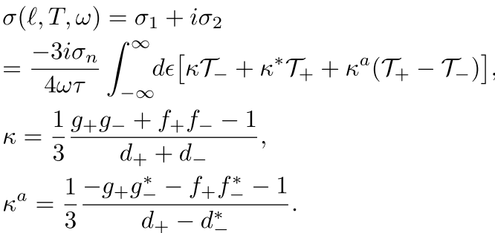
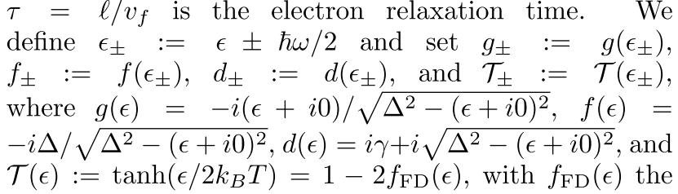
Complex conductivity formula for arbitrary MFP (for $λ≫ξ$)
W. Zimmermann, E. Brandt, M. Bauer, E. Seider, and L. Genzel, Optical conductivity of BCS superconductors with arbitrary purity, Physica C 183, 99 (1991).
D. Rainer and J. A. Sauls, Strong coupling theory of superconductivity, in Superconductivity: From Basic Physics to the Latest Developments, edited by P. N. Butcher and Y. Lu (World Scientic, Singapore, 1995), p. 45.
T. Kubo, Effects of Nonmagnetic Impurities and Subgap States on the Kinetic Inductance, Complex Conductivity, Quality Factor, and Depairing Current Density, Physical Review Applied 17, 014018 (2022)

Slide 25
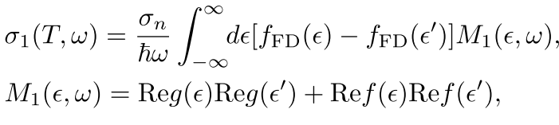
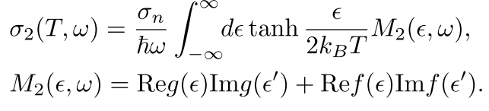
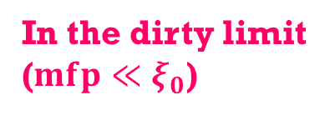

Complex conductivity formula for arbitrary MFP (for $λ≫ξ$)
W. Zimmermann, E. Brandt, M. Bauer, E. Seider, and L. Genzel, Optical conductivity of BCS superconductors with arbitrary purity, Physica C 183, 99 (1991).
D. Rainer and J. A. Sauls, Strong coupling theory of superconductivity, in Superconductivity: From Basic Physics to the Latest Developments, edited by P. N. Butcher and Y. Lu (World Scientic, Singapore, 1995), p. 45.
T. Kubo, Effects of Nonmagnetic Impurities and Subgap States on the Kinetic Inductance, Complex Conductivity, Quality Factor, and Depairing Current Density, Physical Review Applied 17, 014018 (2022)
In the dirty limit
($mfp≪ξ_{0}$)
The well-known
dirty-limit Mattis-Bardeen formula
$$ε^{′}≔ε+ℏω$$

Slide 26
Leading order
nonlinear
correction
Linear response
regime
Thermal Equilibrium
Keldysh
Eilenberger
Keldysh-Usadel
Nonequilibrium
Dynamics
(e.g, strength of microwave)

Slide 27
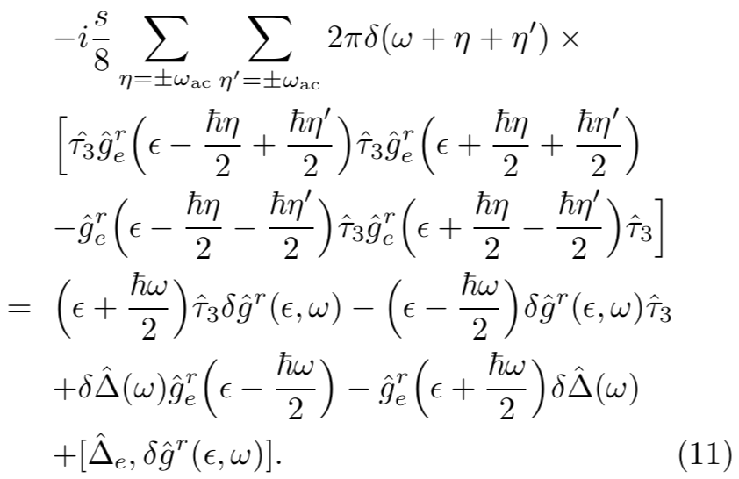
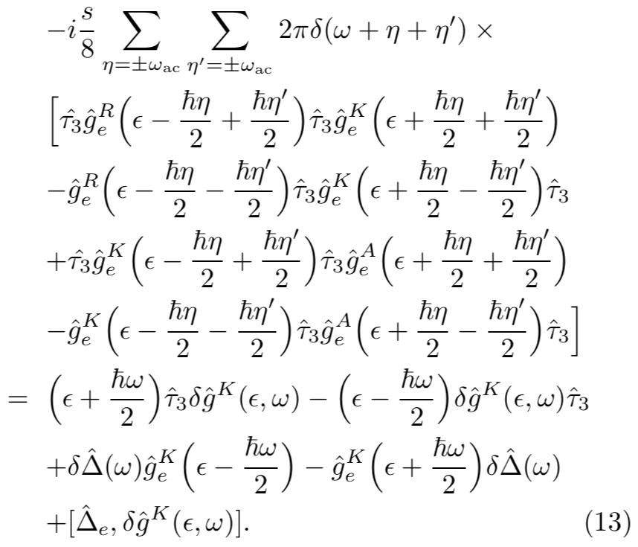
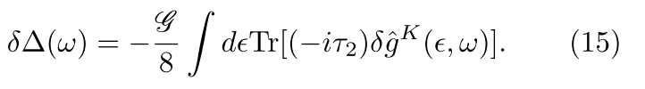
Keldysh–Usadel Equation for SC under a strong ac field
arXiv:2509.09766
We solve these equations to obtain the nonequilibrium corrections ($δ{\hat{g}}^{R, A, K}$ and $δΔ$).

Slide 28
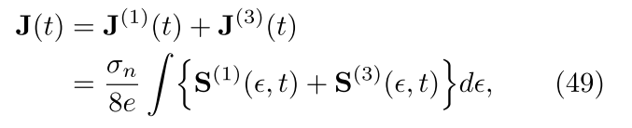
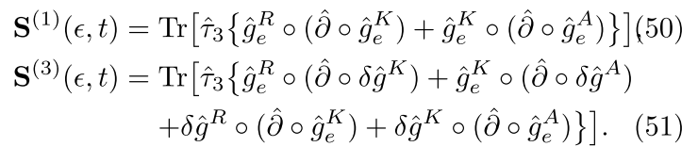


Keldysh–Usadel Equation for SC under a strong ac field
arXiv:2509.09766
We solve these equations to obtain the nonequilibrium corrections ($δ{\hat{g}}^{R, A, K}$ and $δΔ$).
To obtain the current response,
we substitute the solutions ($δ{\hat{g}}^{R, A, K}$, $δΔ$) into
← Linear response
← Nonlinear correction of $𝒪(A^{3})$

Slide 29

Schematically, the results can be illustrated as
$$J∼Agg+Agδg$$
Linear
response
Nonlinear corrections
← Linear response
← Nonlinear correction of $𝒪(A^{3})$

Slide 30
Schematically, the results can be illustrated as
$$J∼Agg+Agδg$$
Linear
response
Nonlinear corrections
← Linear response
← Nonlinear correction of $𝒪(A^{3})$

Slide 31

Schematically, the results can be illustrated as
$$J∼Agg+Agδg$$
Linear
response
Nonlinear corrections

Slide 32
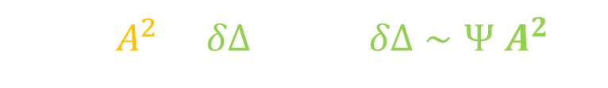
Schematically, the results can be illustrated as
$$J∼Agg+Agδg$$
$δg∼A^{2}+δΔ$ and $δΔ∼Ψ$ $A^{2}$
Linear
response
Nonlinear corrections

Slide 33



Schematically, the results can be illustrated as
$$J∼Agg+Agδg$$
$δg∼A^{2}+δΔ$ and $δΔ∼Ψ$ $A^{2}$
Linear
response
Nonlinear corrections
$$+$$
Contribution mediated
by the nonequilibrium
pair-potential variation
AAA contribution

Slide 34


Schematically, the results can be illustrated as
$$J∼Agg+Agδg$$
$δg∼A^{2}+δΔ$ and $δΔ∼Ψ$ $A^{2}$
Linear
response
Nonlinear corrections
$$+$$
Contribution mediated
by the nonequilibrium
pair-potential variation
AAA contribution
Note: This theory automatically includes
the Eliashberg effect (microwave-induced gap enhancement) as well as the Higgs-mode contribution.
Time averaged $δΔ$:
Eliashberg effect
Time dependent $δΔ$:
Higgs

Slide 35
Eliashberg effect?
Higgs?

Slide 36

Eliashberg effect?
Higgs?
The variation of order parameter $δΔ$ does not appear in standard linear-response theories such as Mattis–Bardeen theory because $δΔ$ is an $𝒪\left(A^{2}\right)$ effect, but it does emerge in nonlinear response.
$$δΔ∝A_{0}^{2}\cos^{2}{ωt}$$

Slide 37

Eliashberg effect?
Higgs?
The variation of order parameter $δΔ$ does not appear in standard linear-response theories such as Mattis–Bardeen theory because $δΔ$ is an $𝒪\left(A^{2}\right)$ effect, but it does emerge in nonlinear response.
$$δΔ∝A_{0}^{2}\cos^{2}{ωt}$$
$$∝1+\cos{2ωt}$$

Slide 38
Eliashberg effect?
Higgs?
The variation of order parameter $δΔ$ does not appear in standard linear-response theories such as Mattis–Bardeen theory because $δΔ$ is an $𝒪\left(A^{2}\right)$ effect, but it does emerge in nonlinear response.
$$δΔ∝A_{0}^{2}\cos^{2}{ωt}$$
$$∝1+\cos{2ωt}$$
Time-averaged nonequilibrium gap variation

Slide 39
Eliashberg effect?
Higgs?
The variation of order parameter $δΔ$ does not appear in standard linear-response theories such as Mattis–Bardeen theory because $δΔ$ is an $𝒪\left(A^{2}\right)$ effect, but it does emerge in nonlinear response.
$$δΔ∝A_{0}^{2}\cos^{2}{ωt}$$
$$∝1+\cos{2ωt}$$
Time-averaged nonequilibrium gap variation
Time dependent nonequilibrium gap variation

Slide 40

Eliashberg effect?
Higgs?
The variation of order parameter $δΔ$ does not appear in standard linear-response theories such as Mattis–Bardeen theory because $δΔ$ is an $𝒪\left(A^{2}\right)$ effect, but it does emerge in nonlinear response.
$$δΔ∝A_{0}^{2}\cos^{2}{ωt}$$
$$∝1+\cos{2ωt}$$
Time-averaged nonequilibrium gap variation
Time dependent nonequilibrium gap variation
qausiparticles
$$Δ$$

Slide 41


Eliashberg effect?
Higgs?
The variation of order parameter $δΔ$ does not appear in standard linear-response theories such as Mattis–Bardeen theory because $δΔ$ is an $𝒪\left(A^{2}\right)$ effect, but it does emerge in nonlinear response.
$$δΔ∝A_{0}^{2}\cos^{2}{ωt}$$
$$∝1+\cos{2ωt}$$
Time-averaged nonequilibrium gap variation
Time dependent nonequilibrium gap variation
qausiparticles
$$δΔ$$
Microwave induced
gap enhancement
$$Δ$$
$$Δ$$

Slide 42
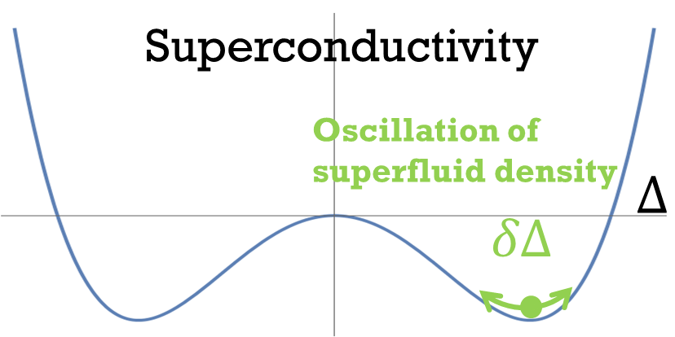
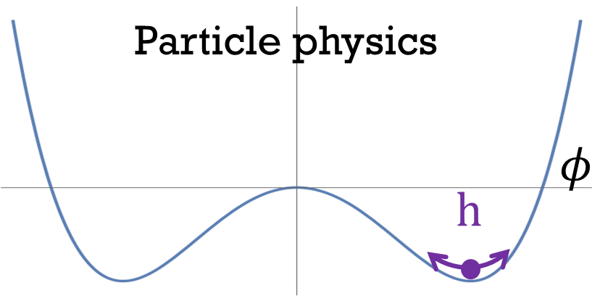
Eliashberg effect?
Higgs?
The variation of order parameter $δΔ$ does not appear in standard linear-response theories such as Mattis–Bardeen theory because $δΔ$ is an $𝒪\left(A^{2}\right)$ effect, but it does emerge in nonlinear response.
$$δΔ∝A_{0}^{2}\cos^{2}{ωt}$$
$$∝1+\cos{2ωt}$$
Time-averaged nonequilibrium gap variation
Time dependent nonequilibrium gap variation
$$δΔ$$
Microwave induced
gap enhancement
$$Δ$$
$$Δ$$

Slide 43
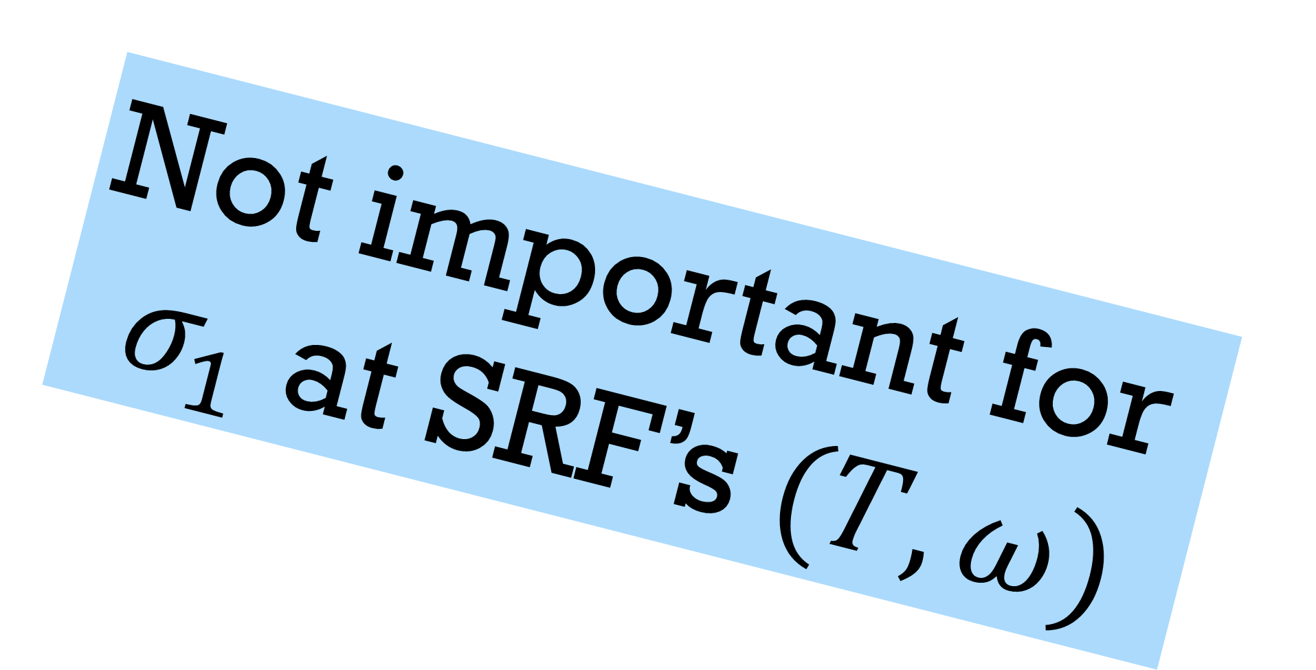
Eliashberg effect?
Higgs?
The variation of order parameter $δΔ$ does not appear in standard linear-response theories such as Mattis–Bardeen theory because $δΔ$ is an $𝒪\left(A^{2}\right)$ effect, but it does emerge in nonlinear response.
$$δΔ∝A_{0}^{2}\cos^{2}{ωt}$$
$$∝1+\cos{2ωt}$$
Not important for
$σ_{1}$ at SRF’s $(T,ω)$
Time-averaged nonequilibrium gap variation
Time dependent nonequilibrium gap variation
$$δΔ$$
Microwave induced
gap enhancement
$$Δ$$
$$Δ$$

Slide 44
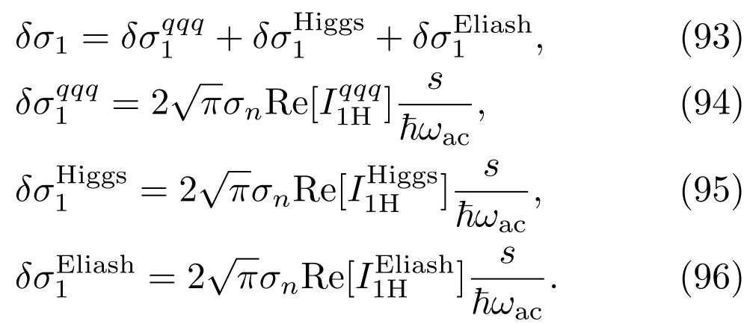
Nonlinear correction
arXiv:2509.09766

Slide 45
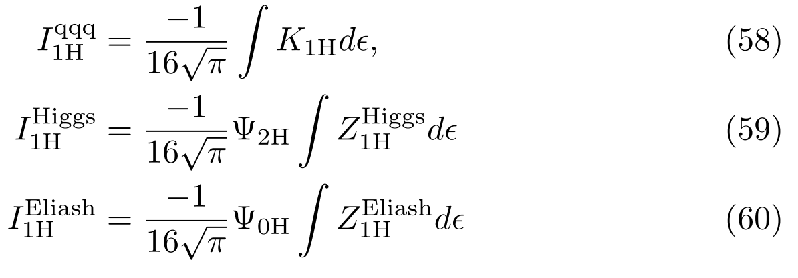
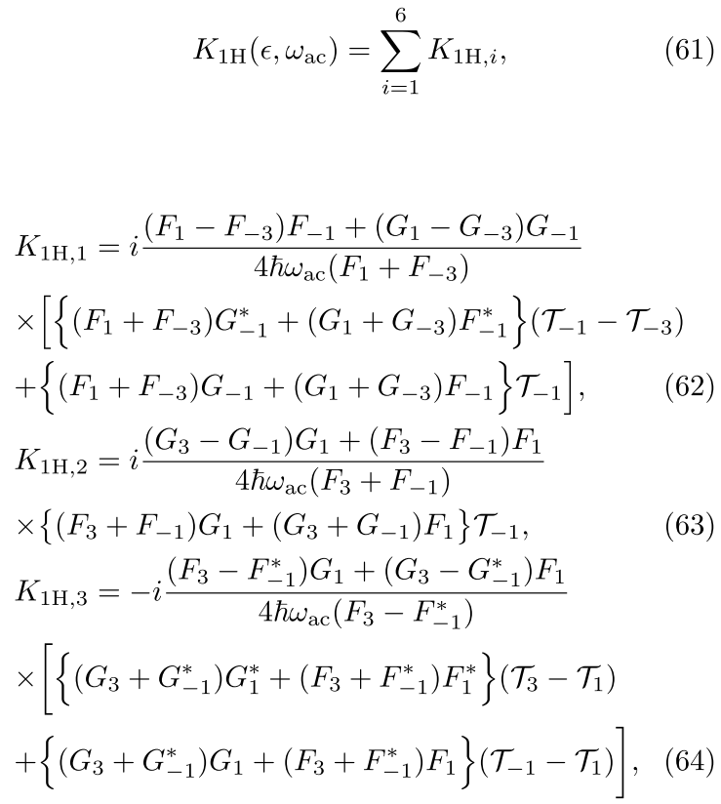
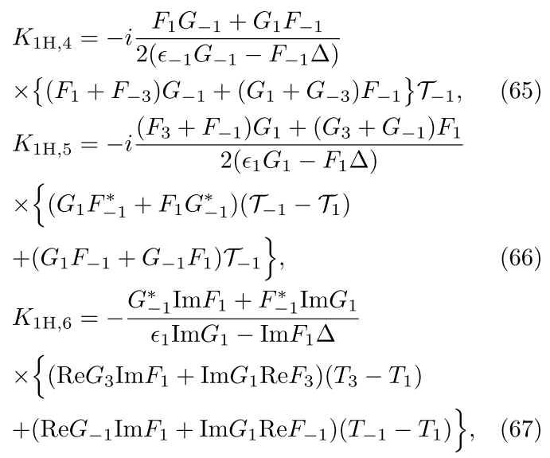
Nonlinear correction
arXiv:2509.09766

Slide 46
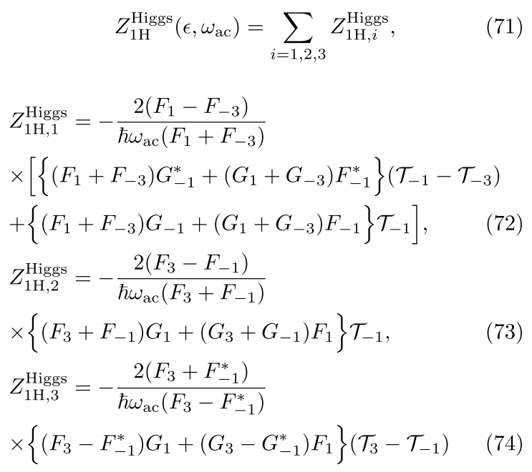
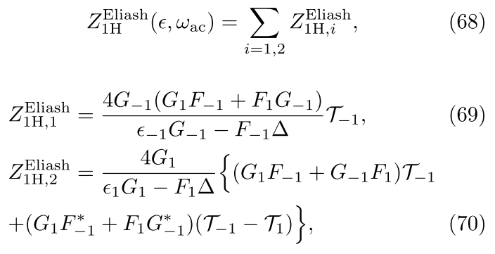


Nonlinear correction
arXiv:2509.09766
Higgs
Contribution:
Time dependent $δΔ$
Eliashberg
Contribution:
Time averaged $δΔ$

Slide 47
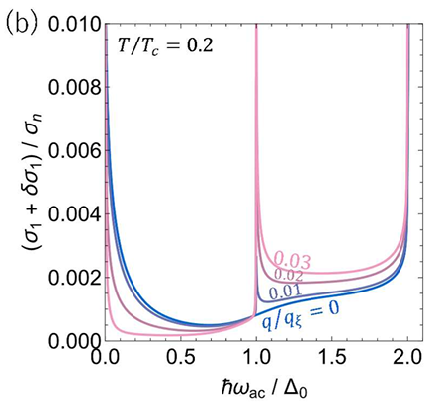
Results

Slide 48
Results
The resonance peak at Δ
comes from the Higgs mode

Slide 49
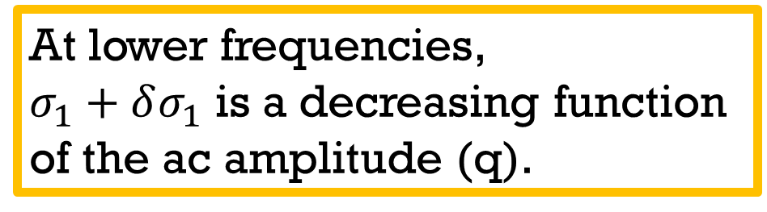
Results
The resonance peak at Δ
comes from the Higgs mode
At lower frequencies,
$σ_{1}+δσ_{1}$ is a decreasing function of the ac amplitude (q).

Slide 50
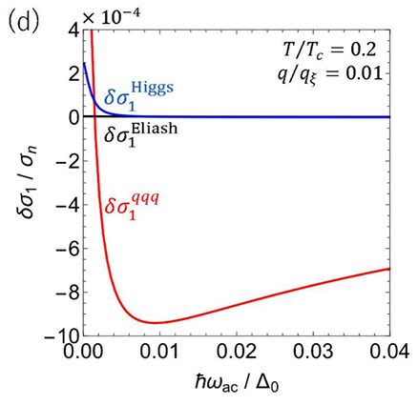
Results
The resonance peak at Δ
comes from the Higgs mode
At lower frequencies,
$σ_{1}+δσ_{1}$ is a decreasing function of the ac amplitude (q).
The AAA term is
the dominant contributor
at low frequencies

Slide 51
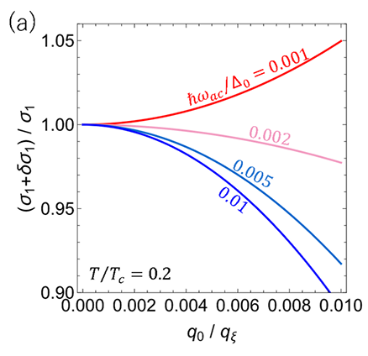
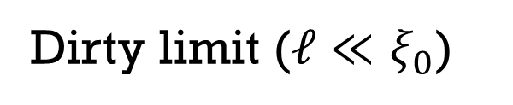
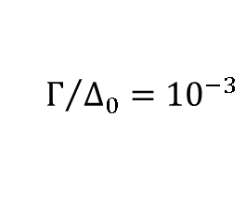
ac amplitude dependent dissipative conductivity
Dirty limit ($ℓ≪ξ_{0}$)
360MHz for Nb
720MHz for Nb
$$Γ/{Δ_{0}={10}^{−3}}$$
1.8GHz for Nb
3.6GHz for Nb
arXiv:2509.09766
Note: this corresponds to a few (mT)

Slide 52
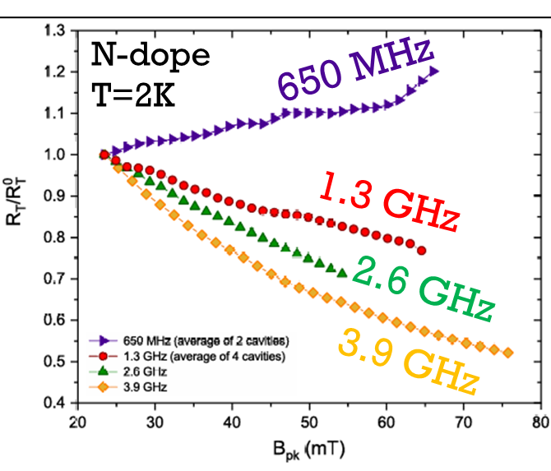


ac amplitude dependent dissipative conductivity
Dirty limit ($ℓ≪ξ_{0}$)
360MHz for Nb
Experiments:
Moderately dirty ($ℓ∼ξ_{0}$)
M. Martinello et al., PRL. 121, 224801 (2018)
P. Dhakal et al., PRAB 27, 062001 (2024)
720MHz for Nb
$$Γ/{Δ_{0}={10}^{−3}}$$
1.8GHz for Nb
3.6GHz for Nb
arXiv:2509.09766
M. Martinello et al., Phys. Rev. Lett. 121, 224801 (2018)
DOI: https://doi.org/10.1103/PhysRevLett.121.224801
Note: this corresponds to a few (mT)

Slide 53
ac amplitude dependent dissipative conductivity
Dirty limit ($ℓ≪ξ_{0}$)
360MHz for Nb
Experiments:
Moderately dirty ($ℓ∼ξ_{0}$)
M. Martinello et al., PRL. 121, 224801 (2018)
P. Dhakal et al., PRAB 27, 062001 (2024)
720MHz for Nb
$$Γ/{Δ_{0}={10}^{−3}}$$
1.8GHz for Nb
3.6GHz for Nb
arXiv:2509.09766
M. Martinello et al., Phys. Rev. Lett. 121, 224801 (2018)
DOI: https://doi.org/10.1103/PhysRevLett.121.224801
Note: this corresponds to a few (mT)

Slide 54
ac amplitude dependent dissipative conductivity
Experiments:
Moderately dirty ($ℓ∼ξ_{0}$)
M. Martinello et al., PRL. 121, 224801 (2018)
P. Dhakal et al., PRAB 27, 062001 (2024)
To deal with the red-framed region, the theory must be extended nonperturbatively to capture the quasiparticle spectrum modified by strong AC currents (DOS smearing).
Gurevich, PRL 113, 087001 (2014)
Kubo-Gurevich, PRB 100, 064522 (2019)
M. Martinello et al., Phys. Rev. Lett. 121, 224801 (2018)
DOI: https://doi.org/10.1103/PhysRevLett.121.224801

Slide 55
Linear
response
regime
Kubo, arXiv:2509.09766
Leading order
nonlinear
correction
Thermal Equilibrium
Keldysh
Eilenberger
Keldysh-Usadel
Nonequilibrium
Dynamics
(e.g, strength of microwave)

Slide 56
Linear
response
regime
Kubo, arXiv:2509.09766
Leading order
nonlinear
correction
Thermal Equilibrium
The SRF theory
(Deep Nonlinear Regime)
Keldysh
Eilenberger
Keldysh-Usadel
Nonequilibrium
Dynamics
(e.g, strength of microwave)

Slide 57
T. Kubo, arXiv:2509.09766 (2025)
Nonperturbative treatment (DOS smearing et al.)
Linear
response
regime
Kubo, arXiv:2509.09766
Gurevich, PRL 113, 087001 (2014)
Kubo-Gurevich, PRB 100, 064522 (2019)
Leading order
nonlinear
correction
Thermal Equilibrium
The SRF theory
(Deep Nonlinear Regime)
Keldysh
Eilenberger
Keldysh-Usadel
Nonequilibrium
Dynamics
(e.g, strength of microwave)

Slide 58


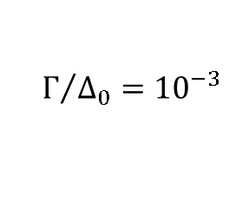
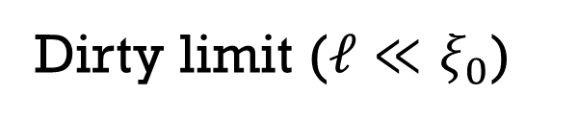
Theoretical prediction: effects of the inelastic scattering rate
$$Γ/{Δ_{0}=0.001}$$
$$Γ/{Δ_{0}=}0.01$$
Dirty limit ($ℓ≪ξ_{0}$)
360MHz for Nb
720MHz for Nb
1.8GHz for Nb
$$Γ/{Δ_{0}={10}^{−3}}$$
3.6GHz for Nb
arXiv:2509.09766

Slide 59
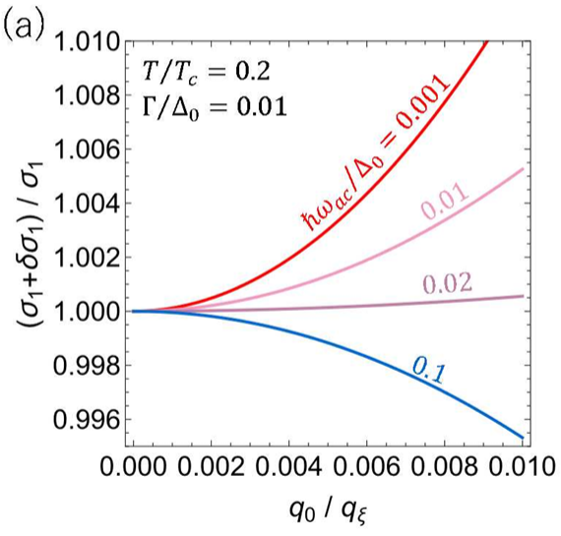
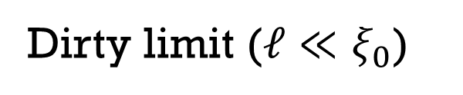
Theoretical prediction: effects of the inelastic scattering rate
$$Γ/{Δ_{0}=0.001}$$
$$Γ/{Δ_{0}=}0.01$$
Dirty limit ($ℓ≪ξ_{0}$)
Dirty limit ($ℓ≪ξ_{0}$)
360MHz for Nb
360MHz for Nb
3.6GHz for Nb
720MHz for Nb
1.8GHz for Nb
7.2GHz for Nb
$$Γ/{Δ_{0}={10}^{−3}}$$
3.6GHz for Nb
36GHz for Nb
arXiv:2509.09766
appendix
arXiv:2509.09766

Slide 60
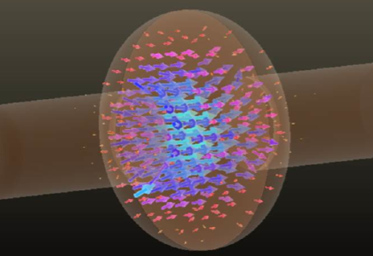
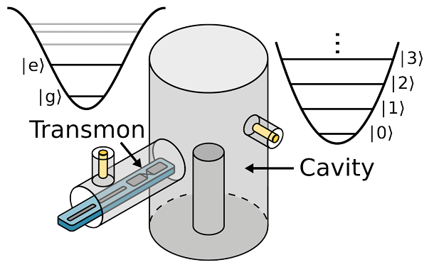
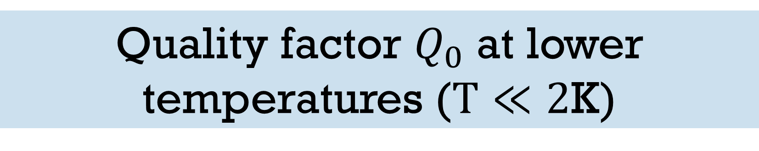
Quality factor $Q_{0}$ at lower temperatures ($T≪2$K)
Quantum memory cavity
for quantum computing
Accelerator cavity
Brock et al., Nature 641, 612 (2025)
https://doi.org/10.1038/s41586-025-08899-y

Slide 61
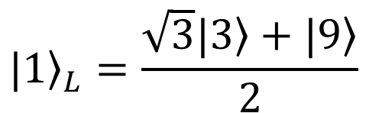

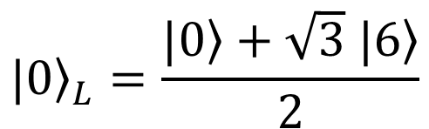



High-Q superconducting cavities allow us to store quantum information redundantly, enabling bosonic error correction.
Brock et al., Nature 641, 612 (2025)
https://doi.org/10.1038/s41586-025-08899-y
Known to reduce the required number of qubits by one to two orders of magnitude.
e.g. binomial code
$${\left.|0\right\rangle }_{L}=\frac{|\left.0\right\rangle +\sqrt{3} |\left.6\right\rangle }{2}$$
$$\left.|5\right\rangle$$
$$\left.|4\right\rangle$$
1 photon loss
1 photon loss
$${\left.|1\right\rangle }_{L}=\frac{\sqrt{3}|\left.3\right\rangle +|\left.9\right\rangle }{2}$$
$$\frac{|\left.2\right\rangle +|\left.8\right\rangle }{\sqrt{2}}$$
$$\frac{|\left.1\right\rangle +2|\left.7\right\rangle }{\sqrt{3}}$$
correct
a remainder of 2
when divided by 3
a remainder of 1
when divided by 3
correct

Slide 62
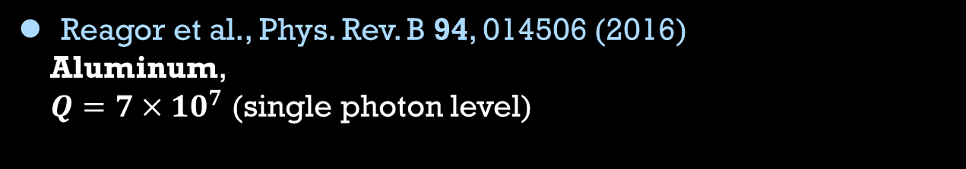
3D coaxial cavity progress
Brock et al., Nature 641, 612 (2025)
https://doi.org/10.1038/s41586-025-08899-y
Yale University
Reagor et al., Phys. Rev. B 94, 014506 (2016)
Aluminum,
$Q=7×{10}^{7}$ (single photon level)

Slide 63
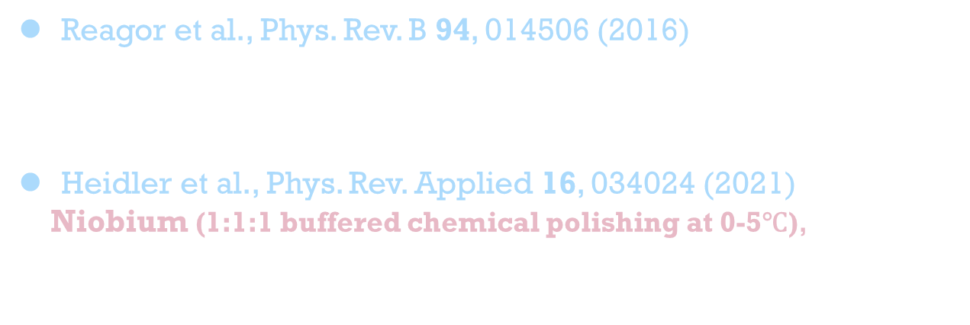
3D coaxial cavity progress
Brock et al., Nature 641, 612 (2025)
https://doi.org/10.1038/s41586-025-08899-y
Yale University
Reagor et al., Phys. Rev. B 94, 014506 (2016)
Aluminum,
$Q=7×{10}^{7}$ (single photon level)
Heidler et al., Phys. Rev. Applied 16, 034024 (2021)
Niobium (1:1:1 buffered chemical polishing at 0-5℃),
$Q=5×{10}^{8}$ (single photon level)
University of Innsbruck

Slide 64
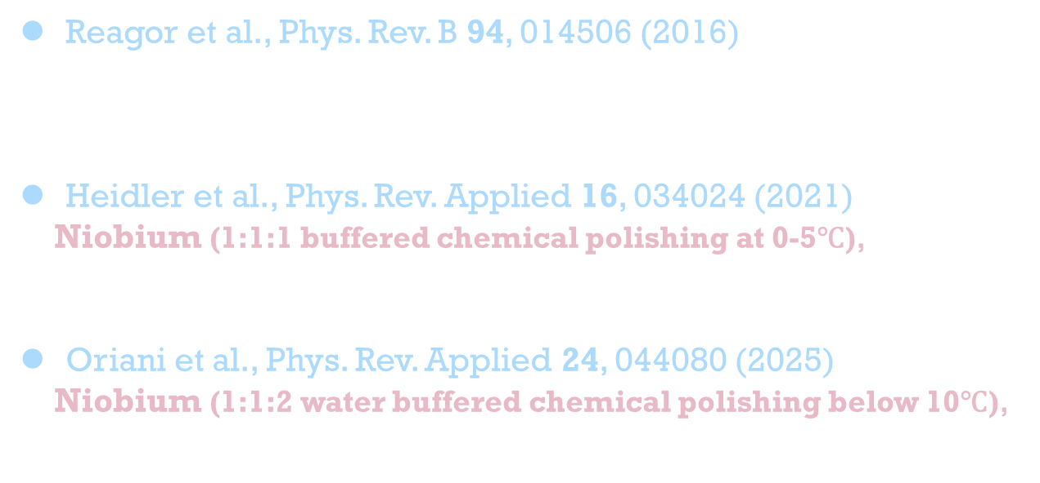
3D coaxial cavity progress
Brock et al., Nature 641, 612 (2025)
https://doi.org/10.1038/s41586-025-08899-y
Yale University
Reagor et al., Phys. Rev. B 94, 014506 (2016)
Aluminum,
$Q=7×{10}^{7}$ (single photon level)
Heidler et al., Phys. Rev. Applied 16, 034024 (2021)
Niobium (1:1:1 buffered chemical polishing at 0-5℃),
$Q=5×{10}^{8}$ (single photon level)
Oriani et al., Phys. Rev. Applied 24, 044080 (2025)
Niobium (1:1:2 water buffered chemical polishing below 10℃),
$Q=1.4×{10}^{9}$ (single photon level)
University of Innsbruck
University of Chicago
↑
The world record (as of 2024)

Slide 65
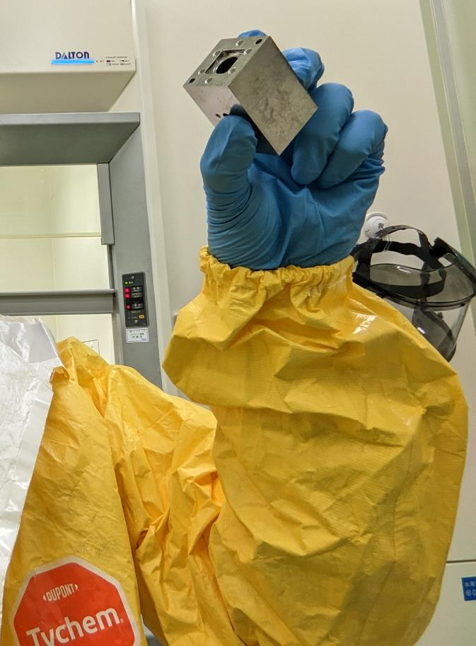
Sometimes, I do experiments (BCP etc)
cavity→
Kubo
↓

Slide 66
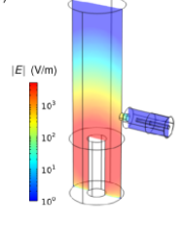

Sometimes, I do experiments (BCP etc)
T. Takenaka, T. Kubo et al.,
arXiv:2510.01819.
Nb coaxial cavity of KEK-NTT collaboration
cavity→
Kubo
↓

Slide 67

Sometimes, I do experiments (BCP etc)
T. Takenaka, T. Kubo et al.,
arXiv:2510.01819.
Nb coaxial cavity of KEK-NTT collaboration
cavity→
Kubo
↓
20mK & Single photon level
We broke
the world record!!!→
Corresponding to
photon lifetime of
~0.1 sec.
T. Takenaka, T. Kubo et al.,
arXiv:2510.01819.

Slide 68

3D coaxial cavity progress
Brock et al., Nature 641, 612 (2025)
https://doi.org/10.1038/s41586-025-08899-y
Yale University
Reagor et al., Phys. Rev. B 94, 014506 (2016)
Aluminum,
$Q=7×{10}^{7}$ (single photon level)
Heidler et al., Phys. Rev. Applied 16, 034024 (2021)
Niobium (1:1:1 buffered chemical polishing at 0-5℃),
$Q=5×{10}^{8}$ (single photon level)
Oriani et al., Phys. Rev. Applied 24, 044080 (2025)
Niobium (1:1:2 water buffered chemical polishing below 10℃),
$Q=1.4×{10}^{9}$ (single photon level)
T. Takenaka, T. Kubo et al., arXiv:2510.01819 (2025)
Niobium (1:1:1 BCP at 25℃ + 900℃ anneal
+ 1:1:1 BCP flush at 25℃ + 600℃ anneal)
Q=3×10⁹ (single photon level)
University of Innsbruck
University of Chicago
KEK&NTT
T. Takenaka, T. Kubo et al.,
arXiv:2510.01819.
The world record

Slide 69


TLS fit
TLS fit
T. Takenaka, T. Kubo et al.,
arXiv:2510.01819.
Even in this record-high-Q cavity, TLS defects still limit the quality factor.
Understanding TLS physics and developing engineering methods to mitigate them are necessary to realize ultra-high-Q cavities for accelerators and quantum computing.
TLS fit
TLS fit
Maybe, my next project.

Slide 71


Gradient $E_{acc}$ (microwave amplitude)
Electric field
Magnetic field

Slide 72


Electric field
T. Kubo
(2013)
$$B_{0}=g E_{acc}$$

Slide 73



$$μ_{0}H_{0}$$
0mT
85mT
170mT
210mT
$$μ_{0}H_{sh}$$
of Nb
Magnetic field
$≃μ_{0}H_{c1}$
of Nb
$$B_{0}=g E_{acc}$$

Slide 74

(⌐■_■) good
Low field (Meissner state)
$$μ_{0}H_{0}$$
0mT
85mT
170mT
210mT
$$μ_{0}H_{sh}$$
of Nb
Magnetic field
$≃μ_{0}H_{c1}$
of Nb
$$B_{0}=g E_{acc}$$

Slide 75
(⌐■_■) good
Low field (Meissner state)
$$μ_{0}H_{0}$$
0mT
85mT
170mT
210mT
$$μ_{0}H_{sh}$$
of Nb
Magnetic field
$≃μ_{0}H_{c1}$
of Nb
$$B_{0}=g E_{acc}$$

Slide 76

＼(^o^)／I’m doomed
High field (vortex state)
$$μ_{0}H_{0}$$
0mT
85mT
170mT
210mT
$$μ_{0}H_{sh}$$
of Nb
Magnetic field
$≃μ_{0}H_{c1}$
of Nb
$$B_{0}=g E_{acc}$$

Slide 77


The ultimate limit of cavities made from bulk material is considered as
$$B_{c1}≤B_{0}^{max}<B_{sh}$$
$$μ_{0}H_{0}$$
0mT
85mT
170mT
210mT
$$μ_{0}H_{sh}$$
of Nb
Magnetic field
$≃μ_{0}H_{c1}$
of Nb
$B_{c1}$:​ the lower critical field, above which the Meissner state becomes energetically unfavorable.
$B_{sh}$: the superheating field, which represents the stability limit of the Meissner state. Ultimate limit for the ideal material.
$$B_{0}=g E_{acc}$$

Slide 78


Maximum field achieved so far
Already close to the theoretical limit?
T. Kubo, Jpn. J. Appl. Phys. 64, 018002 (2025)

Slide 79



Summary of the superheating field
Intrinsic $\frac{λ_{0}}{ξ_{0}}$
Purity
(mfp $ℓ$)
Theory
(applicable to SRF temperature $T≪T_{c}$)

Slide 80

Summary of the superheating field
Intrinsic $\frac{λ_{0}}{ξ_{0}}$
Purity
(mfp $ℓ$)
Theory
(applicable to SRF temperature $T≪T_{c}$)
$\frac{λ_{0}}{ξ_{0}}≫1$
(e.g., Nb₃Sn,
NbN, NbTiN etc.)

Slide 81

Summary of the superheating field
Intrinsic $\frac{λ_{0}}{ξ_{0}}$
Purity
(mfp $ℓ$)
Theory
(applicable to SRF temperature $T≪T_{c}$)
$\frac{λ_{0}}{ξ_{0}}≫1$
$ℓ≫ξ_{0}$
(clean)
(e.g., Nb₃Sn,
NbN, NbTiN etc.)

Slide 82


Summary of the superheating field
Intrinsic $\frac{λ_{0}}{ξ_{0}}$
Purity
(mfp $ℓ$)
Theory
(applicable to SRF temperature $T≪T_{c}$)
$\frac{λ_{0}}{ξ_{0}}≫1$
Analytical result for T=0.
V. P. Galaiko, Sov. Phys. JETP 23, 475 (1966)
$ℓ≫ξ_{0}$
(clean)
$$H_{sh}(0)=0.84H_{c}(0)$$
$H_{sh}\left(T\right)$ for $0≤T≤T_{c}$
G. Catelani and J. P. Sethna,
Phys. Rev. B 78, 224509 (2008)
F. Pei-Jen Lin and A. Gurevich,
Phys. Rev. B 85, 054513 (2012)
(e.g., Nb₃Sn,
NbN, NbTiN etc.)

Slide 83



Summary of the superheating field
Intrinsic $\frac{λ_{0}}{ξ_{0}}$
Purity
(mfp $ℓ$)
Theory
(applicable to SRF temperature $T≪T_{c}$)
$$H_{sh}(0)=0.84H_{c}(0)$$
Analytical result for T=0.
V. P. Galaiko, Sov. Phys. JETP 23, 475 (1966)
$\frac{λ_{0}}{ξ_{0}}≫1$
$ℓ≫ξ_{0}$
(clean)
$H_{sh}\left(T\right)$ for $0≤T≤T_{c}$
G. Catelani and J. P. Sethna,
Phys. Rev. B 78, 224509 (2008)
F. Pei-Jen Lin and A. Gurevich,
Phys. Rev. B 85, 054513 (2012)
(e.g., Nb₃Sn,
NbN, NbTiN etc.)
any $ℓ$
(from clean limit
to dirty limit)
$H_{sh}\left(T\right)$ for $0≤T≤T_{c}$
F. Pei-Jen Lin and A. Gurevich,
Phys. Rev. B 85, 054513 (2012)

Slide 84



Summary of the superheating field
Intrinsic $\frac{λ_{0}}{ξ_{0}}$
Purity
(mfp $ℓ$)
Theory
(applicable to SRF temperature $T≪T_{c}$)
$$H_{sh}(0)=0.84H_{c}(0)$$
Analytical result for T=0.
V. P. Galaiko, Sov. Phys. JETP 23, 475 (1966)
$\frac{λ_{0}}{ξ_{0}}≫1$
$ℓ≫ξ_{0}$
(clean)
$H_{sh}\left(T\right)$ for $0≤T≤T_{c}$
G. Catelani and J. P. Sethna,
Phys. Rev. B 78, 224509 (2008)
F. Pei-Jen Lin and A. Gurevich,
Phys. Rev. B 85, 054513 (2012)
(e.g., Nb₃Sn,
NbN, NbTiN etc.)
any $ℓ$
(from clean limit
to dirty limit)
$H_{sh}\left(T\right)$ for $0≤T≤T_{c}$
F. Pei-Jen Lin and A. Gurevich,
Phys. Rev. B 85, 054513 (2012)
F. Pei-Jen Lin and A. Gurevich,
Phys. Rev. B 85, 054513 (2012)
T. Kubo, Phys. Rev. Research 2, 033203 (2020)
$H_{sh}\left(T\right)$ for $0≤T≤T_{c}$
$ℓ≪ξ_{0}$
(dirty)
Analytical result for T=0.
T. Kubo, Phys. Rev. Research 2, 033203 (2020)
T. Kubo, Supercond.Sci. Tecnol. 34, 045006 (2021)
$$H_{sh}(0)=0.795H_{c}(0)$$

Slide 85

Summary of the superheating field
Intrinsic $\frac{λ_{0}}{ξ_{0}}$
Purity
(mfp $ℓ$)
Theory
(applicable to SRF temperature $T≪T_{c}$)
$$H_{sh}(0)=0.84H_{c}(0)$$
Analytical result for T=0.
V. P. Galaiko, Sov. Phys. JETP 23, 475 (1966)
$\frac{λ_{0}}{ξ_{0}}≫1$
$ℓ≫ξ_{0}$
(clean)
$H_{sh}\left(T\right)$ for $0≤T≤T_{c}$
G. Catelani and J. P. Sethna,
Phys. Rev. B 78, 224509 (2008)
F. Pei-Jen Lin and A. Gurevich,
Phys. Rev. B 85, 054513 (2012)
(e.g., Nb₃Sn,
NbN, NbTiN etc.)
any $ℓ$
(from clean limit
to dirty limit)
$H_{sh}\left(T\right)$ for $0≤T≤T_{c}$
F. Pei-Jen Lin and A. Gurevich,
Phys. Rev. B 85, 054513 (2012)
F. Pei-Jen Lin and A. Gurevich,
Phys. Rev. B 85, 054513 (2012)
T. Kubo, Phys. Rev. Research 2, 033203 (2020)
$H_{sh}\left(T\right)$ for $0≤T≤T_{c}$
$ℓ≪ξ_{0}$
(dirty)
$$\frac{λ_{0}}{ξ_{0}}≲1$$
Analytical result for T=0.
T. Kubo, Phys. Rev. Research 2, 033203 (2020)
T. Kubo, Supercond.Sci. Tecnol. 34, 045006 (2021)
$$H_{sh}(0)=0.795H_{c}(0)$$
(e.g., Nb)

Slide 86


Summary of the superheating field
Intrinsic $\frac{λ_{0}}{ξ_{0}}$
Purity
(mfp $ℓ$)
Theory
(applicable to SRF temperature $T≪T_{c}$)
$$H_{sh}(0)=0.84H_{c}(0)$$
Analytical result for T=0.
V. P. Galaiko, Sov. Phys. JETP 23, 475 (1966)
$\frac{λ_{0}}{ξ_{0}}≫1$
$ℓ≫ξ_{0}$
(clean)
$H_{sh}\left(T\right)$ for $0≤T≤T_{c}$
G. Catelani and J. P. Sethna,
Phys. Rev. B 78, 224509 (2008)
F. Pei-Jen Lin and A. Gurevich,
Phys. Rev. B 85, 054513 (2012)
(e.g., Nb₃Sn,
NbN, NbTiN etc.)
any $ℓ$
(from clean limit
to dirty limit)
$H_{sh}\left(T\right)$ for $0≤T≤T_{c}$
F. Pei-Jen Lin and A. Gurevich,
Phys. Rev. B 85, 054513 (2012)
F. Pei-Jen Lin and A. Gurevich,
Phys. Rev. B 85, 054513 (2012)
T. Kubo, Phys. Rev. Research 2, 033203 (2020)
$H_{sh}\left(T\right)$ for $0≤T≤T_{c}$
$ℓ≪ξ_{0}$
(dirty)
$$\frac{λ_{0}}{ξ_{0}}≲1$$
Analytical result for T=0.
T. Kubo, Phys. Rev. Research 2, 033203 (2020)
T. Kubo, Supercond.Sci. Tecnol. 34, 045006 (2021)
$$H_{sh}(0)=0.795H_{c}(0)$$
any $ℓ$
(from clean limit
to dirty limit)
(e.g., Nb)
N/A
We don’t know $H_{sh}$ of clean Nb

Slide 87
Maximum field achieved so far
Already close to the theoretical limit?
T. Kubo, Jpn. J. Appl. Phys. 64, 018002 (2025)

Slide 88

Maximum field achieved so far
Already close to the theoretical limit?
The answer: we currently have no reliable estimate, because there is no theory of $H_{sh}$ applicable to clean Nb at $T≪T_{c}$.
T. Kubo, Jpn. J. Appl. Phys. 64, 018002 (2025)

Slide 89

Maximum field achieved so far
Already close to the theoretical limit?
The answer: we currently have no reliable estimate, because there is no theory of $H_{sh}$ applicable to clean Nb at $T≪T_{c}$.
Ginzburg–Landau (GL) theory, valid near $T≈T_{c}$, gives
$$B_{sh}\left(T\right){\left.​\right|}_{T≃T_{c}}=1.26B_{c}\left(T\right){\left.​\right|}_{{T≃T}_{c}}$$
$$\left(κ=\frac{λ}{ξ}=1\right)$$
T. Kubo, Jpn. J. Appl. Phys. 64, 018002 (2025)
A. J. Dolgert et al., Phys. Rev. B 53, 5650 (1996)
M. K. Transtrum et al., Phys. Rev. B 83, 094505 (2011)

Slide 90

Maximum field achieved so far
Already close to the theoretical limit?
The answer: we currently have no reliable estimate, because there is no theory of $H_{sh}$ applicable to clean Nb at $T≪T_{c}$.
Ginzburg–Landau (GL) theory, valid near $T≈T_{c}$, gives
$$B_{sh}\left(T\right){\left.​\right|}_{T≃T_{c}}=1.26B_{c}\left(T\right){\left.​\right|}_{{T≃T}_{c}}$$
$$\left(κ=\frac{λ}{ξ}=1\right)$$
If we naively extrapolate this to low temperatures — not theoretically justified — we obtain the rough estimate
$B_{sh}\left(0\right)=1.26B_{c}\left(0\right)$ ?
$=250$ mT ?
T. Kubo, Jpn. J. Appl. Phys. 64, 018002 (2025)
A. J. Dolgert et al., Phys. Rev. B 53, 5650 (1996)
M. K. Transtrum et al., Phys. Rev. B 83, 094505 (2011)

Slide 91



If we believe this rough
estimate of $B_{sh}$ based on GL, we get
T. Kubo, Jpn. J. Appl. Phys. 64, 018002 (2025)
T. Kubo, Jpn. J. Appl. Phys. 64, 018002 (2025)
Note: To achieve $B_{sh}$, it is necessary to eliminate all surface defects. However, this alone is not sufficient to reach $B_{sh}$; it is also essential to ensure that the thermal runaway field $B_{run}$ exceeds $B_{sh}$.
This condition is not always satisfied, particularly at 2 K. It is better to test the cavity at lower temperatures (e.g., 1.8K or 1.6K) to ensure that the condition $B_{run}>B_{sh}$ is satisfied.

Slide 92
NOTE
The above superheating-field theories calculate the dc (equilibrium) superheating field.
Thermal Equilibrium
Keldysh
Eilenberger
Keldysh-Usadel
Driving force of
Nonequilibrium
Dynamics
(e.g, strength of microwave)

Slide 93
NOTE
The above superheating-field theories calculate the dc (equilibrium) superheating field.
Thermal Equilibrium
Is the ac (nonequilibrium) superheating field equivalent to the dc one?
Keldysh
Eilenberger
Keldysh-Usadel
Driving force of
Nonequilibrium
Dynamics
(e.g, strength of microwave)

Slide 94


Summary of my perspective
($≃w$hat I am interested in)
We are only one step away from establishing the SRF theory.
T. Kubo,
arXiv:2509.09766 (2025)
+
Nonperturbative treatment (DOS smearing et al.)
Gurevich, PRL 113, 087001 (2014)
Kubo-Gurevich, PRB 100, 064522 (2019)
→
the SRF theory
Understanding TLS is essential to realizing ultra-high-$Q$ cavities.
The dc superheating field is largely understood, whereas that of clean Nb has not yet been fully understood. In addition, the ac superheating field remains largely unexplored.

Slide 96
Backup

Slide 97
dc + ac

Slide 98


If the AC field is absent, this reduces to a problem of equilibrium superconductivity.
That case was already well understood decades ago.
T. Kubo, Phys. Rev. Applied 22, 044042 (2024) DOI: https://doi.org/10.1103/PhysRevApplied.22.044042
See also, T. Kubo, Phys. Rev. Research 2, 033203 (2020); F. Pei-Jen Lin and A. Gurevich, Phys. Rev. B 85, 054513 (2012)

Slide 99

If the AC field is absent, this reduces to a problem of equilibrium superconductivity.
That case was already well understood decades ago.
T. Kubo, Phys. Rev. Applied 22, 044042 (2024) DOI: https://doi.org/10.1103/PhysRevApplied.22.044042
See also, T. Kubo, Phys. Rev. Research 2, 033203 (2020); F. Pei-Jen Lin and A. Gurevich, Phys. Rev. B 85, 054513 (2012)

Slide 100

If the AC field is absent, this reduces to a problem of equilibrium superconductivity.
That case was already well understood decades ago.
T. Kubo, Phys. Rev. Applied 22, 044042 (2024) DOI: https://doi.org/10.1103/PhysRevApplied.22.044042
See also, T. Kubo, Phys. Rev. Research 2, 033203 (2020); F. Pei-Jen Lin and A. Gurevich, Phys. Rev. B 85, 054513 (2012)

Slide 101


However, once an AC field is present, the problem becomes much more complicated. In that case, we need to use the theory of nonequilibrium superconductivity.
A. Moor et al., Phys. Rev. Lett. 118, 047001 (2017)
T. Jujo, J. Phys. Soc. Jpn. 91, 074711 (2022)
T. Kubo, Phys. Rev. Applied 22, 044042 (2024)
T. Kubo, Phys. Rev. Applied 23, 054091 (2025)
The Keldysh-Eilenberger theory is a microscopic theory of nonequilibrium superconductivity. It is applicable at any temperature ($0≤T≤T_{c}$) and for arbitrary mean free path. In this sense, it serves as the “theory of everything for conventional superconductivity”.
The Keldysh–Usadel theory represents the dirty-limit reduction of the Keldysh–Eilenberger theory of nonequilibrium superconductivity, applicable at any T ($0≤T≤T_{c}$).
T. Kubo, Phys. Rev. Applied 22, 044042 (2024)
T. Kubo, Phys. Rev. Applied 23, 054091 (2025)

Slide 102



Keldysh–Usadel Equation: DC Current with AC Perturbation
T. Kubo, Phys. Rev. Applied 23, 054091 (2025)
Higgs
↓
We solve these equations to obtain the AC-induced nonequilibrium corrections ($δ{\hat{g}}^{R, A, K}$ and $δΔ$).

Slide 103



Keldysh–Usadel Equation: DC Current with AC Perturbation
T. Kubo, Phys. Rev. Applied 23, 054091 (2025)
Higgs
↓
We solve these equations to obtain the AC-induced nonequilibrium corrections ($δ{\hat{g}}^{R, A, K}$ and $δΔ$).
Higgs?
Particle physics
$$φ$$
$$h$$

Slide 104


Keldysh–Usadel Equation: DC Current with AC Perturbation
T. Kubo, Phys. Rev. Applied 23, 054091 (2025)
Higgs
↓
We solve these equations to obtain the AC-induced nonequilibrium corrections ($δ{\hat{g}}^{R, A, K}$ and $δΔ$).
Higgs?
Particle physics
Superconductivity
Oscillation of
superfluid density
$$φ$$
$$Δ$$
$$h$$
$$δΔ$$

Slide 105

Keldysh–Usadel Equation: DC Current with AC Perturbation
T. Kubo, Phys. Rev. Applied 23, 054091 (2025)
Higgs
↓
We solve these equations to obtain the AC-induced nonequilibrium corrections ($δ{\hat{g}}^{R, A, K}$ and $δΔ$).
Higgs?
See the famous review paper:
R. Shimano and N. Tsuji,
Annu. Rev. Condens. Matter Phys. 11, 103 (2020)
Superconductivity
The Higgs mode in superconductivity is an $𝒪\left(A^{2}\right)$ effect. It does not appear in standard linear-response theories such as Mattis–Bardeen, but it does emerge in nonlinear response. In our case, we apply both DC and AC fields. As a result, the Higgs mode shows up as $δΔ∝A_{dc}・A$, and responds linearly to the AC field.
Oscillation of
superfluid density
$$Δ$$
$$δΔ$$

Slide 106
Keldysh–Usadel Equation: DC Current with AC Perturbation
T. Kubo, Phys. Rev. Applied 23, 054091 (2025)
Higgs
↓
We solve these equations to obtain the AC-induced nonequilibrium corrections ($δ{\hat{g}}^{R, A, K}$ and $δΔ$).

Slide 107


Keldysh–Usadel Equation: DC Current with AC Perturbation
T. Kubo, Phys. Rev. Applied 23, 054091 (2025)
Higgs
↓
We solve these equations to obtain the AC-induced nonequilibrium corrections ($δ{\hat{g}}^{R, A, K}$ and $δΔ$).
To obtain the ac response,
we substitute the solutions ($δ{\hat{g}}^{R, A, K}$, $δΔ$) into

Slide 108

Instead of showing the rigorous algebraic calculations, we will look at schematic illustrations that represent the final results.
$$J∼Agg+A_{dc}gδg$$

Slide 109
Instead of showing the rigorous algebraic calculations, we will look at schematic illustrations that represent the final results.
$$J∼Agg+A_{dc}gδg$$

Slide 110

Instead of showing the rigorous algebraic calculations, we will look at schematic illustrations that represent the final results.
$$J∼Agg+A_{dc}gδg$$
$δg∼A_{dc}∙A+δΔ$ and $δΔ∼Ψ$ $A_{dc}∙A$

Slide 111



Instead of showing the rigorous algebraic calculations, we will look at schematic illustrations that represent the final results.
$$J∼Agg+A_{dc}gδg$$
$δg∼A_{dc}∙A+δΔ$ and $δΔ∼Ψ$ $A_{dc}∙A$
$$+$$
AAA cotribution

Slide 112



Instead of showing the rigorous algebraic calculations, we will look at schematic illustrations that represent the final results.
$$J∼Agg+A_{dc}gδg$$
$δg∼A_{dc}∙A+δΔ$ and $δΔ∼Ψ$ $A_{dc}∙A$
$$+$$
AAA cotribution
$$∝A_{dc}∙A$$
$$∝A_{dc}∙A$$
Nonequilibrium corrections due to the Doppler fluctuation of flow $∝A_{dc}∙A$

Slide 113


Instead of showing the rigorous algebraic calculations, we will look at schematic illustrations that represent the final results.
$$J∼Agg+A_{dc}gδg$$
$δg∼A_{dc}∙A+δΔ$ and $δΔ∼Ψ$ $A_{dc}∙A$
$$+$$
AAA cotribution
Then, the complex conductivity is given by
$$σ=\frac{J}{E}∼\frac{ + + }{A}$$

Slide 114











Complex conductivity formula
T. Kubo, Phys. Rev. Applied 23, 054091 (2025)
$ac∥dc$ case
$$σ=σ^{(0)}+σ^{(1)}+σ^{(2)}$$
AAA
contribution
$$∝A_{dc}∙A$$
Higgs
mediated contribution
Nonequilibrium corrections due to the Doppler fluctuation of flow $∝A_{dc}∙A$
$$∝A_{dc}∙A$$

Slide 115




Complex conductivity formula
T. Kubo, Phys. Rev. Applied 23, 054091 (2025)
$ac∥dc$ case
$ac⊥dc$ case
$$σ=σ^{(0)}+σ^{(1)}+σ^{(2)}$$
$$σ=σ^{(0)}$$
$$∼$$
AAA
contribution
No Doppler fluctuation
$$∝A_{dc}∙A$$
Higgs
mediated contribution
Nonequilibrium corrections due to the Doppler fluctuation of flow $∝A_{dc}∙A$
$$∝A_{dc}∙A$$

Slide 116



ac $⊥$ dc
T. Kubo,
Phys. Rev. Applied 23, 054091 (2025)

Slide 117



ac $∥$ dc
ac $⊥$ dc
Resonance peak due to the Higgs mode.
Already observed in experiments!
S. Nakamura et al.,
PRL 122, 257001 (2019)
T. Kubo,
Phys. Rev. Applied 23, 054091 (2025)
T. Kubo,
Phys. Rev. Applied 23, 054091 (2025)

Slide 118




The contributions from the nonequilibrium corrections are significant even at low frequencies
$$σ=σ^{(0)}+σ^{(1)}+σ^{(2)}$$
Direct AAA photon action
Higgs mediated contribution
Significantly contributes to
$Re[σ]$ , $Im[σ]$
even at low frequencies $(ℏω≪Δ)$
Significantly contributes to
$$Im[σ]$$
even at low frequencies $(ℏω≪Δ)$

Slide 119
The contributions from the nonequilibrium corrections are significant even at low frequencies
$$σ=σ^{(0)}+σ^{(1)}+σ^{(2)}$$
Direct AAA photon action
Higgs mediated contribution
Significantly contributes to
$Re[σ]$ , $Im[σ]$
even at low frequencies $(ℏω≪Δ)$
Significantly contributes to
$$Im[σ]$$
even at low frequencies $(ℏω≪Δ)$
Surface resistance
or
quality factor

Slide 120
The contributions from the nonequilibrium corrections are significant even at low frequencies
$$σ=σ^{(0)}+σ^{(1)}+σ^{(2)}$$
Direct AAA photon action
Higgs mediated contribution
Significantly contributes to
$Re[σ]$ , $Im[σ]$
even at low frequencies $(ℏω≪Δ)$
Significantly contributes to
$$Im[σ]$$
even at low frequencies $(ℏω≪Δ)$
Surface resistance
or
quality factor
Kinetic inductance

Slide 121







Current dependent
$σ_{1}(J_{b})$ curve
in ac+dc system
$${ℏω}/{Δ_{0}}=0.02$$
$$0.04$$
$$0.1$$
dc: arbitrary strength
ac: perturbation
$ℓ/{ξ_{0}}=0.31$ (dirty)
$$T/{T_{c}}=0.217$$
T. Kubo, Phys. Rev. Applied 22, 044042 (2024)

Slide 122

Let’s see the orange curves (${ℏω}/{Δ_{0}}=0.02$),which correspond to 7GHz for Nb.
7GHz for Nb
$${ℏω}/{Δ_{0}}=0.02$$
$$0.04$$
$$0.1$$
$ℓ/{ξ_{0}}=0.31$ (dirty)
$$T/{T_{c}}=0.217$$
T. Kubo, Phys. Rev. Applied 22, 044042 (2024)

Slide 123

Let’s see the orange curves (${ℏω}/{Δ_{0}}=0.02$),which correspond to 7GHz for Nb.
$${ℏω}/{Δ_{0}}=0.02$$
Dotted curve:
$$Re[σ^{\left(0\right)}]$$
$$0.04$$
$$0.1$$
$ℓ/{ξ_{0}}=0.31$ (dirty)
$$T/{T_{c}}=0.217$$
T. Kubo, Phys. Rev. Applied 22, 044042 (2024)

Slide 124


Let’s see the orange curves (${ℏω}/{Δ_{0}}=0.02$),which correspond to 7GHz for Nb.
$${ℏω}/{Δ_{0}}=0.02$$
Dotted curve:
$$Re[σ^{\left(0\right)}]$$
$$0.04$$
$$0.1$$
Dashed curve:
Re[$σ^{(0)}+σ^{(1)}]$
$ℓ/{ξ_{0}}=0.31$ (dirty)
$$T/{T_{c}}=0.217$$
Significant contribution from
the direct AAA action term $σ^{(1)}$
T. Kubo, Phys. Rev. Applied 22, 044042 (2024)

Slide 125

Let’s see the orange curves (${ℏω}/{Δ_{0}}=0.02$),which correspond to 7GHz for Nb.
$${ℏω}/{Δ_{0}}=0.02$$
Dotted curve:
$$Re[σ^{\left(0\right)}]$$
$$0.04$$
$$0.1$$
Dashed curve:
Re[$σ^{(0)}+σ^{(1)}]$
Solid curve:
Re[$σ^{(0)}+σ^{(1)}+σ^{(2)}]$
$ℓ/{ξ_{0}}=0.31$ (dirty)
$$T/{T_{c}}=0.217$$
Significant contribution from
the direct AAA action term $σ^{(1)}$
T. Kubo, Phys. Rev. Applied 22, 044042 (2024)

Slide 126











The current-induced reduction of $σ_{1}(J_{b})$ is pronounced as the frequency increases
1.8 GHz for Nb
3.6 GHz for Nb
14 GHz for Nb
$${ℏω}/{Δ_{0}}=0.005$$
$$0.2$$
$$0.01$$
7 GHz for Nb
$$0.02$$
$$0.04$$
The key player is the direct AAA photon action
36 GHz for Nb
$$0.1$$
$$σ=σ^{(0)}+σ^{(1)}+σ^{(2)}$$
$ℓ/{ξ_{0}}=0.31$ (dirty)
$$T/{T_{c}}=0.217$$
Big clue to understand the pronounced anti Q-slope with increasing frequency
T. Kubo, Phys. Rev. Applied 22, 044042 (2024)

Slide 128






The biggest differences between cavities for accelerators and those for quantum applications
Accelerators
T. Kubo et al.,
IPAC2014, Dresden, Germany,
WEPRI022, p.2519
Electric field
distribution
photon number $\left\langle n\right\rangle ∼{10}^{25}$
$T≃2$ K
Quantum computing
T. Takenaka, T. Kubo et al.,
arXiv:2510.01819.
photon number $\left\langle n\right\rangle ∼1$
$T≃20$ mK

