Slide 1
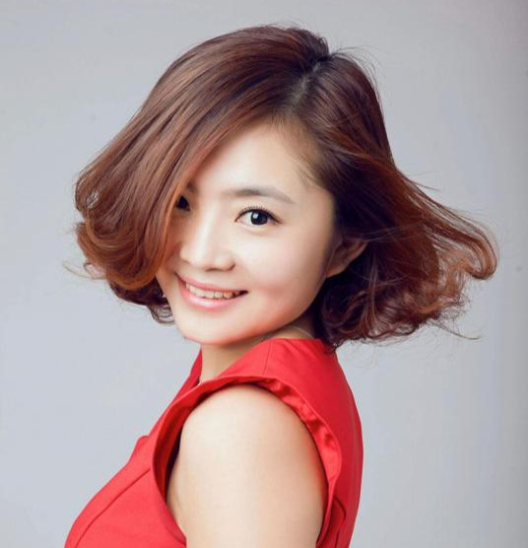
教师简介
19年雅思、托福、各种面试口语资深教师
雅思口语8.5，博士
2003年-2005年在哈尔滨经济广播电台主持英语学习节目；
2005年度获新东方教育集团优秀教师称号；
2009年TOSEL教师资格证持有者
2013年获得哈尔滨新东方骨干教师大赛“讲台女神”奖
2013年获新东方科技集团“功勋教师”称号
2015年ETS官方认证培训师
21世纪口语大赛、外研社口语大赛特邀评委
懂考试
爱考试
懂你
Notes:
英文自我介绍

Slide 2

雅思口语考试评分标准
1
3
流畅度
语 法
词 汇
发 音
2
4
仅仅11-14分钟，发音决定成功的50%

Slide 3
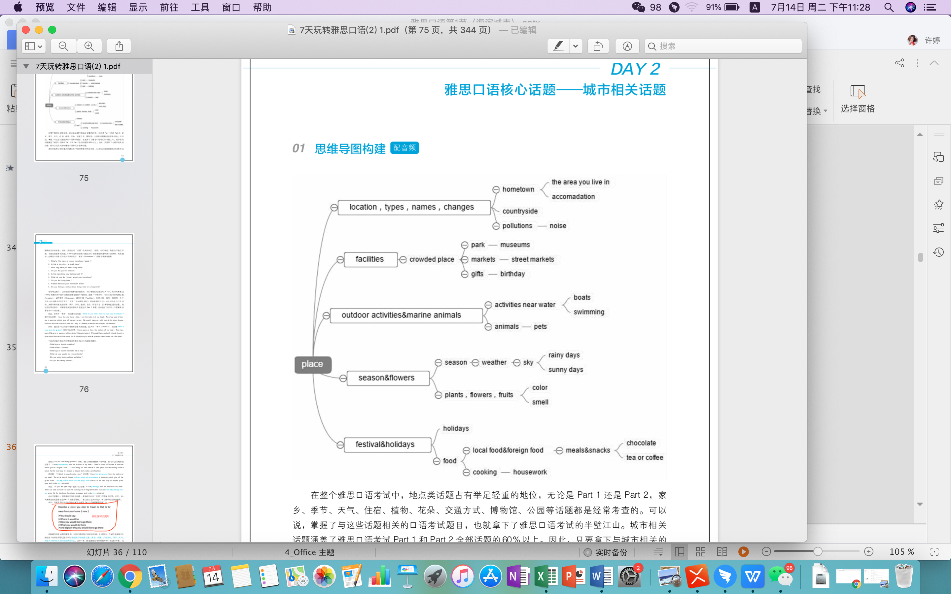

地点类话题
accommodation
1.lost and found
2.taking photos
3.barbecue
4.Geting lost
5.weekend
在 线 学 习 更 高 效
www.genshuixue.com
desserts
cake

Slide 4
地理位置
I am native to 大兴安岭.
Sitting in the northeast of China, 大兴安岭 is a prosperous city noted for ice and snow.
城市类型
To be honest, I have spent considerable amount of time in 大兴安岭. And I love this fascinating city from the bottom of my heart due to the fact that it is a world-famous tourist city and a large number of sightseers are flooding to this region to take a close look at noted tourist attractions such as Hongqi Pedestrian Street and Children’s park...

Slide 5
There’s no denying, the Children’s Park is a must-see in 大兴安岭 where there’ re a large collection of trees and plants, such as pines and lilacs. Pines can survive in the harsh environment in the northeastern part of China which is a kind of evergreen tree. Volunteers, no matter the senior citizens or the youngsters, would be actively involved in planting trees on the Tree Planting Day. Lilacs usually blossom in summer. The most popular color of the flower is purple which resembles romance. There’s a sea of flowers in summer. Taking a deep breath after the rain, we can feel the fragrant smell of flowers and grass, which brings good mood to people. That’s the reason why crowds of people drop a visit there. On sunny days, especially on weekends, people would have a barbecue by the side of park where they could have a relaxing and quality time with family members and friends. We could have various kinds of gourmet food, for instance steak, shish kebab and roast chicken. Steak is absolutely to my taste, which is rich in protein. I usually skip oily food, like fried chicken and French fries. Vegetables in season, such as mushroom, leeks and eggplants, are rich in fibers/ai/ and vitamins /ai/. They are tasty and nutritious.

Slide 6
街道、纪念品商店、纪念品
The most renowned street is named Hongqi Pedestrian Street. Along the streets, there’ re various kinds of local snacks and antiques. No matter the old or young generation would like to hang out with their friends and enjoy shopping in the street market. Visitors could purchase souvenirs and handicrafts, such as furry toys, cross stitches ,jigsaws and refrigerator magnets for our friends as well as ourselves. These souvenirs can strengthen our friendship. Meanwhile, we can recall our fantastic memories. The shopping mall named Zhongyang Plaza along the street is a paradise for shopaholics where people could purchase almost everything from daily necessities to luxuries, for instance cosmetics , stylish clothes and handbags with discounts. The staff always wear a smile on their face to show customers warm welcome. Tian Lala Cafe on the side of street is absolutely my first choice on weekends where I could enjoy a cup of lattee, especially in the morning, which makes me feel refreshed and improves my studying efficiency dramatically. I could fully concentrate on study in this quiet atmosphere. You know, coffee makes my day. Actually, I have a sweet tooth. Sometimes I grab some desserts like muffin, cookie or cheese cake which bring good mood to me. Practically, I have sandwiches for lunch because I grow up eating them. They are one of my life-long favorite food. There' re various flavors to choose from, like ham & cheese, roast chicken and tuna.

Slide 7
节日
The most amusing festival named Blueberry Festival is held annually in August. It is indeed a festival to celebrate harvesting blueberry which appeal people to participate in numerous activities, like tasting blueberry for free and making wine with blueberry such and such. People could have a try of making wine on their own which bring people sense of accomplishment. Participants could also make jam with different types of blueberry with group members with joint effort. They could cooperate with team members to win the game as well as enjoy the excitement of making jam and blueberry cake.

Slide 8
Describe a place you visited on vacation
You should say:
Where it is
When you went there
What you did there
And explain why you went there

Slide 9
Describe a city that you think is interesting
You should say
Where it is
What the city is famous for
Why it is interesting
And explain how you feel about it

Slide 10
Describe a place in a village that you visited
You should say
Where it is
When you visit this place
What you did there
And explain how you feel about this place

Slide 11
Describe a new place you visited
You should say
Where it is
When you went there
Why you went there
And explain how you feel about this place

Slide 12
Describe a house or an apartment you would like to live in
You should say
What it is like
Where it would be
Why you would like to live in this house/apartment
And how you feel about this house/apartment

Slide 13
Describe an exciting book you have read
You should say:
What the book is
When you read it
What the book is about
And explain why you felt excited

Slide 14
Describe an item on which you spent more than you expected
You should say
What it is
How much you spent on it
Why you bought it
And explain why you think you spent more than expected

Slide 15
Describe a piece of clothing
You should say
Where you bought it
How you often wear it
What it is like
How you like it

Slide 16
Describe a café you have been to
You should say:
What the name of this café is
How you feel about this café
What you had in this café
And explain why you went to this café
3 months ago, my bestie and I went to the park cafe +外面有花+美食+reader’s club was held in the cafe and I learned a lot from others and I wanted to be a lifelong+活动

Slide 17
Describe a gift you would like to buy for your friend
You should say
When gift you would like to buy
Who you would like to buy a gift for
Why you would like to buy a gift for him/her
And explain why you choose that gift

Slide 18
Describe an interesting song
You should say
What the song is
What story the song tells
Whether the song is popular
And explain why you think it is interesting

Slide 19
Describe a special cake you received from others
You should say
When it happened
Where it happened
Who you got the cake from
And explain why it’s a special cake

Slide 20
Describe an item of clothing that someone gave you
You should say
What the clothing was
Who gave it to you
When you got it
And explain why this person gave you the clothing

Slide 21
Describe a course that impressed you a lot
You should say
What the course was about
Where you took the course
What you did during the course
And explained why it impressed you a lot

Slide 22
Describe a difficult decision that you once made
You should say
What the decision was about
How you made your choice
What the results of the decision were
And explain why it was difficult to make.

Slide 23
Describe a habit your friend has and you want to develop
You should say
Who your friend is
What habit he/she has
When you noticed this habit
And explain why you want to develop this habit

Slide 24
Describe a time you saw something interesting on social media.
You should say:
when it was
where you saw it
what you saw
And explain why you think it was interesting

Slide 25
Describe a good service you received
You should say:
What the service was
When you received it
Who you were with
How you felt about it

Slide 26
Describe an occasion when you got up early
You should say:
When you got up
What you did
Why you got up early
And how you felt about it

Slide 27
Describe a time when you waited for something special that would happen
You should say
What you waited for
Where you waited
Why it was special
And explain how you felt while you were waiting

Slide 28
Describe a time when you were friendly to someone you didn’t like
You should say
When and where it happened
Who he/she was
Why you didn’t like this person
And explain why you were friendly to him/her on that occasion

Slide 29
Describe a difficult thing you did
You should say
What it was
How you did / completed it?
Why it was difficult?
And how you felt about doing it?

Slide 30
Describe a time when you moved to a new home or school
You should say:
When it happened
Where you moved
Why you moved
And explain how you felt about it

Slide 31
Describe an interesting conversation
You should say:
Who you spoke with
Where you were
What the conversation was about
And explain why you think it was interesting

Slide 32
Describe an interesting conversation
You should say:
Who you spoke with
Where you were
What the conversation was about
And explain why you think it was interesting

Slide 33
Describe an interesting conversation
You should say:
Who you spoke with
Where you were
What the conversation was about
And explain why you think it was interesting

Slide 34
Describe a thing you did to learn another language
You should say:
What language you learned
What you did
How it helped you learn the language
And how you felt about it

Slide 35
Describe a long walk you had
You should say:
When this happened
Where you walked
Who you were with
And explain how you felt about this long walk
Be accustomed to doing / advanced education

Slide 36
part1
Car trip
Do you like to travel by car?
Where is the farthest place you have traveled to by car?
Do you like to sit in the front or back when traveling by car?
Getting lost
Have you ever lost your way?
How can you find your way when you are lost?
Can you read a map when you get lost?
Have you ever helped someone who got lost?

Slide 37
Colors
What colors do you like?
What’s the most popular color in China?
What color makes you uncomfortable in your room?
What’s the color you dislike?
Do colors affect your mood?
Pets and animals
What’s your favorite animals and why?
Where do you prefer to keep your pet, indoors or outdoors?
What’s the most popular animal in China?
Have you ever kept pets?

Slide 38
Parks
Would you like to play in a public garden of park?
What do you like to do when visiting a park?
What are the parks today different from those you visited as a kid?
Would you prefer to play in a personal garden or public garden?
Spending time with others
Do you like talking with people?
Do you like spending time with your friends?
Would you prefer to study alone or with others?
Do you remember a time when you need to cooperate with others?

Slide 39
Weather
What's your favourite season?
Do you prefer dry or wet weather?
What kind of weather is typical in your hometown?
What kind of weather do you like most?
Plants
Do you know anything about growing plants?
Do Chinese people send plants as gifts?
Did you grow any plants when you were young?
Do you keep plants at home?

Slide 40
Taking photo
Do you like taking photos?
Do you want to improve your picture taking skills?
Dreams
Do you often remember your dreams?
Are you interested in others’ dream?
Do you share your dreams with others?
Do you think dreams have special meanings?
Do you want to make your dreams come true?

Slide 41
Art
Do you like drawing?
Do you like to go to the gallery?
Do you want to learn more about art?
Did you learn drawing when you were a kid?
Street market
What do people usually buy on the street market?
Do you prefer to go shopping in the shopping mall or on the street market?
When was the last time you went to a street market?
Are there many street markets in China?

Slide 42
Weather
What's your favourite season?
Do you prefer dry or wet weather?
What kind of weather is typical in your hometown?
What kind of weather do you like most?
Plants
Do you know anything about growing plants?
Do Chinese people send plants as gifts?
Did you grow any plants when you were young?
Do you keep plants at home?

Slide 43
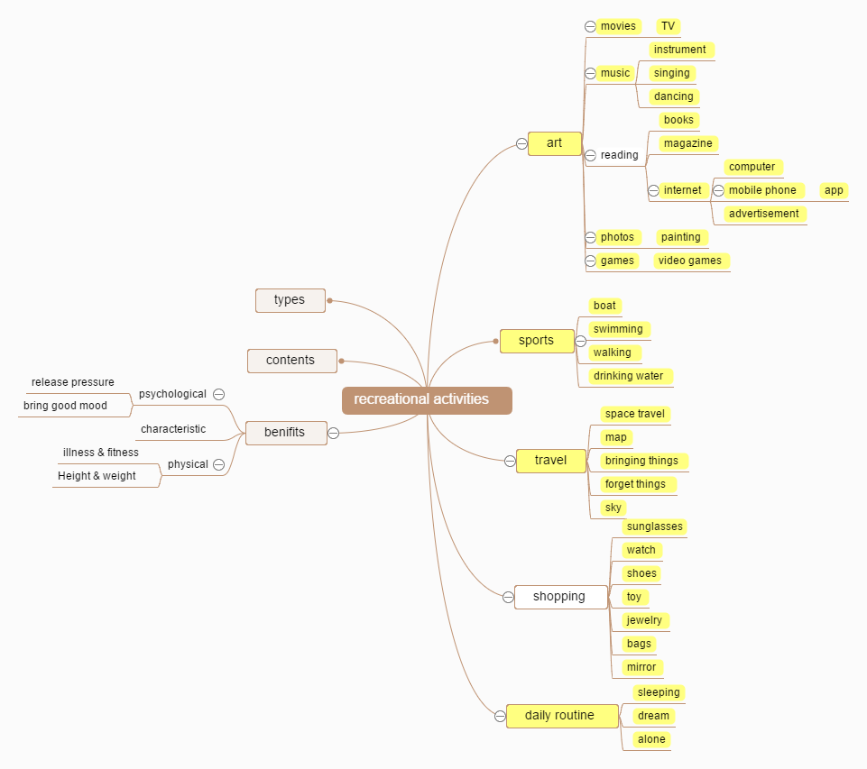
消遣类话题
1.websites
2.headphones
3.time management
benefits
在 线 学 习 更 高 效
www.genshuixue.com
Notes:
2000年开始接触英语教育，从小机构老师到电台主持，经历国内外各大英语考试及国内外教师资格证考试，培训数以万计的考生，培训出口语8.0，8.5分大神，也深知各种口语考生的痛促使我来到这个全国最专业的线上平台授课。

Slide 44
缓解压力
I am fascinated by______(消遣名称), such as ______类别（1），______类别（2），______类别（3）. You know, I am ______（忙于学习/ 工作） every day. I frequently______ （忙于事物）until midnight. It seems that I can never finish my ______（忙于事物）. I am really______ （感受）. However, ______（消遣名称） is the best way to ______优点（1） ______and 优点（2）. I am a big fan of_____(消遣名称).I usually entertain myself by _____(消遣名称).
www.genshuixue.com
www.genshuixue.com
What
types
why
how

Slide 45
缓解压力套用
I am fascinated with doing water sports, such as surfing，breaststroke，and diving. You know, I am hectic with assignments, internship and oral defense. I frequently burn the midnight oil however it seems that I can never get these tons of work done. I feel stressful and depressed from time to time. However, doing water sports is the best way to release pressure and make me feel refreshed. I am a big fan of breaststroke.I usually entertain myself by swimming.

Slide 46
缓解压力套用
By 消遣名称, I could make friends with people who have mutual interests with me from various fields， which can not only expand my social circle but also bring joy and happiness to my life. I could share innermost feeling with others.

Slide 47
缓解压力套用
By 消遣名称, I become more optimistic and persistent. No matter how many difficulties and obstacles I encounter, I'll always wear a smile on my face. I firmly believe where there's a will, there's a way. Every defeat, every heartbreak contains its own seed, its own lesson on how to enhance my overall capability. Because gems cannot shine without polish and I cannot perfect myself without hardship.

Slide 48
性格塑造——勇气
He always has faith and courage to 面对困难 and 挑战. He firmly believes the only thing we have to fear is fear itself. In this rapid developing society, if we’re easily freaked out by various 挑战, then there’s no way we can win the final 胜利. His attitude towards life influenced me a lot. I will never lose the 勇气 to fight for my dream.

Slide 49
ALWAYS WILL I SEEK THE SEED OF TRIUMPH IN EVERY ADVERSITY
1There is no better school than adversity. Every defeat, every heartbreak, every loss, contains its own seed, its own lesson on how to improve my performance next time. Never again will I contribute to my downfall by refusing to face the truth and learn from my past mistakes. Because I know: gems cannot shine without polish, and I cannot perfect myself without hardship.
2 Now I know that there are no times in life when opportunity, the chance to be and do, gathers so richly about my soul as when it has to suffer cruel adversity. Then everything depends on whether I raise my head or lower it in seeking help. Whenever I am struck down, in the future, by any terrible defeat, I will always inquire of myself, after the first pain has passed, how I can turn that adversity into good. What a great opportunity that moment might present….to take the bitter root I am holding and transform it into a fragrant garden of flowers.
3 Always will I seek the seed of triumph in every adversity.

Slide 50
性格塑造——有决心
某人is determined. Whenever he 设立目标, he will 使之实现. He 为我树立了良好的榜样 me. I learnt a lot from him. To some extent, I’m determined as well.

Slide 51
性格塑造——团队精神
人 is the person who is a 有团队精神的人. What’s more, he is capable to make every team member to realize that it is 重要的 to become a high performance team. Then each team member will 良好的合作 with each other which will 提高工作效率without any doubt.

Slide 52
对健康的益处
By _________ (运动类型）, like _______（运动名称），_______（运动名称）and_______（运动名称），I could improve my health condition dramatically. I used to be _________ (身体状况）and _________ (身体状况）. And I was lack of confidence. By __________ (运动名称）, I become __________ (身体状况积极变化） and__________ (身体积极变化 ）. I could improve my speed, strength and flexibility. Right now, I frequently work out with _________ (人群） in the__________ (地点）. This sport does not only build up my body, most importantly, it also shapes my personality.
What
Why
Where
Whom

Slide 53
模版套用
By doing water sports(运动项目）, like surfing, diving and breaststroke, I could improve my health condition dramatically. I used to be skinny (身体状况 ）and short(身体状况）. And I was lack of confidence. By doing water sports (运动项目）, I become more confident (变化） and energetic (变化 ）. I could improve my speed, strength, and flexibility. Right now, I frequently work out with close friends (人群） on the Silver Beach(地点）. This sport does not only build my body, most importantly, it also shapes my personality.

Slide 54
Describe a person who impressed you most when you were in primary school
You should say:
Who this person is
How you know this person
Why he /she impressed you most
And how you feel about this person

Slide 55
Describe a famous athlete you know
You should say:
Who the person is
How you know him or her
What he or she has achieved
Why he is famous

Slide 56
Describe a person who solved a problem in a smart way
You should say:
Who this person is
What the problem was
How he / she solved it
And explain why you think he/she did it in a smart way

Slide 57
Describe a time when you felt proud of a family member
You should say:
When it happened
Who the person is
What the person did
And explain why you felt proud of him/her

Slide 58
Describe a person who you follow on social media
You should say
Who he/she is
How you knew him/her
What he/she posts on social media
And explain why you follow him/her on social media

Slide 59
Describe a someone you really like to spend time with
You should say
Who this person is
How you knew him/her
What you usually do together
And explain why you like to spend time with him/her

Slide 60
Describe a person who contributes to the society
You should say
Who this person is
How you knew him/her
What type of work he/she does
And explain why you think he/she contributes to the society

Slide 61
Describe a skill that was difficult for you to learn
You should say
When you learned it
Why you learned it
How you learned it
How you felt when you learned it

Slide 62
Describe a skill you learned from older people
You should say
What the skill is
Who you learned it from
How you learned it
And how you feel about it

Slide 63
Describe a someone you really like to spend time with
You should say
Who this person is
How you knew him/her
What you usually do together
And explain why you like to spend time with him/her

Slide 64
Concentration
When do you need to be focused?
What may distract you when you’re trying to stay focused?
What do you do to help you concentrate?
Is it difficult for you to stay focused on something?
Science
Do you like science?
When did you start to learn about science?
Which science subject is interesting to you?

Slide 65
Headphone
Do you use headphones?
What type of headphones do you use?
When would you use headphones?
In what conditions, you won’t use headphones?
Shoe
Do you like buying shoes? How often?
Have you ever bought shoes online?
How much money do you usually spend on shoes?
Which do you prefer, fashionable shoes or comfortable shoes?

Slide 66
Sports Program
Do you like watching sport programs on TV?
Do you like to watch live sports games?
Who do you like to watch sports games with?
What kinds of games do you expect to watch in the future?
Mirrors
Do you like looking at yourself in the mirror? How often?
Have you ever bought mirrors?
Do you usually take a mirror with you?
Would you use mirrors to decorate your room?

Slide 67
Cinemas
Did you usually go to the cinema when you were a kid?
Do you usually go to the cinema with your friends?
Do you still enjoy watching the movies you loved as a child?
Do you prefer watching movies at home or at the cinema?
Did you usually go to the cinema when you were a kid?
Do you usually go to the cinema with your friends?
Do you still enjoy watching the movies you loved as a child?
Do you prefer watching movies at home or at the cinema?

Slide 68
Time management
How do you plan your time in a day?
Is it easy to manage time for you?
When do you find it hard to allocate time?
Do you like being busy?
Mobile phone
What was your first mobile phone?
Do you often use your mobile phone for texting or calls?
Will you buy a new one in the future?
How was your mobile phone changed your life?

Slide 69
秒杀part 3
1. 抽象问题具体化：
2. 日常问题举例子：
3. 复杂问题分层次：
www.genshuixue.com
Notes:
2000年开始接触英语教育，从小机构老师到电台主持，经历国内外各大英语考试及国内外教师资格证考试，培训数以万计的考生，培训出口语8.0，8.5分大神，也深知各种口语考生的痛促使我来到这个全国最专业的线上平台授课。

