Slide 1

Magic Unicorns and Beyond
Keith Burnell
Senior Software Engineer
Falafel Software, Inc
@keburnell · DotNetDevDude.com
Notes:
Visual Studio Live! Orlando 2012
©
2012 Visual Studio Live! All rights reserved.

Slide 2
Little about me
Microsoft MVP: ASP.NET/IIS
Senior Software Engineer at Falafel Software, Inc.
Been developing software for > 15 years
Primary focus on the Web stack
Speaker
Author
Notes:
Visual Studio Live! Las Vegas 2011
©
2012 Visual Studio Live! All rights reserved.
Husband, Father
Soccer player, Martial Artist
ASP.NET MVP
Senior Software Engineer for an awesome company in Wisconsin, named Skyline Technologies.
But really, I am just a guy who absolutely loves what he does…maybe a little too much…
And like you wants to keep learning and improving himself.

Slide 3

Notes:
The majority of the applications we write are data centric, that is, the goal of the application is to display some type of data and on occasion provide the means to create/update/delete the data.
That data lives somewhere and 99% of the time that somewhere is a relational data store of some type.
Whether that is a full fledged relational database such as SQL Server, Oracle, or DB2 or its some sort of markup based file store you
- you have some sort of structures that represents data
- and you have relationships that define how one piece of data relates to another piece of data
So this means as well-rounded developers we have to write a lot of data access code and it all basically does the same thing
- Connect to the data store, and possibly start a transaction
- Query for some data and pull it from the data store
- Put the data in some sort of structure consumable and useable by our application
And we do that over and over again
Visual Studio Live! Orlando 2012
©
2012 Visual Studio Live! All rights reserved.

Slide 4
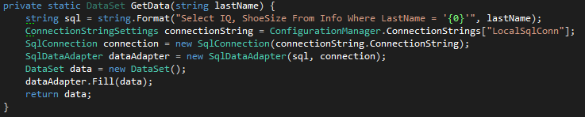
Notes:
Visual Studio Live! Orlando 2012
©
2012 Visual Studio Live! All rights reserved.
And typically that data access code took on the form of…
And now we have this big heavy DataSet to pass around and manipulate…not very performent and certainly not Object Oriented.

Slide 5

Notes:
Visual Studio Live! Orlando 2012
©
2012 Visual Studio Live! All rights reserved.
At this point you may be asking yourself so what? What’s wrong with that approach?
In my day we used DataSets and we liked it!!!!
Well…
It’s not DRY
DRY stands for Do Not Repeat Yourself and in an average application the majority of the code in the snippet from the previous slide will be duplicated many times
And this creates a maintenance nightmare when something inevitably changes
It’s error prone
My SQL query is big magic string…and magic strings always come back to bite you
The only thing magic about magic is strings is that they make your time disappear when trying to debug.
It’s not Object Oriented
My end result is this ultra heavy framework entity that try’s to mimic my database
And that’s not what I want…I want classes that represent my domain or subject tor subject of my application
So where does that leave us…?

Slide 6
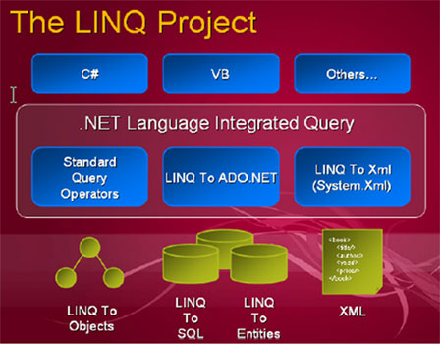
Notes:
Visual Studio Live! Orlando 2012
©
2012 Visual Studio Live! All rights reserved.
LINQ stands for Language Integrated Query and it was released as part of .NET 2.0
LINQ in general is way to query things using strongly typed C# code.
LINQ comes in multiple flavors, LINQ to SQL, LINQ to XML, LINQ to Objects, etc.
For our purposes from this point on when I say LINQ I am specifically talking LINQ to SQL.
LINQ to SQL allows you to use a designer to connect to you database and create a representation of your data inside your Visual Studio solution
In doing this LINQ does some things that alleviates a lot of the issues we discussed with the old DataSet approach.
LINQ creates an abstraction and handles all the database connection plumbing for you…reducing all that code duplication
LINQ allows you to query using strongly typed C# code getting rid of all the magic string SQL query’s
And LINQ also creates a class for each table you drag on your designer, including relationships and the associated child entities allowing you to work directly against .NET classes rather than something like a DateSet

Slide 7

Notes:
Visual Studio Live! Orlando 2012
©
2012 Visual Studio Live! All rights reserved.
Although LINQ to SQL is a huge improvement over the old DataSet approach it still has issues
The classes representing your data are auto-generated and they contain a lot of weight.
They are partial classes so they are extensible but they are still heavy
And ideally I want to be dealing with POCO’s
Secondly although we are now dealing with .NET classes the classes still represent a table from my database and more than likely there is not a 1:1 mapping from database table to Domain class.
- Typically a domain object will be an amalgamation of multiple database tables.
This is an called an impedance mismatch
and it’s what ORM’s where created to help with.

Slide 8
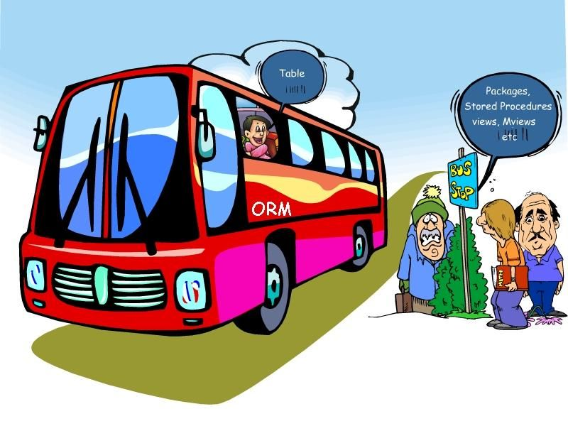
Notes:
Visual Studio Live! Orlando 2012
©
2012 Visual Studio Live! All rights reserved.
An ORM is a tool designed to resolve the impedance mismatch and allow you to define how a domain object in your application maps to one or more database fields.
Mappings can be done using xml configuration files or some ORM’s offer fluent configuration that allows you to configure your mappings right in code.
ORM’s are not new and have been around for a long time. Some of the more popular ORM’s that you have probably heard of are
- nHibernate
- LLBLGen
So where does Microsoft fit in the whole ORM scheme…well….it didn’t start out good.

Slide 9
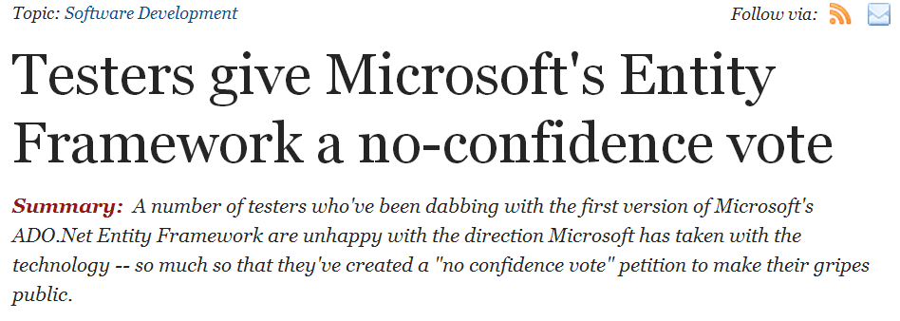
Notes:
Visual Studio Live! Orlando 2012
©
2012 Visual Studio Live! All rights reserved.
Entity Framework is Microsoft’s first true public foray in to the ORM space.
It was released as part of .NET 3.5 SP1 in August of 2008 and was a failure from the start.
So much so that a petition was started pre-release showing the lack of confidence beta users had in the product.
EF v1 completely missed the mark and was missing such core features as the ability to handle foreign keys.
It also went the way of LINQ and auto-generated classes that where tightly-coupled to EF making it’s usage less than ideal for n-tier application development.

Slide 10

Notes:
Visual Studio Live! Orlando 2012
©
2012 Visual Studio Live! All rights reserved.
The second version of Entity Framework, Entity Framework 4, was introduced in April of 2010 as part of .NET 4.0. Hence the 4…it was done for “version alignment, not to distance itself from version 1” ;)
In this release EF4 addressed the issues in V1 and actually set it self up as a possible contender in the ORM space.
Unfortunately EF4 still worked in a database-centric, database first manner. But….

Slide 11

Notes:
Visual Studio Live! Orlando 2012
©
2012 Visual Studio Live! All rights reserved.
Very shortly after releasing Entity Framework v4 an extra set of bits was released as Entity Framework 4.1.
This set of bits was geared towards the concept of a less database centric approach.
Introducing the concept of Code-First development that was so impactful that Scott Hanselman coined it the Magic Unicorn Edition.
So what is Code-First?

Slide 12
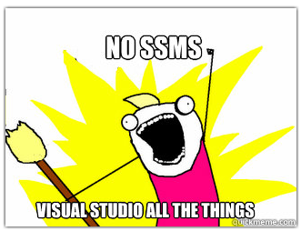
Notes:
Visual Studio Live! Orlando 2012
©
2012 Visual Studio Live! All rights reserved.
So what is Code-First?
Code-First is the concept of developing data driven applications without ever opening SQL Server Management studio or any other database design tool.
With code first you put your focus where your focus belongs and that is your application domain
Your not using designers of any sort
Your writing 100% POCO classes that represent your application domain
I don’t know about you but that is exactly how I want it to be

Slide 13

Notes:
Visual Studio Live! Orlando 2012
©
2012 Visual Studio Live! All rights reserved.
Demo 1:
Basic counsel app
Have my domain classes
Manufacturers -> Models -> Engines
These classes contain simple properties as well as relationships
1 to 1 between Manufacturers and Models
Many to Many between Models and Engines
My extent of dealing with the DB is creating the connection string
Show connection string
The key to EF Code First is the DataContext
Class that inherits from DbContext
Has an override of the base constructor that passes the name of my connection string
And it defines an IDbSet for each of my domain classes.
I also need to have a DataContext Initializer.
This class initializes and configures my datacontext
The reason this is separate class will become obvious a little later when we talk about testing
This class inherits from IDatabaseContextInitializer in this case from DropCreateDatabaseIfModelChanges
There is also DropCreateDatabaseAlways
Now we need to tell EF that our DataContext needs to use that Initializer and there is two ways we can do that
The first is calling Database.SetInitializer and passing a new instance of your initializer
This may look dirty and tightly coupled but remember it only has to be done once per session
You could also do this via Entity Framework configuration section but I like to stay out of configuration unless necessary
With all of that in place we are now ready to write some Data Access Code
In my Main I have some simple code to access the Manufacturers (Disclaimer: This is for demonstration purposes…in the real world you would have a proper data access layer)
That’s it we are now ready to demonstrate EF Code First
Show SQL Server…No DB…nothing up my sleeves.
Run
We now have our database that includes a table for each of the POCO Domain entities we created and registered in the DataContext and each table contains the fields we defined
So what just happened, how did that work?

Slide 14
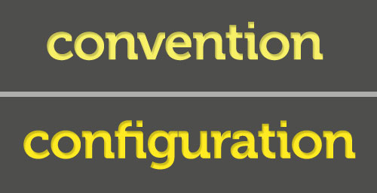
Notes:
Visual Studio Live! Orlando 2012
©
2012 Visual Studio Live! All rights reserved.
A huge driving factor behind the ease at which this was all able to happen is the concept of “Convention over Configuration”
- Convention over Configuration is act of assuming certain industry standards and best practices and using those to generate code or perform certain tasks rather than relying on the developer to explicitly define everything.
Examples:
- A standard convention is that the Primary Key of table is named “Id” or [TableName]Id
- As you can see EF applied that convention to my tables…the “Id” fields are the primary keys
- EF also used the standard convention for creating the Many to Many between Models and Engines

Slide 15

Notes:
Visual Studio Live! Orlando 2012
©
2012 Visual Studio Live! All rights reserved.
Although the conventions in place with EF Code-First is phenomenal it can only get you 90% there…you still need to do some configuration to handle custom and more complex scenarios and to undo the conventions that Microsoft enforces that are just plain wrong.
You can see by looking at our database we have some issues!
- All the strings are VarChar Max and nullable!
- The table names are pluralized and this is a convention that I don’t agree with.
And there are 2 ways you can do this and fortunately for us neither of them require XML!

Slide 16

Notes:
Visual Studio Live! Orlando 2012
©
2012 Visual Studio Live! All rights reserved.
Our first way to configure Entity Framework Code First is fluently. Fluent configuration allows us to write C# (or VB) Code to configure how our POCO classes map to our Database Entities.
Let’s look at how we go about applying some fluent configurations.
- Fluent Configurations are applied in the DataContext and are done as part of the OnModelCreating override. EF11
The first convention I want to override is the pluralizing of the table names when they are created in the DB. EF12
- F5 and see our table names are no longer pluralized
Next I want to configure how my Many to Many is setup
- I want the Many to Many table to be named more user friendly, say “ModelAvailableEngines”
- and I want the tables keys to be in the format [TableName]Id so EngineId and ModelId
- Go back to DataContext and EF13
- Talk about code!
Now let’s look at the other way of configuring.

Slide 17

Notes:
Visual Studio Live! Orlando 2012
©
2012 Visual Studio Live! All rights reserved.
The other way to configure your POCO to DB mapping is using attributes.
And this is done directly in your POCO classes.
Jump over to Manufacturer and
- Make Name and Country required
- Set the String Length
F5 and see changes
Important note here is that these attributes are not EF specific they are part of System.ComponentModel.DataAnnodations so they are part of the core .NET Framework classes
- Your POCO’s are still clean…no references to EF
- These annotations are used by other technologies such as MVC for validation
Now, I could do this same configuration fluently in the DataContext EF14
Run – and get the same result,
so let’s talk about when you should use which means of configuration…

Slide 18
When to Use Which
Fluent
  Used solely to make database behave correctly
  Should have no impact on the design and/or behavior of your domain model
Attribute
  Used for configuration that applies to your domain model
  May or may not impact the database.
Notes:
You probably noticed that I am not a big fan of bullet points in presentations…but I am using bullet points here to emphasize the importance of these statements.
Fluent configuration should be used for configuration pertaining to the database and should not effect your domain model in any manner
Examples: - Specifying the DB table name and domain model class maps to
- Specifying the DB table column the domain model field maps to
- Ignoring a domain model so it is not created/persisted
- Configuring the keys and table names for relationships not able to be picked up by entity framework
Attribute configuration should be used for configuration pertaining to your domain model which may or may not impact your database.
Examples: Required (impacts domain and database)
StringLength (impacts domain and database)
Range (impacts only the domain)

Slide 19

Notes:
Visual Studio Live! Orlando 2012
©
2012 Visual Studio Live! All rights reserved.
Even though EF 4.1 was the Magic Unicorn Edition it still lacked a few things.
The biggest was it did not directly handle enumerations
Others included the spatial data types and a good migration story

Slide 20

(cuz 4 + 1 = 5)
Notes:
Visual Studio Live! Orlando 2012
©
2012 Visual Studio Live! All rights reserved.
So let’s talk about EF 5
First of all it has Enumeration support!
- Show EngineLocationType Enum
- Add EngineLocation property to Model
- Talk about issues with this approach and how ideally you would want the enumerations stored in the database to allow referential integrity and to have the enum value available with queries.
Support for the Spatial DataType
- Allows you to store spatial or geographic data which is cool in itself but what you can do with it in code is much cooler!
- Side track – in order to really demonstrate spatial data type we need data
- Again we are developers and we feel at home in Visual Studio and EF Code First gives us the ability to seed data in code and keep us out of SQL Server or some other DB Tool
- Seeding takes place in the DataContextInitializer
- Go to “Manufacturer.cs” and property for Location of type “DbGeography”
- Seed: “DataContextInitializer” ef15 … talk about what all that code does
- Run this to seed data and show seeded data…including Location field
- Add code to Program.cs to show what you can with Spatial data type. ef16

Slide 21

Notes:
Visual Studio Live! Orlando 2012
©
2012 Visual Studio Live! All rights reserved.
Another big deficiency that was addressed in Entity Framework 5 was the migration story around Code First.
The existing, or pre-EF5 story involved manually doing a schema compare and gathering up the scripts, hoping you caught everything and going from there.
The issue was that because with code first you weren’t ever writing any SQL you didn’t have those scripts you could save off and re-run on your dev/stage/prod DB servers.
Enter Entity Framework Migrations.
- support was released in early form as part of the minor EF 4.3 update, but in order to use Migrations you had to install a separate NuGet package
- this initial release was buggy, awkward and was really “use at your own risk”
- The best way to explain EF Code First Migrations is to just show a demo.
Demo:
- Up until now our database has been dropped and recreated whenever our model changed per the definition in our data context initializer
- This may not always be practical, even during initial development, such as if you are accessing a development database on a server that is shared rather than on your local machine…
- So this is a good way to demonstrate the power of migrations.
- Comment out setting of DatabaseInitializer in Program.cs
- Add a new field to Manufacturer.cs (GrossRevenue)
- Run
** Error saying our model has changed since our DB was last generated and therefore our DB and Model are now out of sync.
-- and it even points us in the direction of Code First Migrations
- Package Manager Console:
Enable-Migrations –EnableAutomaticMigrations
Add-Migration AddGrossRevenueToManufacturer
Update-Database –Verbose
Get the SQL Statement and your all set!

Slide 22

Notes:
Visual Studio Live! Orlando 2012
©
2012 Visual Studio Live! All rights reserved.
So what’s next for Entity Framework?
The next version of Entity Framework is currently in early beta
Let’s take a look at some of the cooler features in the works!
- Implementation of the new Async/Await bits introduced in .NET 4.5
- ToListAsync, ToArrayAsync, etc
- Async version of IQueryable<T> methods (FindAsync, SingleAsync)
- Custom Code First Conventions
- Define default conventions for a type…look at string example
* Show DB…look at strings – nullable and varchar(max)
* Uncomment (in EF6DemoDataContext) and discuss
* Run, show DB now
- Add a new Primary Key convention
* I have legacy tables that use “Key” suffix to define primary keys
* Uncomment dbSet declaration for Parts
* Run and note error
* Instead of adding the attribute to all my POCO’s I can add a new Primary Key Convention
* Run – Show DB
A couple of exciting features are on the roadmap for EF6 but have not yet began to be implemented.
This includes Stored Procedures and Functions in code first and Connection Resiliency which enables database connections to be re-established if they are lost

Slide 23

Notes:
Visual Studio Live! Orlando 2012
©
2012 Visual Studio Live! All rights reserved.
Custom connection AppConfig = independent connection string = independent DB
You can also have a separate Initializer specific to your tests which means all the data scenarios you want whenever you want them
No More Excuses for not testing every scenario!!!!

Slide 24
What Did We Learn?
We write data-centric apps
There is a better way
If at first you don’t succeed…
4 = 2
4.1 = Magic Unicorn
Code-First = the way it should be
And it keeps getting getter
Notes:
That wraps up the presentations, so let’s summarize what we’ve covered
First we covered that out of the box MVC 3 doesn’t provide a very good user experience for mobile and manually coding all the goo that is required id tedious…but certainly possible
MVC 4 handles a lot of the goo for us and what it doesn’t it allows us to implement it with out it too much crazyness
And then we can add jQuery mobile to make this really cool

Slide 25
Thank You!
Slides and Code:
  github.com/KBurnell/EfCodeFirstMagicUnicornAndBeyond
Me:
  Twitter: @KeBurnell
  Blog: DotNetDevDude.com
  E-Mail: Keith@DotNetDevDude.com

