Slide 1

Demo: Look Mom No SSMS
Notes:
Visual Studio Live! Orlando 2012
©
2012 Visual Studio Live! All rights reserved.
Demo 1:
Basic counsel app
Have my domain classes
Manufacturers -> Models -> Engines
These classes contain simple properties as well as relationships
1 to 1 between Manufacturers and Models
Many to Many between Models and Engines
My extent of dealing with the DB is creating the connection string
Show connection string
The key to EF Code First is the DataContext
Class that inherits from DbContext
Has an override of the base constructor that passes the name of my connection string
And it defines an IDbSet for each of my domain classes.
I also need to have a DataContext Initializer.
This class initializes and configures my datacontext
The reason this is separate class will become obvious a little later when we talk about testing
This class inherits from IDatabaseContextInitializer in this case from DropCreateDatabaseIfModelChanges
There is also DropCreateDatabaseAlways
Now we need to tell EF that our DataContext needs to use that Initializer and there is two ways we can do that
The first is calling Database.SetInitializer and passing a new instance of your initializer
This may look dirty and tightly coupled but remember it only has to be done once per session
You could also do this via Entity Framework configuration section in you’re web/app config
With all of that in place we are now ready to write some Data Access Code
In my void Main I have some simple code to access the Manufacturers (Disclaimer: This is for demonstration purposes…in the real world you would have a proper data access layer)
That’s it we are now ready to demonstrate EF Code First
Show SQL Server…No DB…nothing up my sleeves.
Run
We now have our database that includes a table for each of the POCO Domain entities we created and registered in the DataContext and each table contains the fields we defined
So what just happened, how did that work?

Slide 2
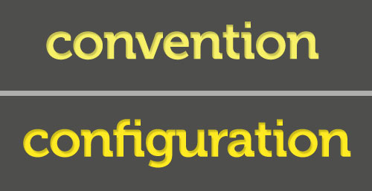
Convention Over Configuration
Notes:
Visual Studio Live! Orlando 2012
©
2012 Visual Studio Live! All rights reserved.
A huge driving factor behind the ease at which this was all able to happen is the concept of “Convention over Configuration”
- Convention over Configuration is act of assuming certain industry standards and best practices and using those to generate code or perform certain tasks rather than relying on the developer to explicitly define everything.
Examples:
- A standard convention is that the Primary Key of table is named “Id” or [TableName]Id
- As you can see EF applied that convention to my tables…the “Id” fields are the primary keys
- EF also used the standard convention for creating the Many to Many between Models and Engines

Slide 3

Of Course You Still Need Configuration
Notes:
Visual Studio Live! Orlando 2012
©
2012 Visual Studio Live! All rights reserved.
Although the conventions in place with EF Code-First are phenomenal they can only get you 90% there…you still need to do some configuration to handle custom and more complex scenarios and to undo the conventions that Microsoft enforces that are just plain wrong.
You can see by looking at our database we have some issues!
- All the strings are VarChar Max and nullable!
- The table names are pluralized and this is a convention that I don’t agree with.
And there are 2 ways you can deal with this and fortunately for us neither of them require XML!

Slide 4

Fluent Configuration
Notes:
Visual Studio Live! Orlando 2012
©
2012 Visual Studio Live! All rights reserved.
Our first way to configure Entity Framework Code First is fluently. Fluent configuration allows us to write C# (or VB) Code to configure how our POCO classes map to our Database Entities.
Let’s look at how we go about applying some fluent configurations.
- Fluent Configurations are applied in the DataContext and are done as part of the OnModelCreating override. EF11
The first convention I want to override is the pluralizing of the table names when they are created in the DB. EF12
- F5 and see our table names are no longer pluralized
Next I want to configure how my Many to Many is setup
- I want the Many to Many table to be named more user friendly, say “ModelAvailableEngines”
- and I want the tables keys to be in the format [TableName]Id so EngineId and ModelId
- Go back to DataContext and EF13
- Talk about code!
Now let’s look at the other way of configuring.

Slide 5
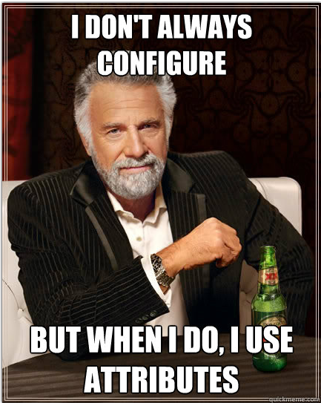
Attribute Configuration
Notes:
Visual Studio Live! Orlando 2012
©
2012 Visual Studio Live! All rights reserved.
The other way to configure your POCO to DB mapping is using attributes.
And this is done directly in your POCO classes.
Jump over to Manufacturer and
- Make Name and Country required
- Set the String Length
F5 and see changes
Important note here is that these attributes are not EF specific they are part of System.ComponentModel.DataAnnodations so they are part of the core .NET Framework classes
- Your POCO’s are still clean…no references to EF
- These annotations are used by other technologies such as MVC for validation
Now, I could do this same configuration fluently in the DataContext EF14
Run – and get the same result,
so let’s talk about when you should use which means of configuration…

Slide 6

Entity Framework 5 (cuz 4 + 1 = 5)
Notes:
Visual Studio Live! Orlando 2012
©
2012 Visual Studio Live! All rights reserved.
So let’s talk about EF 5
First of all it has Enumeration support!
- Show EngineLocationType Enum
- Add EngineLocation property to Model
- Talk about issues with this approach and how ideally you would want the enumerations stored in the database to allow referential integrity and to have the enum value available with queries.
Support for the Spatial DataType
- Allows you to store spatial or geographic data which is cool in itself but what you can do with it in code is much cooler!
- Side track – in order to really demonstrate spatial data type we need data
- Again we are developers and we feel at home in Visual Studio and EF Code First gives us the ability to seed data in code and keep us out of SQL Server or some other DB Tool
- Seeding takes place in the DataContextInitializer
- Go to “Manufacturer.cs” and property for Location of type “DbGeography”
- Seed: “DataContextInitializer” ef15 … talk about what all that code does
- Run this to seed data and show seeded data…including Location field
- Add code to Program.cs to show what you can with Spatial data type. ef16

Slide 7

Entity Framework Migrations
Notes:
Visual Studio Live! Orlando 2012
©
2012 Visual Studio Live! All rights reserved.
Another big deficiency that was addressed in Entity Framework 5 was the migration story around Code First.
The existing, or pre-EF5 story involved manually doing a schema compare and gathering up the scripts, hoping you caught everything and going from there.
The issue was that because with code first you weren’t ever writing any SQL you didn’t have those scripts you could save off and re-run on your dev/stage/prod DB servers.
Enter Entity Framework Migrations.
- support was released in early form as part of the minor EF 4.3 update, but in order to use Migrations you had to install a separate NuGet package
- this initial release was buggy, awkward and was really “use at your own risk”
- The best way to explain EF Code First Migrations is to just show a demo.
Demo:
- Up until now our database has been dropped and recreated whenever our model changed per the definition in our data context initializer
- This may not always be practical, even during initial development, such as if you are accessing a development database on a server that is shared rather than on your local machine…
- So this is a good way to demonstrate the power of migrations.
- Comment out setting of DatabaseInitializer in Program.cs
- Add a new field to Manufacturer.cs (GrossRevenue)
- Run
** Error saying our model has changed since our DB was last generated and therefore our DB and Model are now out of sync.
-- and it even points us in the direction of Code First Migrations
- Package Manager Console:
Enable-Migrations –EnableAutomaticMigrations
Add-Migration AddGrossRevenueToManufacturer
Update-Database –Verbose
Get the SQL Statement and your all set!

Slide 8

Entity Framework 6
Notes:
Visual Studio Live! Orlando 2012
©
2012 Visual Studio Live! All rights reserved.
So what’s next for Entity Framework?
The next version of Entity Framework is currently in early beta
Let’s take a look at some of the cooler features in the works!
- Implementation of the new Async/Await bits introduced in .NET 4.5
- ToListAsync, ToArrayAsync, etc
- Async version of IQueryable<T> methods (FindAsync, SingleAsync)
- Custom Code First Conventions
- Define default conventions for a type…look at string example
* Show DB…look at strings – nullable and varchar(max)
* Uncomment (in EF6DemoDataContext) and discuss
* Run, show DB now
- Add a new Primary Key convention
* I have legacy tables that use “Key” suffix to define primary keys
* Uncomment dbSet declaration for Parts
* Run and note error
* Instead of adding the attribute to all my POCO’s I can add a new Primary Key Convention
* Run – Show DB
Logging
Uncomment log line from AllManufacturersAsync
Run & show debug window.
Stored Procedures!?!?!
DataContext
Show OpenTheGates
Add line to call it in OnModelCreating
Mocking – Not very useful
Show ManufacturerServiceTests

Slide 9

Eases Some Testing Pains Too
Notes:
Visual Studio Live! Orlando 2012
©
2012 Visual Studio Live! All rights reserved.
Custom connection AppConfig = independent connection string = independent DB
You can also have a separate Initializer specific to your tests which means all the data scenarios you want whenever you want them
No More Excuses for not testing every scenario!!!!

