Slide 1
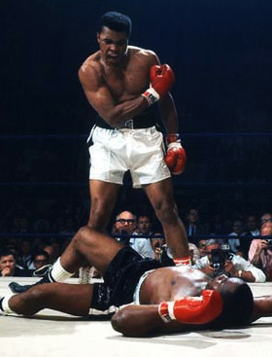
KO your MVC
Keith Burnell
Senior Software Engineer
Email: kburnell@skylinetechnologies.com
Twitter: keburnell
Blog: www.DotNetDevDude.com

Slide 2
Little about me
Senior Software Engineer @ Skyline Technologies
Been developing software for 15+ years
Work on the Microsoft stack.
Spend majority of time developing Web *stuff*.
President of Fox Valley .NET UG.
INETA Speaker.
Blogger: DotNetDevDude.com
Twitter(er): @keburnell
@keburnell ∙ DotNetDevDude.com
Notes:
Scrum most popular.

Slide 3
What’s on Tap
What is Knockout?
What does Knockout get me?
How do I use Knockout?
How do I make Knockout and ASP.NET MVC BFF’s?
@keburnell ∙ DotNetDevDude.com
Notes:
Scrum most popular.

Slide 4



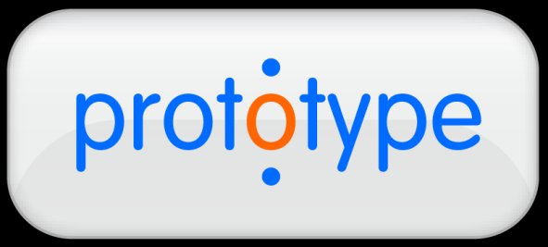
Knockout IS NOT a replacement for
@keburnell ∙ DotNetDevDude.com
Notes:
Scrum most popular.

Slide 5

What is
@keburnell ∙ DotNetDevDude.com
Notes:
Scrum most popular.

Slide 6
MVVM in JavaScript
View
HTML + declarative bindings
Browser
Automatic
ViewModel
JavaScript + observables
Ajax / form posts
“Model”
Server
Any server-side technology
@keburnell ∙ DotNetDevDude.com
Notes:
Scrum most popular.

Slide 7
What do I get by using Knockout?
Declarative bindings
Automatic UI refresh
Dependent properties
Templating
@keburnell ∙ DotNetDevDude.com
Notes:
Scrum most popular.

Slide 8

Observables
@keburnell ∙ DotNetDevDude.com
Notes:
Scrum most popular.

Slide 9
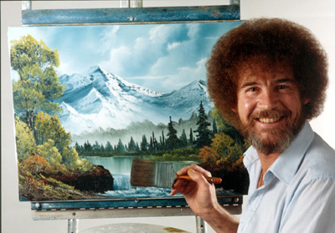
Quick illustration (and intro to jsFiddle)
Happy Trees
@keburnell ∙ DotNetDevDude.com
Notes:
Scrum most popular.

Slide 10
Types of Observables
Observable
Observable Arrays
Dependent/Computed Observables
@keburnell ∙ DotNetDevDude.com
Notes:
Scrum most popular.

Slide 11
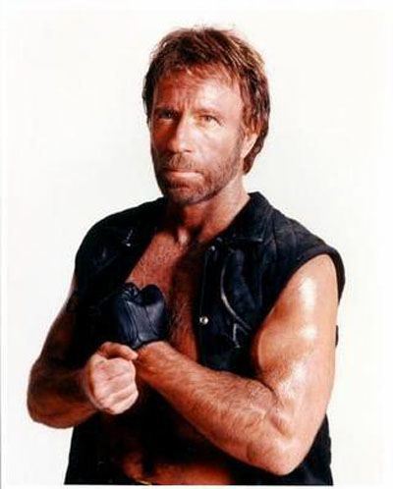
jsFiddle is great for prototyping but real men use Visual Studio
@keburnell ∙ DotNetDevDude.com
Notes:
Scrum most popular.

Slide 12
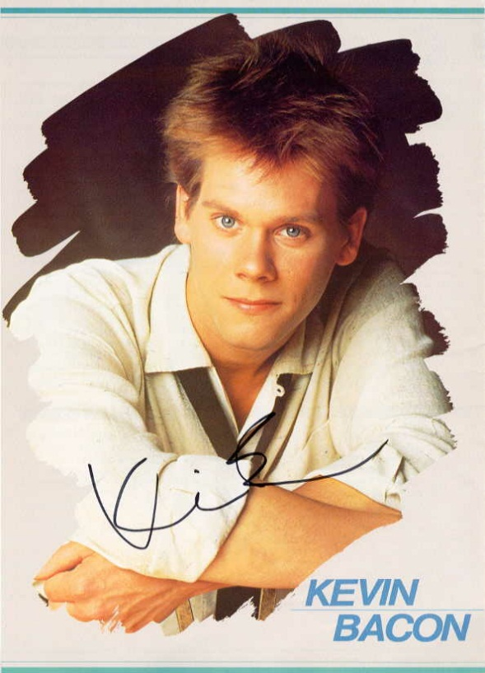
Six Degrees of (Kevin) Bindings
@keburnell ∙ DotNetDevDude.com
Notes:
Scrum most popular.

Slide 13
Text and Appearance
text
html
visible
css
attr
style
@keburnell ∙ DotNetDevDude.com
Notes:
Scrum most popular.

Slide 14
Templates
jQuery
Native KO
@keburnell ∙ DotNetDevDude.com
Notes:
Scrum most popular.

Slide 15

Templates
@keburnell ∙ DotNetDevDude.com
Notes:
Scrum most popular.

Slide 16

Templates
@keburnell ∙ DotNetDevDude.com
Notes:
Scrum most popular.

Slide 17
Control Flow
if
ifnot
with
foreach
@keburnell ∙ DotNetDevDude.com
Notes:
Scrum most popular.

Slide 18
Control Flow
@keburnell ∙ DotNetDevDude.com
Notes:
Scrum most popular.

Slide 19
Control Flow
@keburnell ∙ DotNetDevDude.com
Notes:
Scrum most popular.

Slide 20
Form Bindings
value
options
checked
click
event
enable
disable
selectedOptions
uniqueName
@keburnell ∙ DotNetDevDude.com
Notes:
Scrum most popular.

Slide 21
Form Bindings
@keburnell ∙ DotNetDevDude.com
Notes:
Scrum most popular.

Slide 22
Form Bindings
@keburnell ∙ DotNetDevDude.com
Notes:
Scrum most popular.

Slide 23

Parent Binding Contexts
@keburnell ∙ DotNetDevDude.com
Notes:
Scrum most popular.

Slide 24
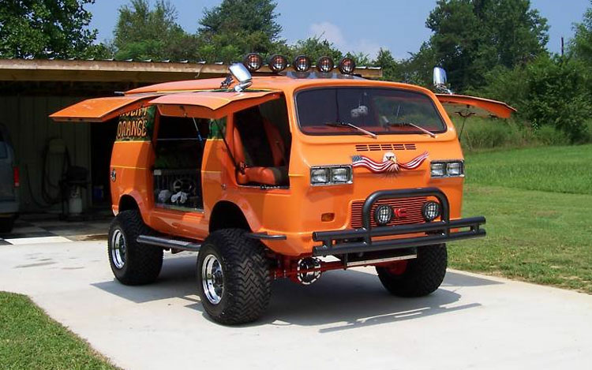
Custom Bindings
@keburnell ∙ DotNetDevDude.com
Notes:
Scrum most popular.

Slide 25
Sample MVC App: Adding in the server side
@keburnell ∙ DotNetDevDude.com
Notes:
Scrum most popular.

Slide 26
Resources
Slides and code https://github.com/kburnell/KO_Your_MVC
Official Knockout website: http://www.knockoutjs.com
Steve Sanderson's blog: http://blog.stevensanderson.com
http://www.KnockMeOut.net
StackOverflow: http://www.stackoverflow.com/questions/tagged/knockoutjs
Knockout Google Group: http://www.groups.google.com/group/knockoutjs
@keburnell ∙ DotNetDevDude.com
Notes:
Scrum most popular.

Slide 27
Tools I Used and/or Talked About
NuGet: http://www.nuget.org
JSFiddle: http://jsfiddle.com
@keburnell ∙ DotNetDevDude.com
Notes:
Scrum most popular.

Slide 28

@keburnell ∙ DotNetDevDude.com
Notes:
Scrum most popular.

Slide 29
Thank You!
Questions?
Twitter: @keburnell
Blog: DotNetDevDude.com
Email: kburnell@skylinetechnologies.com
@keburnell ∙ DotNetDevDude.com
Notes:
Scrum most popular.

