Slide 1
Reach the Mobile Masses with ASP.NET MVC 4 and jQuery Mobile
Notes:
Visual Studio Live! Las Vegas 2011
©
2012 Visual Studio Live! All rights reserved.

Slide 2
Little about me
Microsoft MVP: ASP.NET/IIS
Senior Software Engineer at Skyline Technologies
Been developing software for ~13 years
Primary focus on the Microsoft Web stack
Speaker (Local, Regional, National)
Author (MSDN, Pluralsight)
Notes:
Visual Studio Live! Las Vegas 2011
©
2012 Visual Studio Live! All rights reserved.

Slide 3
Agenda
Why mobile is important
Current state with vanilla MVC3
Making things better with MVC3
New mobile specific features in MVC4
jQuery Mobile
Notes:
Visual Studio Live! Las Vegas 2011
©
2012 Visual Studio Live! All rights reserved.

Slide 4

Stats – Mobile Broadband
1 billion active mobile-broadband subscriptions
Mobile-broadband subscriptions have grown 45% annually over the last 4 years
Currently twice as many mobile-broadband as fixed-broadband subscriptions
ICT 2011 Facts and Figures
http://www.itu.int/ITU-D/ict/facts/2011/material/ICTFactsFigures2011.pdf
Notes:
Visual Studio Live! Las Vegas 2011
©
2012 Visual Studio Live! All rights reserved.

Slide 5
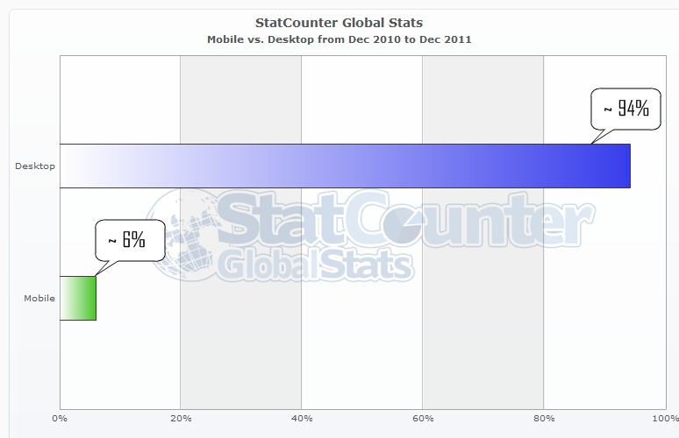
Stats – Mobile vs. Desktop
World Wide (~ 6.8 billion people)
Notes:
Visual Studio Live! Las Vegas 2011
©
2012 Visual Studio Live! All rights reserved.
- Now that’s a huge gap on an overwhelming win by the Desktop but…that is 6% of almost 7 BILLION people
- That is 408 million people that use mobile browser over desktop browser

Slide 6
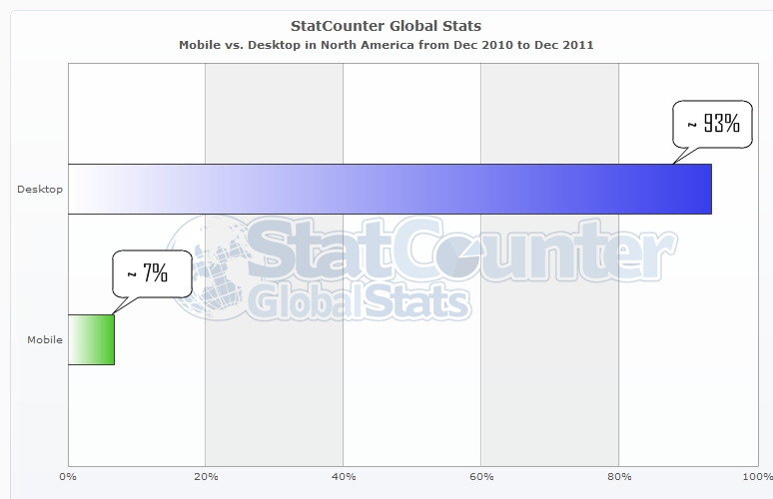
Stats – Mobile vs. Desktop
North America (~ 528 million people)
Notes:
Visual Studio Live! Las Vegas 2011
©
2012 Visual Studio Live! All rights reserved.
- Again another landslide win by the desktop in North America…but that is still
- ~37 million people in the US that use Mobile over Desktop browser

Slide 7
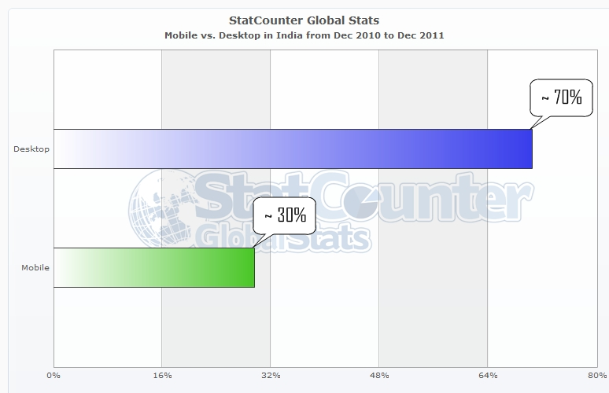
Stats – Mobile vs. Desktop
India (~ 1.7 billion people)
Notes:
Visual Studio Live! Las Vegas 2011
©
2012 Visual Studio Live! All rights reserved.
510 million people

Slide 8
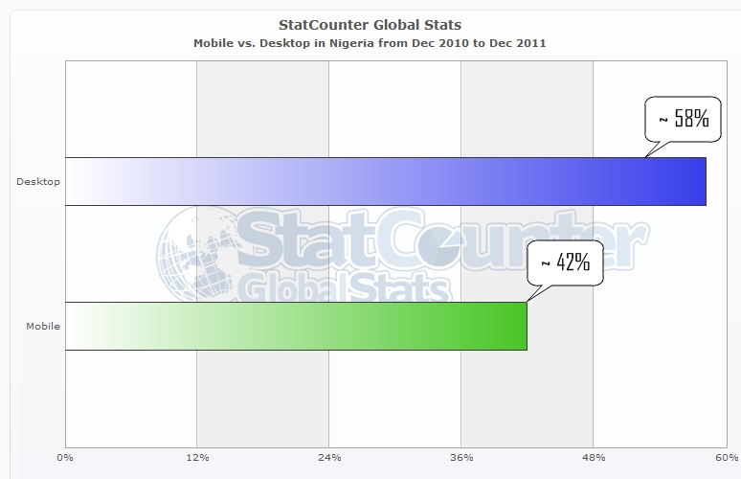
Stats – Mobile vs. Desktop
Nigeria (~ 1.6 million people)
Notes:
Visual Studio Live! Las Vegas 2011
©
2012 Visual Studio Live! All rights reserved.

Slide 9
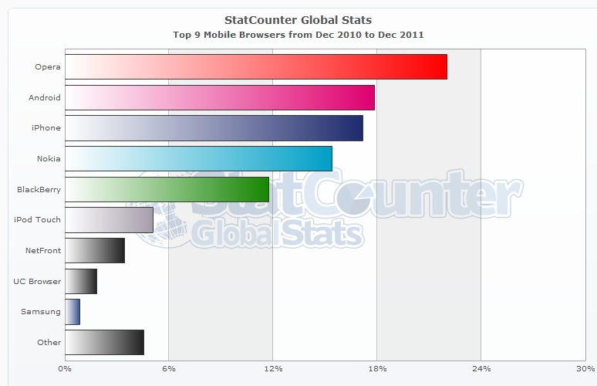
Stats – Mobile Browser Shares
Notes:
Visual Studio Live! Las Vegas 2011
©
2012 Visual Studio Live! All rights reserved.

Slide 10

But What Does It All Mean?
Notes:
Visual Studio Live! Las Vegas 2011
©
2012 Visual Studio Live! All rights reserved.
If your website does not display and/or function correctly on mobile devices you are not reaching your full audience.
Potentially millions of users and millions of dollars being lost!

Slide 11

Current State with MVC 3
Notes:
Visual Studio Live! Las Vegas 2011
©
2012 Visual Studio Live! All rights reserved.
Current State of MVC3 (Slide)
Spin up site
*** Yes I did just F5 and have it run in an iPhone simulator
This is a new tool available from Electric Plum…it’s called Electric Mobile Studio…check it out.
Like I said this is a simulator not emulator.
An emulator emulates the actual hardware of the device
And using a simulator or emulator does not excuse from testing on actual hardware.
Navigate around a bit
Show site in Android Simulator (tiny)
Show site in iOS Simulator (a little better)
What are the issues?
Not really useable w/out a ton of panning and zooming

Slide 12
If you do nothing else…
<meta name=“viewport” content=“width=d
Notes:
Visual Studio Live! Las Vegas 2011
©
2012 Visual Studio Live! All rights reserved.
But…we aren’t helpless
There are things we can do in MVC3 to make for a better mobile user experience
And if you can only take one thing away from this session
It’s use the meta viewport tag!

Slide 13
…at least add a viewport meta tag!
<meta name=“viewport” content=“width=device-width” />
Notes:
Visual Studio Live! Las Vegas 2011
©
2012 Visual Studio Live! All rights reserved.
...at least add a viewport meta tag (slide)
By default all browsers no matter where they are on…on a desktop pc, laptop, mobile phone, tablet … behave like they are rendering on the desktop
Which is why the they are zoomed all the way out
What the meta viewport tag does is instruct the browser to render the content to the width of the device it is being rendered on.
- mm1 Add viewport meta tag to _layout.chtml
- Show site in Android emulator
- Show site in iOS emulator (same)
But you can do more…even today with MVC3
Introduce CSS media queries and adaptive rendering
Implement view switching by creating a custom view engine.
Implement mobile specific views.
3. Use jQuery mobile, PhoneGap, Kendo UI Mobile, etc. to give your site the Native feeling.
Or you could just switch to MVC 4 ;)

Slide 14
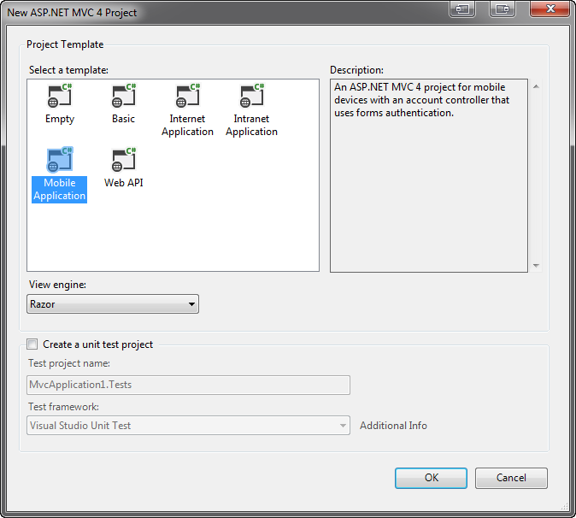
Mobile Project Template
Notes:
Visual Studio Live! Las Vegas 2011
©
2012 Visual Studio Live! All rights reserved.
Mobile Project Template
File -> New Project
MVC4
Next
Notice a new option: "Mobile“
Select Mobile (DON’T DO THIS! Just show the mobile application)
Show site.Css is bare
Show it includes jQuery Mobile (scripts and CSS)
View on mobile emulators
How cool is that!
Of course we don't create Mobile Only sites so let’s look at some of the features added to standard template.
Adaptive Rendering
- show viewport tag in _Layout
- show mobile styles that use Media Queries (search @media)
- spin up site and make smaller to show adaptiveness
- header and footer
- bullet list
- adaptive rendering makes for a much better mobile experience out of the box!
- spin up default site in mobile browsers

Slide 15

Enhancements for Adaptive Rendering
Notes:
Visual Studio Live! Las Vegas 2011
©
2012 Visual Studio Live! All rights reserved.
Adaptive Rendering
Adaptive rendering is the process of dynamically modifiying the display of your page based on the capabilities of the requesting browser.
This can be browser version or device size or anything you can get using CSS media queries.
- show viewport tag in _Layout
- show mobile styles that use Media Queries (search @media)
- spin up site and make smaller to show adaptiveness
- header and footer
- bullet list
- adaptive rendering makes for a much better mobile experience out of the box!
- spin up default site in mobile browsers

Slide 16
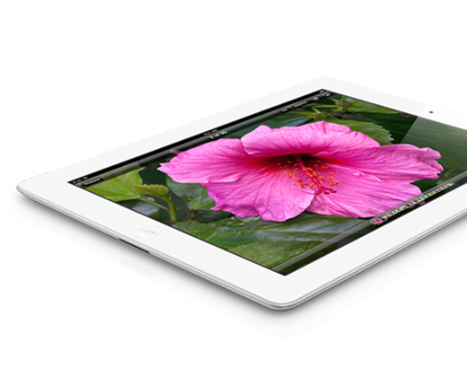
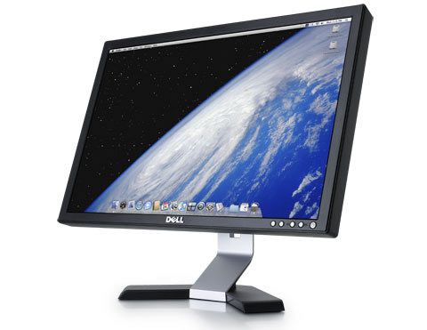
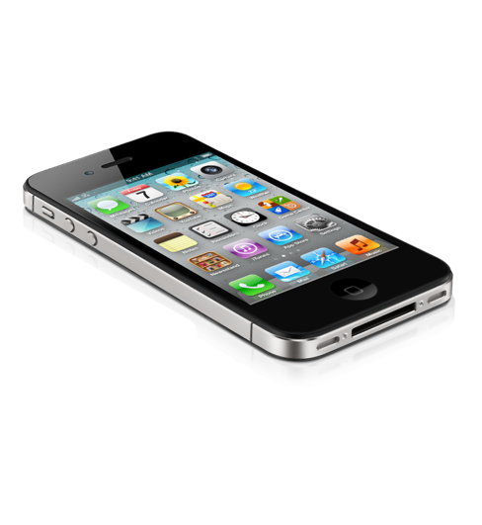
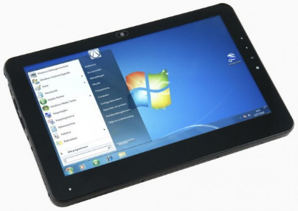
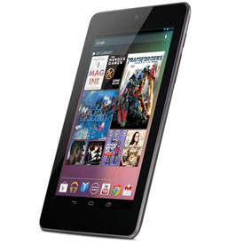
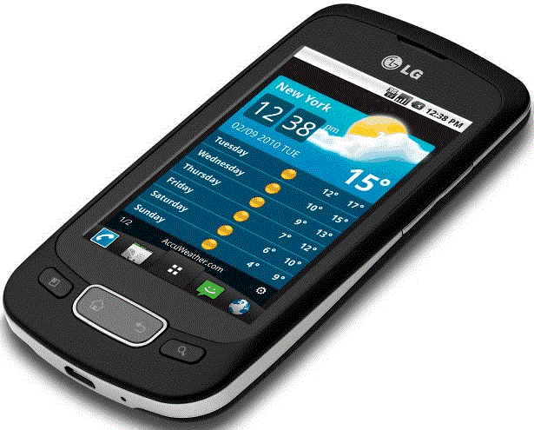
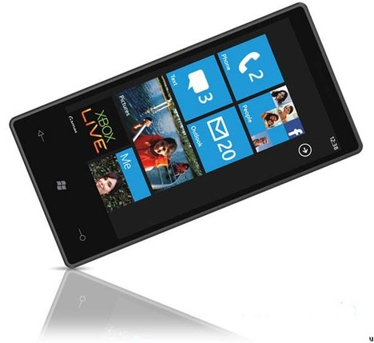
Display Modes
Notes:
Visual Studio Live! Las Vegas 2011
©
2012 Visual Studio Live! All rights reserved.
Lets an application select views depending on the browser making the request.
Can be at
Device level (Mobile Device vs. Non-Mobile Device)
Browser level
This concept is possible in MVC3 using a custom View Engine.
MVC4 implementation is clean and simple!
Mobile Specific Display Mode
Layout
Make copy of _Layout.cshtml and rename to _Layout.mobile.cshtml
Change the “Your Logo Here” text to “Mobile Specific”
Bring it up in
Desktop: No change
iPhone: Header now says “Mobile Specific”
Android: Header now says “Mobile Specific”
This also works for Views
View
Make copy of Views/Home/Index.cshtml and rename to Index.mobile.cshtml
Add <b>* Mobile Specfic*</b> before <p> in section featured
Desktop: No change
iPhone: Says “Mobile Specific” in top section
Android: Says “Mobile Specific” in top section
So those are device specific display modes…so either a mobile device or not…but what if we wanted to target specific browsers…like the iPhone browser or Android browser
Mobile Browser Specific Display Mode
Creating mobile browser specific display modes requires a little more work…but it is still a ton easier that it is in MVC3
To start we need to create our Display Mode and we do that in the Application_Start
mm2
So here I am inserting a new display mode to the DisplayModesProvider Modes collection.
Notice I am inserting this at position 0 because it is fine grained, and I don’t want another display mode to pick this up because it will immediately fall through
I am naming the display mode “iPhone” and this correlates directly to what my views need to be appended with in order for the display mode and view to work
And lastly I am setting the condition where this display mode applies
In this case when the UserAgent contains “iPhone”
That’s all I need do, and now I can work just as I did in the previous example
Layout
Make copy of _Layout.cshtml and rename to _Layout.iphone.cshtml
Change the “Your Logo Here” text to “iPhone Specific”
Bring it up in
Desktop: No change
iPhone: Header now says “iPhone Specific”
Android: No change
And just like device specific display modes…it also works for Views

Slide 17
Dial up the Wow jQuery Mobile
Notes:
Visual Studio Live! Las Vegas 2011
©
2012 Visual Studio Live! All rights reserved.

Slide 18

jQuery Mobile
Notes:
Visual Studio Live! Las Vegas 2011
©
2012 Visual Studio Live! All rights reserved.
An open source library for building touch-optimized web UI’s.
Built on jQuery Core.
HTML5 Markup-driven configuration.
Progressive Enhancement
Accessibility features
Powerful theming support (ThemeRoller)

Slide 19
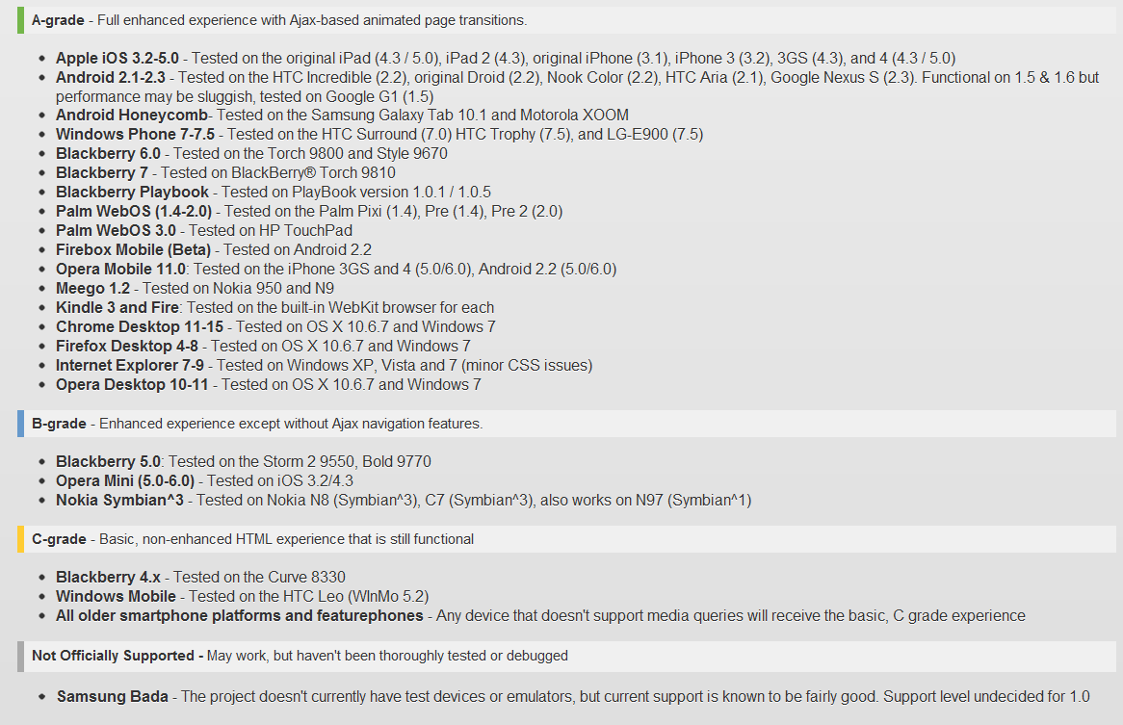
jQuery Mobile Supported Platforms
Notes:
Visual Studio Live! Las Vegas 2011
©
2012 Visual Studio Live! All rights reserved.
Don’t worry…this slide wasn’t meant to be read…just meant to prove the point that jQuery Mobile is very widely supported! ;)

Slide 20
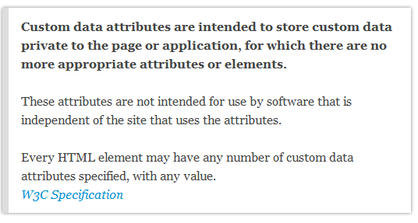
The data-”dash” attribute
Notes:
Visual Studio Live! Las Vegas 2011
©
2012 Visual Studio Live! All rights reserved.
jQuery Mobile configuration is done using the data-dash attribute introduced in HTML5
Key value pairs for storing data, where key is prefixed with data-.
Prefixing with data- ensures that the attributes will be ignored by the user agent.

Slide 21

Demo: Implementing jQuery Mobile
Notes:
Visual Studio Live! Las Vegas 2011
©
2012 Visual Studio Live! All rights reserved.
Installing
I could install jQuery Mobile using by downloading it or pulling down the jQuery.Mobile NuGet package but then I need to
Reference the scripts and CSS files
Create the mobile specific layout and yada, yada, yada
Or I could it install the jQuery.Mobile.MVC package that does all this for me…plus a bunch more
Use 4jQueryMobile project
Pckage Manager Console: Make Sure 4jQueryMobile is selected
install-package jquery.mobile.mvc
Add line to Global.asax.cs if necessary
Show
Content (jQuery.mobile css, images, etc.)
Views/Shared
_Layout.mobile
_ViewSwitcher
Run IT! Mobilification!!
Mobile Headers
And if we had more an app you would see what else it does automagically
Implementing
So that’s how I would recommend installing jQuery Mobile in your MVC application
I am going to switch over to another MVC 4 project to demonstrate how to use jQuery Mobile
Switch to Dream Cars
This is an MVC application where I have already installed the jQuery.Mobile.MVC NuGet Package
I’ll run this and we can see what it does and what just installing jquery.Mobile.MVC does in real application
Mobil header
Mobil navigation buttons
Transitions!
It looks good but not really mobilified other than the header…Let’s start by fixing the Manufacturer Index
Add data-role=“listview” to UL
Refresh
It’s not only style that I can tweak with jQuery Mobile …. I can also add functionality
Say I wanted to filter this list I can simply add the data-filter attribute to my list view and set equal true
F5 – and I now have client filtering of my list
How slick is that??
We can quickly implement this on the other two Index pages
Modes/Index
Engines/Index
Pull up a detail view
Our details views with lists are still pretty boring so lets fix that
Manufacturers/Details
Select
<td><h3>Models:</h3></td>
<td>
And mm3
Select <ul> and mm4
Between <ul> and @foreach mm5
Now that looks good!
Do for Model and Engine if time

Slide 22
What Did We Learn?
It’s possible in MVC 3
MVC 4 makes it easier
jQuery Mobile makes it awesomer
Notes:
That wraps up the presentations, so let’s summarize what we’ve covered
First we covered that out of the box MVC 3 doesn’t provide a very good user experience for mobile and manually coding all the goo that is required id tedious…but certainly possible
MVC 4 handles a lot of the goo for us and what it doesn’t it allows us to implement it with out it too much crazyness
And then we can add jQuery mobile to make this really cool

Slide 23
Thank You!
github.com/KBurnell/MobileMasses
Find me:
  Twitter: @KeBurnell
  Blog: DotNetDevDude.com
  E-Mail: KBurnell@SkylineTechnologies.com

