Slide 1

Current State with MVC 3
Notes:
Visual Studio Live! Las Vegas 2011
©
2012 Visual Studio Live! All rights reserved.
Current State of MVC3 (Slide)
Spin up site in Chrome
Navigate around a bit
Looks good in the browser
Show site in Android Simulator (tiny)
Stop and rerun selecting iPhone as target
Yes I did just F5 and have it run in an iPhone simulator
This is a new tool available from Electric Plum…it’s called Electric Mobile Studio…check it out.
Like I said this is a simulator not emulator.
An emulator emulates the actual hardware of the device
And using a simulator or emulator does not excuse from testing on actual hardware.
Show site in iOS Simulator (a little better)
What are the issues?
Not really useable w/out a ton of panning and zooming

Slide 2
…at least add a viewport meta tag!
<meta name=“viewport” content=“width=device-width” />
Notes:
Visual Studio Live! Las Vegas 2011
©
2012 Visual Studio Live! All rights reserved.
...at least add a viewport meta tag (slide)
By default all browsers no matter where they are on…on a desktop pc, laptop, mobile phone, tablet … behave like they are rendering on the desktop,
the width is 900px and the view is zoomed all the way out.
What the meta viewport tag does is instruct the browser to render the content to the width of the device it is being rendered on.
- mm1 Add viewport meta tag to _layout.chtml
- Show site in Android emulator
- Show site in iOS emulator (same)
But you can do more…even today with MVC3
Introduce CSS media queries and adaptive rendering
Implement view switching by creating a custom view engine.
Implement mobile specific views.
3. Use jQuery mobile, PhoneGap, Kendo UI Mobile, etc. to give your site the Native feeling.
These are all things we could do, and did by hand in MVC3.
Mobile development was a huge focus of the MVC team and a lot of new Mobile specific features have been added to MVC4…let’s take a look at those now.

Slide 3
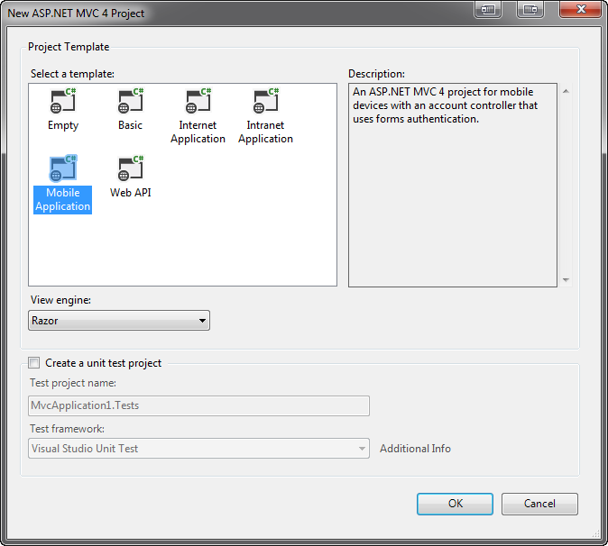
Mobile Project Template
Notes:
Visual Studio Live! Las Vegas 2011
©
2012 Visual Studio Live! All rights reserved.
The focus on mobile is evident as soon as you do a File-New Project in Visual Studio.
Mobile Project Template
Don’t do File New --- Right-click solution and Add -> New Project
MVC4
Next
Notice a new option: "Mobile“
Select Mobile (DON’T DO THIS! Just show the mobile application)
Show site.Css is bare
Show it includes jQuery Mobile (scripts and CSS)
Run it in desktop browser…doesn’t work as a desktop app
View on mobile emulators
How cool is that!
Of course we don't create Mobile Only sites
*** Fortunately for us mobile was a huge focus of MVC4 above and beyond the mobile project template.
*** Let’s look at some of the additions to MVC4 proper that make handling mobile devices inside a desktop browser focused code based

Slide 4

Enhancements for Adaptive Rendering
Notes:
Visual Studio Live! Las Vegas 2011
©
2012 Visual Studio Live! All rights reserved.
Adaptive Rendering
Adaptive rendering is the process of dynamically modifiying the display of your page based on the capabilities of the requesting browser.
This can be browser version or device size or anything you can get using CSS media queries.
The default template in MVC 4 now includes some adaptive rendering
- show viewport tag in _Layout
- show mobile styles that use Media Queries (search @media)
- spin up site and make smaller to show adaptiveness
- header and footer
- bullet list
- adaptive rendering makes for a much better mobile experience out of the box!
- spin up default site in mobile browsers
*** The addition of adaptive rendering to the default mobile template is meant to open your eyes to some new concepts and is to be used as a jumping off point for you to make your sites more accessible to mobile devices.

Slide 5
Display Modes
Notes:
Visual Studio Live! Las Vegas 2011
©
2012 Visual Studio Live! All rights reserved.
Lets an application select views depending on the browser making the request.
Can be at
Device level (Mobile Device vs. Non-Mobile Device)
Browser level
This concept is possible in MVC3 using a custom View Engine.
MVC4 implementation is clean and simple!
Mobile Specific Display Mode
Layout
Make copy of _Layout.cshtml and rename to _Layout.mobile.cshtml
Change the “Your Logo Here” text to “Mobile Specific”
Bring it up in
Desktop: No change
iPhone: Header now says “Mobile Specific”
Android: Header now says “Mobile Specific”
This also works for Views
View
Make copy of Views/Home/Index.cshtml and rename to Index.mobile.cshtml
Add <b>* Mobile Specfic*</b> before <p> in section featured
Desktop: No change
iPhone: Says “Mobile Specific” in top section
Android: Says “Mobile Specific” in top section
So those are device specific display modes…so either a mobile device or not…but what if we wanted to target specific browsers…like the iPhone browser or Android browser

Slide 6
Display Modes
Notes:
Visual Studio Live! Las Vegas 2011
©
2012 Visual Studio Live! All rights reserved.
So that was an example of doing a different display mode based on the broad device type making the request, so mobile versus desktop.
Let’s get more granular and look at creating a display mode specific not only to a mobile device but a specific mobile browser.
Mobile Browser Specific Display Mode
Creating mobile browser specific display modes requires a little more work…but it is still a ton easier that it is in MVC3
To start we need to create our Display Mode and we do that in the Application_Start
mm2
So here I am inserting a new display mode to the DisplayModesProvider Modes collection.
Notice I am inserting this at position 0 because it is fine grained, and I don’t want another display mode to pick this up because it will immediately fall through
I am naming the display mode “iPhone” and this correlates directly to what my views need to be appended with in order for the display mode and view to work
And lastly I am setting the condition where this display mode applies
In this case when the UserAgent contains “iPhone”
That’s all I need do, and now I can work just as I did in the previous example
Layout
Make copy of _Layout.cshtml and rename to _Layout.iphone.cshtml
Change the “Your Logo Here” text to “iPhone Specific”
Bring it up in
Desktop: No change
iPhone: Header now says “iPhone Specific”
Android: No change
And just like device specific display modes…it also works for Views

Slide 7

Demo: Implementing jQuery Mobile
Notes:
Visual Studio Live! Las Vegas 2011
©
2012 Visual Studio Live! All rights reserved.
Installing
I could install jQuery Mobile using by downloading it or pulling down the jQuery.Mobile NuGet package but then I need to
Reference the scripts and CSS files
Create the mobile specific layout and yada, yada, yada
Or I could it install the jQuery.Mobile.MVC package that does all this for me…plus a bunch more
Use 4jQueryMobile project
Pckage Manager Console: Make Sure 4jQueryMobile is selected
install-package jquery.mobile.mvc
Add line to Global.asax.cs if necessary
Show
Content (jQuery.mobile css, images, etc.)
Views/Shared
_Layout.mobile
_ViewSwitcher
Run IT! Mobilification!!
Mobile Headers
And if we had more an app you would see what else it does automagically
Implementing
So that’s how I would recommend installing jQuery Mobile in your MVC application
I am going to switch over to another MVC 4 project to demonstrate how to use jQuery Mobile
Switch to Dream Cars
This is an MVC application where I have already installed the jQuery.Mobile.MVC NuGet Package
I’ll run this and we can see what it does and what just installing jquery.Mobile.MVC does in real application
Mobil header
Mobil navigation buttons
Transitions!
It looks good but not really mobilified other than the header…Let’s start by fixing the Manufacturer Index
Add data-role=“listview” to UL
Refresh
It’s not only style that I can tweak with jQuery Mobile …. I can also add functionality
Say I wanted to filter this list I can simply add the data-filter attribute to my list view and set equal true
F5 – and I now have client filtering of my list
How slick is that??
We can quickly implement this on the other two Index pages
Modes/Index
Engines/Index
Pull up a detail view
Our details views with lists are still pretty boring so lets fix that
Manufacturers/Details
Select
<td><h3>Models:</h3></td>
<td>
And mm3
Select <ul> and mm4
Between <ul> and @foreach mm5
Now that looks good!
Do for Model and Engine if time

