Slide 1

Reach the Mobile Masses with ASP.NET MVC 4 and jQuery Mobile
Keith Burnell
Senior Software Engineer
Email: keith@dotnetdevdude.com
Twitter: keburnell
Blog: www.dotnetdevdude.com
Level: Intermediate
Notes:
Visual Studio Live! Las Vegas 2011
©
2012 Visual Studio Live! All rights reserved.

Slide 2

Little about me
Senior Software Engineer at Skyline Technologies, a Microsoft Gold Partner.
Been developing software for ~15 years
Primary focus on the Microsoft stack.
Spend majority of time developing Web *stuff*.
Consulting for last 10 years.
Vice President of Fox Valley .NET UG.
INETA Speaker.
Blogger (DotNetDevDude.com)
Technology Freak!
Notes:
Visual Studio Live! Las Vegas 2011
©
2012 Visual Studio Live! All rights reserved.

Slide 3
Agenda
Statistics
Current state with vanilla MVC3
Making things better with MVC3
New mobile specific features in MVC4
jQuery Mobile
Notes:
Visual Studio Live! Las Vegas 2011
©
2012 Visual Studio Live! All rights reserved.

Slide 4
Statistics
Notes:
Visual Studio Live! Las Vegas 2011
©
2012 Visual Studio Live! All rights reserved.

Slide 5

Stats – Mobile Broadband
1 billion active mobile-broadband subscriptions
Mobile-broadband subscriptions have grown 45% annually over the last 4 years
Currently twice as many mobile-broadband as fixed-broadband subscriptions
ICT 2011 Facts and Figures
http://www.itu.int/ITU-D/ict/facts/2011/material/ICTFactsFigures2011.pdf
Notes:
Visual Studio Live! Las Vegas 2011
©
2012 Visual Studio Live! All rights reserved.

Slide 6
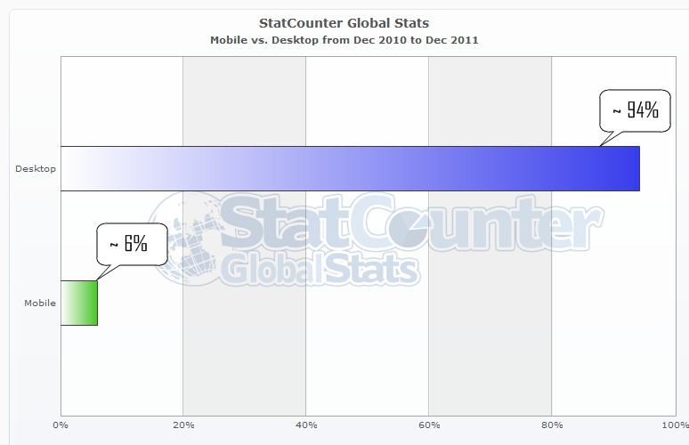
Stats – Mobile vs. Desktop
World Wide (~ 6.8 billion people)
Notes:
Visual Studio Live! Las Vegas 2011
©
2012 Visual Studio Live! All rights reserved.
- That is 408 million people that use mobile browser over desktop browser

Slide 7
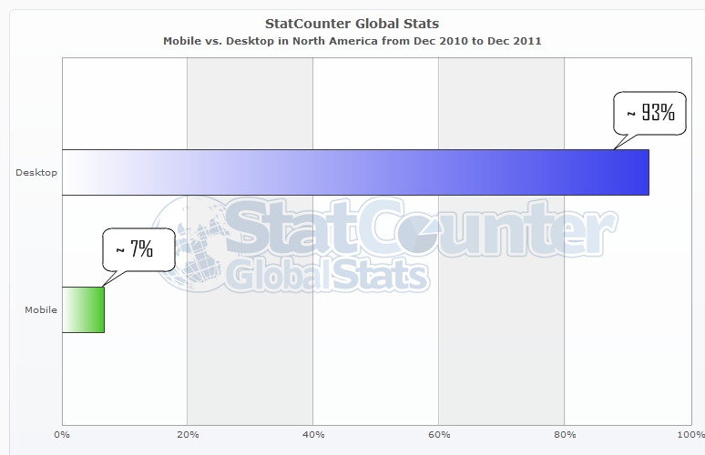
Stats – Mobile vs. Desktop
North America (~ 528 million people)
Notes:
Visual Studio Live! Las Vegas 2011
©
2012 Visual Studio Live! All rights reserved.
- ~37 million people in the US that use Mobile over Desktop browser

Slide 8
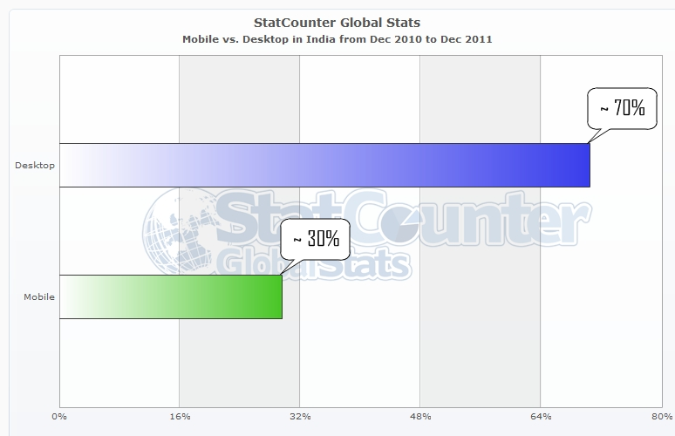
Stats – Mobile vs. Desktop
India (~ 1.7 billion people)
Notes:
Visual Studio Live! Las Vegas 2011
©
2012 Visual Studio Live! All rights reserved.
510 million people

Slide 9
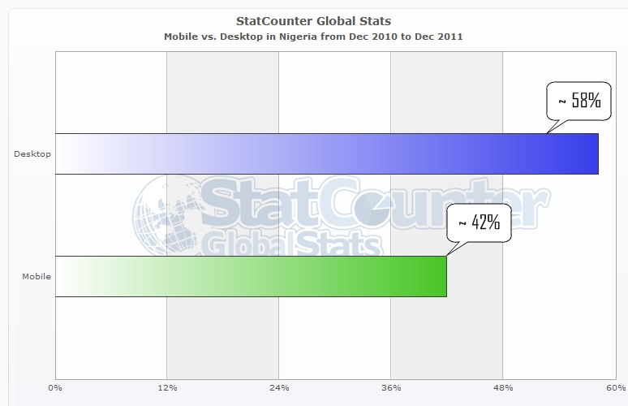
Stats – Mobile vs. Desktop
Nigeria (~ 1.6 million people)
Notes:
Visual Studio Live! Las Vegas 2011
©
2012 Visual Studio Live! All rights reserved.

Slide 10
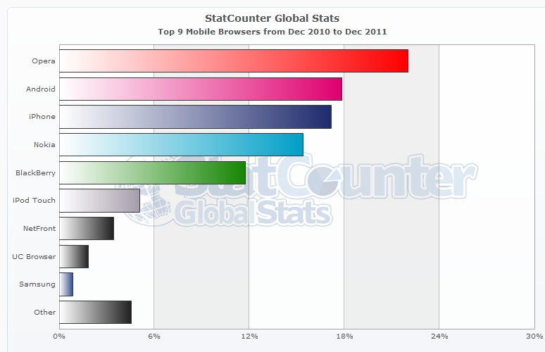
Stats – Mobile Browser Shares
Notes:
Visual Studio Live! Las Vegas 2011
©
2012 Visual Studio Live! All rights reserved.

Slide 11
But What Does It All Mean?
If your website does not display and/or function correctly on mobile devices you are not reaching your full audience.
Potentially means millions of users and millions of dollars being lost!
Notes:
Visual Studio Live! Las Vegas 2011
©
2012 Visual Studio Live! All rights reserved.

Slide 12
Current State With Vanilla MVC3
Notes:
Visual Studio Live! Las Vegas 2011
©
2012 Visual Studio Live! All rights reserved.
Current State of MVC3 (Slide)
- Spin up site
- Navigate around a bit
- Show site in WP7 Emulator (tiny)
- Show site in Android Emulator (tiny)
- Show site in iOS Emulator (a little better)

Slide 13
Vanilla MVC 3 Issues
Android / Windows Phone 7
  To make readable have to zoom way in
  Once zoomed in required to be constantly panning left, right, up, and down
iPhone
  Browser makes a noble attempt to render the page in what it perceives is a more usable view…and does a fairly good job (DAMN APPLE!)
Notes:
Visual Studio Live! Las Vegas 2011
©
2012 Visual Studio Live! All rights reserved.

Slide 14
You can make things better with MVC3
Notes:
Visual Studio Live! Las Vegas 2011
©
2012 Visual Studio Live! All rights reserved.

Slide 15
If you do nothing else…
<meta name=“viewport” content=“width=d
Notes:
Visual Studio Live! Las Vegas 2011
©
2012 Visual Studio Live! All rights reserved.

Slide 16
…at least add a viewport meta tag!
<meta name=“viewport” content=“width=device-width” />
Notes:
Visual Studio Live! Las Vegas 2011
©
2012 Visual Studio Live! All rights reserved.
...at least add a viewport meta tag (slide)
- Add viewport meta tag to _layout.chtml
- Show site in WP7 emulator
- Show site in Android emulator
- Show site in iOS emulator (same)

Slide 17
There is a lot more you can do
Implement view switching by creating a custom view engine.
Implement mobile specific views.
Use jQuery mobile, PhoneGap, Sencha Touch, etc. to give your site the Native feeling.
Notes:
Visual Studio Live! Las Vegas 2011
©
2012 Visual Studio Live! All rights reserved.

Slide 18
But we don’t have to do all the work thanks to
ASP.NET MVC4
Notes:
Visual Studio Live! Las Vegas 2011
©
2012 Visual Studio Live! All rights reserved.

Slide 19
MVC4 : New mobile specific features
Mobile project template
Enhancements for adaptive rendering
Display Modes
Notes:
Visual Studio Live! Las Vegas 2011
©
2012 Visual Studio Live! All rights reserved.

Slide 20
Mobile Project Template
File -> New Project -> Web -> ….
Now you can choose a Mobile Application
Includes jQuery Mobile and the plumbing
Notes:
Visual Studio Live! Las Vegas 2011
©
2012 Visual Studio Live! All rights reserved.
File -> New Project
MVC4
Next
Notice 2 new options "Empty" and "Mobile“
Select Mobile
Show site.Css is bare
Show it includes jQuery Mobile (scripts and CSS)
View on mobile emulators
How cool is that!
If only we created mobile only sites! :)
Of course we don't create Mobile Only (JUST SAY)
Spin up new MVC4 site
- talk a little about the new template
- Haack and the boys actually had a designer's input - looks Purdy
- columns
- Twitter/Facebook
- overall more pleasing to the eye, but who uses the default template anyway!?

Slide 21
Enhancements for Adaptive Rendering
Viewport meta tag included by default
CSS media queries
Notes:
Visual Studio Live! Las Vegas 2011
©
2012 Visual Studio Live! All rights reserved.
Enhancements for adaptive rendering (Slide)
- show viewport tag in _Layout
- show mobile styles that use Media Queries (search @media)
- spin up site and make smaller to show adaptiveness
- spin up default site in mobile browsers

Slide 22
Display Modes
Lets an application select views depending on the browser making the request.
This concept is possible in MVC3 using a custom View Engine.
MVC4 implementation is clean and simple!
Notes:
Visual Studio Live! Las Vegas 2011
©
2012 Visual Studio Live! All rights reserved.
Display Modes (Slide)
- Go through slide
- Show implementation of iPhone Display Mode

Slide 23
Dial up the Wow Factor with jQuery Mobile
Notes:
Visual Studio Live! Las Vegas 2011
©
2012 Visual Studio Live! All rights reserved.

Slide 24
jQuery Mobile: Introduction
An open source library for building touch-optimized web UI’s.
Built on jQuery Core.
HTML5 Markup-driven configuration.
Progressive enhancement.
Accessibility features
Powerful theming support (ThemeRoller)
NuGet: package-install jquery.mobile
Notes:
Visual Studio Live! Las Vegas 2011
©
2012 Visual Studio Live! All rights reserved.
jQuery.Mobile (Slide)
- **** Note on HTML5 markup-driven configuration
- Don't have to worry about a mobile browser not being up to par with the
rest for the HTML 5 features...based on universally adopted standards.
- Talk a bit about progressive enhancements and graceful degradation
- Accessibility features, very important now mobile devices are the norm!
- Install in default project (package-install jquery.mobile)
- Note what it installed
- images
- couple of css files
- scripts
- Run it
- No change on desktop
- No change on Mobile either
- Not Hooked Up because Nuget package just dumps the files.
- So I could manually hook up everything or I could use jQuery.Mobile.MVC

Slide 25
jQuery Mobile MVC (Quick Sidebar)
Includes jQuery Mobile and helper files
  A jQuery Mobile based layout
    Views\Shared\_Layout.mobile.cshtml
  A view-switcher component
    Allows switching between mobile & desktop views
    Views/Shared/_ViewSwitcher.cshtml
    Controllers/ViewSwitcherController.cs
Takes care of a lot of the plumbing
Notes:
Visual Studio Live! Las Vegas 2011
©
2012 Visual Studio Live! All rights reserved.
jQuery.Mobile.MVC
- install via NuGet
- *** Make sure version of jQuery and jQuery mobile in _layout.mobile match installed versions
- Show the new items
* views/shared/_Layout.mobile.cshtml
* views/shared/_ViewSwitcher.cshtml
* controllers/ViewSwitcherController.cs
- Run it
* Desktop no-change
* Mobile emulators
- view switcher
- color
- images are now displayed
- navigate to Account/LogOn (show log on screen)

Slide 26
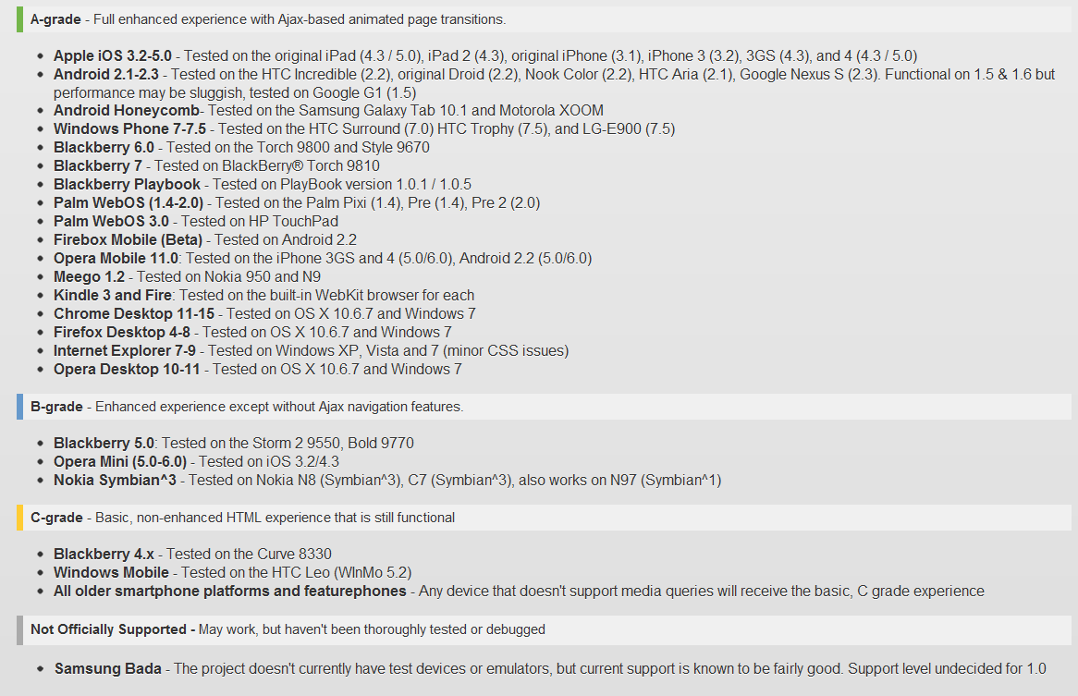
jQuery Mobile: Supported Platforms
Notes:
Visual Studio Live! Las Vegas 2011
©
2012 Visual Studio Live! All rights reserved.

Slide 27
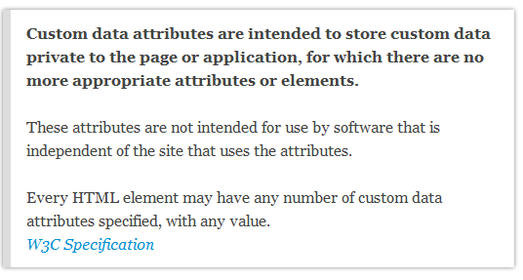
jQuery Mobile: The “data-” attribute
Key value pairs for storing data, where key is prefixed with data-.
Prefixing with data- ensures that the attributes will be ignored by the user agent.
Notes:
Visual Studio Live! Las Vegas 2011
©
2012 Visual Studio Live! All rights reserved.

Slide 28
jQuery Mobile: Page Anatomy
Must be HTML5 doctype
Top level element, typically a DIV tag, with data-role=“page”
Within the top level element any valid HTML can be used but the typical jQuery Mobile structure is.
  <div data-role="page">
  <div data-role="header">...</div>
  <div data-role="content">...</div>
  <div data-role="footer">...</div>
  </div>
Notes:
Visual Studio Live! Las Vegas 2011
©
2012 Visual Studio Live! All rights reserved.
Show doctype declaration in _layout and _layout.Mobile (html5 is the default in MVC4)
Show _layout.mobile for data-role elements

Slide 29
Coding Time!
Making it all Come Together
Notes:
Visual Studio Live! Las Vegas 2011
©
2012 Visual Studio Live! All rights reserved.

Slide 30

Get The Code!
github/kburnell/mobilemasses
Notes:
Visual Studio Live! Las Vegas 2011
©
2012 Visual Studio Live! All rights reserved.

Slide 31

Notes:
Visual Studio Live! Las Vegas 2011
©
2012 Visual Studio Live! All rights reserved.

Slide 32
Thank You!
Twitter: @keburnell
Blog: DotNetDevDude.com
Email: keith@DotNetDevDude.com
Notes:
Visual Studio Live! Las Vegas 2011
©
2012 Visual Studio Live! All rights reserved.

