Slide 1

Test Driving .NET
Keith Burnell
Senior Sofware Engineer Skyline Technologies, Inc
@keburnell · DotNetDevDude.com

Slide 2
Little about me
Microsoft MVP: ASP.NET/IIS
Senior Software Engineer at Skyline Technologies
Been developing software for ~13 years
Primary focus on the Microsoft Web stack
Speaker (Local, Regional, National)
Author (MSDN, Pluralsight)
Notes:
Scrum most popular.

Slide 3
What’s on Tap
Do you need to be doing Test-driven Development?
Types of testing
What is Test-driven development?
Unit Testing
Concepts and strategies you need to know
Laying out your solution for maximum testability
Dependency Injection and Inversion of Control
Mocks, Fakes, Stubs
DI/IoC Tooling
Notes:
Scrum most popular.

Slide 4
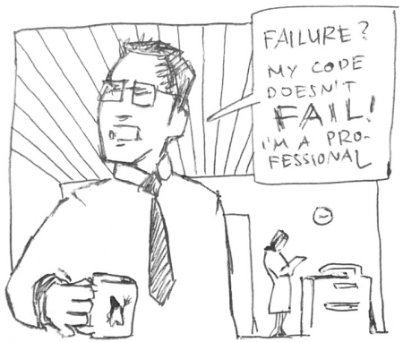
Pop quiz
Notes:
So let’s start out with a quick 3 question, pop quiz. No cheating, we are on the honor system here. ☺

Slide 5
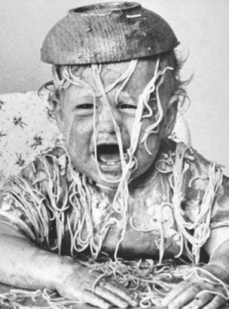
Ever have to deal with spaghetti code?
Notes:
Scrum most popular.

Slide 6
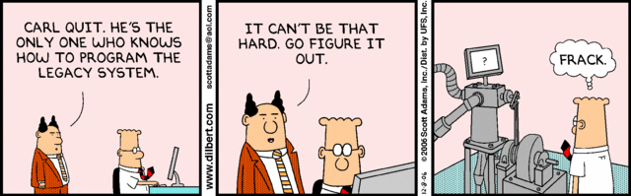
Ever inherit legacy code?
Notes:
Have you ever inherited Legacy Code?
Every company has that one legacy application that gets passed around from new guy to new guy because nobody wants to maintain it.

Slide 7

Ever scared to change code?
Notes:
Ever get a change request that the minute you read you realize the even though the change would require 10 minutes that the effected piece of code is touched by 10,000 other pieces of code and testing will take 6 months
Have fun explaining that to the business ☺

Slide 8
If you answered YES to any of those questions
Then…
Notes:
If you answered “no” to all 3 questions, your are the luckiest developer in the world!
But if you did answer “yes” to one or more of these questions then…

Slide 9

Notes:
You need a way to alleviate the pain and hassle that comes with unmanageable overly complex poorly architected code
More importantly you need a methodology or set of practices that encourages writing better, cleaner, and more concise code…and that is Test Driven Development as well as the techniques required to implement it successfully
But before we talk about what TDD is lets quickly cover what it isn’t

Slide 10
Types of testing that are not keys to test-driven development
Notes:
These types of testing are all VERY important
And implementing TDD does not reduce or remove the need for these types of testing
What it does is significantly reduce the time spent in these testing cycles by
Reducing the number of bugs
Reducing the time needed to resolve bugs

Slide 11
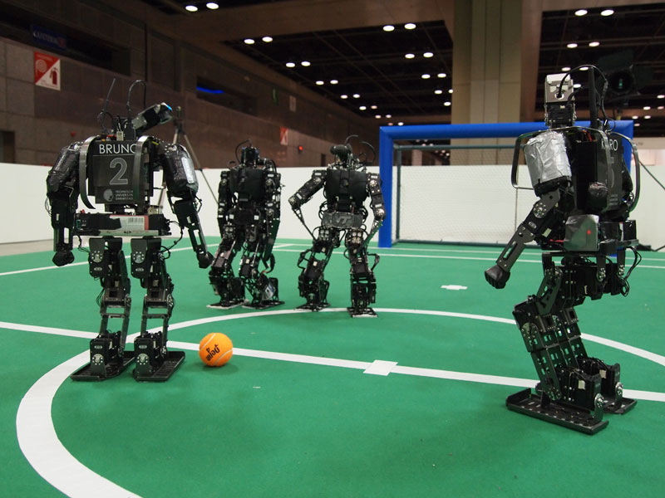
Integration Testing
Notes:
The act of testing 2 or more interconnected pieces of a software system
Necessary evil…but once everything has been unit tested
Can have external dependencies (DB, Services, File System, Hardware, etc.)
Typically run longer than unit tests
Often require setup of resources
Harder to automate
For all those reasons they are run less often

Slide 12
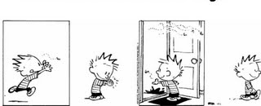
Regression Testing
1 Bug
> 1 Bugs
Notes:
The act of testing the entire software system after applying changes to ensure they did not affect other parts of the system
Complete end – to – end system test
Usually manual

Slide 13
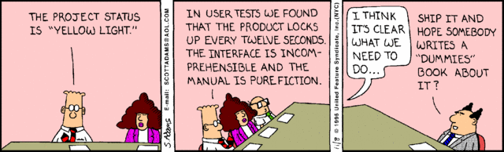
User Acceptance Testing (UAT)
Notes:
The act of testing to make sure system does what the users expect it to do
Lots of users in a room doing whatever it is they do
Manual
Time consuming
Stressful for you and the users

Slide 14

Performance Testing
Notes:
The act of testing to ensure the system meets the performance requirements defined in the SLA.
Test runs are automated but script creation is manual and time consuming
Requires separate data for performing tests
Tooling is expensive

Slide 15

Load Testing
Notes:
The act of testing how the system behaves under load
Automated
Tooling is expensive
Setup is time consuming

Slide 16
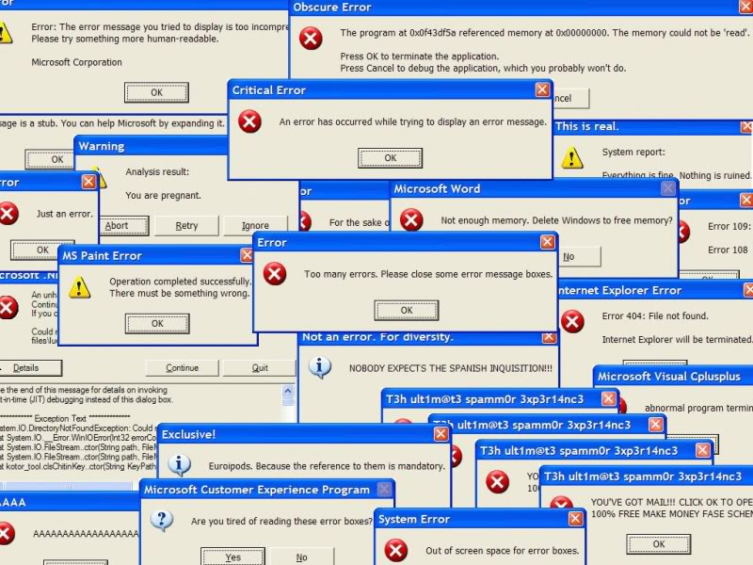
Stress Testing
Notes:
The act of testing the system fails and verifying how the system responds is acceptable
Requires effort to get the system to fail
Typically for verifying error messages and data state are valid during failures
Automated to make system fail, but requires manual verification

Slide 17
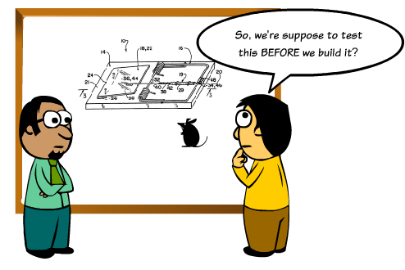
What is Test-driven Development?
Notes:
Test-driven development (TDD) is a software development process that relies on the repetition of a very short development cycle: first the developer writes a failing automated test case that defines a desired improvement or new function, then produces code to pass that test and finally refactors the new code to acceptable standards.
Often referred to Test-First Development
Process of writing tests before writing code
Kent Beck, is credited with having developed or 'rediscovered' the technique

Slide 18
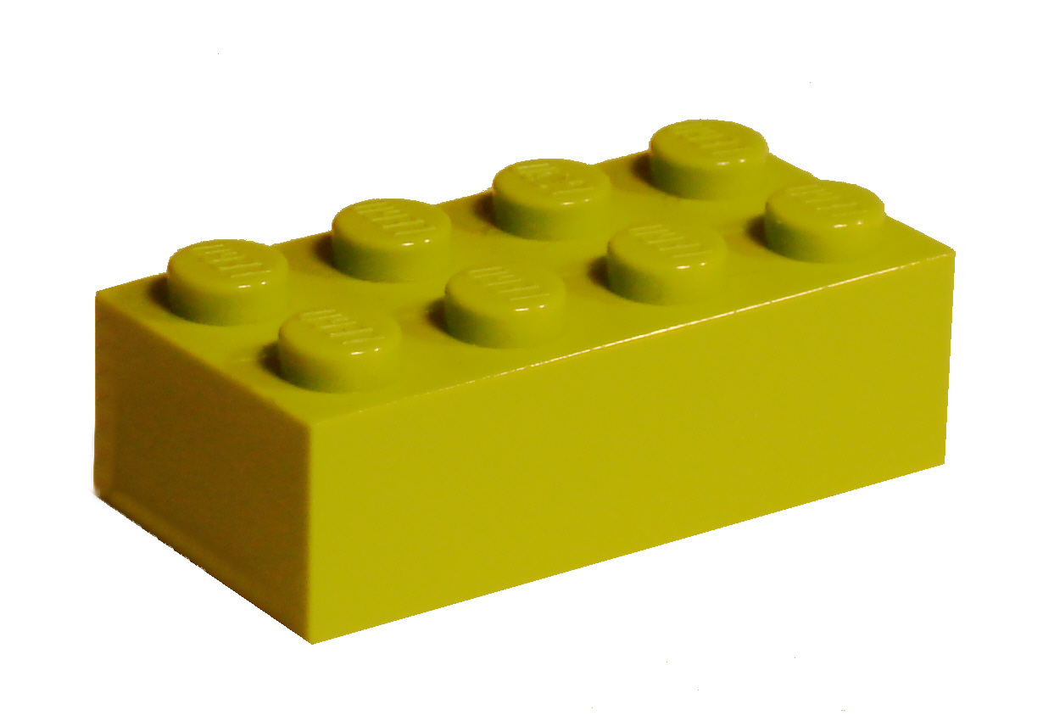
Unit Testing: Key to TDD
@keburnell ∙ DotNetDevDude.com
Notes:
The act of testing piece of code, usually a method, that tests a very small piece of functionality by invoking it and verifying assumptions.

Slide 19
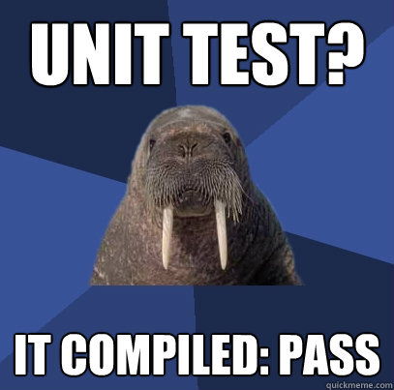
What makes a good Unit Test?
Notes:
So what are the characteristics of a good unit test
It is very easy to write bad unit tests
Bad unit tests are worse than no unit tests
They provide a false sense of security
They provide false system documentation

Slide 20

Automated and Repeatable
Notes:
No manual setup or running should be required
Should be able run the same tests over and over again and get the same results every time

Slide 21
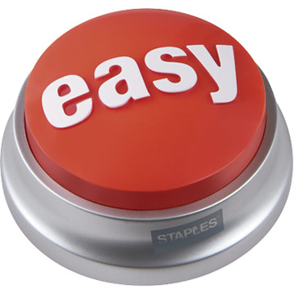
Easy to implement
Notes:
Easy to write
If you find a unit test difficult to write chances are
You are trying to test too much
Your method under test is too complex and should be refactored
Your dependency’s are not isolated

Slide 22

Run on Demand at the Push of a Button
Notes:
Coded using an automated unit testing framework that runs tests at the push of a button
MSTest
nUnit
xUnit
MbUnit

Slide 23

Fast
Notes:
Your unit test suite should run in under 30 seconds in the worse case
If it takes longer they
Developers won’t run the test suite
You tests are using external dependencies

Slide 24

Isolated
Notes:
No external dependency’s
Test this by
Unplugging your network cable
Turning off your Wi-Fi
Shutting down your local DB services
And run your unit test suite – they should all still pass!

Slide 25
Important Concepts & Strategies
Notes:
Scrum most popular.

Slide 26
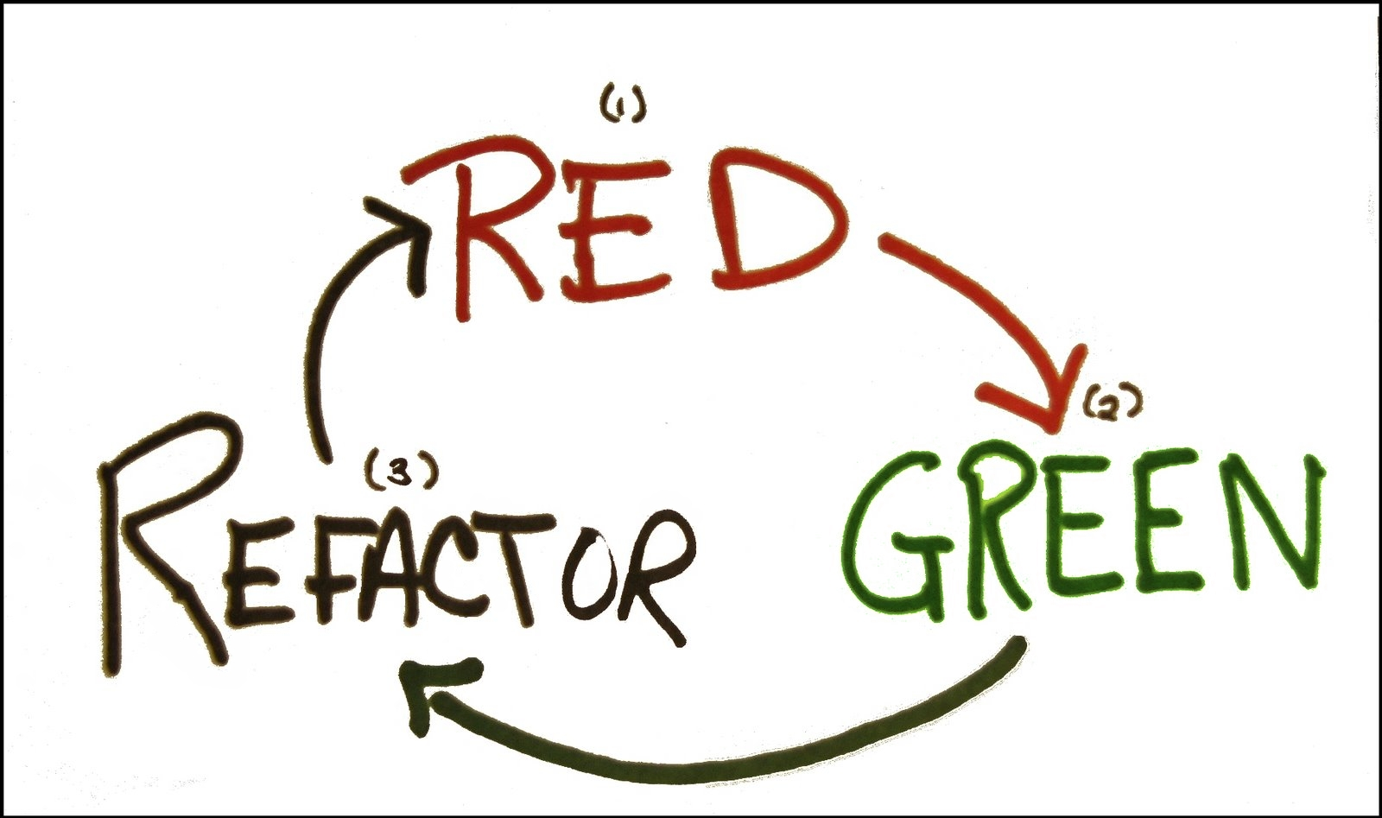
Notes:
Red
Write a failing test
Green
Write just enough code to get the test to pass
Refactor
Clean up the code

Slide 27

Arrange – Act - Assert
Notes:
Arrange
Set up mocks/stubs/fakes
Instantiate class under test
Act
Call the method being tested
Assert
Validate expected outcomes

Slide 28
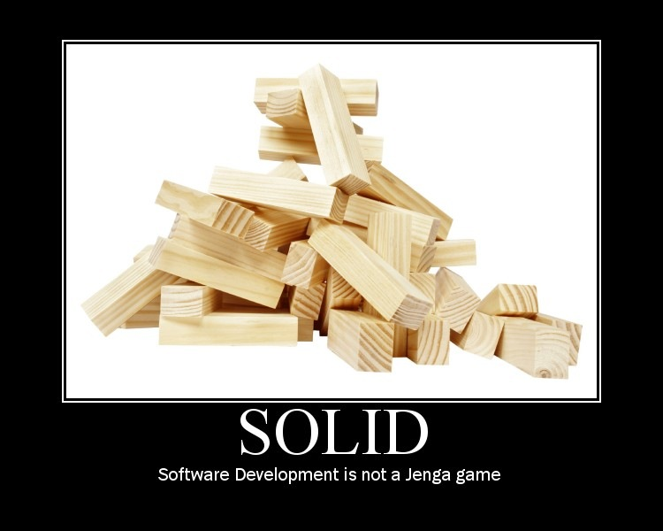
SOLID Principles of Software Development
Notes:
Collection of best-practice object-oriented design principles
Uncle Bob

Slide 29

Single Responsibility Principle
Notes:
Should never be more than one reason for a class to change
A class should have one and only one responsibility
A method should have one and only responsibility
“And” in method names
Long methods

Slide 30

Open Closed Principle
Notes:
Classes should be open to extension and closed to modifications
Public signatures are contracts – Don’t break them!
Sealed classes are bad!

Slide 31
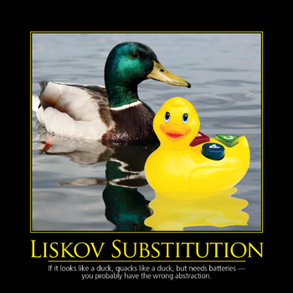
Liskov Substitution Principle
References to base classes must be able to use derived classes without knowing it.
Notes:
References to base classes must be able to use derived classes without knowing it.

Slide 32
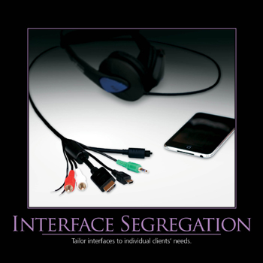
Interface Segregation Principle
Notes:
Interfaces should be fine grained
Interfaces should be client specific
Don’t agree with fine grain

Slide 33
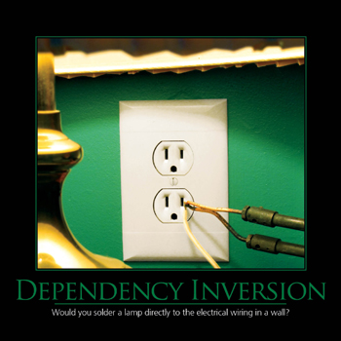
Dependency Inversion Principle
Notes:
Program to Interfaces not Concrete implementations
So when ‘newing up’ use IFoo and not Foo!

Slide 34
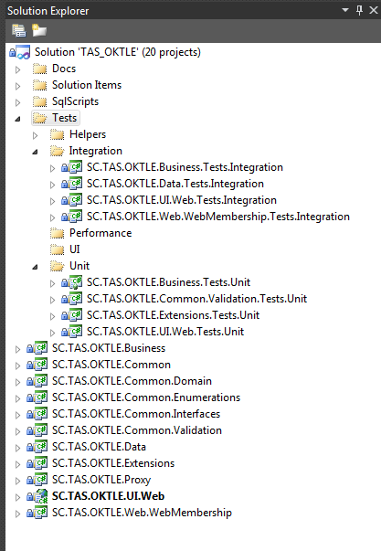
Example Solution Layout
Notes:
Different types of tests should be isolated from other types to allow easily running a group of tests.
Tests should be placed in projects named the same as the project they are testing with a prefix of the type of tests it contains.
Tests should be isolated from actual application code

Slide 35

Naming Your Tests
Notes:
Be descriptive…very descriptive
Long test names are encouraged
Should be able to read a test name and know exactly what it does and more importantly why it would fail

Slide 36
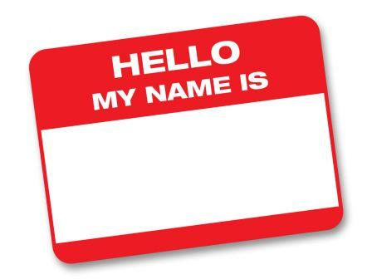
How I Name My Tests
[MethodUnderTest]_[ExpectedResult]_[Conditions]
GetCustomers_ShouldReturn_ListOf_Customers()
CalculateRate_ShouldReturn_25_When_Interest_Is_50_And_X_Is_5()
Notes:
Scrum most popular.

Slide 37
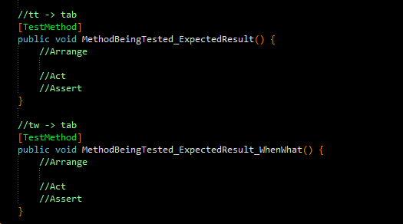
Resharper Live Template for Naming Tests
My unit testing live template is available on my blog:
http://www.dotnetdevdude.com/downloads/code/ ResharperUnitTestTemplates.zip
Notes:
Scrum most popular.

Slide 38

Let’s Write Our First Unit Test - Together!
Notes:
Our contrived example is a simple calculator with an Add method
Must accept to 2 decimals, and return a decimal
Accepting input parameters is something I personally DO NOT test as it is set by method signature and causes a compiler error if there are conflicts
I do test that the output is what I expect because of the incorrect usage of VAR!
VAR IS BAD
Write a test to make sure return value is a decimal
Write test with standard assert
Talk about readability
Talk about NuGet
Install Should
Add using
Re-code test to use .ShouldBeType
Write test to use Should...explain Should
Run test [RED]
Fix It [GREEN]
return 0;
Refactor
Declare decimal calculatedResult and return it

Slide 39
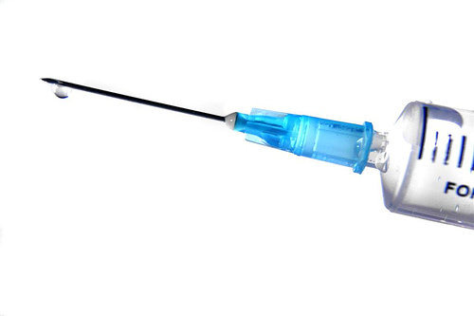
Dependency Injection (DI)
Notes:
The act of “injecting” the dependency’s a class needs.
3 types
Constructor
Property
Interface (really used along with constructor and property, passing in interfaces)

Slide 40

Inversion of Control (IoC)
Notes:
Class doesn’t go out and instantiate/”new up” its dependency’s…it is given them
All it knows is the method signatures it needs

Slide 41

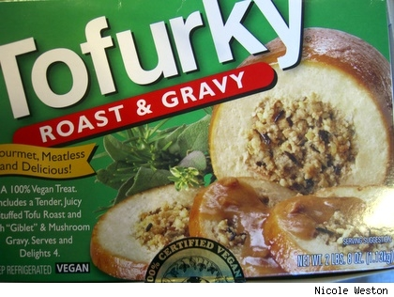
What does implementing DI/IoC get me?
Separation of Concerns
Mockability (we will get to this)
Notes:
Separation of Concerns
Mockability

Slide 42
Let’s Do Some DI/IoC - Together!
Notes:
Look at the new requirement for validation
Show validation service implementation just to prove the point
Add Validation to Calculator Service
Add private property: IValidationService _validator;
Call Validate in Add method
Start with Property Injection
What is the issue?
Have to add code to make sure the dependency’s are set to avoid NULL reference exceptions
We can fix this with Constructor Injection
Next Do Constructor Injection
Hold down fn and alt and hit enter for resharper constructor
What could be the issue (constructor that takes a bunch of parameters)
What’s the issue here?
What happens when you have a bunch of dependency's?
We’ll get to using IoC framework to fix all this

Slide 43

Ruh roh! Test is broken!
Notes:
Now our test is broken
What is the cause?
A dependency is erroring out.
We shouldn’t need to worry about that
Not our responsibility
Not part of what we need to test
Let’s discuss how we can fix this

Slide 44
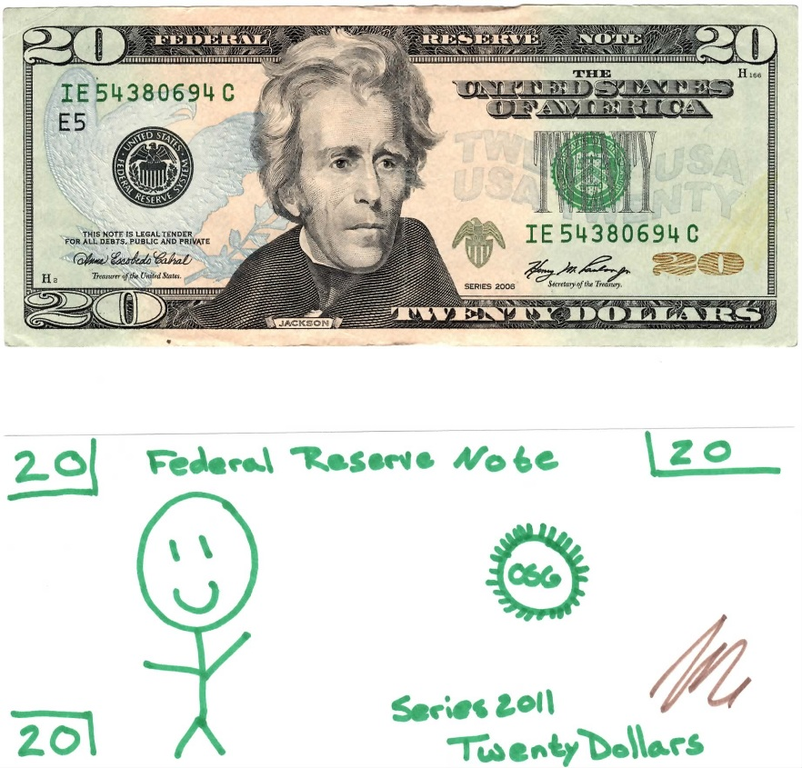
Fakes/Stubs
Notes:
Shell of a class that satisfies the implementation of the class
Return hard coded value
Not asserted against, state is never validated!
Requires no tooling
Let’s fix our broken test with a Fake/Stub
Create Fakes folder in unit test project
Create ‘FakeValidationService’
Add should return true
Pass ‘FakeValidationService” to CalculatorService in test
What’s the issue with fakes?
Need to manually code a fake for dependency!
And need to code for every scenario
Checking for true
Checking for false

Slide 45
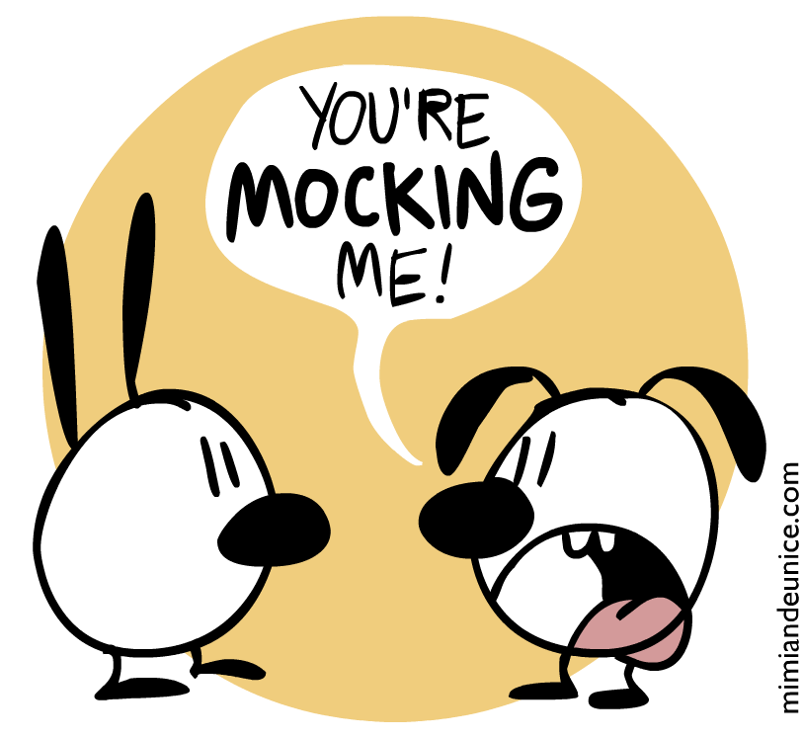
Mocks
Notes:
Simulated object that satisfies the implementation of the class
Mimics the objects behavior in a controlled manner
Asserted against (state is validated)
Requires tooling
Let’s change out our broken test with a Mock
Install RhinoMocks via NuGet
Create private property: private IValidationService _validationService;
IValidationService mockValidationService = _mockRepository.StrictMock<IValidationService>();
Talk about strict mocks vs dynamic mocks
mockValidationService.Expect(x => x.ValidateForAdd(1, 2)).Return(true).Repeat.Once();
Talk about the lambda and the repeat
Add the “ReplayAll” and “ValidateAll”
Modify the Add call to pass the mock
Run it
Go in the code and comment out _validator.ValidateAdd
Run: note test failure because we are using a strict mock
Take a minute for all that to sink in.
Ask if they want to see more examples ☺

Slide 46

DI/IoC Tooling
Notes:
Allows you to configure your dependency’s
Tell the system that when you are using an IFoo then use this specific concrete implementation of Foo
Configuration is done once in the application life cycle – usually at App_Start
Allows for extremely decoupled code
Allows for very easy “swapping” of implementations (bas

Slide 47
Let’s Implement DI/IoC with Tooling - Together!
@keburnell ∙ DotNetDevDude.com
Notes:
Install StructureMap with NuGet to Unit Testing project
Show DependencyResolver and talk about what it is doing
Go to CalculatorService and remove constructor injection
Add
_validationService = DependencyResolver.GetConcreteInstanceOf<IValidationService>();
Build and clean up errors
Run and not PlugIn not defined error – StructureMap is not configured
So let’s configure
ObjectFactory.Initialize(x => x.For<IValidationService>().Use(_validationService));
Run test – and we are golden…but what about our actual application?
Let’s configure that
Create BootStrapper – why is it called that?
public static void Bootstrap() {
ObjectFactory.Initialize(x => { x.For<IValidationService>().Use<ValidationService>(); });
}
Add BootStrapper.BootStrap as first call in Main
Run it
Note error – still not implemented – implement and see that it works
If time implement the spec to check for throwing error

Slide 48
What Did We Learn?
You should be doing TDD
TDD is not as simple as just writing tests
DI/IoC
Mocks/Fakes/Stubs
Notes:
Scrum most popular.

Slide 49
Thank You!
github.com/KBurnell/TestDriving.NET
Find me:
Twitter: @KeBurnell
Blog: DotNetDevDude.com
E-Mail: KBurnell@SkylineTechnologies.com
Notes:
Scrum most popular.

Slide 50
Other Resources
Test Driven Development: By Example (Kent Beck)
The Art of Unit Testing (Roy Osherove)
Roy Osherove’s Blog (http://www.osherove.com)
TypeMock’s website (http://www.typemock.com)
My Website (http://www.dotnetdevdude.com)
@keburnell ∙ DotNetDevDude.com
Notes:
Scrum most popular.

Slide 51
Tools I Used and/or Talked About
NuGet (http://www.nuget.org)
ReSharper (http://www.jetbrains.com/resharper/)
Should Assertion Library (http://should.codeplex.com)
NCrunch (http://www.ncrunch.net)
RhinoMocks (http://hibernatingrhinos.com/open-source/rhino-mocks
StructureMap (http://www.structuremap.net)
@keburnell ∙ DotNetDevDude.com
Notes:
Scrum most popular.

Slide 52
Thank You!
Questions?
Twitter: @keburnell
Blog: DotNetDevDude.com
Email: keith@DotNetDevDude.com
@keburnell ∙ DotNetDevDude.com
Notes:
Scrum most popular.

