Slide 1
Test Driving .NET

Slide 2

Little about me
Notes:
Microsoft MVP: ASP.NET
Senior Software Engineer II at Skyline Technologies
Been developing software for over 10 years
Primary focus on the Microsoft Web stack.
Local/Regional/National Speaker
Author (MSDN, Pluralsight)
President of Fox Valley .NET UG.

Slide 3

What’s on Tap
Notes:
Types of testing
What is Test-driven development?
Unit Testing
Concepts and stuff
Organization
DI/IoC
Mocks, Fakes, Stubs

Slide 4
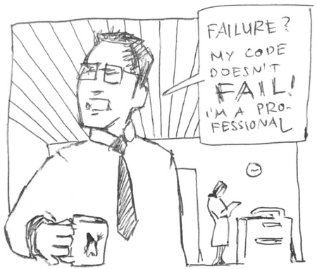
Pop quiz
Notes:
So let’s start out with a quick 3 question, pop quiz. No cheating, we are on the honor system here. ☺

Slide 5

Ever have to deal with spaghetti code?
Notes:
Scrum most popular.

Slide 6
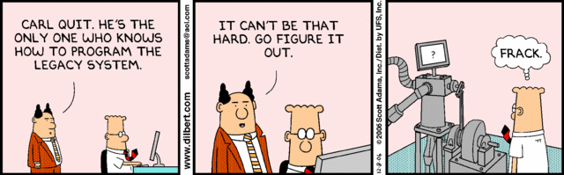
Ever inherit legacy code?
Notes:
Have you ever inherited Legacy Code?
Every company has that one legacy application that gets passed around from new guy to new guy because nobody wants to maintain it.

Slide 7

Ever scared to change code?
Notes:
Ever get a change request that the minute you read you realize the even though the change would require 10 minutes that the effected piece of code is touched by 10,000 other pieces of code and testing will take 6 months
Have fun explaining that to the business ☺

Slide 8
If you answered YES to any of those…
Then…
Notes:
If you answered “no” to all 3 questions, your are the luckiest developer in the world!
But if you did answer “yes” to one or more of these questions then…

Slide 9
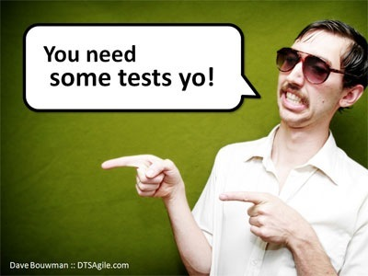
Notes:
You need a way to alleviate the pain and hassle that comes with unmanageable overly complex poorly architected code
More importantly you need a methodology or set of practices that encourages writing better, cleaner, and more concise code…and that is Test Driven Development as well as the techniques required to implement it successfully
But before we talk about what TDD is lets quickly cover what it isn’t

Slide 10
Types of testing that are not keys to test-driven development
Notes:
These types of testing are all VERY important
And implementing TDD does not reduce or remove the need for these types of testing
What it does is significantly reduce the time spent in these testing cycles by
Reducing the number of bugs
Reducing the time needed to resolve bugs

Slide 11
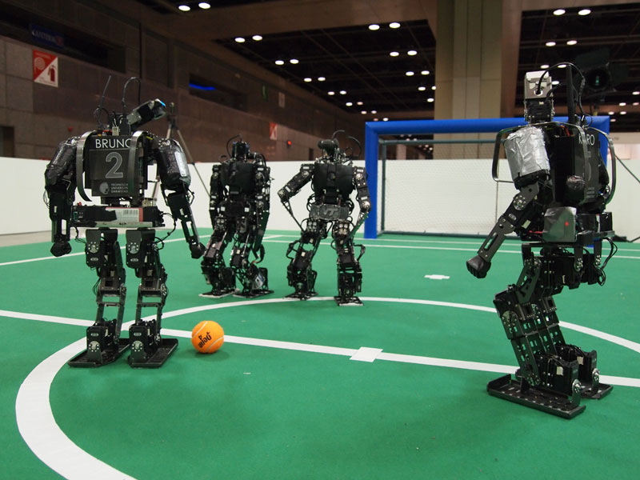
Integration Testing
Notes:
The act of testing 2 or more interconnected pieces of a software system
Necessary evil…but once everything has been unit tested
Can have external dependencies (DB, Services, File System, Hardware, etc.)
Typically run longer than unit tests
Often require setup of resources
Harder to automate
For all those reasons they are run less often

Slide 12
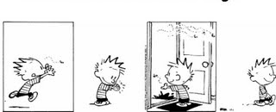
Regression Testing
1 Bug
> 1 Bugs
Notes:
The act of testing the entire software system after applying changes to ensure they did not affect other parts of the system
Complete end – to – end system test
Usually manual

Slide 13
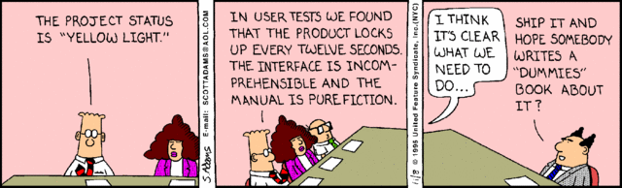
User Acceptance Testing (UAT)
Notes:
The act of testing to make sure system does what the users expect it to do
Lots of users in a room doing whatever it is they do
Manual
Time consuming
Stressful for you and the users

Slide 14

Performance Testing
Notes:
The act of testing to ensure the system meets the performance requirements defined in the SLA.
Test runs are automated but script creation is manual and time consuming
Requires separate data for performing tests
Tooling is expensive

Slide 15

Load Testing
Notes:
The act of testing how the system behaves under load
Automated
Tooling is expensive
Setup is time consuming

Slide 16
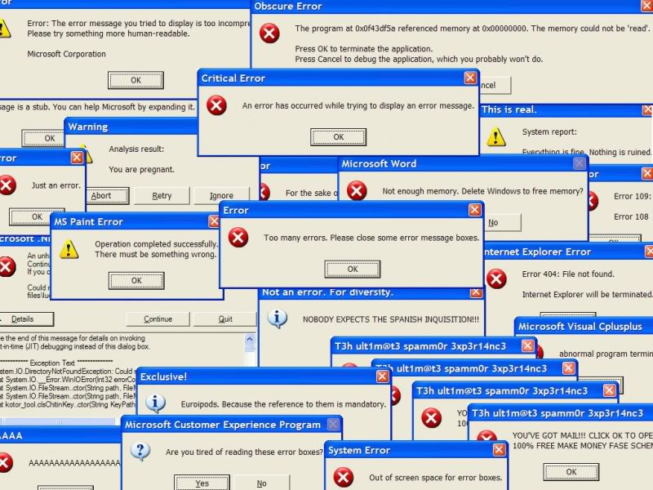
Stress Testing
Notes:
The act of testing the system fails and verifying how the system responds is acceptable
Requires effort to get the system to fail
Typically for verifying error messages and data state are valid during failures
Automated to make system fail, but requires manual verification

Slide 17
Other types of testing
Integration
Load
Regression
Stress
Performance
UAT
Notes:
Integration Testing
Regression Testing
User Acceptance Testing (UAT)
Performance Testing
Load Testing
Stress Testing
These types of testing are all VERY important
And implementing TDD does not reduce or remove the need for these types of
testing
What it does is significantly reduce the time spent in these testing cycles by
Reducing the number of bugs
Reducing the time needed to resolve bugs

Slide 18
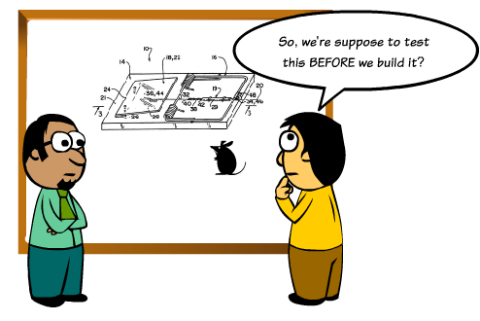
What is Test-driven Development?
Notes:
Test-driven development (TDD) is a software development process that relies on the repetition of a very short development cycle: first the developer writes a failing automated test case that defines a desired improvement or new function, then produces code to pass that test and finally refactors the new code to acceptable standards.
Often referred to Test-First Development
Process of writing tests before writing code
Kent Beck, is credited with having developed or 'rediscovered' the technique

Slide 19
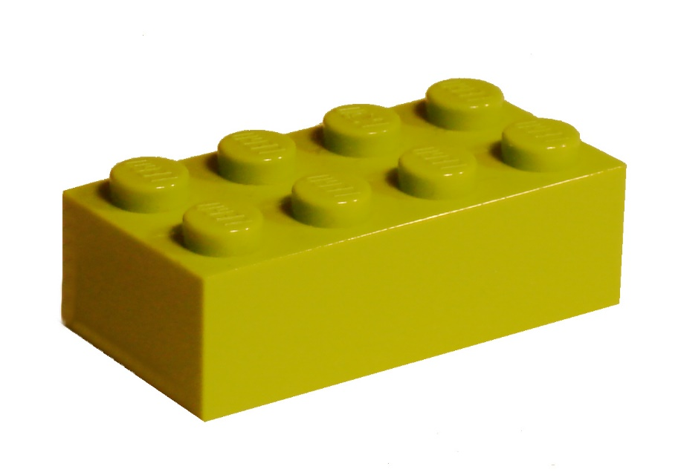
Key to TDD
Notes:
The key to Test-Driven-Development is Unit Testing
The act of testing piece of code, usually a method, that tests a very small piece of functionality by invoking it and verifying assumptions.

Slide 20
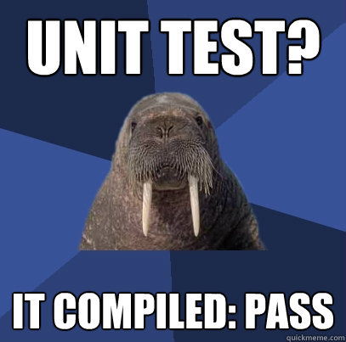
Characteristics of a good unit test
Notes:
So what are the characteristics of a good unit test
Automated and repeatable
Easy to implement
On demand/push of a button
Fast
Isolated
NO Compilation is NOT a good unit test!!!!! [CLICK]
It is very easy to write bad unit tests
Bad unit tests are worse than no unit tests
They provide a false sense of security
They provide false system documentation

Slide 21
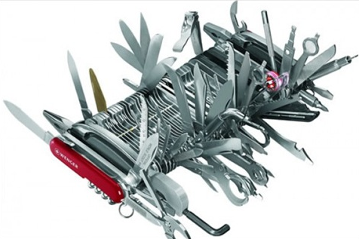
Single Responsibility
Notes:
In order to do test-driven development effectively and to get all the benefits it has to offer you have to apply certain best practices to your code and how you code
The first is the Single Responsibility Principle
- which states “a class should have one and only one reason to change”
- There are some red flags to watch out for in your code which may be signs that you are violating the single responsibility princpile
1. Method name with the word “and” in it
2. Methods that > 75 lines long
3. Methods that have regions in them

Slide 22
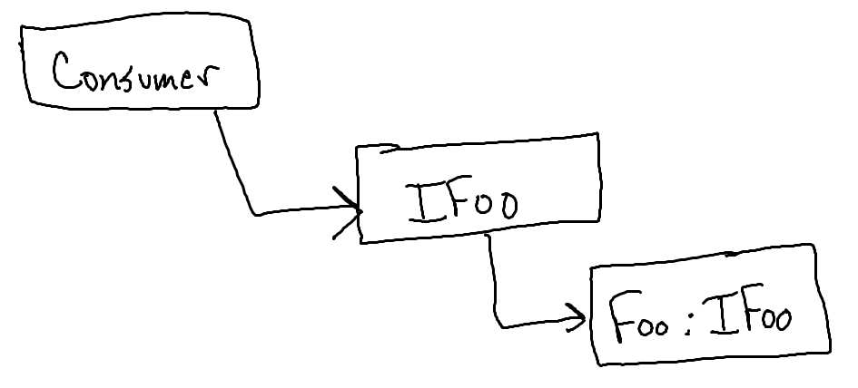
Interfaces Not Implementations
Notes:
The second concept is “Program to Interfaces not Implementations
- When you create classes that will be dependencies to other classes create an interface
- When declaring dependencies inside a class declare them using the Interface

Slide 23

Depend on Abstractions
Notes:
Next is the Dependency Inversion Principle
- states that “high-level modules should not depend upon low-level modules. Both should depend upon abstractions.”
- classic real-world example of this is soldering the wires from a lamp directly to a wall plug. You could do that, and it would work but why not put an abstraction on in between, which would be the plug, the reduces the complexity and increases the portability?

Slide 24
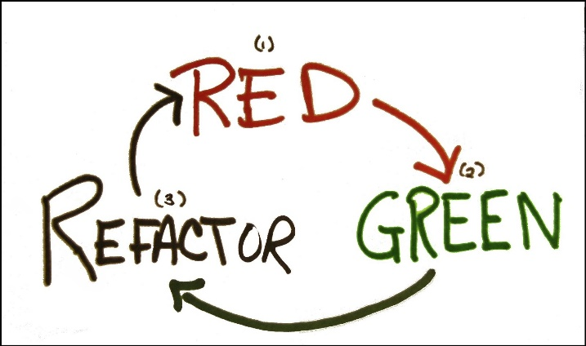
Red-Green-Refactor
Notes:
The next two concepts are applicable when writing your tests;
Red-Green-Refactor is the process of
1. Before doing anything else you write a failing test (most test-runners use red for a failing test)
2. Next you write just enough code to get the test to pass (green = passing test)
3. Then you refactor if necessary

Slide 25
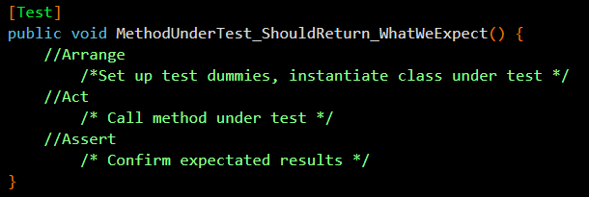
Arrange-Act-Assert
Notes:
Lastly is “Arrange – Act – Assert”
This applies to how your tests should be structured
Arrange: The first lines of code in your test should be for arranging, which means setting up any test dummies whether that is instantiating fakes or setting expectations on mocks, and also setting parameter values and instantiating the class under test
Act: should be single line calling the method under test
Assert: this is where you verify your assumptions and this includes verifying mocks behaved has recorded as well as asserting against the object returned from calling the method under test

Slide 26
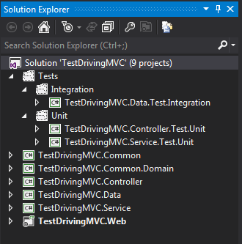
Setting the Foundation
Notes:
Different types of tests should be isolated from other types to allow easily running a group of tests.
Tests should be placed in projects named the same as the project they are testing with a prefix of the type of tests it contains.
Tests should be isolated from actual application code

Slide 27

I Shall Call Him…
[MethodUnderTest]_[ExpectedResult]_[Conditions]
GetCustomers_ShouldReturn_ListOf_Customers()
CalculateRate_ShouldReturn_25_When_Interest_Is_50_And_X_Is_5()
Notes:
The last concept I want to cover before getting in to MVC is naming your tests. How you name your tests is very important.
Be descriptive…very descriptive
Long test names are encouraged
Should be able to read a test name and know exactly what it does and more importantly why it would fail

Slide 28
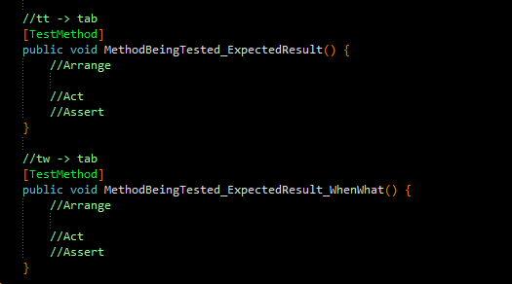
Because I’m Lazy…
My unit testing live template is available on my blog:
http://www.dotnetdevdude.com/downloads/code/ ResharperUnitTestTemplates.zip
Notes:
Scrum most popular.

Slide 29

Demo: Writing a Unit Test
Notes:
Our contrived example is a simple calculator with an Add method
Must accept to 2 decimals, and return the sum of the two inputs
Write a test to make sure return value is a decimal
Write test with standard assert tdd1
Run it – it fails because we don’t have the method implemented…this is our RED
Implement method…have it just return 0…that is all we need to get the test to pass.
Run test…it’s Green…great…but…
Talk about readability
Talk about NuGet
FluentAssertions
result.Should().Be(12);
Refactor
Nothing really to refactor

Slide 30

IoC & DI
Notes:
Inversion of Control
Is the concept of instead of a class directly instantiating all it’s dependencies they are provided at runtime by the caller or consuming class.
So, at design/compile time the class is not aware of a concrete implementation only the contract or interface.
This goes back to one the core concepts we covered…program to interfaces not implementations.
Inversion of Control can be accomplished using Dependency Injection, which
Is the act of “injecting” the dependency’s that a class needs.
You can do this using
Constructors
Properties
We will look at this in more detail in our next demo.

Slide 31

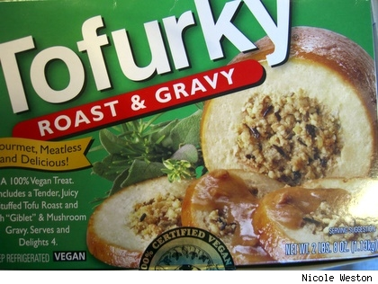
The result is…
Separation of Concerns
Mockability
Notes:
The result of properly implemented DI/IoC is…
Separation of Concerns
A piece of code should only be concerned about it’s core responsibilities.
A business logic class shouldn’t care or know about how the logger is implemented
Mockability
The ability to use stand-ins in place of actual concrete dependencies.
We’ll talk about this much more in a bit

Slide 32
Demo: DI/IoC
Notes:
Look at the new requirement for validation
Show
IValidationService…this satisfies the contract defined in the spec
ValidationService
Start with Property Injection
public IValidationService ValidationService { get; set; }
if (ValidationService.ValidateForAdd(value1, value2)) throw new Exception("DOH!");
What is the issue?
Have to add code to make sure the dependency’s are set to avoid NULL reference exceptions
We can fix this with Constructor Injection
Next Do Constructor Injection
Hold down fn and alt and hit enter for resharper constructor
What could be the issue (constructor that takes a bunch of parameters)
What’s the issue here?
What happens when you have a bunch of dependency's?
We’ll get to using IoC framework to fix all this
Let’s build this…and we should have a build error…can anyone tell me where?
Fix build error
So for now let’s be good little TDD’rs and run our tests to make sure we didn’t break anything
WTF!?! The validation service is erroring out.
In our little self-contained scenario here it is because it I didn’t implement it…but ignore that for now
Consider this one of those situations that I am sure you have all dealt with on many occasions…
Some developer or team is responsible for coding something you are dependent on and they either
Haven’t gotten around to it yet
Or have errors in their code
Guess we can call it a day ;)
That is unless you are fluent on TDD and it’s core concepts.
If you have need to sell TDD to your pointy haired bosses this is the perfect angle
You will now be able to continue coding when external dependencies are not complete or broken or what ever
Let’s talk about how we can do this…

Slide 33
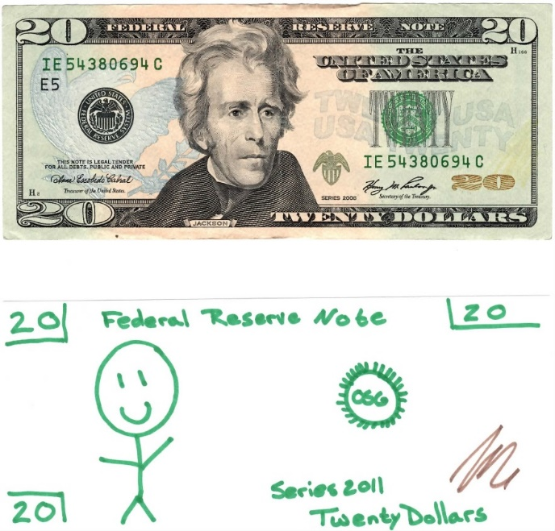
Fakes/Stubs
Notes:
Shell of a class that satisfies the implementation of the class
Return hard coded value
Not asserted against, state is never validated!
Requires no tooling
Let’s fix our broken test with a Fake/Stub
Create Fakes folder in unit test project
Create ‘FakeValidationService’
Implement IValidationService
Add should return true
Pass ‘FakeValidationService” to CalculatorService in test
Run it ---- GREEN!
This is great, we just moved the road block…but
What’s the issue with fakes?
Need to manually code a fake for dependency!
And need to code for every scenario
Checking for true
Checking for false
Let’s talk about MOCKS

Slide 34

Mocks
Notes:
Simulated object that satisfies the implementation of the class
Mimics the objects behavior in a controlled manner
Asserted against (state is validated)
Requires tooling
Let’s change out our broken test with a Mock
Install RhinoMocks via NuGet
[TestMethod]
public void Add_ShouldReturn_Decimal() {
//Arrange
decimal val1 = 1.23m;
decimal val2 = 3.21m;
MockRepository mockRepository = new MockRepository();
IValidationService validationServiceMock = mockRepository.StrictMock<IValidationService>();
validationServiceMock.Expect(x => x.ValidateForAdd(val1, val2)).Return(true).Repeat.Once();
mockRepository.ReplayAll();
ICalculatorService service = new CalculatorService(validationServiceMock);
//Act
var result = service.Add(val1, val2);
//Assert
mockRepository.VerifyAll();
result.ShouldBeType<decimal>();
}
Run it
Go in the code and comment out _validator.ValidateAdd
Run: note test failure because we are using a strict mock
Take a minute for all that to sink in.
OK, so far we are in great shape…but we still have that technical debt out there of using Constructor Injection…and that code smells!
Let’s fix that by implementing some DI/IoC tooling.

Slide 35

DI/IoC Tooling
Notes:
Allows you to configure your dependency’s
Tell the system that when you are using an IFoo then use this specific concrete implementation of Foo
Configuration is done once in the application life cycle – usually at App_Start
Allows for extremely decoupled code
Allows for very easy “swapping” of implementations (bas

Slide 36
Demo: DI/IoC with Tooling
Notes:
Show IoCBootstrapper
Talk about what it does…
Scans all assemblies from the application’s base directory
And uses convention to resolve IFoo to Foo.
In this case we call the Boostrap method from our programs Main method because we are using a console app
In a web app you would do the bootstrapping on Application Start
Back in unit test
Change instantiate of classUnderTest to ObjectFactory.GetInstance<ICalculatorService>();
Run test and note that this fails with a plug in error telling us structuremap is not configured.
This makes sense because our Bootstrap method is not getting called
I don’t want to call the Bootstrap method from my test because I want the flexibility to use other implementations of the interfaces like mocks
Directly before mockRepository.VerifyAll … tdd2
So what we are doing here is configuring Structuremap for the dependencies our test will use.
For ICalculatorService I am telling StructureMap to use the actual production CalculatorService as that is the class under test
And for IValidationService I want to use the mock instance I defined in my test.
Build and run…and you can see we are Green.
So let’s set some breakpoints and debug our unit test so we can see what is going on
Put breakpoint in CalculatorService constructor
And first line of Add method
Run and note PlugIn not defined error – StructureMap is not configured
Debug unit test
First breakpoint is in the constructor
You can see that even though we didn’t directly call the constructor in our code it is hit via StructureMap
And the dependencies are automatically provided…I am getting my mock ValidationService
And as you’d expect if I continue to my second breakpoint I still have my mock ValidationService and it is used in the Add method to bypass the actual ValidationService.
The result of this is
Extremely decoupled code…everything is only aware of interfaces…not contract implementations
Very testable code that I can easily isolate and mock dependencies whenever need be.

Slide 37
What Did We Learn?
You should be doing TDD
TDD is not as simple as just writing tests
DI/IoC
Mocks/Fakes/Stubs
IoC tooling rocks!
Notes:
Scrum most popular.

Slide 38
Thank You!
github.com/KBurnell/TestDriving.NET
Find me:
Twitter: @KeBurnell
Blog: DotNetDevDude.com
E-Mail: KBurnell@SkylineTechnologies.com
Notes:
Scrum most popular.

