Slide 1
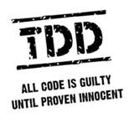
Test Driving ASP.NET MVC
Keith Burnell
Senior Software Engineer II
Email: keith@dotnetdevdude.com
Twitter: keburnell
Blog: www.DotNetDevDude.com

Slide 2
Little about me
Microsoft Web MVP
Senior Software Engineer II at Skyline Technologies
Been developing software for over 10 years
Primary focus on the Microsoft Web stack.
Local/Regional/National Speaker
Author (MSDN, Pluralsight)
President of Fox Valley .NET UG.
Notes:
Scrum most popular.

Slide 3
What’s on Tap
What is and what is not test-driven development
Unit testing
Concepts and strategies you need to know
Laying out and naming your stuff
DI/IoC and Test Dummies
MVC
Routing: What it is and how to test it
Controllers: Isolating and testing
Automated UI Testing
Notes:
Scrum most popular.

Slide 4
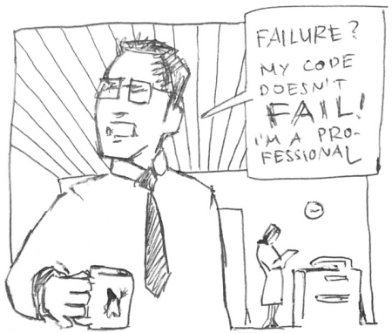
Do I Really Need To Be Doing Test-driven Development?
Notes:
Short answer is “YES”
If you are here hopefully you agree or your mind is at least open to the idea.
My goal is
show you that with out a doubt you should be doing TDD
And once I have brain-washed, err, convinced you - Arm you with the knowledge to spread the word

Slide 5


Slide 6

Ever have to deal with Spaghetti Code?
Notes:
I think there are 2 types of spaghetti code
Tangled mess code
Long code

Slide 7
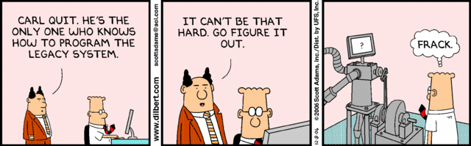
Ever inherit Legacy Code?
Notes:
Don’t deny it every company has at least 1 notorious app
The one where you always eager to pass off to the new guy

Slide 8

Ever scared to make changes?
Notes:
Ever get a change request that the minute you read you realize the even though the change would require 10 minutes that the effected piece of code is touched by 10,000 other pieces of code and testing will take 6 months
Have fun explaining that to the business ☺

Slide 9

If you answered yes to any of those questions
Then…
Notes:
If you didn’t answer yes to any of these questions I will give you my business card because I want to work where you work.

Slide 10

Notes:
You need a way to alleviate the pain and hassle that comes with unmanageable overly complex poorly architected code
More importantly you need a methodology or set of practices that encourages writing better, cleaner, and more concise code

Slide 11
Types of testing that are not keys to test-driven development
Integration Testing
Regression Testing
User Acceptance Testing (UAT)
Performance Testing
Load Testing
Stress Testing
Notes:
These types of testing are all VERY important
And implementing TDD does not reduce or remove the need for these types of
testing
What it does is significantly reduce the time spent in these testing cycles by
Reducing the number of bugs
Reducing the time needed to resolve bugs

Slide 12
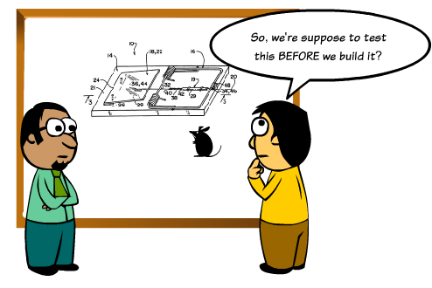
What is Test-driven Development?
Notes:
Test-driven development (TDD) is a software development process that relies on the repetition of a very short development cycle: first the developer writes a failing automated test case that defines a desired improvement or new function, then produces code to pass that test and finally refactors the new code to acceptable standards.
Often referred to Test-First Development
Process of writing tests before writing code
Kent Beck, is credited with having developed or 'rediscovered' the technique

Slide 13
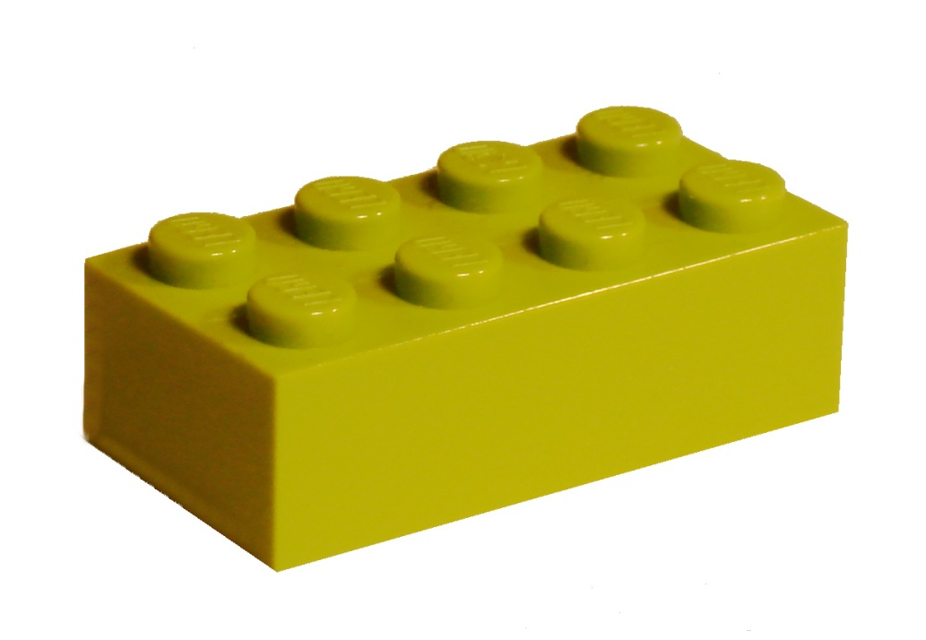
Unit Testing: Key to TDD
Notes:
The act of testing piece of code, usually a method, that tests a very small piece of functionality by invoking it and verifying assumptions

Slide 14

What makes a good Unit Test?
Automated and Repeatable
Easy to implement
Run on demand at the push of a button
Fast
Isolated
Notes:
So what are the characteristics of a good unit test
It is very easy to write bad unit tests
Bad unit tests are worse than no unit tests
They provide a false sense of security
They provide false system documentation

Slide 15
Concepts and Stuff
Red – Green – Refactor
Arrange – Act – Assert
Single Responsibility Principle
Dependency Inversion Principle (DI/IoC)
Notes:
Scrum most popular.

Slide 16
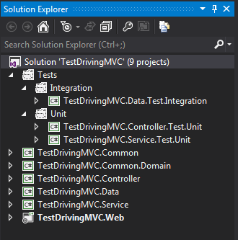
Example Solution Layout
Notes:
Tests should be isolated from the actual code! [CLICK]
Different types of tests should be isolated from other types to allow easily running a group of tests. [CLICK]
Tests should be placed in projects named the same as the project they are testing with a prefix of the type of tests it contains.

Slide 17

Naming Your Tests
[MethodUnderTest]_[ExpectedResult]_[Conditions]
GetCustomers_ShouldReturn_ListOf_Customers()
CalculateRate_ShouldReturn_25_When_Interest_Is_50_And_X_Is_5()
Notes:
Be descriptive…very descriptive
Long test names are encouraged
Should be able to read a test name and know exactly what it does and more importantly why it would fail

Slide 18

Separation of Concerns
MVC = Model – View - Controller
Controller
(Input)
View
(Presentation)
Model
(Logic)
Notes:
MVC is a design pattern that stands for Model-View-Controller. What it strives to do is separate the concerns of an application’s presentation layer by assigning specific roles to the three different components.
[CLICK]
The Controller is responsible for handling all user input. Once input has been received, the Controller will perform any operations/actions it needs to, which might include interacting with the Model.
[CLICK]
The Model represents the core concern/logic of the application. Once the Controller retrieves some model data and performs any work with the model/etc it needs to it constructs a presentation model that describes the model in terms the View can understand.
[CLICK]
The View is the visual representation of the model. It presents the model data to the actual user in a way that is meaningful. In a web application, this would typically be HTML.
With these three pieces in place, your presentation layer becomes cleanly separated in such a way that each component can be developed/tested independently.
[CLICK]
Separation of Concerns!

Slide 19

Created with Best Practices in Mind
Notes:
ASP.NET MVC was created with a clear focus on best practices in both Architecture and Coding
This is a new approach for Microsoft – in the past they always set us up for failure and it was our job to know better
In ASP.NET MVC:
1. There is a clear separation of layers (Model/View/Controller)
2. No designer!
3. No server controls that you can drag on and hook up directly to your Database!
4. They are actually encouraging testing…WHAT?
- Don’t believe me…File -> New Project -> ASP.NET -> “Create a unit test project”….Grant it, it should be defaulted to checked…but Rome was Built in a day
5. MVC has a lot of DI points [Next Slide]

Slide 20
Supported DI Points in ASP.NET MVC
Controllers
registering & injecting controller factories
injecting controllers
Views
registering & injecting view engines
injecting dependencies into view pages
Action Filters
locating & injecting filters
Model Binders
registering & injecting
Value Providers
registering & injecting
Validation Providers
registering & injecting
Model metadata Providers
registering & injecting
Notes:
ASP.NET MVC has a bunch of supported DI points. Not only does this allow you to architect correctly it allows you to plug in non Microsoft tooling

Slide 21

Routing
Handles the incoming request
Maps to controller and action
Can get crazy complex
Notes:
Routing is what makes clean readable url’s in MVC possible.
Handles the incoming request and maps that to a controller and action based on the URL segments
Can get complicated and confusing, luckily they can be tested
Let’s look at a demo of that now.

Slide 22

Demo: Testing your Routes
Notes:
Testing your routes
For testing of my routes and controllers which you will see in a bit I am going to use MVCContrib and specifically the MvcContrib Test Helper
You can find out more about MvcContrib at MvcContrib.codeplex.com
NuGet MvcContrib.MVC3.TestHelper (don’t install – already installed)
Pull up RouteConfig.cs – this has changed a bit since MVC3 where the routes used to be defined directly in the Global.ascx
Out of the box the Routes are defined directly in the RegisterRoutes method.
Now I could still test my routes in my unit tests by creating a new collection of routes and adding the same routes I have created here
But that is duplication of work and in the end I am not 100% certain that I am testing the same routes
And since the order of routes make a huge difference, most specific first and general last, I want to make sure that I am testing exactly what will be used
[Comment out “Out of the box” implementation and replace with “RouteProvider”
So, I created an abstraction on top of this to allow me use the same routes in my tests that I use in my app
Otherwise if I was registering my routes the way it is done out of the box I would not be able to use the same implementation in my tests
Open RouteTester
- Look at the usage of the RouteProvider
Create a test for the default route:
[TestMethod]
public void RequestGoingTo_Whack_ShouldMapTo_Customer_Index() {
//Arrange
string url = "~/";
//Act & Assert
url.ShouldMapTo<CustomerController>(action => action.Index(1));
}
Test for ignore
[TestMethod]
public void RequestTo_Wack_TraceAxd_ShouldBe_Ignored() {
//Arrange
string url = "~/trace.axd";
//Act & Assert
url.ShouldBeIgnored();
}

Slide 23

Controller
Thin and light weight
Loosely coupled
Things to test:
Takes correct action
Includes the right stuff
Notes:
Very little logic
Glorified traffic cop that directs input from the view either down the service road and back to the view, in a different direction (redirect, etc), or to turn around if invalid
Loosely coupled
Dependencies should be injected
Things to be tested
Takes Correct Action
Redirects to the correct view
Returns correct view
Includes correct model

Slide 24
Demo: Isolating and Testing a Controller
Notes:
Isolating the Controller
Talk about DependencyResolver and StructureMap
* Why I rolled my own!
Talk about application structure
Common -> Interfaces -> ICustomerService
Service -> CustomerService
Controller Project
Yes, I put my controller’s in their own project…explain why
Show Global.asax.cs and how controller project is handled with routing [namespace]
CustomerController
With my current architecture - every controller will need an ILoggingService and an I[controller name]Service
I am using StructureMap as my IoC Container, but that requires me to wire up my dependencies one by one
What if there was a way to not have to wire up the dependencies manually for each controller?
Custom Controller Factory
Out of the box the default controller factory just resolves controllers using the default naming convention
You can create a custom controller factory to add functionality and/or override the default functionality
In this case we are going to pimp out the default controller factory with StructureMap
Explain GetControllerInstance
Show how we are using StructureMap and the IContainer
And we need to tell ASP.NET MVC to use the Custom Controller Factory
Global.asax.cs
private void SetControllerFactory() {
ControllerBuilder.Current.SetControllerFactory(new ControllerFactory());
}
SetControllerFactory(); **** After WireUpDependencyInjection();
And then change the Customer Controller to accept the 2 dependencies as inputs
That’s it the combination of ASP.NET MVC and having a StructureMap container in our Controller Factory allows our controllers to automatically resolve their dependencies!
Set a breakpoint in CustomerController.Index to prove it.
Testing the Controller
Open the controller test class, talk about the usage of fakes
In order to test that the correct view is being returned or we are redirecting as necessary or the correct model is being returned we could write some really ugly low-level code that interrogates the controller context…or we could use MVCContrib
NuGet MvcContrib.MVC3.TestHelper (don’t install – already installed)
So let’s test that our Index controller method returns a view named “Index”
[TestMethod]
public void Index_ShouldReturn_ViewNamed_Index() {
//Arrange
CustomerController controller = new CustomerController(_loggingService, _customerService);
//Act
ActionResult result = controller.Index(1);
//Assert
result.AssertViewRendered().ForView("Index");
}
And now we can write a test to make sure the model being returned is the correct type
[TestMethod]
public void Index_ShouldReturn_ViewWithModelofType_Customer() {
//Arrange
CustomerController controller = new CustomerController(_loggingService, _customerService);
//Act
ActionResult result = controller.Index(1);
//Assert
Assert.IsInstanceOfType(((ViewResult) result).Model, typeof (Common.Domain.Customer));
}
Assert…blah blah blah, hard to read!
Should Assertion Library – user readable assertions
((ViewResult) result).Model.ShouldBeType<Common.Domain.Customer>();
Lastly we can test the redirect on our Post
[TestMethod]
public void IndexPost_ShouldRedirectTo_Step2() {
//Arrange
CustomerController controller = new CustomerController(_loggingServiceFake, _customerServiceFake);
//Act
ActionResult result = controller.Index(new Common.Domain.Customer {Id = 1});
//Assert
result.AssertActionRedirect().ToAction("Step2");
}

Slide 25
WatiN: Automated UI Testing
Automate the browser from your tests
Supports IE and FireFox
Allows you test
Navigation
Display logic (visible, etc)
Dialogs
Free
Notes:
Allows you to enter text in input fields, click radio buttons, submit forms, click links, etc.

Slide 26
Demo: WatiN
Notes:
Automated UI Testing w/ WatiN
Already done – but tell them : Install via NuGet and Change the EmbedInteropType to FALSE!!!!!
Create a test for “CustomerIndex_ShouldBeDisplayed_AsThe_DefaultPage”
The first thing we need is a url:
Point out common url field and Setup
The core of WatiN are the browser objects “IE” and “FireFox”
And we declare a new instance and pass in the url
_browser = new IE(url);
At this point we can run this and see that just by declaring a browser and passing a url our site is spun up
Now we can finish our test by interrogating the browser object
In this case we want to verify that we are on the “Customer Index” page and we do that by looking at the title
Browser.Title.ShouldEqual(“Customer Index”);
Run the test – GREEN!
Prove that it works change the expected title and run again
You’ll notice our browser stays open and also that browser has a dispose method so let’s handle this – IN CleanUp!
browser.Close();
browser.Dispose();
What else can we do with WatiN?
How about making sure a field exists on the page…
- Let’s make sure the firstName field is displayed – we will use the browser dev tools to figure out what we are looking for
[TestMethod]
public void CustomerIndex_ShouldContain_DisplayFor_FirstName() {
//Arrange
IE browser = new IE(url);
//Act
Label result = _browser.Label(“firstName”);
//Assert
result.ShouldNotBeNull();
}
Let’s test our button
[TestMethod]
public void Clicking_Next_ShouldDisplayThe_Step2Page() {
//Arange
string url = "http://localhost:11074/";
//Act
IE browser = new IE(url);
browser.Button("next").Click();
//Assert
browser.Title.ShouldEqual("Step 2");
browser.Close();
browser.Dispose();
}
How about testing validation? Let’s make sure that our first name required message is displayed when clicking Create and with nothing in First Name
[TestMethod]
public void FirstNameIsRequired_ValidationMessage_ShouldBeDisplayed_WhenClickingCreate_WithoutFillingIn_FirstName_Field() {
//Arrange
_browser = new IE(Url);
_browser.Button("create").Click();
//Act
Span result = _browser.Span(Find.By("for","FirstName"));
//Assert
result.InnerHtml.ShouldEqual("First Name is required");
}
Now we can test the opposite: Message should not be displayed when we fill in First Name and click Create
[TestMethod]
public void FirstNameIsRequired_ValidationMessage_ShouldNotBeDisplayed_WhenClickingCreate_With_FirstName_Field_FilledIn() {
//Arrange
_browser = new IE(Url);
_browser.TextField("FirstName").TypeText("Joe");
_browser.Button("create").Click();
//Act
Span result = _browser.Span(Find.By("for", "FirstName"));
//Assert
result.Exists.ShouldBeFalse();
}

Slide 27

Slides and demos on GitHub
http://www.github.com/kburnell/TestDrivingASP.NETMVC

Slide 28
Other Resources
Test Driven Development: By Example (Kent Beck)
The Art of Unit Testing (Roy Osherove)
Roy Osherove’s Blog (http://www.osherove.com)
My Website (http://www.dotnetdevdude.com)
MSDN: Test-Driving ASP.NET MVC (http://bit.ly/MO0zXU)
Notes:
Scrum most popular.

Slide 29
Tools I Used and/or Talked About
NuGet (http://www.nuget.org)
ReSharper (http://www.jetbrains.com/resharper/)
Should Assertion Library (http://should.codeplex.com)
RhinoMocks (http://hibernatingrhinos.com/open-source/rhino-mocks
StructureMap (http://www.structuremap.net)
MvcContrib (http://mvccontrib.codeplex.com/)
WatiN (http://www.watin.org)
Notes:
Scrum most popular.

Slide 30

Notes:
Scrum most popular.

Slide 31
Thank You!
Questions?
Twitter: @keburnell
Blog: DotNetDevDude.com
Email: keith@DotNetDevDude.com
Notes:
Scrum most popular.

