Slide 1


Slide 2
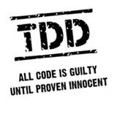
Test Driving ASP.NET MVC

Slide 3

Little about me
Notes:
Microsoft MVP: ASP.NET
Senior Software Engineer II at Skyline Technologies
Been developing software for over 10 years
Primary focus on the Microsoft Web stack.
Local/Regional/National Speaker
Author (MSDN, Pluralsight)
President of Fox Valley .NET UG.

Slide 4

What’s on tap
Notes:
Types of testing
Unit testing
Concepts and stuff
Organizing and naming
MVC: a big leap for Microsoft
Routing: What it is and how to test it
Controllers: Isolating and testing
Automated UI Testing

Slide 5
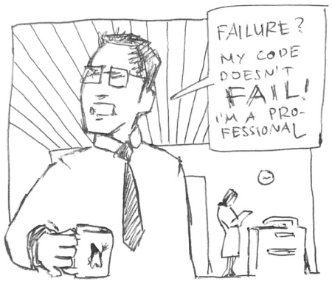
Pop quiz
Notes:
So let’s start out with a quick 3 question, pop quiz. No cheating, we are on the honor system here. ☺

Slide 6

Ever have to deal with spaghetti code?
Notes:
Have you ever had to deal with spaghetti code, either your own or someone else’s?

Slide 7
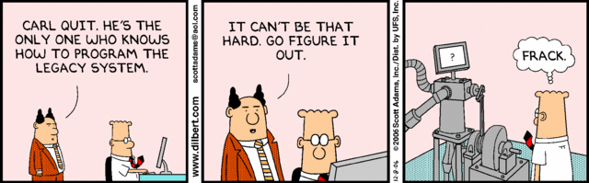
Ever inherit legacy code?
Notes:
Have you ever inherited Legacy Code?
Every company has that one legacy application that gets passed around from new guy to new guy because nobody wants to maintain it.

Slide 8

Ever scared to change code?
Notes:
Ever get a change request that the minute you read you realize the even though the change would require 10 minutes that the effected piece of code is touched by 10,000 other pieces of code and testing will take 6 months
Have fun explaining that to the business ☺

Slide 9
If you answered YES to any of those…
Then…
Notes:
If you answered “no” to all 3 questions, your are the luckiest developer in the world!
But if you did answer “yes” to one or more of these questions then…

Slide 10

Notes:
You need a way to alleviate the pain and hassle that comes with unmanageable overly complex poorly architected code
More importantly you need a methodology or set of practices that encourages writing better, cleaner, and more concise code…and that is Test Driven Development as well as the techniques required to implement it successfully
But before we talk about what TDD is lets quickly cover what it isn’t

Slide 11
Other types of testing
Integration
Load
Regression
Stress
Performance
UAT
Notes:
Integration Testing
Regression Testing
User Acceptance Testing (UAT)
Performance Testing
Load Testing
Stress Testing
These types of testing are all VERY important
And implementing TDD does not reduce or remove the need for these types of
testing
What it does is significantly reduce the time spent in these testing cycles by
Reducing the number of bugs
Reducing the time needed to resolve bugs

Slide 12
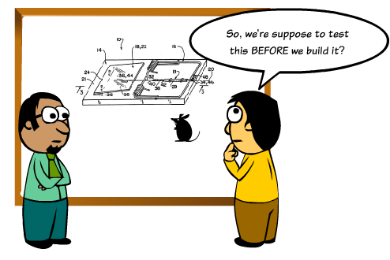
Yes…that is exactly what it means!
Notes:
Test-driven development (TDD) is a software development process that relies on the repetition of a very short development cycle:
first the developer writes a failing automated test case that defines a desired improvement or new functionality,
then produces code to pass that test
finally refactors the new code to acceptable standards.
Often referred to Test-First Development
Process of writing tests before writing code
Kent Beck, is credited with having developed or 'rediscovered' the technique

Slide 13
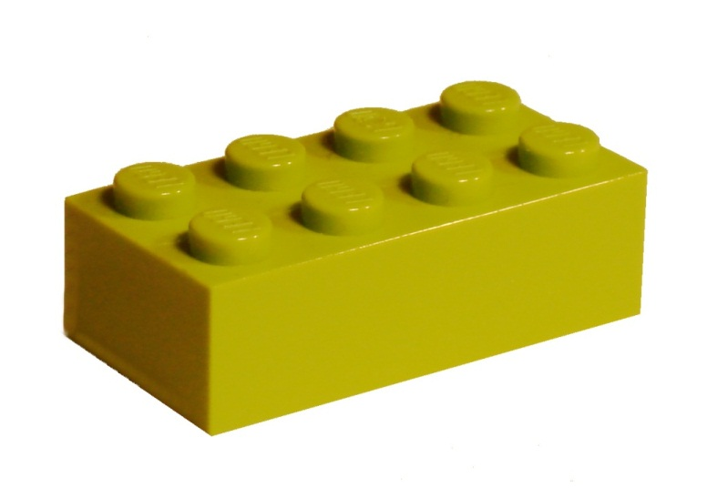
Key to TDD
Notes:
The key to Test-Driven-Development is Unit Testing
The act of testing piece of code, usually a method, that tests a very small piece of functionality by invoking it and verifying assumptions.

Slide 14
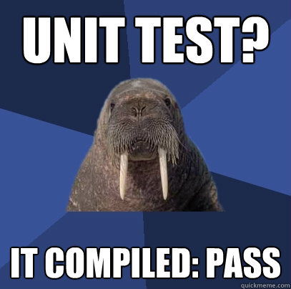
Characteristics of a good unit test
Notes:
So what are the characteristics of a good unit test
Automated and repeatable
Easy to implement
On demand/push of a button
Fast
Isolated
NO Compilation is NOT a good unit test!!!!! [CLICK]
It is very easy to write bad unit tests
Bad unit tests are worse than no unit tests
They provide a false sense of security
They provide false system documentation

Slide 15
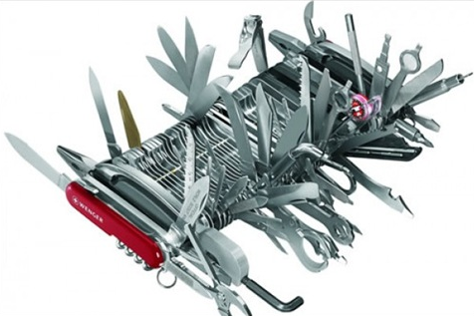
Single Responsibility
Notes:
In order to do test-driven development effectively and to get all the benefits it has to offer you have to apply certain best practices to your code and how you code
The first is the Single Responsibility Principle
- which states “a class should have one and only one reason to change”
- There are some red flags to watch out for in your code which may be signs that you are violating the single responsibility princpile
1. Method name with the word “and” in it
2. Methods that > 75 lines long
3. Methods that have regions in them

Slide 16
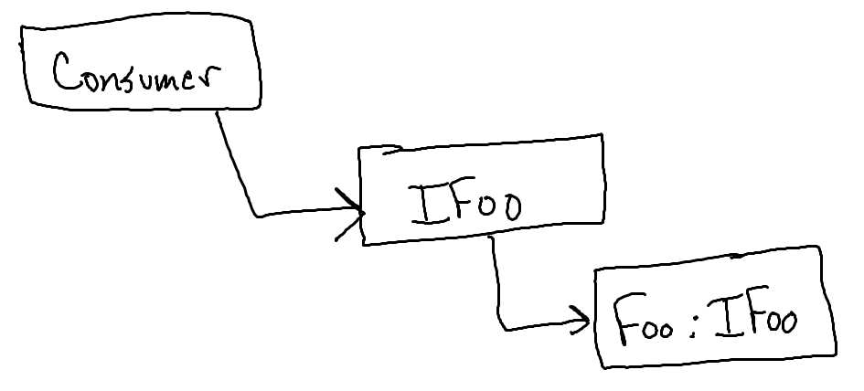
Interfaces Not Implementations
Notes:
The second concept is “Program to Interfaces not Implementations
- When you create classes that will be dependencies to other classes create an interface
- When declaring dependencies inside a class declare them using the Interface

Slide 17

Depend on Abstractions
Notes:
Next is the Dependency Inversion Principle
- states that “high-level modules should not depend upon low-level modules. Both should depend upon abstractions.”
- classic real-world example of this is soldering the wires from a lamp directly to a wall plug. You could do that, and it would work but why not put an abstraction on in between, which would be the plug, the reduces the complexity and increases the portability?

Slide 18
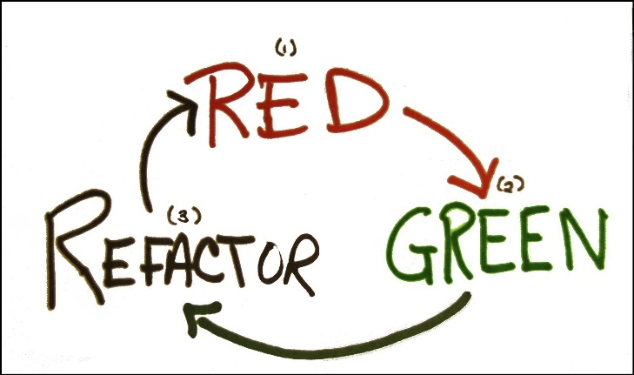
Red-Green-Refactor
Notes:
The next two concepts are applicable when writing your tests;
Red-Green-Refactor is the process of
1. Before doing anything else you write a failing test (most test-runners use red for a failing test)
2. Next you write just enough code to get the test to pass (green = passing test)
3. Then you refactor if necessary

Slide 19
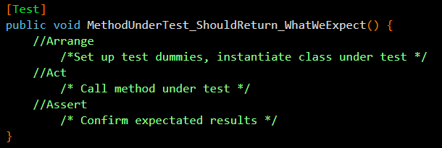
Arrange-Act-Assert
Notes:
Lastly is “Arrange – Act – Assert”
This applies to how your tests should be structured
Arrange: The first lines of code in your test should be for arranging, which means setting up any test dummies whether that is instantiating fakes or setting expectations on mocks, and also setting parameter values and instantiating the class under test
Act: should be single line calling the method under test
Assert: this is where you verify your assumptions and this includes verifying mocks behaved has recorded as well as asserting against the object returned from calling the method under test

Slide 20
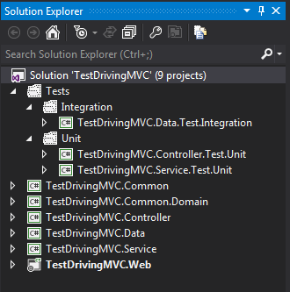
Setting the foundation
Notes:
It is important to start from the beginning with TDD in mind, and where do we all start…by creating the solution. Here is a solution layout that I have found to be most effective.
Tests should be isolated from the actual code! [CLICK]
Different types of tests should be isolated from other types to allow easily running a group of tests. [CLICK]
Tests should be placed in projects named the same as the project they are testing with a prefix of the type of tests it contains.

Slide 21

I shall call it…
[MethodUnderTest]_[ExpectedResult]_[Conditions]
GetCustomers_ShouldReturn_ListOf_Customers()
CalculateRate_ShouldReturn_25_When_Interest_Is_50_And_X_Is_5()
Notes:
The last concept I want to cover before getting in to MVC is naming your tests. How you name your tests is very important.
Be descriptive…very descriptive
Long test names are encouraged
Should be able to read a test name and know exactly what it does and more importantly why it would fail

Slide 22

IoC & DI
Notes:
Inversion of Control
Is the concept of instead of a class directly instantiating all it’s dependencies they are provided at runtime by the caller or consuming class.
So, at design/compile time the class is not aware of a concrete implementation only the contract or interface.
This goes back to one the core concepts we covered…program to interfaces not implementations.
Inversion of Control can be accomplished using Dependency Injection, which
Is the act of “injecting” the dependency’s that a class needs.
You can do this using
Constructors
Properties
We will look at this in more detail in our next demo.

Slide 23

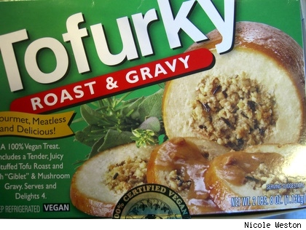
The result is…
Separation of Concerns
Mockability
Notes:
The result of properly implemented DI/IoC is…
Separation of Concerns
A piece of code should only be concerned about it’s core responsibilities.
A business logic class shouldn’t care or know about how the logger is implemented
Mockability
The ability to use stand-ins in place of concrete dependencies.

Slide 24
MVC
Controller
(Input)
View
(Presentation)
Model
(Logic)
Notes:
MVC is a design pattern that stands for Model-View-Controller. What it strives to do is separate the concerns of an application’s presentation layer by assigning specific roles to the three different components.
[CLICK]
The Controller is responsible for handling all user input. Once input has been received, the Controller will perform any operations/actions it needs to, which might include interacting with the Model.
[CLICK]
The Model represents the core concern/logic of the application. Once the Controller retrieves some model data and performs any work with the model/etc it needs to it constructs a presentation model that describes the model in terms the View can understand.
[CLICK]
The View is the visual representation of the model. It presents the model data to the actual user in a way that is meaningful. In a web application, this would typically be HTML.
With these three pieces in place, your presentation layer becomes cleanly separated in such a way that each component can be developed/tested independently.

Slide 25
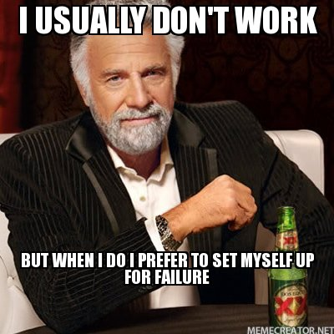
Different approach for Microsoft
Notes:
ASP.NET MVC was created with a clear focus on best practices in both Architecture and Coding
This is a new approach for Microsoft – in the past they Microsoft has had a tendency of setting us up for failure and it was our job to know better
In ASP.NET MVC:
1. There is a clear separation of layers (Model/View/Controller)
2. No designer!
3. No server controls that you can drag on and hook up directly to your Database!
4. They are actually encouraging testing…WHAT?
- Don’t believe me…File -> New Project -> ASP.NET -> “Create a unit test project”….Grant it, it should be defaulted to checked…but Rome was not Built in a day
5. MVC has a lot of DI points
Controllers
Views
Action Filters
Model Binders
View Providers

Slide 26

Notes:
MVC Contrib is a project designed to additional functionality and ease of use to MVC
Hosted on CodePlex
Created and maintain by members of the Austin Mafia
Eric Hexter
Jeffery Palermo
Jimmy Bogard
Brandon Satrom
So a bunch of extremely smart web guys
A lot of the functionality has now been rolled in to ASP.NET MVC but the MvcContrib.Tester is still a must have for testing your Routes, Controllers, and views!

Slide 27
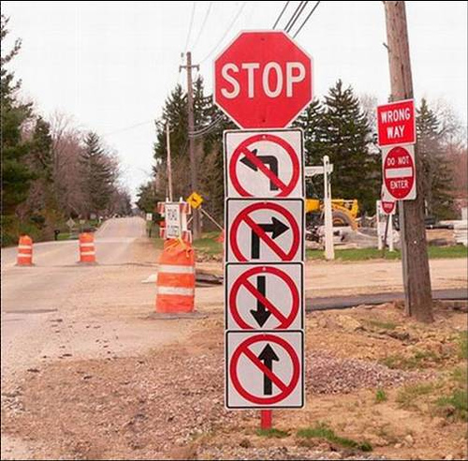
Routing
Notes:
Routing is what makes clean readable url’s in MVC possible.
Handles the incoming request and maps that to a controller and action based on the URL segments
Can get complicated and confusing, luckily they can be tested
Let’s look at a demo of that now.

Slide 28

Demo: Abstracting & Testing Routes
Notes:
*** Start by F5’ing and showing what application does
Isolating your routes
Pull up Global.asax.cx– this has changed a bit since MVC3 where the routes used to be defined directly here, but now we have a new class named “RouteConfig” that that handles registering the routes.
Out of the box the Routes are defined directly in the RegisterRoutes method.
Now I could still test my routes in my unit tests by creating a new collection of routes and adding the same routes I have created here
But that is duplication of work and in the end I am not 100% certain that I am testing the same routes
And since the order of routes make a huge difference, most specific first and general last, I want to make sure that I am testing exactly what will be used
[Show RouteProvider]
So, I created an abstraction on top of this to allow me use the same routes in my tests that I use in my app
Otherwise if I was registering my routes the way it is done out of the box I would not be able to use the same implementation in my tests
Go back to RouteConfig
Select contents of “RegisterRoutes” and type tddmvc1[tab]
So here I have replaced the out of the box registration with my abstraction
Open RouteTester
Look at the usage of the RouteProvider
Create a test for the default route: tddmcv2
Run the test
Everything passes and we are good with that route
Show this works for catching route changes by modifying the route configuration in RouteProvider.ConfigureRoutes and re-running for failure
Now let’s write a test for ignoring Trace.axd: tddmvc3
So using MVCContrib we can test our routes…what about our controllers?

Slide 29
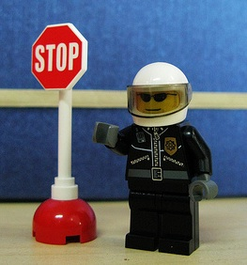
Controllers
Notes:
Very little logic
Glorified traffic cop that directs input from the view either down the service road and back to the view, in a different direction (redirect, etc), or to turn around if invalid
Loosely coupled
Dependencies should be injected
Things to be tested
Takes Correct Action
Redirects to the correct view
Returns correct view
Includes correct model

Slide 30
Demo: Isolating & Testing a Controller
Notes:
Isolating the Controller
CustomerController
With my current architecture - every controller will need an ILoggingService and an I[controller name]Service
I am using StructureMap as my IoC Container, but that requires me to wire up my dependencies one by one
What if there was a way to not have to wire up the dependencies manually for each controller?
Custom Controller Factory
Out of the box the default controller factory just resolves controllers using the default naming convention
You can create a custom controller factory to add functionality and/or override the default functionality
In this case we are going to pimp out the default controller factory with StructureMap
Show ControllerFactory
Explain GetControllerInstance
Show how we are using StructureMap and the IContainer
And we need to tell ASP.NET MVC to use the Custom Controller Factory
Global.asax.cs
**** After WireUpDependencyInjection(); ****
ControllerBuilder.Current.SetControllerFactory(new ControllerFactory());
CustomerController: Select default constructor and tddmvc4
That’s it the combination of ASP.NET MVC and having a StructureMap container in our Controller Factory allows our controllers to automatically resolve their dependencies!
Set a breakpoint in CustomerController.Index to prove it.
Testing the Controller
Open the CustomerControllerTest
Talk about the usage of fakes
I have two fakes that I will be passing in to my controller when it’s time
CustomerServiceFake
LoggingServiceFake
In order to test that the correct view is being returned or we are redirecting as necessary or the correct model is being returned we could write some really ugly low-level code that interrogates the controller context…or we could use MVCContrib
So let’s test that our Index controller method returns a view named “Index”
tddmvc5
And now we can write a test to make sure the model being returned is the correct type
tddmvc6
Assert…blah blah blah, hard to read!
Fluent Assertions Library – user readable assertions
result.Model.Should().BeOfType<Core.Entities.Customer>();
Lastly we can test the redirect on our Post
tddmvc7

Slide 31
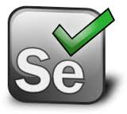
Selenium: Automated UI Testing
Notes:
Automate the browser from your tests
Supports IE, Chrome, FireFox, Opera, Safari
Allows you test
Navigation
Display logic (visible, etc)
Dialogs
Free

Slide 32
Demo: Selenium
Notes:
Automated UI Testing w/ Selenium
Open IndexTest.cs
The basis behind automated UI testing in Selenium is the IWebDriver interface
Look at and discuss WebDriver.cs
We need to make sure as part of cleanup we quit the driver.
tddmvc8: Our first test is to verify that CustomerIndex is displayed as the default view in Chrome.
I initialize my webdriver as a new chrome instance
Then I navigate supplying the url I wish to navigate to
And I verify that the current view is displayed by asserting against the page title
Run it
Let’s do the same test in FF and IE, tddmvc9
What else can we do with Automated UI testing?
How about making sure a field exists on the page…
Let’s make sure the firstName field is displayed – we will use the browser dev tools to figure out what we are looking for
tddmvc10
My arrange is pretty much the same
Initializing my driver
And navigating
My act is getting is where I search for my html element that I am expecting to exist
I get all the HTML Label elements on the page
And then I use LINQ to look for the label whose text is “First Name”
And my assert is to make sure that it is not null which confirms it does exist on the page.
Let’s test our button
Clicking “Next” on the Customer Index page should navigate to Step2
tddmvc11
This time I am using FindElement to find the button by Id and Clicking it
And then asserting that we navigated to the expected page.
How about testing an input form…show CreateTest
How about testing validation? Let’s make sure that our first name required message is displayed when clicking Create and with nothing in First Name
tddmvc12
Now we can test the opposite: Message should not be displayed when we fill in First Name and click Create
tddmvc13

Slide 33
What Did We Learn?
You should be doing TDD
TDD is not as simple as just writing tests
MVC is different
Testing routes and controllers
Automated UI testing
Notes:
That wrap’s up the session but before fielding questions I want to summarize what we covered
We covered the importance of TDD and discussed why you absolutely should be doing it
We the talked about the concepts and practices that are required to do TDD correctly
After that we discussed ASP.NET MVC and how it is a different beast from what we have seen from Microsoft in the past
And then we dove in to how we can test MVC specific functionality such as routes and controllers
And we wrapped up by looking at automated UI testing with Selenium

Slide 34
Thank You!
github.com/KBurnell/TestDrivingASP.NETMVC
Find me:
Twitter: @KeBurnell
Blog: DotNetDevDude.com
E-Mail: KBurnell@SkylineTechnologies.com
Tools
ReSharper: http://www.JetBrains.com/ReSharper
NCrunch : http://www.NCrunch.net
MvcContrib: http://www.MvcContrib.CodePlex.com
Selenium: http://www.SeleniumHq.org

