Slide 1
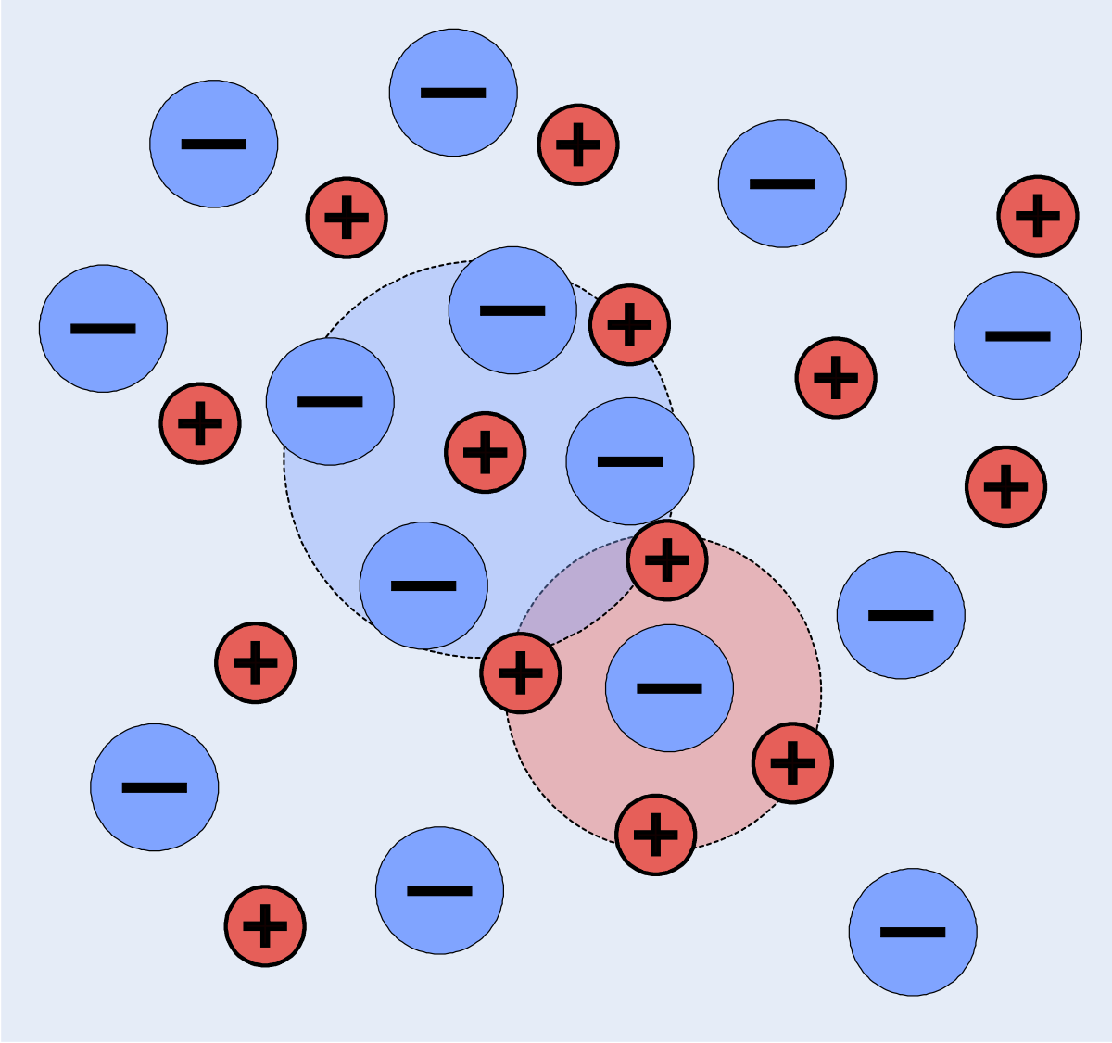
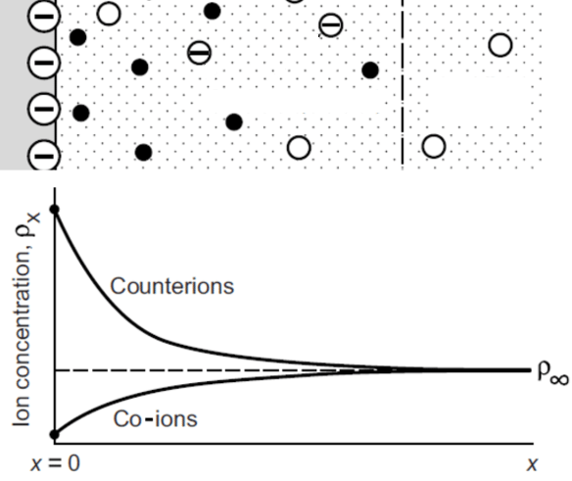


Theory for correlated electrolyte solutions at interfaces
- Nikhil R. Agrawal, Ph.D. Candidate, UC Berkeley
Electrolyte Solution near a charged surface
Interface
Bulk solution
Image Credits: Roland Mattern
(+ve)
Ion-Ion correlations at the ion-scale
Ion-Ion Correlations at the interface-scale
(-ve)
Image Credits: Jingjing Gong

