Slide 1
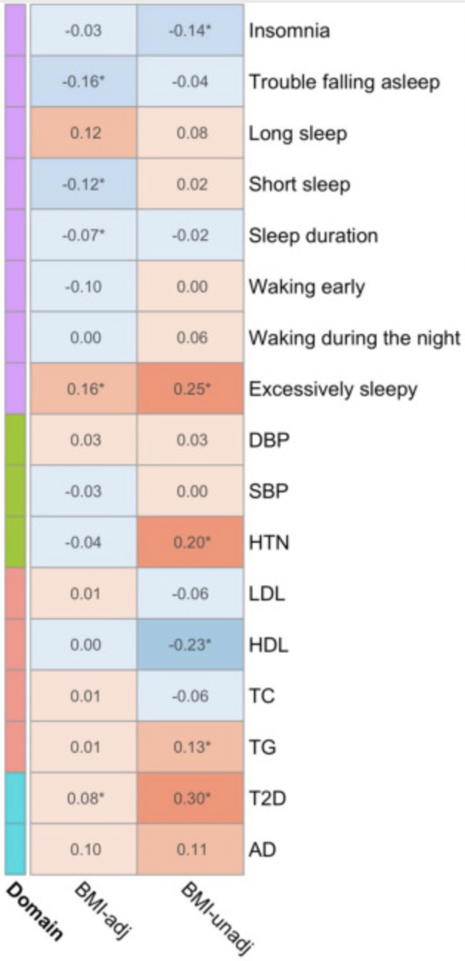
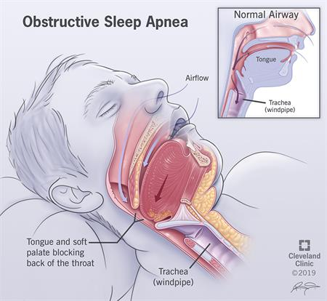
Staci Bell: Masters Student in Biostatistics
https://doi.org/10.1016/j.ebiom.2023.104536

