Slide 1
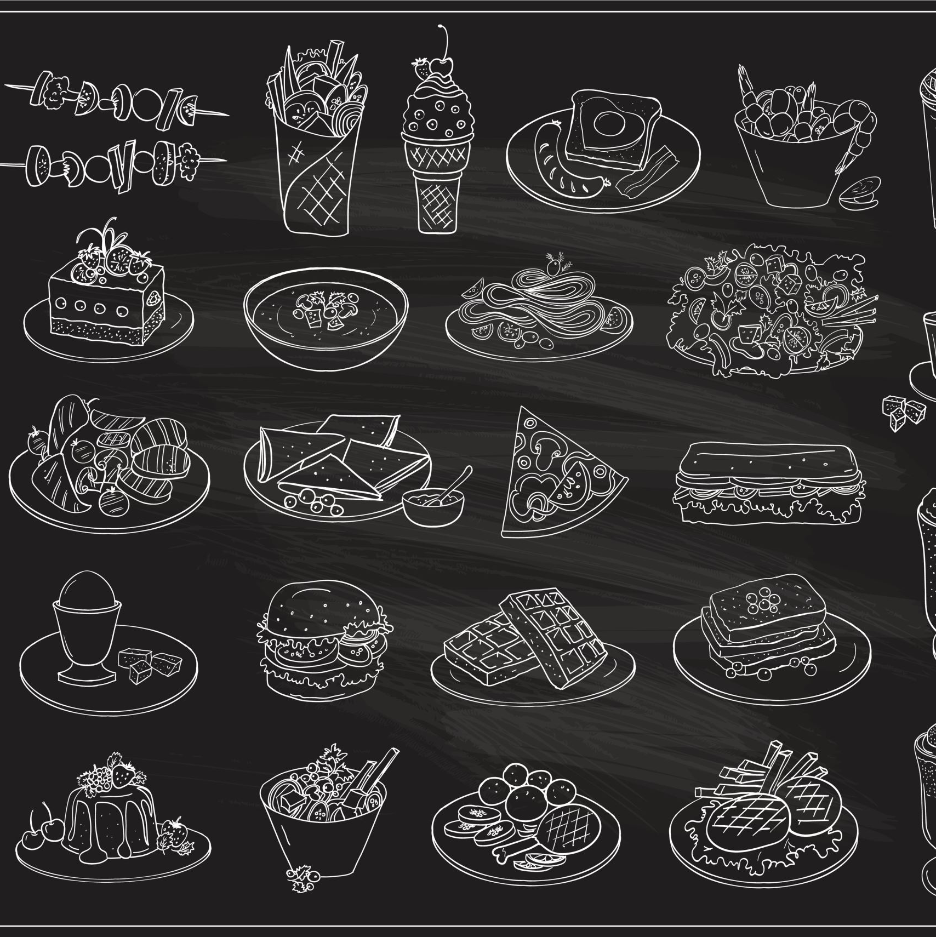
2021 Petco Park Cooler Layout
Maximizing sales through strategic placement of products.

Slide 2
Business Tasks
To design a layout for THE COOLER that is functional and adhere to branding standards for Petco Park based on Sponsorship.
Make THE COOLER loadout more efficient for warehouse staff.

Slide 3
Problem
THE COOLER keeps running out of top selling product during games, losing out on revenue.
Due to COVID-19, our warehouse staff is very thin and cannot load THE COOLER efficiently enough for back-to-back games during a homestand.

Slide 4
Solution
Design a cooler layout that works two ways:
Provide enough product to get through a full homestand.
Hold up to the branding standards of Petco Park.

Slide 5
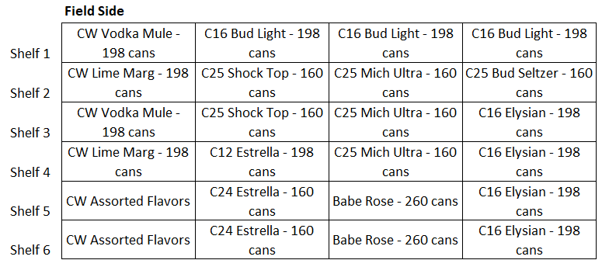
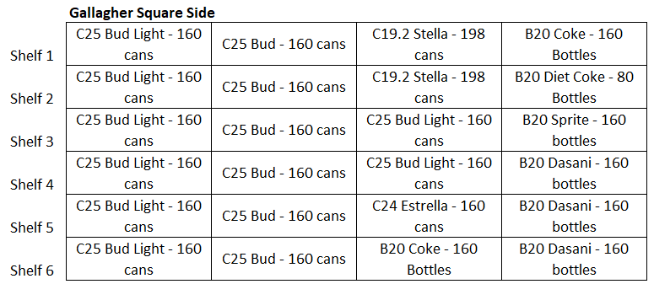
THE COOLER’S CURRENT DESIGN
Consists of eight (8) racks.
Each rack has six (shelves)
Max amount of stock per shelf by can size:
12oz-16oz – 198 cans
Wine – 260 cans
19.2oz – 198 cans
24oz-25oz – 160 cans
20oz Bottles – 160 bottles

Slide 6
Solution
Design a cooler layout that works two ways:
Provide enough product to get through a full homestand.
Hold up to the branding standards of Petco Park.

Slide 7
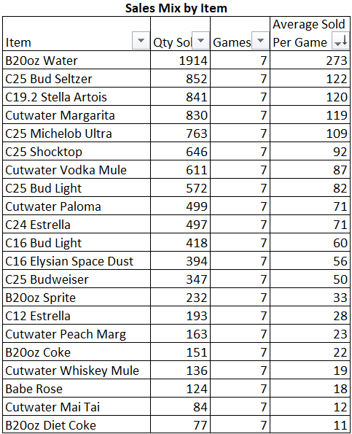
The Sales Data
Pulled sales data from the top grossing homestand of 2021.
Sorted and cleaned this data to make the following table.
Broke down data to average sold per game.

Slide 8
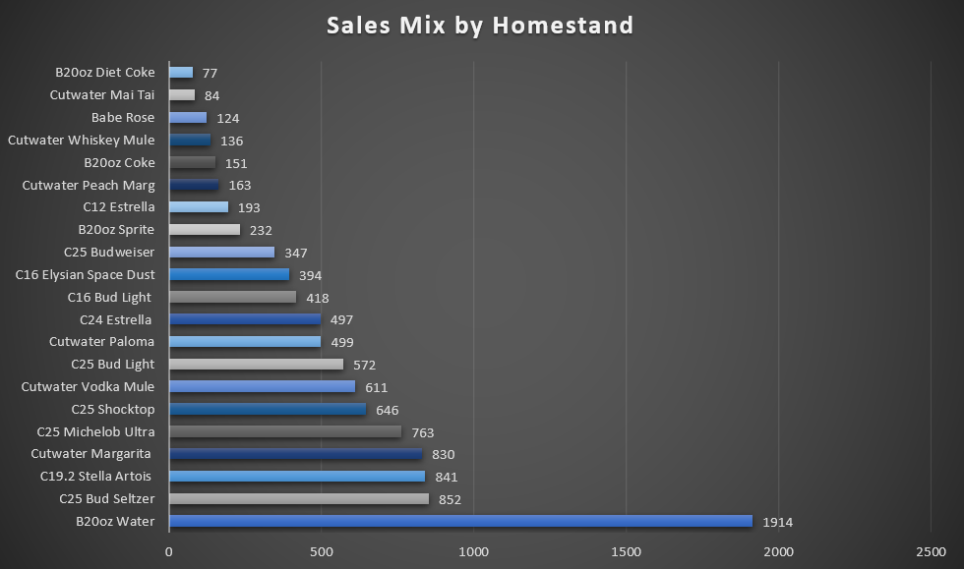
The Sales Data
Pulled sales data from the top grossing homestand of 2021.
Sorted and cleaned this data to make the following table.
Broke down data to average sold per game.

Slide 9
Solution
Design a cooler layout that works two ways:
Provide enough product to get through a full homestand.
Hold up to the branding standards of Petco Park.

Slide 10

THE BRANDING OF IT ALL
THREE MAIN BRANDS IN THE COOLER:
ANHEUSER-BUSCH (THE COOLER’s flagship brand)
COCA-COLA
CUTWATER
Each brand will expect to have their products stocked with integrity and with sales in mind.

Slide 11
Quick hitters on Branding:
Anheuser-Busch
Wants their branded products separate from other brands.
Bud Light, Michelob Ultra and Bud Seltzer are top brands currently.
Coca-Cola
Cooler shelf layout
Coke
Diet Coke
Sprite
Dasani
Cutwater
No particular branding requirements, other than front facing their cans.

Slide 12
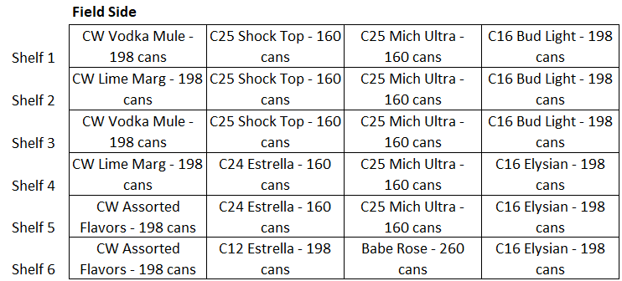

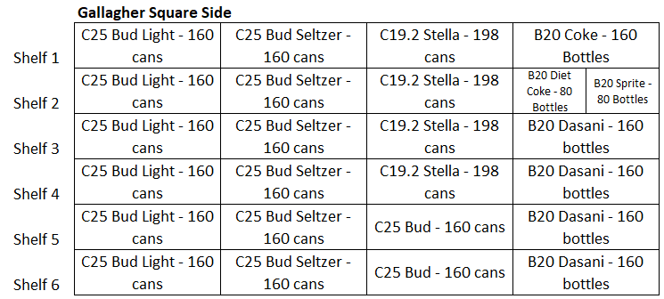
THE COOLER’S NEW DESIGN
Anheuser-Busch
Wants their branded products separate from other brands.
Bud Light, Michelob Ultra and Bud Seltzer are top brands currently.
Coca-Cola
Cooler shelf layout
Coke – 151 sold
Diet Coke – 77 sold
Sprite – 232 sold
Dasani – 1914 sold
Cutwater
No particular branding requirements, other than front facing their cans.

Slide 13
Solution
Design a cooler layout that works two ways:
Provide enough product to get through a full homestand.
Hold up to the branding standards of Petco Park.

Slide 14
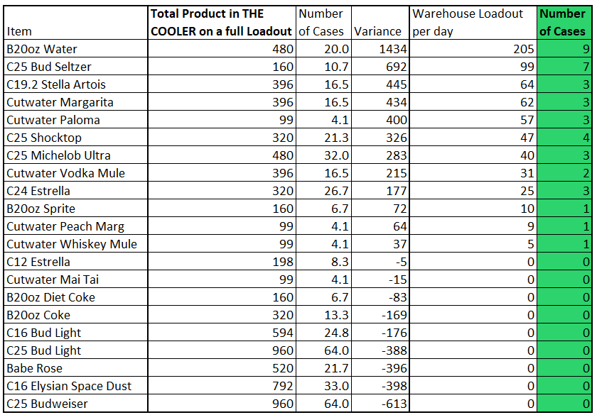
WAREHOUSE LOADOUT – OLD VERSION
Based off inefficient cooler layouts, the warehouse was loading around 40 cases of product a game.
Time consuming and labor intensive.
Additionally, too much stock of slower selling items. (Budweiser, Babe Rose and etc)

Slide 15
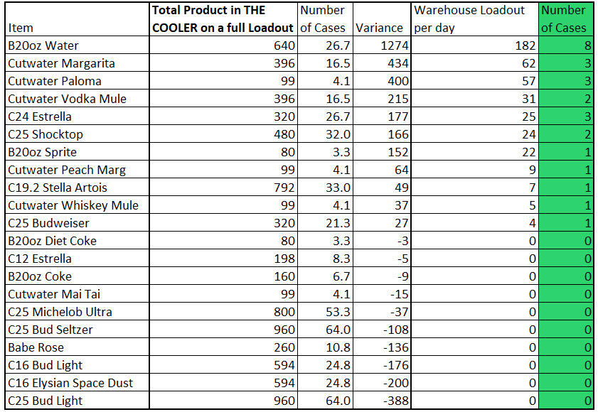
WAREHOUSE LOADOUT – NEW VERSION
New cooler layout provides:
Less product to load per day (26 cases vs 40 cases)
Cutting loadout time and labor cost almost in half.
Ability to maximize sales on top selling items, whilst keeping slower items in stock.

Slide 16
NEXT STEPS
MEET WITH WAREHOUSE AND CONCESSIONS STAFF TO DISCUSS IMPLIMENTATION PLAN. (THIS IS POSSIBLE BETWEEN HOMESTANDS)
TALK WITH AREA SUPERVISOR ABOUT THE NEW COOLER LAYOUT AND EXPECTATIONS.

Slide 17
THANK YOU
- Kyle Burns

