Slide 1
Query Plan Diagnostic Rewrites with Egg
Design of the Egg Plan Transformer (eggplant) Tool
Karl Burtram, June 2, 2022
Advanced Topics in Data Management, CSEP 590D, Spring 2022, University of Washington

Slide 2
Problem Statement
Run query in database tooling and collect an actual execution plan
Data professionals often investigate slow query execution
Query performance tuning often involves using query execution plans to locate suboptimal operations
Differences between estimated and actual relation cardinalities are a common cause of suboptimal plans
Convert query execution plan into eggplant query plan expression
Project addresses this step eggplant using Egg library cost-based rewrite rules to improve expression
Optimized expression can be compared to original to create query plan hint

Slide 3
Egg Plan Transformer (eggplant)
Egg-based query plan expression optimizer that uses cost-based rewrite rules to transform plan expressions
https://www.github.com/kburtram/eggplant
eggplant is provided actual query execution metrics so it has information not available to the DBMS optimizer

Slide 4
Building an Annotated E-Graph
Eggplant implements an Egg::Analyzer to attach the input metadata to enodes will making the egraph

Slide 5
E-graph Classes and Expression Language
Join order
Join algorithm
Storage file access methods
Expression tree shape
Query Plan Expression Grammar
PLAN ::= ( select JOIN )
JOIN ::= ( JOIN_ALGORITHM RELATION_OR_JOIN RELATION_OR_JOIN )
RELATION_OR_JOIN ::= RELATION | JOIN
RELATION ::= (ACCESS METHOD IDENTIFIER )
JOIN_ALGORITHM ::= hashJoin | mergeJoin | nestedLoopsJoin
ACCESS_METHOD ::= scan | seek
IDENTIFIER ::= [ a=z | A=Z ] [ a=z | A=Z|0 =9 ]

Slide 6
Query Plan Expression Rewrite Rules
Rewrite Rules
Name | Type
idx-left | (hashJoin a b) → (hashJoin b a)
order-right | (hashJoin (hashJoin a b) c) → (hashJoin (hashJoin a c) b)
scan-seek | (hashJoin (scan a) b) → (hashJoin (seek a) b)
seek-scan | (hashJoin (seek a) b) → (hashJoin (scan a) b)
hash-join-merge-join | (hashJoin a b) → (mergeJoin a b)
hash-join-nested-loops-join | (hashJoin a b) → (nestedLoopsJoin a b)
merge-join-hash-join | (mergeJoin a b) → (hashJoin a b)
merge-join-nested-loops-join | (mergeJoin a b) → (nestedLoopsJoin a b)
nested-loops-join-merge-join | (nestedLoopsJoin a b) → (mergeJoin a b)
nested-loops-join-hash-join | (nestedLoopsJoin a b) → (hashJoin a b)

Slide 7
Rewrite Cost Function Rules
Join ordering try to move smallest tables downward
Expression shape try to build left-deep tree
Access method is based on ratio of table accessed
Scan if over 80% accessed, Seek if less than 20%
Join algorithm is selected based on cardinality and whether the relation is ordered
Small relations use nested loops, sorted relations use merge, and one small with one large relation use hash

Slide 8
Join Algorithm and Access Method Rewriting
(select
(mergeJoin
(scan tbl1)
(seek tbl2)))
Table Metrics
 | Case 1 | Case 2
tbl1 | cardinality: 3000 rows: 5000 index: primary ordered: true | cardinality: 5 rows: 1000 index: primary ordered: true
tbl2 | cardinality: 20 rows: 1000 index: foreign ordered: false | cardinality: 45 rows: 50 index: foreign ordered: false
Case 1
Case 2
(select
(hashJoin
(scan tbl1)
(seek tbl2)))
(select
(nestedLoopsJoin
(seek tbl1)
(scan tbl2)))

Slide 9
Join Order Rewrite Example
eggplant CLI Output
Input Metadata

Slide 10
Join Order Costing
There are 144 different configurations of 3 relations and 2 joins
Cost function only sees current e-node and its immediate children, making global optimization tricky
Use penalties and cost-scaling to express preferred arrangements
(1)
(2)
(3)

Slide 11
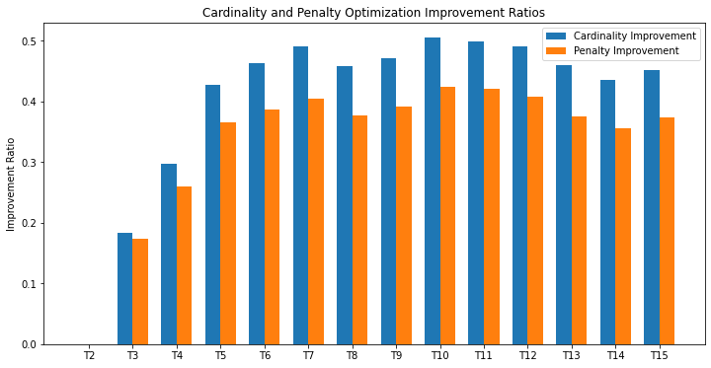
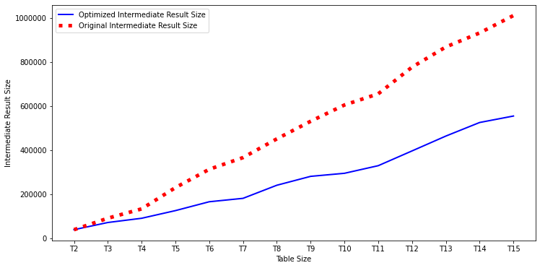
Intermediate Result Size Optimization
Join order optimization is focused on reducing the size of intermediate data
Charts compare randomly generated plans and optimized plans
Optimized intermediate result sets are 40%-50% smaller
Improvements level off around 5 or 6 tables
Penalties and cardinalities are highly correlated
https://github.com/kburtram/eggplant/blob/main/analysis/analysis.ipynb

Slide 12


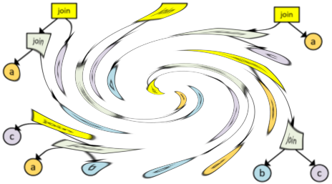
Learnings and Takeaways
Egg makes e-graph equality saturation approachable (and Rust is nice language)
Penalties and contextual numerical adjustments enable non-trivial expression rewrites
Complex optimizations are difficult due to local scope of cost functions and single cost function value
+

