Slide 1
ATLAS × LUCID LIVING
Administrator
Pilot Exploration Plan
Full-access governance. You see every enrollee and configure who can access what — while data-warehouse exports stay locked to the service role.
YOUR LOGIN
pilot.admin@atlas.test · AtlasPilot2026!
atlas × lucid living — Community Navigation Platform Pilot
PILOT.md

Slide 2
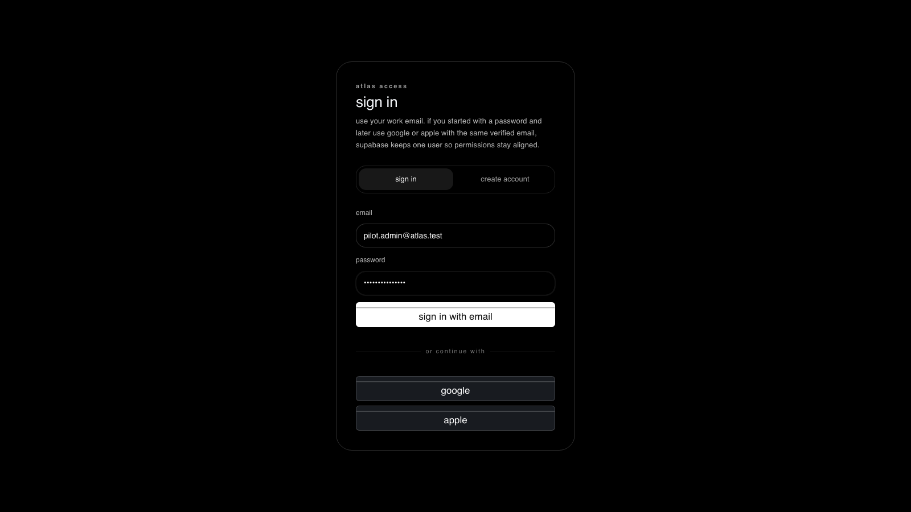
1
STEP 1 OF 5
Sign in as Administrator
WHERE
http://localhost:5173/app
DO
Enter the administrator login and password, then “sign in with email”.
EXPECT
The workspace bootstraps with the administrator shell.
live capture · localhost:5173
atlas × lucid living — Community Navigation Platform Pilot
PILOT.md

Slide 3
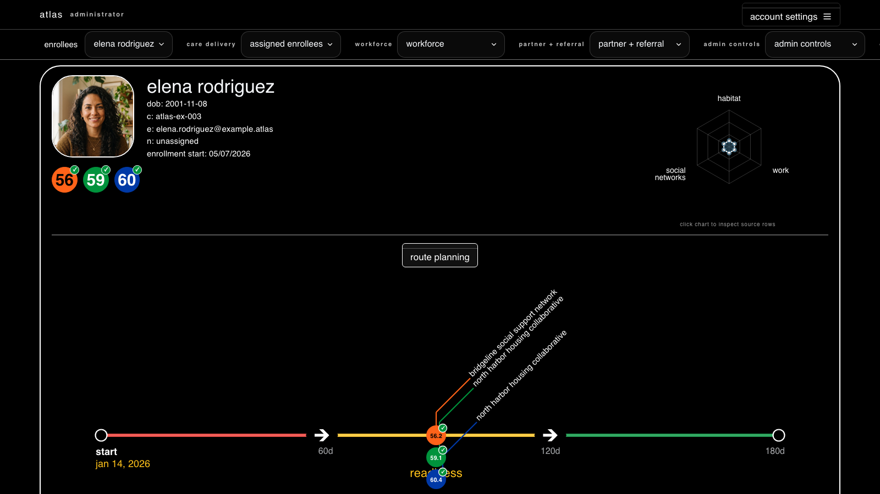
2
STEP 2 OF 5
See every enrollee
WHERE
enrollees → enrollee picker
DO
Open the enrollee picker at the top of the workspace.
EXPECT
All four enrollees are visible (Elena, Marcus, Sandra, test-reference1).
live capture · localhost:5173
atlas × lucid living — Community Navigation Platform Pilot
PILOT.md

Slide 4
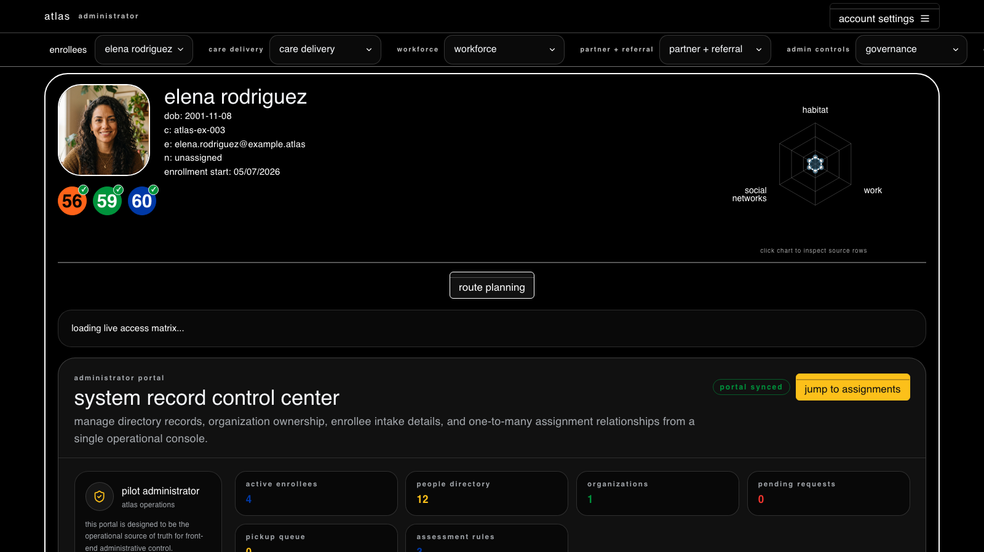
3
STEP 3 OF 5
Governance & access matrix
WHERE
admin controls → governance
DO
Open the system record control center to set roles and one-to-many assignments.
EXPECT
Live counts load (4 enrollees, 12 people, 1 org); assignments are editable.
COMMAND RPC
fn_access_matrix_save_*
live capture · localhost:5173
atlas × lucid living — Community Navigation Platform Pilot
PILOT.md

Slide 5
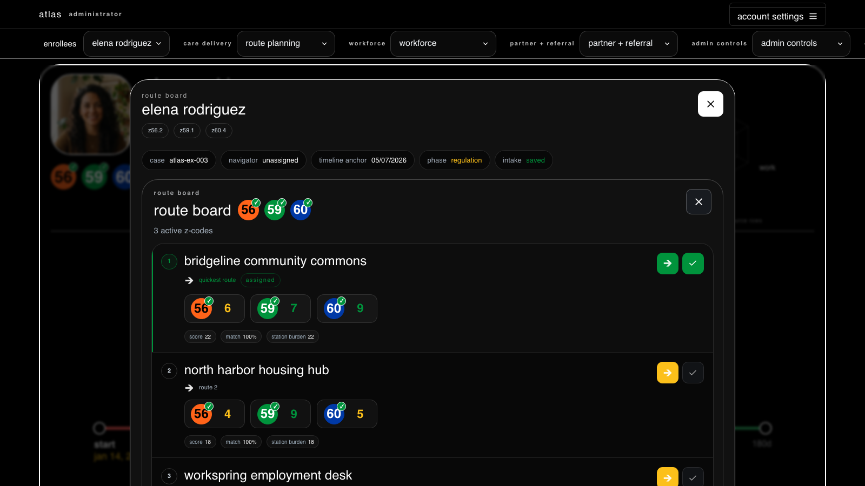
4
STEP 4 OF 5
Plan routes across partners
WHERE
care delivery → route planning
DO
Open an enrollee’s route board to match Z-codes to partner stations.
EXPECT
Ranked partner matches appear with score, match %, and station burden.
live capture · localhost:5173
atlas × lucid living — Community Navigation Platform Pilot
PILOT.md

Slide 6
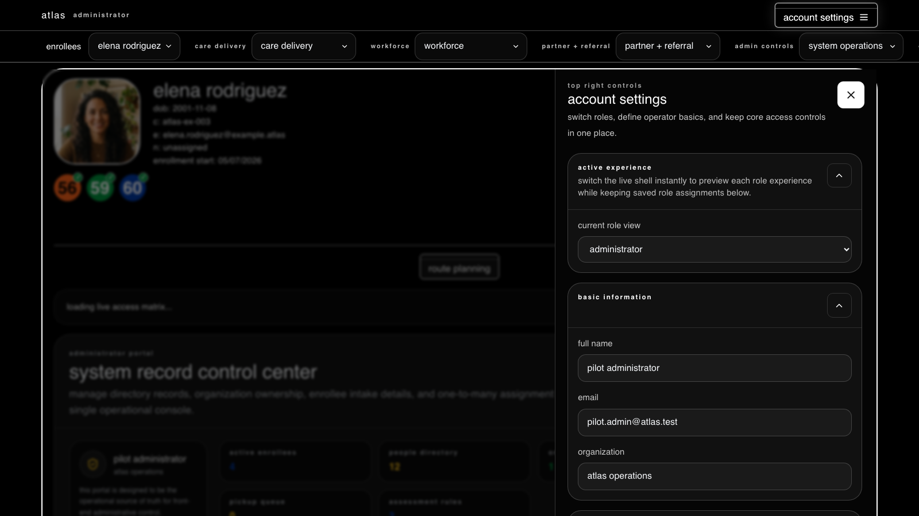
5
STEP 5 OF 5
Switch role view / identity
WHERE
account settings (top-right)
DO
Use the role switcher to preview any role and manage operator basics.
EXPECT
Current role view = administrator; warehouse exports stay service-role only.
live capture · localhost:5173
atlas × lucid living — Community Navigation Platform Pilot
PILOT.md

Slide 7
WRAP-UP
Verify & reset
Confirm alignment — Run verification/pilot_verify.sql to replay every screen read under this identity and print an ok / row-count / error table — no clicking required.
Fail-loud by design — A red banner means a real permission/RLS denial, not an empty screen. The workspace never hides a denial behind blank data.
Reset the pilot — Re-run verification/pilot_setup.sql (idempotent) to recreate the four logins and their seeded scope at any time.
atlas × lucid living — Community Navigation Platform Pilot
PILOT.md

