Slide 1
ATLAS × LUCID LIVING
Navigator
Pilot Exploration Plan
Front-line case work, scoped to your assignments. You see only your two assigned enrollees and drive their journey end to end.
YOUR LOGIN
pilot.navigator@atlas.test · AtlasPilot2026!
atlas × lucid living — Community Navigation Platform Pilot
PILOT.md

Slide 2
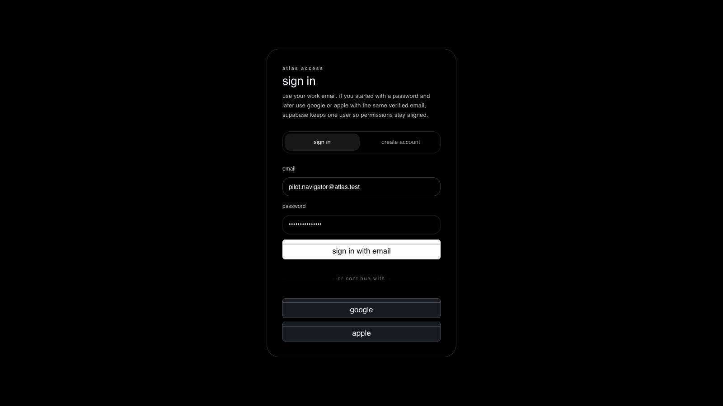
1
STEP 1 OF 6
Sign in as Navigator
WHERE
http://localhost:5173/app
DO
Enter the navigator login and password, then “sign in with email”.
EXPECT
The workspace opens scoped to your assignments.
live capture · localhost:5173
atlas × lucid living — Community Navigation Platform Pilot
PILOT.md

Slide 3
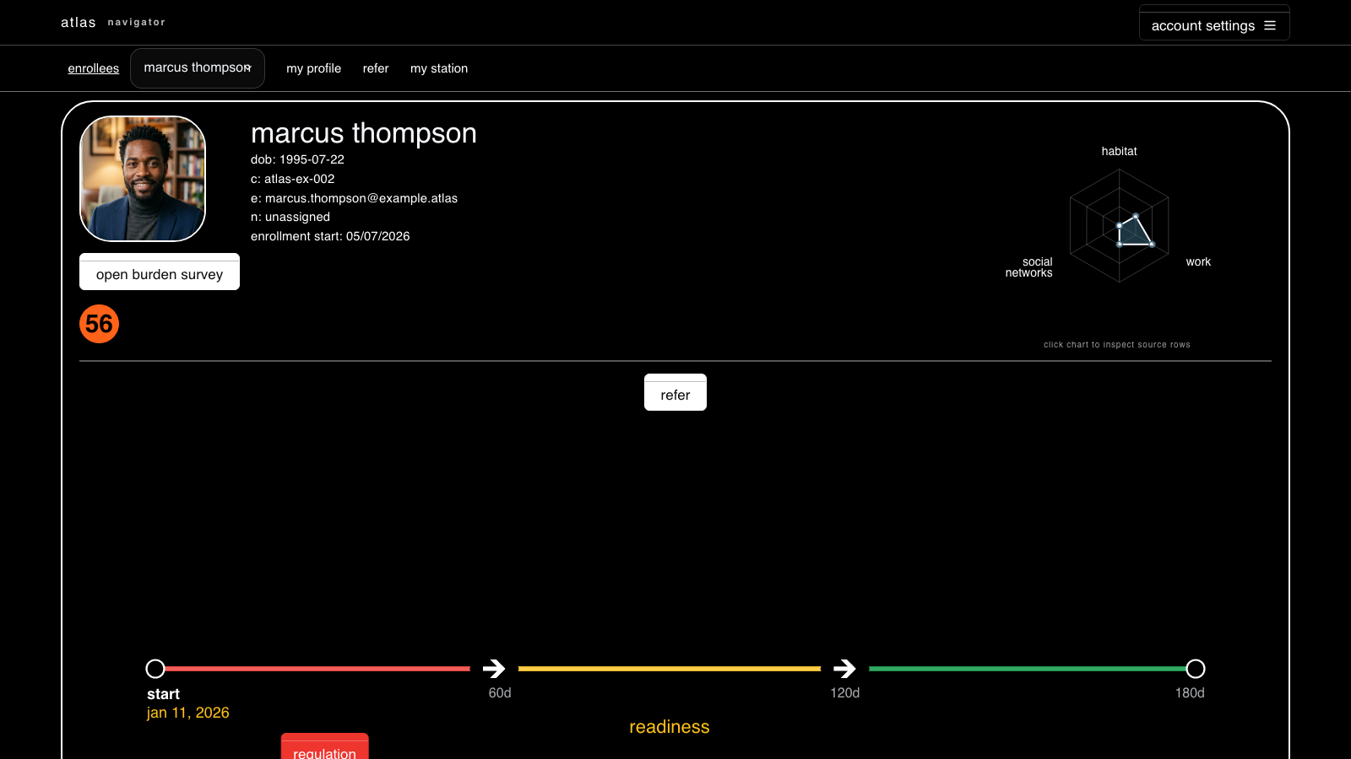
2
STEP 2 OF 6
Only your assigned enrollees
WHERE
enrollees → enrollee picker
DO
Open the enrollee picker.
EXPECT
Only Sandra Morrison and Marcus Thompson appear — your two assignments.
live capture · localhost:5173
atlas × lucid living — Community Navigation Platform Pilot
PILOT.md

Slide 4
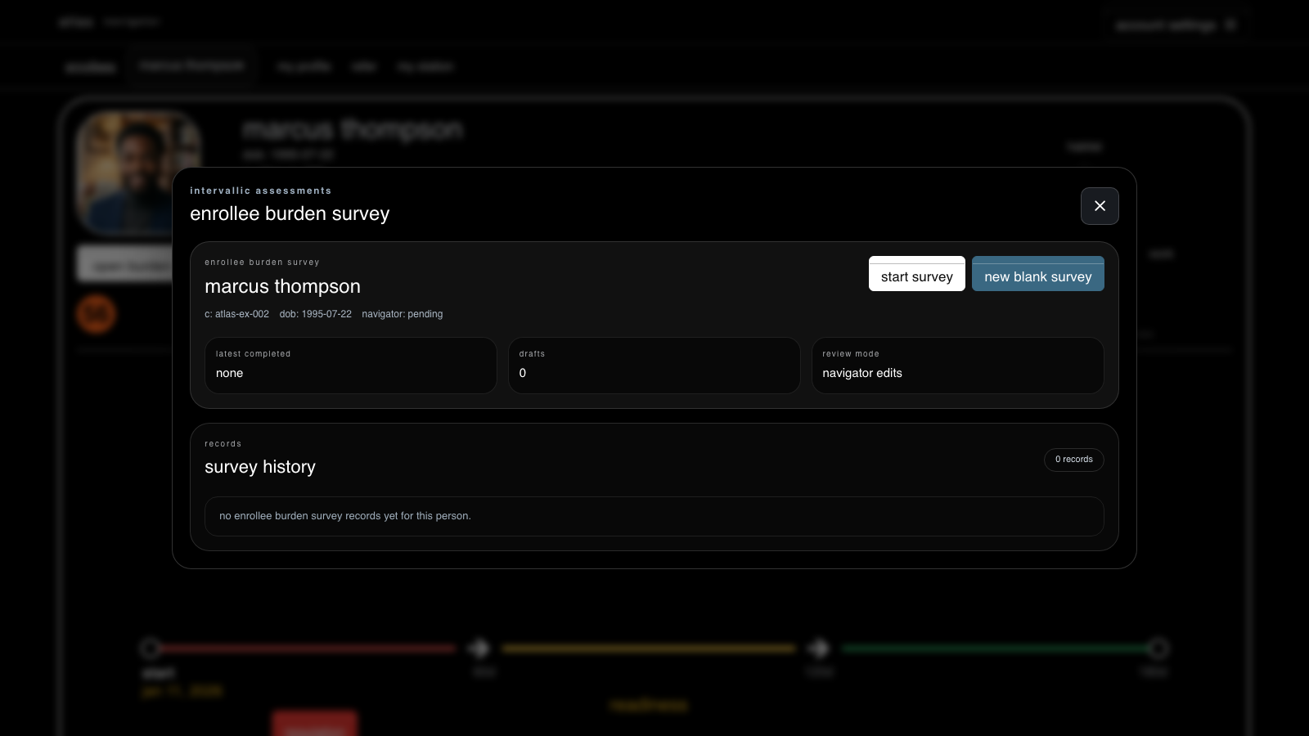
3
STEP 3 OF 6
Complete a burden survey
WHERE
open an enrollee → open burden survey
DO
Open the domain-spectrum burden survey for an enrollee and submit.
EXPECT
The submission saves and history updates.
COMMAND RPC
fn_save_enrollee_burden_submission
live capture · localhost:5173
atlas × lucid living — Community Navigation Platform Pilot
PILOT.md

Slide 5
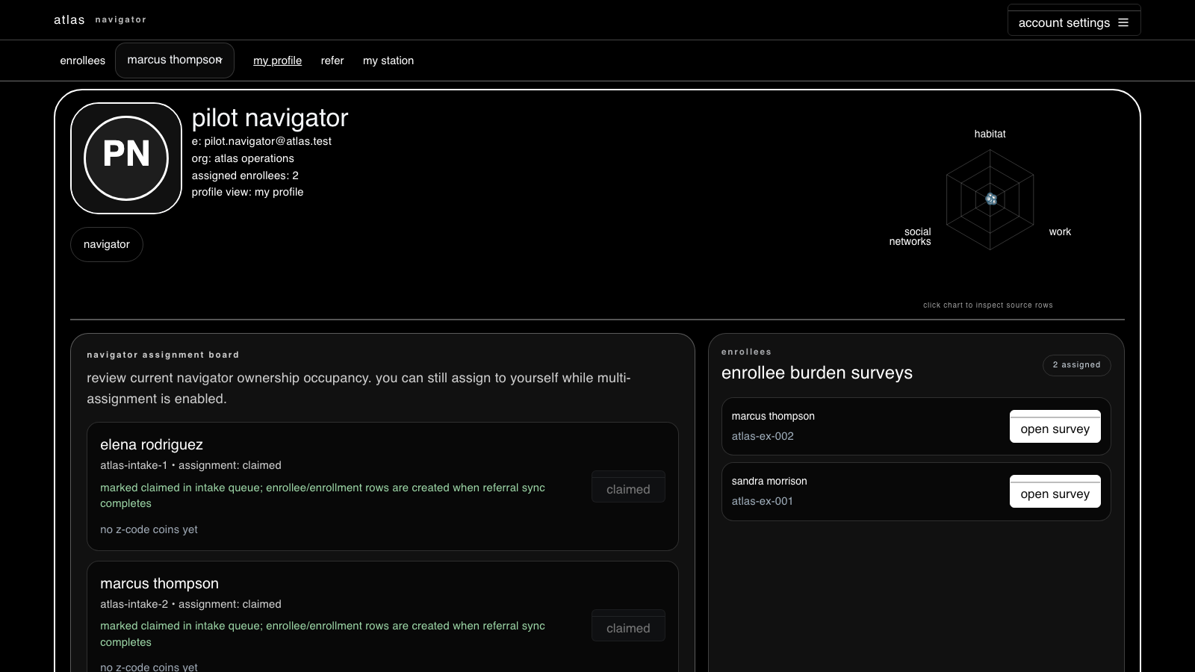
4
STEP 4 OF 6
Your profile & assignments
WHERE
my profile
DO
Review your assignment board and the enrollee burden surveys you own.
EXPECT
Profile shows assigned enrollees: 2, with each claimed enrollment.
COMMAND RPC
fn_save_navigator_competency_assessment
live capture · localhost:5173
atlas × lucid living — Community Navigation Platform Pilot
PILOT.md

Slide 6
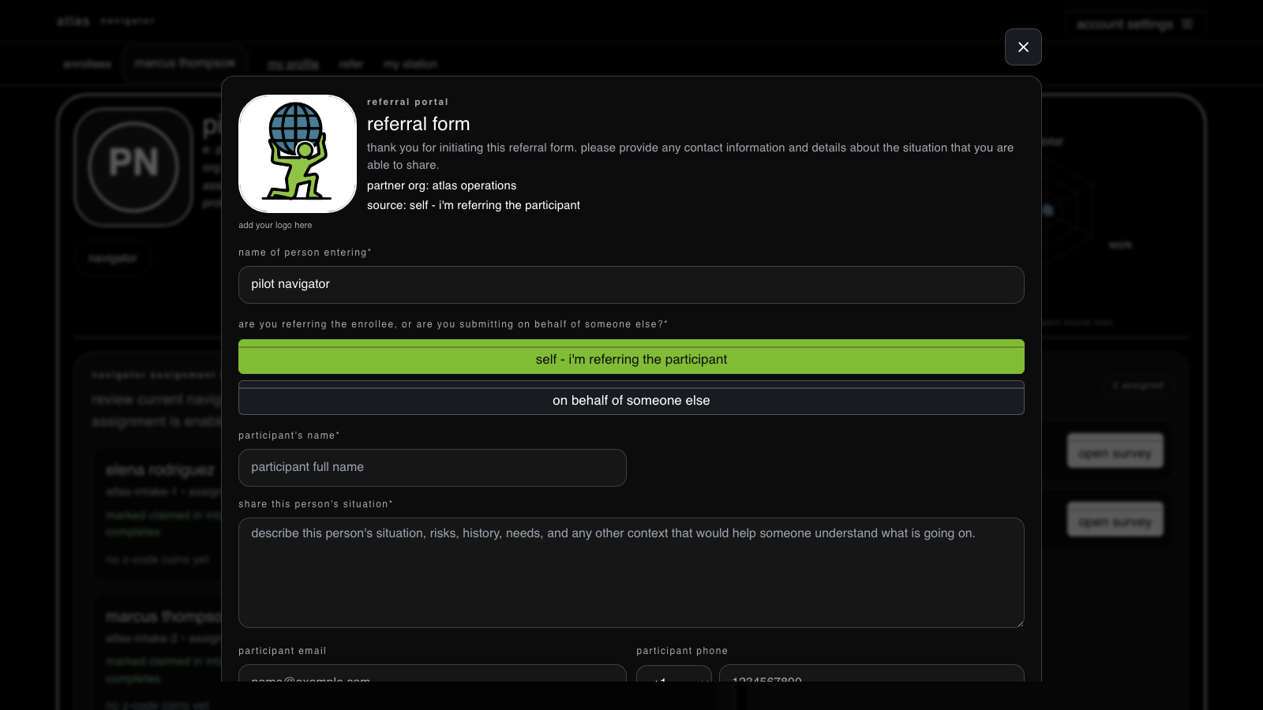
5
STEP 5 OF 6
Refer someone
WHERE
refer
DO
Open the referral form and submit a referral into the intake queue.
EXPECT
The referral enters the same in-system queue staff work from.
live capture · localhost:5173
atlas × lucid living — Community Navigation Platform Pilot
PILOT.md

Slide 7
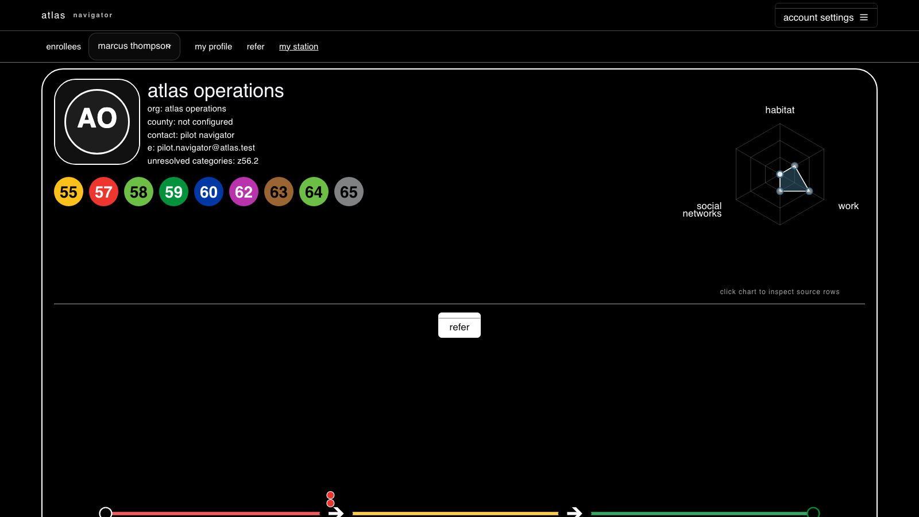
6
STEP 6 OF 6
Your station context
WHERE
my station
DO
Open your station to see the partner org and its Z-code coverage.
EXPECT
Station context resolves for your linked partner organization.
COMMAND RPC
fn_get_my_navigator_station_context
live capture · localhost:5173
atlas × lucid living — Community Navigation Platform Pilot
PILOT.md

Slide 8
WRAP-UP
Verify & reset
Confirm alignment — Run verification/pilot_verify.sql to replay every screen read under this identity and print an ok / row-count / error table — no clicking required.
Fail-loud by design — A red banner means a real permission/RLS denial, not an empty screen. The workspace never hides a denial behind blank data.
Reset the pilot — Re-run verification/pilot_setup.sql (idempotent) to recreate the four logins and their seeded scope at any time.
atlas × lucid living — Community Navigation Platform Pilot
PILOT.md

