Slide 1
ATLAS × LUCID LIVING
Supervisor
Pilot Exploration Plan
Oversight across the navigator team. You supervise every navigator and can see competency rollups and the enrollments your navigators cover.
YOUR LOGIN
pilot.supervisor@atlas.test · AtlasPilot2026!
atlas × lucid living — Community Navigation Platform Pilot
PILOT.md

Slide 2
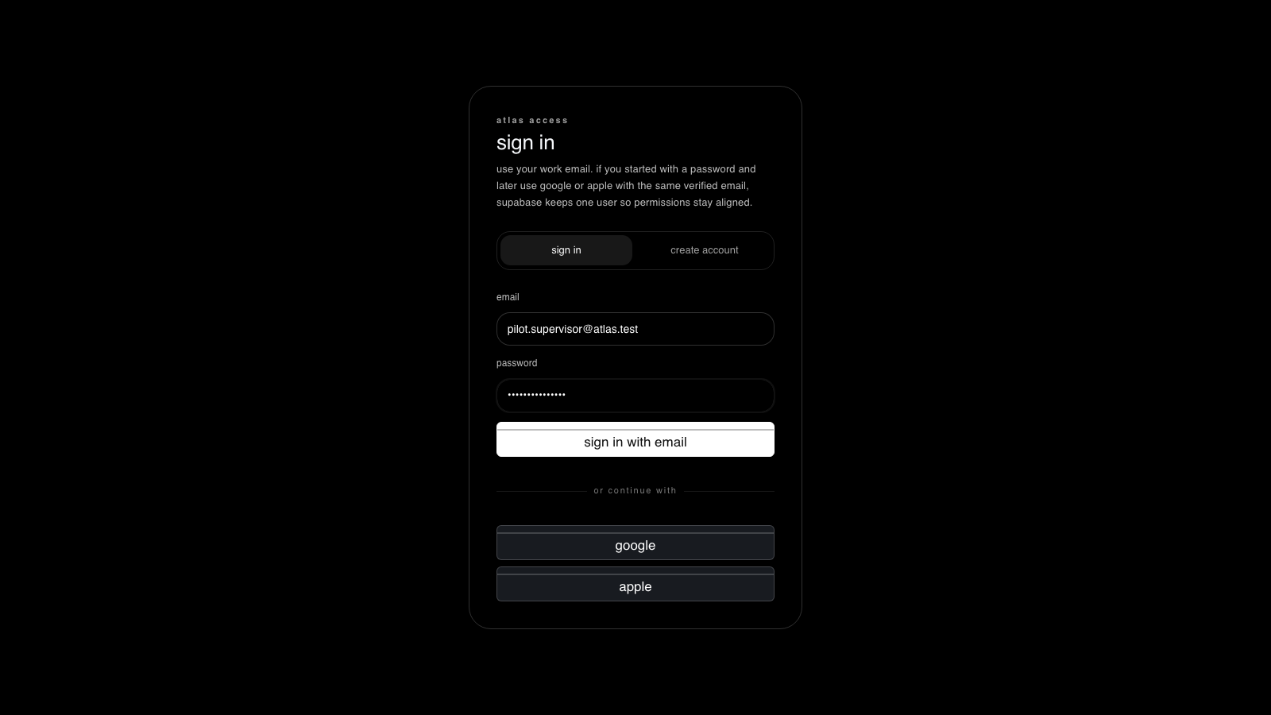
1
STEP 1 OF 4
Sign in as Supervisor
WHERE
http://localhost:5173/app
DO
Enter the supervisor login and password, then “sign in with email”.
EXPECT
The workspace opens with the supervisor shell.
live capture · localhost:5173
atlas × lucid living — Community Navigation Platform Pilot
PILOT.md

Slide 3
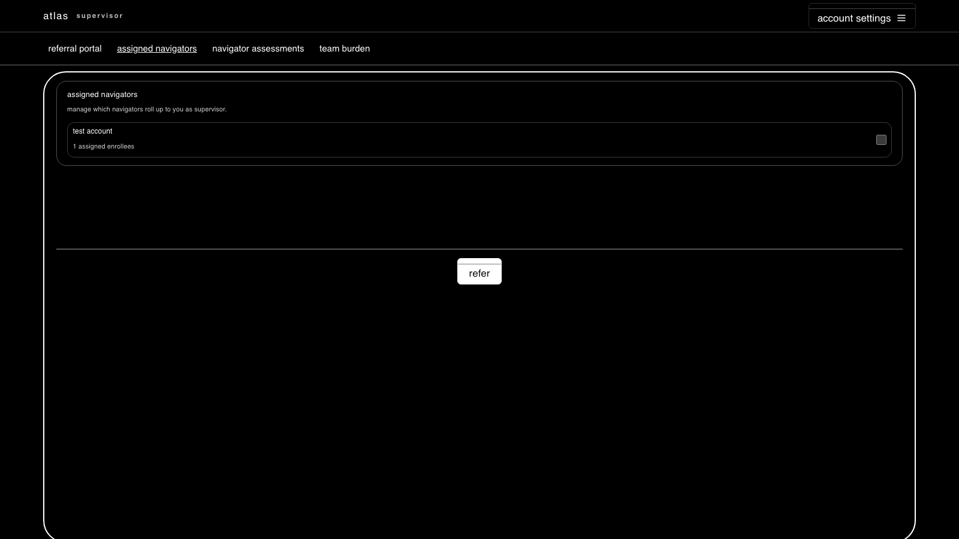
2
STEP 2 OF 4
See your navigators
WHERE
assigned navigators
DO
Open the assigned-navigators board.
EXPECT
The navigators that roll up to you are listed with their enrollee counts.
live capture · localhost:5173
atlas × lucid living — Community Navigation Platform Pilot
PILOT.md

Slide 4
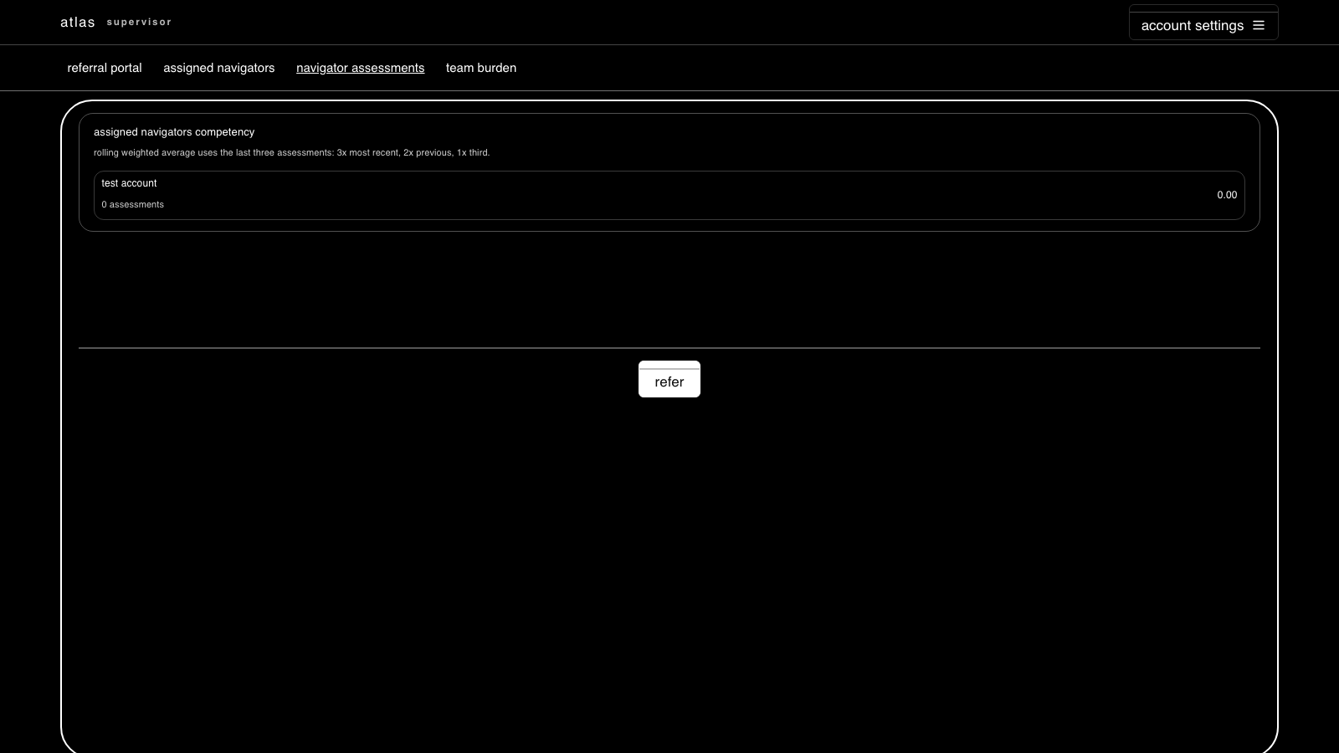
3
STEP 3 OF 4
Competency rollup
WHERE
navigator assessments
DO
Open the competency rollup for your navigators.
EXPECT
Rolling weighted competency (3x / 2x / 1x by recency) is shown per navigator.
COMMAND RPC
fn_save_navigator_competency_assessment
live capture · localhost:5173
atlas × lucid living — Community Navigation Platform Pilot
PILOT.md

Slide 5
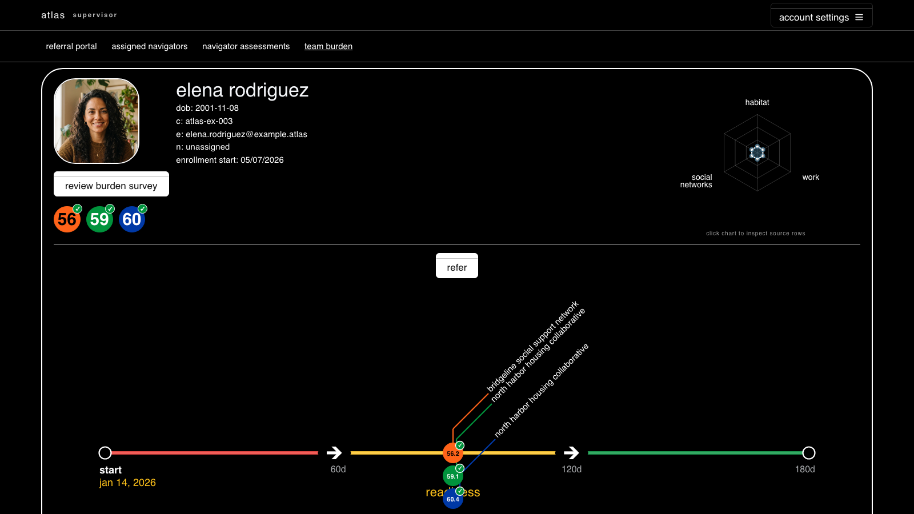
4
STEP 4 OF 4
Team burden
WHERE
team burden
DO
Open the team burden view across your supervised navigators.
EXPECT
Team-level burden metrics populate for your scope only.
live capture · localhost:5173
atlas × lucid living — Community Navigation Platform Pilot
PILOT.md

Slide 6
WRAP-UP
Verify & reset
Confirm alignment — Run verification/pilot_verify.sql to replay every screen read under this identity and print an ok / row-count / error table — no clicking required.
Fail-loud by design — A red banner means a real permission/RLS denial, not an empty screen. The workspace never hides a denial behind blank data.
Reset the pilot — Re-run verification/pilot_setup.sql (idempotent) to recreate the four logins and their seeded scope at any time.
atlas × lucid living — Community Navigation Platform Pilot
PILOT.md

