Slide 1
ATLAS × LUCID LIVING
Partner
Pilot Exploration Plan
Community partner self-service. You report service capacity for your organization — with zero access to enrollee health information.
YOUR LOGIN
pilot.partner@atlas.test · AtlasPilot2026!
atlas × lucid living — Community Navigation Platform Pilot
PILOT.md

Slide 2
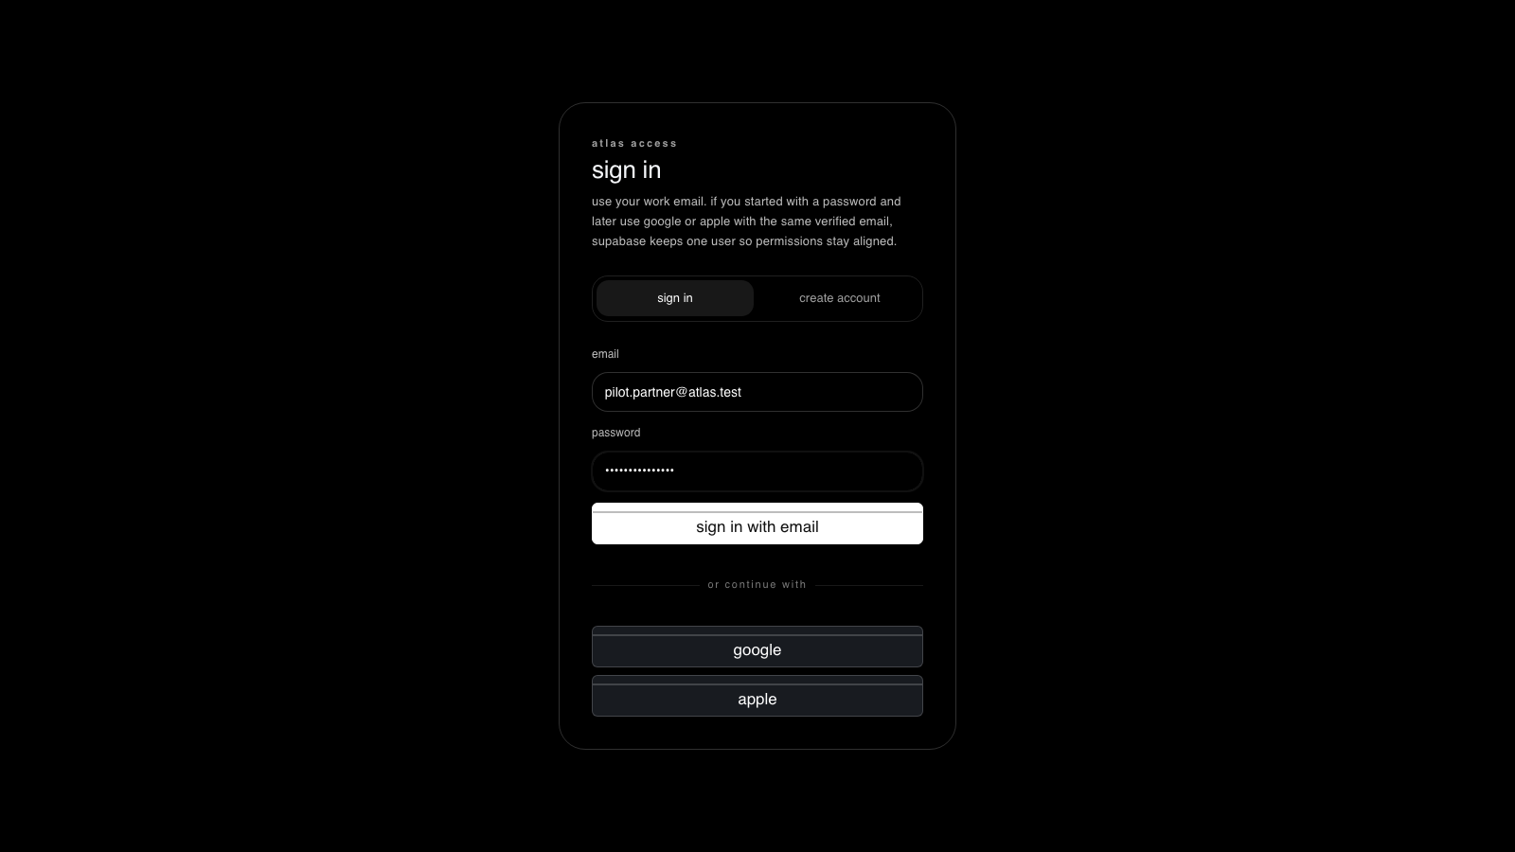
1
STEP 1 OF 5
Sign in as Partner
WHERE
http://localhost:5173/app
DO
Enter the partner login and password, then “sign in with email”.
EXPECT
The workspace opens to your organization — no enrollee roster.
live capture · localhost:5173
atlas × lucid living — Community Navigation Platform Pilot
PILOT.md

Slide 3
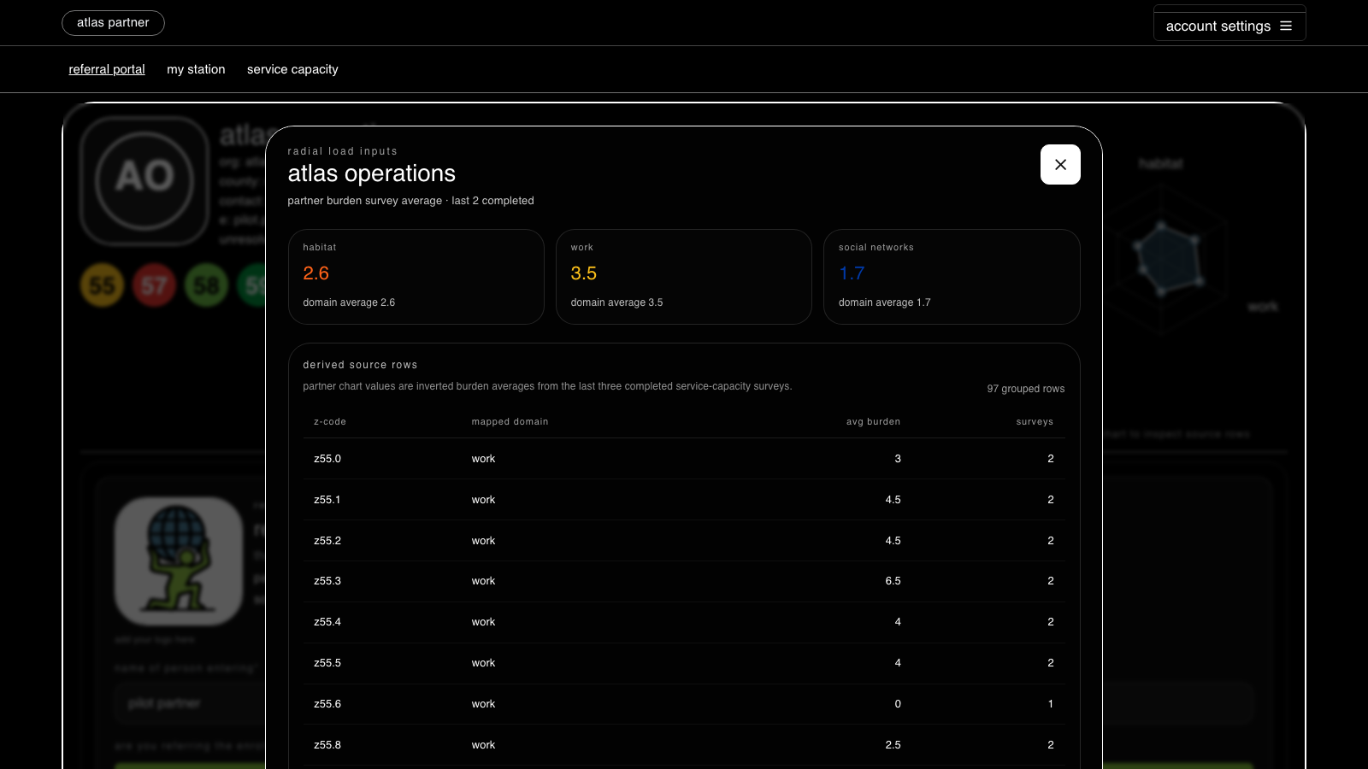
2
STEP 2 OF 5
Your org capacity (no PHI)
WHERE
referral portal
DO
Review your organization’s Z-code coverage and capacity overview.
EXPECT
You see your org’s Z-codes and radial scale — zero enrollee PHI.
live capture · localhost:5173
atlas × lucid living — Community Navigation Platform Pilot
PILOT.md

Slide 4
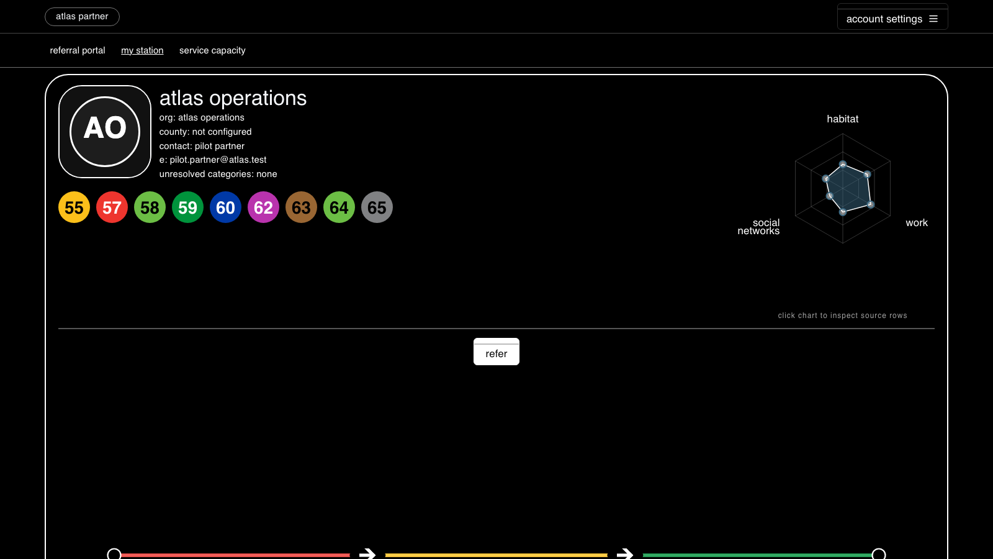
3
STEP 3 OF 5
Your station
WHERE
my station
DO
Open your station context for the organization.
EXPECT
Station Z-code coverage and unresolved categories are shown.
live capture · localhost:5173
atlas × lucid living — Community Navigation Platform Pilot
PILOT.md

Slide 5
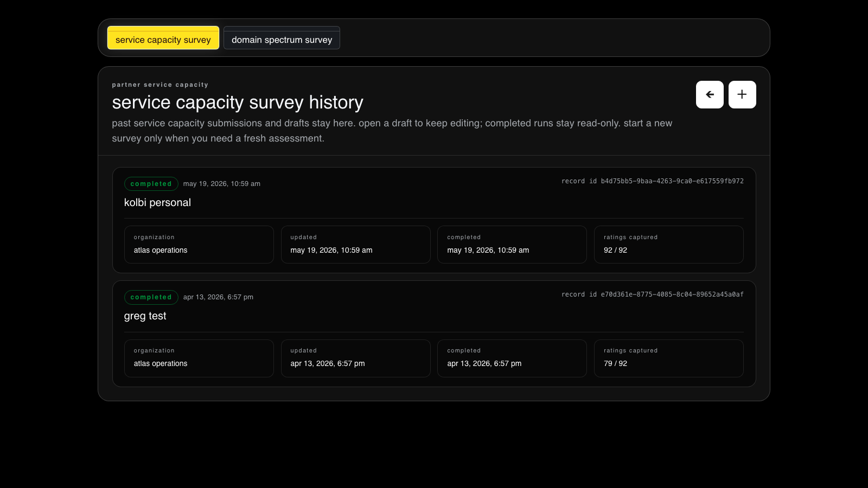
4
STEP 4 OF 5
Service capacity survey
WHERE
service capacity
DO
Open the service-capacity survey history; start or edit a submission.
EXPECT
Completed runs stay read-only; new submissions save for your org.
COMMAND RPC
fn_save_partner_service_capacity
live capture · localhost:5173
atlas × lucid living — Community Navigation Platform Pilot
PILOT.md

Slide 6
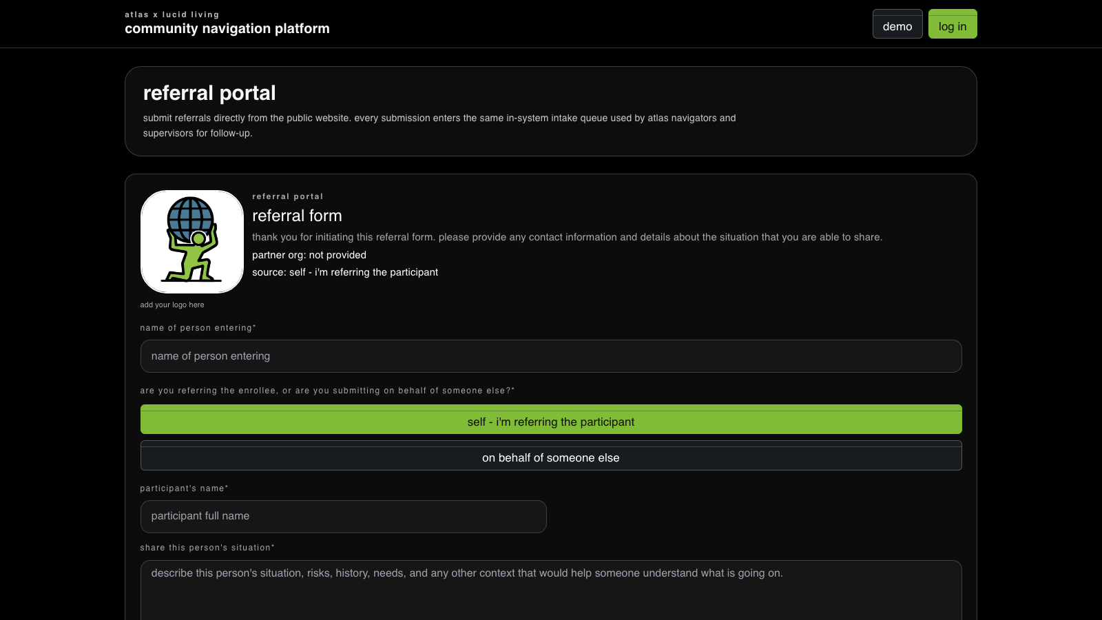
5
STEP 5 OF 5
Public referral (logged out)
WHERE
http://localhost:5173/ (no login)
DO
Sign out and submit a referral from the public Referral Portal.
EXPECT
It persists to the database for staff to claim later — the only anon write.
live capture · localhost:5173
atlas × lucid living — Community Navigation Platform Pilot
PILOT.md

Slide 7
WRAP-UP
Verify & reset
Confirm alignment — Run verification/pilot_verify.sql to replay every screen read under this identity and print an ok / row-count / error table — no clicking required.
Fail-loud by design — A red banner means a real permission/RLS denial, not an empty screen. The workspace never hides a denial behind blank data.
Reset the pilot — Re-run verification/pilot_setup.sql (idempotent) to recreate the four logins and their seeded scope at any time.
atlas × lucid living — Community Navigation Platform Pilot
PILOT.md

