Slide 1
Secure ML Ops Pipeline
Secure MLOps Pipeline for LLM Fine-Tuning

Slide 2
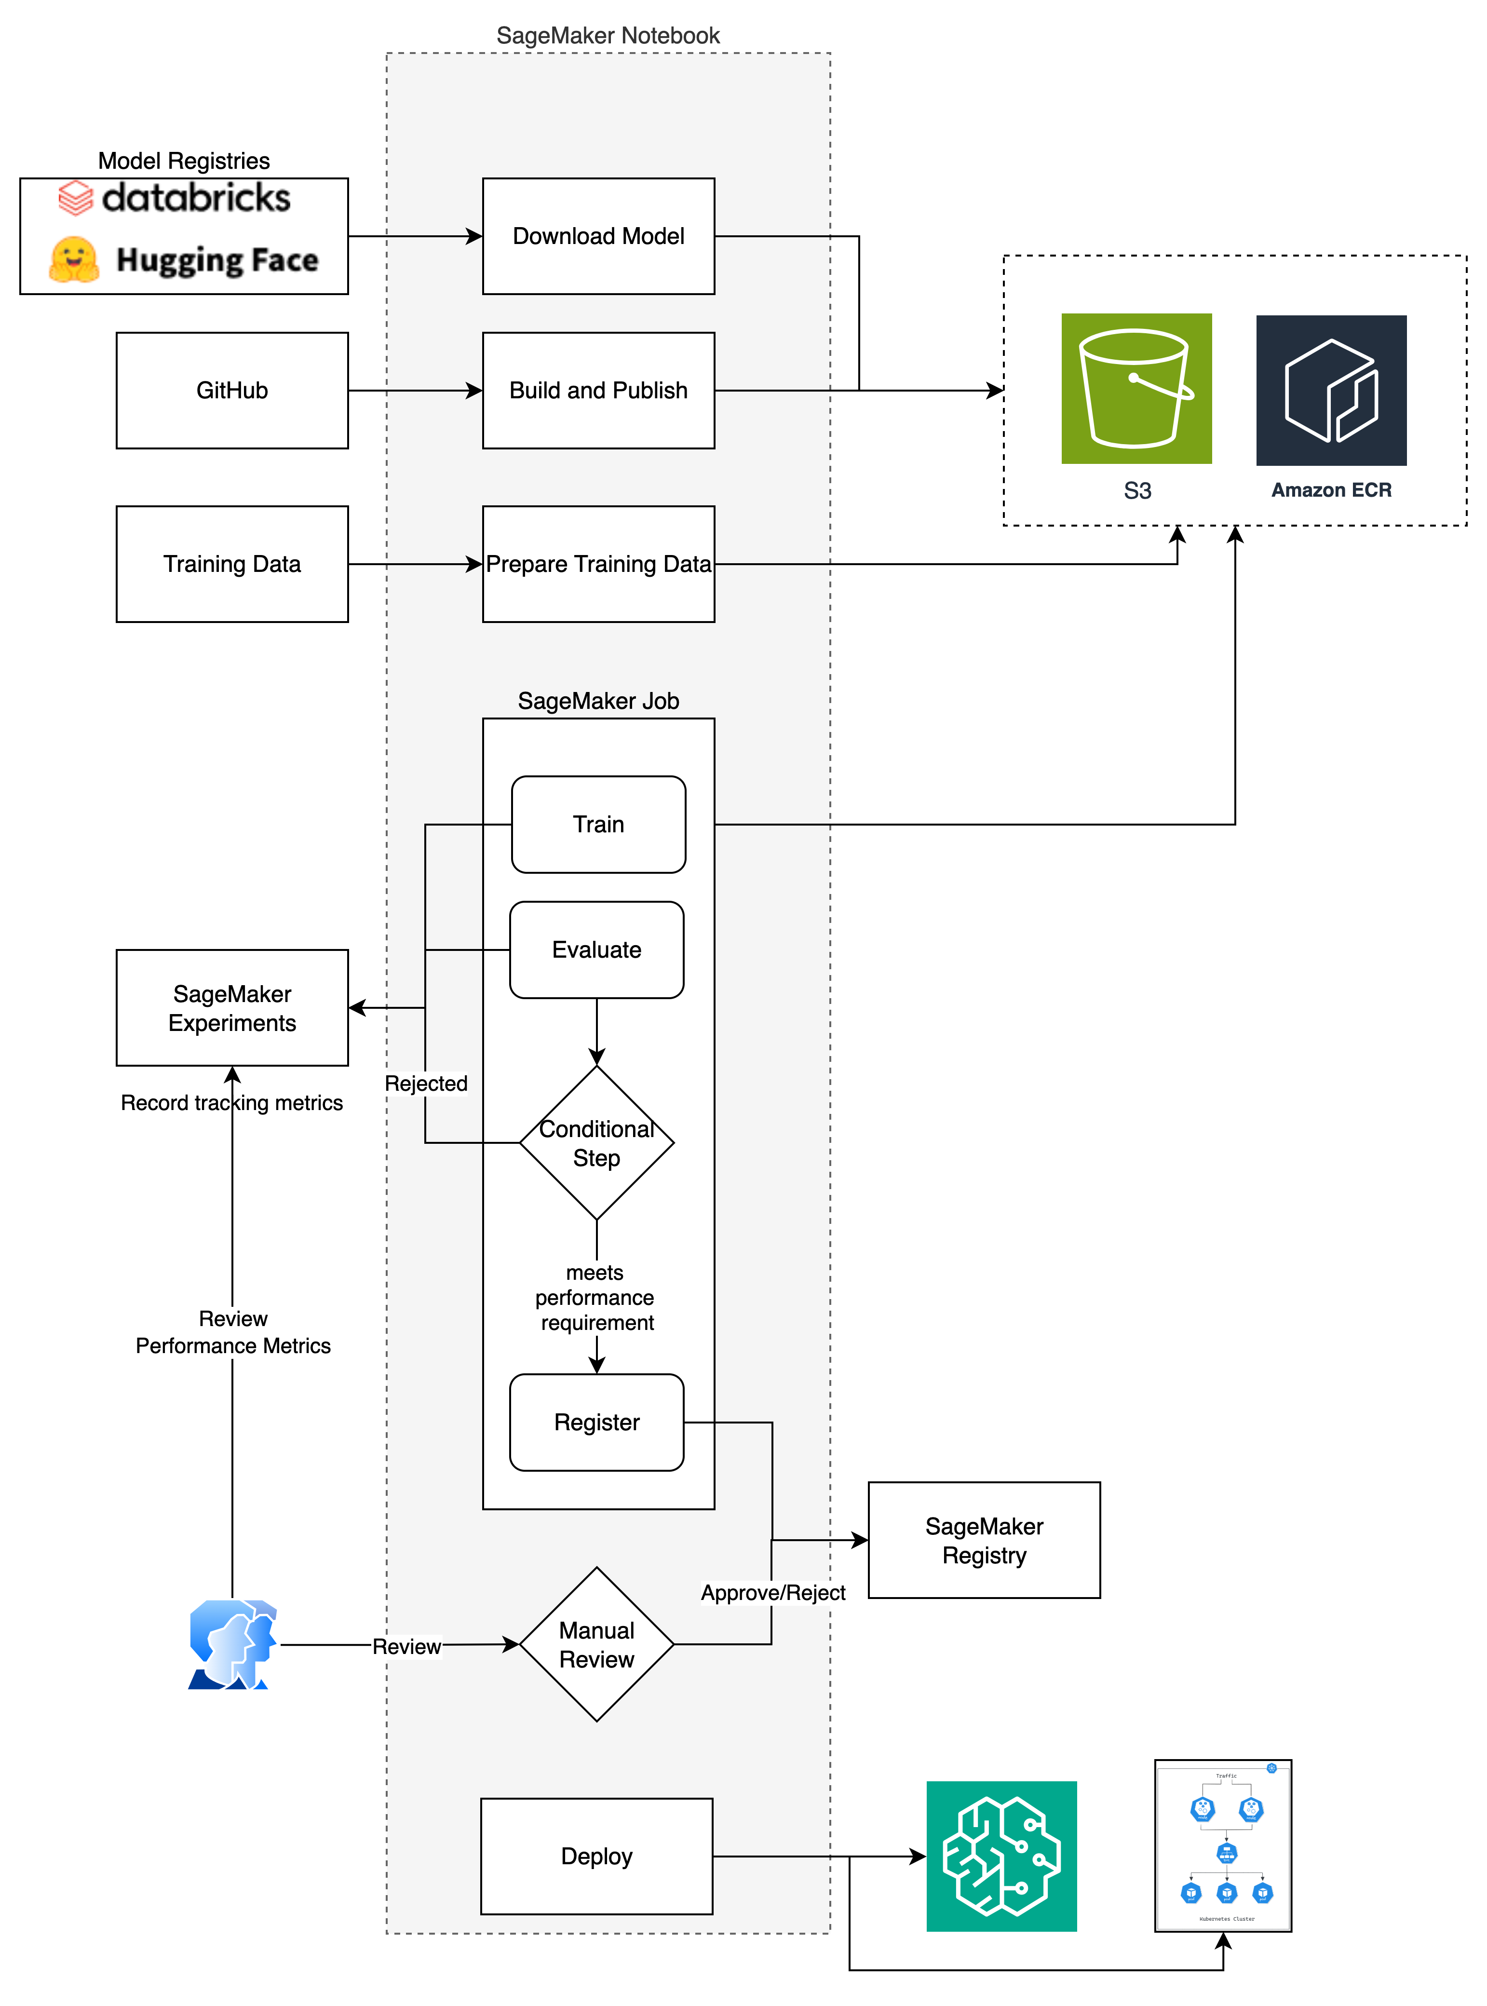

Slide 3
6 Security Layers
Layer 1: Model Acquisition Security
Secure model downloads and integrity verification
Layer 2: Container Security
Vulnerability scanning and hardened containers
Layer 3: Training Security
VPC isolation, encryption, and access controls
Layer 4: Data Security
Encryption at rest, access logging, and retention
Layer 5: Model Governance
Quality gates, versioning, and approval workflows
Layer 6: Deployment Security
Secure endpoints, monitoring, and rate limiting

Slide 4
Layer 1: Model Acquisition Security
⚠ Threat: Malicious model injection, supply chain attacks
Controls Implemented:
✅ Token-based authentication via AWS Secrets Manager
✅ Model integrity verification (checksums)
✅ Audit logging to CloudWatch
✅ No trust of remote code execution
✅ Secure download over HTTPS only
# Secure token retrieval from Secrets Manager
secrets_client = boto3.client('secretsmanager')
response = secrets_client.get_secret_value(SecretId='huggingface/api-token')
token = response['SecretString']
# Download with verification
model_path = snapshot_download(repo_id=model_id, token=token,
local_dir_use_symlinks=False)

Slide 5
Layer 2: Container Security
⚠ Threat: Vulnerable dependencies, container escape, supply chain attacks
Controls Implemented:
✅ AWS ECR with vulnerability scanning (Prisma Compute Remote Registry scan)
✅ Immutable image tags
✅ KMS encryption at rest
✅ Non-root container execution (Prisma Compute)
✅ Minimal attack surface (slim base image)
✅ Regular automated scanning
✅ Image signing (optional)
# Dockerfile Hardening
FROM 763104351884.dkr.ecr.us-east-1.amazonaws.com/pytorch-training:2.1.0-gpu-py310
RUN groupadd -g 1000 mlopsuser && useradd -m -u 1000 -g mlopsuser mlopsuser
USER mlopsuser # Run as non-root

Slide 6
Layer 3: Training Security
⚠ Threat: Data exfiltration, unauthorized access, model poisoning
Controls Implemented:
✅ VPC isolation (optional)
✅ Private subnets with no internet access
✅ VPC endpoints for AWS services
✅ Encrypted inter-container traffic
✅ KMS encryption for training data, model artifacts, EBS volumes
✅ IAM least-privilege roles
✅ Network isolation mode
# Security Configuration
security:
encryption:
s3_kms_key_id: "alias/sagemaker-kms-key"
volume_kms_key_id: "alias/sagemaker-volume-kms-key"
enable_network_isolation: true

Slide 7
Layer 4: Data Security
⚠ Threat: Data breach, unauthorized access, compliance violations
Controls Implemented:
✅ S3 bucket encryption (KMS)
✅ Bucket versioning enabled
✅ Public access blocked
✅ Lifecycle policies for data retention
✅ Access logging
✅ MFA delete protection
✅ Cross-region replication (optional)
# S3 Security Settings
bucket_encryption:
- SSEAlgorithm: 'aws:kms'
KMSMasterKeyID: !GetAtt MLOpsKMSKey.Arn
public_access_block:
BlockPublicAcls: true
RestrictPublicBuckets: true

Slide 8
Layer 5: Model Governance
⚠ Threat: Unauthorized model deployment, model drift, compliance violations
Controls Implemented:
✅ Automated performance threshold validation
✅ Model versioning in SageMaker Registry
✅ Approval workflow (manual/automated)
✅ Model lineage tracking
✅ Experiment tracking
✅ Audit trail
# Quality Gates
thresholds = {
'perplexity_max': 20.0, # Industry best practice
'eval_loss_max': 1.5, # Model quality threshold
}
if not check_thresholds(metrics, thresholds):
approval_status = 'Rejected'

Slide 9
Layer 6: Deployment Security
⚠ Threat: Unauthorized access, data leakage, model serving attacks
Controls Implemented:
✅ VPC endpoint deployment
✅ Data capture for monitoring
✅ Auto-scaling with security
✅ HTTPS-only endpoints
✅ IAM-based access control
✅ Request/response encryption
✅ Rate limiting
✅ Model monitoring (drift, bias, quality)
# Endpoint Security
endpoint_config = {
'DataCaptureConfig': {'EnableCapture': True, 'KmsKeyId': kms_key_id},
'KmsKeyId': kms_key_id,
'EnableNetworkIsolation': True
}

Slide 10
Compliance & Regulatory Standards
SOC 2
HIPAA Ready
GDPR
✅ Encryption at rest and in transit
✅ Access controls and audit logging
✅ Change management workflows
✅ Monitoring and alerting
✅ BAA-eligible AWS services
✅ Data encryption
✅ Access logging
✅ Network isolation
✅ Data encryption
✅ Data retention policies
✅ Right to deletion
✅ Complete audit trail
CIS
✅ AWS Account Hardening
✅ Kubernetes Node Hardening
✅ IAM Hardening
✅ S3 Hardening

